Slide 1
How LS Central supports ferries and travel retail, in addition to duty free processes
Joerg Schmikale
Jakob Nickelsen

Slide 2
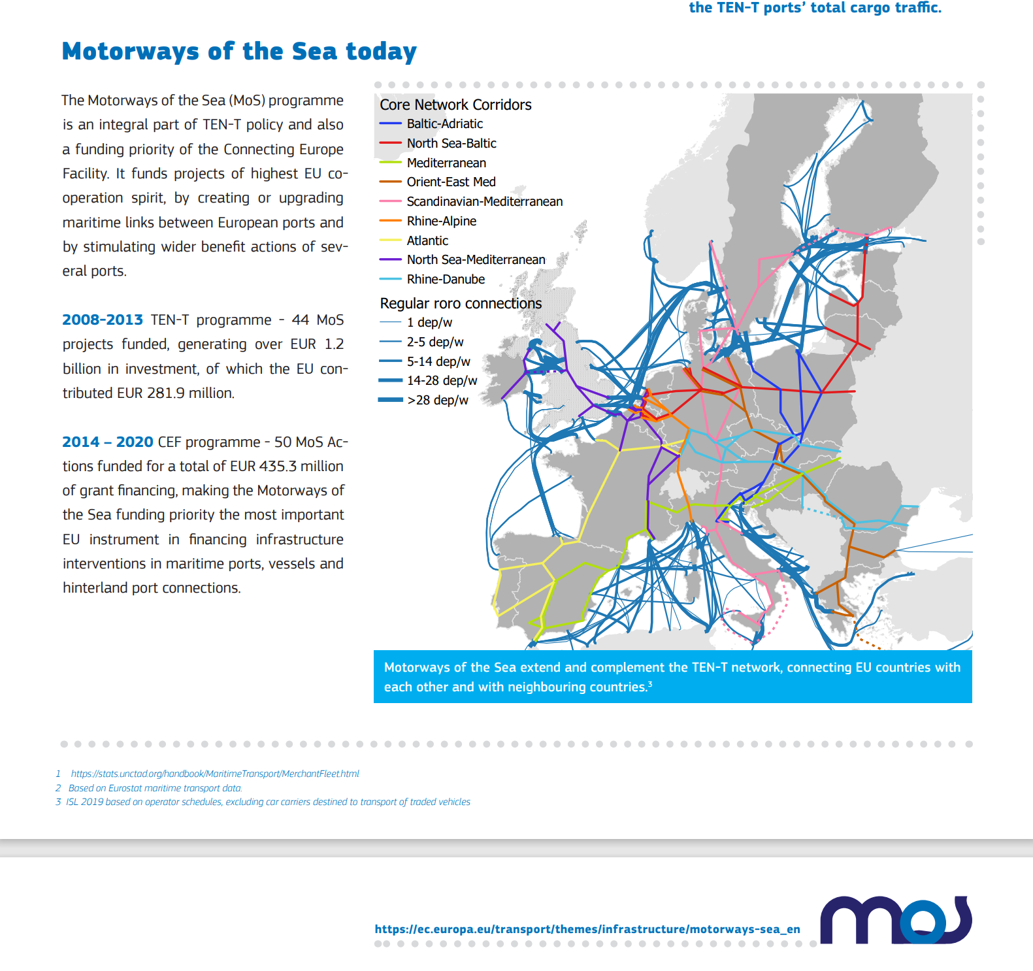
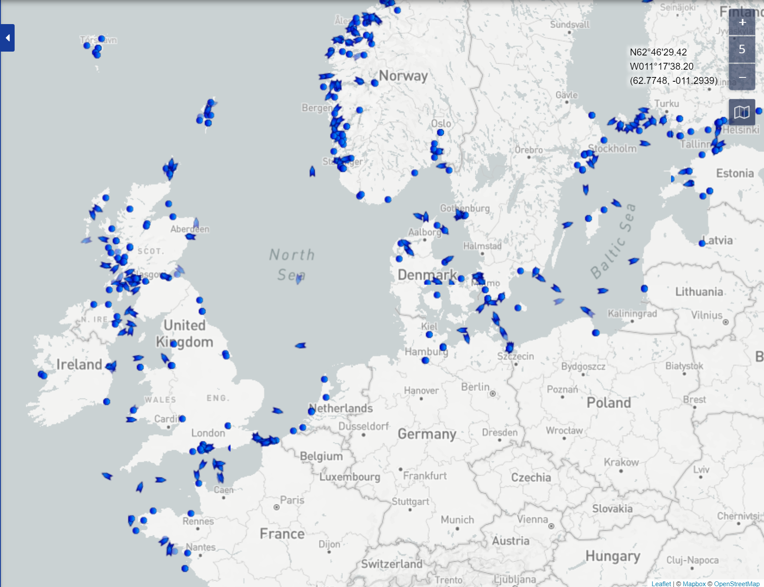
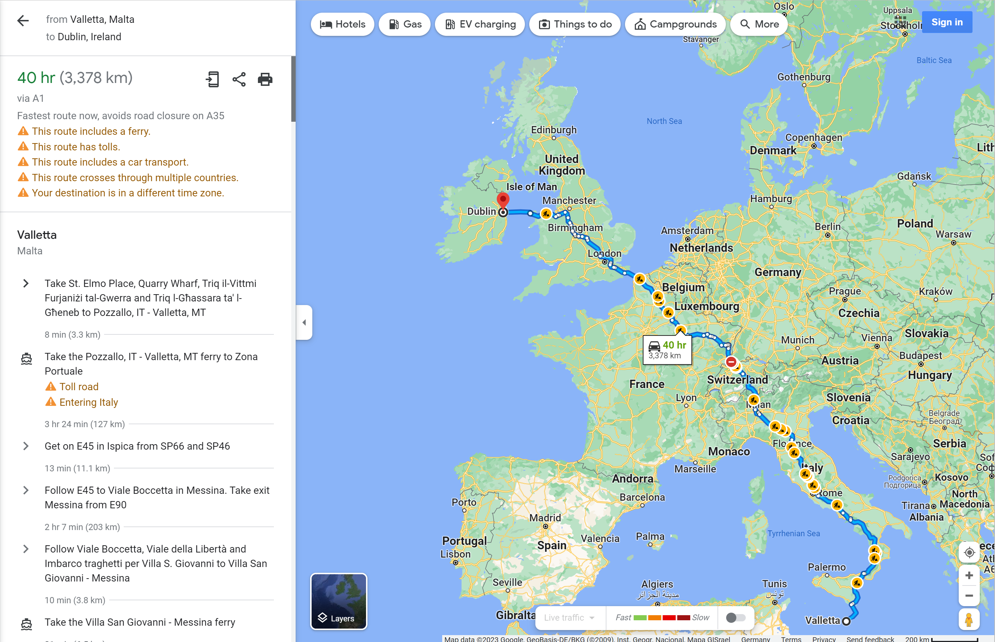
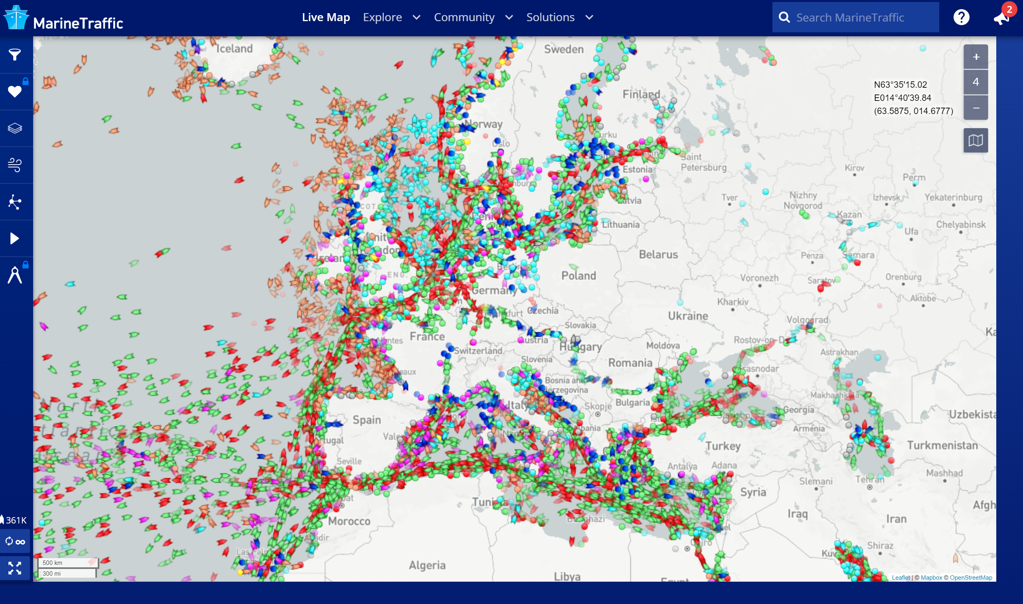
Is it possible to travel by car from La Valetta to Dublin?

Slide 3



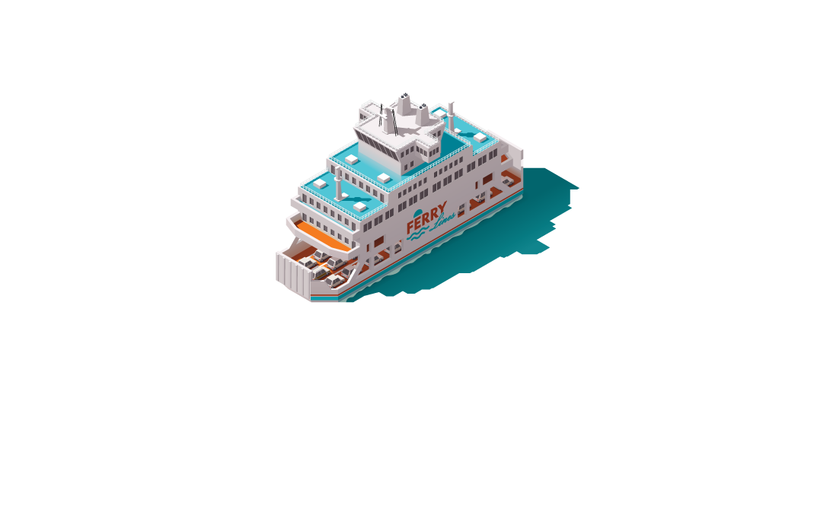





Unified Commerce for Cruise and Ferries
Entertainment
Restaurant Management
Retail Management
Member Management
Activities Management
Campaign Management
Inventory Management
Replenishment
Bar
Lounge
Restaurant
Cabin
Shop
Meeting

Slide 4





Cruise and Ferries System – a distributed environment
3rd Party MDM
3rd Party
booking engine
Setup Data
Master Data
Booking Data
^{CORPORATE HQ}
^{and Region}
Setup Data
Master Data
Booking Data
^{VESSEL}
^{POINTS OF SALE}
^{Retail}
^{F&B}
Setup Data
Master Data
Booking Data

Slide 5
Cruise and Ferries System – a distributed environment
3rd Party WMS
3rd Party
financials
Transaction data
Inventory data
Financial data
^{CORPORATE HQ}
^{and Region}
Transaction data
Inventory data
Financial data
^{VESSEL}
^{POINTS OF SALE}
^{Retail}
^{F&B}
Transaction data

Slide 6
LS Retail consulting modules for travel industry
Ferry module
Route Management System
Duty free module
Leveraging Business Central and LS Central Functionality
Financials
Inventory
Hospitality
Retail
Bookings
Member Management
Extending LS Central standard for travel industry
LS Retail Consulting services involvement strongly recommended

Slide 7
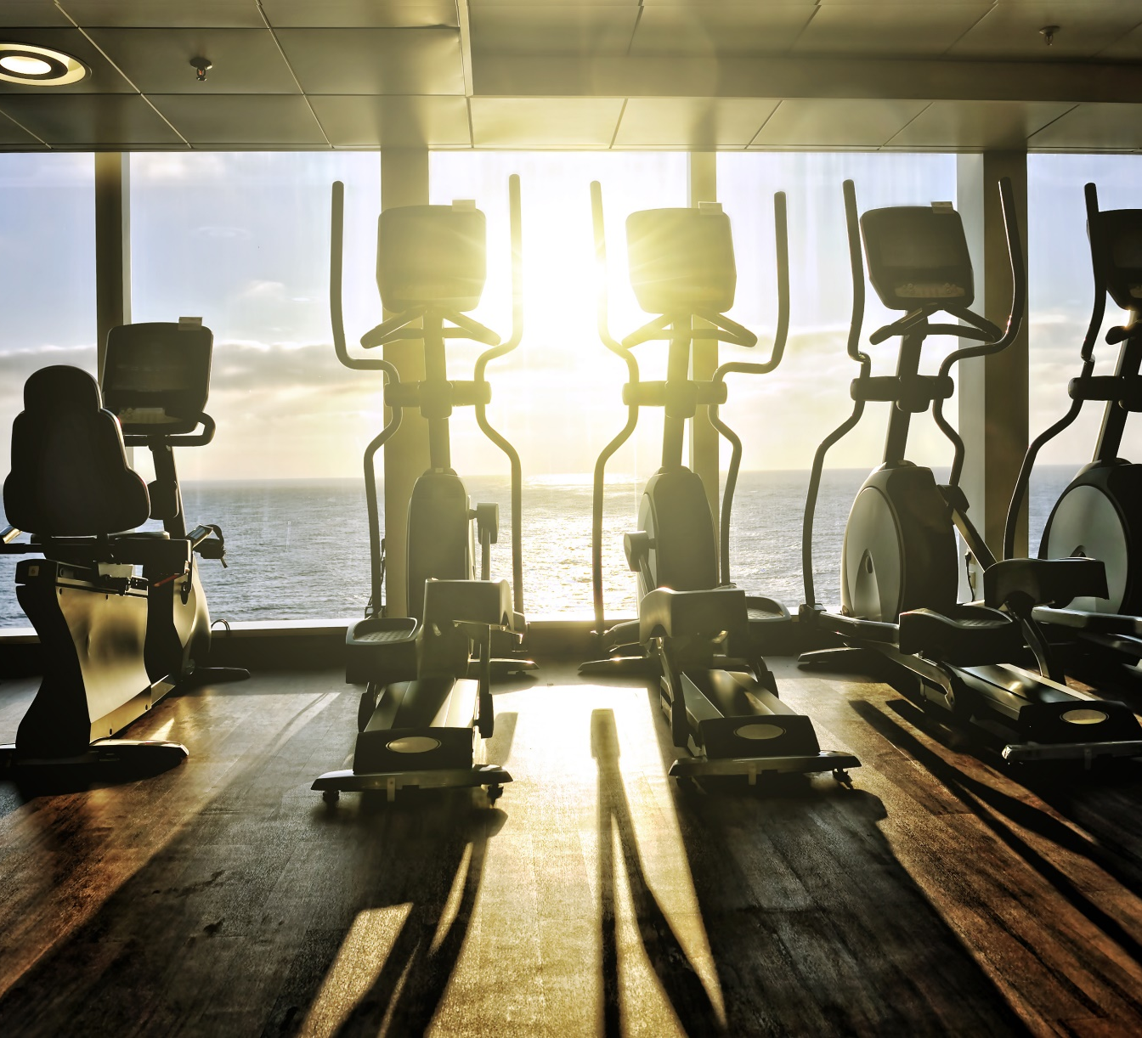
Bookings with Ferry module
Highlights
Reservations and service management
Resource management
Appointments and accesses
Conferences and events
Group bookings
Benefits
Complete visibility for staff
Offers simple process to book activities
Supports multiple choice allowance on guest reservation

Slide 8
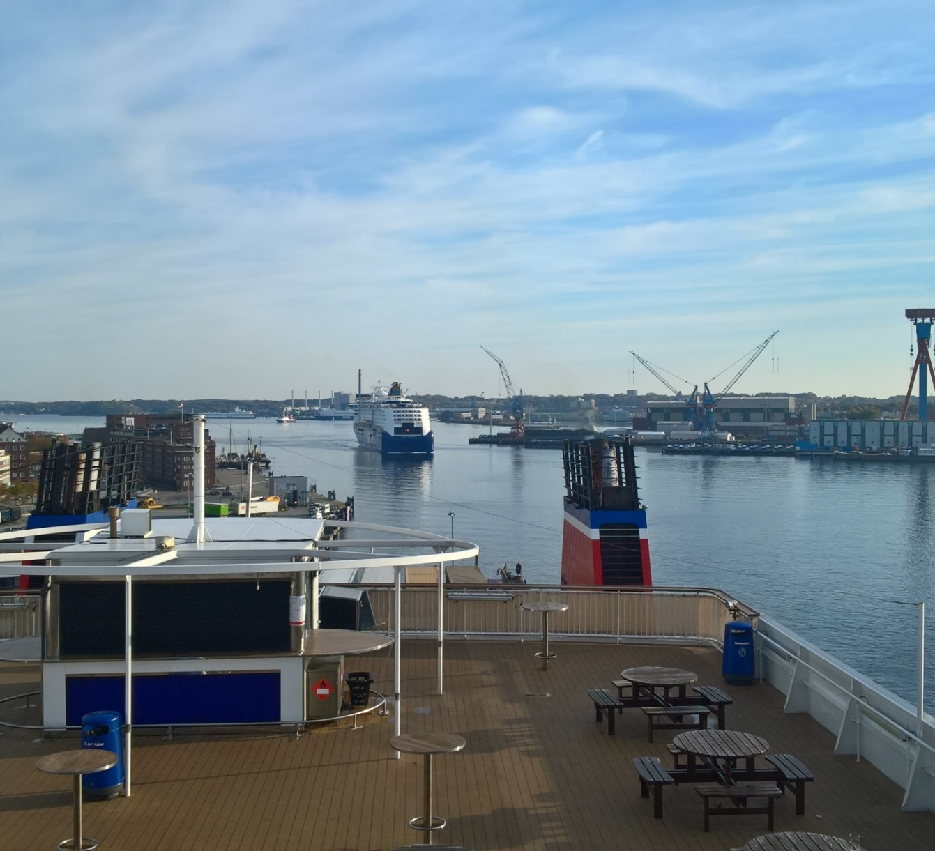
Ferry module for LS Central
Extension on Bookings for LS Central based on ferry requirements
Supporting Bookings for LS Central in distributed environment – (replications/webservices)
Extension on API´s to capture boarding card information for identification
Prebook table reservation with certain items for passengers to consume onboard
Coupons to be possible to be used multiple times for specific products, product groups and item categories

Slide 9
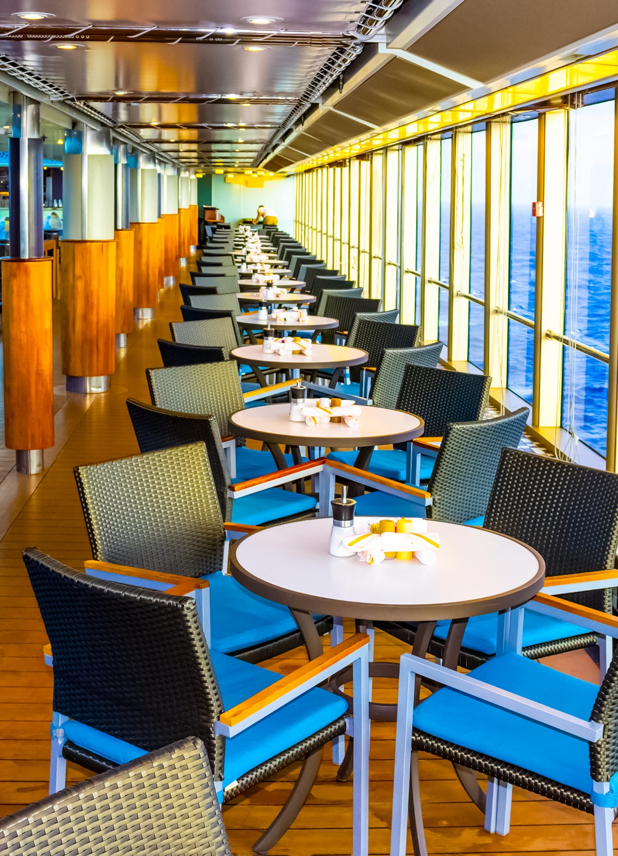
Ferry module for LS Central
Process to find and post the pre-bookings quickly in self-service mode
Guest hands over the card to restaurant staff member or scans it in a self-service machine.
The reservation with preordered meals/buffet and payment is processed and finalized.
The dining table is marked as seated.
Once the vessel is back in harbor a function can be used to clear all seated table.
Welcome!
Please have a seat at table 6

Slide 10
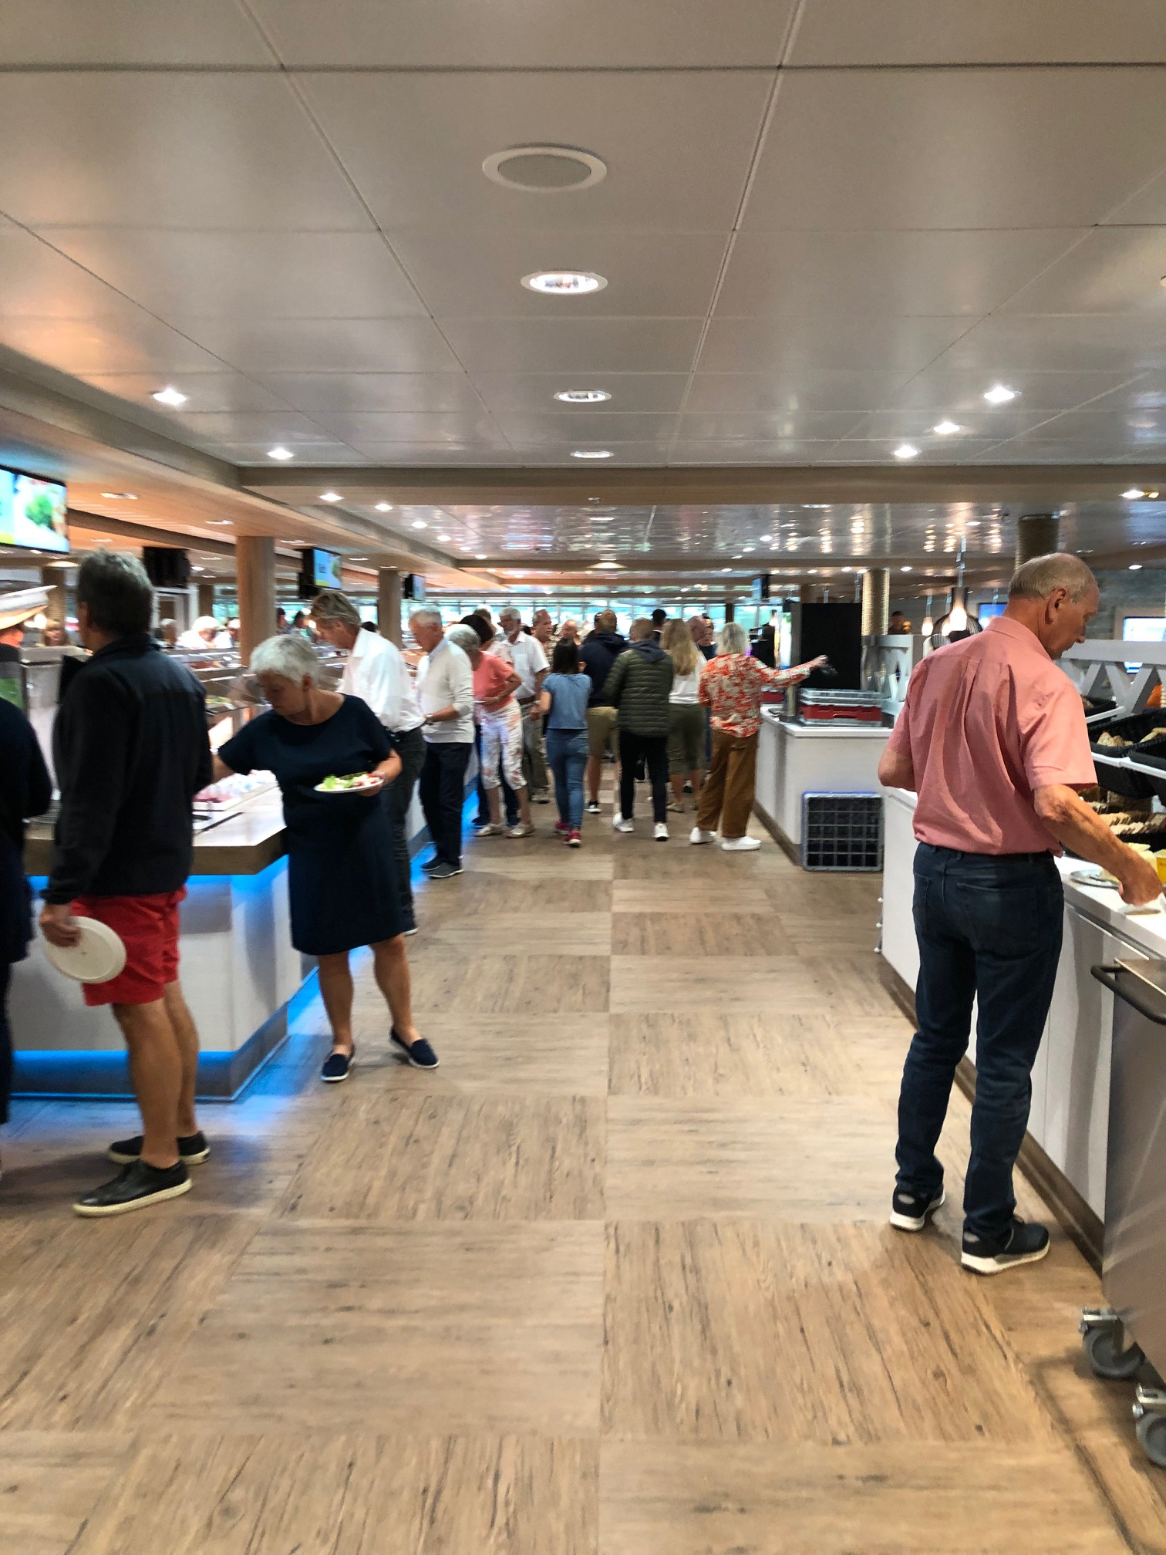
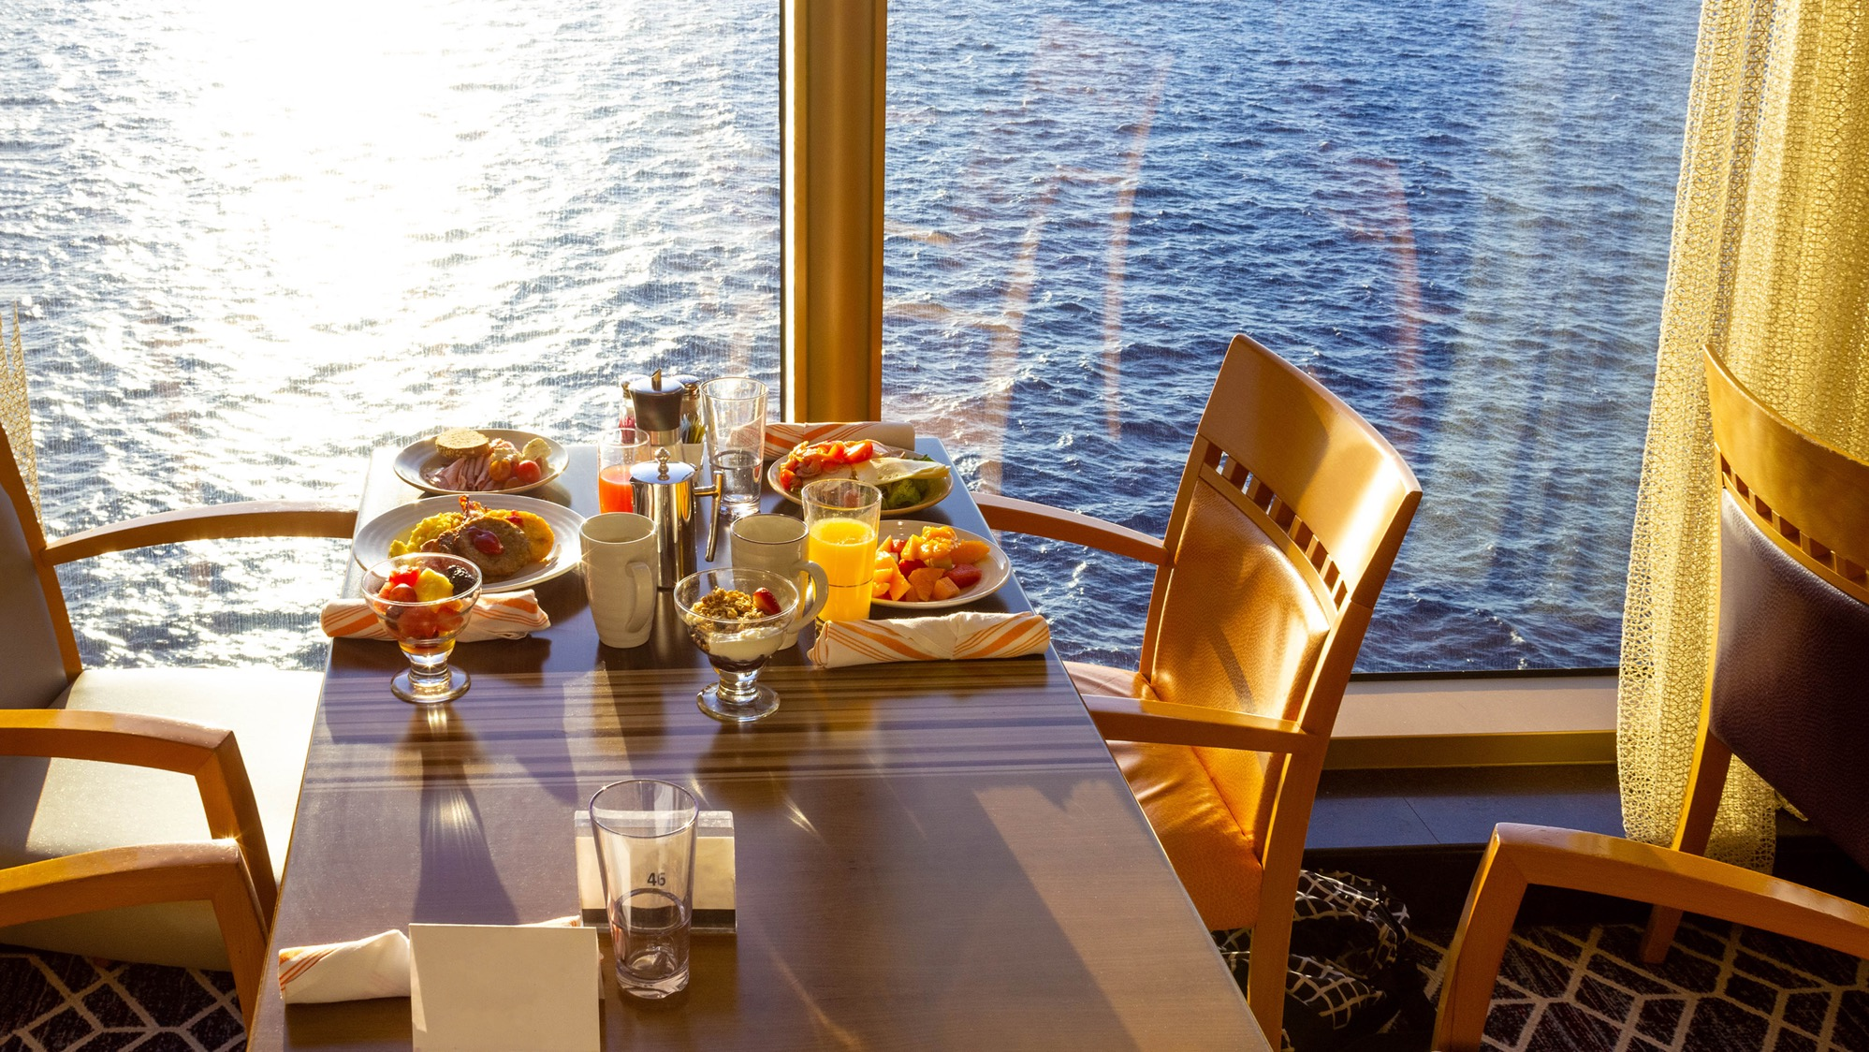
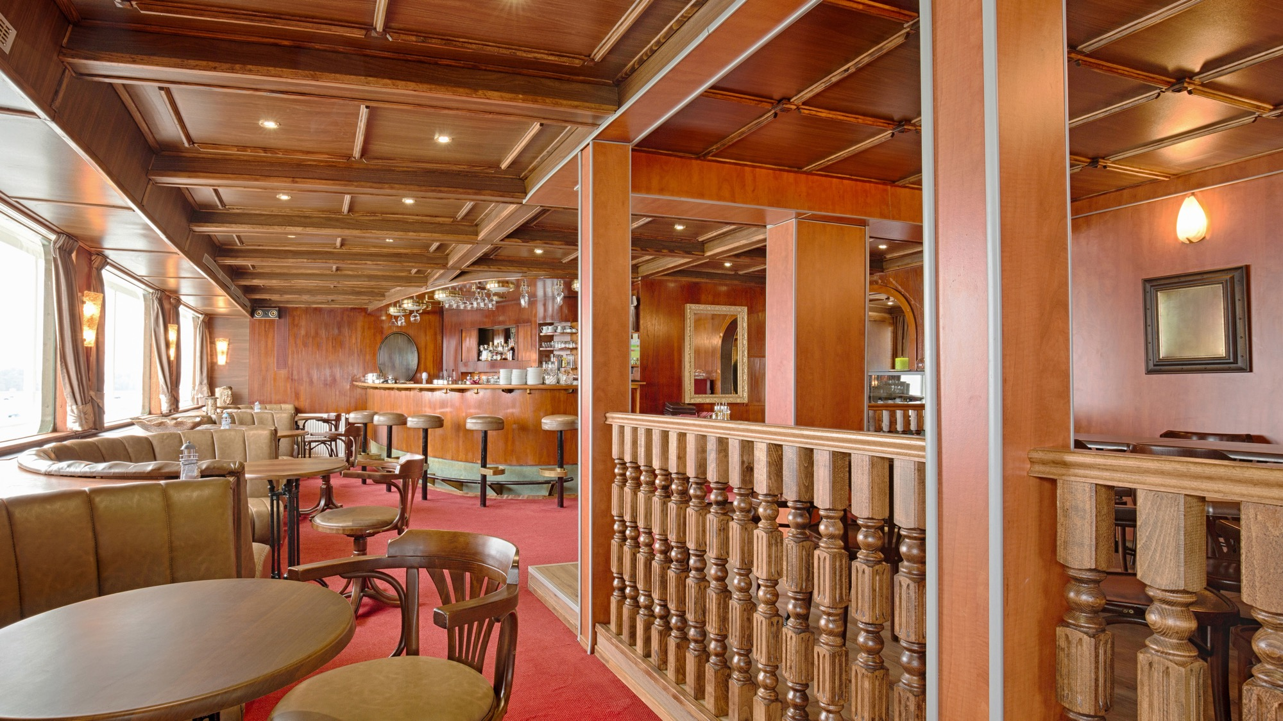
LS Central for restaurants
Restaurants
Dining a la carte
Buffets
Bars
Cafes
Show lounges
Fast Food
Self Service POS
F&B for Conferences and Events

Slide 11
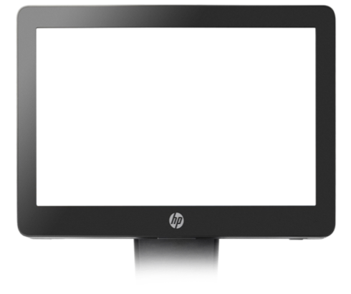
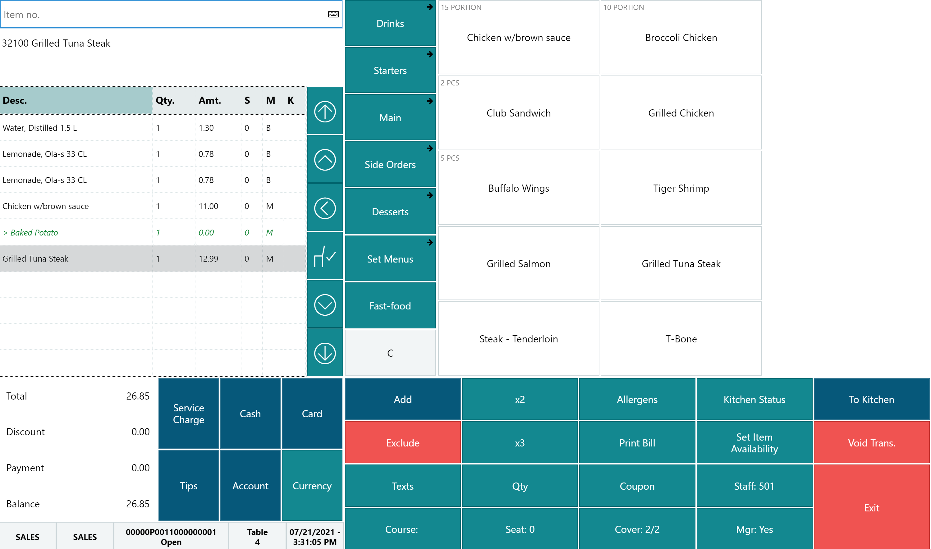
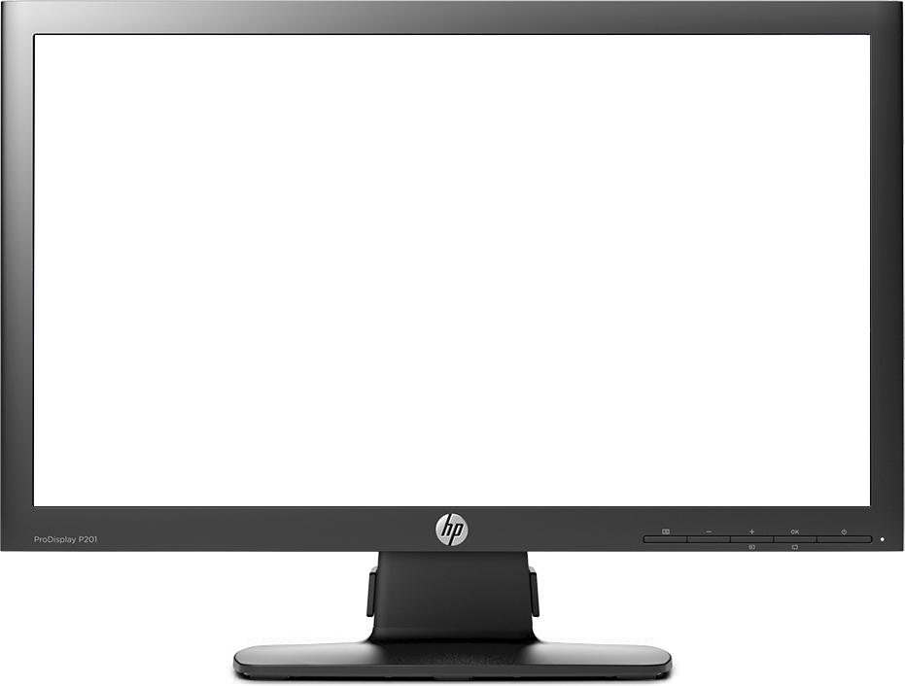
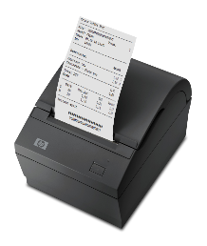
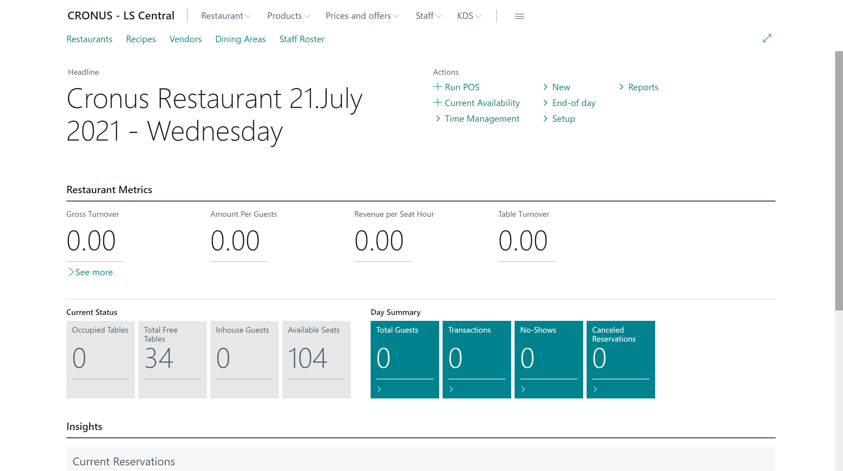
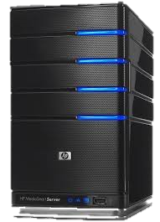
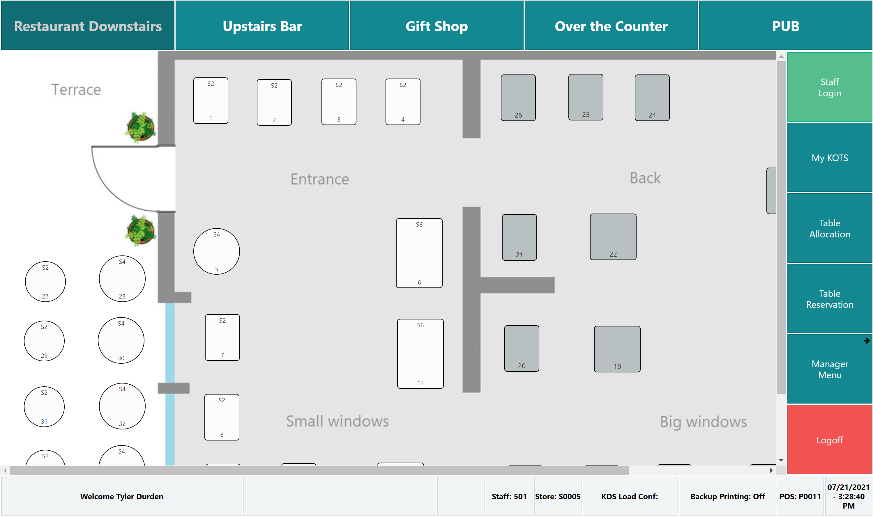

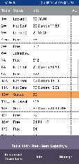
Hospitality system architecture Vessel
LS Central
POS
Restaurant Back Office
LS Central
Self Service POS
Kitchen
Display
Vessel Server
Restaurant Server
Kitchen Server
LS Central
Mobile POS
Kitchen
Printing

Slide 12
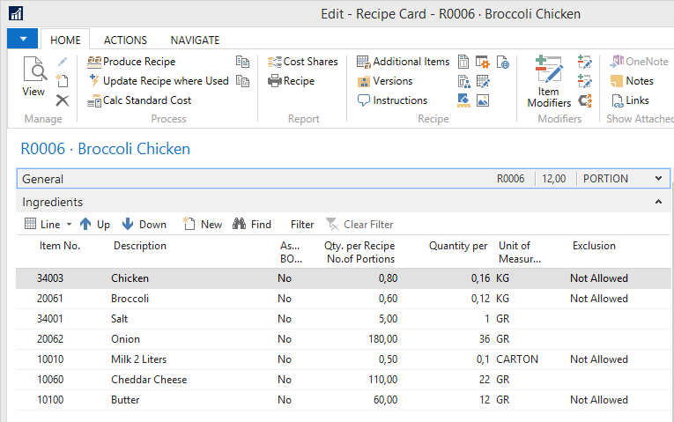

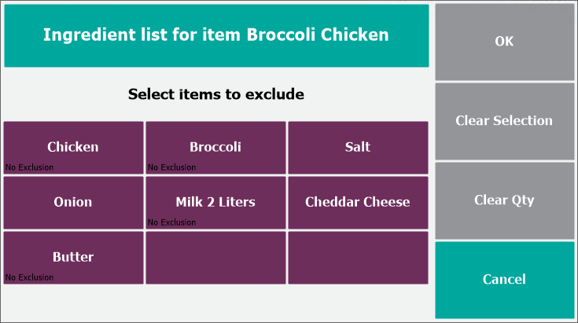
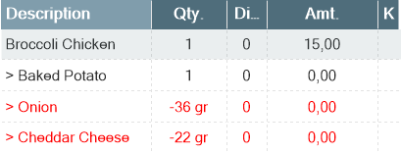

Kitchen management
Restaurant
Recipe Management
Kitchen Printing
Kitchen Displays
POS1
POS2
KDS
Kitchen Displays
Grill
Bar
Kitchen Service
Kitchen Displays
Expeditor
Kitchen Displays
Colds

Slide 13

Route Management System ( RMS )
Stores and Restaurants on the Vessel
Rules changing with Direction
Direction by RMS ( GPS )
Vessel move – Vessels can go to different Routes
GPS
Leg 2 VAT
Leg 1 VAT
Harbor
Harbor
Route

Slide 14
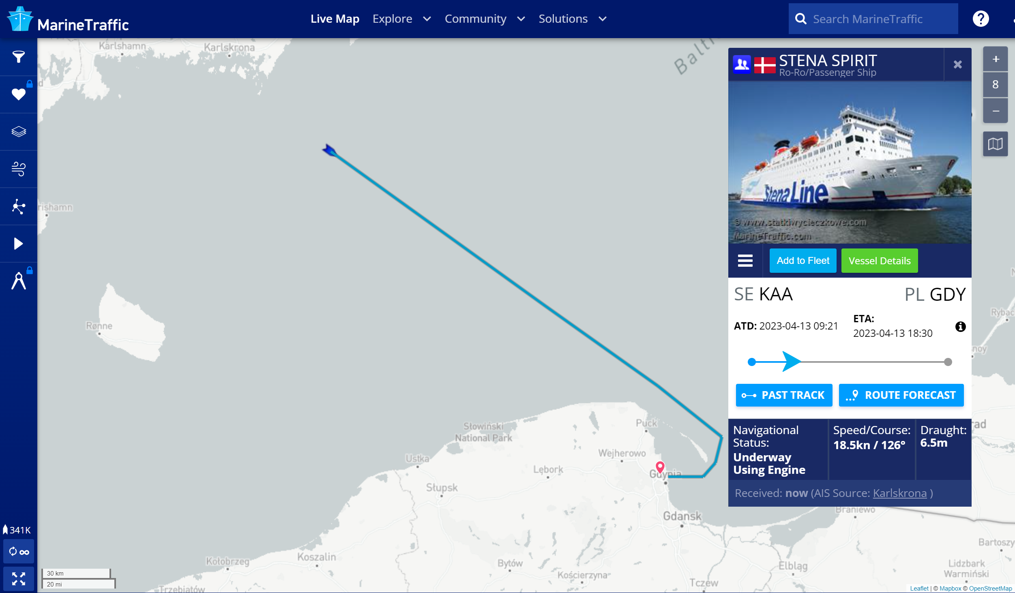
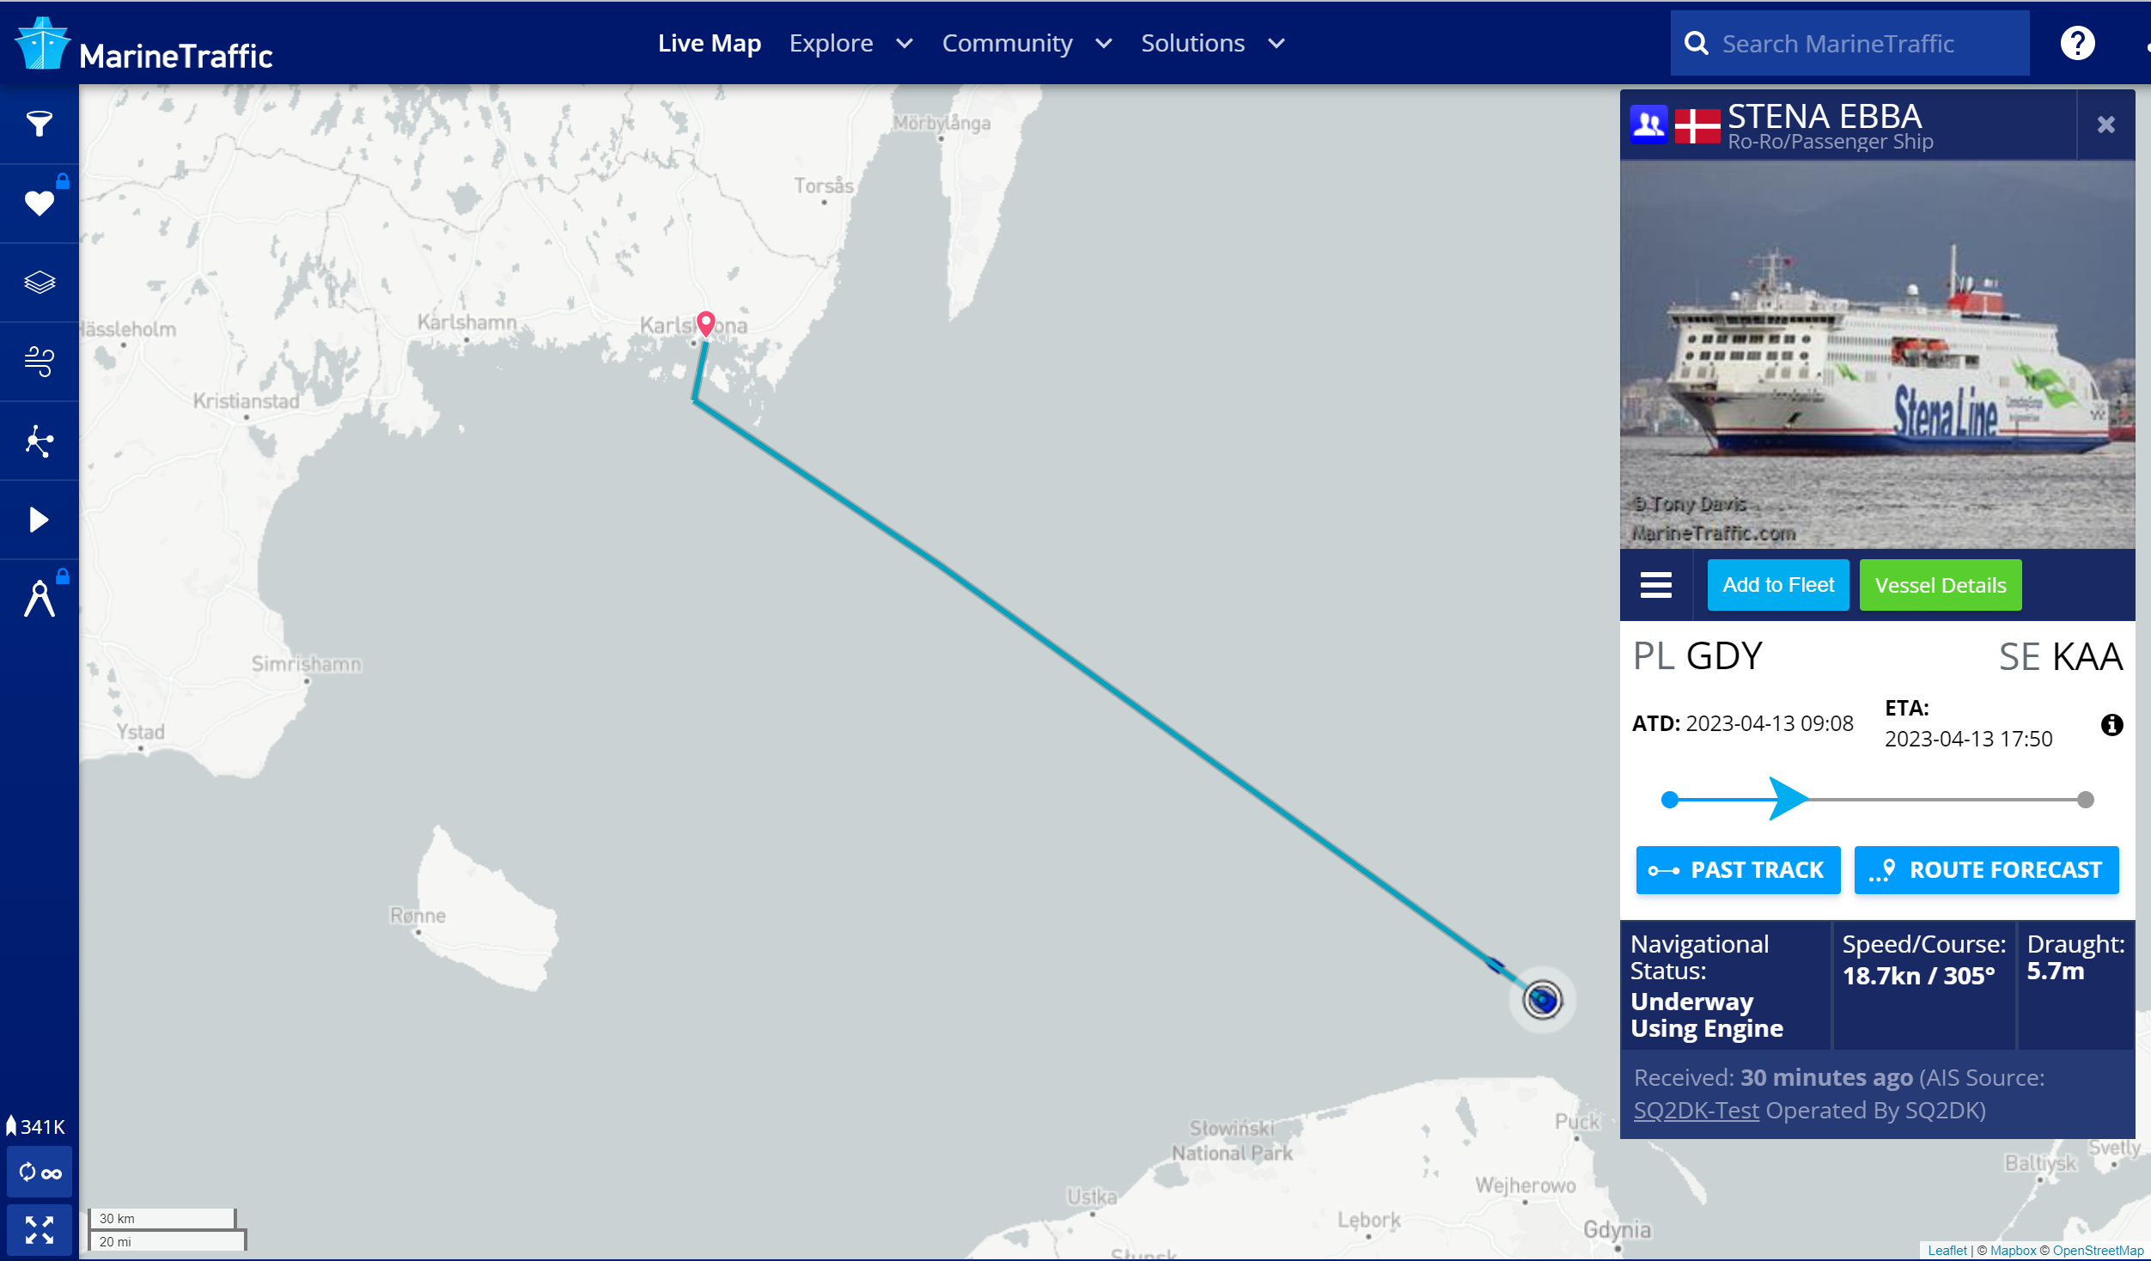
Route Management
Combines Stores and Restaurants for a Vessel by Dimension
Supports VAT change based Route / Leg
Route Karlskrona - Gdynia
Leg 1 Sweden -> Poland
Swedish VAT
Onboard Consumption
Non-Fiscal sales
Leg 2 Poland -> Sweden
Polish VAT
Onboard Consumption
Fiscal sales

Slide 15


LS Central Duty Free
Stores / Restaurants are at an Airport/Site
Land side / Air side
Rules changing with Destination
Destination by Boarding Pass
Destination based Taxes and other Rules
Airport/Site
Airport/Site

Slide 16
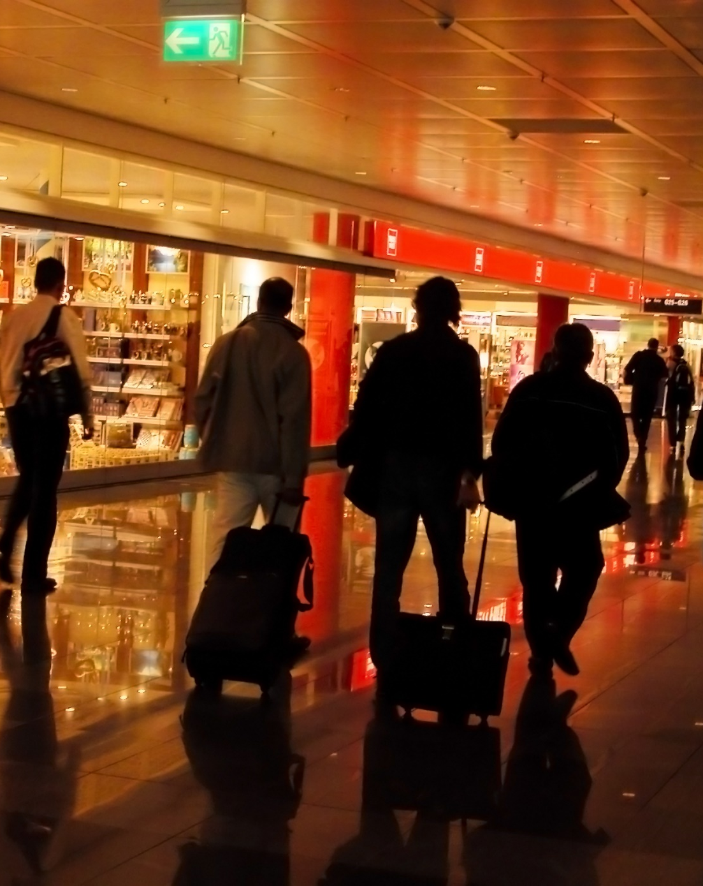
Duty free module for LS Central
Tax calculation based on the travelling route
Prices, discounts and posting based on the route
Tax refund / Reverse tax discount
Quantity or amount limitation
STEB handling
Currency utility
Capture of boarding card information
Capture of passport information
Flight information and time tables

Slide 17
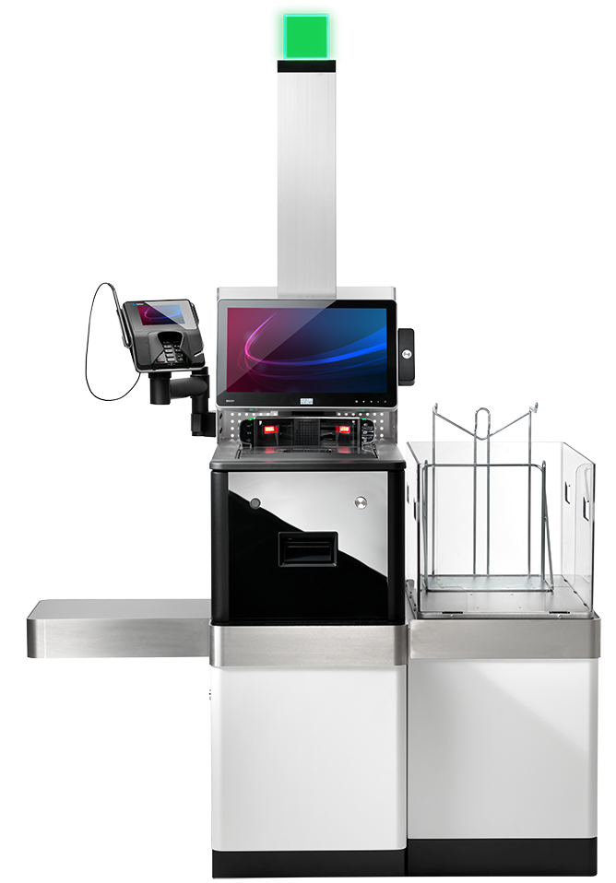
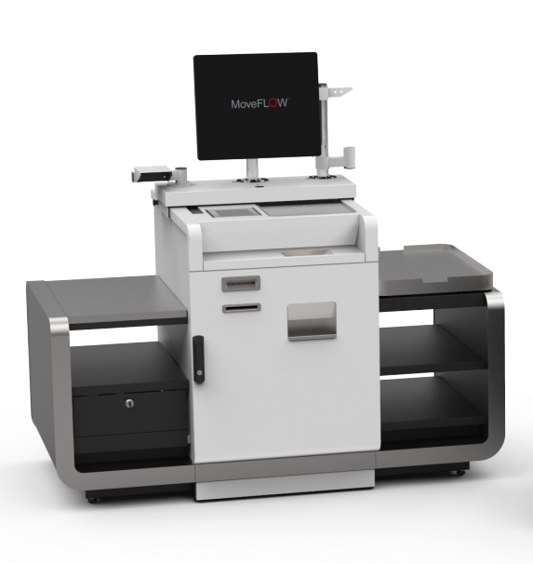
Retail self-service checkout
3rd Party Self Checkout Integration
Soft/Hardware Security Features
Border Shops
LS Central POS
Software Security Features
Limited Hardware Security Features
Vessels
Border Shops

Slide 18
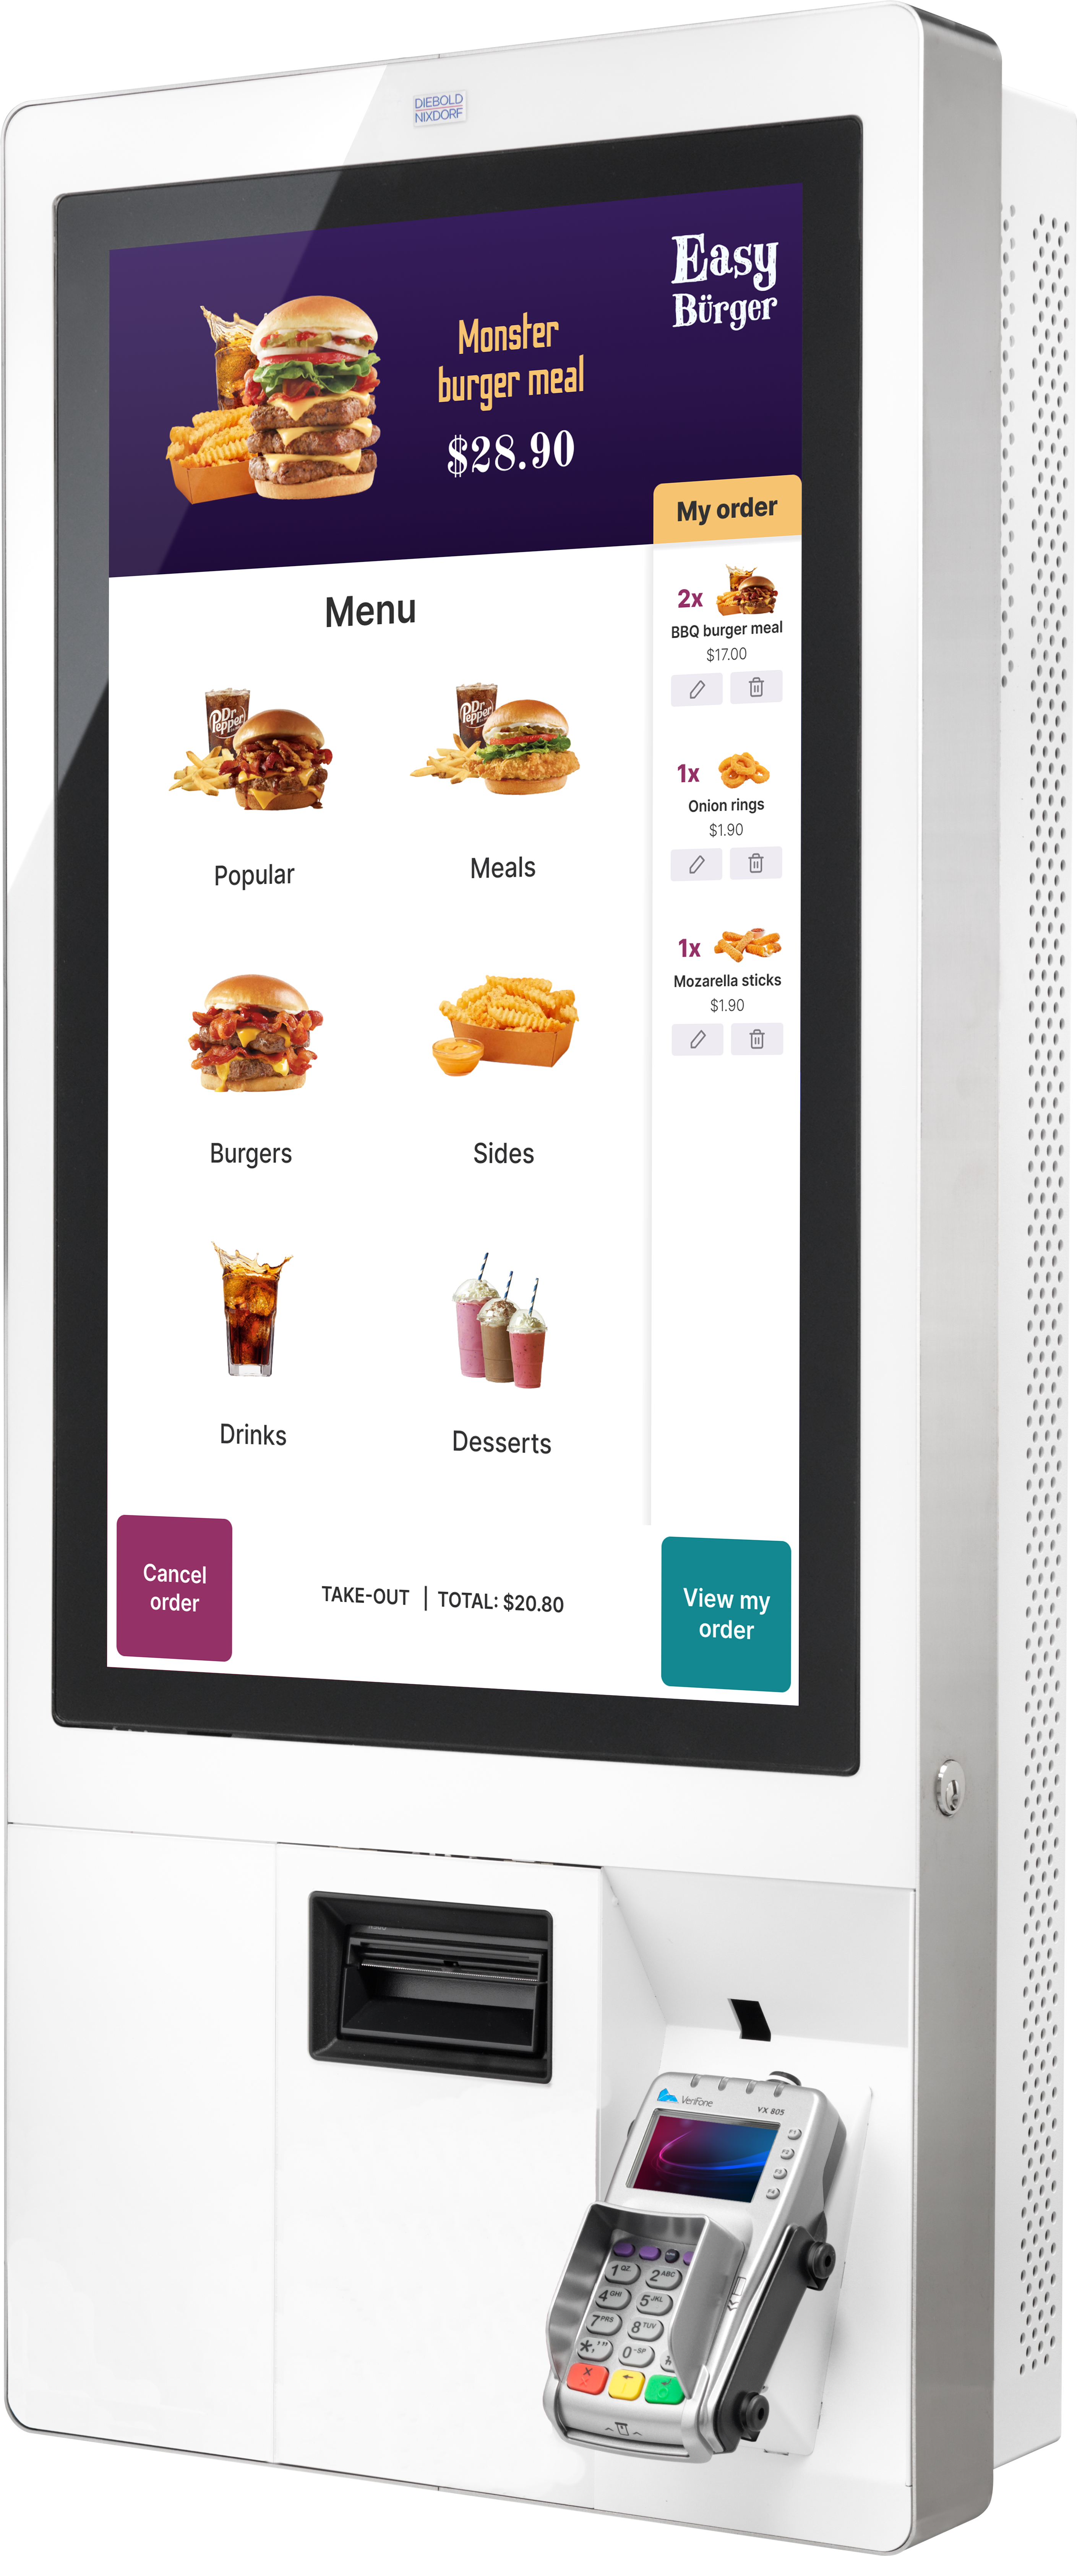
Self-service kiosk

Slide 19
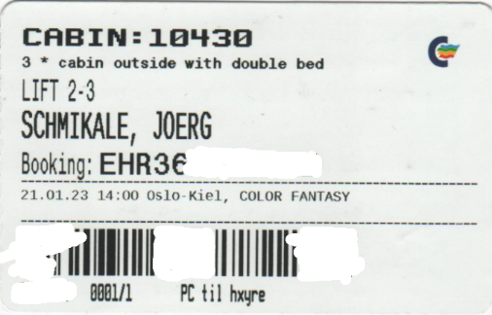
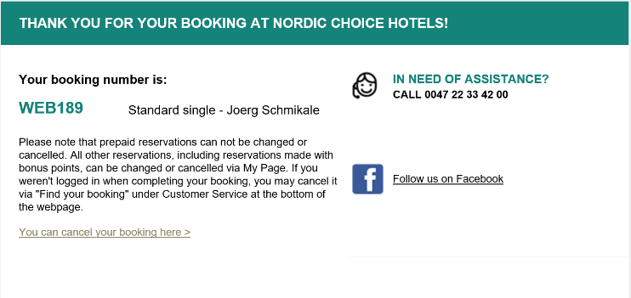
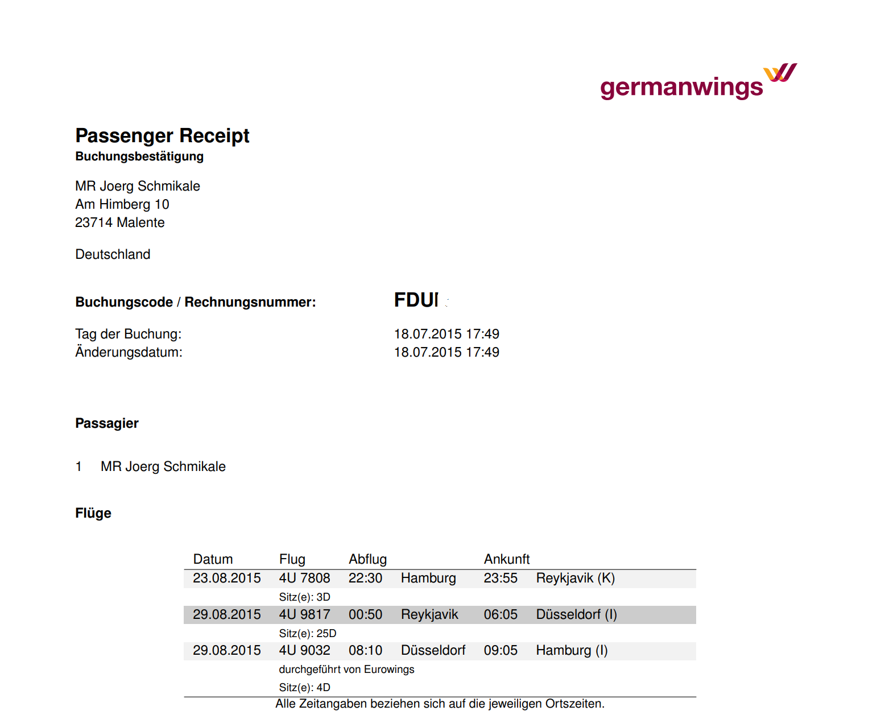
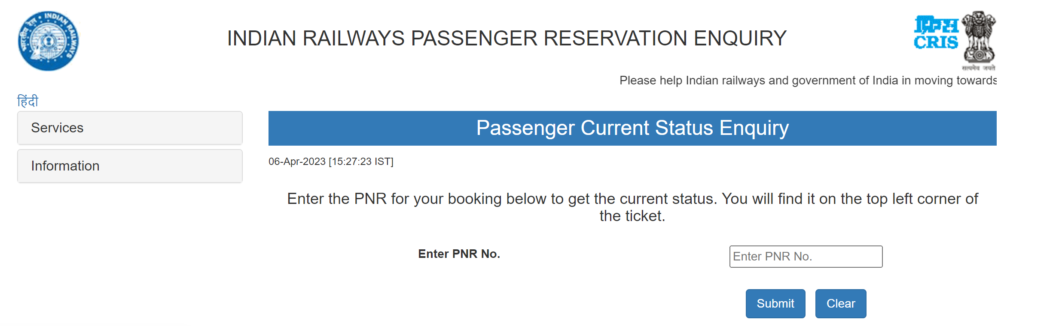
The PNR – a booking number
Passenger Name Record
In aviation also called Filekey
Contains Information about a Booking
Used for Example by
Ferry Companies
Hotels
Airlines
Train Companies

Slide 20
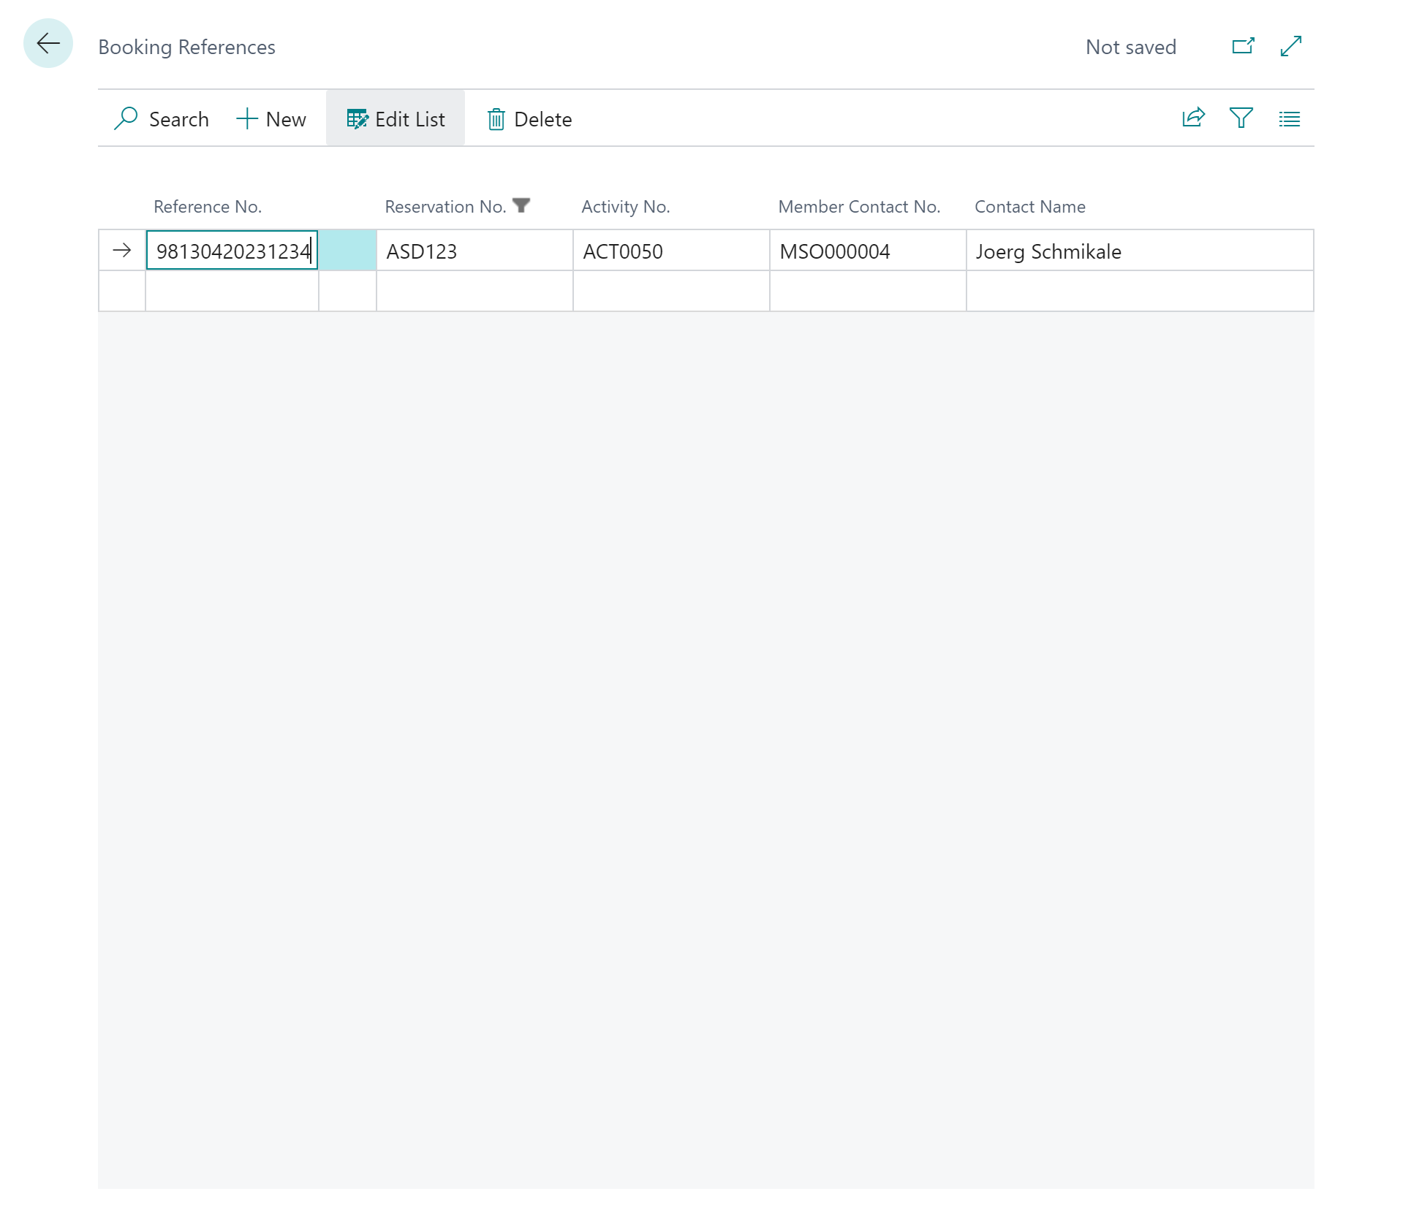
Ferry module booking reference number
Extends the PNR
Makes the PNR scan-able
Connects booked Services and Activities

Slide 21
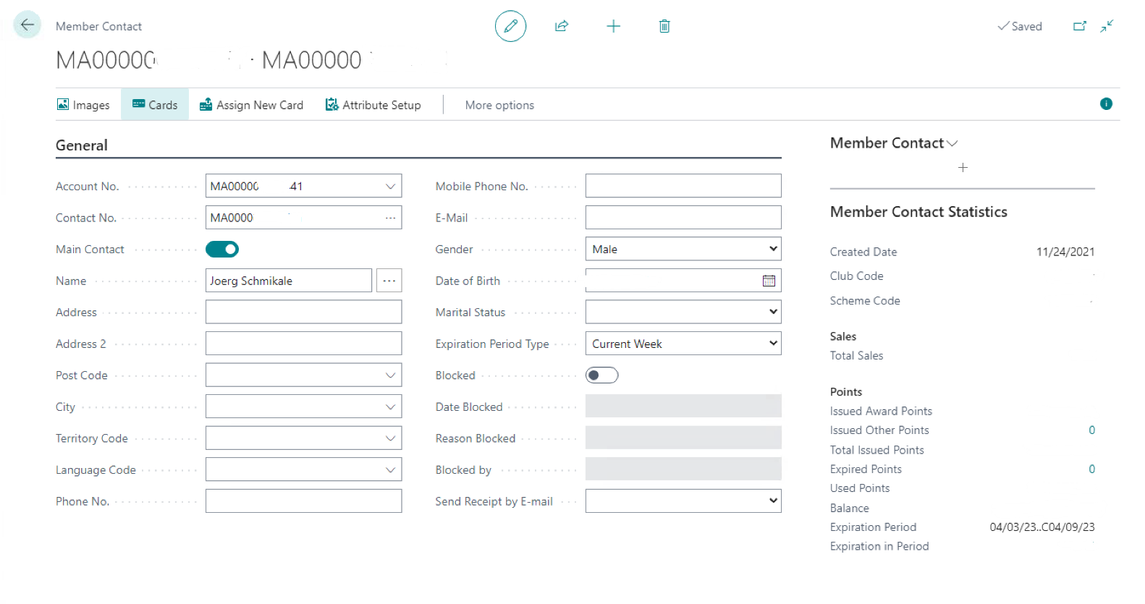
The Member Number
Is a part of Member Management
Can connect a booking history

Slide 22

Ferry module demo

Slide 23
LS Retail Consulting modules for travel industry
Ferry module for LS Central
Manage Bookings and Services OnBoard
Route Management System for LS Central – RMS
Manage Financials
Duty free module for LS Central
Manage Duty Free Sales

Slide 24
Enjoy the Journey!
Thank you

