Slide 1
LS Express
The Perfect Retail Solution for Small Business
Stephen Ward
Sales Associate

Slide 2

Table of Contents
What is LS Express
What are the Benefits of the platform
What sets it apart
Feature overview
How you can use LS Express to grow as a partner
How to become an LS Express Partner
Closing thoughts

Slide 3

What is LS Express
LS Express is an online Point of Sale (POS) system for small retailers using Microsoft Dynamics 365 Business Central. This retail POS extension is integrated with the Microsoft suite of products, which means no more switching in and out of applications:
You can now do everything in one, single system and as it is cloud-based, LS Express costs a fraction of the price of an offline POS.

Slide 4
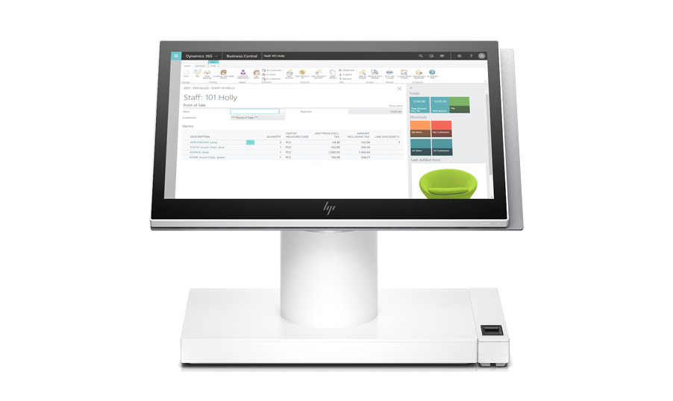
What is LS Express
LS Express extends the capabilities of Microsoft Dynamics 365 Business Central by adding the retail functionality. It also shares the familiar Microsoft look and feel and business logic. Manage your inventory, sales, and accounting in the same environment, without having to switch in and out of different applications.
The total integration to the Microsoft suite gives you many possibilities to improve service and increase profitability: customize your sales receipts adding your logo or greetings in Microsoft Word, or run your customer sales history through Microsoft’s Power BI to optimize your purchasing.

Slide 5

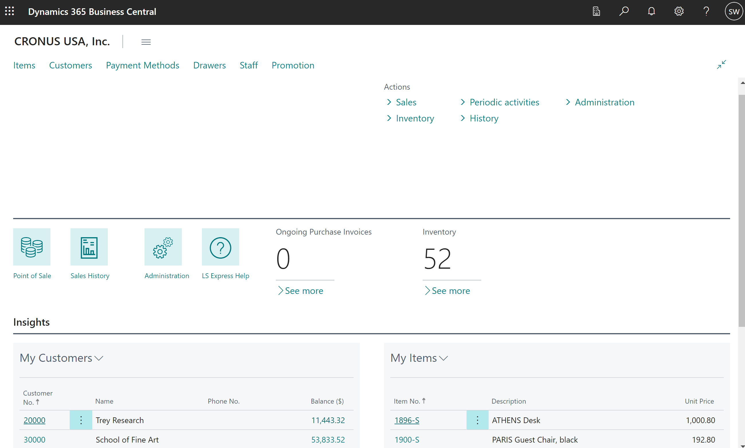

Slide 6
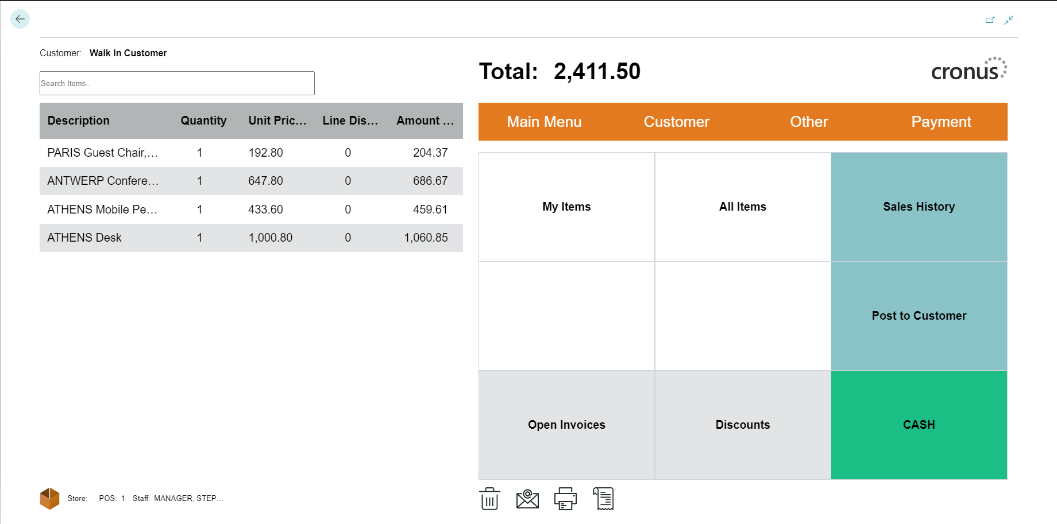
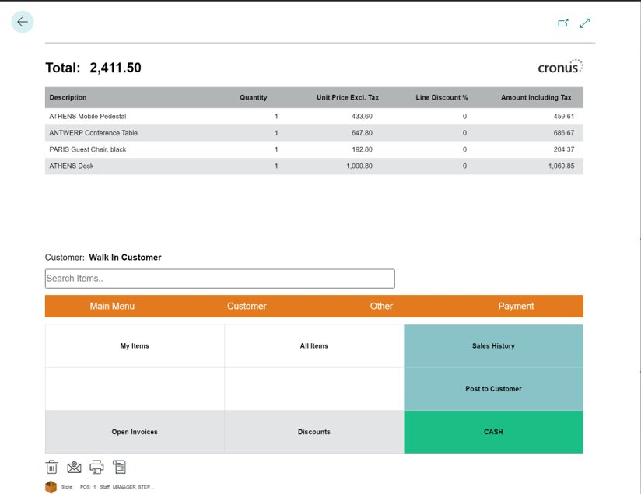

Slide 7
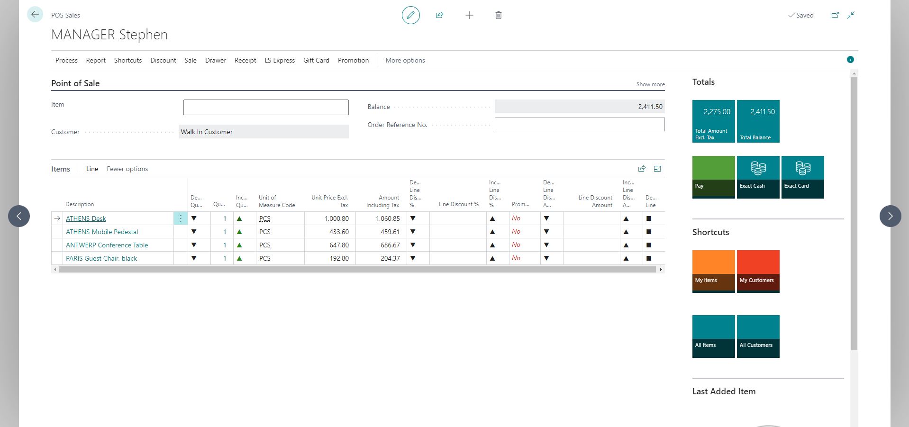

Slide 8
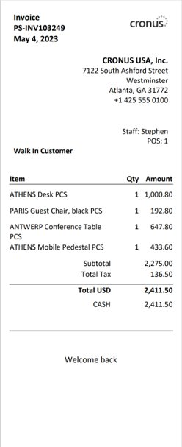


Slide 9
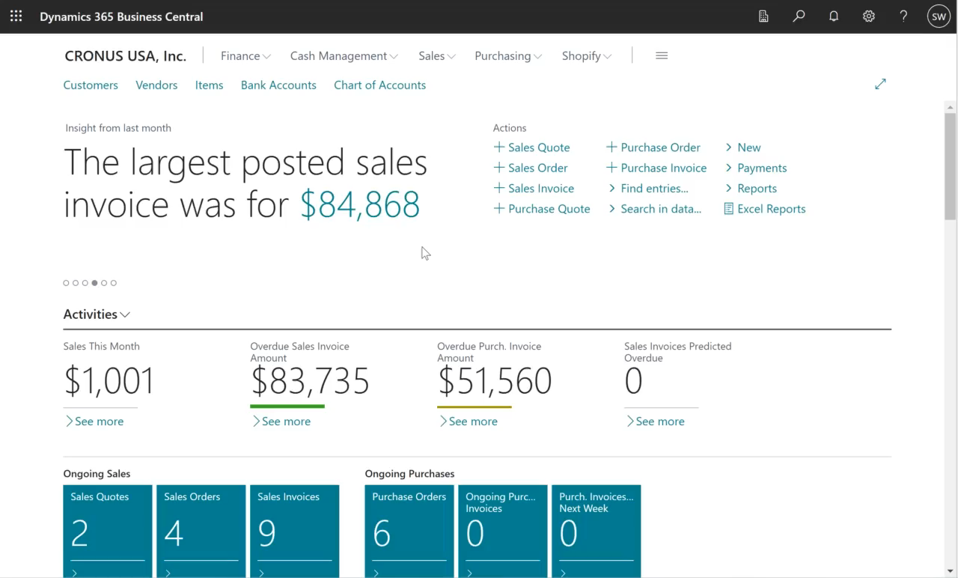

Slide 10
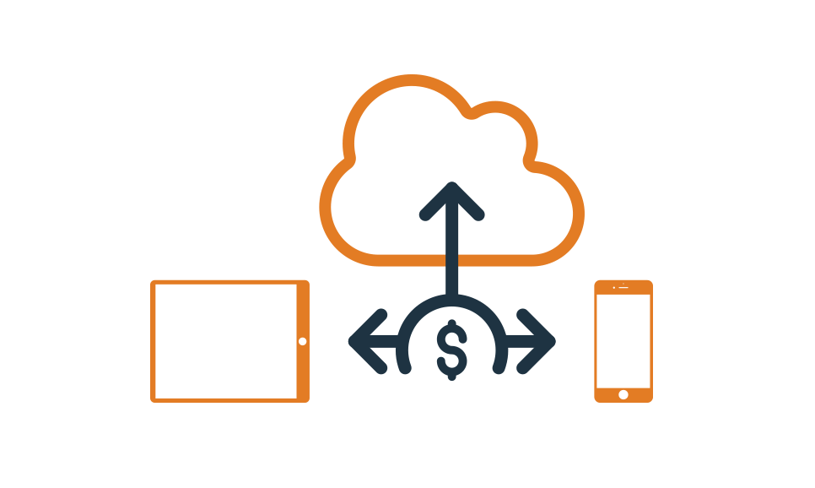
Scale Your Investment to Meet Your Needs
Decrease your maintenance and startup costs and stay within budget with a cloud-based software solution.
With LS Express you pay only for the licenses you need: choose the number of POS that best fits your company.
It’s high season, and you need more POS? Just contact our licensing team and we will increase or decrease their number, depending on your business needs. You don’t need an IT team to do that – and it just takes a few minutes. Quick, simple and convenient.

Slide 11
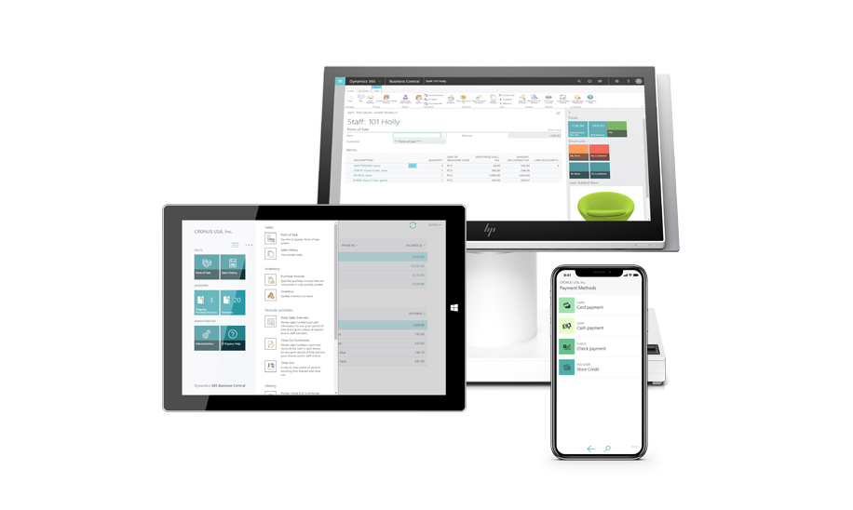
The Hardware-Independent Solution
The LS Express POS app is hardware-independent and has a responsive interface. This means you can run it in your favorite web browser on tablets, mobiles and computers using Windows, iOS or Android.
The system is fully optimized for touch screen, making it an ideal fit for dynamic and service-oriented businesses looking for a flexible, mobile Point of Sale including food trucks, pop-up stores, farmer markets and more.
Log into the system and keep track of your sales in real time, wherever you are: as LS Express runs in the cloud, your data is always maintained up to date across your sales devices

Slide 12
Introducing an Easier Workday
Easy to run and maintain
  Setting up LS Express takes less than 10 minutes – and you are ready to sell.
Familiar business environment
  It’s very easy to learn for anyone used to Microsoft products, such as Office.
Touch optimized and responsive
  Run it on your favorite web browser on mobile, tablet or computer.
Lower costs
  Decrease your maintenance and startup costs with a cloud-based software solution.

Slide 13
Introducing an Easier Workday
Always up to date*
  The system updates automatically at every new release.
Your business, anywhere, anytime
  Access your data safely any time you need to, wherever you are.
Easily add LS Pay
  Add the LS Pay module to your point of sale for extra security.
E-commerce with Shopify
  LS Express comes with a built-in connector to Shopify.

Slide 14

Benefits Benefits Benefits!
Receipt Management
Print or email your receipts and Invoices
Simple Returns
Product replacements, refunds, vouchers, or store credit
Payment options
Cash, vouchers, store credits, cards, coupons, and combinations
Suspend and retrieve transactions
Improve your accounting capabilities and get a complete overview of what is happening in your retail store

Slide 15

Benefits of Selling LS Express
Expand your universe of opportunities
    Don’t limit yourself based on budget, timeline, customizations.
Fast Sales Cycles
    LS Express is often closed in just a couple months or less
Keep busy and earn revenue while prospecting for LS Central
    With fast turn around, you don’t need to be concerned with tying up your bandwidth

Slide 16

LS Express Partner Program Benefits
Partner discounts on SaaS license sales
Service revenue opportunities:
  Training
  Support
  Integration services
  Hardware services
  etc.
Early roadmap visibility
Access to technical resources and defined escalation process/path
Access to LS Retail Portal and marketing assets
Access to demo environment
Assigned sales contact
Sales planning and alignment
Access to LS Express specialists during sales engagement
Special LS Express partner badge

Slide 17

LS Express Training
Demo Tenant in the US, contact the licenses team for help with getting access.
Initial Orientation training.
EF-100 Introduction to LS Express
LS Express introduction
Setup basics
POS operations, refund, and more
Additional configurations
Multiple stores setup
Payment methods
License management
Printing with PrintNode
LS Pay app for LS Express
Connecting LS Express to Shopify
Permissions

Slide 18
LS Express Resources
LS Express Demonstrations, general questions, setup help, partnership inquiries:
Stephen Ward – Stephen.ward@lsretail.com
Advanced online help, country availability, advanced setup, customizations, PSP lists, etc....
LS Express Online Help – www.help.lsexpress.lsretail.com
LS Express capabilities, roadmap, advanced information:
Sigrun Marta – Martasi@lsretail.com

Slide 19


Blomahonnun (before)
Case Study
“LS Express has made our business more organized and professional. Since we implemented it, the system has saved us the amount of work of one whole staff member. This means we have a lot more spare time, which we can finally dedicate to creating new flower arrangements, and to serving our customers,”
Orders managed via phone and email
Outdated systems in place
Inaccurate and slow inventory management
No overview of store activities
Time consuming, error ridden accounting
Blomahonnun (after)
Quick implementation
Current automated systems
Rapid & simple accounting
Total visibility of inventory
Saving time and money

Slide 20


Thank You

