Slide 2
How to implement an eCommerce project
Kristjan Asvaldsson
Omair Zuberi
Petur Thor Sigurdsson

Slide 3

Our Journey Today
Introduction to eCommerce for LS Central
Running a Project
Handling Customizations
LS Retail Consulting Services
Q&A

Slide 4
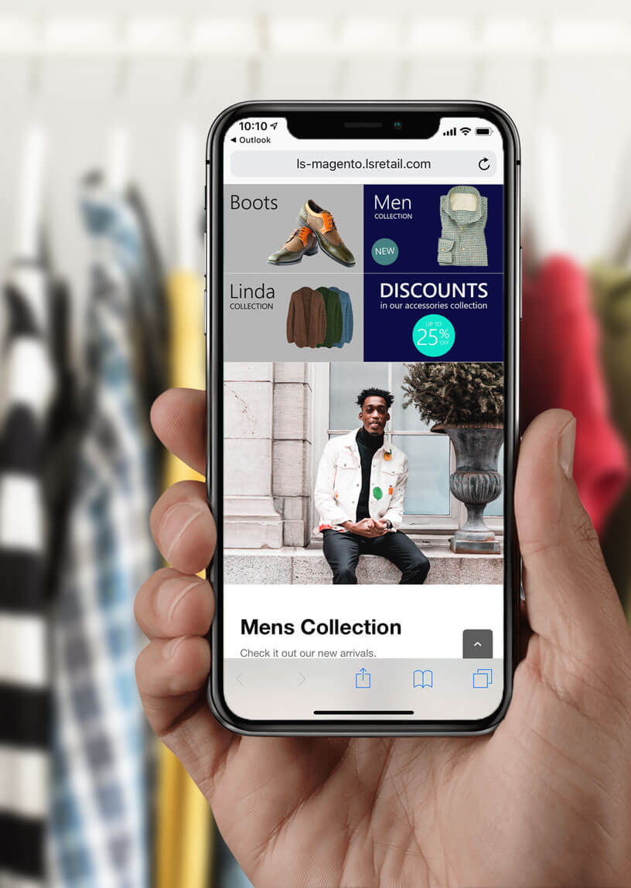
Introduction
What is eCommerce for LS Central
Topology
Installation
Configuration

Slide 5
Introduction
What is LS eCommerce
Topology
Installation
Configuration

Slide 6





Retail
Hospitality
Activity
Pharmacy
Retail
eCommerce API
LS Commerce Services
3rd party
eCommerce
providers

Slide 7
Introduction
What is LS eCommerce
Topology
Installation
Standalone
Virtual Machine
Configuration

Slide 8
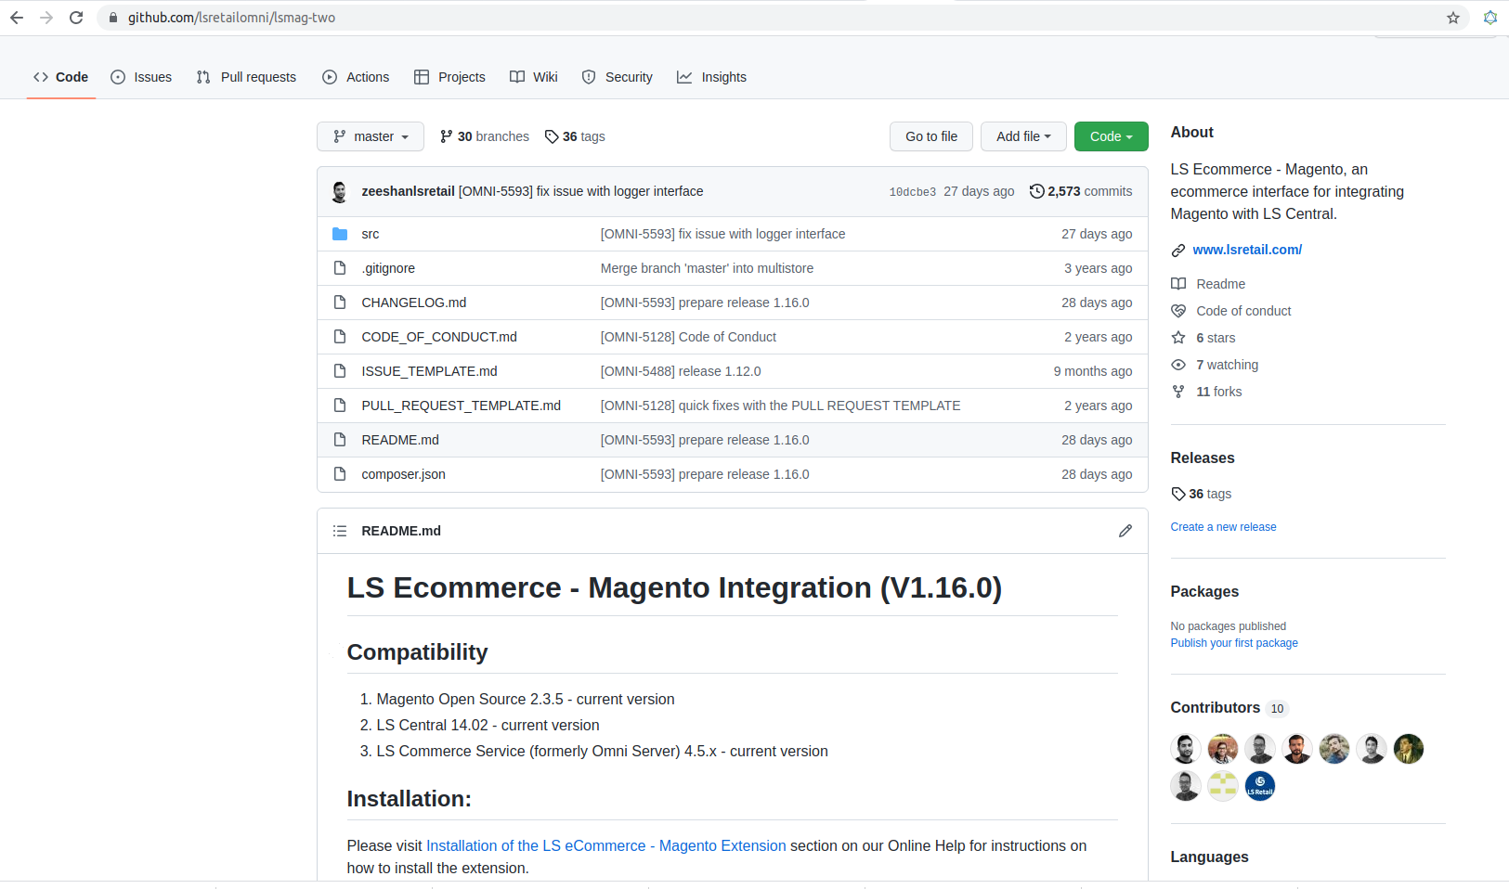
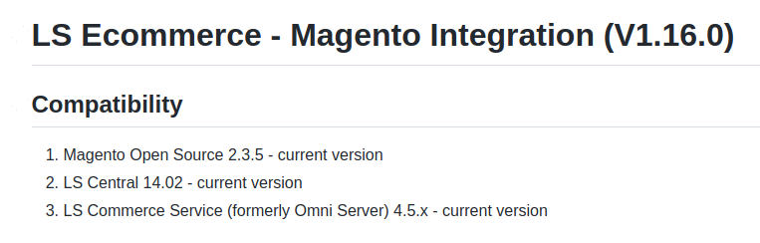

Slide 9
Introduction
What is LS eCommerce
Topology
Installation
Standalone
Virtual Machine
Configuration

Slide 10
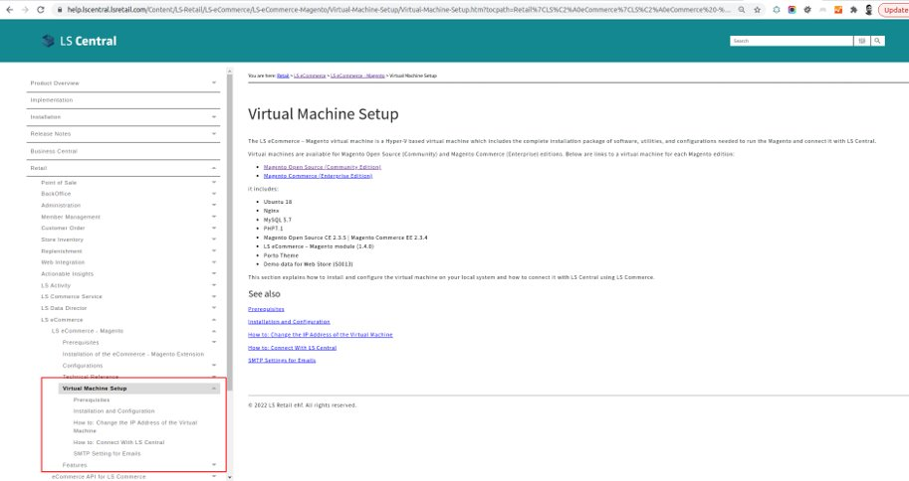

Slide 11
Introduction
What is LS eCommerce
Topology
Installation
Configuration

Slide 12
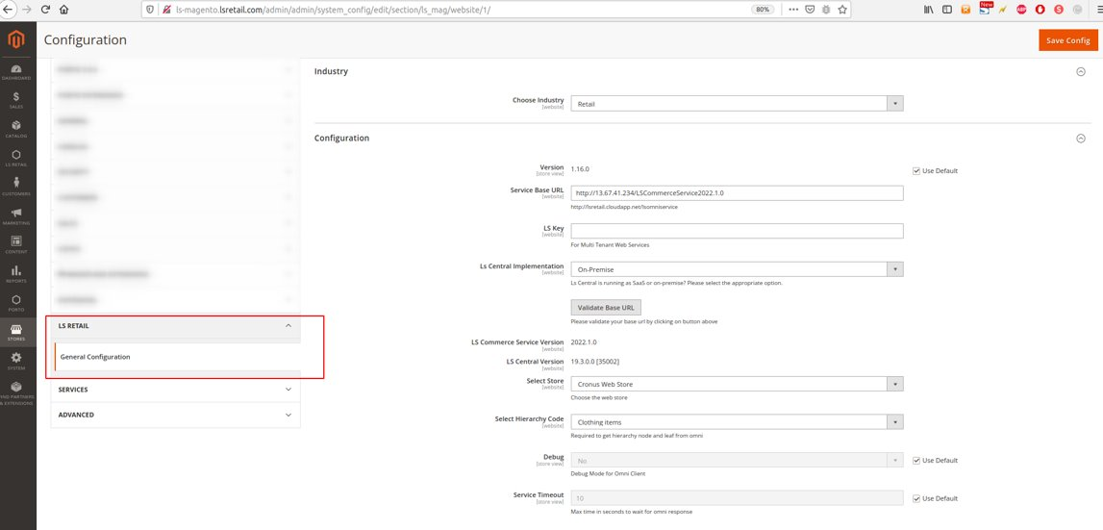

Slide 13
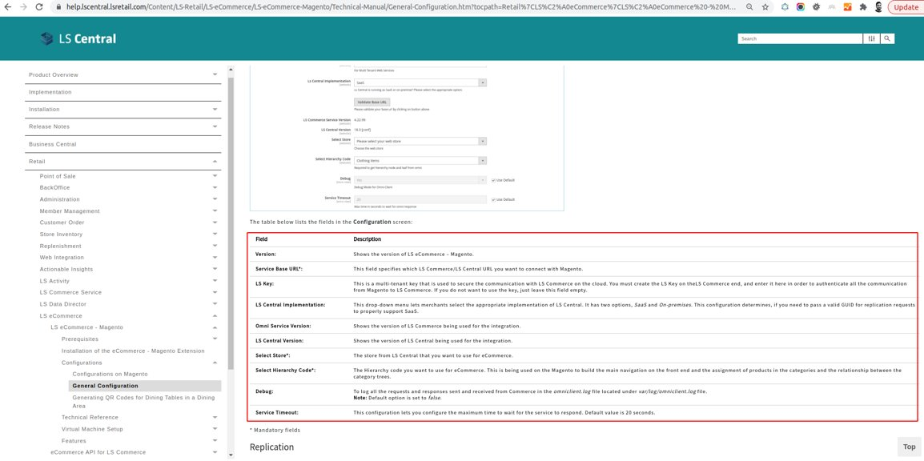

Slide 14
Running a Project

Slide 15

Running a Project
Scoping
Selecting the Magento Platform
Look and Feel
Hosting

Slide 16

Scoping
Client Requirements
Supported Features
Gaps?

Slide 17
Running a Project
Scoping
Selecting the Magento Platform
Look and Feel
Hosting

Slide 18
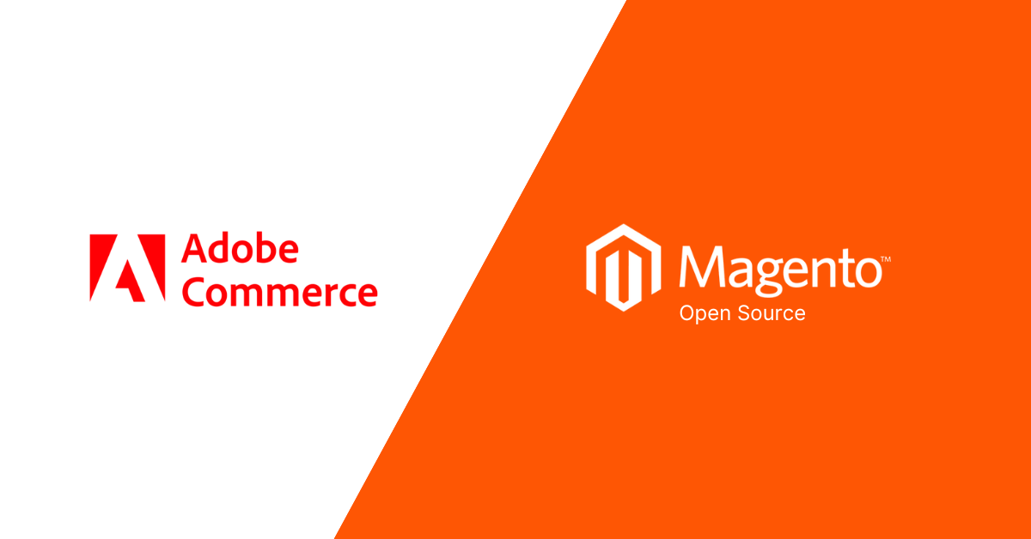
Adobe Commerce vs Magento Open Source
Store Size
Scalability
Cost
Advance Features
Hosting
Adobe Support

Slide 19
Running a Project
Scoping
Selecting the Magento Platform
Look and Feel
Hosting

Slide 20
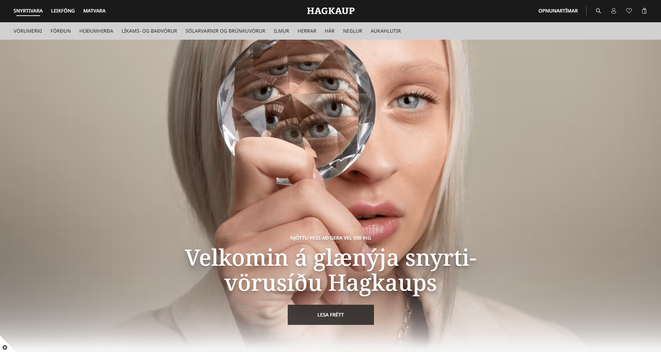
Look & Feel
Marketplace Themes
Custom Designs
PWA (Progressive Web Apps)

Slide 21
Running a Project
Scoping
Selecting the Magento Platform
Look and Feel
Hosting

Slide 22
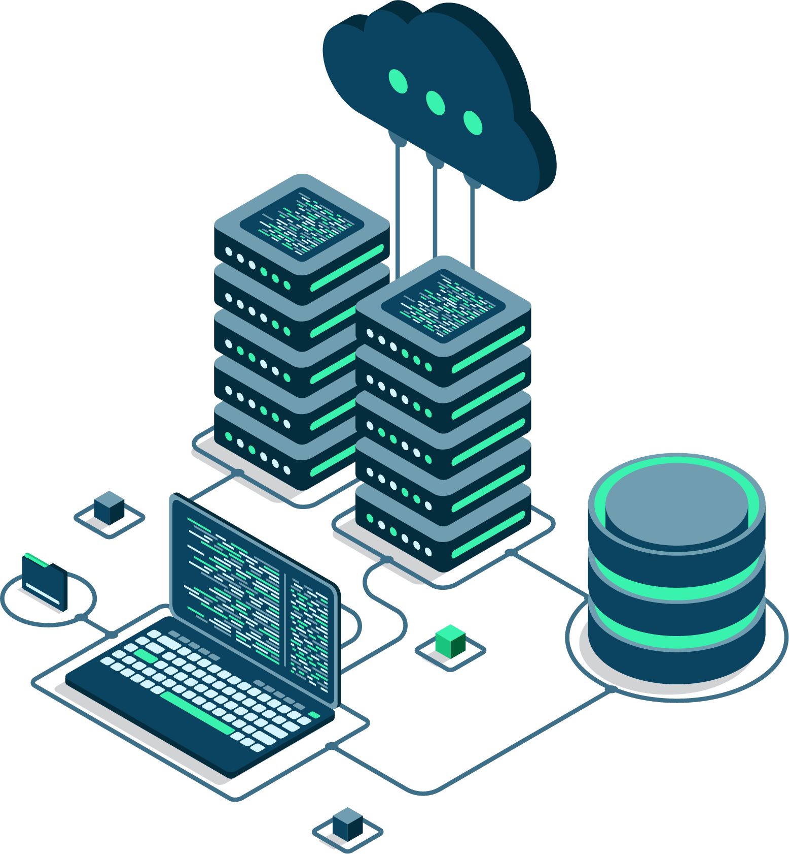
Hosting
Adobe Commerce Cloud
On Premise
Third Party

Slide 23
Handling Customizations

Slide 24
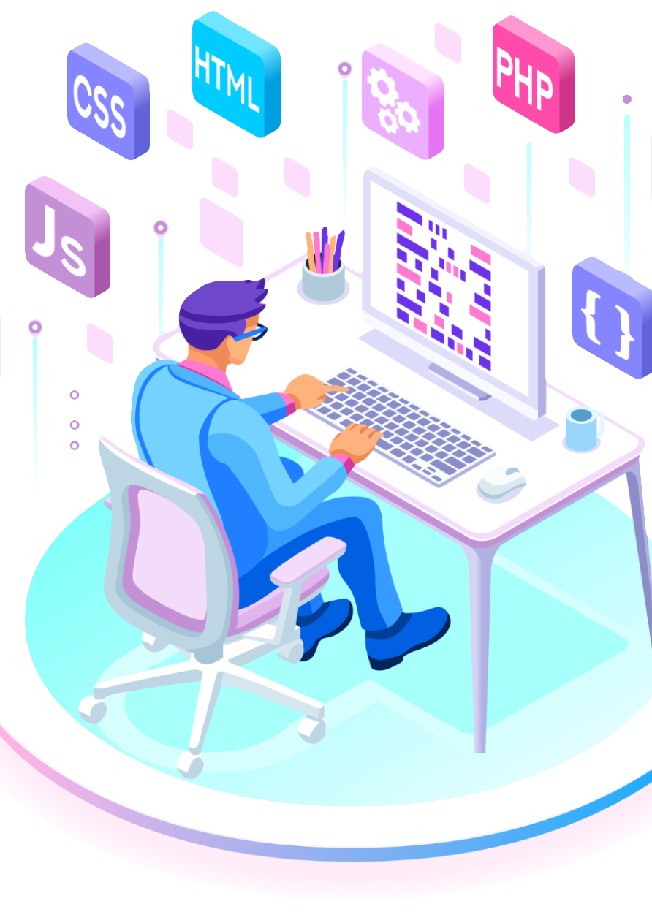
Customizations
Frontend – UI
Magento
LS eCommerce – Magento module
LS Commerce Service
LS Central

Slide 25
LS Retail Consultancy

Slide 26

LS Retail Consultancy
Discovery Workshops
Training
Customization Requests
Deployment

Slide 27
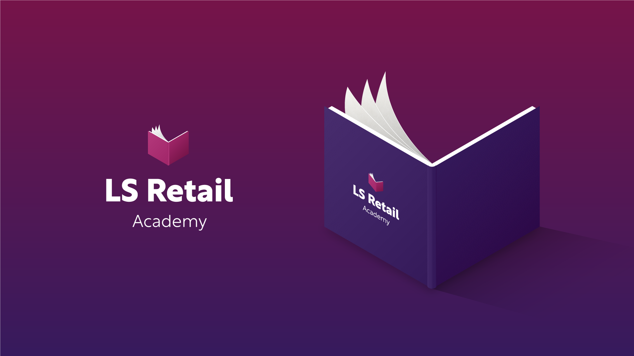

Slide 28
Thank you

