Slide 1
LS Central SaaS Onboarding
Adalbjorg Karlsdottir
Onboarding lead

Slide 2
Your Journey to LS Central Saas
Overview Session
SaaS Training
Onboarding Guide
Implementation Guide
CAP

Slide 3
Your Journey to LS Central Saas
Overview Session
SaaS Training
Onboarding Guide
Implementation Guide
CAP

Slide 4
Your Journey to LS Central Saas
Overview Session
SaaS Training
Onboarding Guide
Implementation Guide
CAP

Slide 5

SaaS Overview session
https://calendly.com/lsconboarding/onboarding

Slide 6
Your Journey to LS Central Saas
Overview Session
SaaS Training
Onboarding Guide
Implementation Guide
CAP

Slide 7


LS Retail Academy – SaaS Training
Partner Center
Delegate Admin role
Admin Center
Administrative tasks for tenants
Online POS vs. Hybrid POS

Slide 8
LS Retail Academy – SaaS Training
Partner Center
Delegate Admin role
Admin Center
Administrative tasks for tenants
Online POS vs. Hybrid POS
Update Service – NEW
https://portal.lsretail.com/courses-on-demand/

Slide 9
Overview session and CF-900
  Mandatory
  Before purchasing a customer license in SaaS

Slide 10
Your Journey to LS Central Saas
Overview Session
SaaS Training
Onboarding Guide
Implementation Guide
CAP

Slide 11
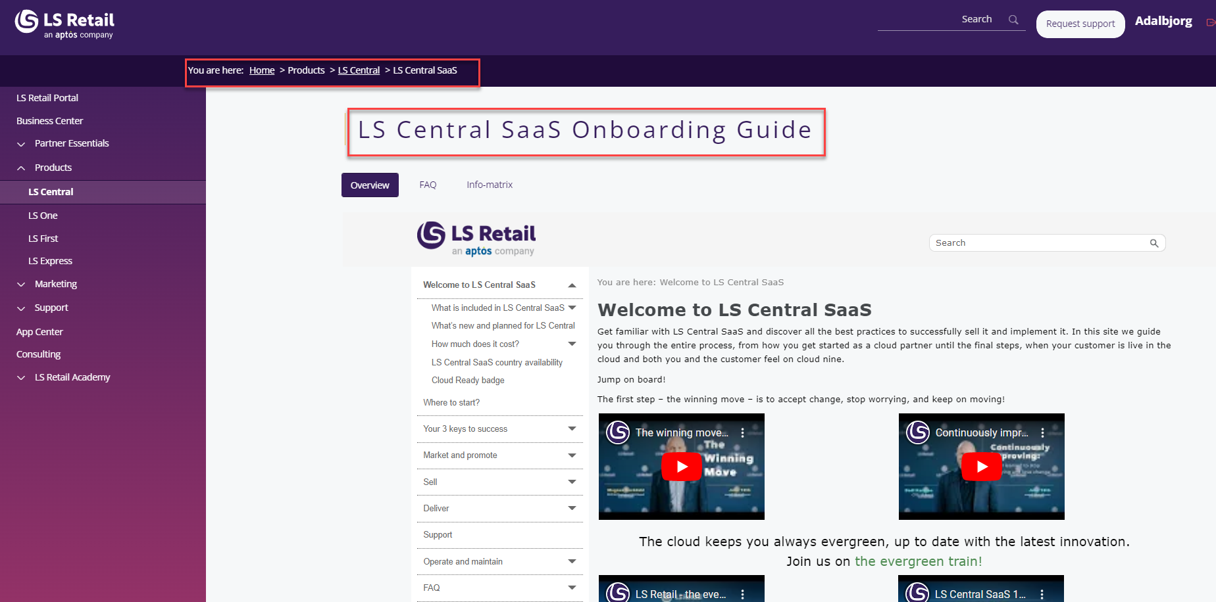
LS Central SaaS Onboarding Guide

Slide 12
LS Central SaaS Onboarding Guide

Slide 13
Your Journey to LS Central Saas
Overview Session
SaaS Training
Onboarding Guide
Implementation Guide
CAP

Slide 14
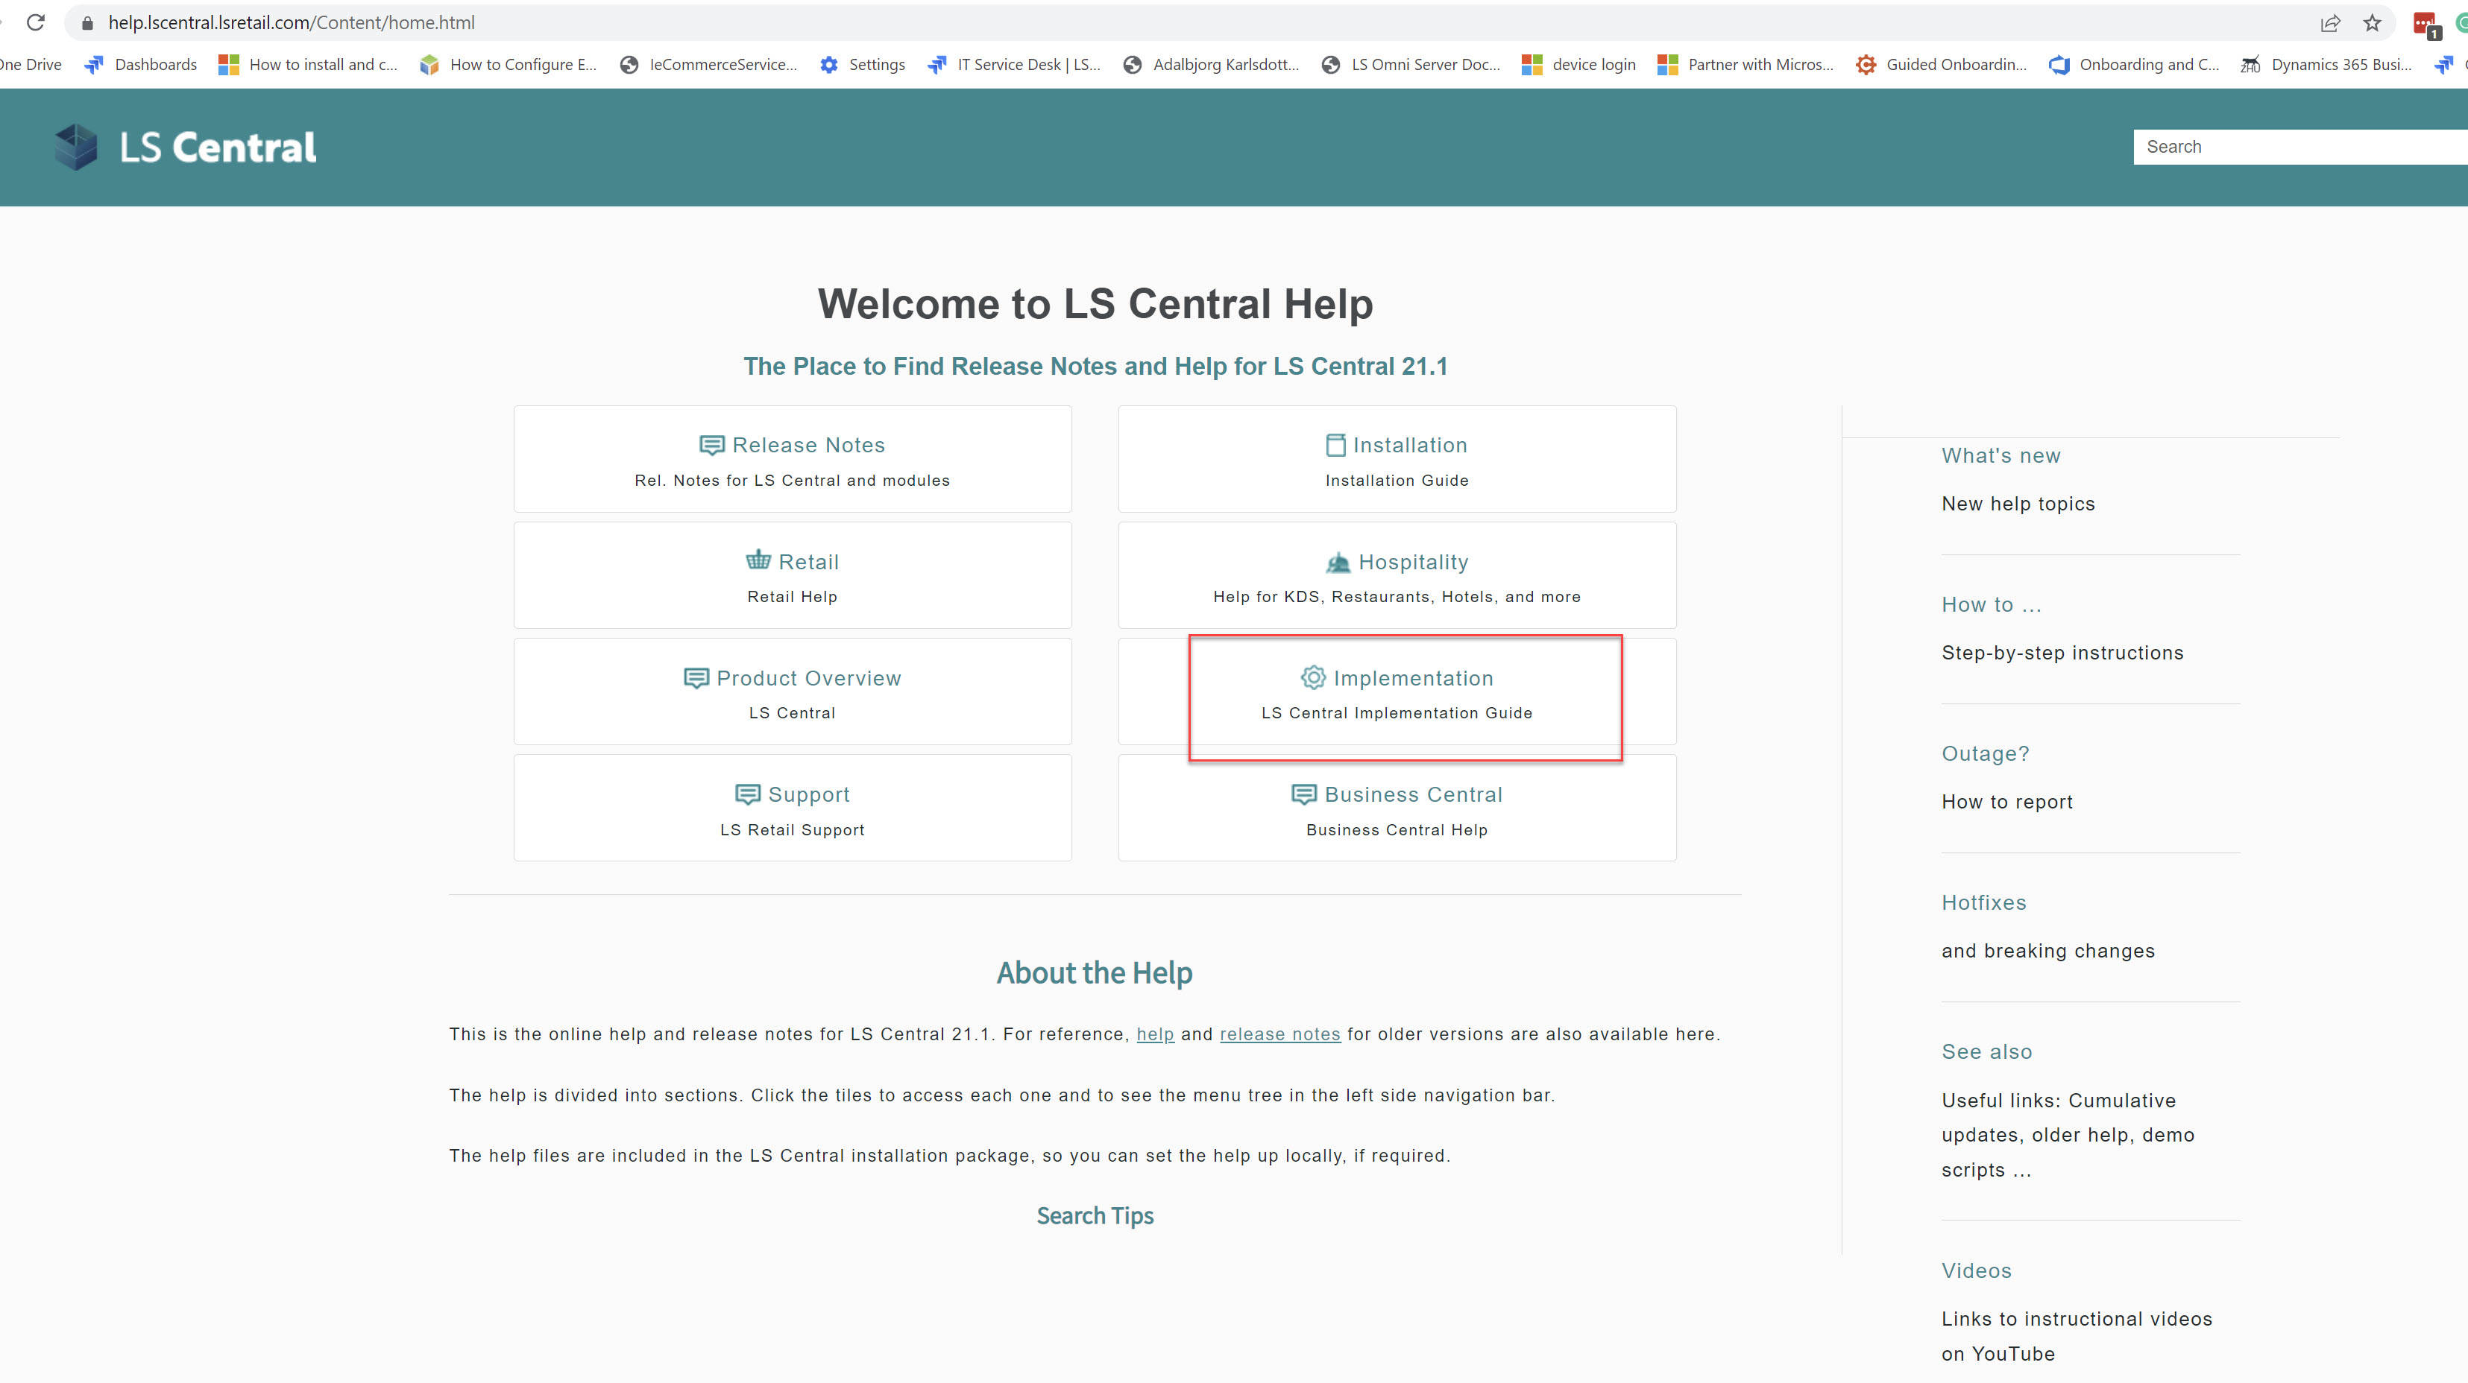
Implementation Guide

Slide 15

Customer story

Slide 16
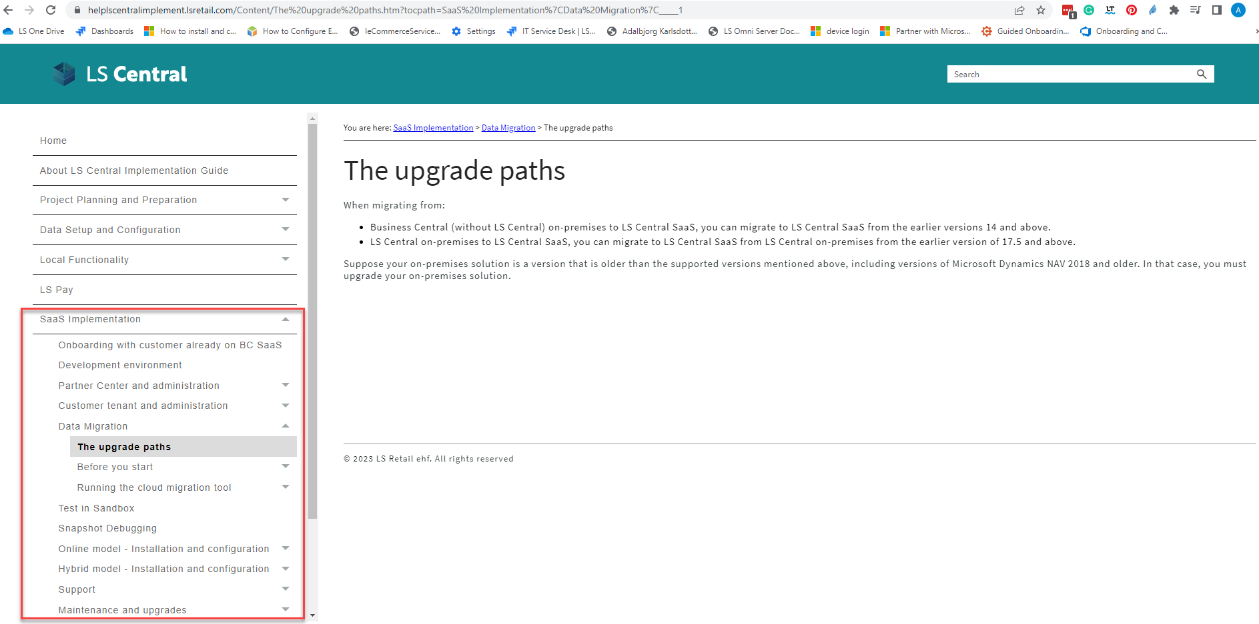
How to move your data to SaaS?

Slide 17
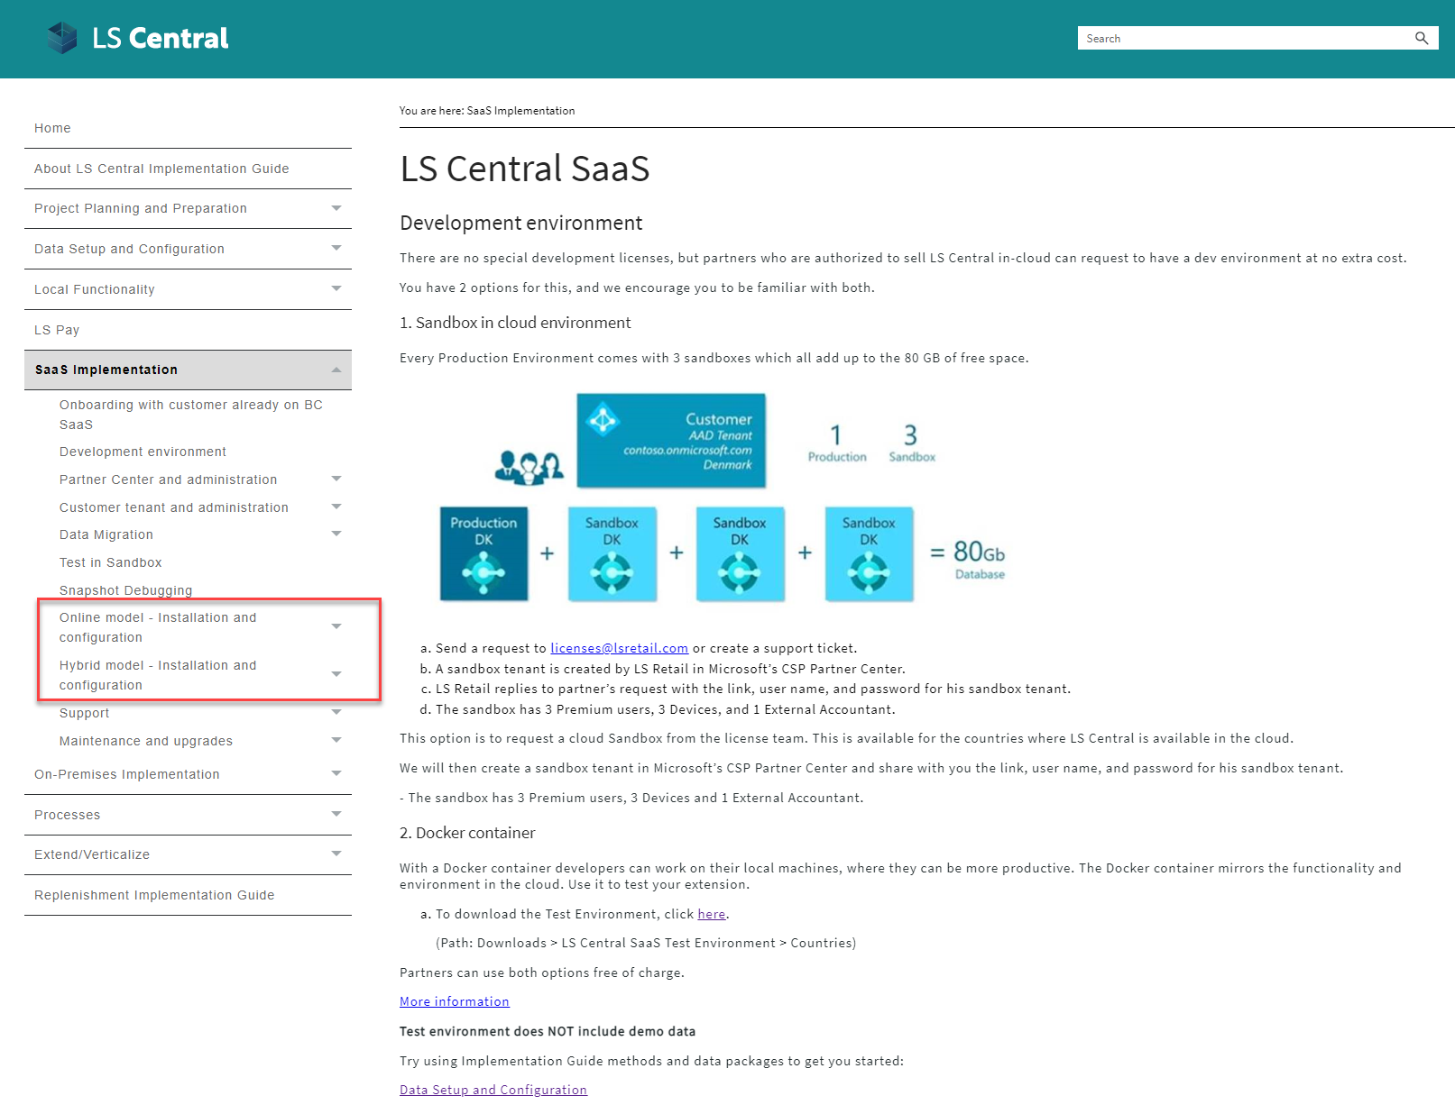



Online or Hybrid?
Web
Replication
LS Central in SaaS
HQ
Hybrid component server
Store
Online POS
Offline POS
Offline POS Service

Slide 18


Online POS
HEAD OFFICE IN THE CLOUD
BACK OFFICE
ONLINE POS
ONLINE POS
ONLINE POS

Slide 19











Online POS
Microsoft Dynamics 365
Business Central
HQ
Store
POS 1
POS N
Hardware Station
…

Slide 20



Hybrid POS
BACK OFFICE
HEAD OFFICE IN THE CLOUD
Sales data pushed after each sale
(Webservice)
Sales data pushed after each sale
(Webservice)
Master data pulled from HQ
(Scheduled Webservice job)
STORE 1
STORE 2
Master data replicatied to POS
(Data Director)
HYBRID COMPONENT SERVER
Master data replicatied to POS
(Data Director)
POS MASTER
Offline POS
Offline POS
DATA DIRECTOR
Offline POS
Offline POS
UPDATE SERVICE

Slide 21
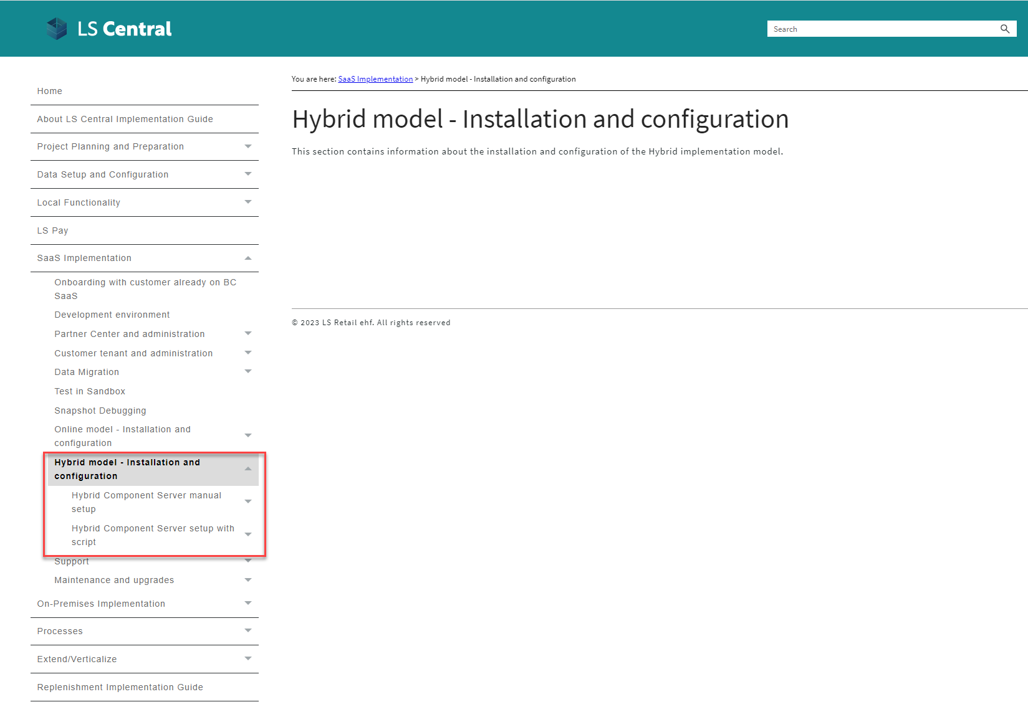
Hybrid POS

Slide 22
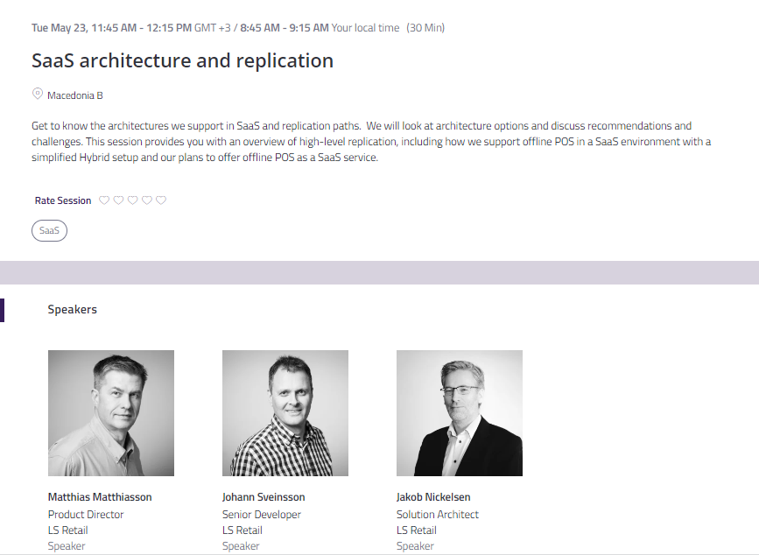
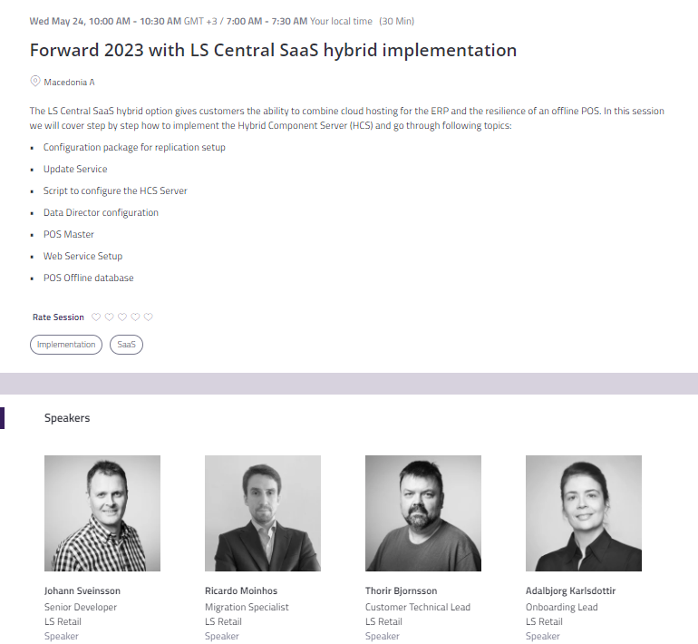
Hybrid POS

Slide 23
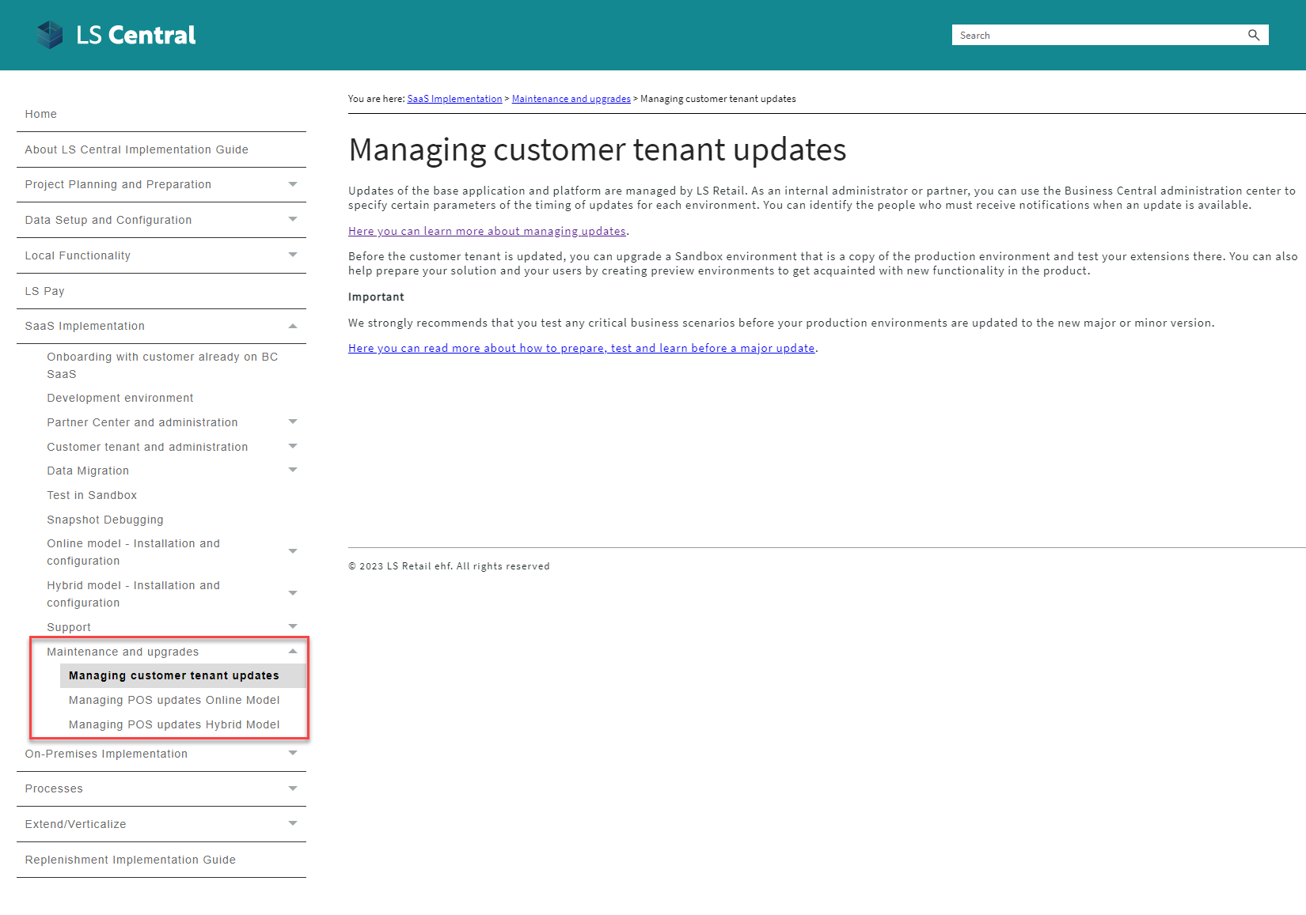
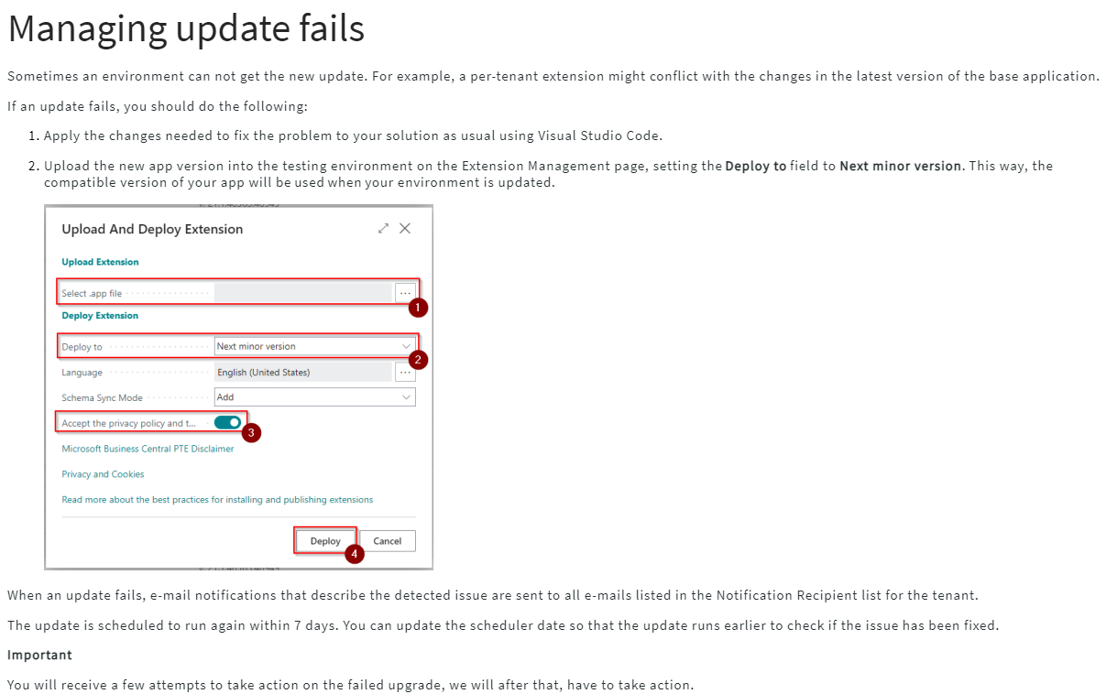
Updates in SaaS
Last selectable Scheduled Update date
Update is available
Outside upgrade window
Within upgrade window
Test window
Upgrade starts*
Day 1
Day 14
Day 21
* If Scheduled Update date has not been set earlier within the upgrade window
The day when the version of LS Central SaaS becomes available
The day when the update is automatically scheduled
The last day you can choose to extend your upgrade date to.

Slide 24
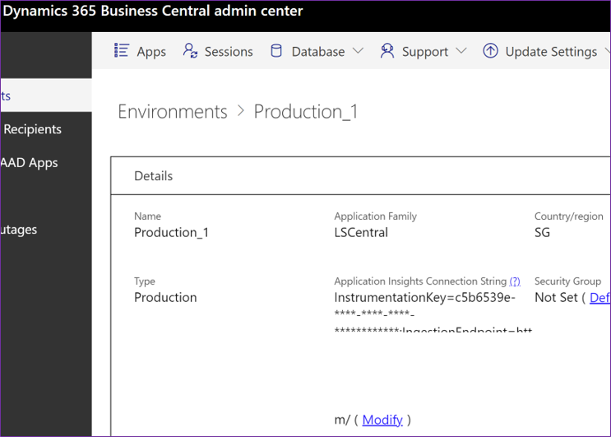
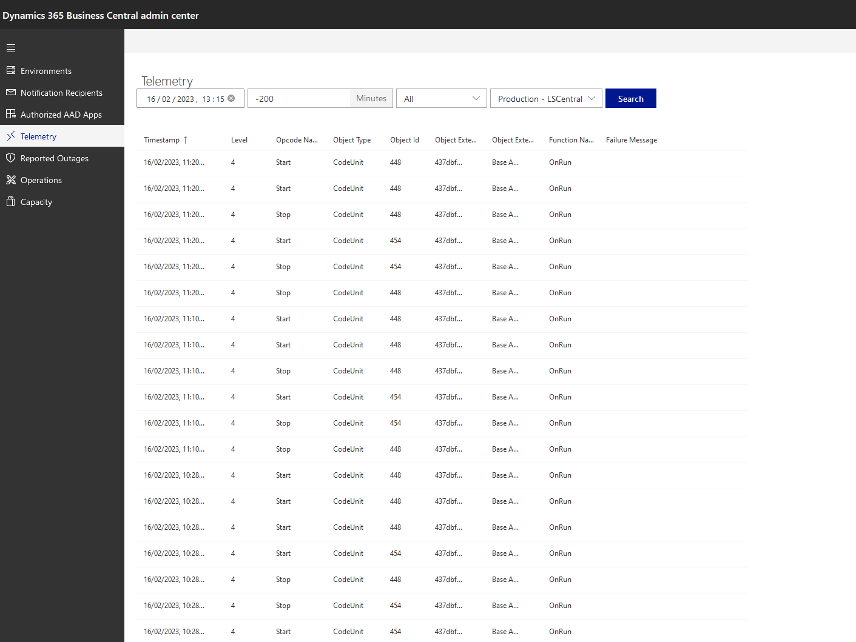
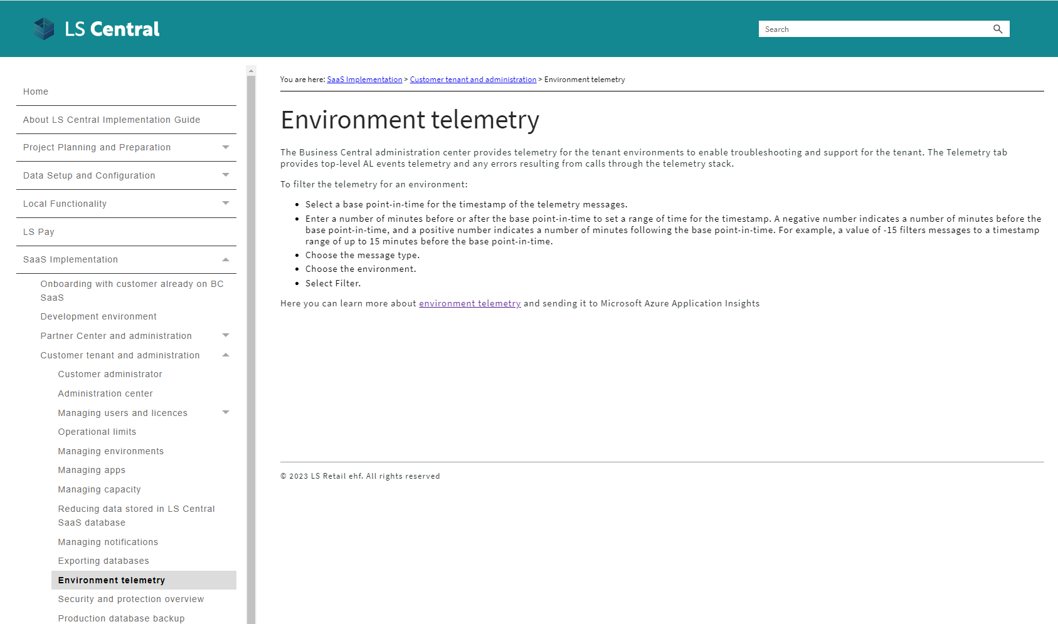
Telemetry

Slide 25
Your Journey to LS Central Saas
Overview Session
SaaS Training
Onboarding Guide
Implementation Guide
CAP

Slide 26
How are we supporting you in
your SaaS journey?

Slide 27



Partners journey to SaaS
Phase 1 – CSP Partner
CSP
130+ onboarding
sessions with partners
Overview
Training

Slide 28

CAP
Cloud Acceleration Program

Slide 29

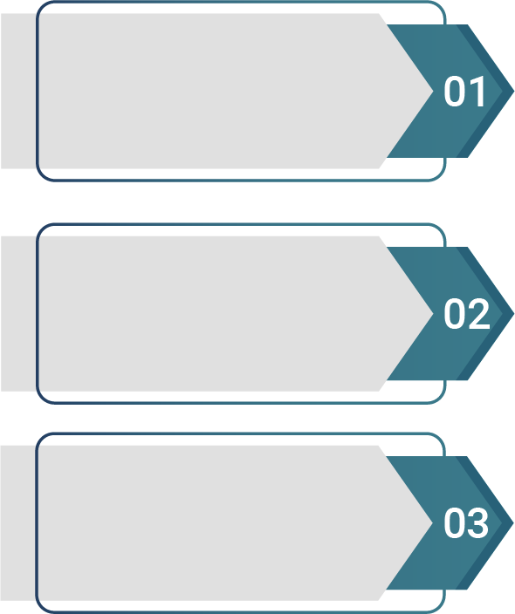
Partners journey to SaaS
Phase 2 – Cloud Acceleration Program (CAP)
  Guided Onboarding
SaaS License
SaaS Project
Evaluation Meeting
  Onboarding with
  Consulting Team

Slide 30
CAP – Guided Onboarding
Migration
Test environment

Slide 31



CAP – Guided Onboarding
First Store/
POS
Q&A Session
Migration
Test environment
First HO/POS
Update

Slide 32
CAP – Guided Onboarding
First Store/
POS
Q&A Session
Migration
Test environment
First HO/POS
Update

Slide 33

Onboarding with consulting

Slide 34
How much does it cost?

Slide 35

LS Central SaaS – Large Implementations
  Microsoft
  Concierge Program

Slide 36

Book a session with the Onboarding team
Book your overview session when it fits you​
Use link​
https://calendly.com/lsconboarding/onboarding ​
​
Do you need a 30-minute session to ask any SaaS-related questions​
Use link​
https://calendly.com/lsconboarding/30minsession

Slide 37
Recap
Overview Session
SaaS Training
Onboarding Guide
Implementation Guide
CAP

Slide 38
Thank you

