Slide 2


Ólafur Jónsson
Mobile and LS Central
Andri Fannar Freysson
Product owner
Developer
Olafur@lsretail.com
Andrif@lsretail.com
Notes:
Hello everyone and welcome to today’s webinar on Mobile & LS Central. My name is Olafur Jonsson and I am product owner for LS Central devices here at LS Retail, with me is Andri Fannar Freysson software developer in the mobile device team.
Before we get started, I would like to go over a few items, so you know how to participate in todays event. This webinar is being recorded and we will distribute a link to the recording shortly after the webinar. All participants are muted, and we will have a Q&A session at the end, so as we progress through the webinar, please type in your questions in the question panel found at the question console and I will then read out loud the questions at the end of the session and try answer your questions.

Slide 3






Mobile apps for LS Central
Mobile POS
Mobile inventory
LS Central AppShell
LS Central ScanPayGo *
Developed to support business processes
* unreleased
Notes:
LS Retail has released a number of mobile solutions through the years like
Mobile POS,
Mobile Inventory
LS Central AppShell
and now we are giving you a preview of our upcoming LS ScanPayGo App
What they all have in common is that they were developed to support certain business processes like enhanced instore experiences and personal services, handling inventory processes on a mobile device, handling que busting when normal check out lanes are full etc.
All of these are important in the Unified Commerce context - extending the functionality of LS Central to a mobile device to have the same functionality and data.

Slide 4
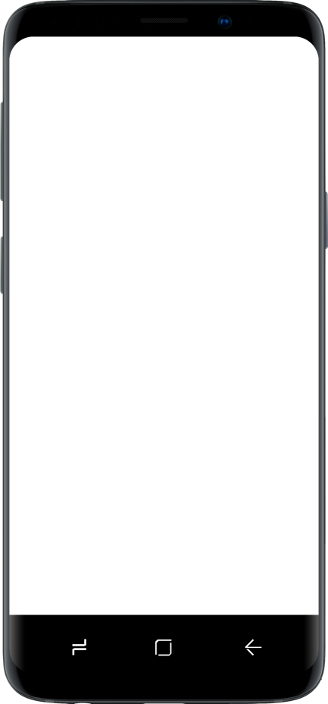
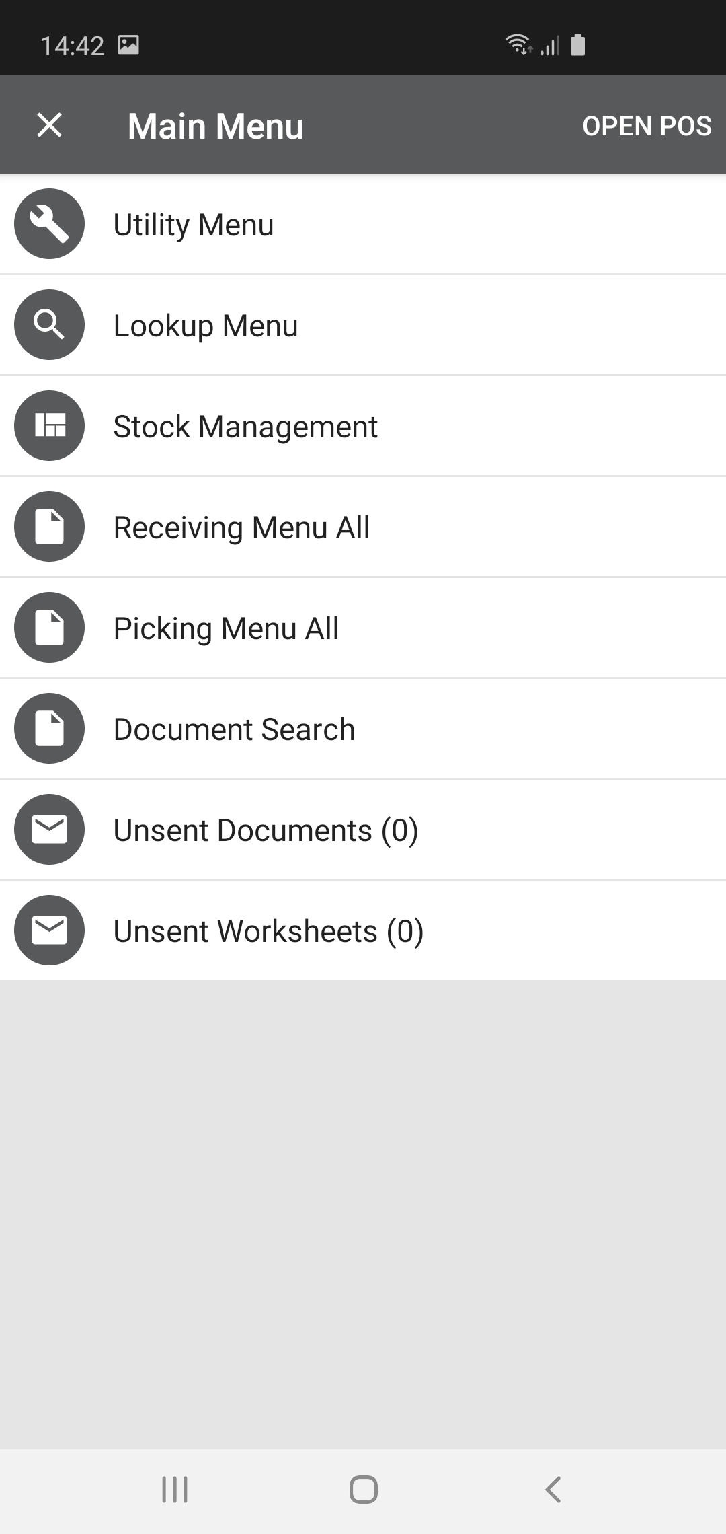
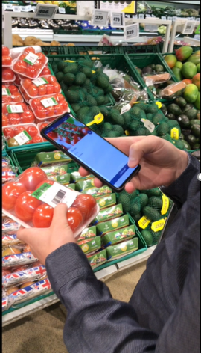

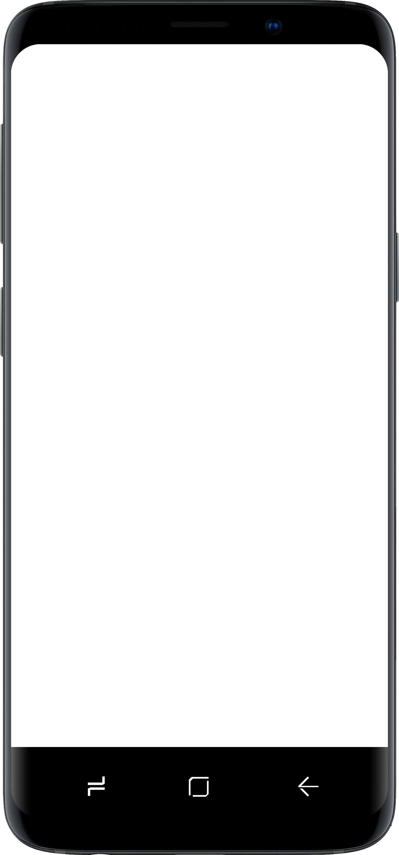
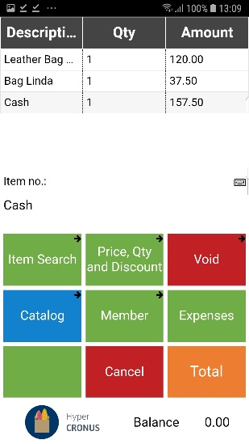
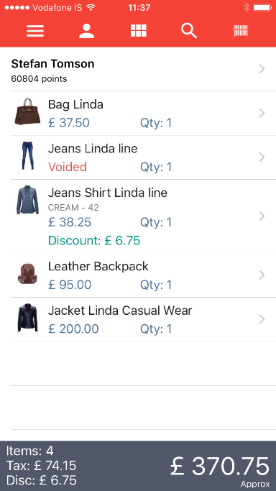
The apps
LS Central AppShell
Mobile POS
Mobile Inventory
LS Central ScanPayGo
Notes:
These Apps are different in functionality to serve their purpose and run on different platforms. Android is LS Retail mobile platform of choice, so all the apps are available on Android, but the LS Central AppShell is also available on iOS and Windows to run for example on Windows tablet devices.
<Click>
We will start by discussing the options we have to run a POS solutions on a mobile device and then
<Click>
Then take a look at Mobile Inventory and its latest feature
<Click>
Lastly, we will give you a sneak-peak into LS Central ScanPayGo the we have been working on and is still yet to be released.

Slide 5


vs
! AppShell ! Mobile POS
The LS Central AppShell
the Mobile POS
Omni Server
LS Central AppShell
LS Central
Mobile POS
LS Central
App to run webPOS on a device in a controlled way
Standalone POS app with limited functionality that connects to LS Central through LS Omni server
Gives POS direct access to peripherals *
Printers (Epson EPos, Zebra link OS)
LS Pay connected EFT device
Camera built into a mobile device to scan
AppShell Mobile POS
* Available in Android version
Notes:
To run a POS on a mobile device you have two choices, the webPOS running in the LS Central AppShell or the Mobile POS.
The AppShell starts a browser and runs our webPOS that communicates directly with LS Central. Connection to pheripherals is either by LS Hardware Station or thru direct access when using the Android version. I recently hosted a webinar on the webPOS, and I recommend looking at the for more information on the AppShell.
The Mobile POS is a special POS App with limited POS functionality that uses LS Omni Server to connect to LS Central. It also has direct access to pheripherals.

Slide 6
! AppShell ! Mobile POS
webPOS AppShell
vs
Mobile POS
webPOS in LS Central AppShell
Mobile POS
Limited POS functionality through LS Omni server
Customization needs to be done by LS Retail
Offline capabilities with automatic sync on reconnecting
POS has direct access to peripherals
Ideal for
Outdoor use (tickets, attractions) – when it needs to be off-line
Pop-up stores
Travel retail
…
Full functionality of LS Central webPOS
Same customizations as traditional POS
Always online
Access to peripherals direct or through LS Central Hardware Station
Ideal to run the POS on a mobile device in a regular retail environment
AppShell Mobile POS
Notes:
So what option to choose when you want to run a POS on a mobile device? The first choice is always the webPOS running in the LS Central AppShell. There you are using the same POS as on a stationary device and therefore you have always the latest features and can customize it like the traditional POS. But note that as with LS Central the mobile device needs to have a network access to be On-line.
The Mobile POS has the basic POS functions pre-programmed and gets the data thru the LS Omni server. It has a database running on the device so it can store data and therefore it can be off-line when there is no network access and then resync with LS Central when it is on-line again. So the Mobile POS is the solution of choice in scenarios were it must be possible to go off-line. For example in Outdoor cases, travel retail etc.
But the first choice would always be to use LS Central running in the AppShell.

Slide 7
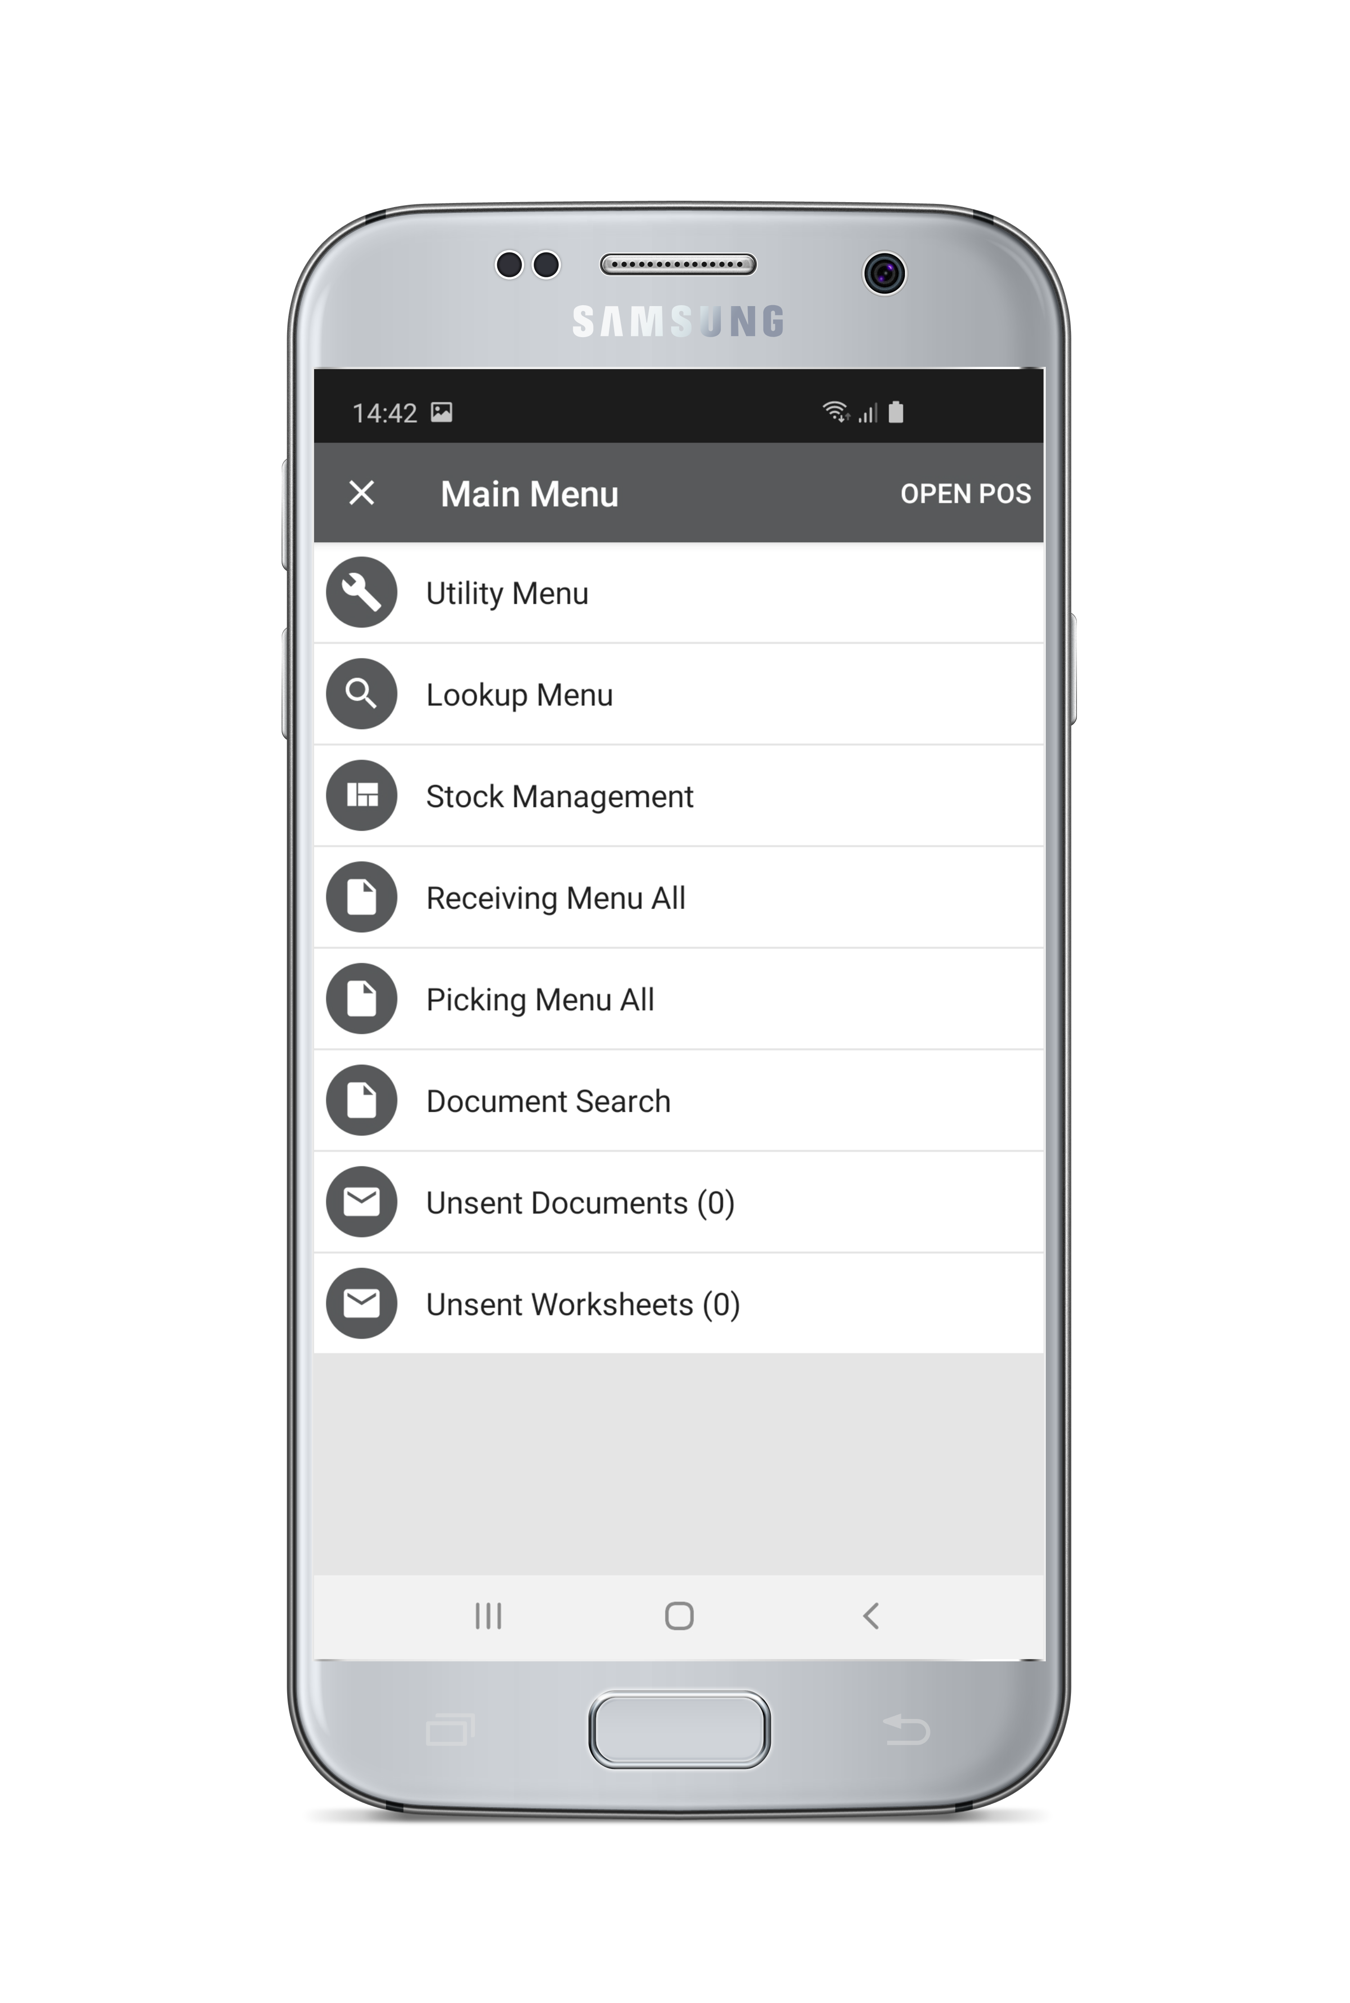
Mobile inventory
! Mobile inventory
Mobile inventory extends LS Central’s powerful inventory functionality (PO / TO / picking, receiving, counting …) to mobile devices
Perform inventory tasks where needed
Update inventory info quickly
Scan barcodes instead of keying in data: reduce errors and need for data maintenance
Make the best use of info delivered from supplier
Eliminate paper as data storage
Mobilizes inventory processes
Mobile inventory
Notes:
LS Central has powerful functionality for the Inventory processes: Purchase Orders, Transfer Orders, Picking, Receiving, Counting etc. The Mobile Inventory solution extends these inventory process to a mobile device, being able to perform the tasks on the handheld as you were working in the LS Central Back office. Enabling the user to view and update the stock information on the location is the key thing. It enables the information to be entered at the earliest moment and minimizes keying in data - which increases speed and reduces errors. It also eliminates the need of using paper to prerecord data that is then needed to be re-key in the system or the use of specialized handheld machines, often having the need for Excel sheets as the middle layer for the data.
In fact this is a good example of our Unified Commerce story were we are always working on one data no matter on what device or platform the solution is – and there is no need to move data between different systems or silos.
<Click>
So the goal with the solution is to Mobilize the Inventory functions.

Slide 8

The architecture
! Mobile inventory
Mobile inventory uses the LS Omni Server
Passes data to and from LS Central
Ensures backwards compatibility and multi-tenant
Can connect to multiple ERPs
All setup of mobile inventory (menu, store, terminal, user,…) is retrieved at startup from LS Central
Master data is replicated from LS Central and stored on the mobile device
Offline capabilities: collects and stores working data on the handheld, then sends to LS Central
eCommerce API
LS Omni Server
LS Central
Mobile inventory
Notes:
The architecture of the solution is that Mobile Inventory is an App stored on a mobile device. It has its own database stored on the device. It uses Omni Server to connect to LS Central in the backoffice. The role of the Omni Server is to shield mobile Inventory from knowing anything about the Backoffice system it is communicating with. So that can be LS Central, LS One etc.
Omni server also handles backwards compatibility with older versions of LS Central and the ability to connect to a LS Central server whether it is located in store or in cloud. When multiple store servers are setup, we always want to connect Mobile Inventory to the head office server to update the master directly.
The configuration of Mobile Inventory is done in LS Central Back office, what is to appear in the menu in Mobile Inventory, what store is used, terminal and users – all done in the Back office and then replicated to the Mobile inventory App at startup. This is very flexible and powerful as everything that is going to appear in Mobile App is configured in LS Central, so there is no need to be updating the App itself if the menu changes for example, it is controlled from LS Central.
A key thing in architecture is that the App has its own database were it stores all the setup information it receives from LS Central as well as all the master data, like the item master. This allows Mobile Inventory to work even there is no internet access. This is very important as often it used where network access is limited. This has no affect on the usage of the Mobile Inventory as it stores and read its data from the local Database and it only requires on-line access when it needs to communicate with LS Central.

Slide 9
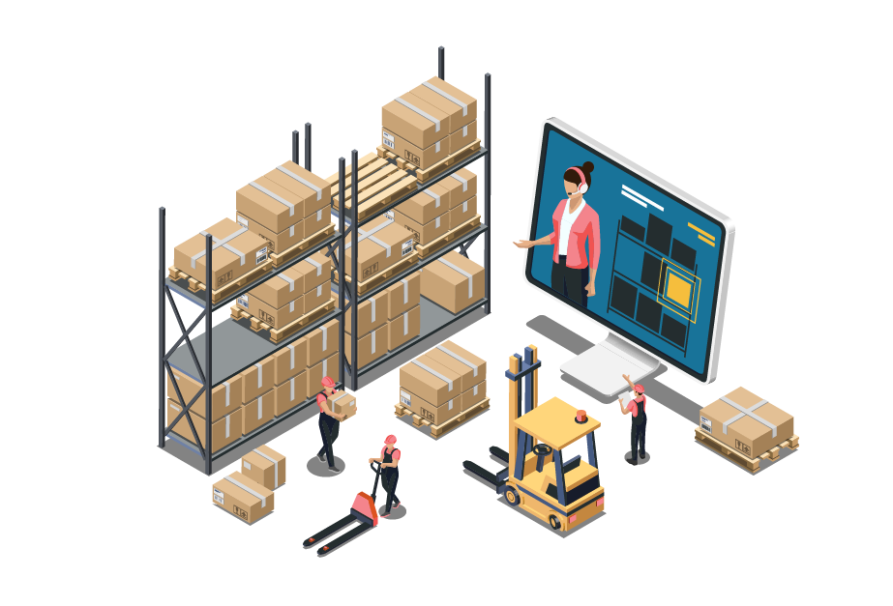
LS Central inventory processes
! Mobile inventory
The processes:
Purchase ordering
Return management
Picking
Receiving
Stock request
Stock transfer
Stock counting
Label printing
With LS Central:
Handled in standard system
Documents and worksheets
Controlled by rules and user rights
Automatically updating stock info and giving correct status
Adding Mobile inventory:
Functions and data available at mobile device
View tasks and current inventory info on the spot
Update by scanning and sending directly to LS Central
Add texts and pictures if needed
Easier, simpler and faster
Mobile inventory
Notes:
The LS Central Inventory processes are <Click>
The standard processes like Purchase ordering, Return Management, Picking, Receiving, Etc. <Click>
In LS Central these are handled in standard system using documents and worksheets. The setup is controlled by rules and user rights and when the documents are posted the inventory status is up to date. <Click>
But when adding the third gear, the mobile Inventory, the functionality and data is available on the spot allowing the user to finish their work by scanning barcodes and entering information. To enhance the inventory information they can even add pictures of items in the shipments as well as text. So he inventory process is Easier, Simpler and Faster.

Slide 10

New features
! Mobile inventory
Customer feedback drives development
Recent changes include
Faster scanning
Add a picture in receiving
Load balance in posting large worksheets
And more …
Mobile inventory
Notes:
The Mobile Inventory app is one the most popular app LS has released and we get a lot of feedback from our customers that drives our development.
Among recent features we have added is more options to making scanning faster, by using default or last ordered quantity if next barcode is scanned, possibility to add a picture with item which can be useful feks if it is damaged in someway, and improvements to the communication when sending large worksheets to LS Central and more.

Slide 11
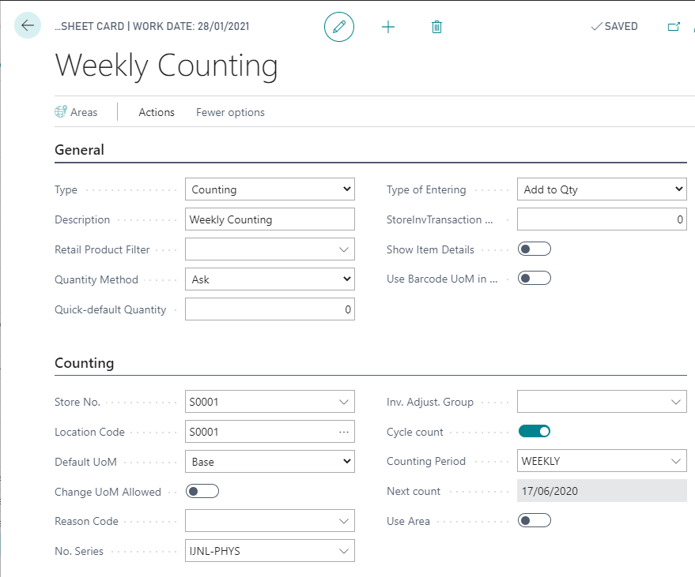
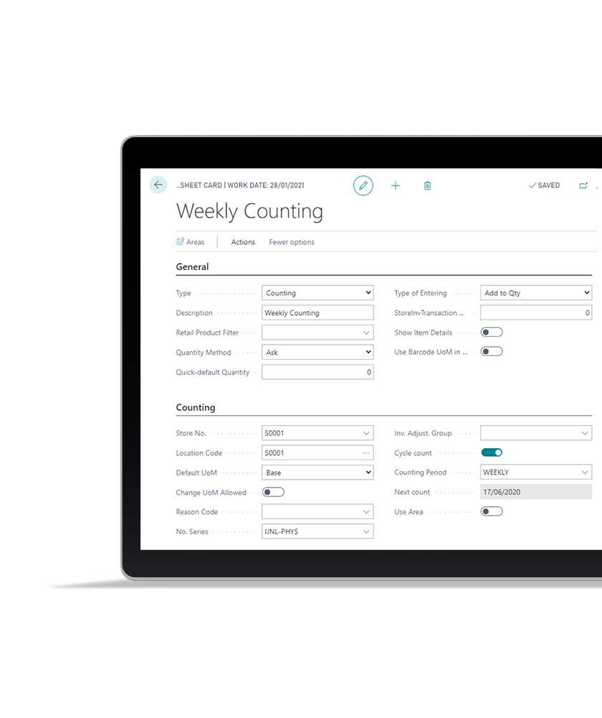
Cycle counting
In LS Central:
For each item that must be counted at a regular interval (on a "cycle"), set counting period, for ex. “weekly”.
Create worksheet journal for the counting period.
Run “Get cycle count item”: all applicable items are added to the worksheet.
This list is also refreshed when you select the Cycle counting worksheet in the Mobile inventory app.
Notes:
A recent feature we have added is the support for Cycle counting, that is when some items are counted at a regular interval e.g. on a "cycle". This is mandatory in some type of businesses like with the pharmacies and is also a good way to keep the stock information accurate because there’s always measurement ongoing instead of the whole stock counted which usually forces the operations to stop and requires heavy workforce.
In LS Central you define the Counting Periods, set that period to Items, Create worksheet journal for the counting period and get the data that will be in that counting worksheet. The list is also refreshed when Cycle counting worksheet is selected from the Mobile Inventory App

Slide 12
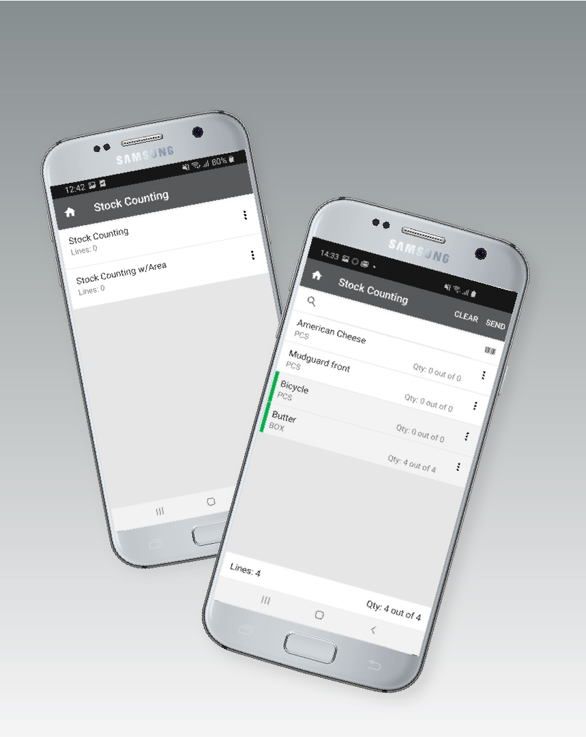
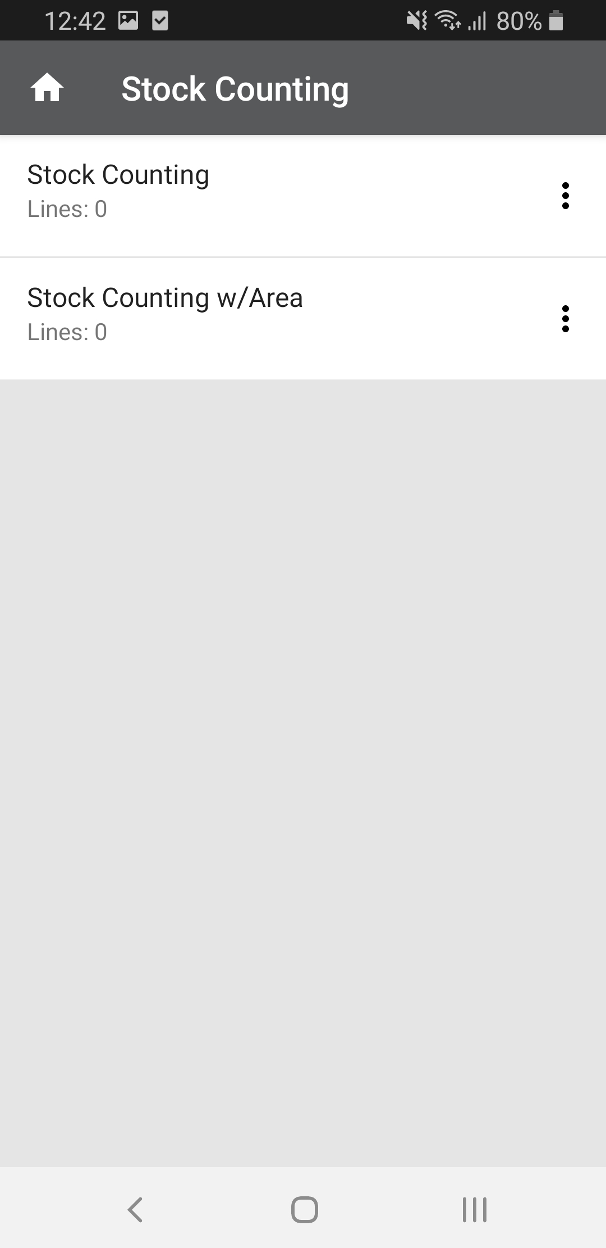
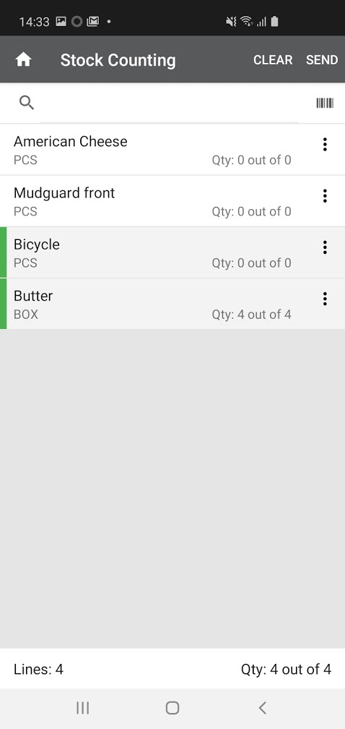
Cycle counting
! Mobile inventory
In Mobile inventory:
Select Cycle Counting worksheet from menu.
Worksheet displays all the items that need to be counted.
Items that have already been counted are marked in a different color.
You can’t send the worksheet back to LS Central until all the items in the worksheet have been counted.
Mobile inventory
Notes:
In Mobile Inventory the user selects Cycle Counting worksheet from the menu
When opened, the list displays all the items that need to be counted. The user can then start to count the items and when he has entered a quantity the items is marked in the list with color to indicate that it has been counted. As all the items in a cycle count worksheet have to be counted - it is not possible to send the worksheet back to LS Central until that has been done.

Slide 13
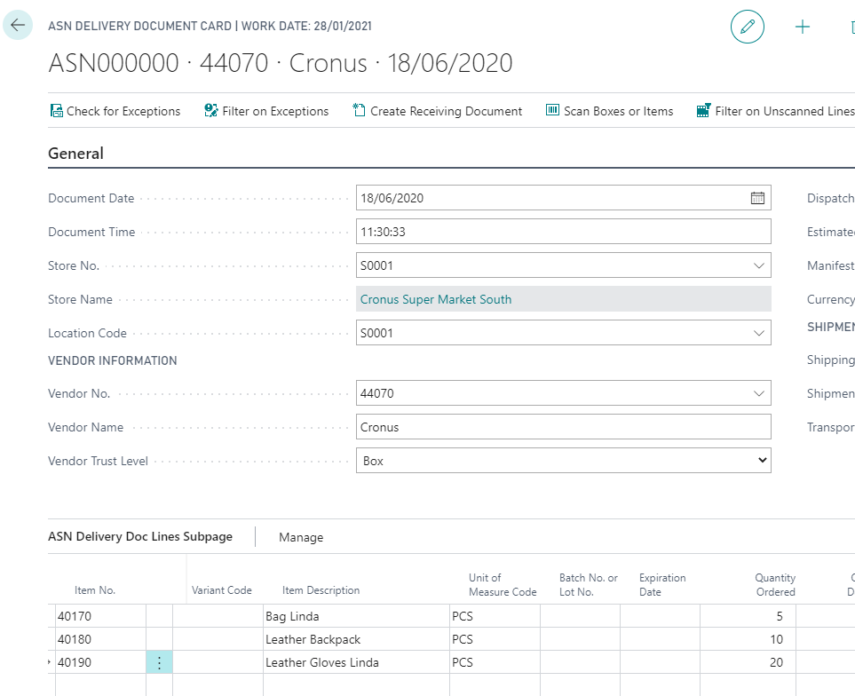
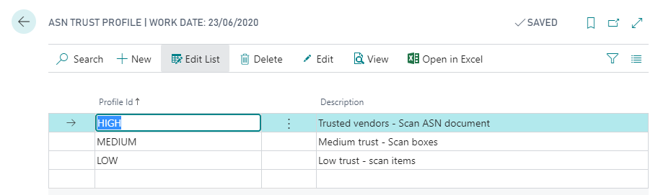
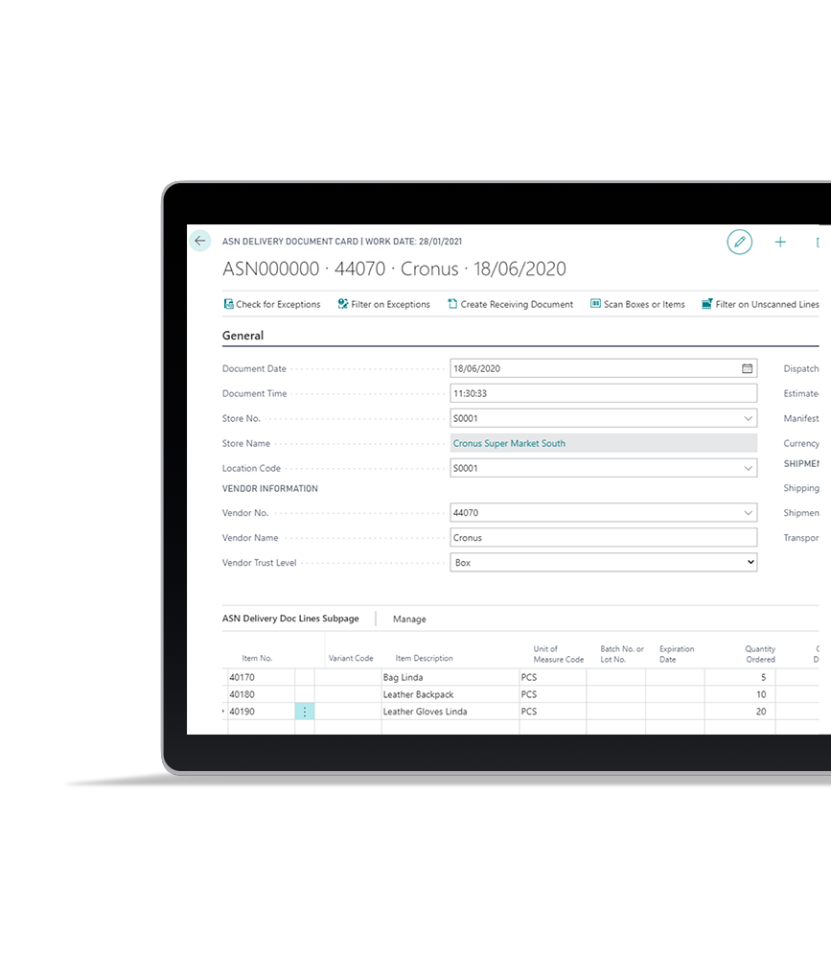
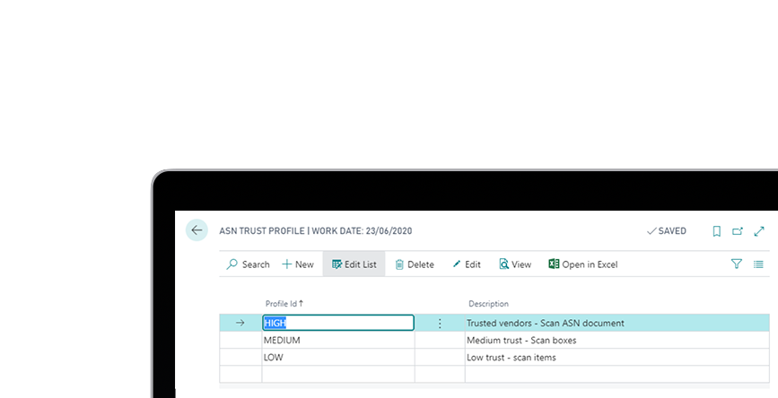
Advanced Shipping Notice (ASN)
The general process:
Store sends purchase order(s) to supplier.
Supplier decides what items to put in a shipment, from one or more orders.
Supplier sends the store an ASN electric notification about the shipment: when it will arrive, what it will contain, items from POs, box info, etc.
The store reads the ASN document into LS Central and processes it (importing ASN is an integration work).
ASN document, and trust level of vendor, are sent to Mobile inventory to be worked on when items arrive.
Notes:
Another feature we are adding is support for Advanced Shipping Notices – or ASNs as they are generally called. ASN is a notification of pending deliveries, similar to a packing list sent by a supplier or third-party logistics company to a buyer. It can include items from many purchase orders and the purpose of it is to notify the customer when shipping occurs and provide physical characteristics about the shipment so the customer can be prepared to accept delivery.
The ASN document can be read into LS Central, but please note that this in an integration work in each case. It is also possible to define a trust level of Vendors in LS Central, that can be used to indicate whether shipments from the Vendor can be accepted without being counted. This info is then sent to Mobile Inventory to be worked on when items arrive.

Slide 14
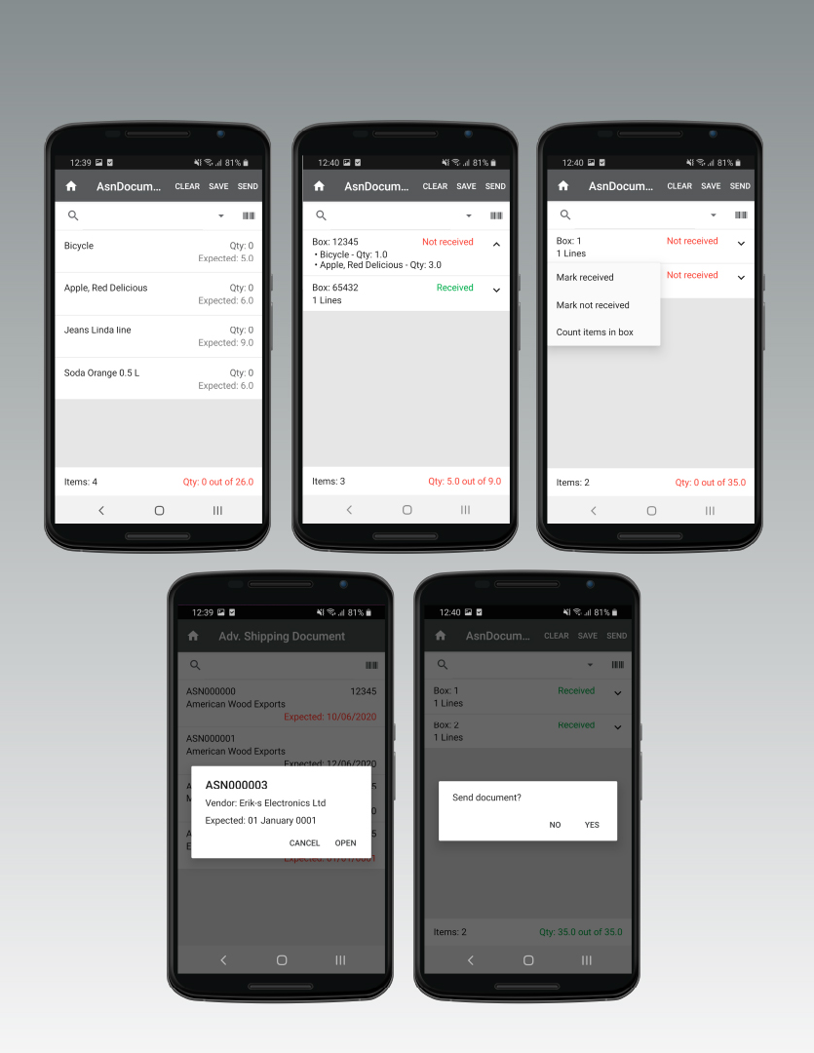
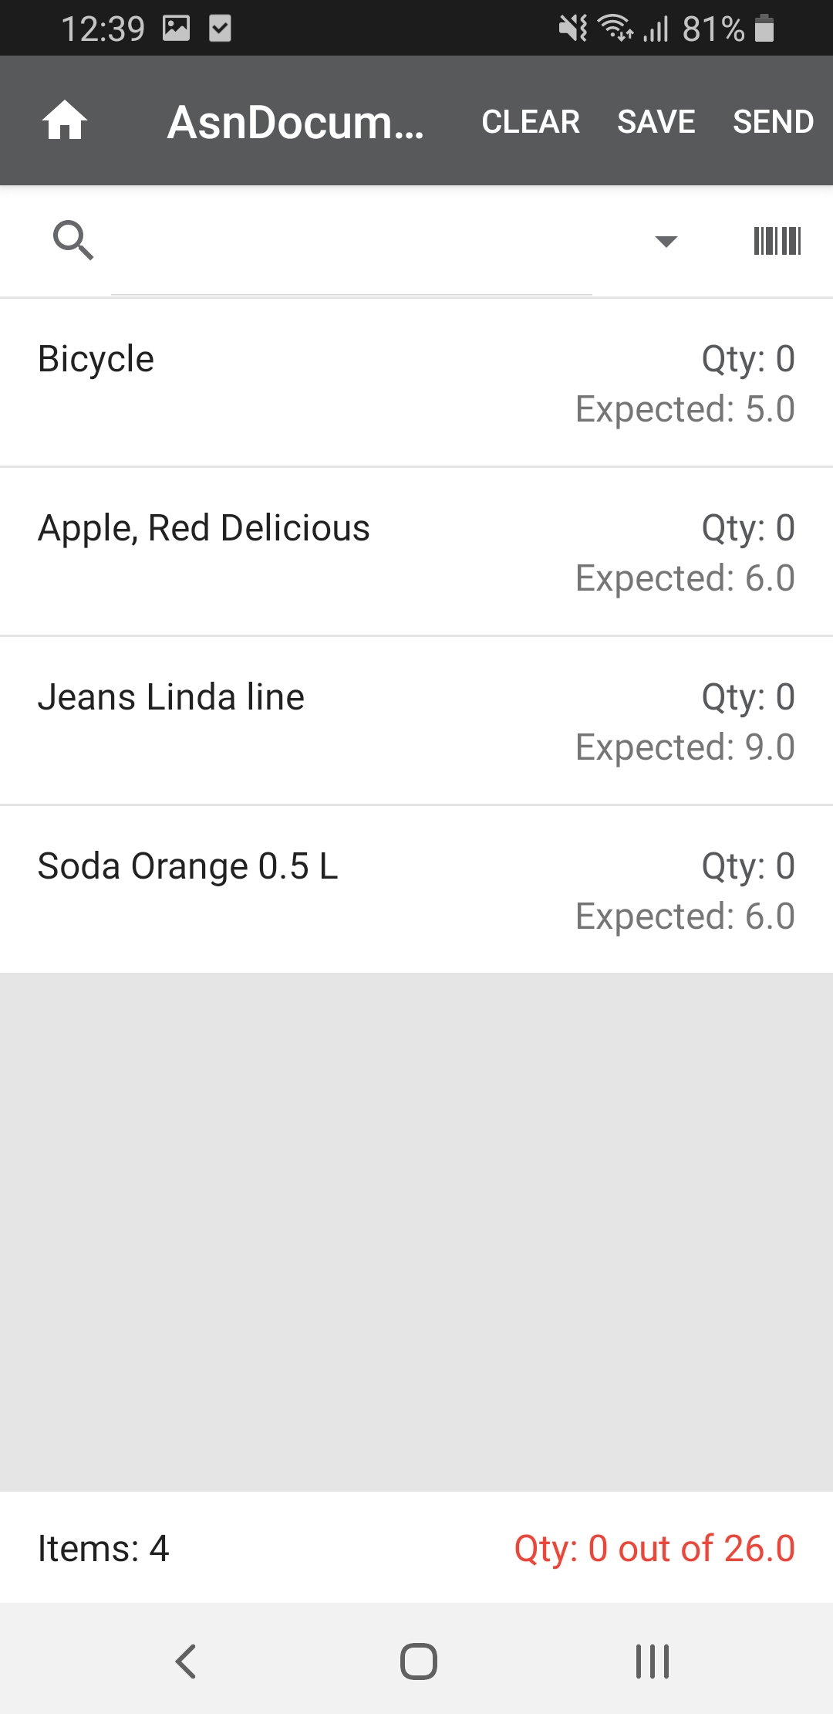
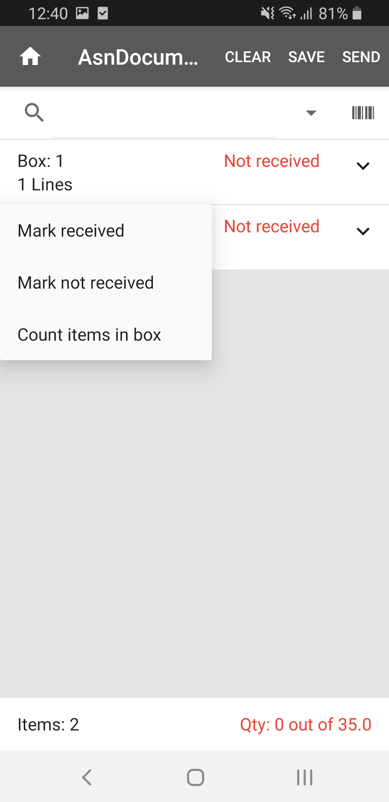
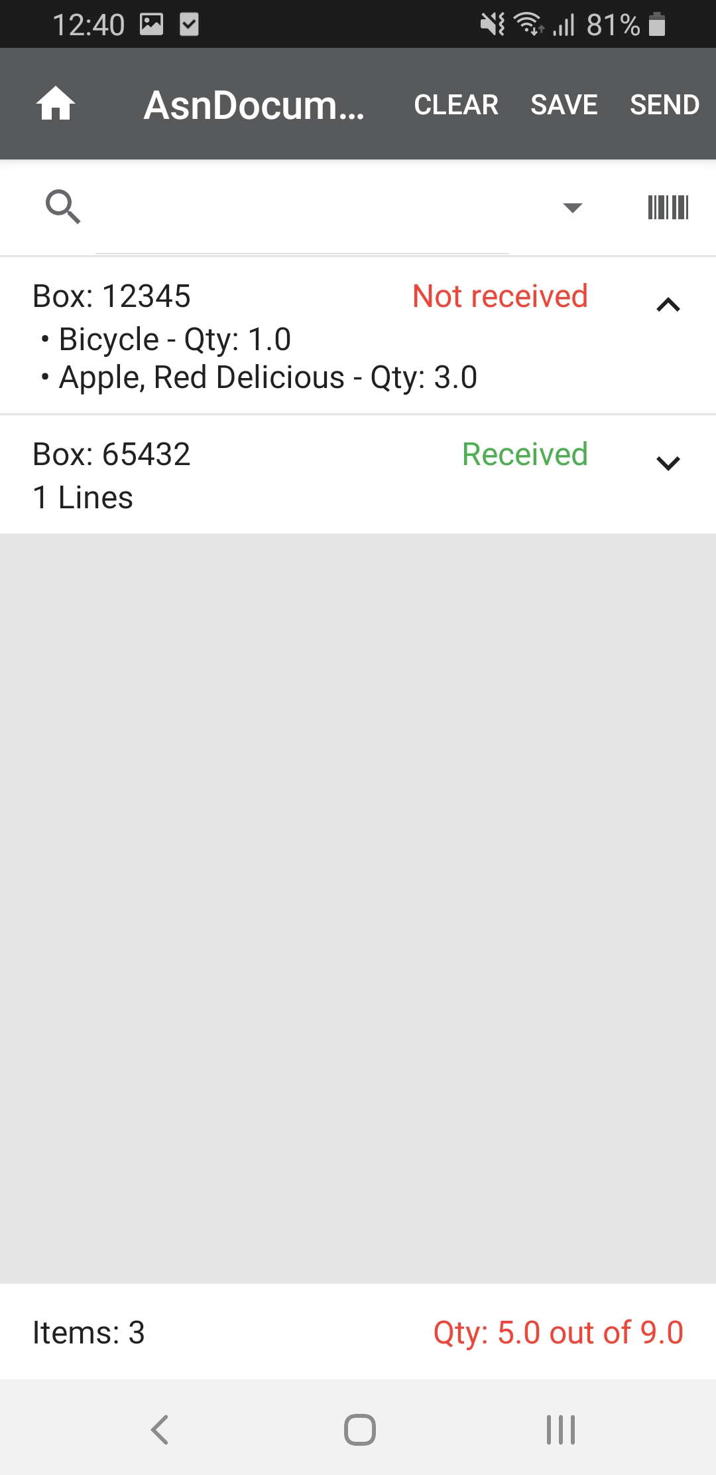
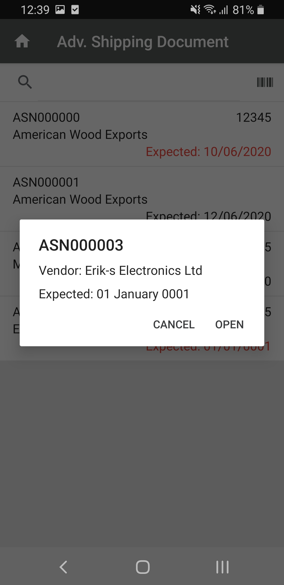
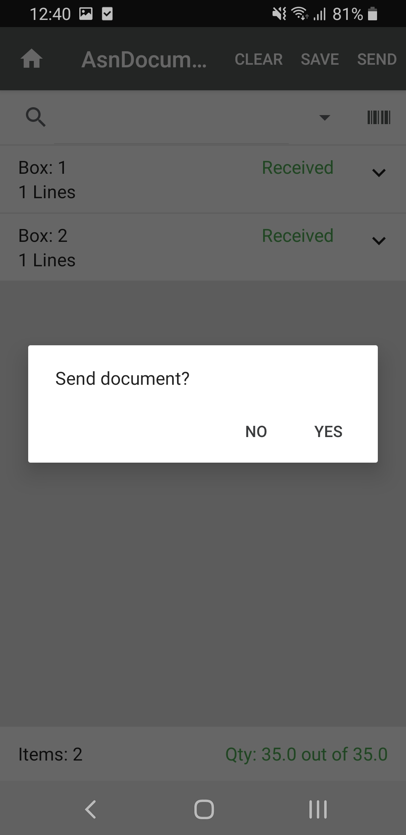
ASN in Mobile inventory
! Mobile inventory
Select ASN document
Scan barcode of item/box
Based on trust level of vendor, you can
Accept all or box directly without counting
Count part of/entire shipment
…or handle according to a standard receiving process
ASN document is sent to LS Central to be processed
Mobile inventory
Notes:
In Mobile Inventory the user selects ASN document and receives a list of all ASN documents that have been created.
Then selects the document to work with and if the document is from a trusted vendor, mark it received without counting or the items can be counted like in a normal receiving process.
When finished the document is sent back to LS Central to be processed.

Slide 15
Start and finish on a handheld
! Mobile inventory
The standard process requires three steps:
Create a document in LS Central
Send to Mobile inventory, and receive back with data
Post the document in LS Central
Today, you can start and finish in one step, in Mobile inventory
Document is generated in LS Central and sent to Mobile inventory
When document is sent back to LS Central it is automatically processed
Changes have been applied to:
Purchase order receive
Transfer order receive
In the future, more inventory document processes will be simplified the same way
1. LS Central
2. LS Mobile Inventory
3. LS Cental
1. LS Mobile Inventory
Mobile inventory
Notes:
We have worked on a number of changes based on feedback from our customers, relating to the steps needed when working on inventory tasks.
The standard way is to start in LS Central, then use Mobile Inventory to gather the data and finish in LS Central by posting the documents.
We are working on changing this so the process can start when selecting an operation in Mobile Inventory and when the data has been sent to LS Central it is automatically posted there.
We have applied these changes to Purchase order receive and Transfer order receive and will continue the work in later releases.

Slide 16
LS Central ScanPayGo
! LS Central ScanPayGo
Mobile self-checkout
Pay-and-leave solution for customers
R&D project: working prototype in Android
Next steps: get more feedback, finalize version 1 and go into a pilot project
How does it work?
Consumers download the SPG app to their own mobile phone
Open the app when in store
Scan the barcode to see product information and add to basket
Finish, pay, and leave following store procedures
LS Central ScanPayGo
Notes:
So Now to the fun part. The product that we call LS Scan Pay Go. You might ask yourself What is this?
In its simplest form its a Consumer app that is a mobile self Checkout solution. This is a Research and development project that we
have been working on. What would this app do for a consumer. As an example, this is a Zero touch solution that would be good during the
Covid time we are experiencing now, No checkout lines, and it would provide a personalized shopping experience.
We have created a working prototype in Android and showed a demo to some partners
and customers to get a feedback on what they would like to see in such a solution and what is needed to improve the one we got.
So How would it work?
The Consumer downloads the SPG app to their own mobile phone. When inside a store, he or she opens the app.
The Consumer scans in the barcodes on the items, and puts the items inside a bag. When they are done scanning
all items, the consumer would either pay inside the app and leave the story, or pay at a register by transferring the items from the app
to a register by scanning in a QR code that is generated inside the app.
But for a further demonstration lets see a short video demonstrating how it would work.

Slide 17
The architecture
! LS Central ScanPayGo
Android and iOS* app downloaded from App store
Runs on customer’s own mobile device
LS Omni Server connects to LS Central
Can be located in store or in-cloud
Uses iBeacon technology to identify the store where the customer is
LS Central calculates prices and discounts
*iOS version in development
Azure
LS Central
HQ
Store
LS Central
LS Omni Server
Customer
ScanPayGo
LS Central ScanPayGo
Notes:
Lets look at the Architecture of the App.
This app is a consumer facing app that would be downloaded in customers mobile devices.
The App connects to a LS Omni server and is using the same API that the eCommerce is using.
The omni Server than connects to LS Central witch can be located in the store or in the cloud.
The app doesn't store anything on the phone every data is gotten by a web request
You can log into the app by making an account or if you don't want to make an account you can skip that but that of course means you dont have all the benefits
of having an account.
Lets say you have multiple stores how should the app know in what store you are in ? For that we have made connection
to Ibeacons that would have to be set up inside the store to let you know what store you are in. You could also choose manually what store you are in,
And we have also been discussing adding in GPS coordinates to make sure you are shopping in the right store.
When you have finished adding in all items and are going to the payment screen the transaction gets calculated threw LS Central to make it 100% sure
you are getting all the right prices for your items. And when finishing the payment the Transaction is send as external transaction to LS Central.

Slide 18

! LS Central ScanPayGo
Scan and add to basket
Scanning items to
LS Central ScanPayGo
Notes:
Now I am going to walk over a couple of features that are inside the Scan Pay Go App.
First of all we have the ability to Scan in items using the camera on the phone and scanning in barcodes. when an item is scanned, we can see all the information about the item.

Slide 19
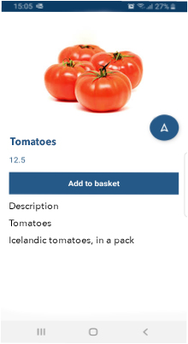
! LS Central ScanPayGo
Scan and add to basket
View item info
Item description
Ingredients, allergens, nutrient
Add to basket
LS Central ScanPayGo
Notes:
For example the item Description, ingredients, allergy and nutrition value. This of course means that all those information would have to be stored inside LS Central.

Slide 20
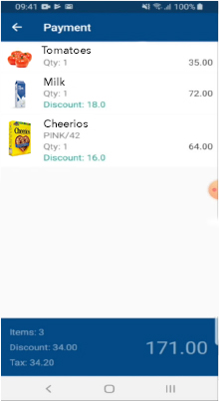
! LS Central ScanPayGo
Scan and add to basket
Calculate basket
Using member discount if logged in
LS Central ScanPayGo
Notes:
When you have scanned in all items and are heading over to the payment screen the basket gets send to LS central for a calculation to make sure you are getting all the
right prices. If a user of the app would have an account. You get the benefits of making him a personal member discount that are set up in Ls Central. When he would calculate his basket a discount would be added to the basket according to the member that is logged on.

Slide 21
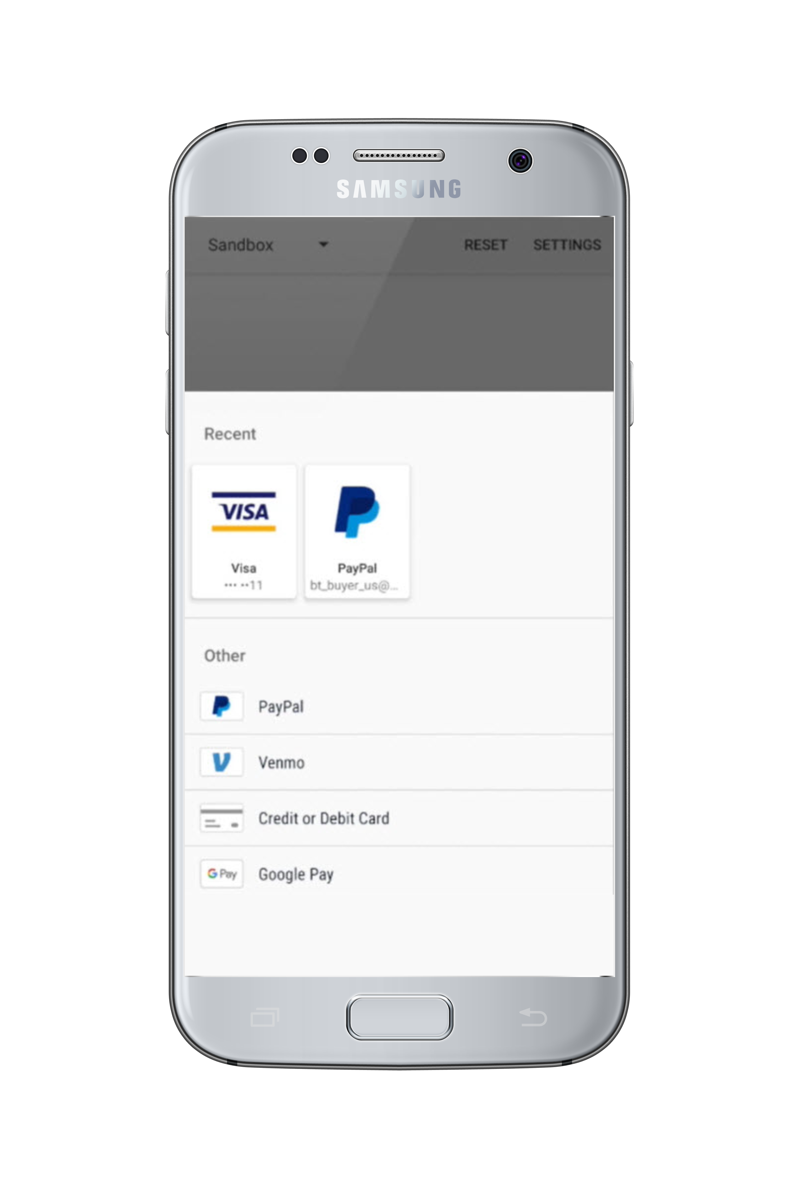
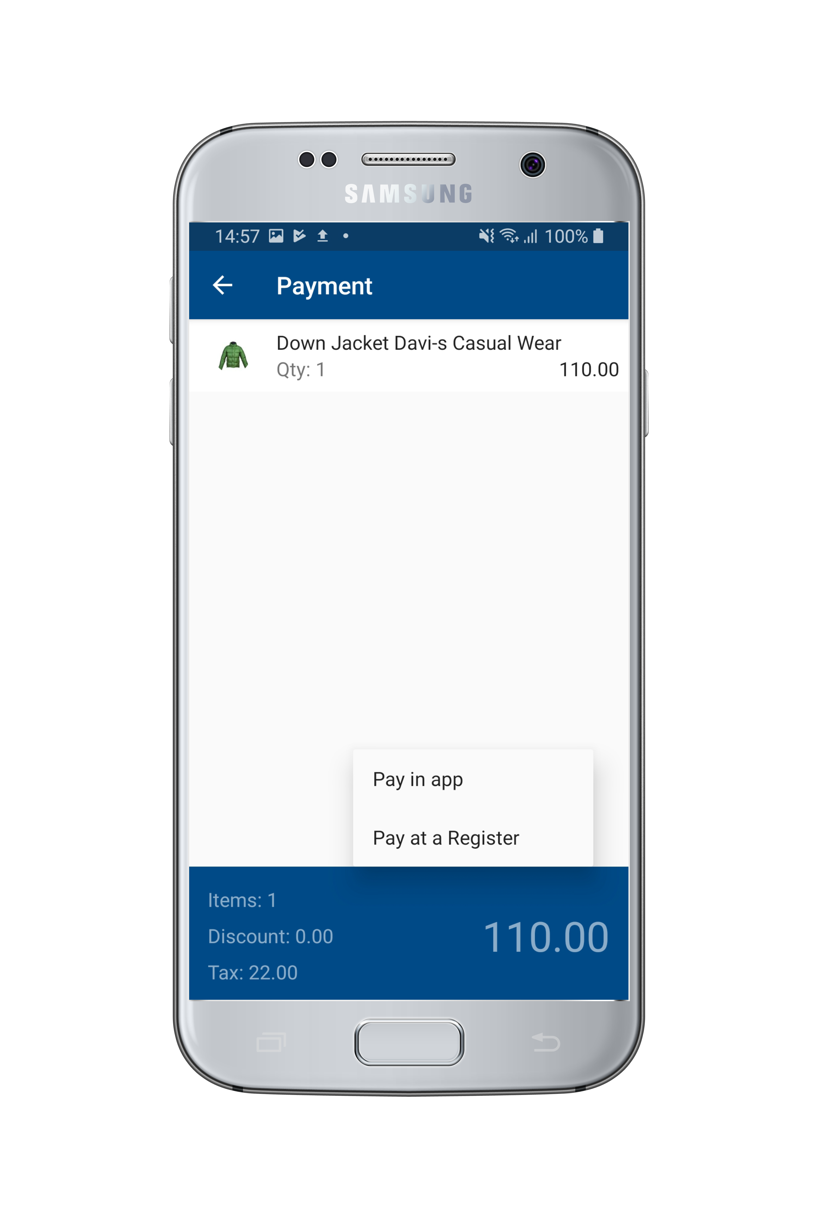
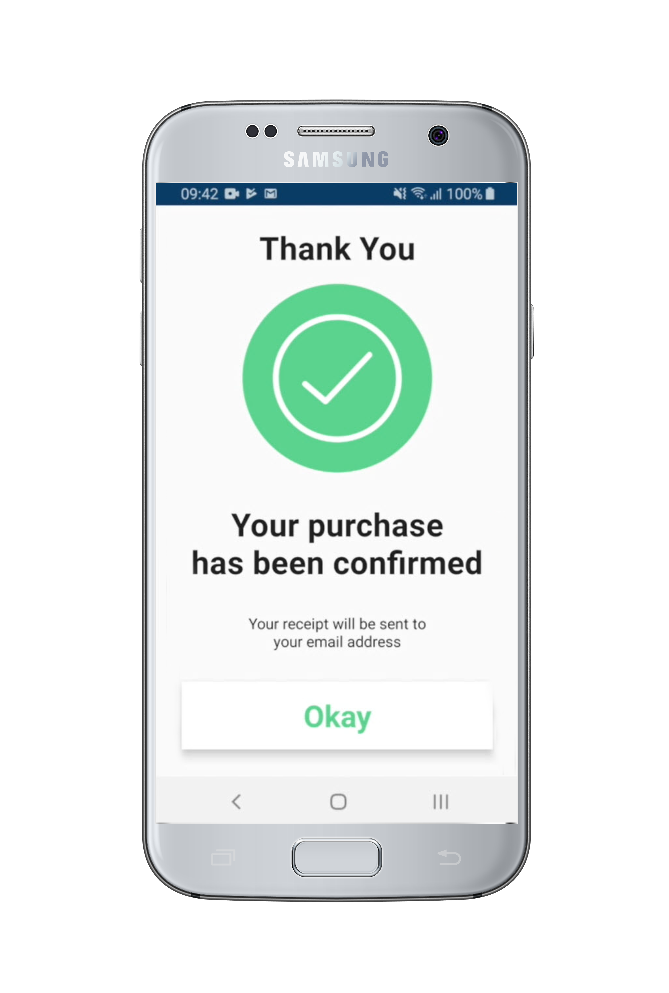
Paying for items
! LS Central ScanPayGo
Three payment options
In app
At manned POS
At self-service POS machine
Payment in app is subject to available options in each country/region
* Depends on retailer’s processes
LS Central ScanPayGo
Notes:
We have Three options available for payment. One is paying inside the app which means you just put in your Credit Card information and finish paying. And walk outside the store.
The other two is paying at a self-service POS machine or at a manned POS. That would mean you scan everything you want to buy inside the app an than you would choose the option pay at a register
and that would transfer everything over to the self-service POS or manned Pos by scanning in an QR code on the App. You would than finalize the payment there.

Slide 22
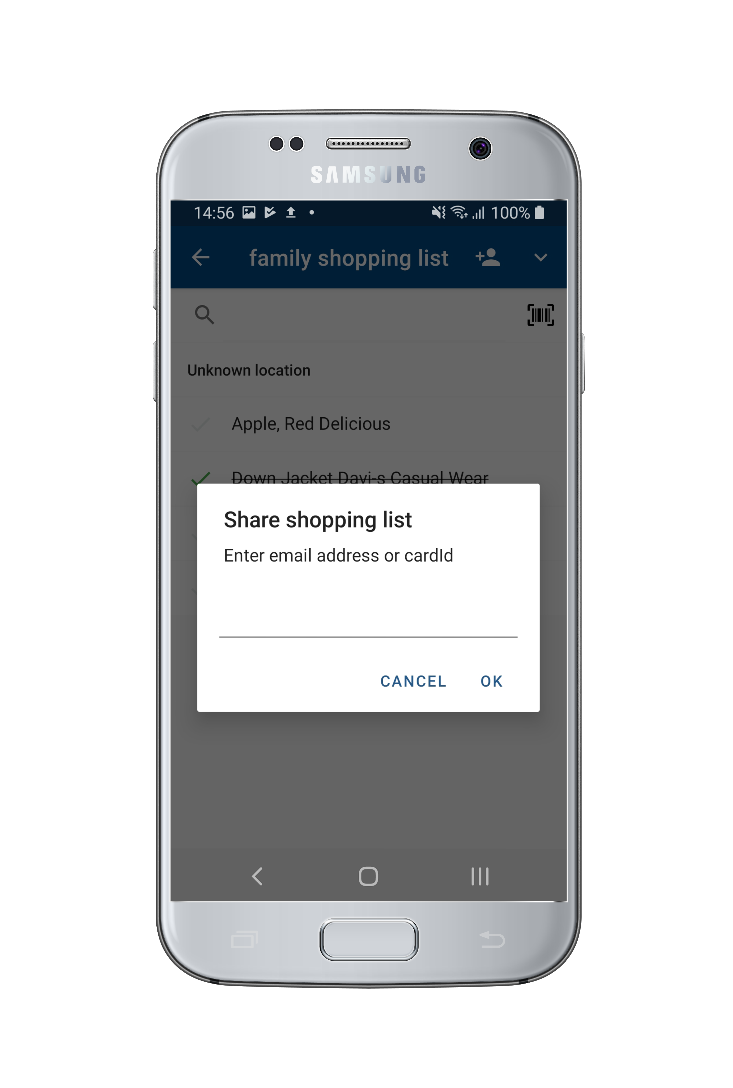
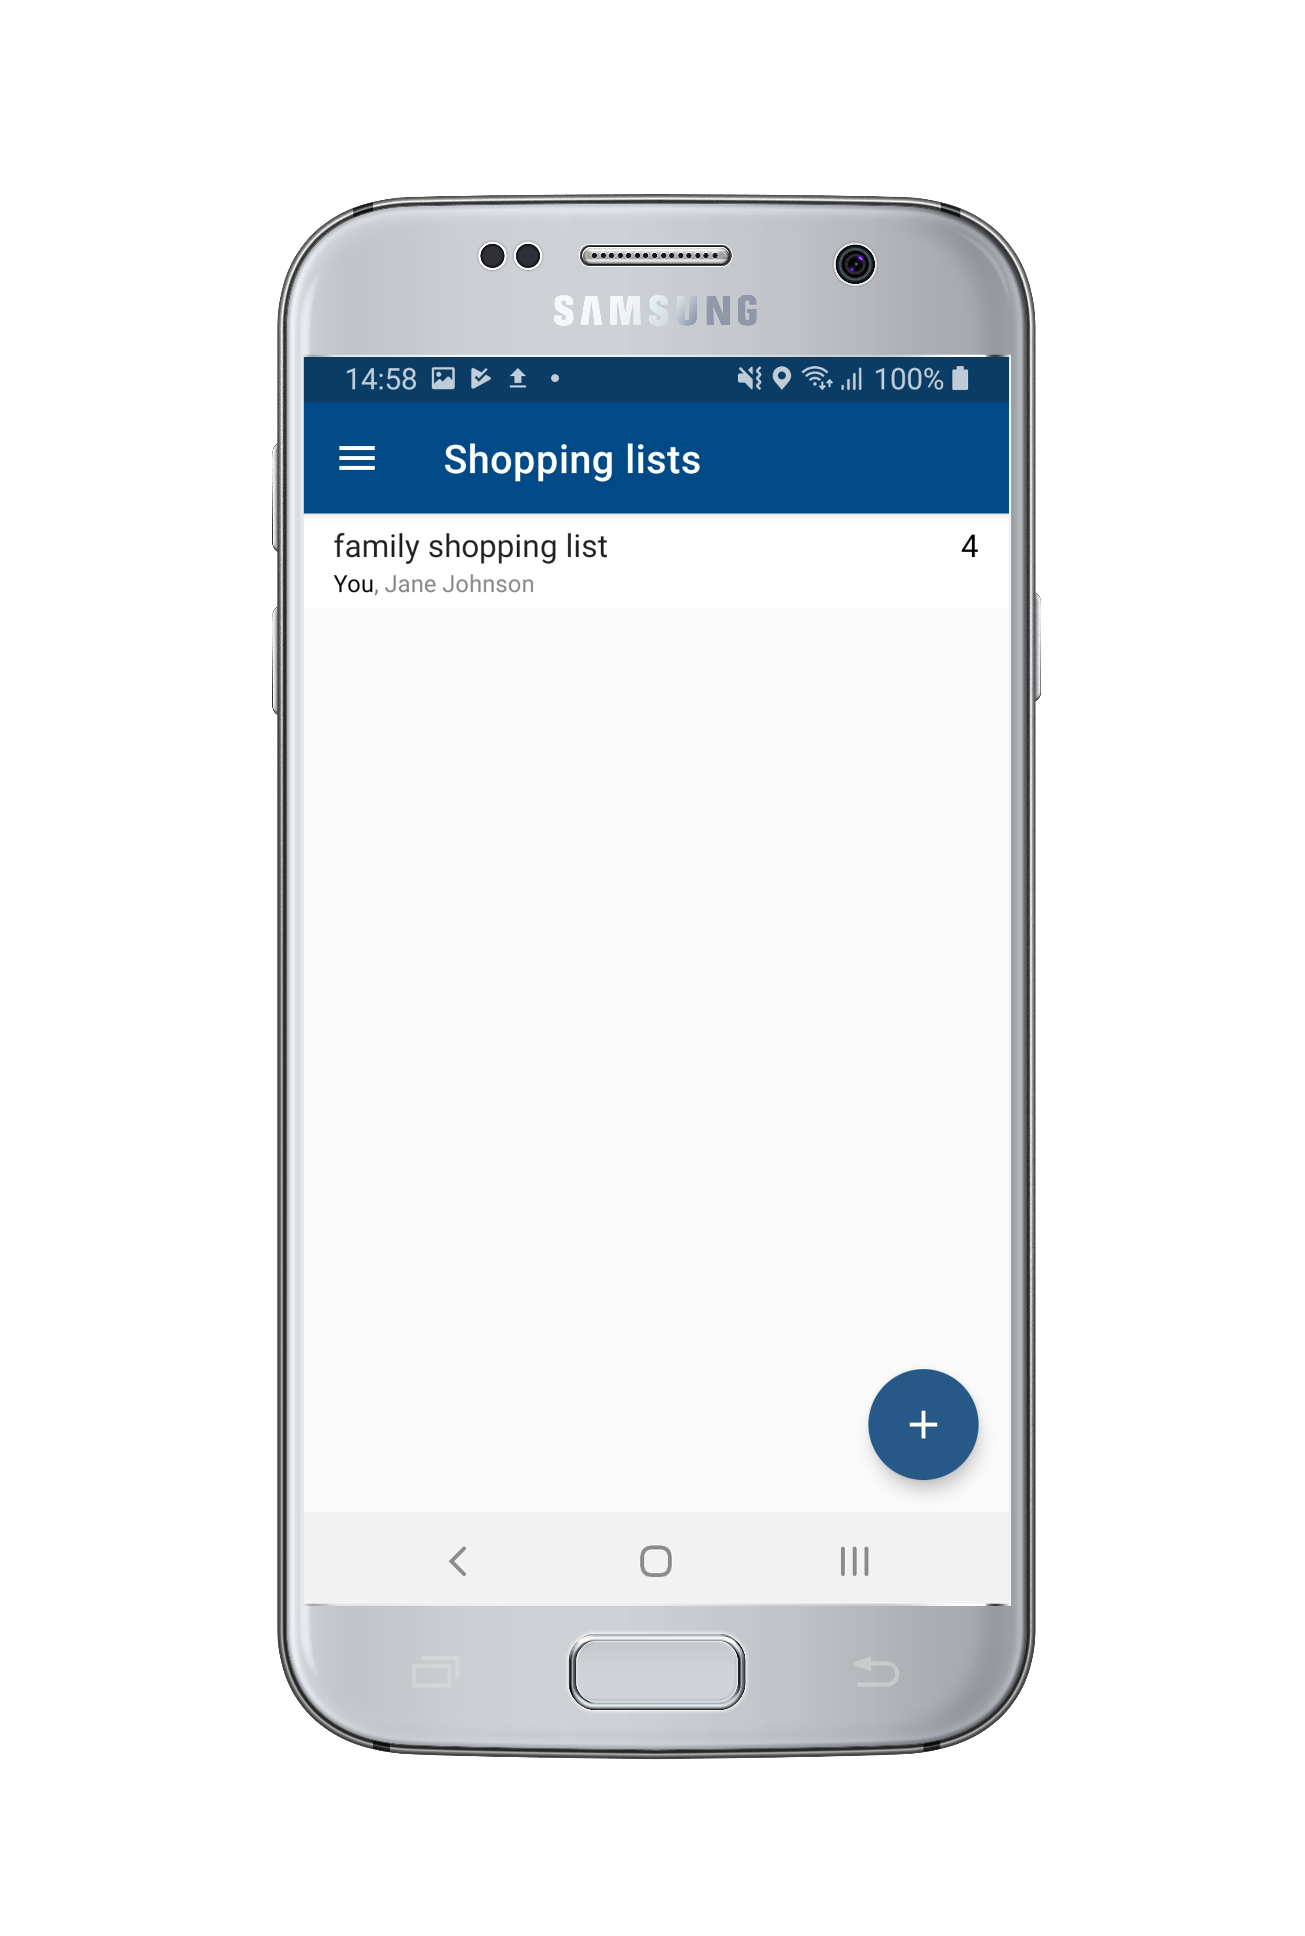
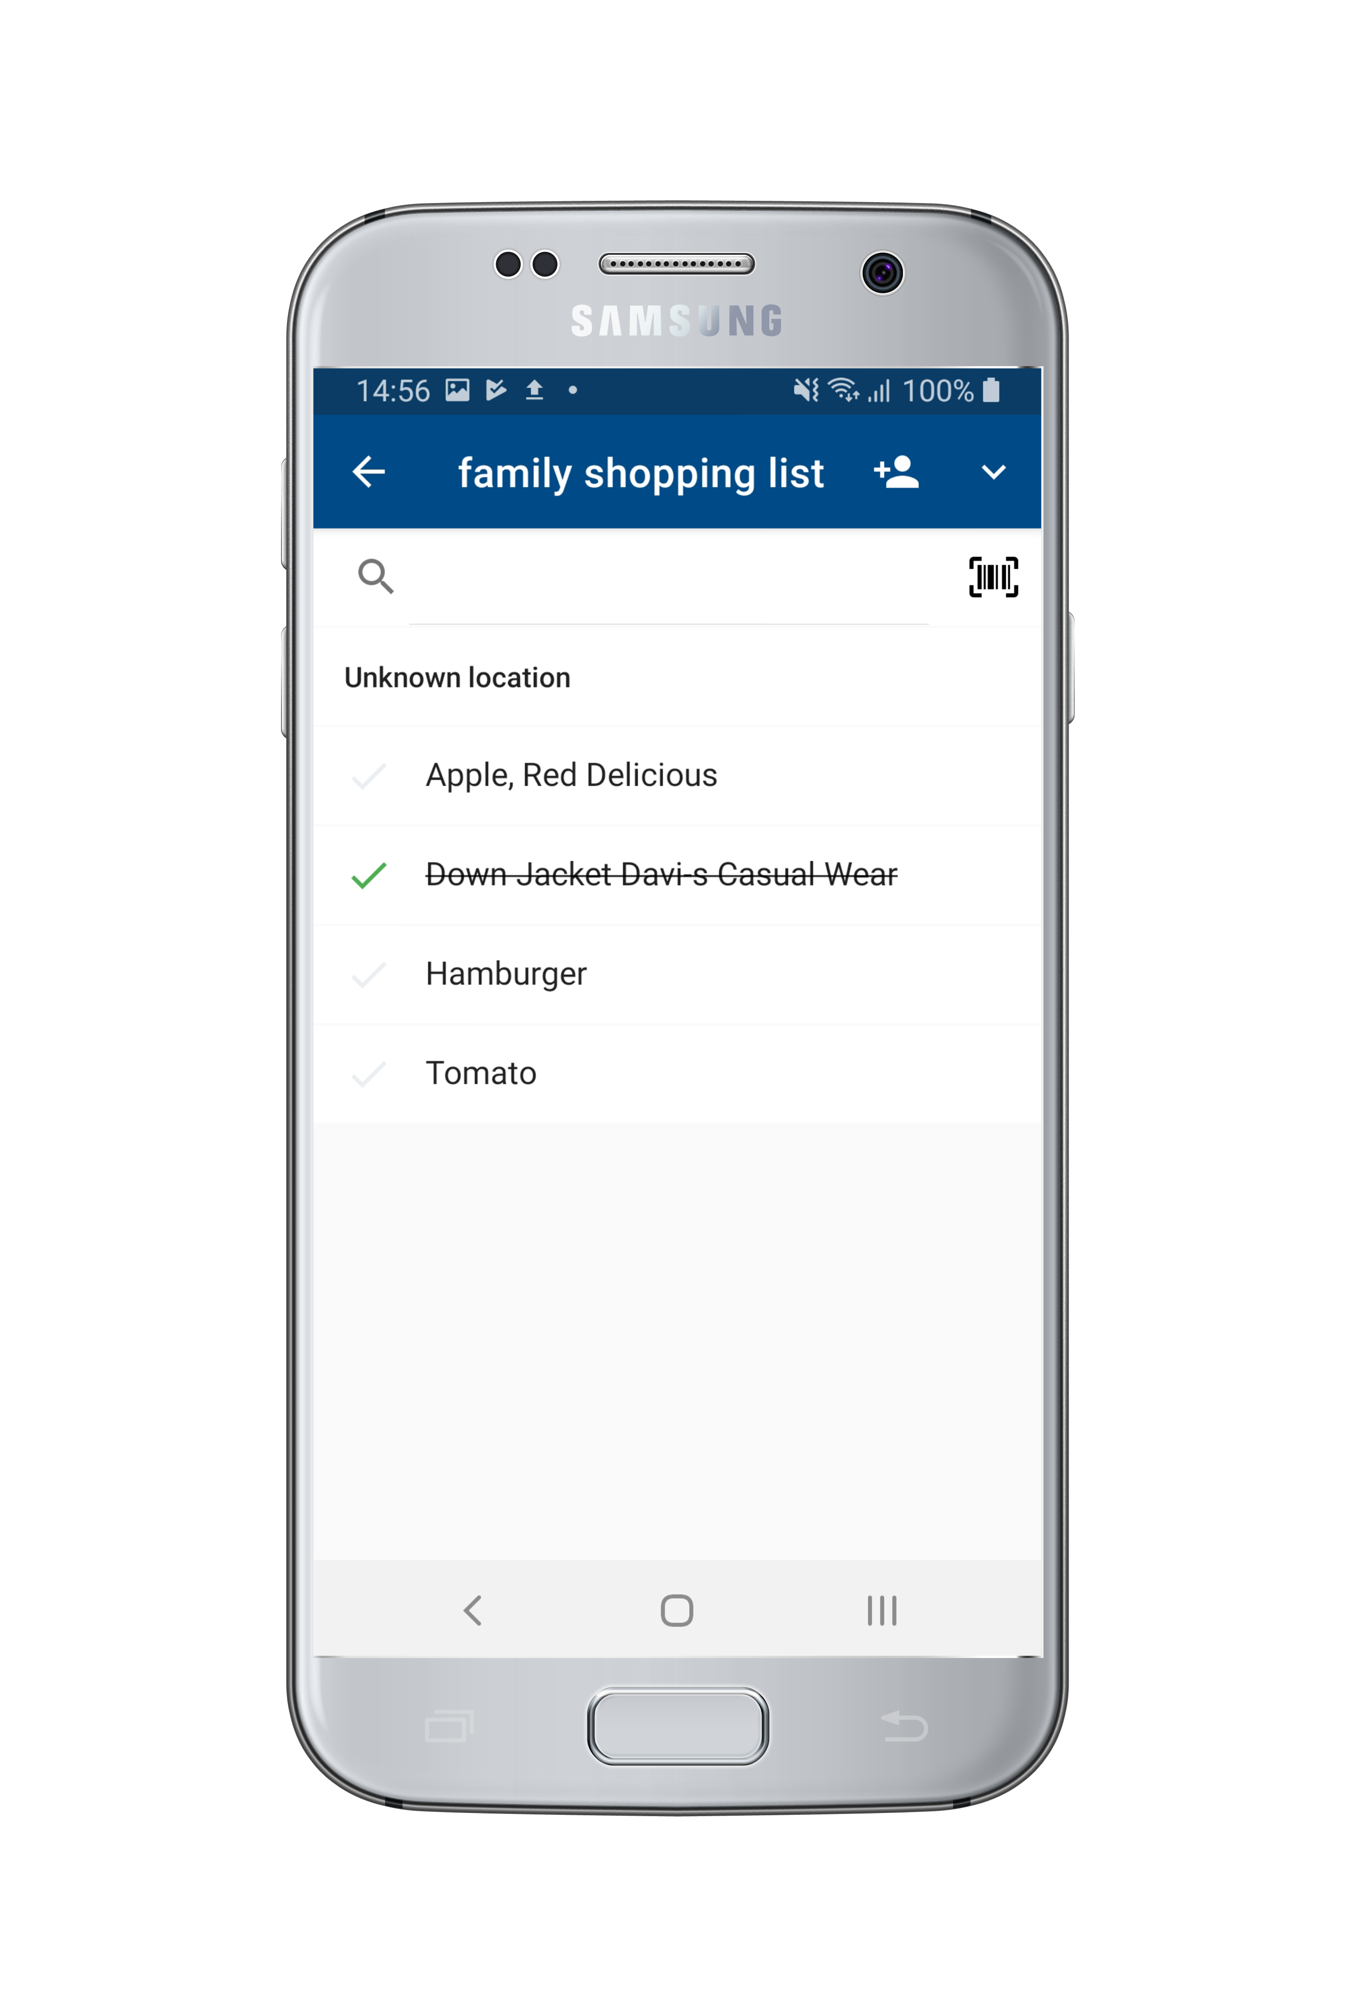
! LS Central ScanPayGo
Shopping lists
Personal shopping lists
To add items, scan a barcode or key in
Share with other users
When you add an item to the basket, it is deleted from shopping list
Items in shopping list can include item location and can be sorted by location
LS Central ScanPayGo
Notes:
Another feature that we have made is shopping lists. That means that inside the app you can make a personal Shopping lists and add items to the list by either scanning
them in from your fridge or searching for them inside the app. The cool thing about the shopping list is that you can share the shopping list with family members, friends
or whom ever you want to share it with. So a family could have a shared shopping list and add items to it so only one person needs to go pick them up from the store.
When inside the store and you scan in an item to your basket the item gets marked off from your shopping list.
Another cool feature regarding the shopping list is that inside LS Central you can add in a location to each item. That means that When a consumer goes to the store and is going to shop from his shopping list
the items gets order by the location of the items. witch should make the shopping experience easier simpler faster.

Slide 23
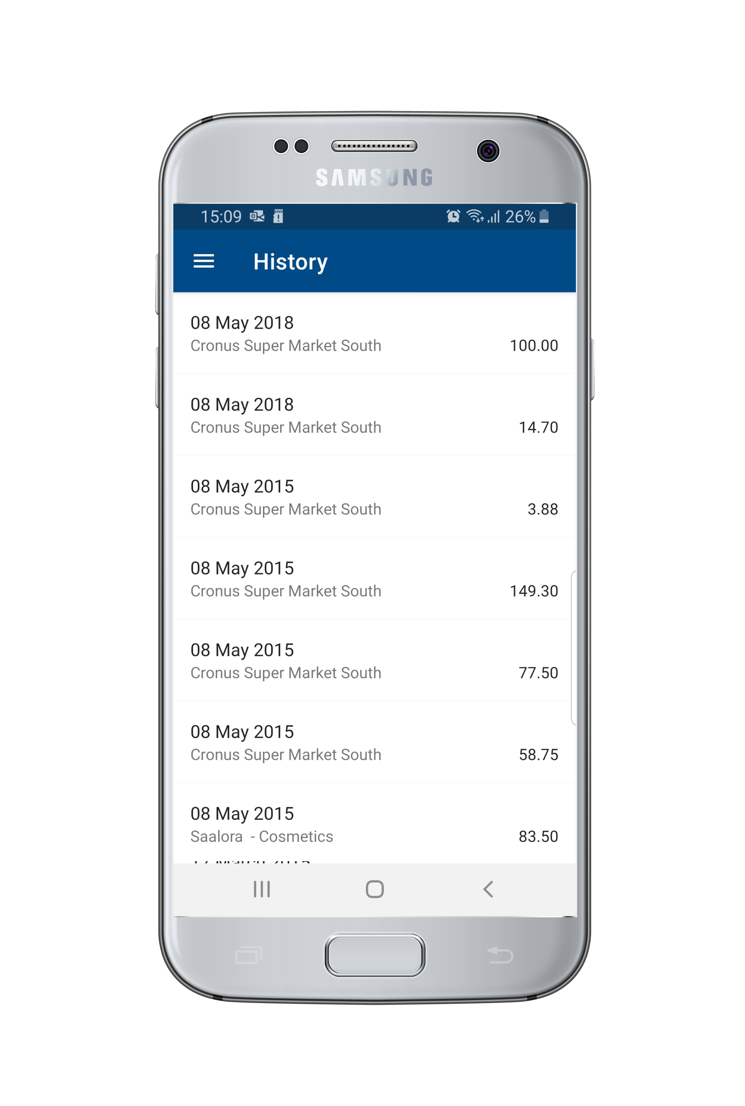
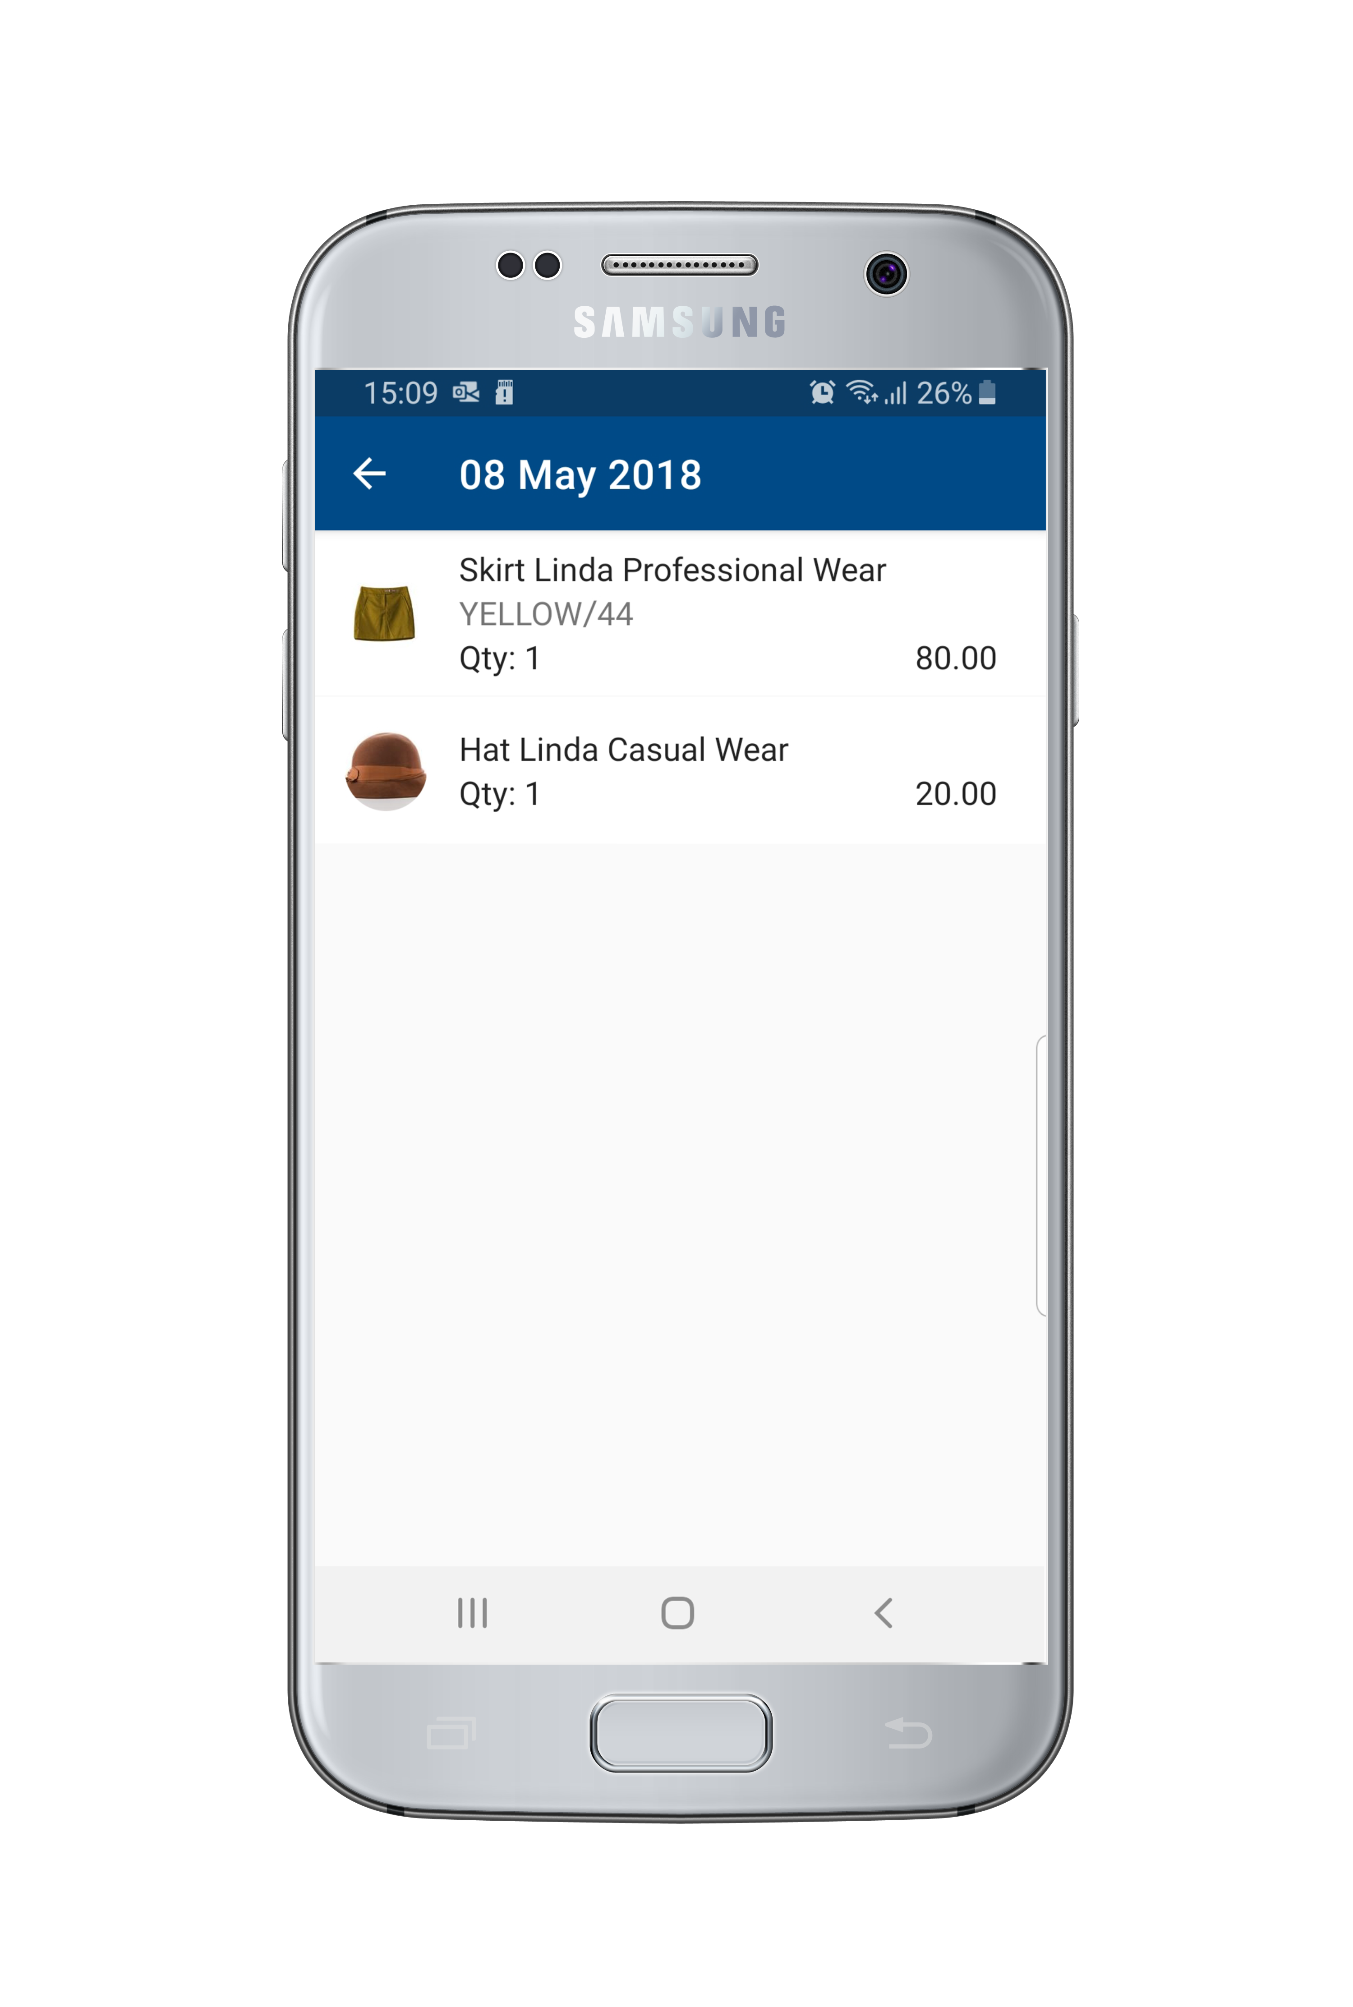
! LS Central ScanPayGo
Shopping history
See shopping history:
Past purchases
Total amount per transaction per day
Details per transaction
Item
Quantity
amount
LS Central ScanPayGo
Notes:
People or always getting more and more interested in having an overview of there spending's. And therefore if people would make an account in the app you could see all your shopping history.
You can click each transaction and see every item that you have bought for that transaction. so managing your finances should be easier.

Slide 24
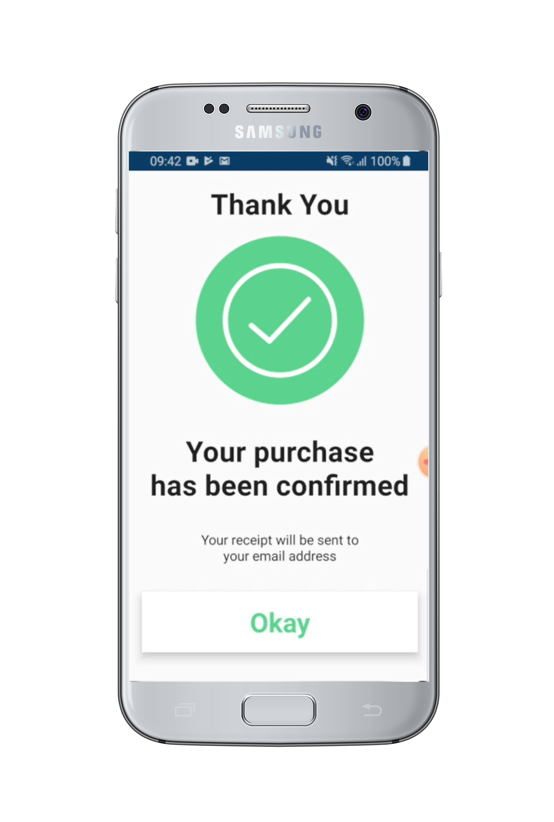
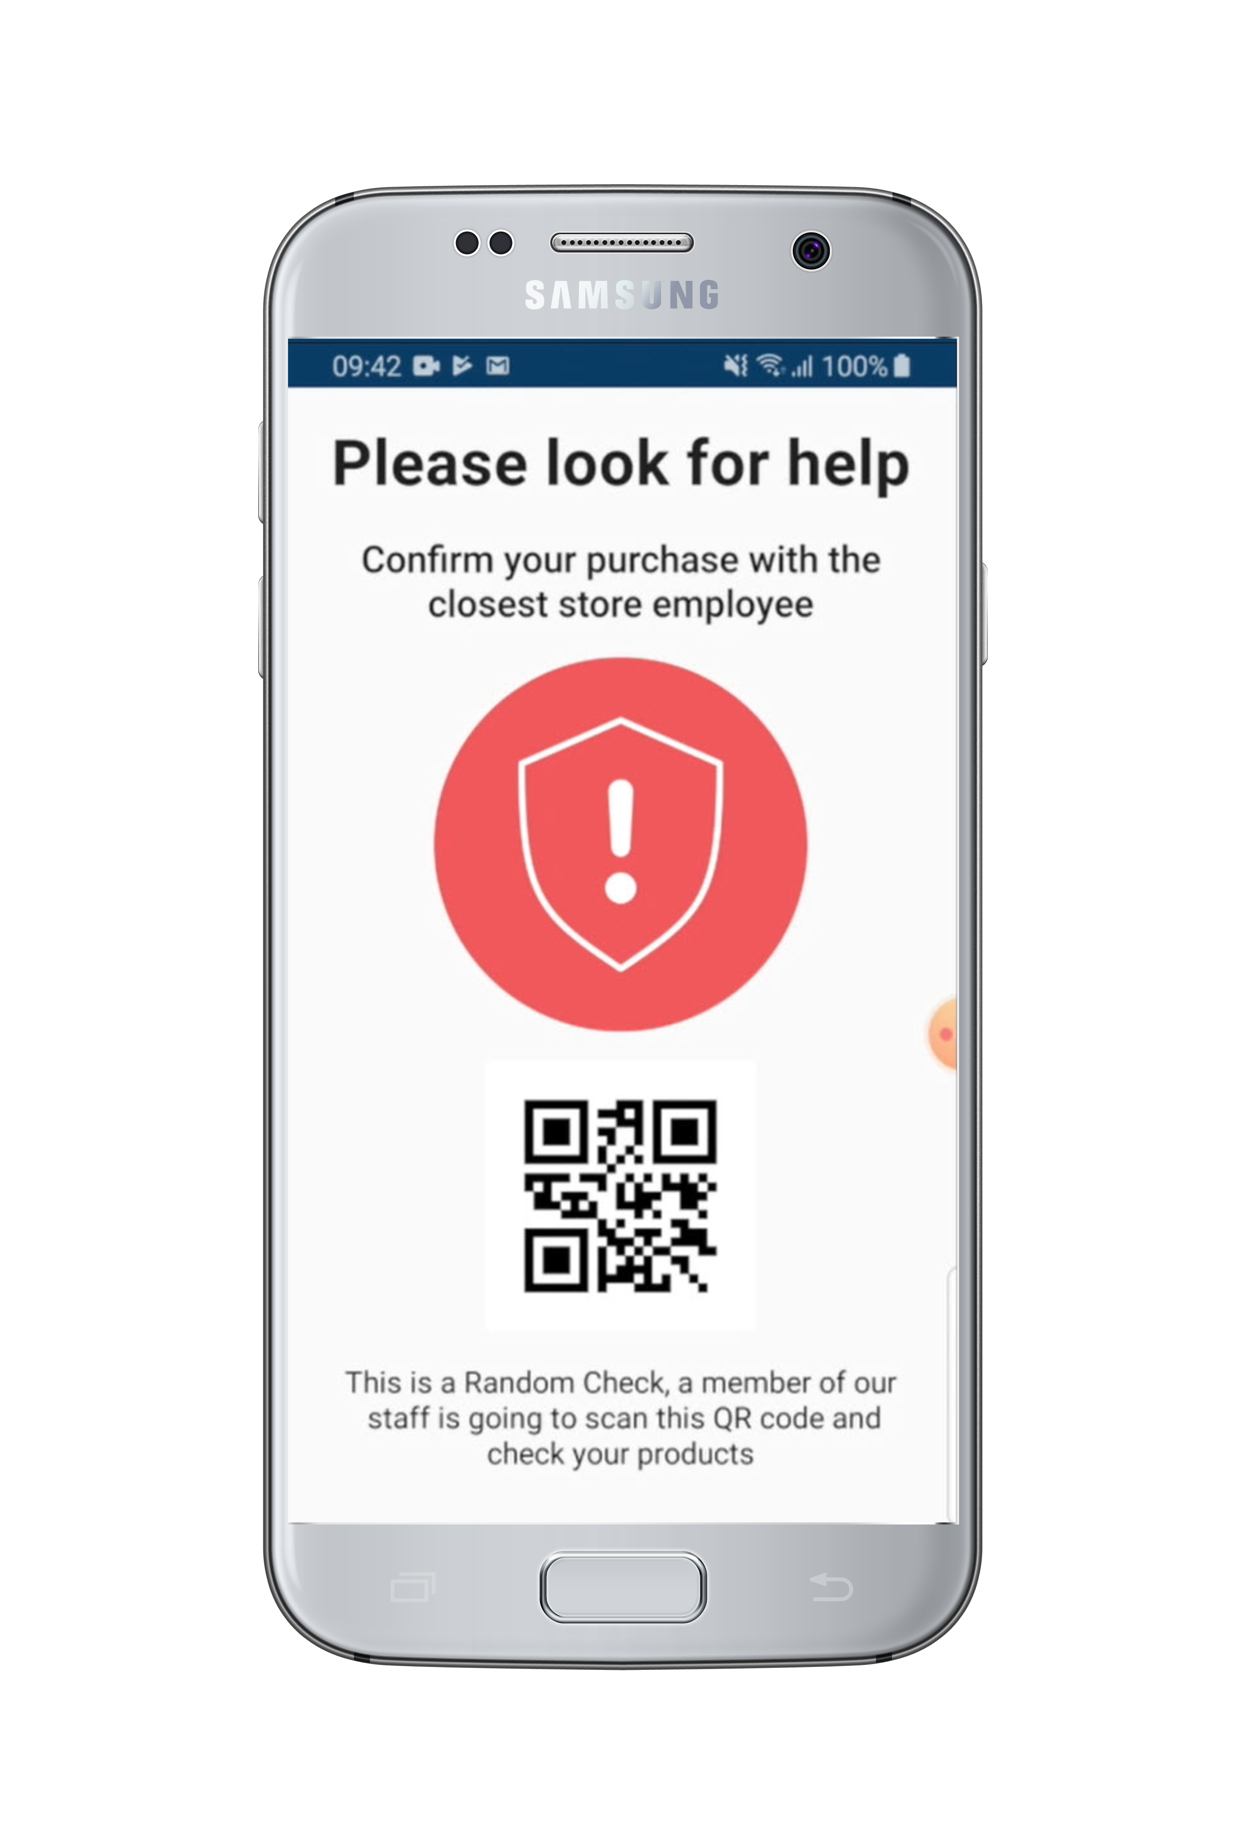
Security considerations
! LS Central ScanPayGo
Security issues
Is the customer scanning the right items and quantities?
Is everything paid for when the customer leaves?
are dealt with depending on the retailers’ specific processes
Today, in the app
After payment, two types of messages can be displayed:
Customer can leave
A store employee must first verify payment
You can include a QR code to open a gate to leave
This process will be finalized with each retailer
LS Central ScanPayGo
Notes:
Security considerations, We have had a lot of conversations about this. and common concerns or is the customer scanning the right items and quantities when putting items to the bag?
is the item paid for when the customer leaves the stores with a bag of items ?
Of course we don't have the answers for everything and most of the questions that have to be tackled vary between each retailers so we think that this process would be handled with each retailer.
But we have added in two types of support to help you indicate if people have paid for the product or not.
When the Customer has finished paying for a transaction he gets routed to a screen that either says thank you for you purchase with a green indicator that means you can walk outside of the store.
And the Other case is that you would get a Red indicator that says Confirm you purchase with the closest store employee. and that would mean that the consumer would have to go to a employee that would
scan in a qr Code to get the transaction and check if everything matches.

Slide 25
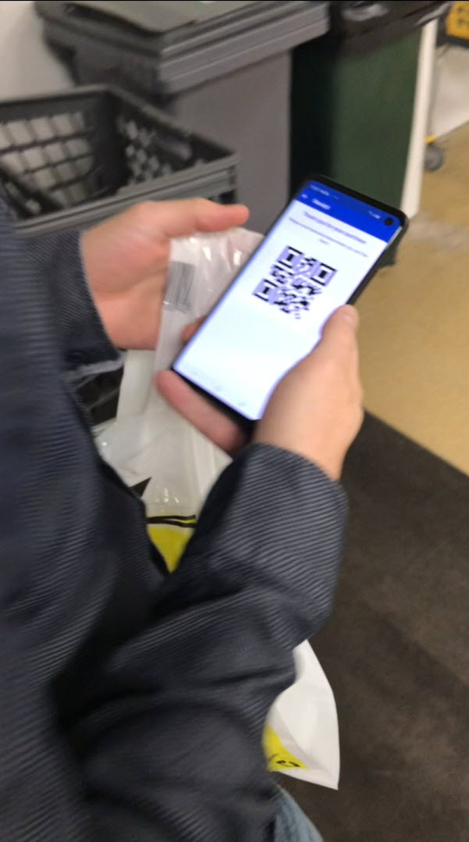
Were do we go from here?
! LS Central ScanPayGo
Send your feedback – we love it..
Add click-and-collect?
Add recipes?
Face ID recognition to identify customer and age?
And more wild ideas…
Finalize version one based on ideas and trial prototypes
Go for a pilot for rollout – anyone interested?
Stay tuned …
LS Central ScanPayGo
Notes:
We would love to get your feed back on this product Because like most of our work here it is driven on customer feedback and since this is a new product we would best benefit to get as much feedback
as possible. But what would be the next step for this product. Many ideas have come to our minds few of them are for example adding in click and collect, who hasn´t asked them selfes the questions
what should we have for dinner and there for the idea of having Recipes inside the app to help people decide what they should have for dinner has come up, we have even discussed the idea
of face id recognition to allow you to buy alcohol and cigarettes if you have the age to buy it. So If you have any great ideas please contact us and let us know we will be happy to get them.
But what is next is to finalize the first version based on ideas and trial prototypes.
And than the next step would to go for a pilot for a rollout.

Slide 26

Questions?
Notes:
So now lets move to the questions and we will now going to begin answering the questions submitted during today’s presentation. As a reminder, you can still submit questions through the Questions pane in your attendee control panel. And the first question is …..

Slide 27
Notes:
Thank you so much for attending todays webinar. If you have any further questions, please don’t hesitate to contact me via email. So on behave of LS Retail thank you very much for joining me today – stay safe and have a great rest of your day. Bye bye.

