Slide 1
What Can Performance Audit Tell You about Your System
Damir Babikov

Slide 2
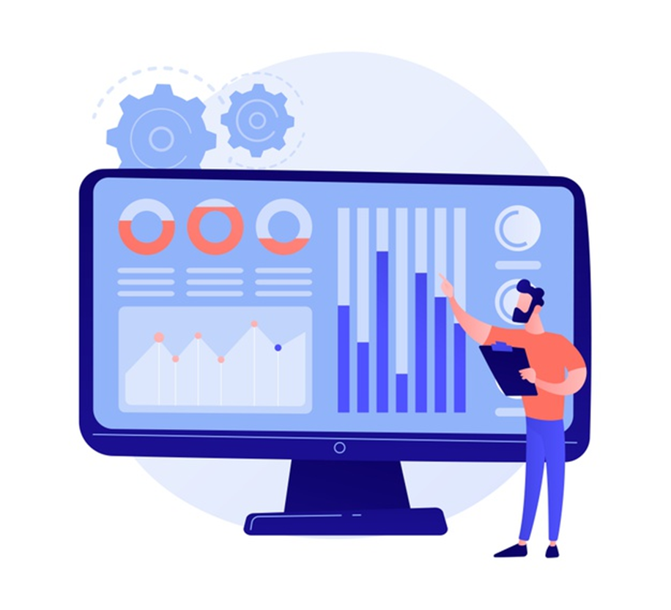
What is Performance Audit
Service provided by LS Retail to partners and customers
Your implementation's health status
Best practice
Report, with explanation during online meeting
Guidance & support, if required

Slide 3

My System is Slow...
Architecture – what is installed where and purpose
Configuration – what options used
Load – who is doing what, when, scheduled, integration
Network – not an issue, until it is
Hardware
SQL – where is my DBA
Events, performance counters, custom traces

Slide 4
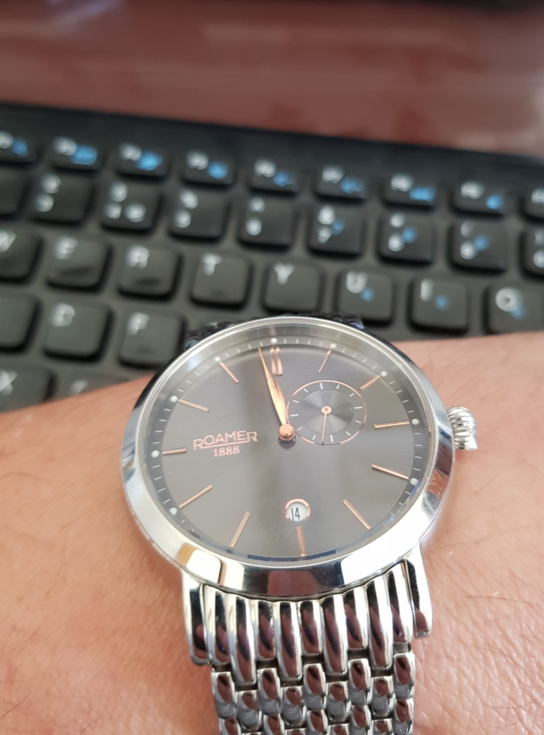
When Should I Order One
Future and in-progress implementations
Prepare before go-live
Execute during pilot
Then execute for full system load
Existing, already live implementation
Not better time than now
Repeat after major architecture changes

Slide 5

Case Study X
Architecture
Older, on-premises, public cloud, many db, high concurrency
Symptoms
Response time increase x10 at peak time only
Analysis
Base line, captured perf. counters over time, reviewed wait stats
Tools
Log Analytics, Performance Counters
Root Cause
Idle connections, pooled connections not reused

Slide 6
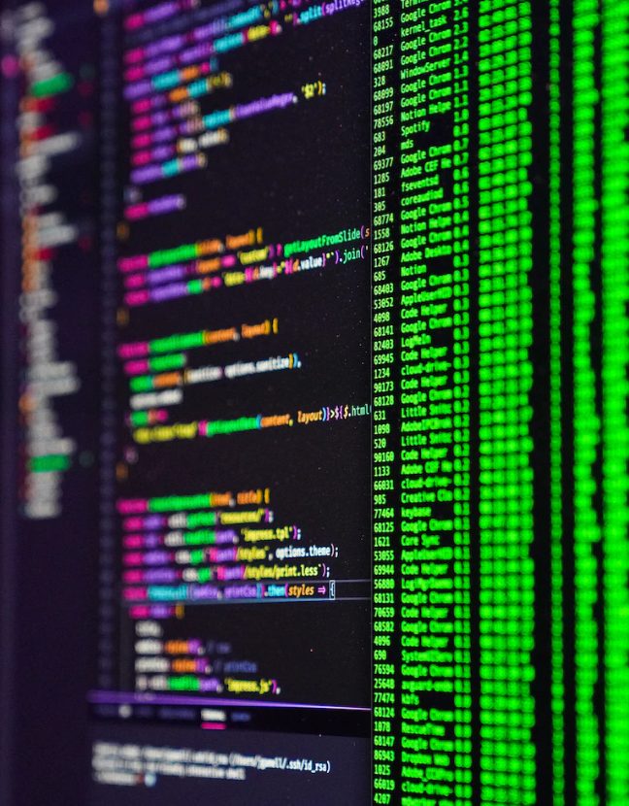
Case Study Y
Architecture
Recent BC version, on-premises, private data centre, distributed, many POS
Symptoms
Slow custom process affecting user experience
Analysis
Base line, initial using Query Store, deeper using Trace
Tools
Log Analytics, SQL Query Store + Trace
Root Cause
Suboptimal AL code

Slide 7

Case Study Z
Architecture
Older, on prem, private, remote clients, direct connect, WAN, multitenant, CAL+AL
Symptoms
Slow custom process affecting user experience in particular location
Analysis
Base line, compare over time, test screen capture, replay with traces
Tools
Log Analytics, Custom Performance Counters (network latency), Custom Traces, Query Store
Root Cause
Suboptimal CAL code + excess data

Slide 8
Thank you!

