Slide 2
Reselling LS Central SaaS - value proposition
Speaker name
John Baker

Slide 3

Agenda
Why LS Central SaaS?
How to differentiate SaaS from on-premises
  what elements you should focus on with different prospects
SaaS Economics
  Highlighting the value
  Cloud Promotions & Programs
SaaS Support & Wins for Partners

Slide 4

Why LS Central SaaS?
Market Realities
  “Organizations are moving rapidly to the cloud in an effort to modernize environments, improve system reliability, support hybrid work models and address other new challenges”.. Gartner
  Lean Staffing… IT departments and elsewhere
  Shrinking margins mandate hyper focused cost controls
Market interest / demand
Benefits
Microsoft’s focus & value

Slide 5
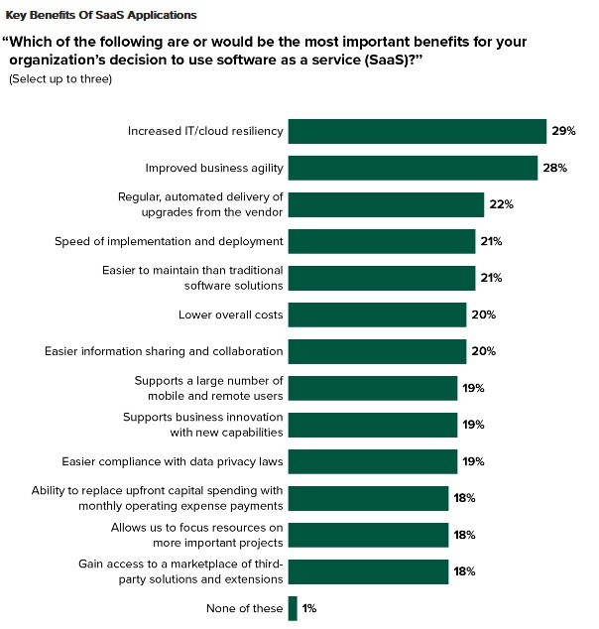
SaaS Top of Mind
In this Forrester graph of SaaS benefits, the following are some of the top reasons being considered:
Increased IT resiliency
Improved business agility
Automated delivery of upgrades
Speed of implementation
Easier maintenance,
and lower overall costs.

Slide 6

Reliability
Built on Microsoft Dynamics 365

Slide 7

Accessibility
THE POS
is always operational
KEEP ON SELLING
even when offline
DATA SYNCS
automatically
No internet? No problem!

Slide 8
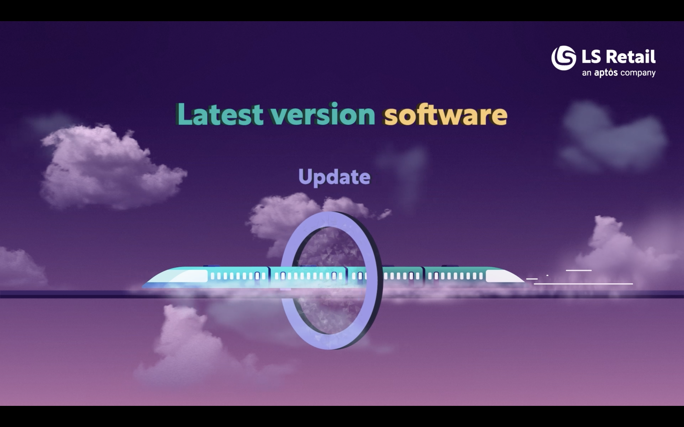

Slide 9
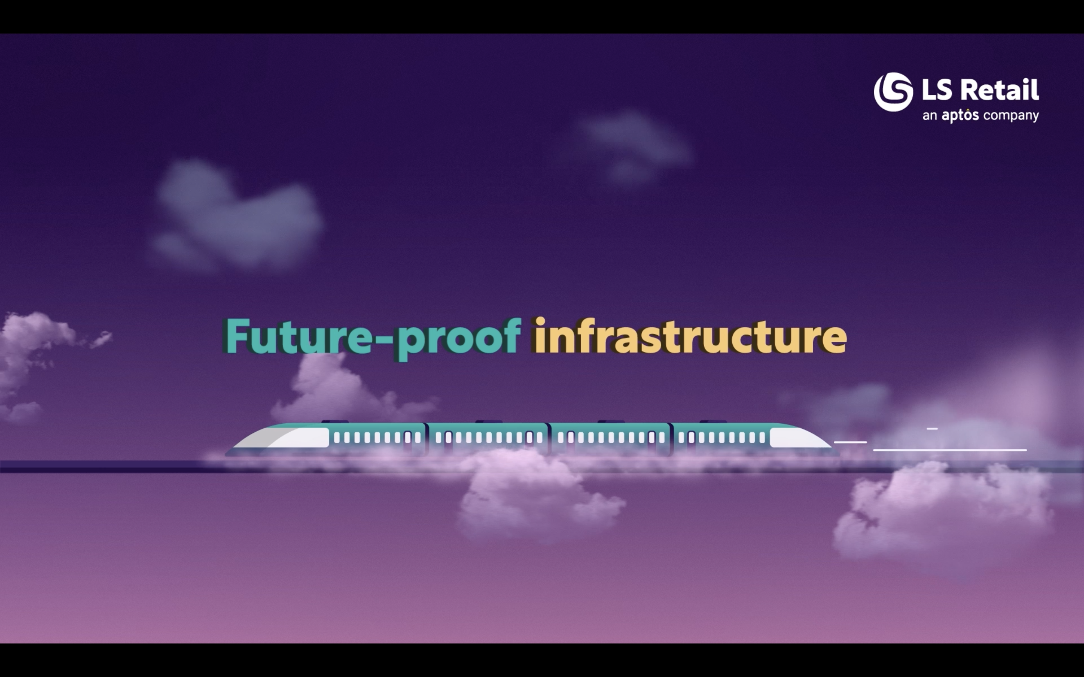

Slide 10
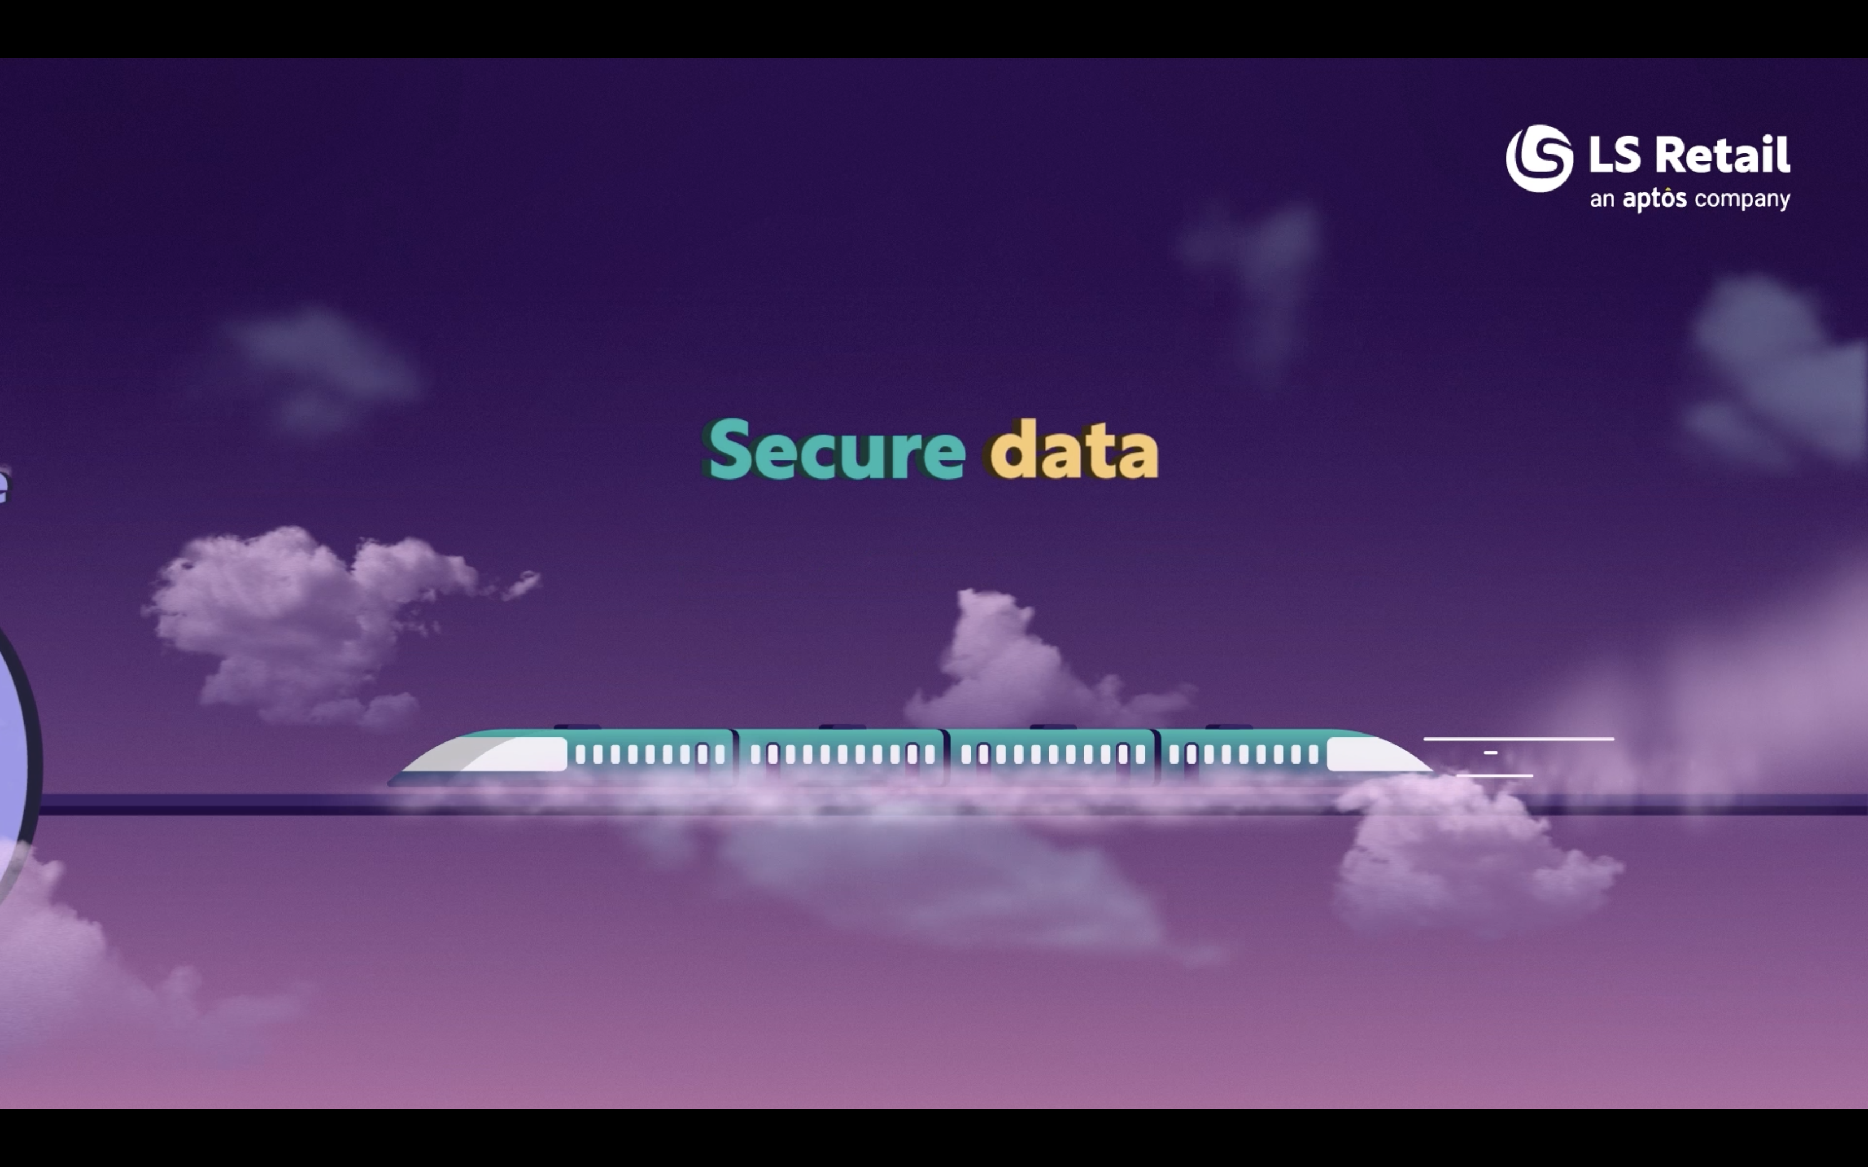

Slide 11


SaaS Economics
Top of Mind
License & Annual Enhancement Plan
Often Overlooked
IT Staffing
IT infrastructure (servers, database etc)
Energy cost for servers
Security costs
Network costs
Upgrade costs

Slide 12

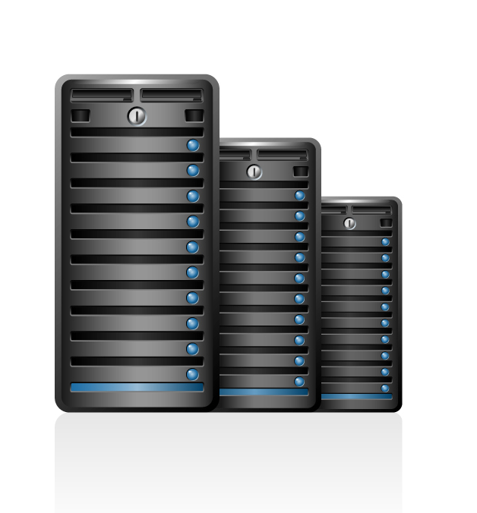
Key Comparative Criteria
SaaS
OR
PRIVATE CLOUD
Considerations | SaaS | “On Premise”
Licensing Type… Paid How? | Monthly Subscription | Perpetual | Monthly Subscription
User $ / Device License Qty. | May increase / decrease | Purchased Once / Fixed | May increase / decrease
Hosting? | Included | Azure or other | Azure or other
On your own servers? | Hosted Only | Yes… Virtually | Yes… Virtually
Off-Line Capable | Yes | Yes | Yes
Annual Enhancement Plan | Included | 18% X License Value | Included
Manage Environment | No | Yes | Yes
Updates applied? | Automatic… Limited Choice | When you choose | When you choose
Service fee for update | Little to none | Yes | Yes

Slide 13
SaaS vs Perpetual license for Customer
Customer
 | Cost components | Year 1 | Year 2 | Year 3 | Year 4 | Year 5 | Total 5 Years
Licensing & maintenance | SaaS | $ 57,912.00 | $ 57,912.00 | $ 57,912.00 | $ 57,912.00 | $ 57,912.00 | $ 289,560.00
 | Perpetual | $ 84,764.12 | $ 12,930.12 | $ 12,930.12 | $ 12,930.12 | $ 12,930.12 | $ 136,484.60 | 47% | of SaaS subscription
Other cost | Infra/ hosting cost |  |  |  |  | $ 1000 per month | $ 60,000.00
 | IT manpower |  |  |  |  | $ 1000 per month | $ 60,000.00
 | Upgrade |  |  |  |  | 33% of 5 years total | $ 45,039.92
 |  |  |  |  |  | Total cost with Perpetual | $ 301,524.52 | 104% | of SaaS subscription

Slide 14
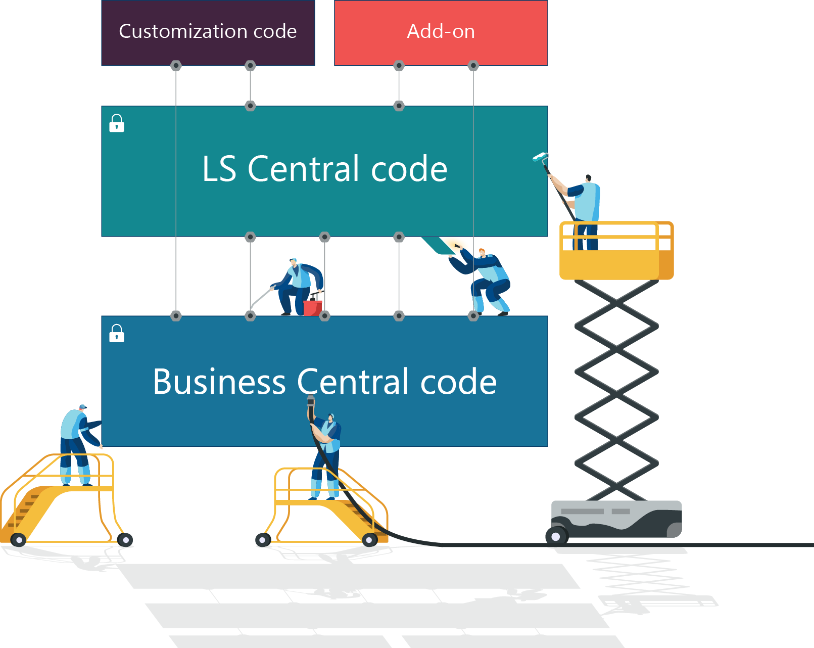
Extensibility Framework
Coding with Events & Extensions
New modular development environment
Built for upgradability
Makes migration easier, simpler and faster
Still keeping the ability to extend functionality
This technology has ability to stay current without projects

Slide 15
Anytime,
Anywhere
Lower
Initial
investment
Latest innovation
Prospects of LS Central SaaS
Lower
Long-term
Cost
Secure
Reliability

Slide 16



Helping Partners Succeed & Benefits

Slide 17
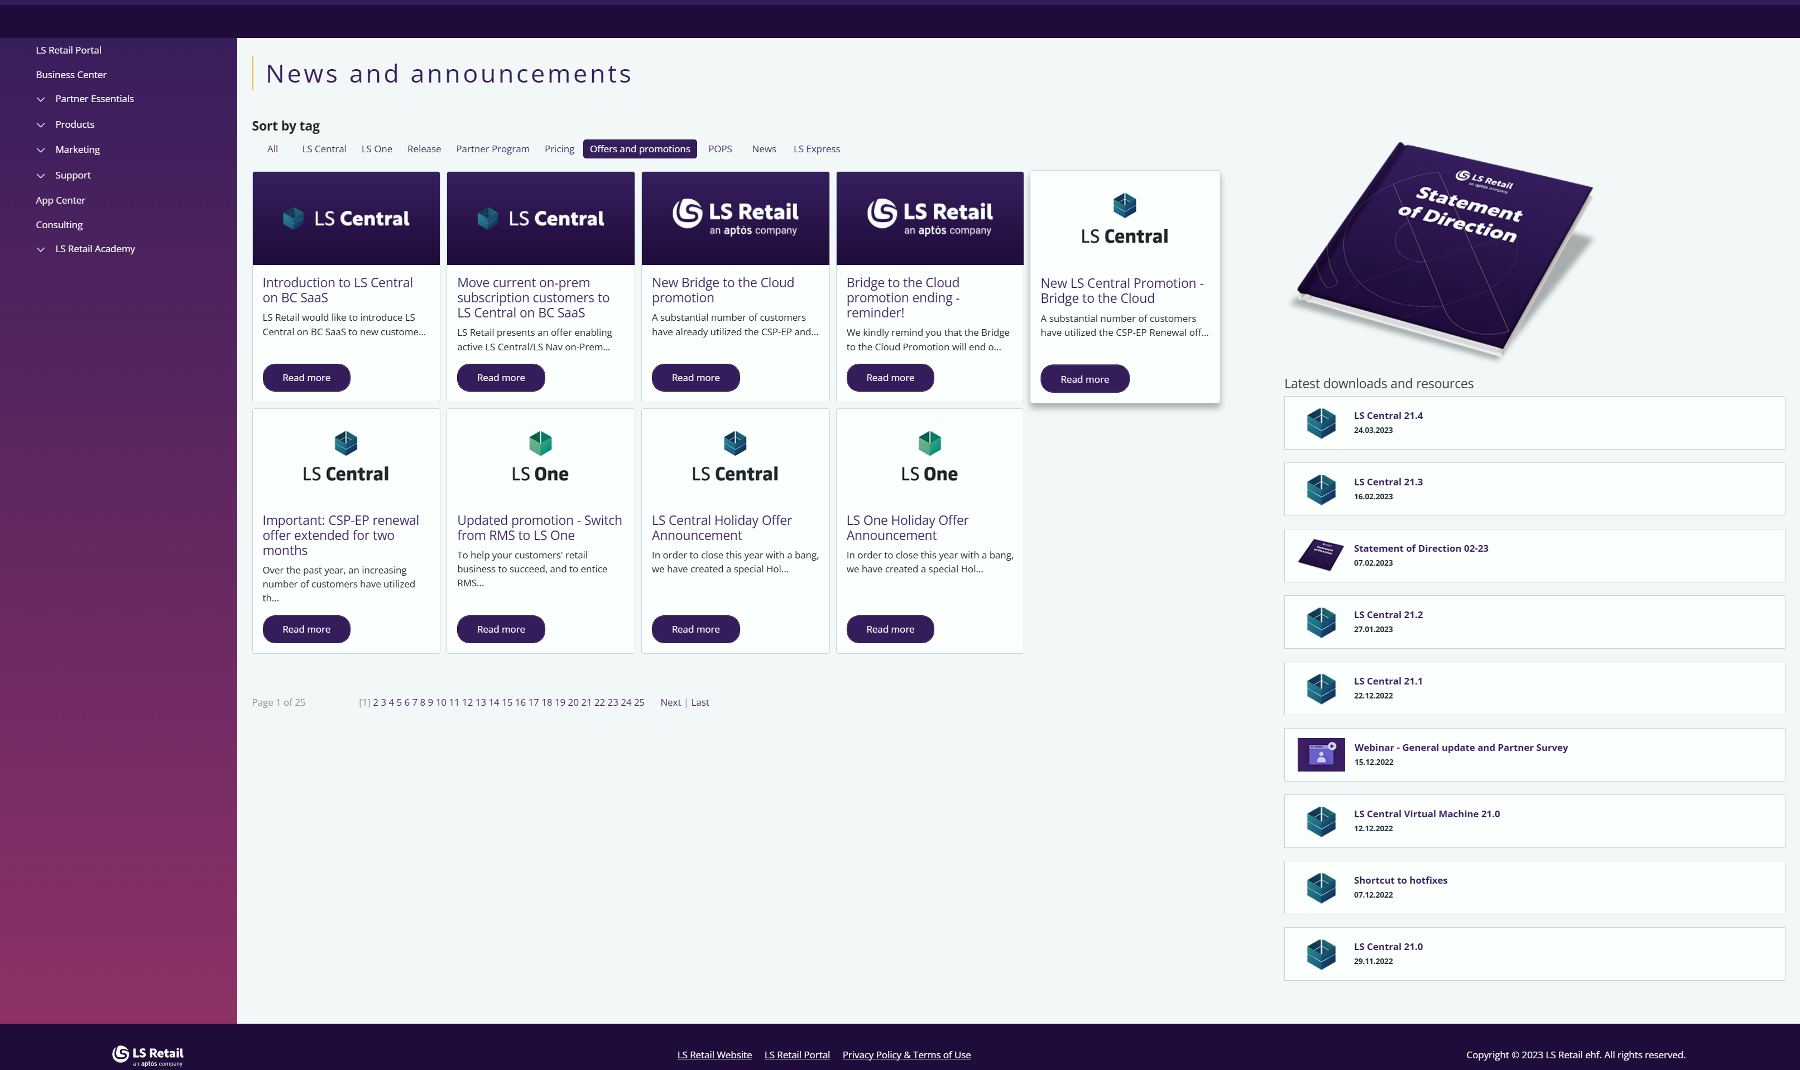
Partner Portal… Offers & Promotions

Slide 18

Partners… Getting Started with LS Central SaaS
SaaS Onboarding
Cloud Acceleration Program (CAP) Prerequisite: Certified in CF-900 LS Central SaaS
Microsoft Concierge
Microsoft’s support for large SaaS implementation
To ensure a successful project
Subject to nomination by LS Retail *
Not yet taken LS Central SaaS training?
On-demand Starter Plan
EUR 750 for 3 months access
EUR 250 for certification test

Slide 19
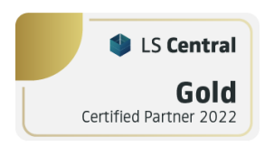
SaaS vs Perpetual license for Partner
Example: 10 users in Head Office, 30 stores with 1 device each, LS eCommerce integration, LS Pay.
SaaS subscription
Qty. | Module description | Unit price (USD) | List price | Customer price
10 | Dyn365 Business Central Essentials | $ 70.00 | $ 700.00 | $ 700.00
10 | LS Central Base - Per Full User | $ 30.00 | $ 300.00 | $ 300.00
30 | Offline Store | $ 5.00 | $ 150.00 | $ 150.00
30 | Retail Device SAL for Retail & Hospitality | $ 85.00 | $ 2,550.00 | $ 2,550.00
30 | LS Pay - per Device | $ 10.00 | $ 300.00 | $ 300.00
1 | LS eCommerce Base | $ 136.00 | $ 136.00 | $ 136.00
30 | LS eCommerce - per Device | $ 3.00 | $ 90.00 | $ 90.00
 |  |  | MRR | $ 4,226.00
 |  |  | Annual | $ 50,712.00
Partner margin: 20% | Partner Share
Monthly Recurring Revenue (MRR) | $ 845.20
Annual Recurring Revenue (ARR) | $ 10,142.40
Perpetual license
Qty | Module description | Unit price (USD) | List price | Customer price
10 | Dyn365 Business Central Essentials | $ 1,400.00 | $ 14,000.00 | $ 14,000.00
10 | LS Central Base - Per Full User | $ 697.20 | $ 6,972.00 | $ 6,972.00
30 | Store/Commerce Pack incl 1 Retail Device CAL | $ 1,411.20 | $ 42,336.00 | $ 42,336.00
0 | Retail Device CAL for Retail & Hospitality | $ 823.20 | $ - | $ -
30 | LS Pay - per Device | $ 134.40 | $ 4,032.00 | $ 4,032.00
1 | LS eCommerce Base | $ 3,276.00 | $ 3,276.00 | $ 3,276.00
30 | LS eCommerce - per Device | $ 40.60 | $ 1,218.00 | $ 1,218.00
 |  |  | LICENSE | $ 71,834.00
 |  |  | BREP | $ 12,930.12
Partner margin: 15% for lic, 14% for BREP | Partner Share
License | $ 10,775.10
BREP | $ 1,810.22

Slide 20
Key Takeaways
LS Central SaaS is the best fit for companies who want flexibility and the latest innovation.
Factor in hidden cost when comparing SaaS vs Perpetual license.
Position the short and long term benefits of LS Central SaaS – technology and cost factor.
Migrate your existing customers to Cloud through promotions and programs.
Leverage on the support available to kick-start your LS Central SaaS journey.

Slide 21
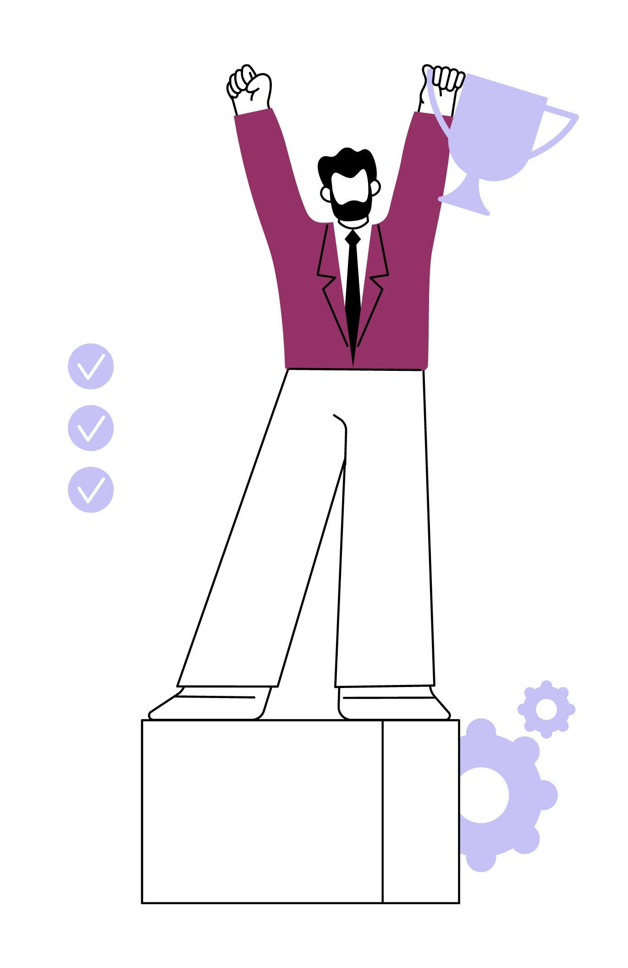
Everybody
Wins

Slide 22
Thank you

