Slide 3

Intelligent Cloud Suite
add intelligence to your ERP!
LS Insight
LS Recommend
LS Forecast
Martin Kleindl
Product Director
Martin.Kleindl@LSRetail.com

Slide 4



Dubrovnik

Slide 5

















Slide 6
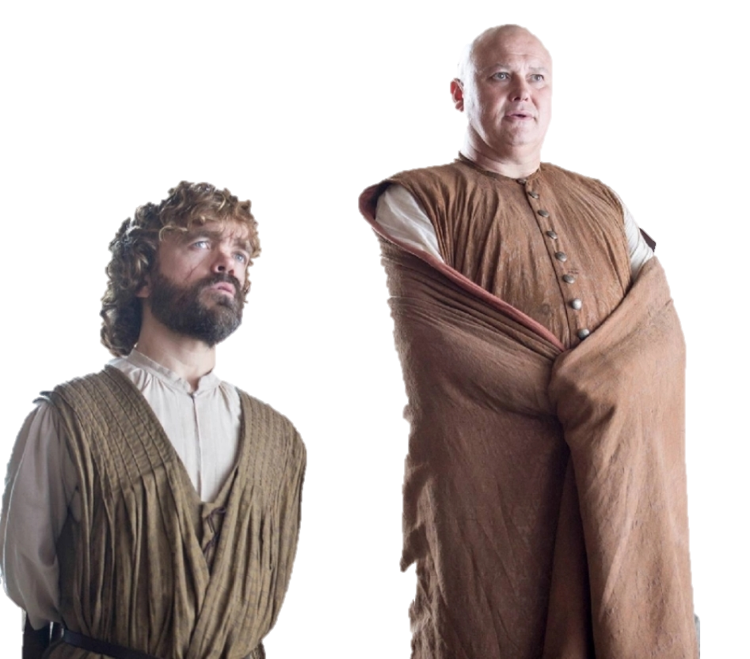

Slide 7

Intelligent Cloud
Suite

Slide 8

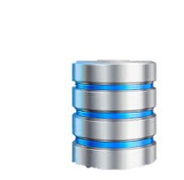
Intelligent Cloud
Suite
LS Insight
(Datawarehouse & Analytics)
LS Central (ERP)

Slide 9
Intelligent Cloud
Suite
New release:
Q1 2022
LS
Recommend
LS
Forecast
LS
Basket Analysis
LS Insight
(Datawarehouse & Analytics)
LS Central (ERP)

Slide 10

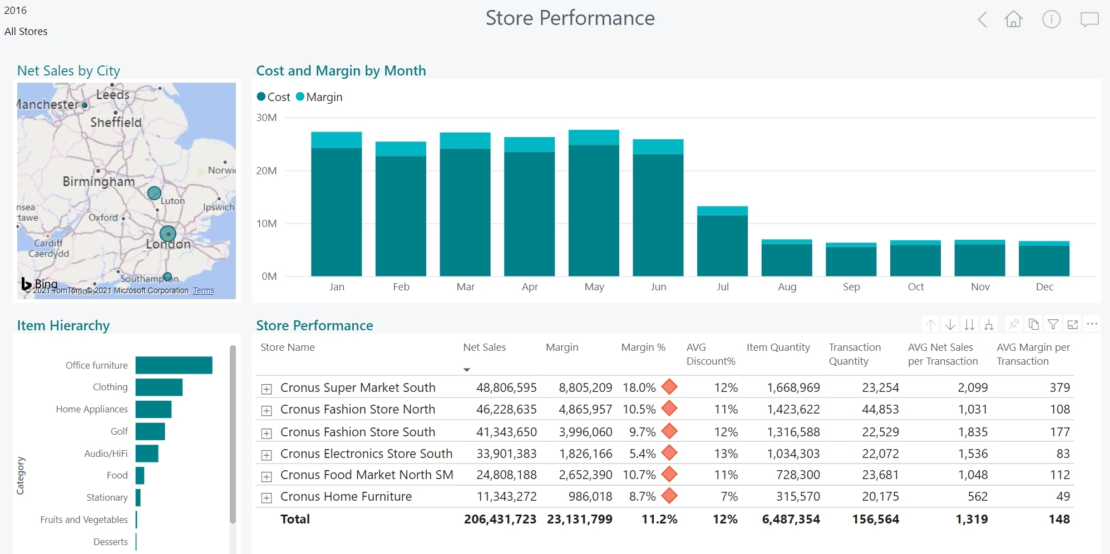
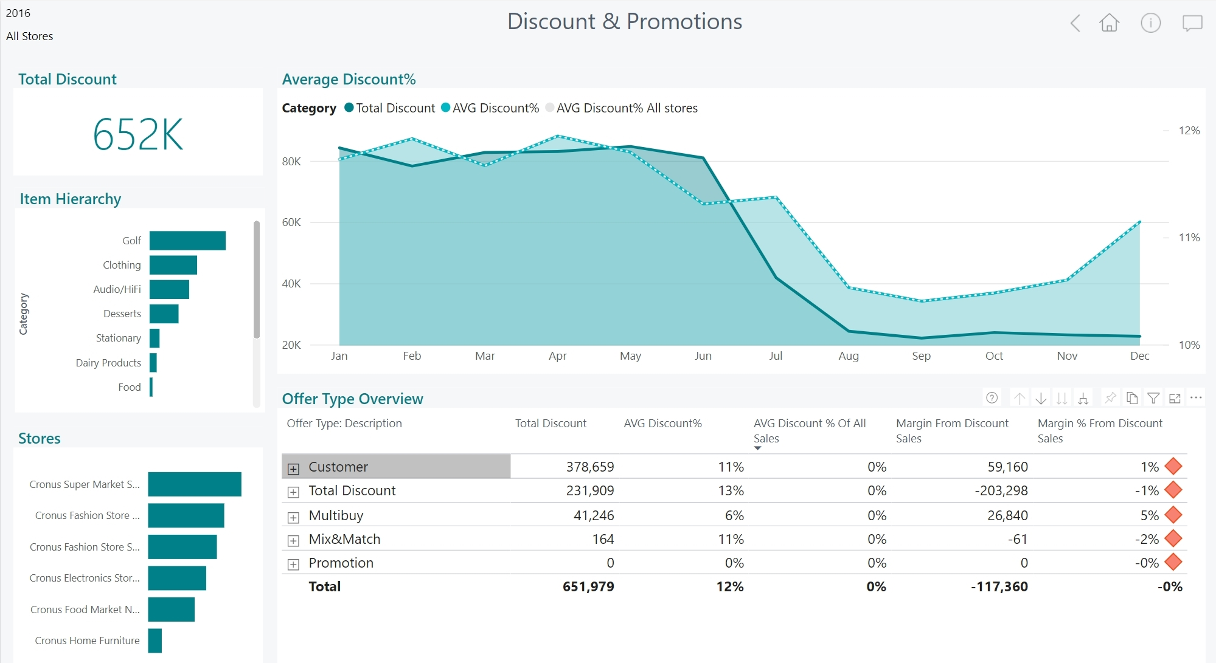
LS Insight
Datawarehouse and Analytics platform
  Datawarehouse built on Azure SQL (Cloud)
  Open, easy to extend with other data sources
  Reports and Dashboards based on Power BI
  Browser based, supports mobile devices
  Report templates for Sales, Inventory, Supply Chain, Actionable Insights and Hotels. More to come
  Hosted by customers
Access actionable reports.
Take better business decisions.

Slide 11

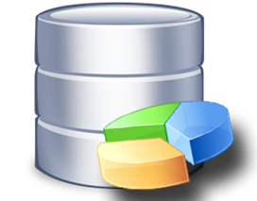



LS Insight
Architecture options
  LS Central On-prem → LS Insight Cloud
  (Azure Data Factory)
  LS Central Cloud → LS Insight Cloud
  (Data Director & Webservices)
  LS Central On-prem → LS Insight on-prem
  (SQL Server Int. Services or Data Director, Azure Data Factory)
  LS Central Cloud → LS Insight on-prem
  (evaluating demand, Data Director & Webservices)
Cloud
On-premise
Azure Data
Factory
Data Director
Webservices

Slide 12
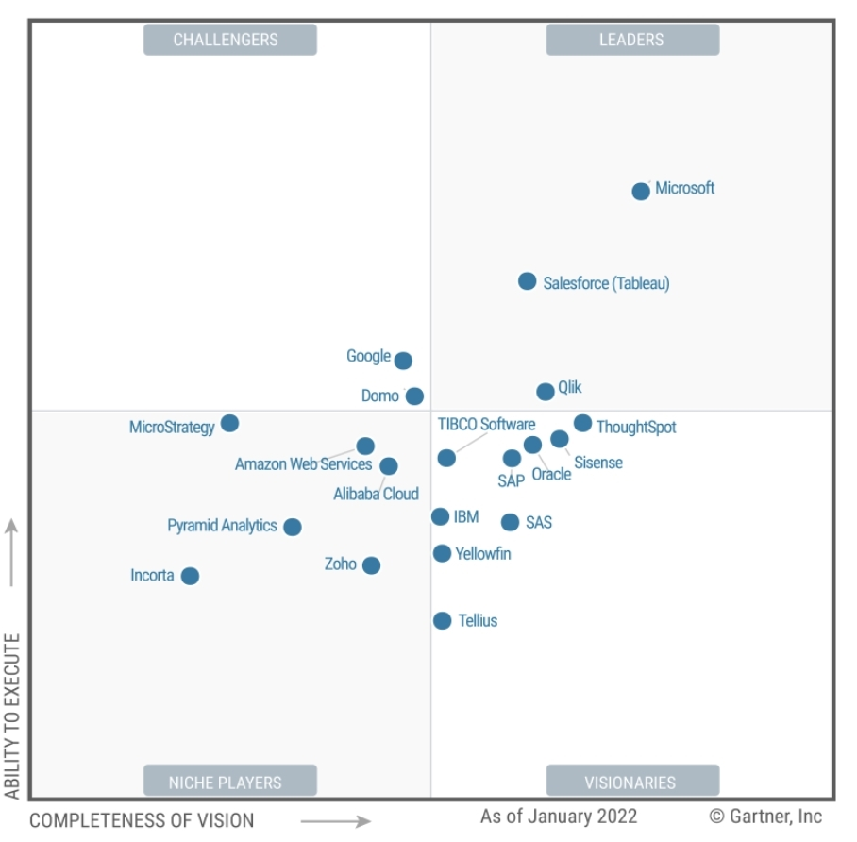
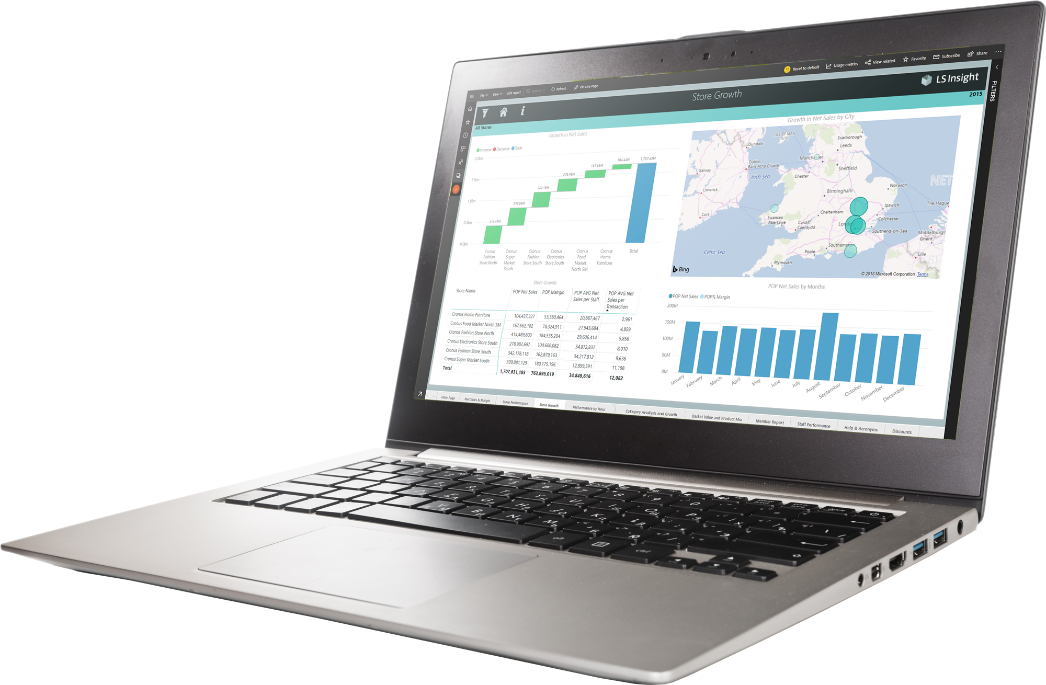
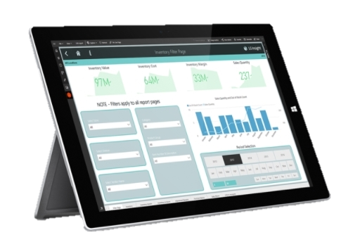

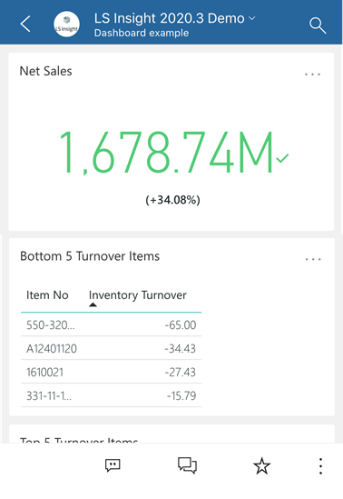
LS Insight
Gartner®
^{March 2022}
PBI named as Leader in Analytics & BI Platforms
and scored highest for the 4th consecutive year.
^{Microsoft Power BI has helped}
^{over 250,000 organizations}
including 97 percent of Fortune 500
*) Magic Quadrant for Analytics and Business Intelligence Platforms,
from 2013 – 2022

Slide 13
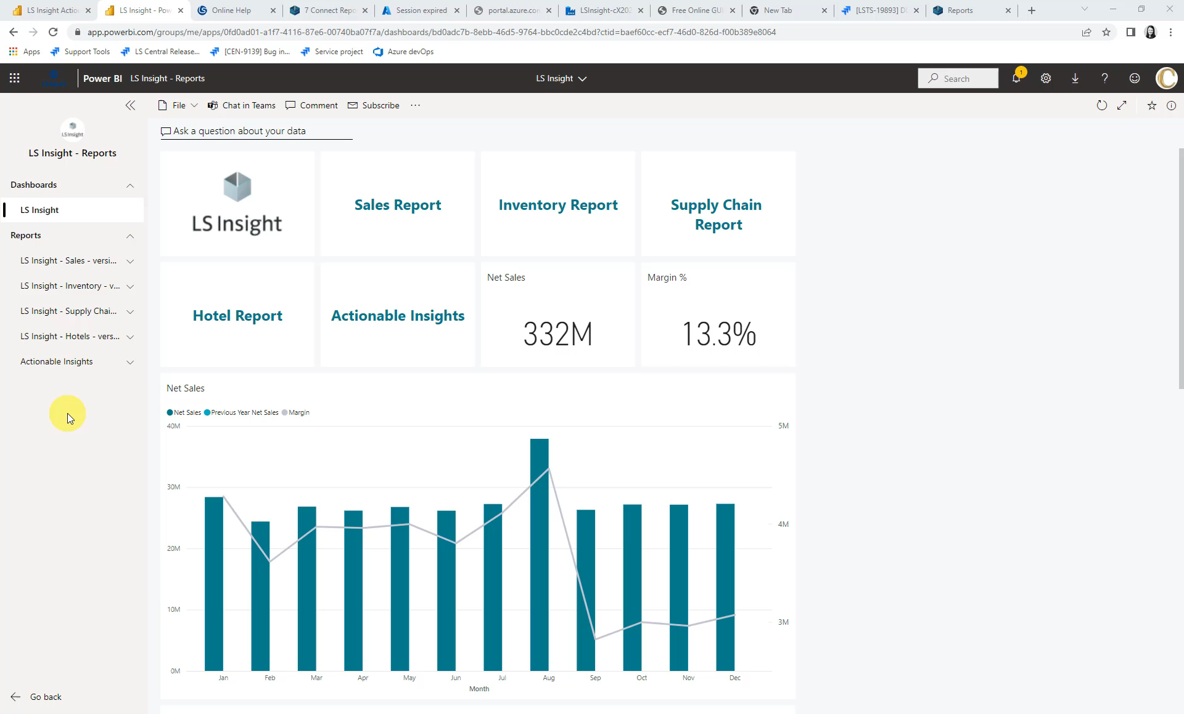

Slide 14
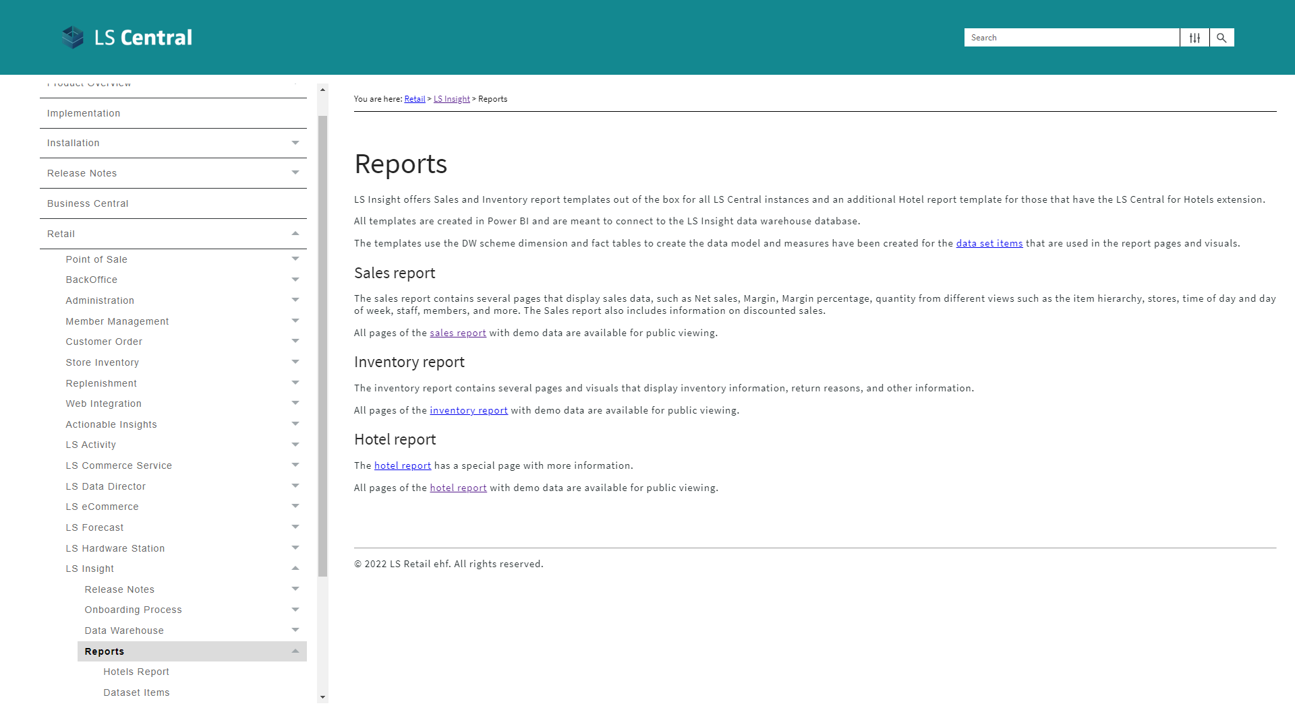

Slide 15
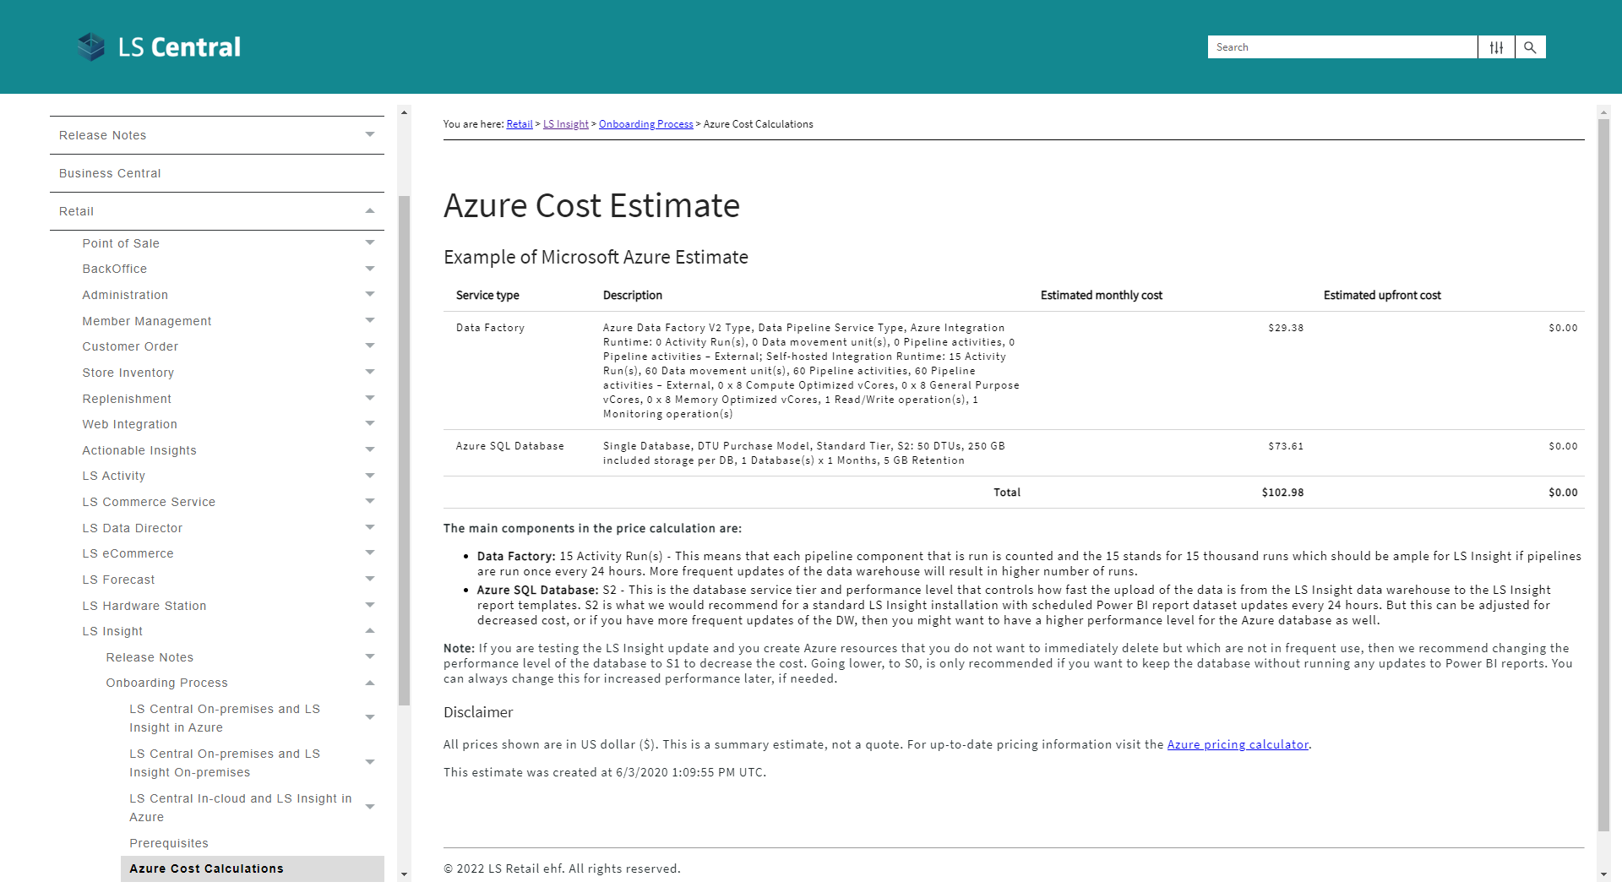

Slide 16
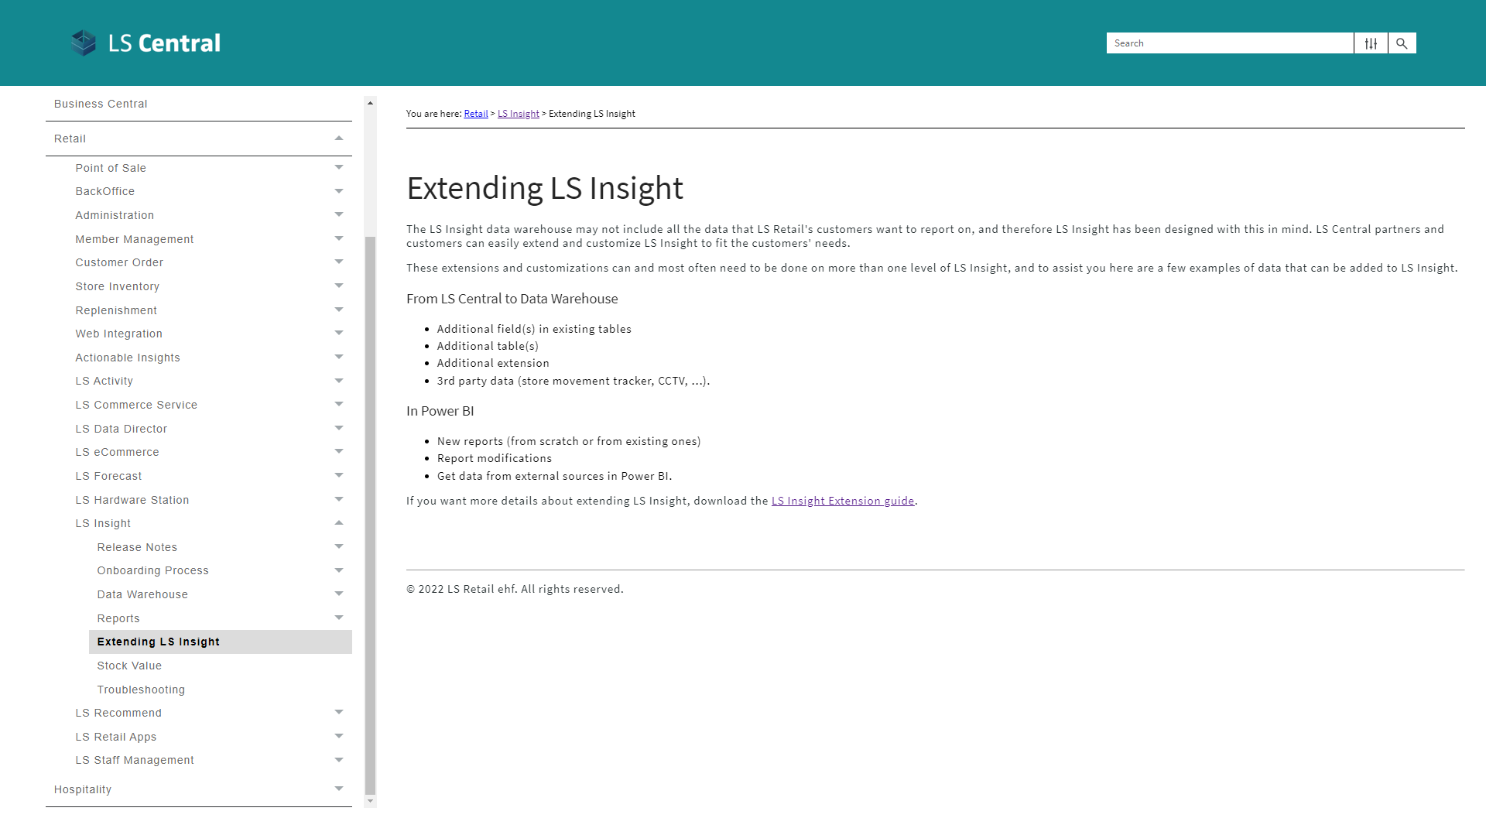

Slide 17
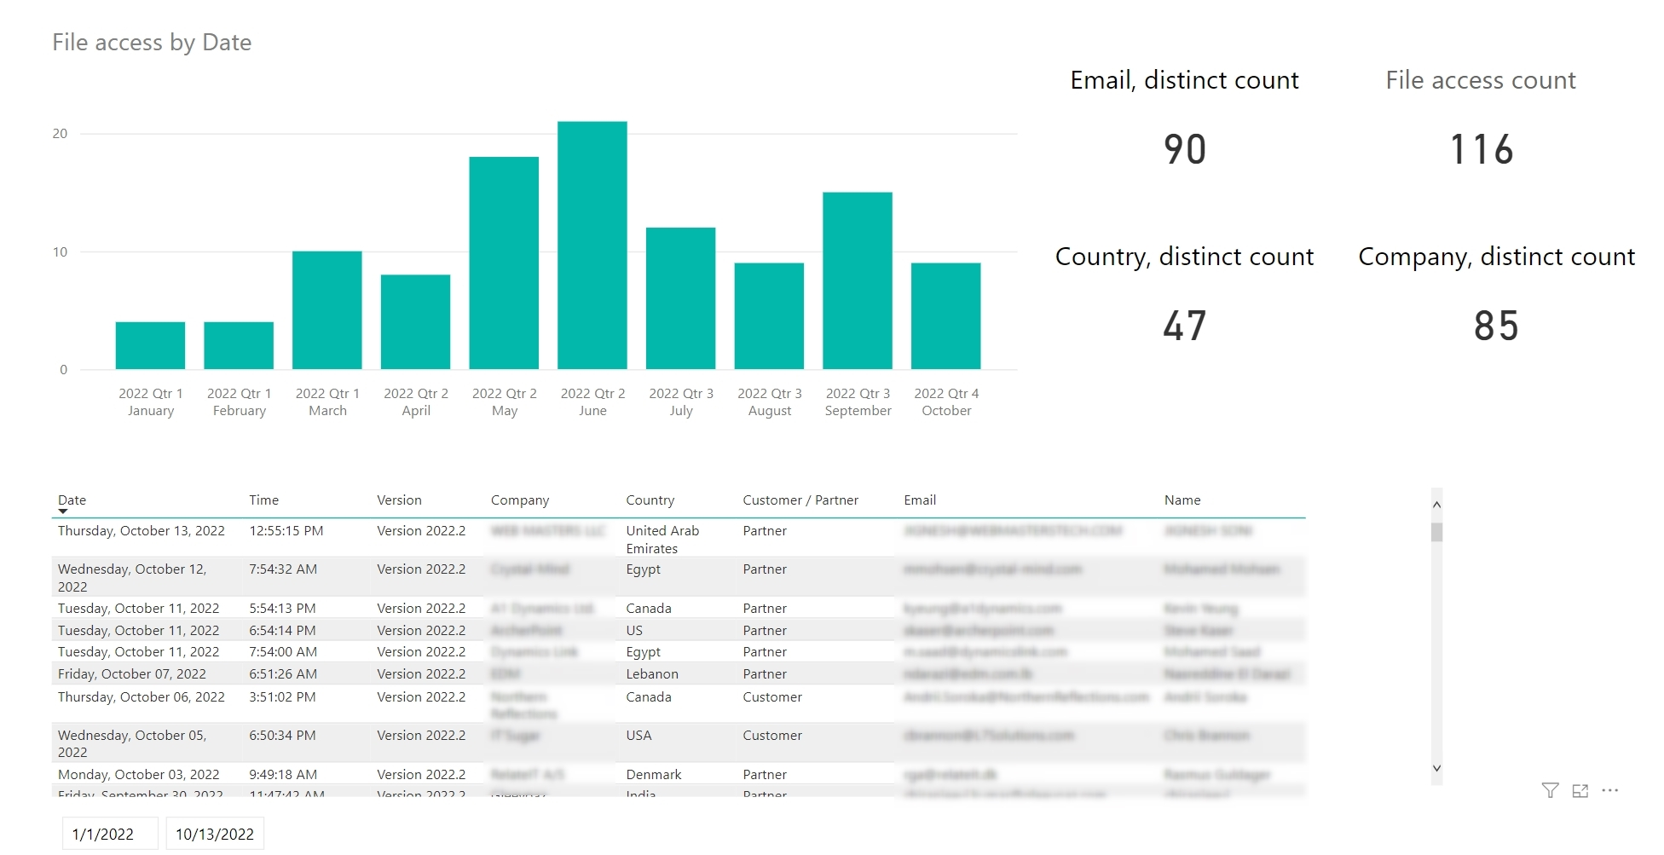
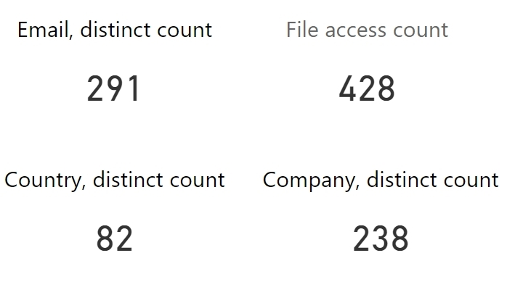
Since 2020
(when we started logging)

Slide 18

Try it
Request form:
https://portal.lsretail.com/Products/LS-Insight
Get product files
Follow onboarding instructions, Done!
Documentation
LS Retail Online Help, LS Insight
https://help.lscentral.lsretail.com/
PowerBI readiness
Documentation
https://docs.microsoft.com/en-us/power-bi/
Learning
https://docs.microsoft.com/en-us/learn/
How to get started ?

Slide 19

LS Recommend
Machine learning solution
Azure cloud-based solution
Software as a Service (SaaS)
Easy to start
Low risk
Pay as you go

Slide 20


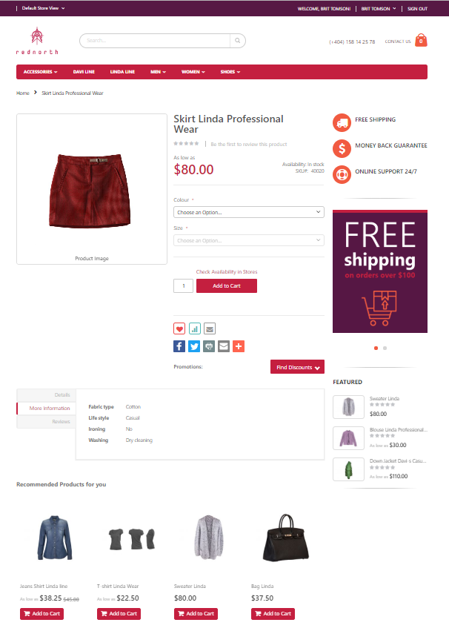

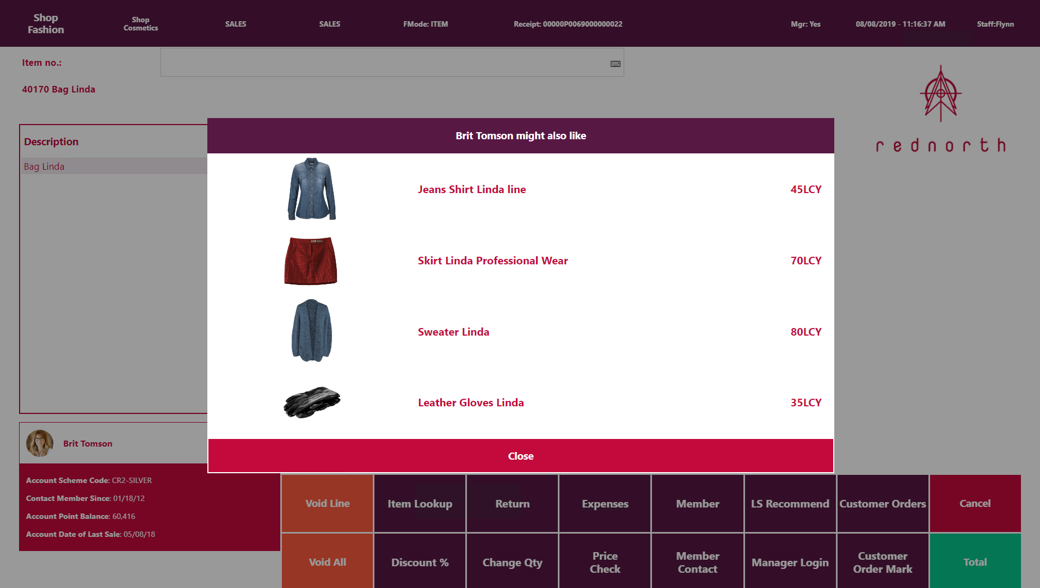
LS Recommend
Product recommendations
  Basket analysis and Recommendation engine
  Provides targeted, personalized suggestions
  based on your shopping history and preferences
  Optimized upselling and cross-selling
  Supports POS and eCommerce
  SaaS solution - hosted by LS Retail
Know what your customers want, before they do
through machine learning

Slide 21

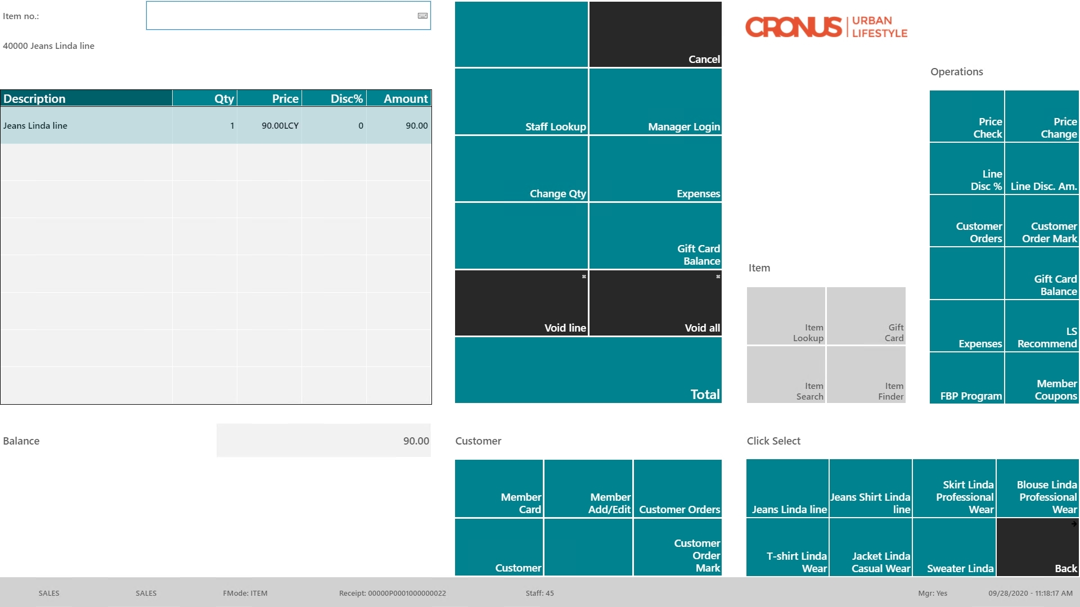
Item “Jeans”
in the sale

Slide 22
Item “Jeans”
in the sale
Recommendation
triggered manually
or
when pressing “TOTAL”

Slide 23
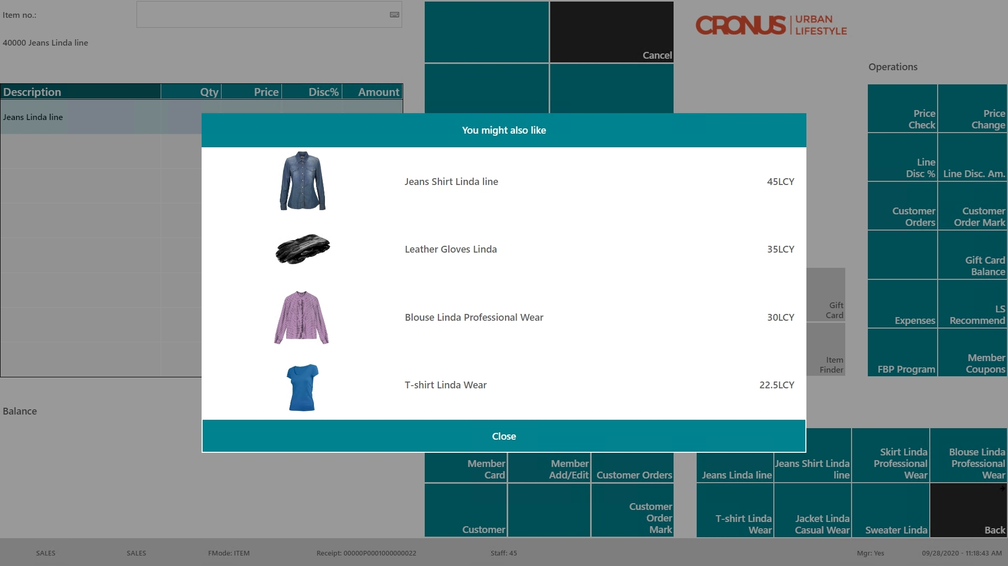
Item “Jeans”
in the sale
Recommendation
triggered manually
or
when pressing “TOTAL”
Recommendation
page with
options

Slide 24
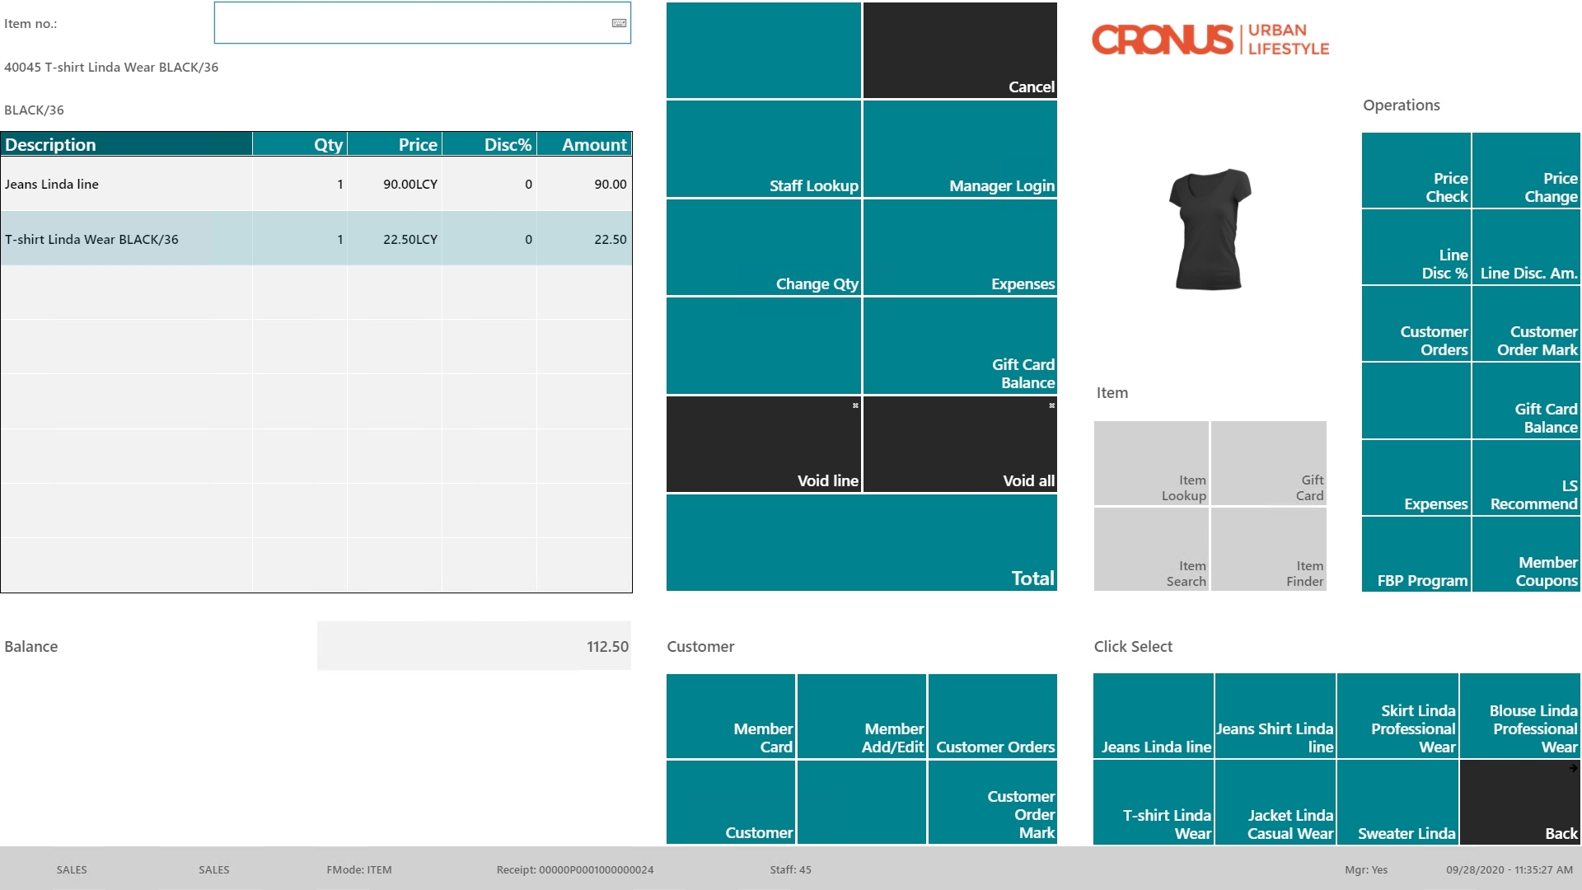
Item “Jeans”
in the sale
Recommendation
triggered manually
or
when pressing “TOTAL”
Recommendation
page with
options
Item “T-Shirt”
added

Slide 25

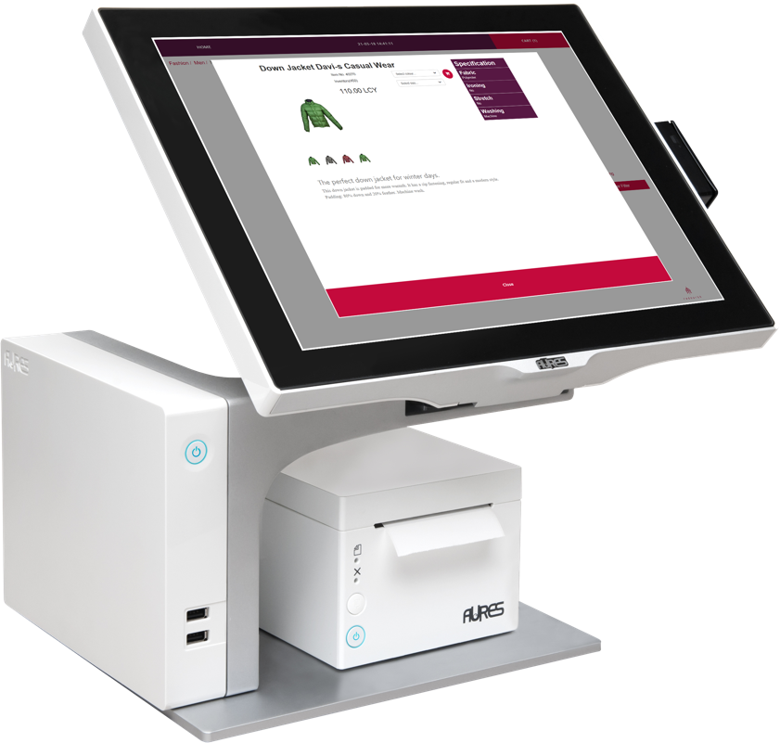
LS Recommend
Model calculation
  Version 2 available (LS Central 19.5)
  Supports LS Central SaaS
  Simplified setup in LS Central
  Faster Model calculation
  Improved scalability with Model Readers
  Pricing model change
  Now based on considered
  Transaction Sales Lines during
  calculation
Model download
Model Reader
Model Reader
Recomm-
endation

Slide 26
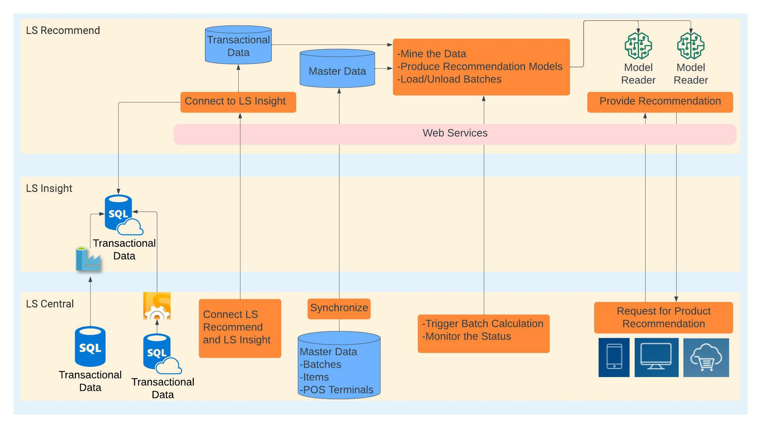
LS Recommend
hosted by LS Retail
hosted by customer
operated by customer

Slide 27



PRICE MODEL
Cost per run
Billed monthly
(calculated from considered Transaction Sales Lines)
Pack LSREC-10M
Pack LSREC-50M
Pack LSREC-100M
Pack LSREC-1B
(0 – 10M TSL)
(10M – 50M TSL)
(50M – 100M TSL)
(100M – 1B TSL)
Fixed cost:
decreasing price; price per 1 Mio Trans. S. Lines
Base pack (includes 1 Model Reader)
Additional Model Readers
Invoice:
1 x Base Pack
0 x Add. Model Reader
1 x LSREC-50M (30@ 3€)
1 x LSREC-100M (90@ 2€)
Calculation
(30 Mio TSL)
Calculation
(90 Mio TSL)
250,00
0,00
90,00
180,00
End of month:
01.04
30.04
Pack LSREC- 50M
30 * 3€ = 90,00€
Pack LSREC- 100M
90 * 2€ = 180,00€
Total
520,00
* example prices for explanation

Slide 28

How to get started?
Try it
Reach out to LS Retail’s Partner Operations team or the responsible Sales Manager in your region
Subscribe for LS Recommend service
Receive account information for setting up the module
Install LS Insight (it’s free!!)
LS Central
Base setup, Define items to be considered
Upload sales history, calculate model, GO!
Resources
LS Retail Academy course (available soon)
Documentation, Online Help
https://help.lscentral.lsretail.com/

Slide 29
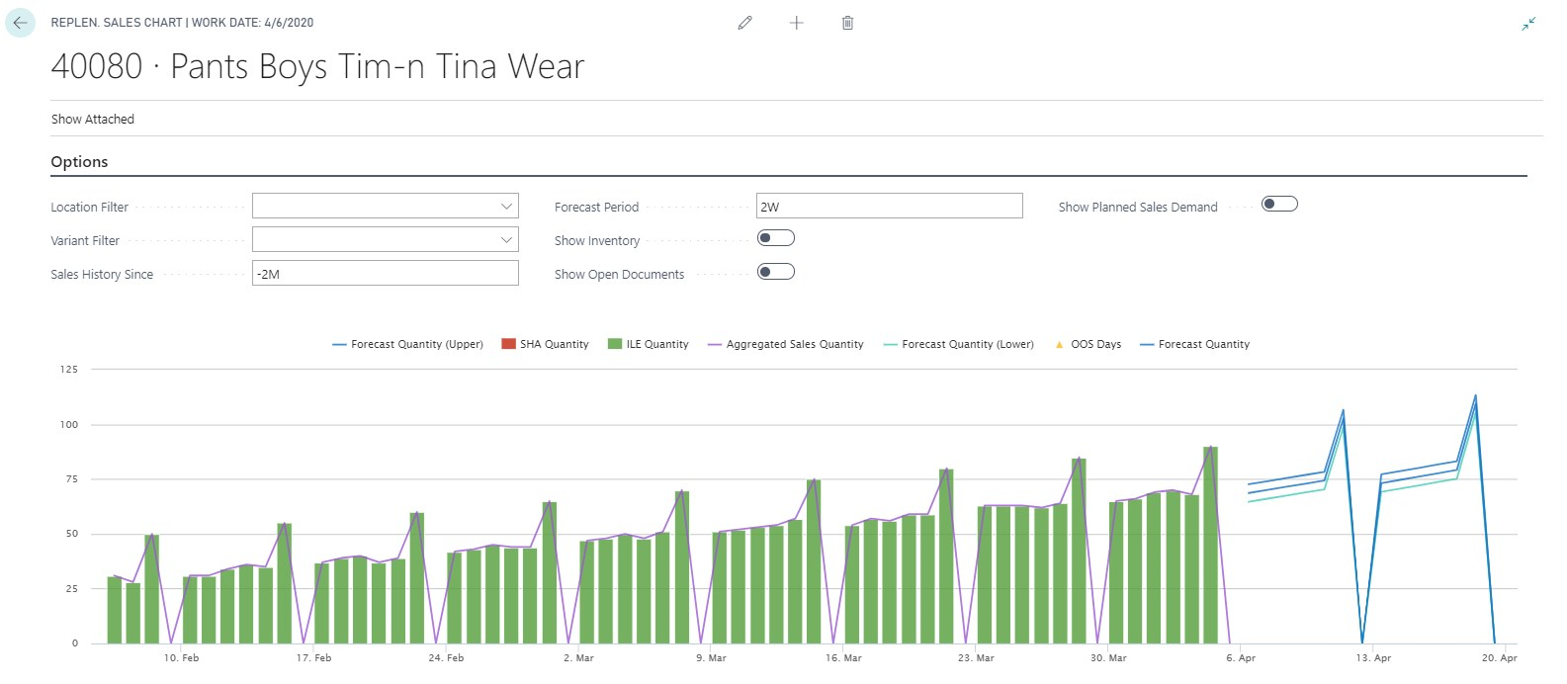
LS Forecast
Forecast
with
Quality measurement
Sales History

Slide 30

LS Forecast
Advanced sales forecasting for everyone
  Predicts future sales based on sales history
  Improves availability
  Reduces out-of-stock situations
  Automatic forecast model selection
  Turn-key solution, no data scientists needed
  SaaS solution - hosted by LS Retail
Increase availability and sales
with advanced sales demand forecasts
Sales history
Forecast

Slide 31
LS Forecast
LS Forecast:
Turn-key solution
Seamless integration
with Replenishment
No data scientists/experts
needed
Advanced
demand forecasting
for everyone
LS Replenishment
Planning & Data Maintenance
Manual Replenish- ment
Automatic Replenish- ment
Execution
Monitoring
Sales & Purchase Budgets
Allocation
Plans
Buyer‘s Push,
Stock Recall
Allocation Rules
Variant Weight Dim. Pattern
Demand Forecasts
Store Stock
Redistribution
Purchase & Transfer
Orders
Stock Requisition
Buyer‘s Workbench
Inventory and Demand
Store
Capacity
Stock Coverage
Vendor Performance
Open to Buy
Assortment Mgmt.
Lifecycle Mgmt.
Replenishment Journal Calculation
Threshold Mgmt.
Lifecycle Planning WS
Cross Docking
Manual Purch. & Transfer Orders
Replen. Item Quantity Calculation
Out-of-Stock Calculation
Item Import

Slide 32
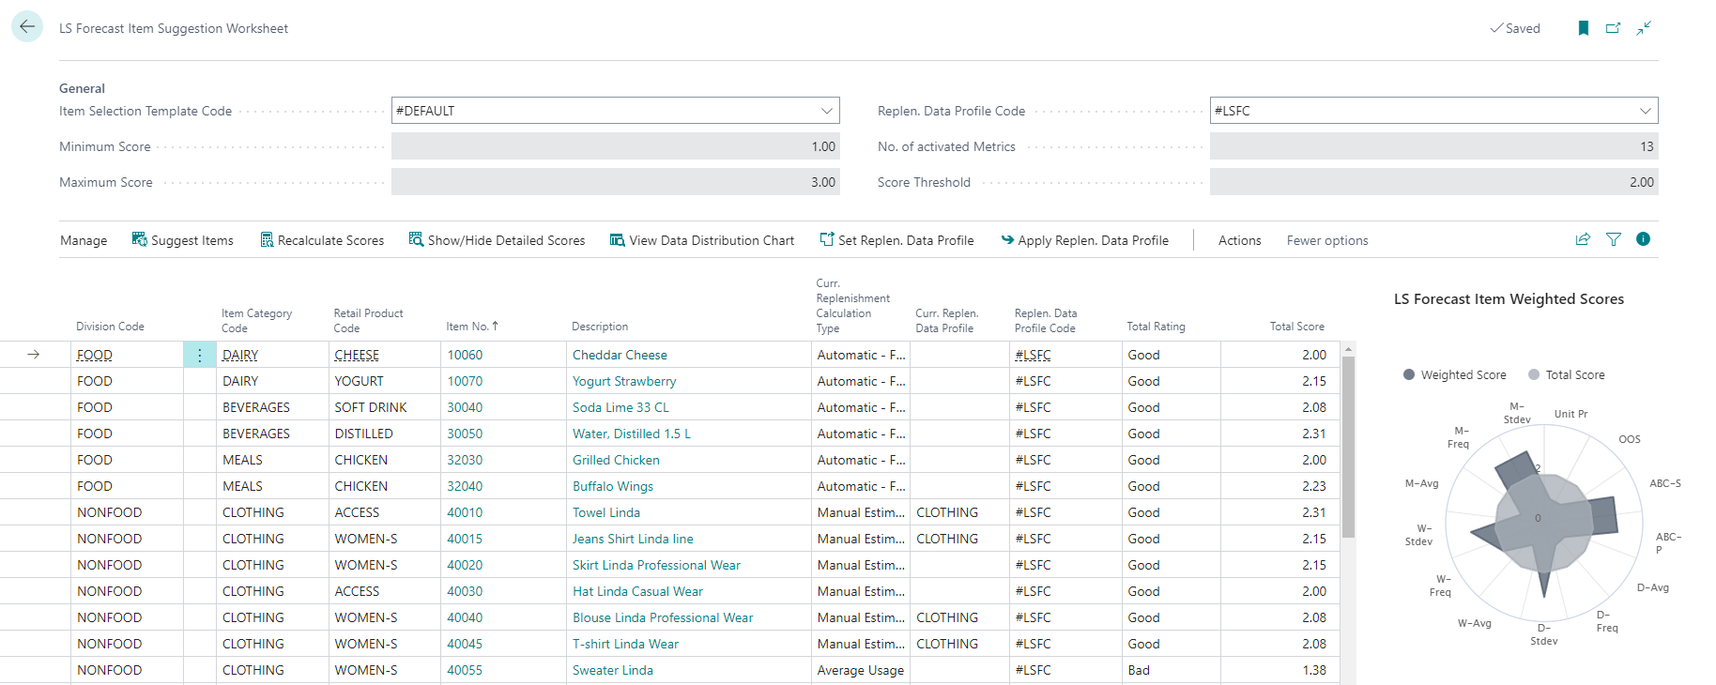
LS Forecast: Item Suggestion Worksheet
Tool for partners and customers
Identify good item candidates
Scorecard approach with weights
Easy, simple, fast
Total Rating
Total Score

Slide 33
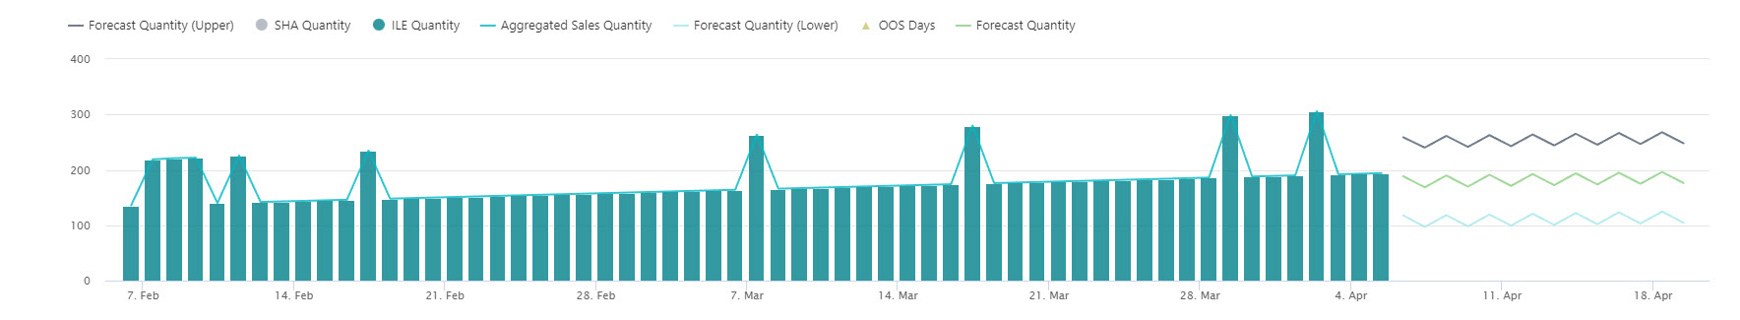
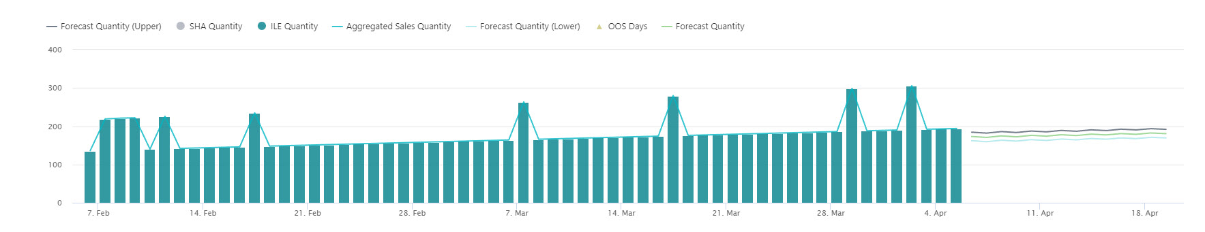
LS Forecast: additional dimensions
40300 – Linda Sleeveless Dress
Without dimension:
RRR R R R R R R
With dimension RAIN:

Slide 34
LS Forecast: additional dimensions
40300 – Linda Sleeveless Dress
Without dimension:
RRR R R R R R R
With dimension RAIN:
RR R R R

Slide 35
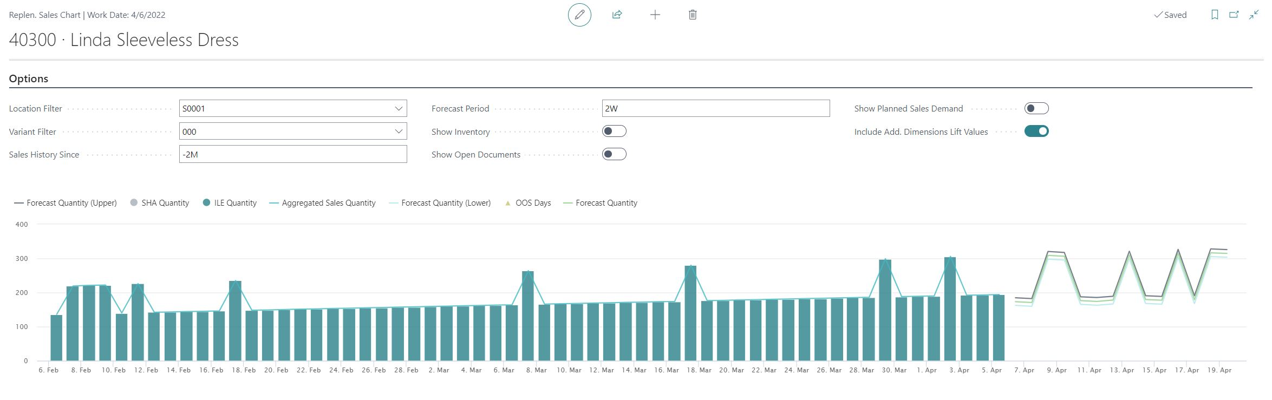
LS Forecast: additional dimensions
40300 – Linda Sleeveless Dress
With dimension RAIN and lift values:
RR R R R

Slide 36
LS Forecast: additional dimensions
What we do
RRR R R R R R
RR R R R
New table
for “RAIN”
history
New table
for “RAIN”
forecast

Slide 37
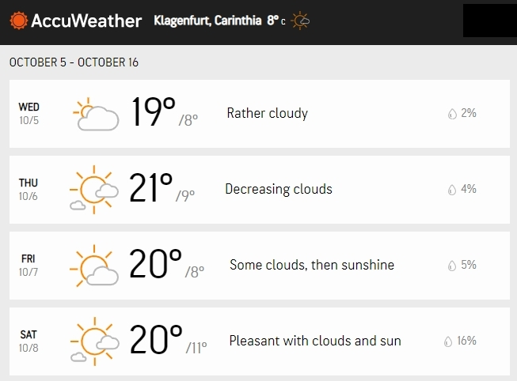
LS Forecast: additional dimensions
Additional dimensions
Affects:
Enables LS Forecast to forecast based on
weather data, etc.
Solution:
Detect dimension patterns
in time series
5 Location based dimensions
2 Item based dimensions
Integration to Replenishment
Out of the Box integration with AccuWeather ☺
Easy to extend for your dimensions

Slide 38
PRICE MODEL
Cost per run
Billed monthly
(calculated from Item/Variant/Location calculations per run)
Pack LSFC-10k
Pack LSFC-50k
Pack LSFC-100k
Pack LSFC-500k
Pack LSFC-1M
(0 – 10k calculations) 5,98€
(10k – 50k calc.) 2,98€
(50k – 100k calc.) 2,49€
(100k – 500k calc.) 1,80€
500k – 1Mio calc.) 1,20€
No fixed cost
decreasing price; price per 1000 calculations
Invoice:
1 x LSFC-50k (30@ 2,98€)
1 x LSFC-100k (90@ 2,49€)
Run 1
(30.000 calc.)
Run 2
(90.000 calc.)
89,40
224,10
End of month:
01.04
30.04
Pack LSFC- 50k
30 * 2,98€ = 89,40€
Pack LSFC- 100k
90 * 2,49€ = 224,10€
Total
313,50
* example prices for explanation

Slide 39
How to get started?
Try it
Reach out to LS Retail’s Partner Operations team or the responsible Sales Manager in your region
Subscribe for LS Forecast service
Receive account information for setting up the module
Install LS Insight (it’s free!!)
LS Central
Base setup, Define items to be considered
Upload sales history, calculate model, GO!
Resources
LS Retail Academy training
Documentation, Online Help
https://help.lscentral.lsretail.com/

Slide 40

The future
LS Insight
New report packs (hotel & hospitality)
Alternative approach for data load (via Azure Data Lake)
LS Forecast
Generic Forecasts
LS Recommend
Improvements based on your feedback
LS Basket Analysis
Basket analysis solution to calculate correlations in sales history
Will affect:
- Assortment decisions
- Promotions and Discount Offers

Slide 41

?

Slide 43
Questions?

