Slide 1
Forward 2023 with
LS Central SaaS hybrid implementation
Adalbjorg Karlsdottir
Johann Sveinsson
Ricardo Moinhos
Thorir Bjornsson

Slide 2

Agenda
Hybrid implementation - Hybrid Component Server (HCS)
  Concept
  Installation steps and some remarks
HCS installation with a script
HCS SaaS
Notes:
2

Slide 3





Hybrid Implementation - HCS
On-Prem Hybrid Component Server
Hosted in Azure or on own hardware
HCS is a communication layer between SaaS and Store/POS where the scheduler is running
POS or Store running fully offline
Online functionality with Web Service Requests
  Send Transactions
  Member Management
  Customer Order
  Customer validation …..
Replication
Head office user
Hybrid Component Server
Web Service
Replication
STORE
Offline Store
BackOffice user
Offline POS’s

Slide 4


What is Hybrid Component Server
On-Prem server with LS BC SQL Database
  POS Master Service Tier
  POS Master Database
Scheduler for replication jobs
  Pushing and pulling data
Data Director
  SQL connection
  Web Service requests
Update Service
All setup is in the SaaS instance
Hybrid Component Server
UPDATE SERVICE
DATA DIRECTOR
POS MASTER
STORE
Offline Store
BackOffice user
Offline POS’s

Slide 5
Hybrid Component Server Setup
Step 1 - Prepare the HCS installation
Step 2 - Import configuration packages
Step 3 - Run the HCS install on POS master server
Step 4 - Data Director settings
Step 5 - Hybrid cloud components
Step 6 - POS master
Step 7 - Prepare and install the first POS device
Step 8 - POS Sales date to SaaS HQ database
See further in LS Retail Online Help
Hybrid Component Server
UPDATE SERVICE
DATA DIRECTOR
POS MASTER

Slide 6
Hybrid Component Server Setup - highlights
Replication and web service users
LS Update Service packages and logs
HCS port usages
Automating the HCS creation in Azure with a script
The future of the Hybrid Component Server
Hybrid Component Server
UPDATE SERVICE
DATA DIRECTOR
POS MASTER

Slide 7
Prepare the HCS installation
The Hybrid Component Server is not a part of the SaaS service. The customer or partner needs to host it and manage it. The server can be in Azure or on an in-house server.
Download the Hybrid Component Server installer and configuration packages
https://portal.lsretail.com/products/ls-central/hybrid-components-server/

Slide 8
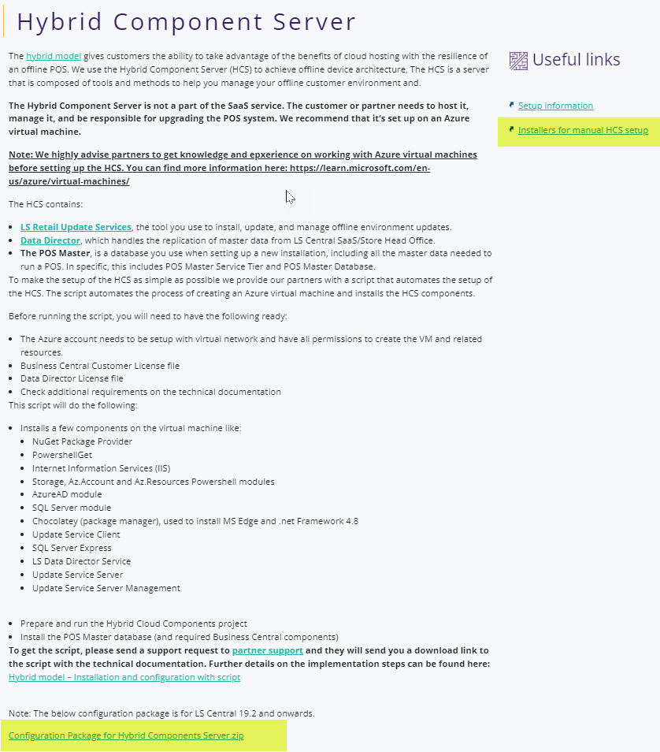
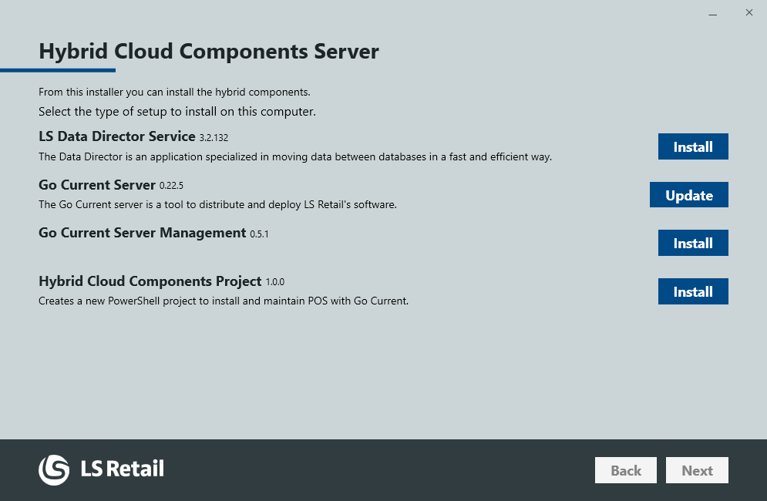

Prepare the HCS installation
Installers for manual HCS setup
hybrid-cloud-components-server.exe
configuration-package-for-hybrid-components-server-v19-2.zip

Slide 9
Import configuration packages
Scheduler Jobs
  HCC_INIT – First time data from SaaS to POS-Master by normal jobs
  HCC_JOBSYNC – To sync Jobs and Subjobs from SaaS to POS-Master
  HCC_UPDATE – To update data from SaaS to POS-Master by actions
  HCC_UPDATE_TO_POS – Update offline POS with data from POS-Master
Subjobs
Distribution Locations
  HEADOFFICE – SaaS instance
  POSMASTER – HCS Server
Retail Setup
Webservices

Slide 10
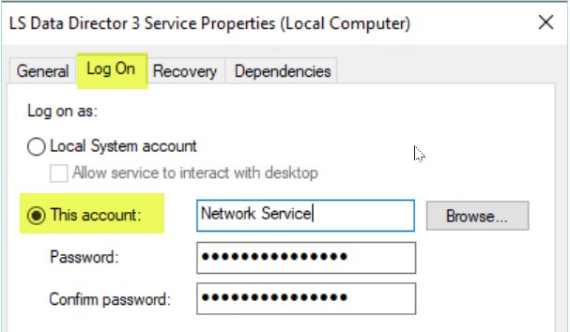
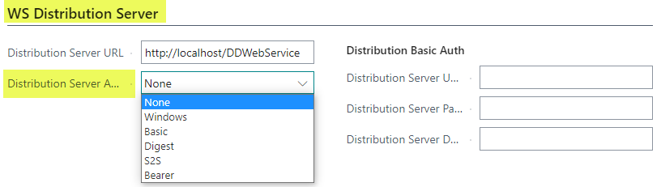
Users for the Replication
The user on the Data Director service should have access to POS Master SQL database
Distribution Location:
  WS Distribution Server, this is a user that is needed for BC to connect to the Data Director through web service requests on IIS. Mainly used if the Data Director instance is on a different machine, than the BC server.

Slide 11
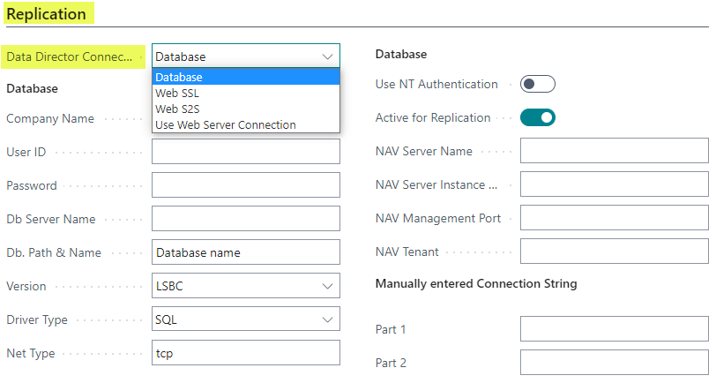
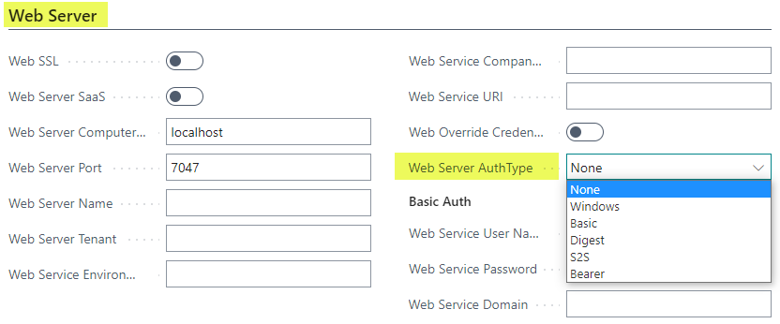
Users for the Replication
Distribution Location:
  Replication: If the distribution location is pointing to a local SQL database, then the connection is Database. If this is a SaaS location, then options Web SSL, Web S2S or Use Web Server Connection are selected.
  Web Server: This is a web service user that is needed for the scheduler job in BC to connect to another BC instance to read Pre-actions or replication counters. If “Data Director Connection Type” is “Use Web Server Connection” then this user and connection is used for the Data Director for replication.

Slide 12
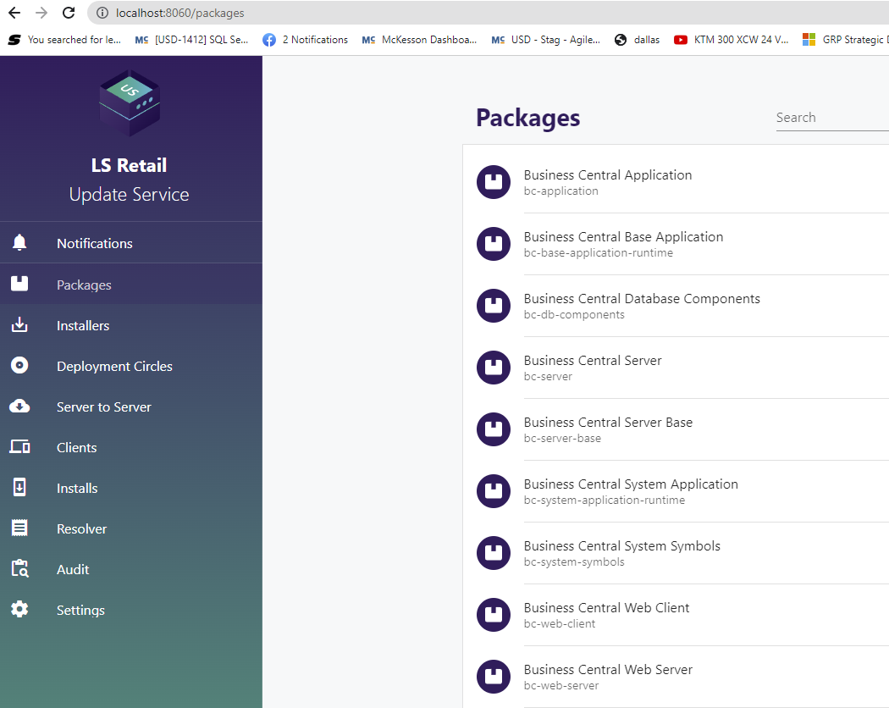
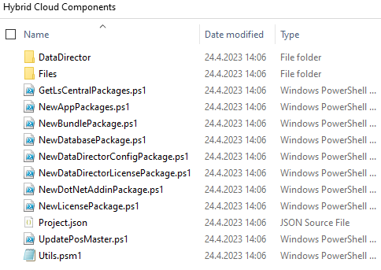
Hybrid cloud components
C:\ProgramData\LS Retail\GoCurrent\Client\Log

Slide 13
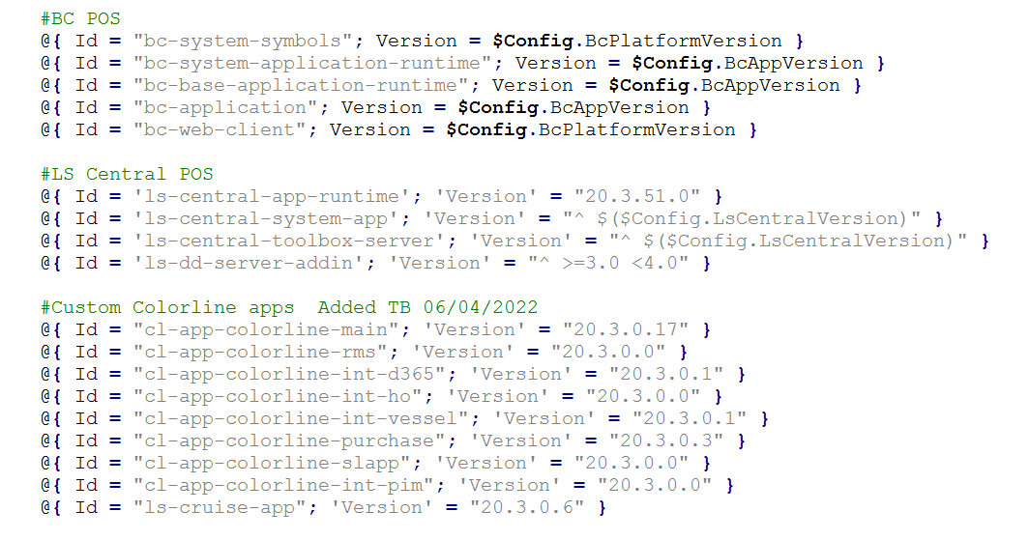
Update HCS and offline devices
Hybrid Component Server
UPDATE SERVICE
DATA DIRECTOR
POS MASTER

Slide 14
Offline POS – connection to US host
Ports that need to be open
Business central
  7045-7049 default ports
Update services
  17750, 8060
Data Director
  16860/16850
HardwareStation
  8088, 8082
VPN tunnel
Hybrid Component Server
UPDATE SERVICE
DATA DIRECTOR
POS MASTER

Slide 15
Agenda
Hybrid implementation - Hybrid Component Server (HCS)
  Concept
  Installation steps and some remarks
HCS installation with a script
HCS SaaS
Notes:
15

Slide 16

HCS Script – Automating the HCS creation in Azure
What are the Main Goals?
Automate the installation/setup process
  Easing the implementation
  Making our partner’s life easier
Standardize the environment among customers
  Allowing easier troubleshooting

Slide 17
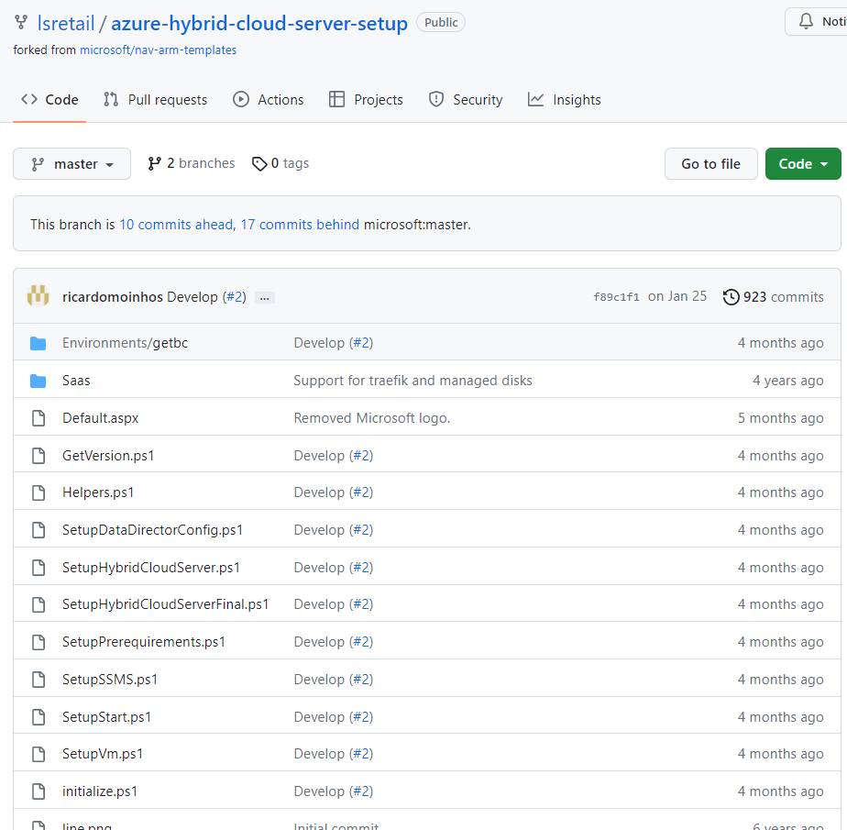


HCS Script – Automating the HCS creation in Azure
More about the script
Makes usage of ARM Templates to setup the Azure resources
Only for Azure (although the script could be adapted for on-prem VMs if needed)
Open Source
Available on GitHub (submit your own pull requests ☺)
Technical documentation and kickstart script available through the Partner Support
Resource Group Name = '<Azure Resource Group Name>'
Storage Account Name = '<Storage Account Name>'
Virtual Machine Name = '<Virtual Machine Name>'
Virtual Machine Admin Password = '<password>'
Virtual Machine Size = 'Standard_D2_v3'
Network Interface Name = '<Pre-existing Network Interface Name>'
HCS WebServices URL = 'https://lscentral.api.bc.dynamics.com/v2.0/<tenant id>/Production/WS/<company>/Codeunit/RetailWebServices'
Kickstart Powershell Script
Variables

Slide 18


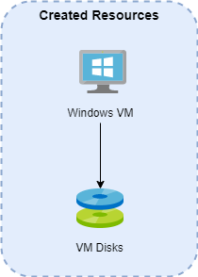
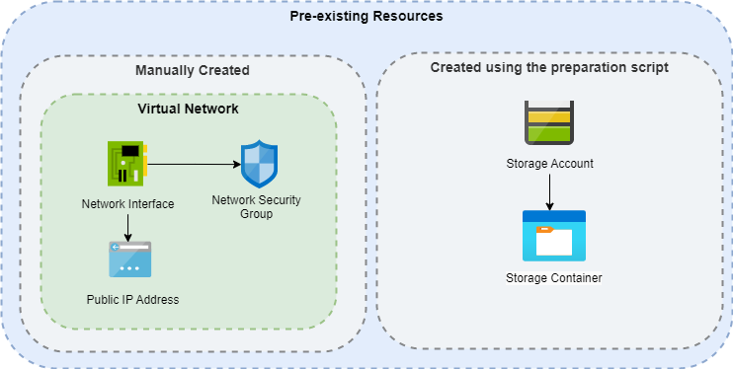

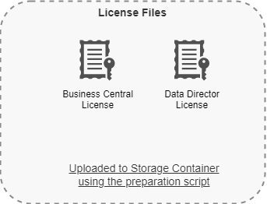
HCS Script – Automating the HCS creation in Azure
Pre-requirements
  Valid Azure Subscription
  Virtual Network with a network interface setup (could be done using the ARM template)
Kickstart scripts
  Preparation script
    Creates the Storage Account/Container and uploads BC/DD licenses
      Storage account only needed during the initial setup
  Environment setup script
    Creates the VM

Slide 19
HCS Script – Automating the HCS creation in Azure
Pre-requirements
  Valid Azure Subscription
  Virtual Network with a network interface setup (could be done using the ARM template)
Kickstart scripts
  Preparation script
    Creates the Storage Account/Container and uploads BC/DD licenses
      Storage account only needed during the initial setup
  Environment setup script
    Creates the VM

Slide 20
HCS Script – Automating the HCS creation in Azure
Pre-requirements
  Valid Azure Subscription
  Virtual Network with a network interface setup (could be done using the ARM template)
Kickstart scripts
  Preparation script
    Creates the Storage Account/Container and uploads BC/DD licenses
      Storage account only needed during the initial setup
  Environment setup script
    Creates the VM

Slide 21
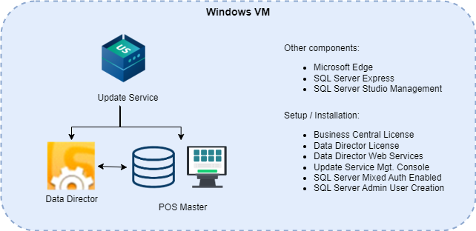
HCS Script – Automating the HCS creation in Azure
Pre-requirements
  Valid Azure Subscription
  Virtual Network with a network interface setup (could be done using the ARM template)
Kickstart scripts
  Preparation script
    Creates the Storage Account/Container and uploads BC/DD licenses
      Storage account only needed during the initial setup
  Environment setup script
    Creates the VM

Slide 22
Agenda
Hybrid implementation - Hybrid Component Server (HCS)
  Concept
  Installation steps and some remarks
HCS installation with a script
HCS SaaS
Notes:
22

Slide 23




HCS SaaS – Offline POS support
Phase 1
Same POS functionality and availability
SaaS server pushes (scheduler) out replication data to Azure storage (run by LS Retail)
Offline POS queries HQ for package information, then fetches replication packages from Azure storage for local import
Up-to-date replication status in the HQ
Update Service Server hosted by the customer
  Updates offline POS environment applications
SaaS Server
LS Retail
Azure Storage
Update Service Server
HQ
Store
Online POS
Offline POS
Offline POS Service

Slide 24


HCS SaaS – Offline POS support with Updated Services by LS Retail
Phase 2
LS Retail offers Update Service as a Azure service
SaaS Server
LS Retail
Azure Storage
LS Retail
Update Service
HQ
Store
Online POS
Offline POS
Offline POS Service

Slide 25
Thank you

