Slide 1
Expanding into a new market with LS Central for pharmacies
Einar Pall Gudlaugsson
Henrik Oskar Thordarson

Slide 2





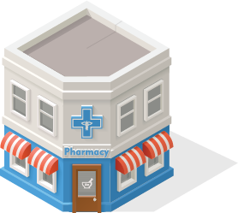
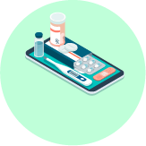
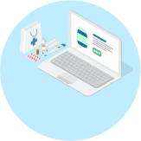
Unified Dispensing
All-in-one dispensing suite
End-to-End dispensing suite
ERP
Finance
Warehousing
Automatic replenishment
Advanced Shipping Notification
Dispensing
E-prescriptions
Rx master data
Dose dispensing
Integration
Localization for prescription & insurance gateways
Retail
Personal Care
Loyalty
360-degree view of the customer
Clienteling
Personalized service on the pharmacy floor
Appointments and reservations
eCommerce
Retail and prescriptions
Prescription
Retail items
Click & collect
Home delivery
Traditional
Social media
Customer
App
Done
We know dispensing
Web

Slide 3

Pharmacy is a big market
Until now focusing on larger chains
Hybrid - working hard to make SAAS ready
A possibility for partners to have hosted services (hybrid SAAS) enter the market for smaller pharmacies.
  Egypt 75,000 pharmacies
  Turkey 26,000 pharmacies
  Spain 22,000 pharmacies
  France 21,500 pharmacies
  (Italy 19,300 pharmacies)
  Germany 19,000 pharmacies
  (U.K. 14,000 pharmacies) 5,500
  (Poland 12,000 pharmacies)

Slide 4
Markets are calling for new alternatives
Only a few solutions in the Rx market
Online-only pharmacies are disrupting markets
Customer retention needs are high as pharmacies try to differentiate them self's from the competition
OMNI channel approach is becoming the norm with customers expecting another
Purchase via mobile App or Online stores is becoming the norm
Diversify in different markets allows for a more stable business
Crisis and pandemic proven business

Slide 5

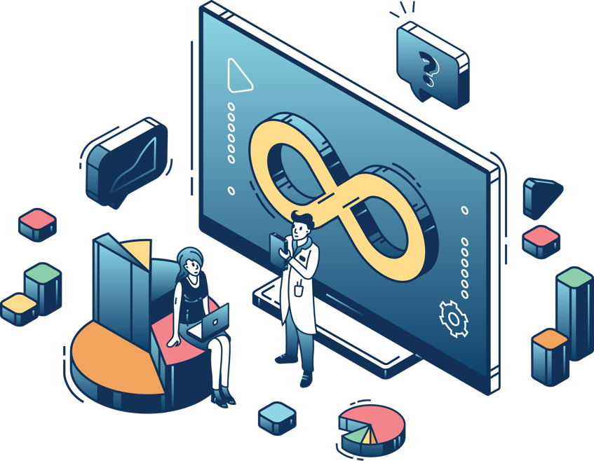
LS Retail Consulting Services
Vision and mission:
The LS Retail consulting services’ aim is to increase the success of our partners and customers worldwide.
Our goals are to:
Increase the capability and capacity in the channel
Support our partners and customers in sales, and in the full project lifecycle
Increase the quality of the implementations
Reduce project risk and cut down implementation time
Improve license revenue generated by our partners
Bring customer insights into product development

Slide 6

All in one package or modular
Rx handling
Dose dispensing (CDS)
Retail – full LS Central functionality with POS
Replenishment
Bookings – Apointment booking Flu shots
Subscription
eCommerce (web + app)
B2B
Time registrations (Staff management)
Smartcard integrations
Warehouse pharmacy (web orders delivered directly from a warehouse)
Loyalty
Analytics

Slide 7














Customer orders
How
At ordering
Full/Pre-paid
Click &
Collect
eCommerce
Collect
Store
Special
orders
At collection
Delivery
Sourced
Payment
Sourcing
engine
Mobile loyalty
Endless
aisles
Store
Store
transfer
Store (POS)
Home delivery
At ordering
Full
Warehouse
Vendor

Slide 8






LS Central for pharmacies
Online ordering
Advisory role
Health and beauty
Easy check-out
Subscriptions
Services

Slide 9
DEMO

Slide 10

Member management for LS Central
Unlimited number of member accounts and clubs
Easy to integrate to external loyalty systems
  Standard Voyado integration
Member attributes (segmentation) allow for personalized offers to customers
  Attributes can be external or internal
  Offers and discounts that are valid for all or some members
  Free items / coupons / points
Points
  Points collection
  Earn extra points for specific items
  Use points as a payment
  Lower sales price by using points
Frequent buyer program – only valid for members
The loyalty program in LS Central

Slide 11
























Health and Beauty with LS Central

Slide 12
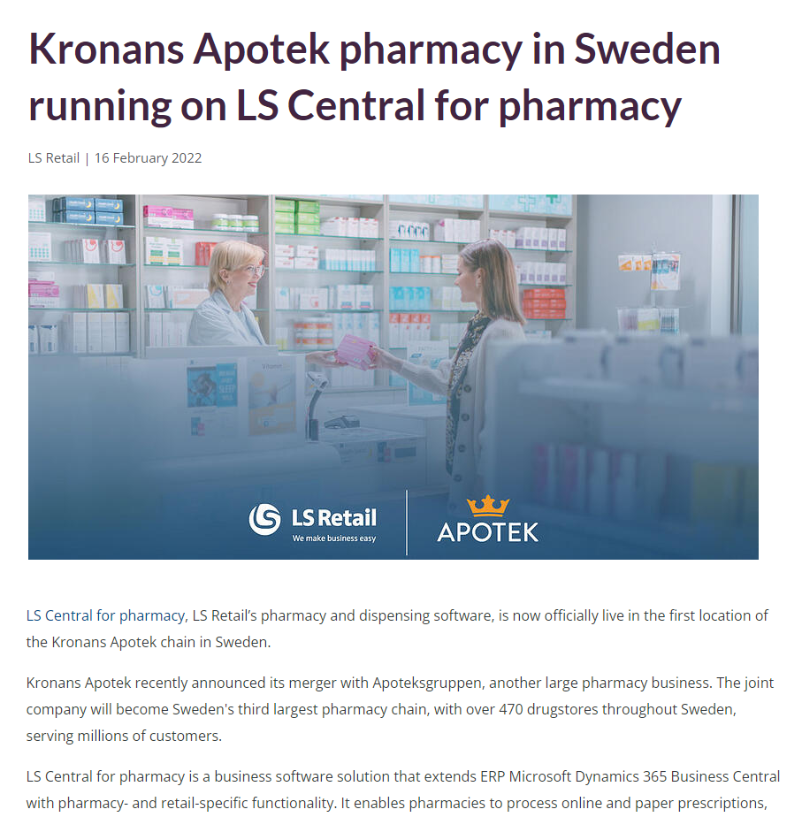
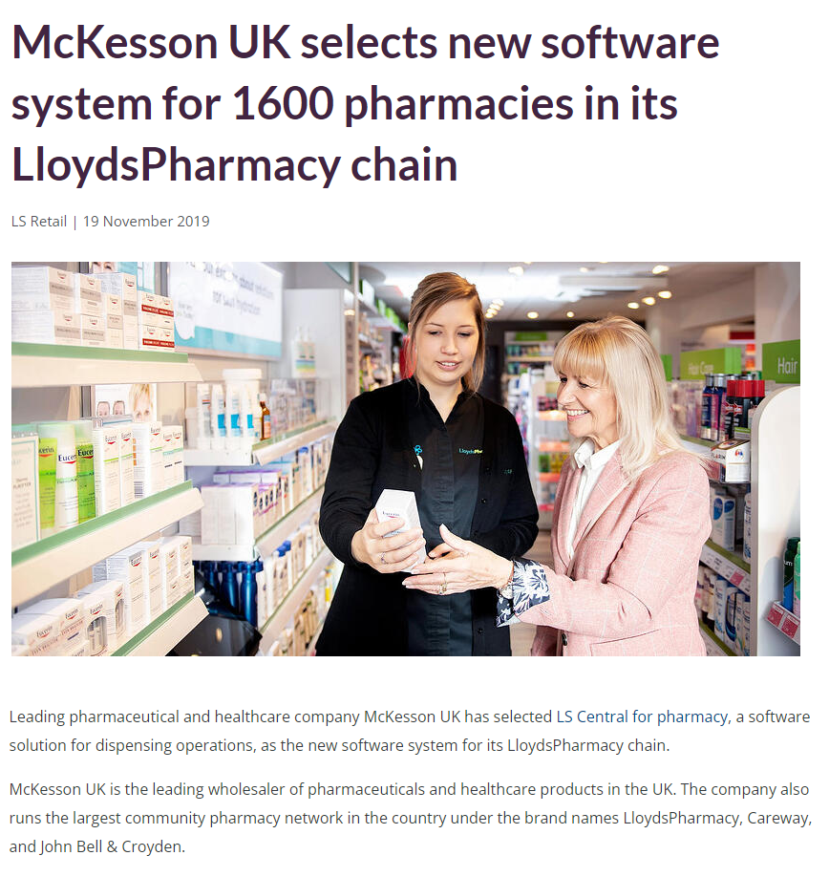

Link here
Link here
Customer stories
www.lsretail.com/customers

Slide 13
Thank you

