Slide 1


Slide 2

GitHub & DevOps
Speaker name
Sahar Mehdizadeh, Boon Leng, Bryan Koh

Slide 3
Objective
Familiarize with GitHub Contribution process for LS Central.
Take away the DevOps best practices to build stable operating environment with various improvements on different stages of software development life cycle.

Slide 4
Agenda
GitHub Contribution to LS Central Releases
DevOps Best Practices – Definition of Ready & Definition of Done
DevOps Best Practices – Development and Testing Process
DevOps Best Practices – Release and DevOps Process

Slide 5



GitHub Contribution
Who could contribute?
What will you gain as a partner?
GitHub Mirroring
Workflow & Demo
LS Retail Team
Mirroring & Processing Pull Requests
GitHub Repository
Contributing
Partners

Slide 6
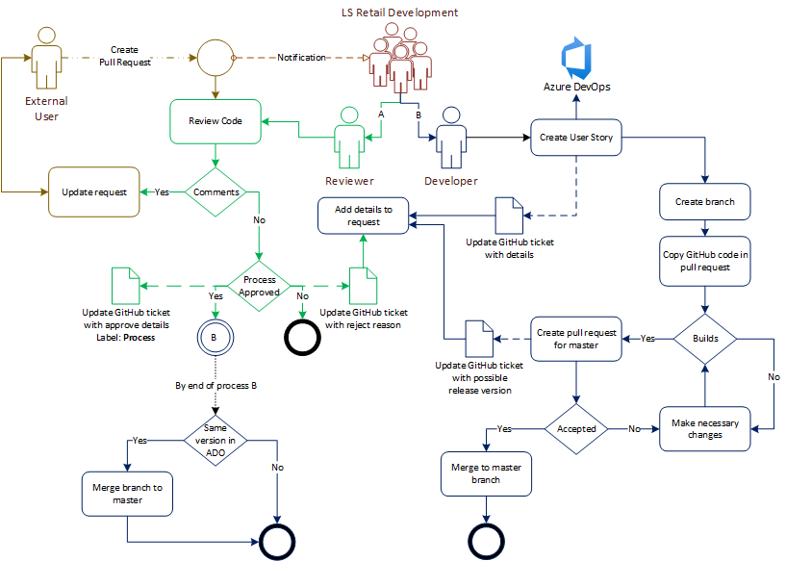


Slide 7
GitHub Contribution
How does DevOps help?
  Code reviews
  Well-formed story based on GitHub pull request including acceptance
  and testing criteria
  Automated tests
  Automated builds
  Release is ready to go

Slide 8
Agenda
GitHub Contribution to LS Central Releases
DevOps Best Practices – Definition of Ready & Definition of Done
DevOps Best Practices – Development and Testing Process
DevOps Best Practices – Release and DevOps Process

Slide 9
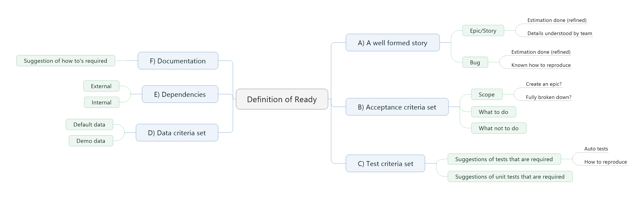
Definition of Ready (DoR)

Slide 10
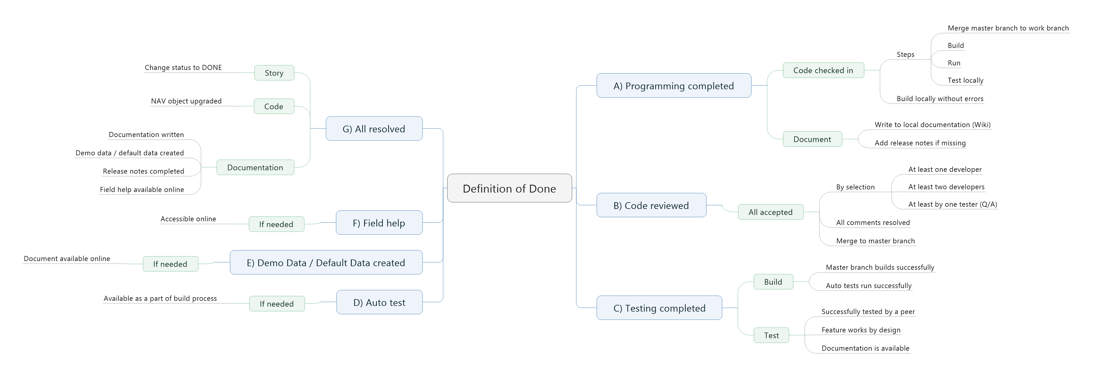
Definition of Done (DoD)

Slide 11
Agenda
GitHub Contribution to LS Central Releases
DevOps Best Practices – Definition of Ready & Definition of Done
DevOps Best Practices – Development and Testing Process
DevOps Best Practices – Release and DevOps Process

Slide 12
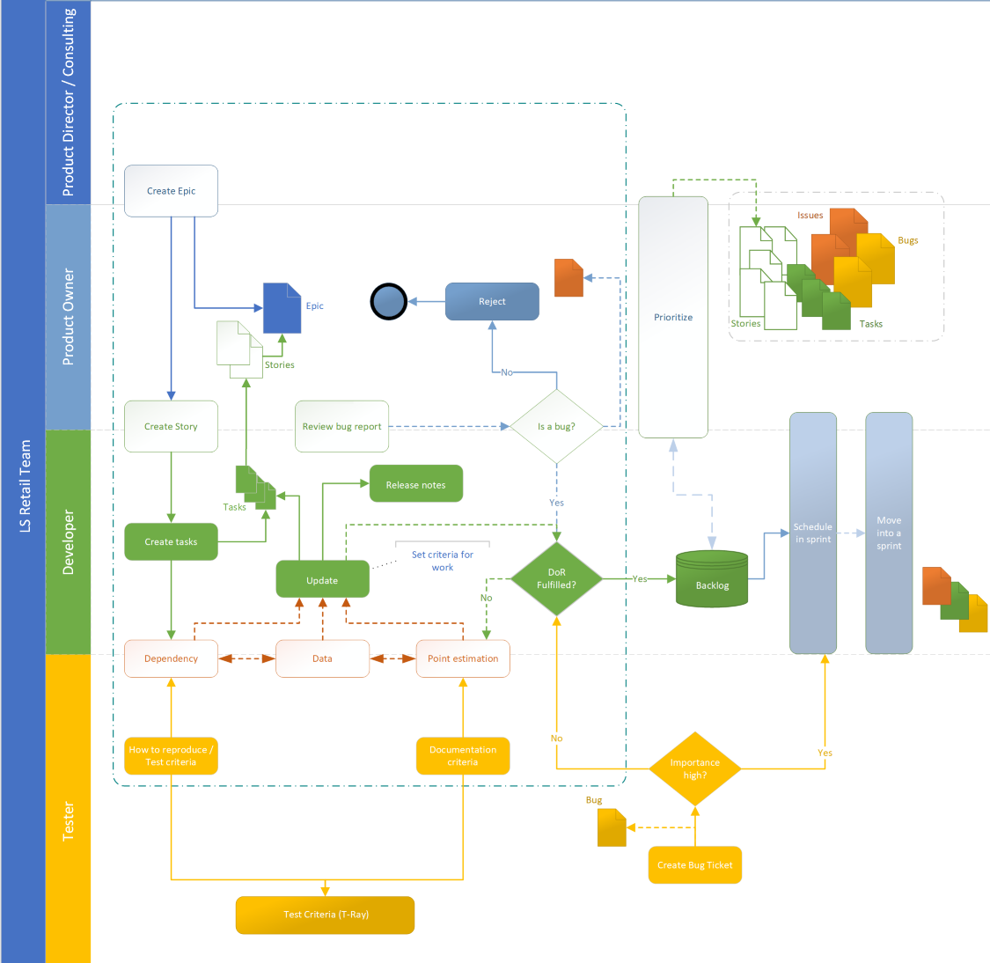
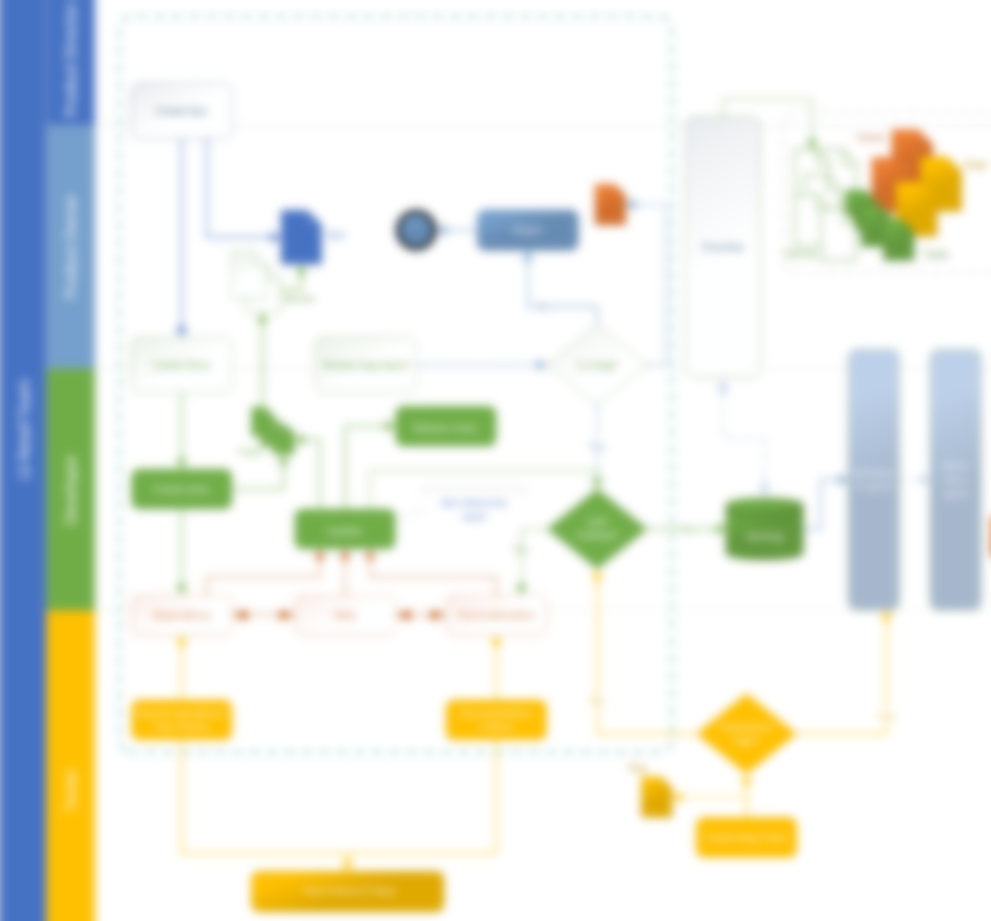

Slide 13
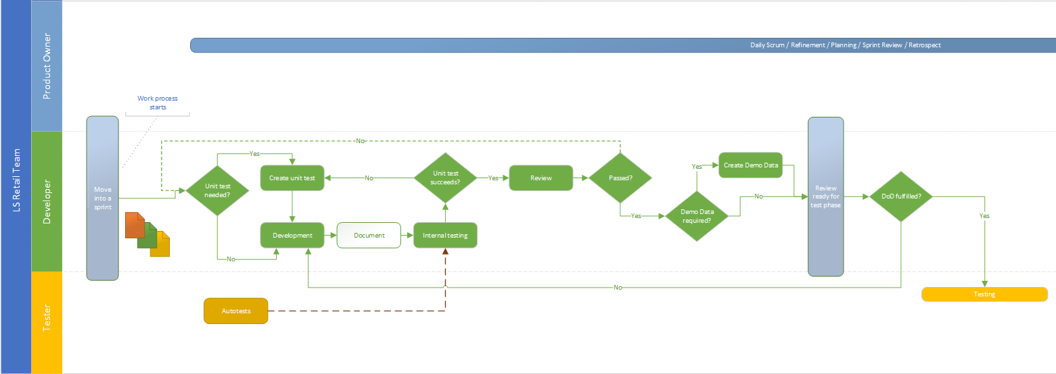
Development and Testing Process

Slide 14
Agenda
GitHub Contribution to LS Central Releases
DevOps Best Practices – Definition of Ready & Definition of Done
DevOps Best Practices – Development and Testing Process
DevOps Best Practices – Release and DevOps Process

Slide 15
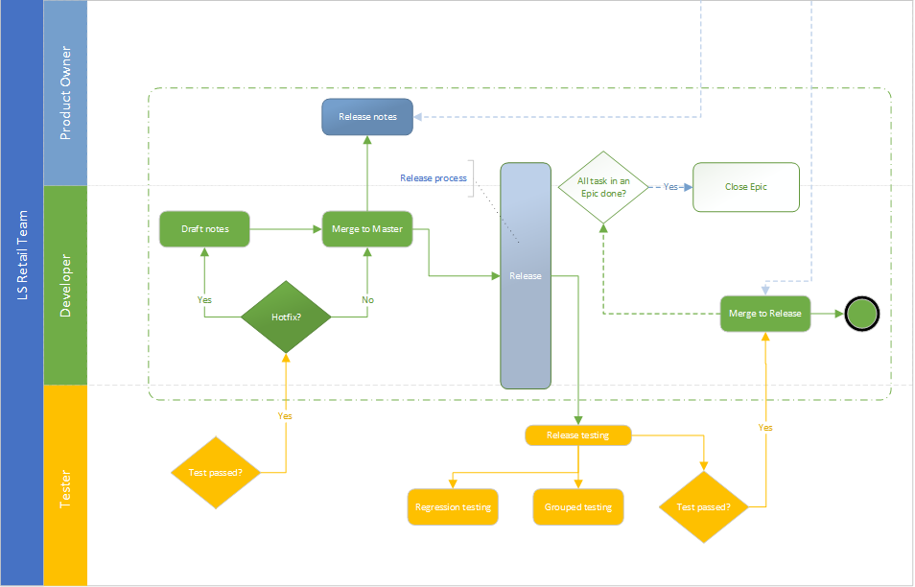
Release Process

Slide 16
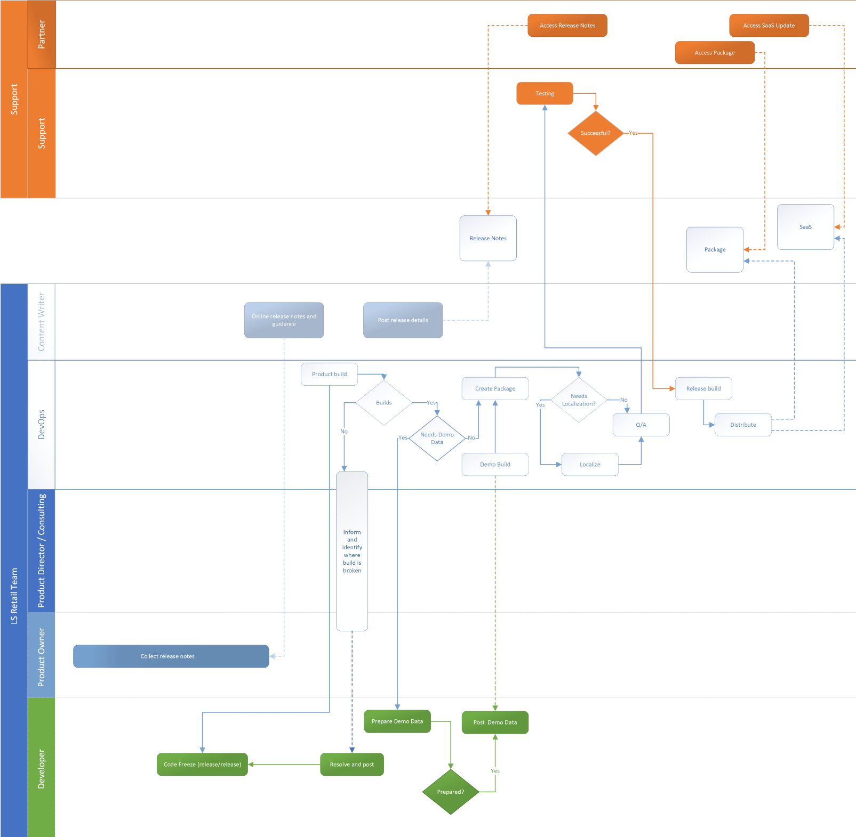
DevOps Process

Slide 17
DevOps Process

Slide 18
Summary
GitHub Contribution to LS Central
  Workflow and pull request process
Definition of Ready & Definition of Done
What are the key points to prepare and when can consider you are done?
Development and Testing Process
Workflow
Release and DevOps Process
    Workflow

Slide 19
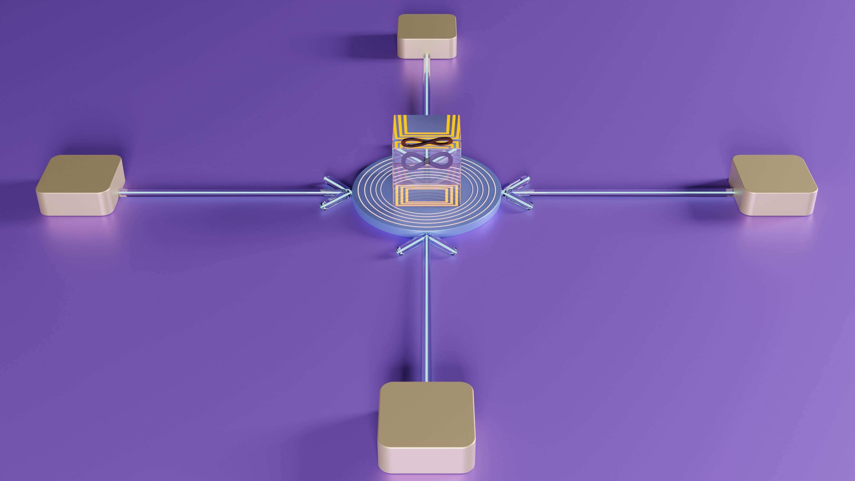
Conclusion
Partners to contribute to LS Central release for minor bug fixes and event requests.
Take away the DevOps best practices to build stable operating environment with various advantages:
  On-time delivery
  Covering all required functionalities
  High quality releases
  Reduced complexity
  Faster issue resolution

Slide 21
GitHub & DevOps
Sahar Mehdizadeh Momen
Boon Leng Lee
Bryan Koh
Technical Consultant
sahar.momen@lsretail.com
boon.leng.lee@lsretail.com
Bryan@lsretail.com

Slide 22
Thank you

