Slide 1


Slide 2

Expand your business with Bookings for LS Central
Activities make the experience memorable
Urdur Anna Bjornsdottir
Consulting manager
Seema Gupta
Senior Consultant

Slide 3
Agenda
Bookings for LS Central – new features
  Member Contact enhancements
  Activity Host
  Event/conference functions
  Banqute Event Order report
  Enhanced Matrix – visual overview
  Comments framework
Demonstration
Customer Story
Roadmap for 2023

Slide 4

Complex processes for the organization

Slide 5
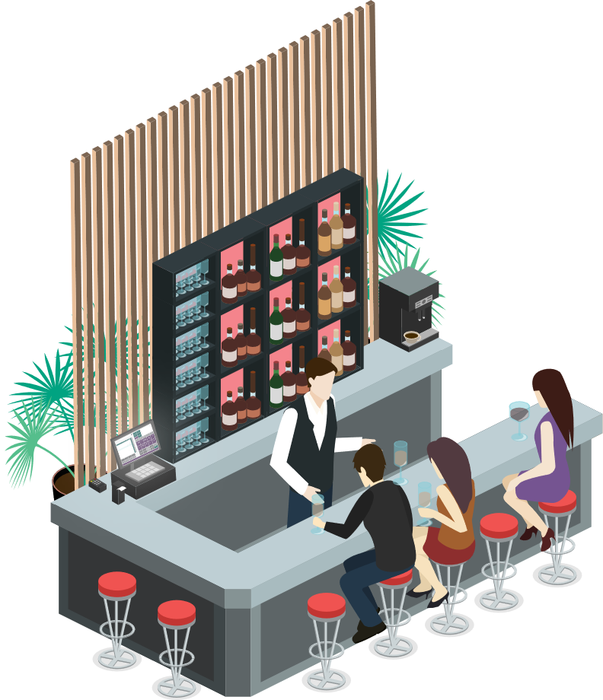
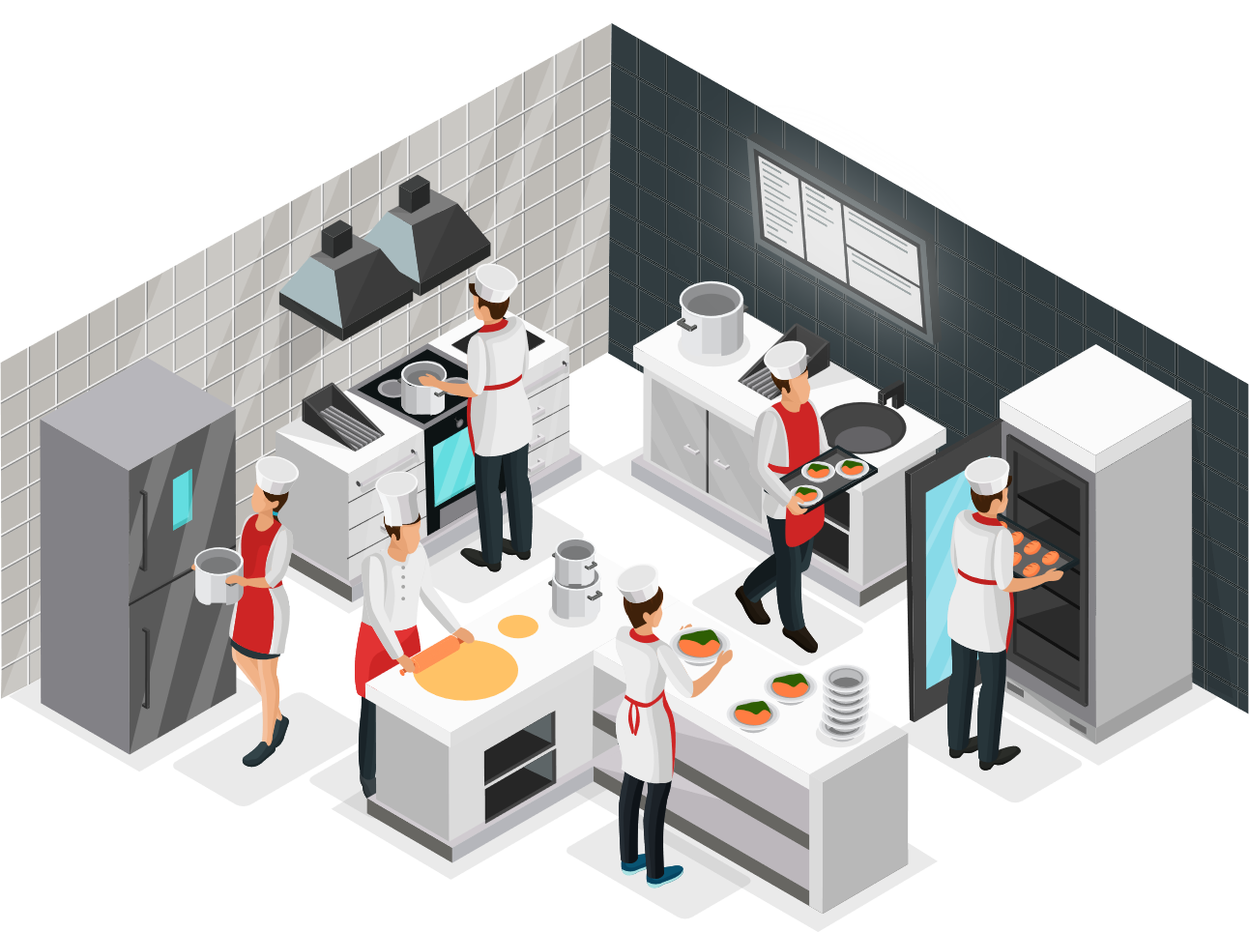





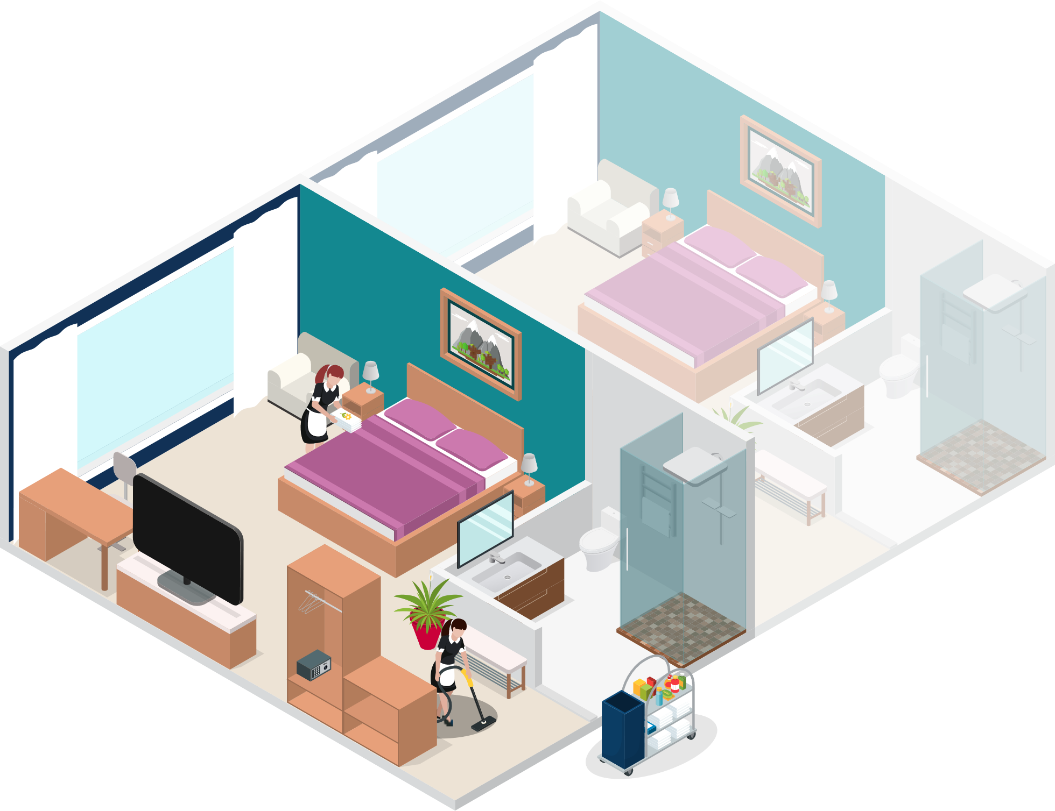
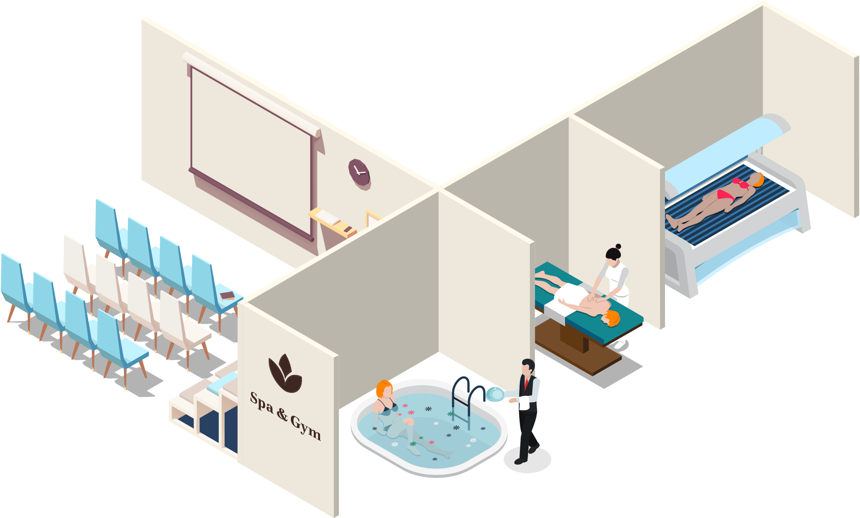

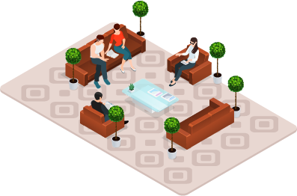
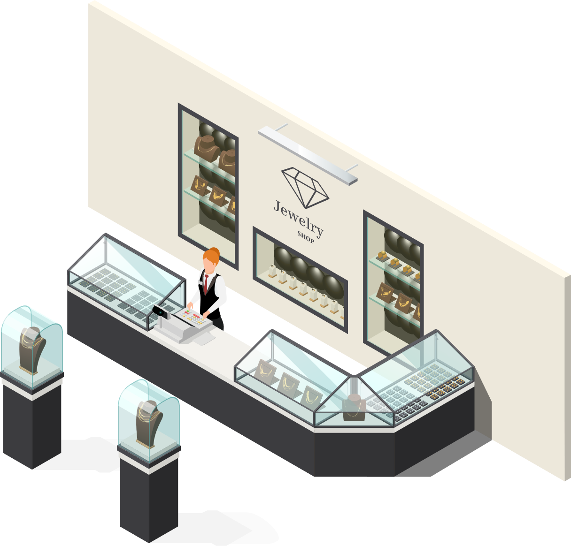


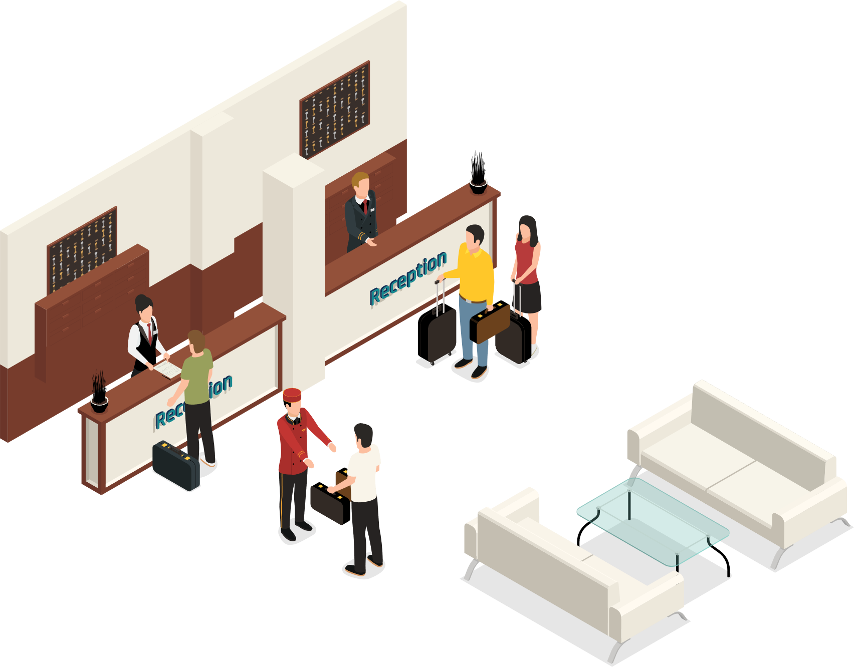
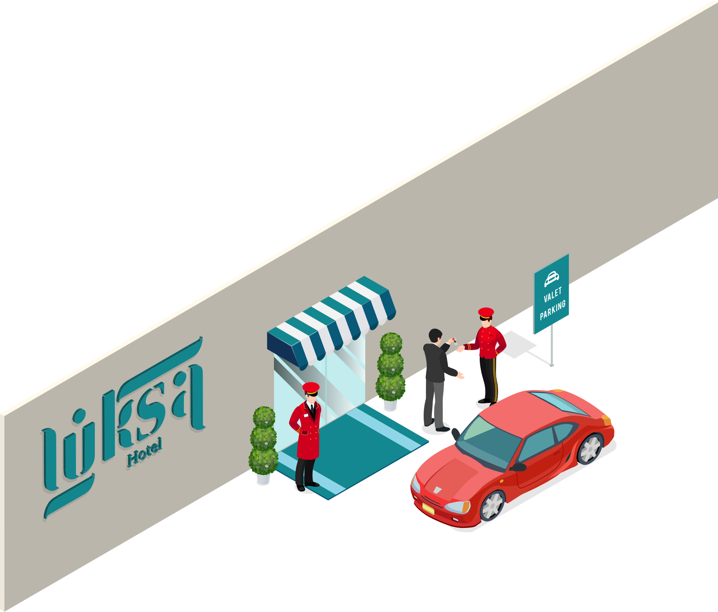



LS Central
Restaurants/KDS
Retail
Staff Mgmt
Bookings
Hotels
Member Mgmt

Slide 6







LS Central
for your operations
Challenges
Consolidate
Insights
Solutions
Unify
Transparency
Lack of overview
Complex processes
for employees
Smooth
guest journey
Empower
employees
ntegrate guest info
from external and internal
data sources

Slide 7
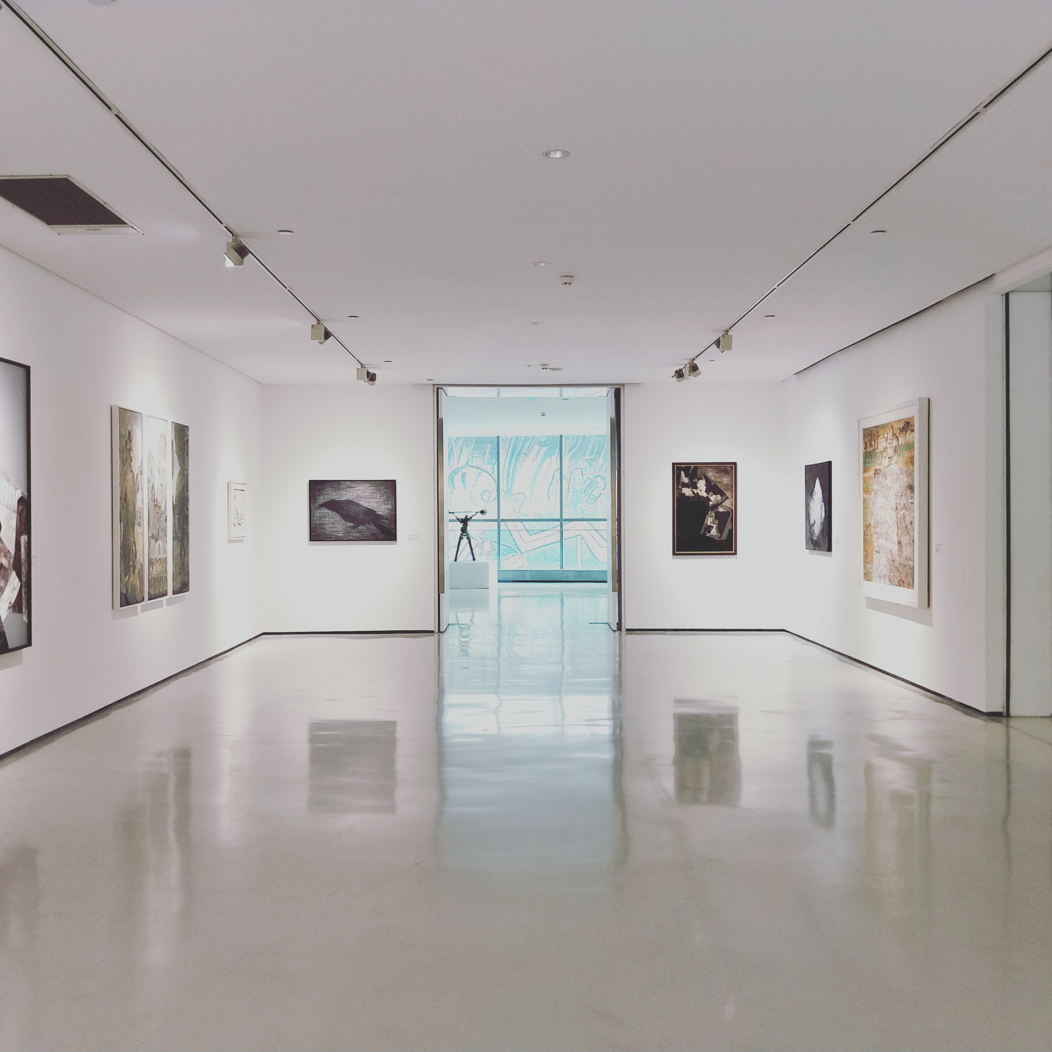
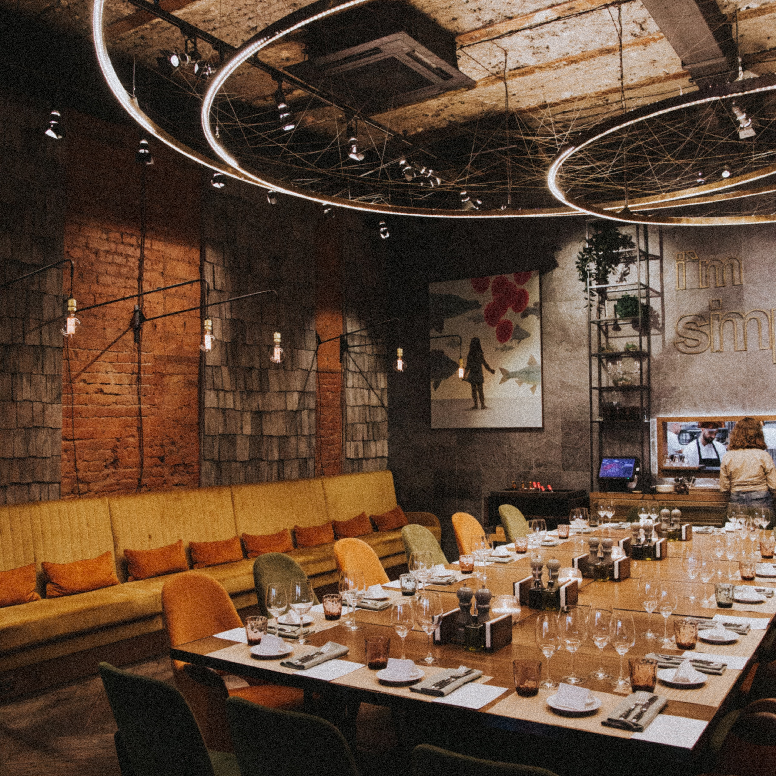
Bookings for LS Central
New functionality

Slide 8
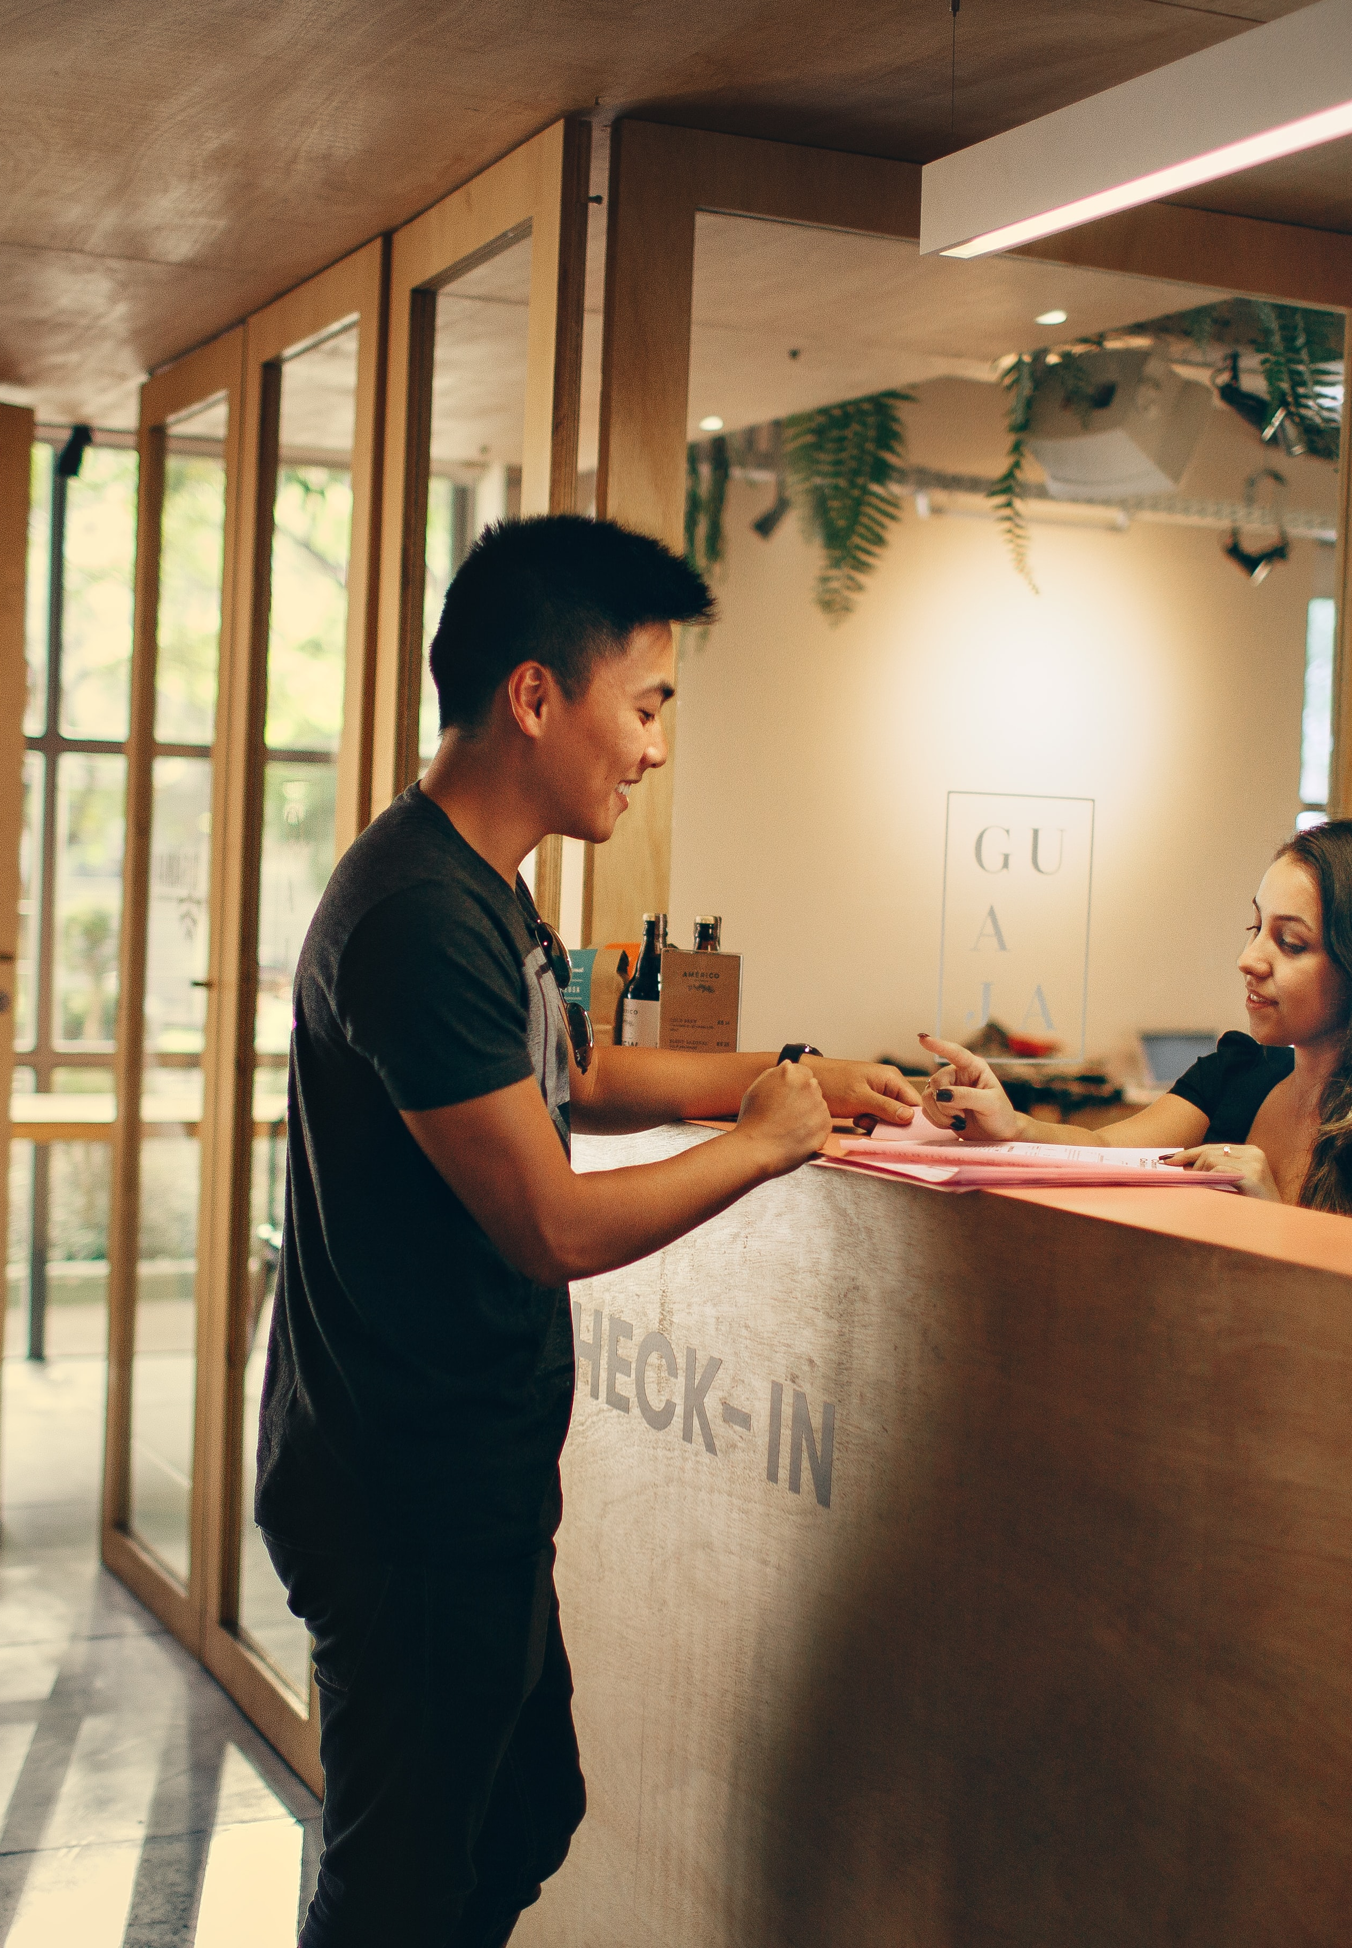
Member Contacts enhancements
Collecting guest/client data
Member contacts linked to reservations and activities
Member contacts can be automatically created
Name and other personal data used for the member contact creation

Slide 9
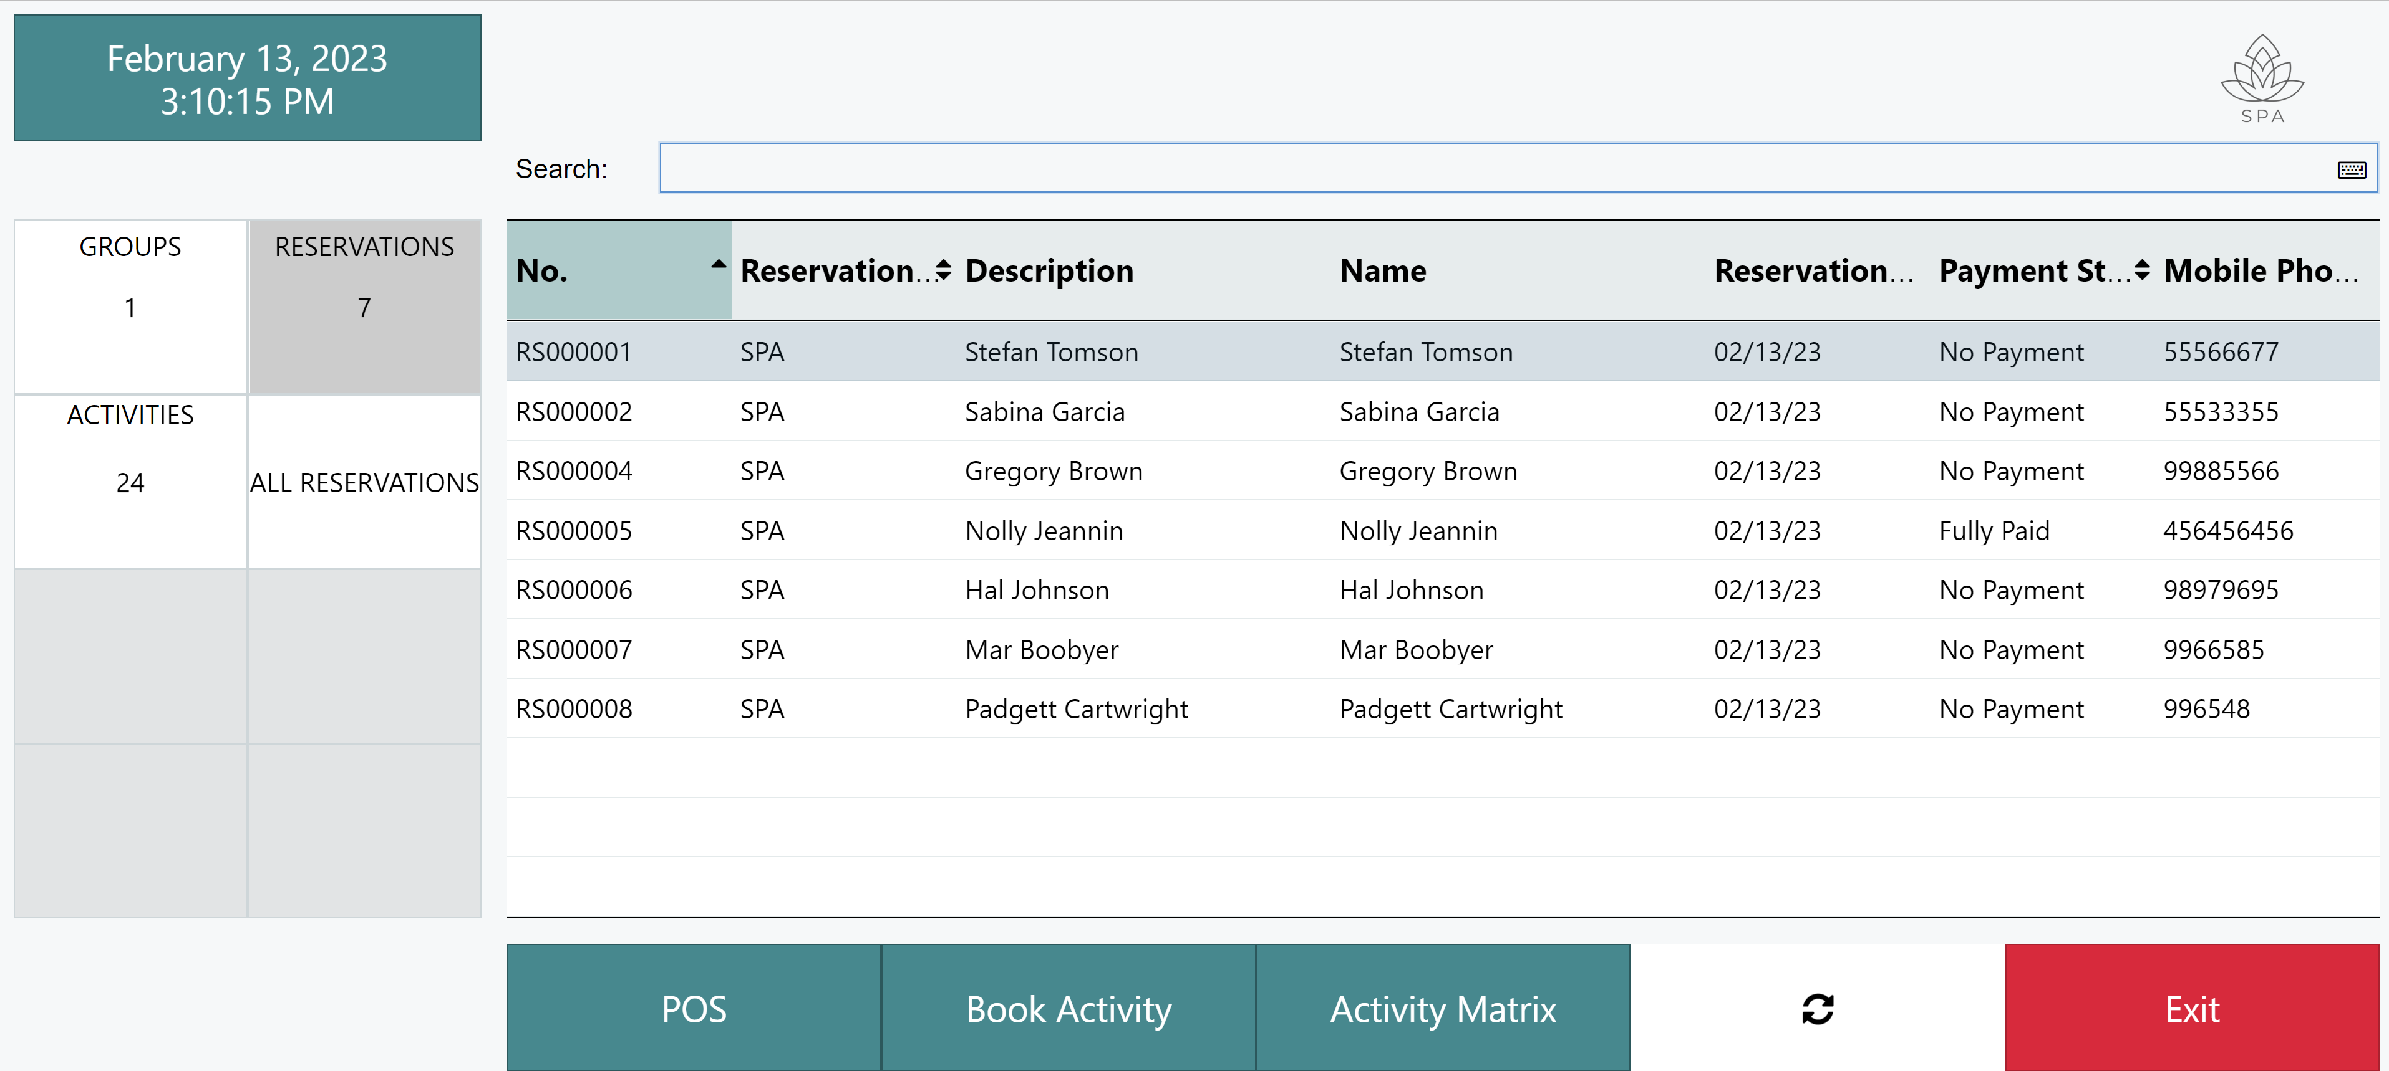
Activity Host – Reception

Slide 10
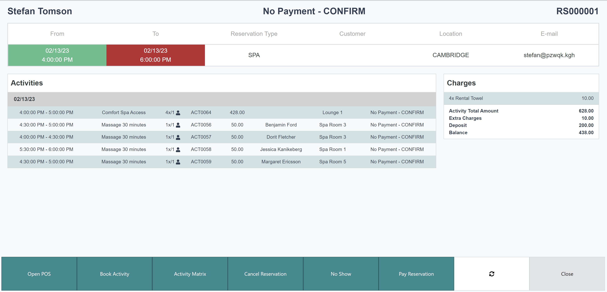
Activity Host – Reservation overview

Slide 11
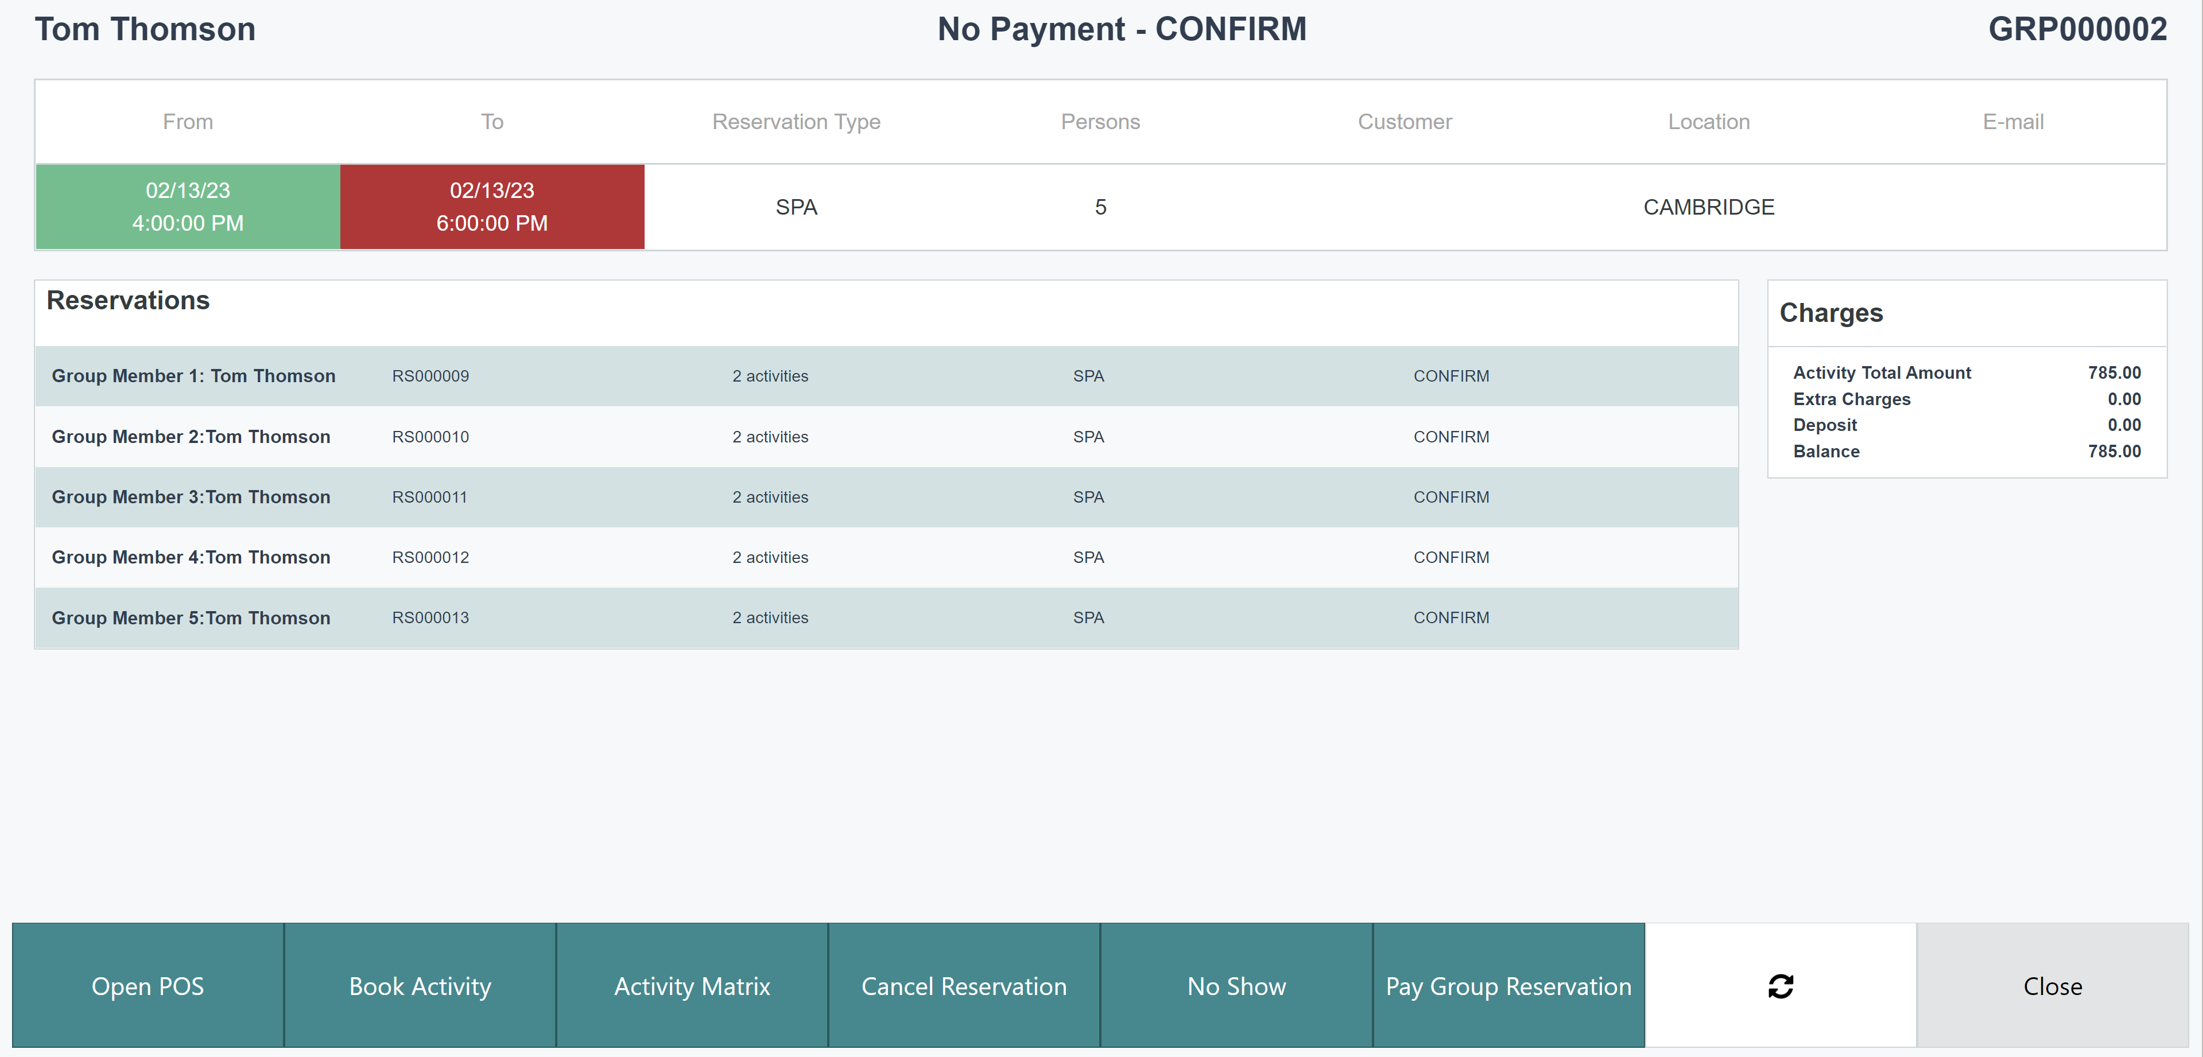
Activity Host – Group reservation

Slide 12
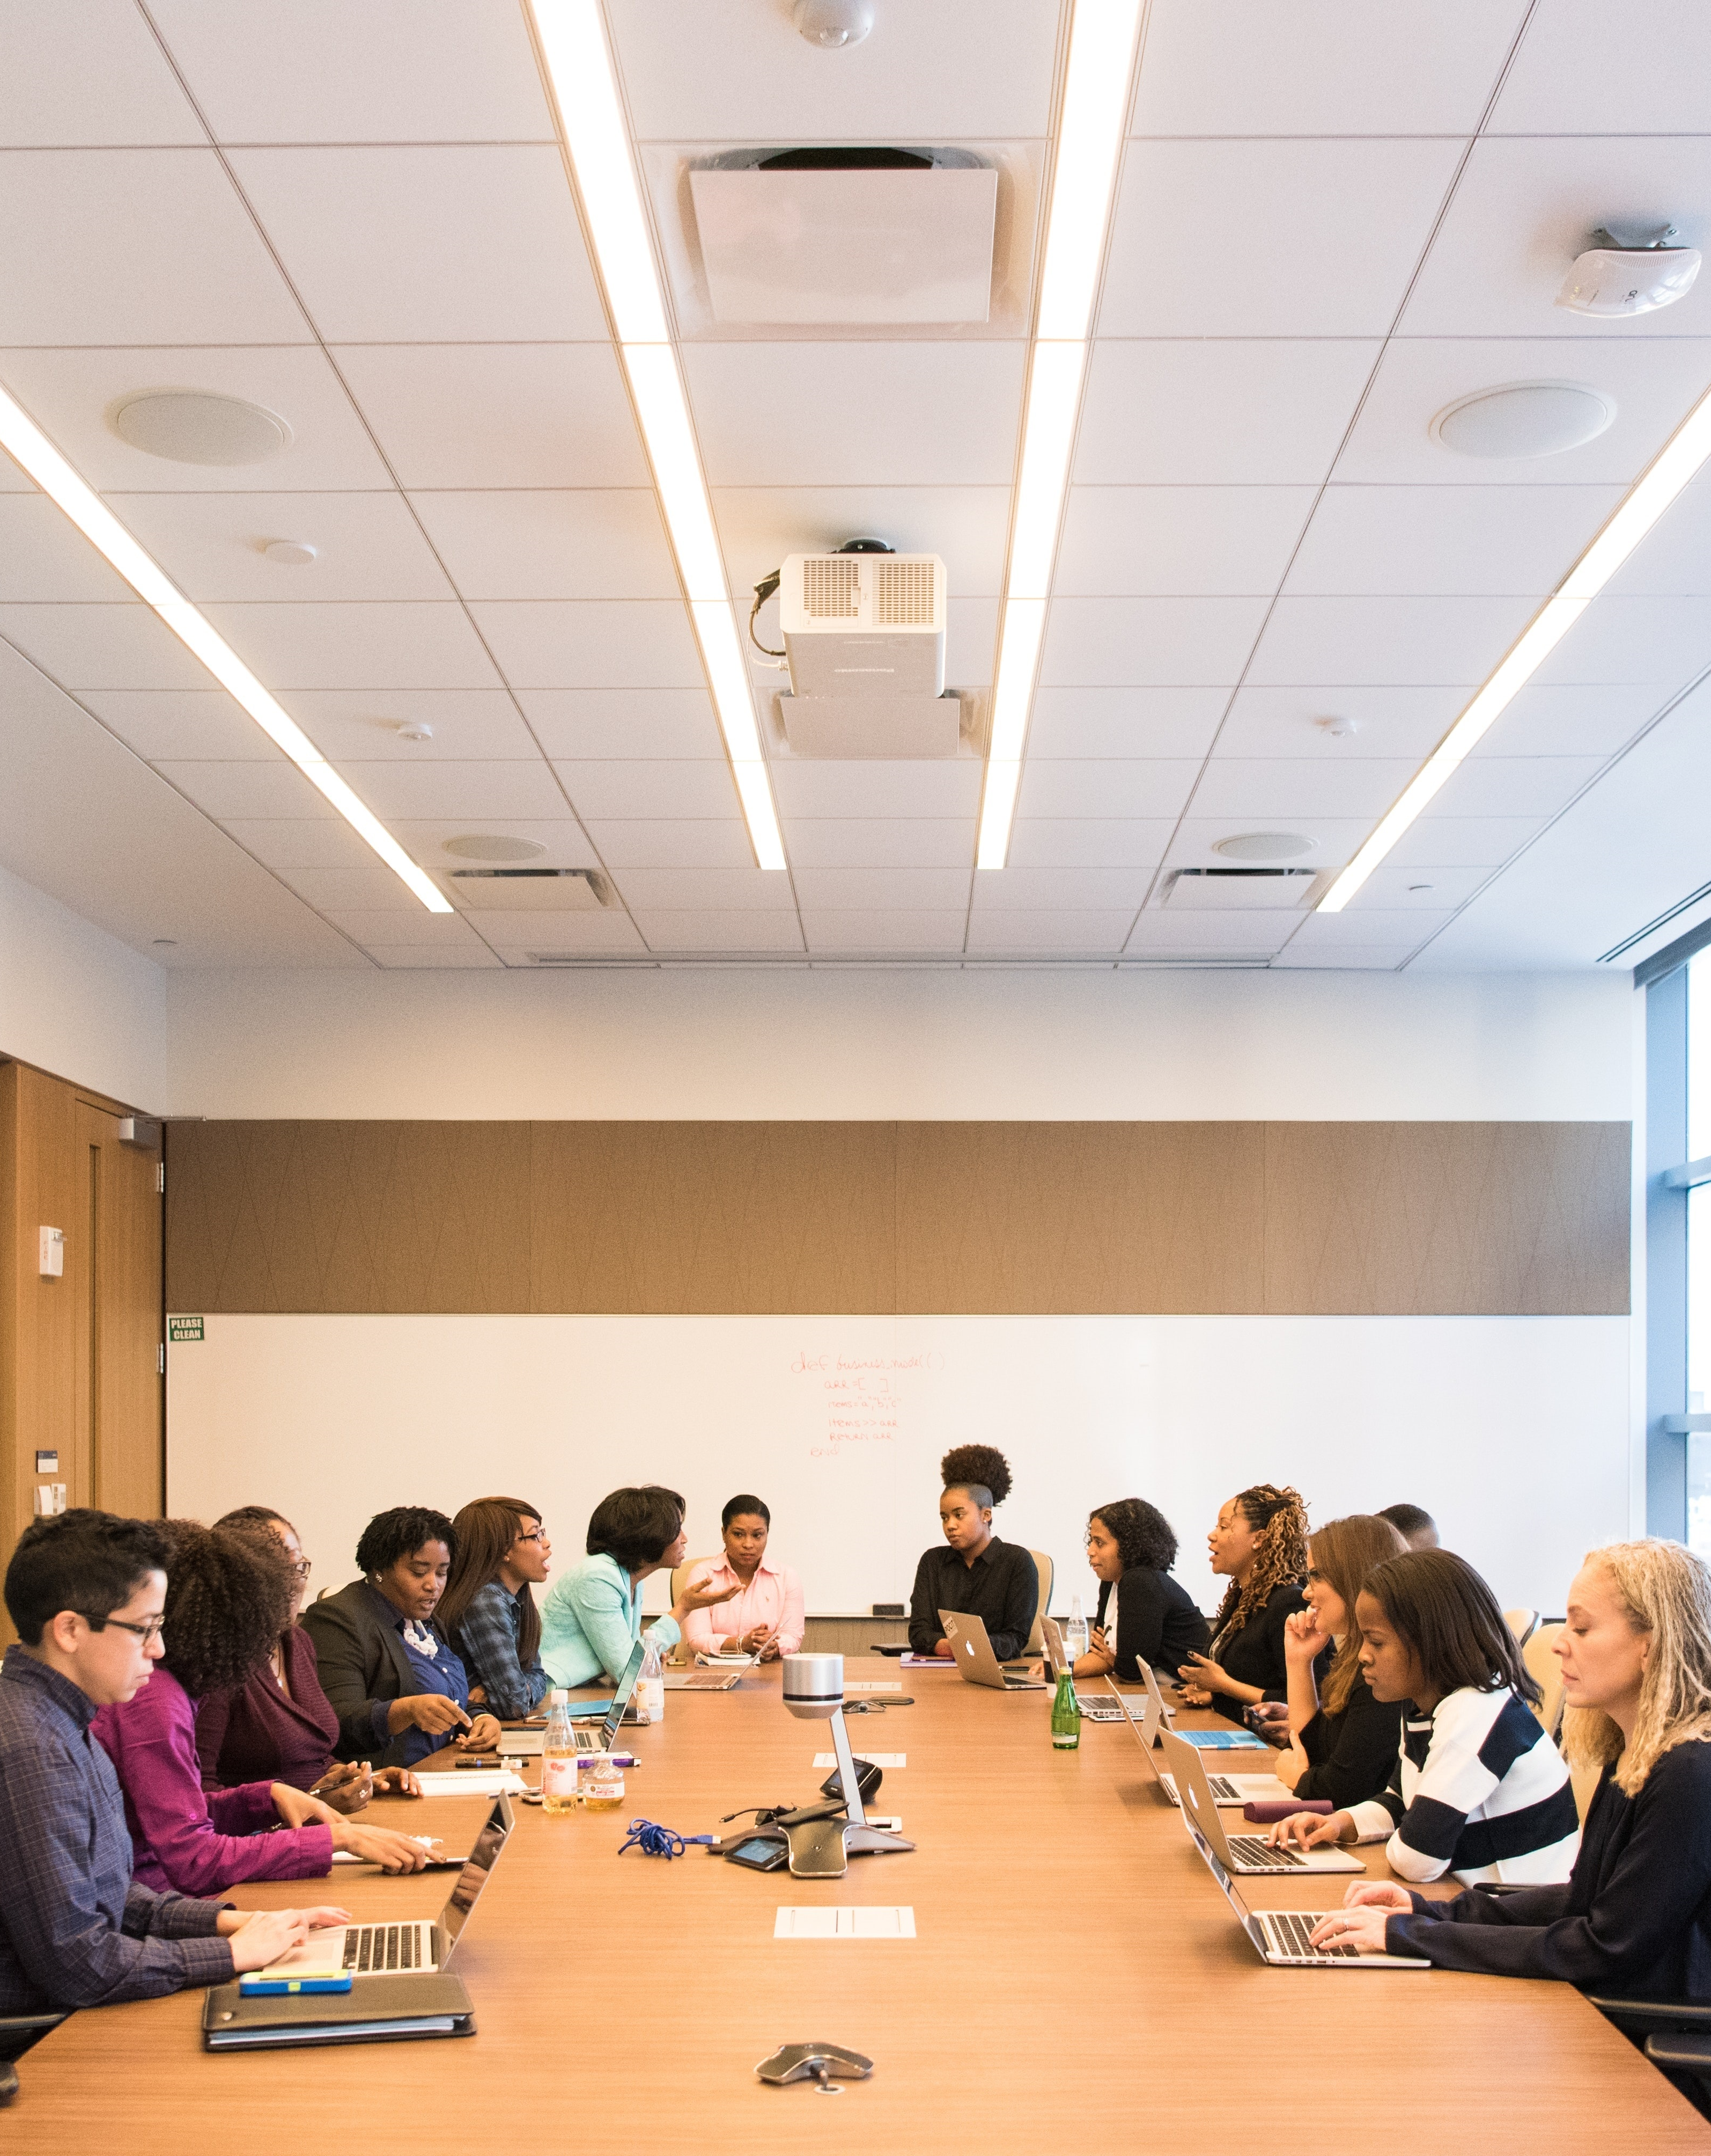
Conference/Events functions
Event and conferences
Additional equipment to the events
Scheduling agenda
Task management
F&B items and charges
BC quotes and invoices
Banquet Event Order Report
Version tracking of the reports

Slide 13
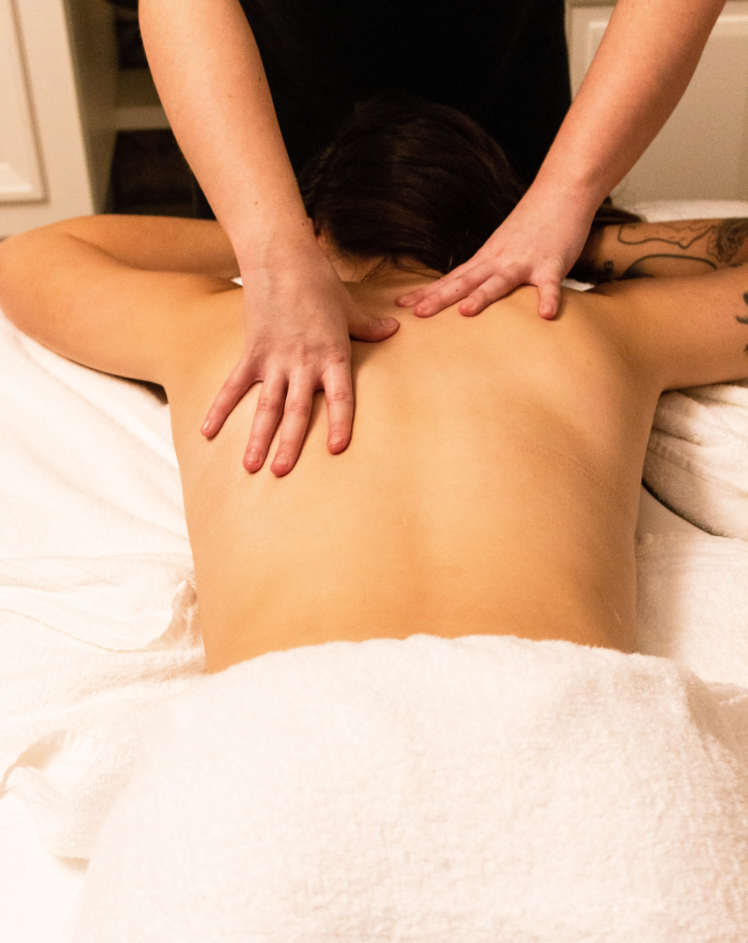
Matrix - visual overview
View of resources availability and assignments
Configurable view of appointments details and customer info
Day view for multiple resources
Week view for one resource
Drag and drop function
Create/view multiple appointment per time slot

Slide 14
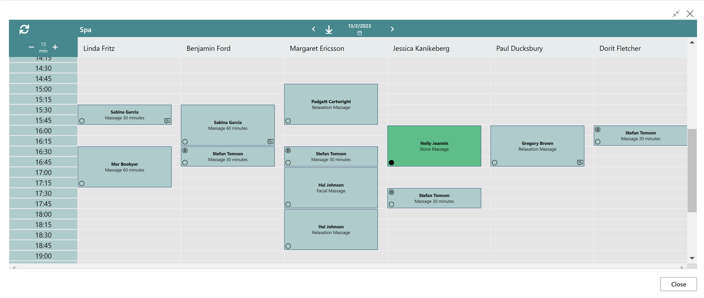
Matrix - visual overview

Slide 15
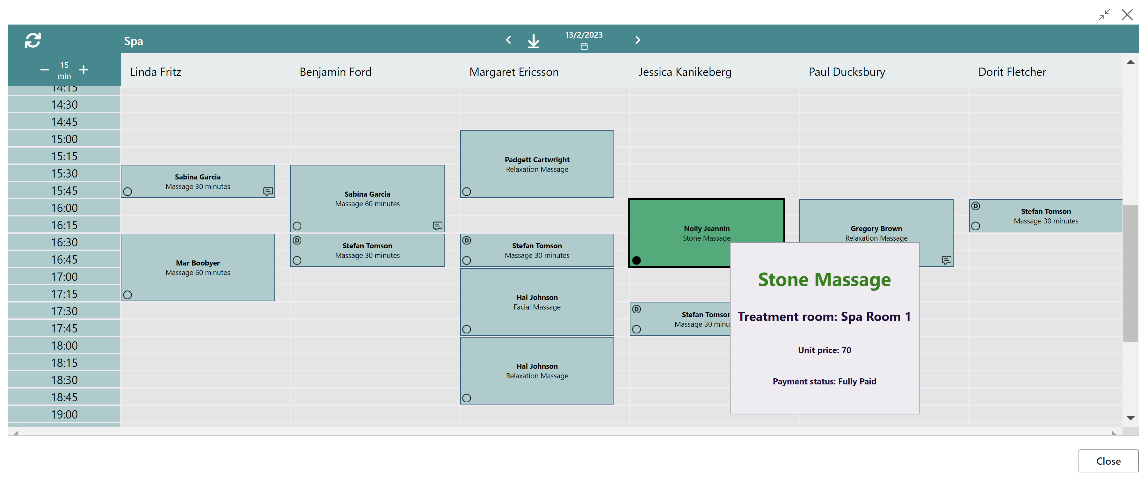
Matrix - visual overview

Slide 16
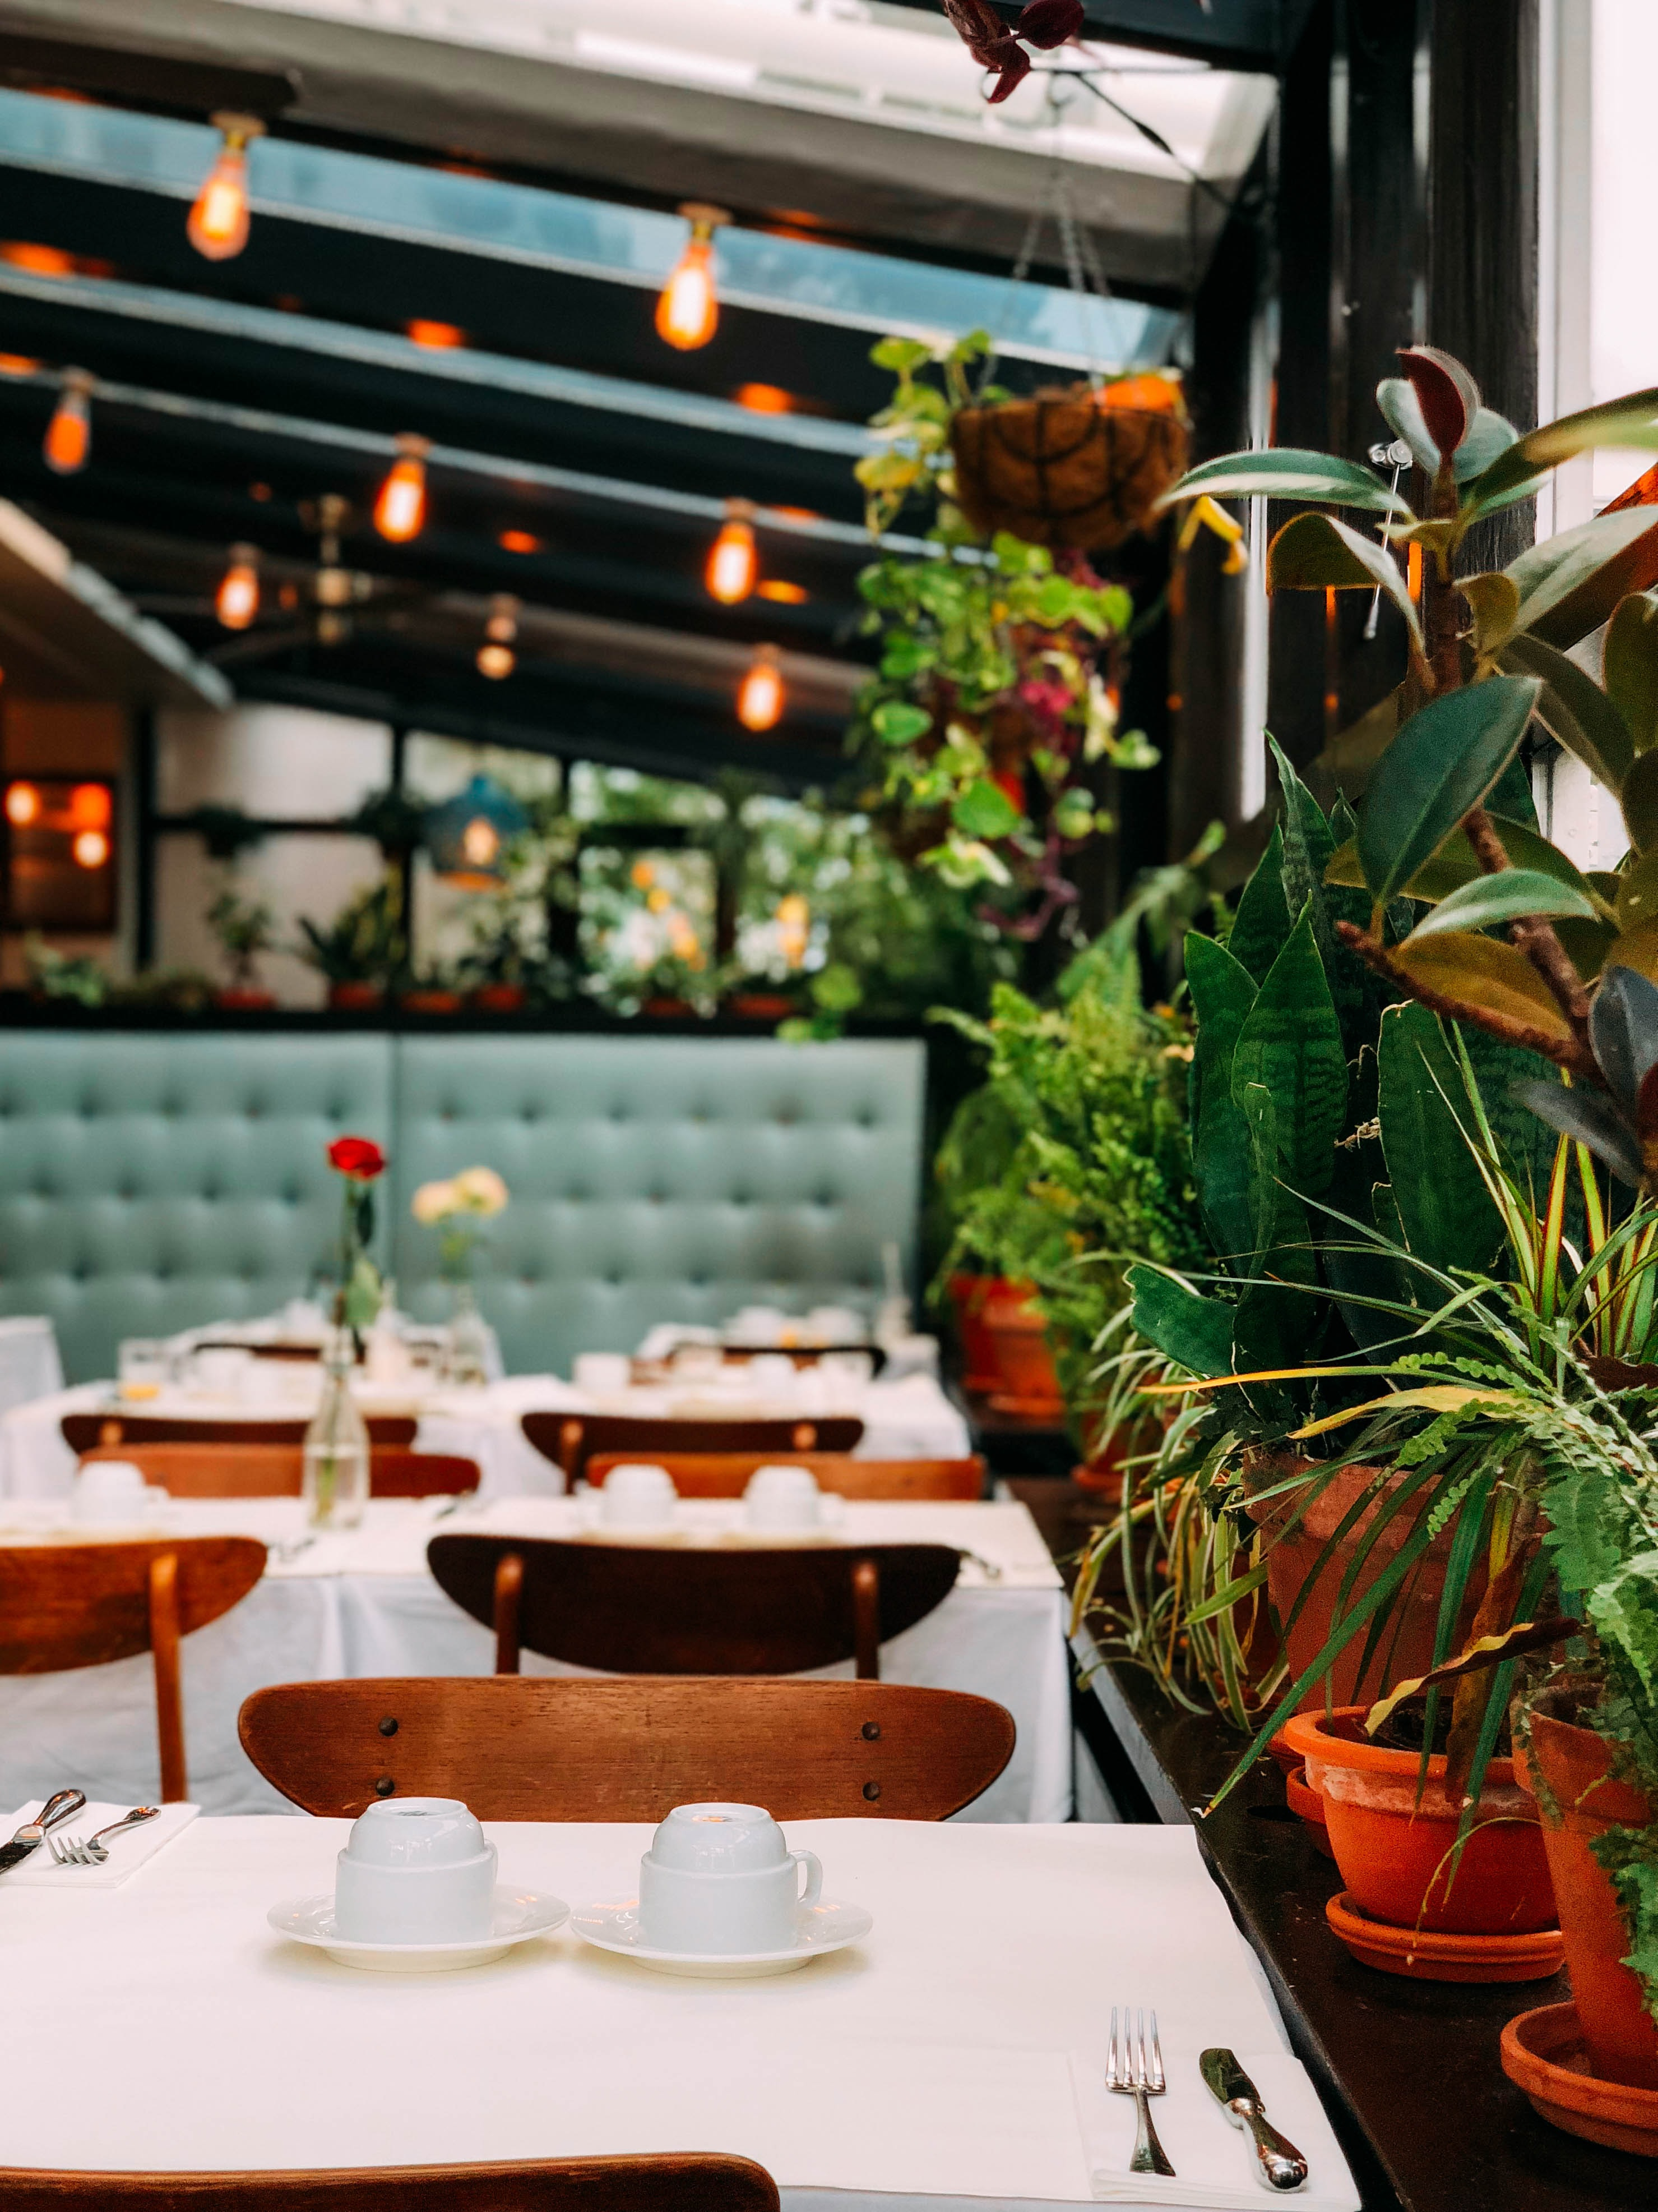
Comments framework
Comments on multiple places
Collecting all to one table structure
  Activities, Reservation and Groups
  Dining table reservations
  Hotel Reservations
Give staff full overview of the guest comments
Enhance the service experience and possibilites

Slide 17
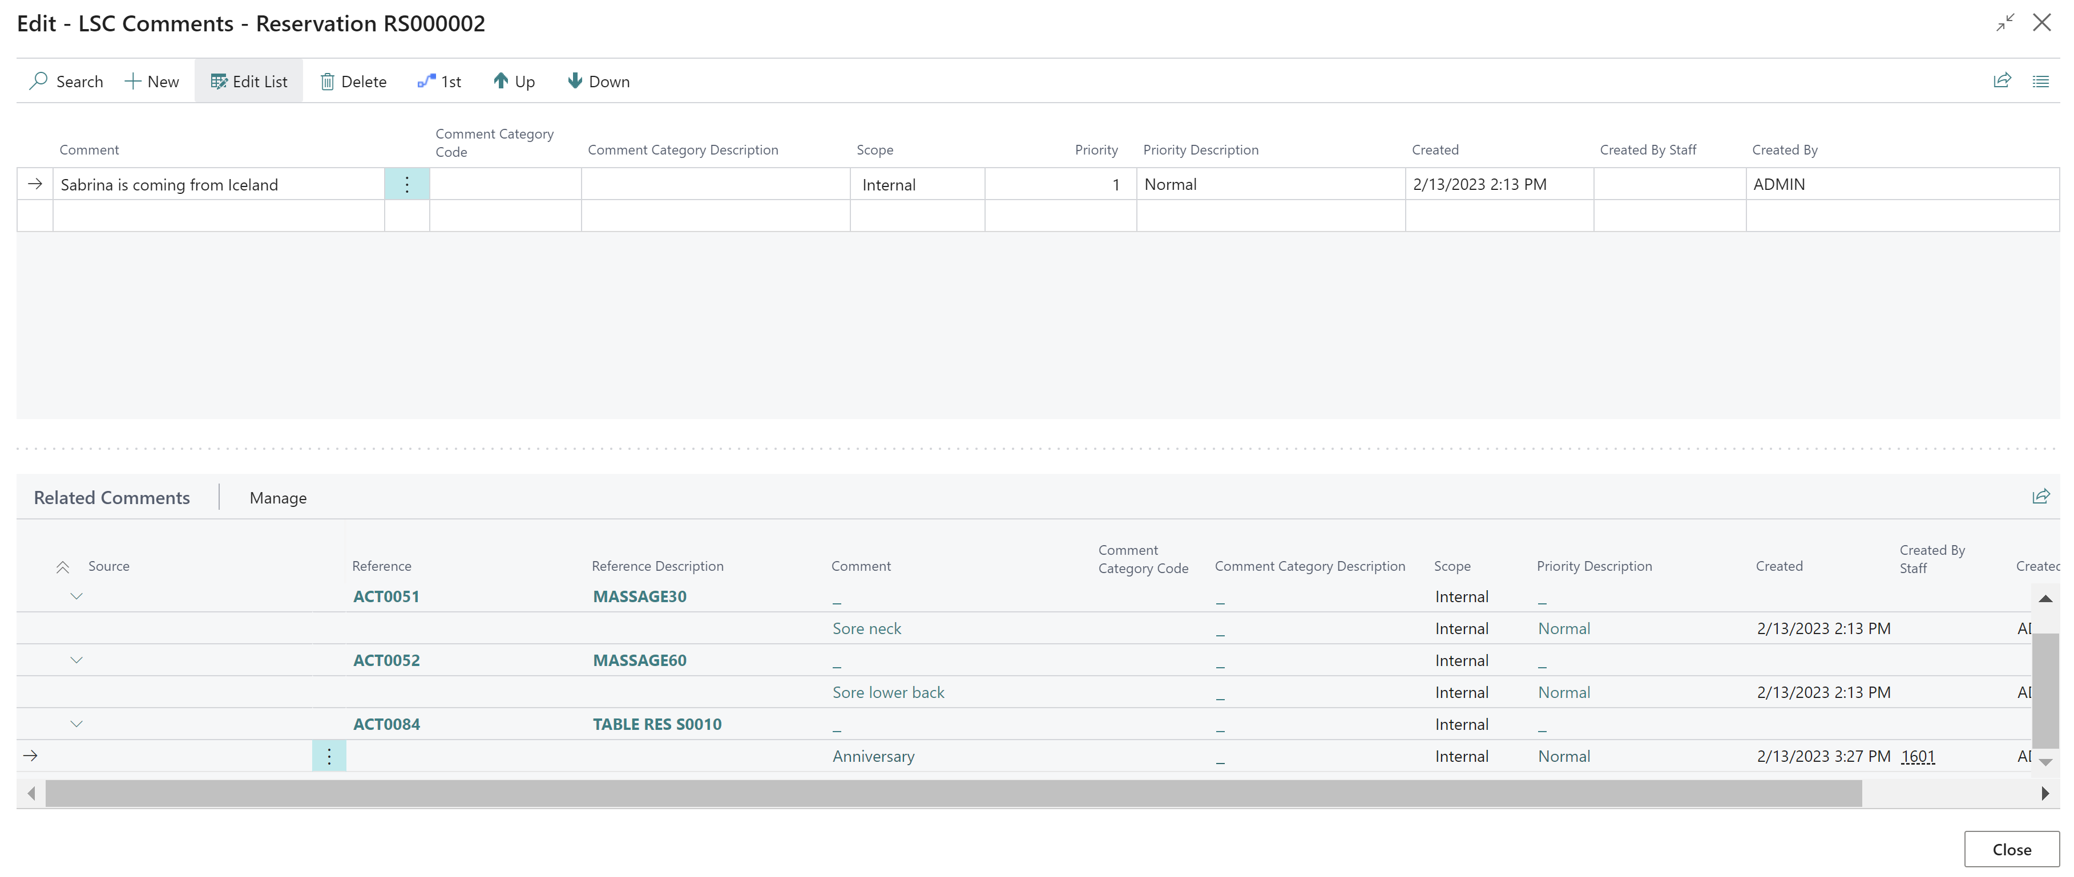
Comments – One table structure

Slide 18

DEMO

Slide 19
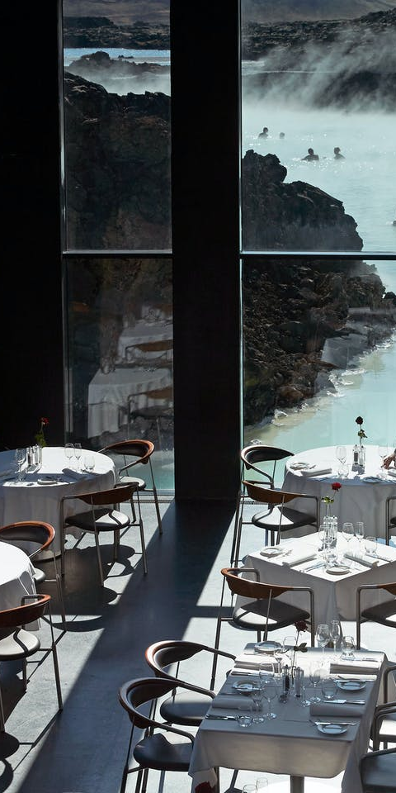
Demo
Member: Teresa Vorley
  Special requests:
    10 pax tables
    Red tablecloths
Conference for 50 people
  Conference room from 10:00am to 06:00pm
  Speaker system
  Lunch at 12:00pm
    Sandwich
    Drinks
  Break at 02:00pm
    Drinks
    Coffee
    Croissant
  Dinner at 06:00pm at a Restaurant
    3 course dinner

Slide 20
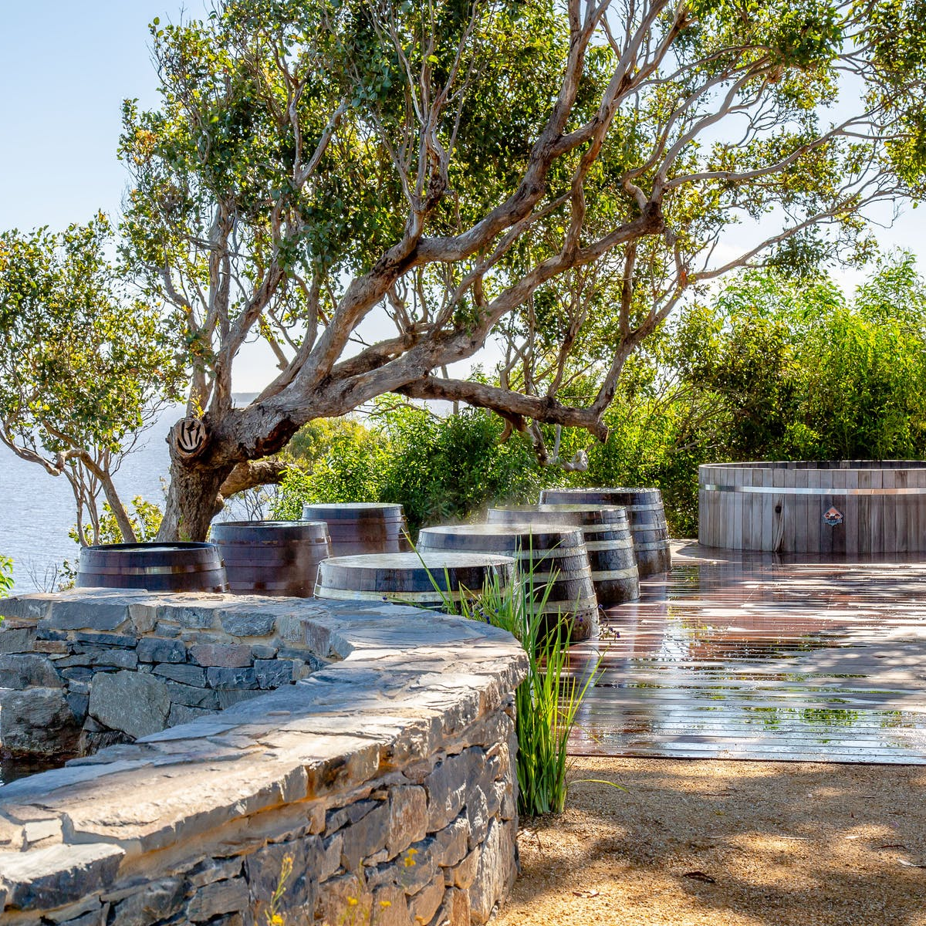
Customer Story

Slide 21
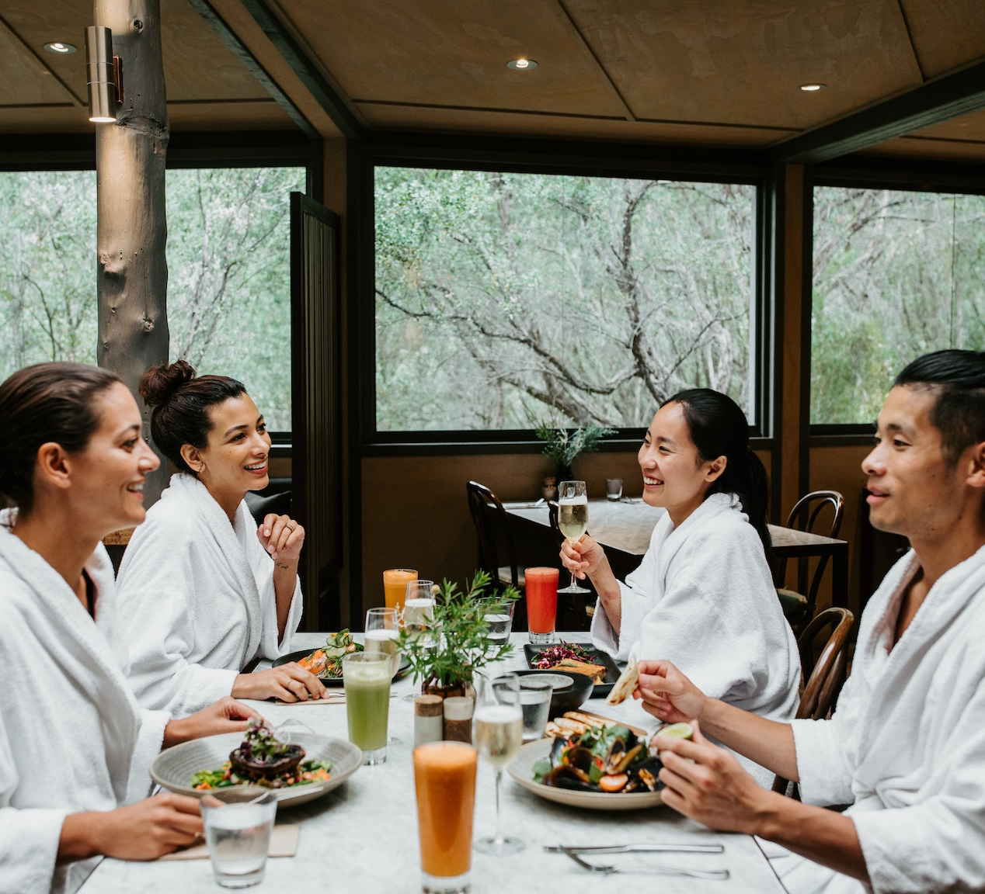
Peninsula Hot Springs
Located in Australia
  Metung Hot Springs
  Fingal Hot Springs
  Phillip Island Hot Springs
Spa Resort
  LS Central for Retail
  LS Central for Restaurants
  LS Central for Hotels
  Bookings for LS Central
  Staff Management for LS Central

Slide 22
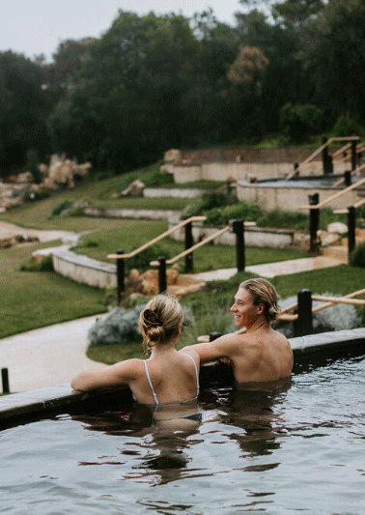

Peninsula Hot Springs
Reservation for accommodation, bathing, packages and treatments
Online and walk in reservations
Prebooked food orders and a la cart restaurants
Keeping track of guests details and history

Slide 23
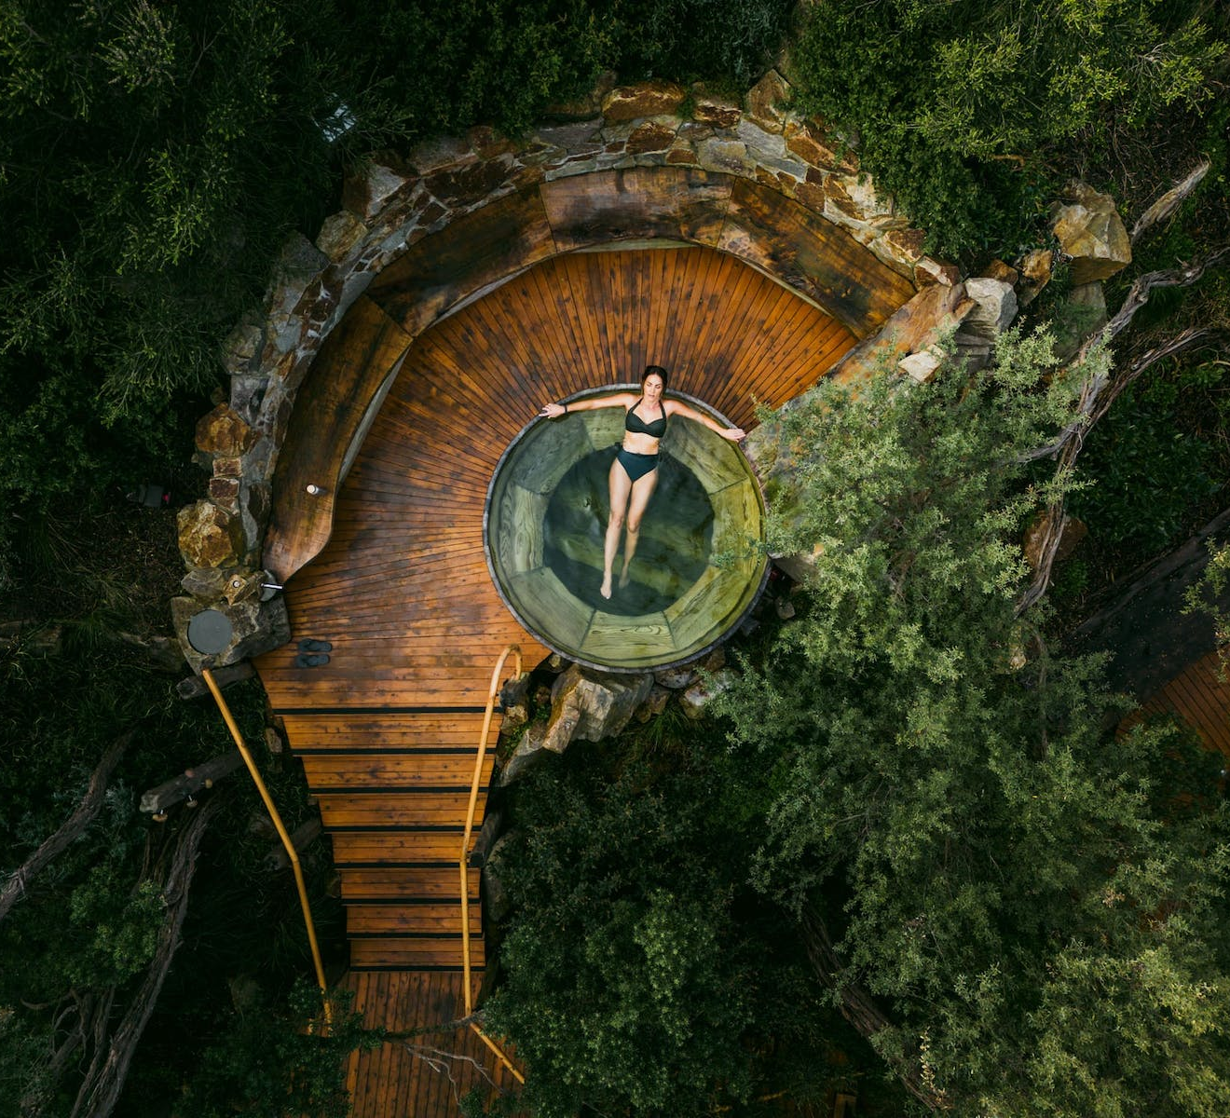
Peninsula Hot Springs
Looking to implement an "all in one" solution for the operations
Implementation in cooperation with local partner
Fully remote implementation
Management vision clear and project support important
Customer pushing for standard solution

Slide 24
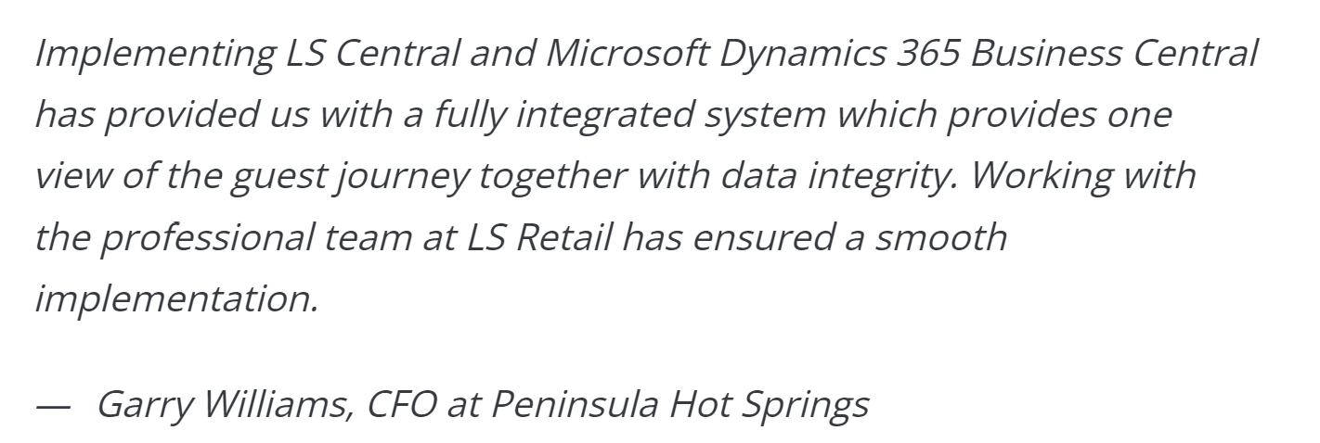
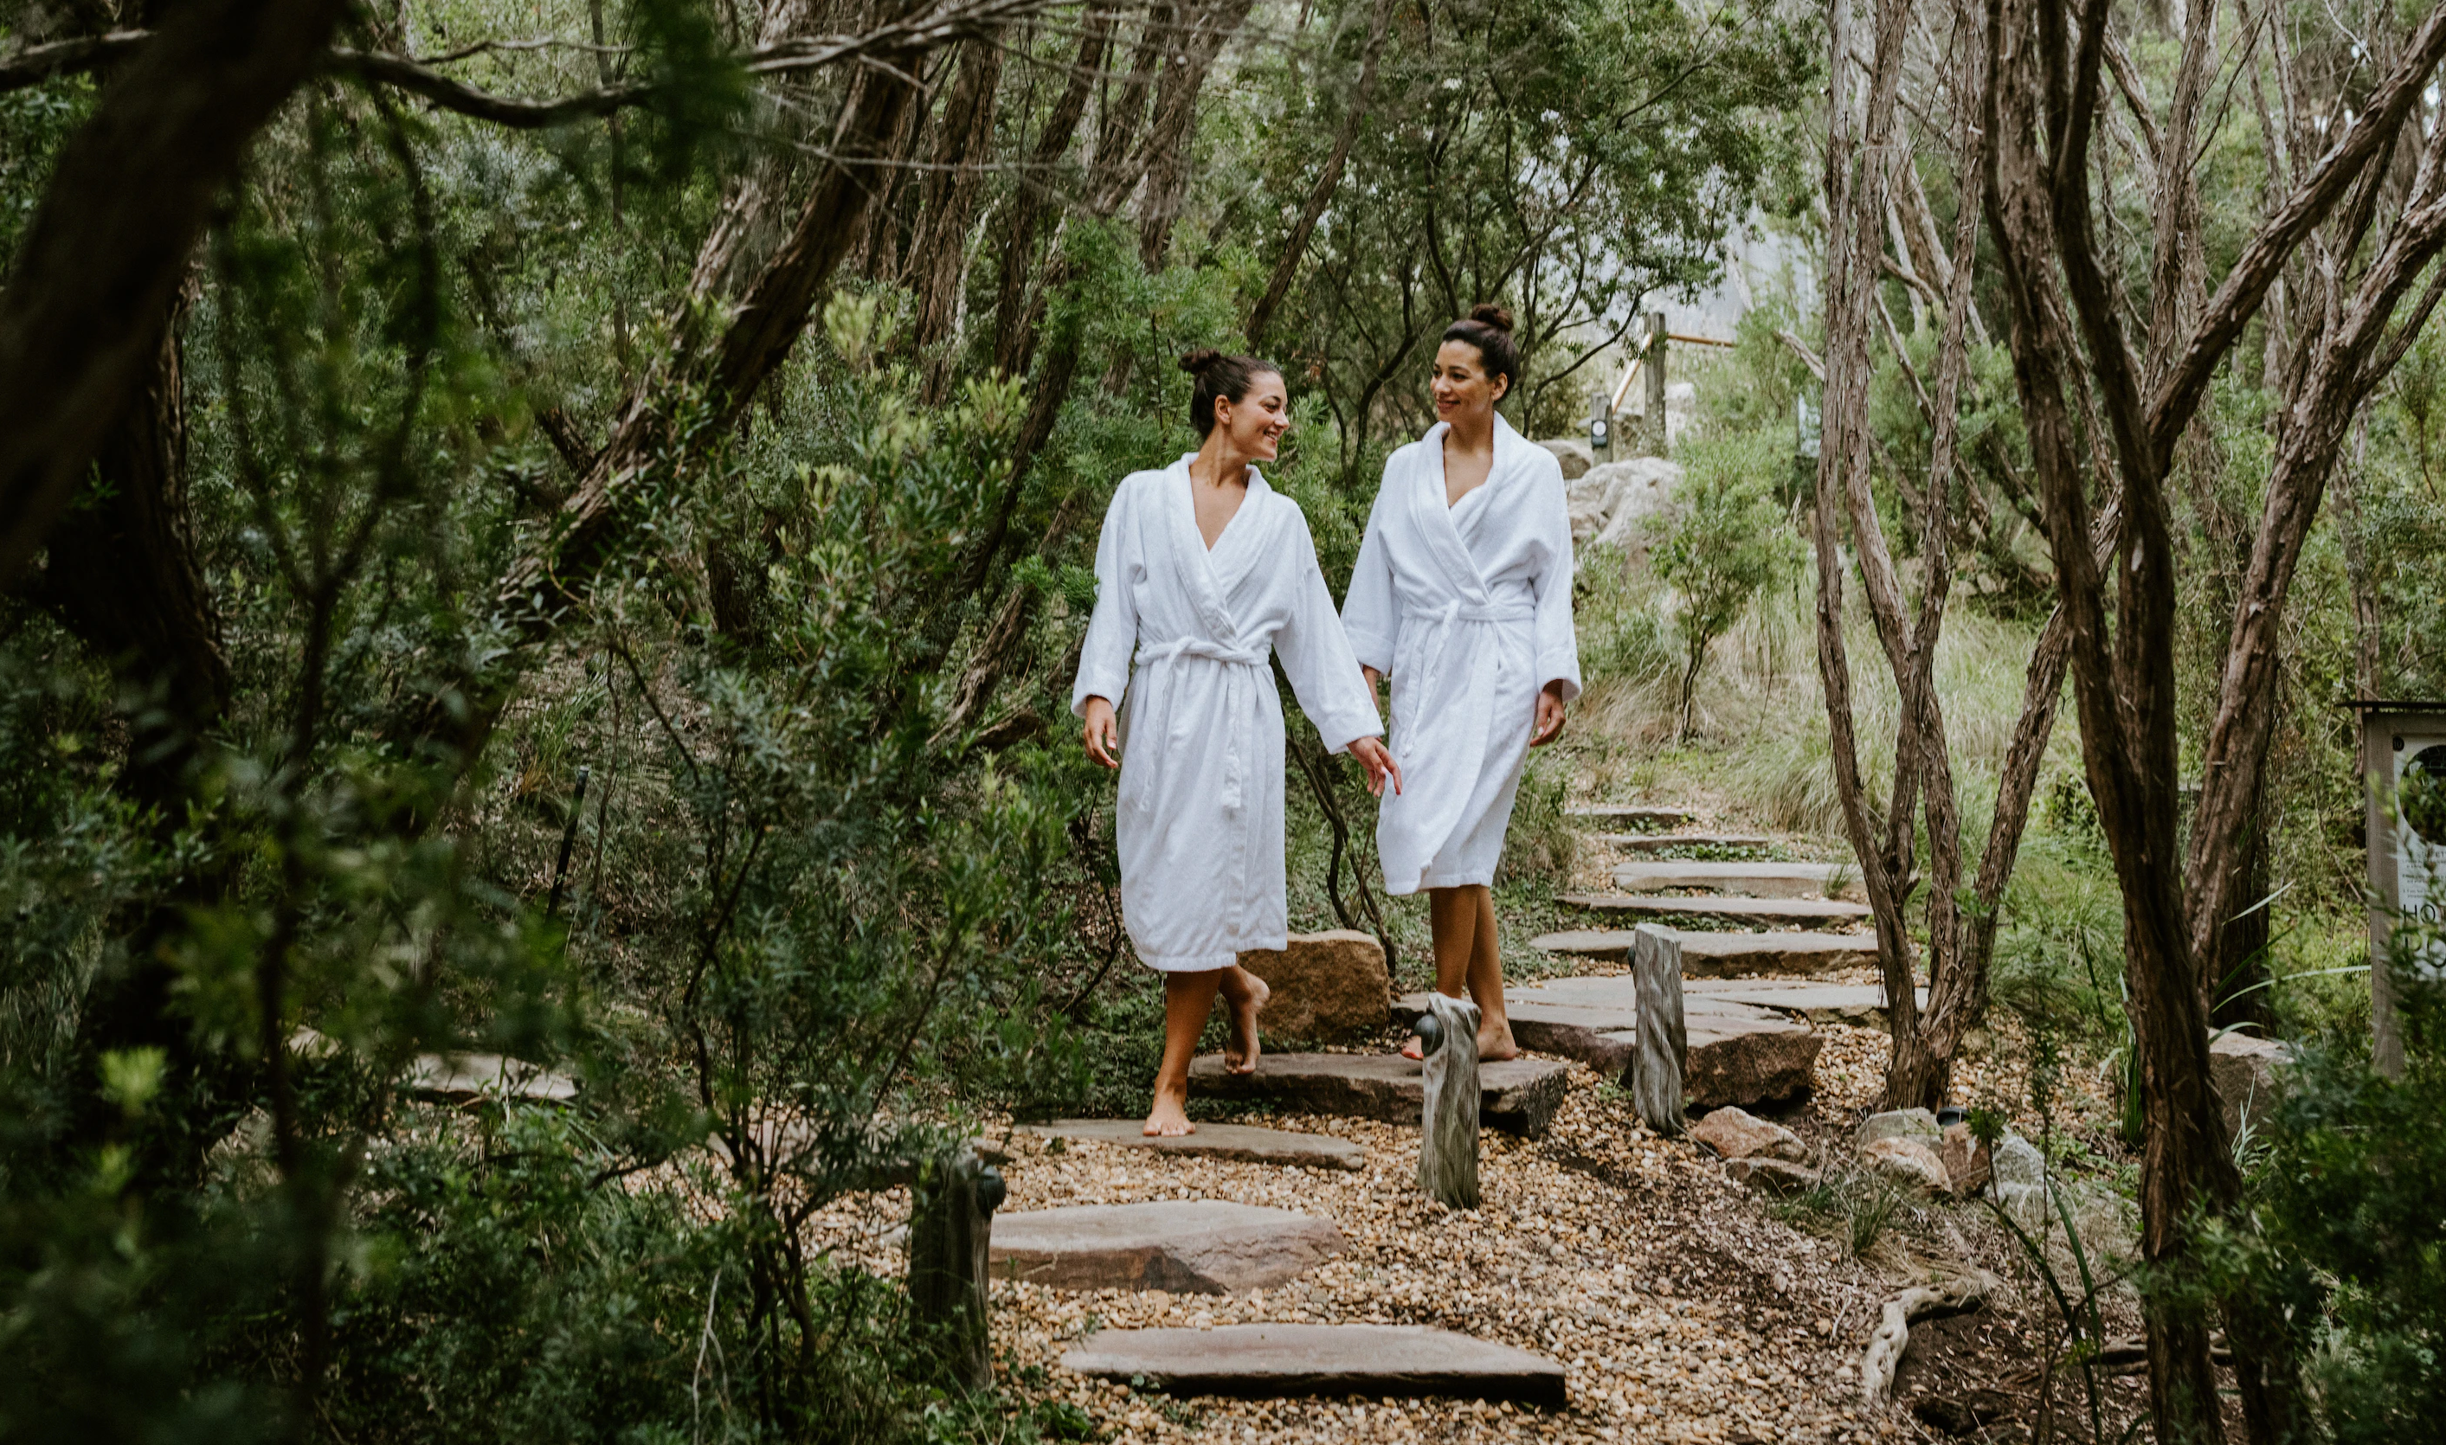
Peninsula Hot Springs
As little customization as possible
Internal change management and training
Rollout of first small location
Smooth go live
Currently implementing next location

Slide 25
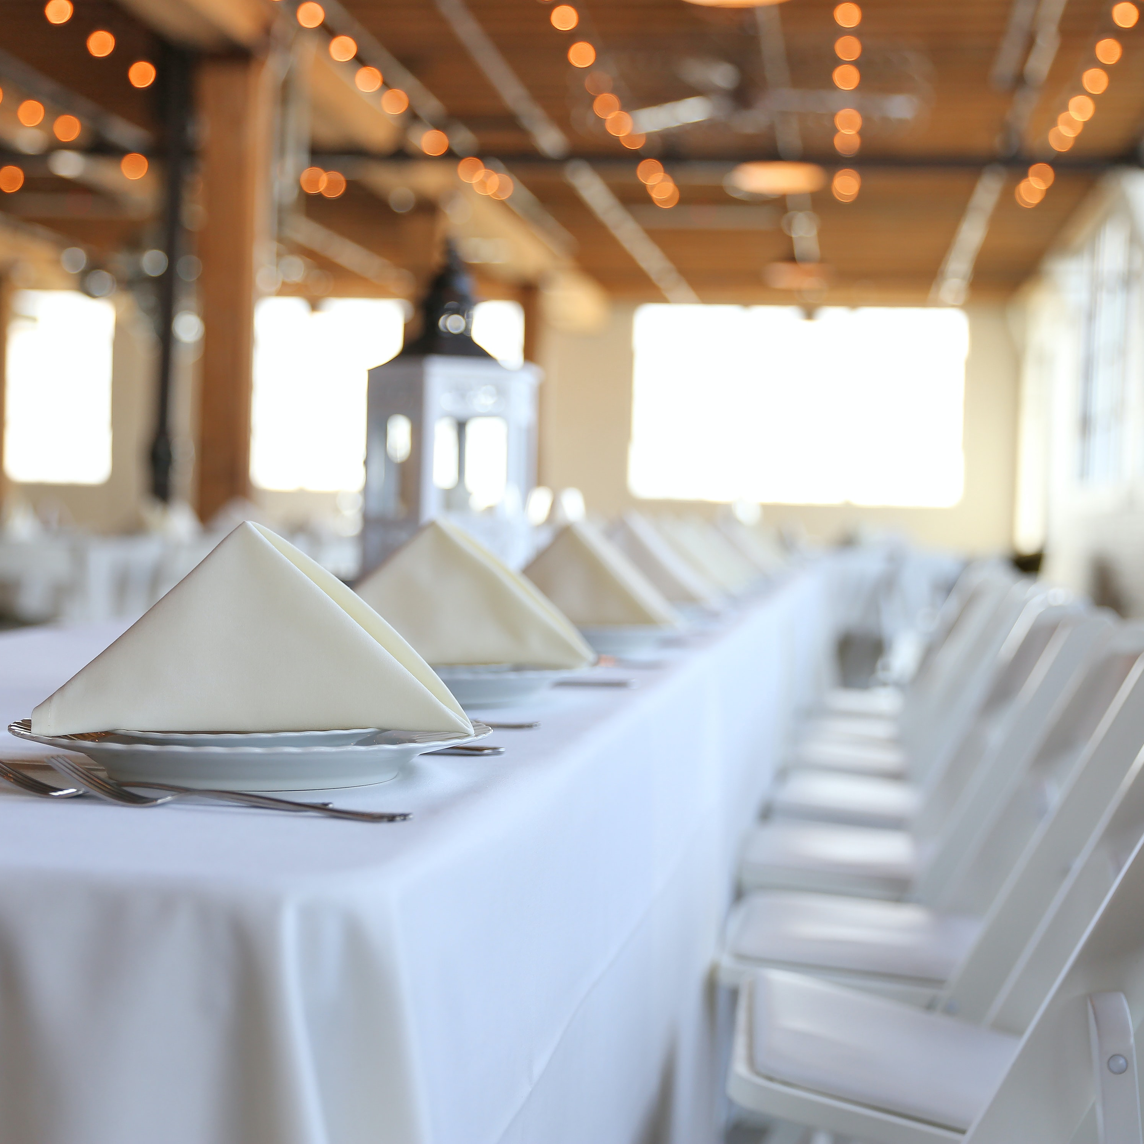
Roadmap

Slide 26

Bookings Roadmap - 2023
2022
Matrix Web App
Matrix enhancements (icons, resource week view)
Activity Front Desk Host on POS
H1 2023
Comments Framework
Activity REST API’s
Activity pricing based on activity variant
Recurring activities
H2 2023
Event Management – Day view for Event categories
Event Management – Event scheduling
Activity Front Desk Host with Activity details
Ticketing enhancements
* Dates and features are subject to change

Slide 27
Thank you

