Slide 1
Contactless guest experience for hospitality
Alejandro Vázquez
Senior Consultant
Petur Thor Sigurdsson
Product Director

Slide 2
Agenda
What is new in Self-Service
QR Code Ordering

Slide 3
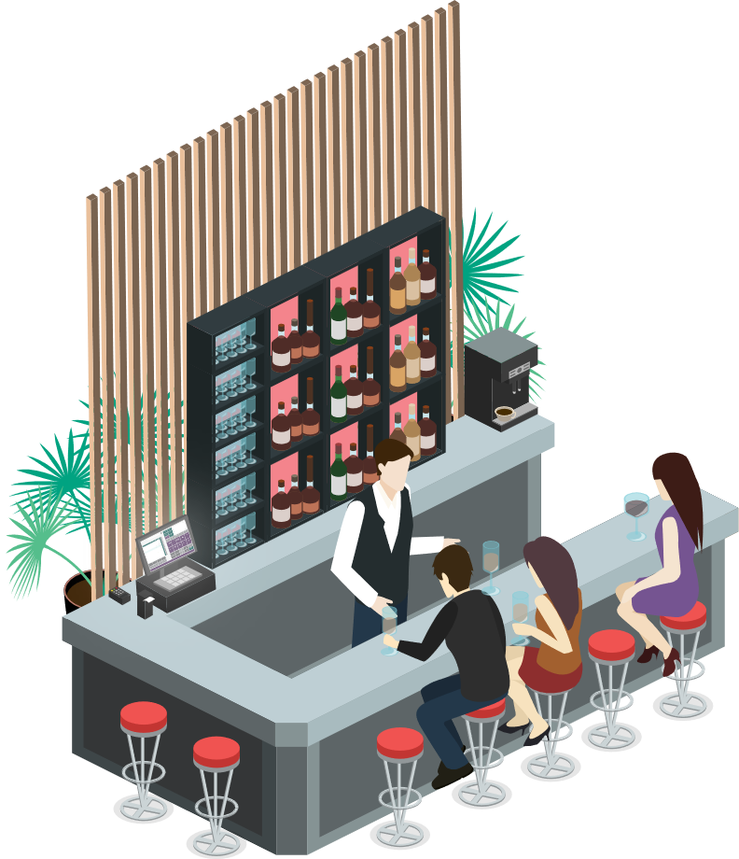
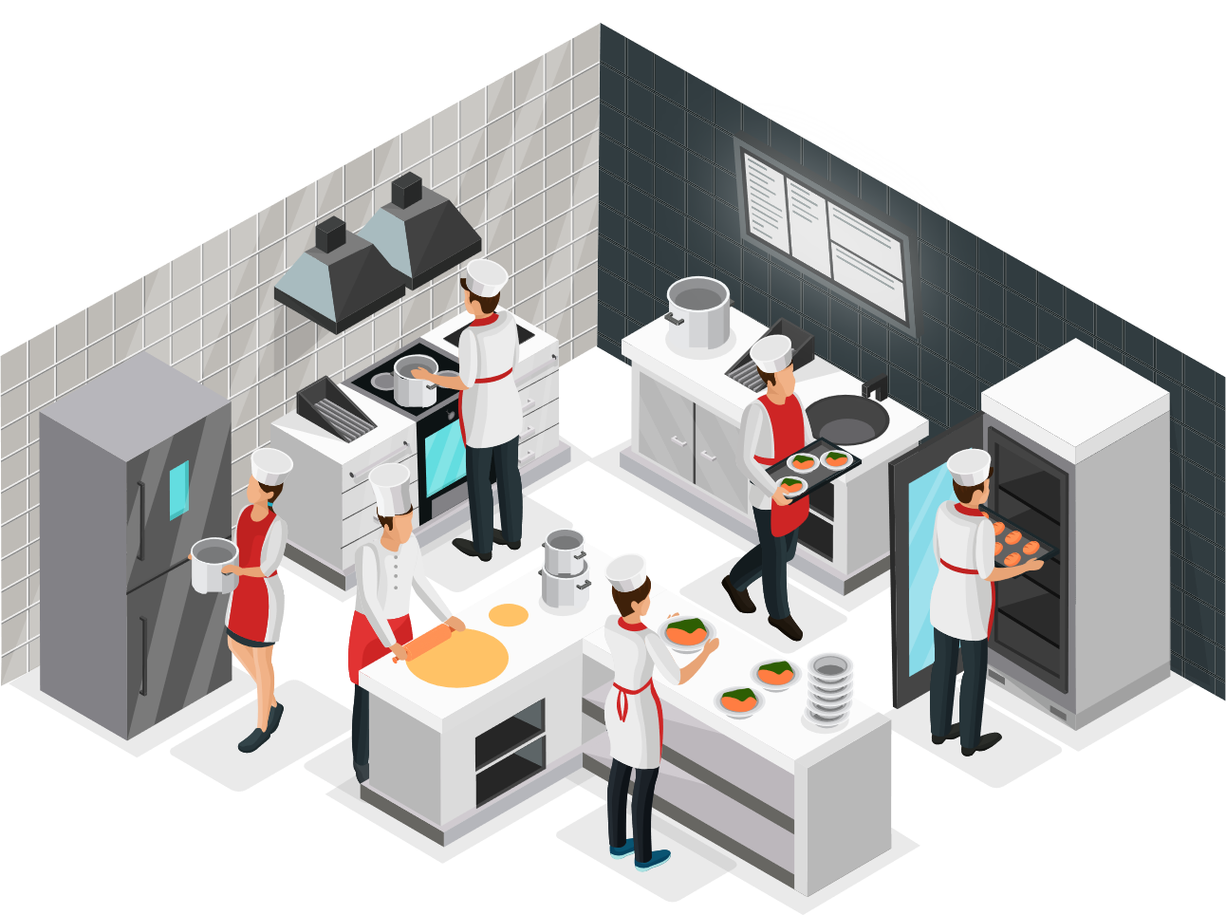


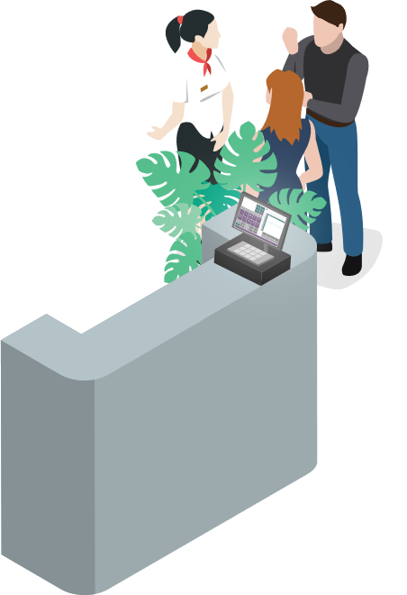

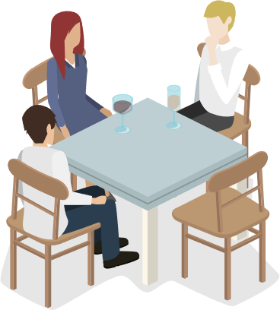
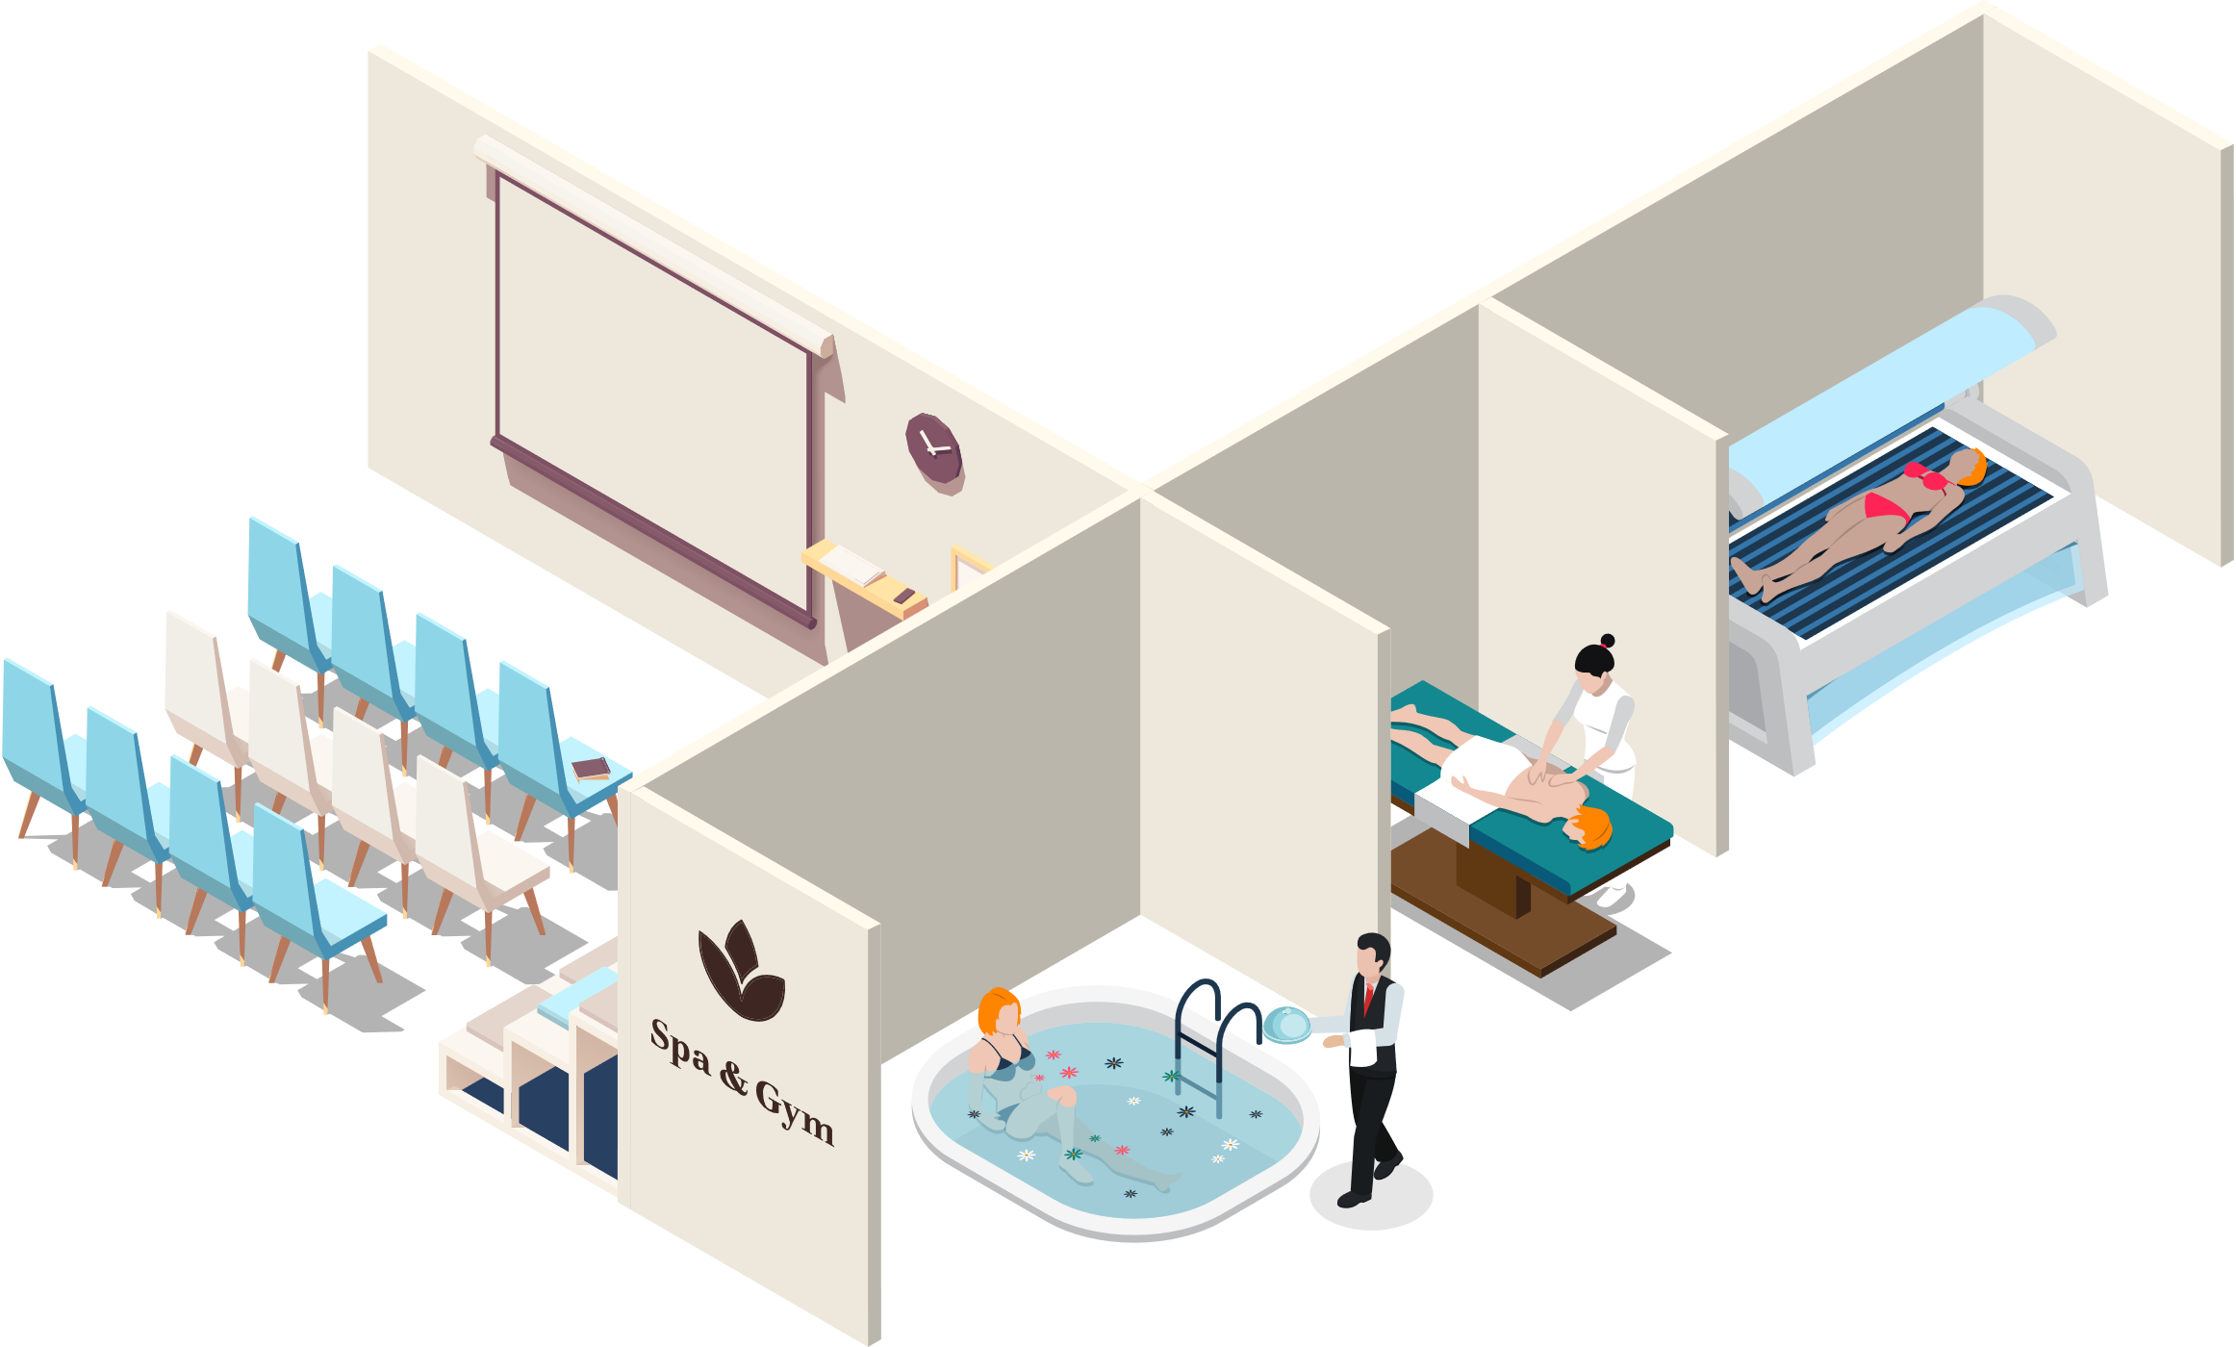
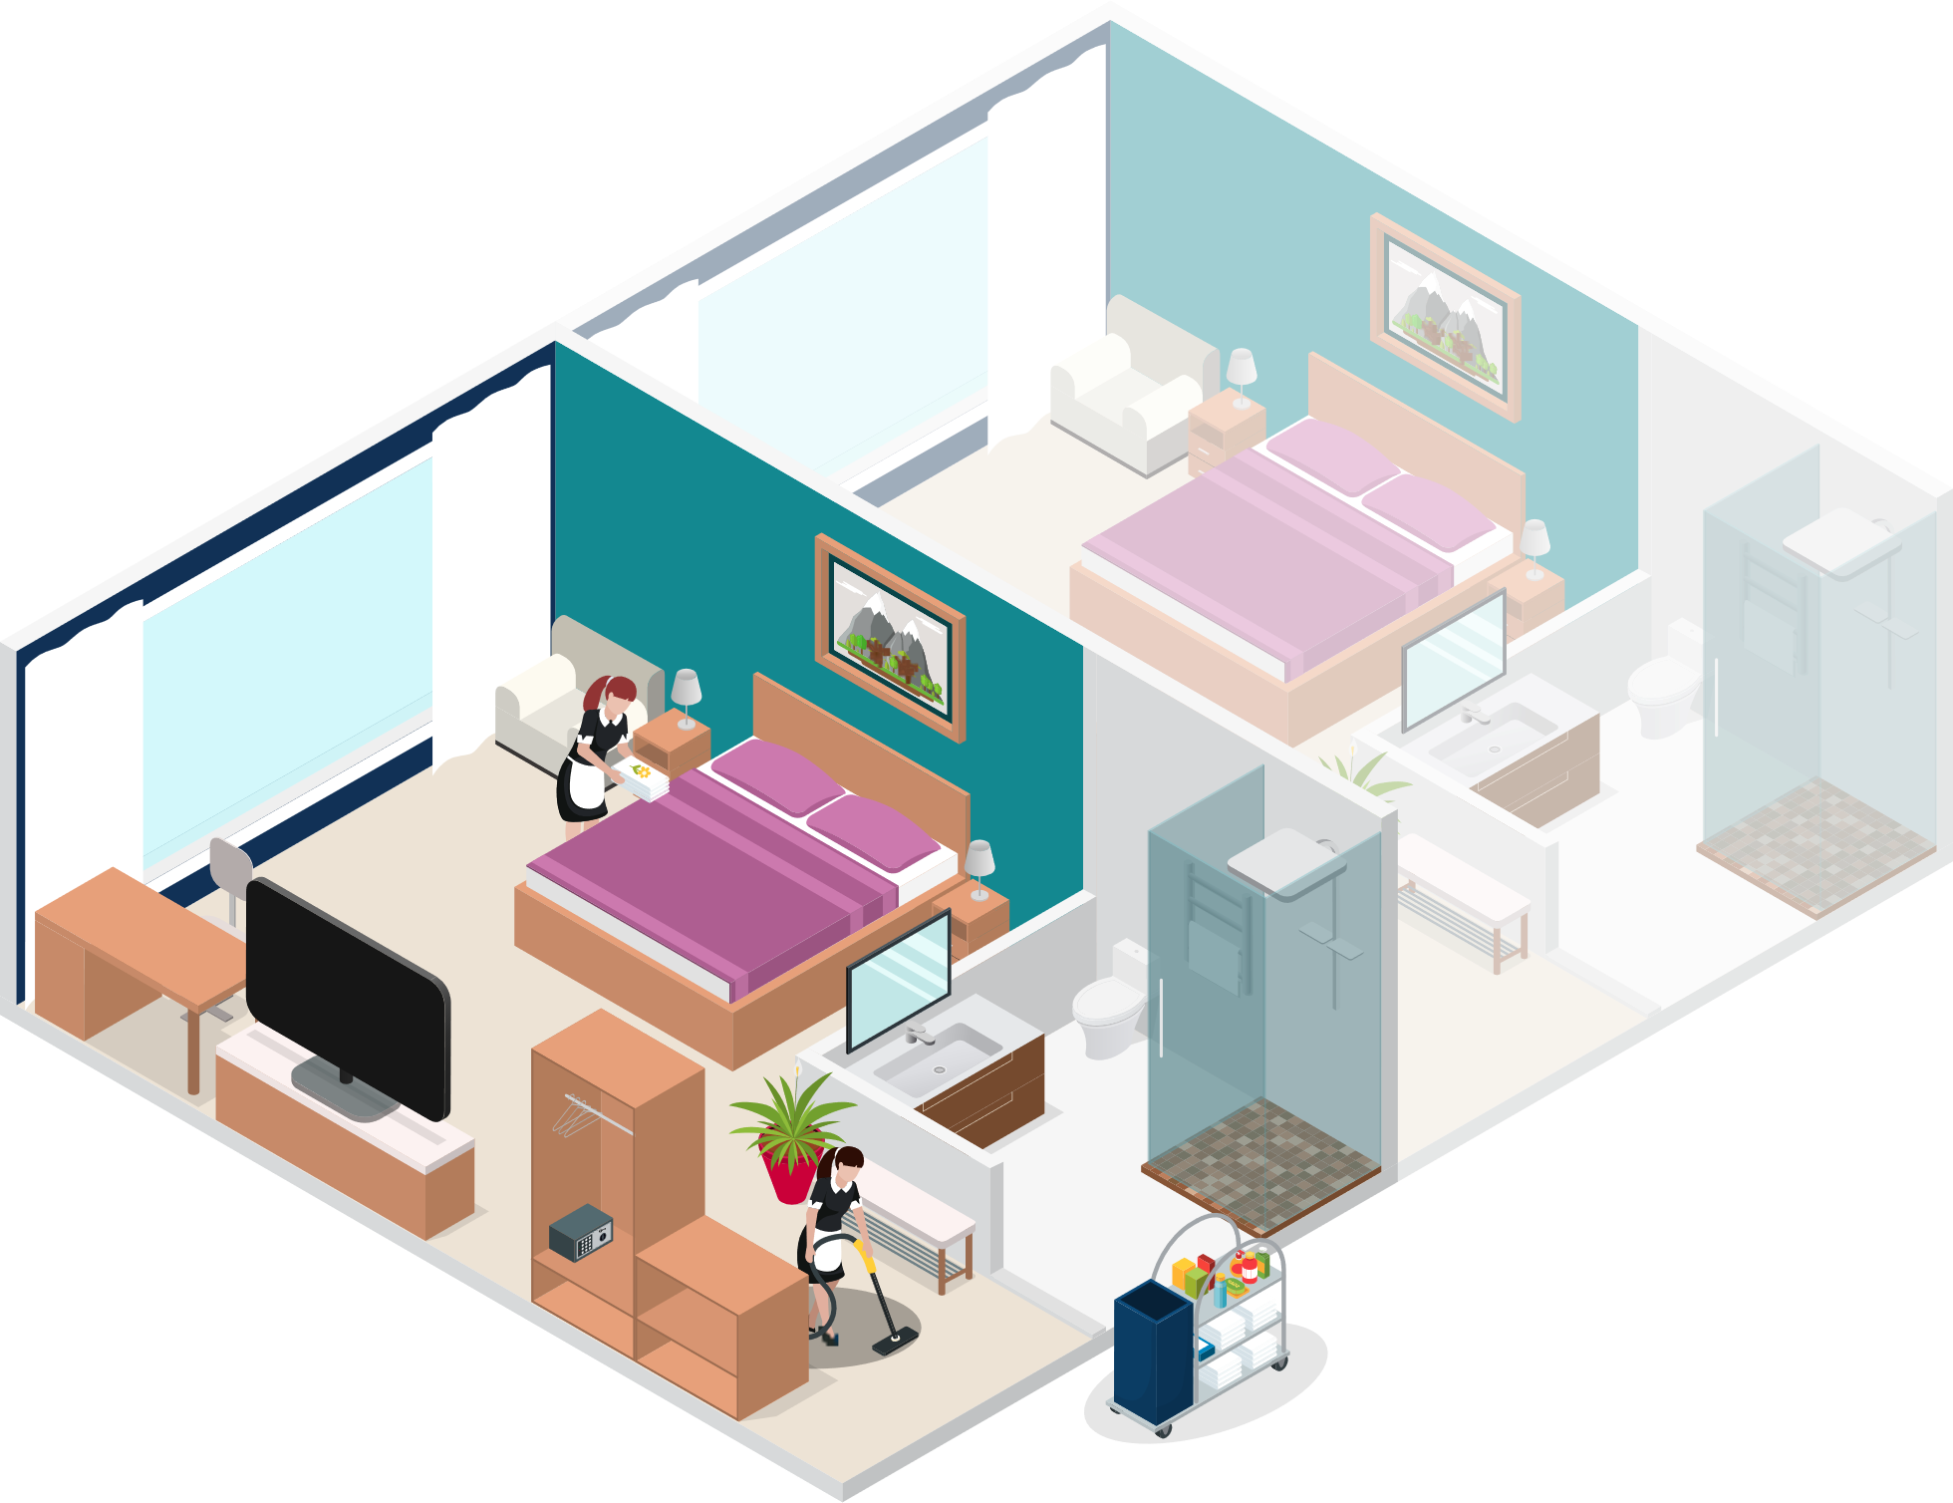
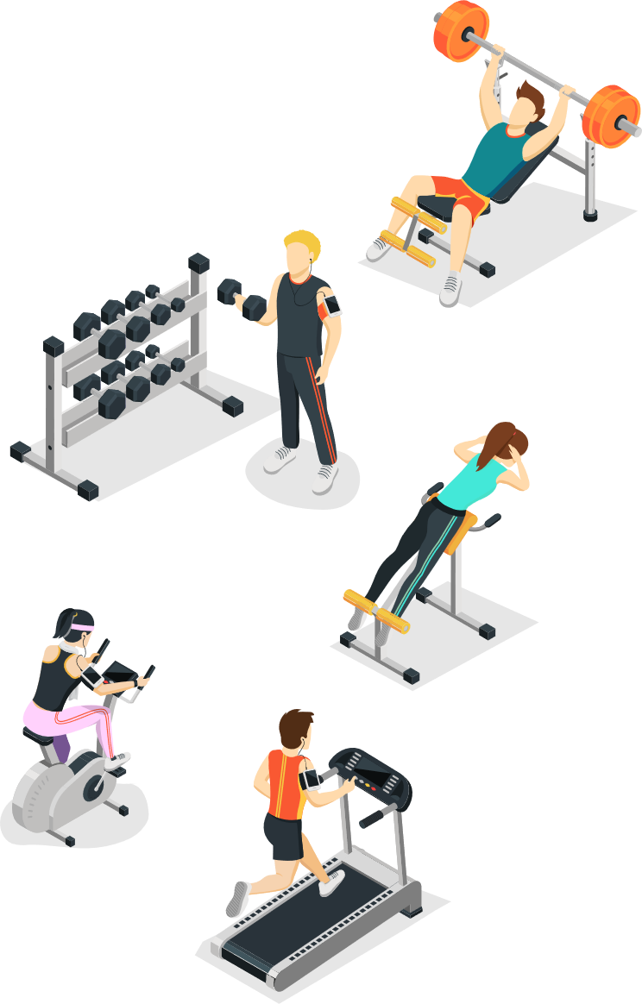
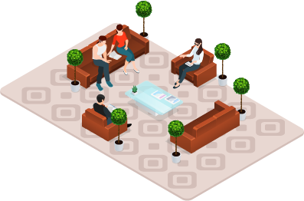
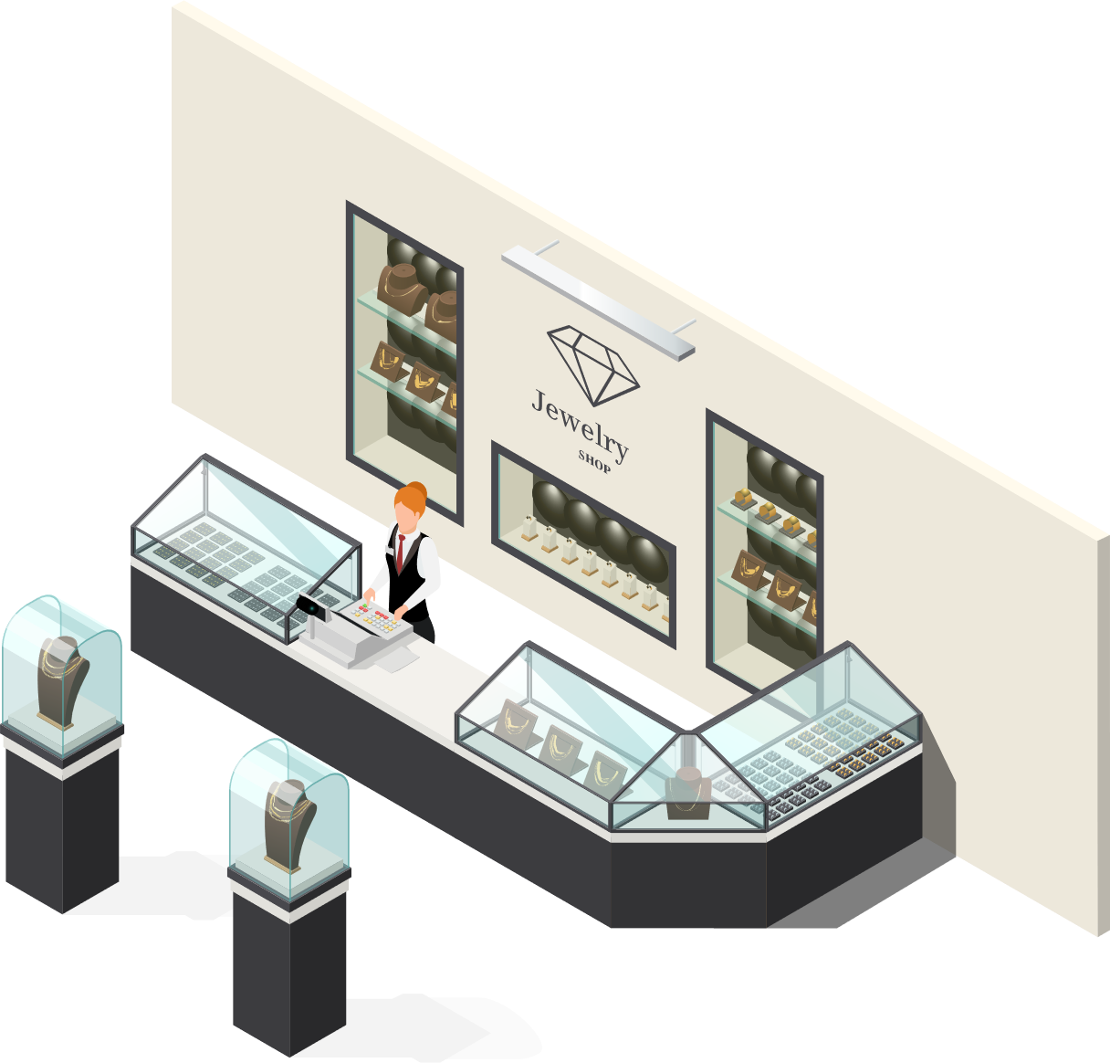


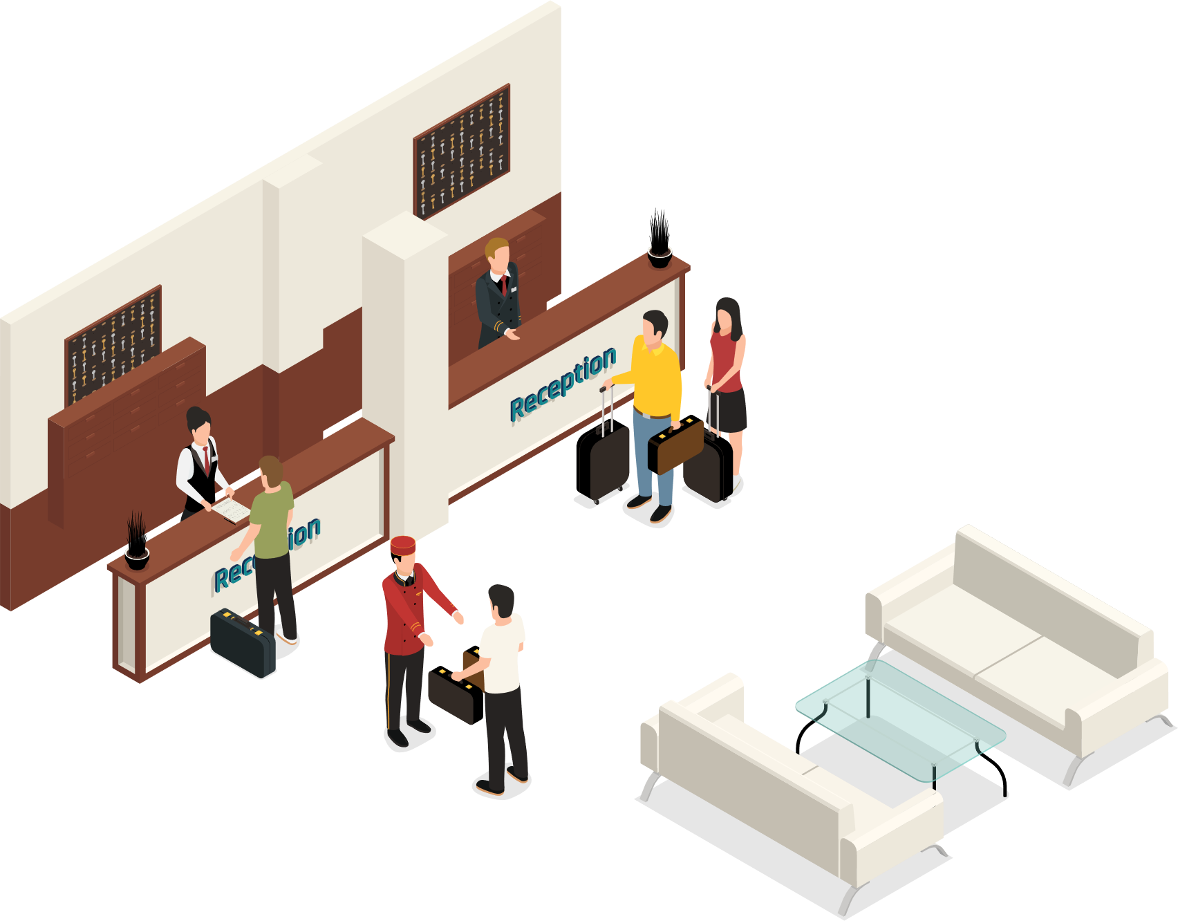
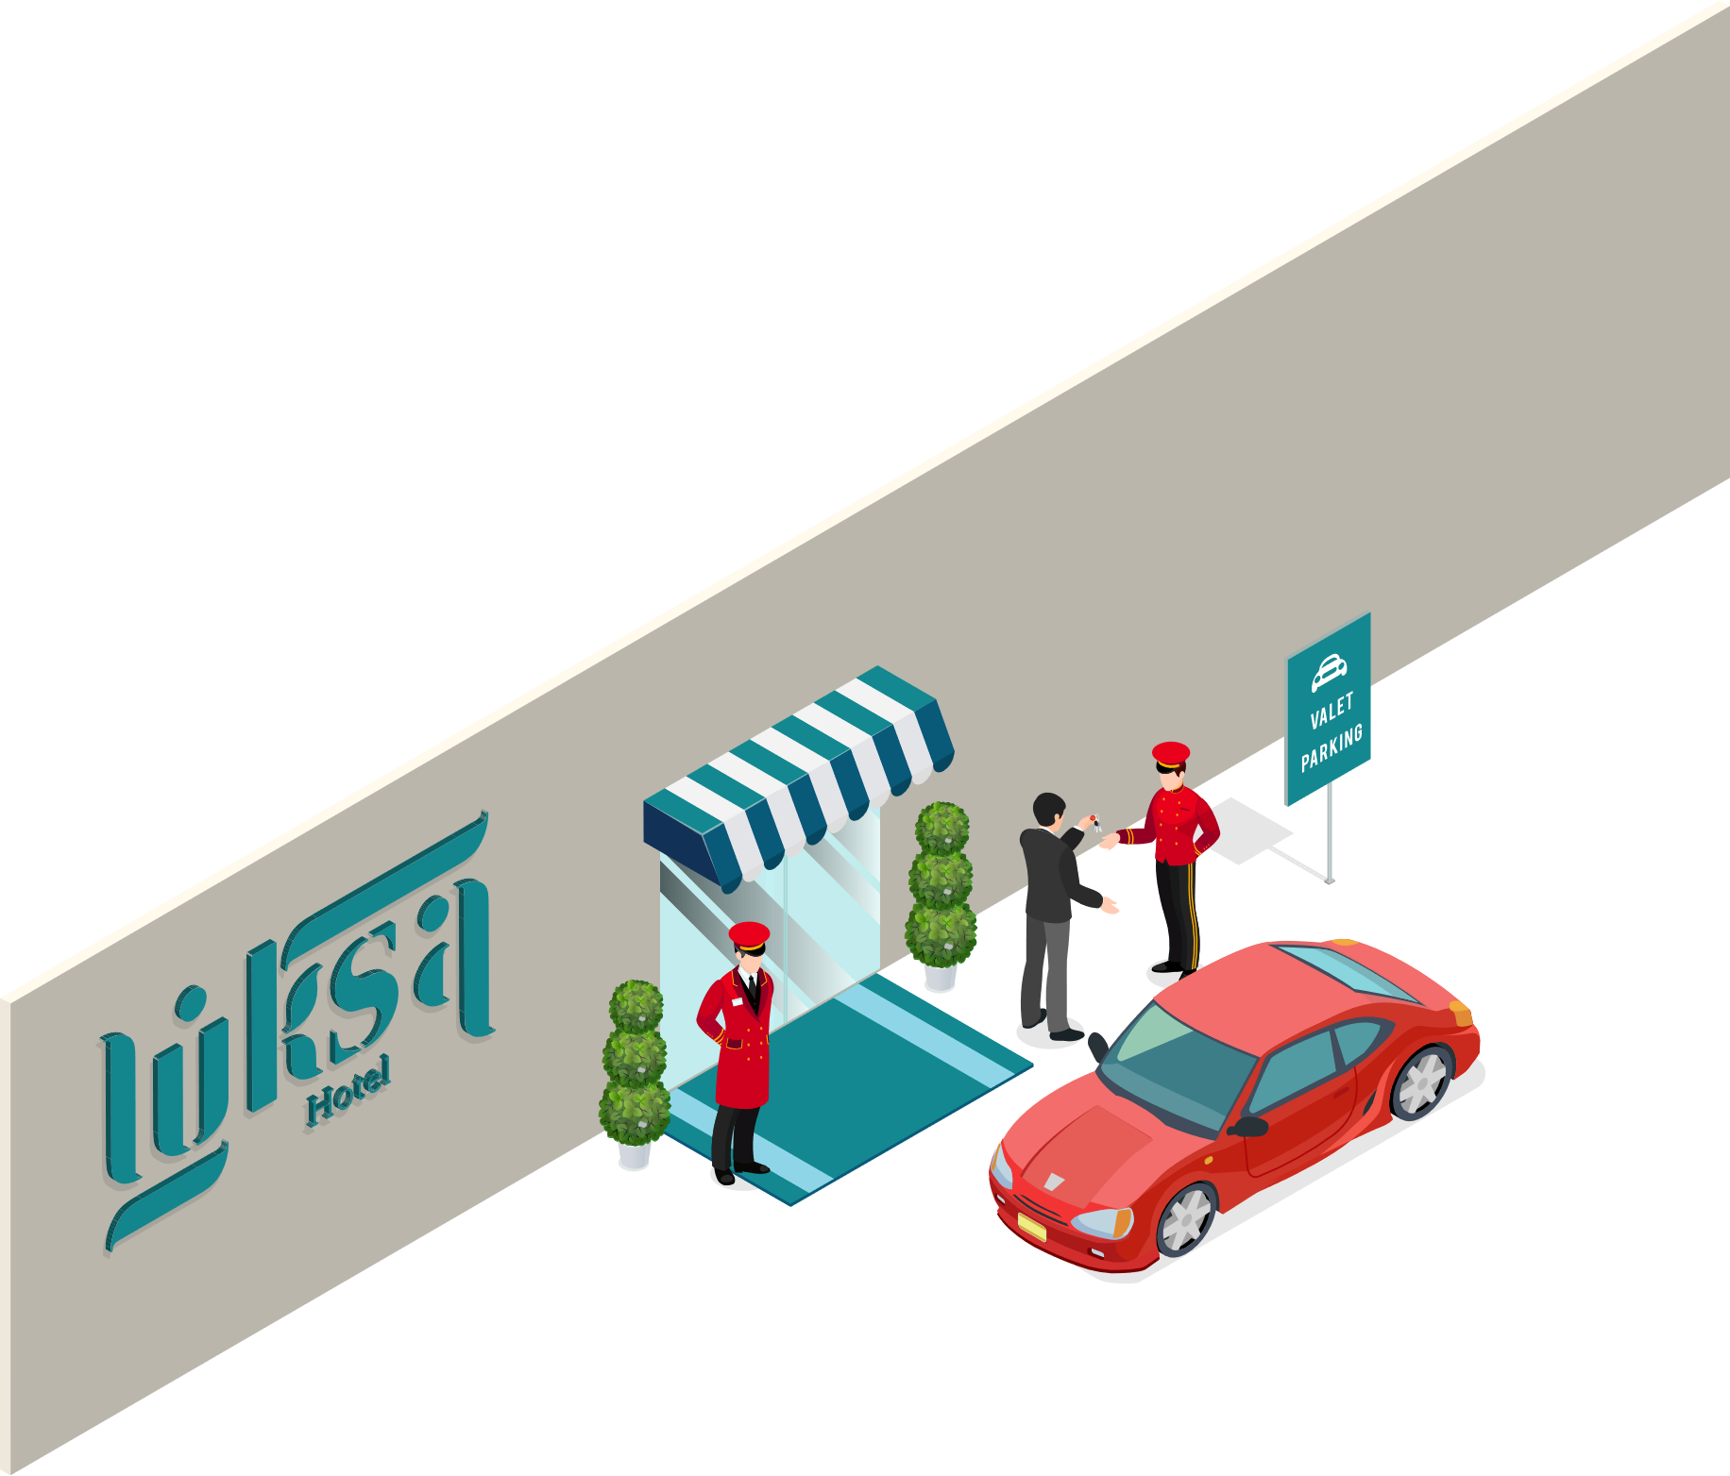


LS Central
LS Central
Food & Beverage
Bookings
Staff Mgmt
KDS
Hotels

Slide 4
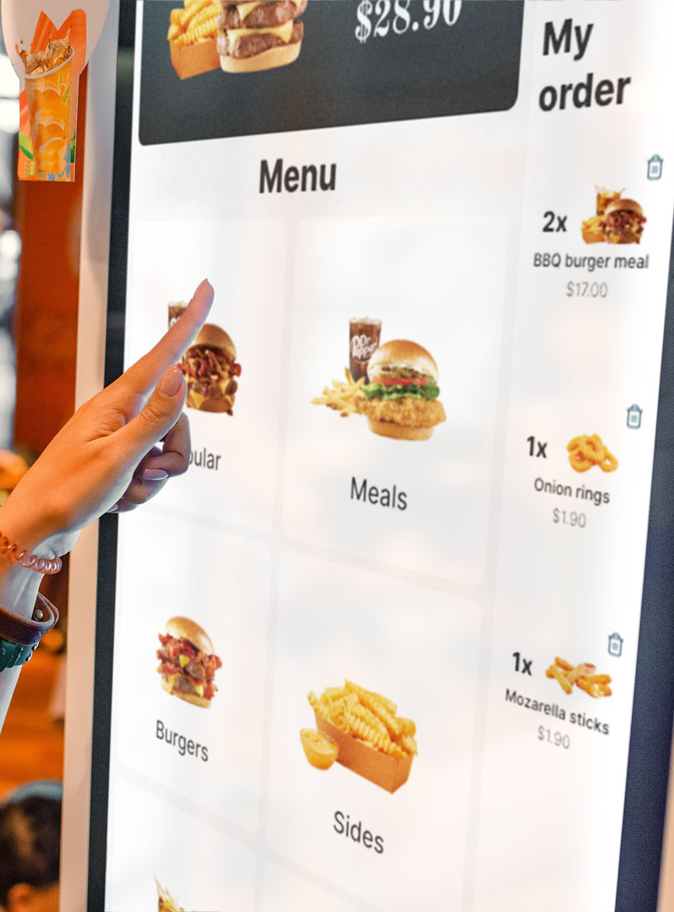
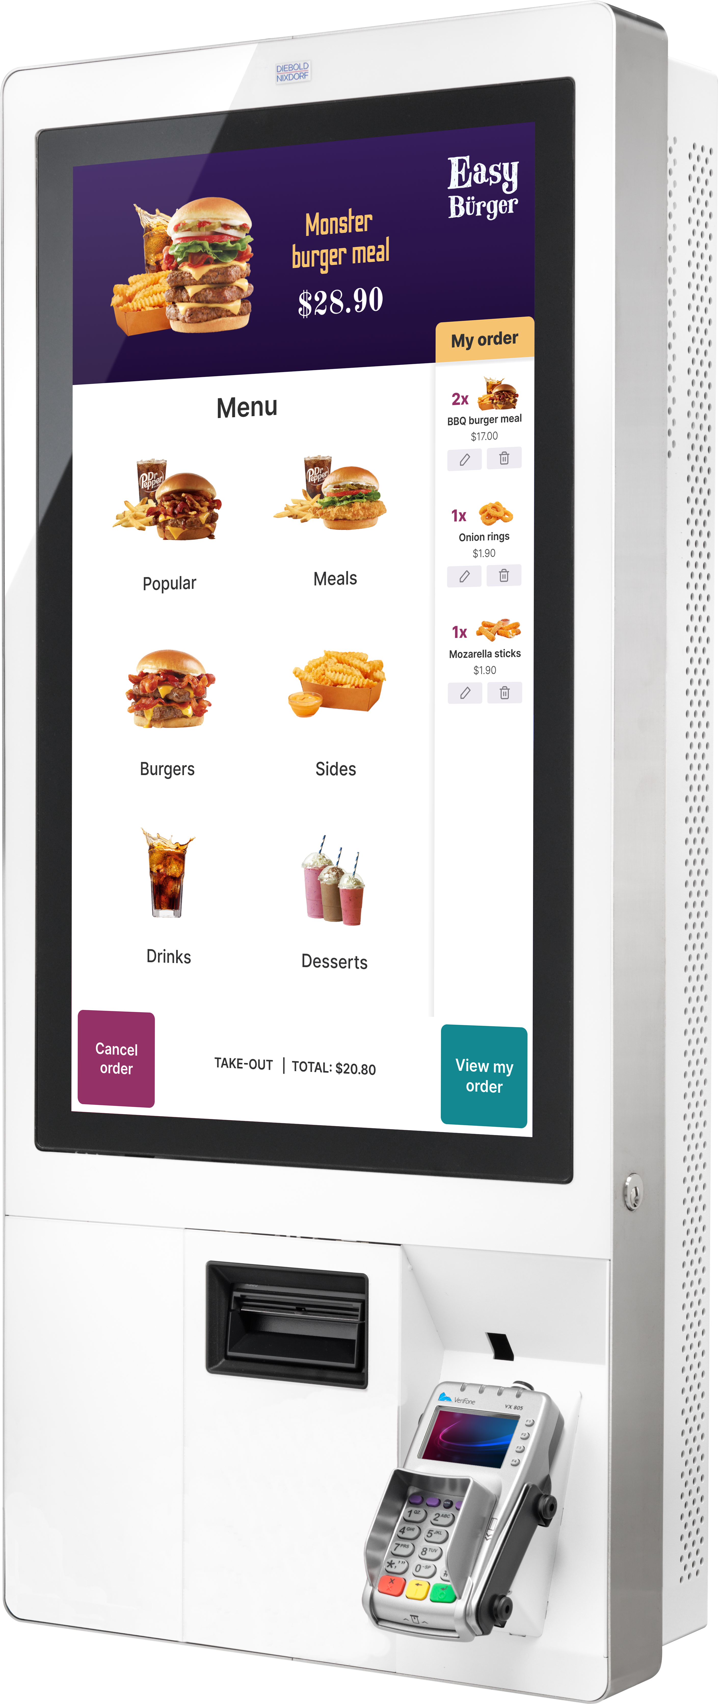

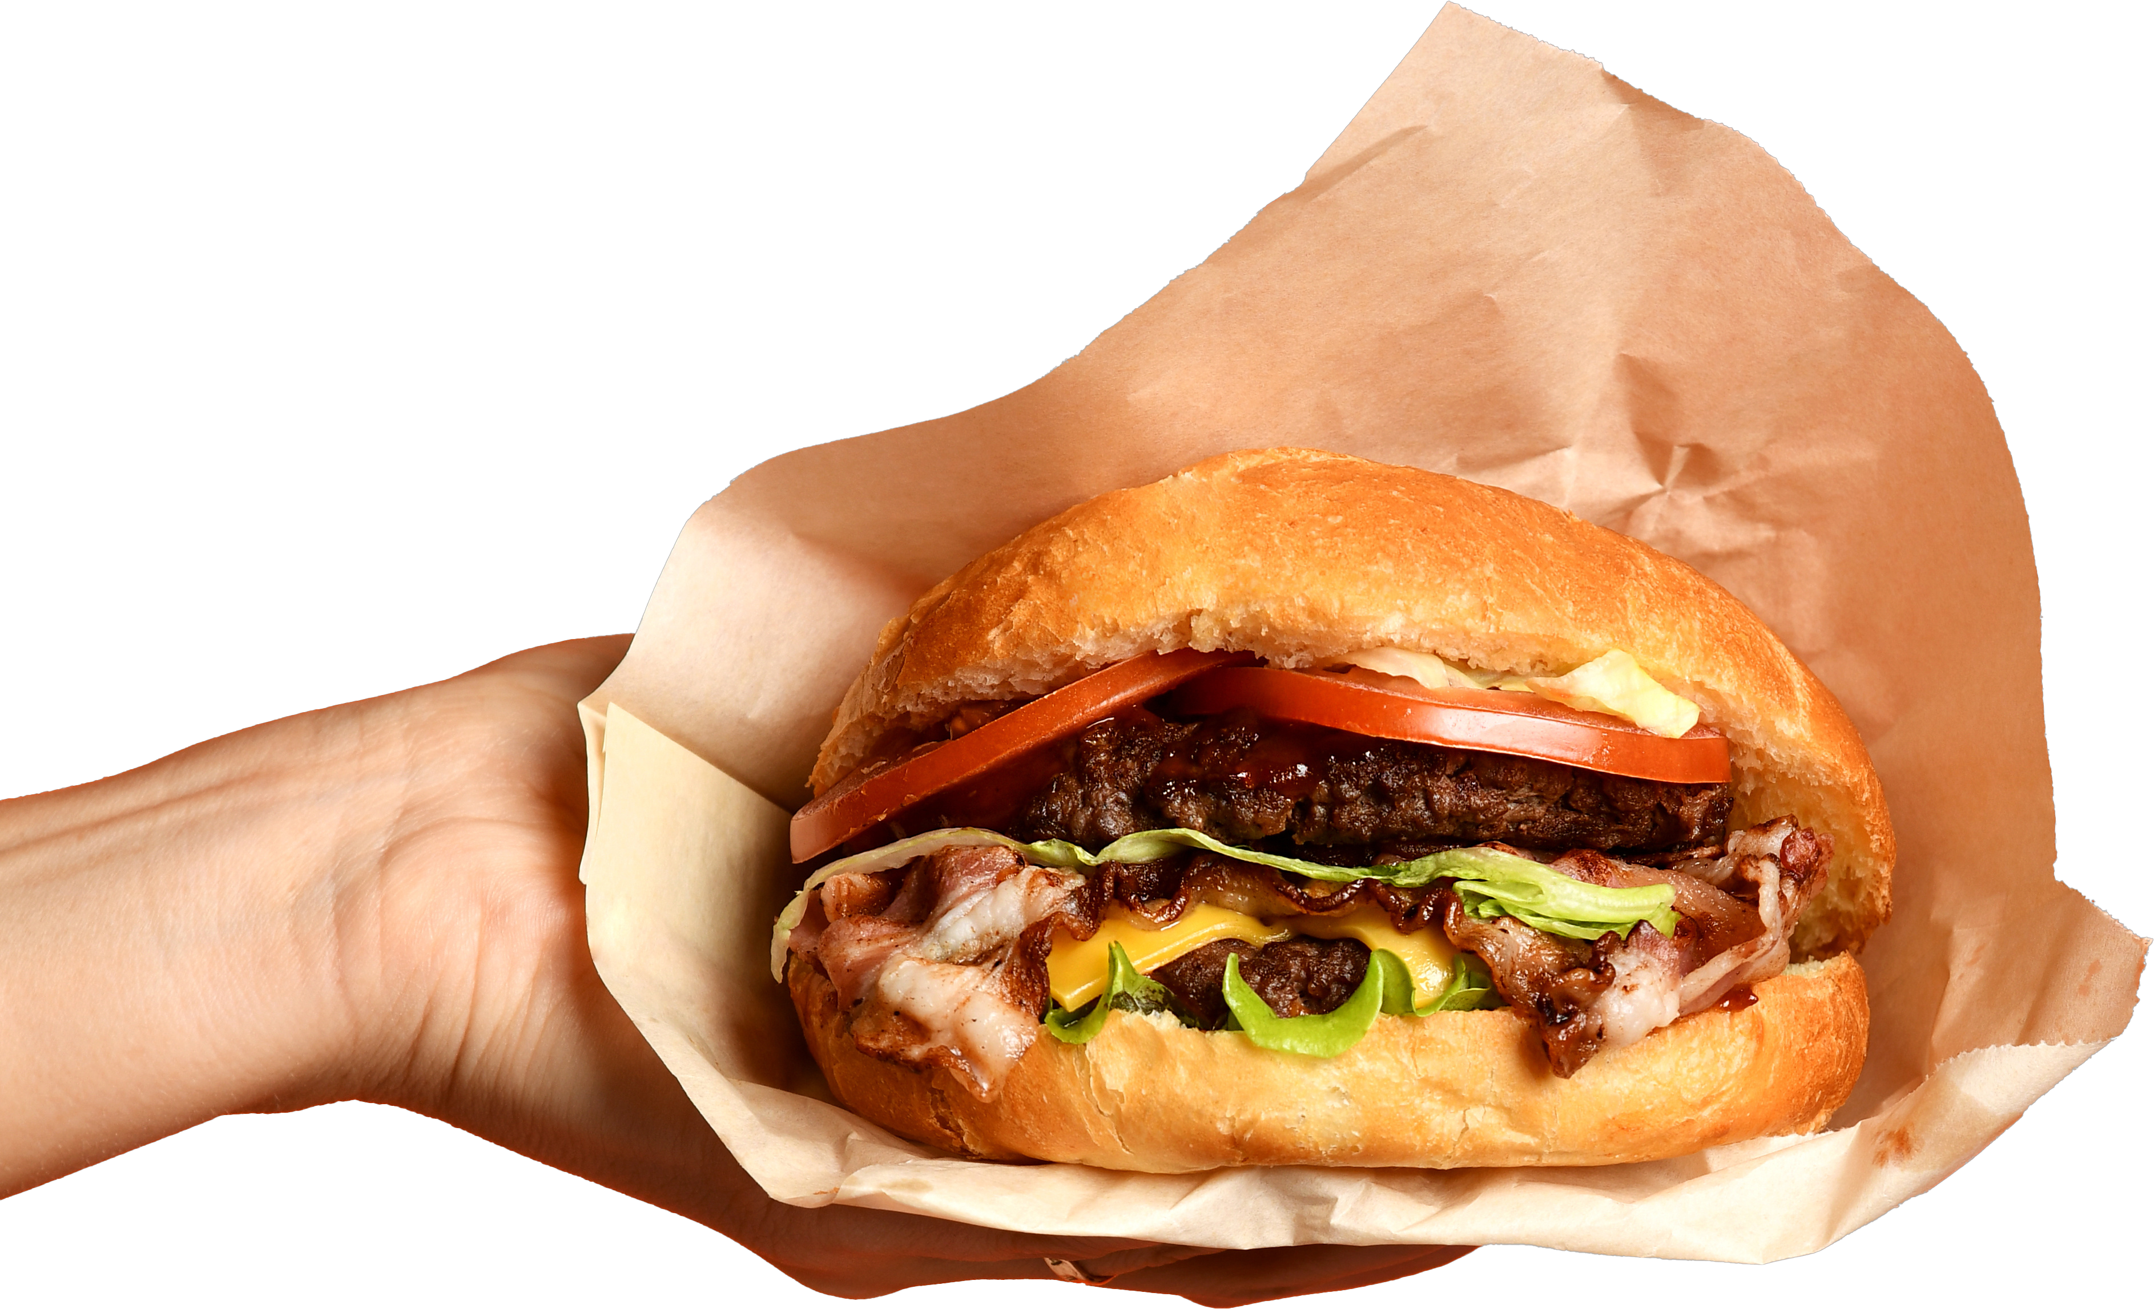
Self-service kiosk benefits
Increases the restaurant's capacity to receive orders and serve more customers in less time
Reduced labor cost
Revamped UI

Slide 5
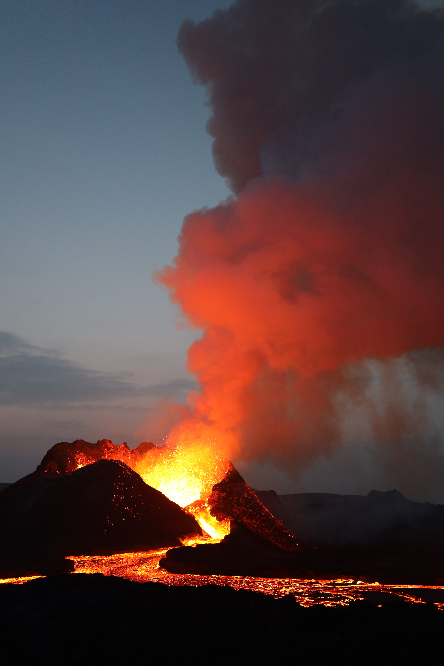
Latest additions
Kiosk enhancements
eCom ordering with QR code ordering
QSR Host
KDS enhancements
Comments

Slide 6

Kiosk
Recent enhancements
Roadmap
Refactored order flow
Multi-Language
Scan items
Scan member
Responsive layout
Discounts
Accessibility
Make it a meal
Cross-selling

Slide 7
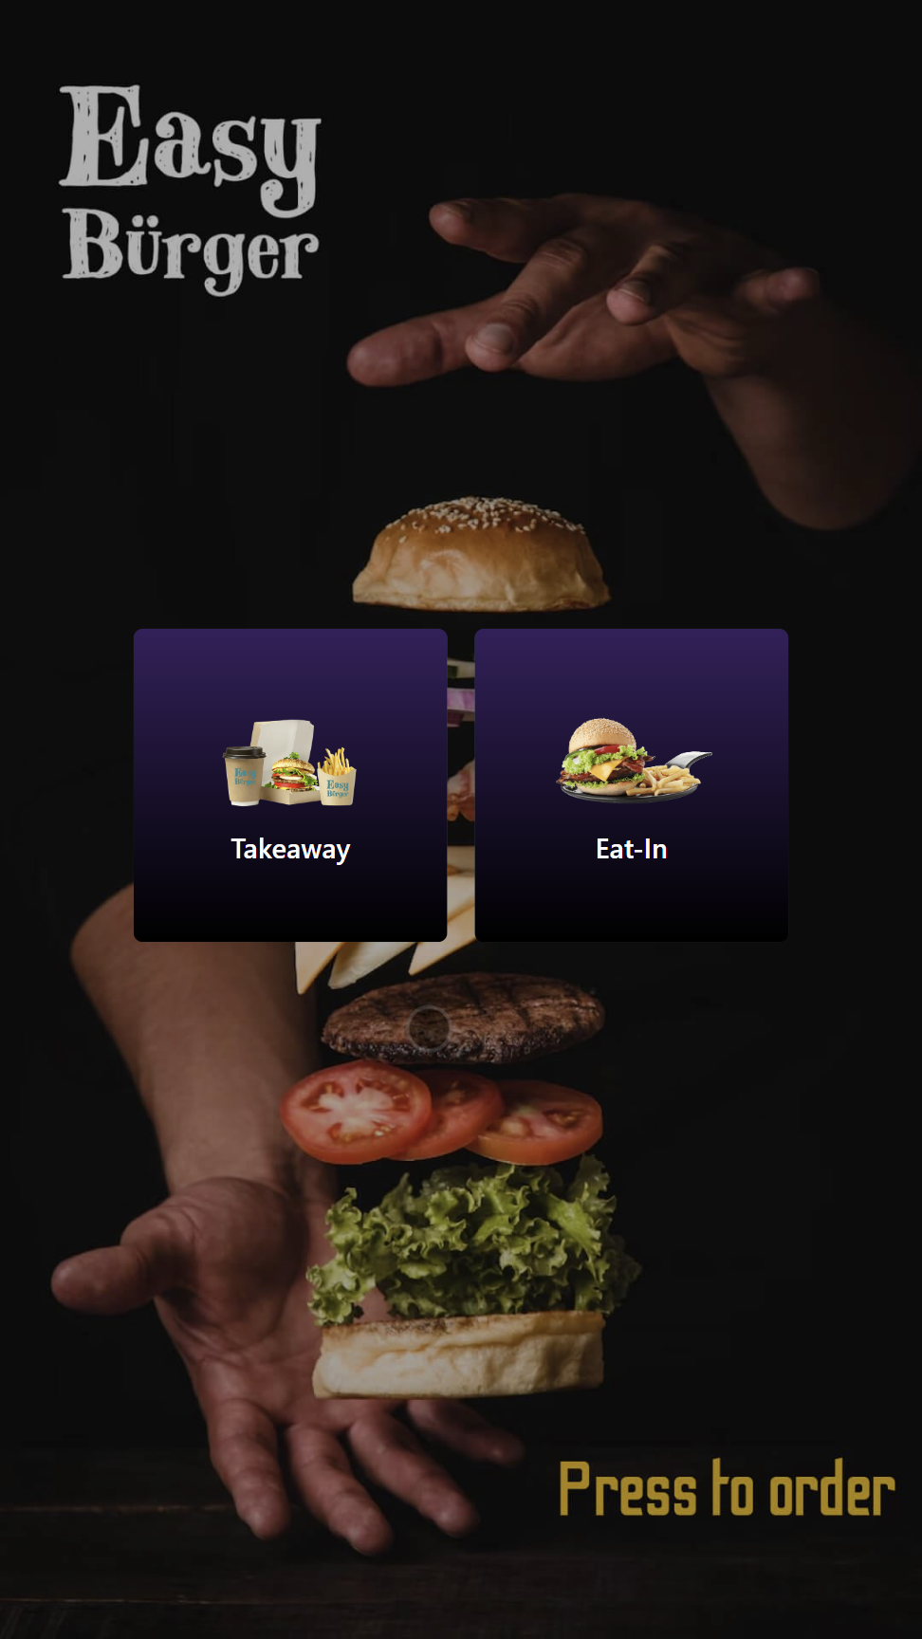
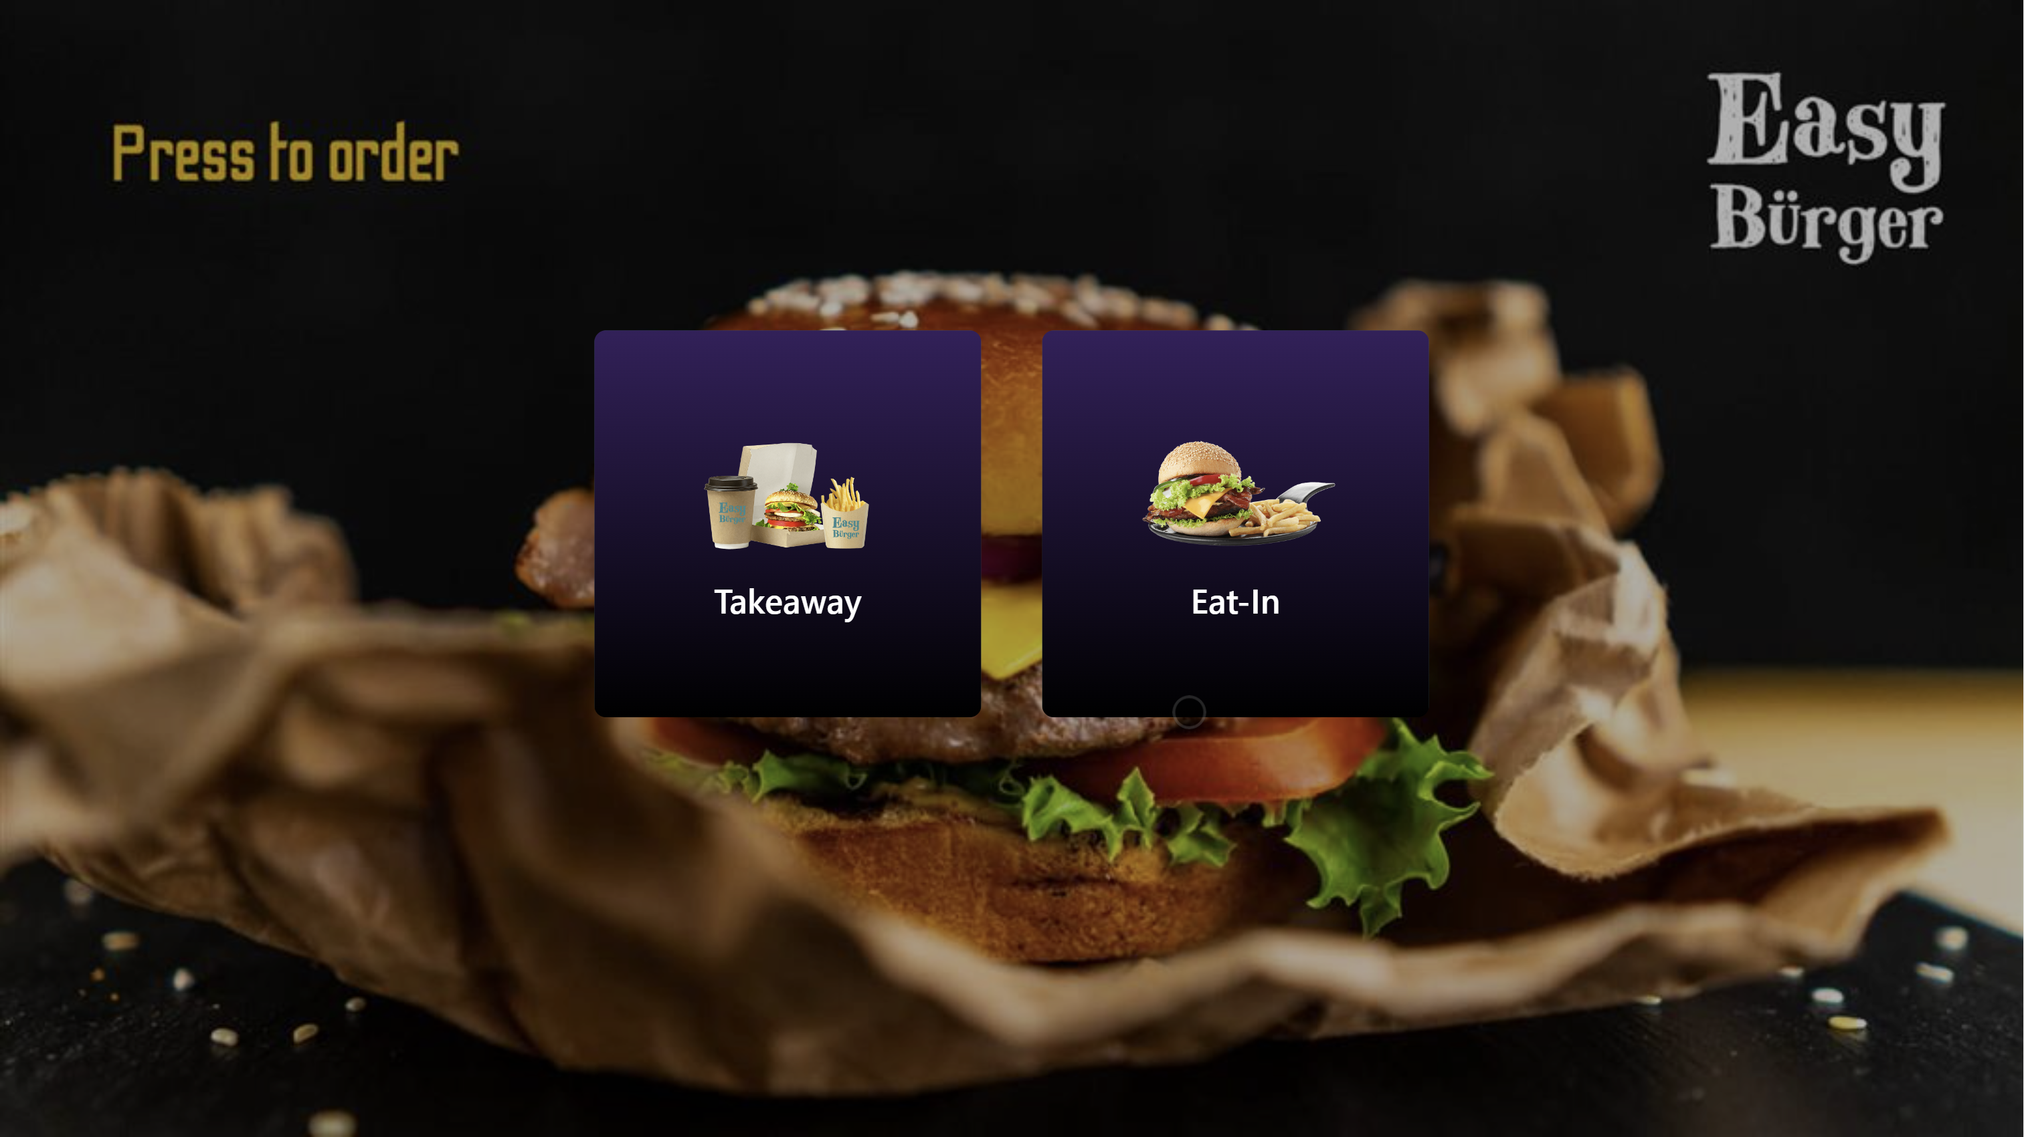

Slide 8
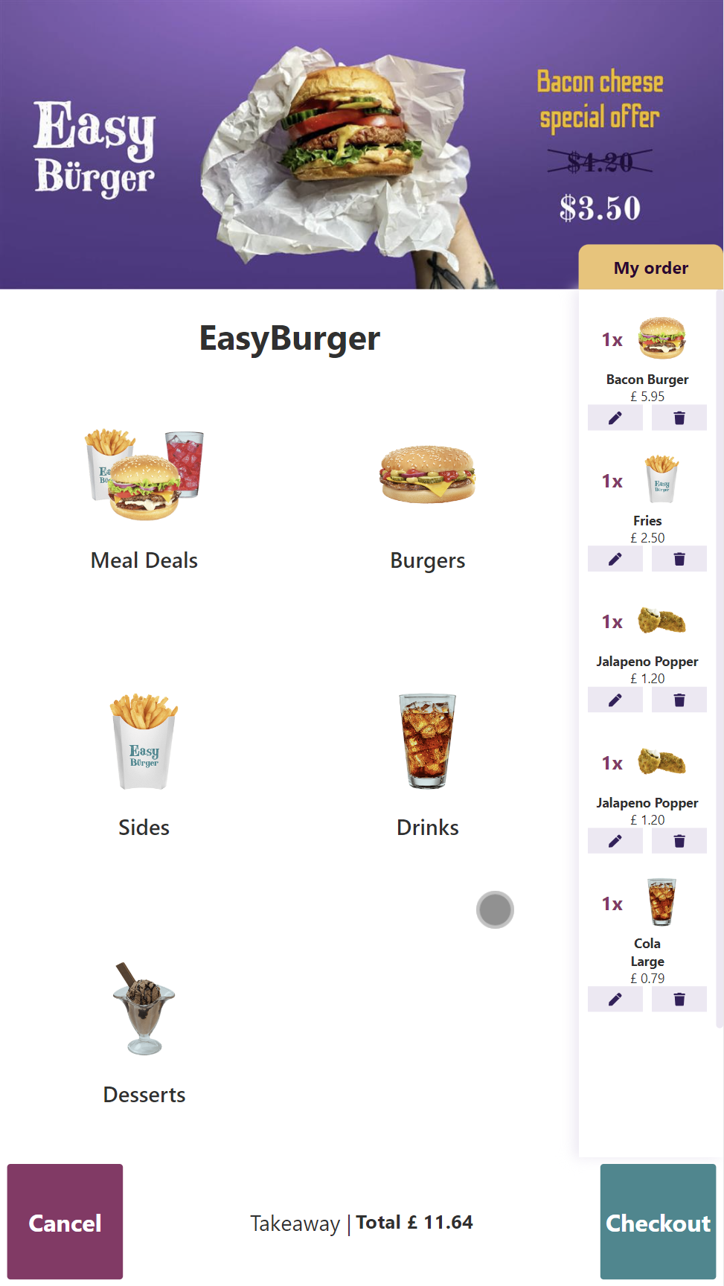
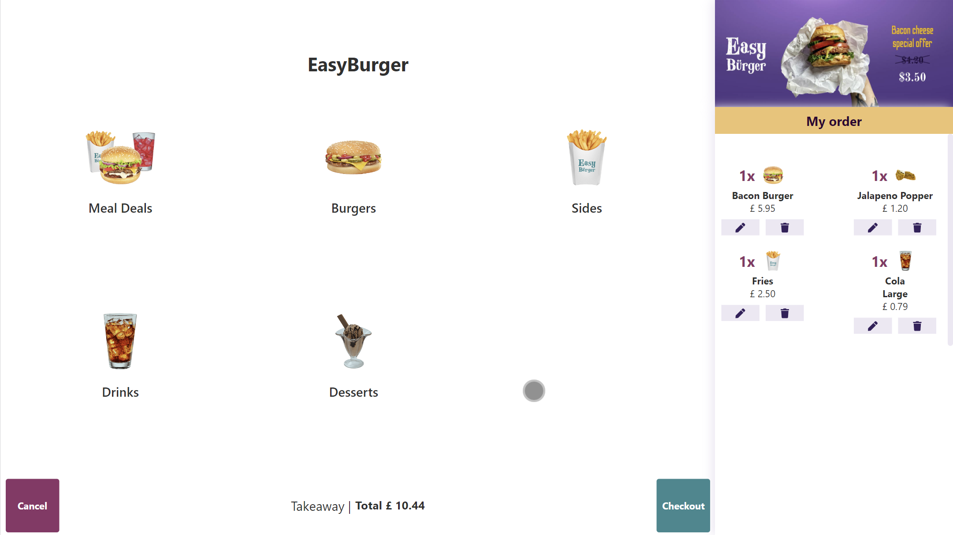

Slide 9
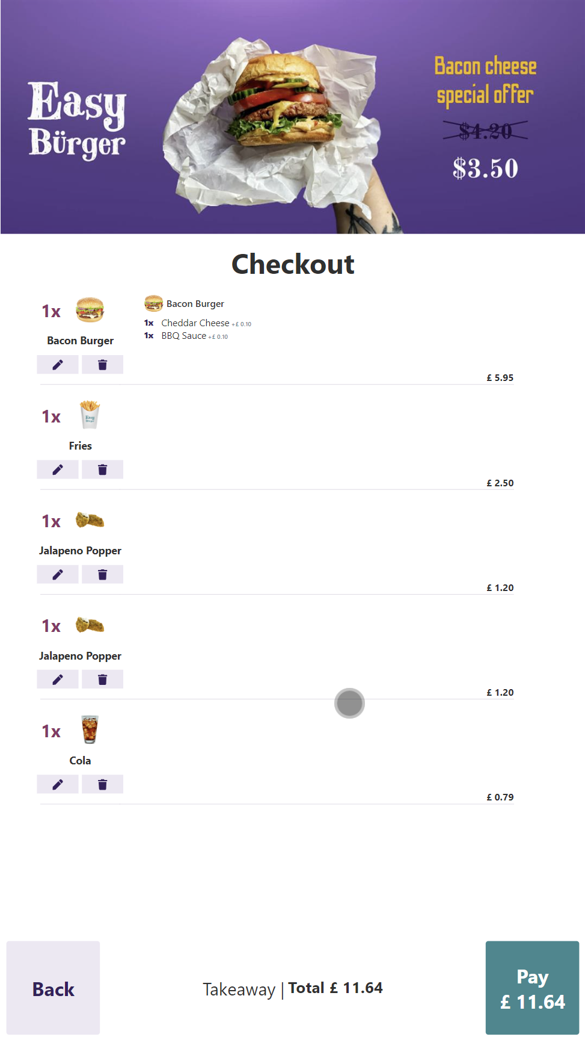
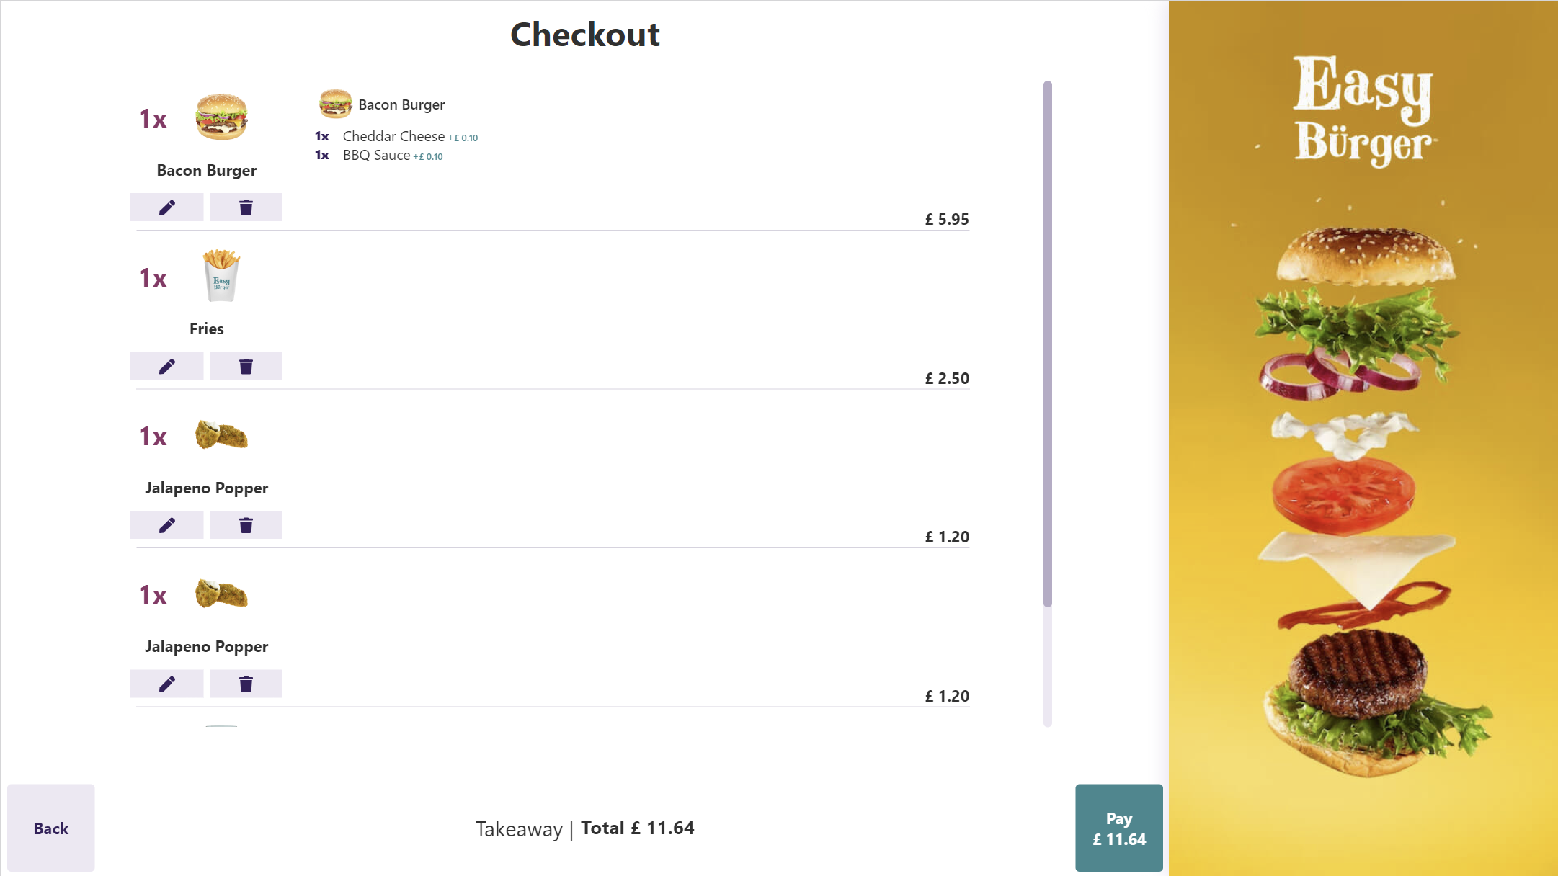

Slide 10

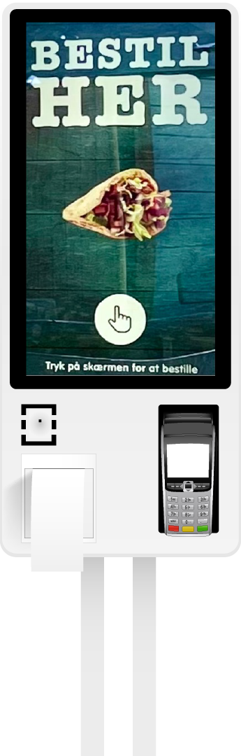
Customer implementation: Djurs Sommerland
Complete upgrade to LS Central
3 Restaurants using Kiosk
3 Kitchens with KDS
18 Self-Services
Online On-Prem with 91 POSs
> 10000 transactions per day

Slide 11
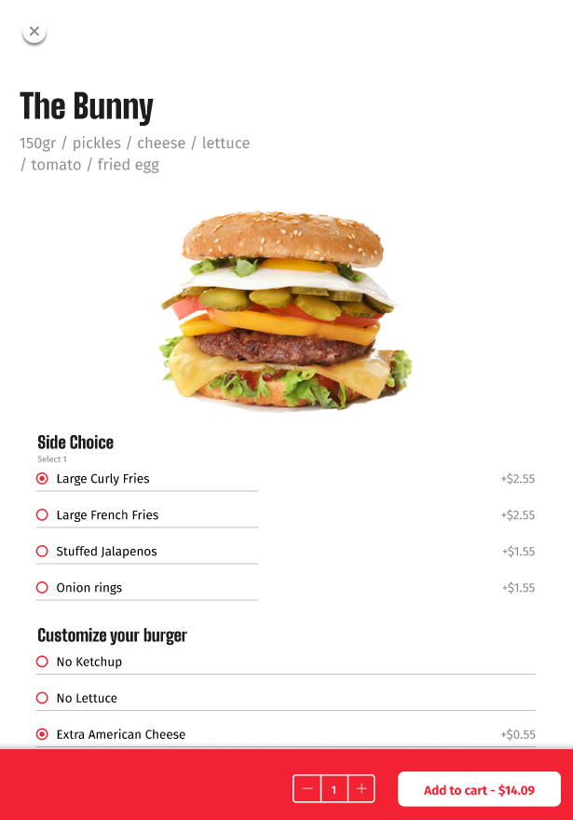
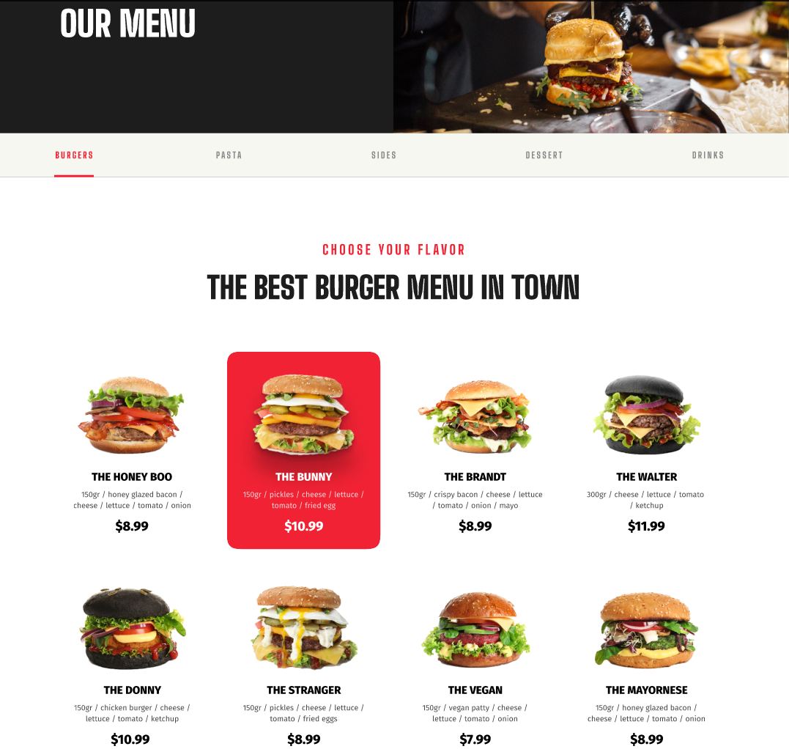
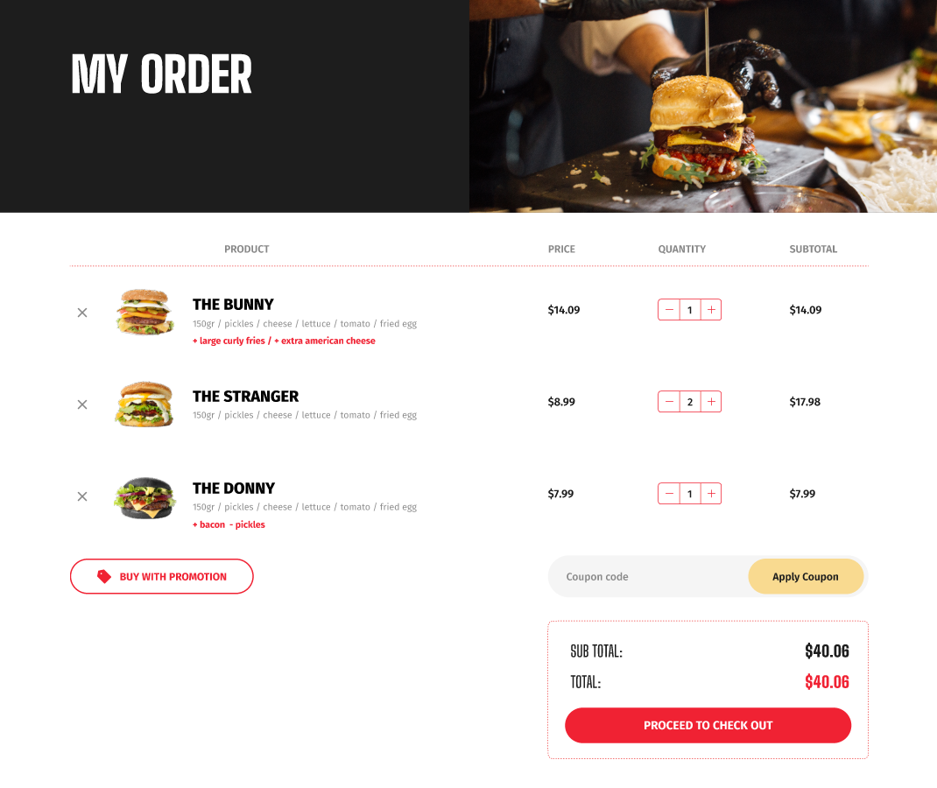
eCommerce for Hospitality – Online food ordering

Slide 12
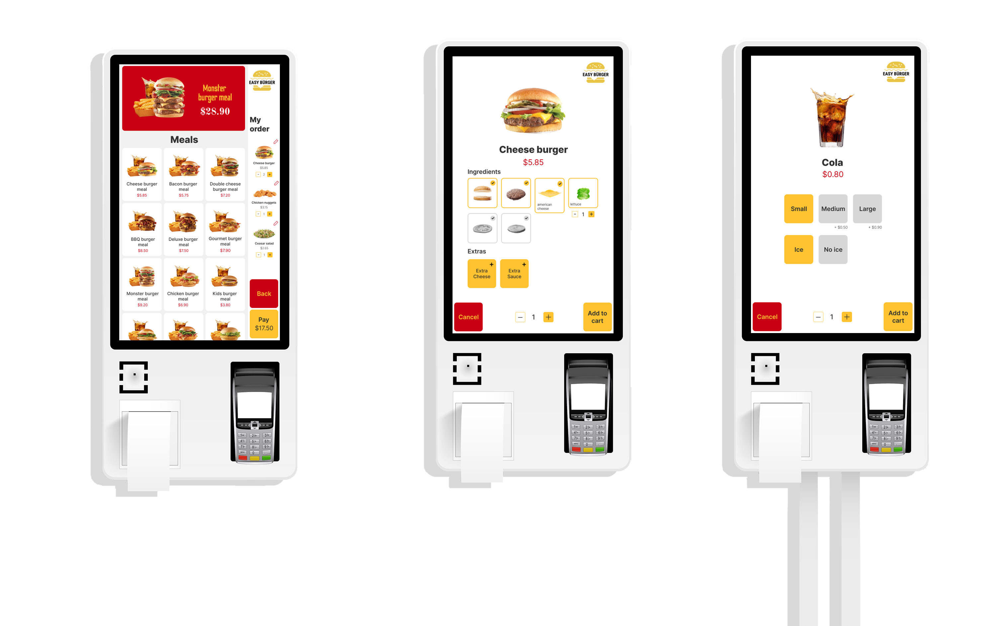

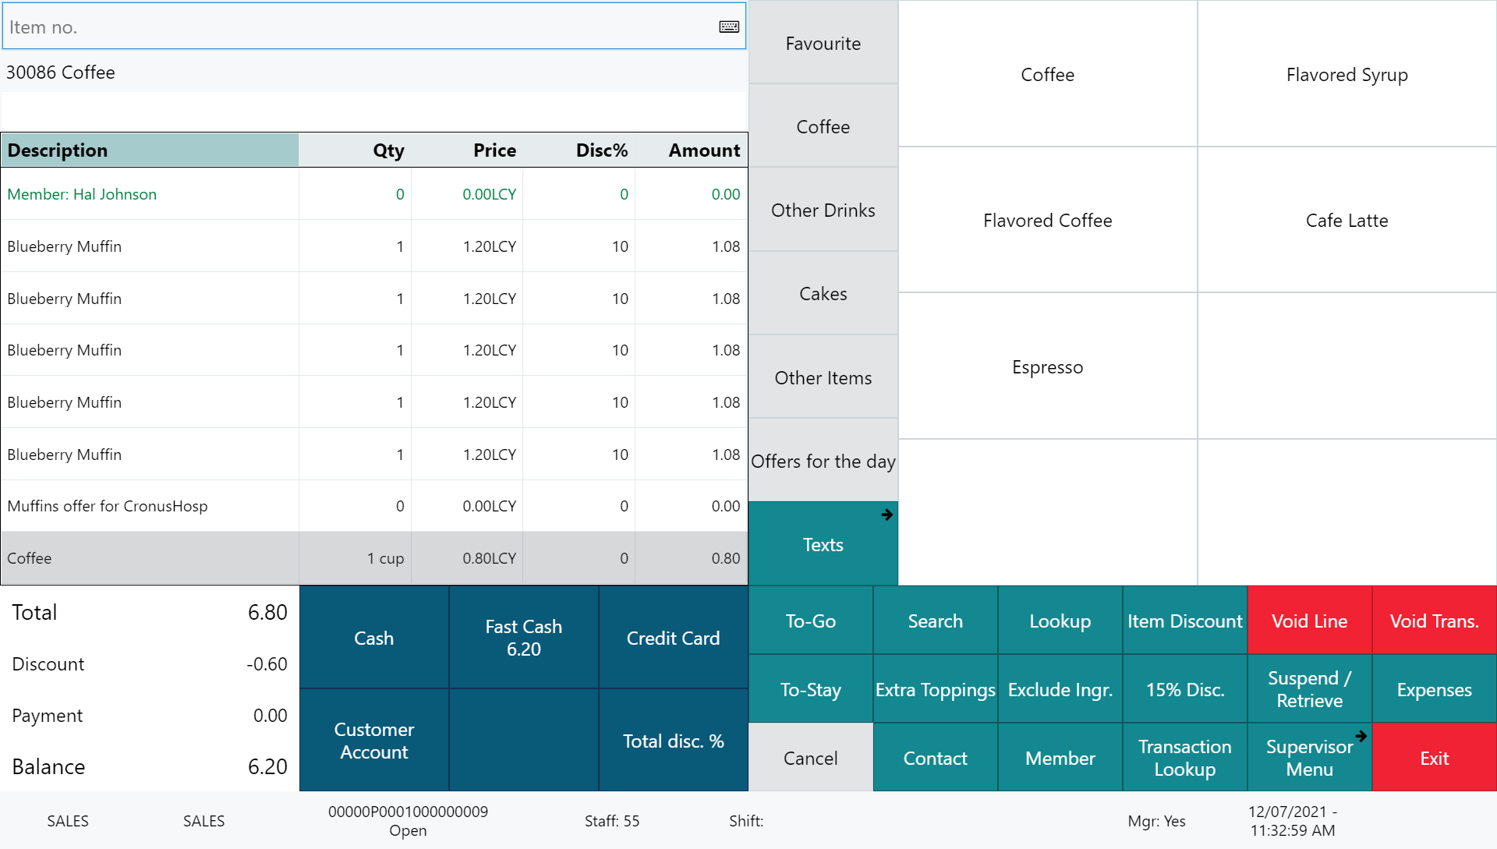
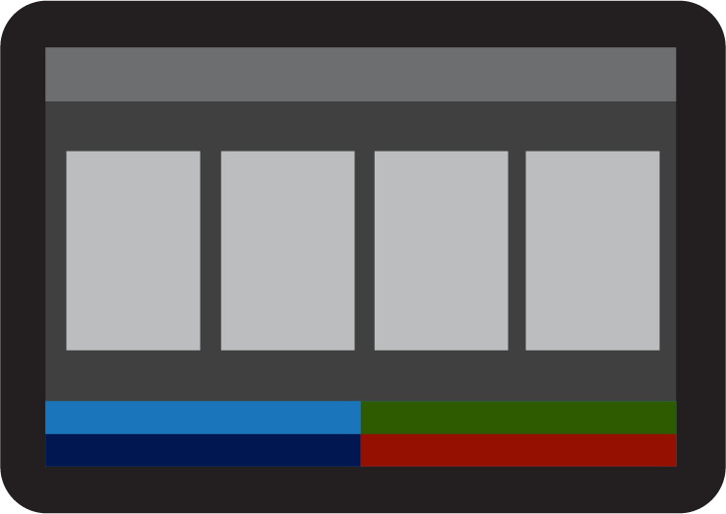


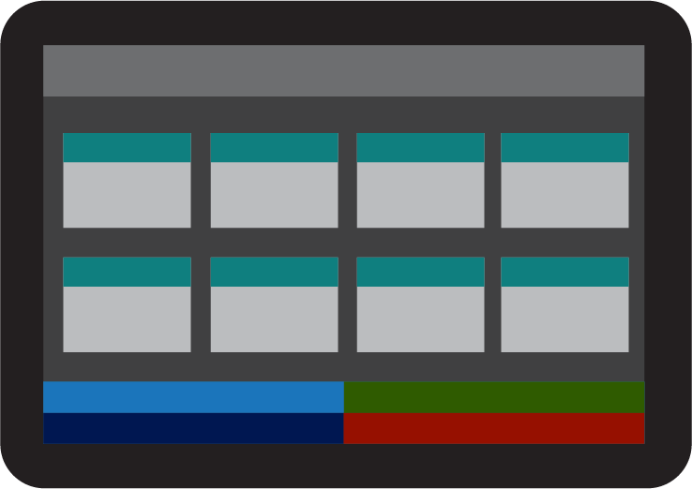


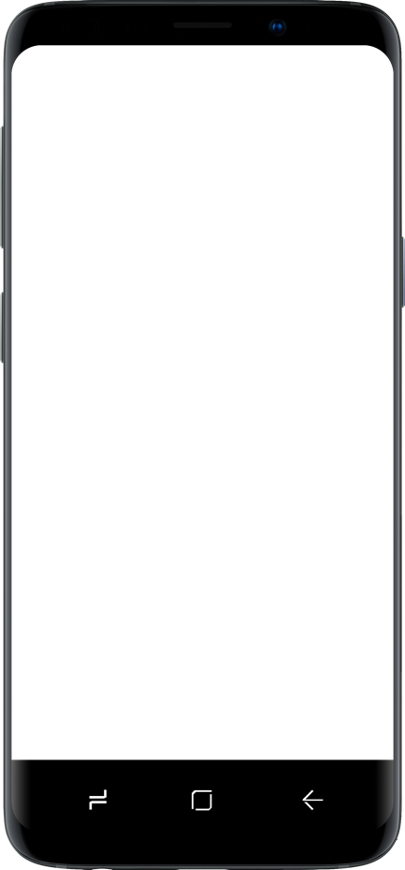
Restaurant
KDS preparation stations
Self Service Kiosks
POS 1
POS 2
LS KDS
Grill
KDS
Cold
Expeditor
station
Kitchen Service
Dessert
Bar
Online ordering

Slide 13
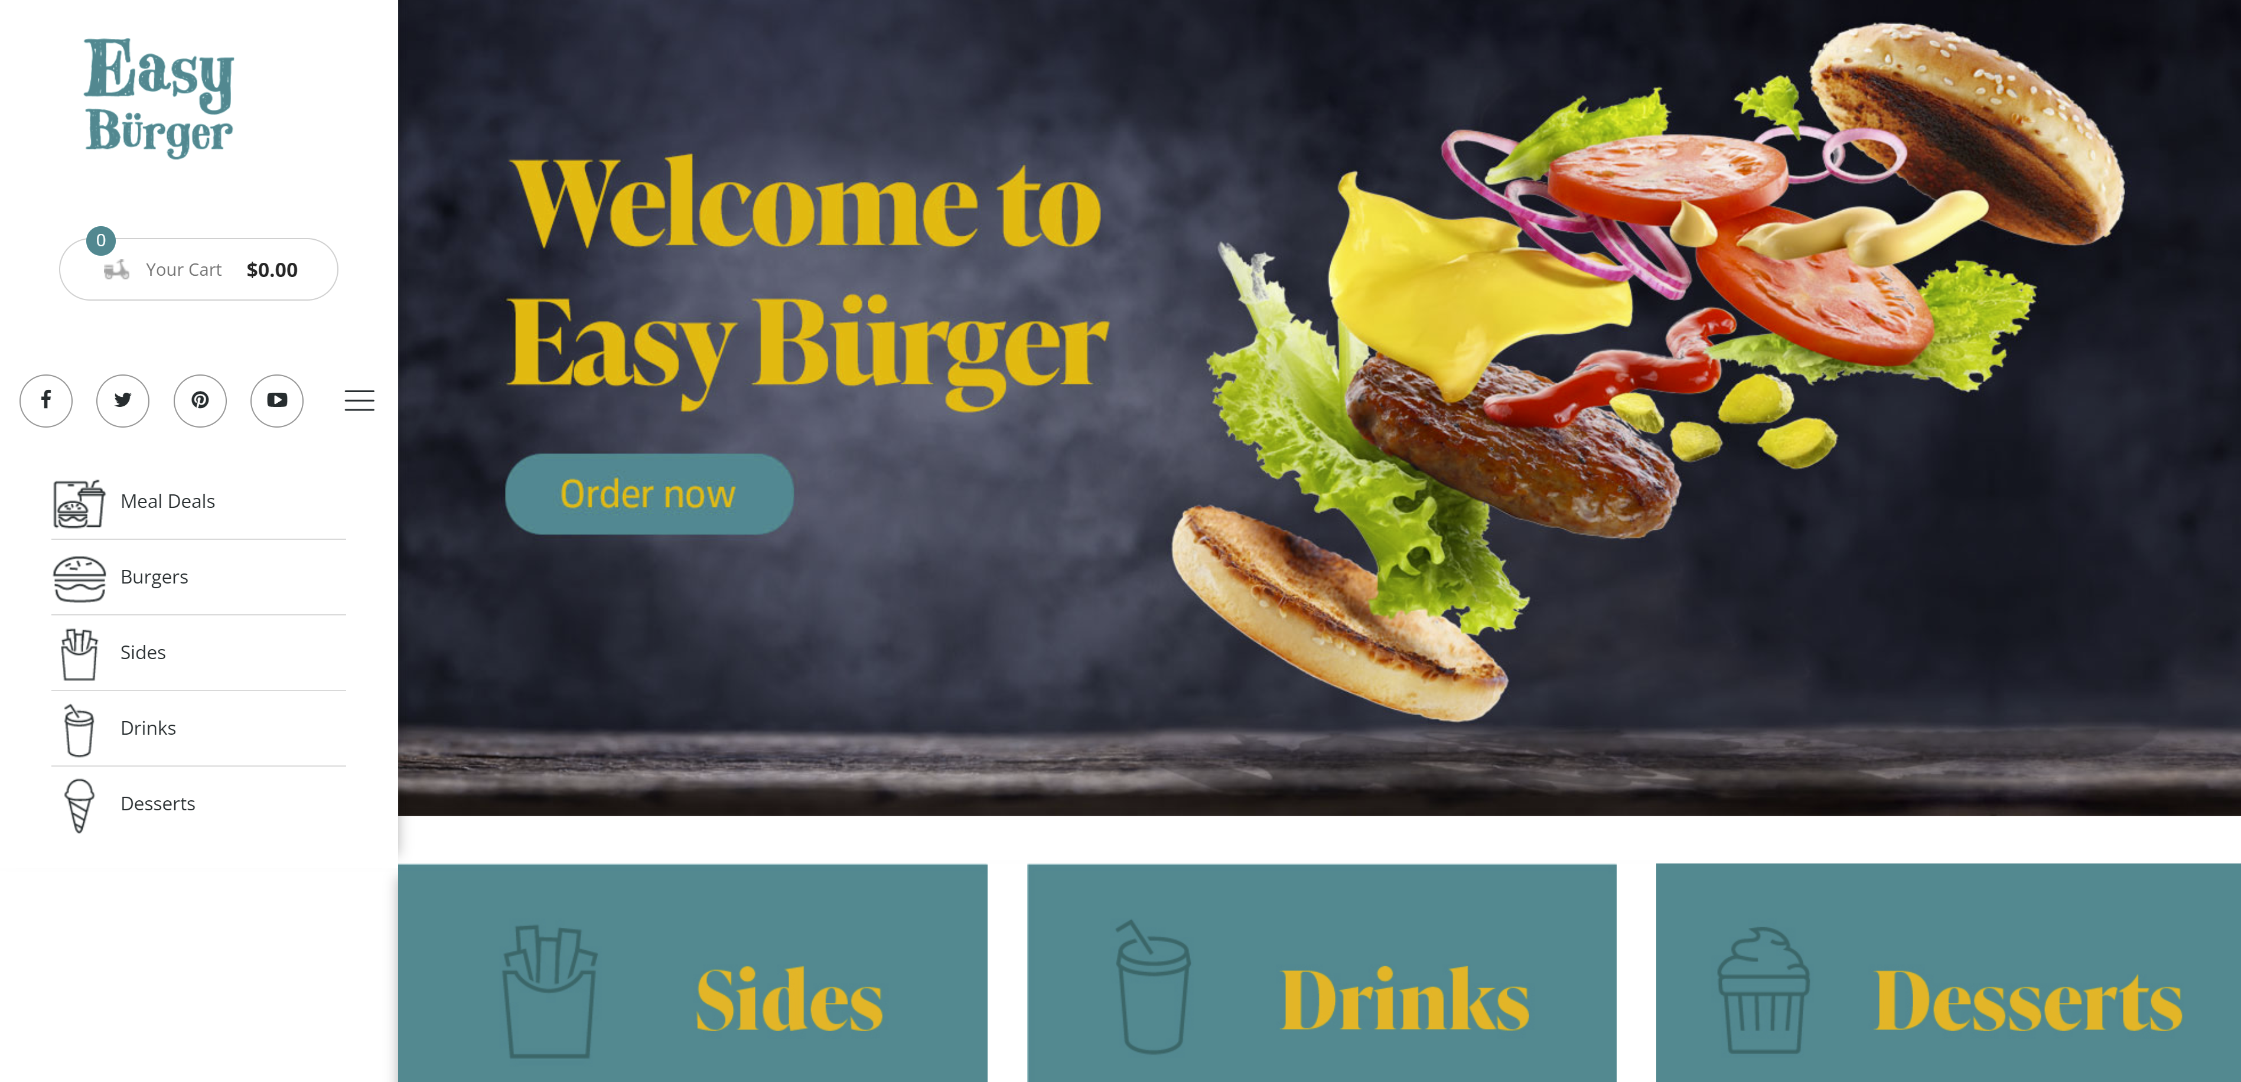
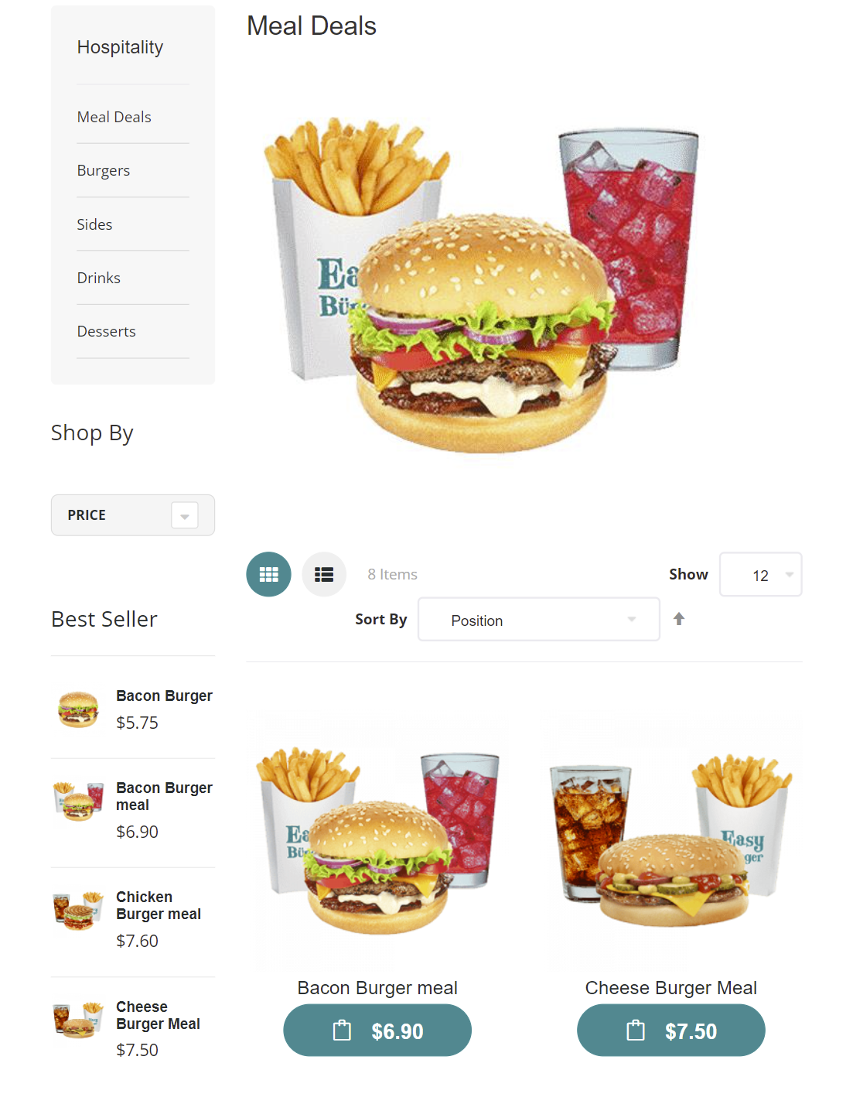
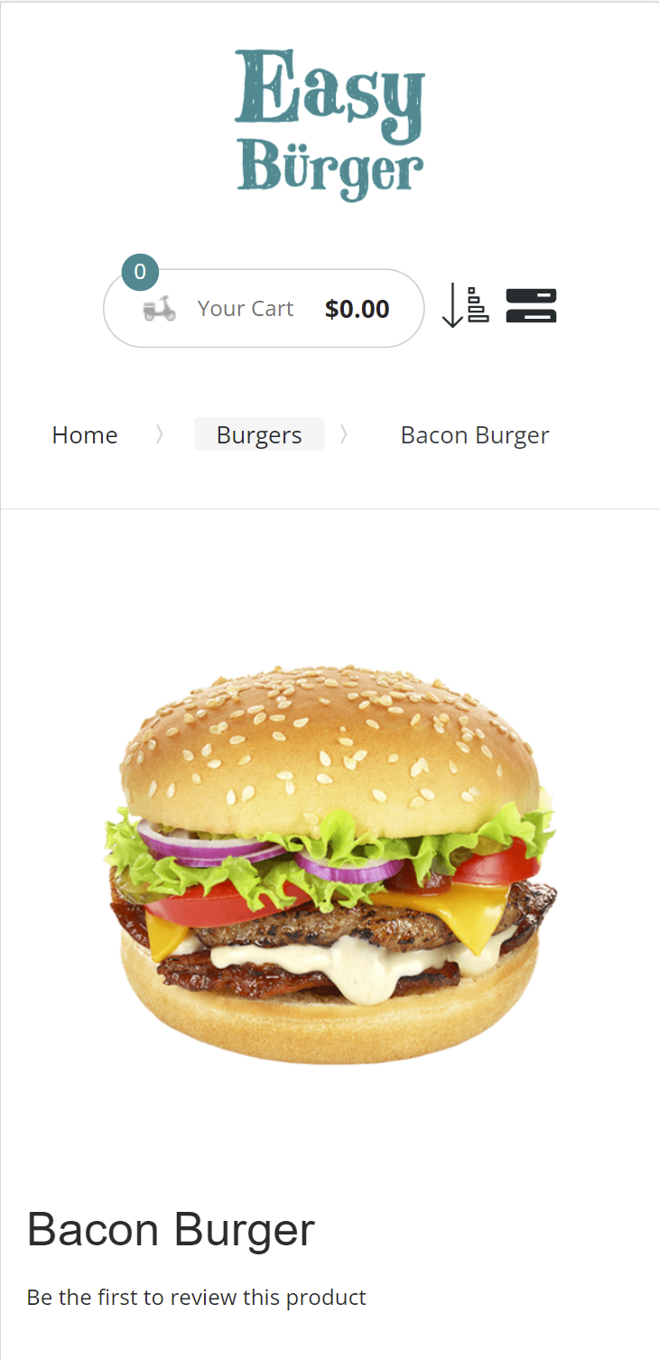
Magento UI options
Traditional
Progressive Web App (PWA)

Slide 14
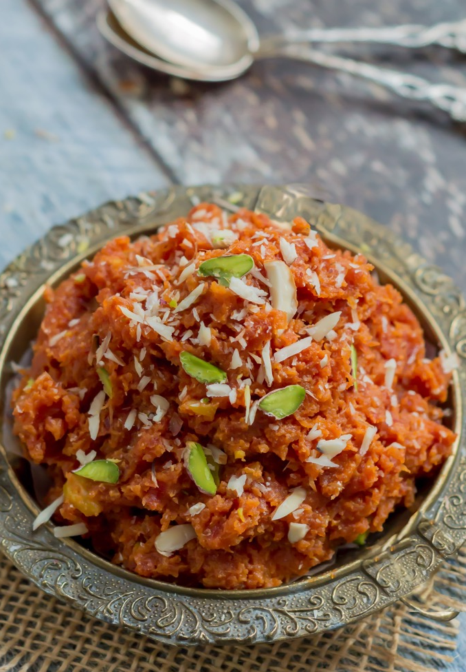
Features
Take-away and dine-in
Menu setup in LS Central
  Items (Images, longer descriptions)
  Deals, with price change support
  Modifiers
  Ingredients and allergens
Basket calculation via LS Central
Customers are member contacts in LS Central
Orders instantly posted to LS Central and routed to the KDS

Slide 15
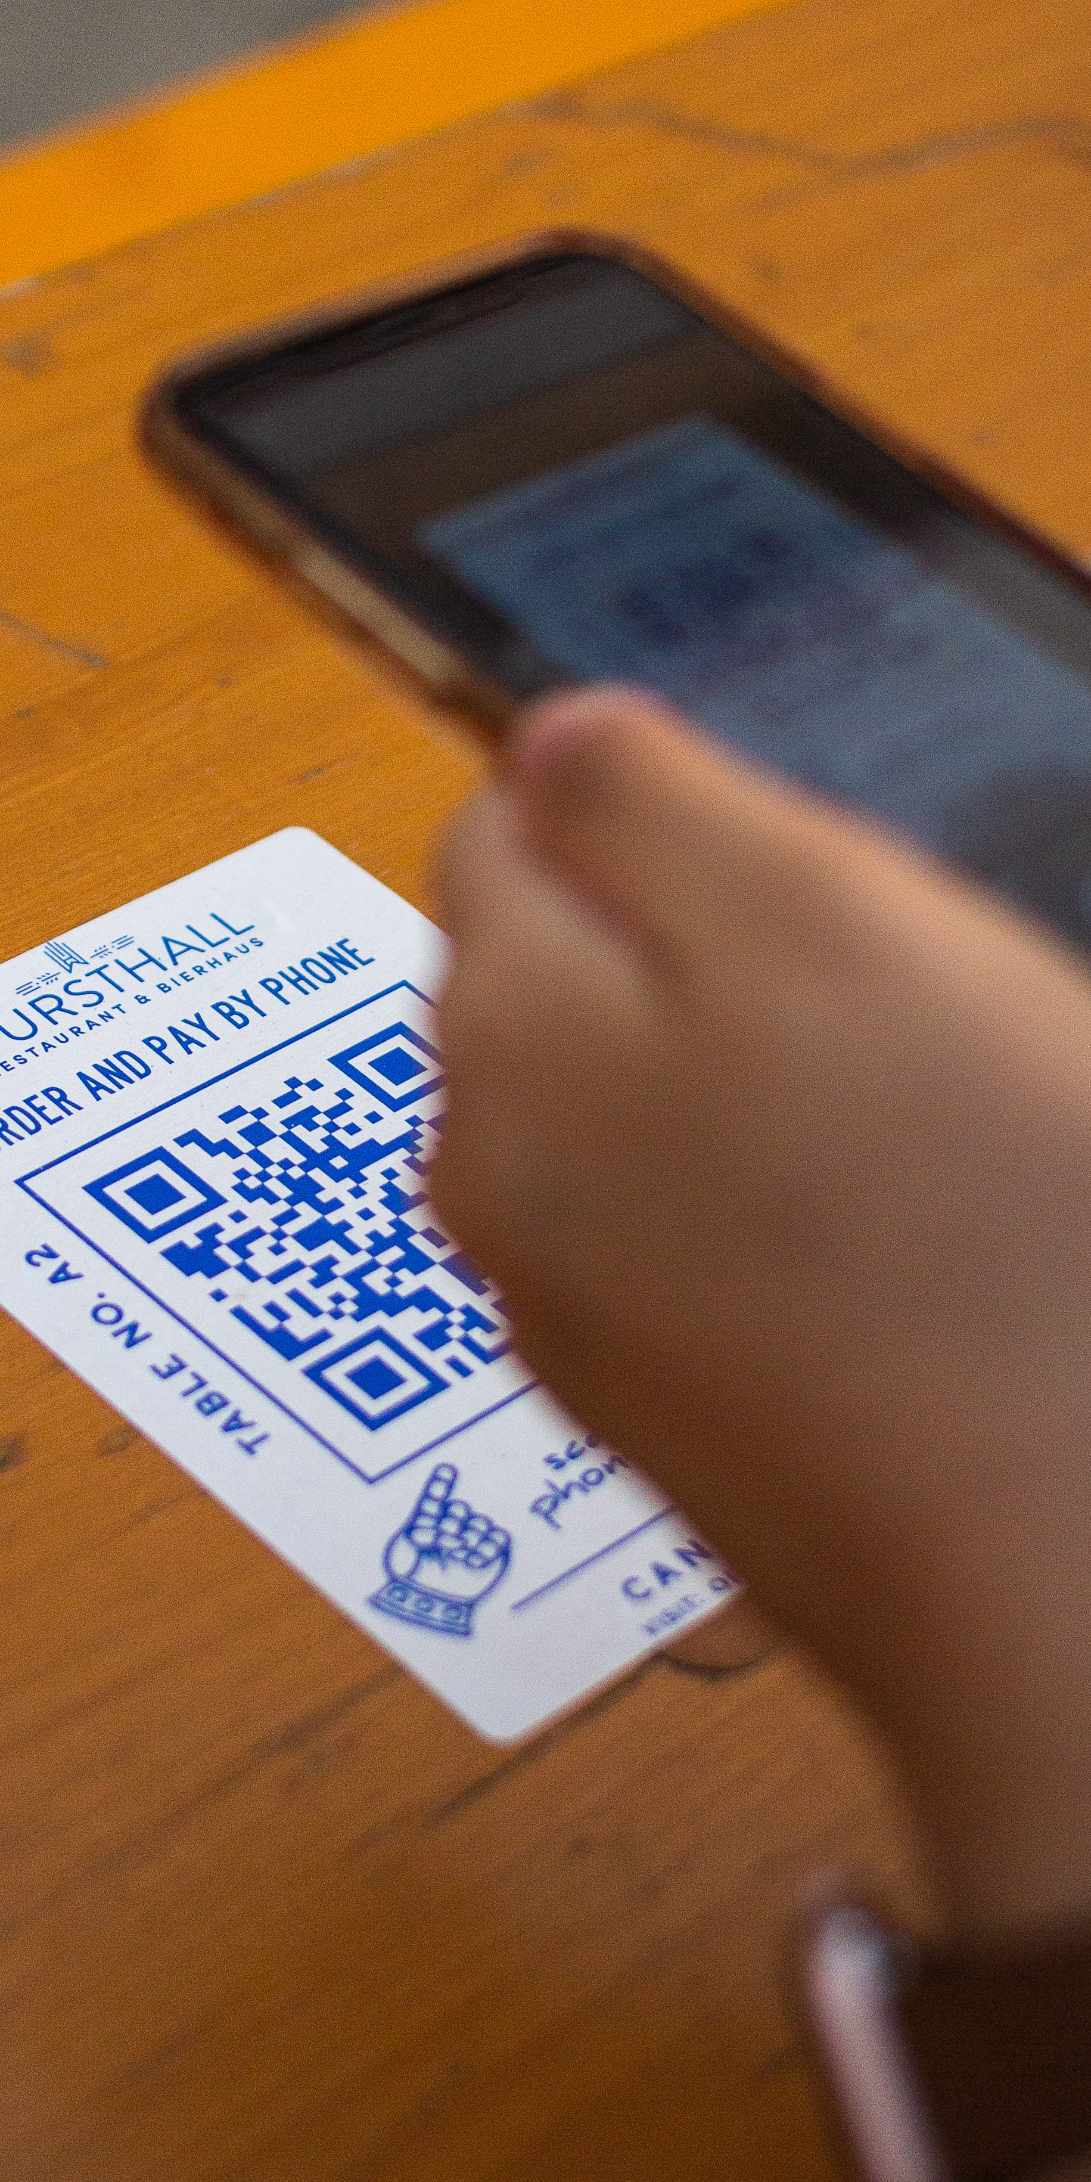
QR Code ordering process
Customer scans a QR Code at a restaurant table, directing the customer to the restaurant’s website and disclosing the ID of the customer’s location (table, seat, cabin, etc.)
Customer orders via the web site. Payment is either online or on the POS.
The order is instantly posted to LS Central and routed to the KDS system for preparation
When ready LS Central instructs the waiters where to deliver the dish

Slide 16
Thank you

