Slide 3


Analytics
for LS Central
Martin Kleindl | Omair Zuberi
Product Director | Solution Architect
Martin.Kleindl@LSRetail.com| OmairZu@LSRetail.com

Slide 4

The king is dead, long live the king !
LS Insight is now …
Analytics for LS Central

Slide 5

Agenda
Why Analytics for LS Central?
Covered Business Intelligence scenarios
Classical BI (focus on history)
Near real-time BI (focus on today)
Roadmap
How to get started

Slide 6

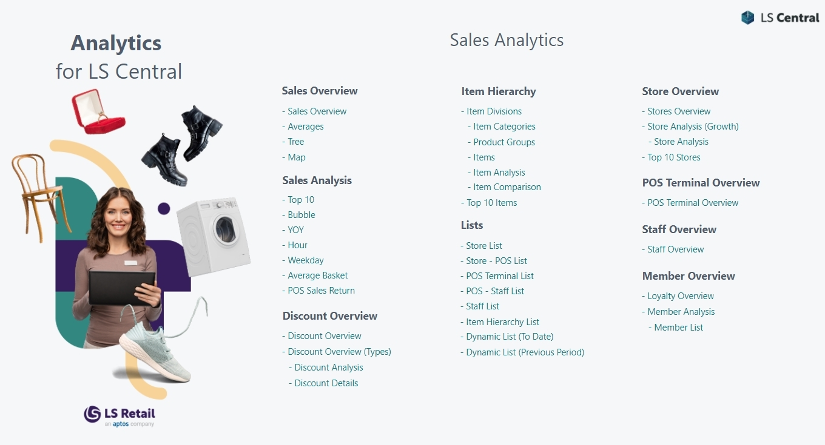





Business Intelligence software options
…
Microsoft
Connector

Slide 7
The
Microsoft way
(with PBI connectors)

Slide 8


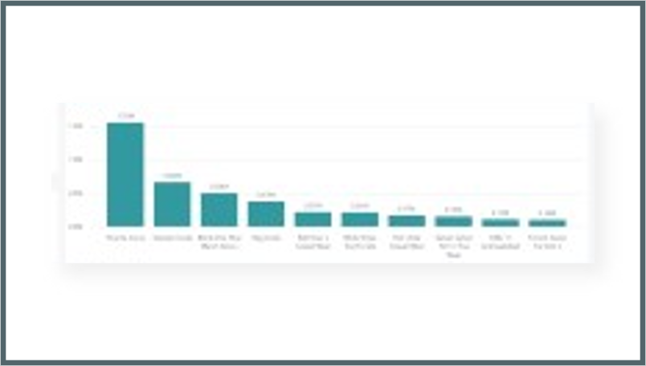
The Microsoft way
Business Central
Power BI
Service
Power BI
Reports
Power BI
Connector
Data
API
API
Query
business logic
API

Slide 9

The Microsoft way
Business Central
Power BI
Service
Power BI
Reports
Complexity
API
Power BI
Connector
Data
API
API
API
API
API
API
API
API
Query
business logic
API
API
API
API
API
API
API
API
API

Slide 10
The Microsoft way
Business Central
Power BI
Service
Power BI
Reports
Direct Query
or Import ?
Power BI
Connector
Data
API
API
Query
business logic
API

Slide 11
The Microsoft way
Business Central
Power BI
Service
Power BI
Reports
Direct Query
Performance issues
if high data volume
Power BI
Connector
Data
API
API
Query
business logic
API

Slide 12
The Microsoft way
Business Central
Power BI
Service
Power BI
Reports
Import Mode
Data size issues
and cost
Power BI
Connector
Data
API
API
Query
business logic
API

Slide 13

The Microsoft way
Business Central
Power BI
Service
Power BI
Reports
Good
for small projects
Power BI
Connector
Data
API
API
Query
business logic
API

Slide 14
The Microsoft way
Business Central
Power BI
Service
Power BI
Reports
Reports
No templates → start from zero
Power BI
Connector
Data
API
API
Query
business logic
API

Slide 15
Analytics
for LS Central

Slide 16
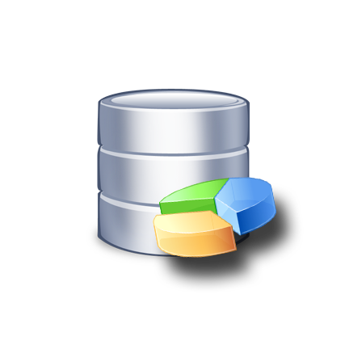
Analytics for LS Central
Business Central
Azure SQL Server Datawarehouse
Power BI
Service
Power BI
Reports
Tables
(on-prem)
Data
warehouse
to load and
aggregate
data
Data
Tables
(SaaS)
Query
business logic

Slide 17
Analytics for LS Central
Business Central
Azure SQL Server
Datawarehouse
Power BI
Service
Power BI
Reports
Tables
(on-prem)
Dataware house
Data
Tables
(SaaS)
Staging
Query
business logic
Prestaging

Slide 18
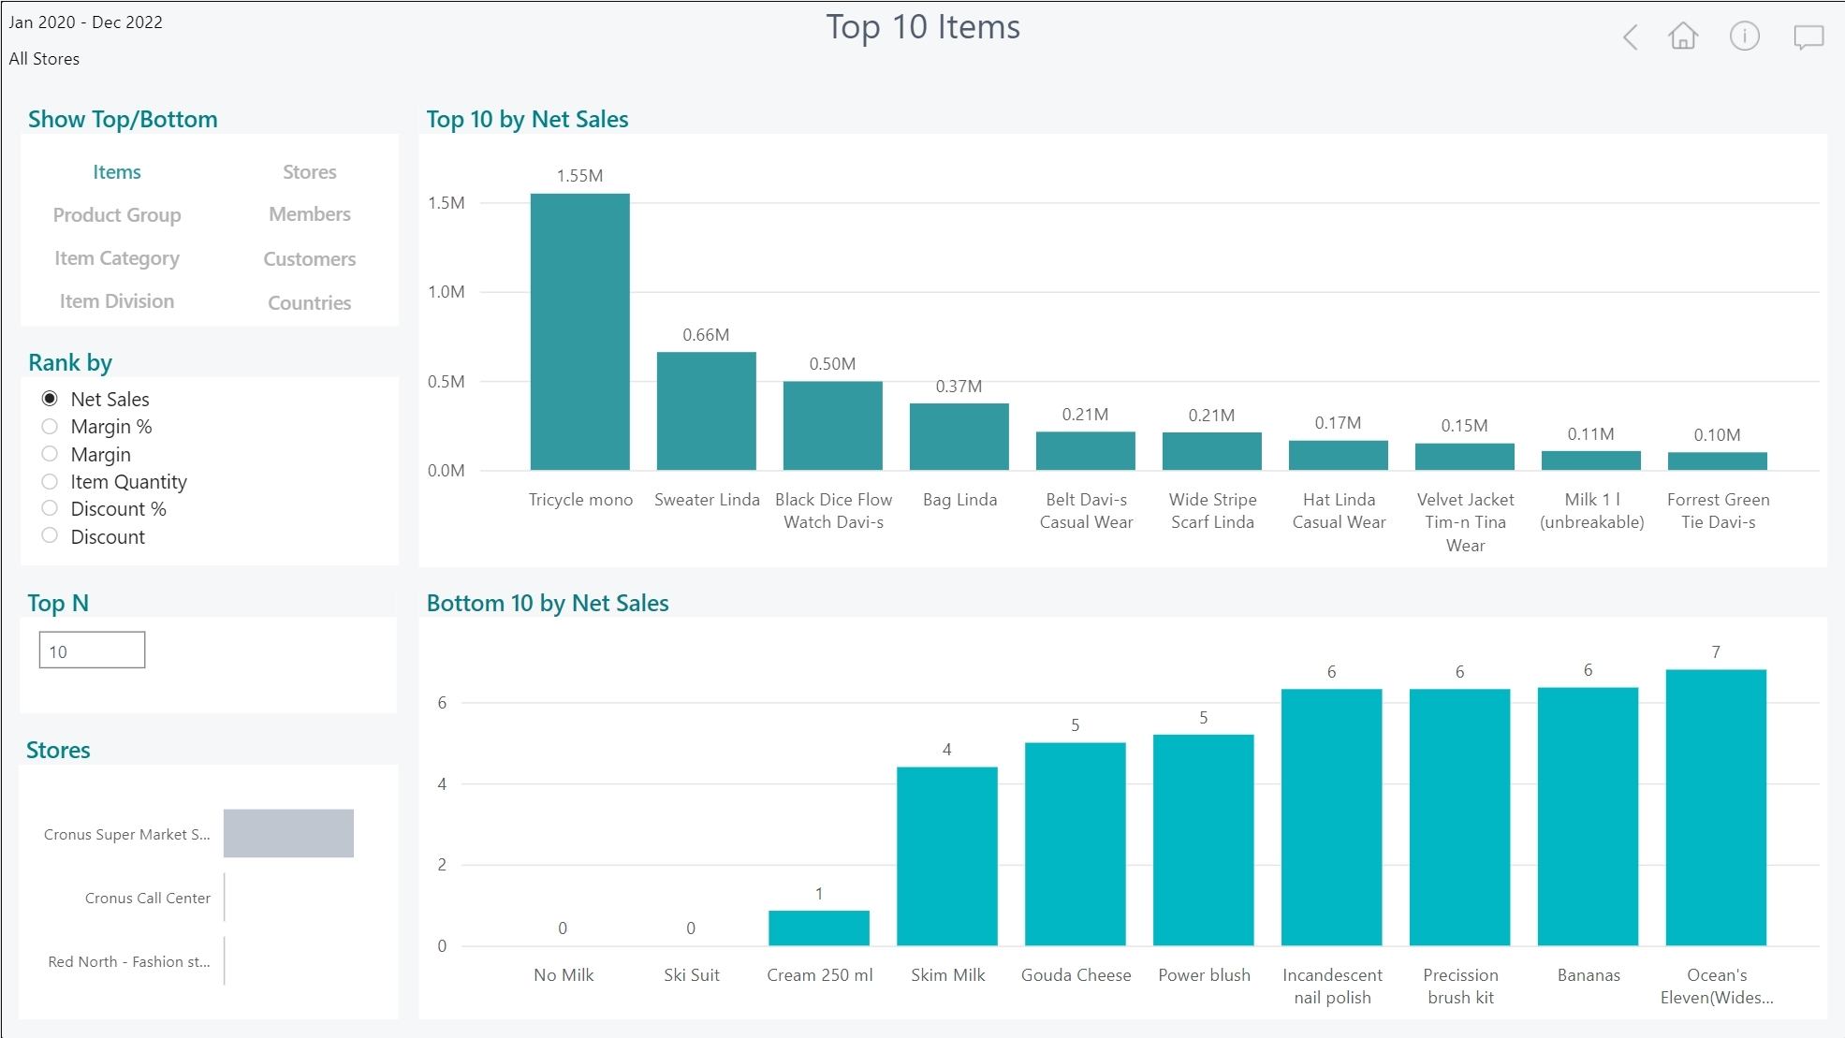
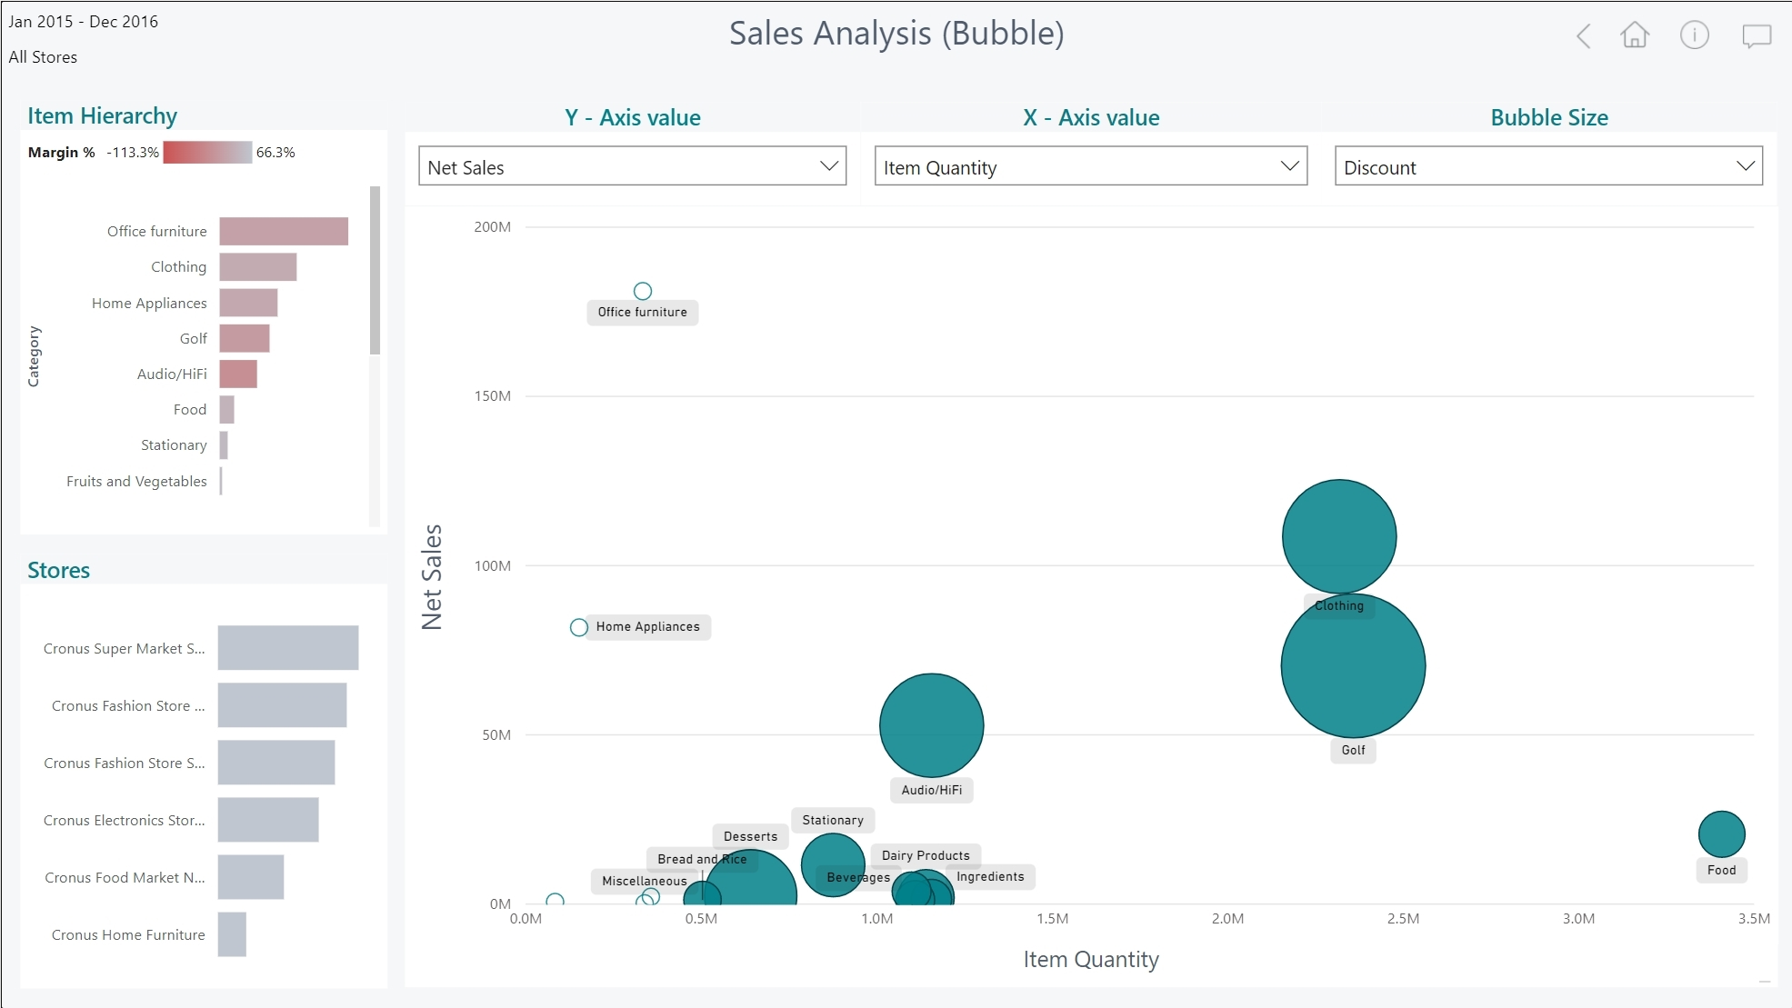


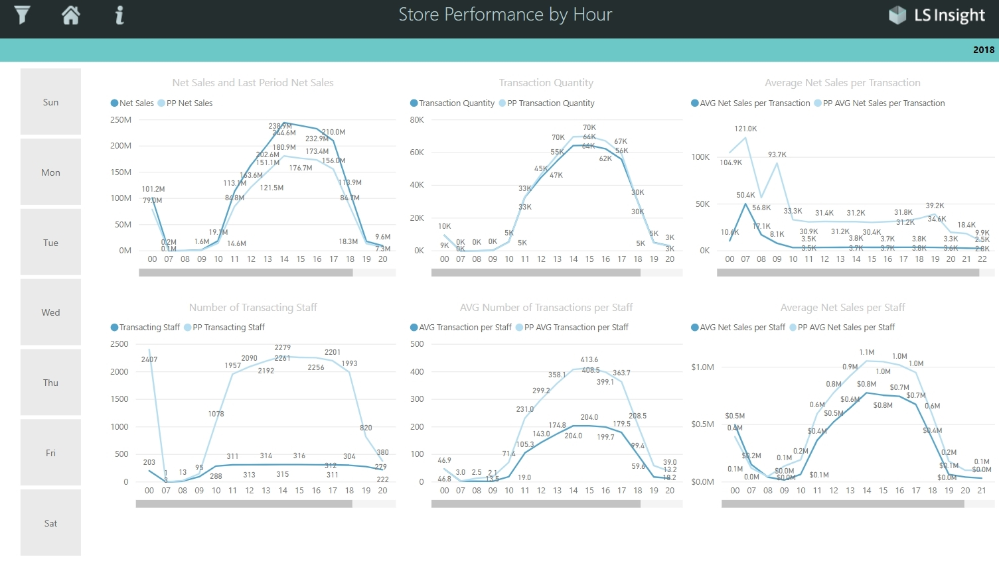
Analytics for LS Central
100+
Business Central
Azure SQL Server
Datawarehouse
Power BI
Service
Power BI Report
templates
Azure Data
Factory
Dataware house
Tables
(on-prem)
Dataware
house
Data
Staging
Staging
Query
business logic
Tables
(SaaS)
Query
business logic
Prestaging
Prestaging
Data Director
Webservices
Azure Data
Factory

Slide 19
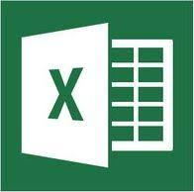

Analytics for LS Central
Analytics - Data warehouse
  Standard Microsoft technology
    Azure SQL Server or SQL Server
    Azure Data Factory (ETL processes and pipelines)
  Easy to extend (new fields, tables, and other data sources)
LS Retail ….
Provides ready-to-use data model, pipelines and logic
You ….
Setup SQL Server (Azure /on-prem)
Download and setup the deployment package from LS Retail
Connect to BC, Load data → GO!
…
Analytics – Data WH
LS Central

Slide 20
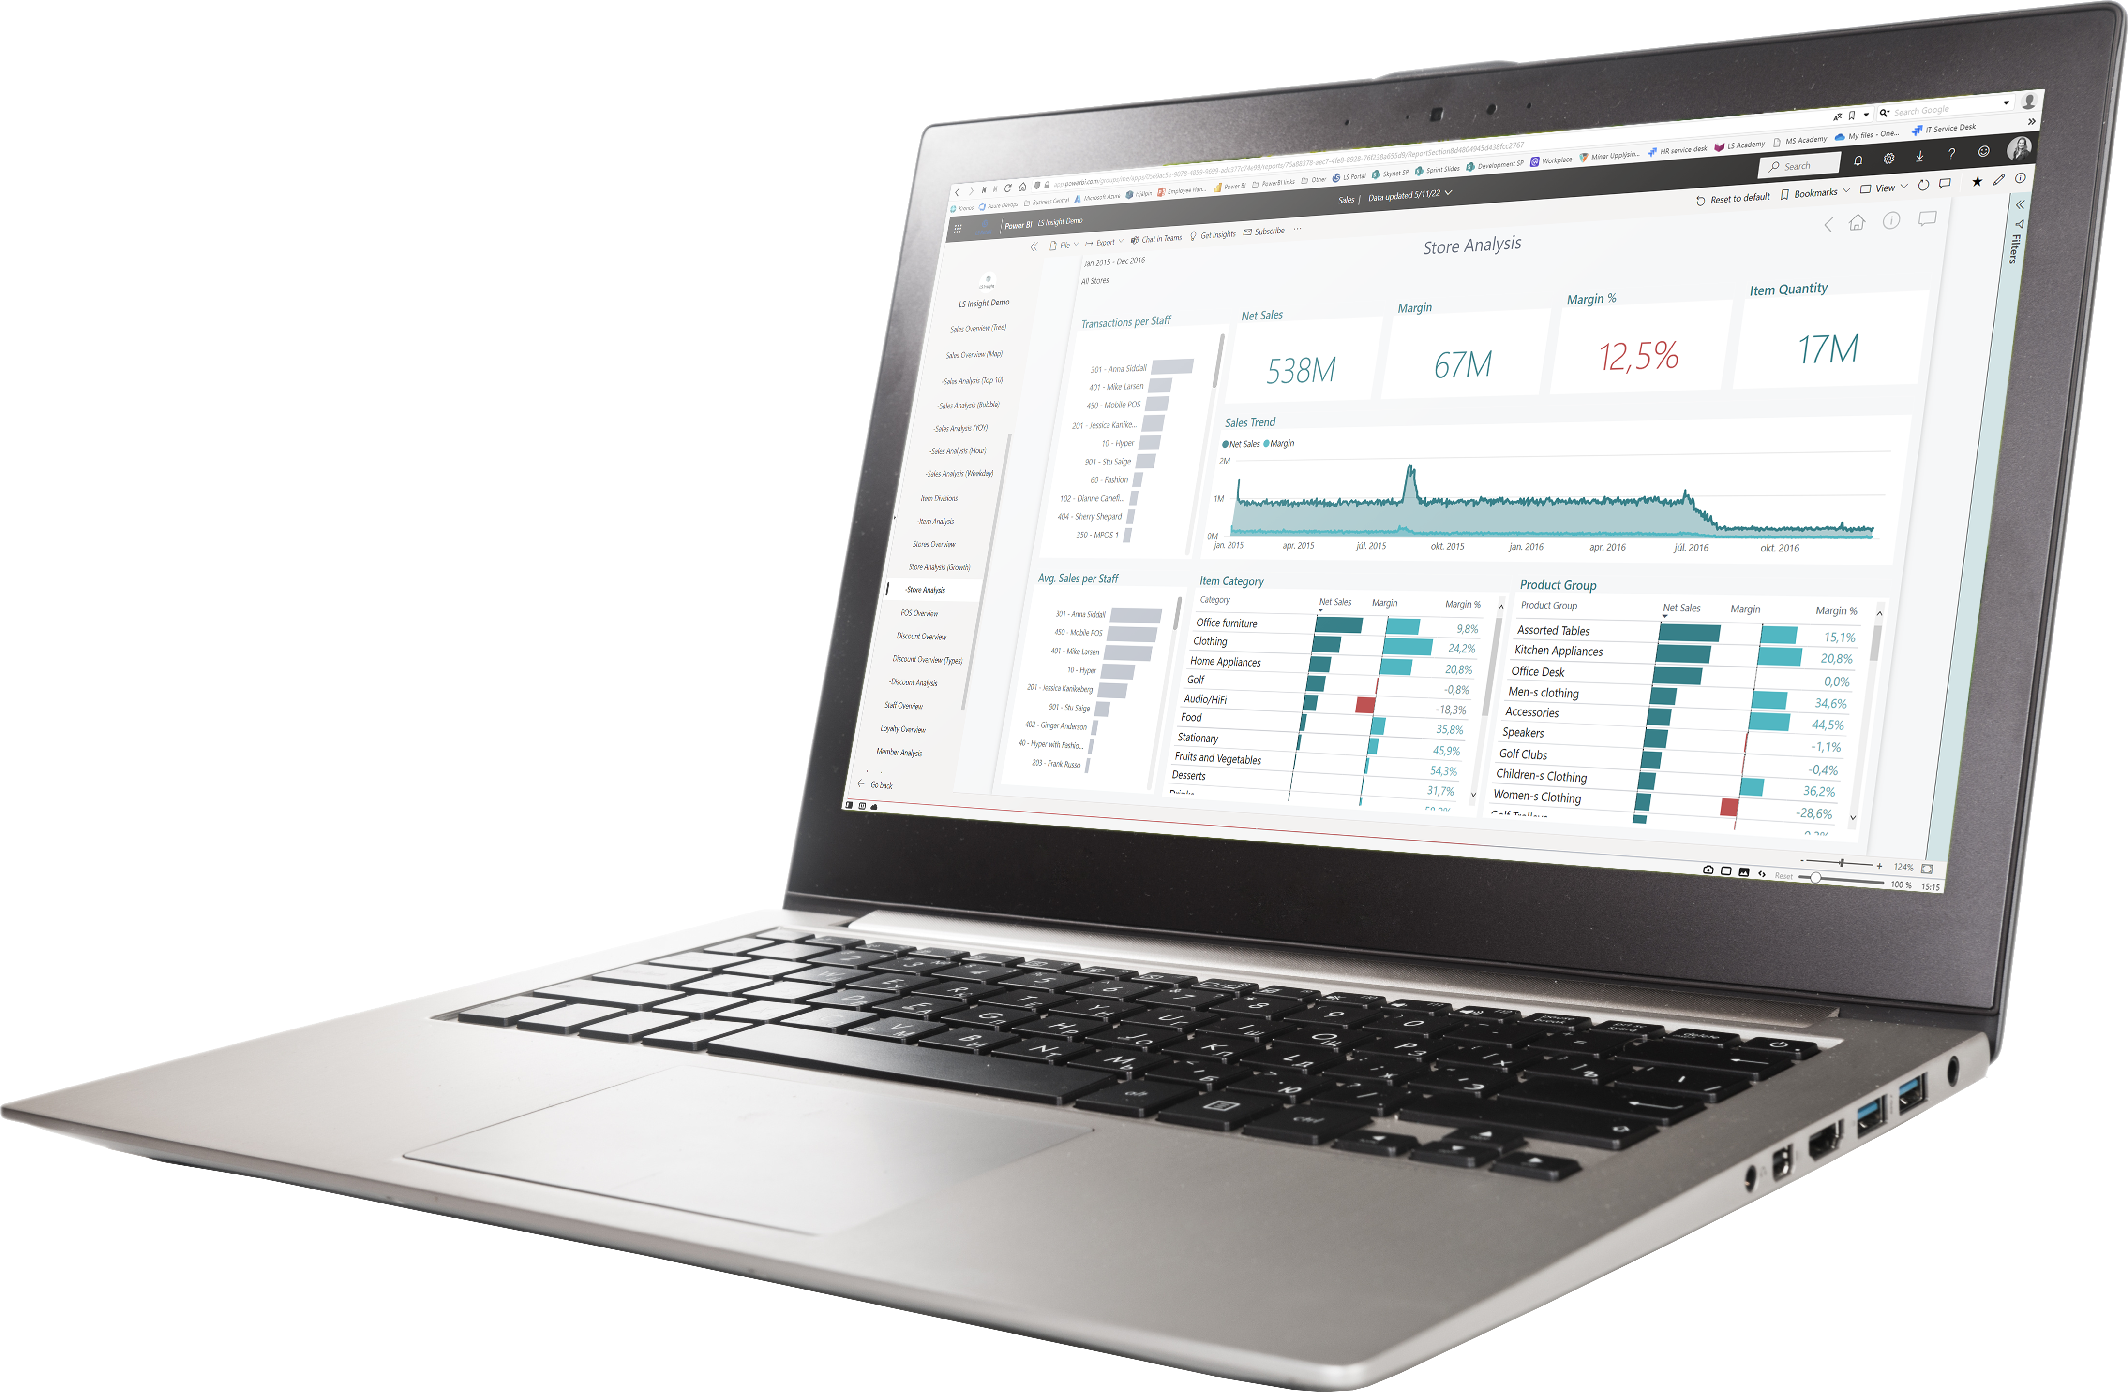
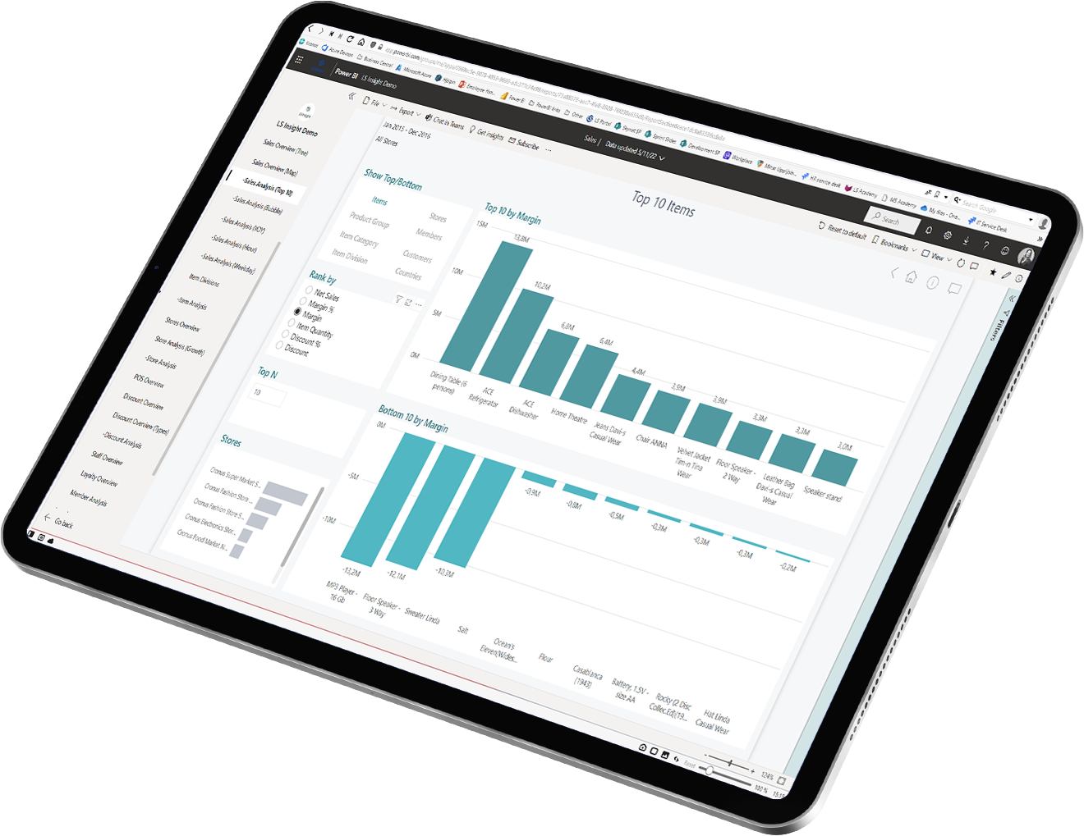
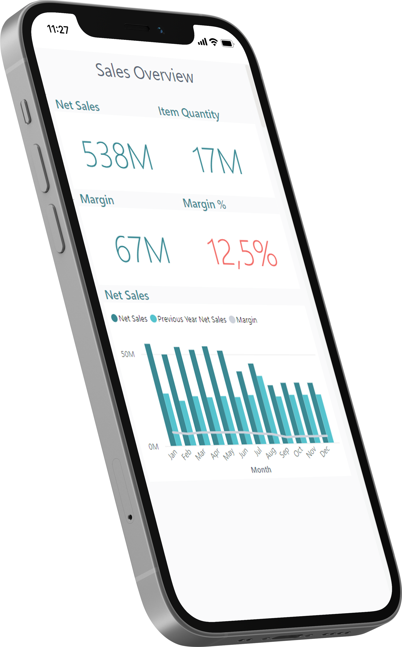
Analytics for LS Central
Analytics - Reports
  Power BI based Report and Dashboard templates
    Built on data from Analytics Data warehouse
    100+ report page templates
  Easy to adapt, extend or build your own
  Strong integration with MS Teams, Excel and Powerpoint
LS Retail ….
Provides ready-to-use report templates
You ….
Subscribe Power BI (@ Microsoft)
Setup the report packages from the deployment package
Connect to DW, Load data → GO!

Slide 21
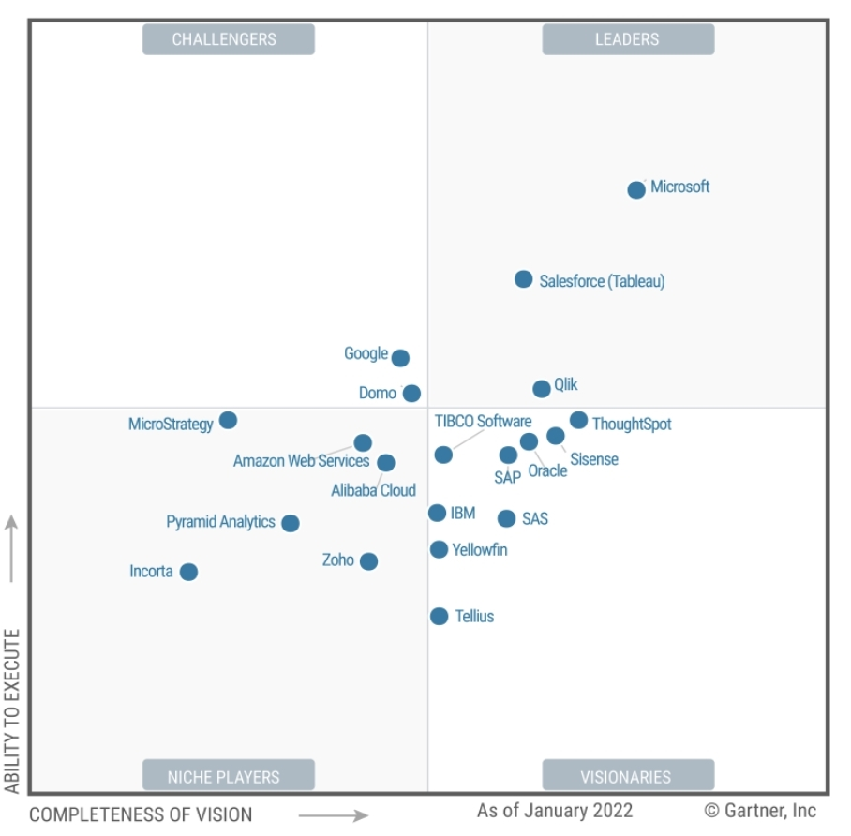
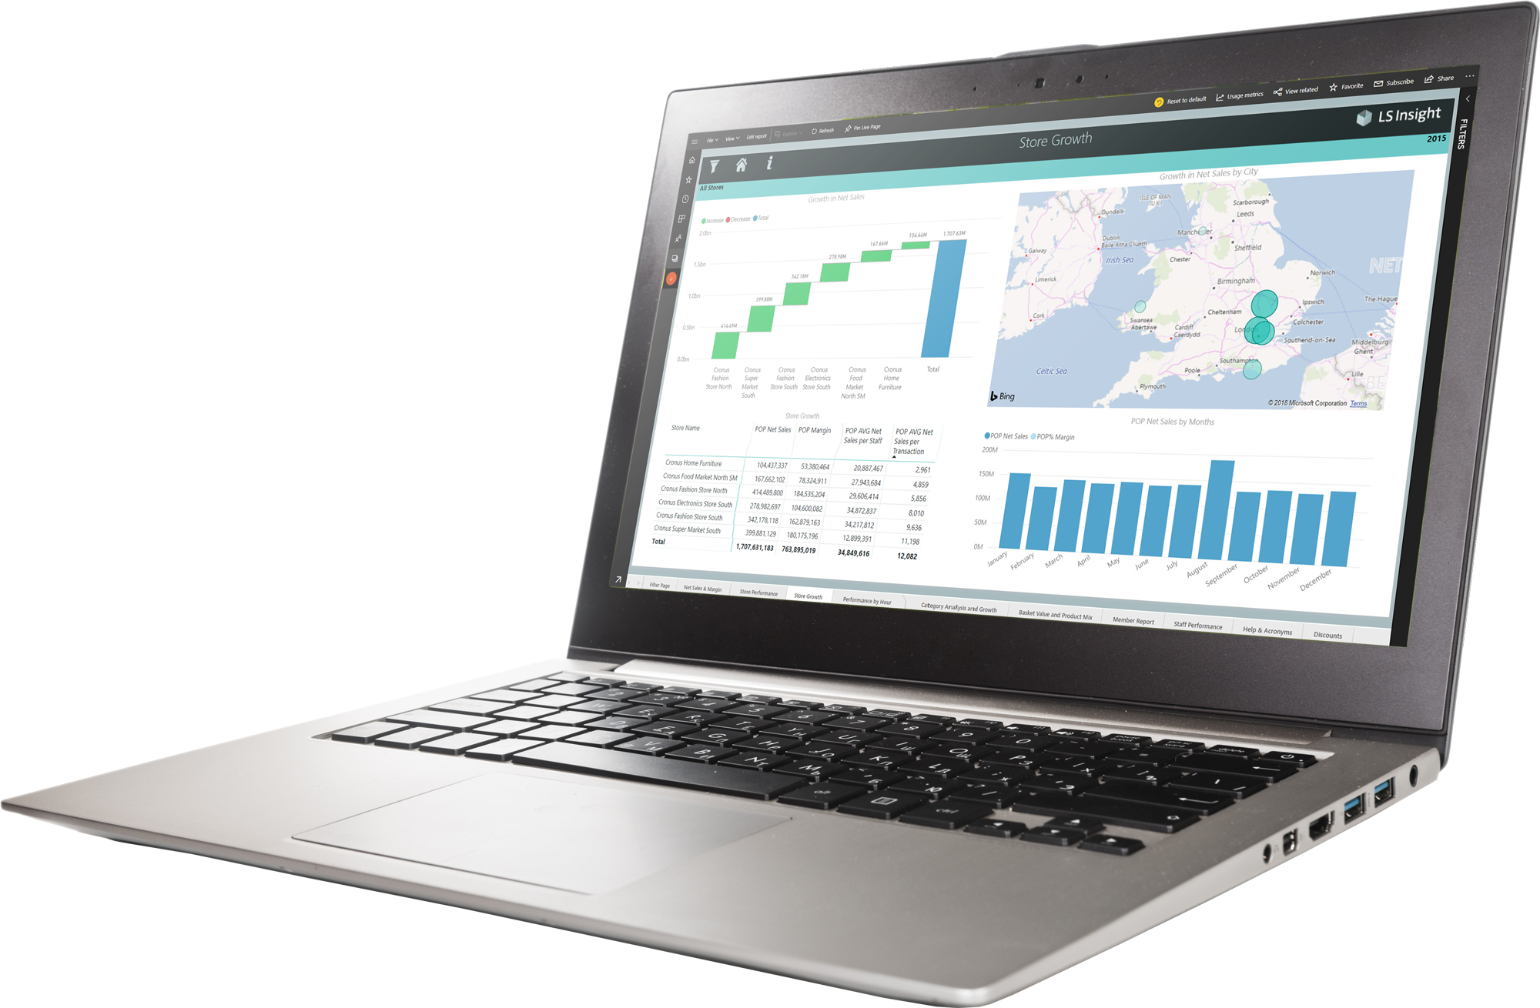
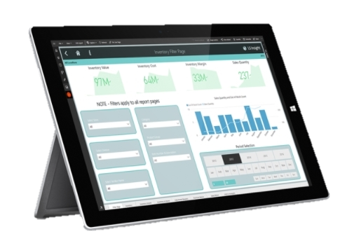

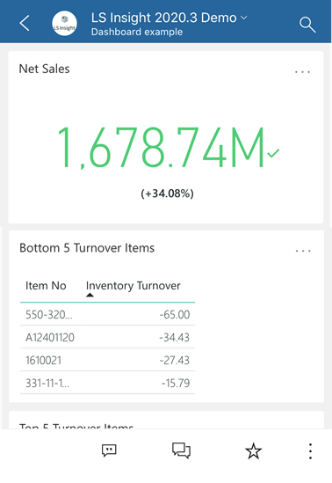
Analytics for LS Central
Gartner®
^{March 2022}
PBI named as Leader in Analytics & BI Platforms
and scored highest for the 4th consecutive year.
^{Microsoft Power BI has helped}
^{over 250,000 organizations}
including 97 percent of Fortune 500
*) Magic Quadrant for Analytics and Business Intelligence Platforms,
from 2013 – 2022

Slide 22
Analytics for LS Central
Report packs
  Sales
  Inventory
  Supply Chain
  Actionable Insights
  Hotels
  Constant improvements and additions based on customer feedback
  Industry specific report packs currently in development

Slide 23
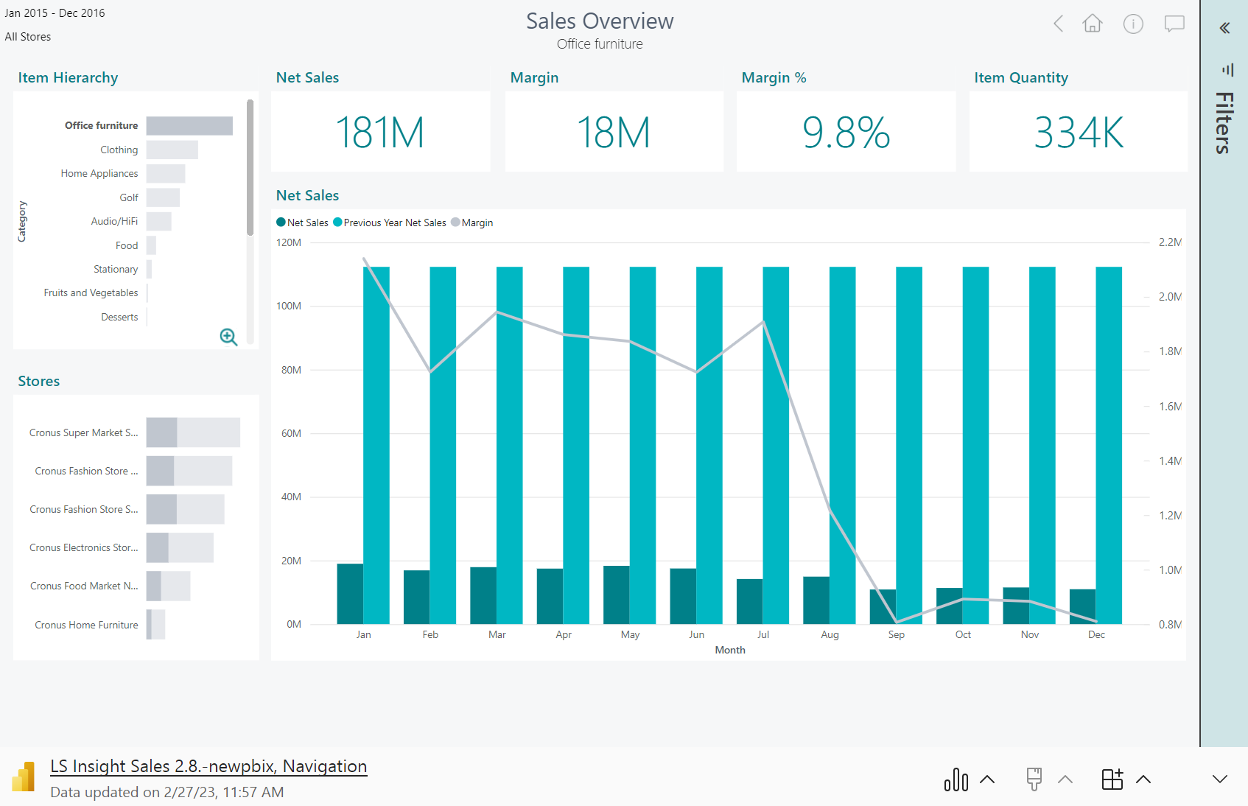
Analytics for LS Central – Sales (Live)

Slide 24
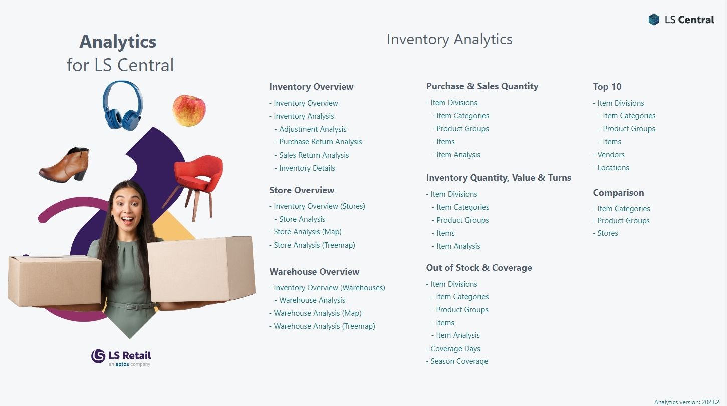
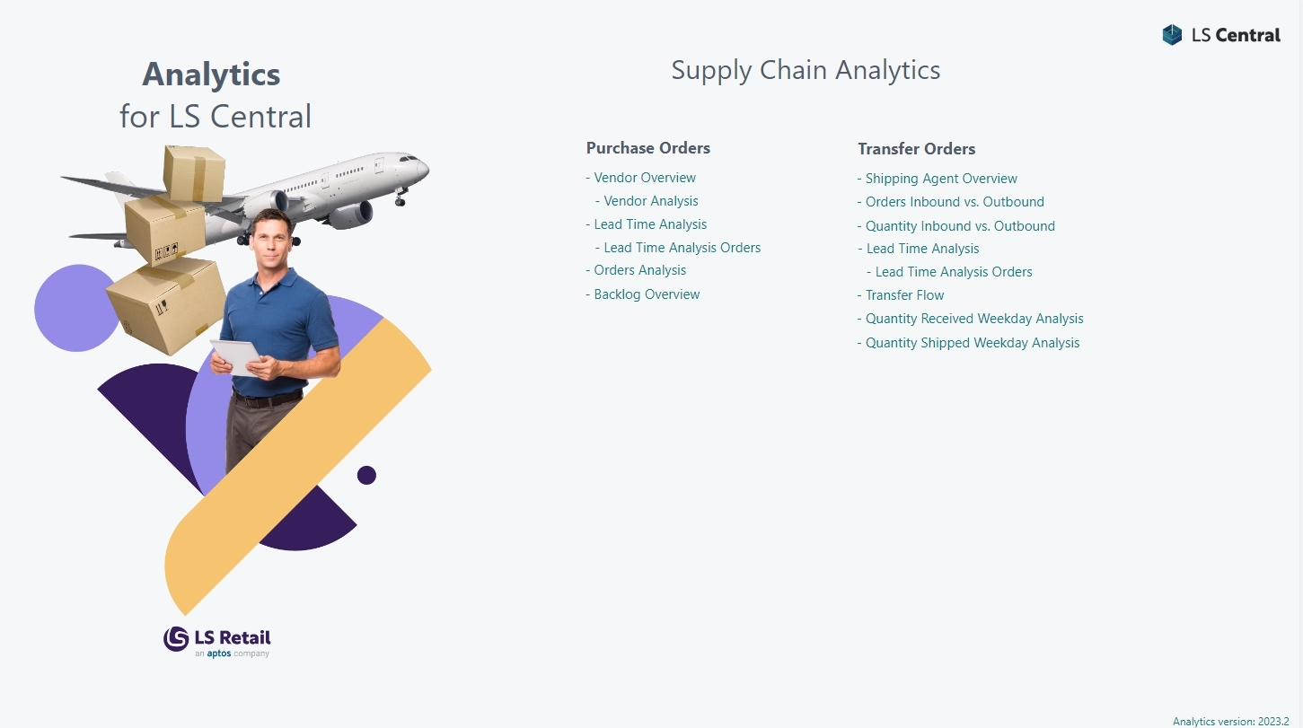
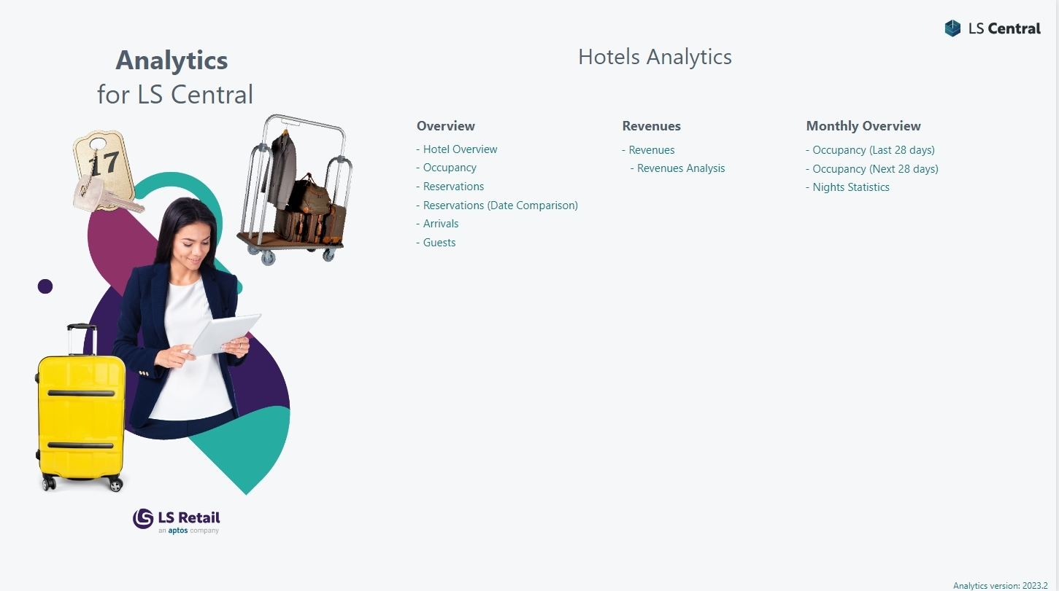
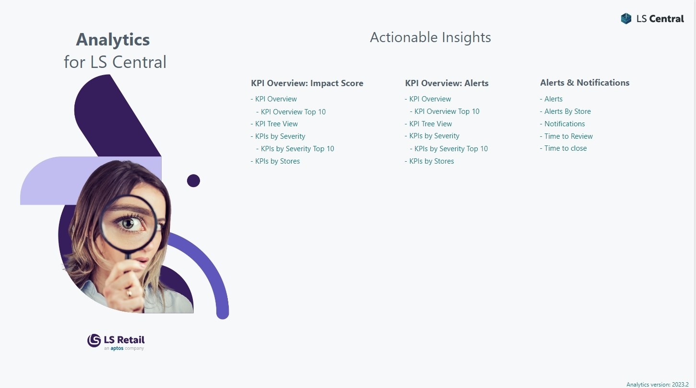

Slide 25
Near real time
reports

Slide 26


Business Central
Azure SQL Server
Datawarehouse
Power BI
Service
Power BI Report
templates
Tables
(on-prem)
Datawarehouse
Data
Tables
(SaaS)
Staging
Query
business logic
Azure Data
Factory
Prestaging
Data Director
Webservices
Replicating transactions
every 10 minutes
Direct query
to unprocessed and filtered data in the data warehouse

Slide 27
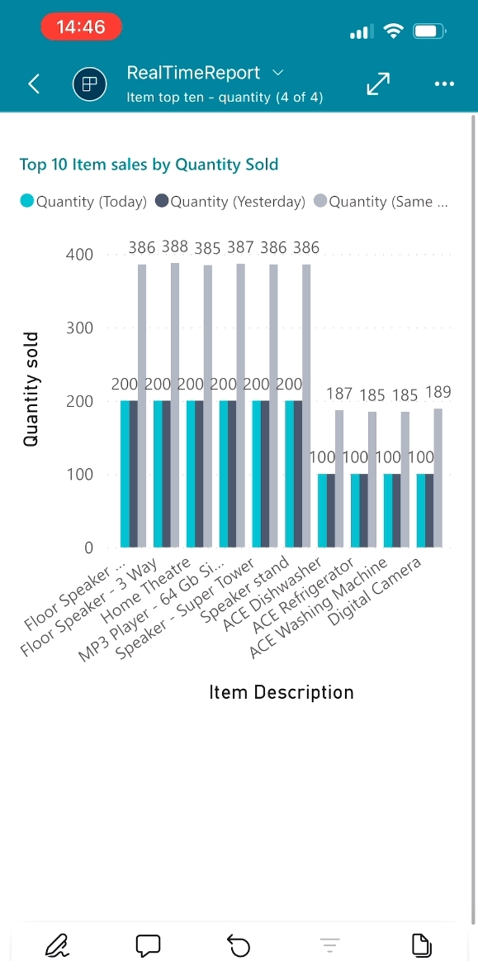
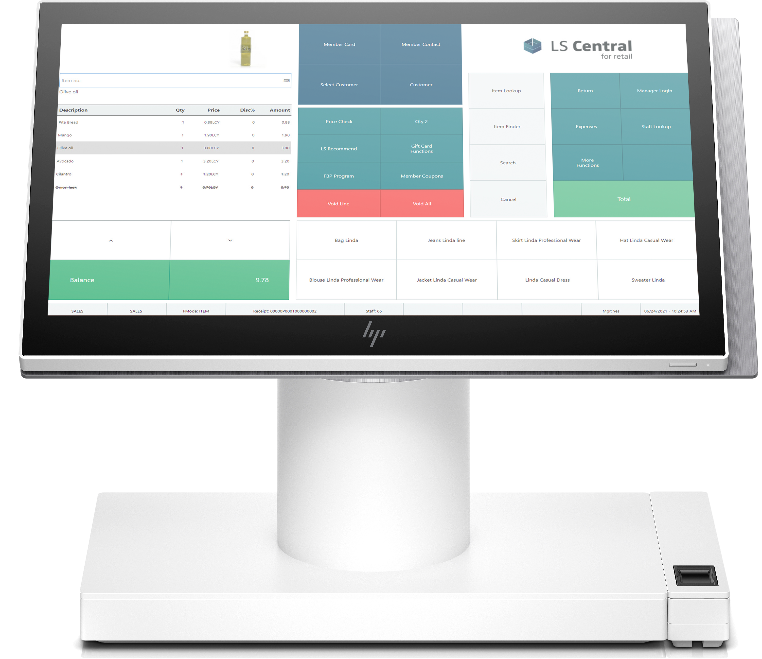
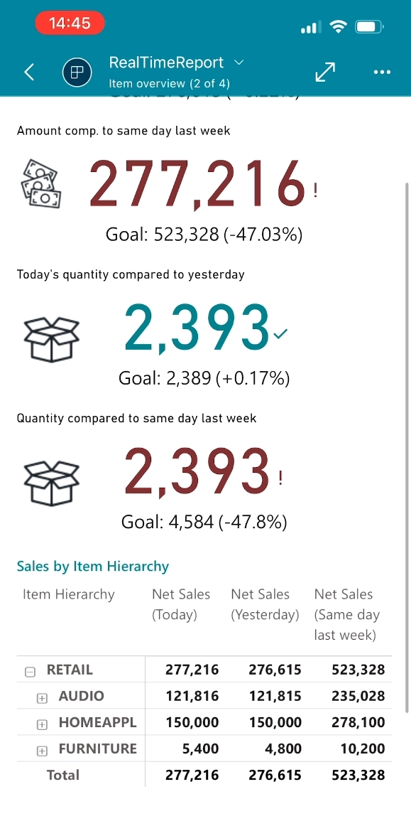
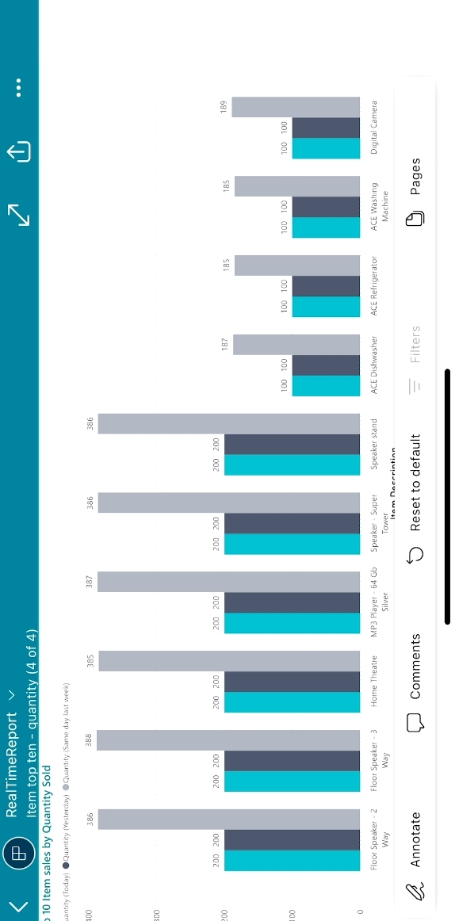
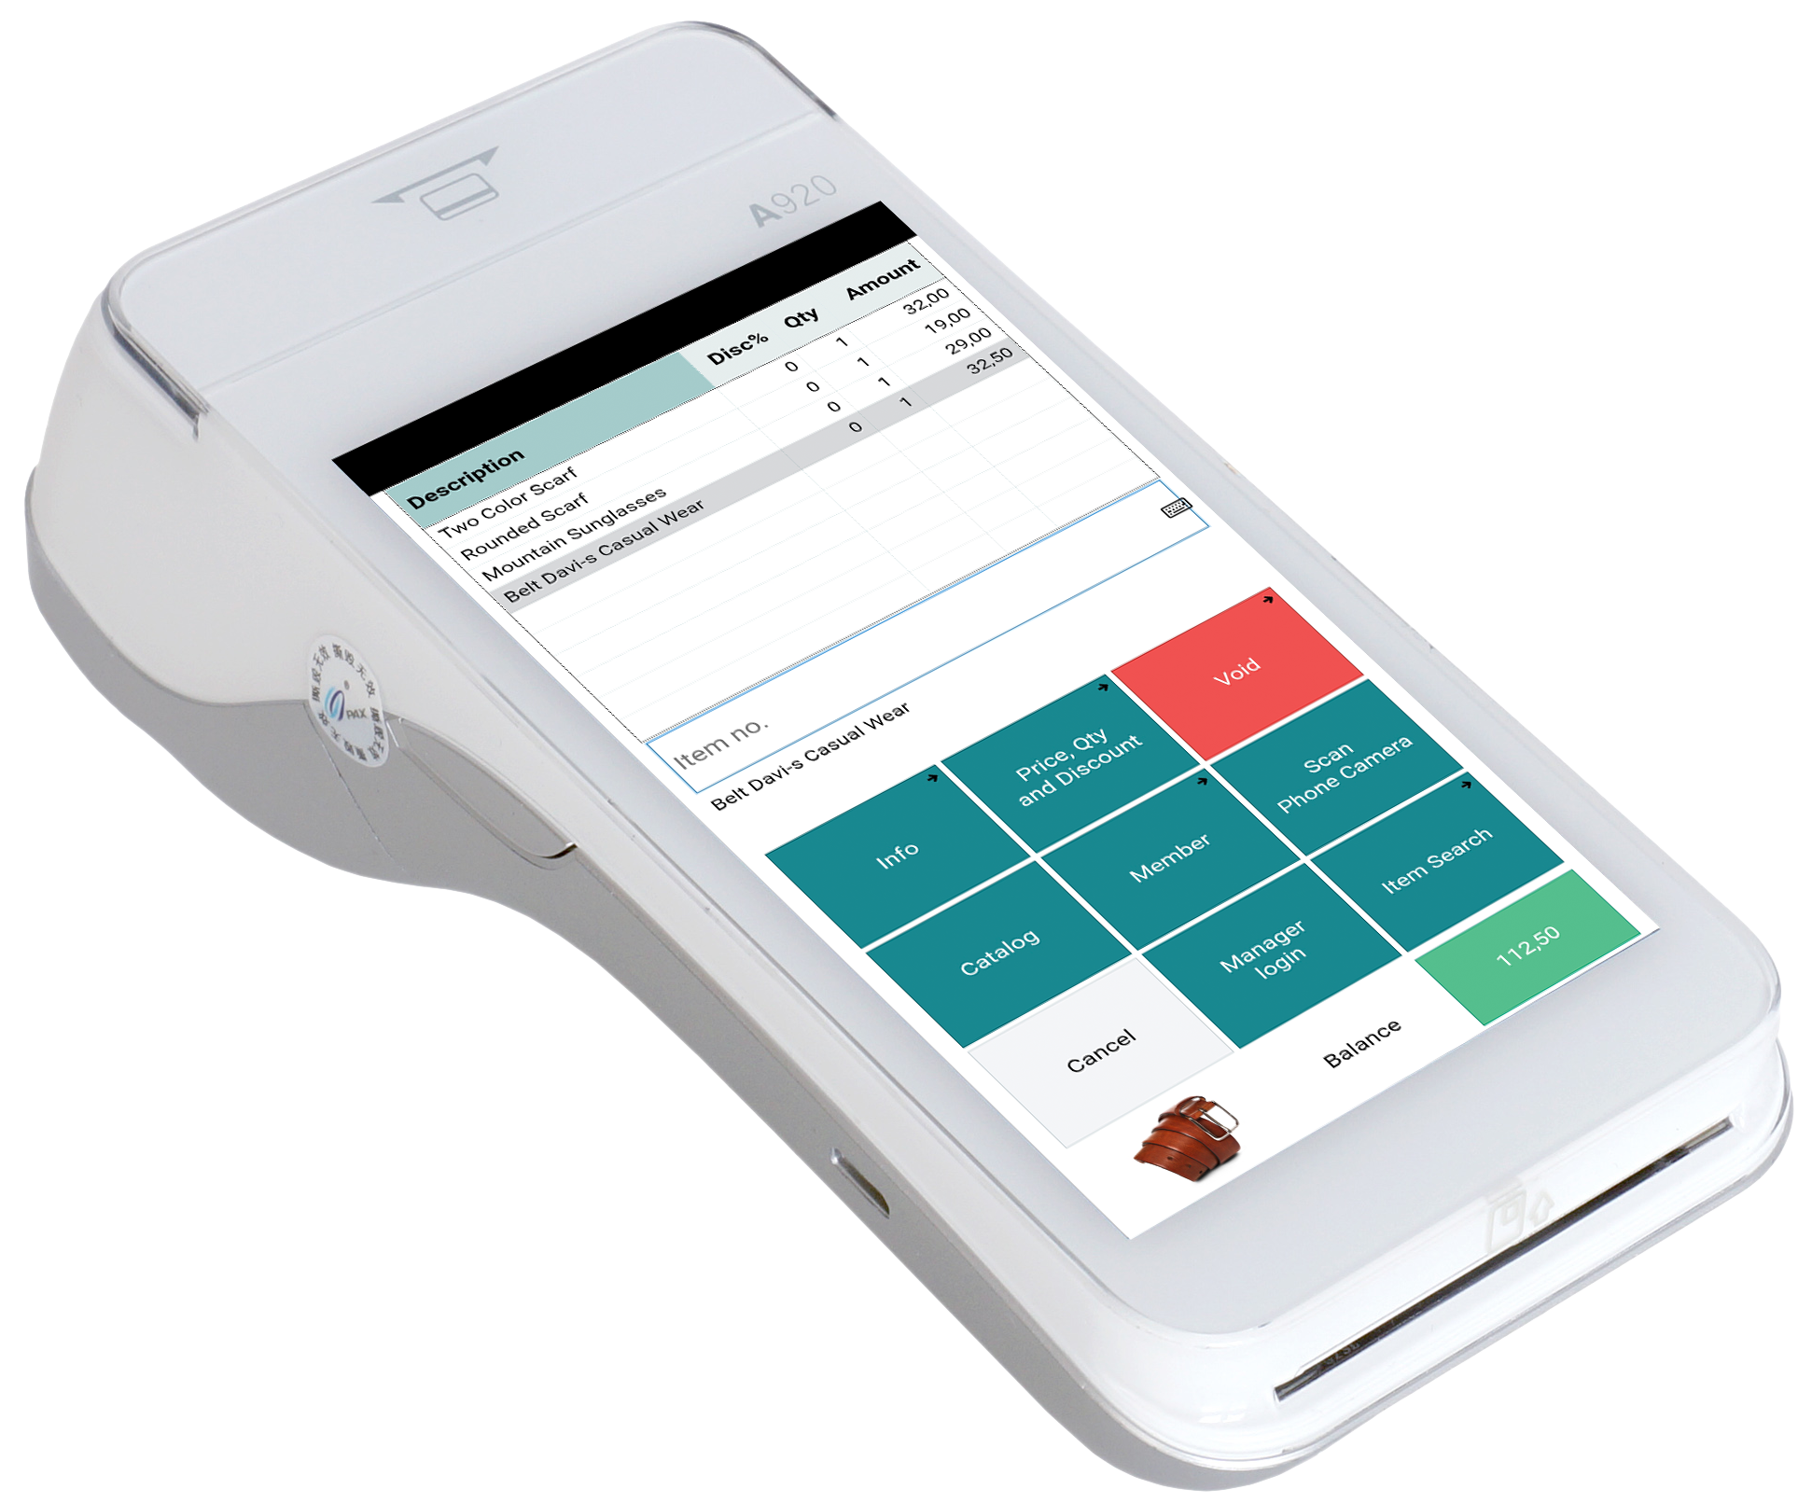
Near real-time reporting (today’s sales)

Slide 28
Analytics for LS Central
Architecture Options
Customization

Slide 29
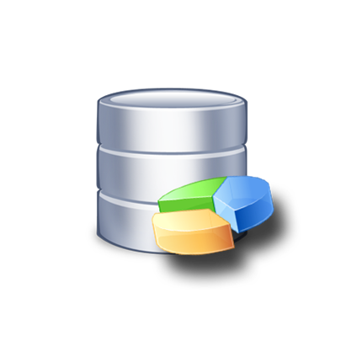
Analytics for LS Central – Architecture options
Business
Central
Analytics DW
for LS Central
Power BI
Service
Business
Central
Cloud
DW on
Azure SQL
DW on
on-prem SQL
Azure Data
Factory
Data Director
Webservices
On-premise
Power BI
Connector

Slide 30

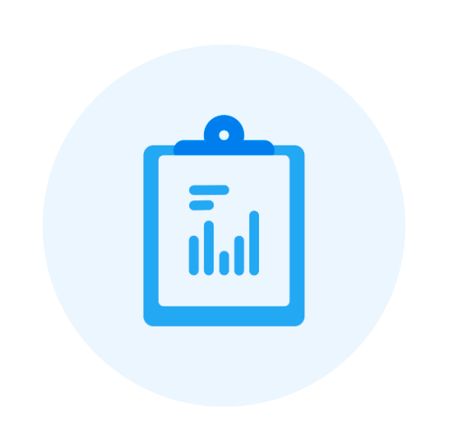

Customizations
LS Central
Additional field(s) in existing tables
Additional table(s)
Additional extension
3rd party data (store movement tracker, CCTV, …)
Power BI
New reports (from scratch or from existing)
Report modifications
Get data from external sources in Power BI
Documentation for customization scenarios
is available in online help

Slide 31



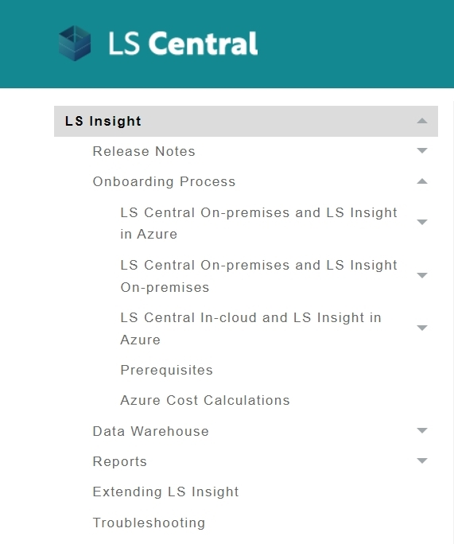
How to get started
Apply for Analytics
Reach out LS Retail’s License department
Request your License Code
Setup
Receive mail with personalized download link
Download product deployment package from LS Retail
Follow documentation in LS Retail’s Online Help
  Setup environment
  Run deployment script for data warehouse, setup data load
  Subscribe to Power BI
  Connect Power BI reports to data warehouse
Done ☺
We are here to help !
LS Retail
Online Help

Slide 32
The future
Report packs
  General improvements
  More operational, list oriented, report pages
  Hospitality report pack
  Finance report pack (tbd)
Near real-time reports
Demo data generation tool
We listen to you!

Slide 33

When will you start your strategic move
with Analytics for LS Central ?

Slide 34
Thank you

