Slide 1
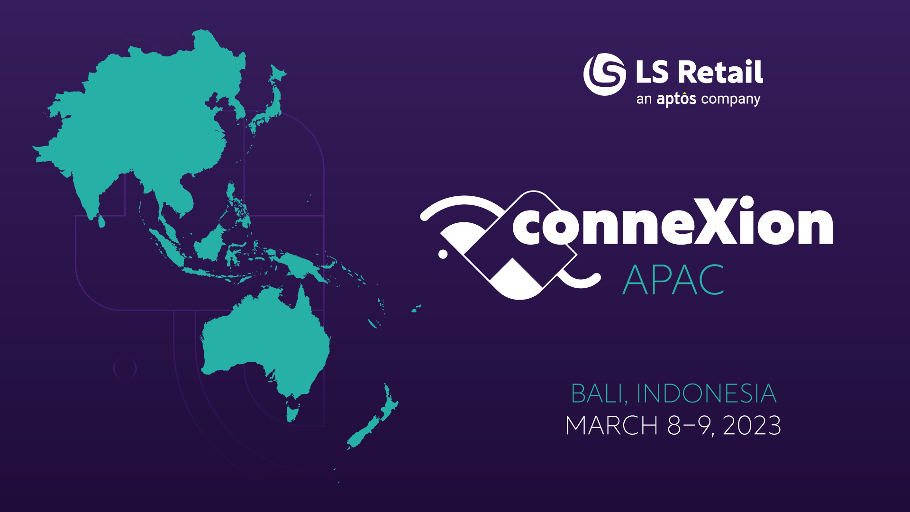

Slide 2
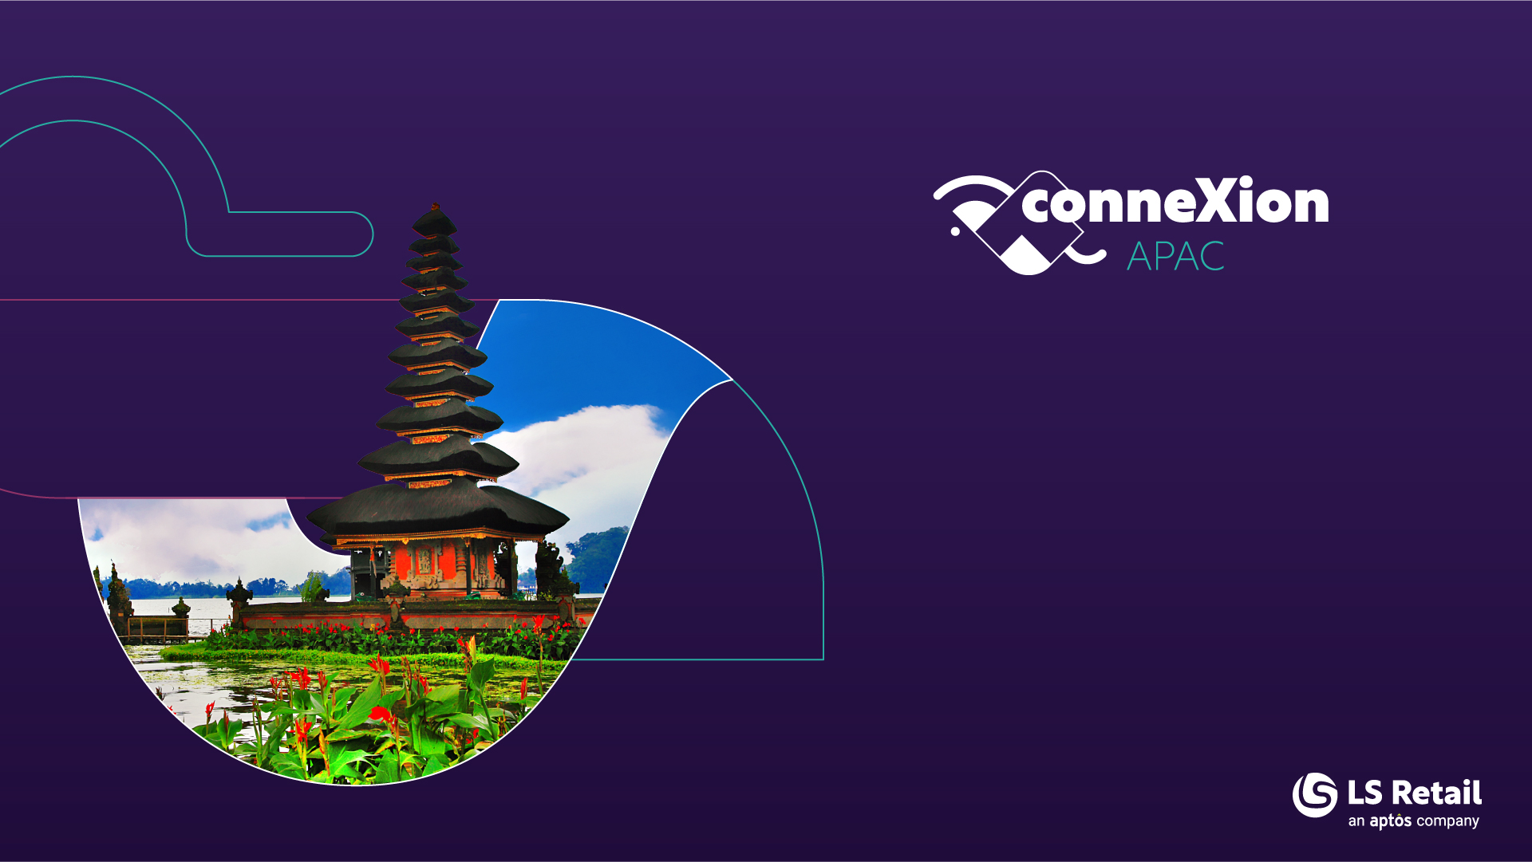
Project Methodology for all project sizes
Krist Tee
Project Manager

Slide 3

SUCCESS
Success certainty with right advice.
Enhance Partner and Customer capability
Eliminate doubt, avoid fallacies, mitigate unknows
Collaborate as ONE Team with Partner and Customer

Slide 4

Why Project Governance
Traceable, Auditable and Transparent
Align with stakeholders in simple, clear, and documented decision and actions taken
Tailor with customer/partner own project methodology
Project Oversight Approach and Collaboration Expectations
Roles and Responsibility with Communication Plan

Slide 5
Change management
process
During the project either party may request in writing additions, deletions or modifications to the services described in the SOW. The Change Management Process that will be employed is defined below.
  Both parties agree to follow this process and to use the Change Request Form.
    Identify and document
    Assess impact, estimate cost and prioritize
    Acceptance / Rejection

Slide 6

Project Tools
Meetings :
  Kickoff Meeting
  Steering Committee Meeting
  Project Meeting, Delivery, Release Meeting
  Scrum meetings
  Frequency of Meeting and duration (weekly, biweekly, monthly)
Project Documents – Meeting Status, Meeting Notes, Emails, Issue List, Risk and Opportunity Plan etc.
PMS tools e.g., ClickUp, Azure DevOps, Email

Slide 7

Roles and Responsibility
PM – LS Retail Project Manager
CPM – Client/Partner Project Manager
RM – LS Retail Release Manager
CRM – Client/Partner Release Manager
TM – Project Team Member
SH – Stakeholders of Project
Partner/Client Sponsor

Slide 8
Project and Consulting tools
Microsoft TEAMS
Emails
ClickUp – where Partner provided with SPACE and FOLDER per Client with LIST per Project.
Tools used by Partner or Client for Project and/or Documents
Project and Customer documents are saved on SharePoint WORKPOINT with predefined structure.
Development and Source Control is managed in Azure DevOps for Code Repository

Slide 9
Quality of Service Requirements (Non-Functional)
Not always directly linked to a Business Process (but can be)
The title of each quality-of-service requirement should capture its definition by presenting a context, an action, and a measurement.
Example: Title: "During a catalog search, return the search results in less than three seconds.“
Additional Pointers:
  It is useful to capture more detail that explains why the requirement is necessary in the Description.
  Describe why the persona would value the requirement and why this level of service is required.
  Provide context and justification.

Slide 10
Project Governance
Project Oversight Working Sessions
Meetings throughout the project which will help guide and build plans and management of the project.
Project Oversight Approach and Expectations
Pilot Go-live Approach and Expectations
Rollout Approach
Non – Functional Analysis Workshops
Quality of service or non-functional requirements include performance, usability, reliability, availability, data integrity, security, affordability, serviceability and upgradeability, deliverability, maintain-ability, design, and fit and finish.

Slide 11

Sign offs
Once all in scope Business Processes workshops are completed and Requirements collected, a submission for Sign-off will be sent to the Customer to confirm this will be considered the full requirements list for the project.
If new or changing requirements surface a change to the project can be logged in order to handle.

Slide 12
Workshop Communication
If any of the following occur, written communication should be sent to LS Retail & Customer PM, and relevant project team for awareness.
Any Key decisions needed or made
Any new or changing risks or blockers
Any Delays to agreed delivery dates, timelines or quality
Any impacts to other business areas that require coordination or agreement

Slide 13
Key Engagement Areas
Assortment
Management
Procurement
Promotions
& Price Management
Loyalty or
Member
Management
Store
Operations
Client
overview
G/L
Account
Receivables
Account
Payables
Fixed
Assets
Assortment
Hospitality
QSR
Fine
Dining
Recipes
KDS
Sales
Channels
Retail
Forecast
Periodic
Discounts
Price
Strategy
Clubs &
Schemes
Accounts & Members
Stores
Management
Inventory
Processes
Staff
Management
Cashiers
& Staff
Open To Buy
Users &
Retail Users
POS
Operations
POS
Processes
POS
Layout
ABC
Variants
Prices and
Deals
Tender types
and
processing
Coupons
Frequent
Buyer
Campaigns,
Tracking,
Offers
Cash
Management
Cost
Accounting
Inventory
Channels
Onboarding
Cash
Management
Legal
entities
Sales
Channels
Reporting
Requirements
Current
system
and data
LS Recommend
ERP
LS Action Hub
Methodology
Opening
Balance
Historic Data
Items
Customers
Vendors
Members
Open
Documents
IT
Environment
POS
Hardware
Architecture
Integrations
Data Migration
Users and Retail Users
Permissions and Security
Operations
Project
Approach
Training
Testing
Deployment
Config vs Enhancement
Workshops
Timeline
Store
Processes
Responsibilities
Data
Migration

Slide 14
Project Lifecycle
Statement of Work – agreement
Project Scope and Planning
Environment Establishment
Kick Off
Business Process and Analysis Workshops
Detailed Requirement Design
Configuration
Sign Off
Change Management

Slide 15
Key Project Milestones
1 | Final Requirements list | Planning
2 | Final GAP list for the design phase determined | Planning
3 | Functional Design Document (Customization GAPS ONLY) | Design
4 | Project Scope defined | Design
5 | Project Plan | Design
6 | Development delivery acceptance | Executing
7 | Functional testing acceptance | Executing
8 | Staging/Product environment setup acceptance | Executing
9 | End User Training complete | Deployment
10 | User Acceptance Testing complete | Deployment
11 | Production environment Cut over setup complete | Deployment
12 | Cut over Acceptance Testing complete | Deployment
13 | Go/No-Go Acceptance | Deployment
14 | System live | Deployment
15 | Transition to Support complete | Closing
16 | Formal project closure, acceptance and sign-off | Closing
Tollgate thresholds will be determined for each milestone within the planning phase of the project in order to reach sign-off.

Slide 16
Master SOW
Sign off on common understanding on approach and methodology

Slide 17

Accelerated Discovery
Address Pain Point Area with value assurance.
Requirement identification
High Level Solution Architecture
POC or Scoping Workshop or Training
LS Project and Consulting guidance
Support Partner sales initiatives / Customer for greater success.

Slide 18
Key Engagement Areas
Assortment
Management
Procurement
Promotions
& Price Management
Loyalty or
Member
Management
Store
Operations
Client
overview
G/L
Account
Receivables
Account
Payables
Fixed
Assets
Assortment
Hospitality
QSR
Fine
Dining
Recipes
KDS
Sales
Channels
Retail
Forecast
Periodic
Discounts
Price
Strategy
Clubs &
Schemes
Accounts & Members
Stores
Management
Inventory
Processes
Staff
Management
Cashiers
& Staff
Open To Buy
Users &
Retail Users
POS
Operations
POS
Processes
POS
Layout
ABC
Variants
Prices and
Deals
Tender types
and
processing
Coupons
Frequent
Buyer
Campaigns,
Tracking,
Offers
Cash
Management
Cost
Accounting
Inventory
Channels
Onboarding
Cash
Management
Legal
entities
Sales
Channels
Reporting
Requirements
Current
system
and data
LS Recommend
ERP
LS Action Hub
Methodology
Opening
Balance
Historic Data
Items
Customers
Vendors
Members
Open
Documents
IT
Environment
POS
Hardware
Architecture
Integrations
Data Migration
Users and Retail Users
Permissions and Security
Operations
Project
Approach
Training
Testing
Deployment
Config vs Enhancement
Workshops
Timeline
Store
Processes
Responsibilities
Data
Migration

Slide 19
Functional Design
Present Solution to Steering Committee
Approval to Triage
Deep Dive Workshop
Proceed with Dev
Requirement
Process
Gap
Business Process
In scope process areas
Requirements
What does the system need to do
Fit or Gap
Configuration or Define Change required
Design/Configure solution
Configuration and Deploying of Approved modifications
Testing
Series of Different test suites
Solution Architecture

Slide 20
POC Workshop vs Analyzes Workshop
POC Workshop
  Process Groups
    Business Processes
      Requirement – some requirements collected in order to identify general solution fit or gaps to scope and estimate an implementation project.
Analysis Workshops
  Process Groups
    Business Processes
      Requirement – all requirements captured and tracked in Azure DevOps grouped under in-scope business processes. All entries will then evolve as part of the project and drive deliverables.

Slide 21
Proof of Concept (POC) Workshops Objective
Utilizing the in-scope Business Processes as a guide, sessions will be held with customer subject matter experts (SMEs) and decision makers to collect General Requirements which describe what the stakeholders expect from the product.
These outputs will be taken as inputs into defining the scope of needs and enabling the ability to estimate a Pilot implementation and Rough Order of Magnitude (ROM) for Rollout.

Slide 22
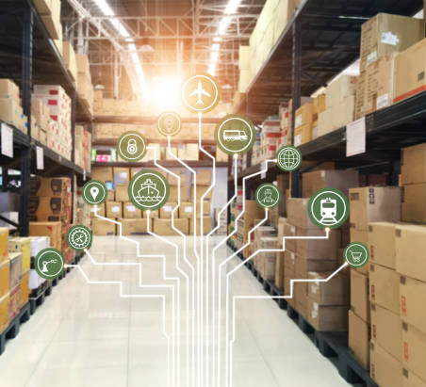
Scope documentation
During scope session all areas within scope are identified
Complexity and potential challenges are as well identified
Often most GAPs on high-level have been identified
All integration has been identified
Migration, Training, Testing and Deployment approach has been identified on high level

Slide 23
Core Process Breakdown
Process Groups
Will capture the business areas within the Scope of the Project. IE Store Operations, Employee Management and Labor scheduling.
  Business Processes
  Identifies the business activities within the Scope of the Project under each Process Group. IE Create and manage stores, Create and manage terminal, Setup and manage employees
    Requirement
    During Analysis Workshops Customer Specific Requirements that are required for the Project, entered as children of Business Processes. IE Ability to Create Multiple Price Groups, Ability to Price Deal Modifier Groups
In the POC the focus is primarily on Process Groups and Business Processes however some key requirements will also be captured.

Slide 24
Other Key Points
Workshops are not training or a demo of the solution. It is to get information from you. The solution may be displayed to aid it explaining a question or to clarify understanding.
The POC Environment will not be modified or mocked up beyond what it is currently as a result to information collected or discussed in the workshops.
The outputs of the information collected will be used in a final presentation in the format of a scope and estimate for a Pilot implementation (IE there will not be a formal business process/requirements document drafted with all findings from the workshops). There will be a power point presentation created for the general overview.

Slide 25

Accelerated Training
Fast track growth of knowledge
Strengthen and expand Partner/Customer resources capacity
Leverage on LS Consulting Expert Knowledge
Leverage on LS Product Team through Consulting

Slide 26

Accelerated Advisory
Areas : Requirements, Process Mapping Fit-Gap, Solution Architecture,
Design
Impart fresh ideas, expertise, best practices for quality, avoid risks
Latest improvements, closer to Product
Efficient completion, greater project success,
Simple upgradable, maintainable system, stable and efficient
Positive Experience and Confidence of Success

Slide 27
Functional Design
Present Solution to Steering Committee
Approval to Triage
Deep Dive Workshop
Proceed with Dev
Requirement & Design Process
Gap
Business Process
In scope process areas
Requirements
What does the system need to do
Fit or Gap
Configuration or Define Change required
Design/Configure solution
Configuration and Deploying of Approved modifications
Testing
Series of Different test suites
Solution Architecture

Slide 28
Workshop Session Scope
Understanding of needs around the following:
Functional Business Processes
Technical Needs and Goals
Project Oversight Approach and Expectations
Pilot Go-live Approach and Expectations
Rollout Approach

Slide 29
Business Process and Analysis Workshops
Utilizing the in scope Business Processes as a guide, sessions will be held with customer subject matter experts (SMEs) and decision makers to collect Business Requirements which describe what the stakeholders expect from the product.
This is typically focused on Functional Areas of the solution.
Weekly Meeting Post workshops for scope and requirement
To product a FIT or GAP requirement document
All integration has been identified
Migration, Training, Testing and Deployment approach has been identified on high level

Slide 30
Solution Design Document
Functional Requirements have been identified
Business process solution has been documented
  But neither Technical Analyzes nor Design has been conducted yet
Overall high-level estimated development budget is estimated
There are as well documents for
  High Level Project Plan
  Data Migration Plan
  Training Plan
  Testing Plan
    whereas client is expected to provide Test Scenarios and Test Cases
  Deployment Plan

Slide 31
Scope documentation
During scope session all areas within scope are identified
Complexity and potential challenges are as well identified
Often most GAPs on high-level have been identified
All integration has been identified
Migration, Training, Testing and Deployment approach has been identified on high level

Slide 32
Discussing Requirements
Requirements describe what the stakeholders expect from the product.
Requirements should easily be discussed using the vocabulary and concepts of the business domain.
Avoid using solution specific language.

Slide 33
Writing Requirements
What is a Requirement?
Requirements describe what the stakeholders expect from the product.
Requirements should be written so that they can easily be discussed with the business stakeholders, using the vocabulary and concepts of the business domain.

Slide 34
Weekly Review Session
At the end of the Workshop week, a quick review will be done to talk through all requirements collected in that week.
Common stakeholders might include a
  subject matter expert (SME)
  business analyst (BA)
Goal is to identify any open follow-up topics or cleanup needed for the requirement that was not completed in the session.
The requirements
  should be reviewed by the appropriate stakeholders to ensure that they adequately describe all user interactions with the product.
  once confirmed as valid will later be reviewed against the current out of box solution to identify them as either a Fit or a Gap.

Slide 35
Writing Requirements
Good Requirements:
Outline a problem and is not obscured by proposed solutions to the problem.
Captures all relevant user interactions with the product based on Project Scope limits.
Are directly linked to an in-scope Business Process
The scenario has a single interpretation that is easily understood.
The scenario is testable
Defines constraints and accepts commercial standards.
Does not conflict with other scenarios.
Has one or two sentences in the work item description
Contains numbered steps in the work item description

Slide 36
Writing Requirements - Example
Title:
  Customer buys a meal online with a Credit Card for Delivery.
Description:
  A customer orders a meal on a Web site and pays with a credit card. The order is passed to a restaurant, which prepares and delivers the meal.
    A customer visits the Web site and creates an order for a meal.
    The Web site redirects the customer to a payment site to make payment.
    The order is added to the restaurant's work list.
    The restaurant prepares and delivers the meal.

Slide 37

Development vs. Configuration
Development takes place when LS Retail must enhance or extend the code in the standard application or create new programs to satisfy a client’s requirement.
Configuration consists in enabling the system to satisfy a client’s business requirements by utilizing functionality contained in the standard system.
Development and test work will be defined, agreed, and estimated during the design process. A change request or a Statement of Work will be raised to cover the extra work..

Slide 38

Project Delivery
Knowledge Transfer
  Training Documents, Training Sessions for Trainers
  Test case/scripts, test case/scripts reviews
Codes base, Configuration Base, Script, Applications etc.
Delivery Governance – Code, Test & Release Management,

Slide 39
Functional Design
Present Solution to Steering Committee
Approval to Triage
Deep Dive Workshop
Proceed with Dev
Delivery
and Release
Delivery
Gap
  Release Management
  Issues Management
  Pre Go Live
Business Process
In scope process areas
Requirements
What does the system need to do
Fit or Gap
Configuration or Define Change required
Design/Configure solution
Configuration and Deploying of Approved modifications
Testing
Series of Different test suites
Solution Architecture

Slide 40
Project Ad-Hoc Services
Open Service Consulting Yearly Support
Negotiated Consulting Hours for e.g., 20 hours with 2 hours Project and Service Hours

Slide 41
Project Ad-Hoc Services
Resourced Based Support
Contracted Hours of Support of Resource per time interval e.g. per week

Slide 42
Project Criteria
Depending on Options of Advisory Requirement :
  Project Management could be categorized into certain packages.
    i. Task Based Management (10% or minimum or 2 hours)
    ii. Project Based Management by Advisory Option (20% of Advisory)
    iii. Project Based Management Full Options (30% of Advisory)

Slide 43
Question, Feedback?

Slide 44
Thank you

Slide 45
Development vs. Configuration
Development takes place when LS Retail must enhance or extend the code in the standard application or create new programs to satisfy a client’s requirement.
Configuration consists in enabling the system to satisfy a client’s business requirements by utilizing functionality contained in the standard system.
Development and test work are not included in scope. This will be defined, agreed, and estimated during the design process. A change request will be raised to cover the extra work.
Configuration work is included in scope and is the focal point of the design and system build phases.

