Slide 1
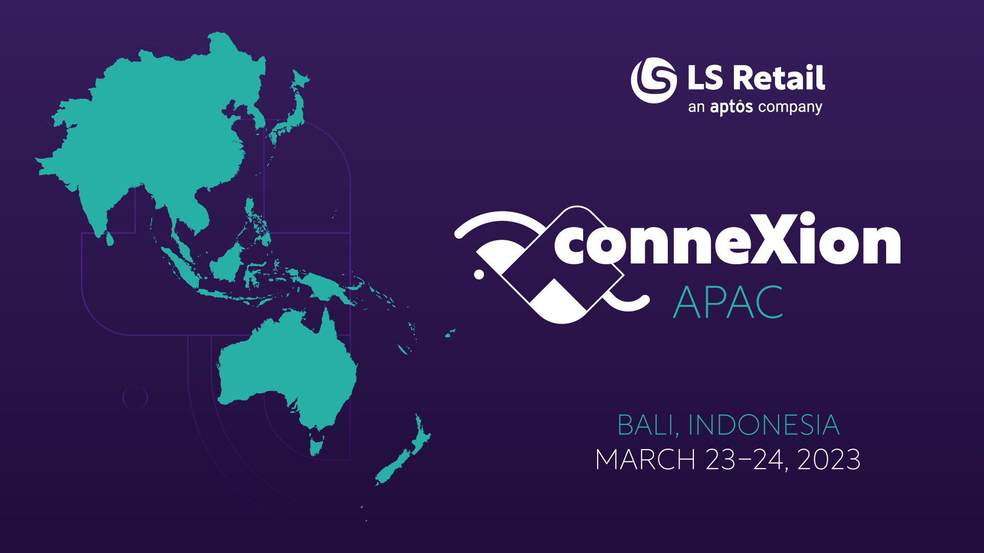

Slide 2


Bjarni Asmundsson
Regional Director
Bjarni@LSRetail.com
Discover clarity and insights with
Performance Audit
Martin Kleindl
Product Director
Martin.Kleindl@LSRetail.com

Slide 3
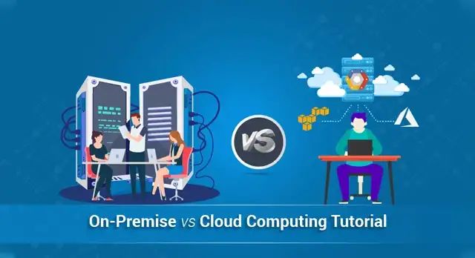
What is On-Prem?
All installations that are not SaaS (Software as a Service)
Therefore, including hosted
solutions like…
  Private cloud
    Microsoft Azure (Azure)
    Amazon Web Services (AWS)
    Google Cloud Platform (GCP)
  Hosting Center
  and your own hardware

Slide 4

The Why? What will you gain as a client or partner?
Comprehensive report
  Quick overview over the health status of the solution
  Actionable Insights which are prioritized
  Input into best practices approach
  Guidance on housekeeping processes
Then what?
  You should do yearly health-check
  Potentially get support working the action-list
  Consider further review on specific business processes

Slide 5

What does LS Central solution consist off
Microsoft’s
  SQL Server and SQL Express
  Dynamics 365 Business Central service tier(s)
  Internet Information Services (IIS)
  Browser based client – Edge
LS Retail’s
  Data Director
  LS Commerce Service
  Update Service
  Hardware Station
  mobile Inventory / mobile POS
  Kitchen Display System
  LS Central AppShell

Slide 6



Architecture
Dynamics 365 cloud
SaaS
HQ
  Microsoft SQL Server
  Microsoft Dynamics 365 Business Central
  LS Commerce Service
    eCom, ScanPayGo, integrations, mobile Inventory/POS
Online POS
  running browser and most likely LS Central AppShell and LS Hardware Station
Offline POS
  Microsoft SQL Express, Microsoft Dynamics 365 Business Central, LS Data Director
  LS Hardware Station, LS Central AppShell
Dynamics 365 OnPrem
1
HQ
Hybrid component server
LS Commerce
2
LS Commerce
Store
Online POS
Offline POS
Offline POS Service
Online POS
Offline POS
Offline POS Service
3
4
5

Slide 7
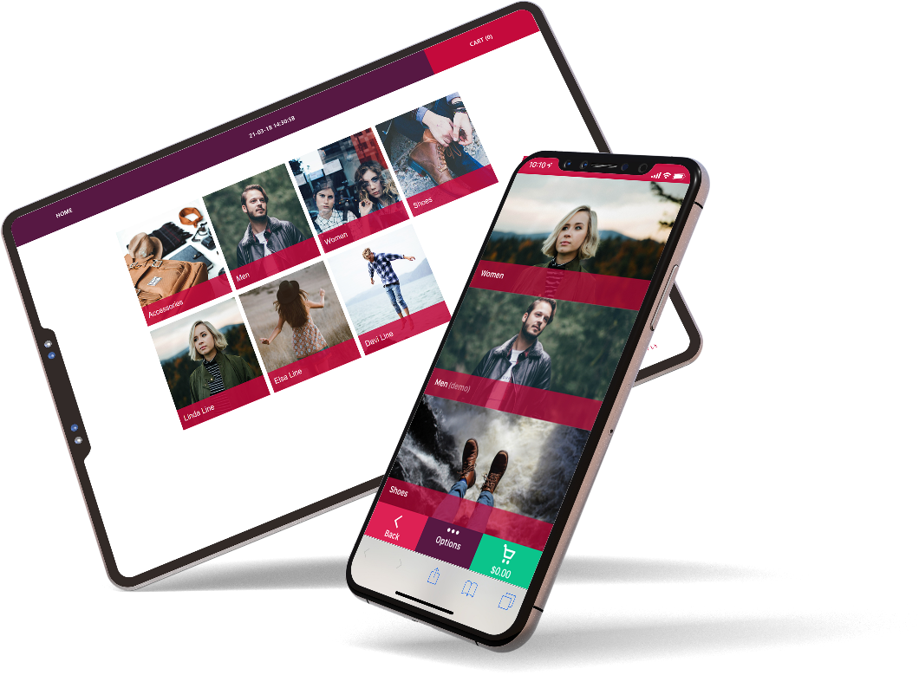
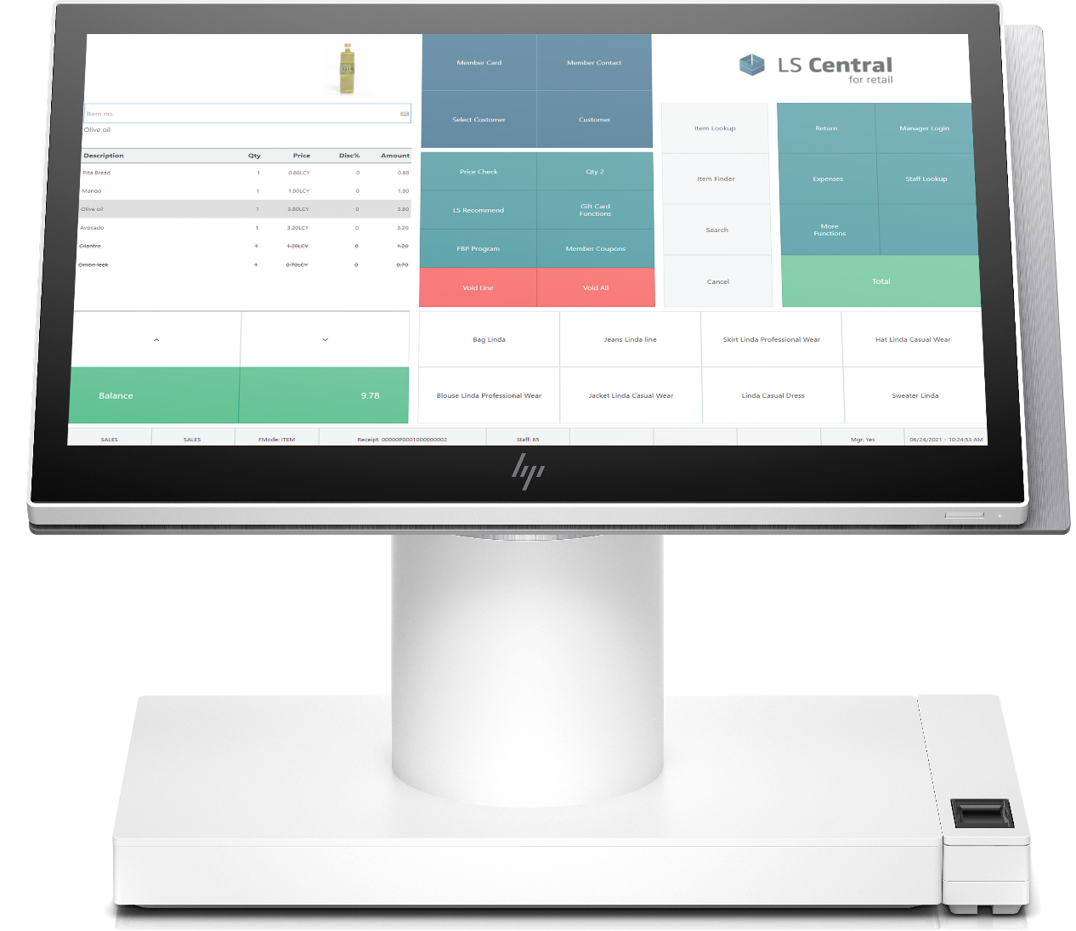
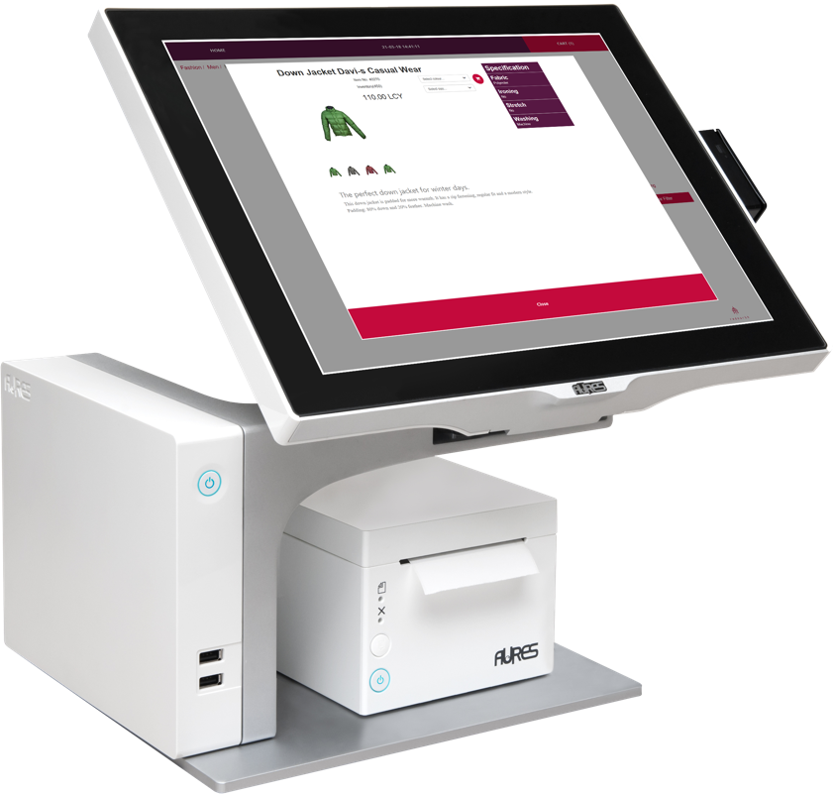
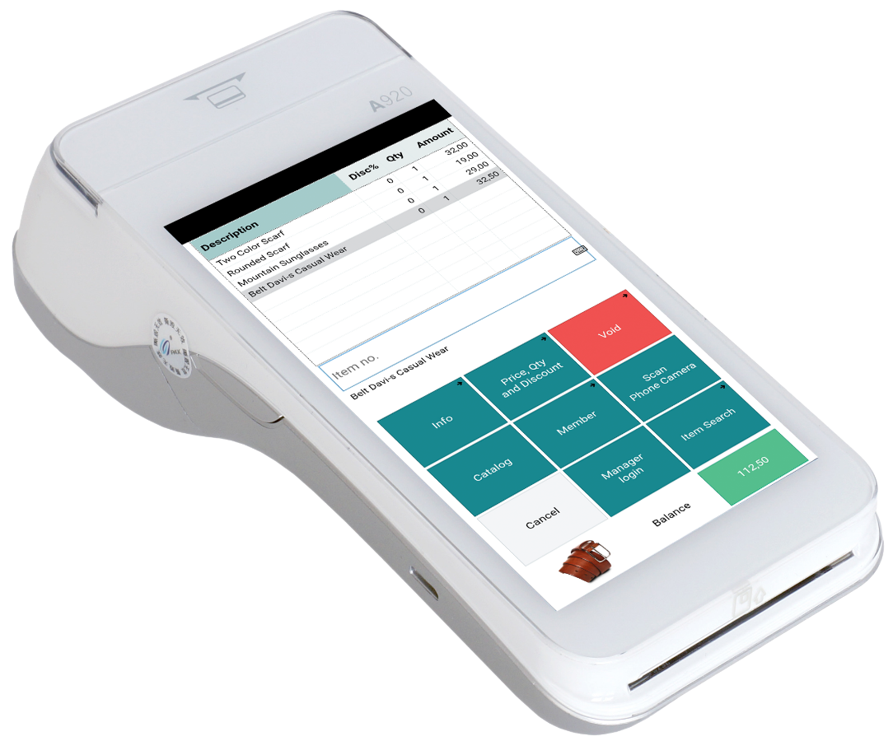
The Offline POS
Store
Or could be called Offline POS Service
aka Store Server
  Never both used for the same POS
Normally running SQL Express
  is limited to 10 Gb size
  is limited to 1410 Mb RAM
  has limited out of the box maintenance options, but can be worked around
  is limited to lesser of 1 socket or 4 cores
Consider SQL Standard if running
Offline POS Service (Store Server) in demanding environment
Offline POS
Offline POS Service
https://learn.microsoft.com/en-us/sql/sql-server/editions-and-components-of-sql-server-2019?view=sql-server-ver16#Cross-BoxScaleLimits

Slide 8

Inventory
for LS Central
Performance improvements for
large retailers
Martin Kleindl
Product Director
Martin.Kleindl@LSRetail.com

Slide 9
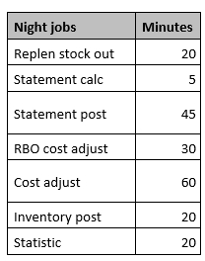
The Challenge
Challenges for large retailers
  Data volume in Ledger Entry tables
    Item Ledger Entries
    Value Entries
  Long running processes
    Statement Calculation
    Statement Posting
    Replenishment Out of Stock calculation
    Replenishment Item Quantity and Journal Calculation
    Cost Adjustment & Posting
  We made huge improvements for the LS Retail processes
  For Microsoft processes we need to find and build out-of-the-box solutions/approaches.
Example from customer

Slide 10


Current approach
G/L Entries
Item Ledger Entries
Store 1
- Cash
- CC
Store 2
- Cash
- CC
Store 500
- Cash
- CC
Store 1
- Item A, 10 pcs
- Item B, 20 pcs
Store 2
- Item A, 20 pcs
- Item B, 20 pcs
Store 500
- Item A, 15 pcs
- Item C, 10 pcs
Sales
Statement
Calc.
Statement Post
Store 1
Sales
Statement
Calc.
Statement Post
Store 2
…………………………………………………………………………………………….......…
Sales
Statement
Calc.
Statement Post
Store 500
Many stores
→ data volume
→ long running
processes

Slide 11
New approach
Aggregated Posting for Store Locations
Current approach
Item Ledger Entries
for individual stores
New approach
  Item Ledger Entries
  for aggregated Store Location(s)
  Details are stored in a new table
  “LS Inventory Entries”
Item Ledger Entries
current
LS Inventory
Entries
new
Store 1
---------------
---------------
Store 2
---------------
---------------
Store 3
---------------
---------------
Store 4
--------------- ---------------
Store 500
--------------- ---------------
Store 1
---------------
---------------
Store 2
---------------
---------------
Store 3
---------------
---------------
Store 4
--------------- ---------------
Store 500
--------------- ---------------
Store “RETAIL”
---------------
---------------

Slide 12

New approach
G/L Entries
Item Journal
Store 1
- Cash
- CC
Store 2
- Cash
- CC
Store 500
- Cash
- CC
Store 1
- Item A, 10 pcs
- Item B, 20 pcs
Store 2
- Item A, 20 pcs
- Item B, 20 pcs
Store 500
- Item A, 15 pcs
- Item C, 10 pcs
Sales
Statement
Calc.
Statement Post
Store 1
Sales
Statement
Calc.
Statement Post
Store 2
…………………………………………………………………………………………….......…
Sales
Statement
Calc.
Statement Post
Store 500
Store “RETAIL”
- Item A, 45 pcs
- Item B, 40 pcs
- Item C, 10 pcs
1. Aggregate
Stores
2. Post

Slide 13
New approach
G/L Entries
Store 1
- Cash
- CC
Store 2
- Cash
- CC
Store 500
- Cash
- CC
Store 1
- Item A, 10 pcs
- Item B, 20 pcs
Store 2
- Item A, 20 pcs
- Item B, 20 pcs
Store 500
- Item A, 15 pcs
- Item C, 10 pcs
Sales
Statement
Calc.
Statement Post
Store 1
Sales
Statement
Calc.
Statement Post
Store “RETAIL”
- Item A, 45 pcs
- Item B, 40 pcs
- Item C, 10 pcs
Store 2
…………………………………………………………………………………………….......…
Sales
Statement
Calc.
Statement Post
Store 500
Item Ledger
Entries
Detailed
LS Inventory
Entries

Slide 14
Document posting
Purchase Order
creation
Item Ledger
Entries
Process flow
    Document Posting
    (Purchase Orders, Transfer Orders, …)
    Location is replaced
    with generic Store Location (“RETAIL”)
    Document posting
    creates LS Inventory entries
release
Store 1
---------------
---------------
Store “RETAIL”
---------------
---------------
Store “RETAIL”
---------------
---------------
LS Inventory
Entries
Store 1
---------------
---------------

Slide 15


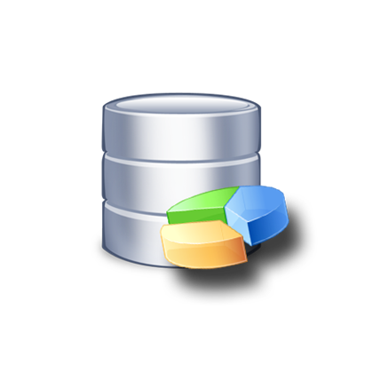
Inventory for LS Central
The scope & timeline
Core solution prototype
(Statement posting, document handling)
Performance tests
Mandatory “core” features
  Selected Page improvements
  POS Inventory Lookup
  Stock Counting process
Release
Project based work
Customizations for
  Reports
  Pages
  Processes
  Integrations
handled as project by partners with optional support from LS Retail consulting

Slide 16
Performance
Audits
find the bottlenecks in your
environment

Slide 17
Performance Audit
HQ
Dynamics 365 OnPrem
1
Health Audit of SQL server
Installing Microsoft Monitoring Agent
  all Service Tiers servers (NST)
  including servers running
    LS Data Director (WIP)
    LS Commerce
  Consuming Event Viewer Log
    sent to LS Retail’s Azure environment
    Parsing it for Business Central detailed information
If hosted in Azure
  Optional to enable Azure Application Insights
SQL
2
1
Data Director
2
LS Commerce
NST
2
NST
NST
NST
NST
2
NST

Slide 18
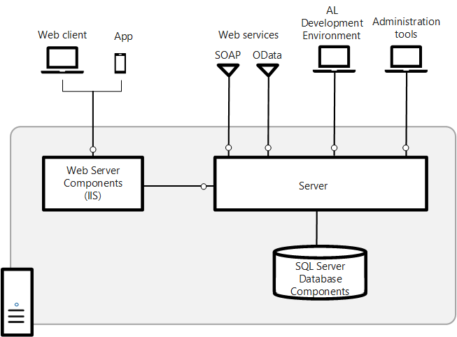
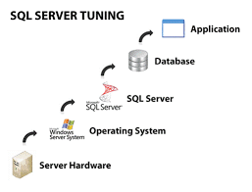
Performance Audit - SQL
Hardware
  RAM, Disk System, CPU, Network
Operating System
  Version, Disk Management, RAM
SQL Server
  Datafile setup and distribution on disks
  Service Parameters
  Wait statistics
Database
  Parameters
  Housekeeping processes
Application
  Index maintenance and tuning

Slide 19
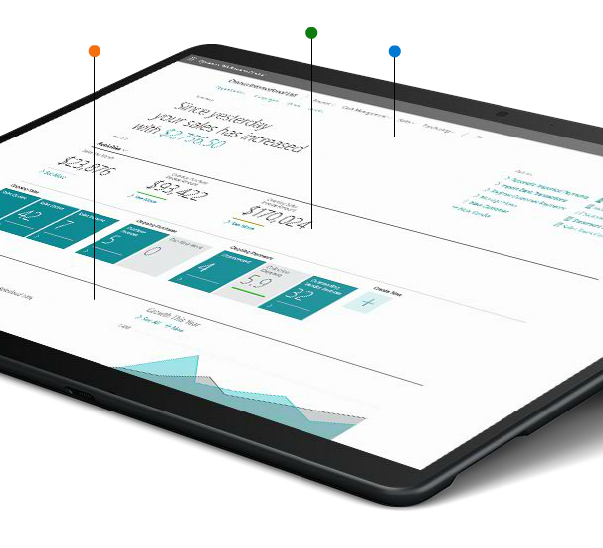
Performance Audit – Services and Service Tiers
Indication of Load schedule and Incidences per hour per day in graphical format
  Deadlocks
  Table Locks
  Long running SQL Queries
Extensions impacting performance
Performance Profiler
Table Information
Database and Table growth info
Housekeeping processes

Slide 20
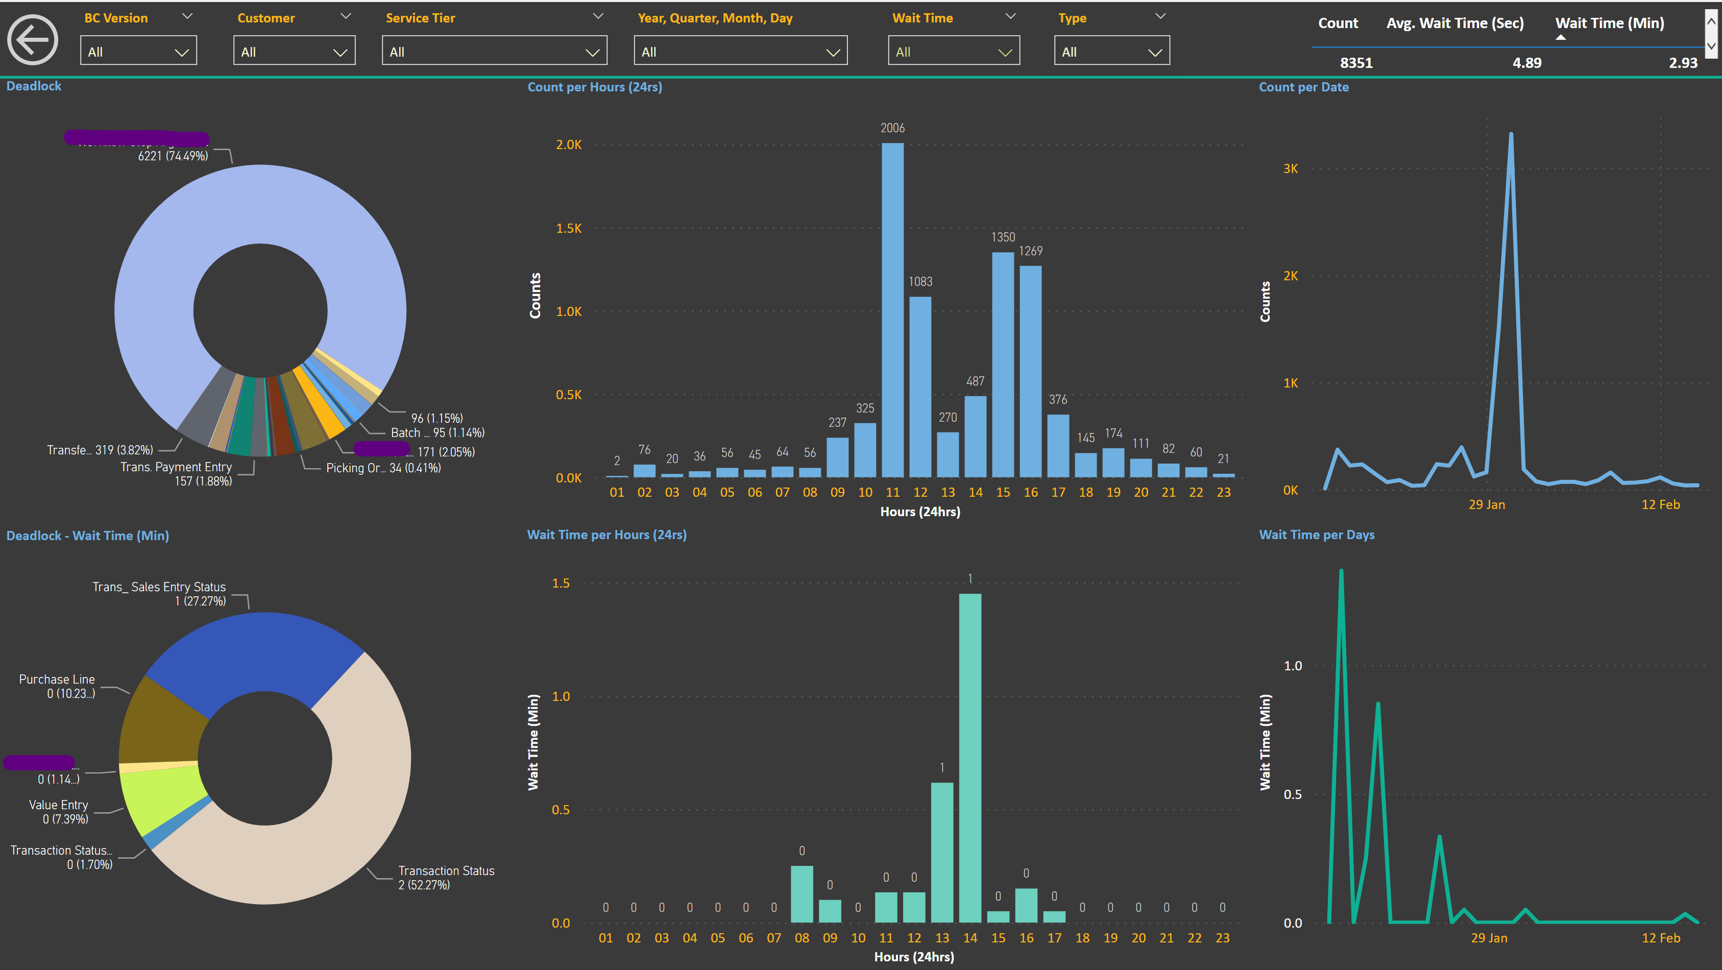

Slide 21
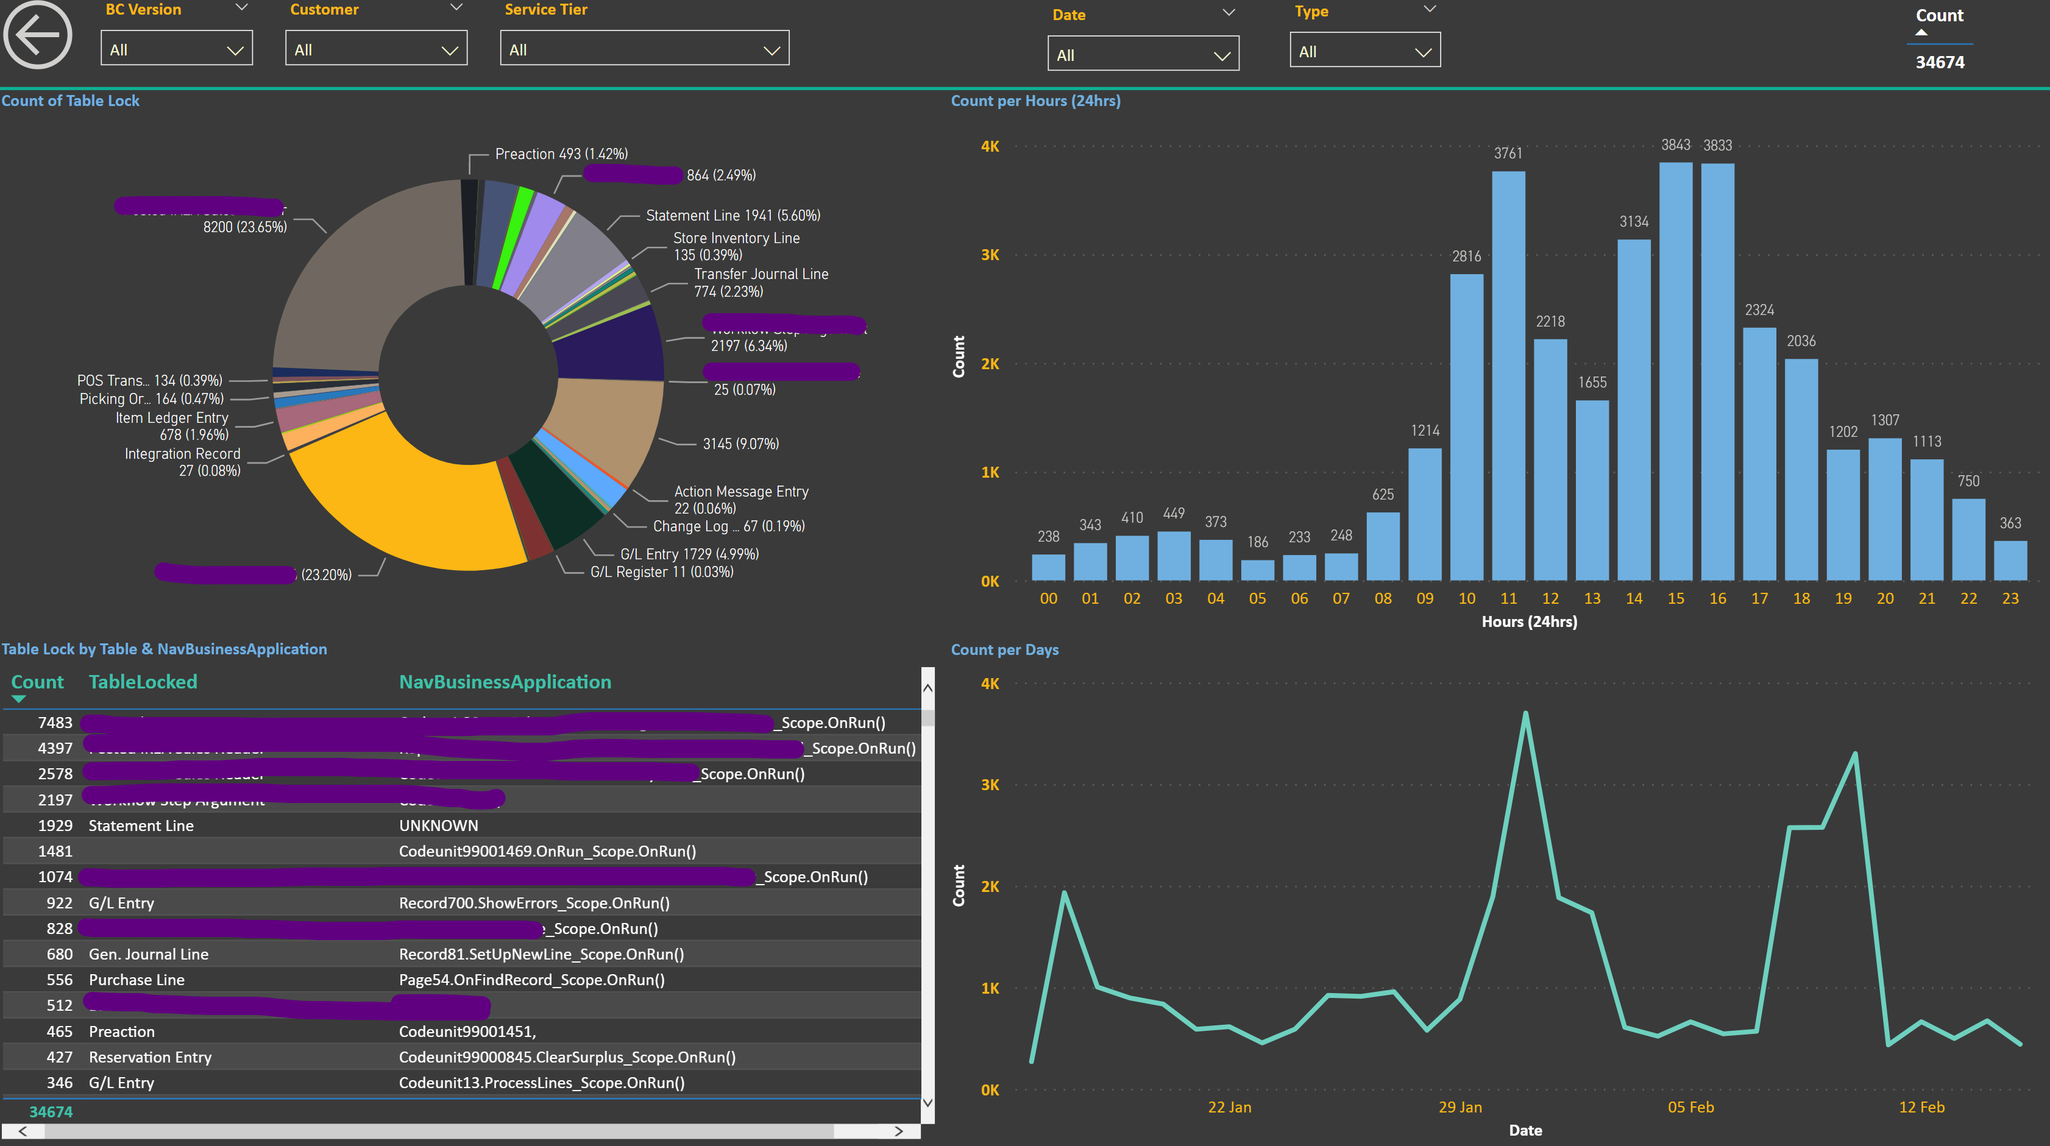

Slide 22
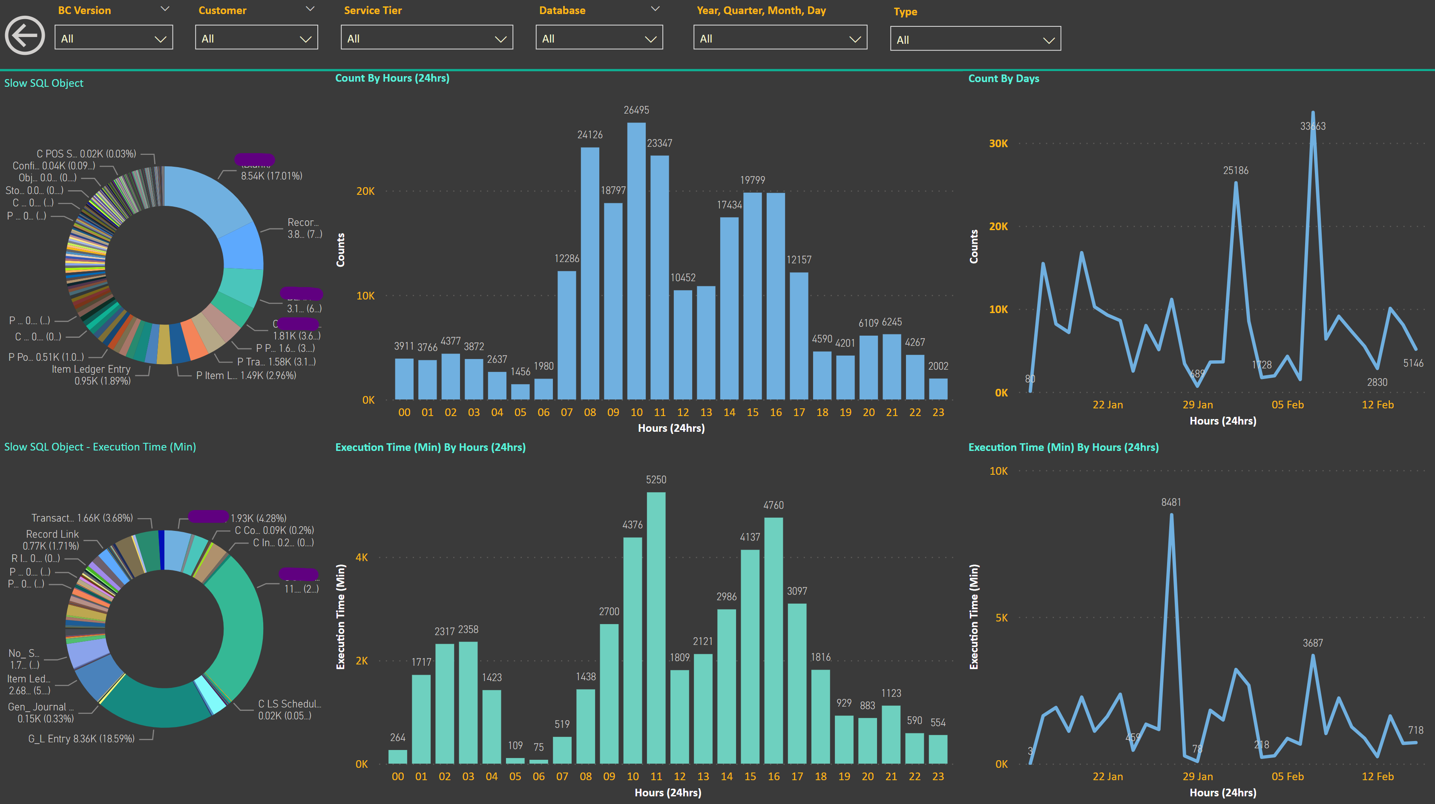

Slide 23
The Audit Output
Detailed overview of performance
SQL review for both hardware and software
Prioritized list of recommended actions

Slide 24
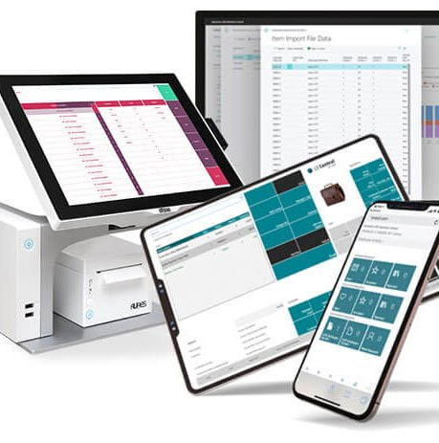
questions?
คำถาม?
câu hỏi?
问题?
mga tanong?
pertanyaan?
質問？
pitakonan?
질문?
ຄໍາຖາມ?
soalan?
Bjarni Asmundsson
Regional Director
bjarni@LSRetail.com

Slide 25
Thank you

