Slide 1
Expand your business with Bookings for LS Central
Activities make the experience memorable
Gígja Eyjólfsdóttir
Senior Consultant
Anna Dís Þorvaldsdóttir
Senior Consultant

Slide 2
Agenda
Bookings for LS Central – new features
Member Contact enhancements
Activity Host
Event/conference functions
Banquet Event Order report
Enhanced Matrix – visual overview
Comments framework
Demonstration
Roadmap for 2023

Slide 3

Complex processes for the organization

Slide 4
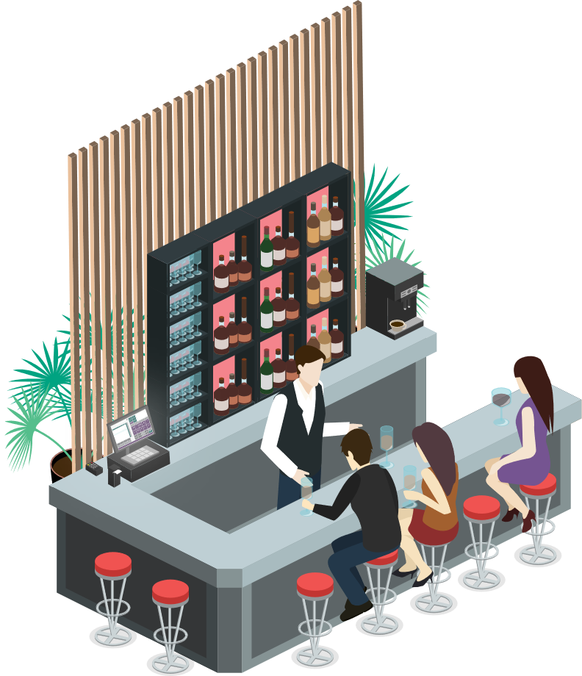






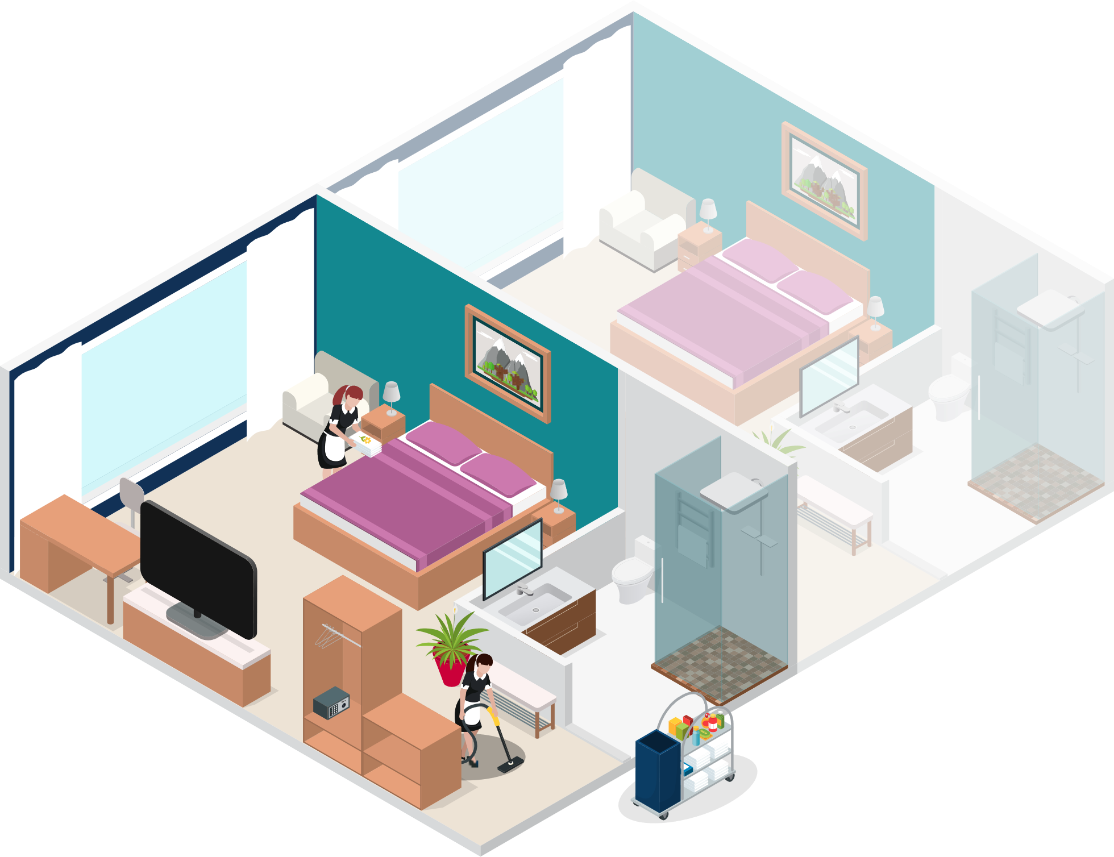
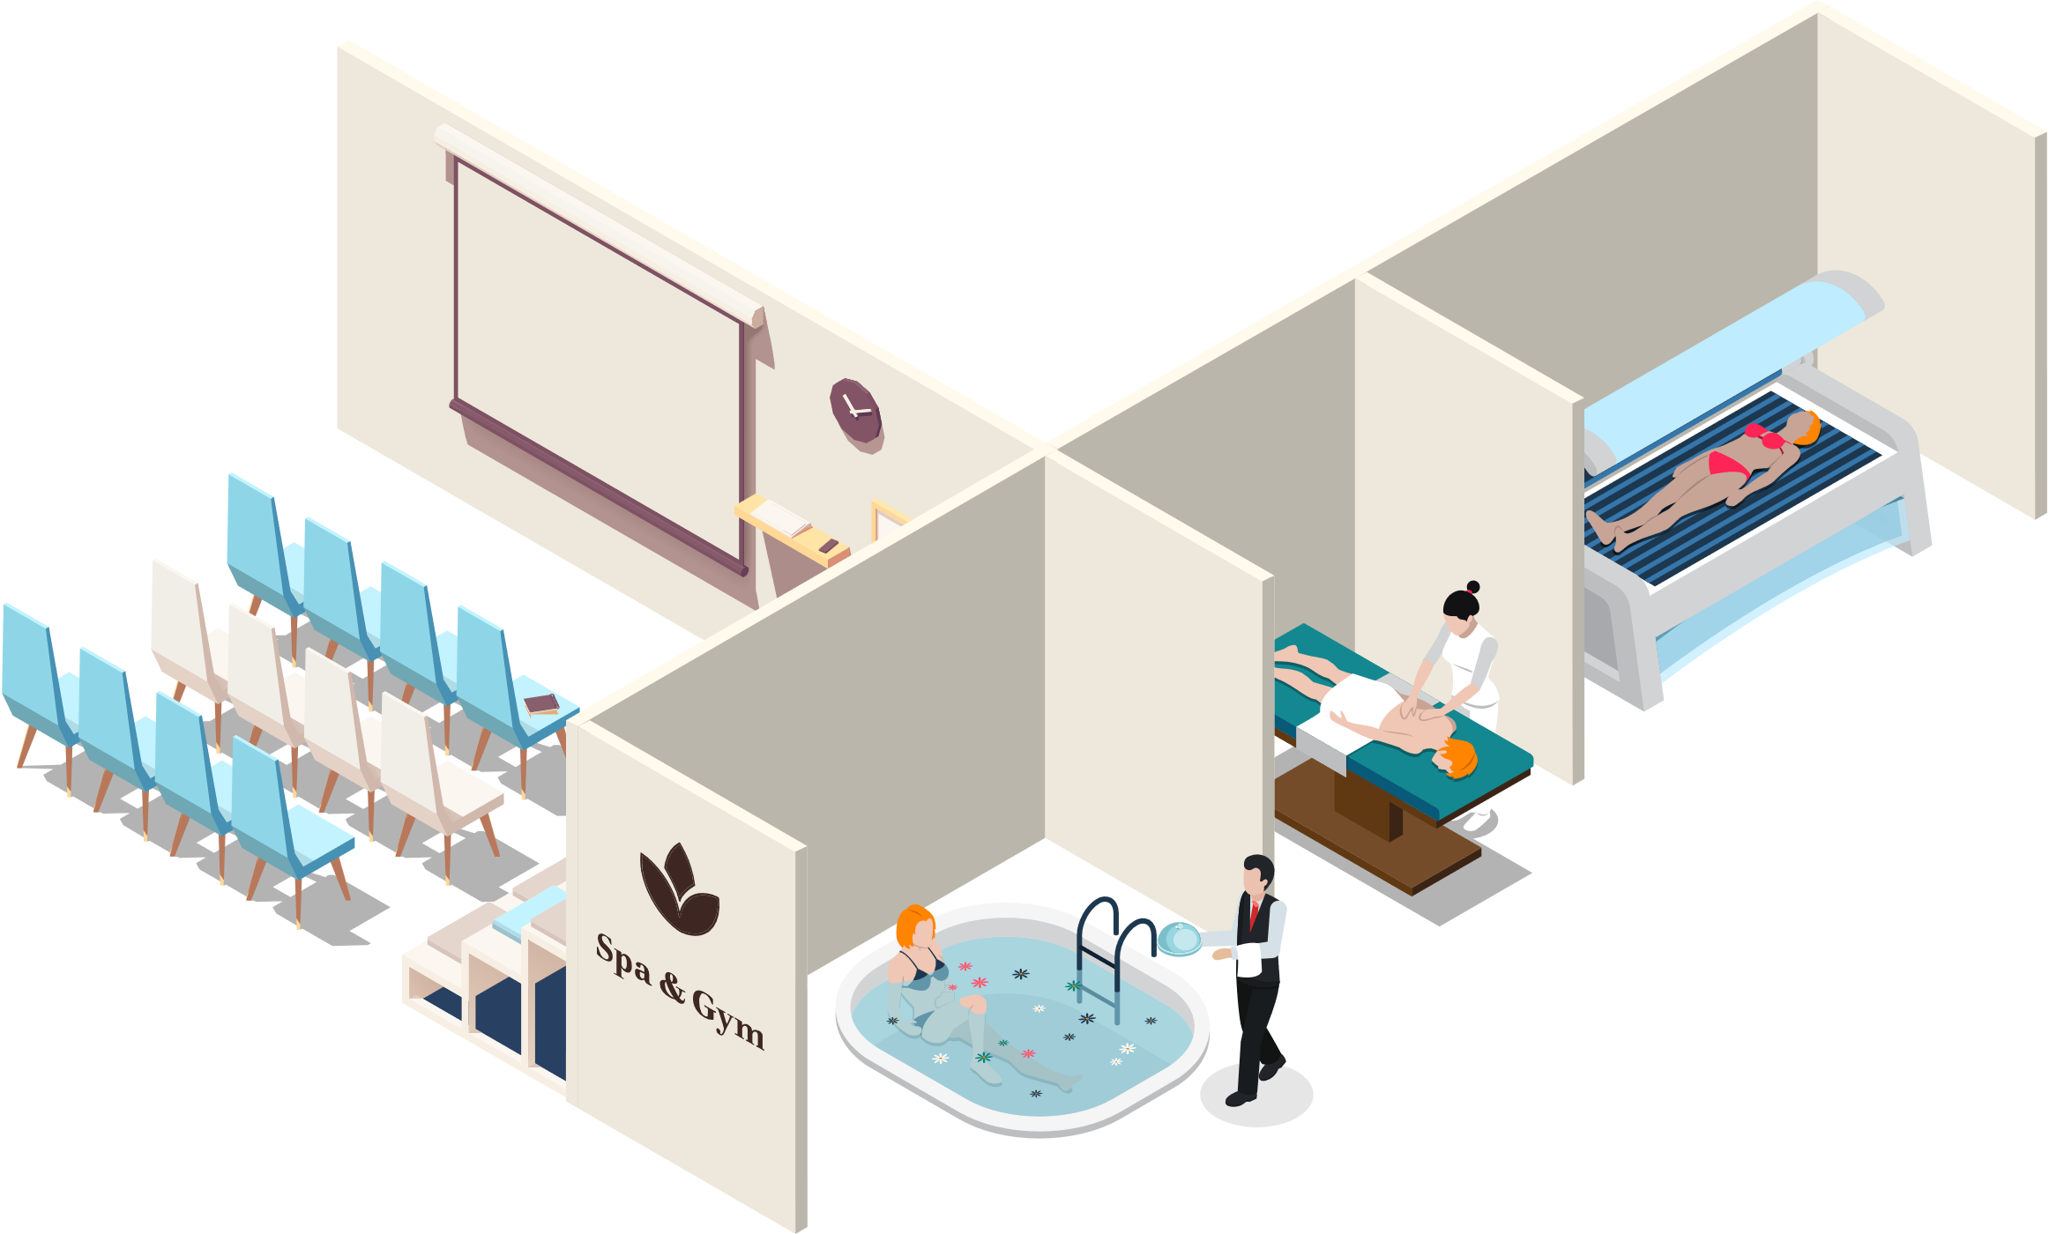


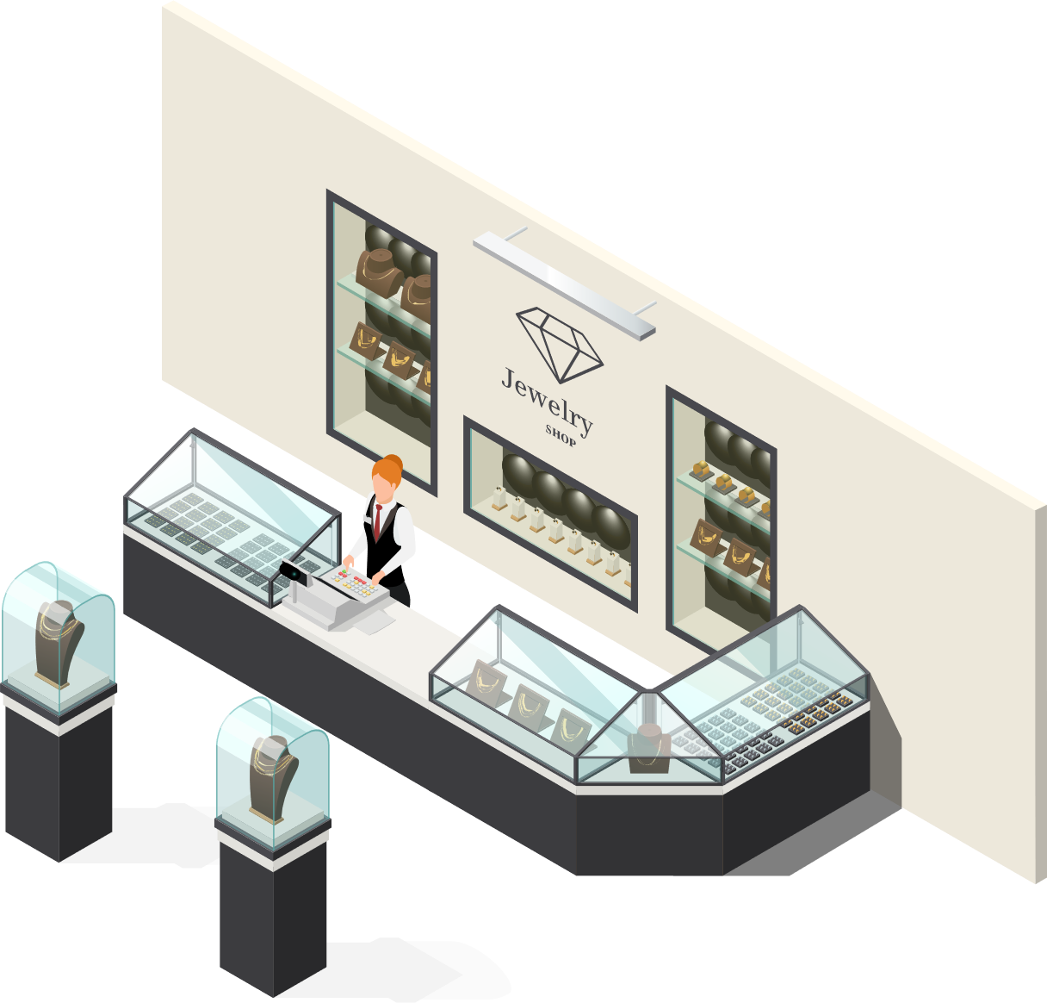


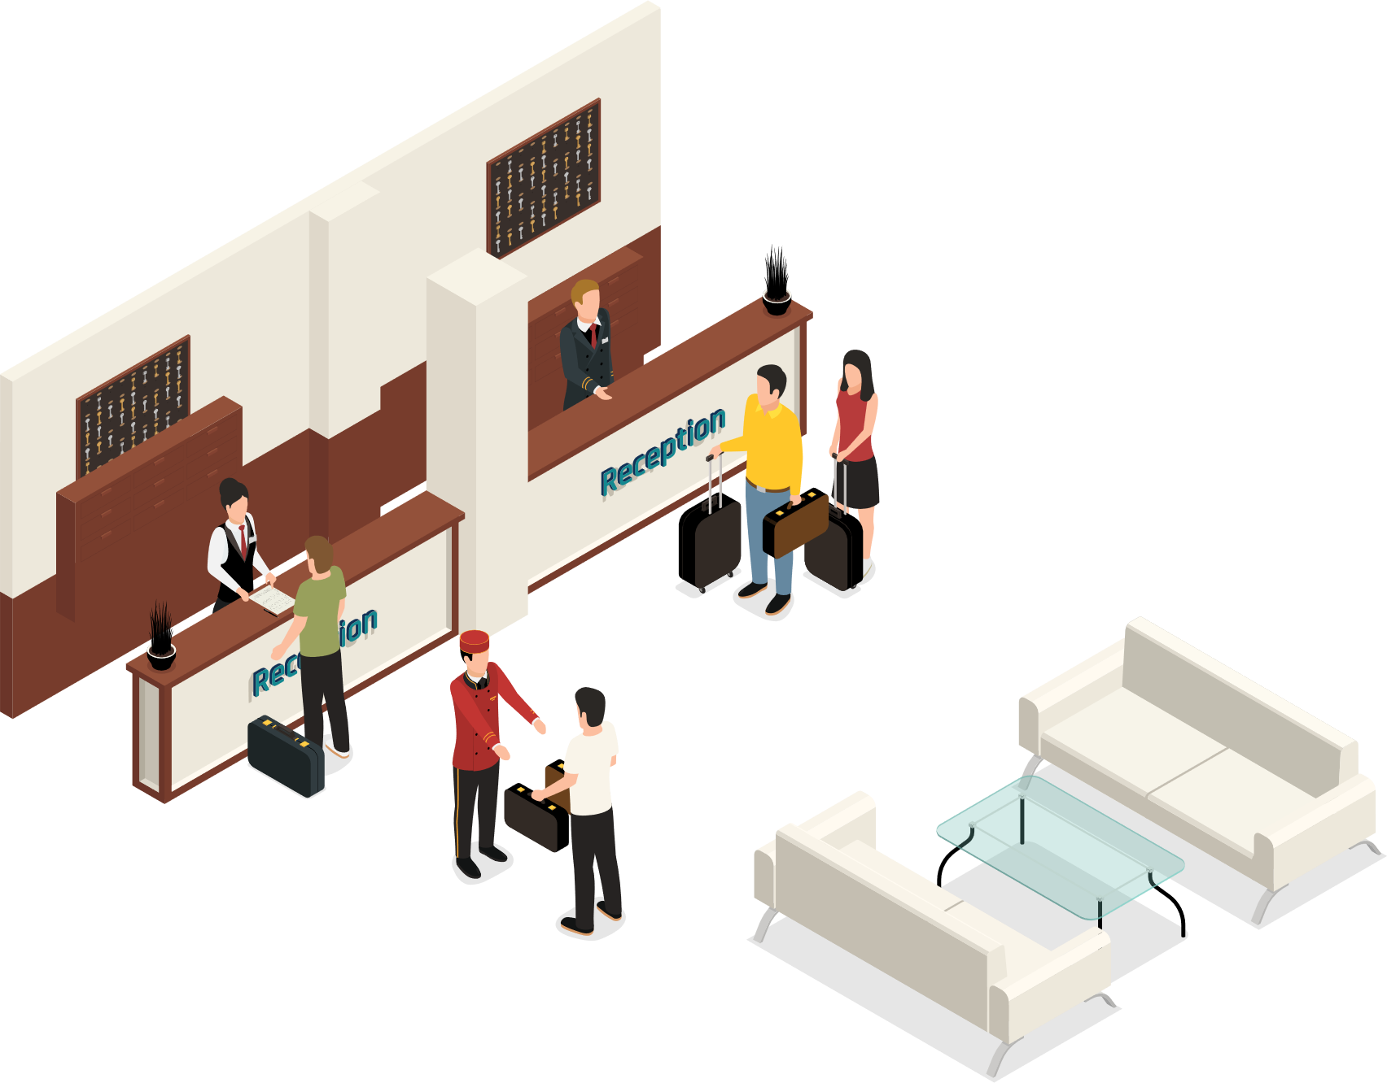
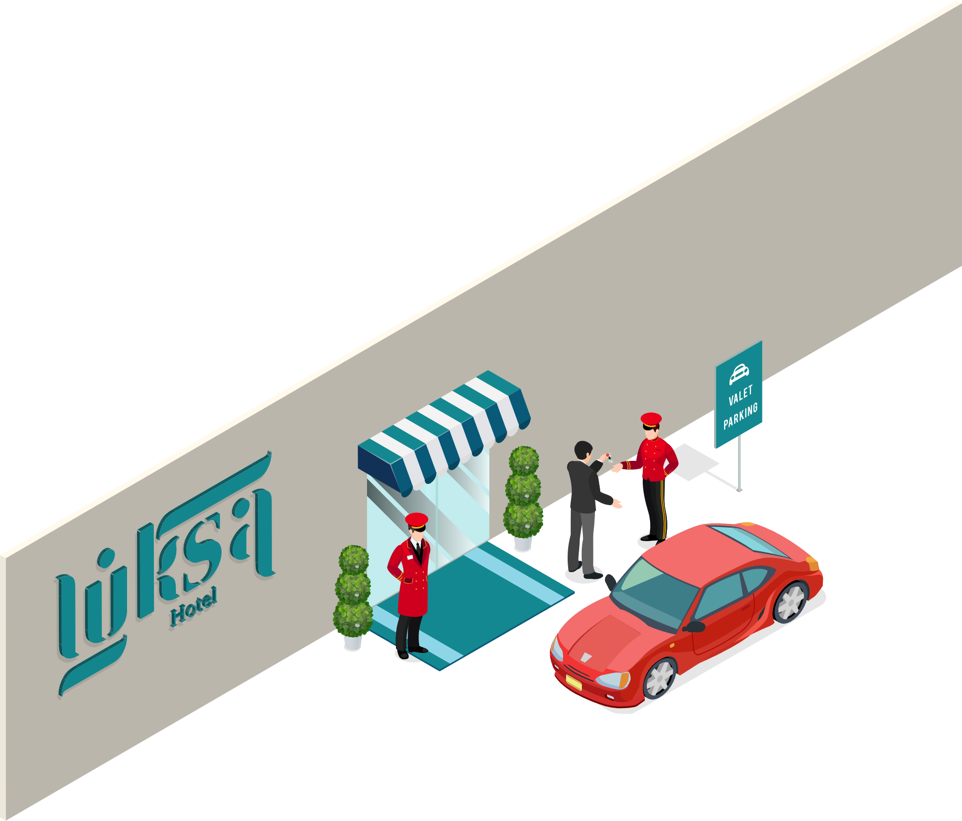



LS Central
Restaurants/KDS
Retail
Staff Mgmt
Bookings
Hotels
Member Mgmt

Slide 5







LS Central
for your operations
Challenges
Consolidate
Insights
Solutions
Unify
Transparency
Lack of overview
Complex processes
for employees
Smooth
guest journey
Empower
employees
ntegrate guest info
from external and internal
data sources

Slide 6
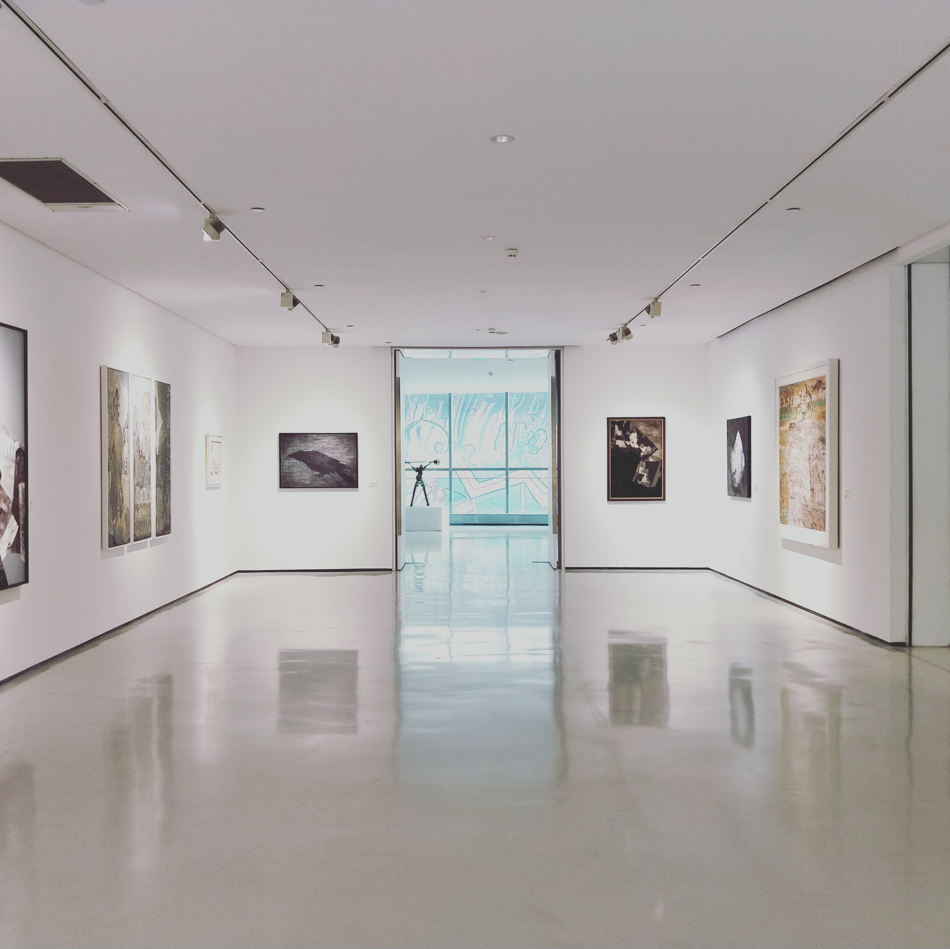
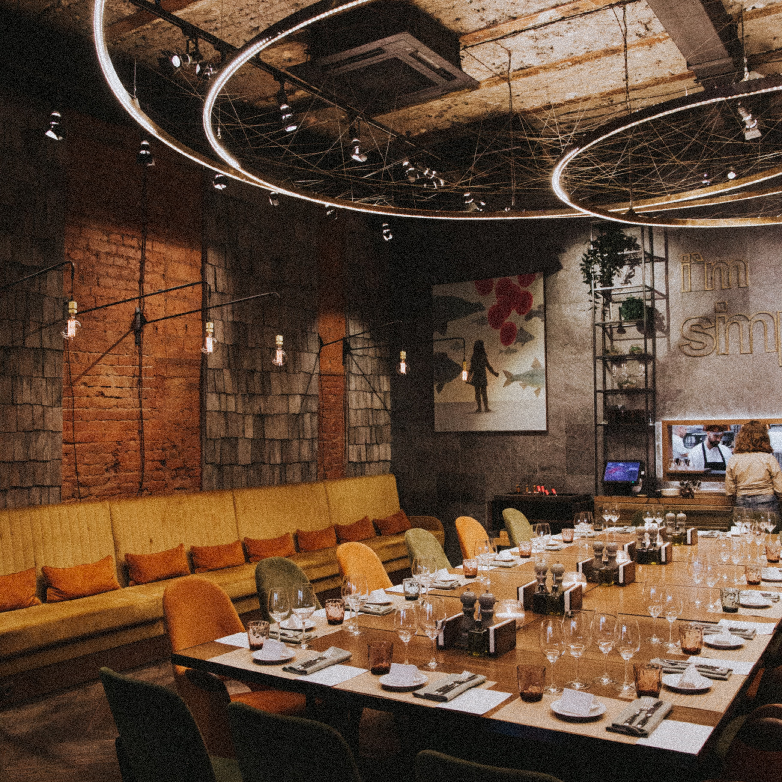
Bookings for LS Central
New functionality

Slide 7

Member Contacts enhancements
Collecting guest/client data
Member contacts linked to reservations and activities
Member contacts can be automatically created
Name and other personal data used for the member contact creation

Slide 8
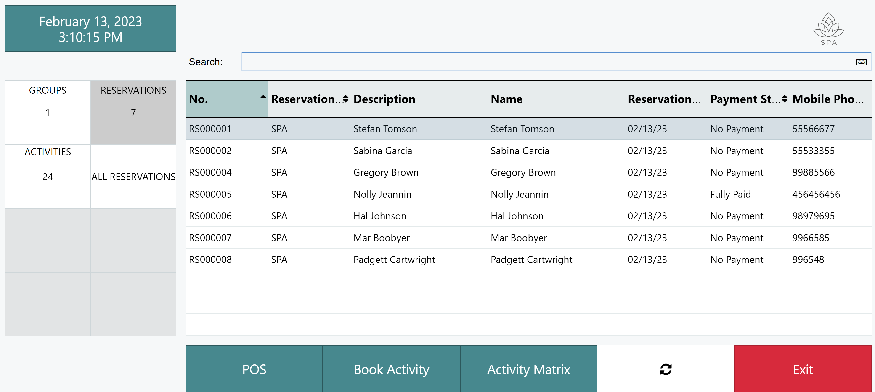
Activity Host – Reception

Slide 9
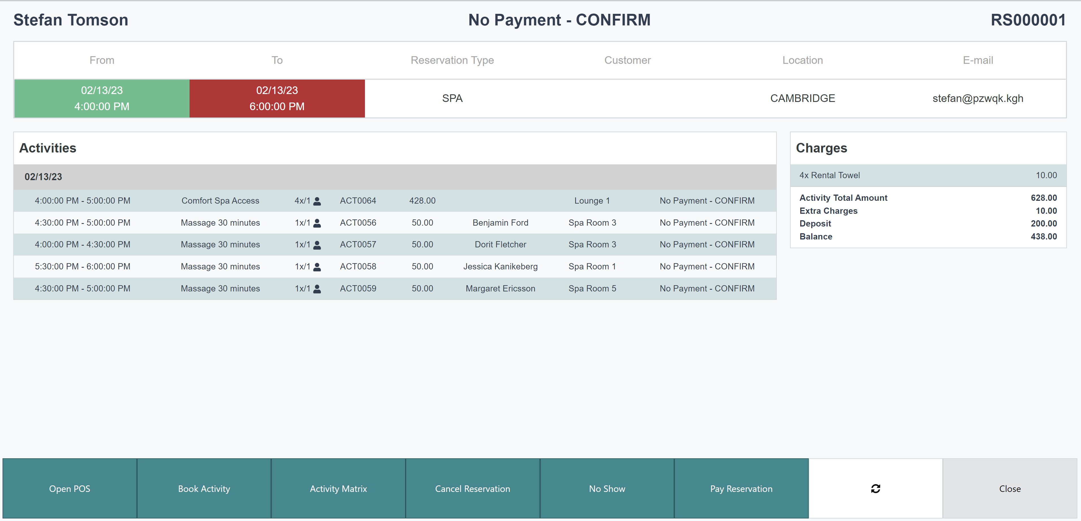
Activity Host – Reservation overview

Slide 10
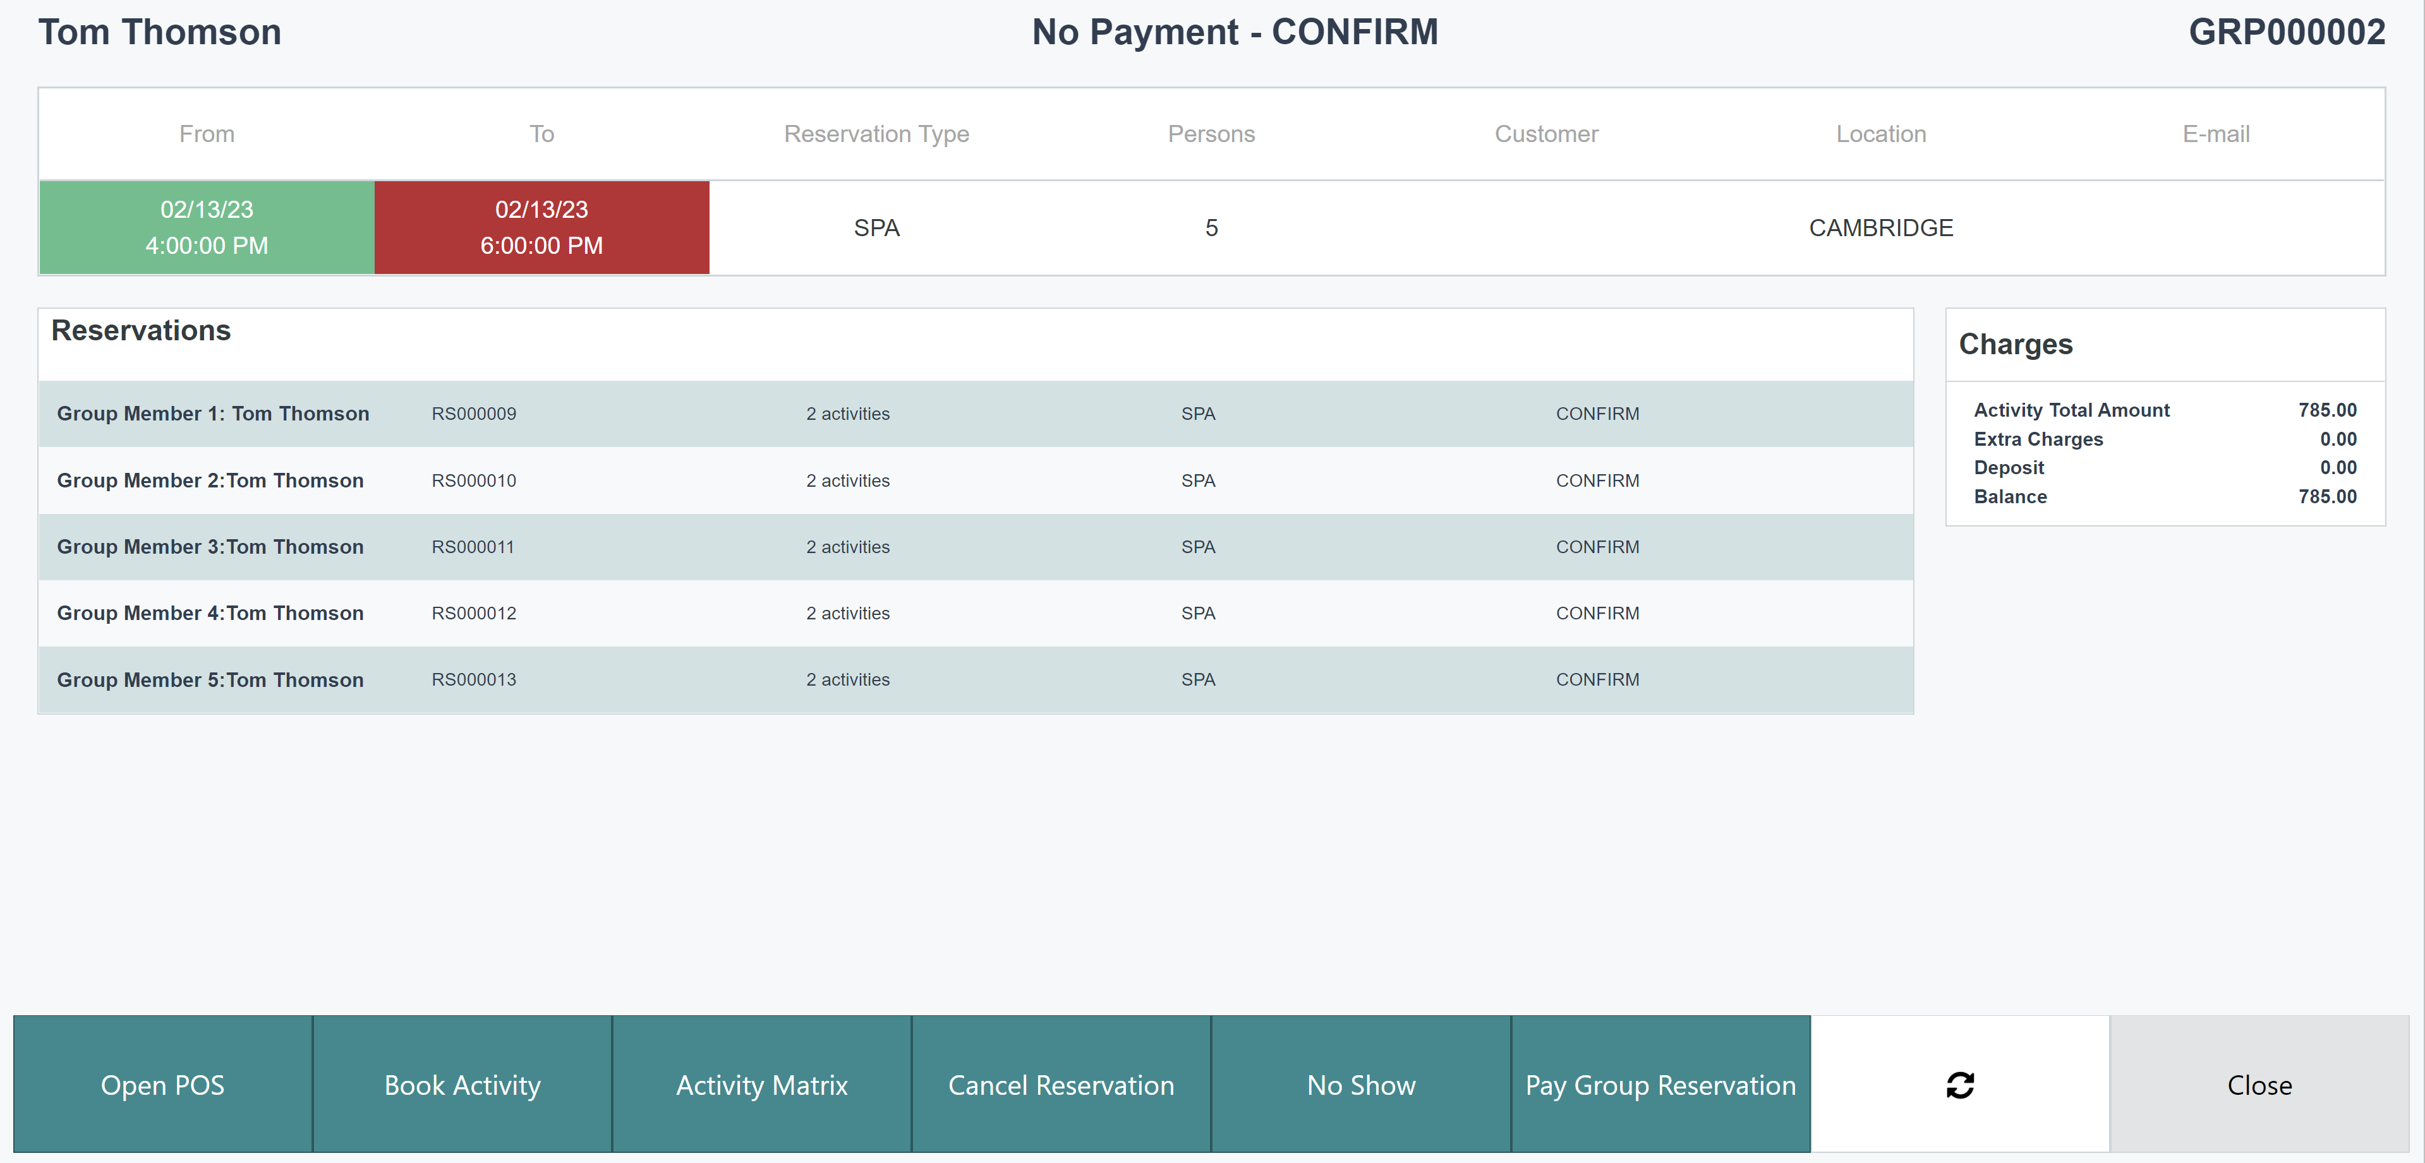
Activity Host – Group reservation

Slide 11

Matrix - visual overview
View of resources availability and assignments
Configurable view of appointments details and customer info
Day view for multiple resources
Week view for one resource
Drag and drop function
Create/view multiple appointments per time slot

Slide 12
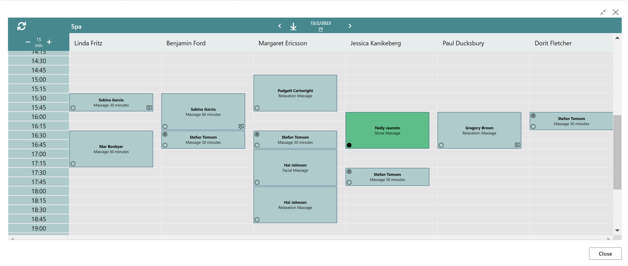
Matrix - visual overview

Slide 13
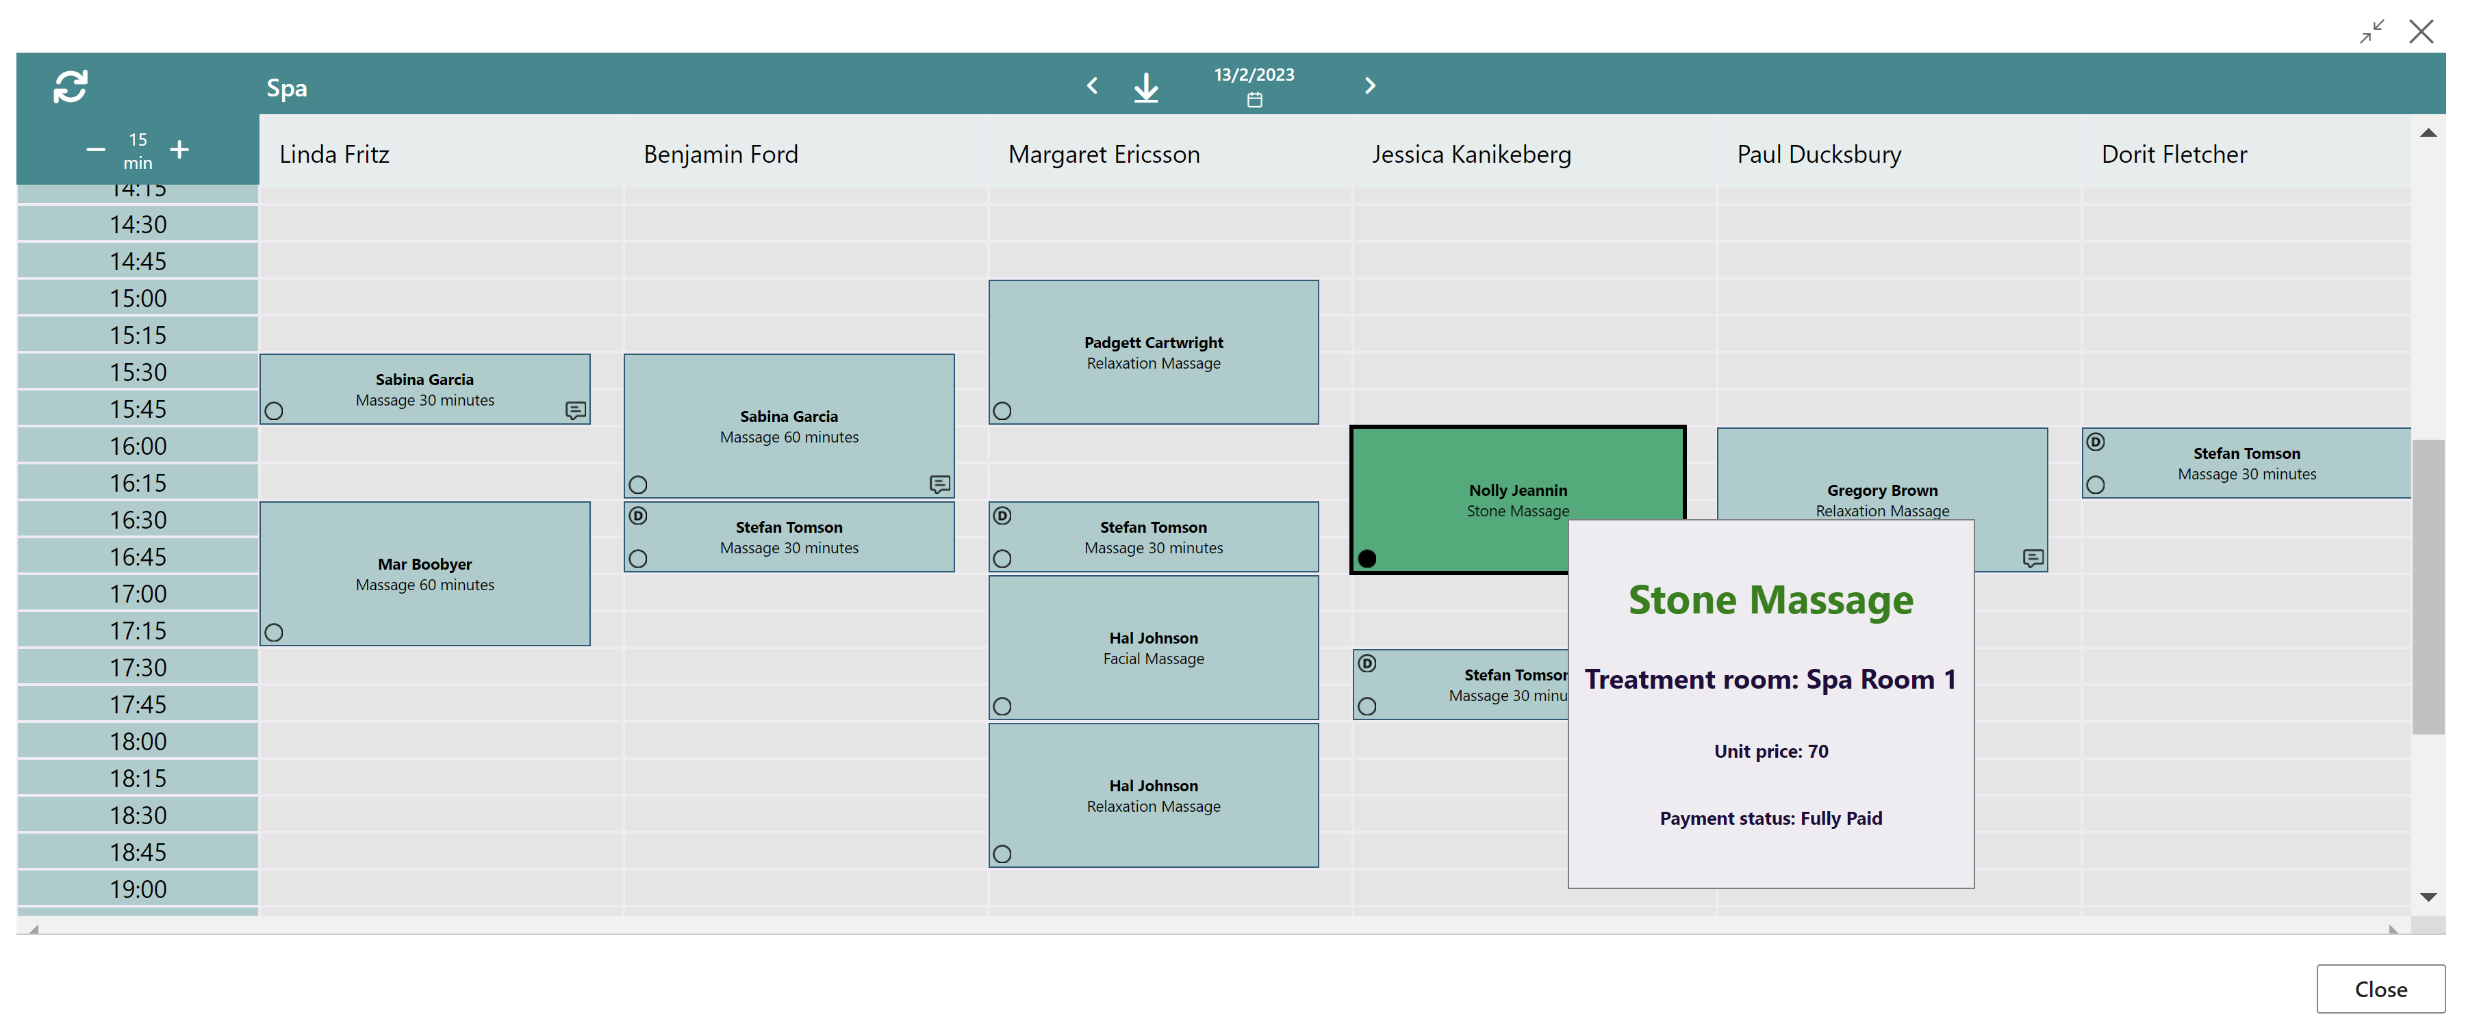
Matrix - visual overview

Slide 14

Comments framework
Comments on multiple places
Collecting all to one table structure
Activities, Reservation and Groups
Dining table reservations
Hotel Reservations
Give staff full overview of the guest comments
Enhance the service experience and possibilites

Slide 15
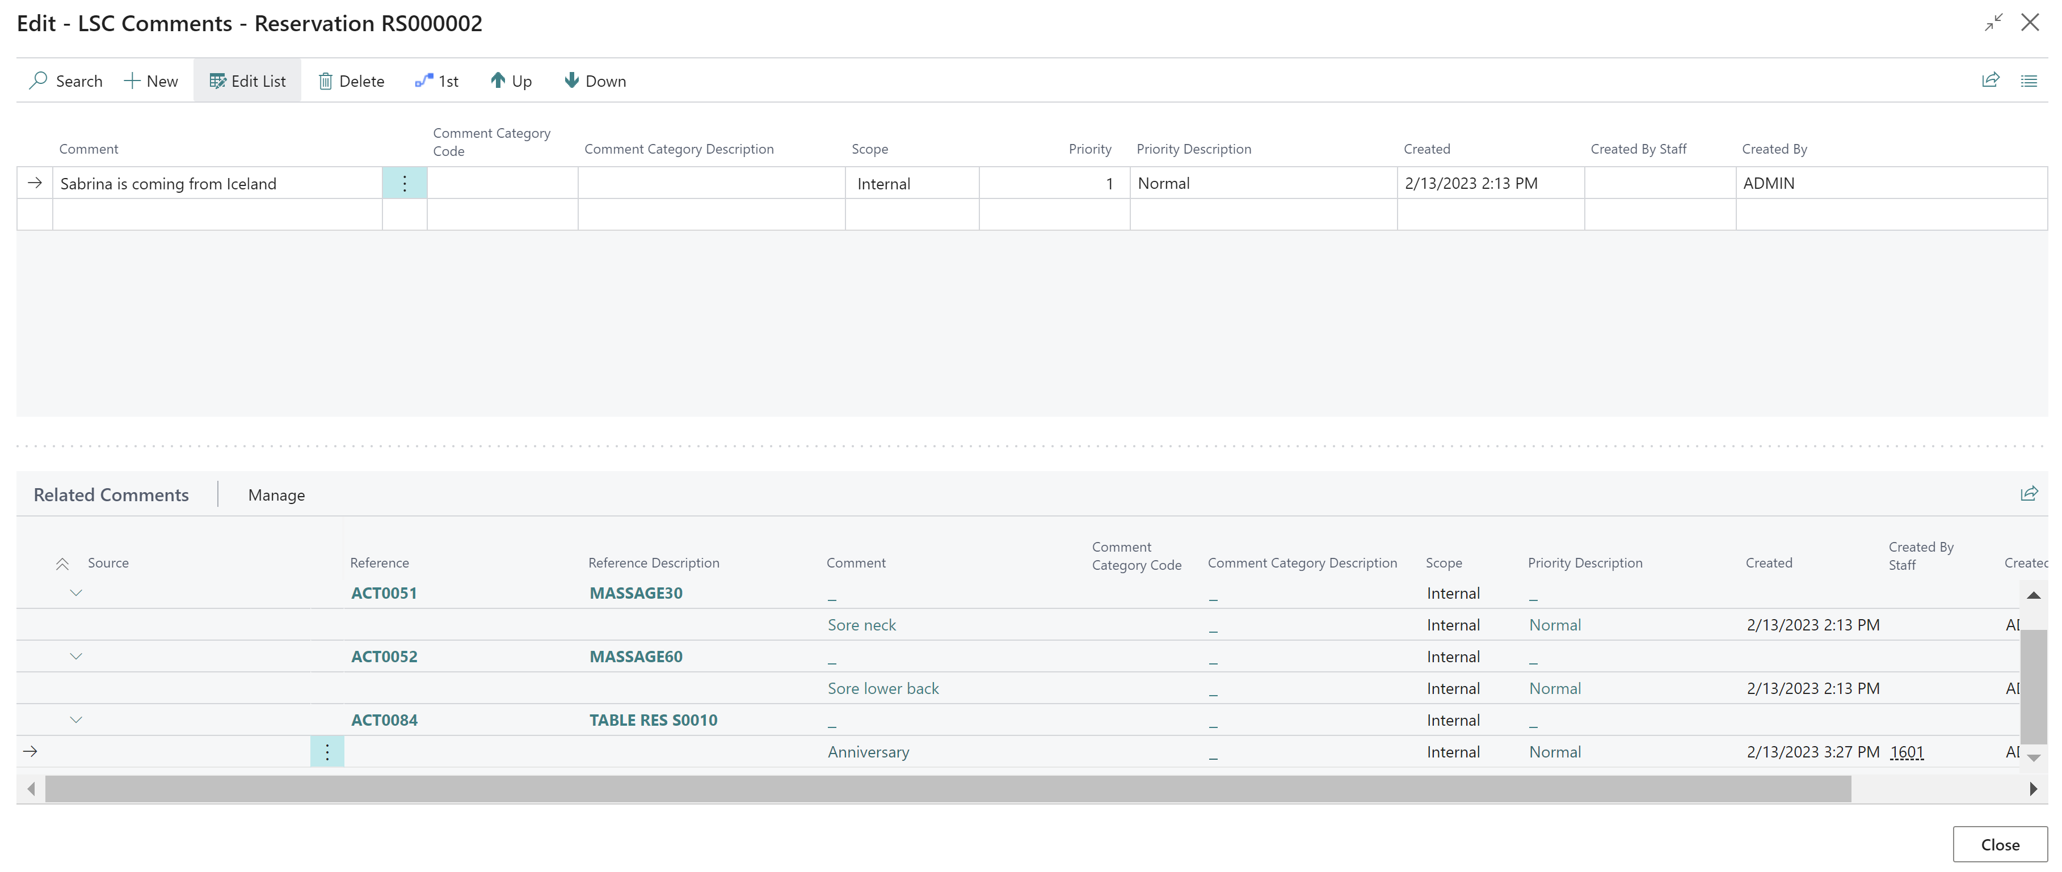
Comments – One table structure

Slide 16

Roadmap

Slide 17

Bookings Roadmap - 2023
H2 2023
Comments Framework
H1 2024
Event Management – Day view for Event categories
Activity REST API’s
Activity pricing based on activity variant
Recurring activities
Event Management – Event scheduling
Activity Front Desk Host with Activity details
Ticketing enhancements
* Dates and features are subject to change

Slide 18
Thank you

