Slide 1


Slide 2

LS Central for Hotels
Deep dive
Gunnar Orn Thorsteinsson
Product Director
Urdur Anna Bjornsdottir
Consulting Manager

Slide 3

Not just a PMS
eCommerce Integration
Web Integration
3rd party
Channel Manager Connector
LS Pay
Integration to payment providers
LS Central
Analytics
predictive abilities
Staff Management
Staff rosters and timetabling
Bookings
Reservations
and activities
Hotels
Property Mgmt System and Channel Mgmt
KDS
Kitchen management
Restaurants
Food and beverage
Loyalty
Member
Mgmt
Retail
Stores and Backoffice
Microsoft Dynamics 365 Business Central
Power BI

Slide 4

Hotel rates
Rate plans with dynamic pricing (periods)
Offset of BAR and Derived Rate Codes
Rate attributes with items, activities and/or rate packages
Segment base pricing for different channels
All channels updated in real time
Multi-currency support
Rate restrictions
Discounts

Slide 5



Channel manager
Channel Management Systems
Connects to Channel Management Systems or directly to booking engines (OTA)
Multi-property and multi-channel management
LS Central for hotels is certified by SynXis and SiteMinder
BEC is extensible so partners can write own BEC plugins (certification) instead of using connectors provided by LS
Booking Engine Connector
LS Central for Hotels
Web Integration
3rd party

Slide 6

Reservation management
Reservations – individual and groups
Activities and dining reservations
Reservation extras
Guest lists
Room allocation – automatic and on Tape Chart
Flexibility – change dates, guests and activities
Comments
Tasks

Slide 7
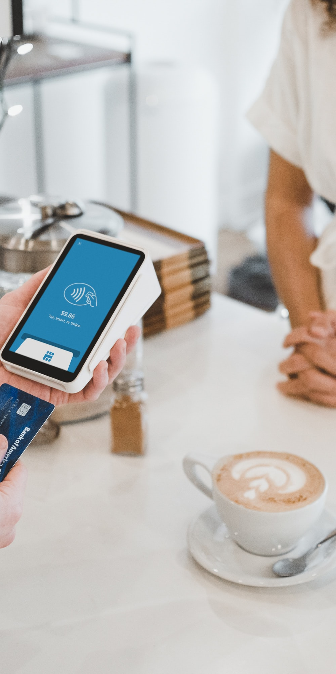
Invoice management
Routing rules
Flexible invoices – Guest, Company, Paymaster
Transfer balances
Deposits
Price changes
Improved overview
Pay on POS or create Sales Invoice in BO
Statement posting
Night audit w. Accrual Accounting

Slide 8
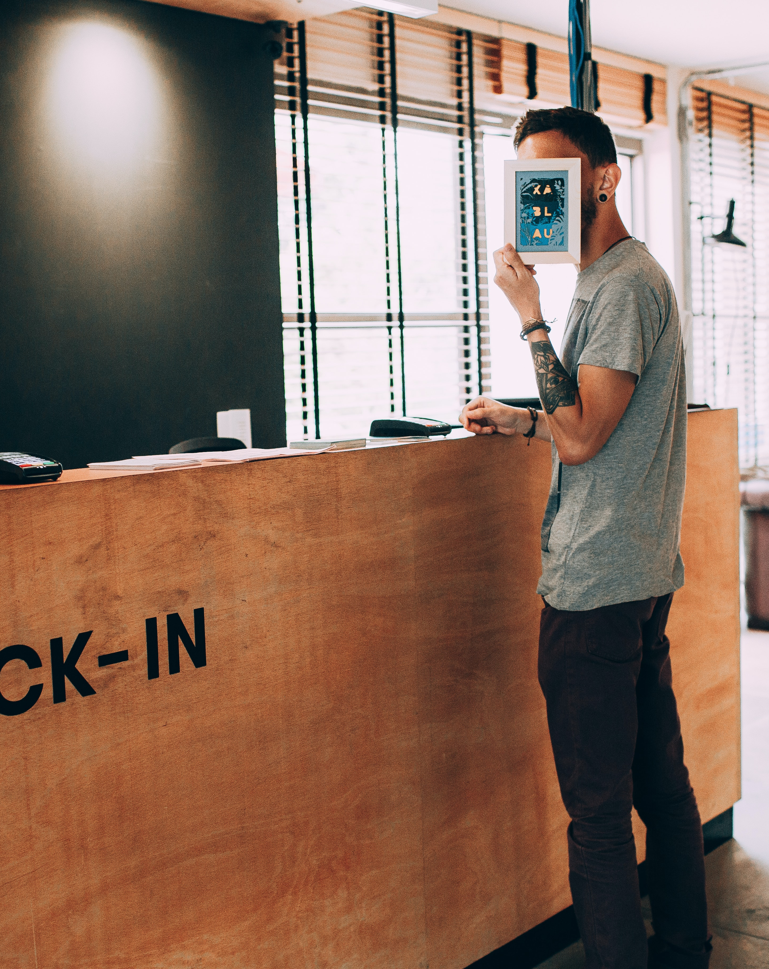
Hotel Front Desk
Front desk role center
Front desk POS
Book activities/table reservation on POS
Charge to room
Split bill
Floor plan and housekeeping view

Slide 9

Housekeeping management
Housekeeping role center
Housekeeping tasks with estimates
Rules for stayover, check-out, check-ins and vacant
Housekeeping status
Role budgets
Housekeeping API
Housekeeping App (consulting solution)

Slide 10

Analytics
11 report pages
  Hotel Overview
  Occupancy
  Reservations
  Reservations (Date Comparison)
  Arrivals
  Guests
  Revenues
  Revenue Analysis
  Occupancy (Last 28 days)
  Occupancy (Next 28 days)
  Night Statistics

Slide 11

Setting up Hotels
Configuration packages to set up processes, inventory etc.
Import reservations
  Configuration packages (Excel)
  Staging tables to review prior to import
  Hotel reservation number is mapped to old number

Slide 12

Hotel future
Q1 2023
Comments Framework
Q2 2023
Hotel Contracts
Hotel Allowances for reservation extras
Multi-property availability view
Serial Bookings (Linked Reservations)
Q3 2023
Multi-company bookings
Room Management (Attributes, joining, …)
Reservation payment tokens with pre-auth
Hotel Allotments
Housekeeping rules and tasks
Hotel Integrations (RMS, KEY locking, ….)
Rate Code Matrix

Slide 14
Thank you

