Slide 2

LS Insight Deep Dive
Andrej Zajec
Technical Sales Executive
Andrej@lsretail.com

Slide 3



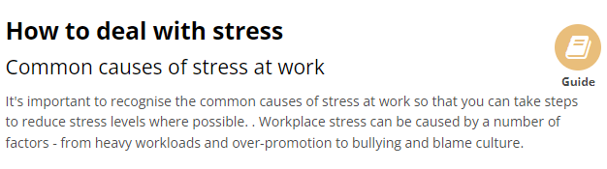
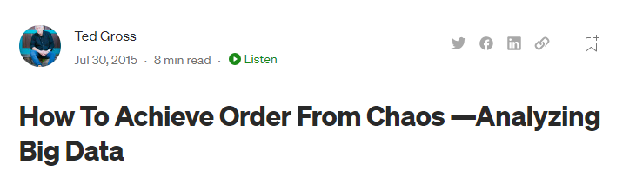
https://www.amazon.com/Take-Stress-Chaos-Calm-Re-Energize/dp/1628650850
Where?
Why?
https://www.psychologytoday.com/us/blog/the-happiness-health-connection/202104/the-happiness-health-connection
Who?
When?
How?
https://www.nibusinessinfo.co.uk/content/common-causes-stress-work
https://tedwgross.medium.com/how-to-achieve-order-from-chaos-analyzing-big-data-3eb6626e488

Slide 4
Daily revenue
Today
Dubrovnik
EUR
42

Slide 5
42
18.10.2022
42°38'29.7"N 18°06'37.0"E
EUR

Slide 6
Inc | Curr | Date | Loc
42 | EUR | 18.10.2022 | 42°38'29.7"N 18°06'37.0"E
35 | EUR | 17.10.2022 | 42°38'29.7"N 18°06'37.0"E
40 | EUR | 16.10.2022 | 42°38'29.7"N 18°06'37.0"E
50 | EUR | 15.10.2022 | 42°38'29.7"N 18°06'37.0"E

Slide 7
42
18.10.2022
42°38'29.7"N 18°06'37.0"E
EUR

Slide 9


Slide 10

LS Insight
LS Central

Slide 11




LS Intelligent Cloud
LS Insight
LS Forecast
LS Recommend
- Data Hub
LS Insight
OLAP
LS Central
OLTP

Slide 12
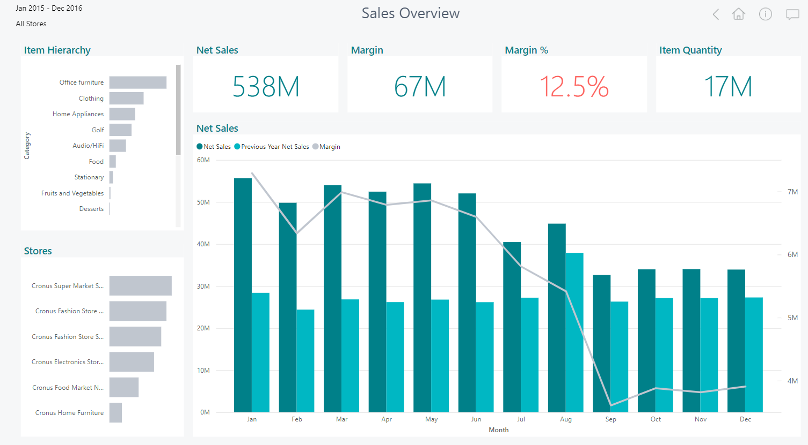



LS Insight – Analytics
LS Insight – Data Hub
LS Central
…

Slide 13



LS Insight – Analytics
DW tables
2
LS Insight – Data Hub
Staging tables
1
Pre-staging tbls
1
LS Central
0
LS tables

Slide 14
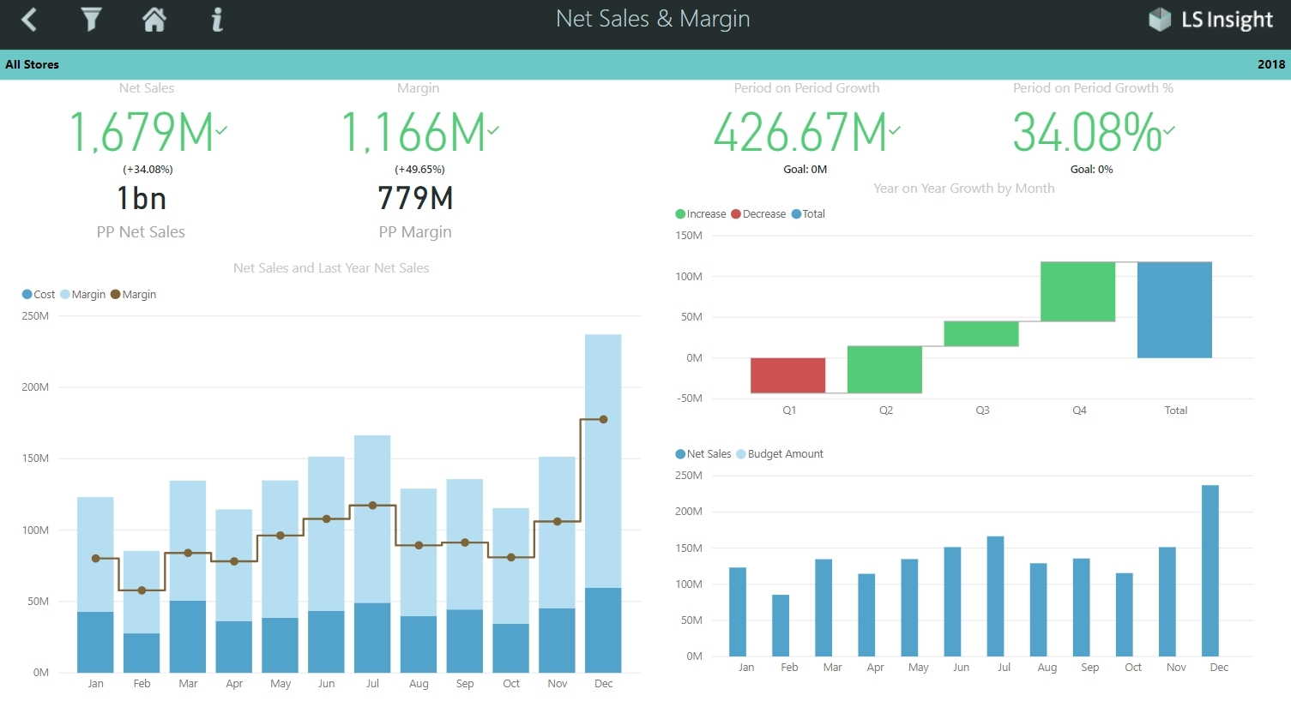
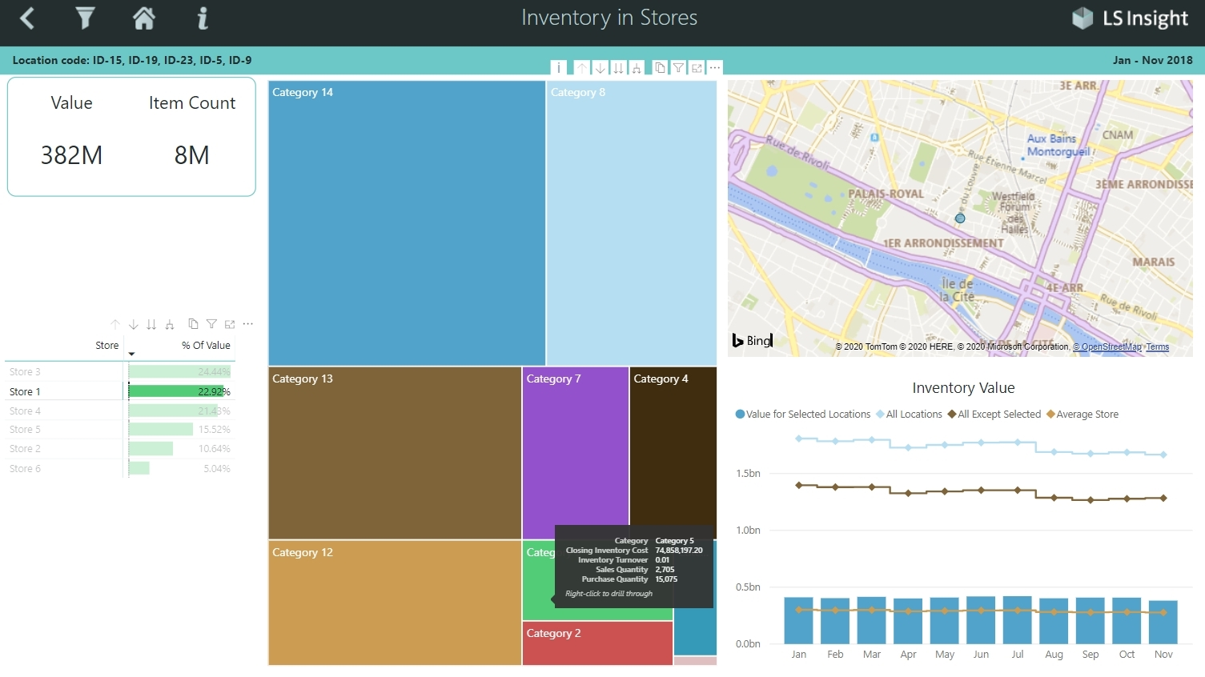
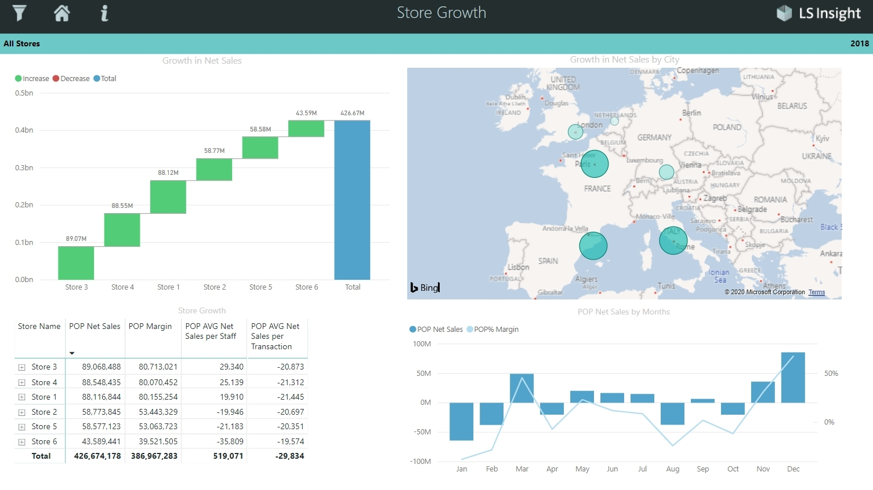
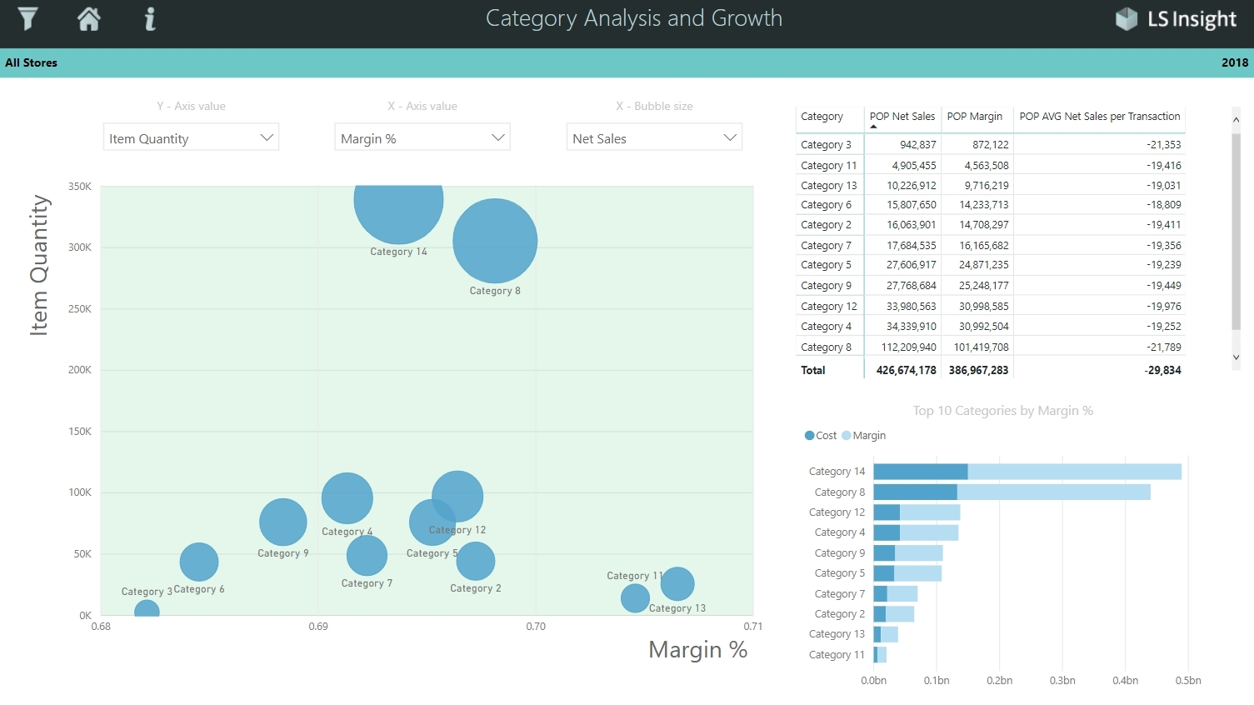
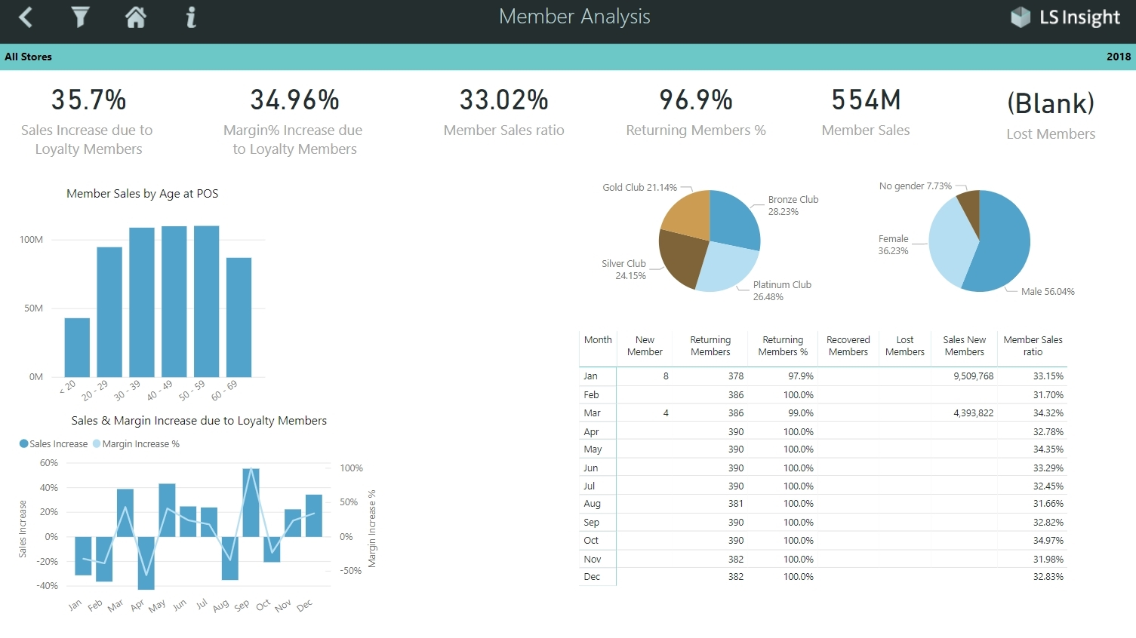
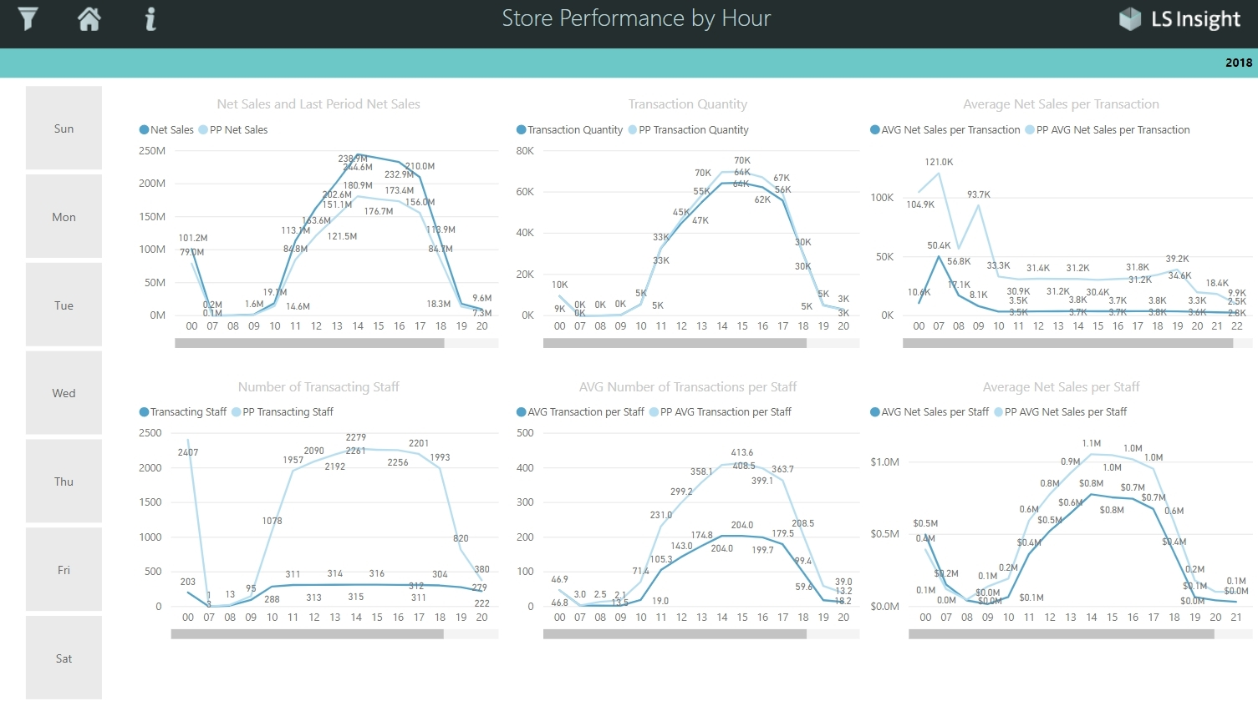
LS Insight
Analytics
It’s for FREE!!!
Your cost: Hosting and operating
https://azure.microsoft.com/en-us/pricing/calculator/
Data Hub

Slide 15


Extending LS Insight
+
+
+
LS Insight – Analytics
LS Insight – Data Hub
LS Central

Slide 16


LS Insight Roadmap
LS Insight – Analytics
LS Insight – Data Hub
LS Central

Slide 17

Benefits for you
Data Hub & Analytics
One data platform for all your reporting
needs
Mobile devices support
Easy to extend with other data sources
Strong integration with other Microsoft
products (Power Apps)
On-premises or in the cloud
Easy to get started
Data Hub and Analytics for free
(only hosting cost)
PowerBI reports to start with
Large PowerBI community

Slide 18
How to get started?
Try it
Request form:
https://portal.lsretail.com/Products/LS-Insight
Get product files
Follow onboarding instructions, Done!
Documentation
LS Retail Online Help, LS Insight
https://help.lscentral.lsretail.com/
PowerBI readiness
Documentation
https://docs.microsoft.com/en-us/power-bi/
Learning
https://docs.microsoft.com/en-us/learn/

Slide 19


Slide 20
Thank you

