Slide 1
Technical setup workshop
Thorir Bjornsson

Slide 2
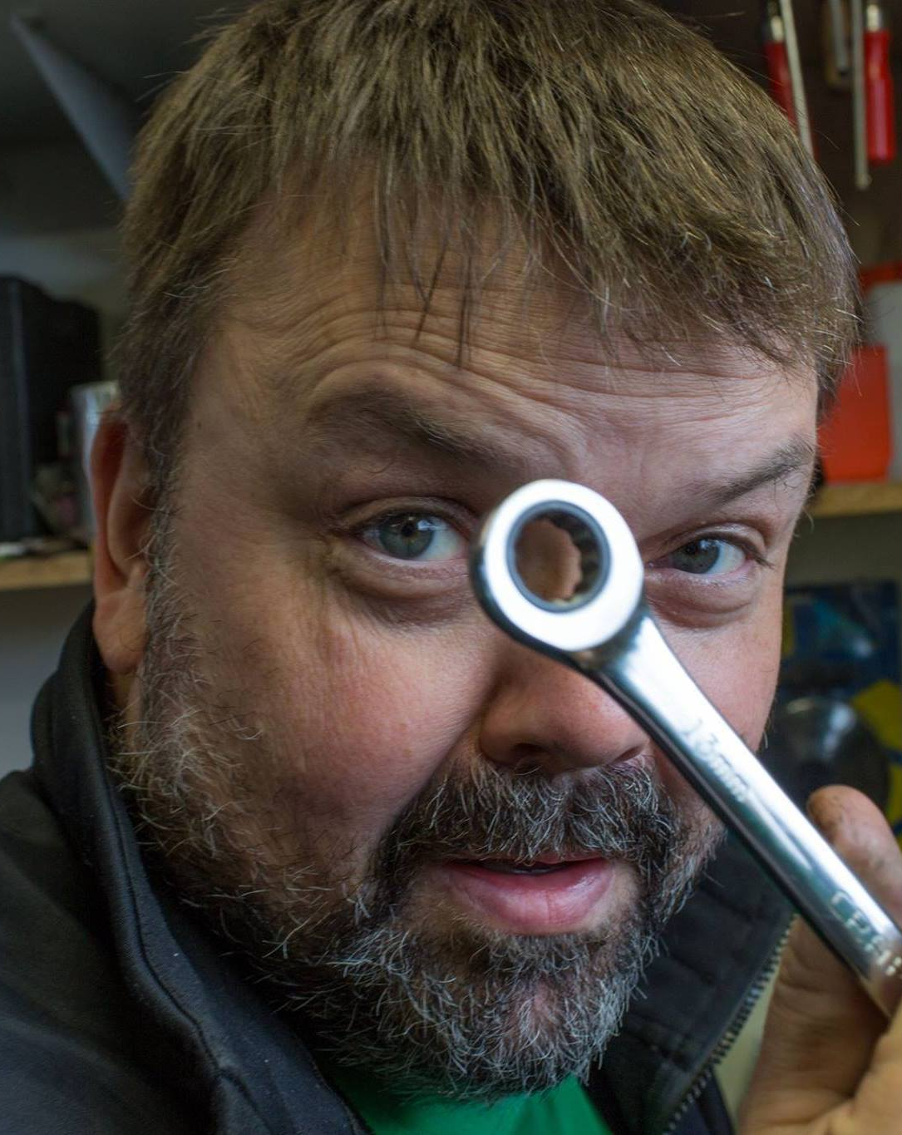
Agenda Technical Workshop
OPOS setup
HardwareStation
Virtual Station
LS Central
KDS server

Slide 3
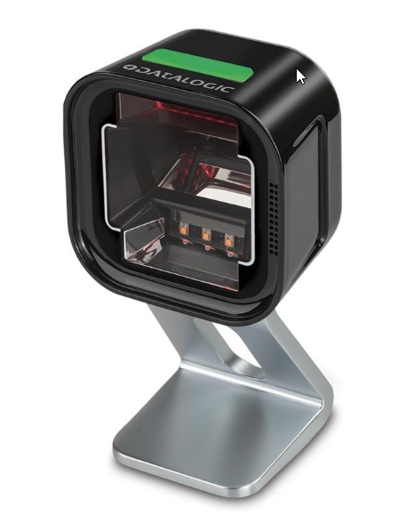
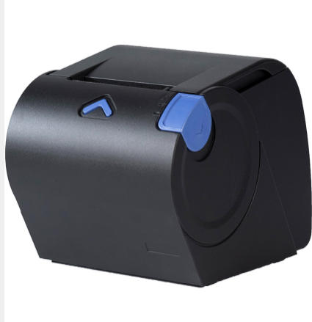
Technical Workshop
OPOS setup
Toshiba printer
Datalogic scanner
Demo

Slide 4
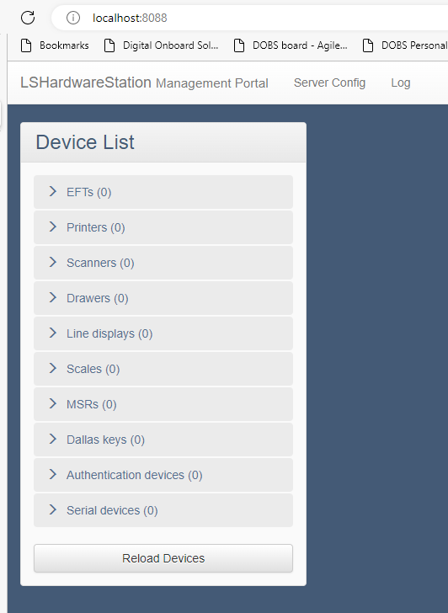
Technical Workshop
HardwareStation
Printing
Scanning
Logs
Demo

Slide 5
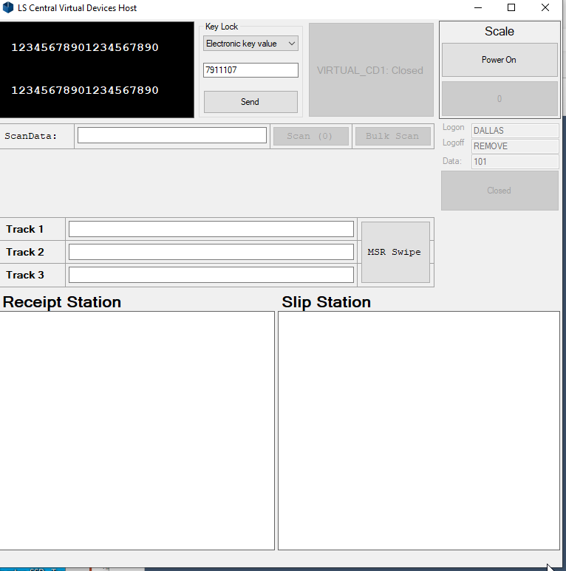
Technical Workshop
Virtual Station
Setup and demo

Slide 6
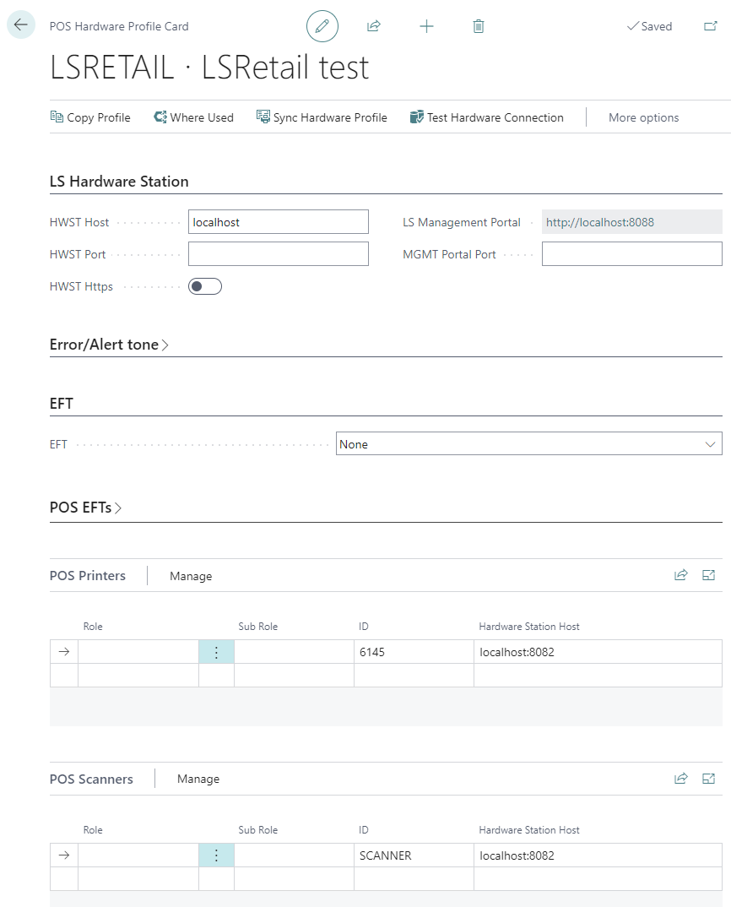
Technical Workshop
LS Central
Hardware and setup

Slide 7
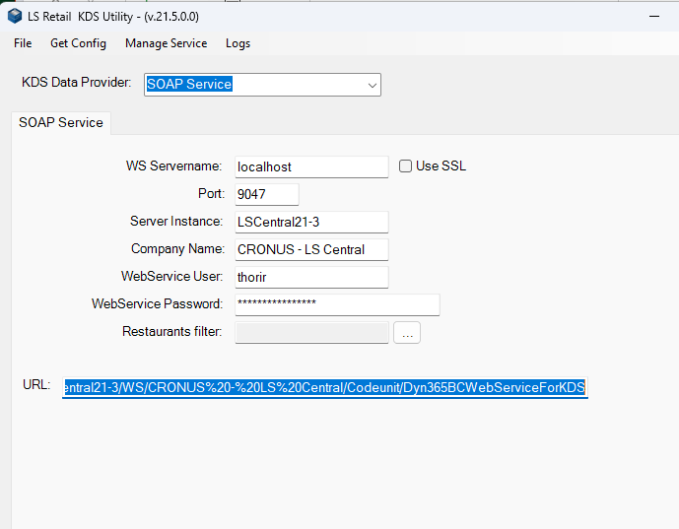
Technical Workshop
KDS server
KDS printing
Display station
Demo

Slide 8
Thank you

