Slide 3


Alejandro Vázquez
Senior Consultant
alejandrova@lsretail.com
How to handle large implementations
Johann Sveinsson
Senior Developer
johann@lsretail.com

Slide 4
Large customer definition by Microsoft
Records
  User Table >= 1.000
  Sales Invoice > 800.000
  Item Ledger Entry > 3.500.000
  G/L Entry table > 17.000.000
Data Sizes
  400 GB On-Prem
  160 GB Migrated from On-Prem
Browser interaction
  82.000 in one hour
  385.000 in one day
Web Services Calls
  5.700 in one minute
  2.700.000 in one day
Transactions
  6000 sales orders posted in one day
  3.300 lines on one sales order

Slide 5
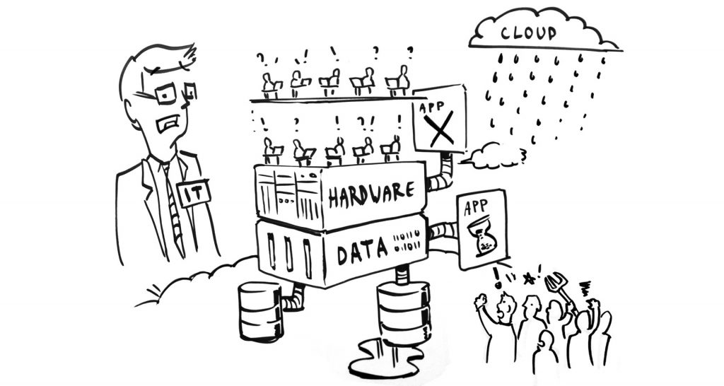
Does anyone recognize these challenges?
24 hours is not enough for operational processes
Replenishment processing time
Statement Posting time
Document Posting time
Cost Adjustments
Table locks
Deadlocks
POS or User facing challenges

Slide 6
What should we be addressing
Solution architecture
POS best practices
Posting challenges
Performance issues
Hundreds of users
Operational guideline
Performance monitor

Slide 7

Architecture
SaaS
Hybrid SaaS
OnPrem
OnPrem - Online POS
OnPrem/Hybrid - Store Server and POS clients
OnPrem/Hybrid - Fully resilient POS

Slide 8
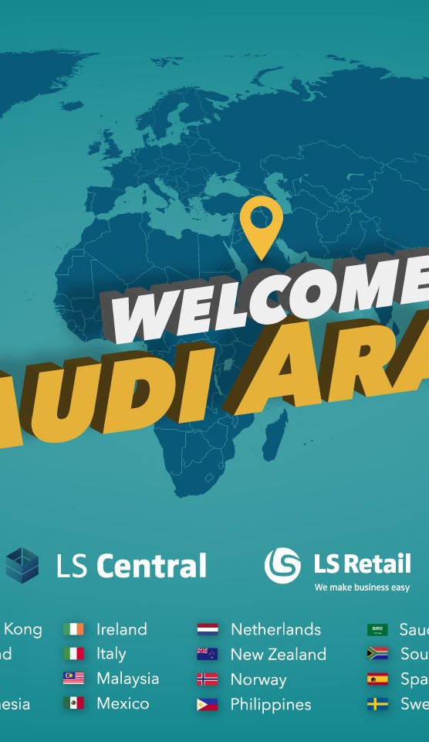
SaaS
Integrations
Cloud services
Continuous upgrades

Slide 9
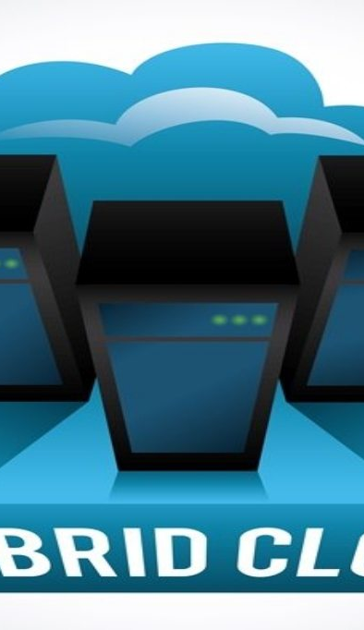
Hybrid and OnPrem Architecture
For Hybrid SaaS
  LS Hybrid Cloud Server
For Hybrid SaaS and OnPrem
  LS Update Services
  SQL Server / SQL Express
  Microsoft Dynamics 365 Business Central service tier
  LS Central AppShell
  LS Hardware Station
  LS Data Director
  LS KDS

Slide 10
Server config - Get it right from the start
SQL Server – all about RAM and fast disks
DONTs
  Mechanical drives
  Standard SSDs
  Shared resources
DOs
  Enough RAM
  Azure Premium SSDs
    few of them (OS, Data, Log, Temp)
  High IOPS
  MaxDOP and CoThP
  Maintain free space in database
  Maintain indexes
OS
Data
Log
TempDB

Slide 11
Server config - Get it right from the start
Service Tier – all about CPU and RAM
DONTs
  ? Don’t skip the DOs
DOs
  Good CPU and RAM
  Adjust Data Cache parameter
  More than one service tier on the same box
  Distribute Services
  Load Balancer

Slide 12
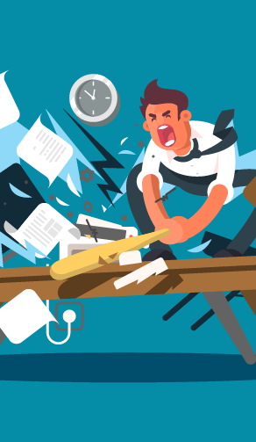
Normal Challenges
The 24 hours syndrome
The evilness of table extension
Coding guidelines

Slide 13

Large Scale Highlights
What Worked Well
  Scaling and load balancing
  Update Service
  Deployment of releases
Surprises
  180 w/s requests per second
  1800 concurrent user connection
  30000 batch requests per second
Do
  Create custom telemetry
  Use performance counters
  Enable Query Store
  Automate testing
Don't
  Install components manually
  Ignore guidelines
  Forget to update documentation
  Use same service account and machine for all services

Slide 14
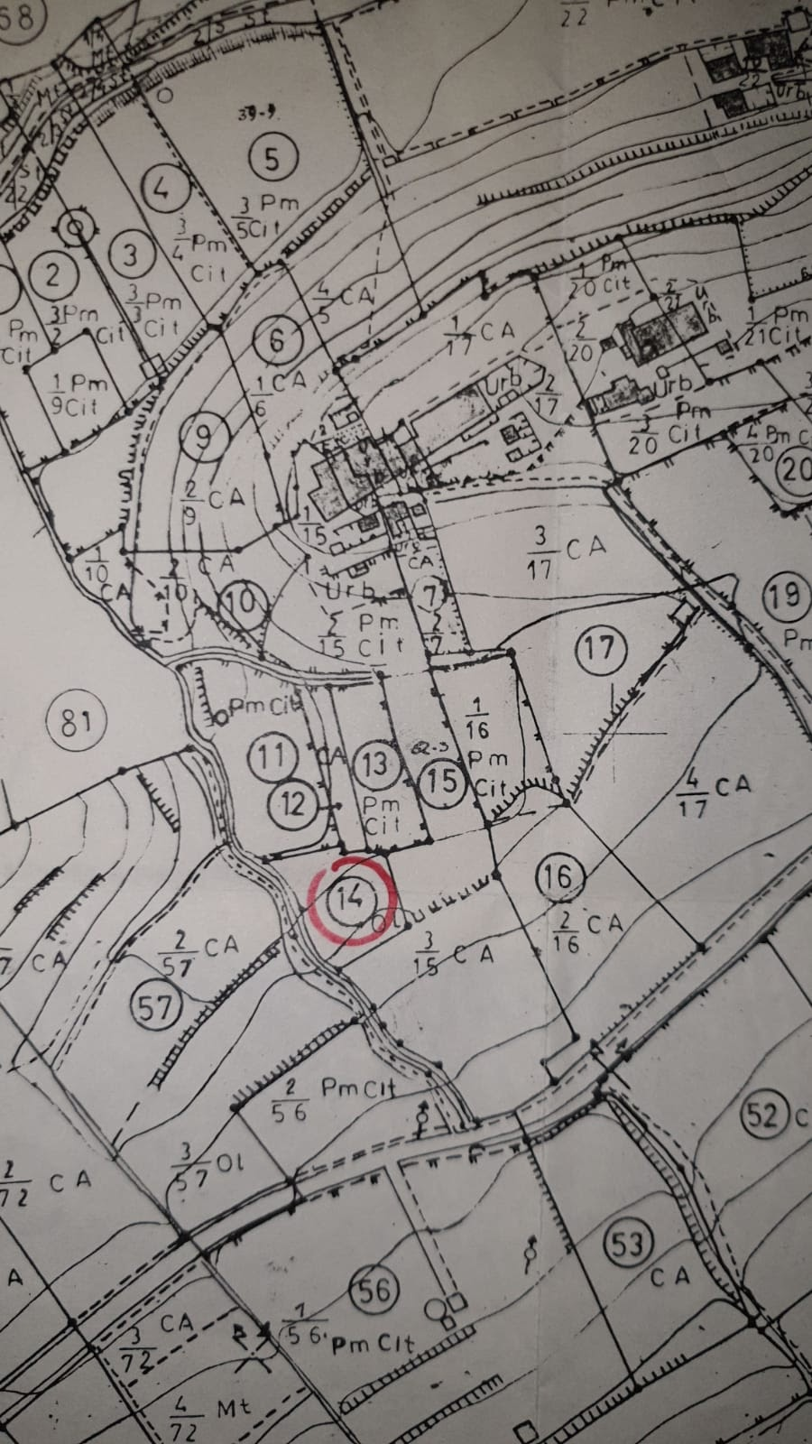
Planning Large Scale
Q: will it work?
Challenges: many unknowns
System architecture
Number of active users
Volumes of activity
System response time
Hardware requirements (POS, kiosks, kitchen, etc.)
Cost of solution

Slide 15
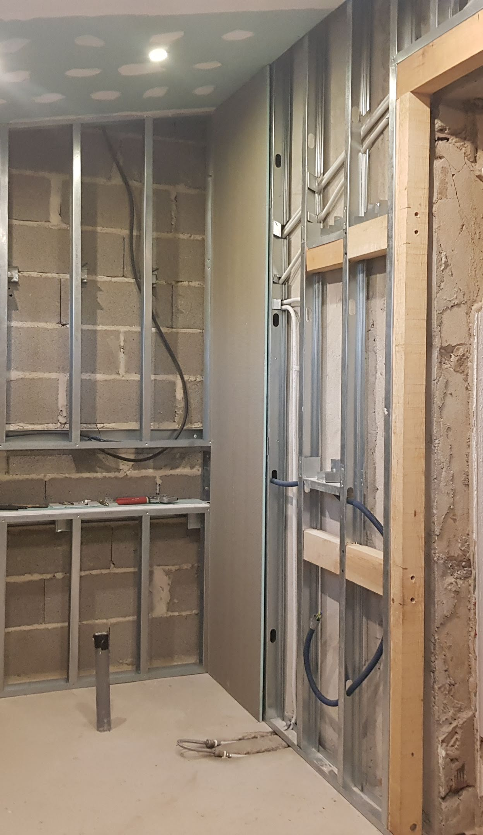
Deploying
Q: How do we roll out?
Challenges: execute planned deployment of hardware & software in predictable and repeatable fashion
Multiple environments – development, production and all in between
Initial build of all environments
Update of all environments – platform, application and data

Slide 16

Managing our Business as Usual
Q: Is it working?
Challenges: real time monitoring and alerts
How well is it working – what is considered normal
Custom telemetry – specific events emitted by solution, captured, stored and evaluated in near real time
Detect and resolve issues before users had a chance to report them
Business continuity and recovery plans – keep up to date and practice execution

Slide 17
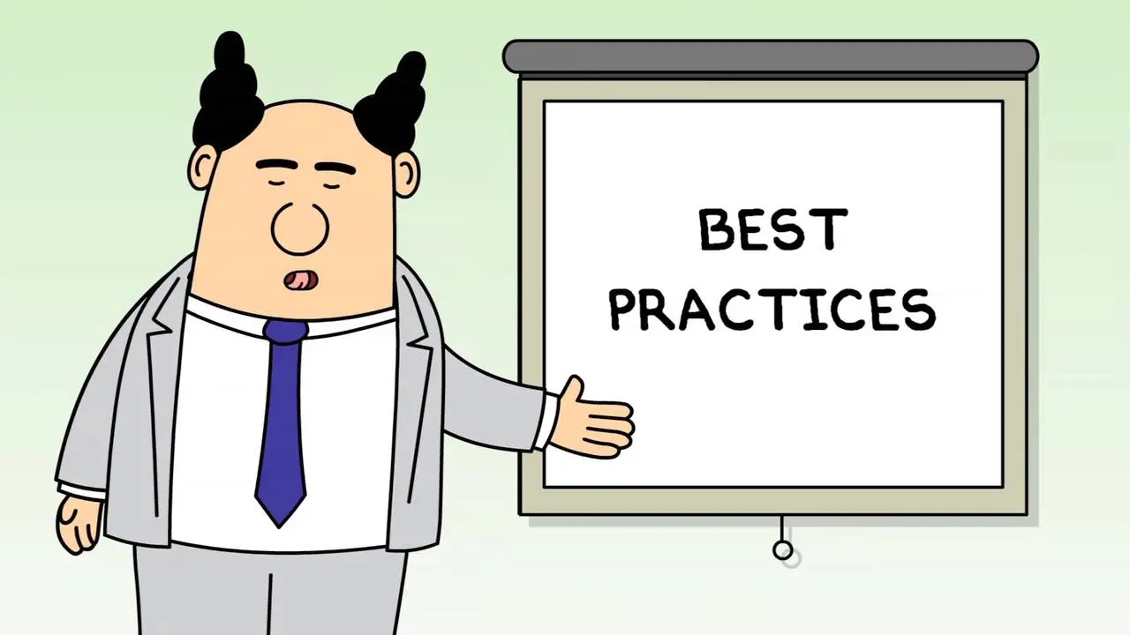
Operation Guide 101
Make sure both hardware and software is configured best possible way to fit the client needs
Review solution performance metrics once a year at least
Monitor data growth
Log tables
Archive Data
Index Optimization
Action tables
Desktop Browser – avoid older browsers
SQL Compatibility Level

Slide 18
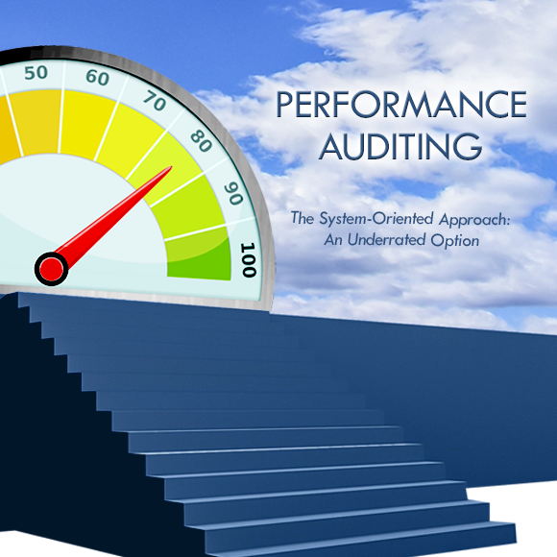
Performance audits or reviews
Structural approach
Review environment, hardware and software
Very often reasons for major bottlenecks are found in hardware or software configuration or solution architecture
Base SQL tuning
Identifying in fast and structured way where there are challenges
Senior resources from LS Retail, presence in all regions
Minor footprint on client environment
Following slides are showing combined data from few live client environment in multiple time-zones / regions.
Data is aligned to client time-zone

Slide 19

How do we do this?
This is low footprint on client’s environment, only thing needed is installing Microsoft Monitor Agents on the servers.
LS Retail provides Secret Key and Azure Log Workspace ID which are configured in the Agents.
Then data starts getting collected into private Workspace in LS Retail’s Azure environment.
As data is collected it is parsed / washed and then presented in PowerBI

Slide 20
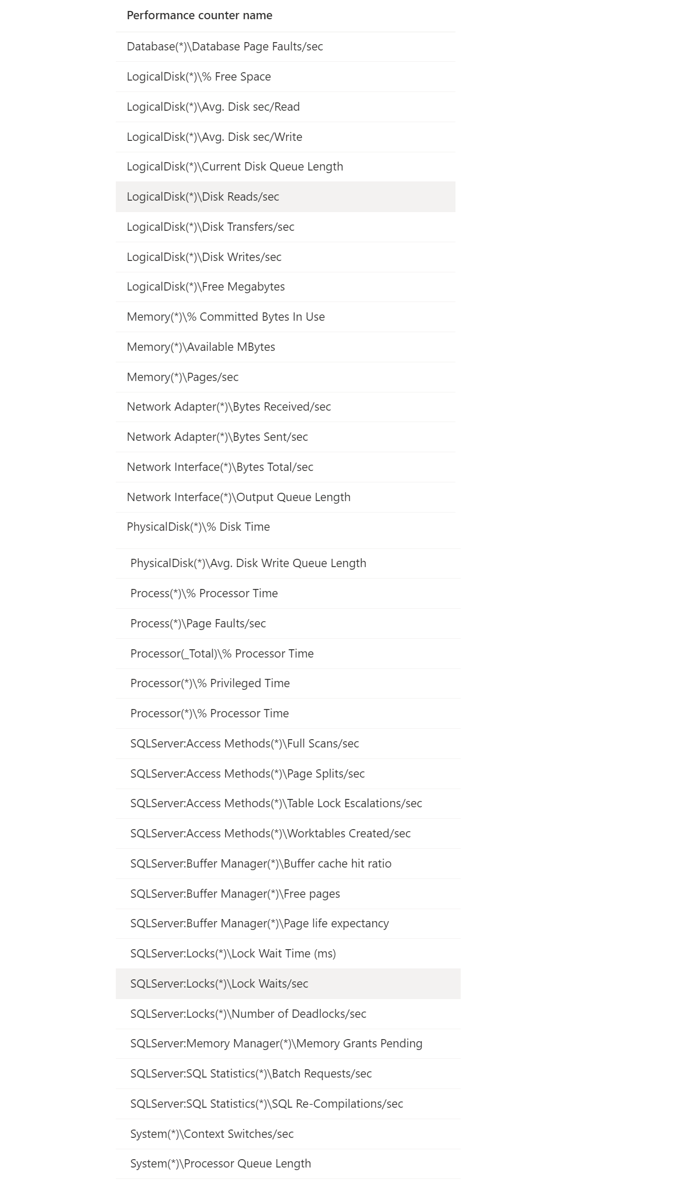
Windows Performance Counters
CPU
Disk
Network
RAM
SQL server(s)
Service Tier Servers
Other servers
Basically, all Servers can me added to monitoring and the log files parsed for recognized events.

Slide 21
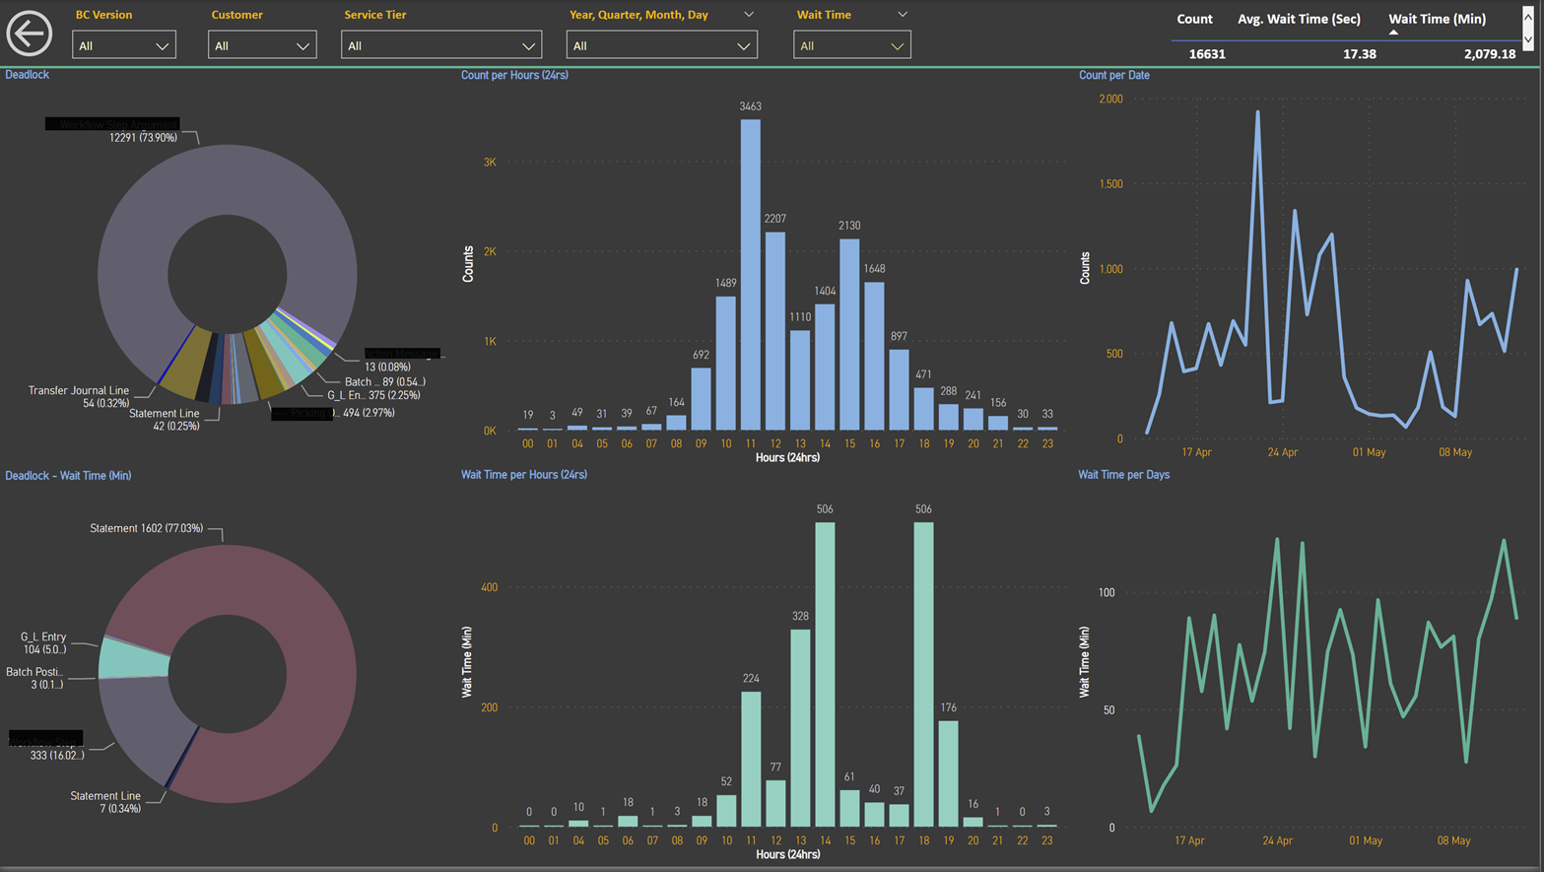
Deadlocks
Worst thing ever!
Processes being rolled back
Opening Hours

Slide 22
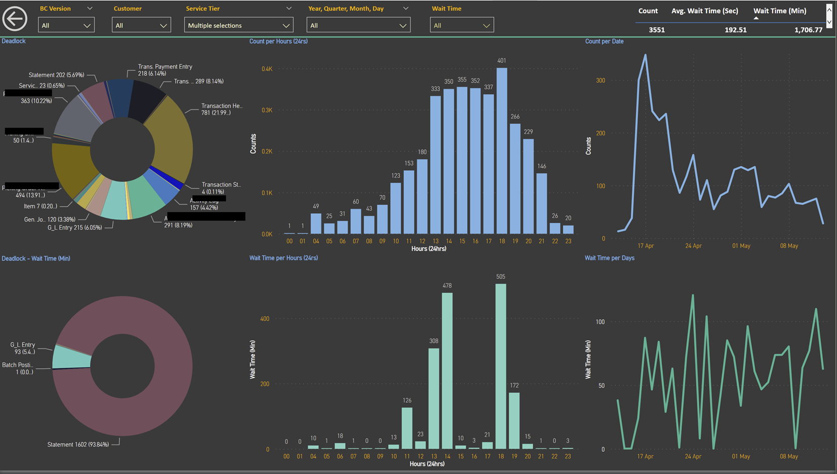
Deadlocks take #2

Slide 23
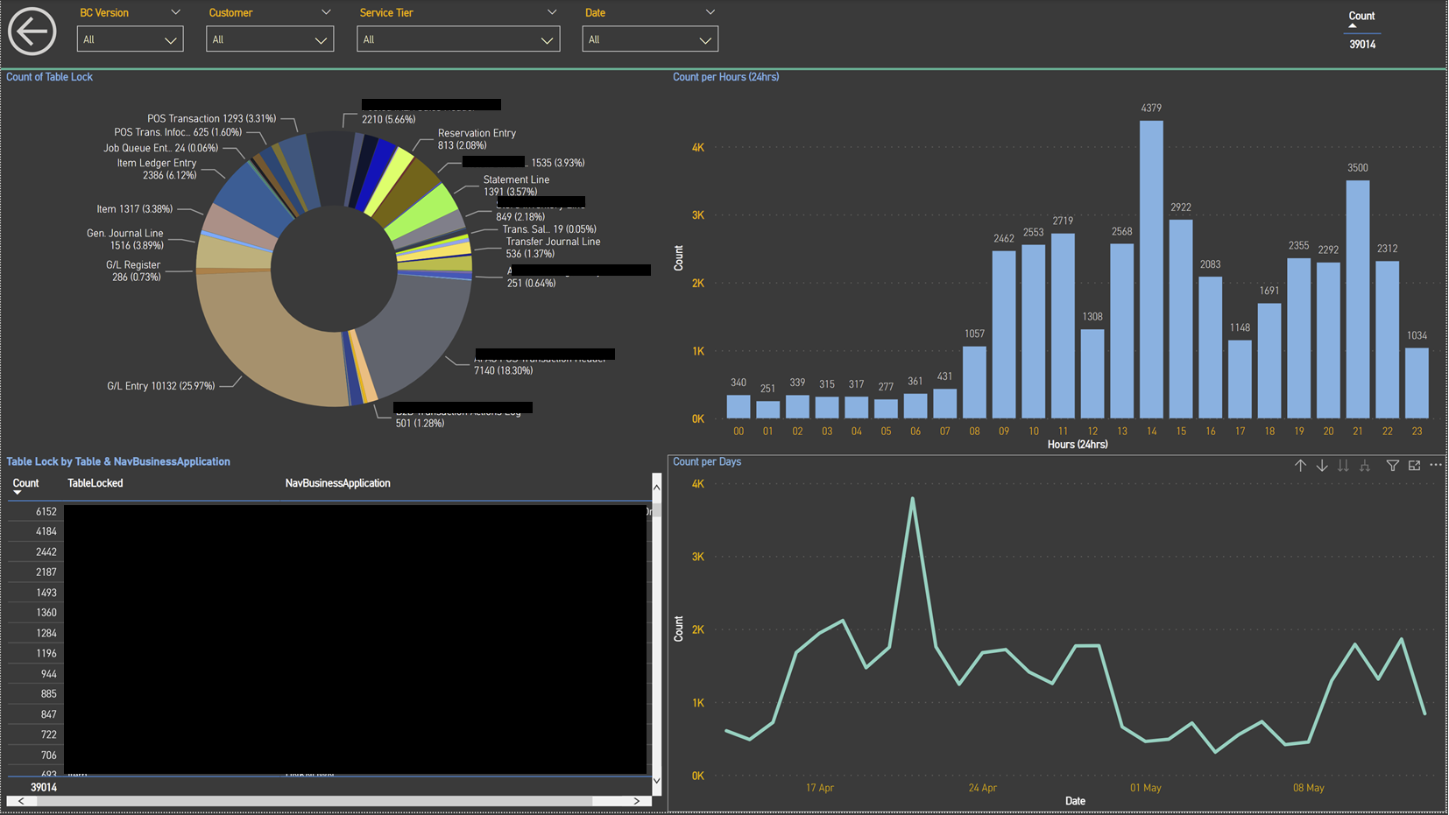
Table locks
These are so bad as well

Slide 24
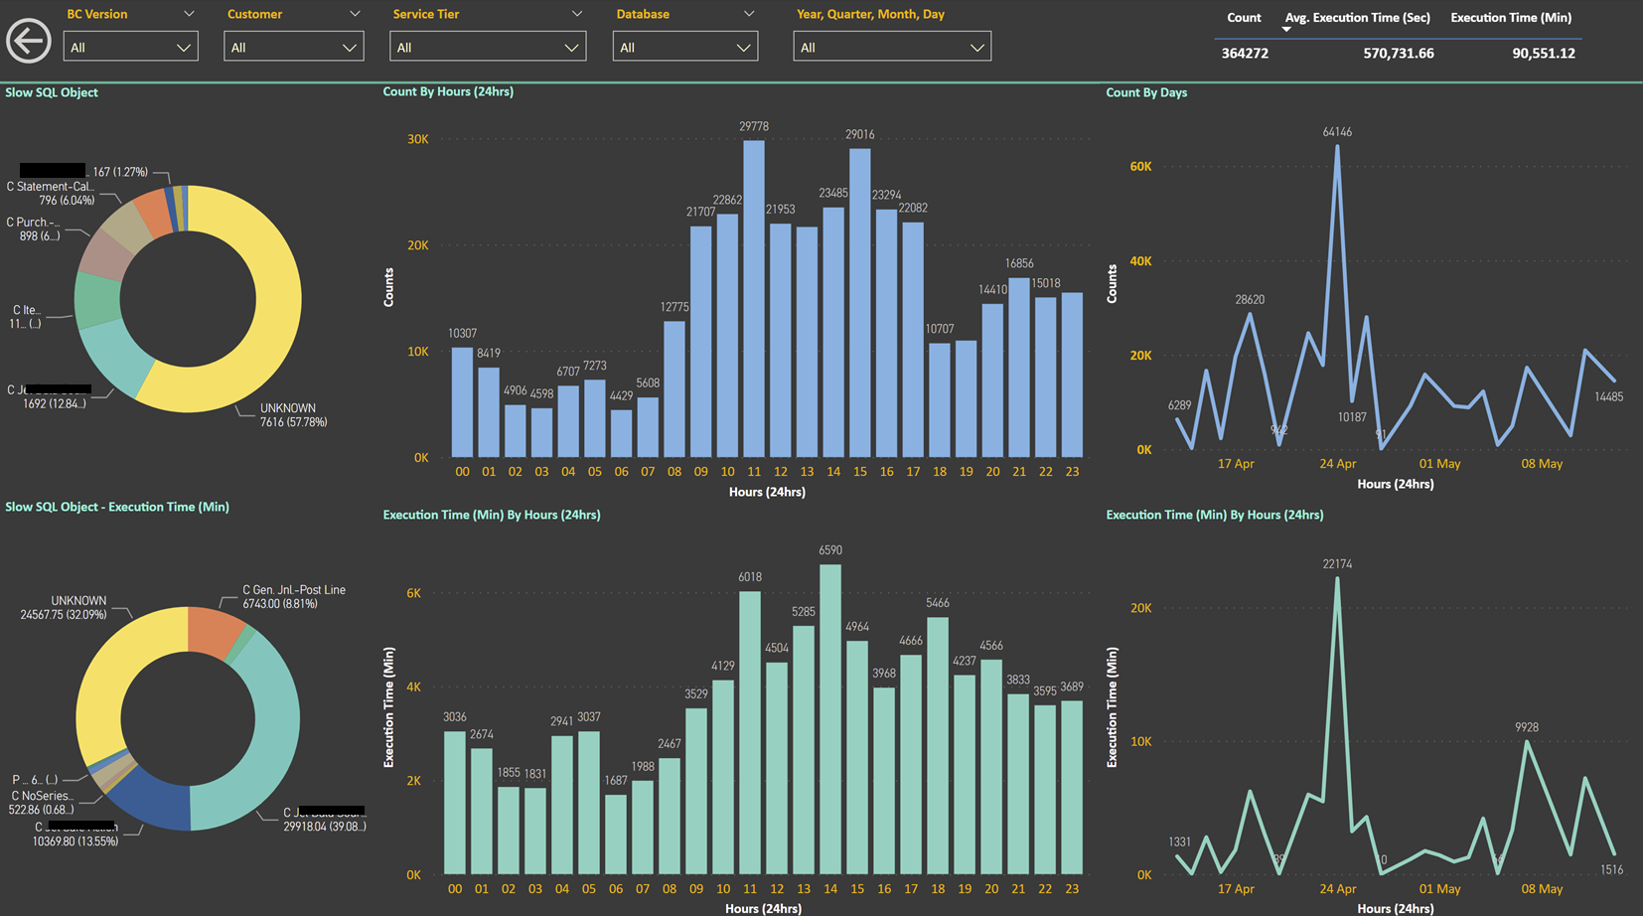
Long running SQL Queries
Long running SQL Queries is normal, it is just identifying if there are abnormal processes in between and if it can be scheduled or planned better

Slide 25
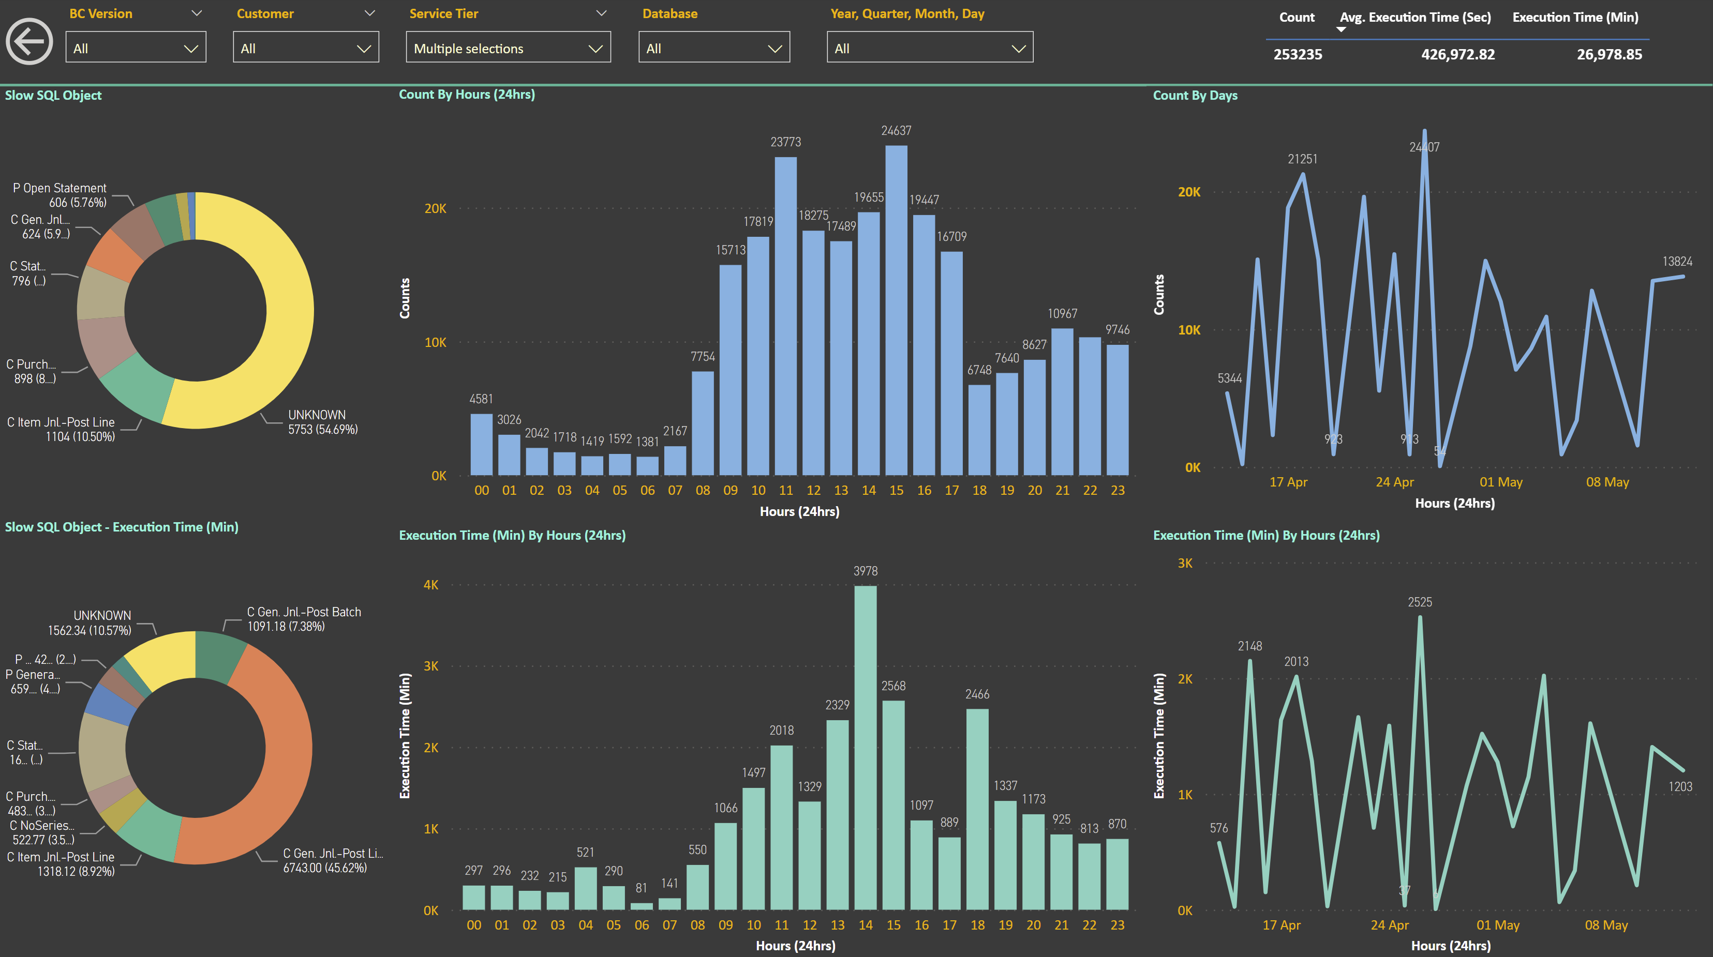
Long running SQL Queries – take #2

Slide 26
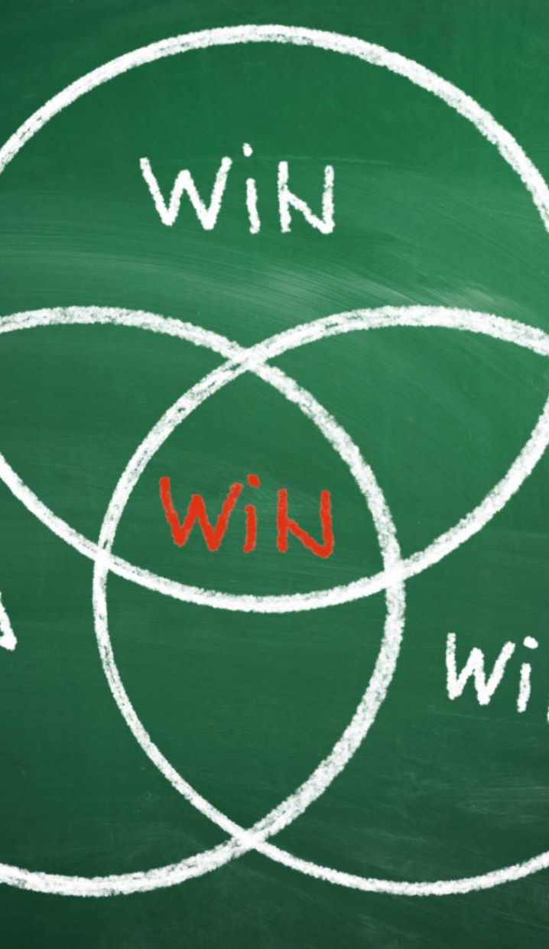
What is the goal here?
Entry point
  Audit/analyzes platform with PowerBI dashboards
  Partners or clients can sign up and push data in
  Standard view and analyzes
  High level identifications on bottlenecks
Further analyzes or reviews
  More detail review and analyzes
  SQL auditing tools
  Activate and use SQL Query Store
  Extensions or Code review
  Give partner/client direct access to the outcome report
LS Retail has already used this approach on multiple installations in different regions, with successful results on identifying bottlenecks and where to focus for enhancements

Slide 27
Thank you

