Slide 1
eCommerce for LS Central
Part II
Petur Thor Sigurdsson
Product Director

Slide 2






Retail
Hospitality
Activity
Pharmacy
Retail
eCommerce API
Commerce Service for LS Central
3rd party
eCommerce
providers

Slide 3






Eco system: Available Payment Plugins
Payment Service Provider
(PSP)
Point of Sale
Transaction Repository

Slide 4
Magento Unified
Commerce Demo

Slide 5

Traditional UI
Progressive Web App (PWA)
eCommerce API
Commerce Service for LS Central

Slide 6
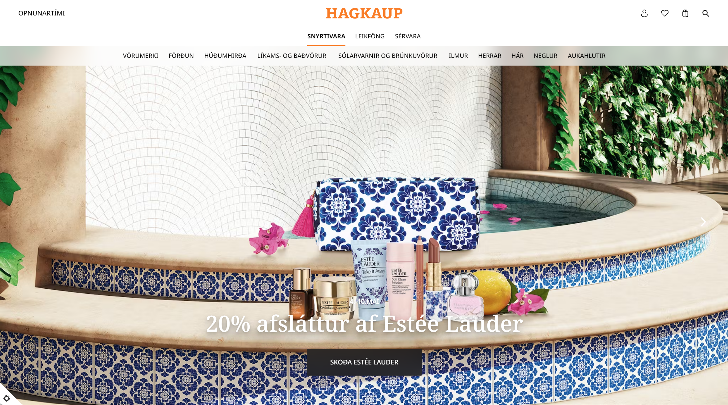

Slide 7
Thank you

