Slide 2



Photo by mbl.is/Kristinn Magnússon
Discover how LS Express can open up new opportunities in a changing world
Sigrun Marta Sigmarsdottir
Product Owner

Slide 3


Slide 4



Slide 5
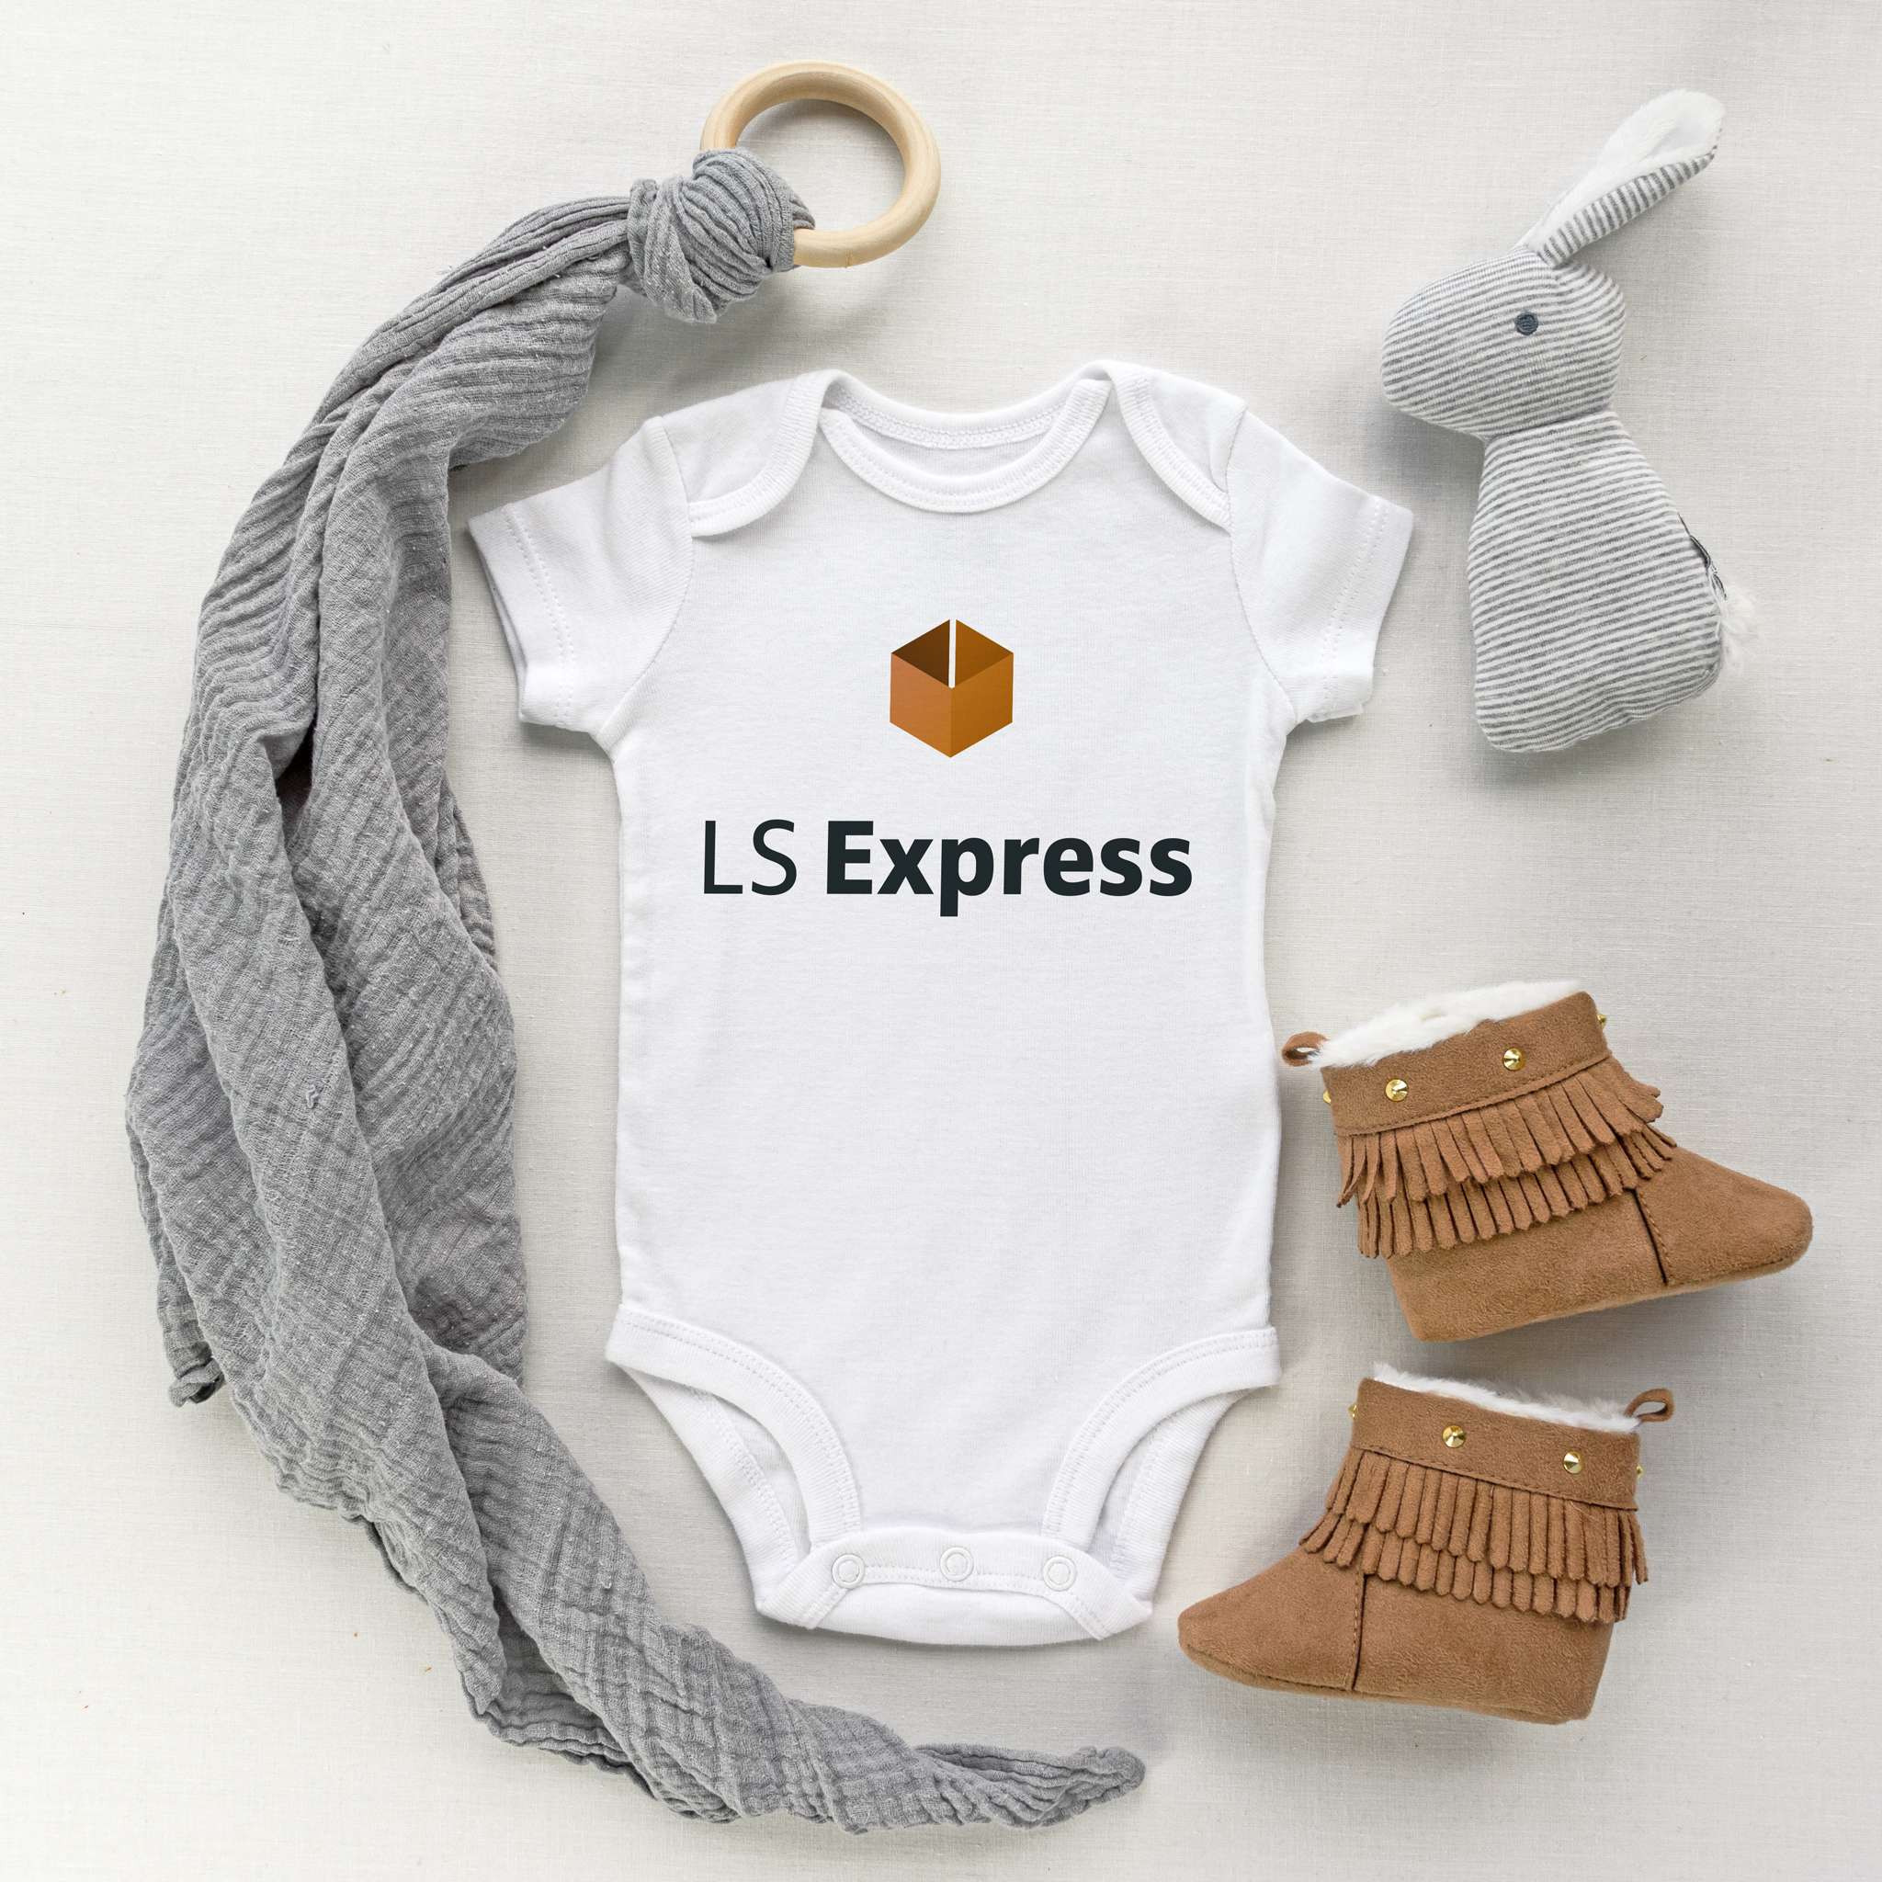
The smallest member
of the LS Retail family
Extension to MSFT D365 Business Central
Purely a SaaS solution
(no offline functionality)

Slide 6
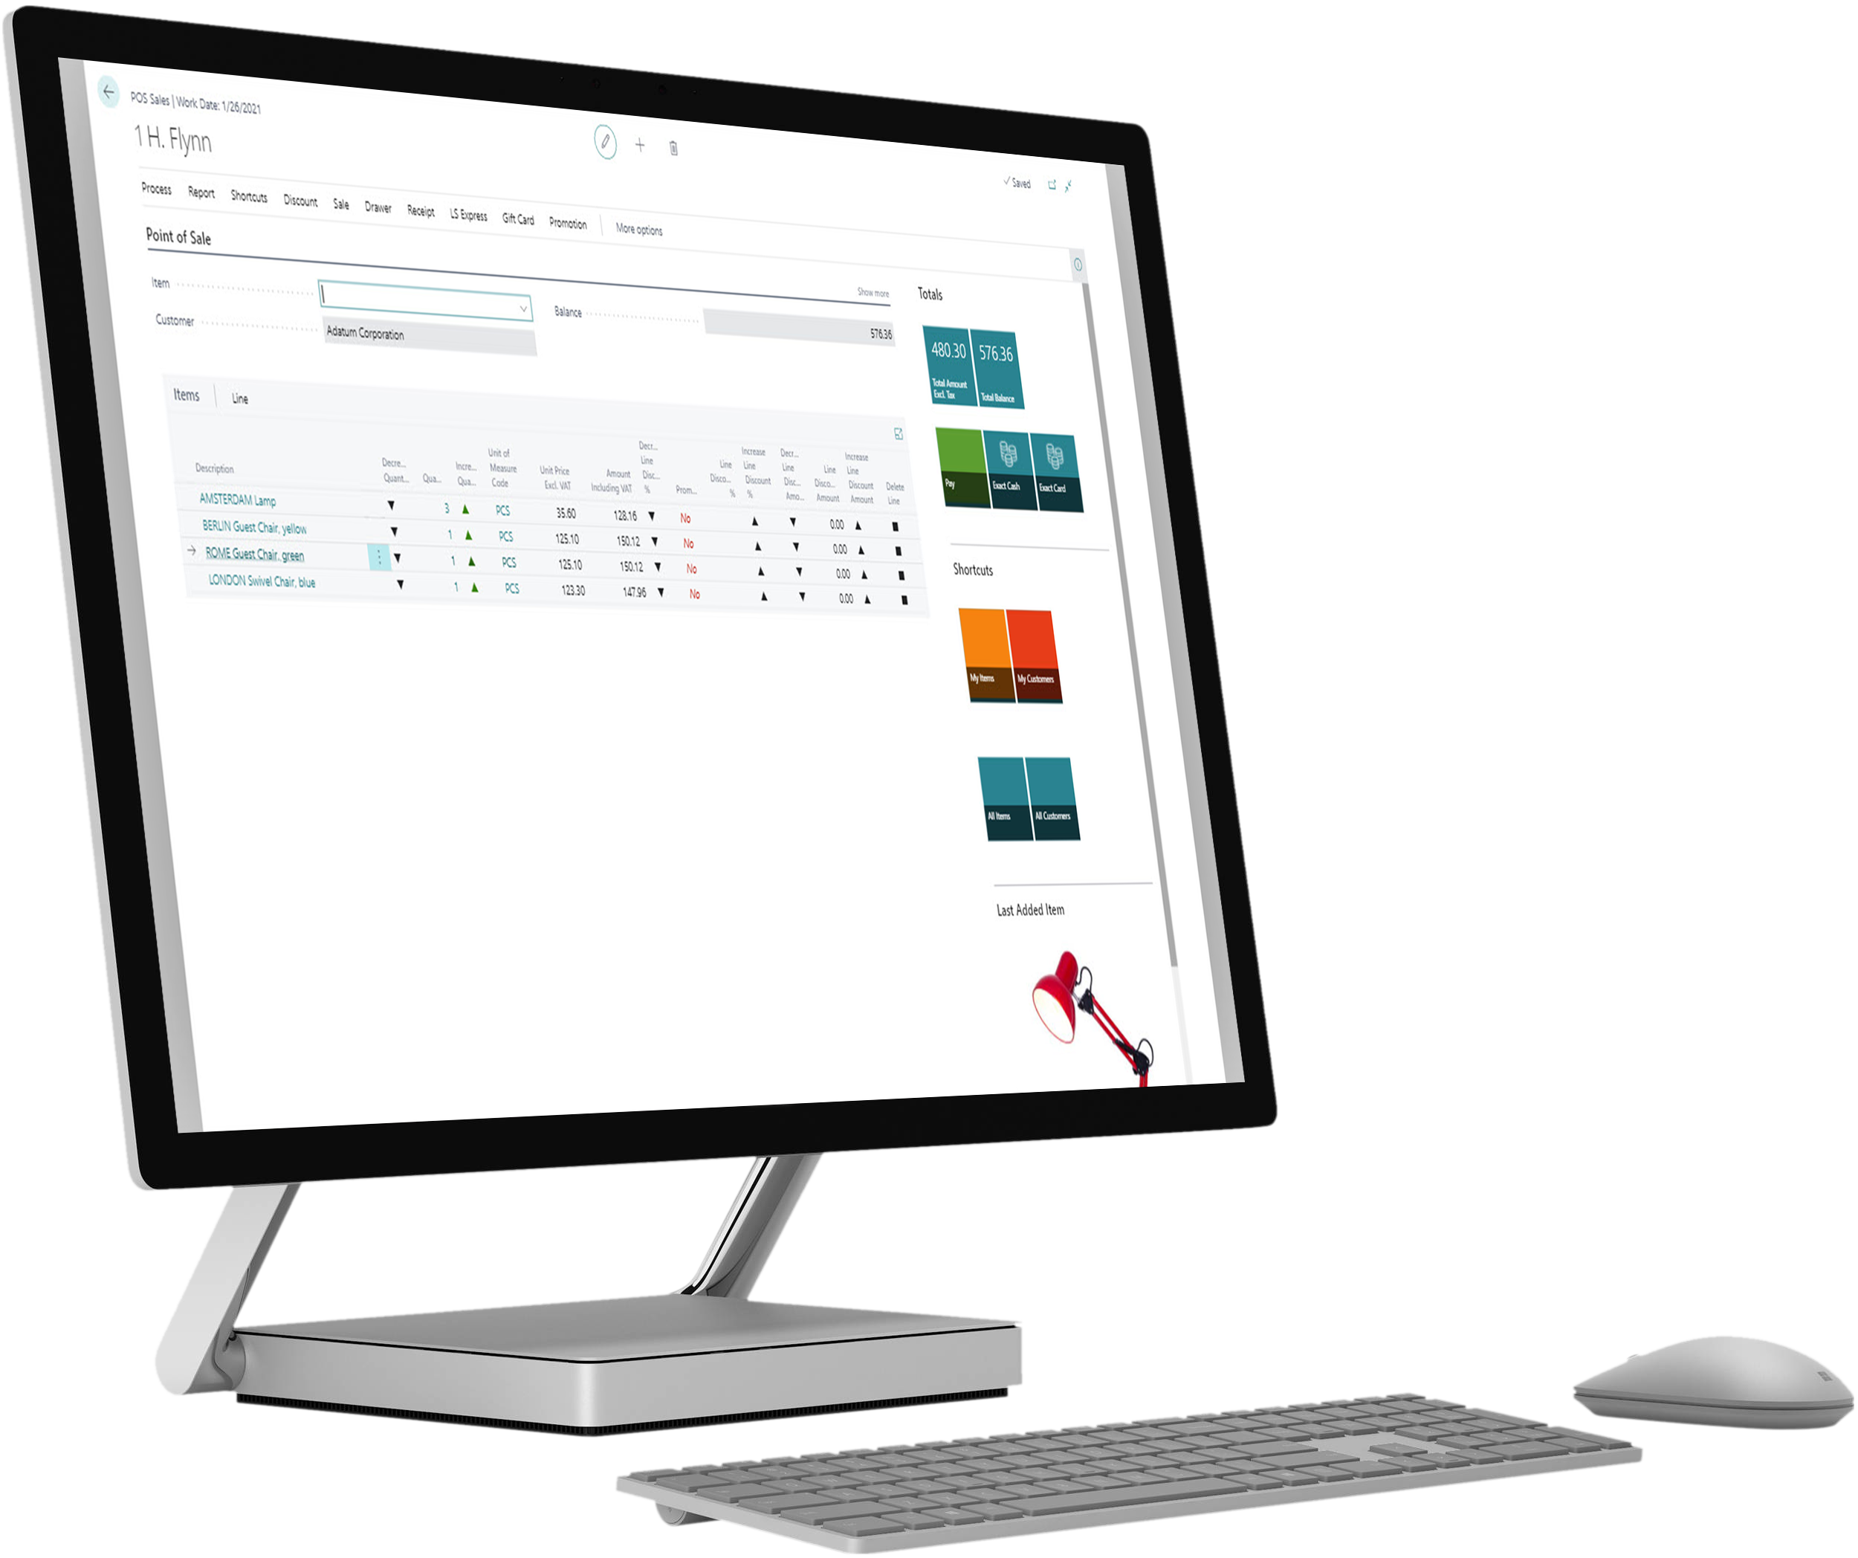
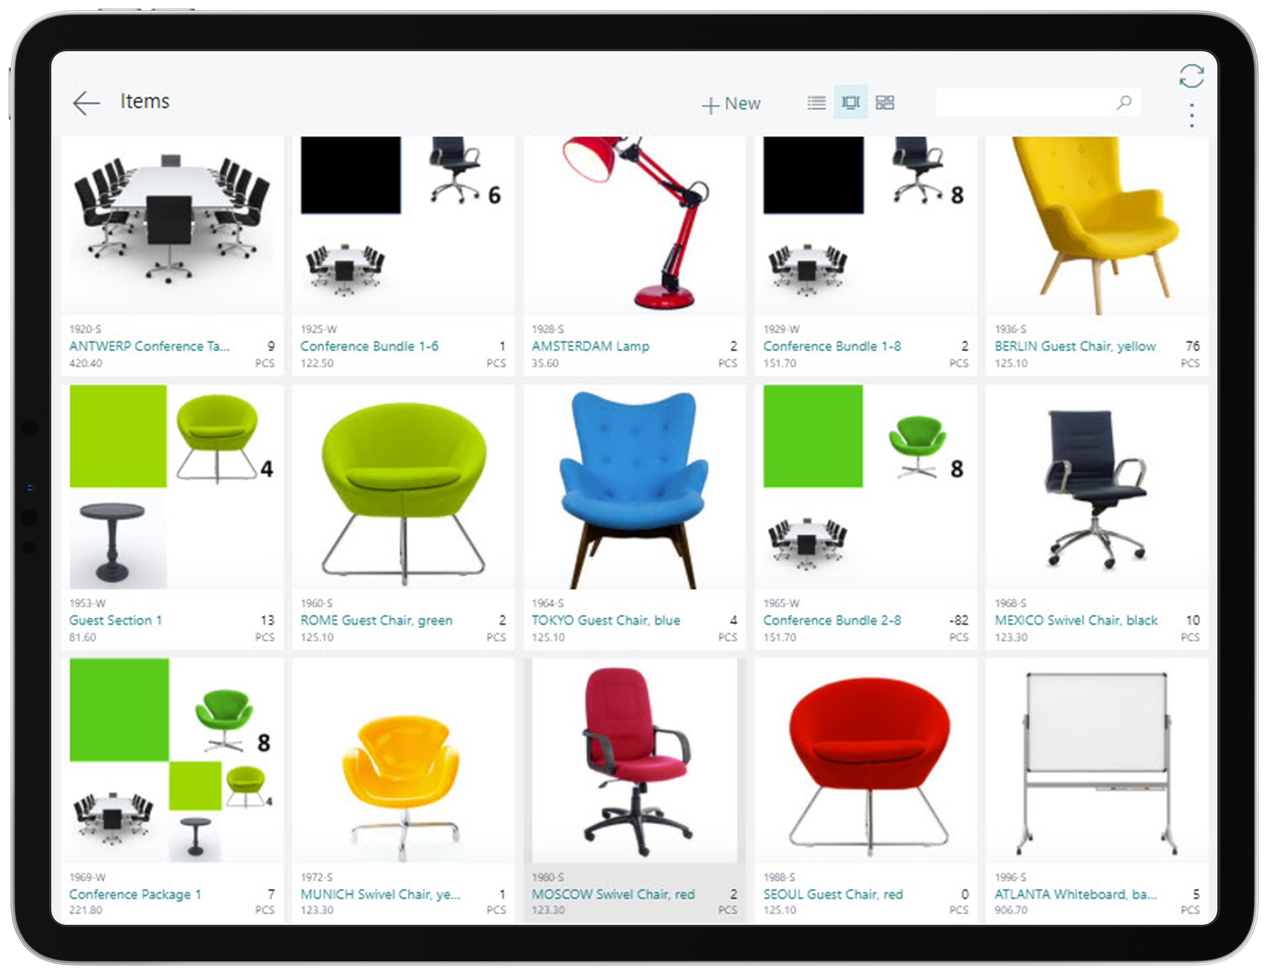
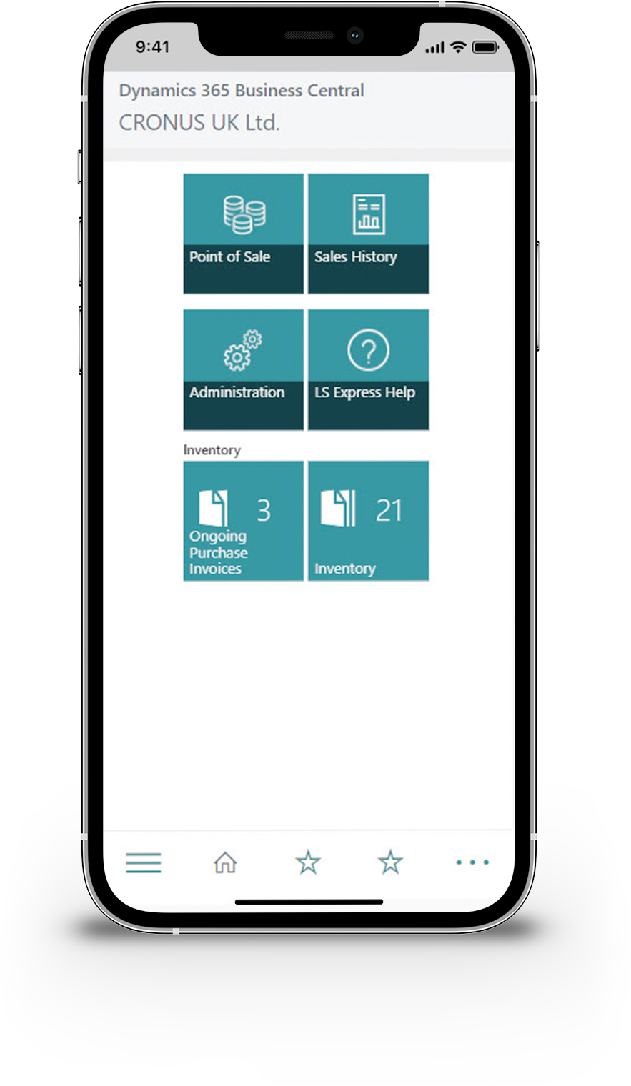
Use it on any device

Slide 7

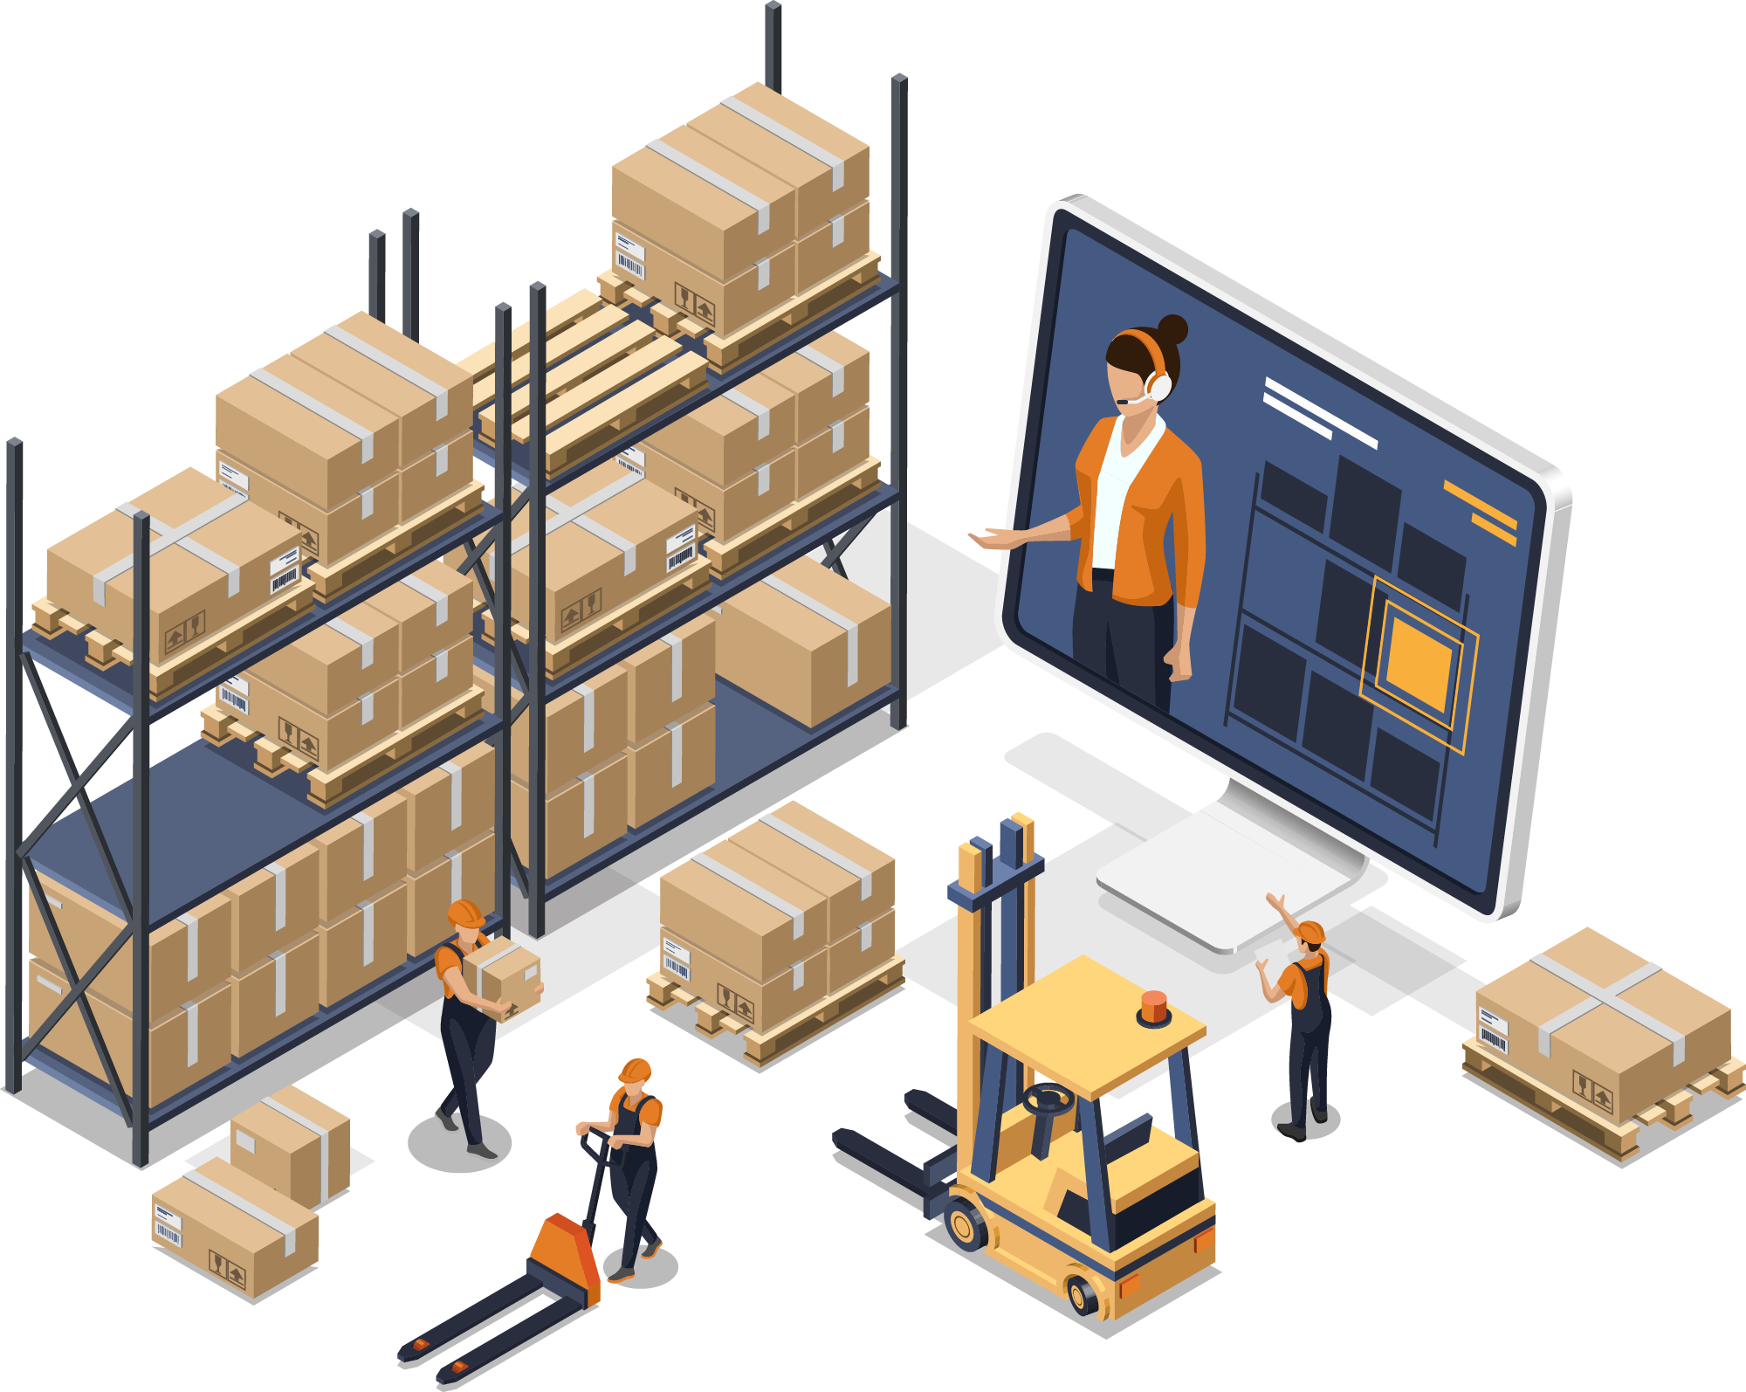
Wholesaler/warehouse
Already have Business Central
No physical store?
Need the added functionality of a POS
Occasional sales over the counter
Want to be able to accept credit cards

Slide 8

Small retailer – Coffee shop
Small retailer - up to 5 stores
Need a simple POS system
Kitchen Printing functionality
Connects directly to your BC ERP
Access your data from anywhere on any device
Plug and Play - No complex hardware integration
LS Pay connects LS Express to the Card terminal

Slide 9
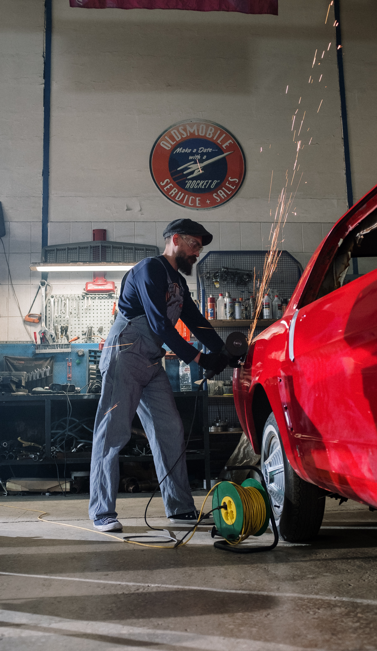
Small retailer – Car service
Selling services
Selling parts from stock
Finances managed in Business Central
One Point of Sale per garage
LS Pay connects LS Express to the Card terminal

Slide 10
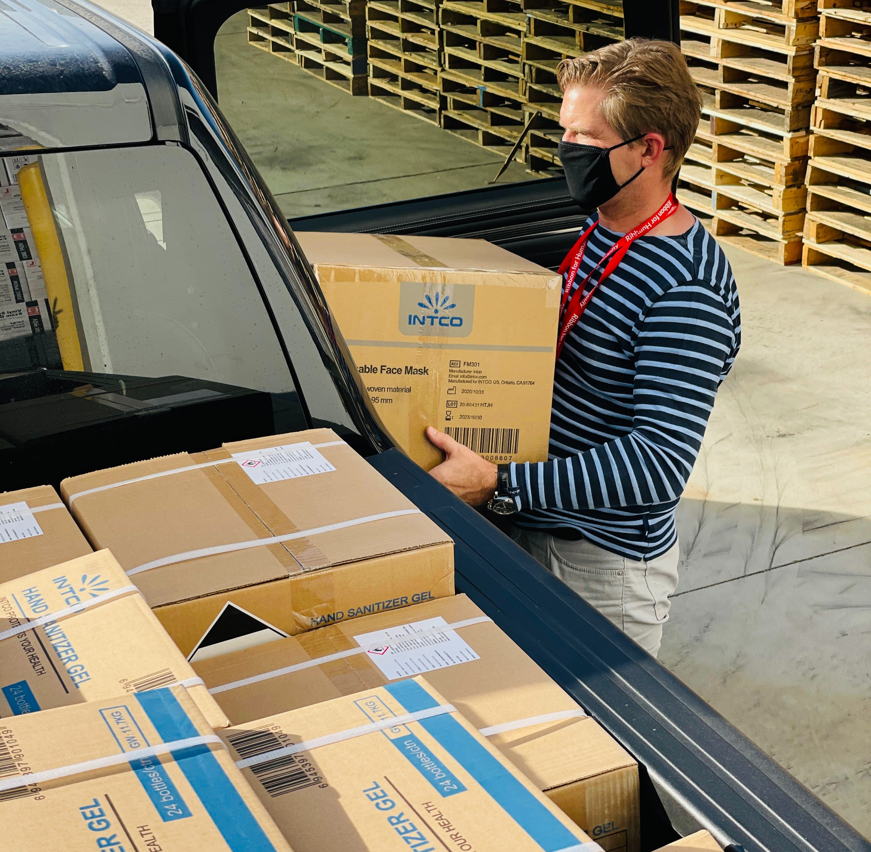

Local store – Offer curbside pickup
Offer your customer the option to
Click and collect
Enable local pickup in Shopify
Receive payment through your web-store or offer the customers to pay on pickup
Manage inventory and all accounting in Business Central and LS Express
*see Shopify.com for their prices

Slide 11
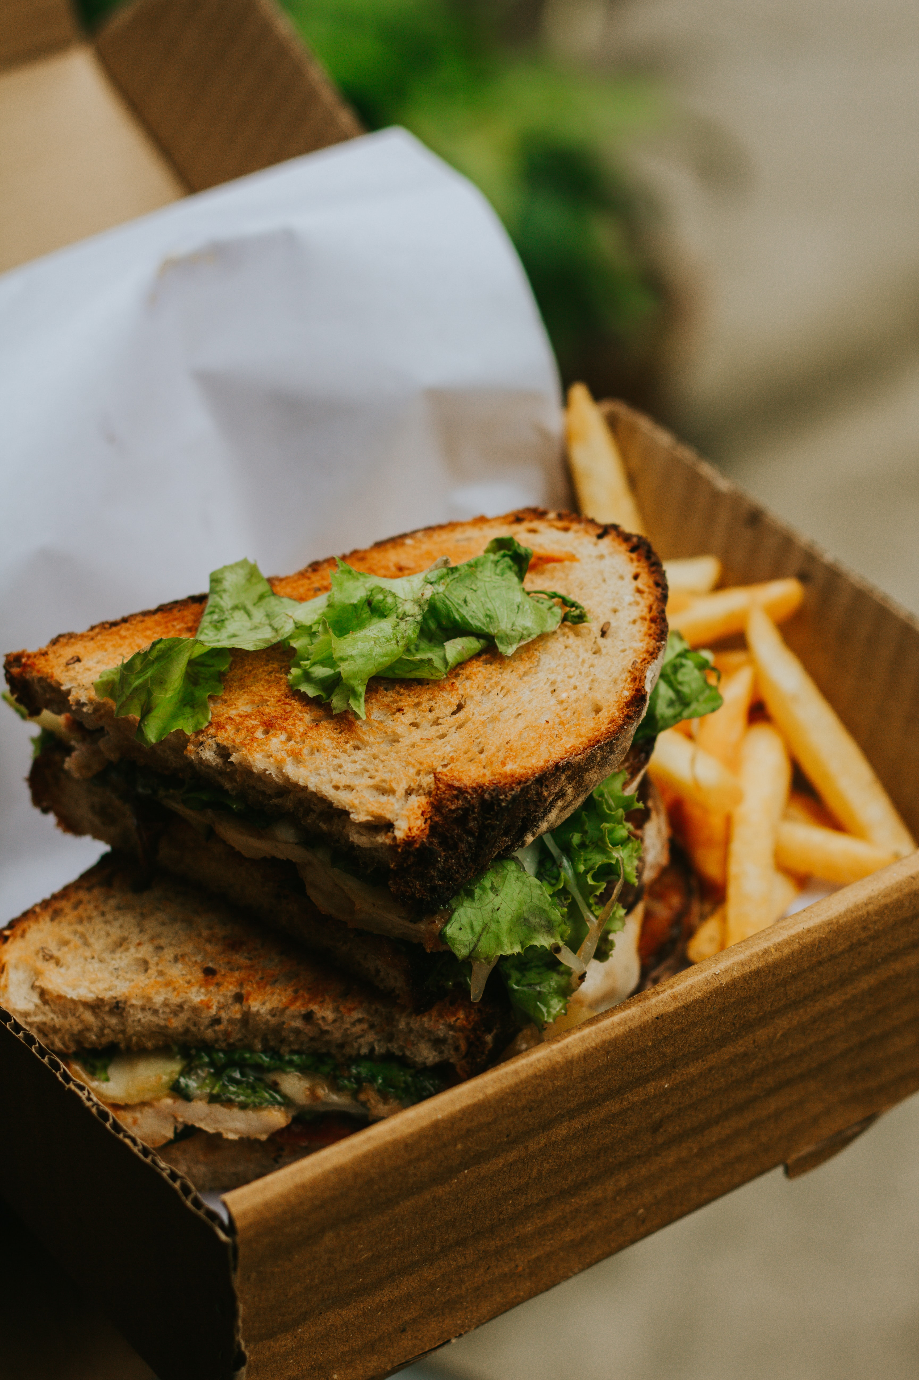
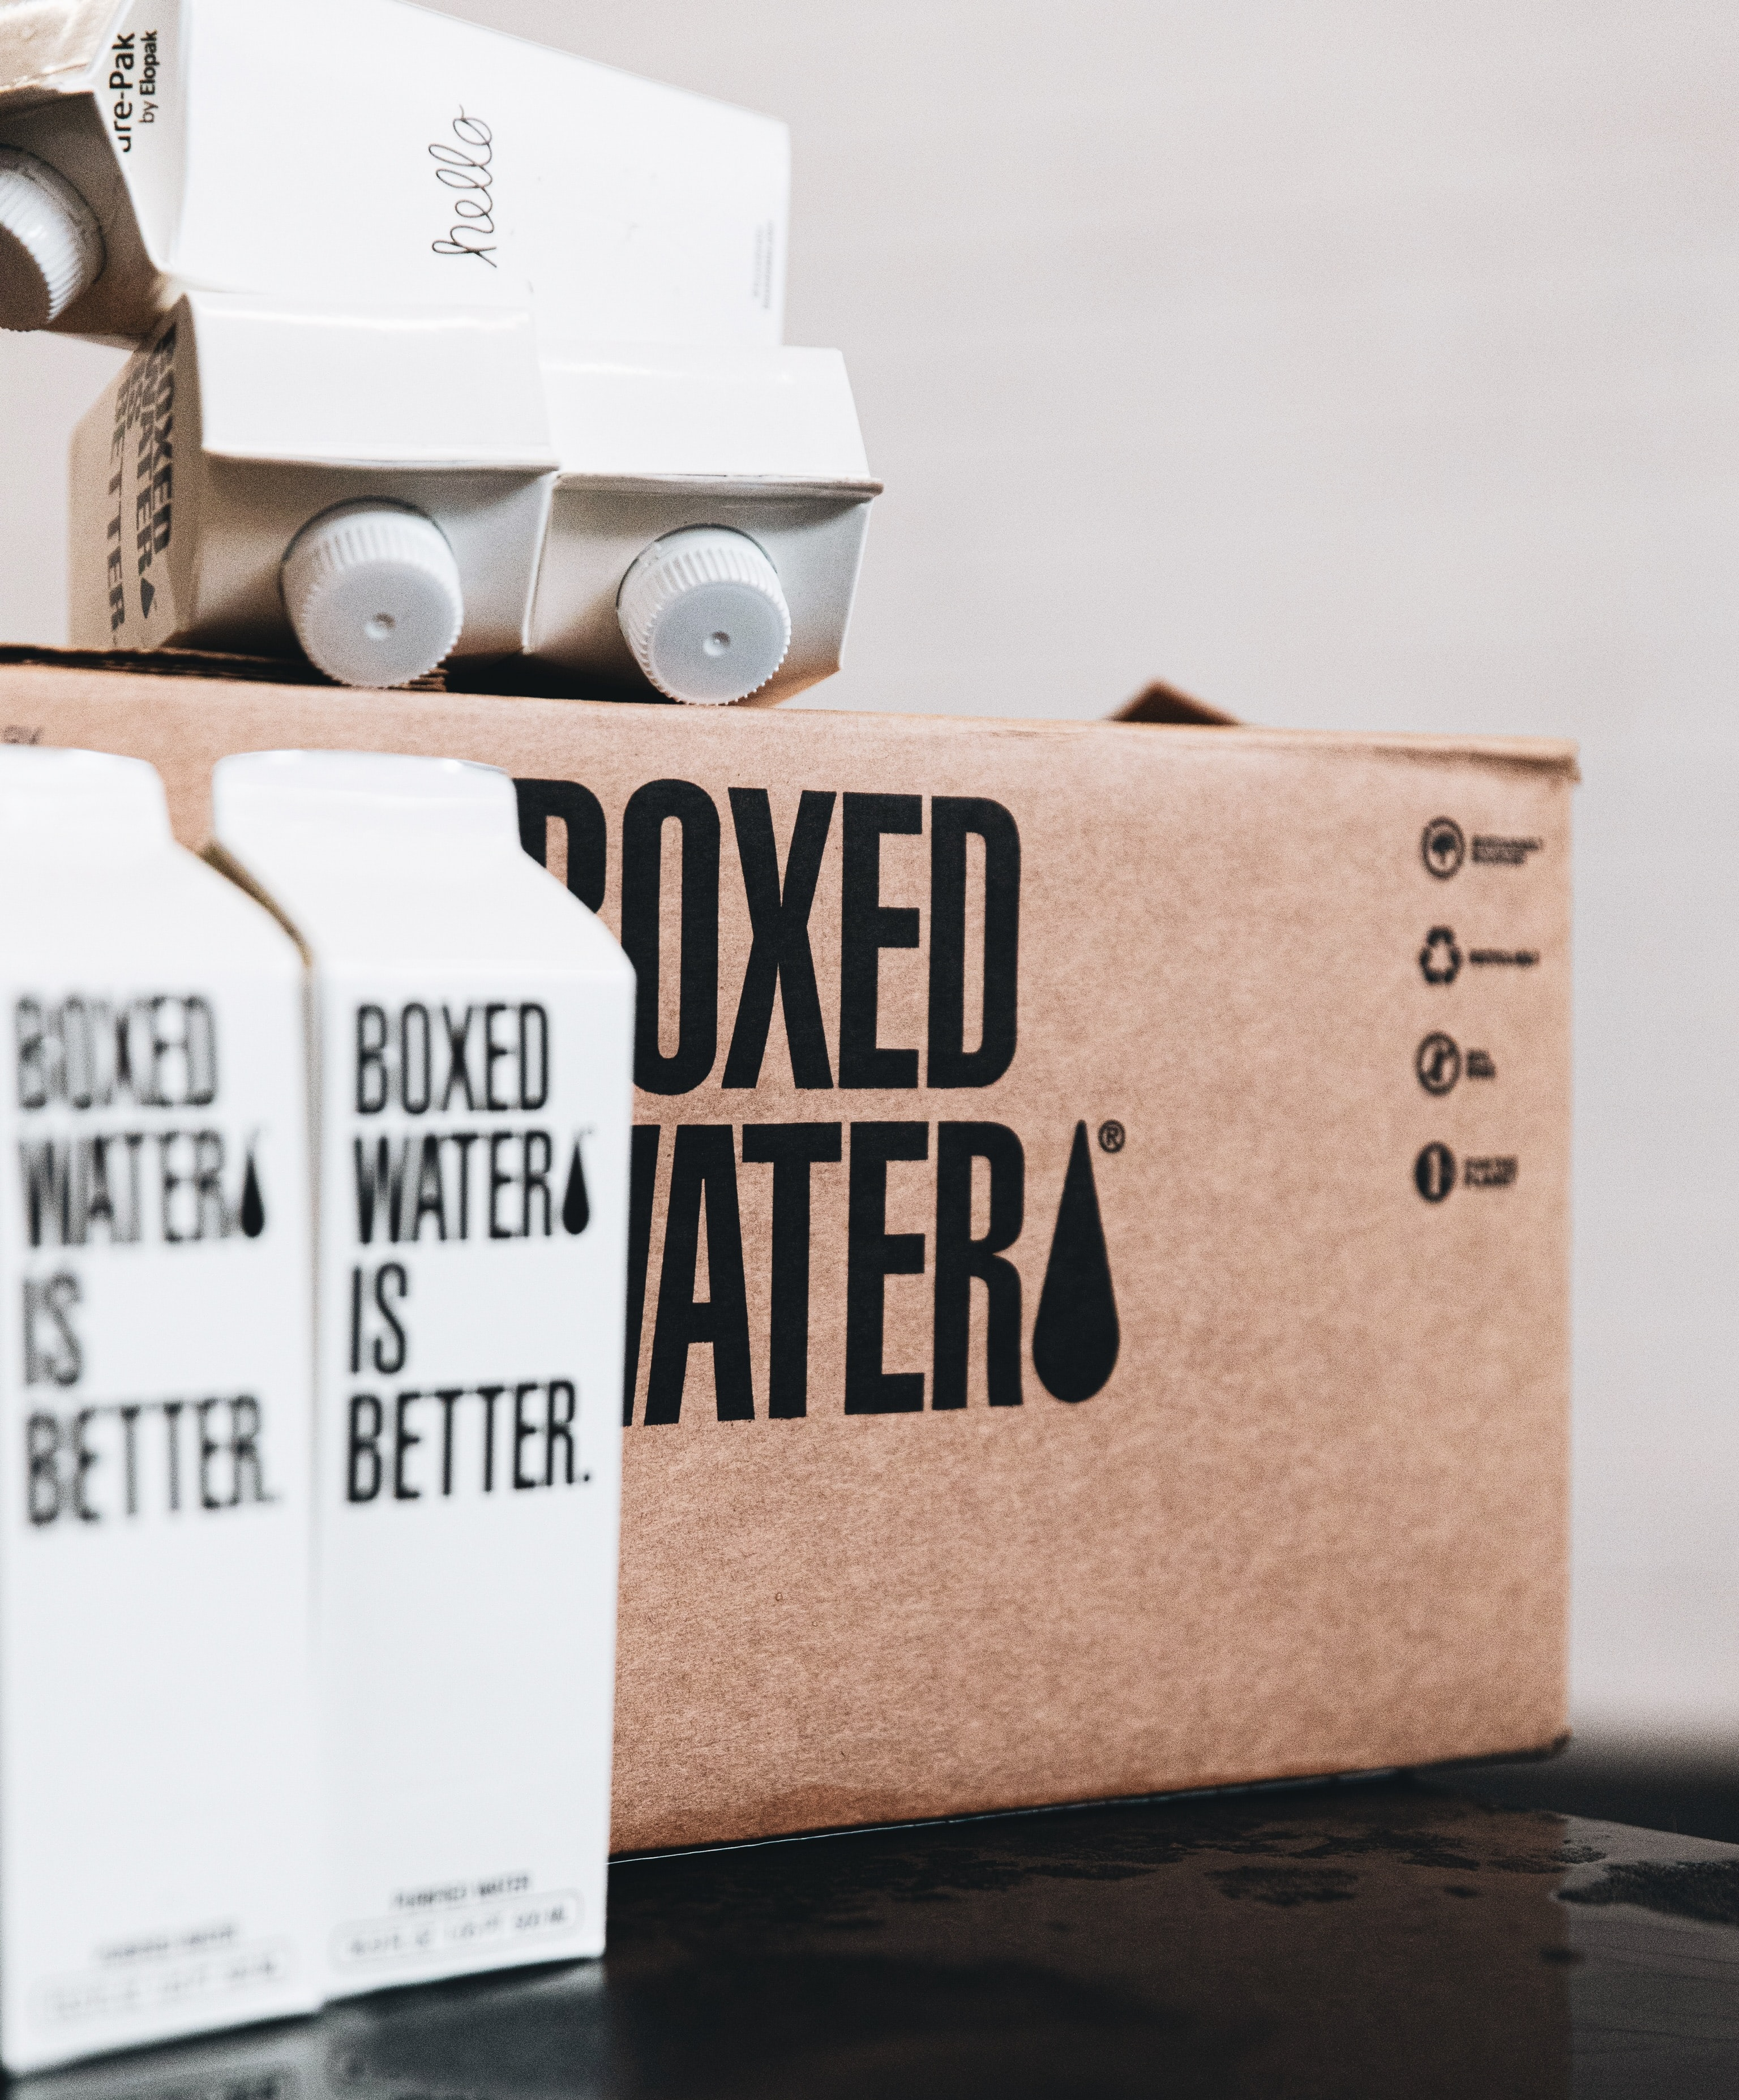

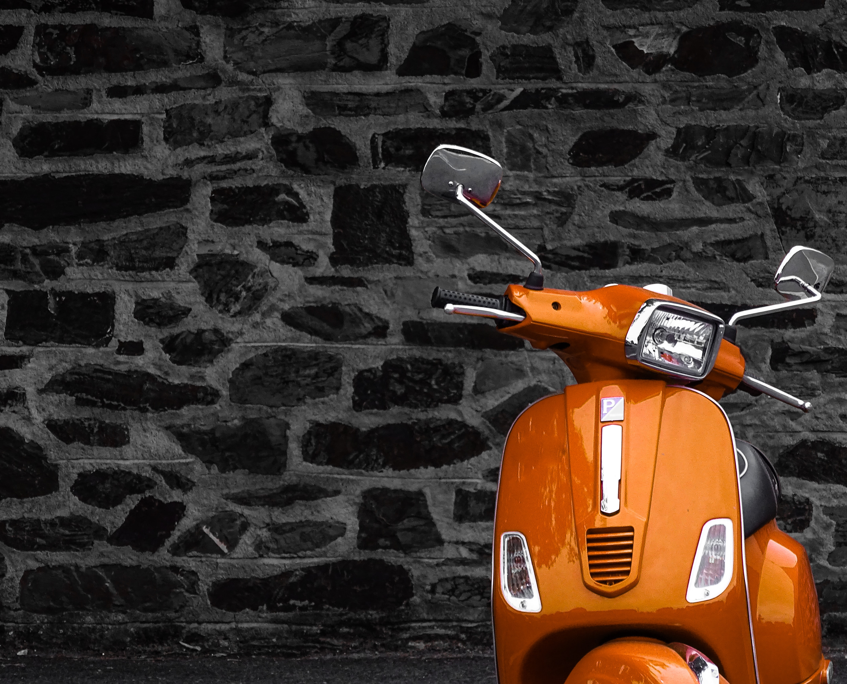

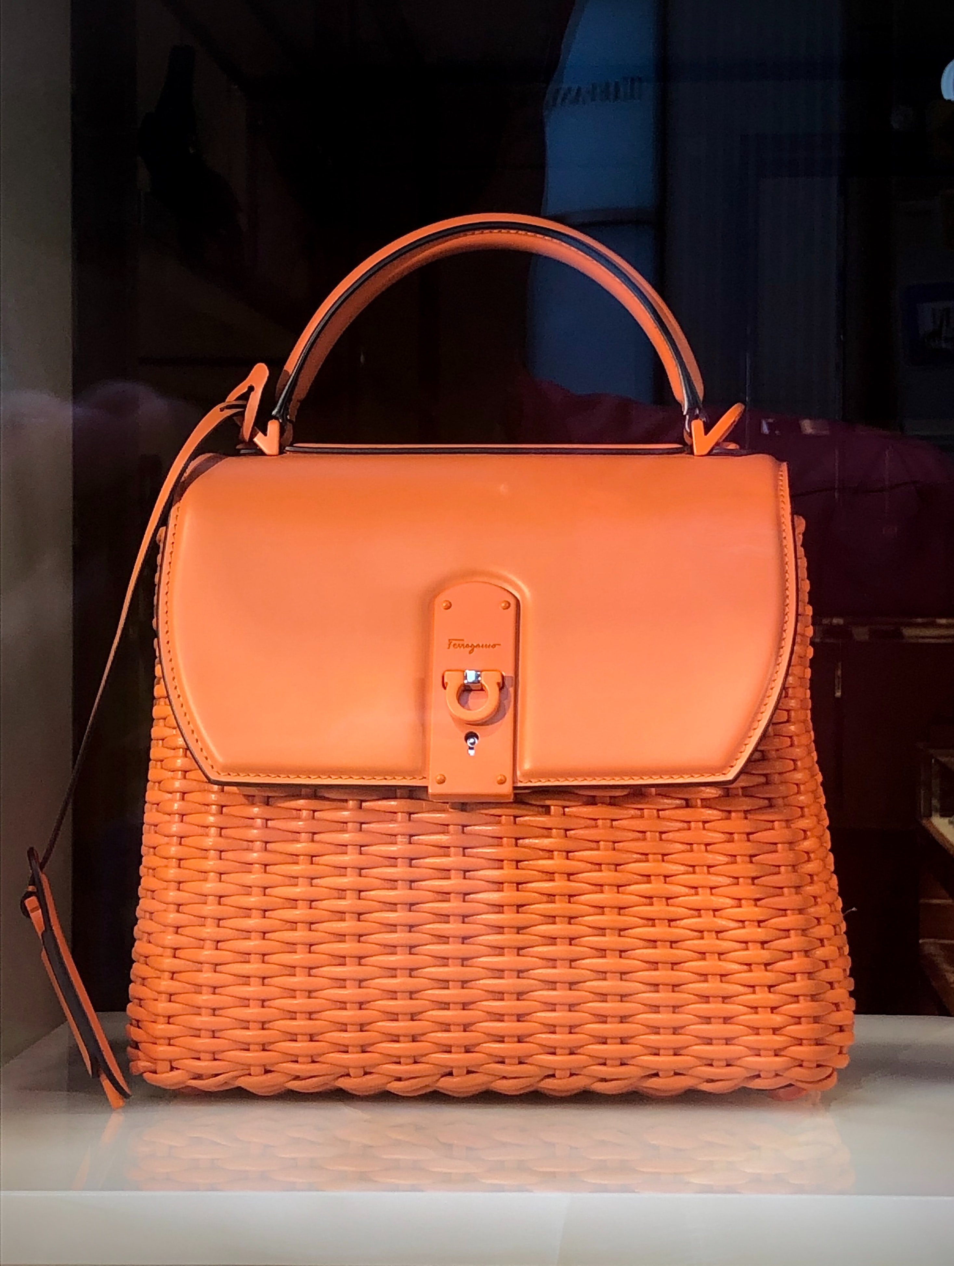
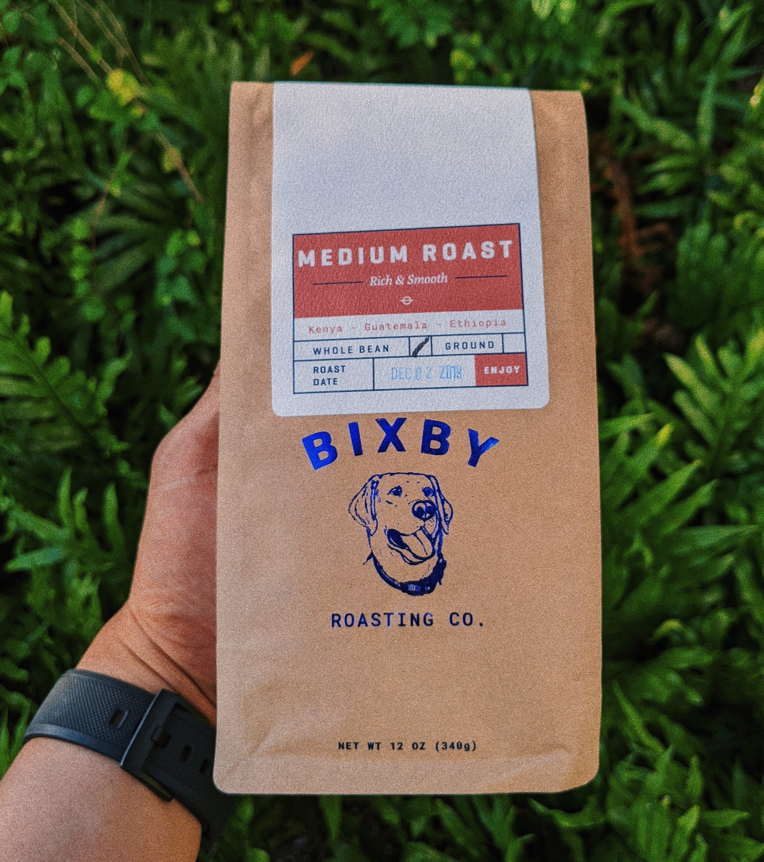
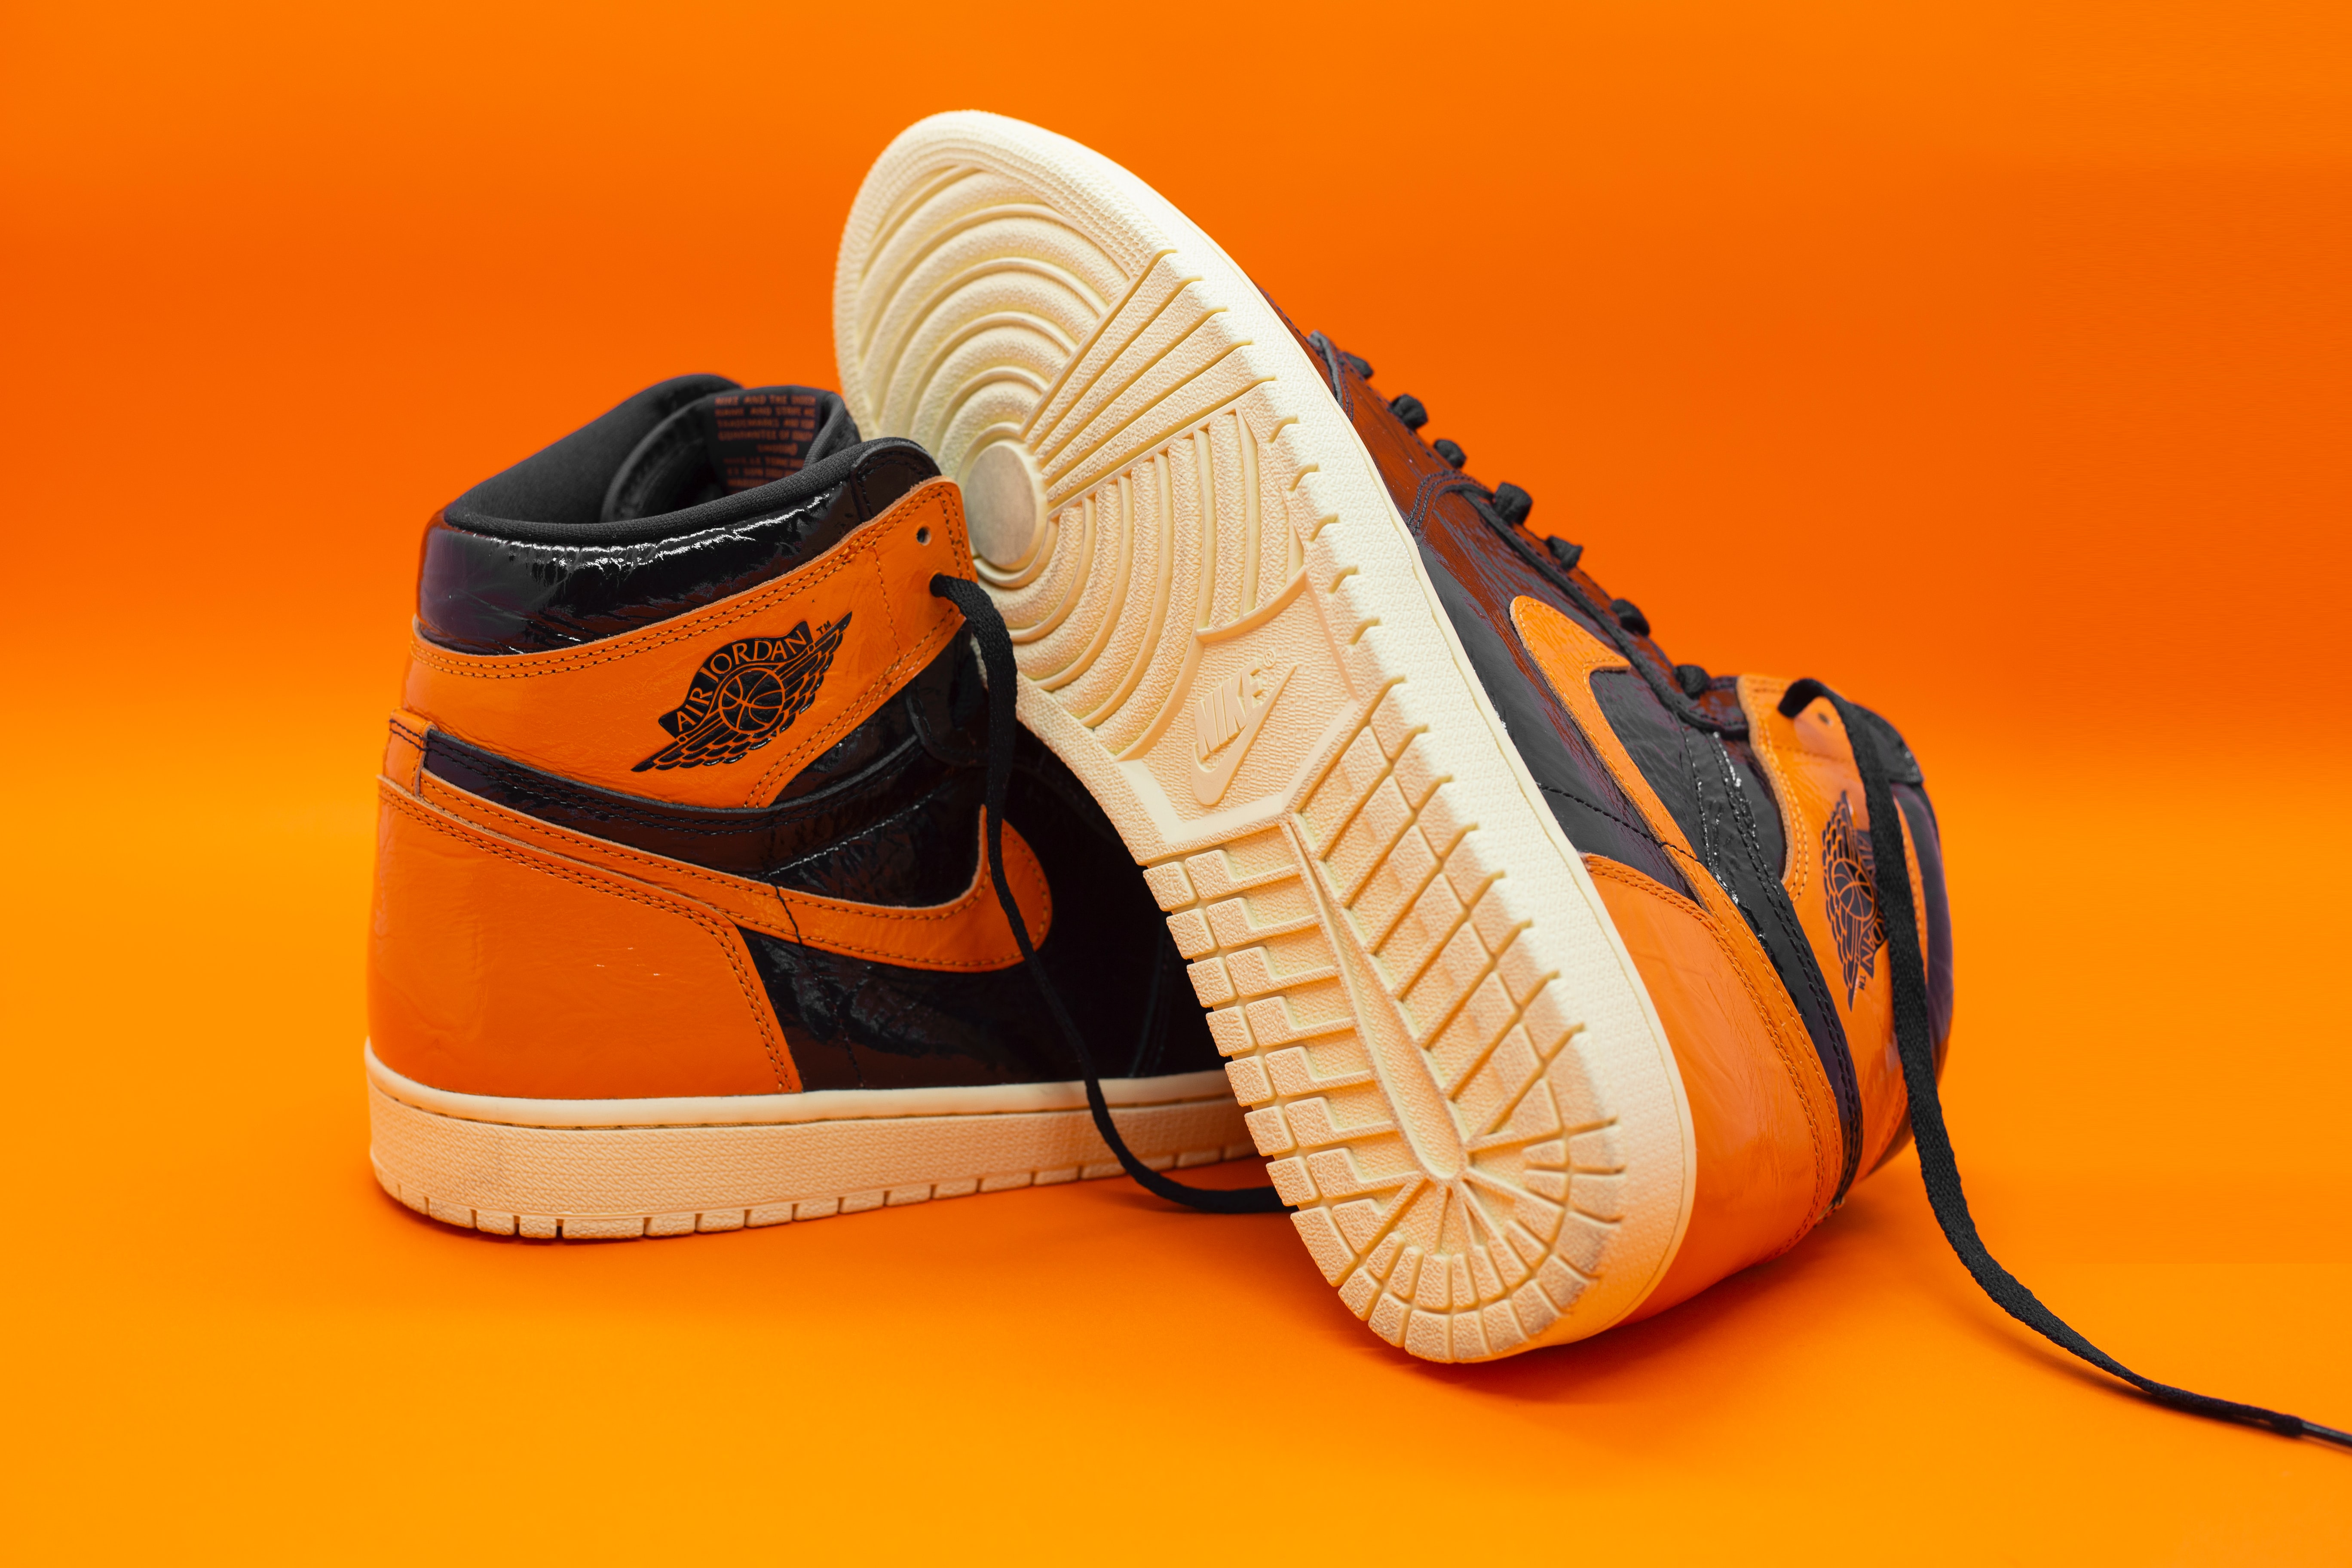
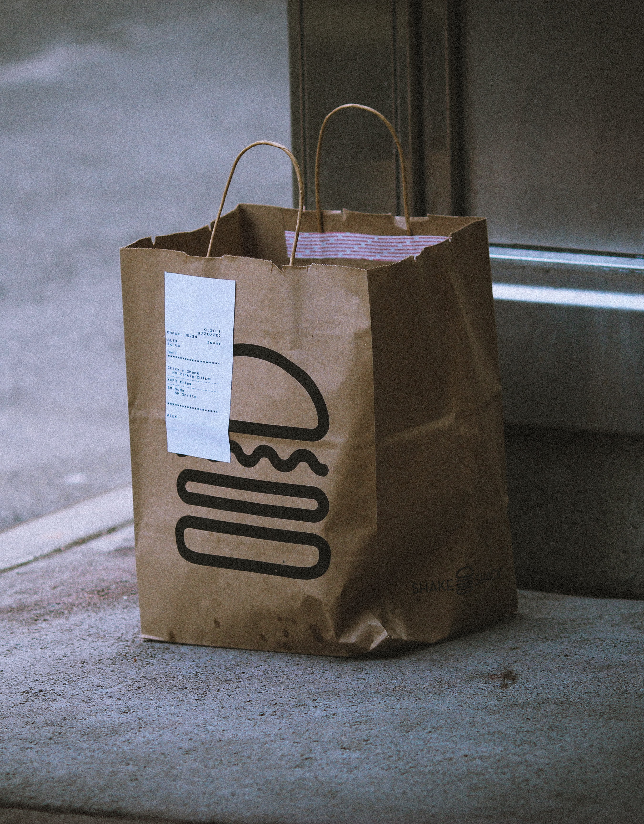


Slide 12
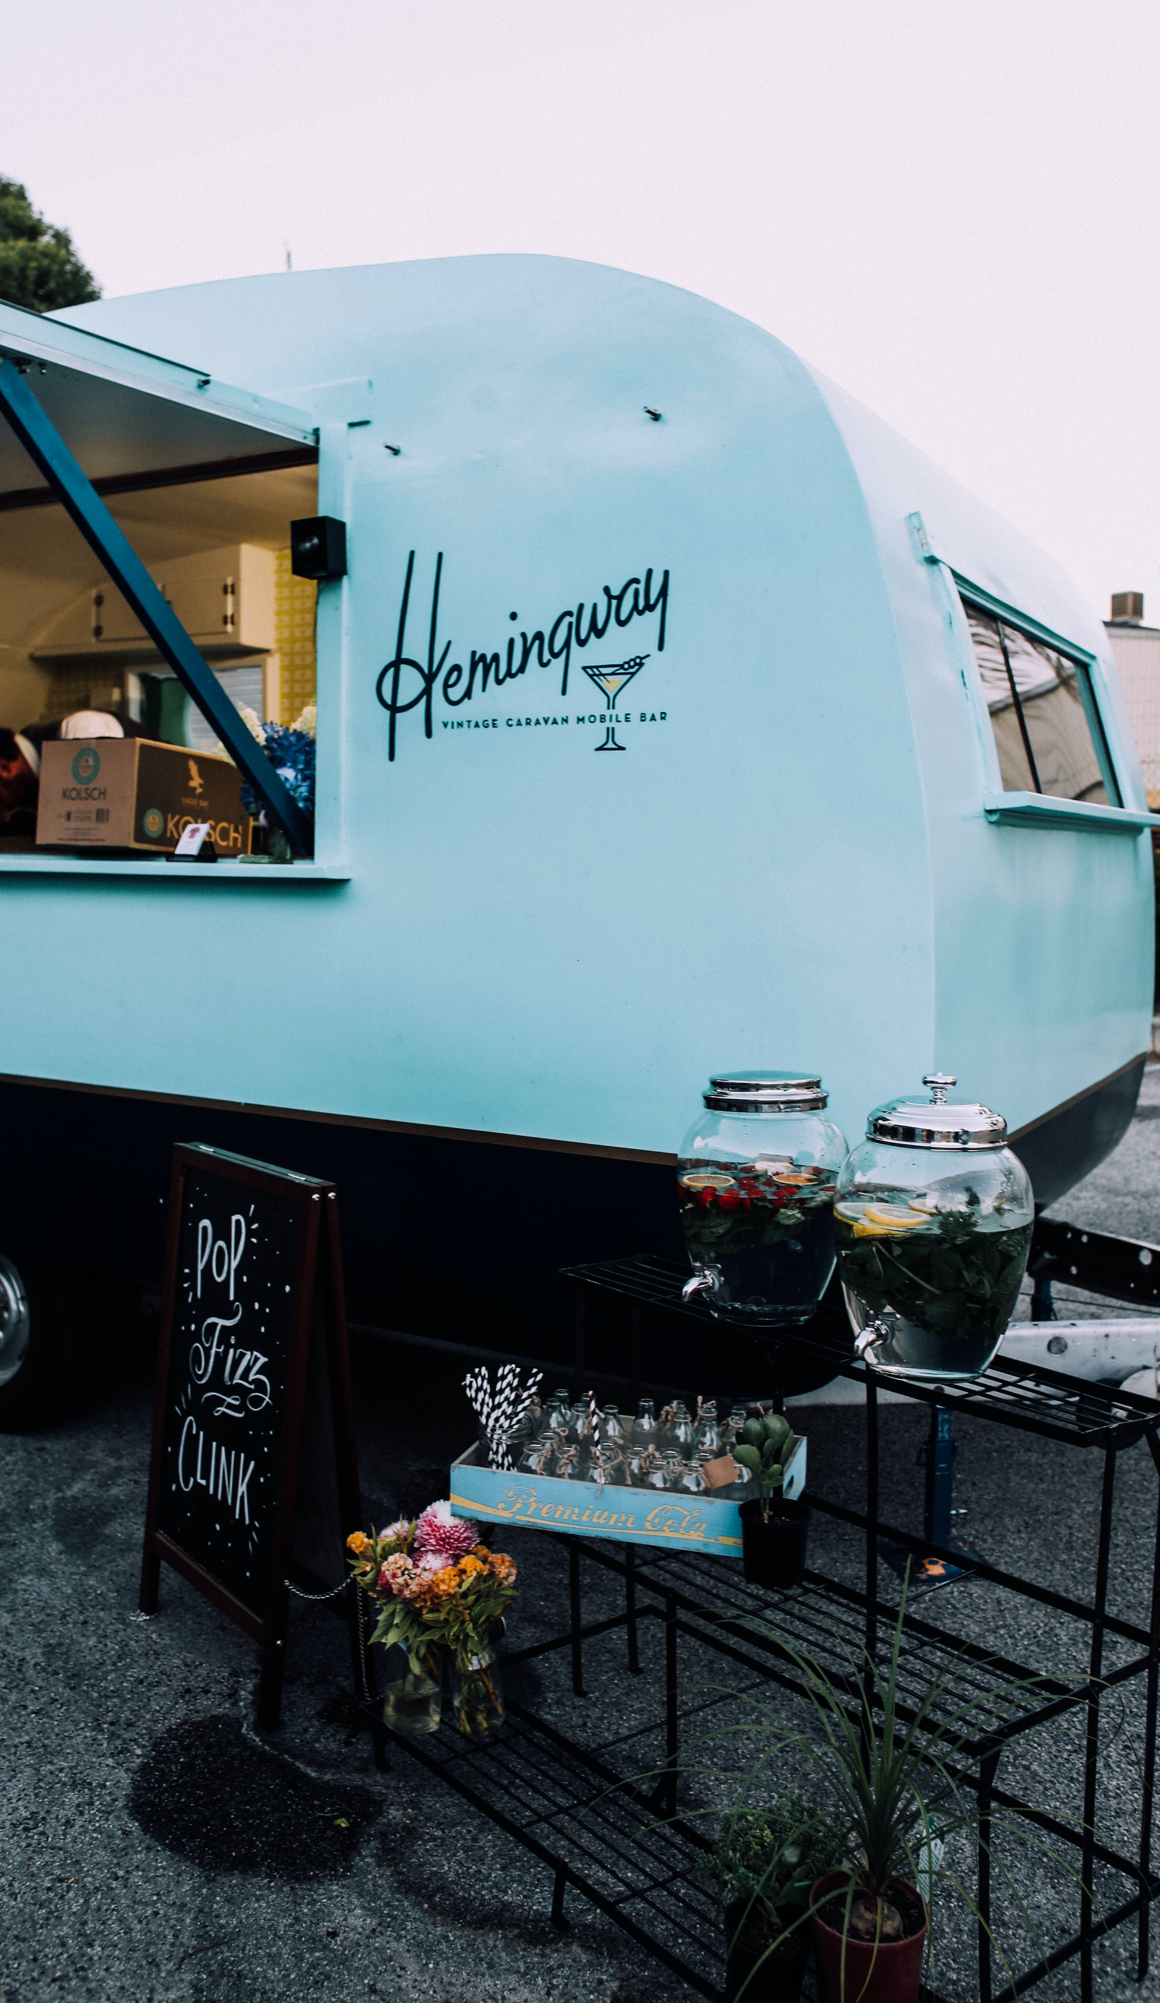
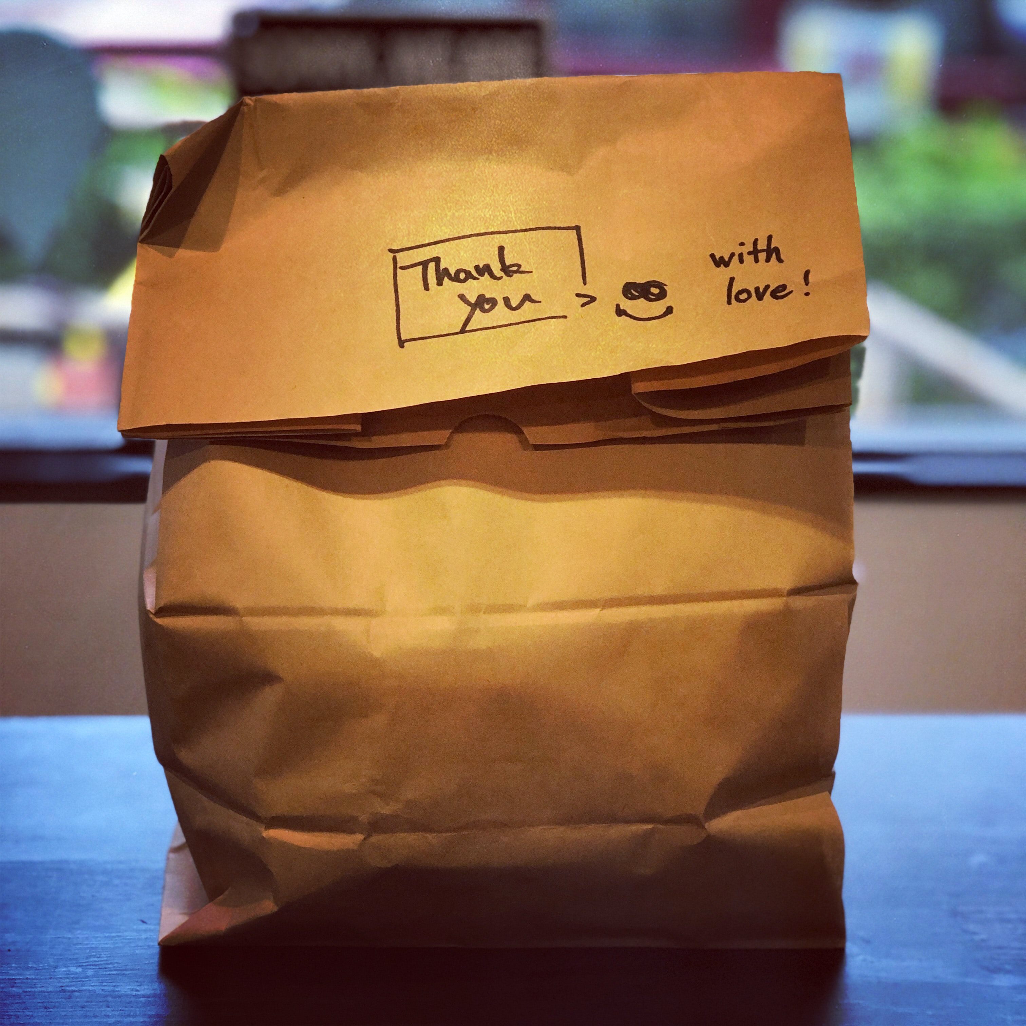

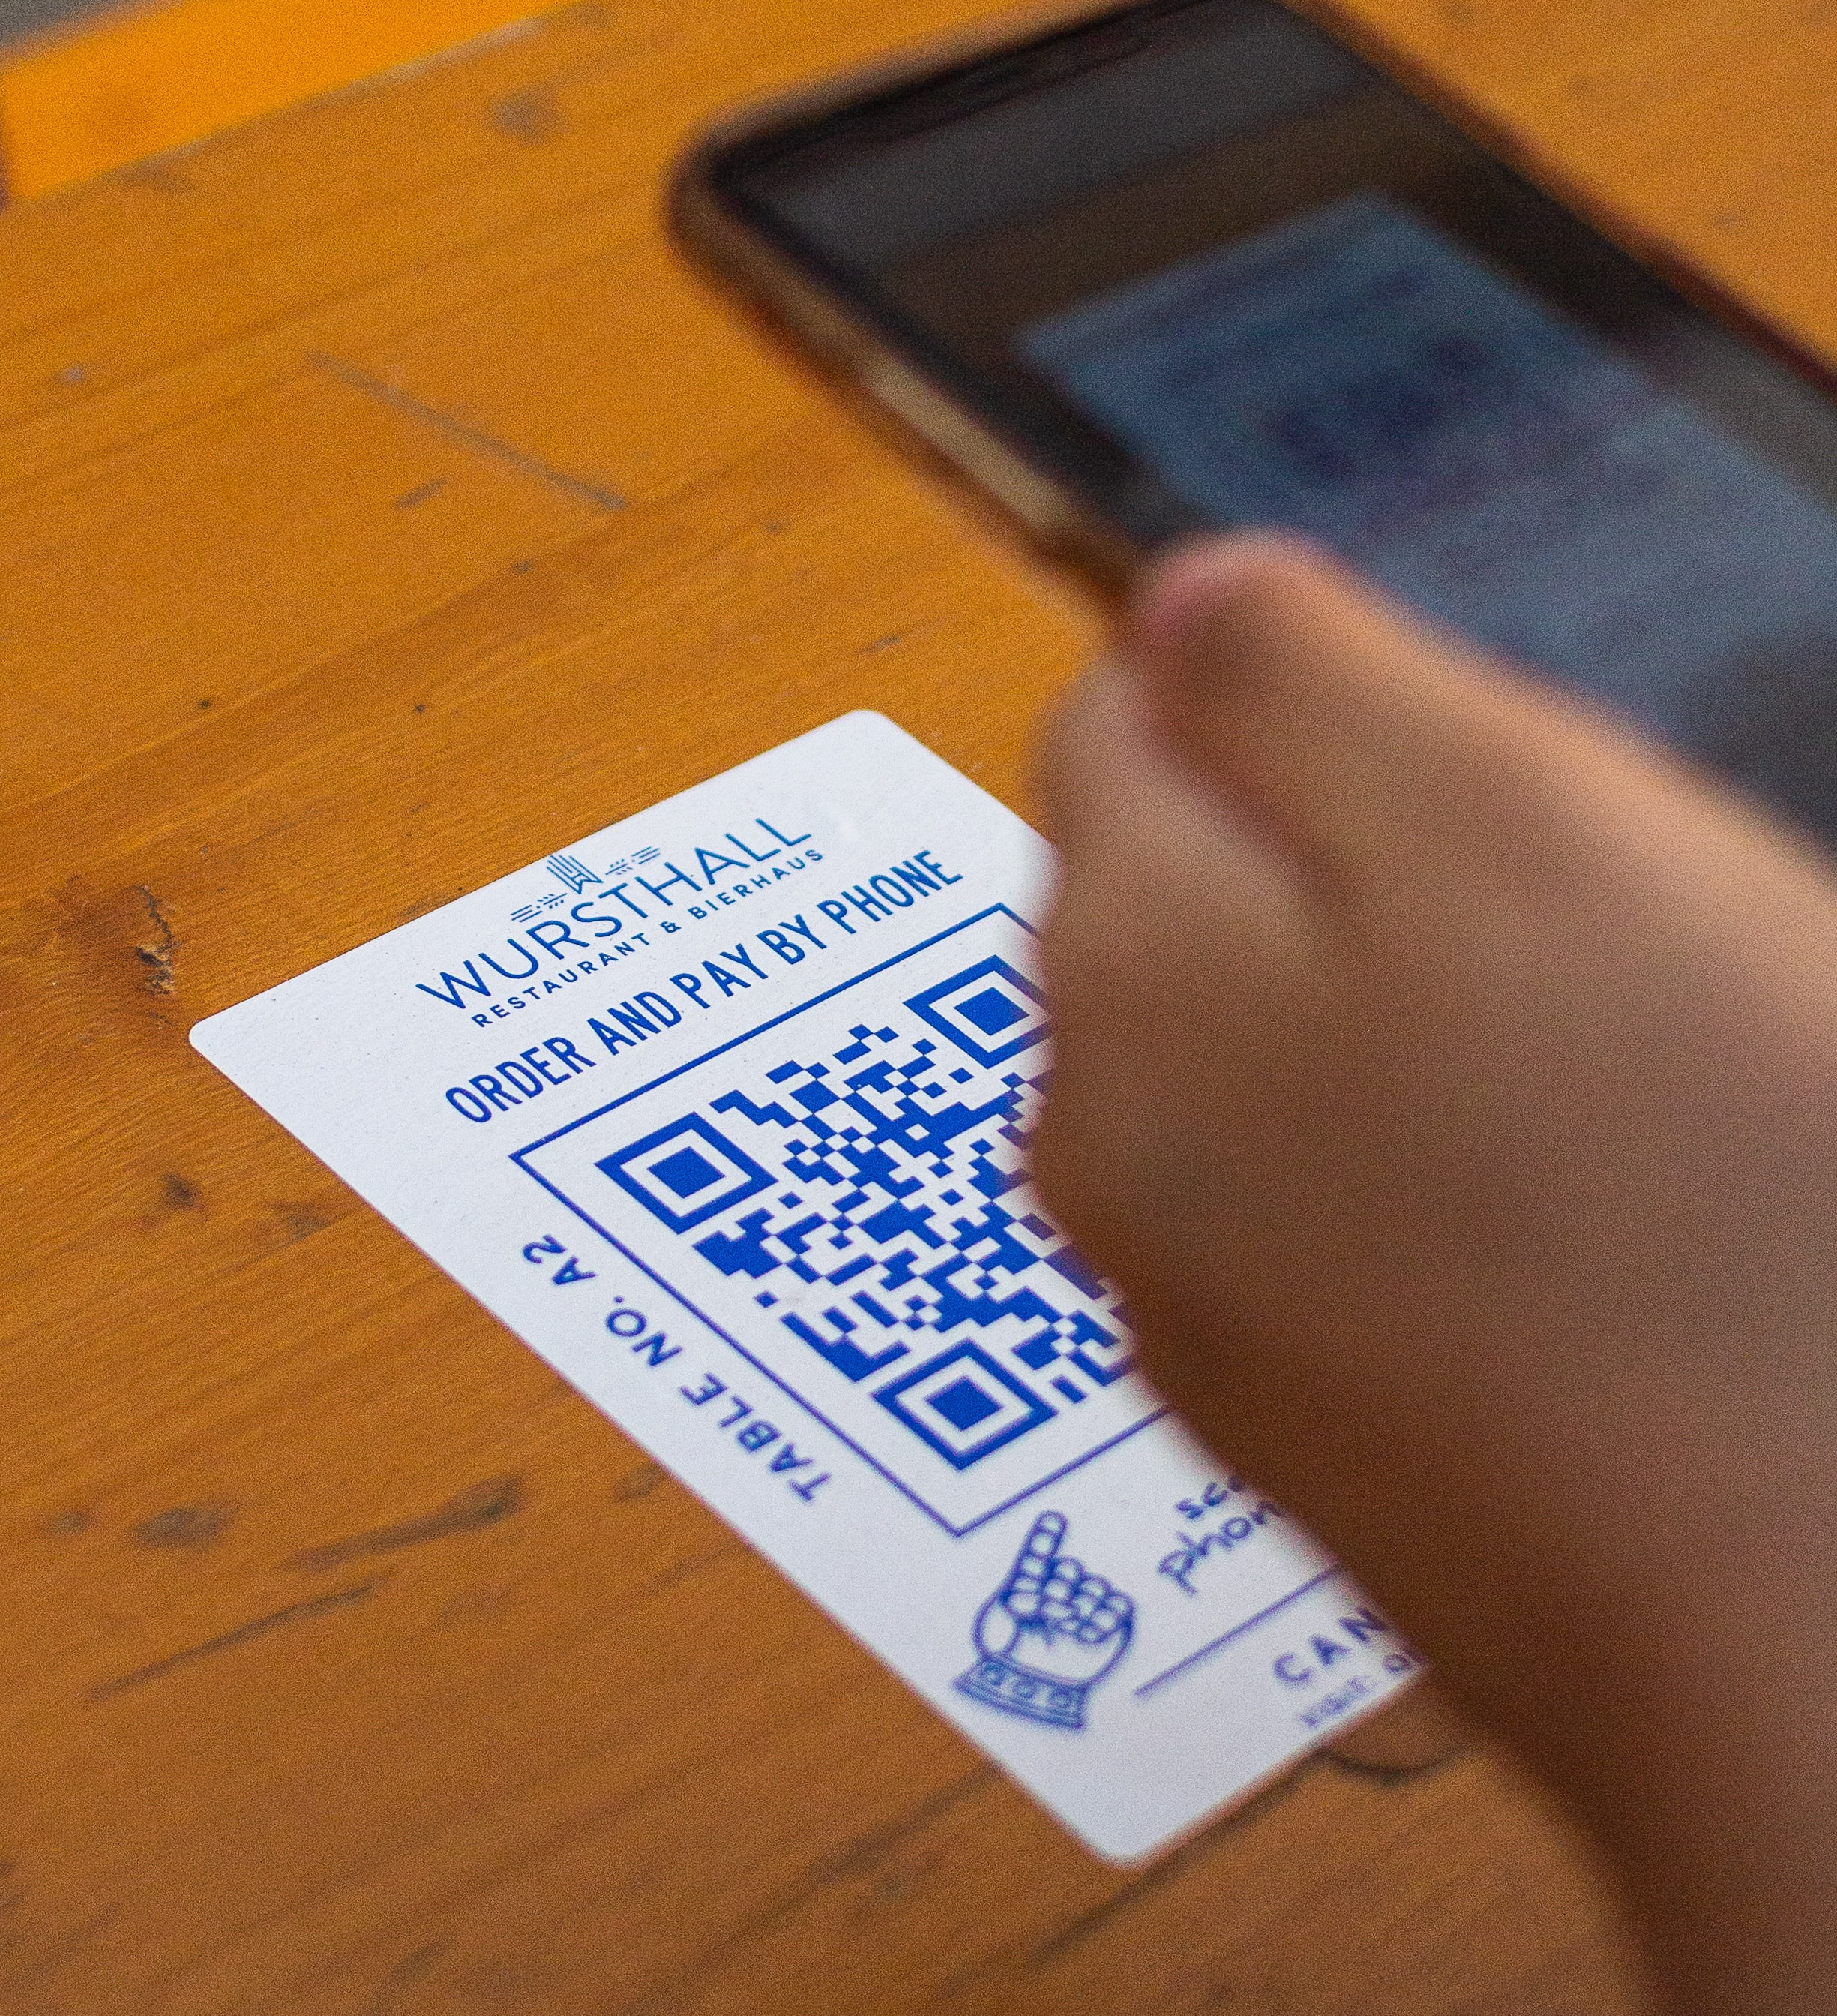
Food truck
Contactless ordering
QR code for your shopifystore URL
Send in an order using your phone
Finish the payment and everything
Just insert your table #
Get your food once it is ready

Slide 13
Selling points - why
Simple solution, small businesses
Easy setup - No hardware integration
Works on any device
Built in Shopify connector to your own Shopify-store*
Add LS Pay for seamless connection to your card terminal
Customer self-service
Competitive price!
*See Shopify.com for details on their prices

Slide 14




















Availability
Denmark
Finland
Germany
Australia
France
Spain
New Zealand
Great Britain
Iceland
The Netherlands
UAE
Mexico*
Austria*
United States
South Africa
Sweden*
Switzerland
Singapore
Belgium
Canada
The goal is to make LS Express available anywhere where Business Central is available

Slide 15
Demo time

Slide 16
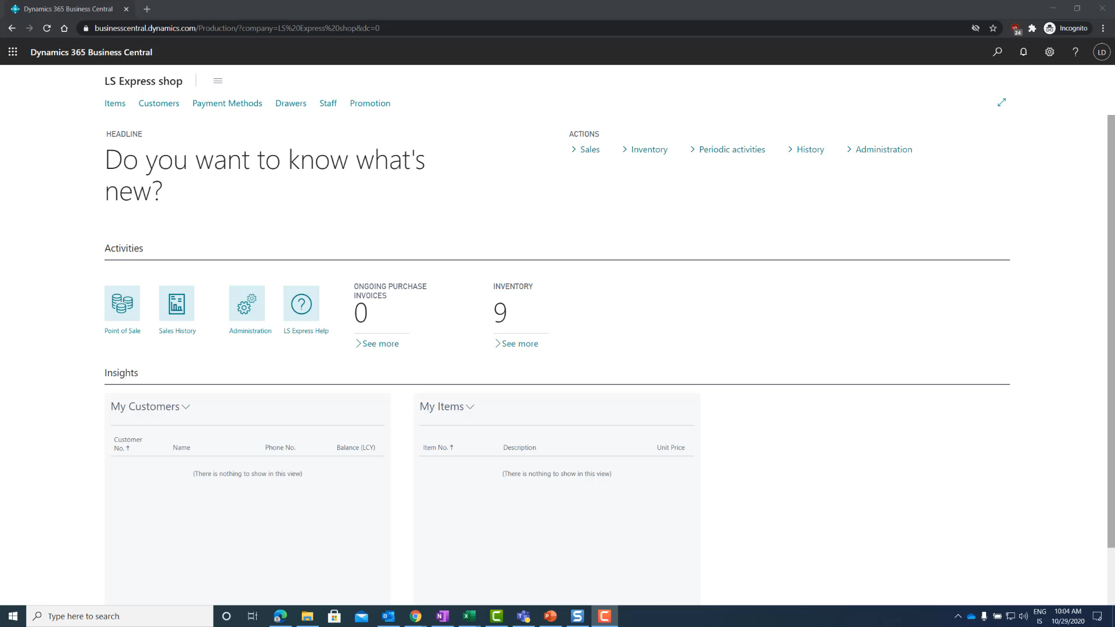
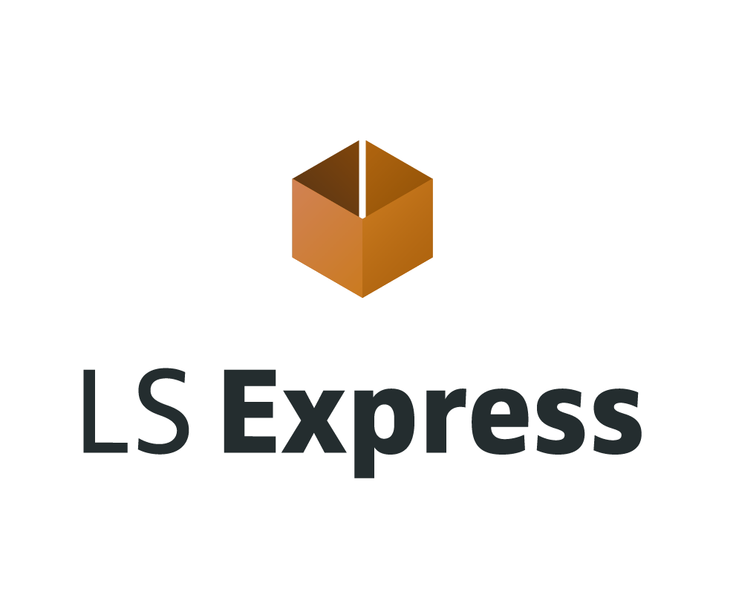
Shopify store showing

Slide 17
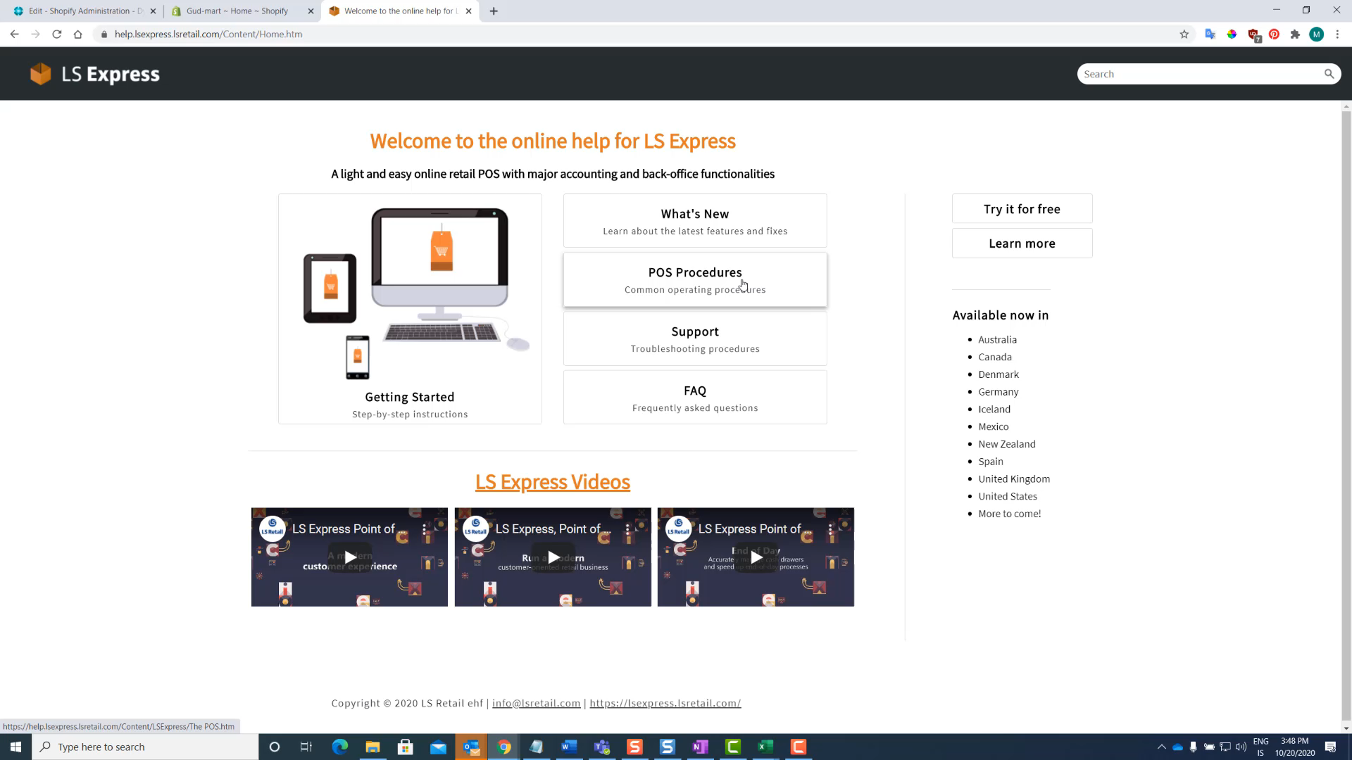

Slide 18
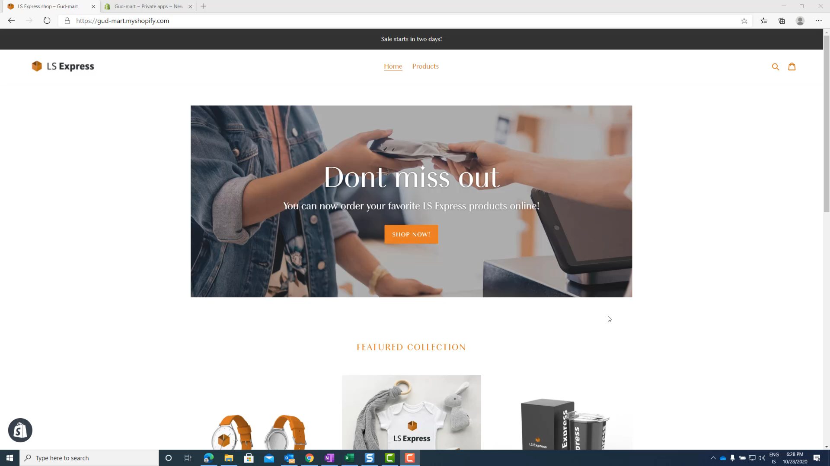

Slide 19
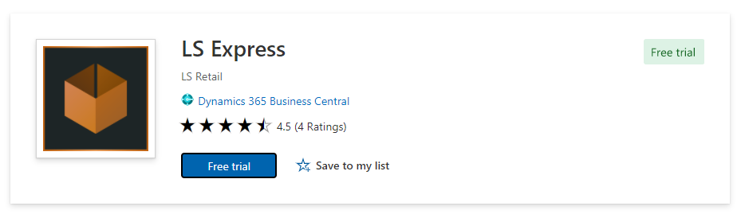
Free trial for 30days!

Slide 20
Q & A

