Slide 2


Slide 3

How can implemenations be improved and achieved faster?
Seema Gupta
Senior Consultant
Urdur Anna Bjornsdottir
Consulting manager

Slide 4



Slide 5
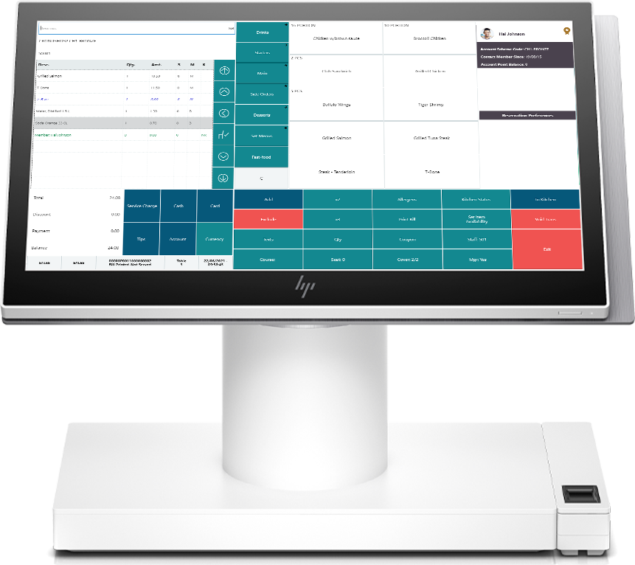

Unified within BC
Extensive functionality
Flexible/complex
Long implementation
Upgrade processes

Slide 6
vs. Competitors
Unified within BC
Extensive functionality
Flexible/complex
Long implementation
Upgrade processes
Standalone
Limited functionality
Inflexible/simple
Quick implementation
Auto updated

Slide 7
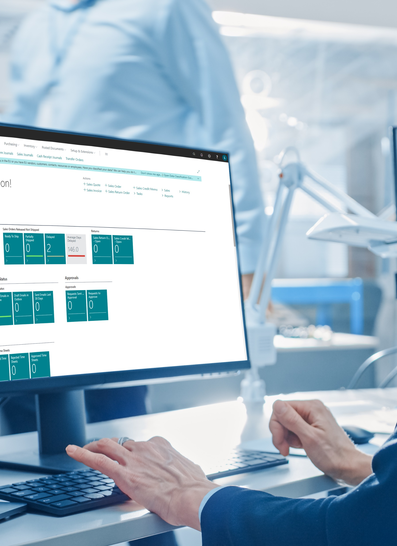
How to simplify implementations?
Tools
Methods
Packages
Scripts
Automation
Power platforms
Etc.

Slide 8

Easier, Simpler, Faster

Slide 9

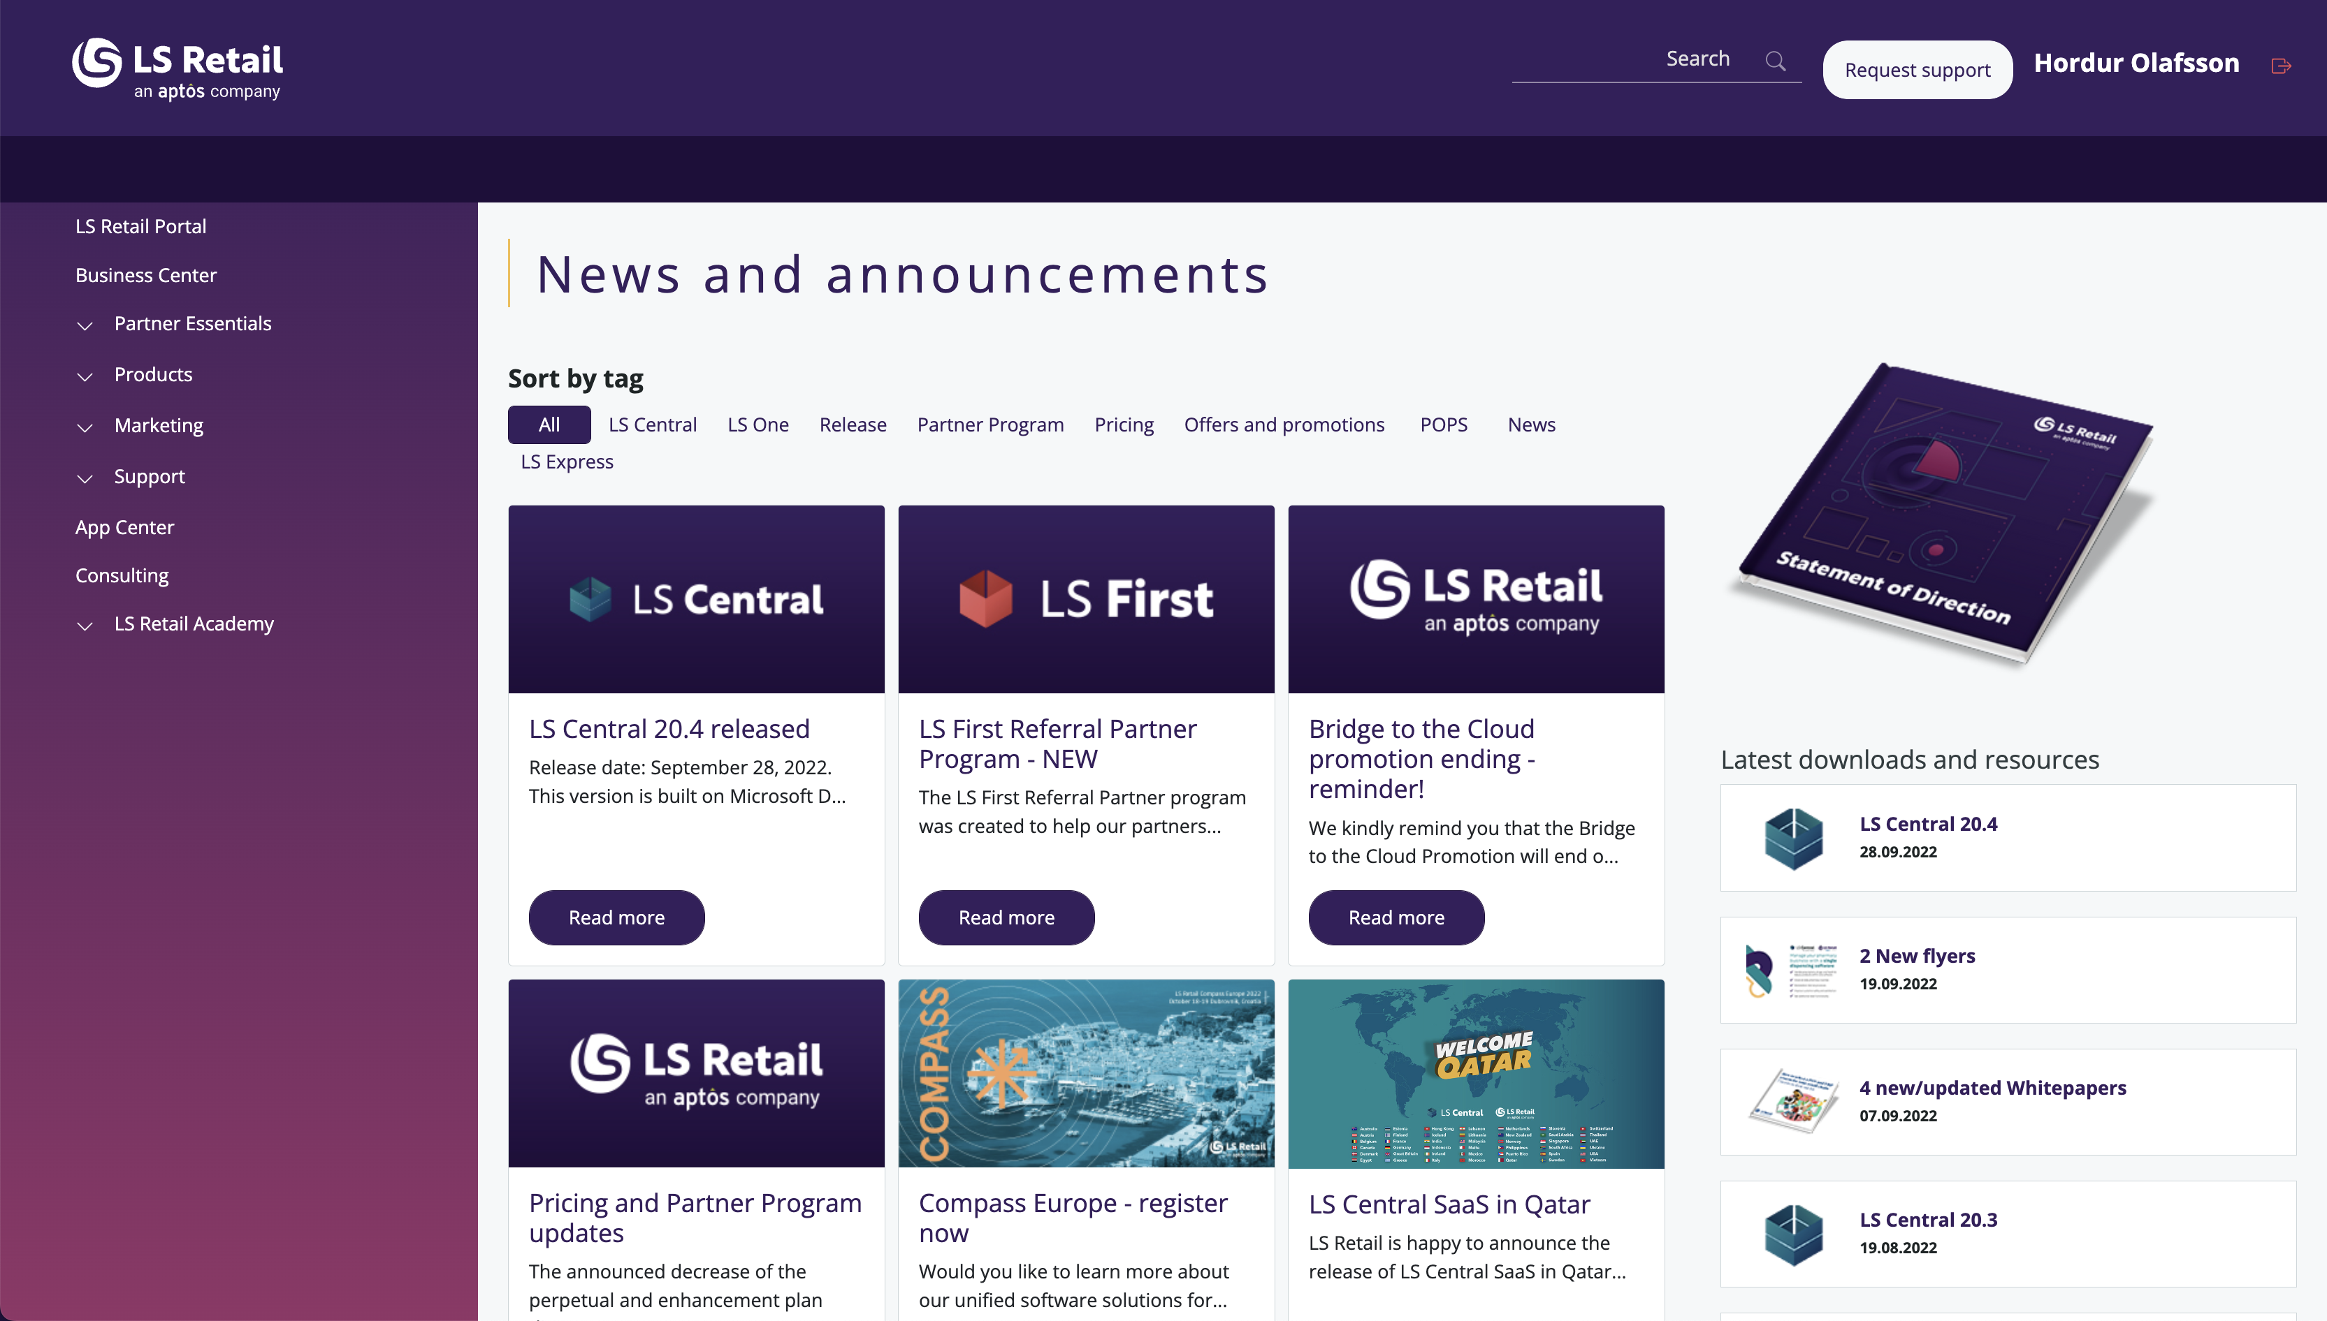
Investment from LS Retail
Strategic approach
Support partners
Ease implementation process
Different tools and methods
LS Central Implementation guide
LS Retail Update service
LS Retail migration tools

Slide 10

Each customer is different
New customer
Time
Functions
Size
Data
Quality

Slide 11

Each customer is different
Customer on NAV, LS NAV or BC, LS Central
Version
Code
Size
Data
Quality

Slide 12
Re-implementation vs upgrade

Slide 13

Re-implementation
Indicators for a re-implementation;
Business value comes from new functionality and data
Change in solution fulfills the new business problem/opportunity
The company has entered a new line of business
The business has grown or acquired other companies
New installation to latest version
Leave old code and data
Fresh start

Slide 14


Re-implementation
New and clean data
No redundant code
No legacy data
Runs faster and more flexible
New processes and functions
Need to re-structure data
No legacy data
New processes and functions
Re-write customization

Slide 15
Upgrade
Indicators for an upgrade;
Business didn’t evolve much
Processes are still valid
Legacy data is crucial for the daily work
Recent implementation
Data is reliable
Low customizations
No need to revisit processes and setup
Legacy data available directly
Less re-definitions and re-developments

Slide 16
Upgrade
Faster if in a recent version
No re-entering data
Similar processes
Legacy data is available
Slower if in an older versions
Performance impact due to data and customizations
Bad data
Still using old processes
Some customizations might be now available by default

Slide 17
Upgrade path for LS Central
On Prem
SaaS
The recommended way
LS NAV 2015
LS NAV 2016
LS NAV 2017
LS NAV 2018
LS NAV on BC v13
LS Central 13
LS Central 14.2
LS Central 15
LS Central 16
LS Central 17
LS Central 18
LS Central 19
LS Central 19
LS Central 20
LS Central 21
Using Upgrade Codeunits
Using Table Migration Extensions
Using Cloud Migration Tool
Spoiler: Although it is recommended to migrate from the same LS Central version on-prem to the same version on SaaS, in theory you should be able to migrate directly from LS Central 17.5 or later to SaaS (as long as there are no breaking changes in your own extensions).
LS Central 17.5 or later
LS Central 21

Slide 18
LS Retail Migration Process
Documentation
Step-by-step documentation based on Microsoft’s guidelines
LS Retail Migration tools
Powershell module to automate some migration steps
Already available on the Powershell Gallery
Ricardo Moinhos
Migration Specialist
ricardomo@lsretail.com
New-UpgradeInitializationScript
New-UpgradeAppsStructure
Convert-BC14CALObjectsToTableSchemaOnly
A wizard to automate the migration scripts creation
Generates a config.json file that can be updated and reused
Creates the migration extensions needed for the migration process, as suggested in Microsoft guidelines
Will allow you to rename the tables in BC 14 to conform the new table naming introduced in LS Central 17.5
Repair-CustomExtensionFrom174orEarlier
Will update references to LS Central objects in your custom extensions
Variables, parameters, object extensions and other properties

Slide 19
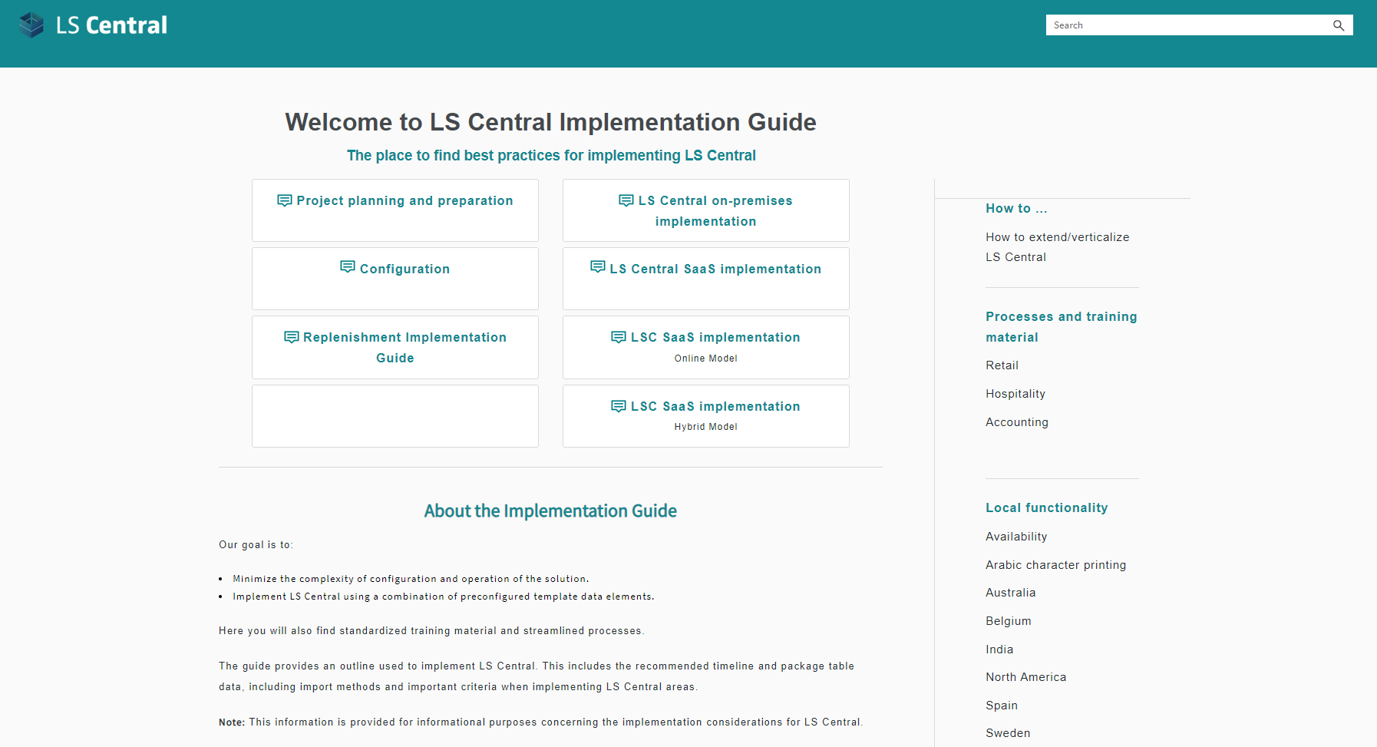
LS Central implementation guide
Goal
Minimize the complexity of configuration and operation of the solution
Provide tools to implement LS Central by using a combination of preconfigured templates
The method
Define the core of LS Central
Create base structure of functionality that is easy to maintain
Plug in additional feature later made simpler

Slide 20

Assisted setup

Slide 21

How can the this be improved to reach the finish line faster?

Slide 22
Thank you

