Slide 1
LS Central for hotels
Not just a PMS
Gunnar Orn Thorsteinsson
Product Director

Slide 2

LS Central for hotels
Simple
Processes
Holistic
Flexible
Navigatable
Powerful
Seamless

Slide 3

Not just a PMS
eCommerce Integration
Web Integration
3rd party
Channel Manager Connector
LS Pay
Integration to payment providers
LS Central
Analytics
predictive abilities
Staff Management
Staff rosters and timetabling
Bookings
Reservations
and activities
Hotels
Property Mgmt System and Channel Mgmt
KDS
Kitchen management
Restaurants
Food and beverage
Loyalty
Member
Mgmt
Retail
Stores and Backoffice
Microsoft Dynamics 365 Business Central
Power BI

Slide 4
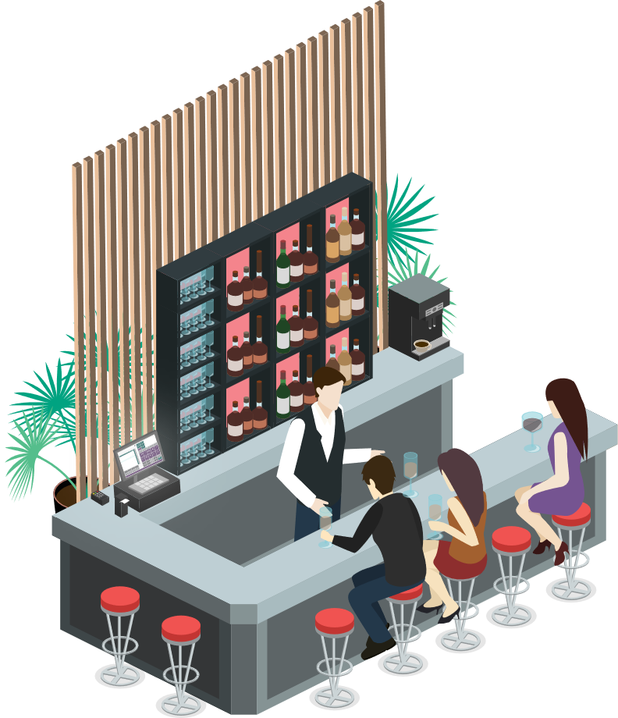
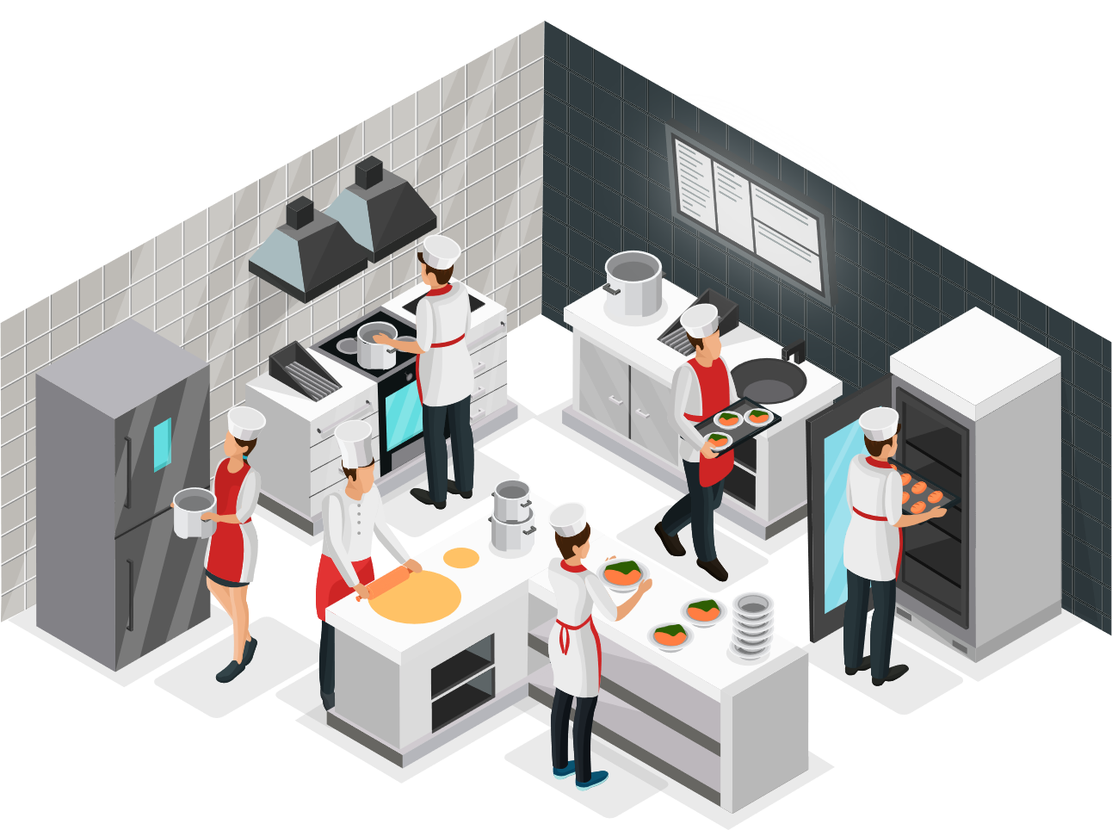





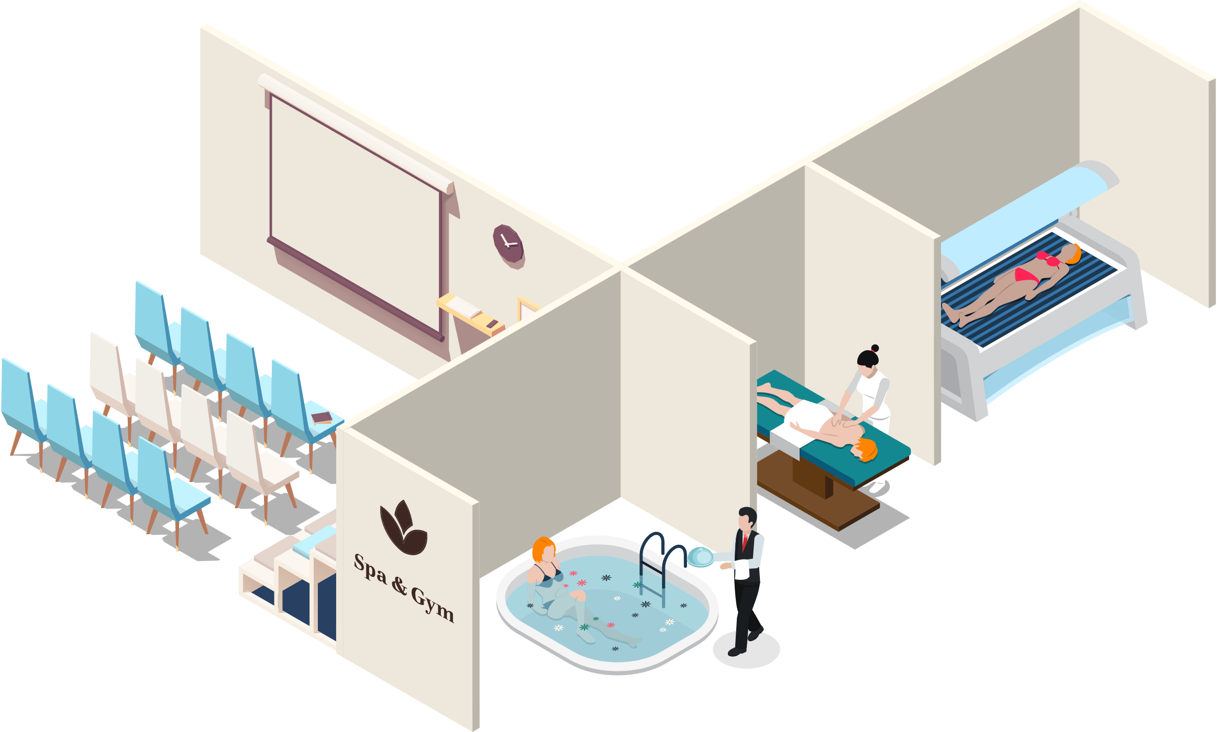
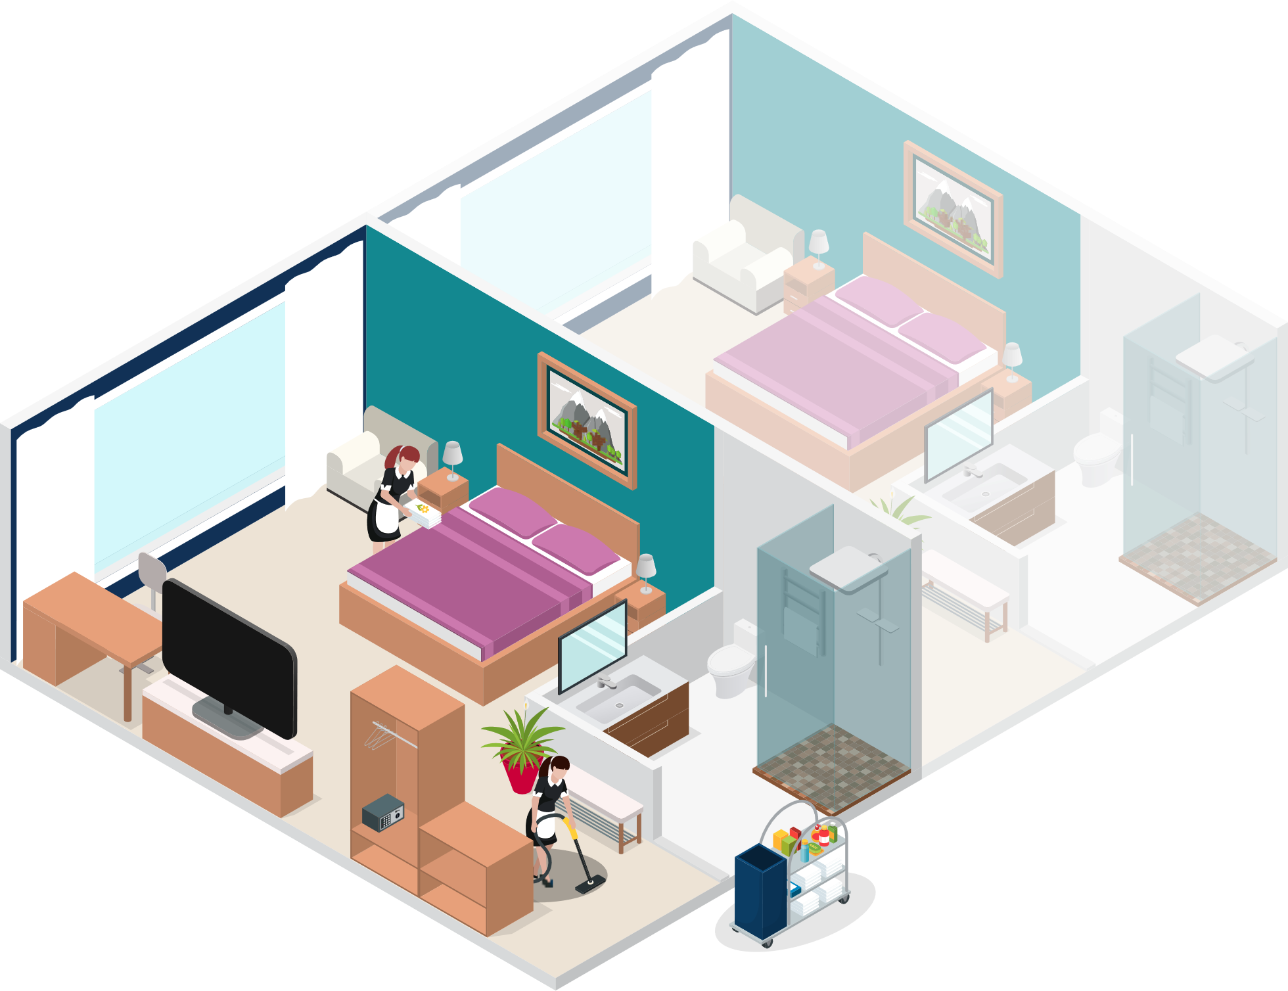


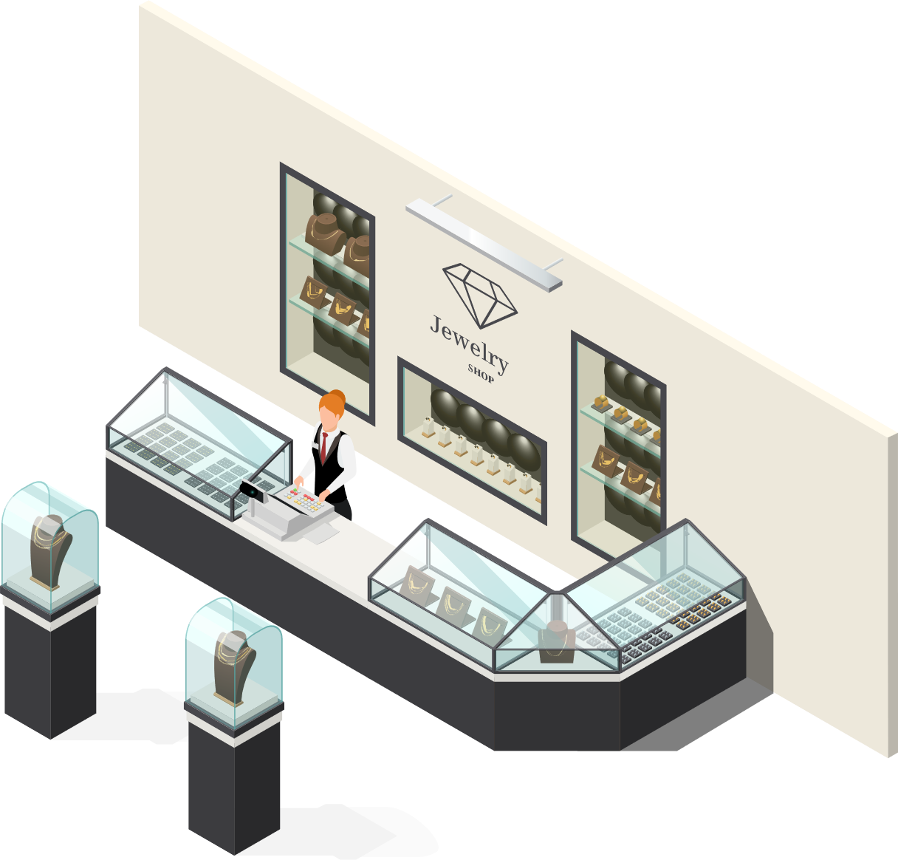


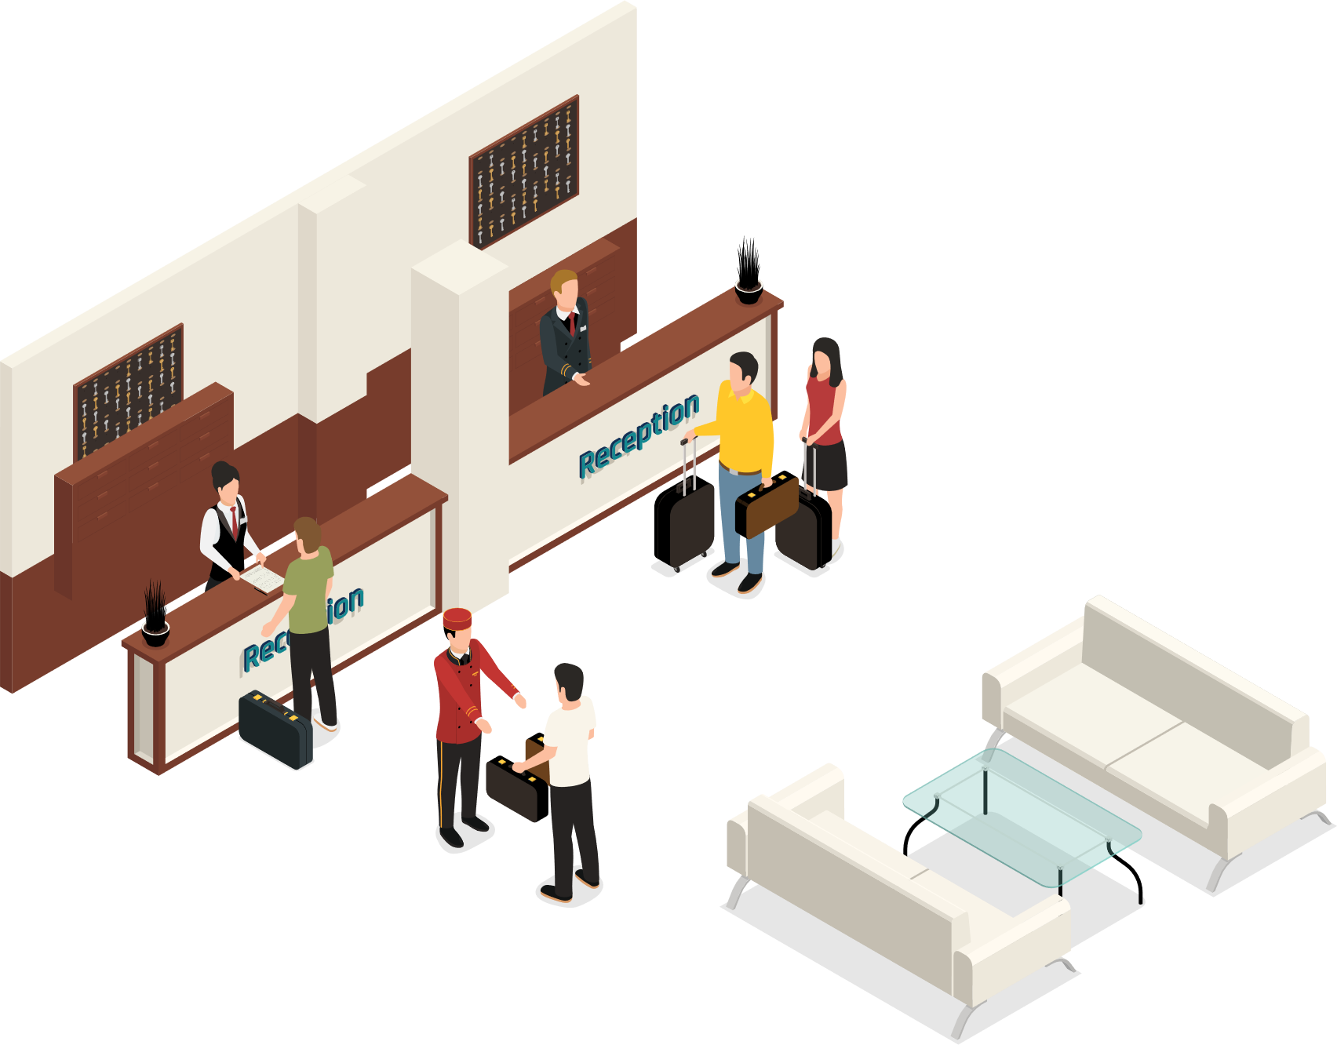
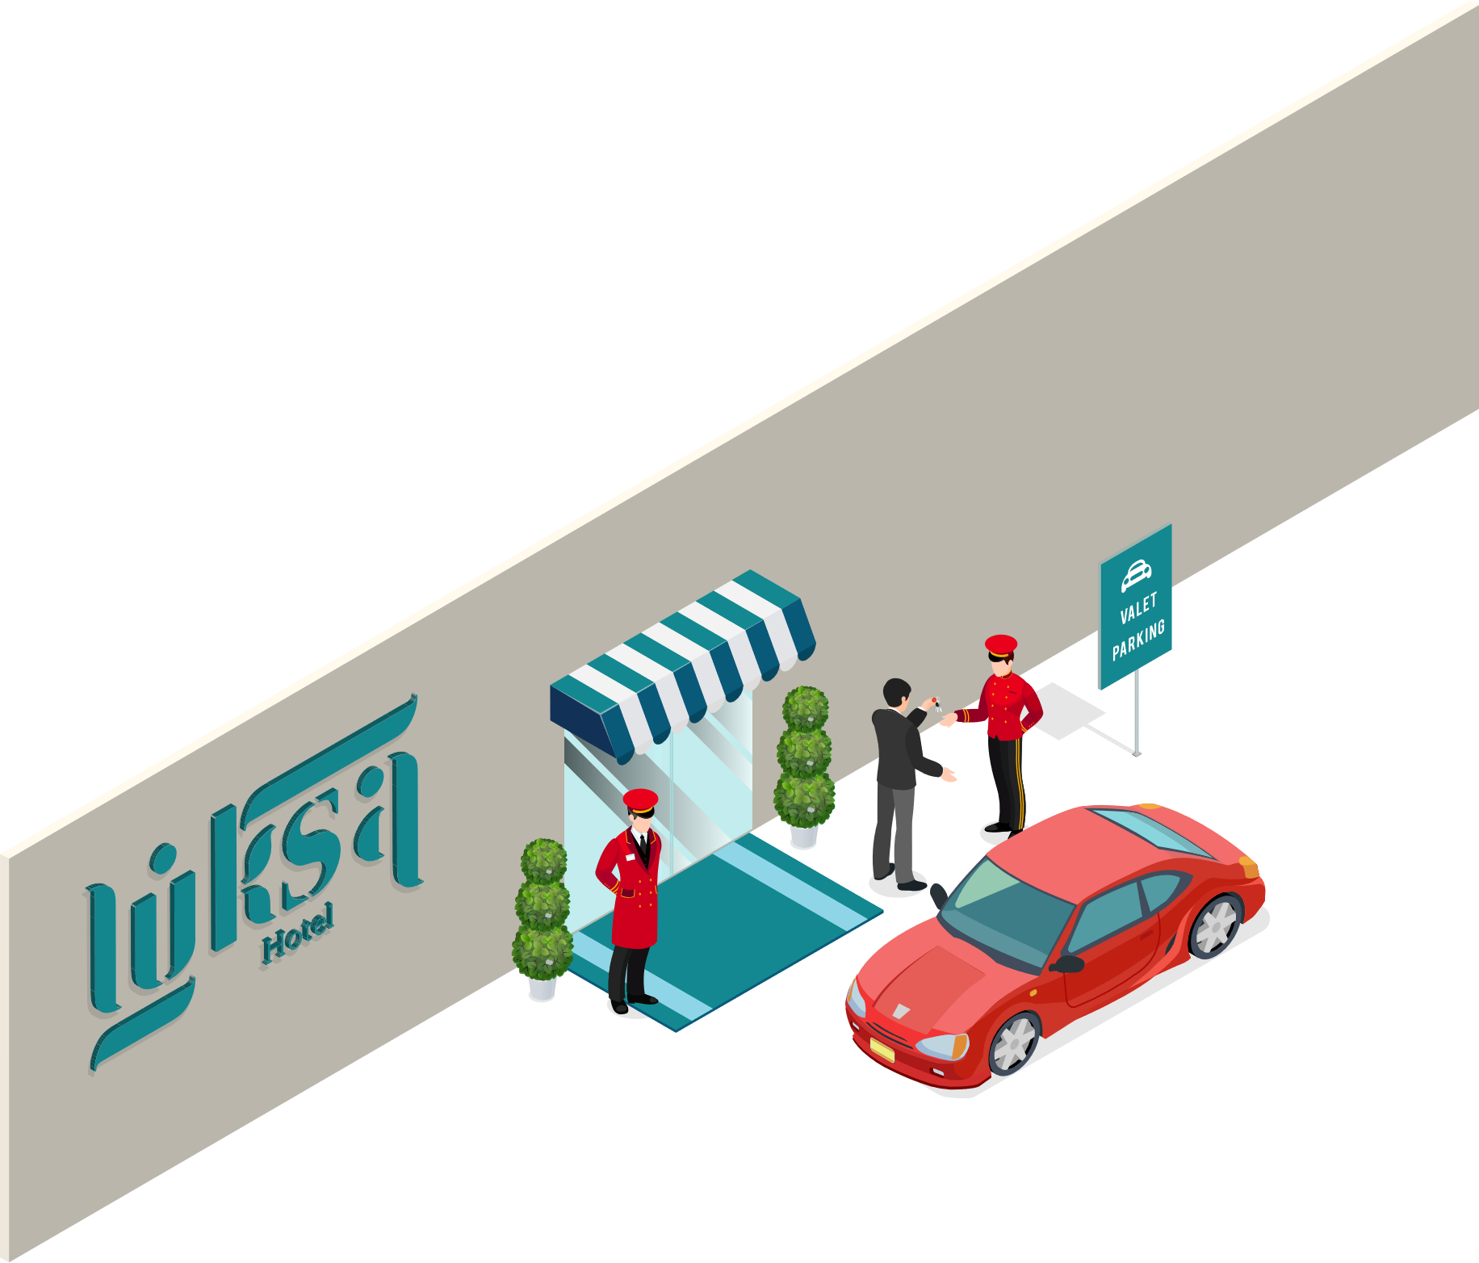


LS Central for hotels
LS Central
Food & Beverage
Bookings
Staff Mgmt
KDS
Hotels

Slide 5
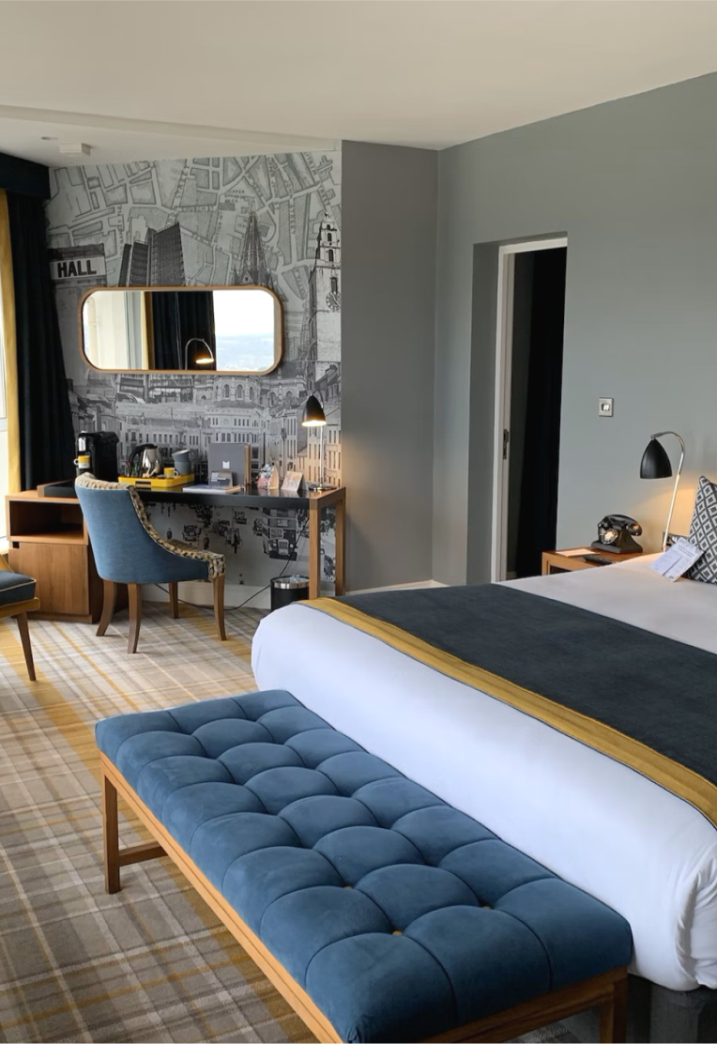
LS Central for hotels
Rate Code Management
Flexible Rate Code setup with Rate Attributes
Items, activities and/or packages
Offset of BAR and Derived Rate Codes
Dynamic pricing for periods or specific days
Restrictions & Overbooking limitations
Reservation Management
Individual Reservations
Group Reservations
Reservations with activities and/or other extras
Guest Management
Comments

Slide 6

LS Central for hotels
Invoice Management
Routing Rules
Folios: Guest - Paymaster - Customer
Preview - Invoices
Deposit and Cancellation schedules
Discounts
Statement Posting
Night Audit with Accrual Accounting
Balance Transfers
Multiple Role Centers
Back Office
Front Desk
Housekeeping
Channel Manager

Slide 7
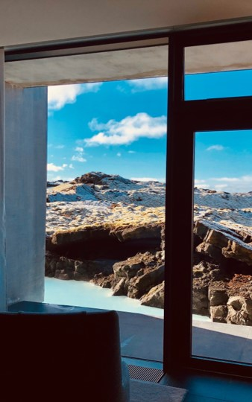
LS Central for hotels
Front desk POS
Reservation search
Reservation management (check-in, charge, check-out)
Day View
Housekeeping
Rules
Tasks
Real-time status
Analytics
Standard 11 reports that can be enhanced and customized
Channel manager and API’s
SynXis
SiteMinder

Slide 8
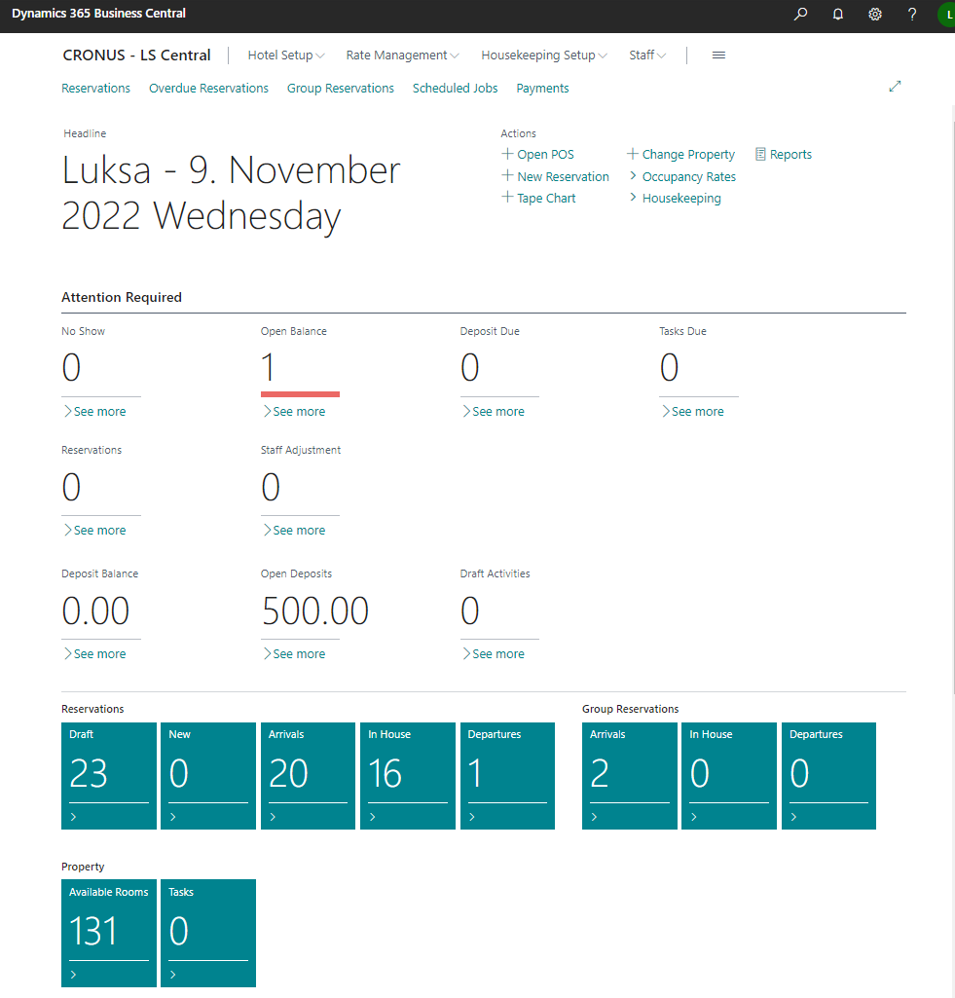
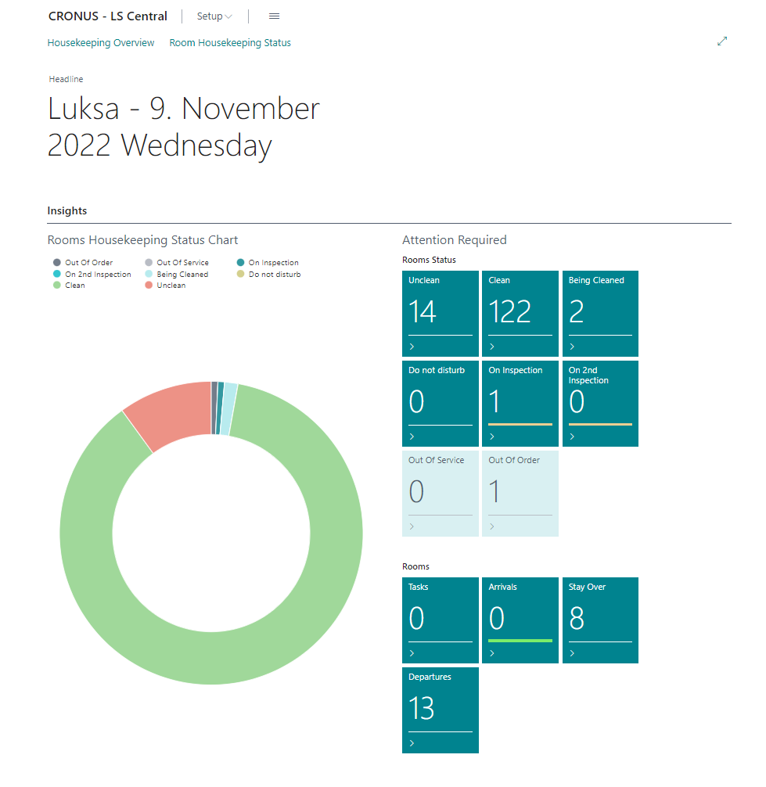
Role Centers
Front Desk
  Housekeeping

Slide 9
Role Centers

Slide 10
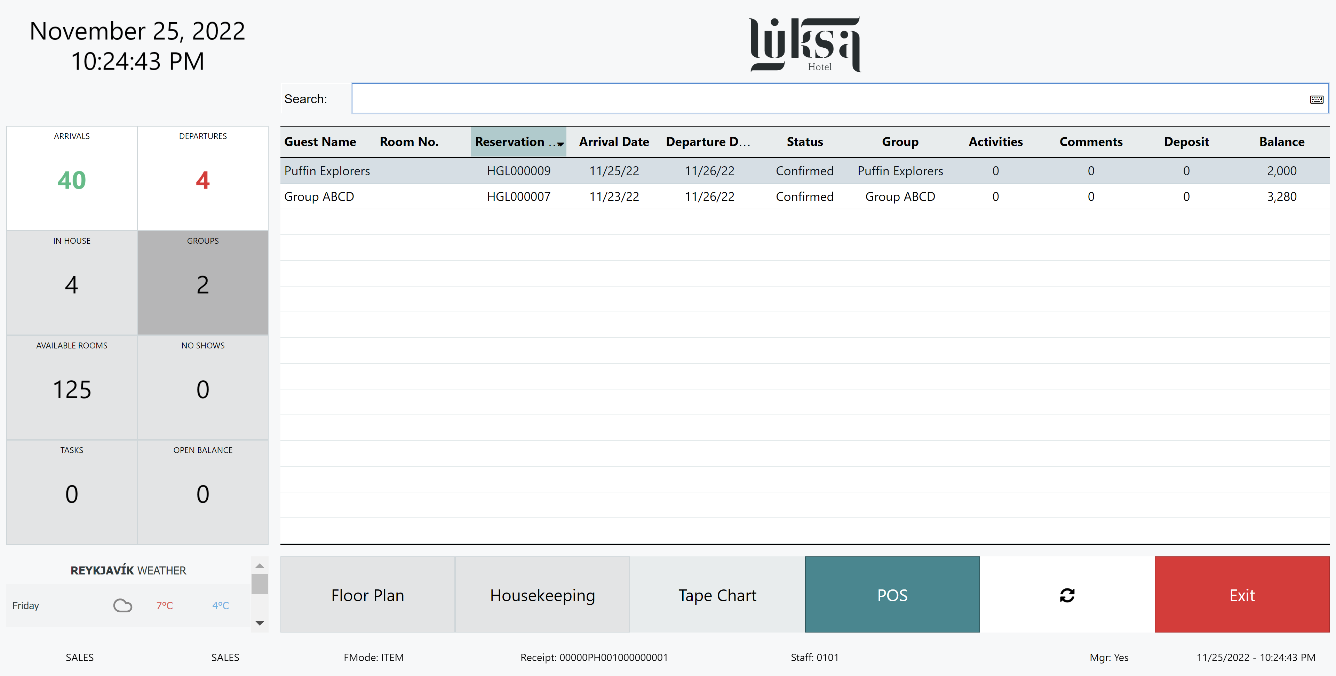

Slide 11
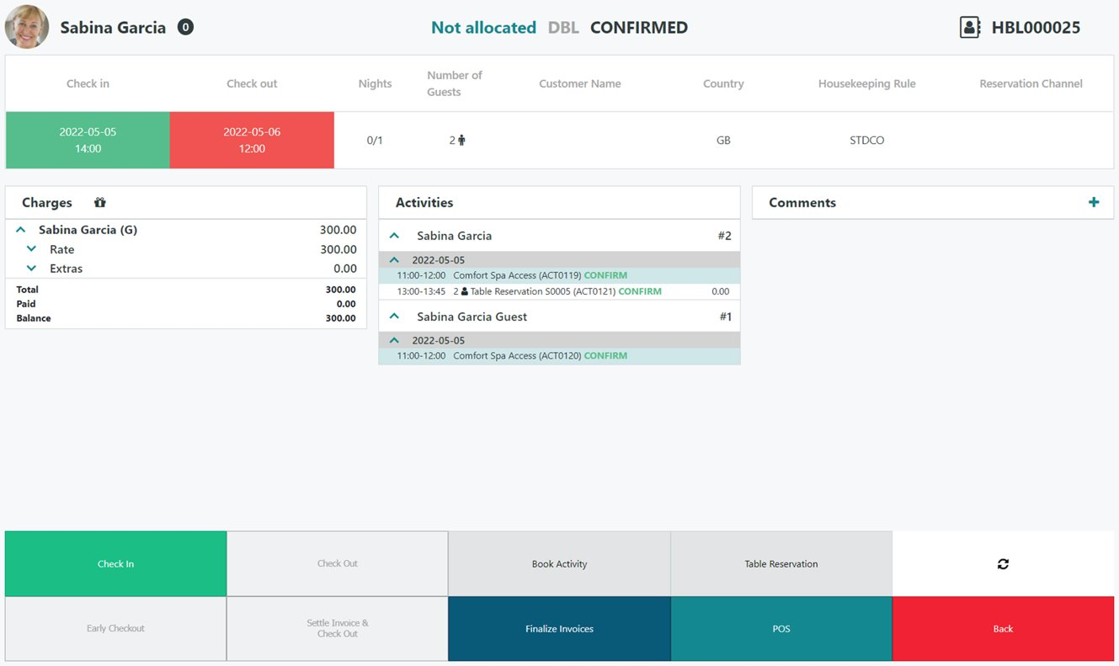

Slide 12
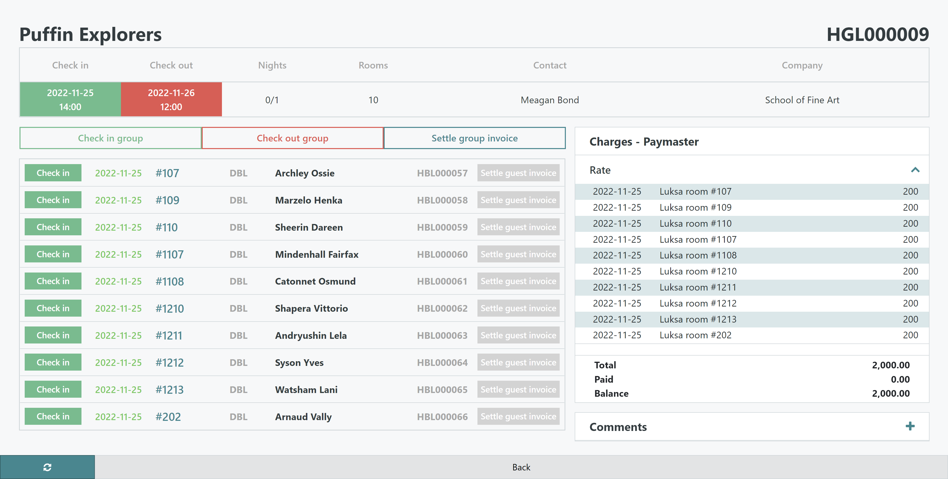

Slide 13
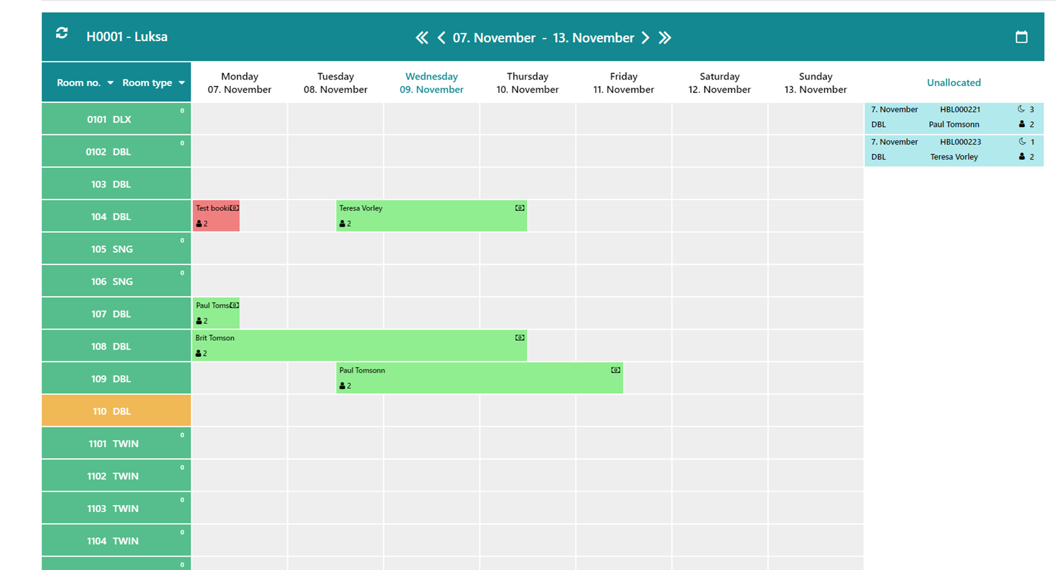

Slide 14
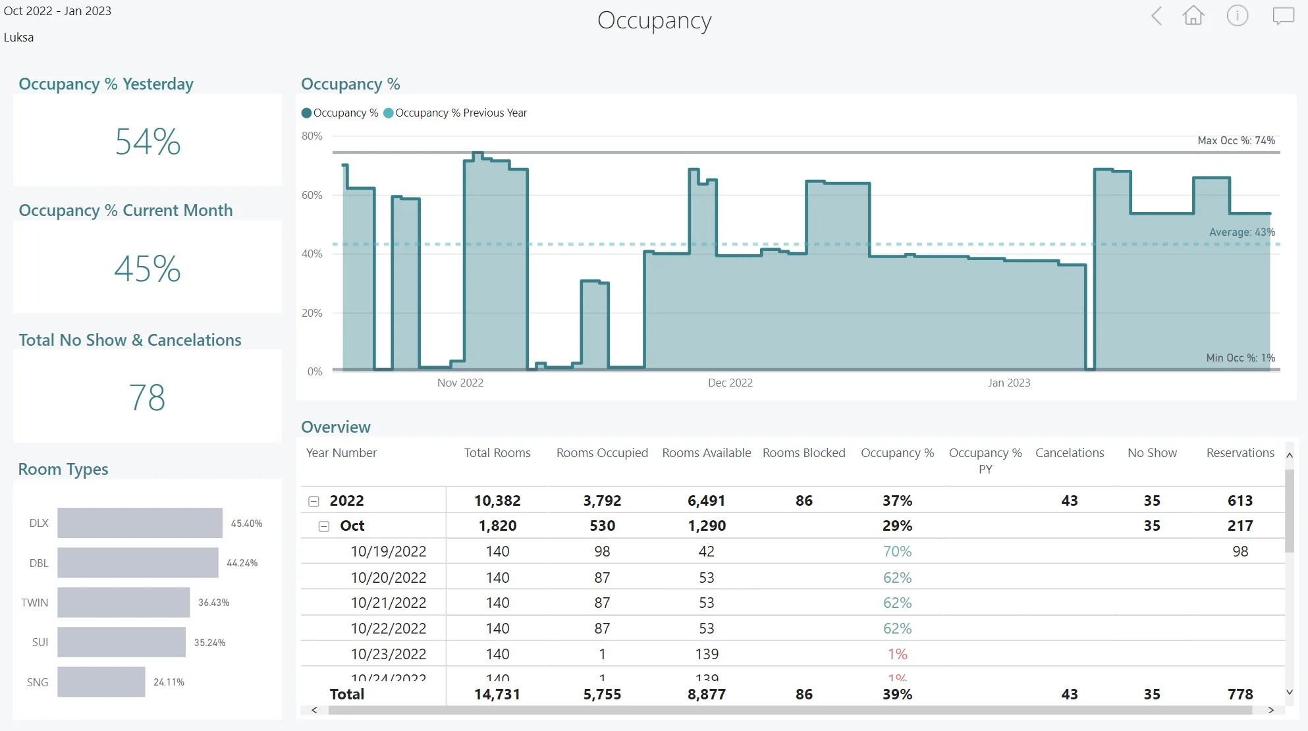

Slide 15
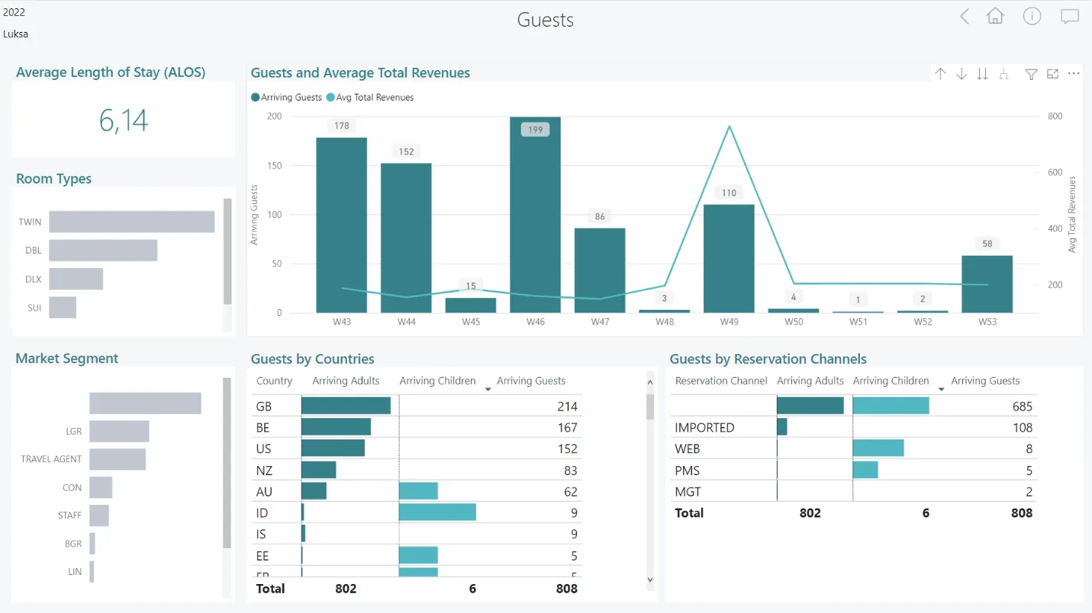

Slide 16

LS Central for hotels roadmap
Folio Management
Reservation Extras
Enhanced visibility of rate codes and restrictions
Guest management
Member for each guest
Room attributes
Folios for reservations
Hotel Allotments and Contracts
Call-off allotments
Token usage in Hotels
Reservation tokens
Rate Code Matrix
Folios on POS
Deprecate Split Bill panel
Release back conditions
Member tokens
Room allocation
Room joining
Member discounts
Guest registration info
Serial Bookings
Linked reservations
Multi Company
Contracts
Room management
Allowances
Features are subject to change

Slide 17
Thank you

