Slide 1
Quicker implementations:
Configuration packages to speed up and standardize LS Central for Hotels implementations
Gígja Eyjólfsdóttir
Jakob P. Nickelsen

Slide 2
Agenda
Implementation challenges
Why configuration packages?
Benefits of using configuration packages in implementations
LS Central for hotels implementation
Demonstration
Reference story

Slide 3

Challenges in implementations
Misaligned expectations
Tight timelines
Employee readiness
Project preparedness
Data migration/integrity
Data coming from multiple sources
Data in multiple formats
Manual work in configurations
NAV/BC - Upgrade or reimplementation?

Slide 4

Configuration packages
Expectations, timeline, and preparation settled
Data identified
Data isolated
Data washed
Implementation task
What to do manually
What to import
D365 Business Central
Configuration packages

Slide 5
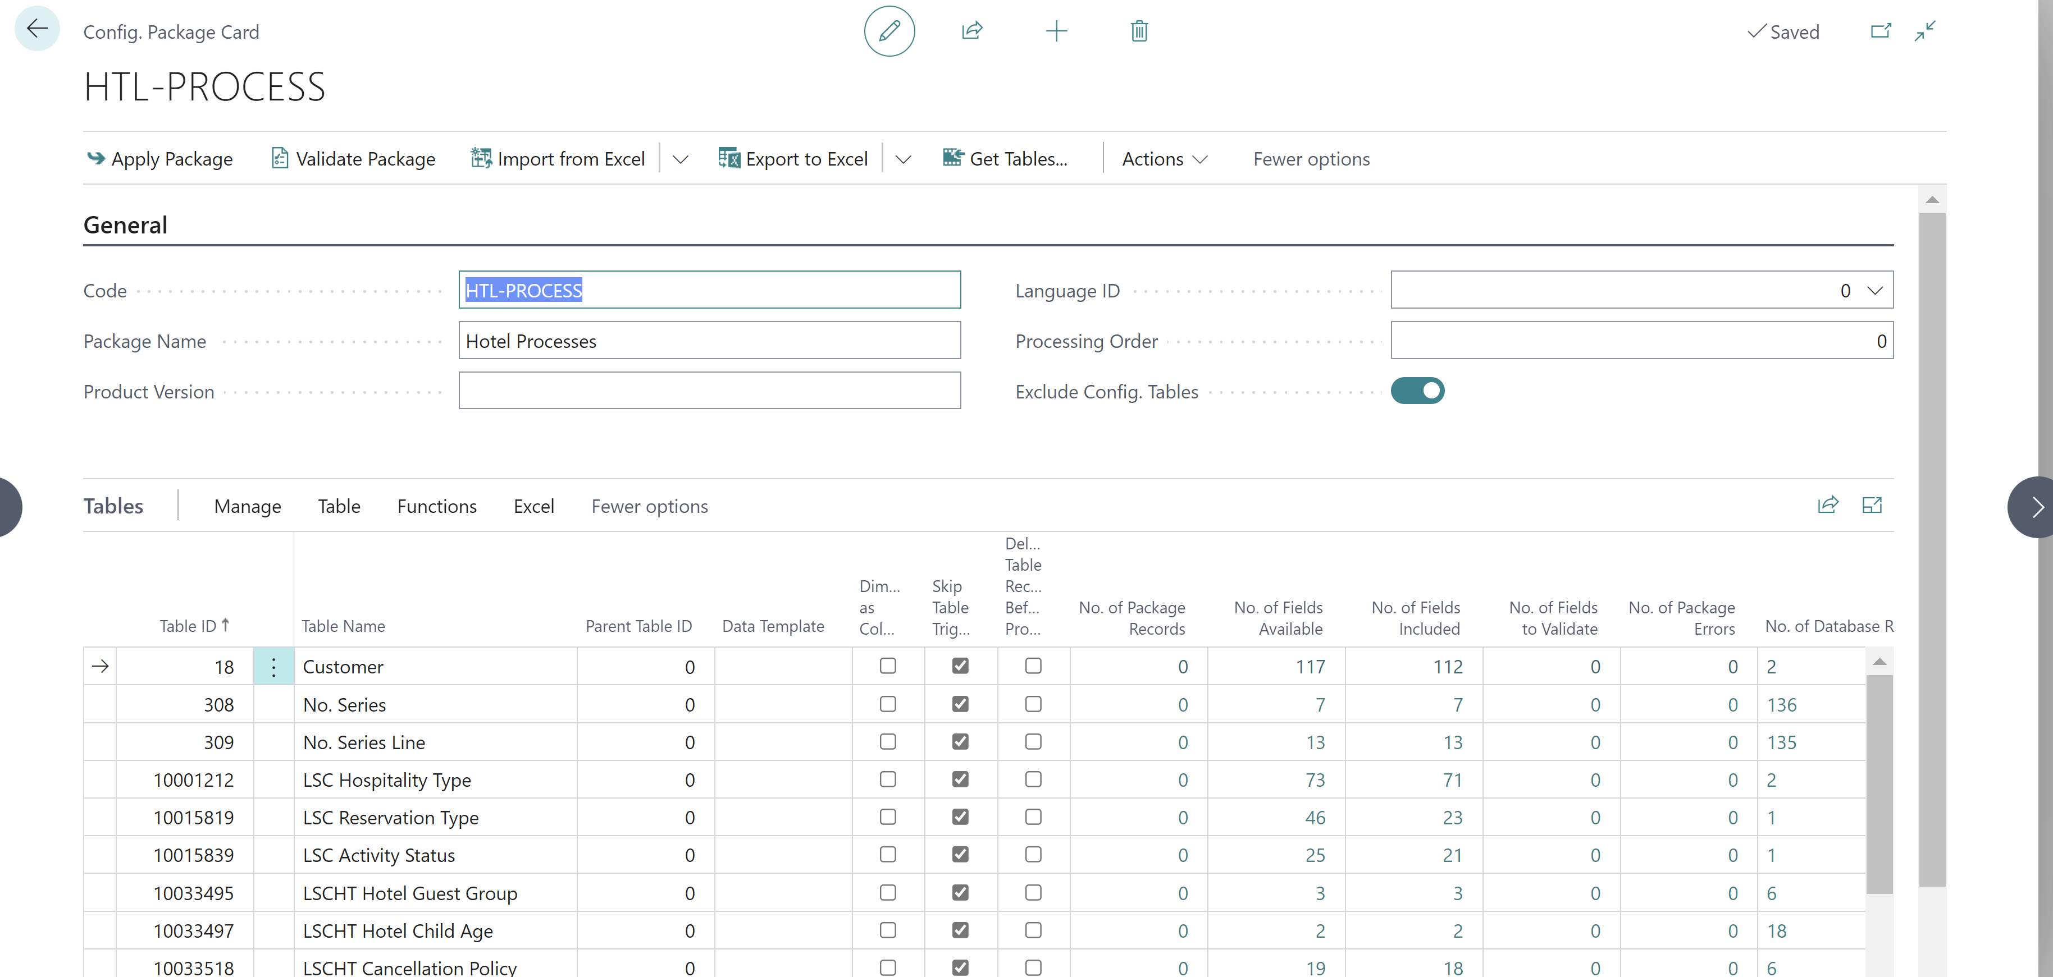
Why configuration packages?
Configuration worksheets & configuration packages
Worksheets are good as checklists
Packages great for multiple tables
Ultimately gives you the same
Easily import data
Extremely useful on a day-to-day maintenance
Even to correct faulty data or errors

Slide 6
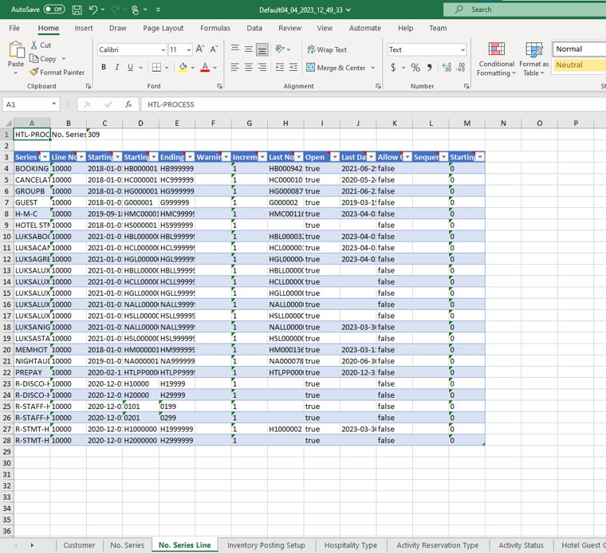
Why configuration packages?
The challenges
The amount of Data
Validation for good and for bad
Number series
The logic stays with the user
You should know Excel!
Vital for collecting and refining data
Excellent in combining data for BC
Brilliant in manipulating data
Garbage in, garbage out

Slide 7

The benefits of using configuration packages
Packages can work with templates when creating Master data
The validation process secures data integrity
Maintain strict data structure and it is useful!
LS Retail uses it for recreating the demo company with every release.

Slide 8

Configuration packages for Hotels
LS Retail development team provided packages when developing the solution
Opportunity to ease up implementation process
Resulting in easier, simpler faster configurations

Slide 9
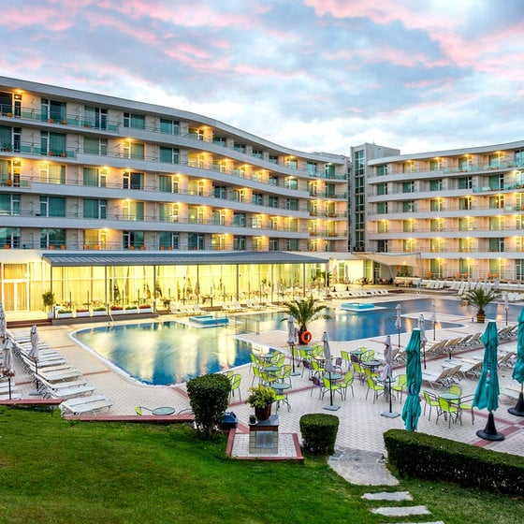
Fitting for all customers?
Fits to majority of hotel customers
Preparation effort can depend on a few factors
Adjustment needed for customers:
Running multi property hotels
Highly customized solutions
Complex rate codes

Slide 10

Package process
Before starting to apply the packages following needs to be done:
Business Central setup
Chart of account
Posting setup
LS Central setup
Retail setup
Items
Income/Expense accounts

Slide 11
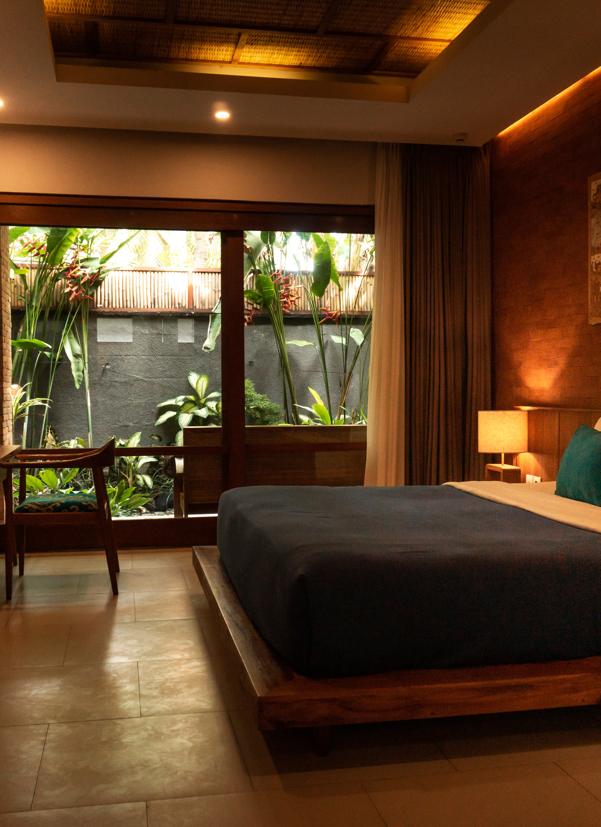
Packages
HOTELWEBTEMPLATES
POS reservation view and start up controller
HTL-FOUNDATION
POS Menu profiles
POS Interface profiles
POS Functionality profiles

Slide 12

Packages
HTL-PROPERTY
Location
Hotel setup
Store setup
Terminals
Etc.
HTL-PROCESS
BC based data
No. series
Tender types
Member management
Etc.

Slide 13
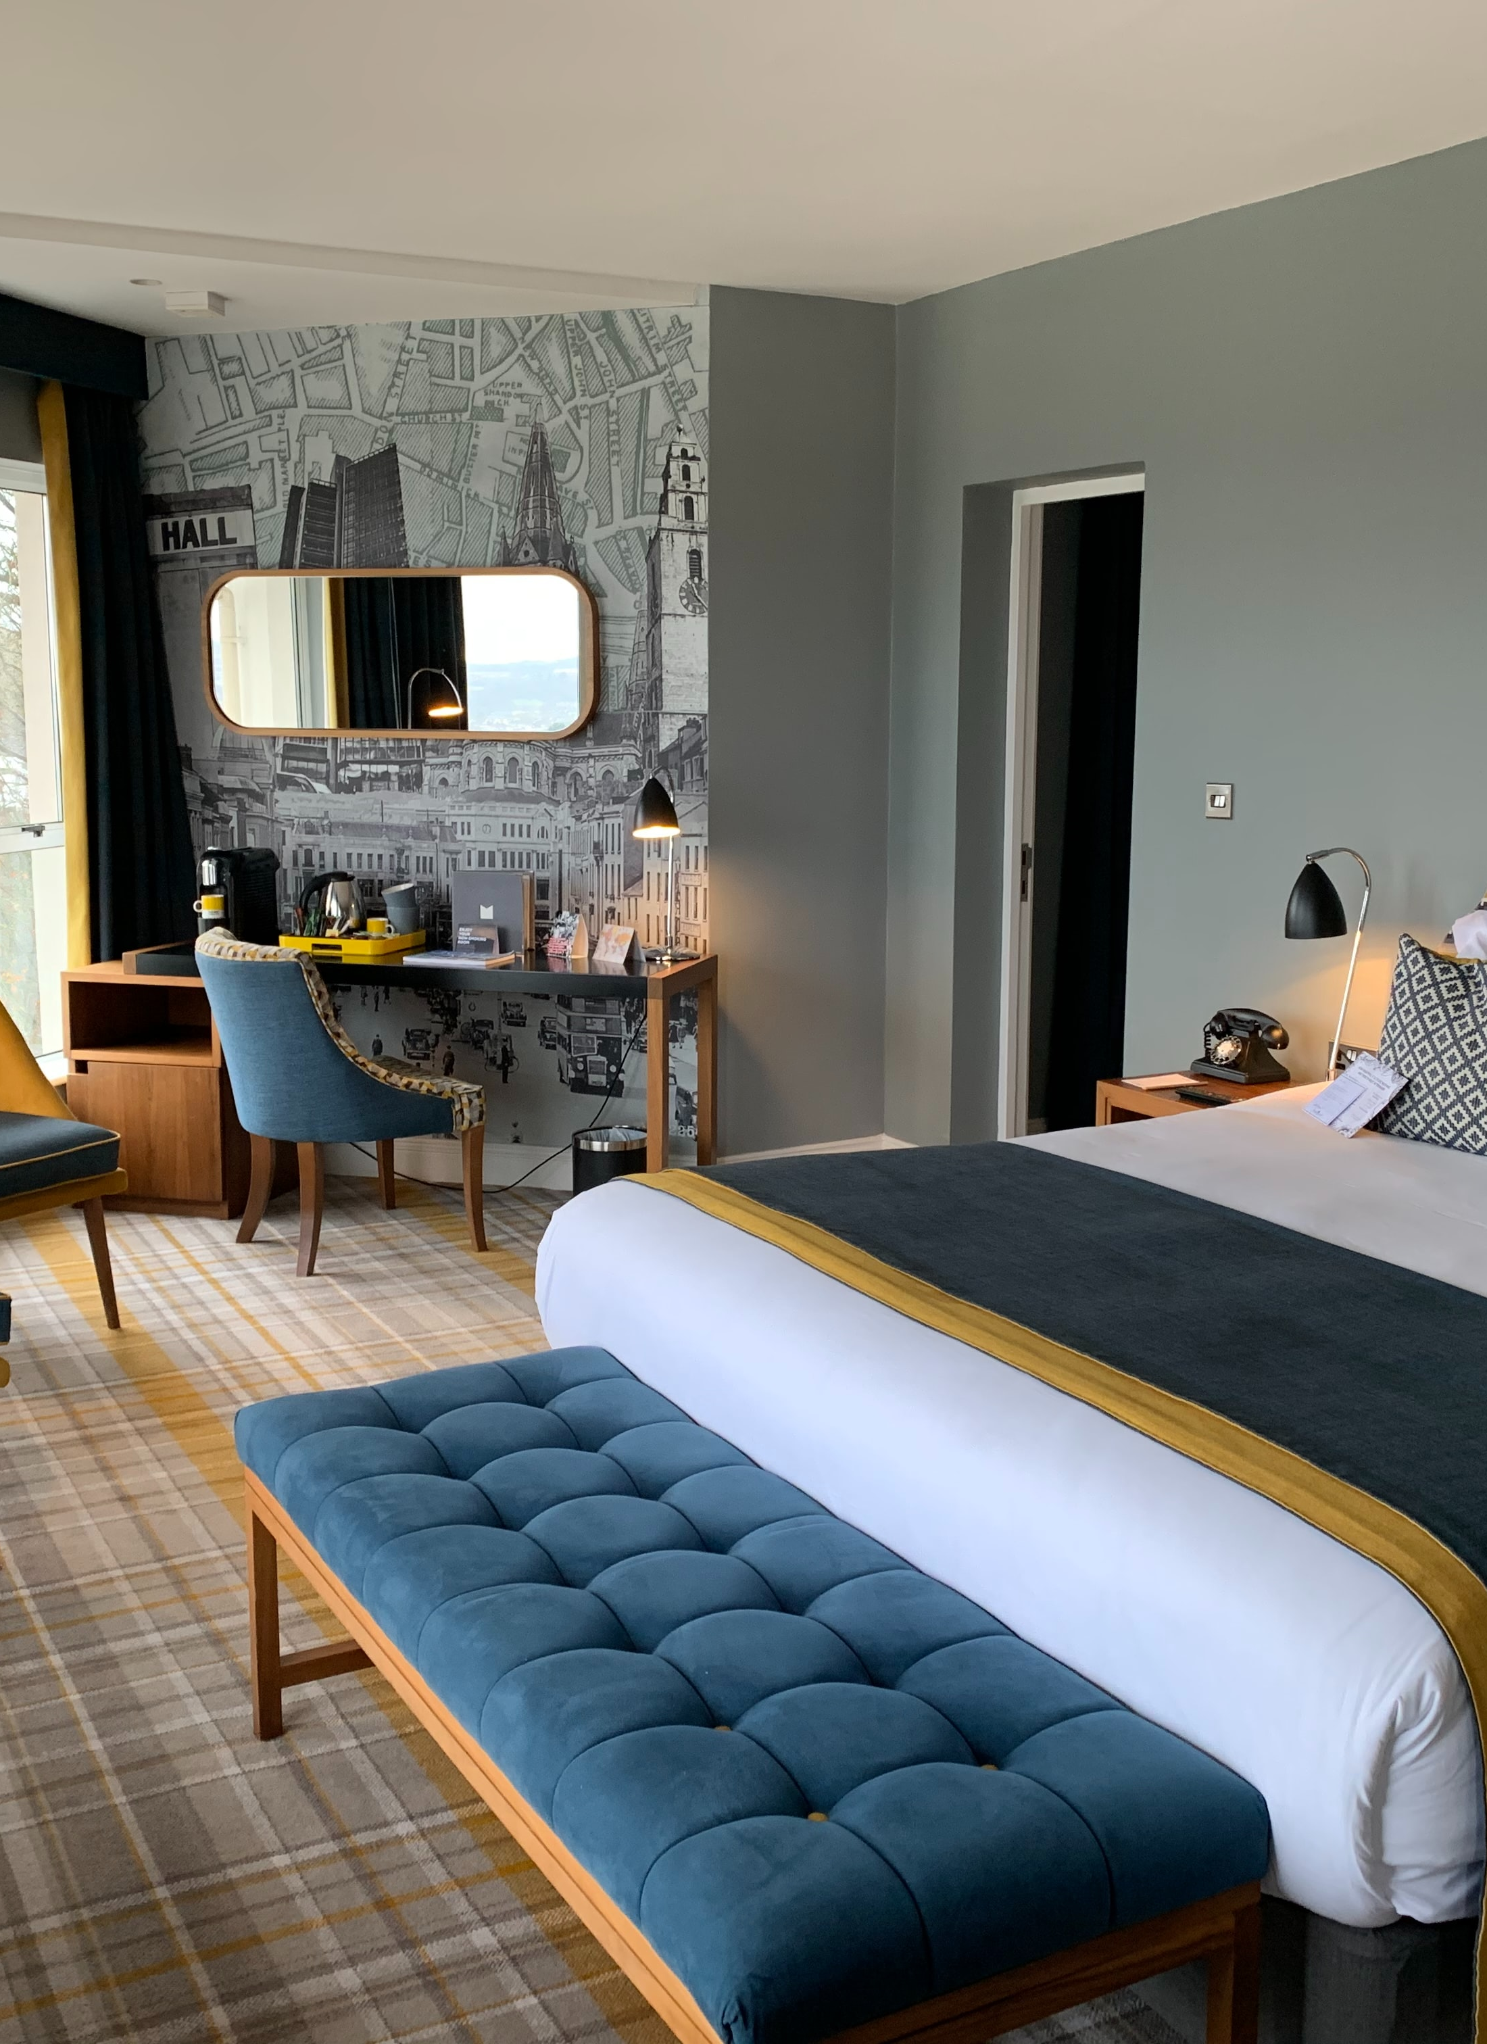
Packages
HTL-INVENTORY
Room Types
Rooms
Etc.
HTL-RATES
Rate codes
Rate code lines
HTL-STAGING
Importing tool

Slide 14
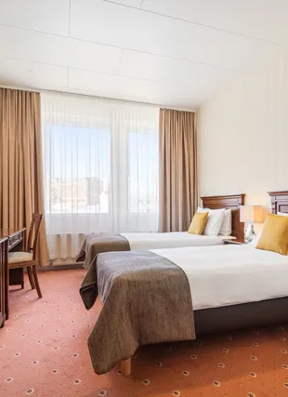

Hótel Ísland - Iceland
Implementation done in 4 weeks
High level analysis & design
Configurations done with packages
Testing
Training
Integration
Migration
Go Live
Going live live 30th of May
SaaS implementation

Slide 15
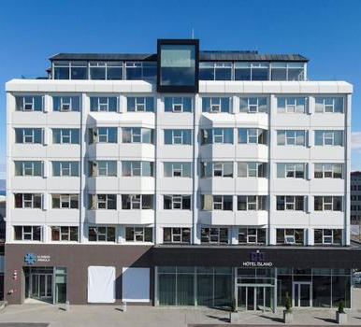

Hótel Ísland - Iceland
“We were quickly drawn to the idea of being able to connect all different part of our business in one platform”
How is it going?
Proof of concept project for this approach
One property with only hotel module
Aim on roll out to other properties and implementing other modules

Slide 16
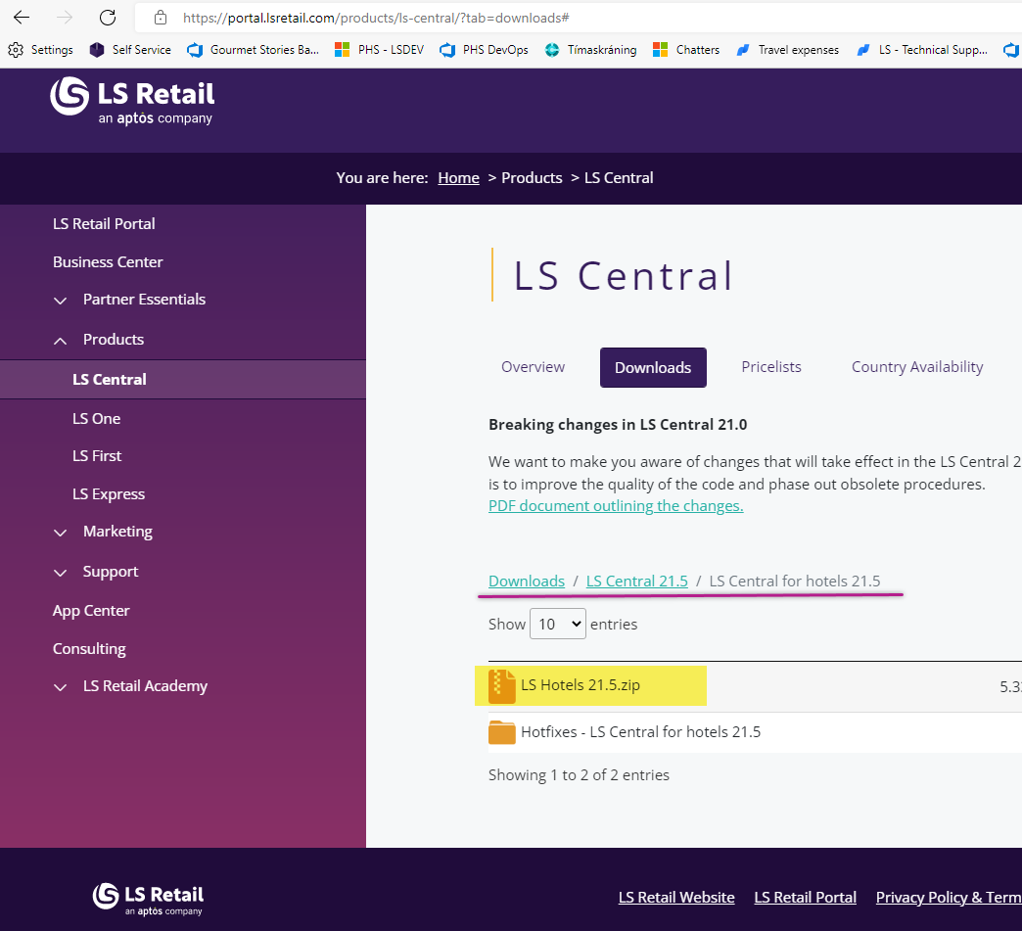
Tool for partners
Accessible on the LS Retail partner portal
Same approach being investigated for other modules:
LS Central for retail
Bookings for LS Central
LS Central for restaurants
Etc.

Slide 17
Thank you

