Slide 2

Matthias Matthiasson
LS Central SaaS
Offline POS in-cloud (Hybrid Cloud)
Product Director
matti@lsretail.com

Slide 3










Project management
Retail
Financial management
Operations management
Hospitality
Omni
Sales & service management
Reporting & analytics
Supply chain management

Slide 4
What is included in LS Central SaaS?
Project management
Hosted applications/apps
Business Central
LS Central
Base functionality
Activity (LS Central 16.0)
Staff Management (LS Central 16.0)
eCommerce*
Mobile Inventory App*
Mobile POS App*
* Customer hosted Omni Server
Retail
Financial management
Operations management
Hospitality
Omni
Sales & service management
Reporting & analytics
Supply chain management

Slide 5


















LS Central SaaS country availability
Denmark (DK)
Great Britain (GB)
South Africa (ZA)
Available now
Iceland (IS)
Canada (CA)
United States (US)
Finland (FI)
Philippines (PH)
Germany (DE)
Singapore (SG)
Australia (AU)
New Zealand (NZ)
Sweden (SE)
Available soon
Hong Kong (HK)
Norway (NO)
UAE (AE)
Mexico (MX)
Spain (ES)
More information: https://portal.lsretail.com/Products/LS-Nav/Downloads/Localization

Slide 6
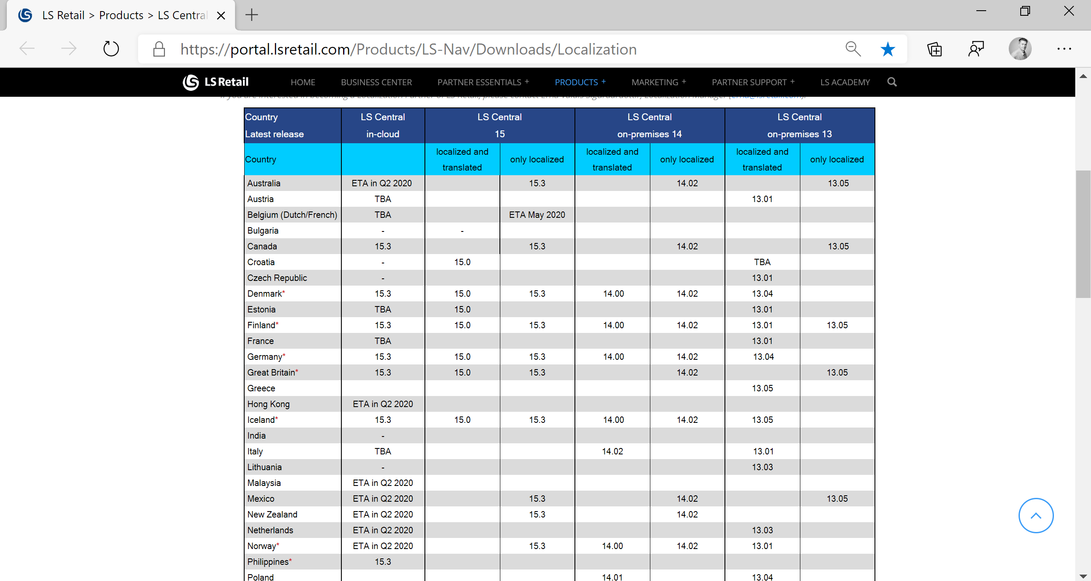
https://portal.lsretail.com/Products/LS-Nav/Downloads/Localization

Slide 7



LS Central SaaS Architecture
Head Office in cloud
Hybrid Cloud
Component Server *
Offline Store Server
Online POS
Offline POS
Online or Offline POS with store server
Hosted by customer in
Azure or on prem

Slide 8
LS Central Offline POS licenses
Head Office in-cloud
Needed for offline POS:
Retail device subscription (CSP) - Dual rights license (flf) for the offline POS (MS Partner Source)
The Offline Store SKU subscription – - Data Director license file (LS Retail)
Hybrid Cloud Component Server comes with the solution free of charge
Hybrid Cloud
Component
Server
Offline POS

Slide 9
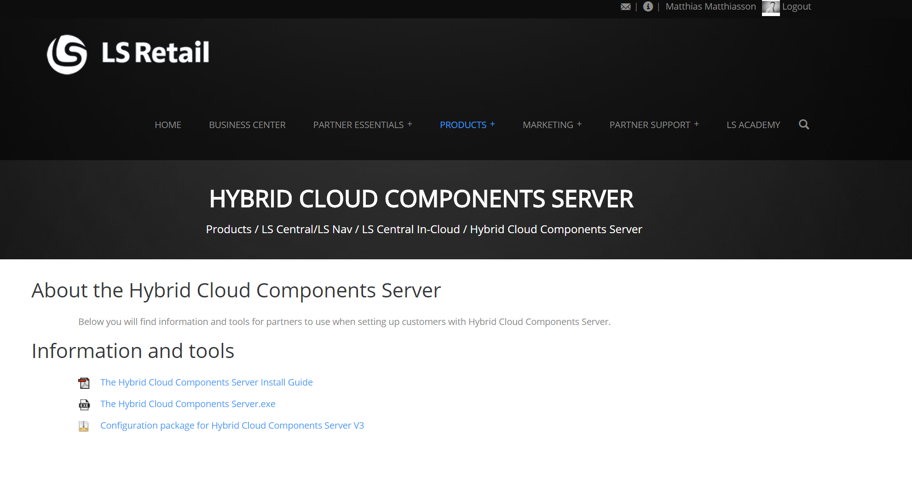
Install Hybrid Cloud Component Server (HCCS)
Install Hybrid Cloud Components Server
GoCurrent installer
Fetches needed apps from LS Retail GoCurrent Server

Slide 10
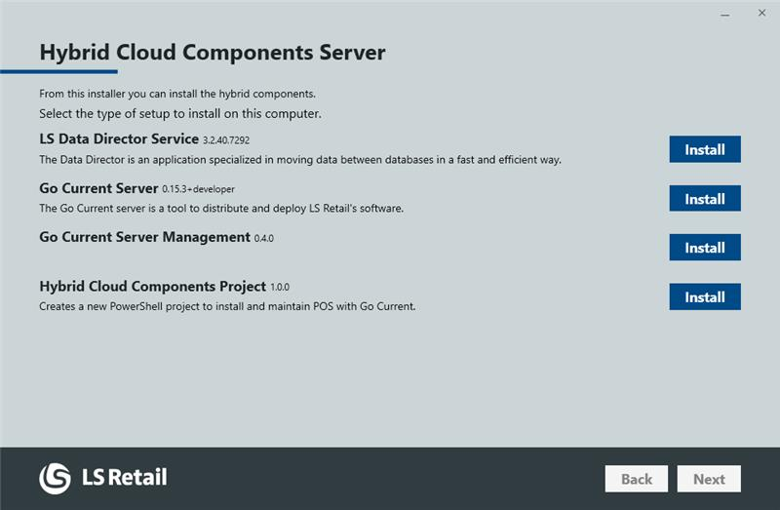
Install HCCS
Will install
Business Central
Services Tier
SQL (POSMaster)
GoCurrent
Data Director

Slide 11
Install HCCS
HCCS is not part of the LS Central SaaS hosting service
HCCS is installed and maintained by customer (retailer)
HCCS can be hosted:
Virtual Machine in the cloud (ex: Azure)
Customer Head Office environment
Head Office in-cloud
Hybrid Cloud
Component
Server
Offline POS

Slide 12
Data to POSMaster
Setup all needed data in Head Office database
Get replication setup (HCC_JOBSYNC)
HCC_JOBSYNC is inserted into the empty SQL database by the install process
Fetches distribution locations, jobs and sub-jobs
Run initial replication job (HCC_INIT)
Normal replication job
Fetches all data
HCCS Scheduler replicates changes (HCC_UPDATE )
Fetches pre-actions from Head Office database (normal job)
Replicates data by pre-actions
Head Office in-cloud
Hybrid Cloud
Component
Server
Offline POS

Slide 13
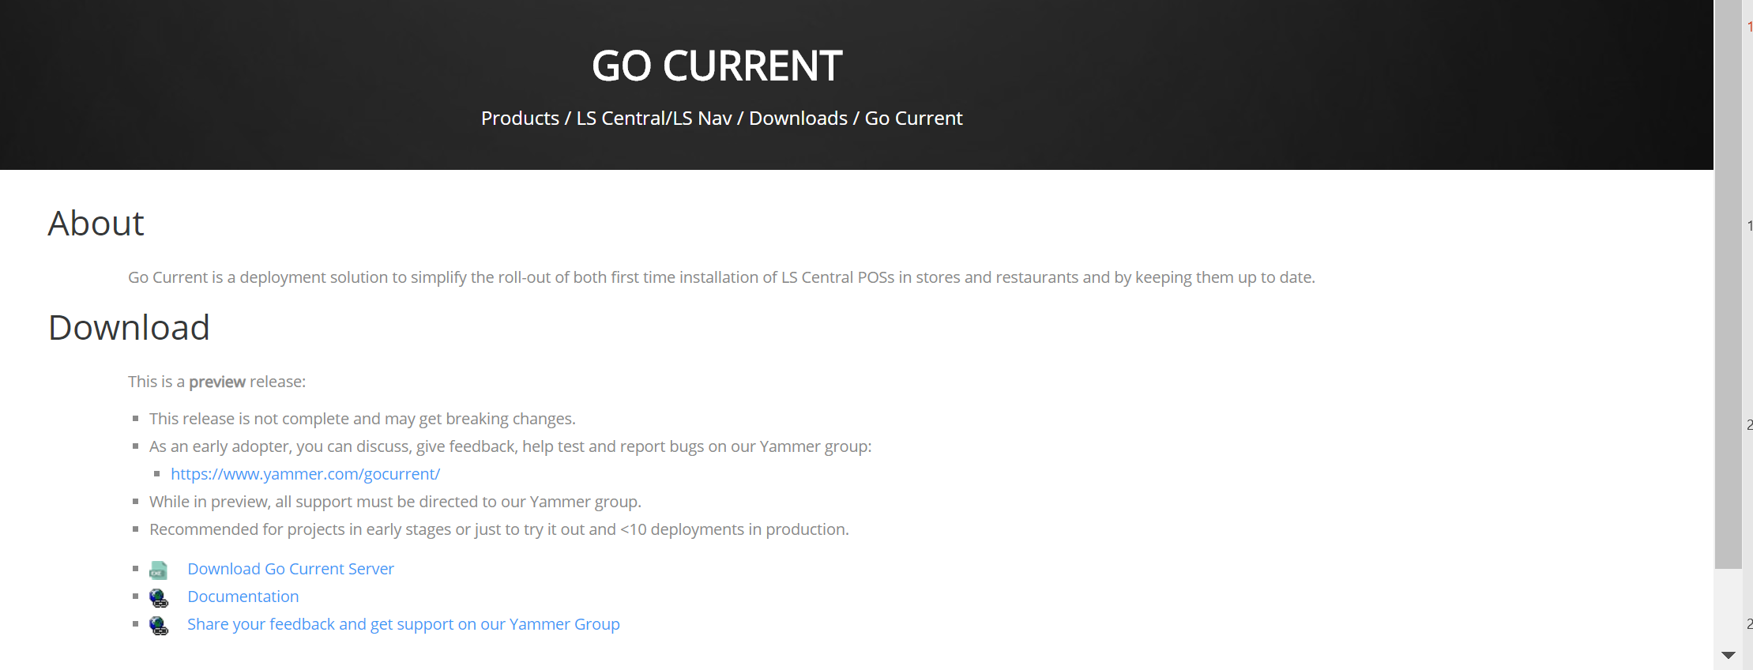
Install Offline POS
GoCurrent used to install all offline POS
HCCS GoCurrent holds POS configuration
Default offline POS configuration included in HCCS install
Partner can customize configuration as needed
Add AL extensions for POS
Get more information on
GoCurrent on LS Retail Portal Link to Portal
Create POS Master database for in GoCurrent for offline POS
Create a GoCurrent package
Head Office in-cloud
Hybrid Cloud
Component
Server
Offline POS

Slide 14
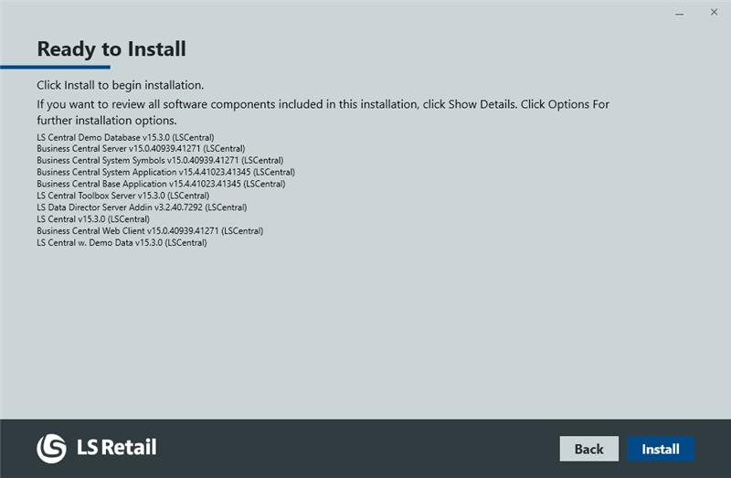
Install Offline POS
Offline POS GoCurrent installer will install:
SQL and POSMaster Database
Business Central
Environment and Apps
LS Central Apps
LS Central Toolbox
LS Data Director
BC Modern Client
LS Central AppShell
Any other configuration specified
Head Office in-cloud
Hybrid Cloud
Component
Server
Offline POS

Slide 15
Upgrade offline POS environment
Head Office in-cloud
Upgrade frequency decided by customer
Would most likely not be as frequent as cloud instance (ex: 6-month interval)
Can be done in batches
All configurations done in HCCS GoCurrent instance
GoCurrent can be used to upgrade
Extensions
SQL executables and data upgrade
Business Central executables
LS Central
Apps / Hardware Station / Toolbox
Hardware OPOS drivers
Hybrid Cloud
Component
Server
Offline POS

Slide 16


HCCS GoCurrent
LS Retail GoCurrent Server
LS Central 15.3
Customers HCCS GoCurrent Server
LS Central 15.3
Offline POS
Device
LS Central 15.3
LS Central 15.3
LS Central 15.3

Slide 17

HCCS GoCurrent
LS Retail GoCurrent Server
LS Central 15.3
LS Central 16.0
Customers HCCS GoCurrent Server
LS Central 15.3
Offline POS
Device
LS Central 15.3
LS Central 15.3
LS Central 15.3

Slide 18
HCCS GoCurrent
LS Retail GoCurrent Server
LS Central 15.3
LS Central 16.0
Customers HCCS GoCurrent Server
LS Central 15.3
LS Central 16.0
Offline POS
Device
LS Central 15.3
LS Central 15.3
LS Central 15.3

Slide 19
HCCS GoCurrent
LS Retail GoCurrent Server
LS Central 15.3
LS Central 16.0
Customers HCCS GoCurrent Server
LS Central 15.3
LS Central 16.0
Offline POS
Device
LS Central 15.3
LS Central 15.3
LS Central 16.0

Slide 20
HCCS GoCurrent
LS Retail GoCurrent Server
LS Central 15.3
LS Central 16.0
Customers HCCS GoCurrent Server
LS Central 15.3
LS Central 16.0
Offline POS
Device
LS Central 16.0
LS Central 16.0
LS Central 16.0

Slide 21
Data to Offline POS
Head Office in-cloud
HCCS scheduler replicates changes to the Offline POS using pre-actions (HCC_UPDATE_TO_POS)
Hybrid Cloud
Component
Server
Offline POS
Offline POS
Offline POS
Offline POS
Offline POS

Slide 22
Data from Offline POS
Head Office in-cloud
Transaction sent with webservice replication at end of transaction posting
Hybrid Cloud
Component
Server
Offline POS

Slide 23


Omni Service
Head Office in-cloud
Omni Server can be hosted on HCCS
External
eCommerce
Mobile Loyalty Apps
Internal
Mobile Inventory App
Mobile POS App
Hosting as an Azure App Service
eCommerce
Hybrid Cloud
Component
Server
External Omni
Server
Internal
Omni
Server
Offline POS
Mobile Inventory
Mobile POS

Slide 24
x
Onboarding Specialist “buddy”
LS Retail development has created a “buddy” program
The intention is to resolve in-cloud related technical issues for partners with go-live in-cloud projects
The “buddy” will act as a liaison between the partner and the development teams to resolve these issues
Contact your partner manager about enrolment in the program

Slide 25
x
Hybrid Cloud Component Server Release
Released in version LS Central 15.3
Currently only available for partners participating in the Hybrid Cloud release program
LS Retail development teams gives additional support to partners that have a go live projects in-cloud with offline POS
Please contact me if you need further information

Slide 26
x
Simple and standard processes
Setup
Implementation
Maintenance
Of
Hybrid Cloud Component Server
Offline POS devices

Slide 27
matti@lsretail.com

