Slide 1

Microsoft Keynote
Mike Morton
Vice President, SMB Business Applications
Microsoft

Slide 2







Dynamics 365 Business Central offerings
Connects sales, service, finance, and operations teams in a single SMB optimized solution
to help them adapt faster, work smarter, and deliver results.
Financial Management
Project Management
Sales
Management
Manufacturing Management
Reporting &
business insights
Service Management
Supply chain Management

Slide 3

What SMB customers value when choosing an ERP
Core functionality
Finance, supply chain management
Ease and speed of implementation
Business is changing faster than ever and SMBs need agility
Collaboration and productivity
The lines between productivity, communication,
and business applications are blurring
Reliability, performance, security,
compliance, and scale

Slide 4
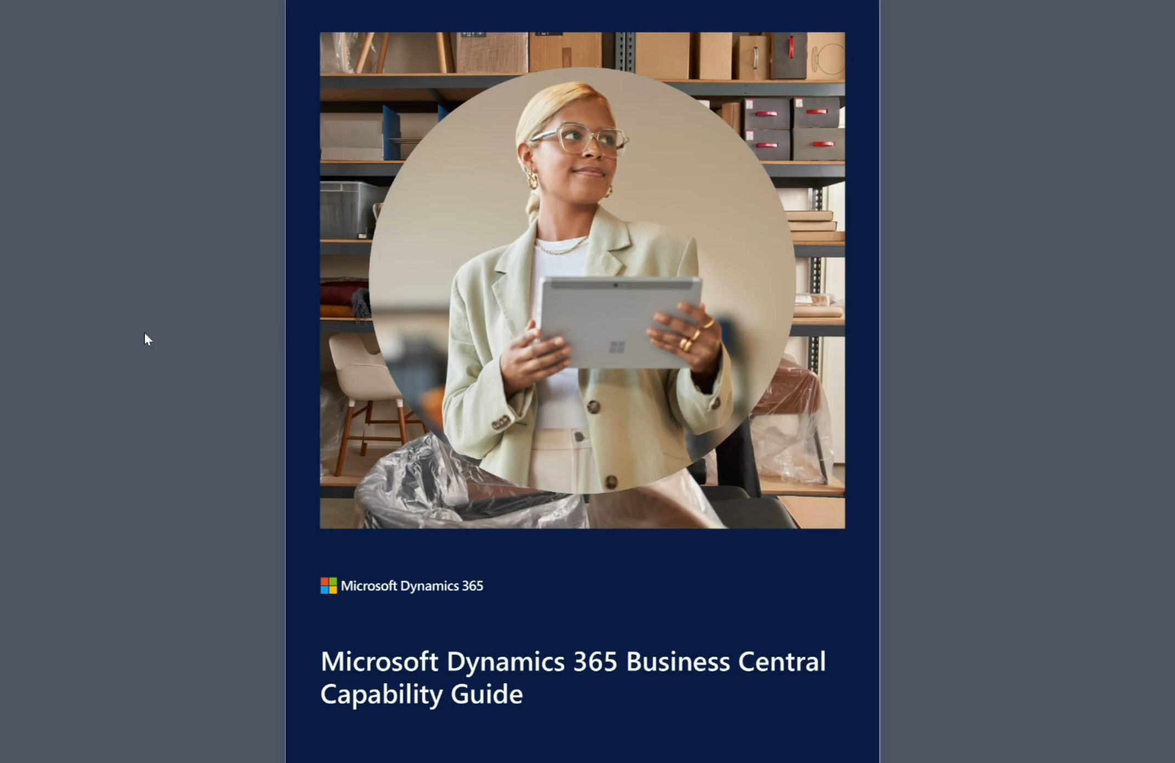
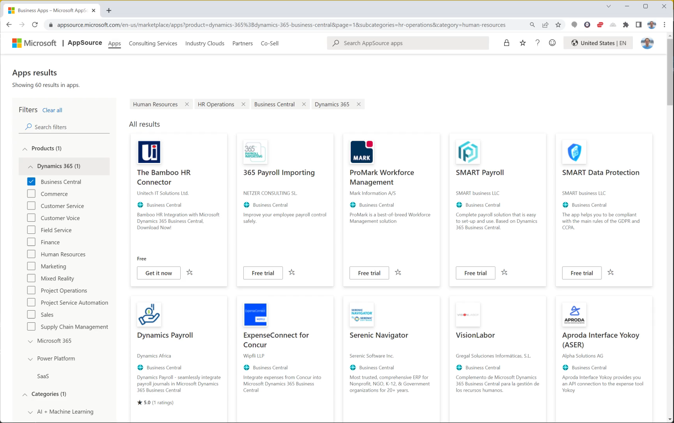
Business Central differentiation: core functionality
Global core ERP capabilities in the SMB segment without customization through a unique combination of built-in features and rich ISV ecosystem
High quality core functionality for finance, sales,
service, supply chain, projects, and operations
aka.ms/BCcapabilities
Unmatched ecosystem with geographic
and industry specific solutions
Seamless experience with consistent UX,
one bill via a Dynamics 365 partner,
and app management via AppSource

Slide 5


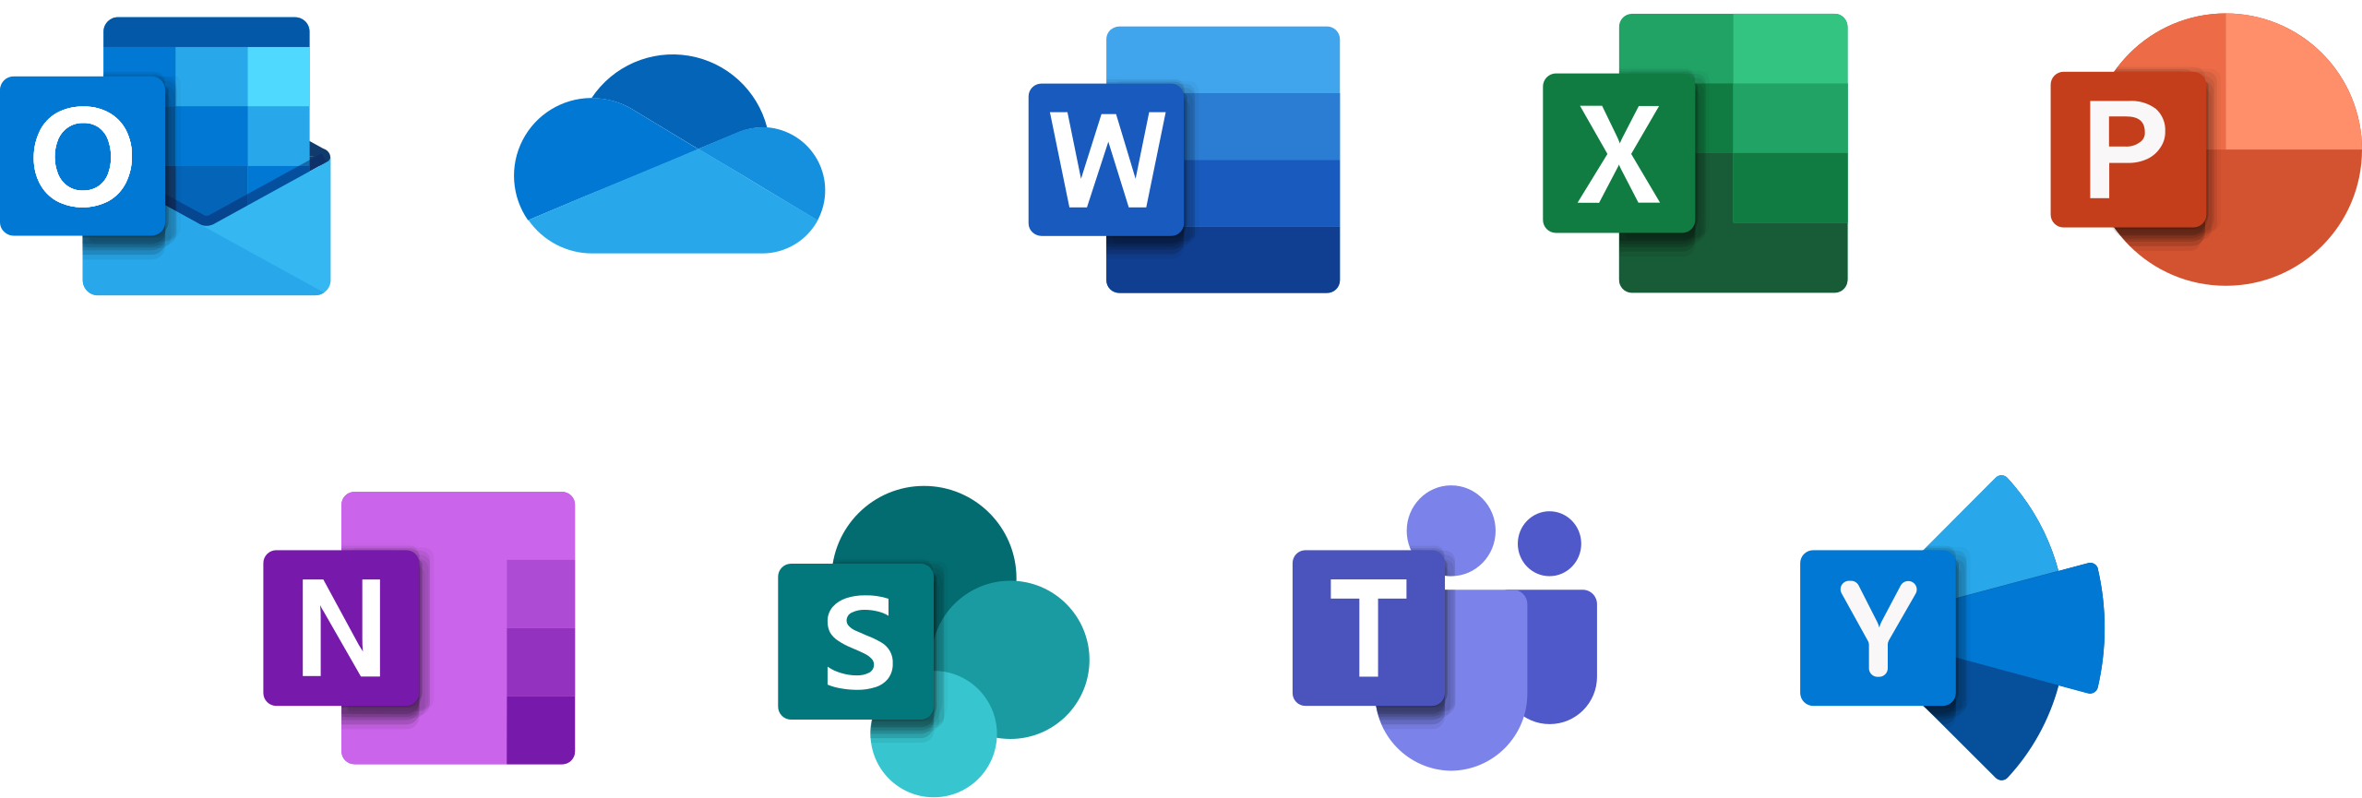
Business Central differentiation: collaboration and productivity
Unmatched experiences built on the broad Microsoft ecosystem
Microsoft 365
Business Central
Power Platform
Microsoft Dynamics 365 Copilot

Slide 6















Business Central Differentiation: reliability, performance, and scale
The best cloud platform for ERP
Performance
and scale
Security
40+ microservices
21 Azure regions
Business continuity
and disaster recovery
Compliance
Learn more: aka.ms/BCsecurity & aka.ms/BCcompliance

Slide 7


Business Central differentiation: ease and speed of implementation
Implementations are often measured in weeks, not years. Onboarding efforts include:
Customer interview
Teaching tips,
tours, spotlights
Partner
specific trial
Getting started checklist
Management
API
Onboarding
framework
https://aka.ms/
BConboarding
Configuration questionnaire
Configuration
packages
Manual
setup
Assisted
setup wizards

Slide 8
Core functionality
Collaboration
and productivity
Finance
Use statistical accounts to collect data
for financial reports
Review general ledger accounts faster
Do data analysis inside Business Central
Sync master data management across companies
Enhanced Intercompany capabilities
Supply chain
Inventory enhancement
Warehouse enhancements
Shopify returns
Key tips
Drag and drop for file dialog
More compact adaptive cards​
Copilot - Marketing text suggestions
Security controls for Teams cards​
Simplified setup of Power Automate
New Power Automate templates with multiple choices
Use Power Automate inside Business Central
More document approval workflows
Simplified for environments and companies

Slide 9

Inventory and warehouse
Undo transfer shipments
Define content of
created warehouse
documents with filters
Define invoice posting policy for various users
Add more columns through personalization to gain more insight on more pages
Post multiple transfer orders at the same time
Use advanced
warehouse functionality
with minimal complexity
Set default dimensions on locations, inventory documents, and journals
Usability improves for item tracking codes: visibility, creation of new entries
Easier to create
opening balances for
item tracked inventory
Ship and receive
non-inventory items on
warehouse documents
Preview item journals and twenty other journals and documents before posting
Synchronize returns,
refunds from Shopify

Slide 10
Dynamics 365 Business Central
2023 release wave 2 investment areas
Core
ERP
Collaboration
and productivity
Ease and speed
of implementation
Performance
and scale
Finance
  Multi-company
  G/L
  A/R & A/P
  Regulatory
Reporting
  Out-of-the box Power BI App
  Analysis Mode
  Report Explorer
  Enable Developers
Supply chain
  Improved picking process
  SKU management
  Fulfillment suggestions
  Improved Warehouse Management for jobs and manufacturing
Generative AI
  Marketing Text
  Platform Support
  And more to come…
Teams & Office Integration
  Teams
  Outlook
Power Platform
  Power Automate
  Power Apps
  Dataverse
Geographic expansion
  Andorra
  Armenia
  Azerbaijan
  Bahamas
  Bermuda
  Bolivia
  British Virgin Islands
  Cambodia
  Cameroon
  Cayman Islands
  Ethiopia
  Fiji
  Ghana
  Guernsey
  (United Kingdom)
  Isle of Man
  (United Kingdom)
  Jersey (United Kingdom)
  Kazakhstan
  Kosovo
  Liechtenstein
  Macao (SAR China)
  Madagascar
  Malawi
  Mozambique
  Namibia
  Nepal
  San Marino
  Sao Tome & Principe
  Senegal
  Tanzania
  Uganda
  Zambia
Fundamentals
  Performance
  Reliability
  Tooling
Efficient Development
  Connected experience
  AppSource Monetization
  AL Go and DevOps in GitHub
  Efficient Troubleshooting
Administration
  Access Control
  App Management
  Migrations
User experience
  Action bar
  Navigation
  Drag and Drop
  Search
  Error handling
  Time Sheets
  Onboarding
  User Assistance
  Cloud Connectivity
  Setup
October 2023
April 2024
October 2024

Slide 11
Microsoft Cloud
Runs on trust
Your data is your data
Your data from any fine-tuning is not
used to train the foundation AI models
Your data is protected by the most comprehensive enterprise compliance
and security controls

Slide 12
Leader in AI and Business Applications
Others demo generative AI capabilities in their solutions – Microsoft has durable advantages.
1
2
3
4
Undisputed
leader in
generative AI
AI across
the Microsoft portfolio
First mover &
self-reinforcing ecosystem
Compliance
and data
boundaries
Microsoft is the premier and primary partner of OpenAI, the undisputed leader in generative AI. This allows us early access to new models, custom tuning of models, and optimized infrastructure (Azure AI super computing scale).
Customers running Microsoft 365, Teams, SharePoint, LinkedIn, Dynamics 365, etc. will have the broadest access to data that can be used as context/prompting with foundation models.
Training based on a large corpus of company specific terminology, language, culture, communication style, etc.
Borderless User Experiences that span productivity, communications, business app, and developer tools
Microsoft saw the promise of this technology back in 2019
when we made the first
OpenAI investment, and we have been shipping innovation since early 2021. AI is a
self-reinforcing ecosystem, where greater usage results in better models.
Other companies will have to work third party services. Microsoft will ensure:
Data stays within Microsoft ecosystem – Many customers will not accept their data
being sent to third parties.
Data boundaries – Data stays within promised data boundaries (e.g., data in Germany stay in Germany, Government clouds, European Union Data Boundary (EUDB), etc.), including information staying within the company.

Slide 13
Thank you

