Slide 3

Replenishment
for LS Central
what’s new
Martin Kleindl
Product Director
Martin.Kleindl@LSRetail.com

Slide 4


Slide 5
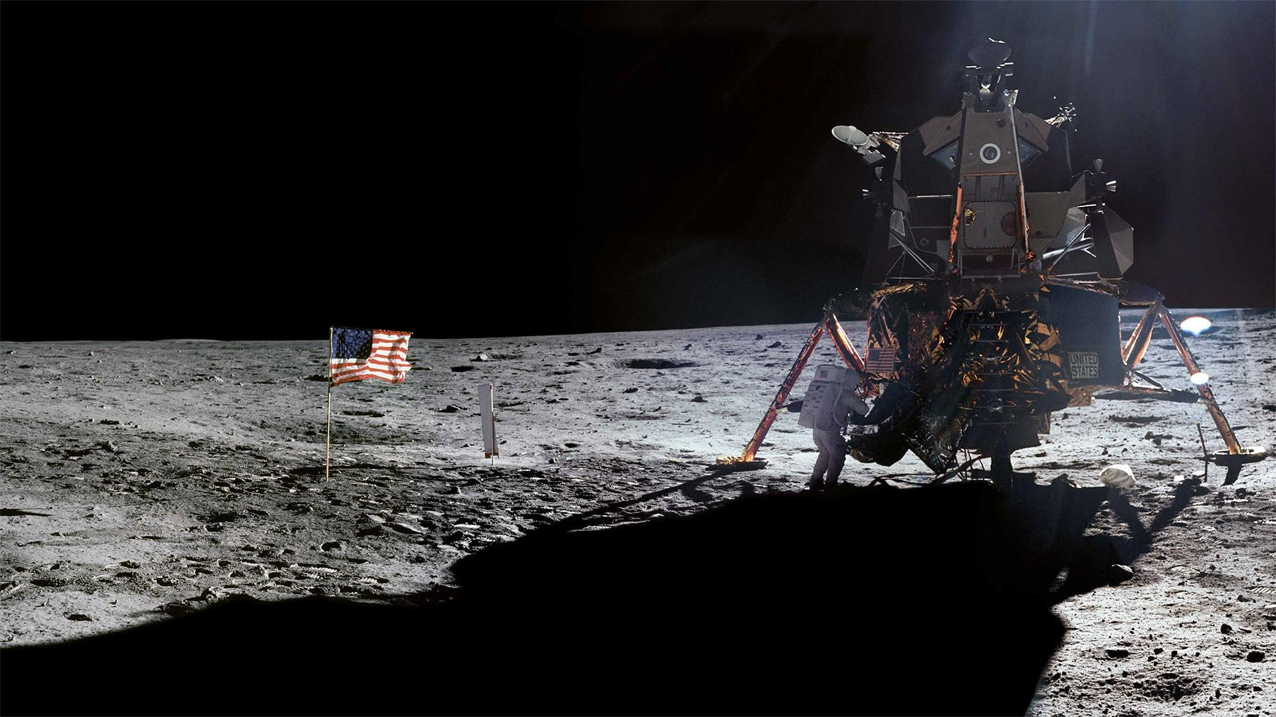
“HOUSTON”
WAS THE FIRST WORD
SPOKEN FROM THE MOON
Astronaut Neil Armstrong clearly said upon landing on the moon: “Houston, Tranquility Base here, the Eagle has landed.”

Slide 6
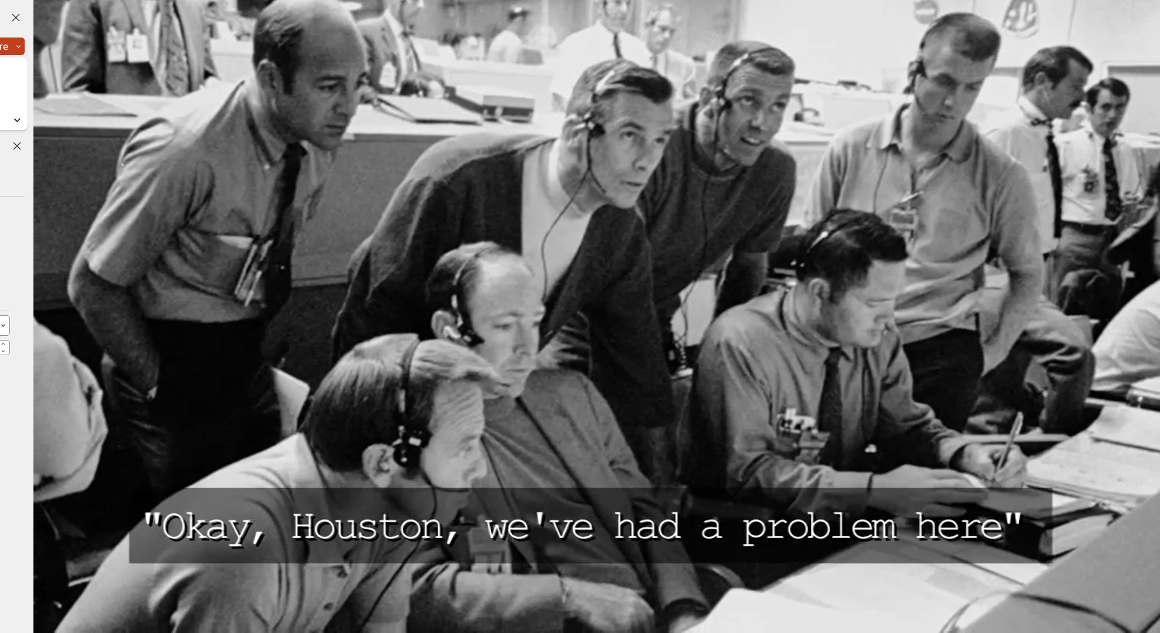

Slide 7
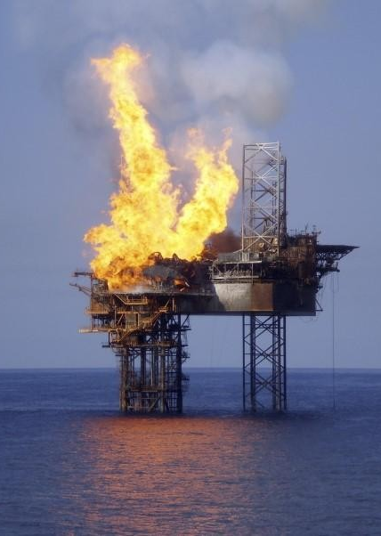

Burning platform
SaaS customer
Cosmetics
100 Stores/Locations
18.000 Items
Approx. 27.000 POS Transaction lines / day
Replen. calculation: OOS, RIQ + Journals
Replenishment calculation
7 (seven!!) hours

Slide 8

Replenishment - Performance
Basic Replenishment process
Out of Stock Calculation
Replen. Item Quantity Calculation
Replen. Journal Calculation
Detect current OOS situations
Calculate current stock situation
Calculate historical sales performance
Calculate demand
Calculate proposals for Purchase or Transfer

Slide 9
Replenishment - Performance
Basic Replenishment process
Out of Stock Calculation
Replen. Item Quantity Calculation
Replen. Journal Calculation
Detect current OOS situations
Calculate current stock situation
Calculate historical sales performance
Calculate demand
Calculate proposals for Purchase or Transfer

Slide 10



Parallel calculation
Existing flow (with NAS)
Master Scheduling Job Linked Scheduler Jobs
(run by NAS)
CU 10012221
“LSC Replen. Parallel Master”
CU 10012200
“LSC Replen.
Calc. Qtys”
On-premise
Assigns
next check
date/time
New flow (without NAS, but Background sessions)
Master Scheduling Job Linked Scheduler Jobs
CU 10012214
“LSC Replen. Parl. Master SaaS”
CU 99001467
“LSC Scheduler Util”
Cloud
Starts
background
sessions
On-premise
CU 10012200
“LSC Replen.
Calc. Qtys”

Slide 11




Parallel Replenishment Calculation Tests in SaaS
Test Environment
Performance Test Results:
Items: 10.000
Locations: 50
ILE records: 36 Mio.
Replenishment Calculation | Baseline Calc. Time | 10 Parallel Calc. Time | Improvement
RIQ | 4 hours 3 mins | 38 mins | 84.50 %
OOS | 6 hours 25 mins | 1 hour 18 mins | 79.08 %
Calculated Entries
RIQ entries: 523.315
OOS entries: 5,6 Mio.

Slide 12

Parallel Replenishment Calculation Tests in SaaS
Test Environment
Performance Test Results:
Items: 10.000
Locations: 50
ILE records: 36 Mio.
Replenishment Calculation | Baseline Calc. Time | 10 Parallel Calc. Time | Improvement
RIQ | 4 hours 3 mins | 38 mins | 84.50 %
OOS | 6 hours 25 mins | 1 hour 18 mins | 79.08 %
Calculated Entries
RIQ entries: 523.315
OOS entries: 5,6 Mio.

Slide 13
Replenishment - Performance
Basic Replenishment process
Out of Stock Calculation
Replen. Item Quantity Calculation
Replen. Journal Calculation
Detect current OOS situations
Calculate current stock situation
Calculate historical sales performance
Calculate demand
Calculate proposals for Purchase or Transfer

Slide 14
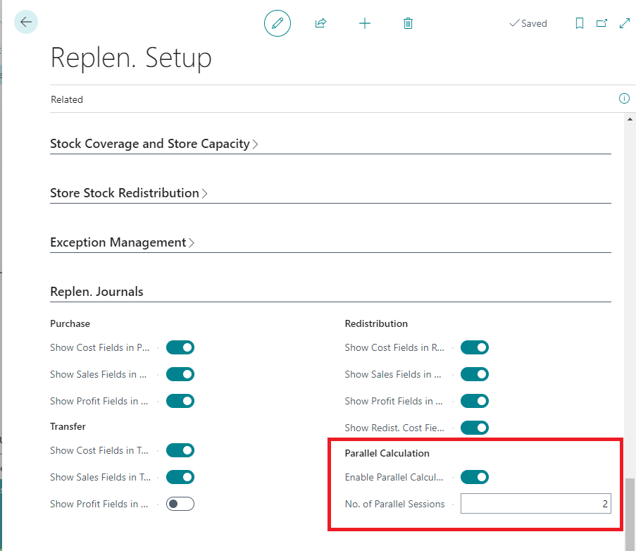
Replenishment - Performance
Replen. Journal Calculation
Code optimizations
Usage of TempTables and flush late in code
Parallel calculation

Slide 15


Parallel Replenishment Journal Calculation
Calculate
Journal
Replen. Journal
Lines
Child Journal 1
Background session
50 Items (1001.. 1050)
Replen. Journal
100 Items
(1001..1100)
2 Parallel sessions
Item No. | Location Code
1001 | S0001
1051 | S0001
Child Journal 2
Background session
50 Items (1051.. 1100)

Slide 16
Parallel Replenishment Journal Calculation
Replen. Journal
Lines
Child Journal 1
Background session
50 Items (1001.. 1050)
Replen. Journal
100 Items
(1001..1100)
2 Parallel sessions
Item No. | Location Code
1001 | S0001
1002 | S0001
1051 | S0001
1052 | S0001
Child Journal 2
Background session
50 Items (1051.. 1100)

Slide 17
Parallel Replenishment Journal Calculation
Replen. Journal
Lines
Child Journal 1
Background session
50 Items (1001.. 1050)
Replen. Journal
100 Items
(1001..1100)
2 Parallel sessions
Item No. | Location Code
1001 | S0001
1002 | S0001
1003 | S0001
1051 | S0001
1052 | S0001
1053 | S0001
Child Journal 2
Background session
50 Items (1051.. 1100)

Slide 18
Parallel Replenishment Journal Calculation
Replen. Journal
Lines
Child Journal 1
Background session
50 Items (1001.. 1050)
Replen. Journal
100 Items
(1001..1100)
2 Parallel sessions
Item No. | Location Code
1001 | S0001
1002 | S0001
1003 | S0001
1004 | S0001
1051 | S0001
1052 | S0001
1053 | S0001
1054 | S0001
Child Journal 2
Background session
50 Items (1051.. 1100)

Slide 19
Parallel Replenishment Journal Calculation
Replen. Journal
Lines
Child Journal 1
Background session
50 Items (1001.. 1050)
Replen. Journal
100 Items
(1001..1100)
2 Parallel sessions
Item No. | Location Code
1001 | S0001
1002 | S0001
1003 | S0001
1004 | S0001
1051 | S0001
1052 | S0001
1053 | S0001
1054 | S0001
Child Journal 2
Background session
50 Items (1051.. 1100)

Slide 20
Parallel Replenishment Journal Calculation
Replen. Journal
Lines
Replen. Journal
100 Items
(1001..1100)
2 Parallel sessions
Item No. | Location Code
1001 | S0001
1002 | S0001
1003 | S0001
1004 | S0001
1051 | S0001
1052 | S0001
1053 | S0001
1054 | S0001

Slide 21


Parallel Replenishment Journal Calculation
Performance Tests
Performance Test Results
Test Environment
No. of Parallel Sessions | Original Calc. Time (mins) | New Calc. Time (mins) | Improvement %
1 | 56 | 50 | 11%
2 | 56 | 26 | 54%
5 | 56 | 12 | 79%
10 | 56 | 10 | 82%
Items: 12.000
Locations: 50
Calculated Entries
Jrnl. Detail Lines: 600.000
Jrnl. Log Lines: ~8 Mio.
Duration: 56 minutes

Slide 22
Replenishment
Planning & Data Maintenance
Manual Replenish- ment
Automatic Replenish- ment
Execution
Monitoring
Sales & Purchase Budgets
Allocation
Plans
Buyer‘s Push,
Stock Recall
Allocation Rules
Variant Weight Dim. Pattern
Demand Forecasts
Store Stock
Redistribution
Purchase & Transfer
Orders
Stock Requisition
Buyer‘s Workbench
Inventory and Demand
Store
Capacity
Stock Coverage
Vendor Performance
Open to Buy
Assortment Mgmt.
Lifecycle Mgmt.
Replenishment Journal Calculation
Threshold Mgmt.
Lifecycle Planning WS
Cross Docking
Manual Purch. & Transfer Orders
Replen. Item Quantity Calculation
Out-of-Stock Calculation
Item Import

Slide 23



Further Improvements
Multi-company Replenishment
Now also for available for SaaS (with webservices)
Parallel processing (→ 80% time reduction)
Assembly Orders
Consideration of Assembly Orders in Replen. calculation
Advanced Lead Time handling
Lead Time for Purchase Orders (vendor driven)
Lead Time for Transfer Orders (location driven)
Cross Docking for partial deliveries
Improved process
Manual Replenishment overhaul
Complete process overhaul & UI improvements for
Allocation Plans, Buyer’s Push & Stock Recall
Cross Docking

Slide 24
Lead Time per Vendor & Destination Location
Vendor
Vendor No. | Lead Time
44000 | 1D
Item Vendor
Vendor No. | Item No. | Lead Time
44000 | 10000 | 2D
NEW!
Item Vendor Destination Location
Vendor No. | Item No. | Location Code | Lead Time
44000 | 10000 | S0001 | 3D
44000 | 10000 | S0002 | 4D

Slide 25
Further Improvements
Multi-company Replenishment
Now also for available for SaaS (with webservices)
Parallel processing (→ 80% time reduction)
Assembly Orders
Consideration of Assembly Orders in Replen. calculation
Advanced Lead Time handling
Lead Time for Purchase Orders (vendor driven)
Lead Time for Transfer Orders (location driven)
Cross Docking improvements
Improved process for partial deliveries
Manual Replenishment overhaul
Complete process overhaul & UI improvements for
Allocation Plans, Buyer’s Push & Stock Recall
Cross Docking

Slide 26
Work in progress

Slide 27

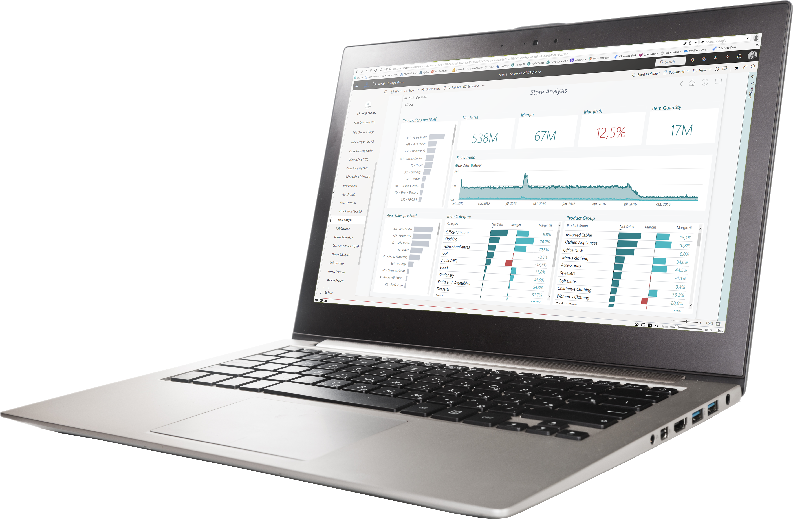
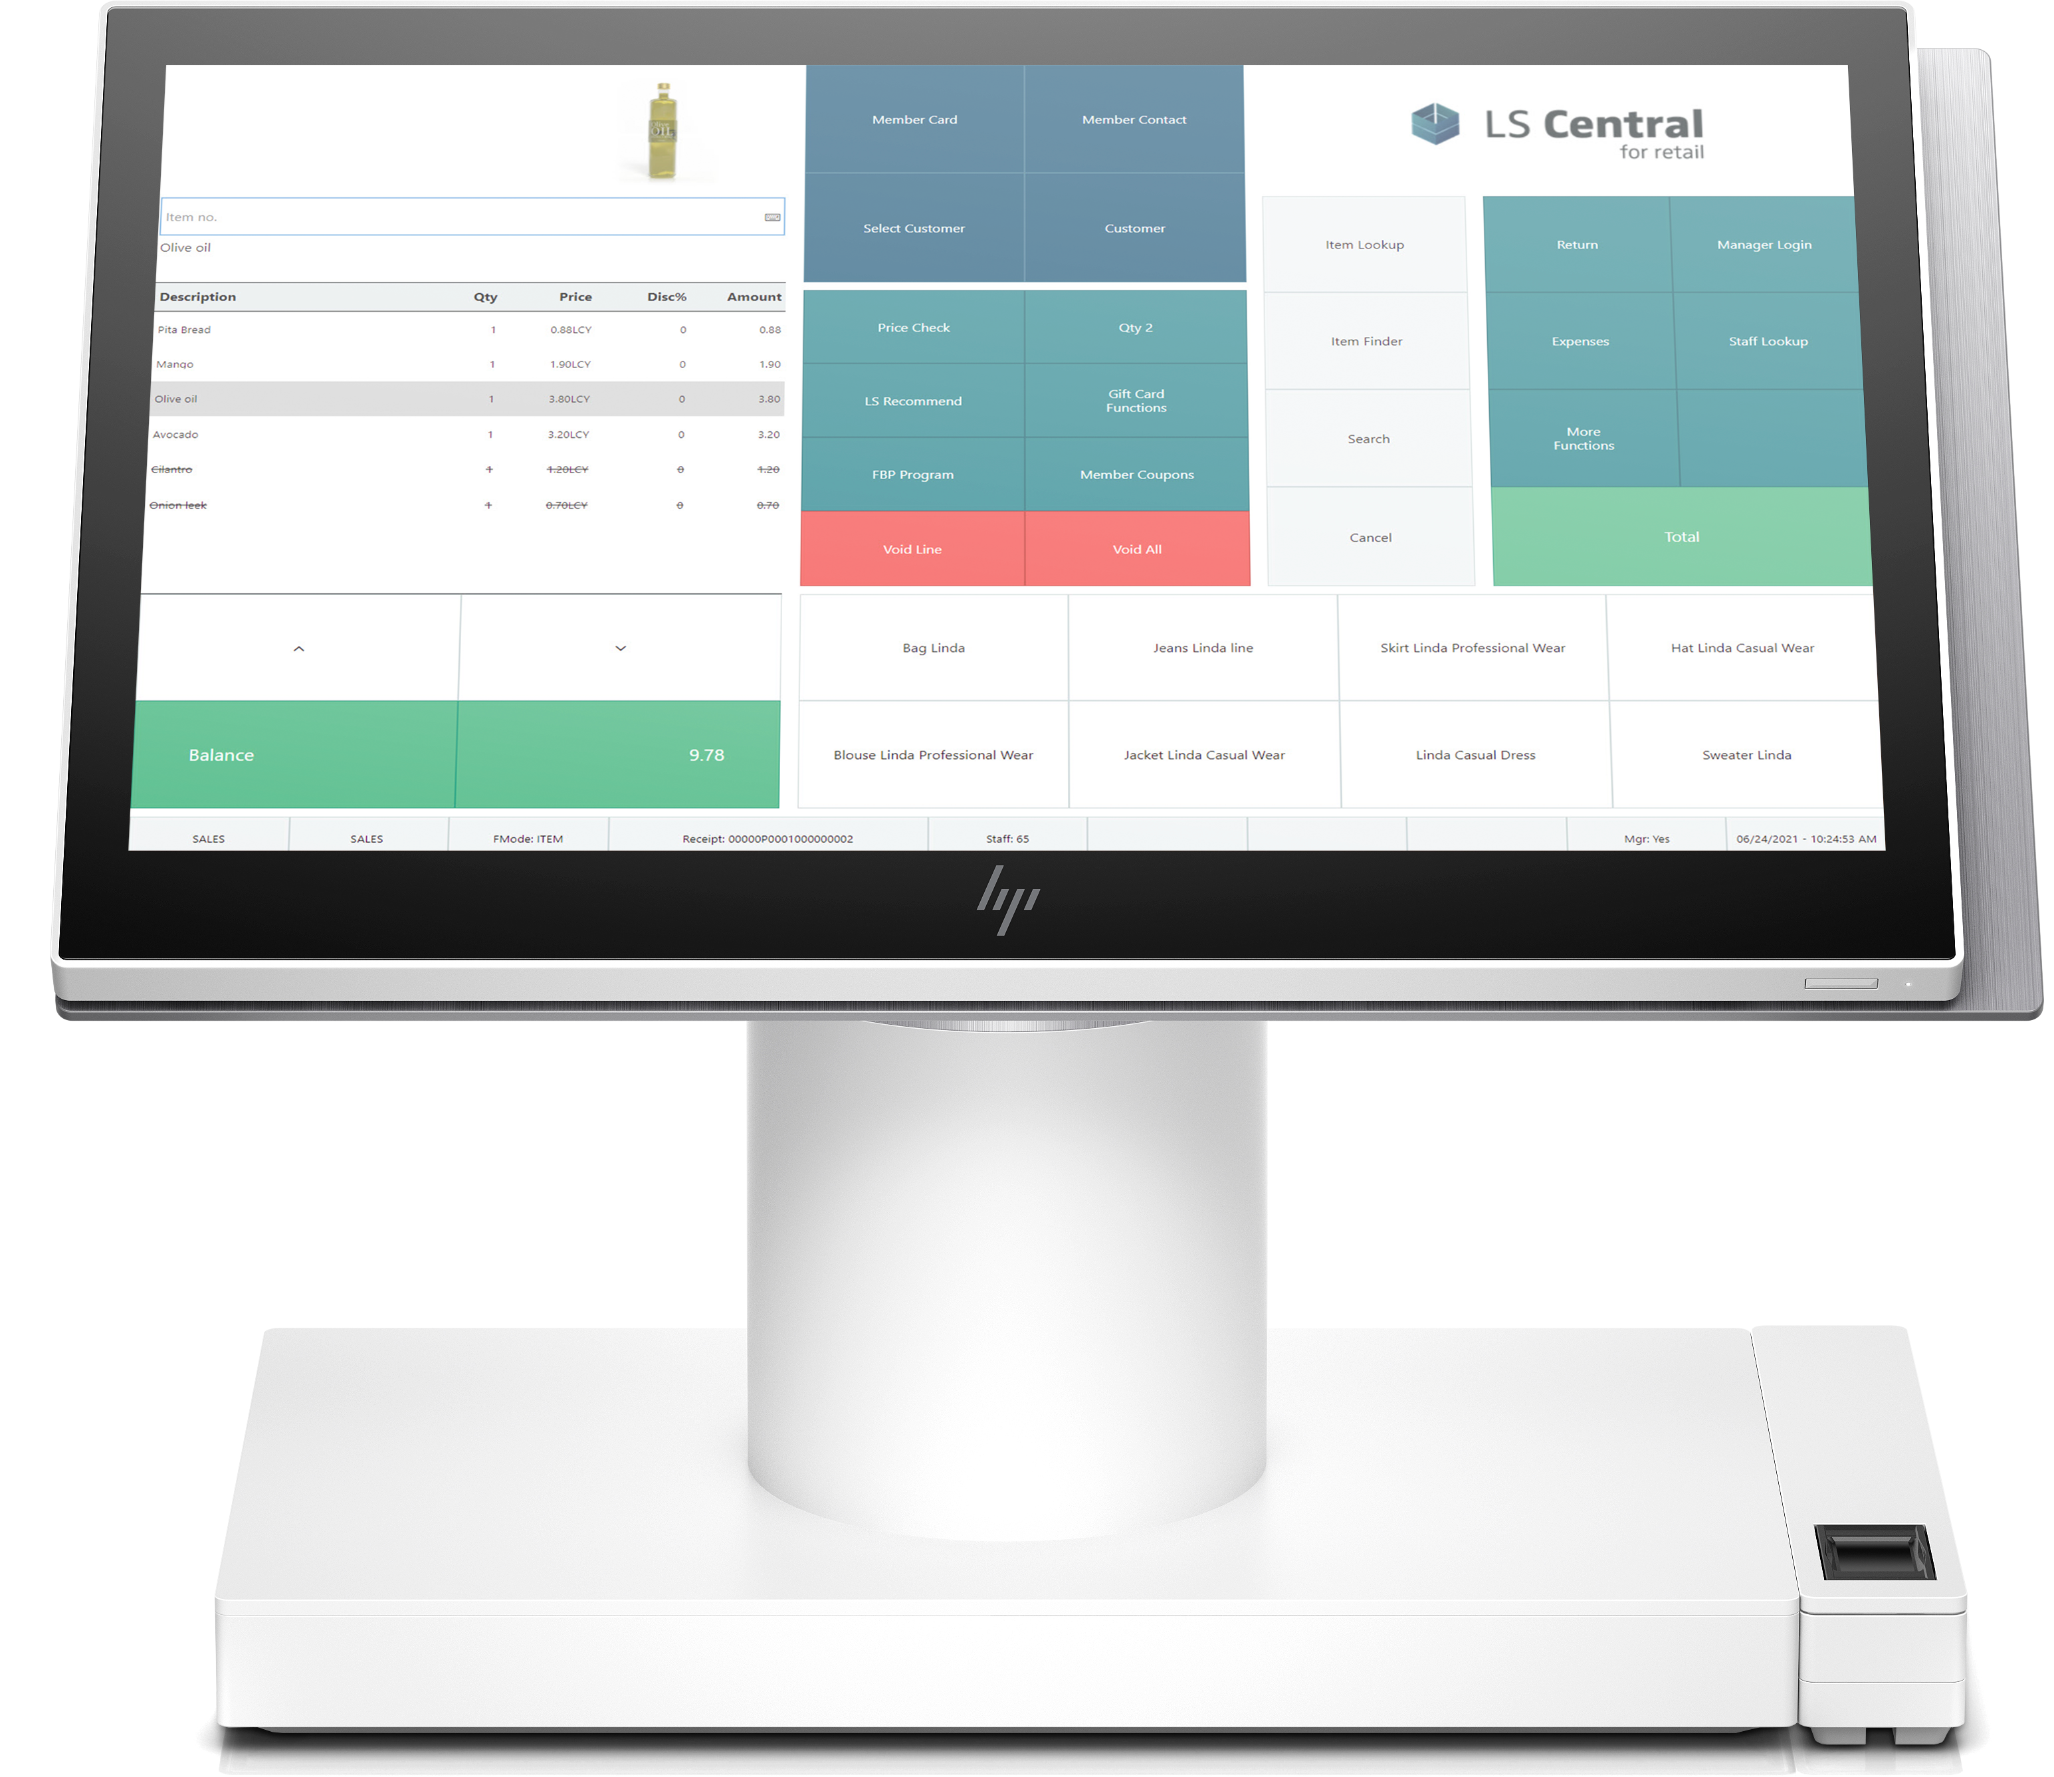

versus
Sales
Meals / BOM
Replenishment
(Ingredients / Components)

Slide 28


Scenarios
Recipe/BOM centric
Make to Order
(QSR; Sell and produce on the fly; E.g. Burger)
Make to Stock
(Produce in advance with Assembly Orders; E.g. Cake)
Plan driven
(Canteens / Event business; produce and purchase in advance
with daily or weekly plans)
Ingredient/Component centric (no recipes) – Fine Dining
Inventory driven
(refill ingredient inventory based on stock level)
Sales driven
(refill ingredient inventory based on ingredient sales history or consumption)
I am an artist !!
Recipes are for
beginners
☺

Slide 29

Replenishment calculation
BOM
Components
Component (Beef Patty)
Bun
Beef Patty
Bacon
Onion
Tomato
Cheese
Salad
Cucumber
Ground Beef
Salt
Pepper
Vendor 1
Bacon, Beef
Component
Replen. Journal
BOM
Replen. Journal
Vendor 2
Tomato
Salad, …
Component
Replen. Journal

Slide 30
Live Demo

Slide 31

Is this functionality for Hospitality
only ?

Slide 32

Status
Recipe/BOM centric
Make to Order
Make to Stock
Plan driven
Ingredient/Component centric
Inventory driven
Sales driven
Planned release
Q2 2023

Slide 33

What happened
to
LS Forecast ?

Slide 34

LS Forecast
Forecast calculation
Advanced
calculation
logic
LS Forecast
Master data
Sales history
Forecast
results
Replenish-ment
LS Central

Slide 35
LS Forecast
Advanced
calculation
logic
Master data
Sales history
Forecast
results
Replenish-ment
LS Central

Slide 36
LS Forecast
3rd party
Forecasting
Engine
Forecast calculation
Advanced
calculation
logic
Master data
Sales history
Forecast
results
Replenish-ment
LS Central

Slide 37
LS Forecast
3rd party
Forecasting
Engine
Improved
integration
options
Forecast calculation
Advanced
calculation
logic
Master data
Sales history
Forecast
results
Replenish-ment
LS Central

Slide 38

The future
Out-of-Stock Management improvements
  Improved calculation process
  Better presentation of results
Multi-Warehouse Replenishment
  Improved processes for scenarios with multiple warehouses
  Secondary warehouses for items
  Warehouse to warehouse transfers
Season Management
  End of season management (carry-overs)
  Mass data management
Further performance improvements & process enhancements

Slide 39
Burning platform
SaaS customer
Cosmetics
118 Stores/Locations
18.000 Items
Approx. 27.000 POS Transaction lines / day
Replen. calculation: OOS, RIQ + Journals
Replenishment calculation
7 (seven!!) hours
7 hours

Slide 40


Burning platform
SaaS customer
Cosmetics
118 Stores/Locations
18.000 Items
Approx. 27.000 POS Transaction lines / day
Replen. calculation: OOS, RIQ + Journals
Replenishment calculation
7 (seven!!) hours to 1,5 hours (with 4 par. Processes)
1,5 hours

Slide 41
Thank you

