Slide 1


Slide 2

LS Central for Hotels
Not just a PMS
Gunnar Orn Thorsteinsson
Product Director

Slide 3

LS Central for hotels
Simple
Processes
Holistic
Flexible
Navigateable
Powerful
Seamless

Slide 4

Not just a PMS
eCommerce Integration
Web Integration
3rd party
Channel Manager Connector
LS Pay
Integration to payment providers
LS Central
Analytics
predictive abilities
Staff Management
Staff rosters and timetabling
Bookings
Reservations
and activities
Hotels
Property Mgmt System and Channel Mgmt
KDS
Kitchen management
Restaurants
Food and beverage
Loyalty
Member
Mgmt
Retail
Stores and Backoffice
Microsoft Dynamics 365 Business Central
Power BI

Slide 5
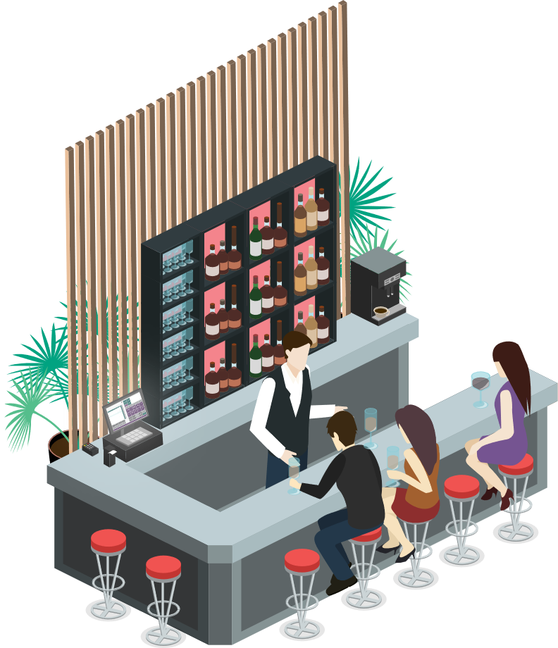






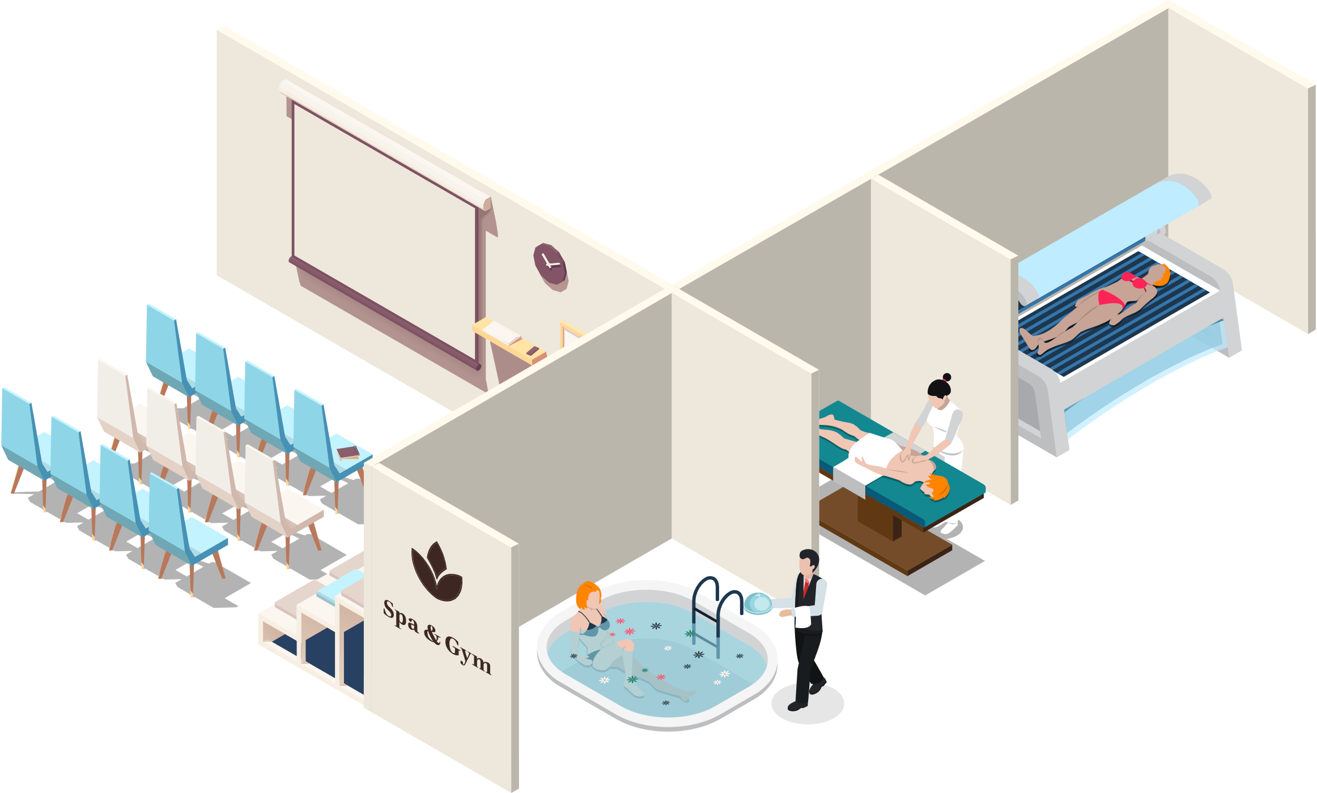
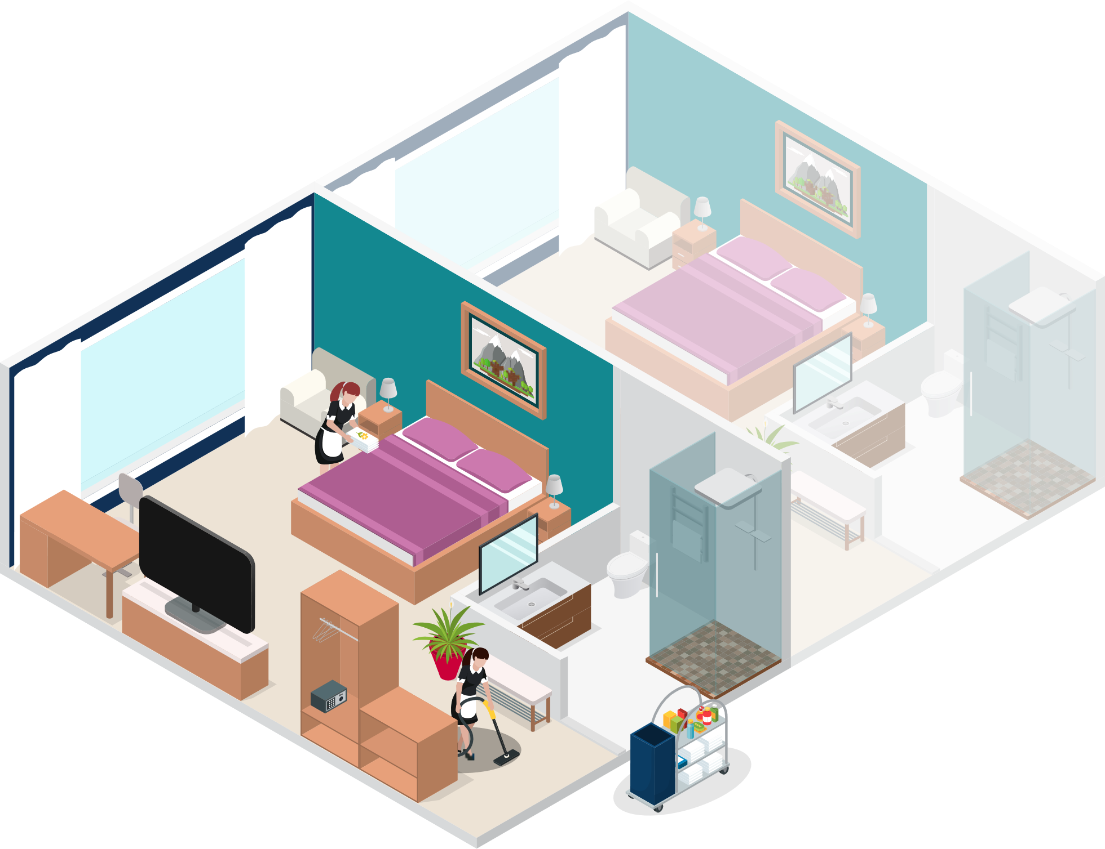


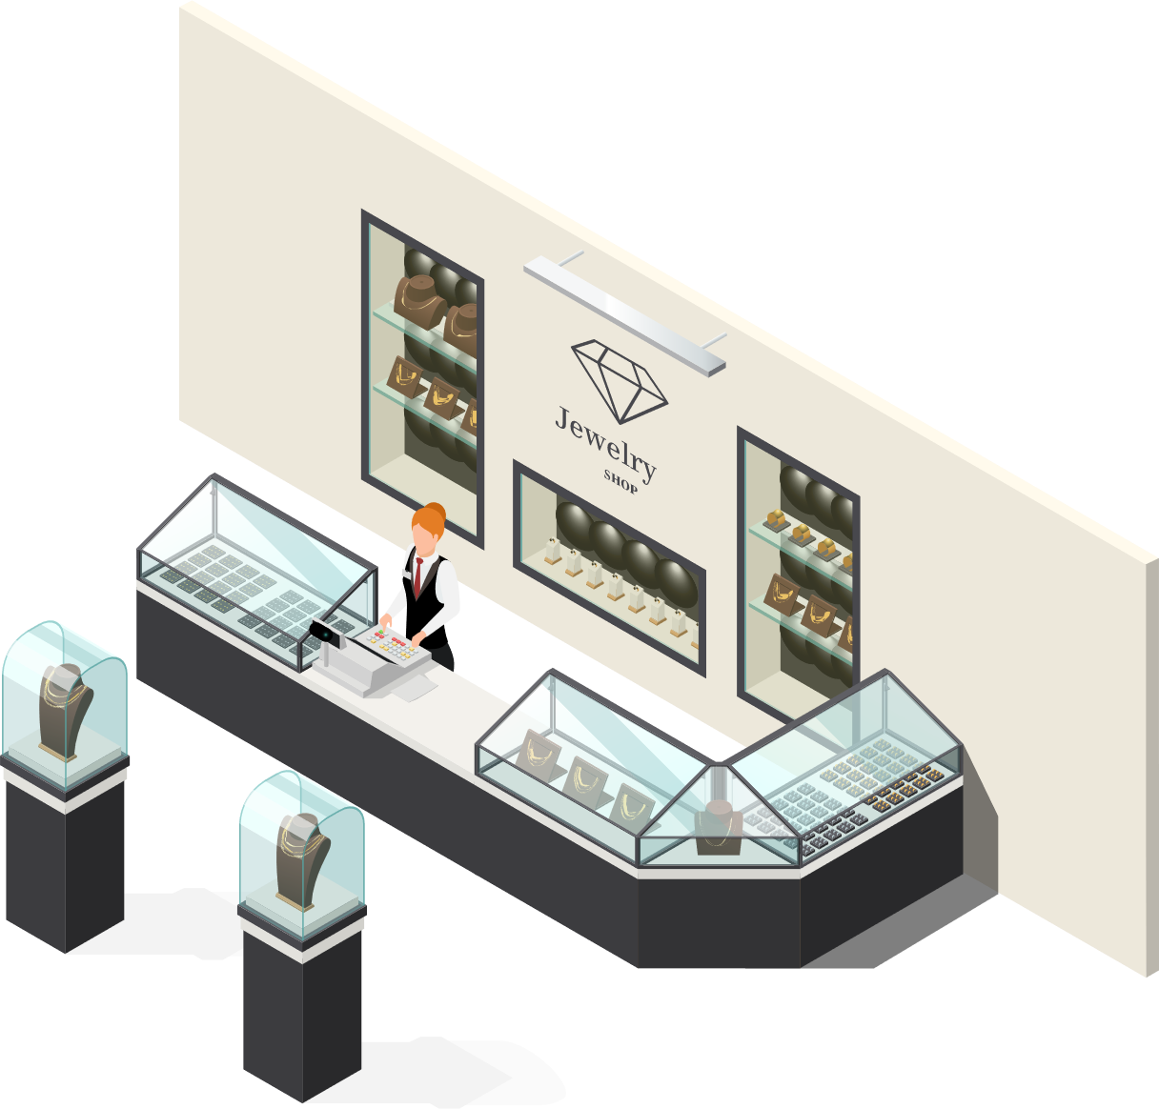


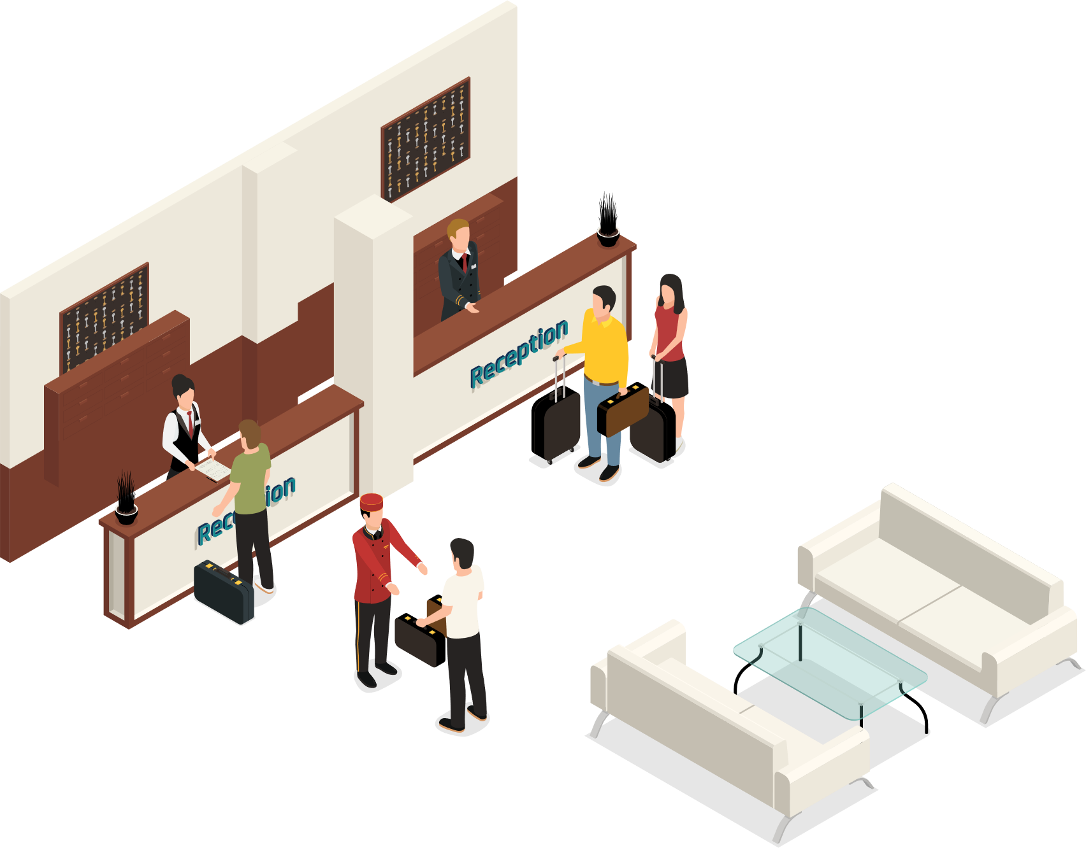
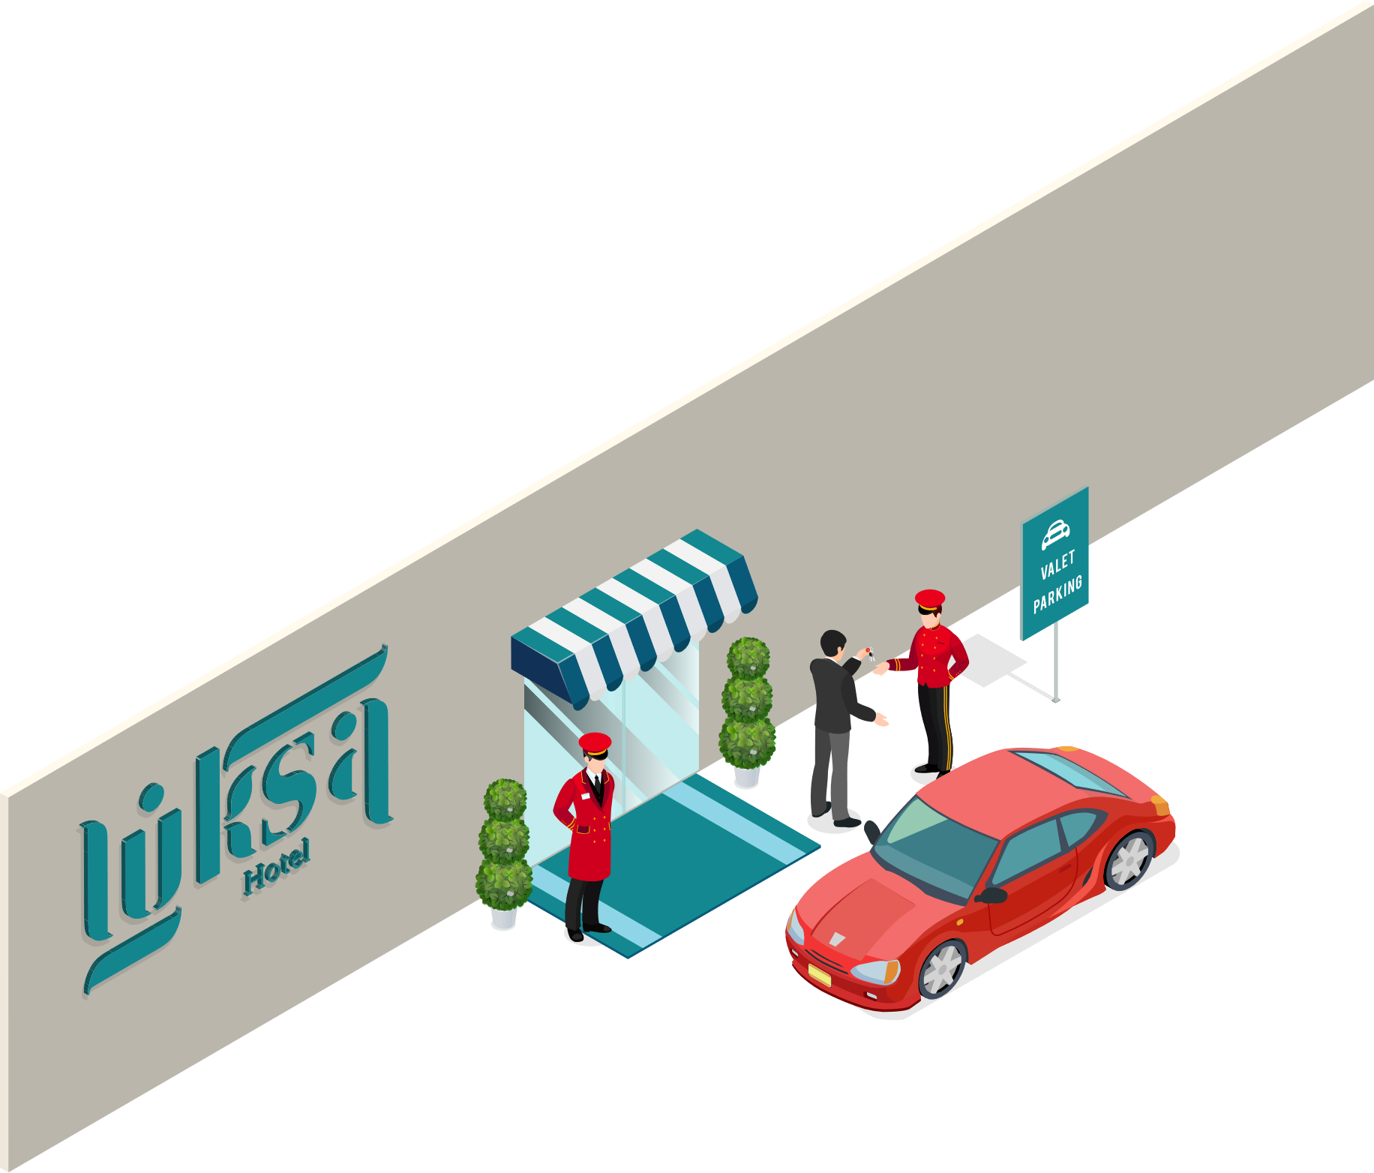


LS Hospitality
LS Central
Food & Beverage
Activity
Staff Mgmt
KDS
Hotels

Slide 6
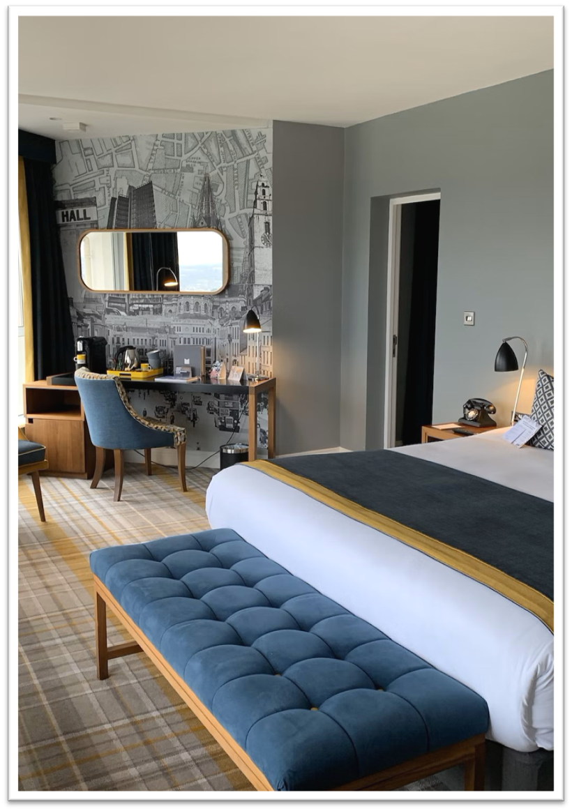
LS Central for Hotels
Rate Code Management
Different Rate Code setup
Items, activities and/or packages
Offset of BAR and Derived Rate Codes
Period or specific days
Restrictions & Overbooking limitations
Cancellations & Deposit policies
Reservation Management
Individual Reservations
Group Reservations
Reservations with activities and/or other extras

Slide 7
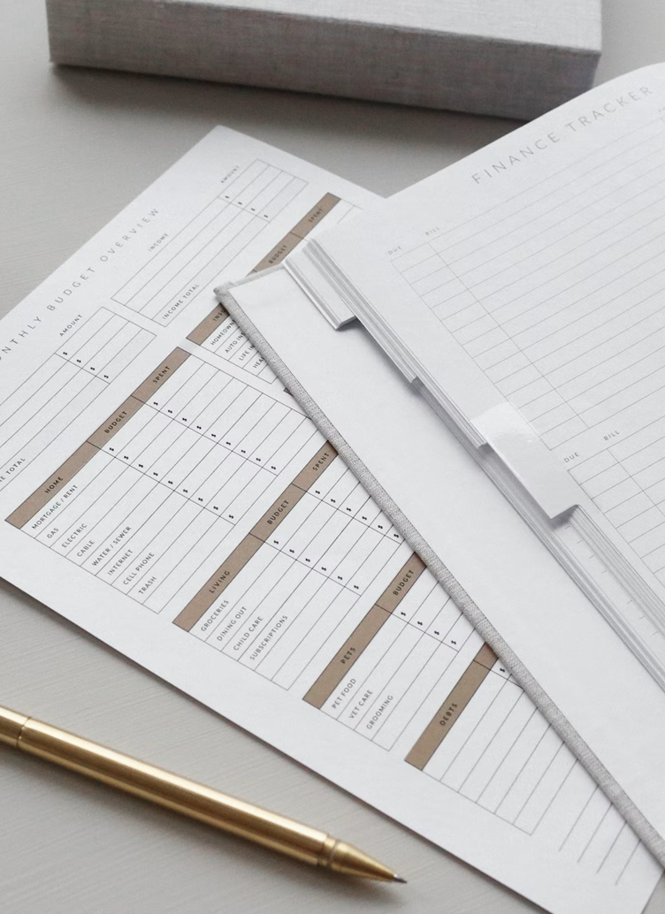
LS Central for Hotels
Invoice Management
Routing Rules
Guest - Paymaster - Customer
Preview - Invoices
Deposits
Discounts
Statement Posting
Night Audit
Different Role Centers
Back Office
Front Desk
Housekeeping
Channel Manager

Slide 8
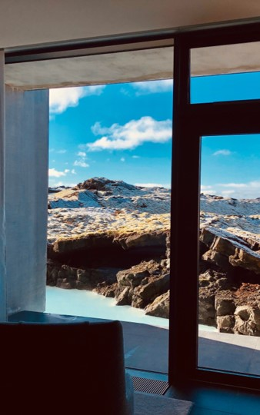
LS Central for hotels
Front desk POS
Reservation search
Reservation management (check-in, charge, check-out)
Housekeeping
Rules
Tasks
Real-time status
Analytics
Standard 11 reports that can be enhanced and customized
Channel manager and API’s
Role center
SynXis
SiteMinder

Slide 9
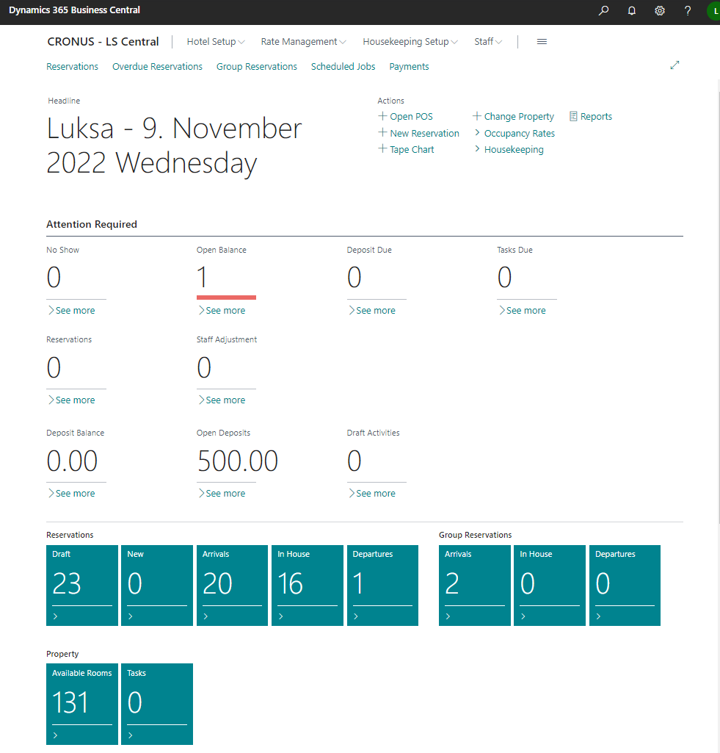
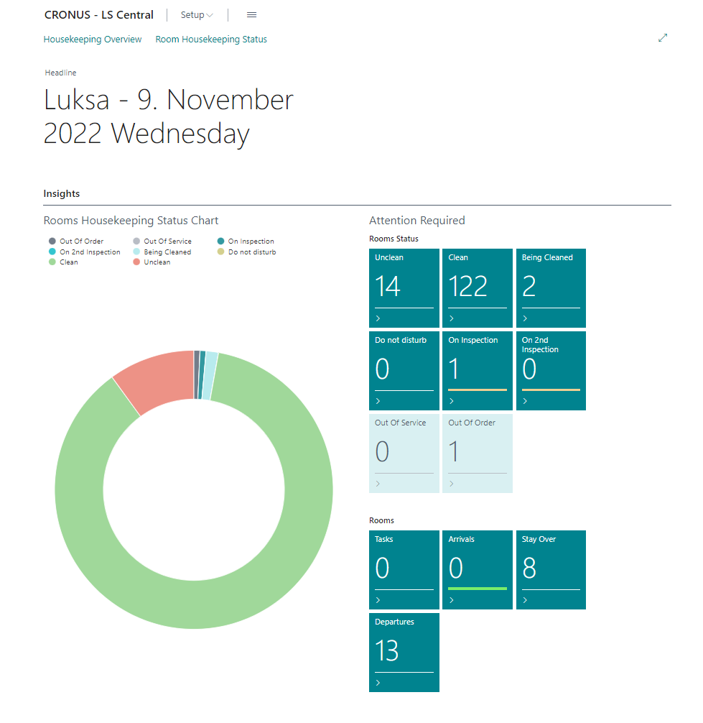
Role Centers

Slide 10
Role Centers
Front Desk
  Housekeeping

Slide 11
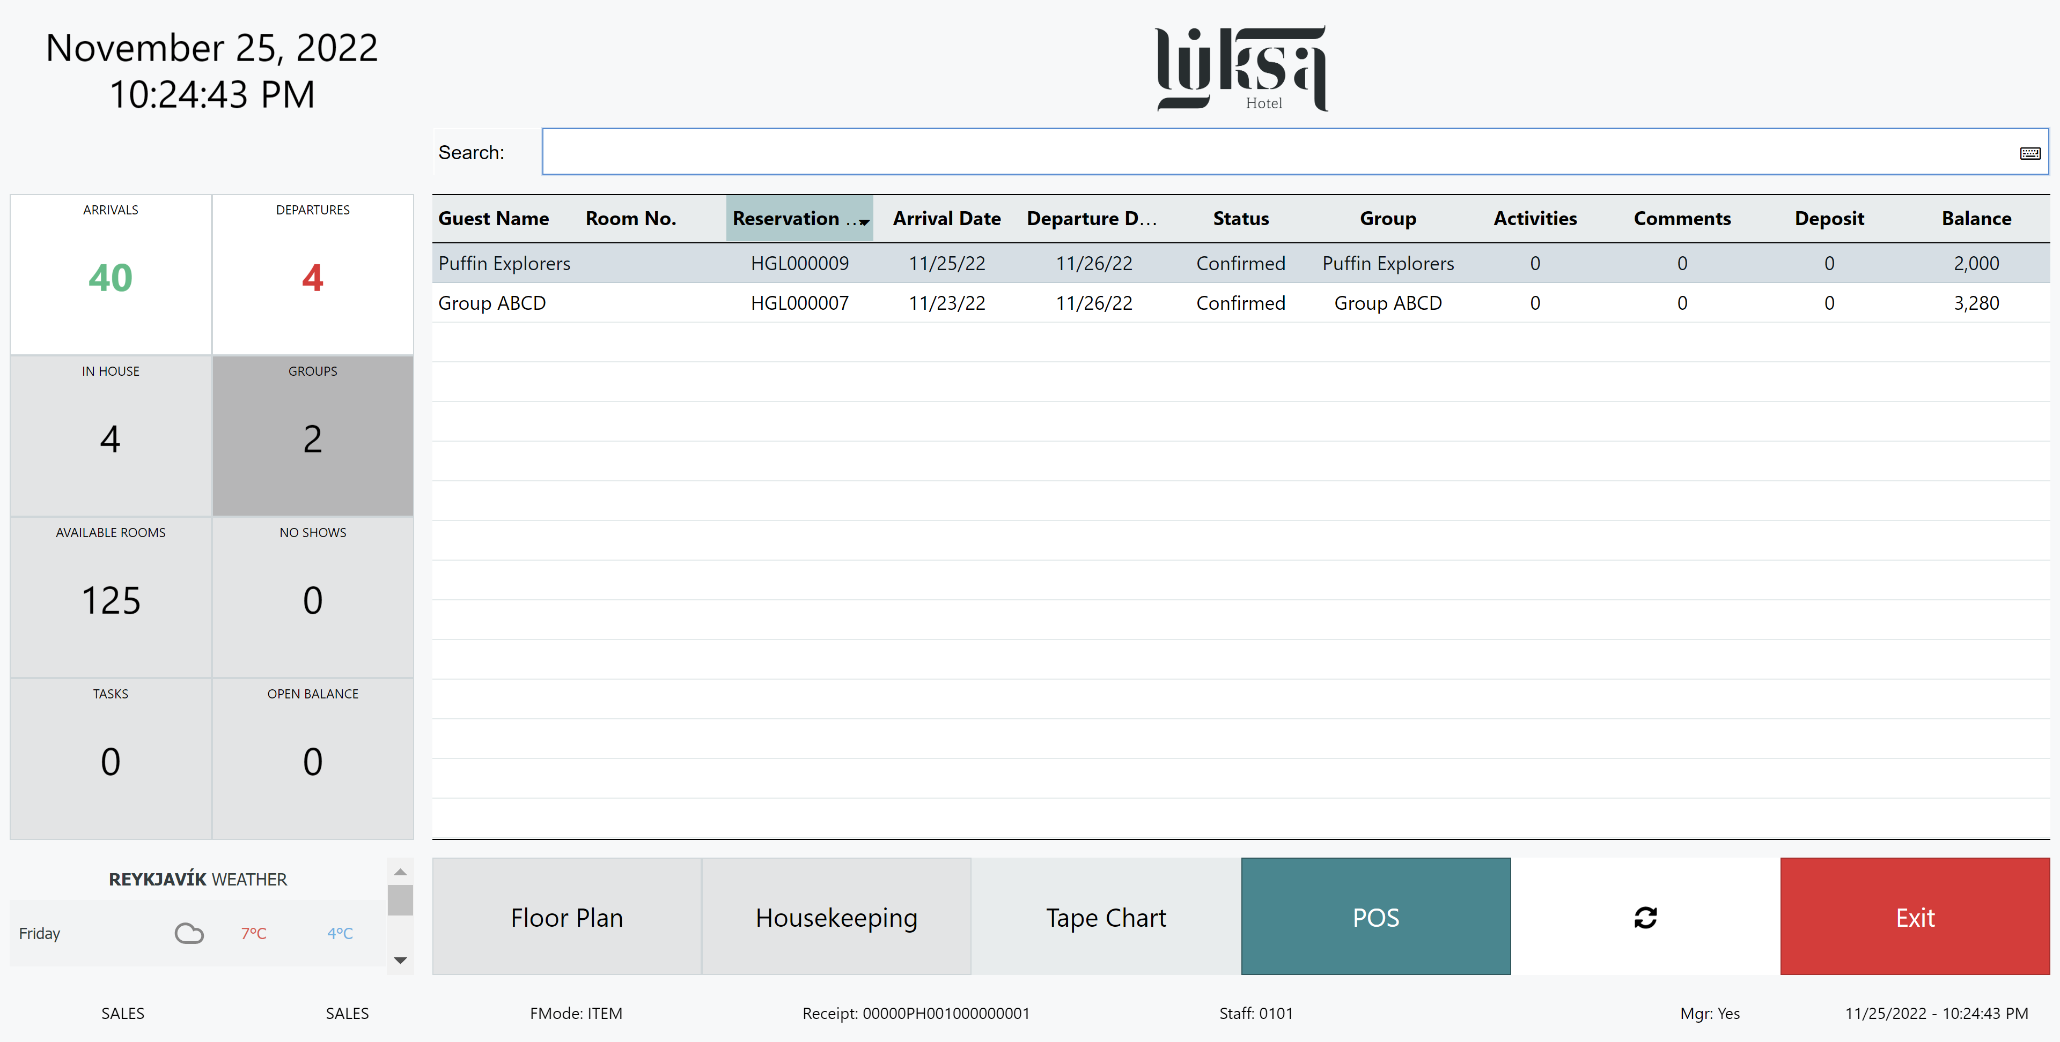

Slide 12
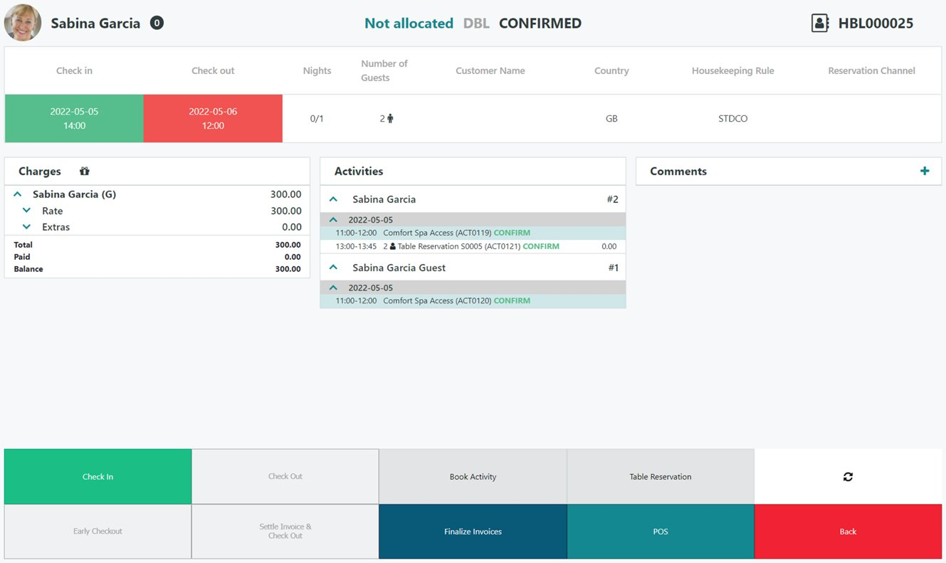

Slide 13
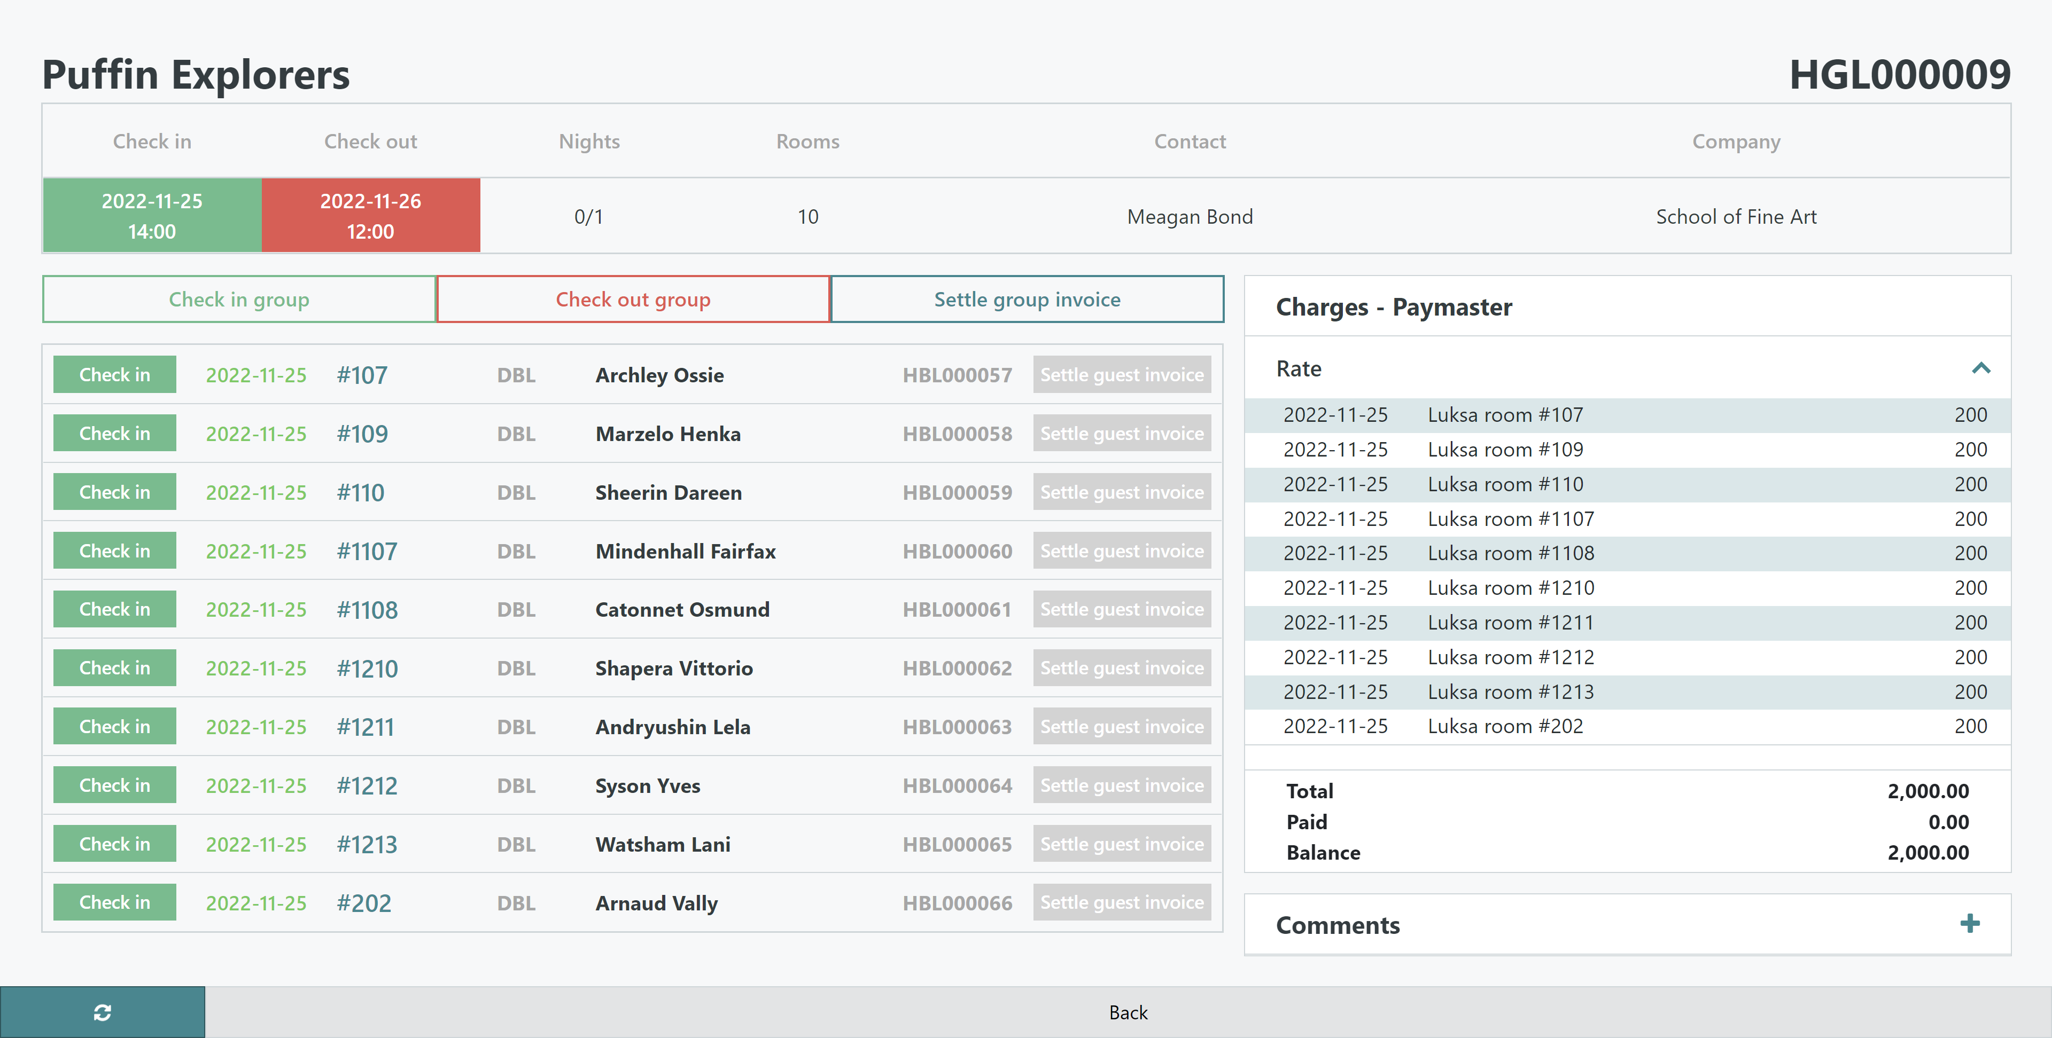

Slide 14
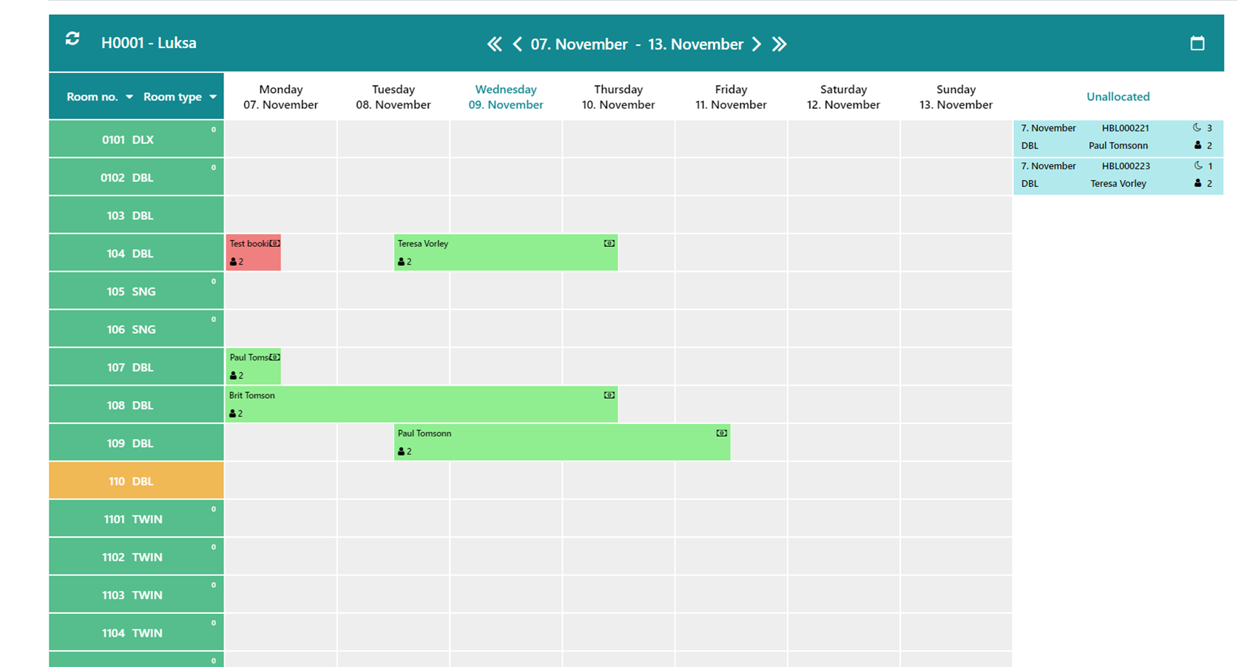

Slide 15
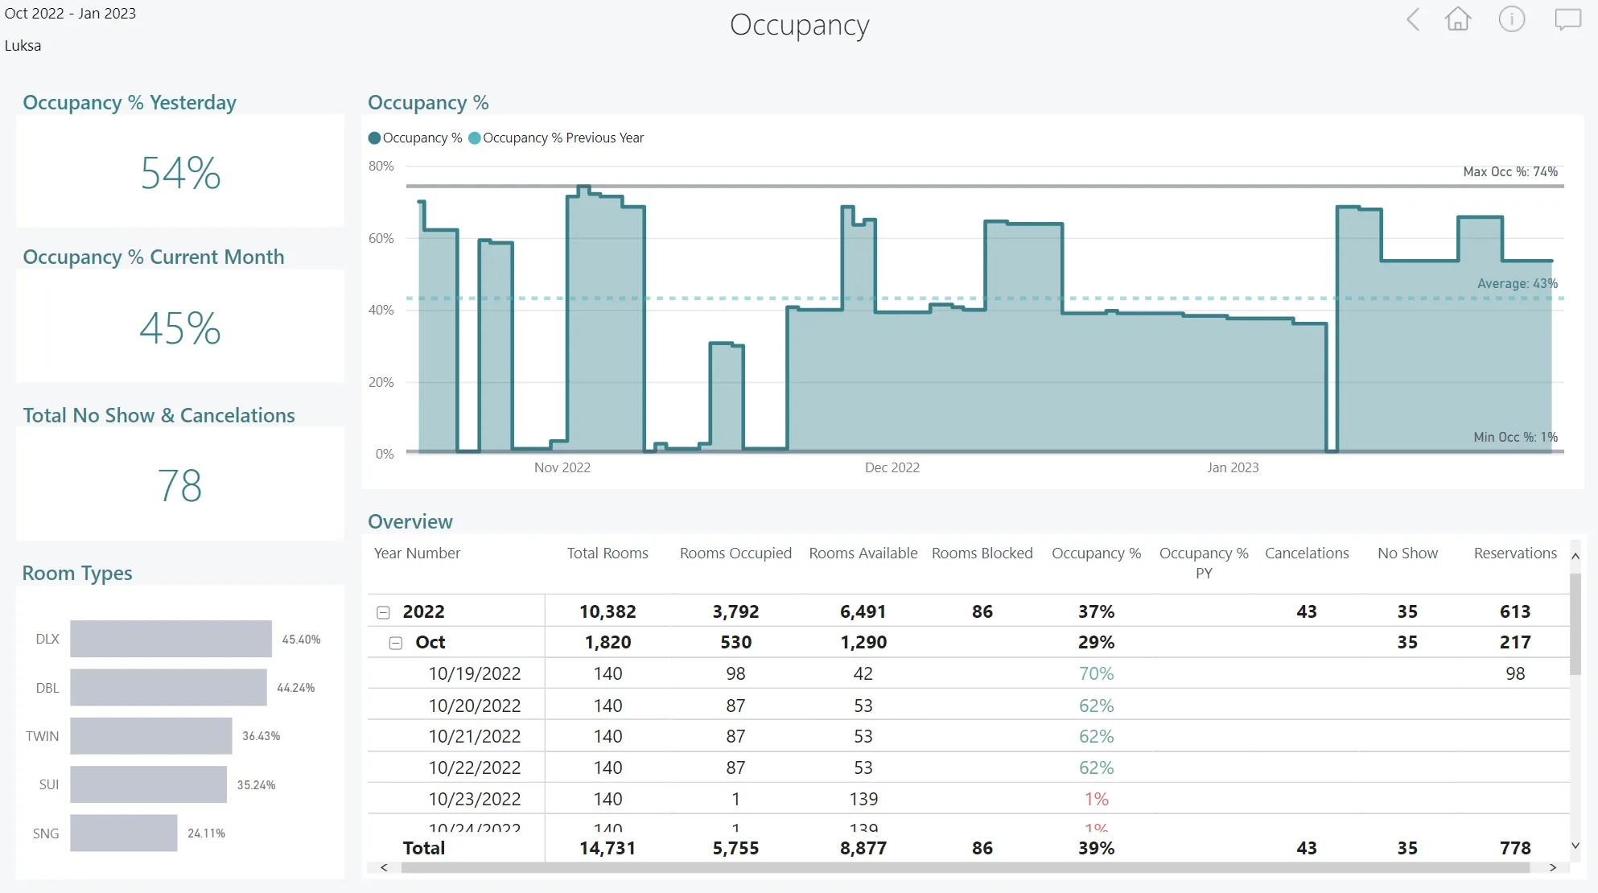

Slide 16
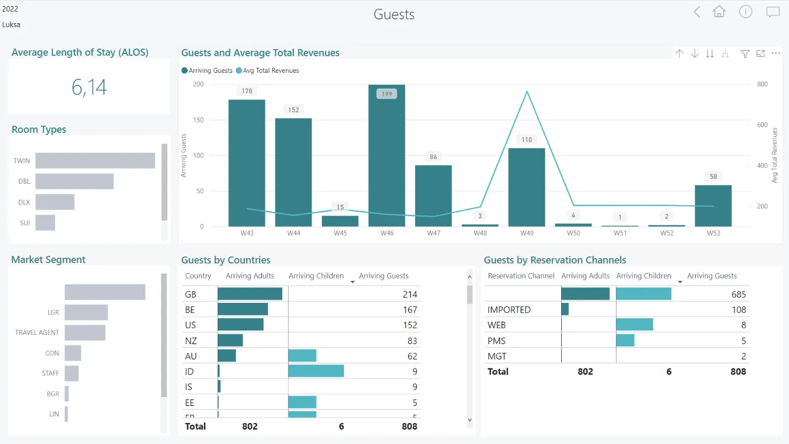

Slide 17
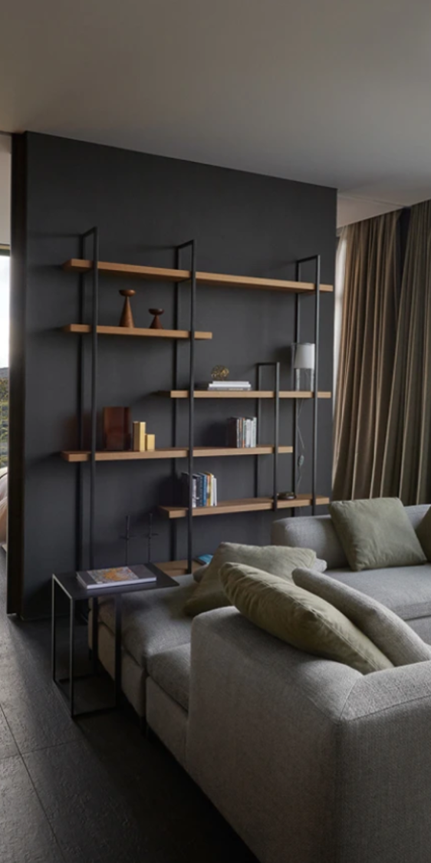
Hotel roadmap H1 2023
2022
Hotel Discounts
Accrual Accounting
Housekeeping rules and tasks
H1 2023
Comments Framework
Hotel Contracts
Hotel Allotments
Payment tokens with pre-auth for reservations
H2 2023
Serial Bookings (Linked Reservations)
Multi-company bookings
Rate Code Matrix
Room Management (Attributes, joining, …)
* Dates and features are subject to change

Slide 19
Thank you

