Slide 1
How to implement an eCommerce project
Petur Thor
Sigurdsson
Alejandro
Vasquez

Slide 2

Our Journey Today
Introduction to eCommerce for LS Central
Running a Project
Handling Customizations
LS Retail Consulting Services
Q&A

Slide 3
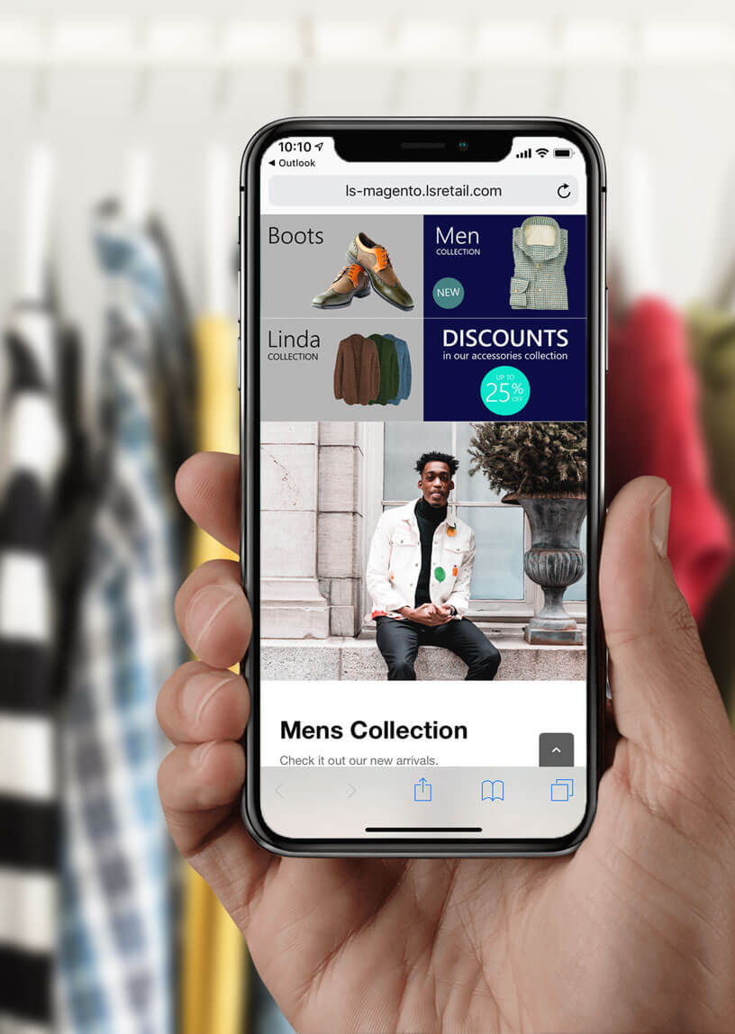
Introduction
What is eCommerce for LS Central
Topology
Installation
Configuration

Slide 4
Introduction
What is eCommerce for LS Central
Topology
Installation
Configuration

Slide 5






Retail
Hospitality
Activity
Pharmacy
Retail
eCommerce API
Commerce Service for LS Central
3rd party
eCommerce
providers

Slide 6
Introduction
What is eCommerce for LS Central
Topology
Installation
  Standalone
  Virtual Machine
Configuration

Slide 7
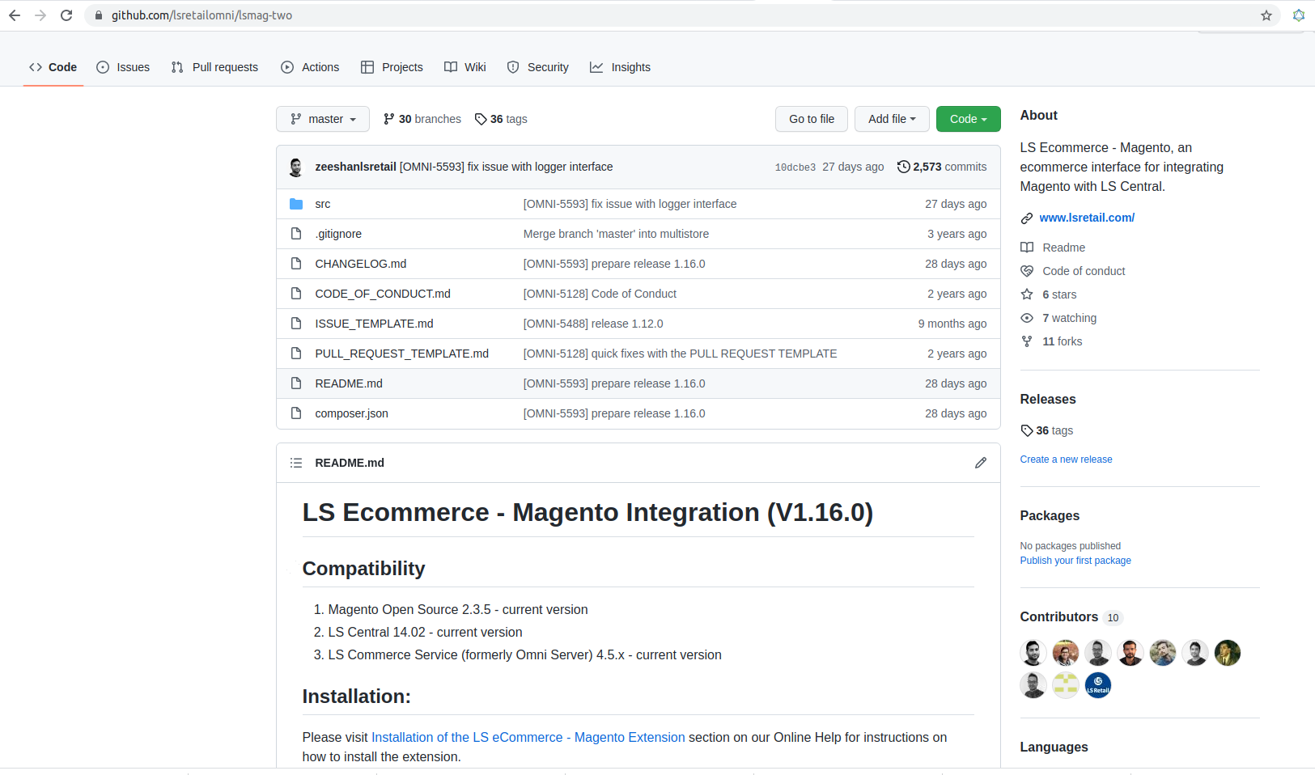
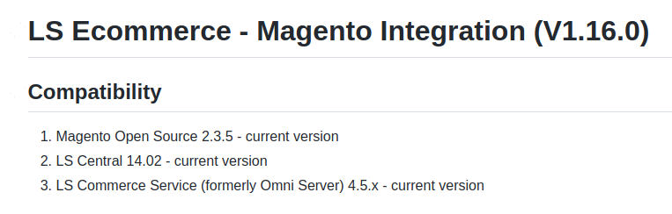

Slide 8
Introduction
What is eCommerce for LS Central
Topology
Installation
  Standalone
  Virtual Machine
Configuration

Slide 9
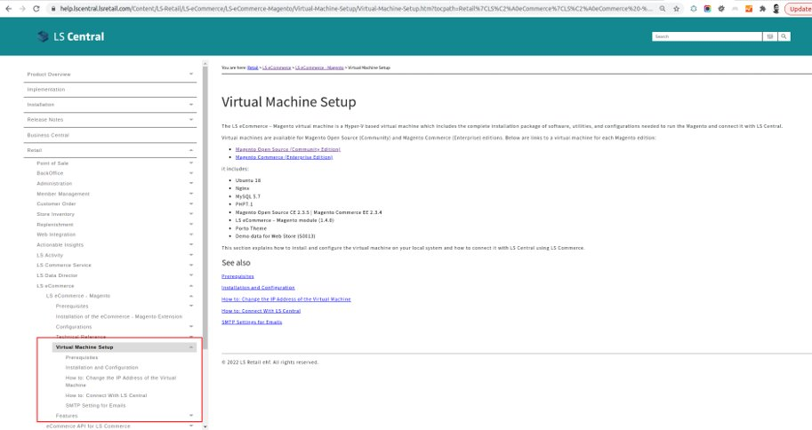

Slide 10
Introduction
What is eCommerce for LS Central
Topology
Installation
Configuration

Slide 11
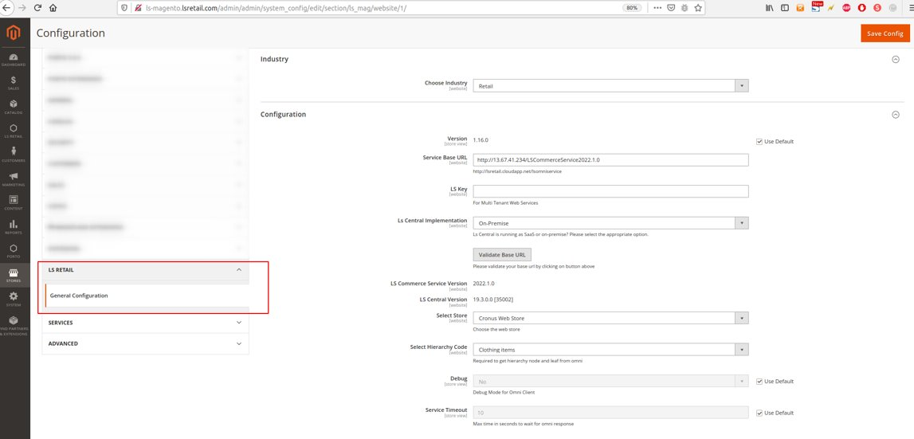

Slide 12
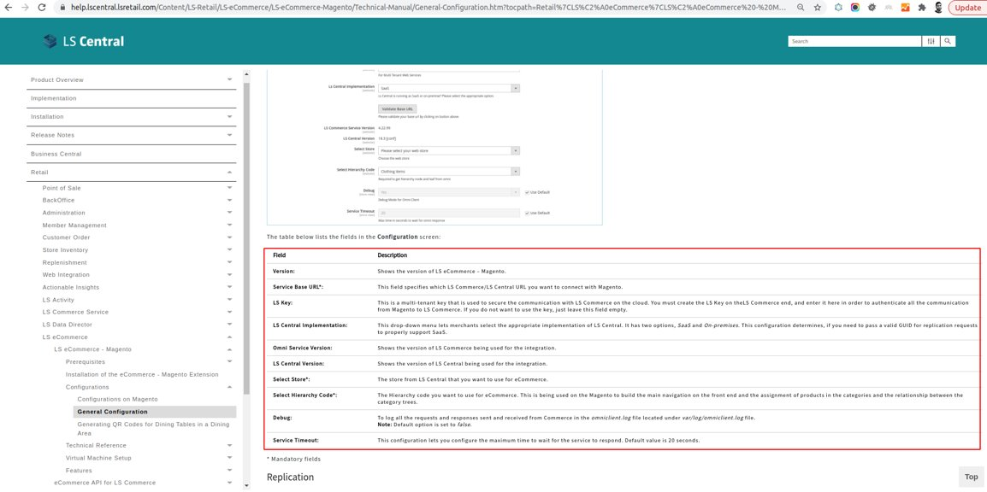

Slide 13
Running a Project

Slide 14

Running a Project
Scoping
Selecting the Magento Platform
Look and Feel
Hosting

Slide 15

Scoping
Client Requirements
Supported Features
Gaps?

Slide 16
Running a Project
Scoping
Selecting the Magento Platform
Look and Feel
Hosting

Slide 17
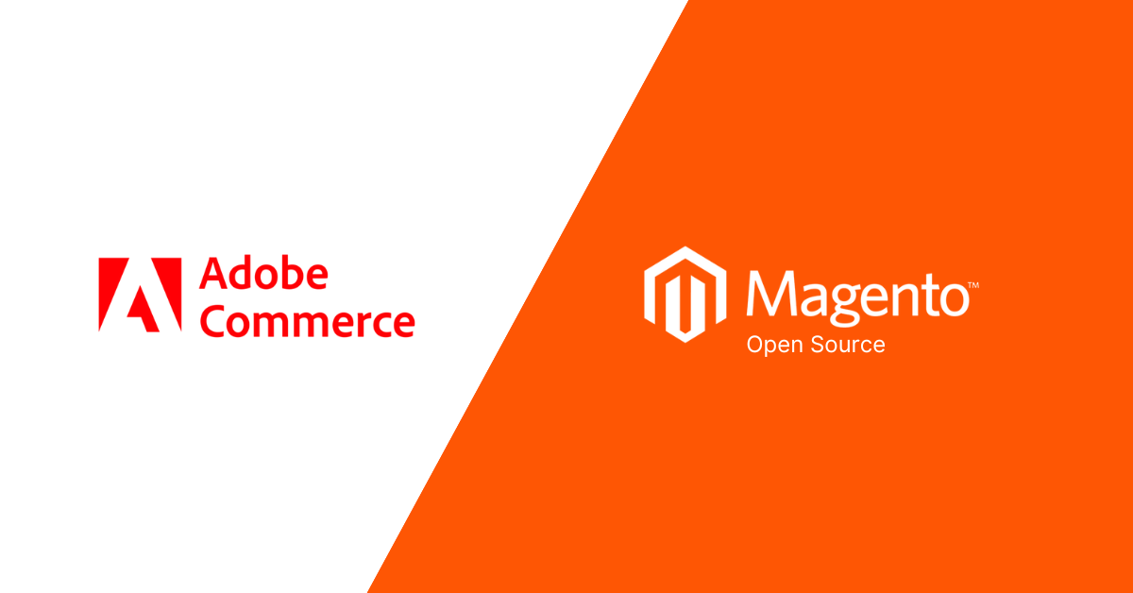
Adobe Commerce vs Magento Open Source
Store Size
Scalability
Cost
Advance Features
Hosting
Adobe Support

Slide 18
Running a Project
Scoping
Selecting the Magento Platform
Look and Feel
Hosting

Slide 19
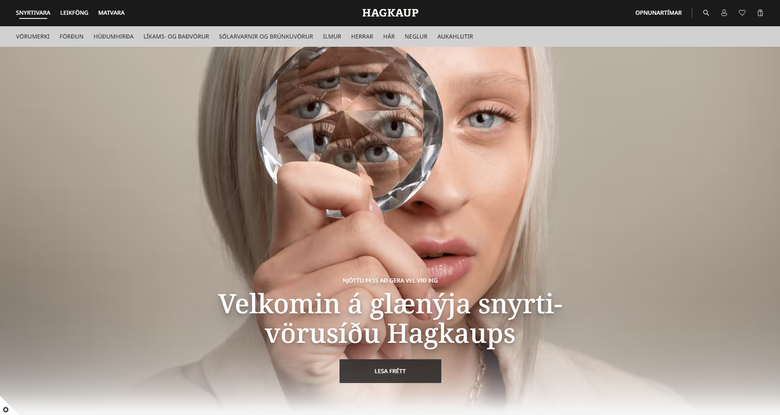
Look & Feel
Marketplace Themes
Custom Designs
PWA (Progressive Web Apps)

Slide 20
Running a Project
Scoping
Selecting the Magento Platform
Look and Feel
Hosting

Slide 21
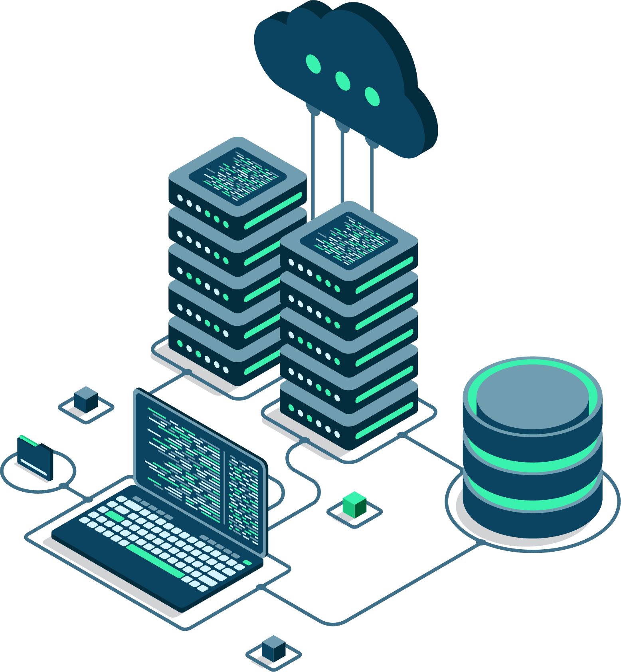
Hosting
Adobe Commerce Cloud
On Premise
Third Party

Slide 22
Handling Customizations

Slide 23
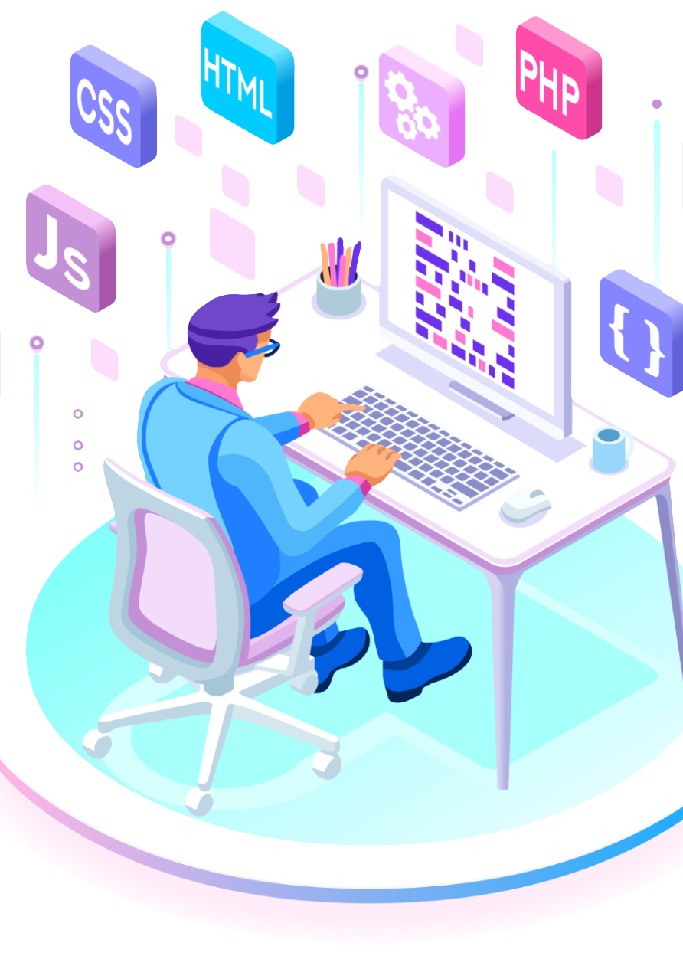
Customizations
Frontend – UI
Magento
eCommerce for LS Central -
Magento module
Commerce Service for LS Central
LS Central

Slide 24
LS Retail Consultancy

Slide 25

LS Retail Consultancy
Discovery Workshops
Training
Customization Requests
Deployment

Slide 26
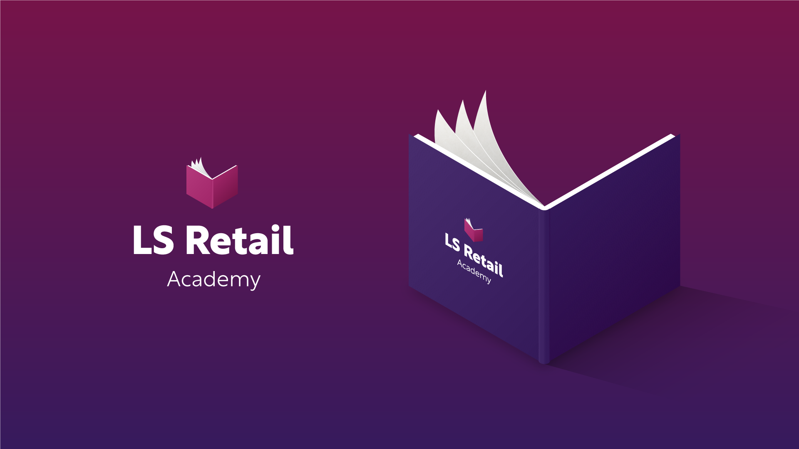

Slide 27
Thank you

