Slide 2
Expand your business with Bookings for LS Central
Activities make the experience memorable
Gunnar Orn Thorsteinsson
Dave Barrans
Product Director
Solution Architect

Slide 3

Complex processes for the organization

Slide 4
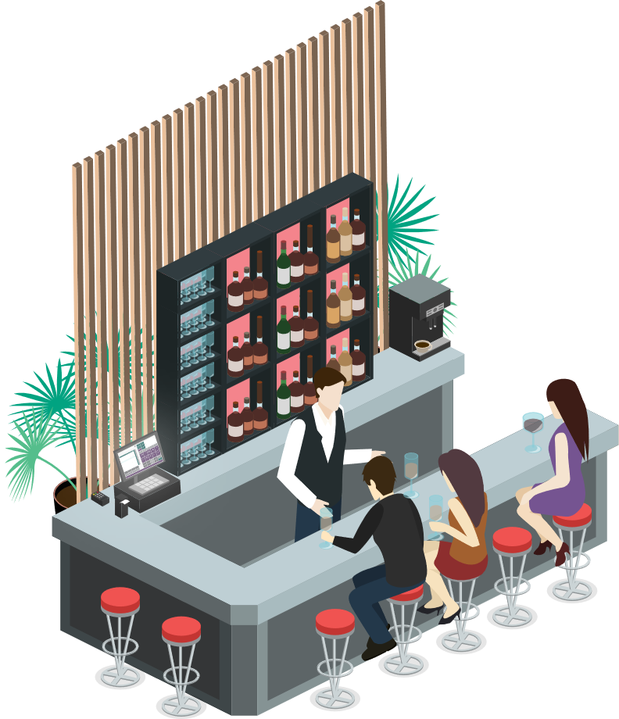
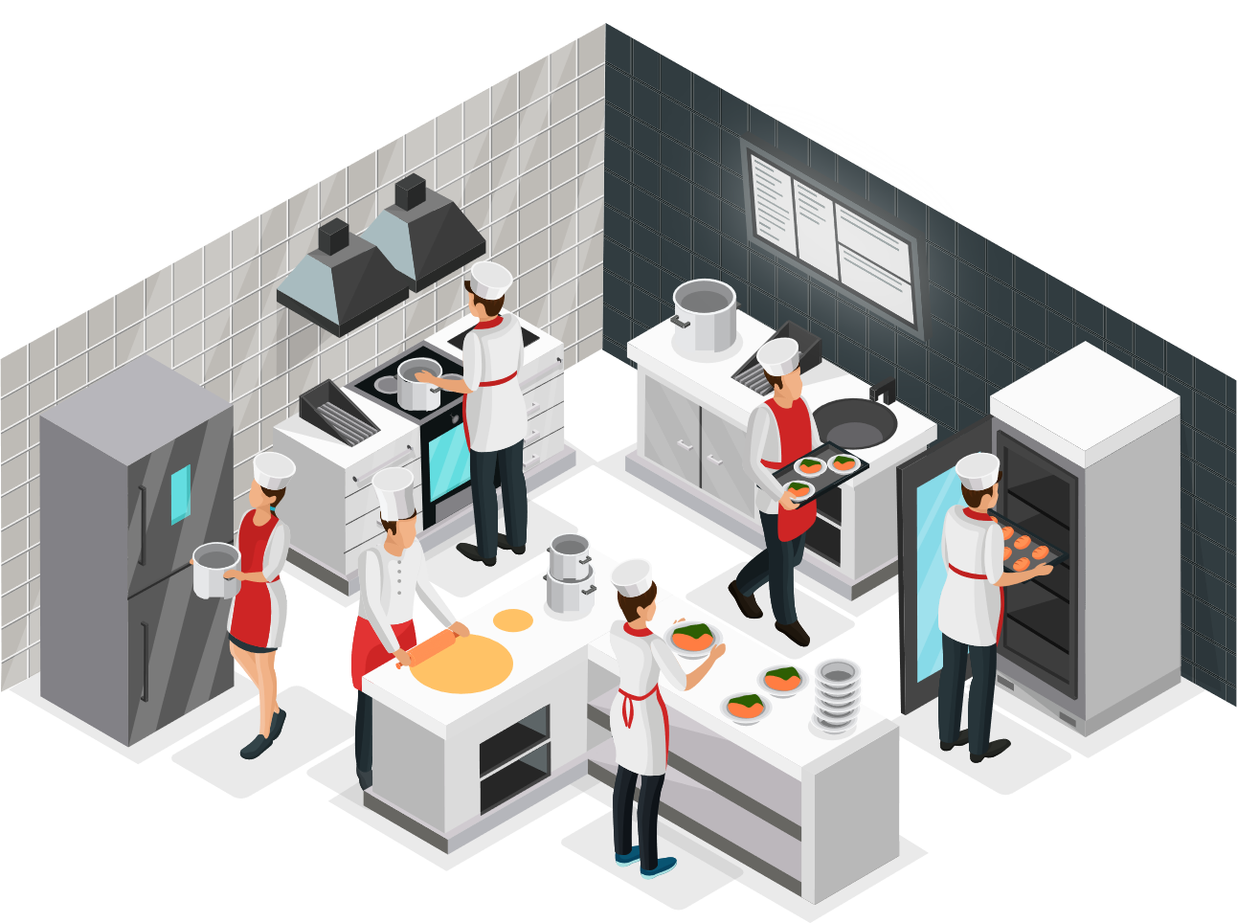





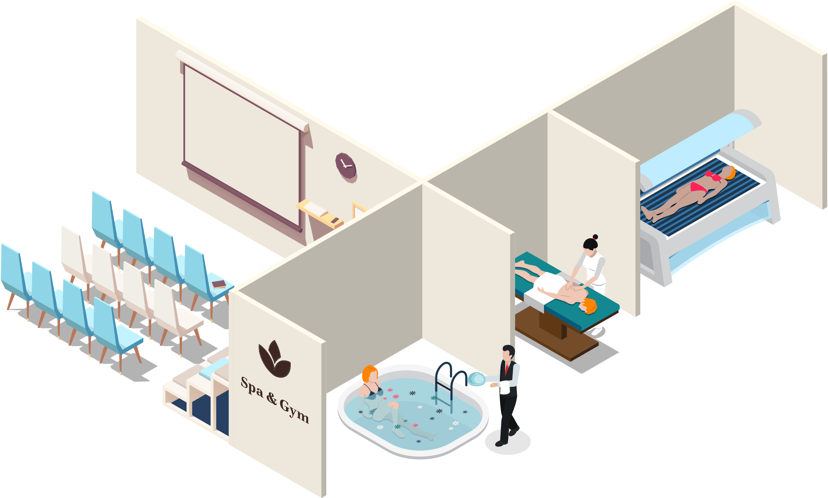
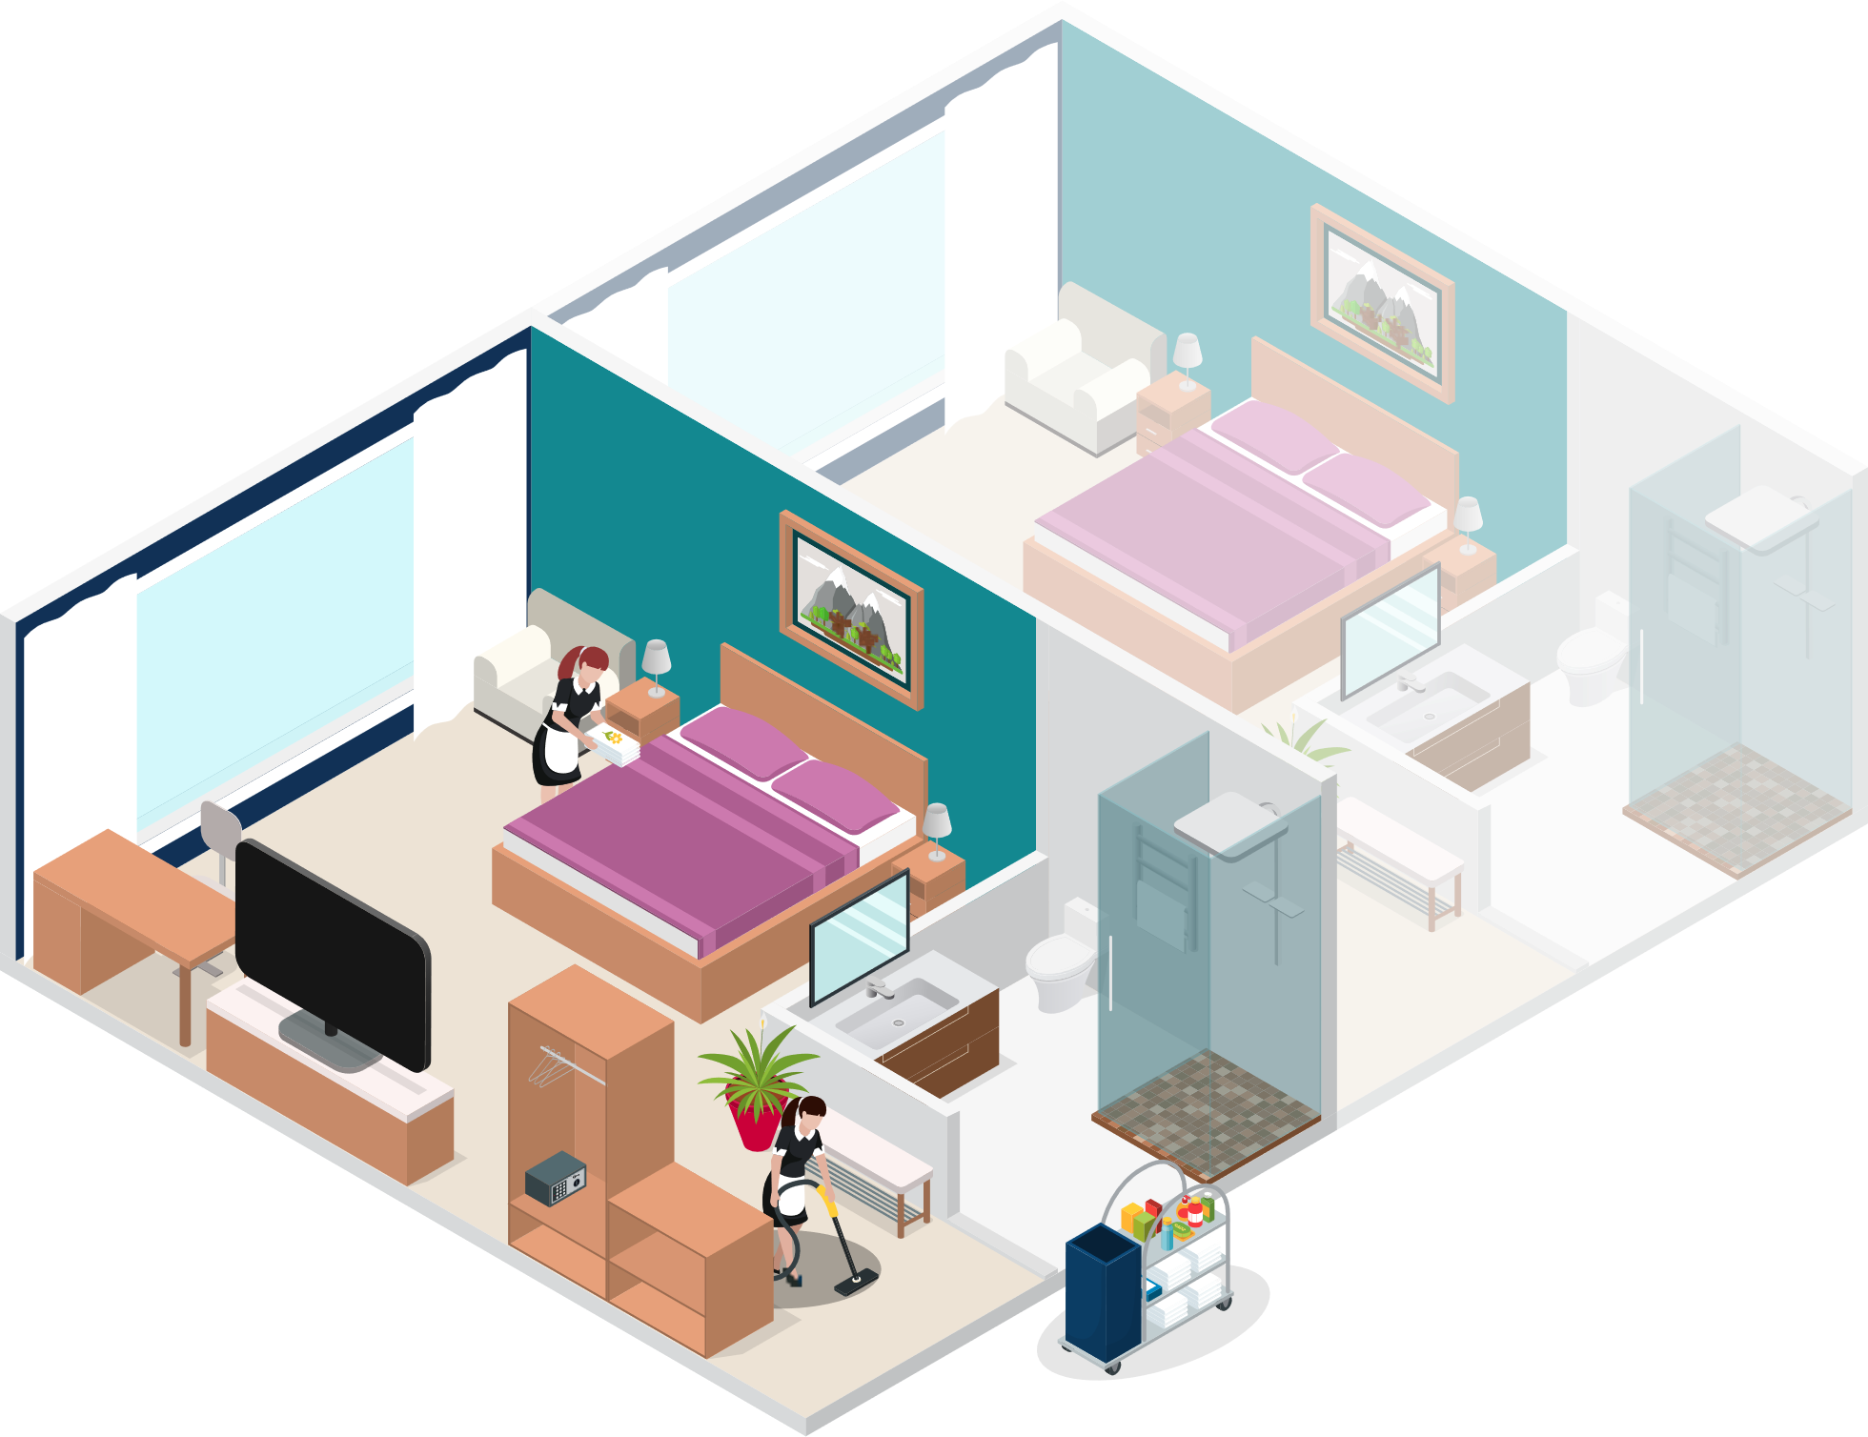
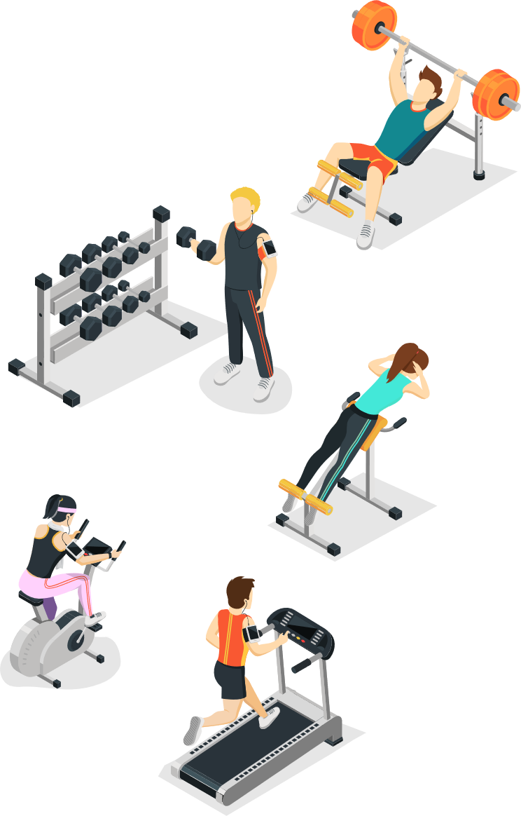
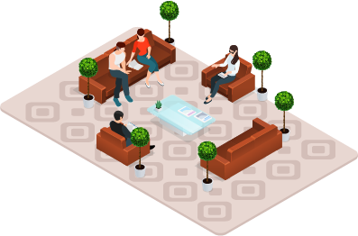
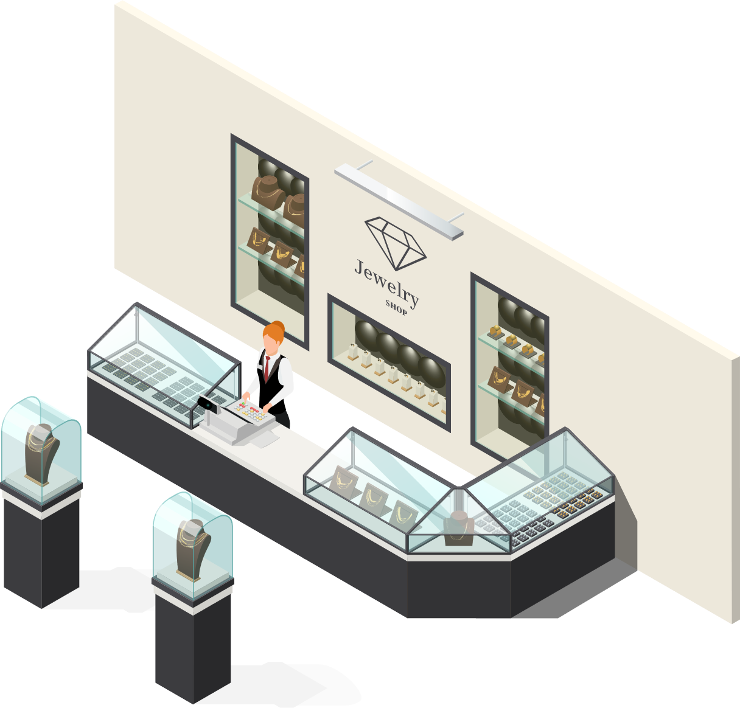


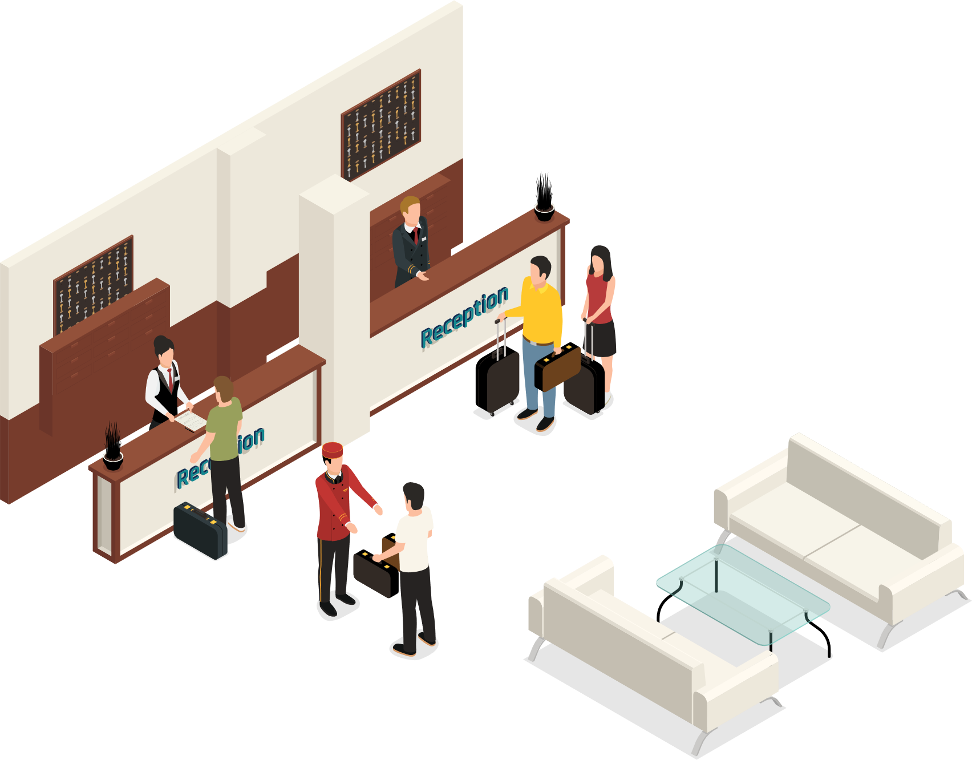
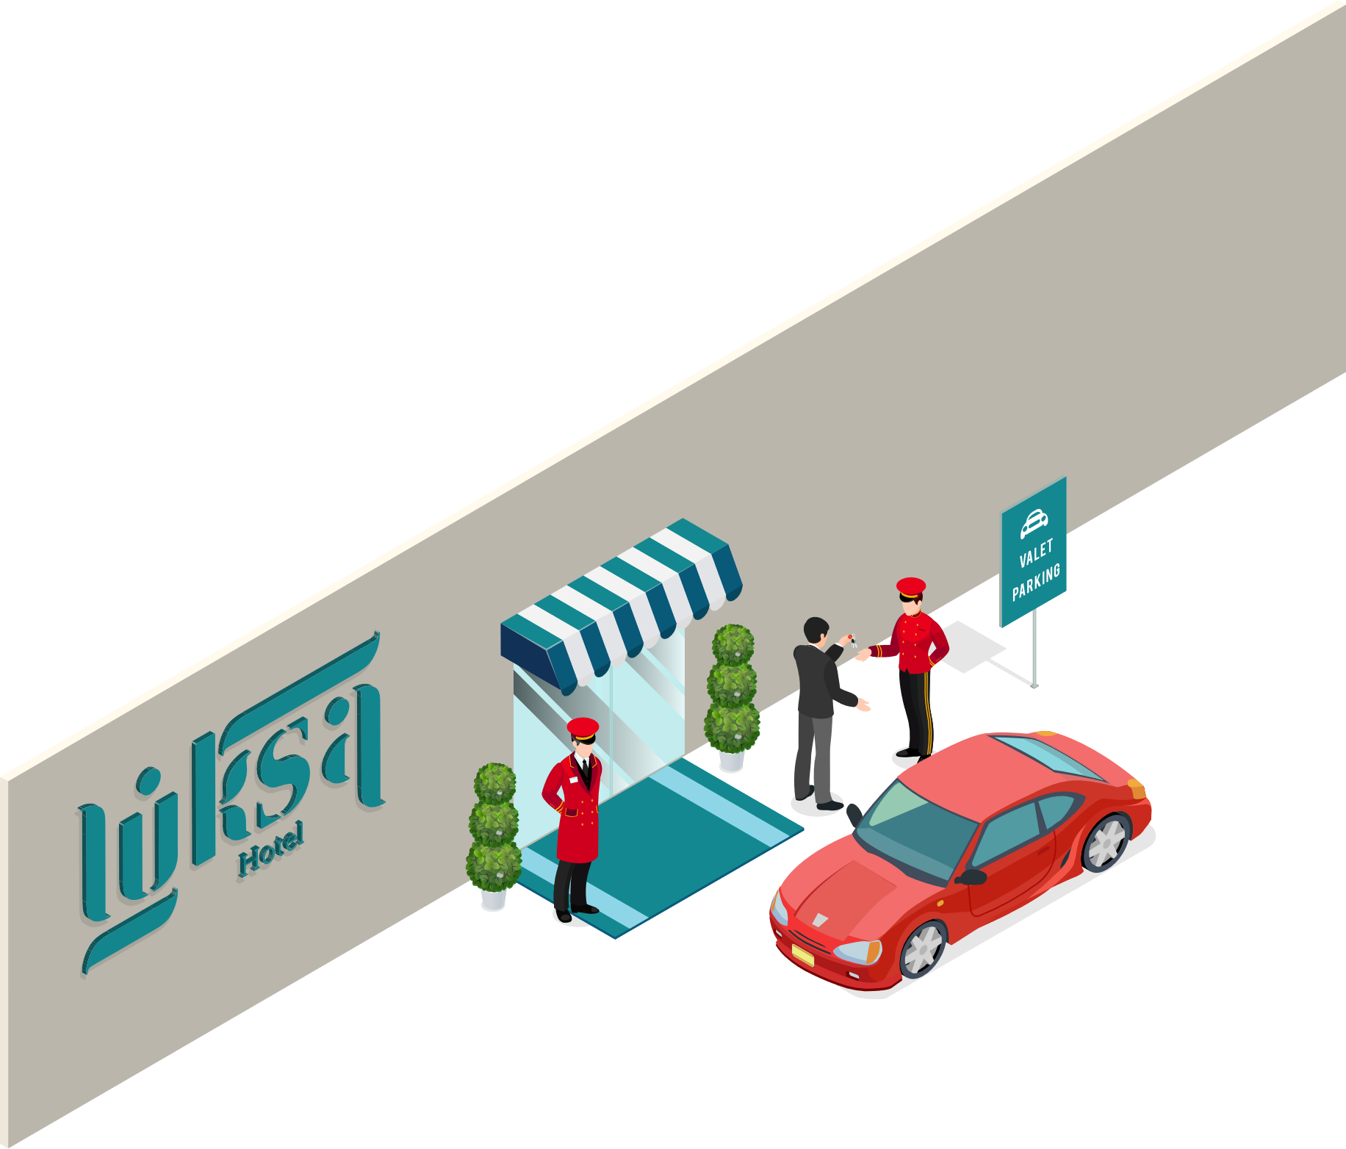


LS Hospitality
LS Central
Food & Beverage
Bookings
Staff Mgmt
KDS
Hotels

Slide 5







LS Central
for your operations
Challenges
Consolidate
Insights
Solutions
Unify
Transparency
Lack of overview
Complex processes
for employees
Smooth
guest journey
Empower
employees
ntegrate guest info
from external and internal
data sources

Slide 6
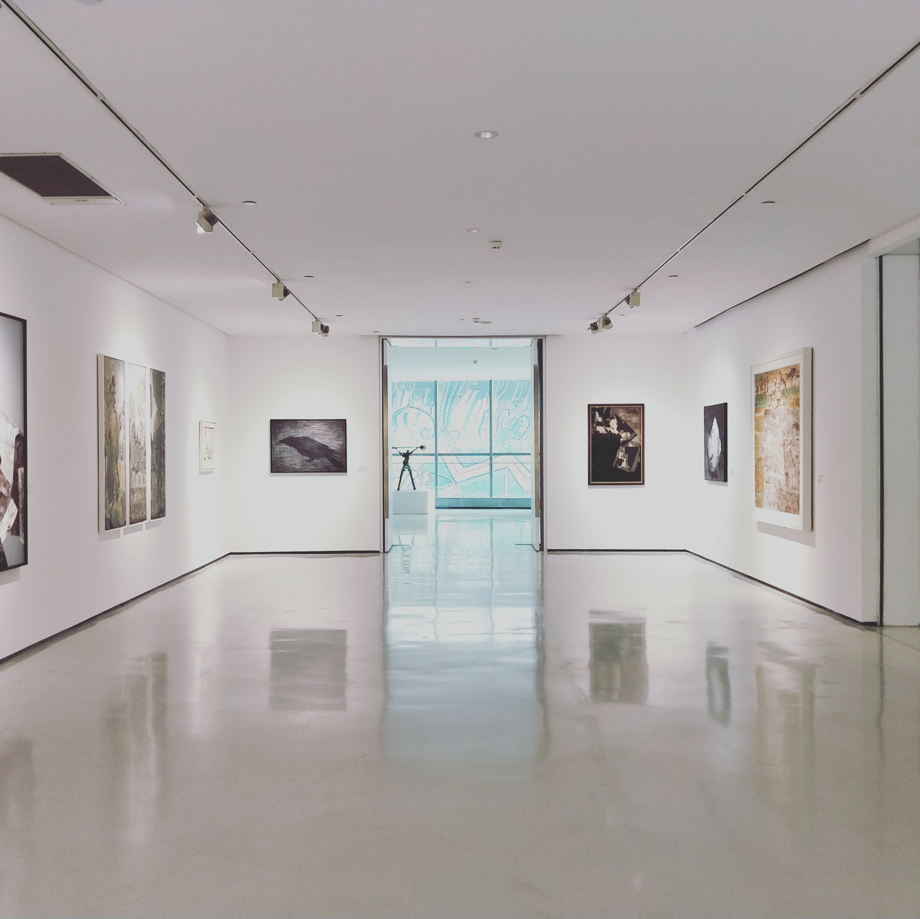
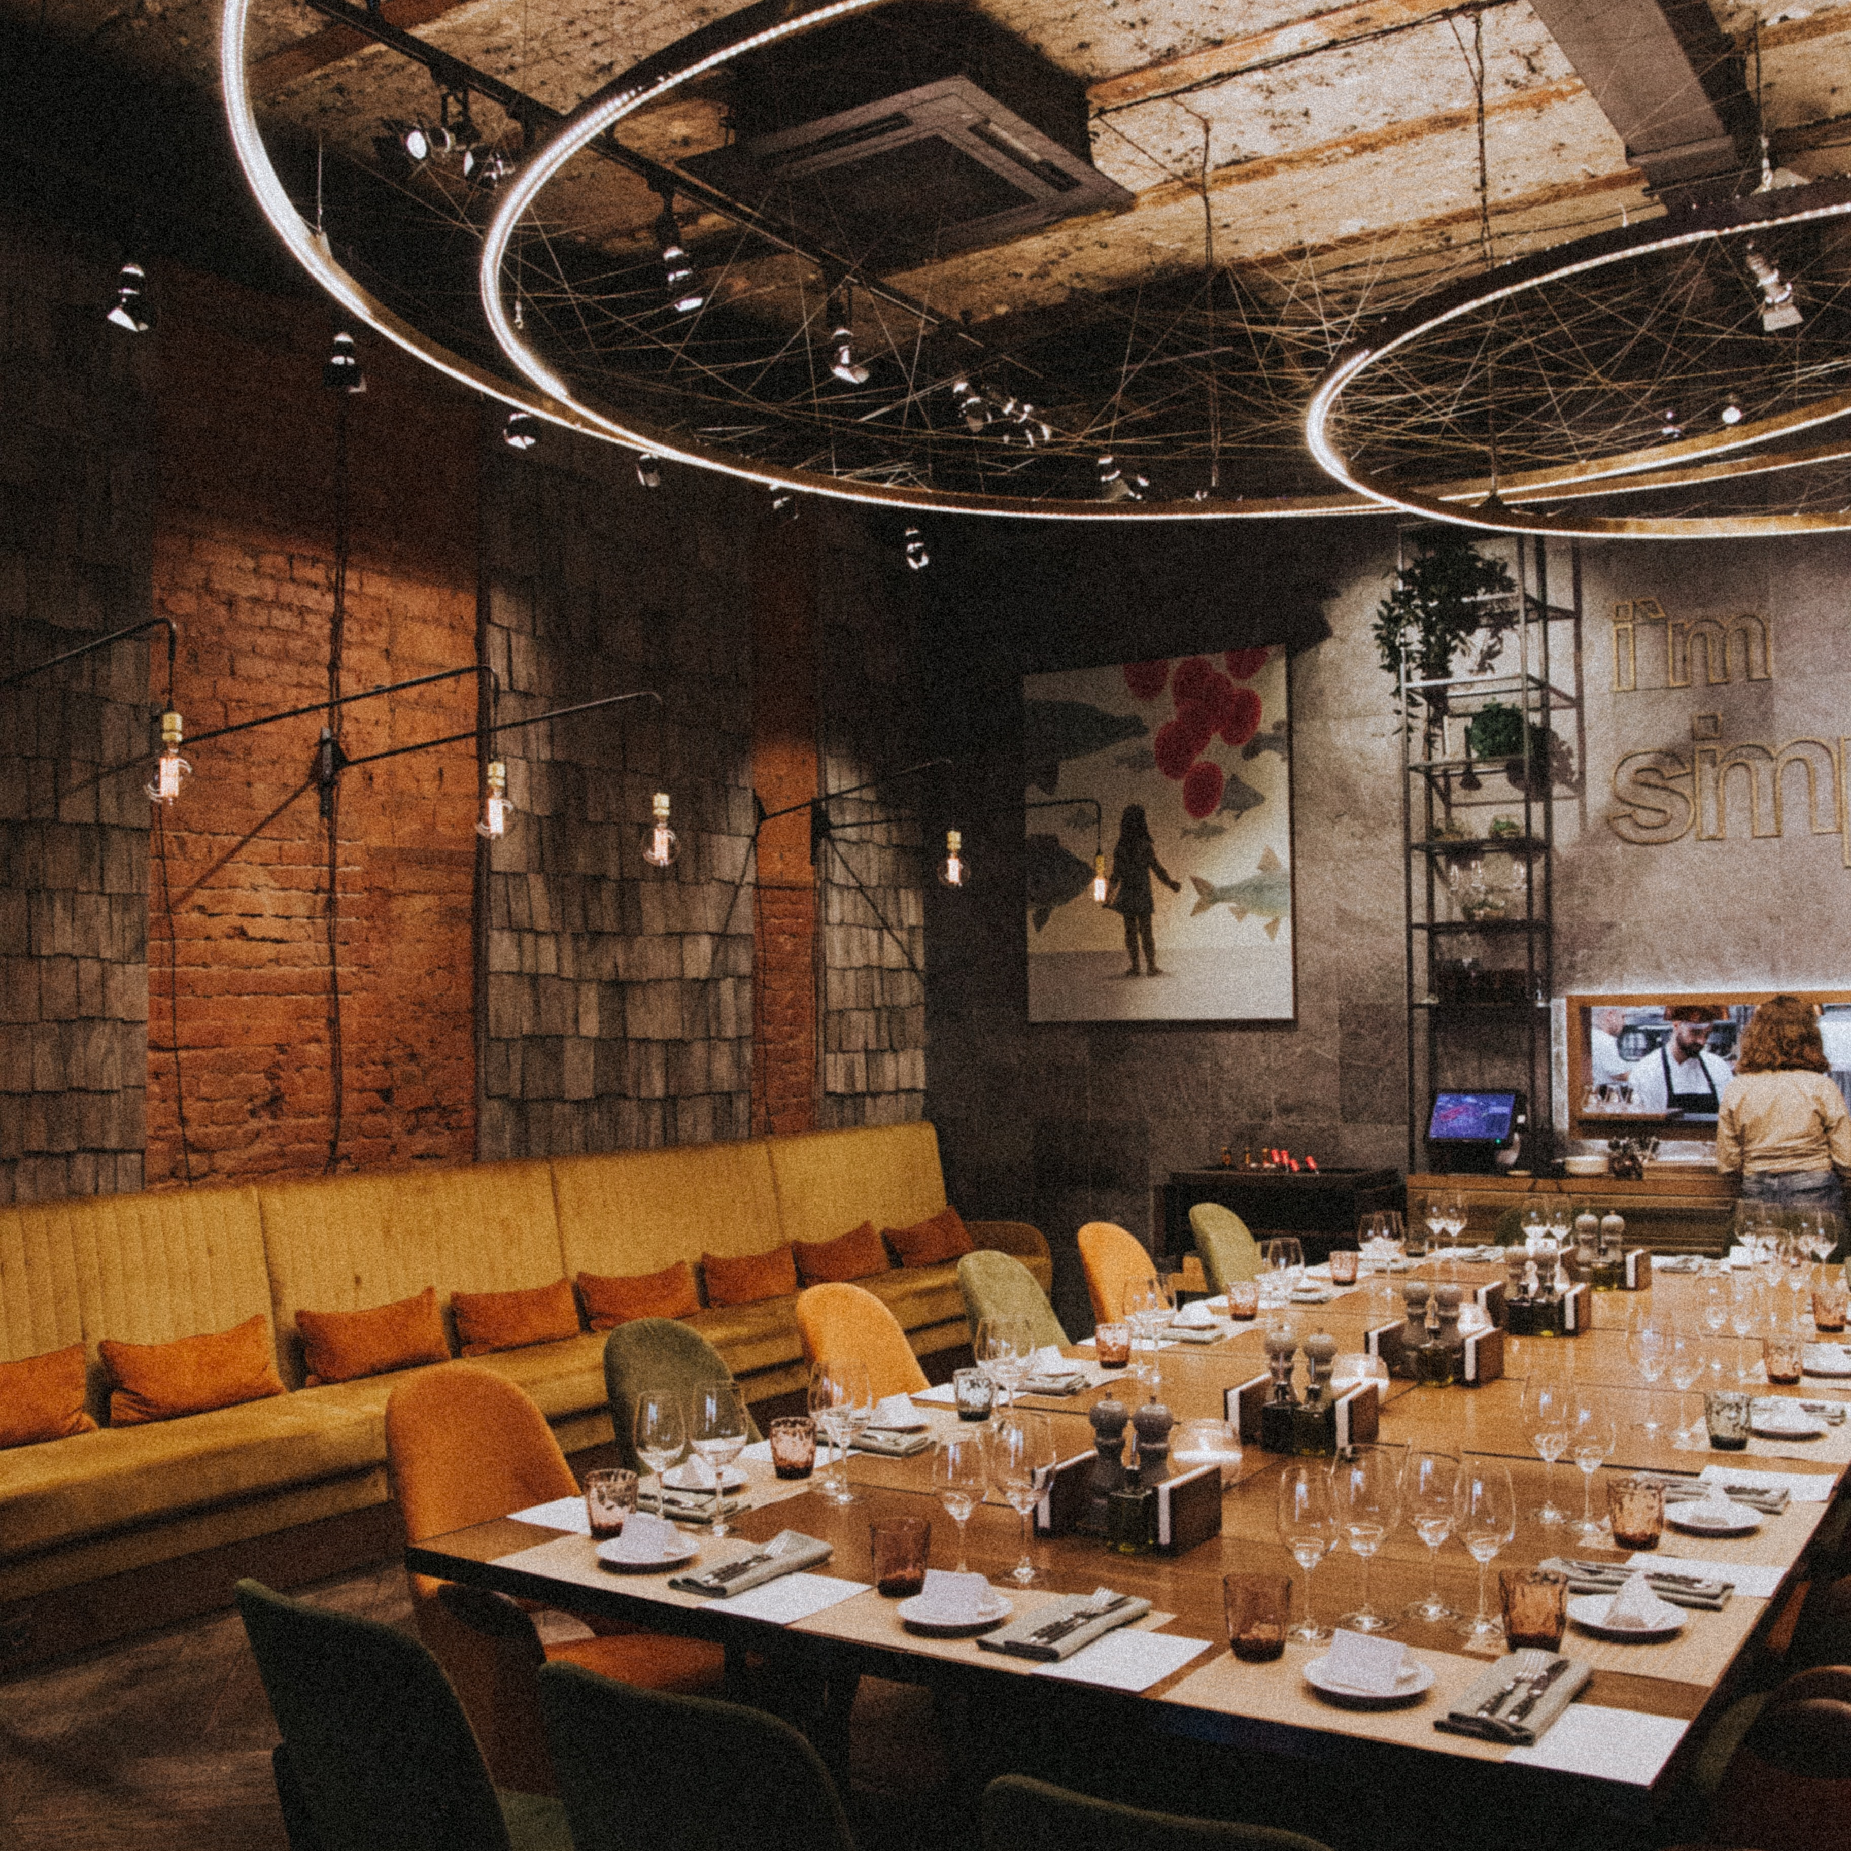
Bookings for LS Central
New functionality

Slide 7
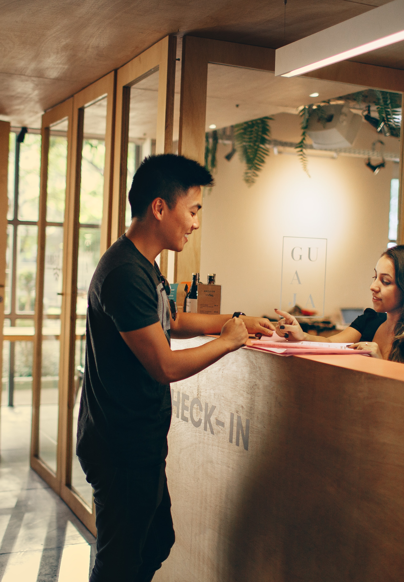
Member Contacts enhancements
Collecting guest/client data
Member contacts linked to reservations and activities
Member contacts can be automatically created
Name and other personal data used for the member contact creation

Slide 8
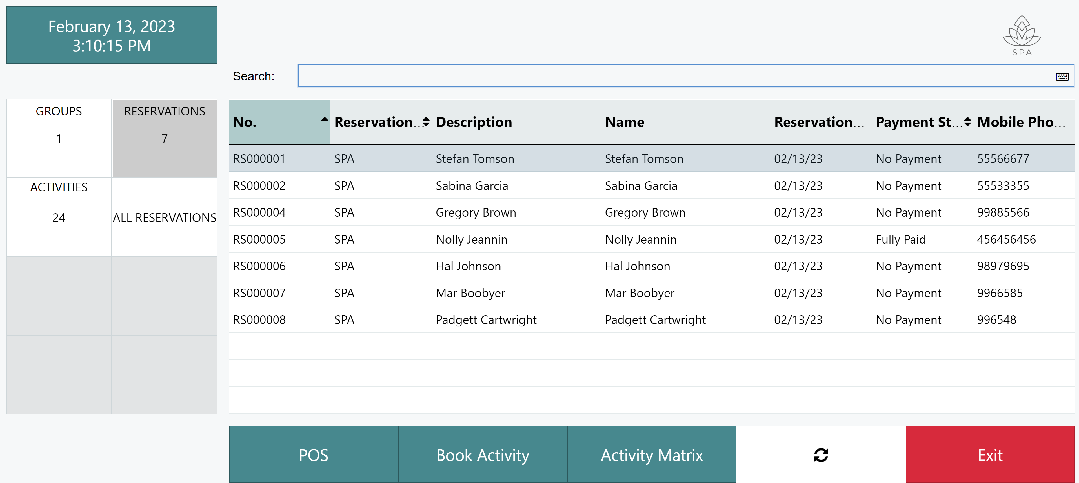
Activity Host – Reception

Slide 9
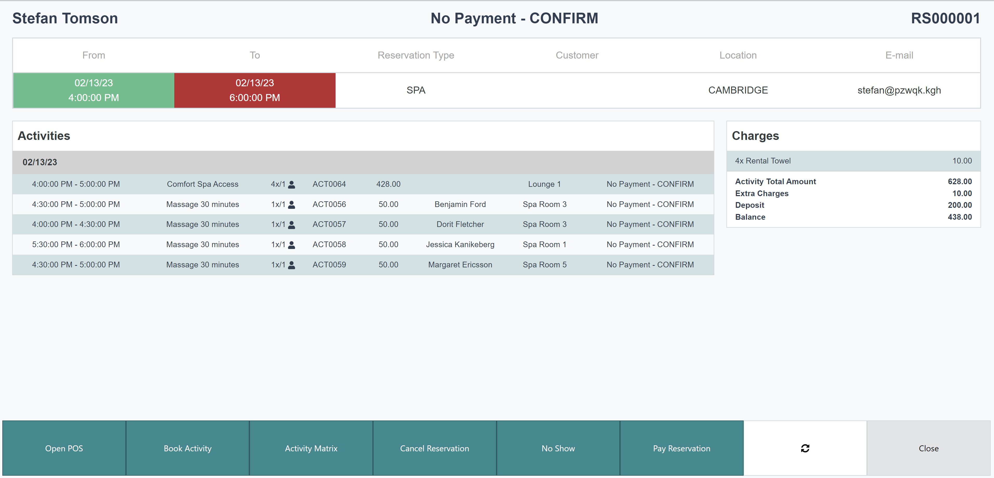
Activity Host – Reservation overview

Slide 10
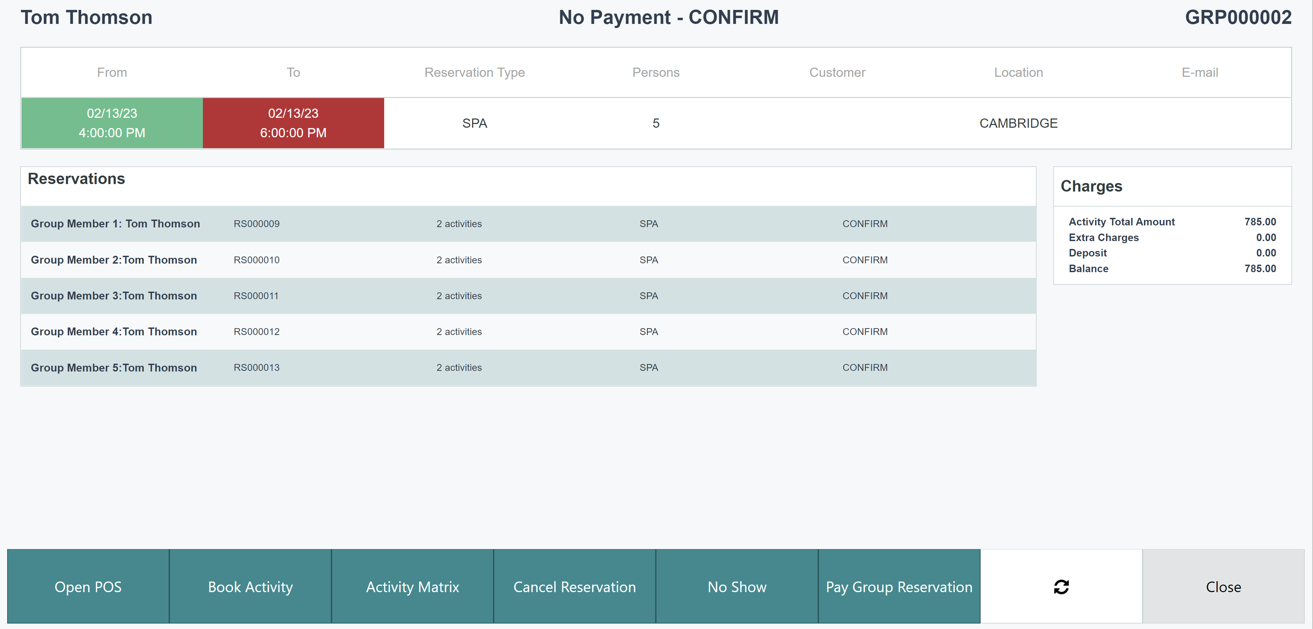
Activity Host – Group reservation

Slide 11

Conference/Events functions
Event and conferences
Additional equipment to the events
Scheduling agenda
Task management
F&B items and charges
BC quotes and invoices
Banquet Event Order Report
Version tracking of the reports

Slide 12
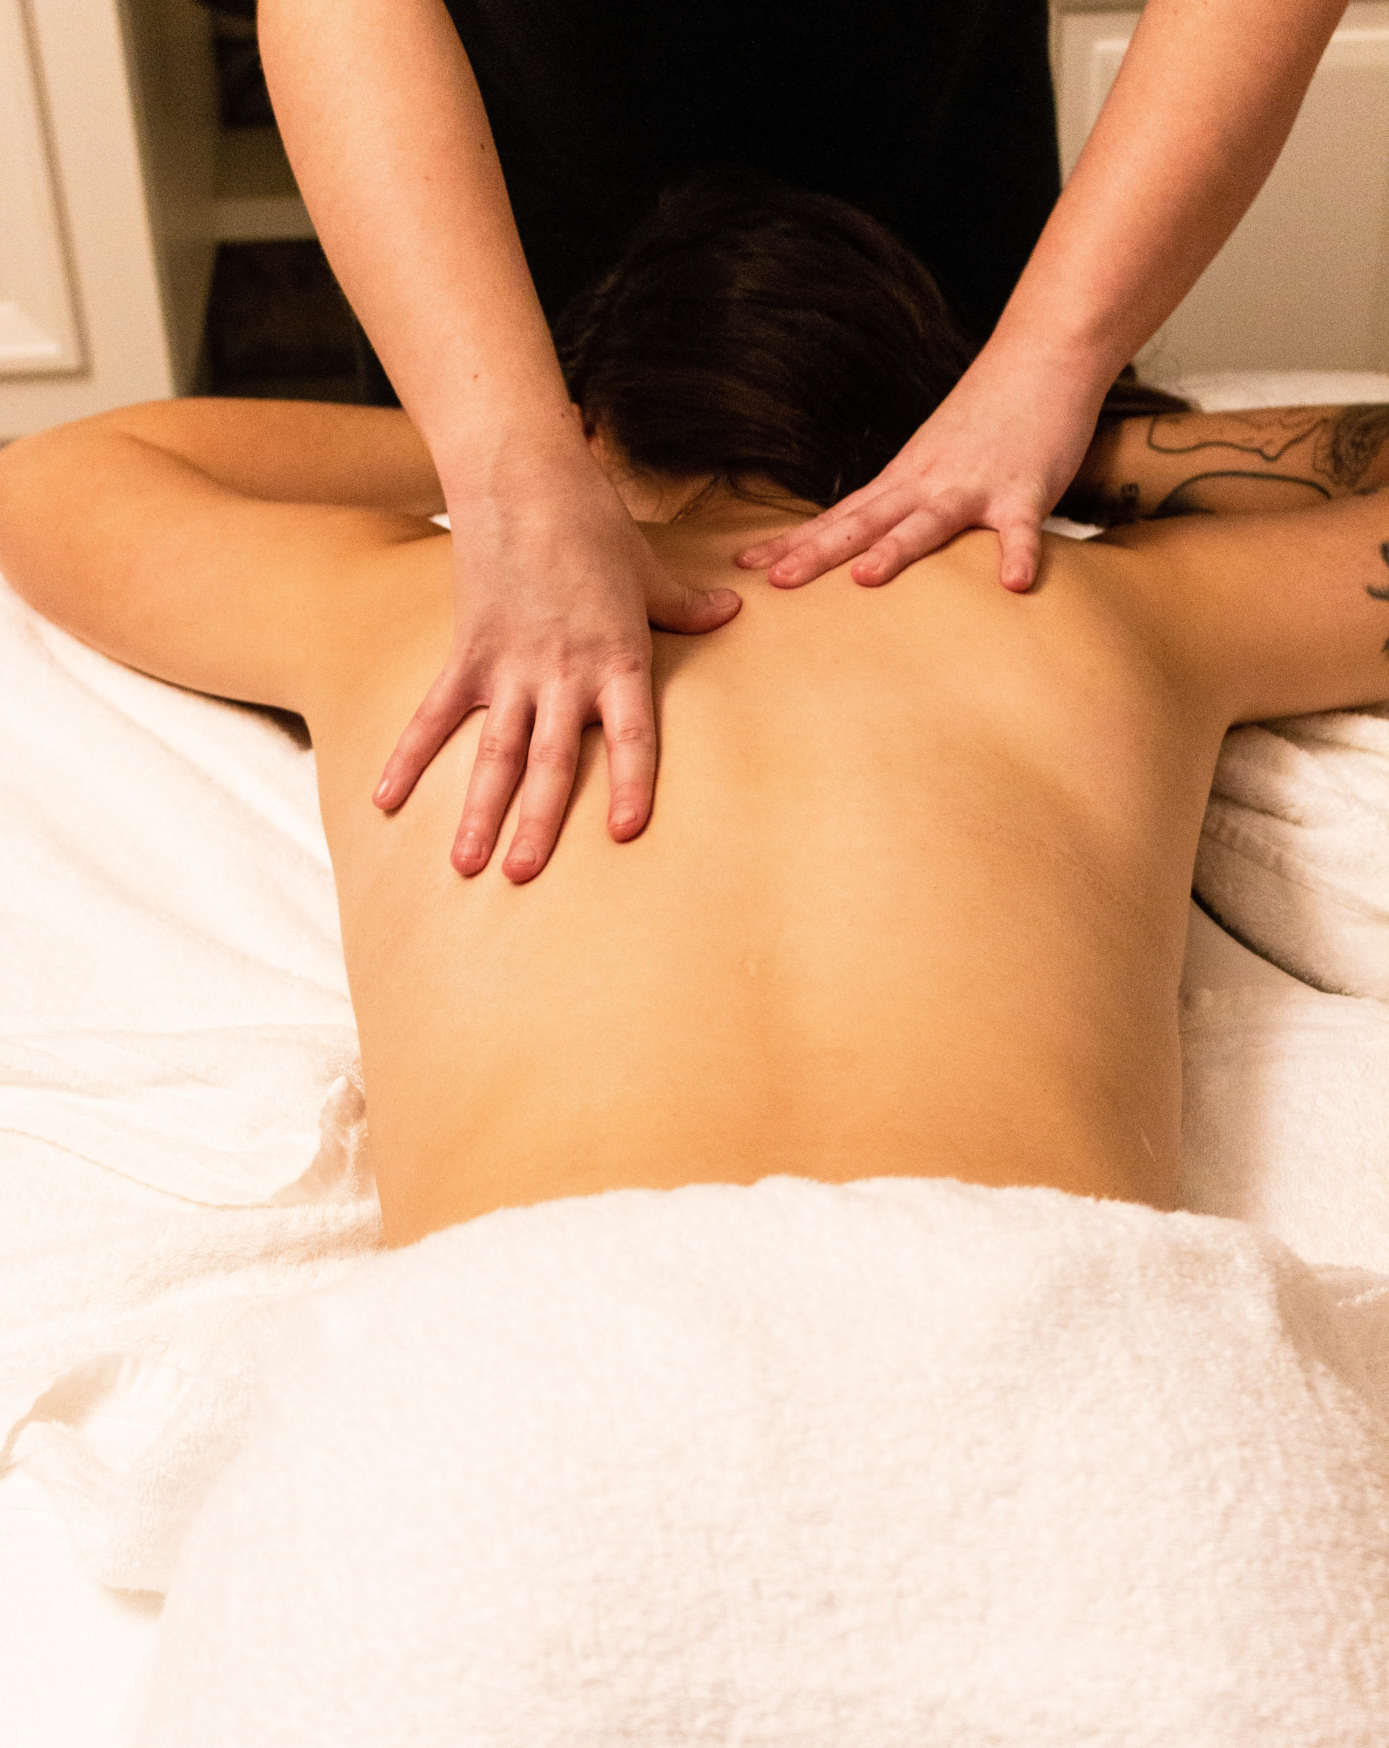
Matrix - visual overview
View of resources availability and assignments
Configurable view of appointments details and customer info
Day view for multiple resources
Week view for one resource
Drag and drop function
Create/view multiple appointment per time slot

Slide 13
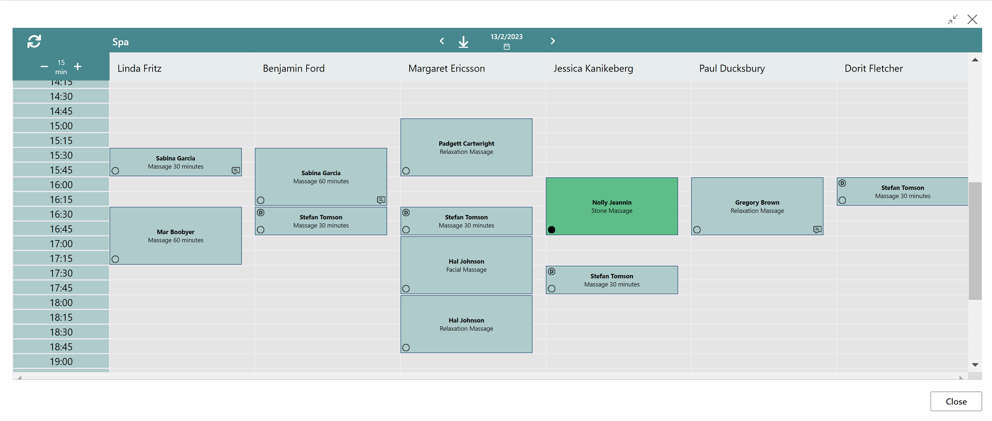
Matrix - visual overview

Slide 14
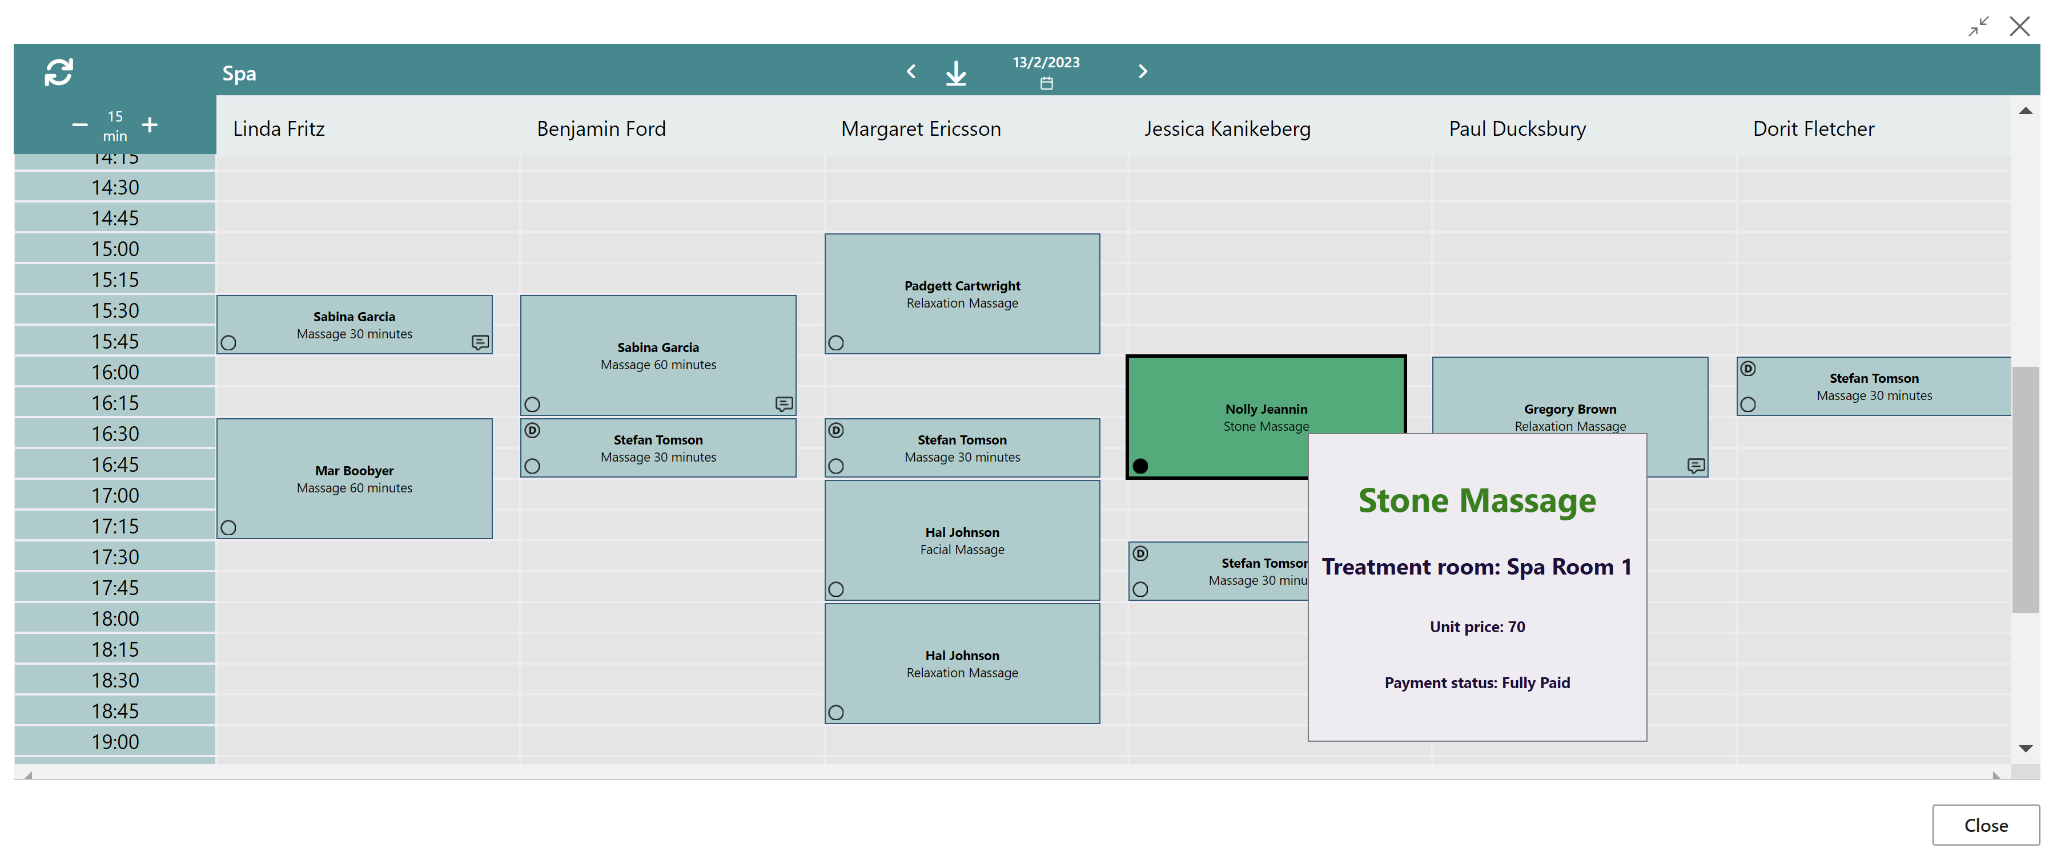
Matrix - visual overview

Slide 15
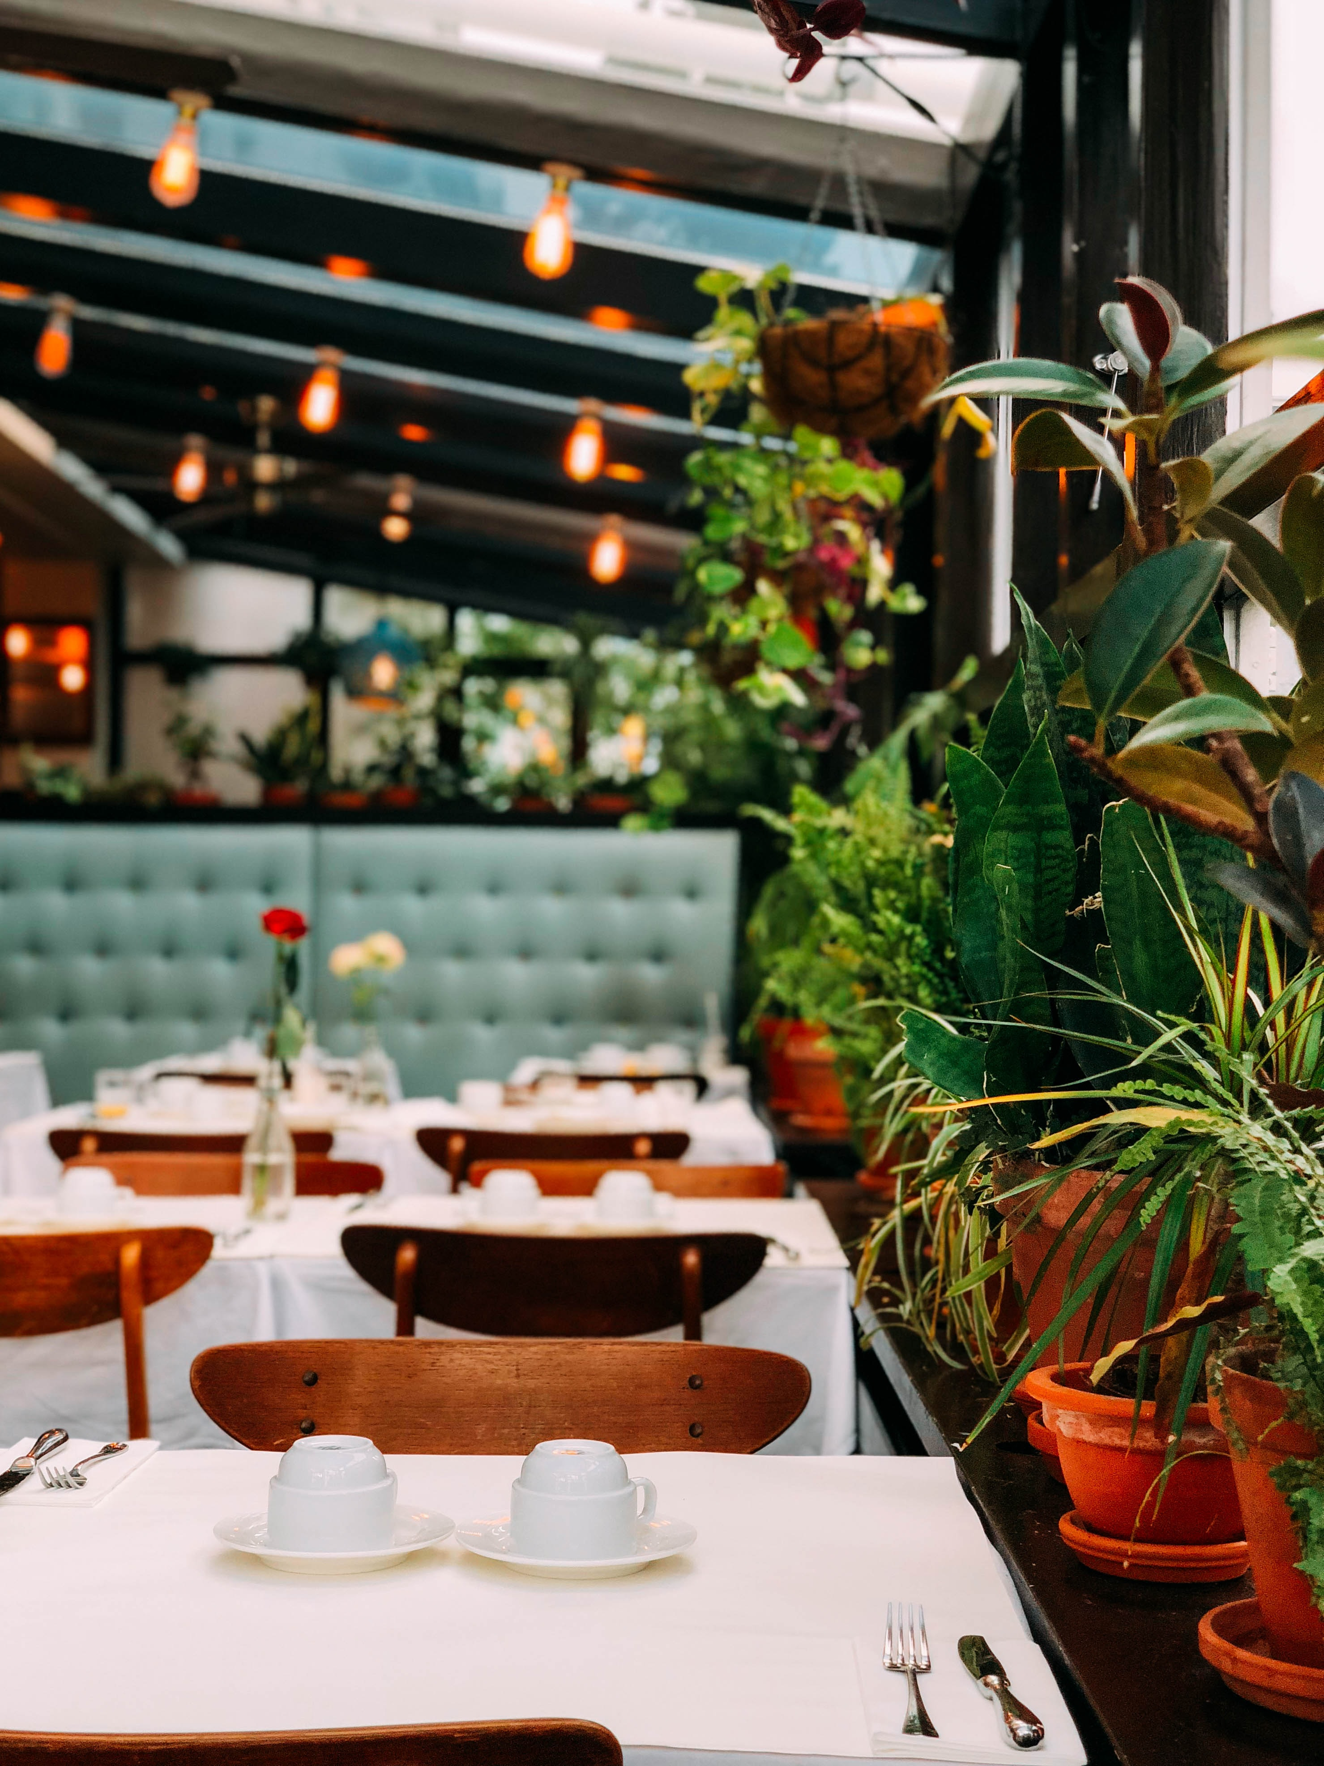
Comments framework
Comments on multiple places
Collecting all to one table structure
  Activities, Reservation and Groups
  Dining table reservations
  Hotel Reservations
Give staff full overview of the guest comments
Enhance the service experience and possibilites

Slide 16
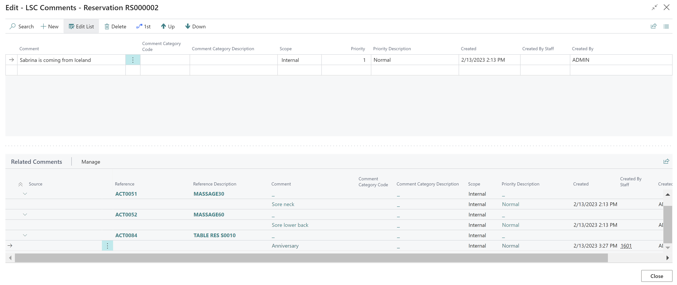
Comments – One table structure

Slide 17

DEMO

Slide 18
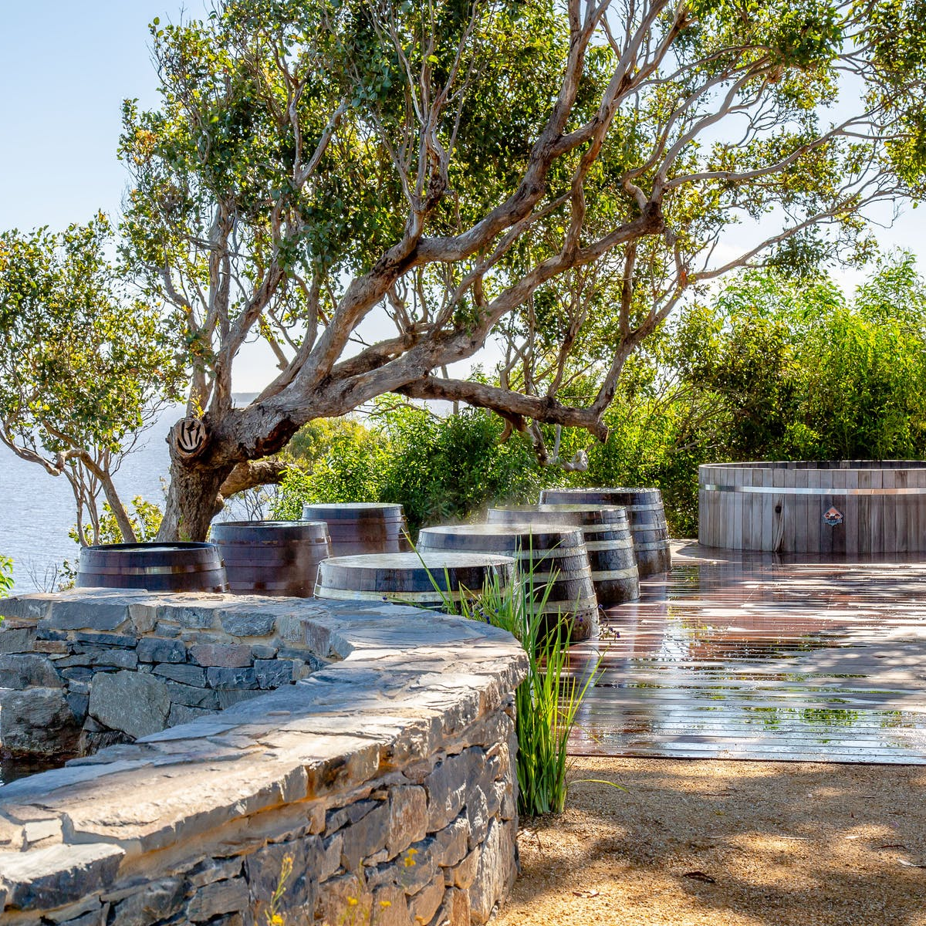
Customer Story

Slide 19
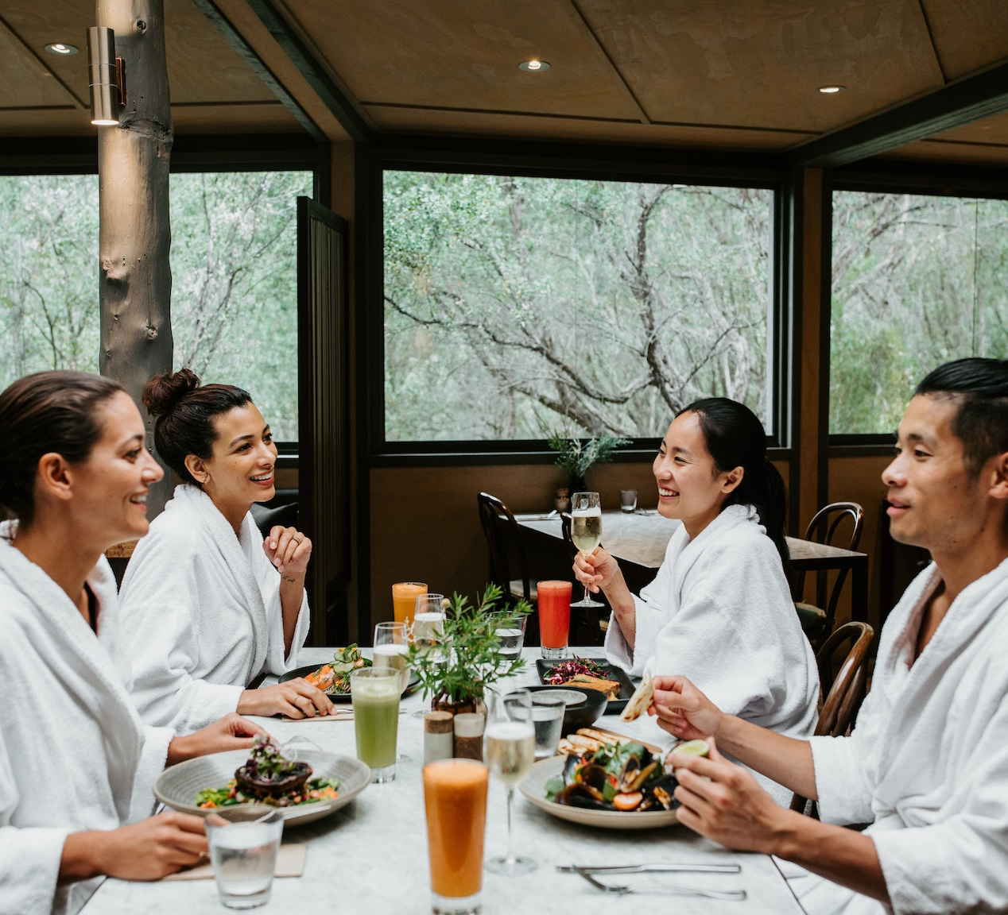
Peninsula Hot Springs
Located in Australia
  Metung Hot Springs
  Fingal Hot Springs
  Phillip Island Hot Springs
Spa Resort
  LS Central for Retail
  LS Central for Restaurants
  LS Central for Hotels
  Bookings for LS Central
  Staff Management for LS Central

Slide 20
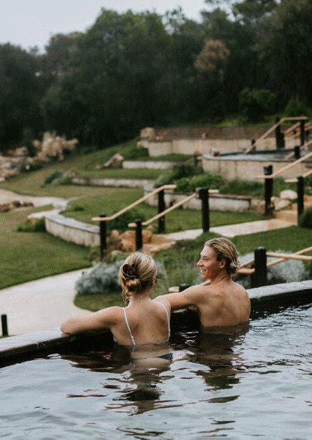

Peninsula Hot Springs
Reservation for accommodation, bathing, packages and treatments
Online and walk in reservations
Prebooked food orders and a la cart restaurants
Keeping track of guests details and history

Slide 21
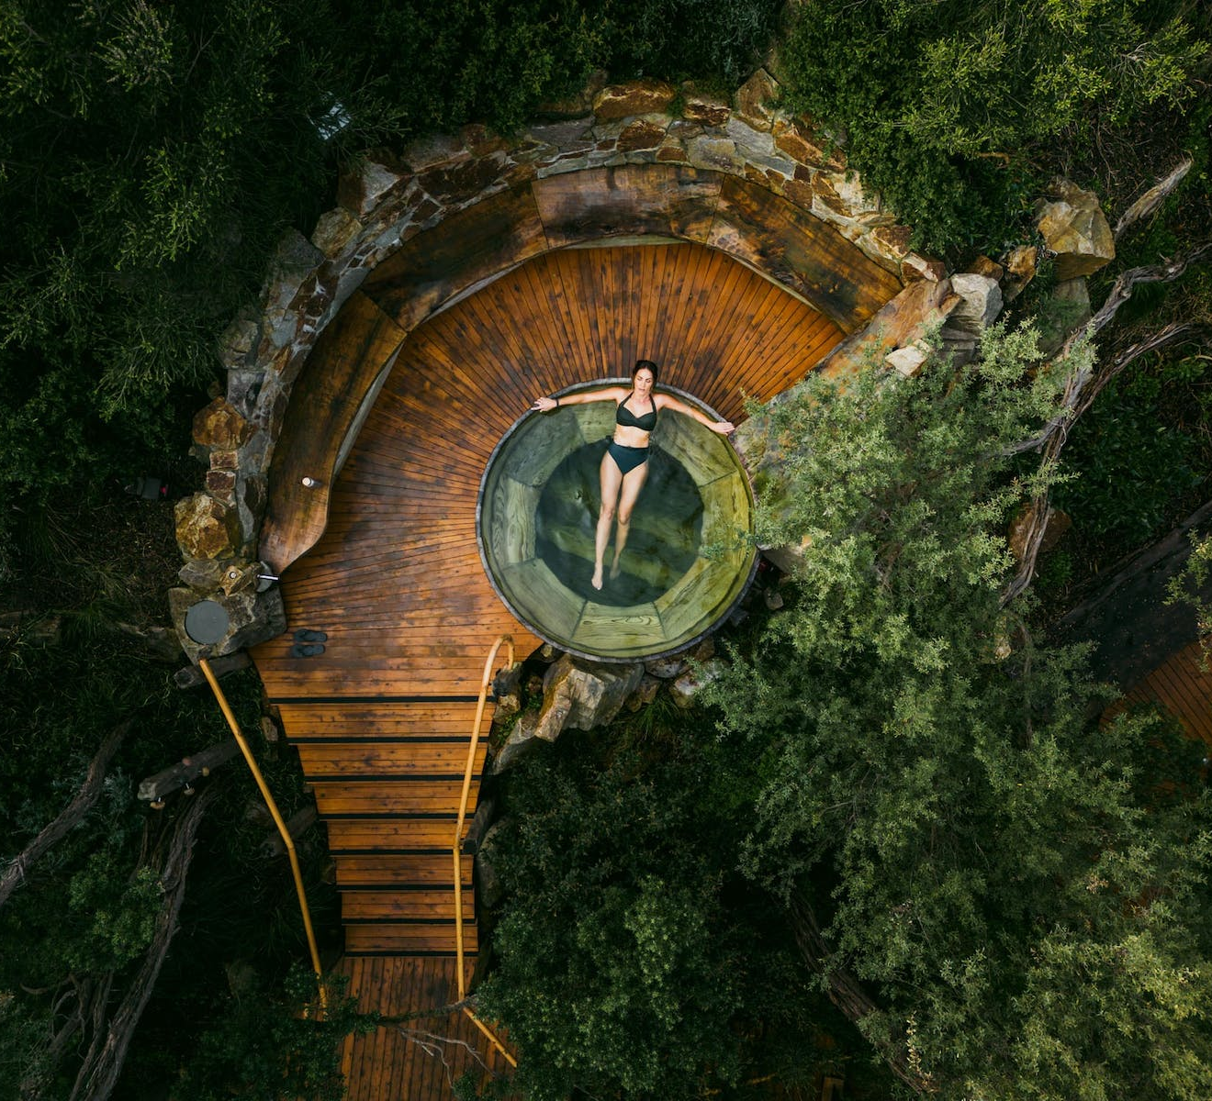
Peninsula Hot Springs
Looking to implement an "all in one" solution for the operations
Implementation in cooperation with local partner
Fully remote implementation
Management vision clear and project support important
Customer pushing for standard solution

Slide 22
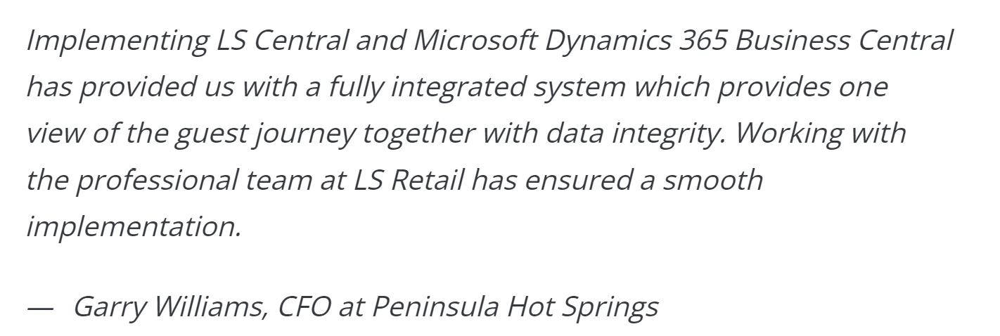
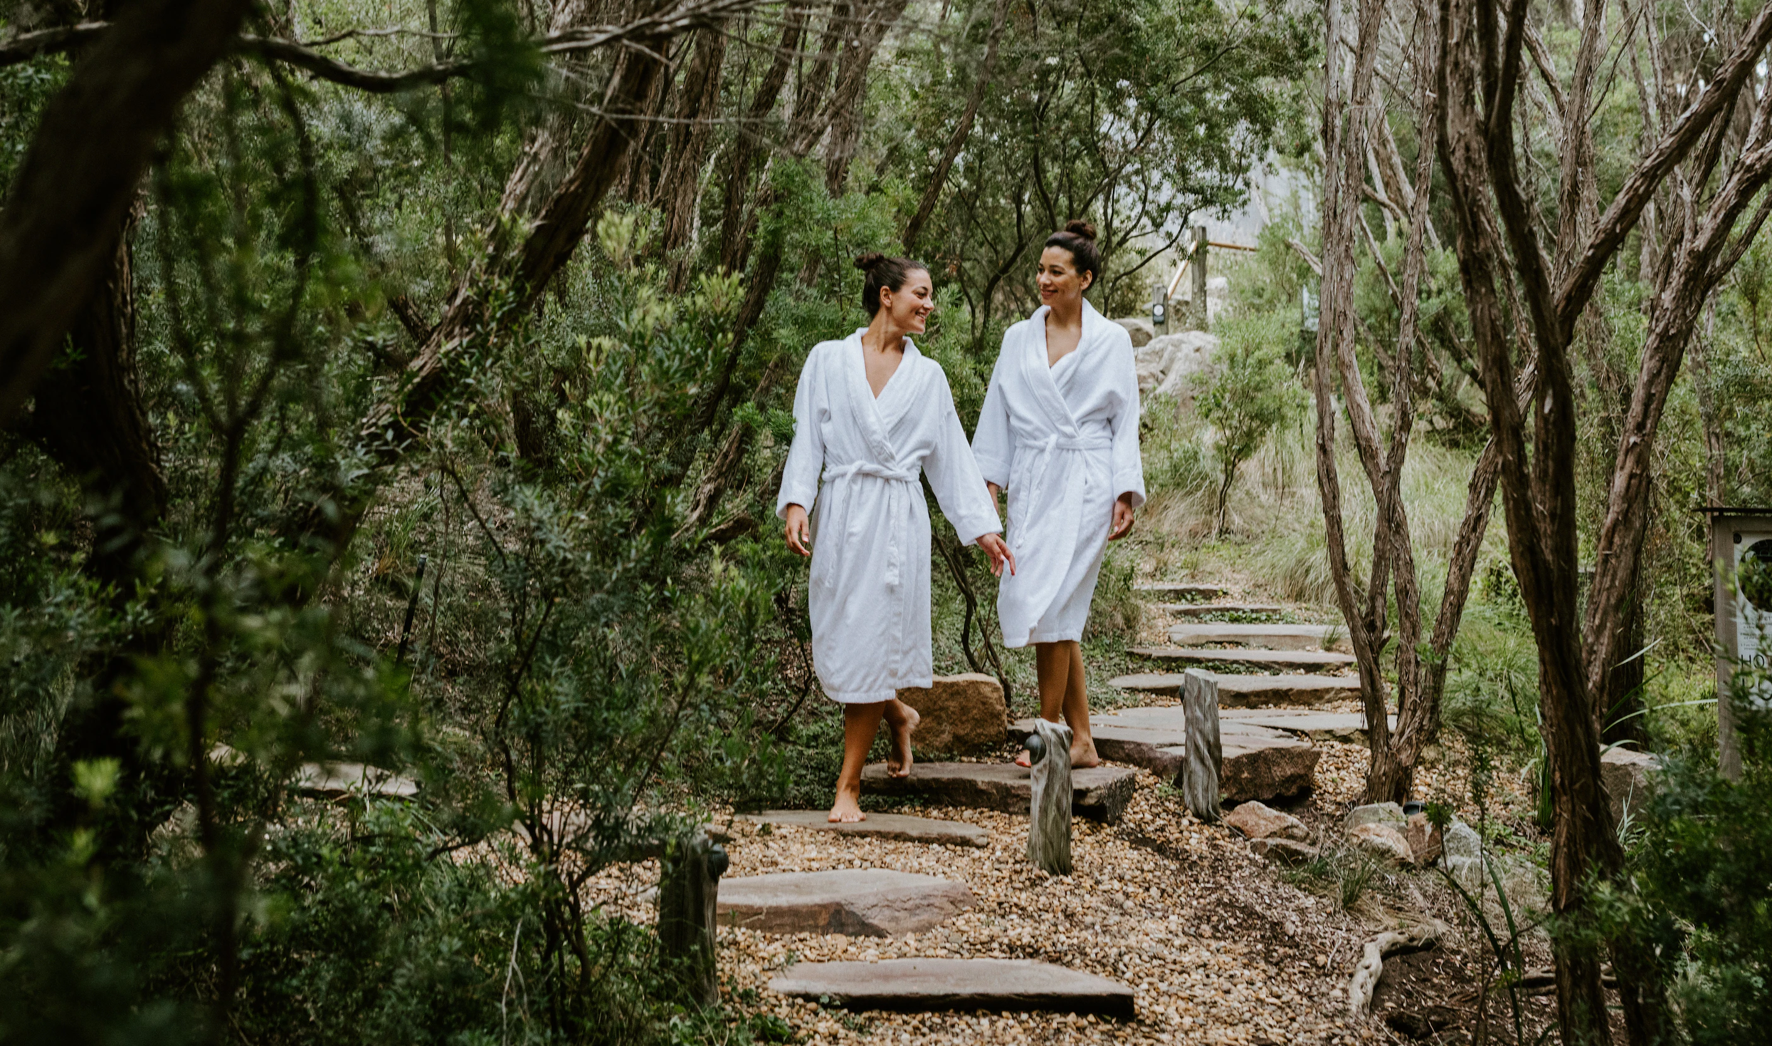
Peninsula Hot Springs
As little customization as possible
Internal change management and training
Rollout of first small location
Smooth go live
Currently implementing next location

Slide 23

Bookings for LS Central roadmap
Guest Types
Recurring Activities
Event Management
Activity pricing based on Guest Type
Also for Hotels
Warnings
Re-assignments
Day view for Event categories
Event scheduling
Activity Front Desk Host
Enhanced reservation view
Enhanced group view
Activity details
Matrix
Month viewRecurring activities
Task Management
Statistics
Features are subject to change

Slide 24
Thank you

