Slide 2

LS Pay for
Business Central

Slide 3


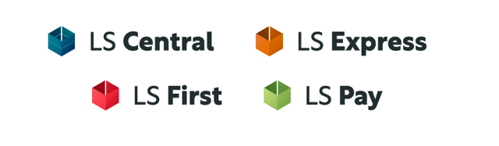
LS Pay is now an
official product

Slide 4



Slide 5




The payment topology
Payment Service Provider (PSP)
Acquirer / Processor
Pin Entry Device
(PED)
Merchant

Slide 6
The payment topology
Payment Service Provider (PSP)
Acquirers / Processors
Pin Entry Device
(PED)
Merchant

Slide 7





LS Pay – High level architecture
Adyen
Adyen
LSPay API
LS Pay
Engine
Planet
Planet
Verifone
Verifone

Slide 8


LS Pay - Deployment
HO/BO
Call center
Self check-out
Kiosks
Scan Pay Go
Hardware
Station
LS Pay
Service
3rd party
POS provider

Slide 9

LS Pay for Business Central
Business
Central
Hardware
Station
LS Pay
Service
3rd party
POS provider

Slide 10

LS Pay
Service

Slide 11
LS First
3rd Party Applications (Kiosks)
LS Pay
Service

Slide 12
LS Central
LS Express
POS
BO
HO (Hotels)
Call Center
POS
BO
LS First
3rd Party Applications (Kiosks)
LS Pay
Service

Slide 13
LS Central
LS Express
POS
BO
HO (Hotels)
Call Center
EFT Extension
POS
BO
EFT
Extension
LS First
3rd Party Applications (Kiosks)
LS Pay
Service

Slide 14
Business Central
LS Central
LS Express
POS
BO
HO (Hotels)
Call Center
EFT Extension
EFT Extension
POS
BO
EFT
Extension
LS First
3rd Party Applications (Kiosks)
LS Pay
Service

Slide 15
Business Central
LS Central
LS Express
LS Pay App
POS
BO
HO (Hotels)
Call Center
EFT Extension
EFT Extension
POS
BO
EFT
Extension
Sales Documents
LS First
3rd Party Applications (Kiosks)
LS Pay
Service

Slide 16
Sales Documents
Payment Features

Slide 17
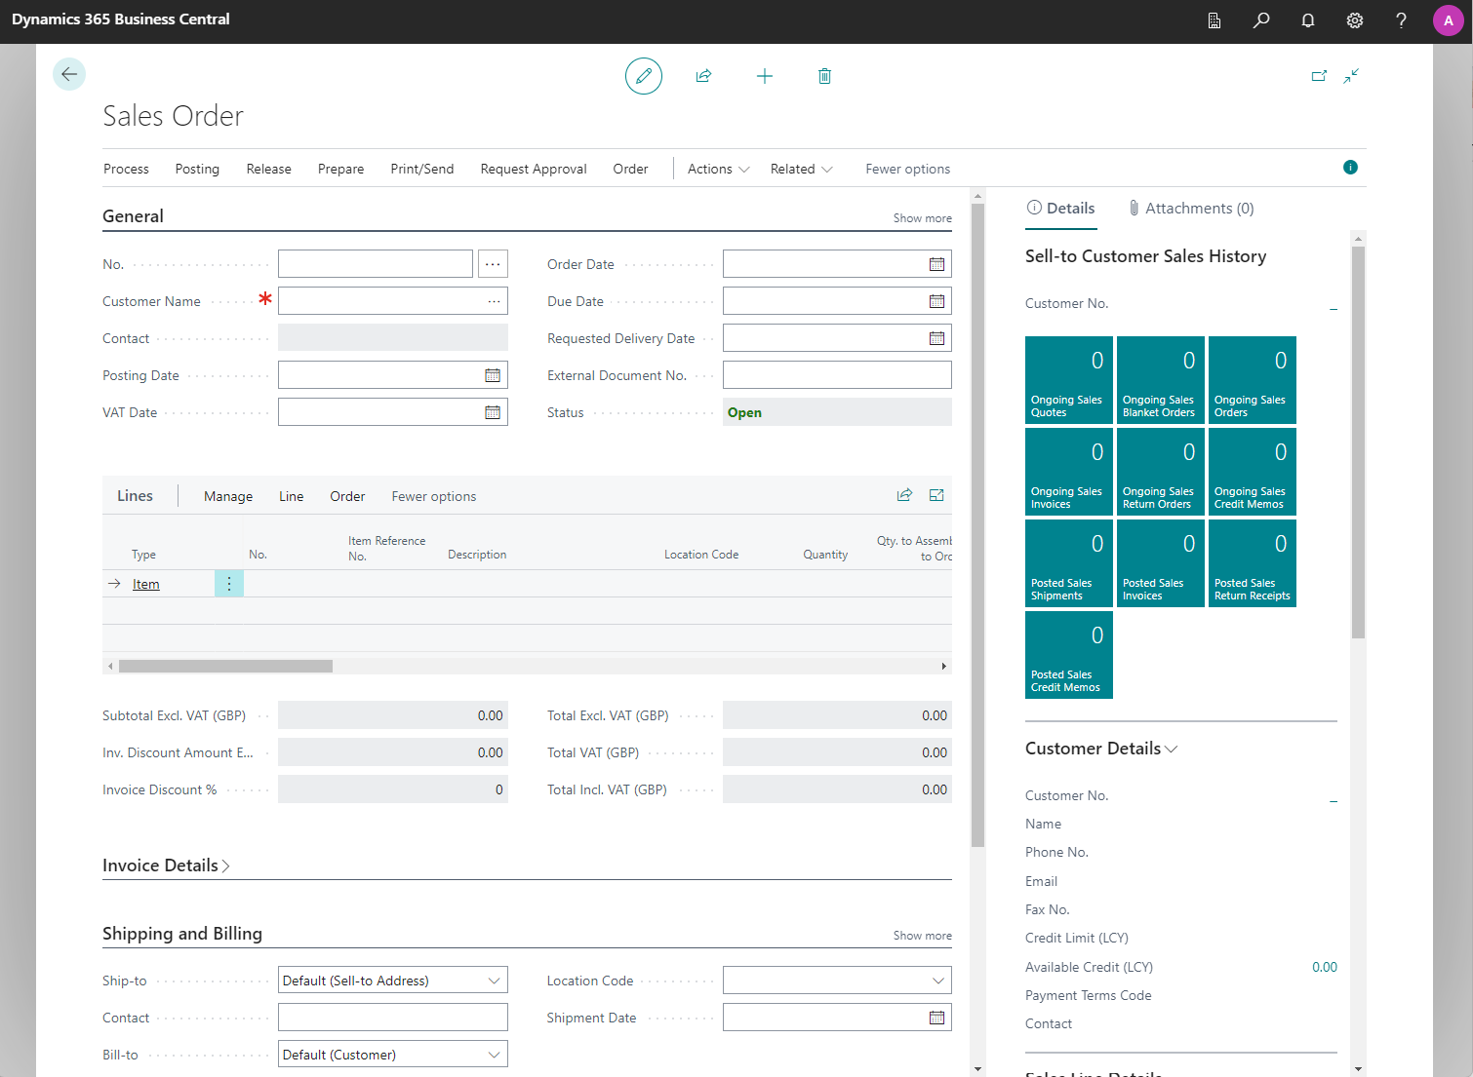
Sales Orders
Generic payment support
Full payment/capture on placing orders
Pre-authorization on placing orders and full capture on shipping
Extending the time period of pre-authorizations
Adjusting pre-authorization amounts catering for unknown shipping costs
Support for “card on file”
Card not present support
  Manual card number entry on PED
  Payment links by email and text messages
Support for alternative payment methods

Slide 18
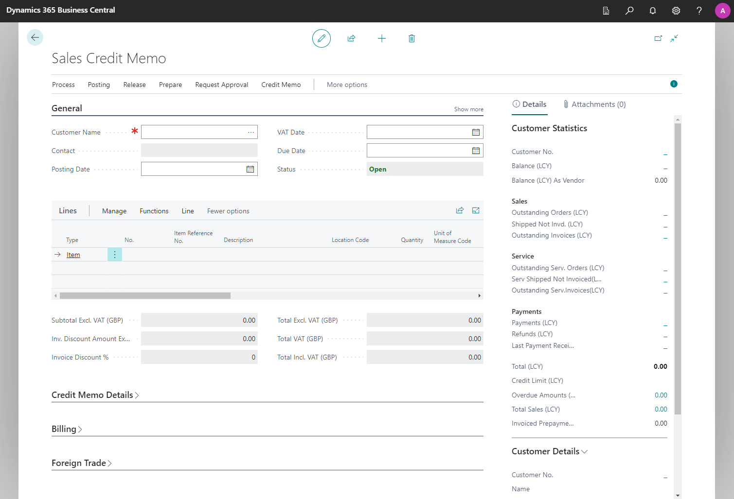
Sales Credit Memos
Generic return/cancel support
Voiding completed payments
Refunding completed payments
Cancelling existing pre-authorizations
Modifying existing pre-authorizations

Slide 19
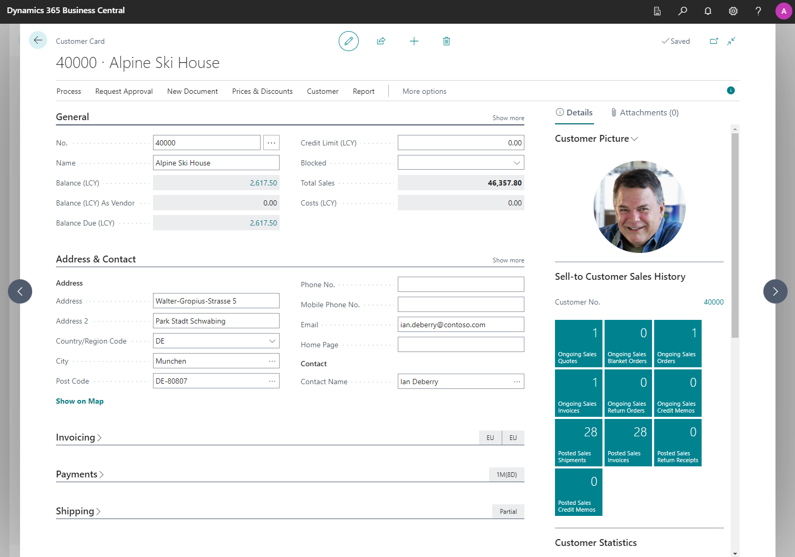
Customer accounts
Generic payment support for customer accounts
Paying multiple invoices at once
Card on file library

Slide 20

Online orders
Eco system: Available Payment Plugins
Generic 3rd party eCommerce pre-authorizations
Full capture
Cancels
Modifications
3rd party
eCommerce
provider
LS Pay App
Business
Central

Slide 21
50+ Supported countries

Slide 22






Supported PSPs – Americas

Slide 23

Support - Canada
Processors:
Adyen, Planet, Moneris, Chase, Global Payments, Fiserv, FISGlobal & Interac
Terminals/PEDs:
Adyen
  AMS1, S1E, S1F2
Verifone Engage
  M400, M440, M424, P400, E285, E280, V400m, V400c, V240m
Verifone Android
  T650c, T650p, T650m, T650t, Ux700, M424, M440
Ingenico
  Move, Desk & Lane
PAX
  A920Pro, A77, A60, A30, A35, IM30

Slide 24

Support – United States
Processors:
Adyen, Planet, Chase, Global Payments, Fiserv, FISGlobal, Elavon, TSYS, Heartland, Vantive & WorldPay
Terminals/PEDs:
Adyen
  AMS1, S1E, S1F2
Verifone Engage
  M400, M440, M424, P400, E285, E280, V400m, V400c, V240m
Verifone Android
  T650c, T650p, T650m, T650t, Ux700, M424, M440
Ingenico
  Move, Desk & Lane
PAX
  A920Pro, A77, A60, A30, A35, IM30

Slide 25










Vision - Americas

Slide 27

Timeline
1st release launch in Q1 2024

Slide 28
Thank you

