Slide 1
Winter, Spring,
Summer and Fall
Replenishment for fashion
Martin Kleindl
Product Director

Slide 2





Slide 3

Items
Colors, Sizes
Prepacks
Seasons
Planning, Budgets,
Open-to-Buy
Assortmt.
Mgmt.
Allocation Plans,
Purchase Orders
Replenish ment
Store Stock Redistribu- tion
End-of-Season Sales
Stock Recalls

Slide 4
Items
Colors, Sizes
Prepacks
Seasons
Planning, Budgets,
Open-to-Buy
Assortmt.
Mgmt.
Allocation Plans,
Purchase Orders
Replenish ment
Store Stock Redistribu- tion
End-of-Season Sales
Stock Recalls

Slide 5
Budgets and open-to-buy
Budgets with limitless levels and top-down and bottom-up approach
Features:
  Calculate budgets from historical data
  Master-child budget consolidation
  Excel integration
  Advanced copy features
  for budget versions
  Budget breakdown
  to stores, items and days
  Integration with
  automatic replenishment
  Open-to-Buy calculation
Intergration
Budget
Budget
Automatic Replenishment
Bottom-Up
(Consolidation)
Top-Down
(Break down)
Budget Clothes
Budget Shoes
Break down to:
- Stores
- Items
- Days
Budget Cloth-Men
Budget Cloth-Women

Slide 6
Items
Colors, Sizes
Prepacks
Seasons
Planning, Budgets,
Open-to-Buy
Assortmt.
Mgmt.
Allocation Plans,
Purchase Orders
Replenish ment
Store Stock Redistribu- tion
End-of-Season Sales
Stock Recalls

Slide 7






Assortment management
  Easy and powerful assortment management with top-down approach and inheritance
  Drastically reduces effort and cost for maintaining assortments
  Full transparency
  Reduces risk of failure
  with versions and assortment history
  Supports grading
Assortment
Items
Stores

Slide 8
Live Demo

Slide 9
Items
Colors, Sizes
Prepacks
Seasons
Planning, Budgets,
Open-to-Buy
Assortmt.
Mgmt.
Allocation Plans,
Purchase Orders
Replenish ment
Store Stock Redistribu- tion
End-of-Season Sales
Stock Recalls

Slide 10

Manual replenishment
Processes for seasonal/one-time items
Concepts
  Plan/rule driven with Fashion Matrix
  Push-principle
  Allocation rules
  (distribution rules for stores)
  Variant weight curves
  (distribution rules for sizes, colors, …)
Processes
  Allocation Plan
  Buyer’s Push
  Manual Purchase & Transfer Orders
Vendor A
Purchase
and/or
Push
Warehouse 1
Store 1
Store 2
Store 3

Slide 11

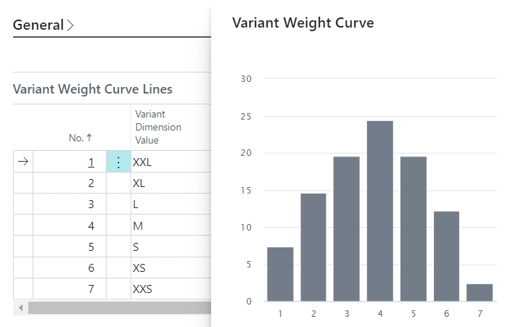
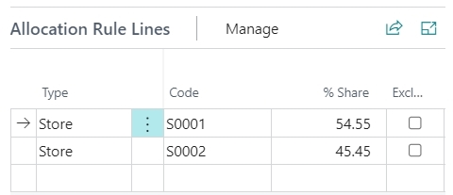
Allocation & Variant Rules
Distribute items to stores based on store allocation rules and size/color weight curves
Calculation of size/color distribution from historical sales data
  Based on item categories and product groups
  Geographical influence factors
  (distribution curves on global stores and store groups level)

Slide 12
Items
Colors, Sizes
Prepacks
Seasons
Planning, Budgets,
Open-to-Buy
Assortmt.
Mgmt.
Allocation Plans,
Purchase Orders
Replenish ment
Store Stock Redistribu- tion
End-of-Season Sales
Stock Recalls

Slide 13
Automatic replenishment
For reoccurring items
Concepts
  Demand driven
  Pull-Principle
  Multiple warehouses
  Different item flows
  Multiple calculation methods
Processes
  Periodic calculation of stock and demand across the supply chain
  Proposals for transfers and purchases
  Automatic or manual document creation and processing
To warehouse
with Xdocking
To store
To warehouse
Vendor A
Vendor B
Vendor C
Warehouse 1
Warehouse 2
Store 1
Store 2
Store 3
Store 4
Store 5

Slide 14
Live Demo

Slide 15
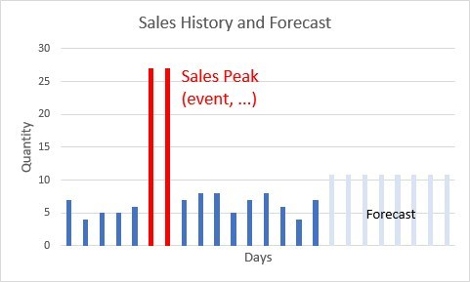


Important concepts
Planned Sales Demand
  Plan future events that have a demand impact
  Adjust expected sales and replenishment
Sales History Adjustment
  Simulate sales history for new items
  Simulate sales history for new stores
  Correct biased sales history (peaks, etc.)
Out-of-Stock Management
  Monitor and track Out-of-Stock situations
  Consideration in demand forecasting
  Handling of warehouse shortages

Slide 16
Items
Colors, Sizes
Prepacks
Seasons
Planning, Budgets,
Open-to-Buy
Assortmt.
Mgmt.
Allocation Plans,
Purchase Orders
Replenish ment
Store Stock Redistribu- tion
End-of-Season Sales
Stock Recalls

Slide 17

Store stock redistribution
WHSE
Store 5
Easy, simple, fast approach
  Define allowed routes to avoid non efficient transfers
  Calculation of overstocked and understocked stores
  Selection of redistribution strategy
  Proposal of optimal Transfer Order combinations with integration to Bing maps (route planning)
  Elimination of non efficient proposals
  Creation of Transfer Orders
Store 4
Store 1
Store 2
understocked
overstocked
Store 6
Store 3
overstocked

Slide 18
Live Demo

Slide 19
Items
Colors, Sizes
Prepacks
Seasons
Planning, Budgets,
Open-to-Buy
Assortmt.
Mgmt.
Allocation Plans,
Purchase Orders
Replenish ment
Store Stock Redistribu- tion
End-of-Season Sales
Stock Recalls

Slide 20
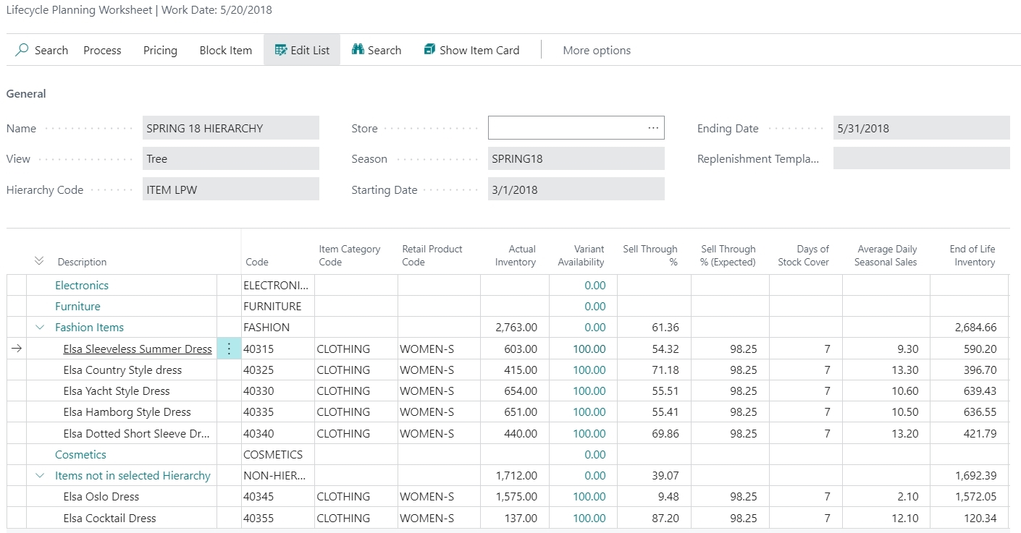


Lifecycle worksheet
Business goal:
Provide an overview of inventory, sell-through and
variant availability for seasonal items
Easy detection of stock-outs
Easy detection of slow selling items
Easy workflows
Block from purchasing
Apply new price or discount to increase sales
END of SEASON
SALE

Slide 21
Lifecycle worksheet
Business goal:
Provide an overview of inventory, sell-through and
variant availability for seasonal items
Easy detection of stock-outs
Easy detection of slow selling items
Easy workflows
Block from purchasing
Apply new price or discount to increase sales

Slide 22
Lifecycle worksheet
Apply Discounts
Apply new (lower) Prices
Business goal:
Provide an overview of inventory, sell-through and
variant availability for seasonal items
Easy detection of stock-outs
Easy detection of slow selling items
Easy workflows
Block from purchasing
Apply new price or discount to increase sales

Slide 23
Items
Colors, Sizes
Prepacks
Seasons
Planning, Budgets,
Open-to-Buy
Assortmt.
Mgmt.
Allocation Plans,
Purchase Orders
Replenish ment
Store Stock Redistribu- tion
End-of-Season Sales
Stock Recalls

Slide 24

Manual replenishment
Processes for seasonal/one-time items
Concepts
  Plan/rule driven
  Push-principle
  Allocation rules
  (distribution rules for stores)
  Variant weight curves
  (distribution rules for sizes, colors, …)
Processes
  Stock Recall
  Manual Transfer Orders
Vendor A
Recall
Warehouse 1
Store 1
Store 2
Store 3

Slide 25
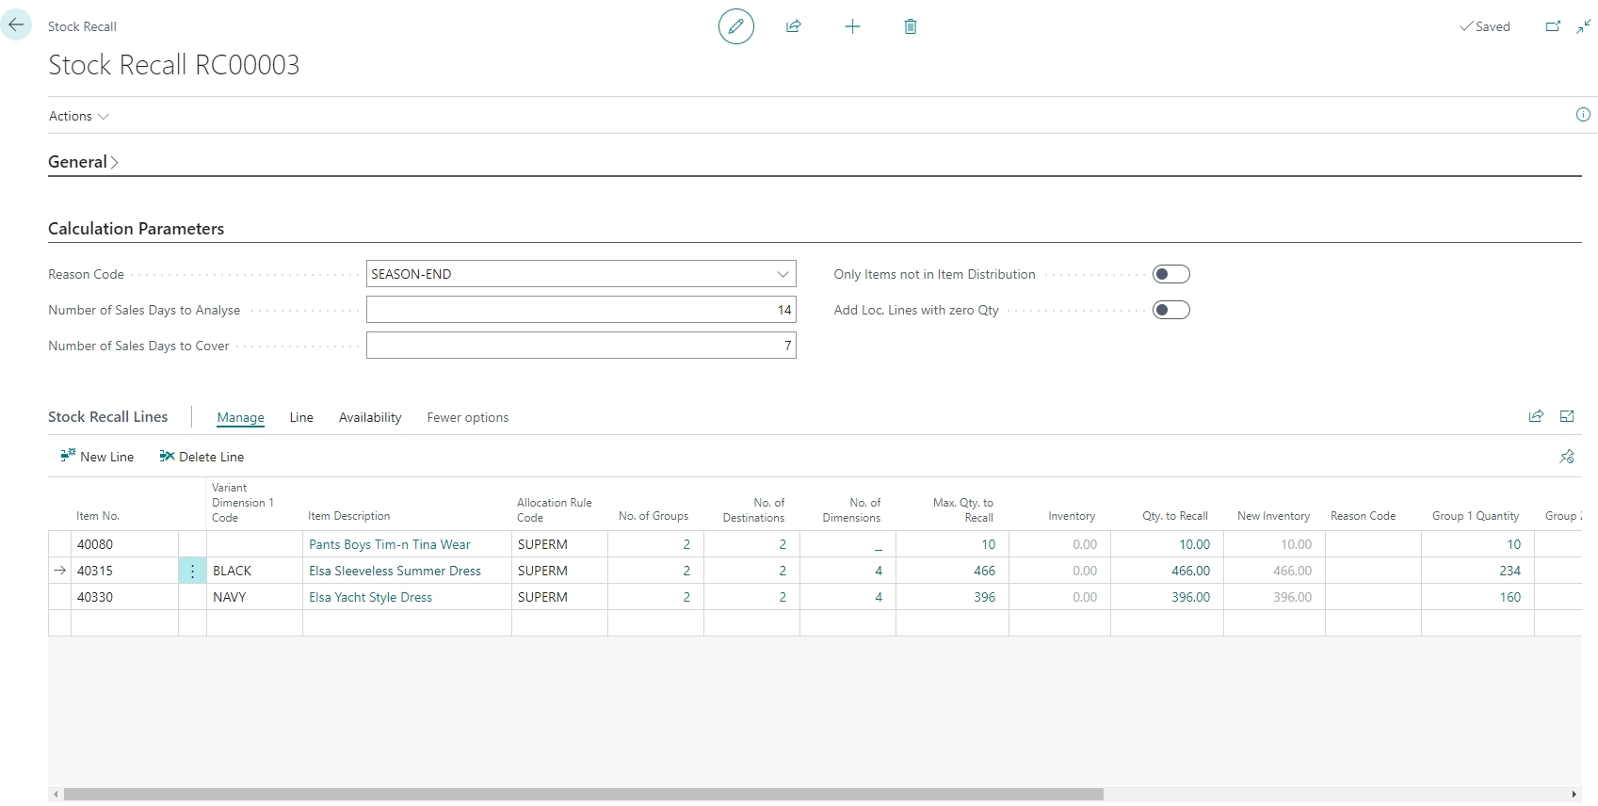
Stock Recall

Slide 26
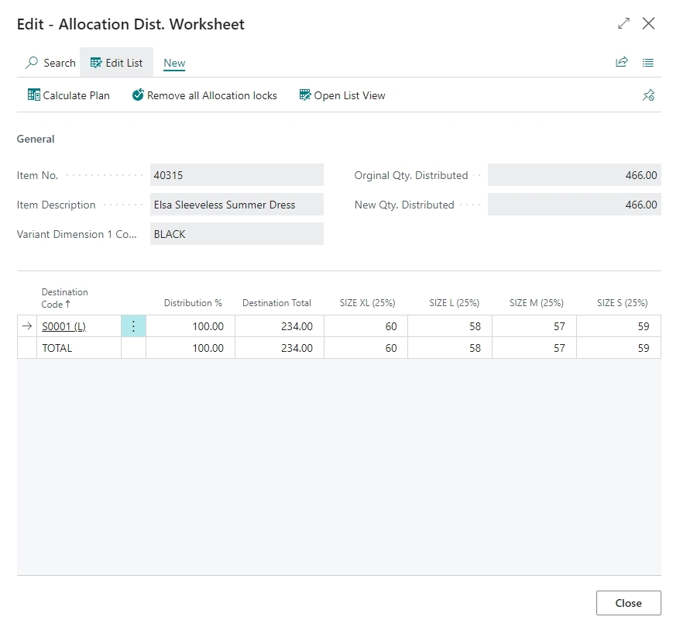
Stock Recall

Slide 27
Items
Colors, Sizes
Prepacks
Seasons
Planning, Budgets,
Open-to-Buy
Assortmt.
Mgmt.
Allocation Plans,
Purchase Orders
Replenish ment
Store Stock Redistribu- tion
End-of-Season Sales
Stock Recalls

Slide 28
Replenishment
Planning & Data Maintenance
Manual Replenish- ment
Automatic Replenish- ment
Execution
Monitoring
Sales & Purchase Budgets
Allocation
Plans
Buyer‘s Push,
Stock Recall
Allocation Rules
Variant Weight Dim. Pattern
Demand Forecasts
Store Stock
Redistribution
Purchase & Transfer
Orders
Stock Requisition
Buyer‘s Workbench
Inventory and Demand
Store
Capacity
Stock Coverage
Vendor Performance
Open to Buy
Assortment Mgmt.
Lifecycle Mgmt.
Replenishment Journal Calculation
Threshold Mgmt.
Lifecycle Planning WS
Cross Docking
Manual Purch. & Transfer Orders
Replen. Item Quantity Calculation
Out-of-Stock Calculation
Item Import

Slide 29

More functionality
Stock Coverage Management
Capacity Management
Item Import
Vendor Performance Measurement
Roadmap
  Prepack improvements
  Enhanced Season Management

Slide 30


Of course, you can!

Slide 31
Thank you

