Slide 1
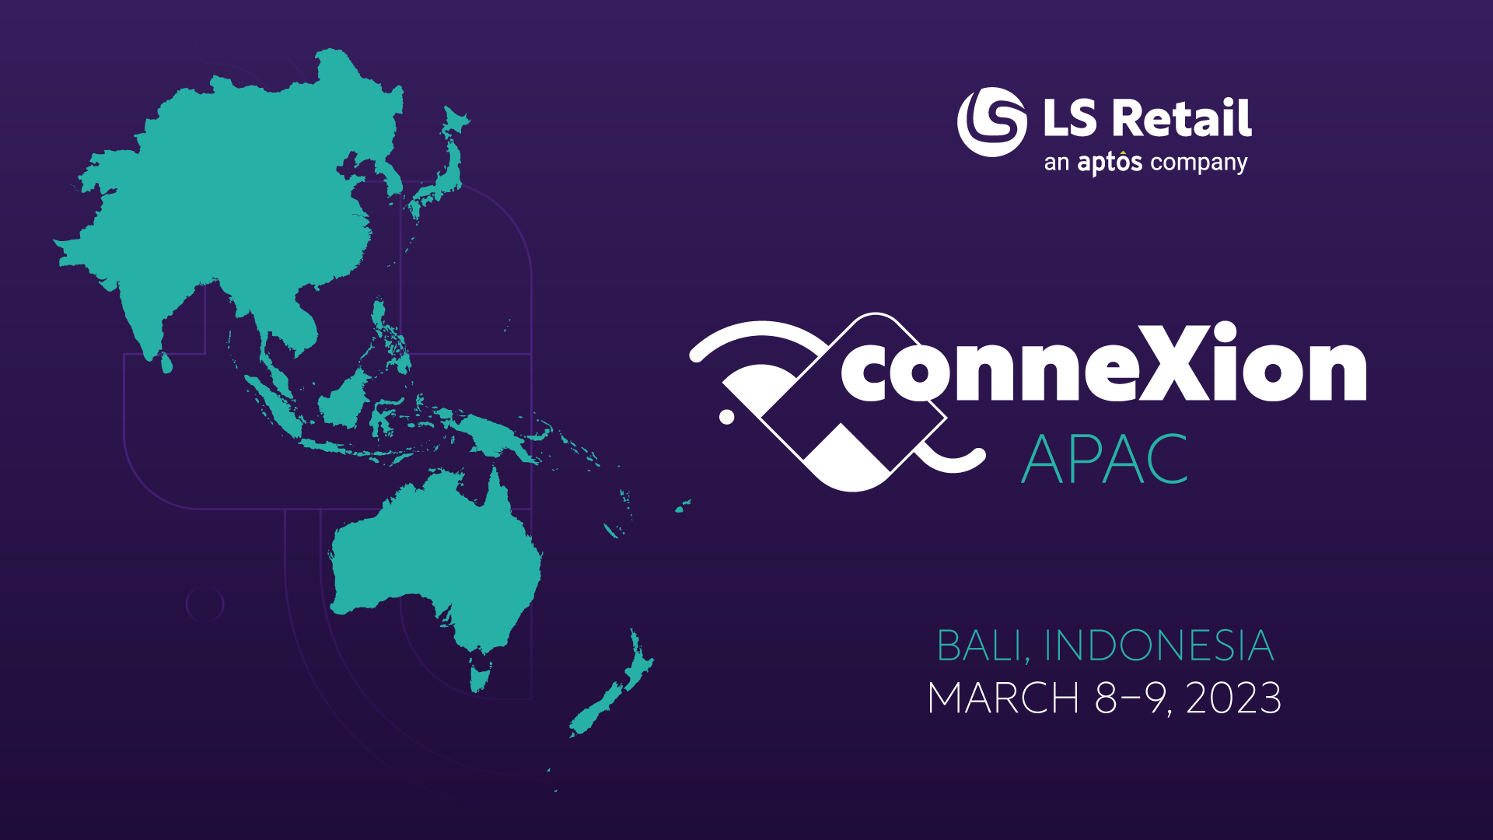

Slide 2
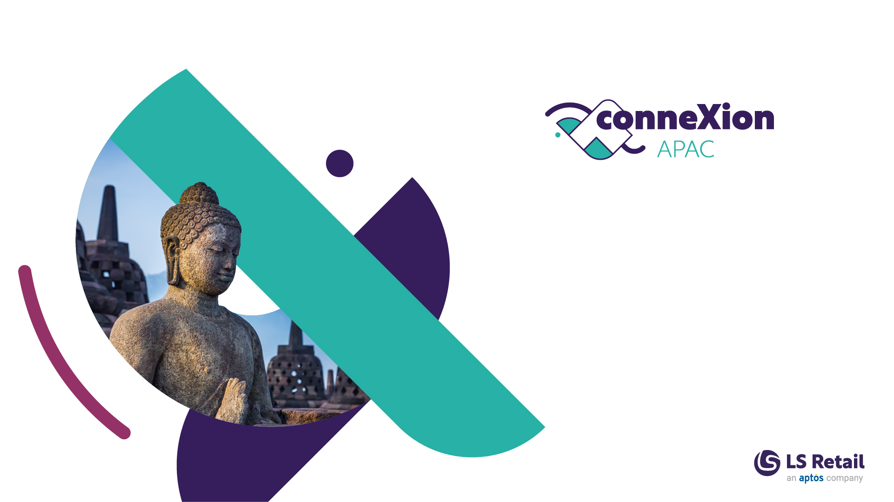
Telemetry
Monitoring and Analyzing Telemetry for Business Central
Bryan Koh, Boon Leng & Sahar Mehdizadeh
Technical Consultant
Notes:
Hello Everyone! We are glad you could join us today. We are very excited about today’s topic on Telemetry for Business Central. Have you gone thru this situation before, that the certain processes in the system become slower and you might or might not have clue on what’s goes wrong. Telemetry with Business Central could be your answer to it.
For those of you who don’t know us already, my name is Bryan and together with me today is Boon Leng and Sahar. We are the Technical Consultant from the APAC Consulting.

Slide 3
Our 30 minutes
journey together...
What, Why
Collecting Data - Setup
Querying Data with KQL
Analyzing Data with PowerBI
Demo
Telemetry Costs
Notes:
Firstly, we will look at the What and Why, next we will go thru the Setup required, then we will learn how to query the data and finally we will show you how to the data to the PowerBI. And we will also give you a high level overview of the costs involved for Telemetry.
For the setup to querying and analysing, I will explain it first follow by a demo by Boon Leng.
https://www.linkedin.com/pulse/whats-new-dynamics-365-business-central-telemetry-2022-pontoppidan
https://www.linkedin.com/pulse/business-central-power-bi-telemetry-app-now-supports-aad-pontoppidan?trk=articles_directory

Slide 4
Our 30 minutes
journey together...
What, Why
Collecting Data - Setup
Querying Data with KQL
Analyzing Data with PowerBI
Demo
Telemetry Costs

Slide 5


What is Telemetry in Business Central?
Dynamics 365
Business Central
Azure
Application Insights
Notes:
Business Central emits telemetry data for various activities and operations on environments and apps/extensions.
Azure Application Insights is a service hosted within Azure that gathers telemetry data for analysis and presentation.
In layman terms, it is about collecting telemetry data/log data from Business Central and sending it to a workspace on the Cloud, which is the Azure Application Insights. Then we can further analyze the data with KQL query.

Slide 6
What is Telemetry in Business Central?
Business Central
On-Prem
Business Central
SaaS
App
Notes:
Application Insights is a built-in feature in Business Central, and it support both On-Prem and SAAS model. If we configure at the service tier level, then it will send all telemetry generated by the Business Central to Azure Application Insights workspace.
If you only want to monitor only selected app, then you can configure it at the app level under app.json, but this need to be done by the developer when they package the app.

Slide 7
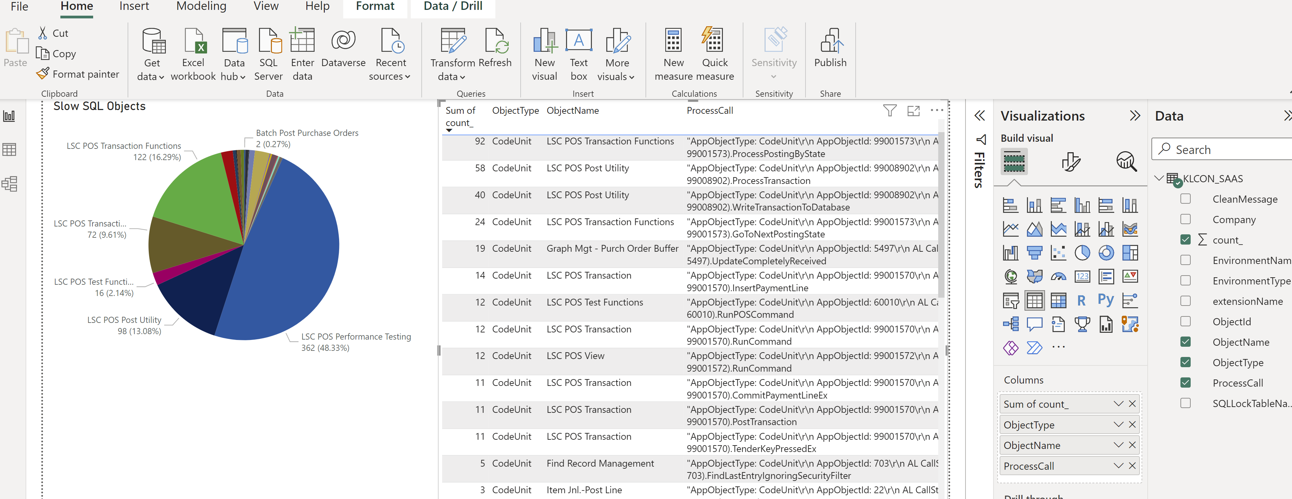
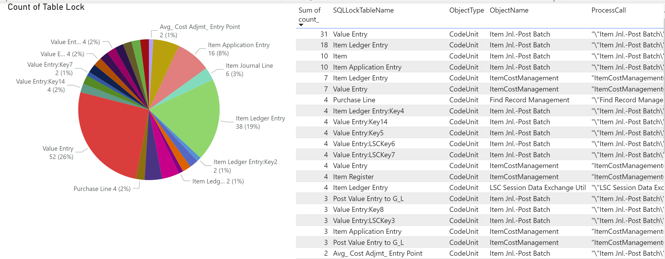
Why?
Notes:
WHY are Telemetry is important and useful?
It give you a look at the activities and general health of your environments/apps, so you can diagnose problems and analyze operations that affect performance. The three most common areas that we look into are deadlock, table lock and slow SQL statement.

Slide 8
Our 30 minutes
journey together...
What, Why
Collecting Data - Setup
Querying Data with KQL
Analyzing Data with PowerBI
Demo
Telemetry Costs

Slide 9
Collecting Data –
The Setup
Azure Application Insights
Business Central – On-Prem
Business Central – SaaS
Individual Apps
Notes:
There are two main setup area, first is the Azure Application Insights and second is the Business Central or the app level.

Slide 10
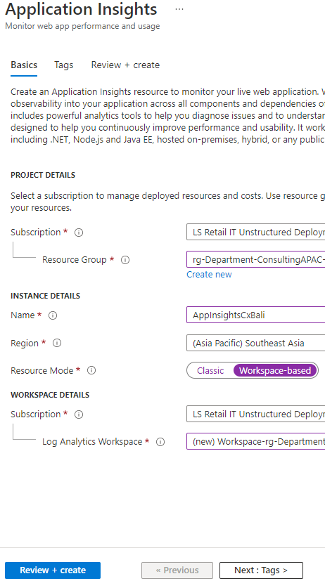
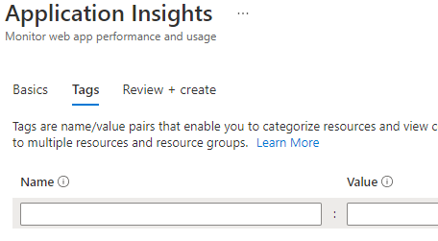
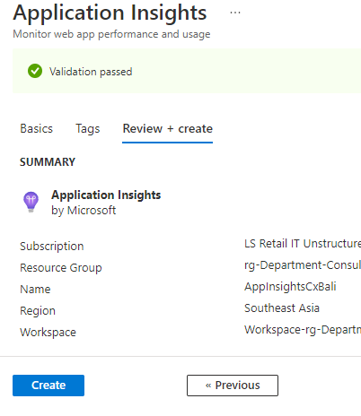
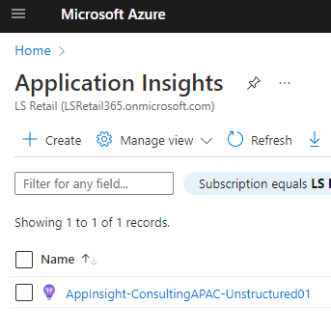
Collecting Data –
Azure Application
Insights Setup
2
3
1
4
Notes:
In the first area of the setup, it is to create the new Application Insights Workspace.
Image1: Login to Azure Portal, Go to Application Insights, Click [Create]
Image2: Then fill up the necessary information, give a [Name] to the application insights and select the nearest region.
Image3: Fill up the tags. Tags is use to categorize resources and view consolidated billing by applying the same tag to multiple resources and resource groups.
Image4: Finally, click [Create]. This process will take only about 1 to 2 minutes.

Slide 11
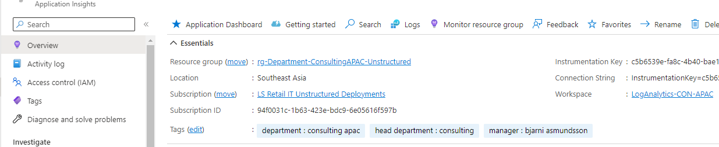
Collecting Data –
Azure Application Insights Setup
Instrumentation Key: BC 2019
release wave 2 to BC 2020 release wave 2
Connection String: BC 2021
release wave 1 and onwards
Notes:
Then go to Application Insights resource, copy down either the instrumentation key or connection string depends on your BC version.
For BC 2019 release wave 2 (BC15) to BC 2020 release wave 2 (BC17), copy the Instrumentation Key
For BC 2021 release wave 1 (BC18) and onwards, copy the Connection String.

Slide 12
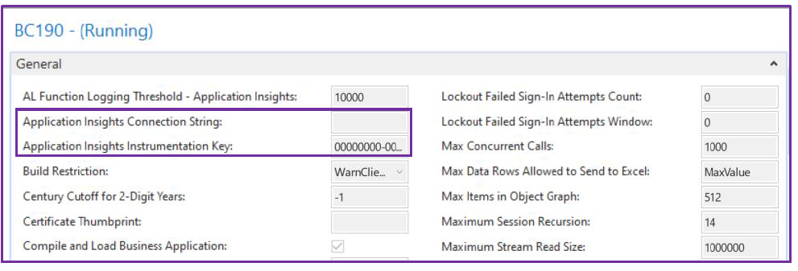
Collecting Data –
Service Tier Setup (BC On-Prem)
Notes:
Then we go to the second area of the setup. For Business Central On-Prem, go to the BC Service Tier, and paste the value that you copied earlier to either the Connection String or Instrumentation Key, and restart the service.

Slide 13
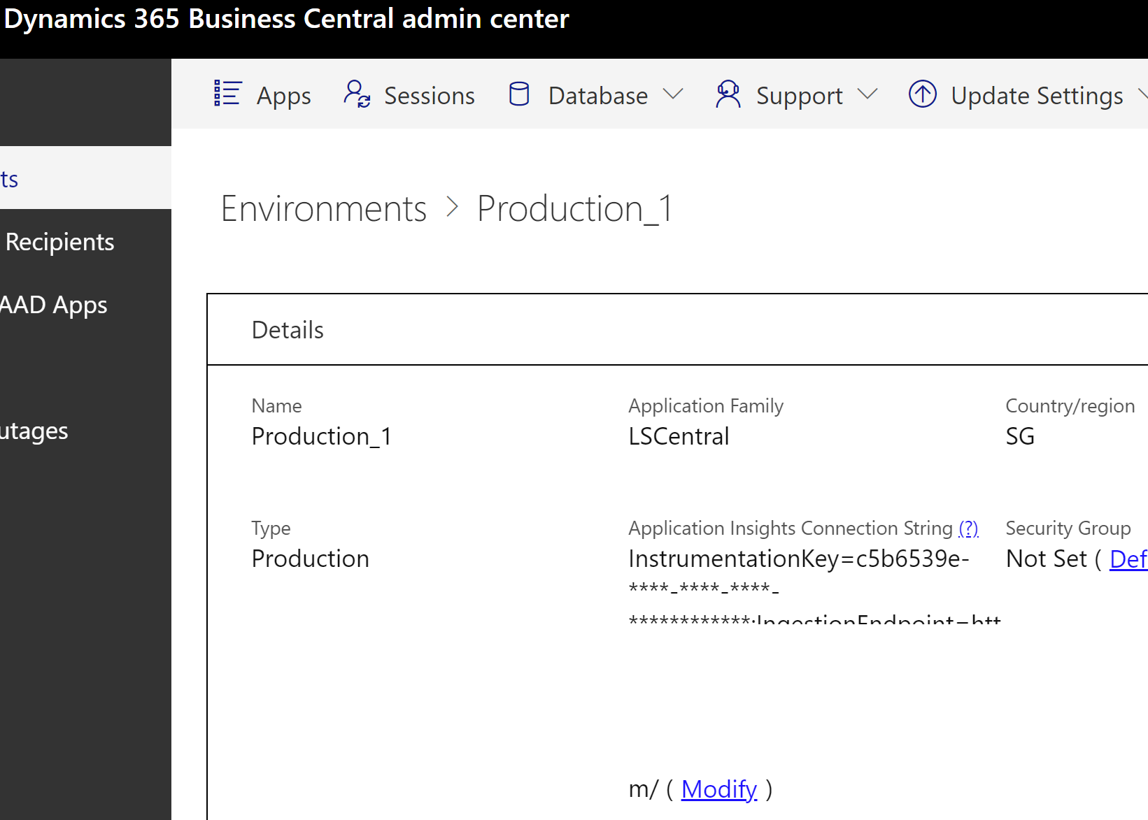
Collecting Data –
Service Tier Setup
(LS Central SaaS)
Notes:
For LS Central SAAS, go to Dynamics 365 Business Central admin center and select the environment that you want to enable the Application Insights. Copy the Connection String to [Application Insights Connection String].

Slide 14
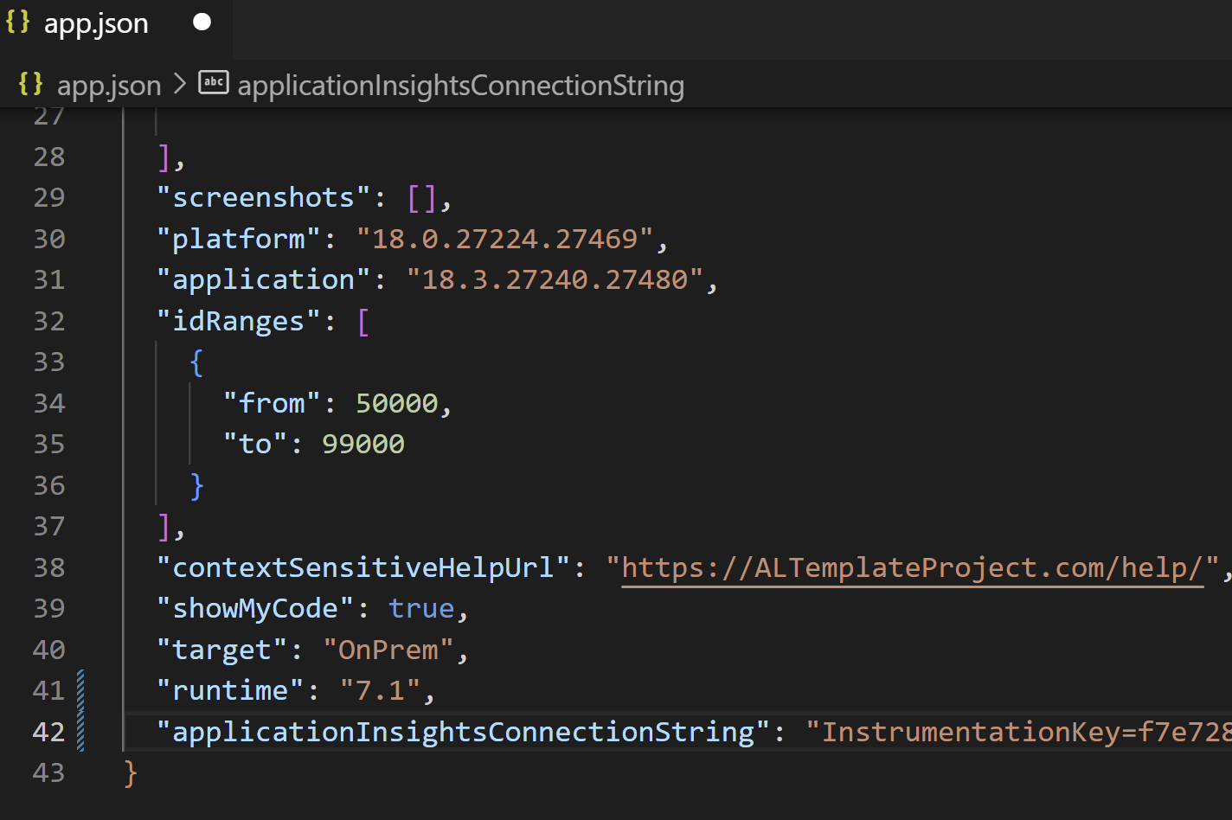
Collecting Data – App
Notes:
For app level, you can add the "applicationInsightsConnectionString” or “applicationInsightkey” into the app.json, and package the app.

Slide 15
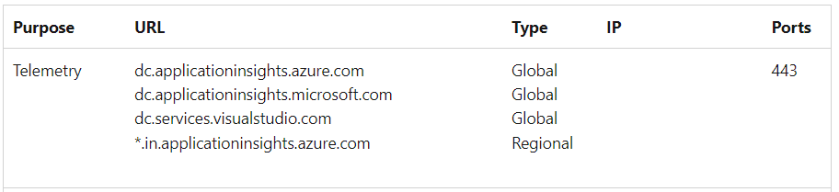
Collecting Data – Firewall
Reference: https://learn.microsoft.com/en-us/azure/azure-monitor/app/ip-addresses
Notes:
If after the setup, and Azure Application Insights did not receive any data, then you can double check your firewall setup.

Slide 16
Our 30 minutes
journey together...
What, Why
Collecting Data - Setup
Querying Data with KQL
Analyzing Data with PowerBI
Demo
Telemetry Costs

Slide 17
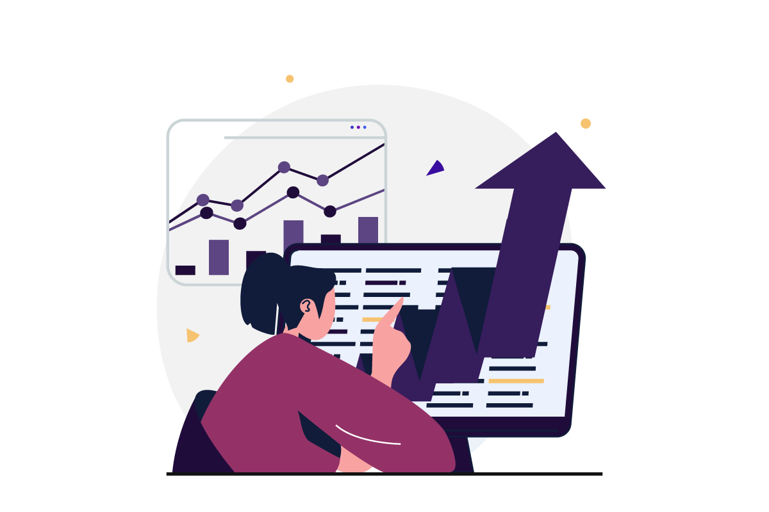
Querying Data with Kusto Query
Language (KQL)
Read-only request
Request is stated in plain text
Made of one or more statements
Case-sensitive
More: https://learn.microsoft.com/en-us/azure/data-explorer/kusto/query/
Notes:
You can use KQL to explore your data and discover patterns, identify anomalies, create statistical modeling, and more. The query uses schema entities that are organized in a hierarchy similar to SQLs: databases, tables, and columns.
It is for query data only, we cannot use it to modify the data.
It is case-sensitive for everything – table names, table column names, operators, functions, and so on.

Slide 18
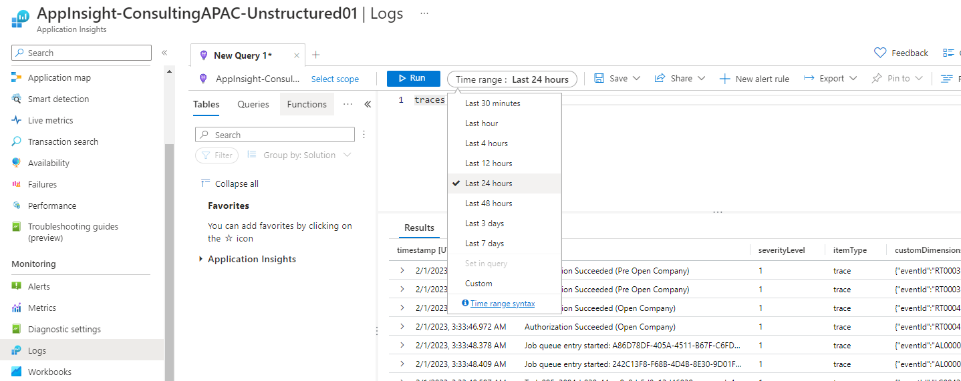
Analyzing Data with Kusto Query Language (KQL)
Notes:
To query the log data, go to Logs in your application insights workspace, and write your KQL in the query editor. We are going to use the traces schema and you can set the time range of the data to be returned. Click the [Run] to execute it.

Slide 19
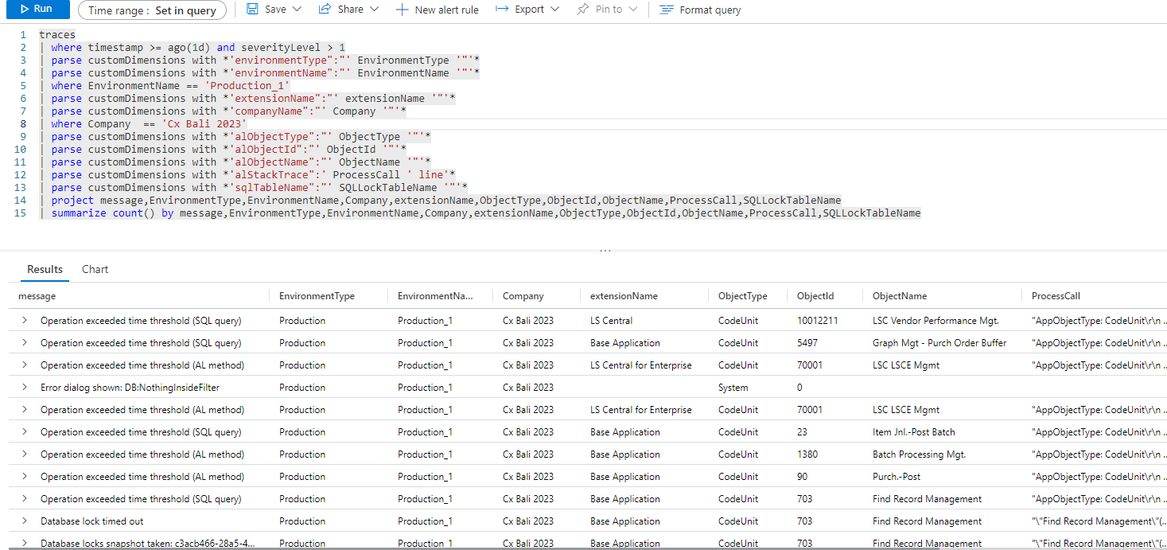
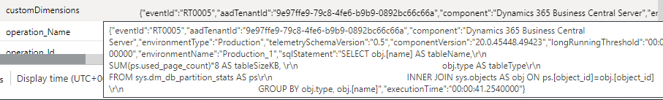
Analyzing Data with Kusto Query Language (KQL)
Notes:
In this KQL, we are going to query the traces for period of last 1 days for event with severityLevel above 1.
One of the important column is the customDimensions where it store more useful data. We can use it to identify the patterns or keywords.
Then we use the parse function to extract data out of customDimensions, example the object type, object id, and so on.

Slide 20
Our 30 minutes
journey together...
What, Why
Collecting Data - Setup
Querying Data with KQL
Analyzing Data with PowerBI
Demo
Telemetry Costs

Slide 21
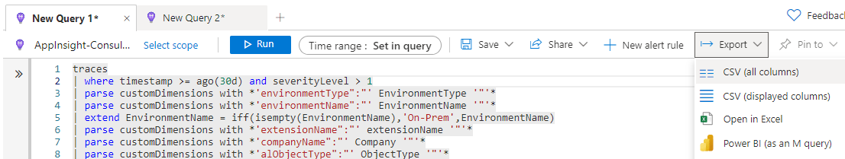
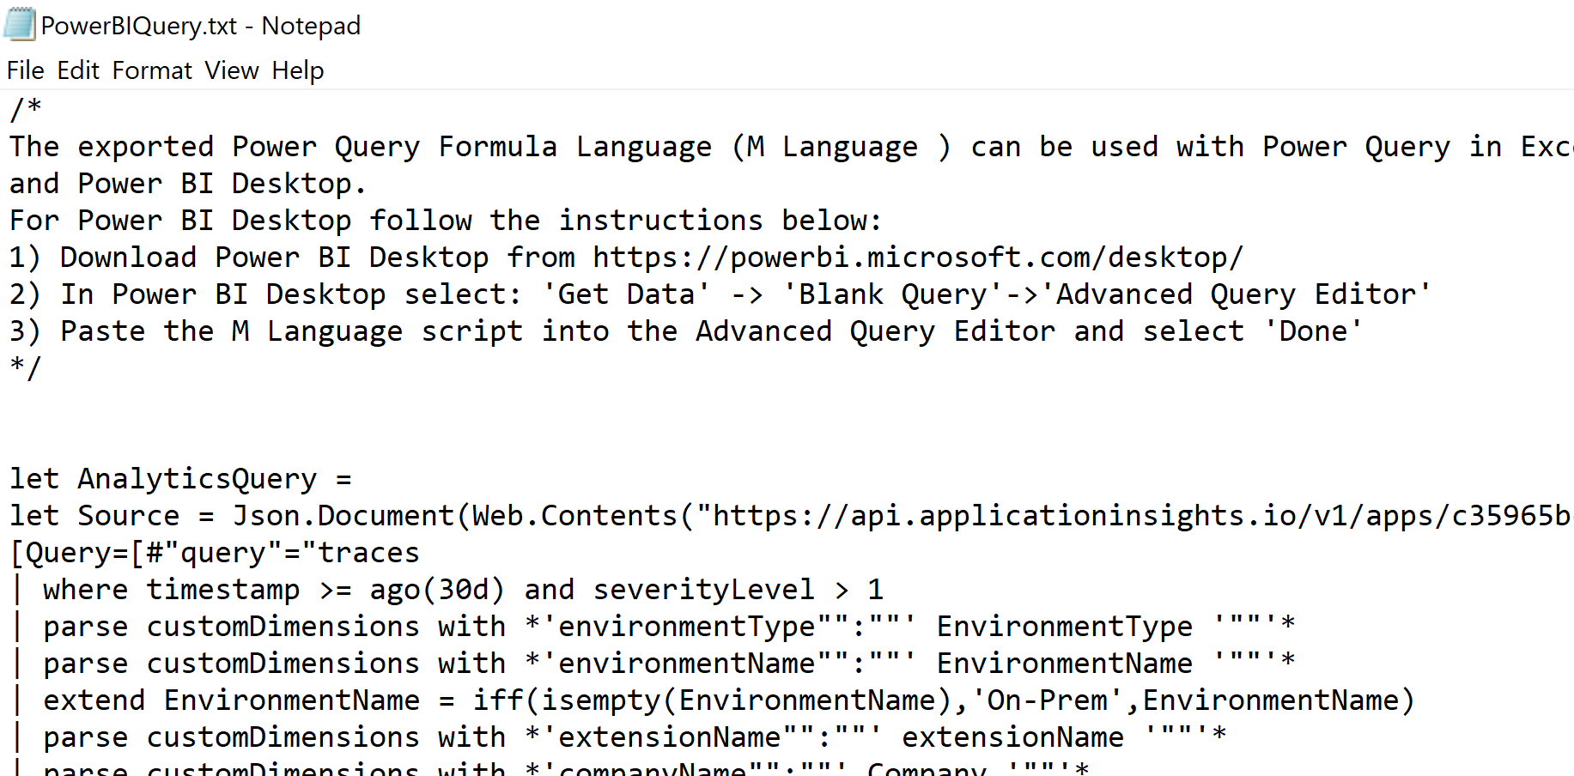
Analyzing Data with PowerBI
Notes:
We can also use PowerBI to analyse and present the data in a graphical presentation like pie chart, bar chart, and so on.
How to do it? Very simple, go to Click the Export, and choose PowerBI (as an M query).
Open the txt file and copy the query into your PowerBI.

Slide 22
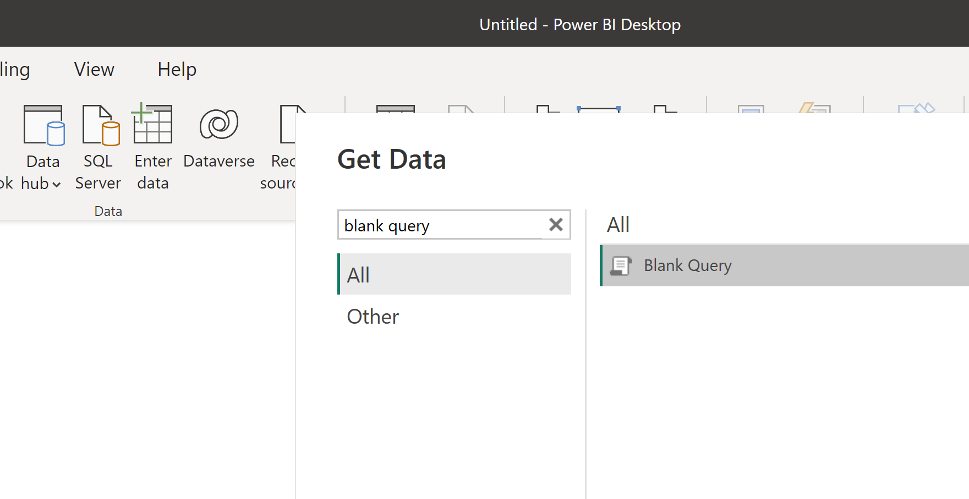
Analyzing Data with PowerBI
Notes:
Create a new PowerBI, choose Get Data.
Search for blank query and click [Connect]

Slide 23
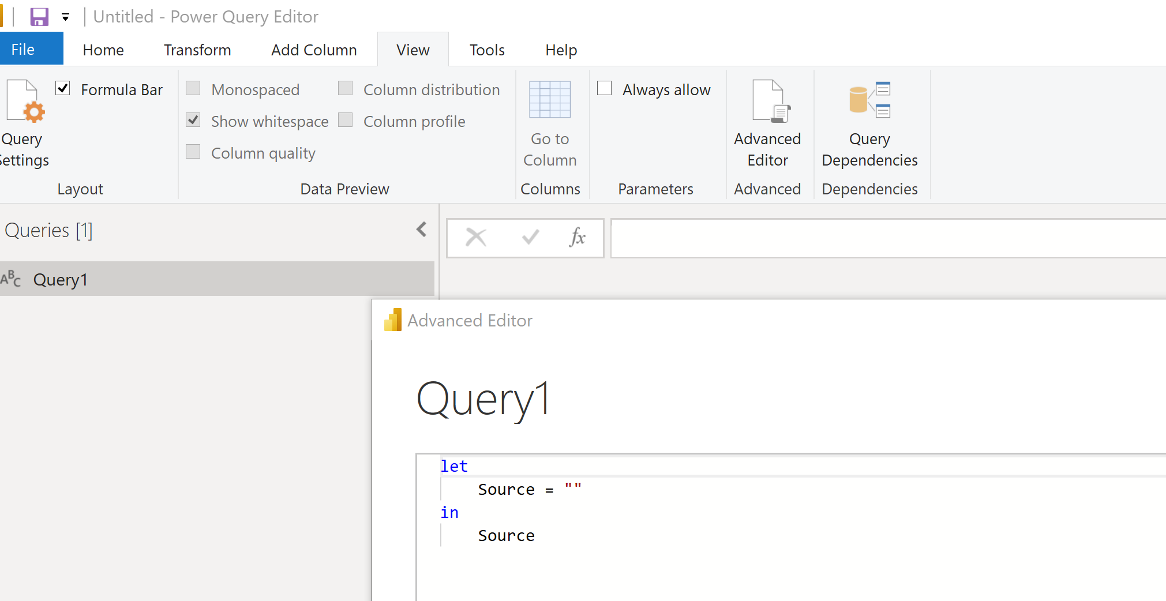
Analyzing Data with PowerBI
Notes:
Under View menu, click the [Advanced Editor]
Paste the query that you copy from the txt file into here, Query1.

Slide 24
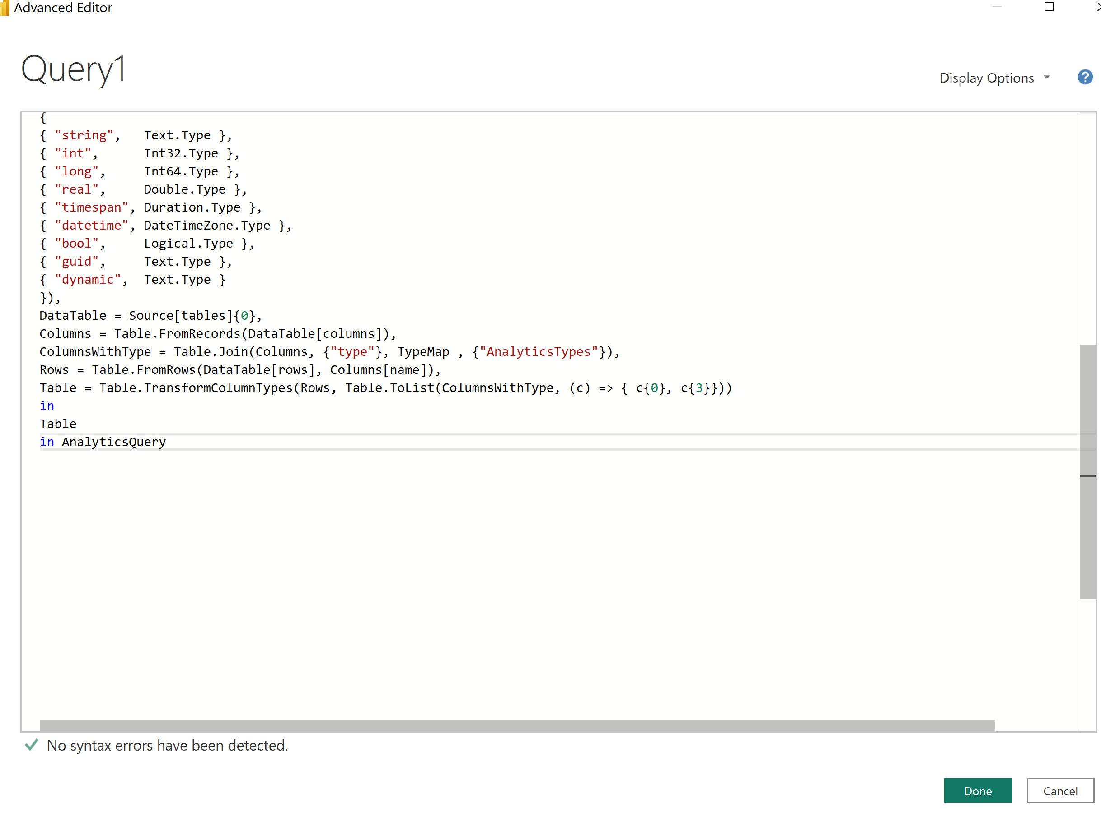
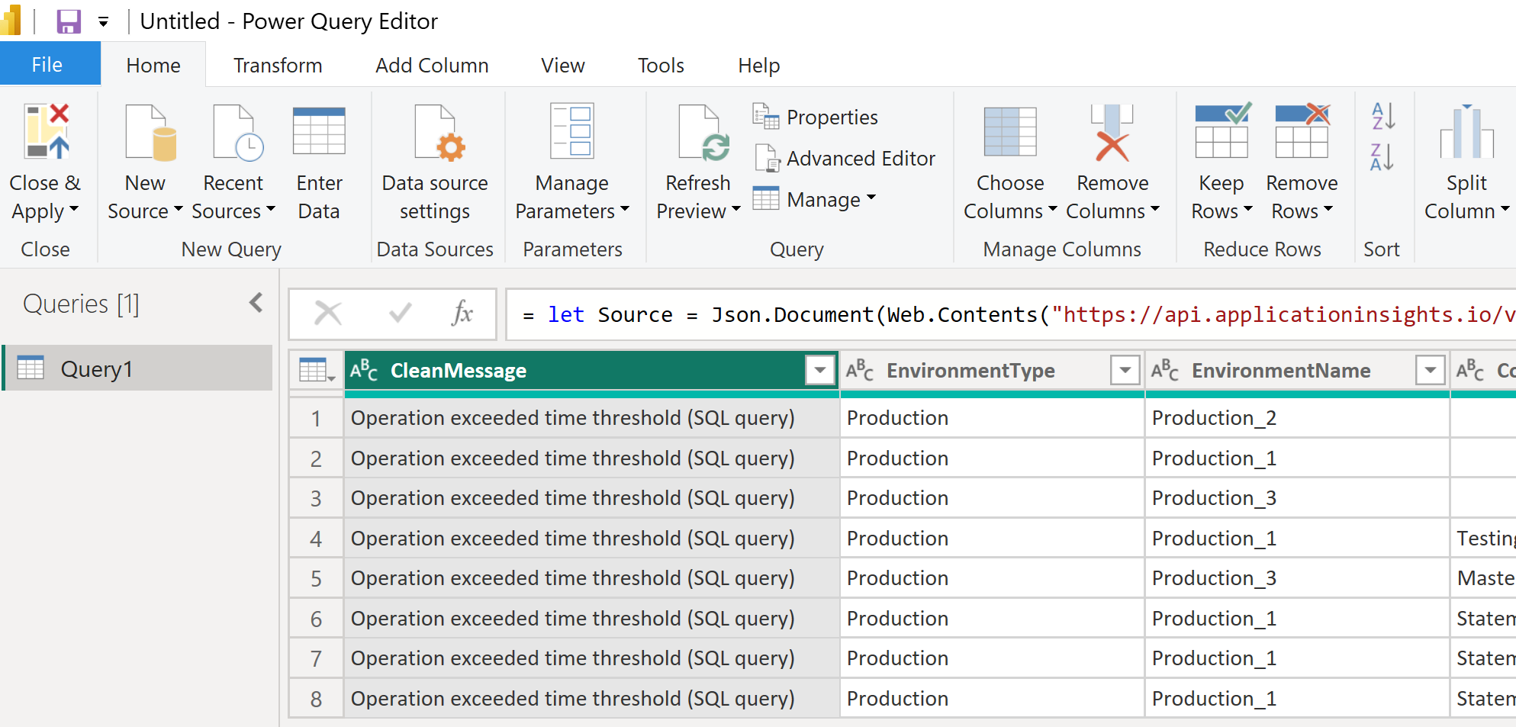
Analyzing Data with PowerBI
Notes:
After paste it, click Done.
If prompt for credential, enter your login user and password to the Azure Application Insights
If successful, you will see the dataset.
Click Close & Apply

Slide 25
Analyzing Data with PowerBI
Notes:
With the dataset returned from Application Insights, now you can create your own charts for analysis.
The three most common areas that we look into are deadlock, table lock and slow SQL.

Slide 26
Our 30 minutes
journey together...
What, Why
Collecting Data - Setup
Querying Data with KQL
Analyzing Data with PowerBI
Demo
Telemetry Costs

Slide 27
Our 30 minutes
journey together...
What, Why
Collecting Data - Setup
Querying Data with KQL
Analyzing Data with PowerBI
Demo
Telemetry Costs

Slide 28
Telemetry Costs
Azure Application Insights is billed based on
  Volume
  Time
Pricing Tier
  Pay-as-you-go
  Commitment Tiers
More: https://azure.microsoft.com/pricing/details/monitor/
Notes:
Volume: The volume of telemetry data that is sent (data ingestion)
Time: How long time you want data to be available (data retention). For application insights, it included of 90 days data retention for free. Data retained beyond 90 days will be charged for each GB of data retained for a month (pro-rated daily).
Commitment Tiers: with savings over pay-as-you-go.

Slide 29
Our 30 minutes
journey together...
What, Why
Collecting Data - Setup
Querying Data with KQL
Analyzing Data with PowerBI
Demo
Telemetry Costs
Notes:
In our last 30 minutes journey, you have heard why it is important to have application insights enabled, so you can look at the activities and general health of your environments/apps. And to setup, it is also very straightforward, two area 1) Create Application Insights Workspace 2) Configure the Service Tier/App. Then you can use a simple KQL to query the data and using the parse function to extract important data. Finally, present the dataset in PowerBI with graphs.

Slide 30
Q&A

Slide 32
Thank you

