Slide 2

SaaS Architecture and replication
Adalbjorg Karlsdottir
Onboarding Lead
Adalbjorg@lsretail.com

Slide 3
Overview
LS Central on Premise vs. LS Central in SaaS
Scheduler – business as usual
Data Director – what is new?
Web Replication
Hybrid Component Server

Slide 4


Architecture
Retailer Hosted or
Outsourcing Hosted
HQ
Data Director
Store
Offline POS
Offline POS Service

Slide 5

Architecture
Dynamics 365 cloud
HQ
Store
Online POS

Slide 6
Architecture
Dynamics 365 cloud
HQ
Hybrid component server
Store
Online POS
Offline POS
Offline POS Service

Slide 7
Architecture
Web
Replication
Dynamics 365 cloud
HQ
Hybrid component server
Store
Online POS
Offline POS
Offline POS Service

Slide 8
Scheduler

Slide 9
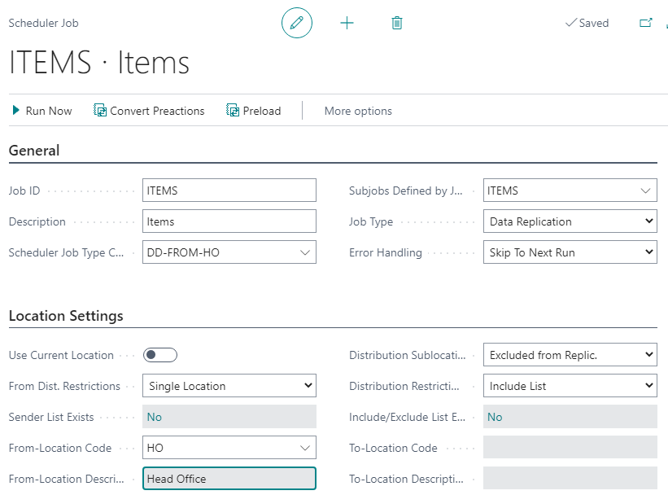
Scheduler - overview
Runs the job
Job has list of tables that
should be replicated
(subjobs)
Source
Destination

Slide 10
Scheduler – types of jobs
Normal Job
Normal Job – Replication Counter
Action Job – By Preactions/Actions

Slide 11
Scheduler – types of jobs
Normal Job
Normal Job – Replication Counter
Action Job – By Preactions/Actions

Slide 12
Data Director

Slide 13



Data Director
DD gets the data
Generates data files and compresses the data
Sends it over to destination Host
Destination host unpacks the data and inserts the data
DD Service
Destination Host
DD Service
Hybrid Server

Slide 14


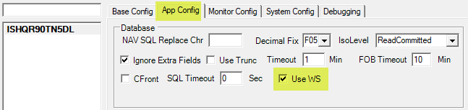



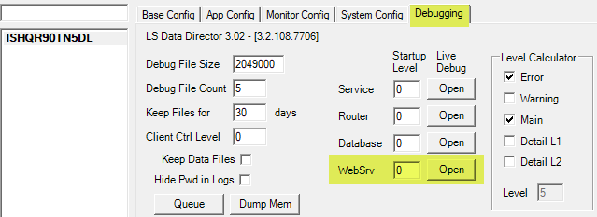
Data Director – replicate from LS Central SaaS
Data Director Configuration
Data Director instance on-prem
Data Director plug-in to SaaS with Web Service
SaaS
Job Monitor
Data Director
Hybrid Component Server

Slide 15
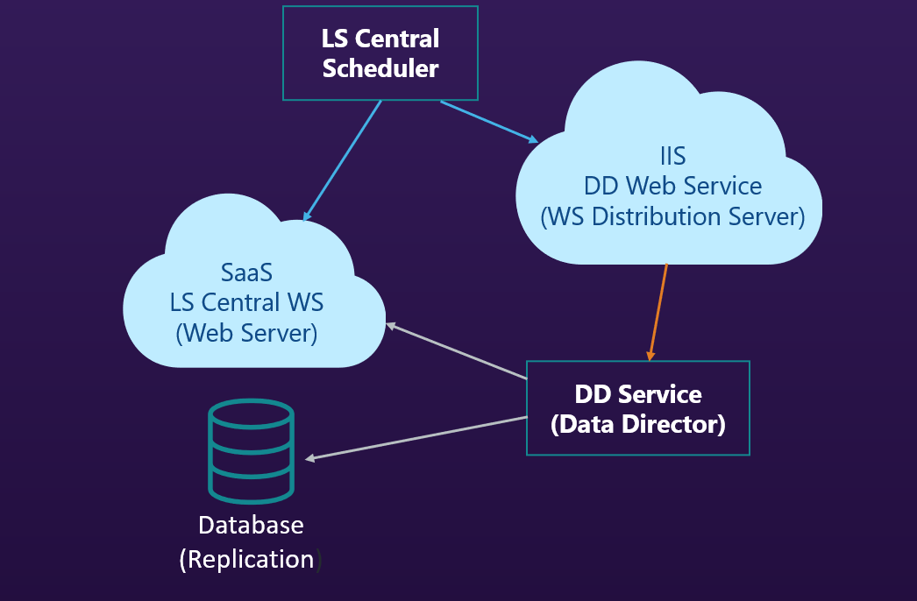
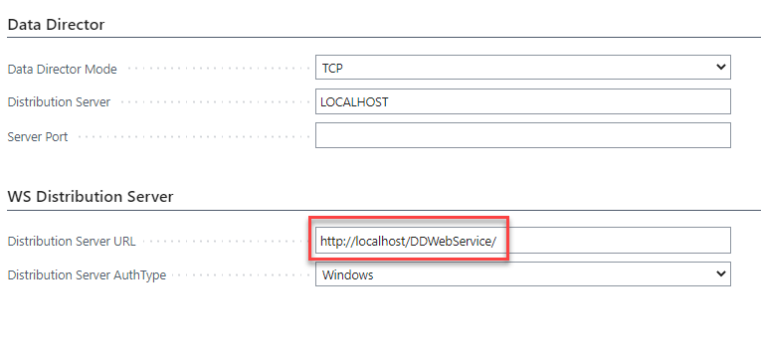
Data Director – no dll

Slide 16
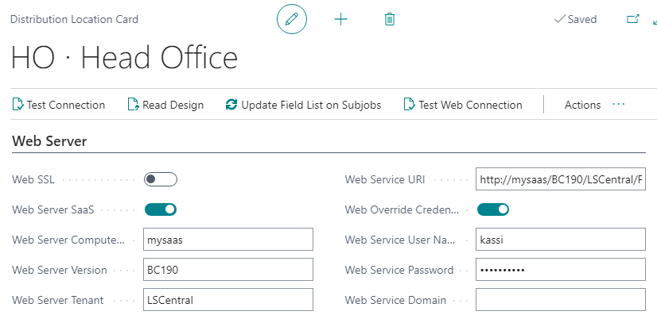
Data Director – no dll
Distribution Location card
Web Server
  LS Central Web Service to query for Pre-actions / Replication counter
LS Central
Scheduler
SaaS
LS Central WS
(Web Server)

Slide 17

Data Director
HO SaaS
LS Central
Scheduler
DD Service
DD Service
IIS
DD Web Service
(WS Distribution Server)

Slide 18
Web Replication

Slide 19
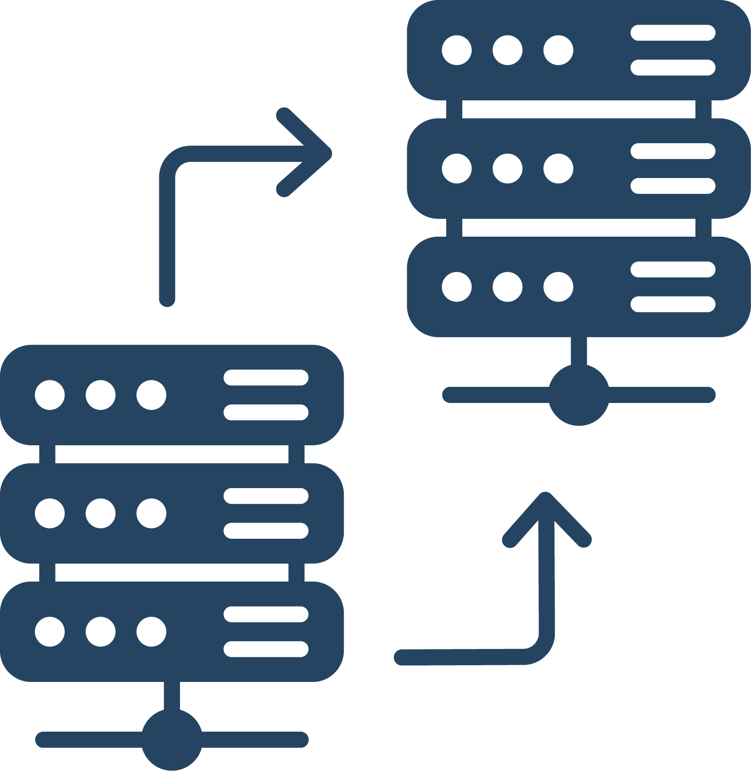
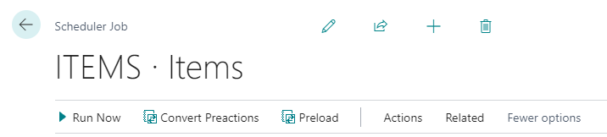
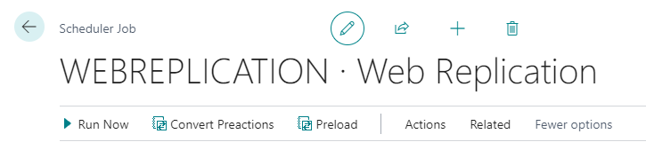
Web Replication
Internal BC method to replicate data
Replication without Data Director
The Process is divided into two steps:
Scheduler jobs (replication jobs) to create replication requests, passed to web replication module
Replication of the actual data handled by the web replication module

Slide 20
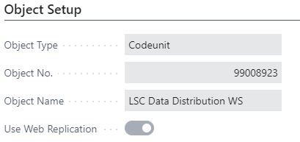
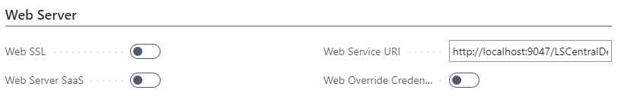
Web Replication
Replication activated on the Scheduler job card
All Destination Locations must have valid Web Server Connection.
Monitoring UI found in the Scheduler Setup page

Slide 21
Web Replication - limitations
From distribution – current location
Normal jobs – only Add-update
Only replication between identical tables
Some other filtering limitations and constants on linked table

Slide 22
Replication Overview

Slide 23
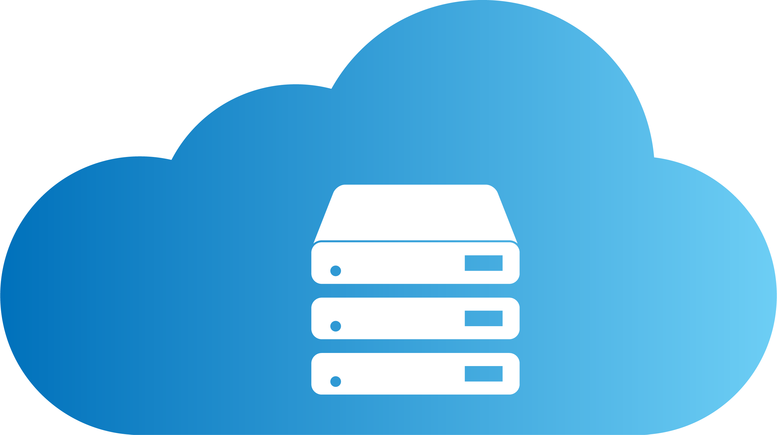



Web Replication
HQ
Replicate trans. using POS ws
Dynamics 365 cloud
Replicate trans. Using Web Replication in background session
DD in webservice mode
Web service lookup and validation for
Member mgt.
Customer order
Inventory lookup etc.
HYBRID COMPONENT SERVER
Azure
POS MASTER
DATA DIRECTOR
UPDATE SERVICE
Replicate master data using DD and Scheduler
Store
Offline POS
Offline POS Service

Slide 24
Web Replication
HQ
Replicate trans. using POS ws
Dynamics 365 cloud
Replicate trans. Using Web Replication in background session
DD in webservice mode
Web service lookup and validation for
Member mgt.
Customer order
Inventory lookup etc.
HYBRID COMPONENT SERVER
Azure
POS MASTER
DATA DIRECTOR
UPDATE SERVICE
Replicate master data using DD and Scheduler
Store
Offline POS
Offline POS Service

Slide 25
Hybrid

Slide 26
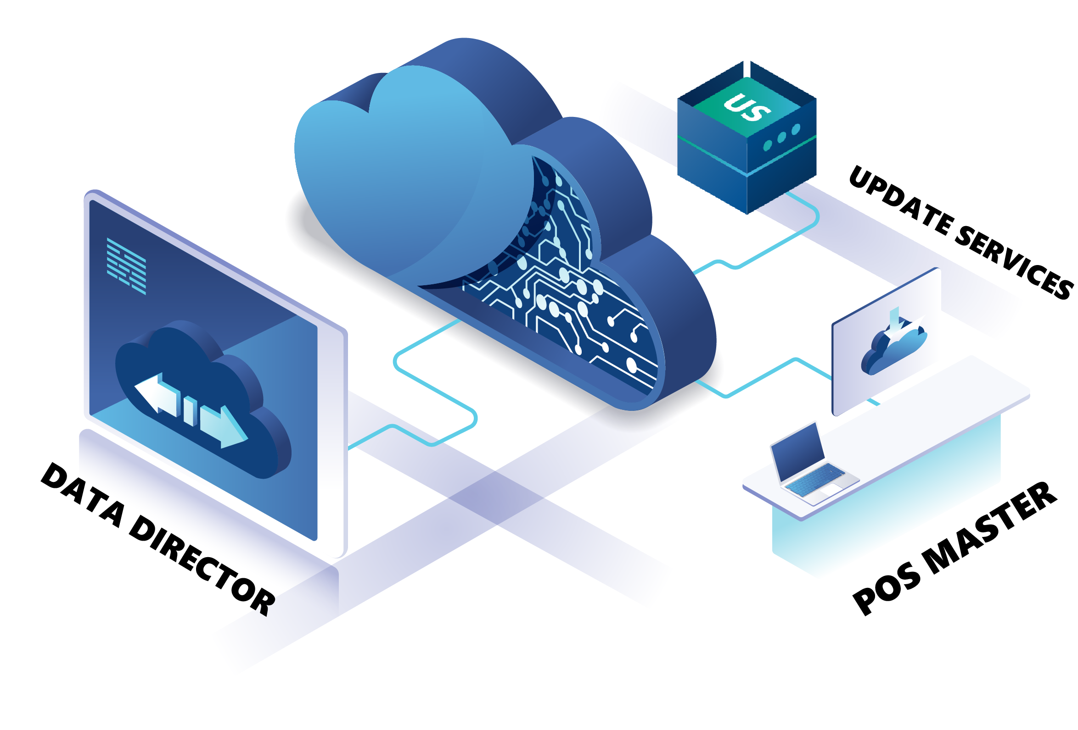
Hybrid Component Server

Slide 27
Hybrid Component Server

Slide 28

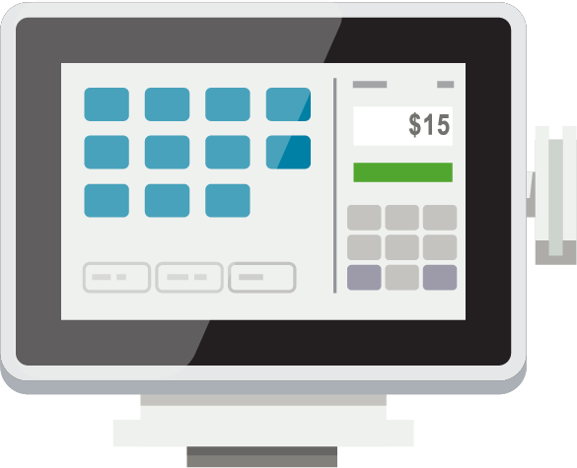
Head office user
HEAD OFFICE IN THE CLOUD
SendTransaction WS
DD Webservice mode​
SendTransaction using Web Replication​
HYBRID
COMPONENT SERVER
POS MASTER
DATA DIRECTOR
UPDATE SERVICE
DD
DD
STORE 1
STORE 2
Back office
Offline POS
Offline POS
Offline POS
Offline POS

Slide 29
Hybrid Component Server – performance
Leaner Preaction logs
Split jobs
Smaller batches
Initial job as a normal job
HCS
POS MASTER
DATA DIRECTOR
UPDATE SERVICE

Slide 30
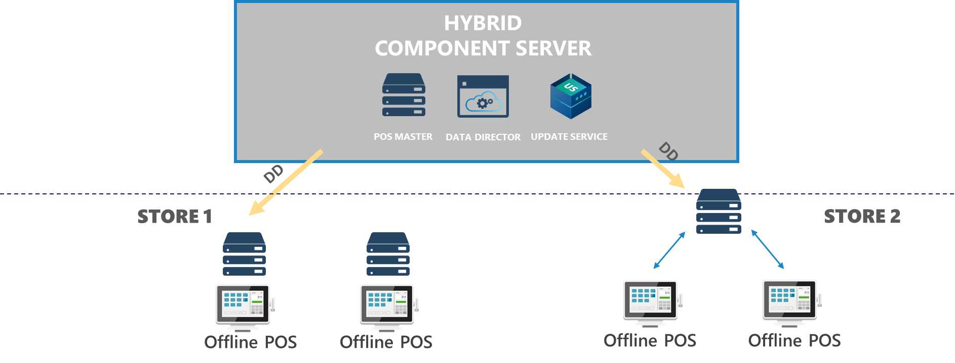


Hybrid Component Server – HCS to offline POS
AZURE
v
Hybrid Component Server
Firewall
Firewall
POS

Slide 31
Hybrid Component Server – HCS to offline POS
AZURE
Hybrid Component Server
v
Firewall
Firewall
POS
VPN Tunnel

Slide 32
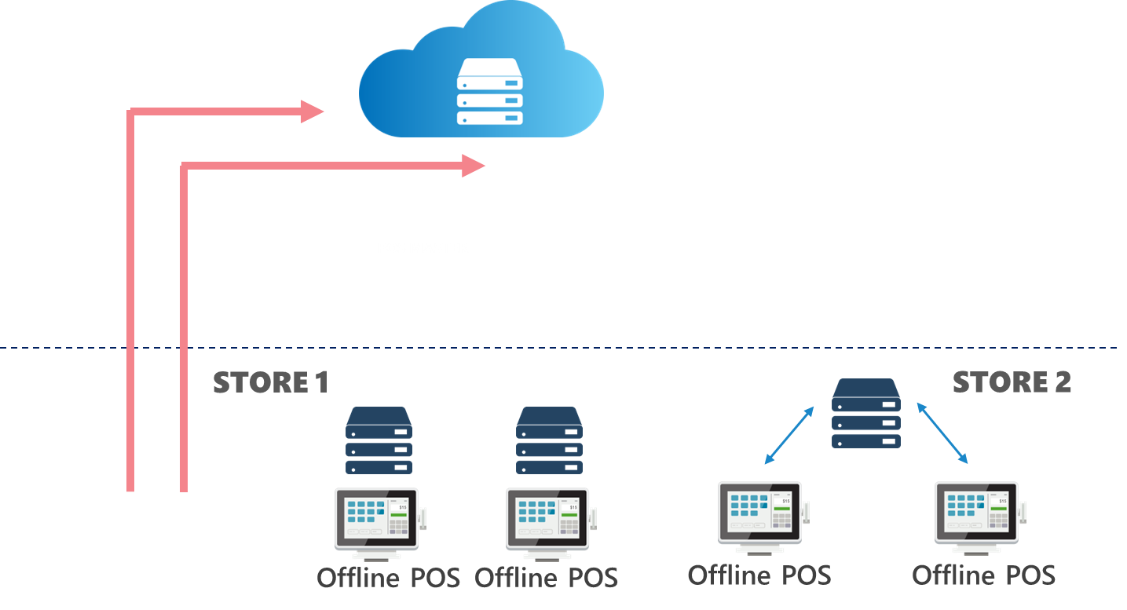
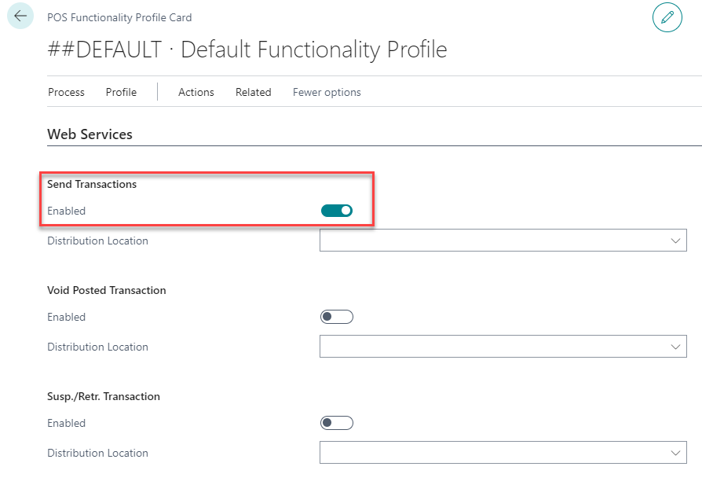
Send transaction

Slide 33
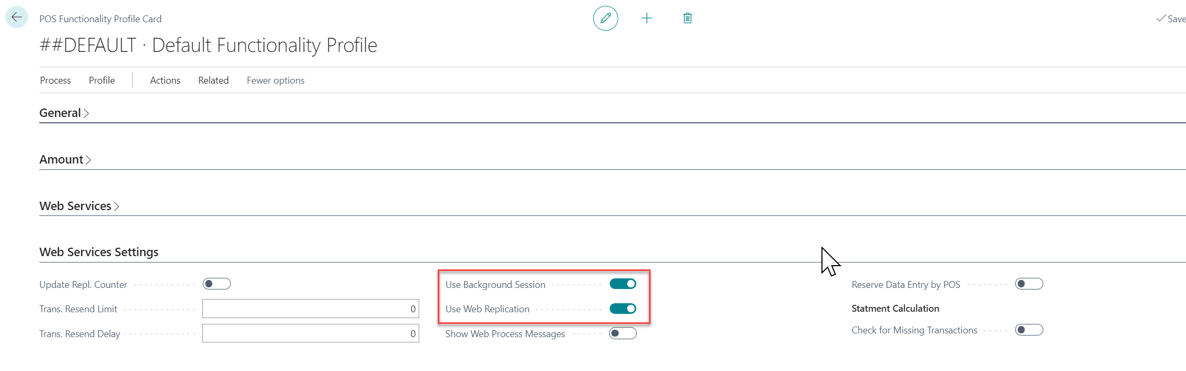
Send transaction

Slide 34
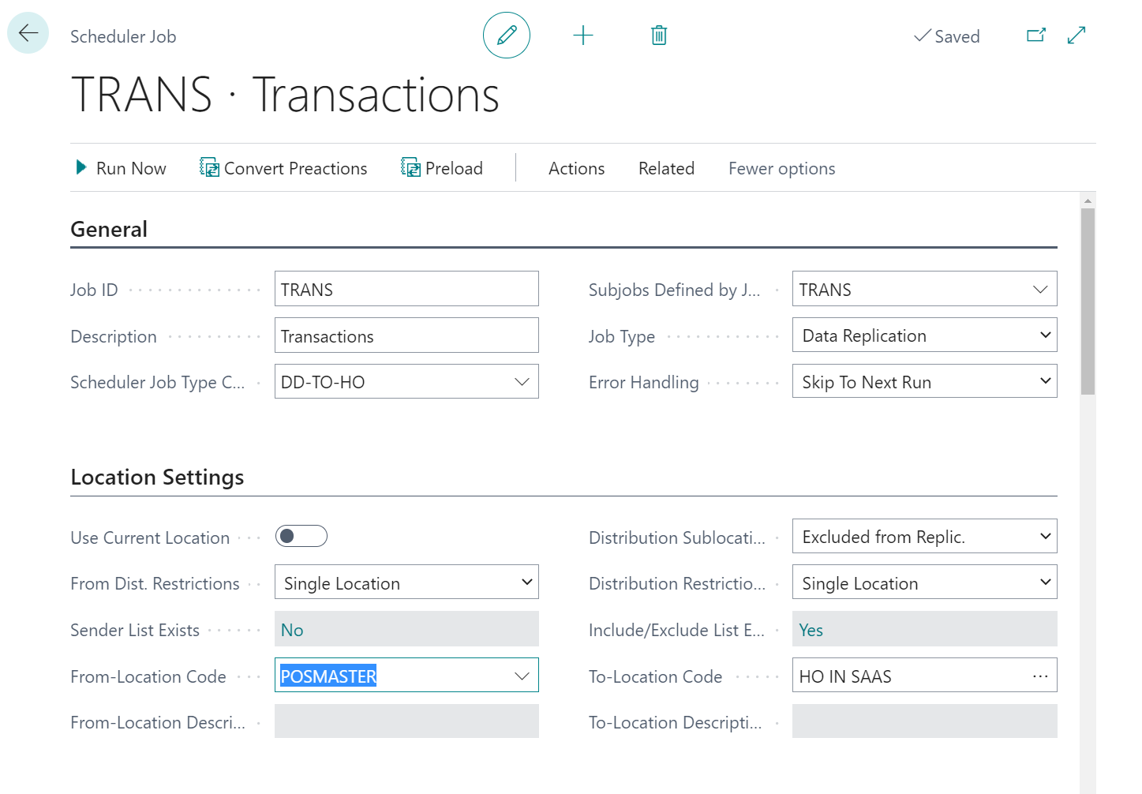
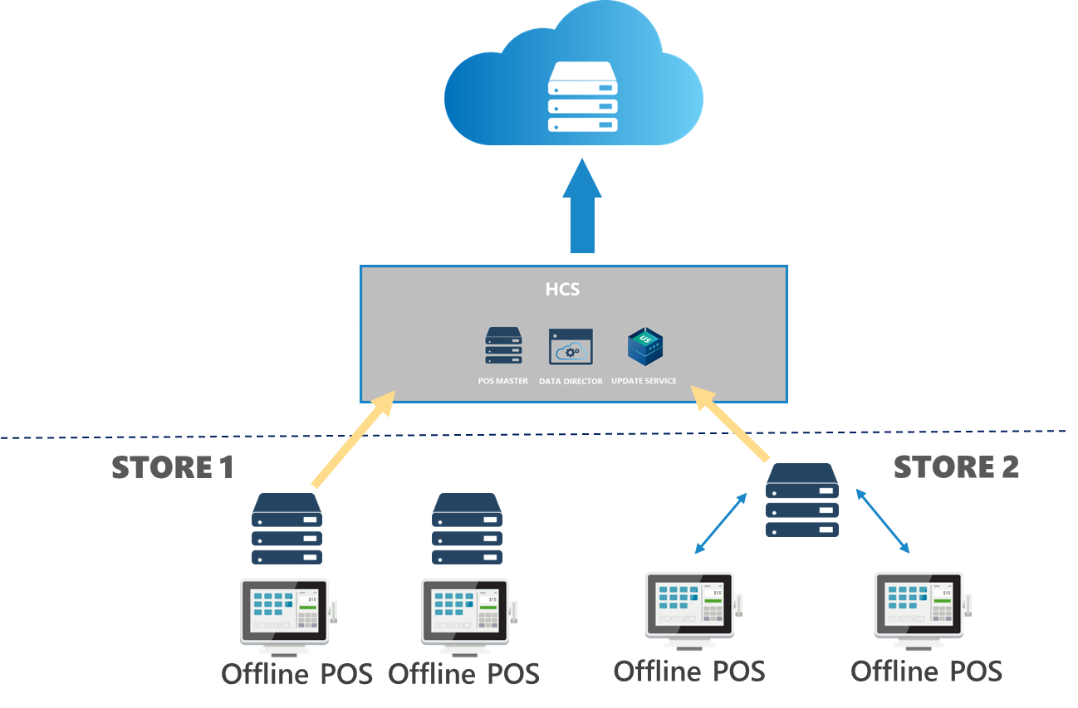
Send transaction

Slide 35
Head office user
HEAD OFFICE IN THE CLOUD
SendTransaction WS
DD Webservice mode​
SendTransaction using Web Replication​
HYBRID
COMPONENT SERVER
POS MASTER
DATA DIRECTOR
UPDATE SERVICE
DD
DD
STORE 1
STORE 2
Back office
Offline POS
Offline POS
Offline POS
Offline POS

Slide 36
Q&A time

