Slide 2

Kerim Karan
Replenishment Overview
Functional Consultant
kerimka@lsretail.com
Notes:
Good day everyone, and welcome to today's webinar on LS Replenishment.
My name is Kerim Karan and I am Functional Consultant here at LS Retail.
<Break>
Before we get started, You will have the opportunity to ask questions today by typing your questions into the Questions pane in this webinar.
You may send in your questions at any time during the presentation;
I will do my best to address these during the Q&A session at the end of today’s webinar or if I do not get to it during the Q&A
I will answer them afterwards and distribute a pdf with the questions and answers
<Break>

Slide 3

Overview
Replenishment Setup(Item, Store, Warehouse)
Replenishment Rules and Methods
Automatic Transfers and Purchase Orders
Buyers push and allocations
Notes:
So today we will be touching on several Replenishment Concepts in the LS Central solution.
We will be looking at options and solutions for different replenishment types
We will demonstrate different replenishments rules and calculation methods;
We will create transfer and purchase order recommendations with the use of automatic replenishment;
and use manual replenishment options like buyers push and allocation plans
Plus also and see other options that are available

Slide 4

What is Replenishment?
“Replenishment is the act of filling something up again by replacing what has been used.”
Notes:
What is replenishment?
Well the dictionary meaning of replenishment is
the act of filling something up again by replacing what has been used.
In LS Central this would mean replacing items that had been sold.
We do this via Purchase Orders. This is nothing new and retailers have been doing this for centuries.
But this is an important thing to do right
as if you do not have items; or have too many items; you will reduce profits.

Slide 5
Why is replenishment important?
Out of Stock
Up to 43% will shop someplace else
Up to 25% will not purchase substitute
72% of stockouts are due to inadequate instore replenishment
Overstock
Every $ of stock is less in the bank.
https://hbr.org/2004/05/stock-outs-cause-walkouts
Notes:
Why is a good replenishment system important?
Studies show us that up to 43% of consumers when faced with a store being out of stock of an item will go to another store to buy the same item;
also up to 25% of consumers will continue shopping in the store but not buy a substitute for their desired purchase.
72% of these stock outs at the store are due to in-store ordering and replenishment practices, i.e, ordering too little or ordering too late.
So, if we think about the dictionary meaning again - replenishment is the act of filling something up again by replacing what has been used – we need to add to this definition for retail. Replenishment is not only the act of filling something up, but also predicting what we will need ahead of time.
If I have 100 items and I can only order every 30 days how many do I need? This is not enough information is it?
But if you are to do a manual order with a paper and pen this is all the information that you would have.
Therefore, 72% of stock outs being the due to instore practices… well this can be put down to the store not having the information it needs to do its job correctly
This is where LS Central can help. By using data in different ways we can suggest an order for you. Not only is this quicker then using a pen and paper, it is also more precise, quicker and easier.

Slide 6

Questions ???
Notes:
Questions

Slide 7
Notes:
Thank you everyone for attending today’s webinar on LS Replenishment.
If you have any other questions, please contact myself at kerimka@lsretail.com.
You will also receive a follow-up email within the next few days with a link to view a recording of today’s webinar and other material.
On behalf of LS Retail, thank you for joining us today, and have a great rest of your day!

Slide 8
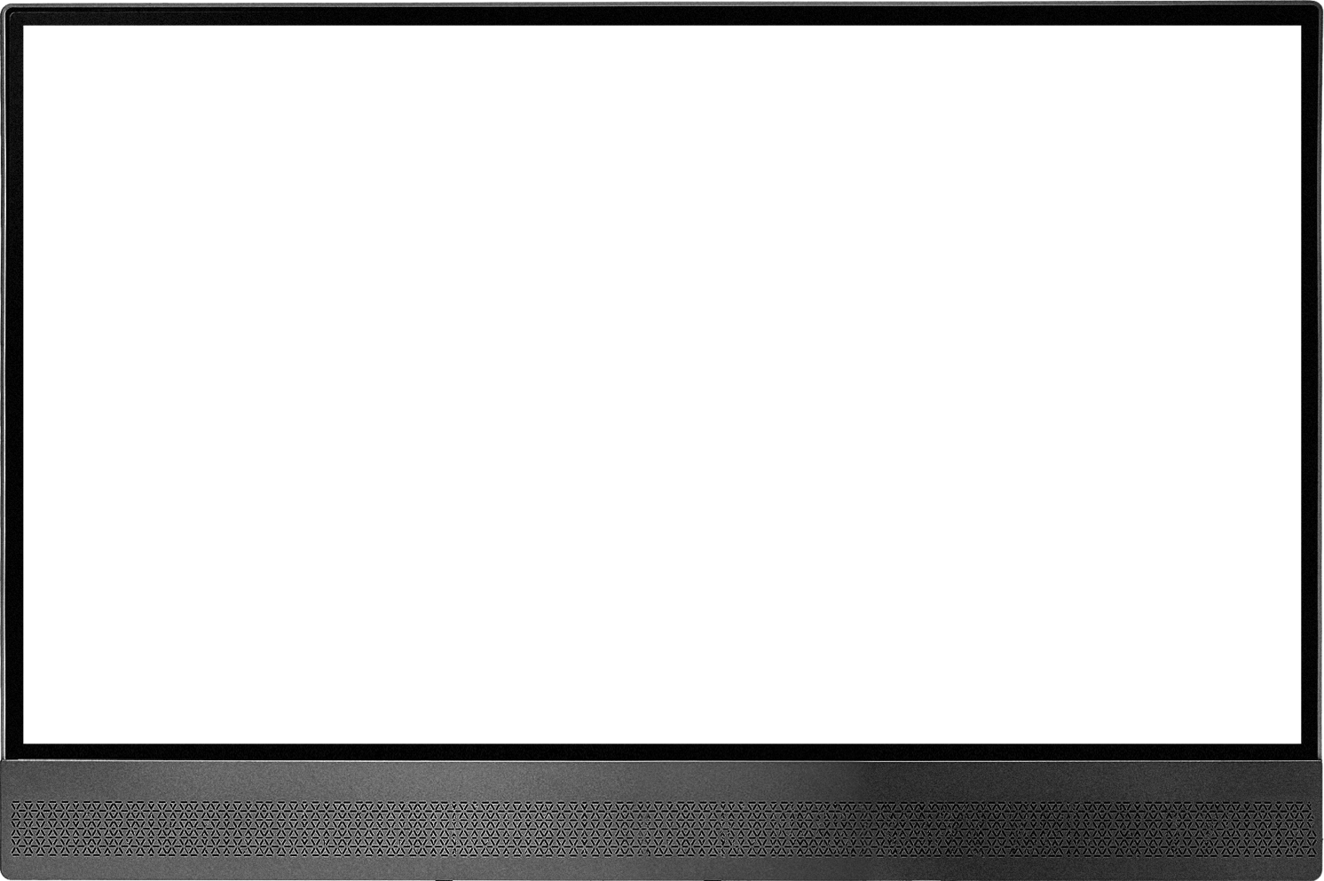
Desktop/POS

Slide 9

POS/Tablet

Slide 10

Tablet/surfacePro

Slide 11

Tablet/iPad

Slide 12
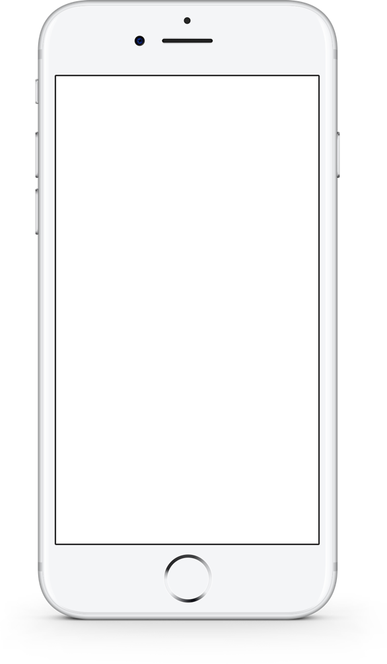

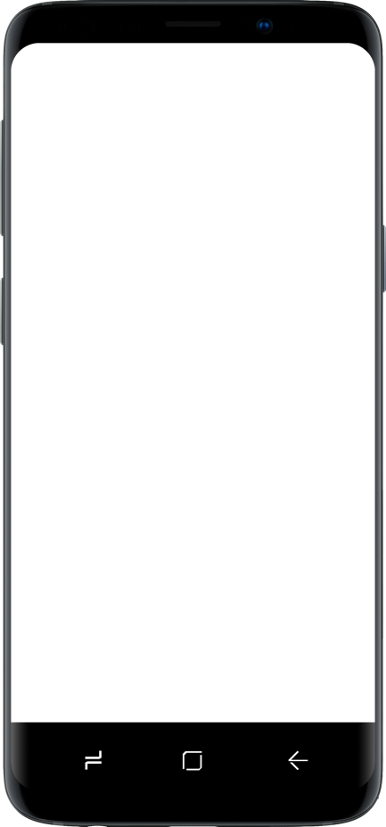
Mobile

Slide 13



































































































Slide 14











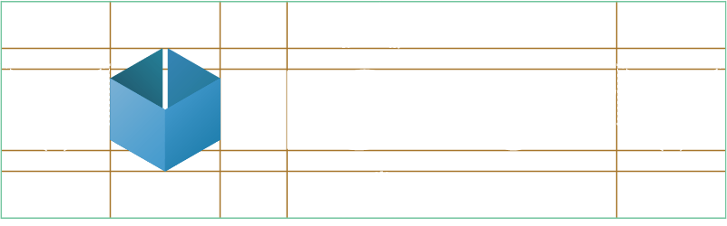
The width of the logo “box” and the logo ‘S’ mark the minimum space required around the logo

Slide 15
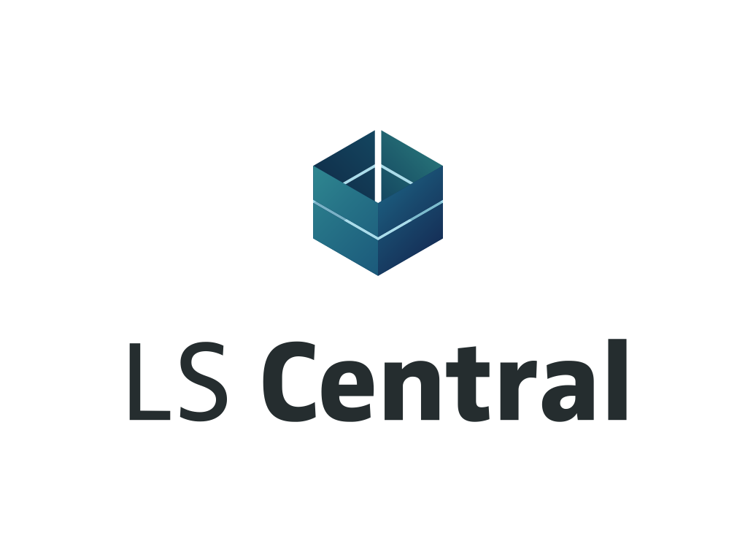

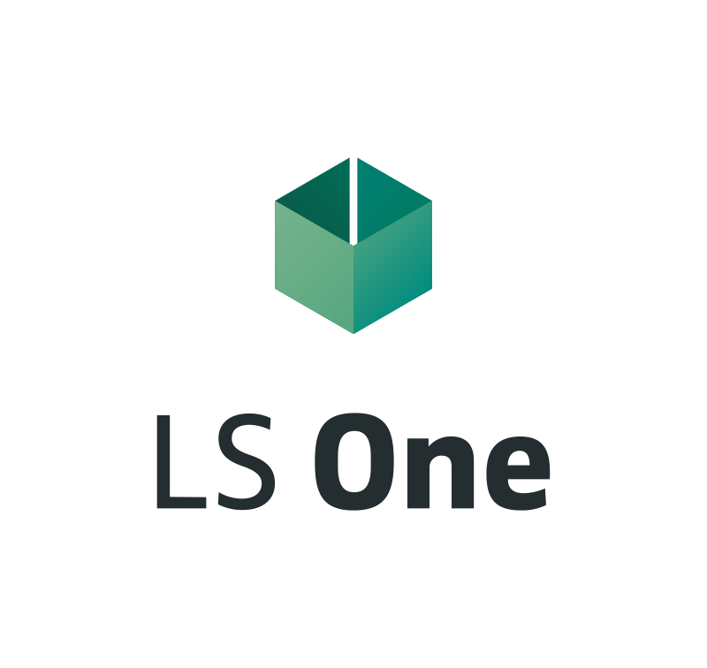
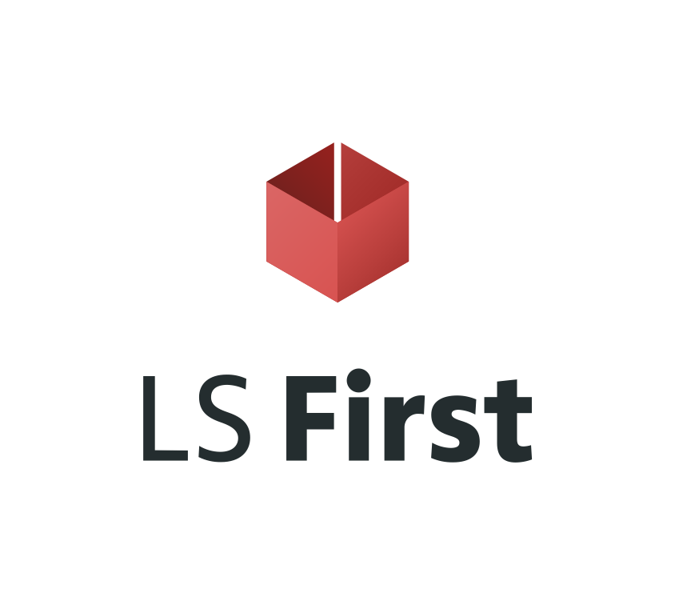
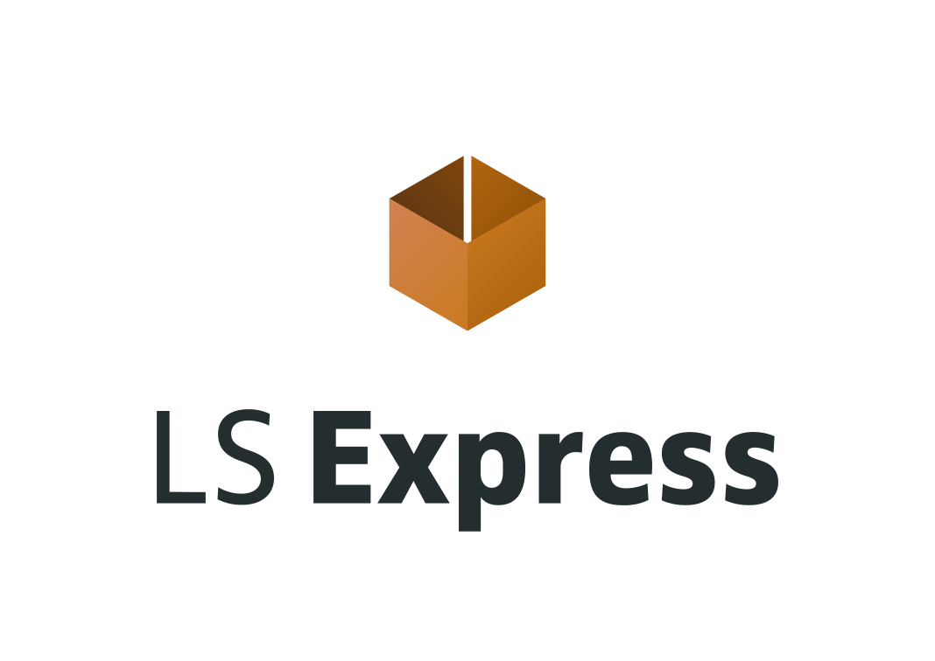



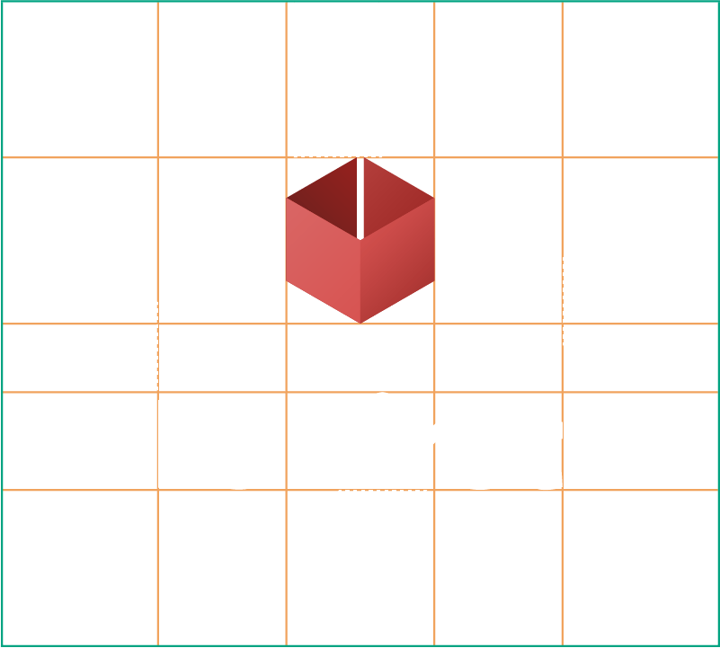
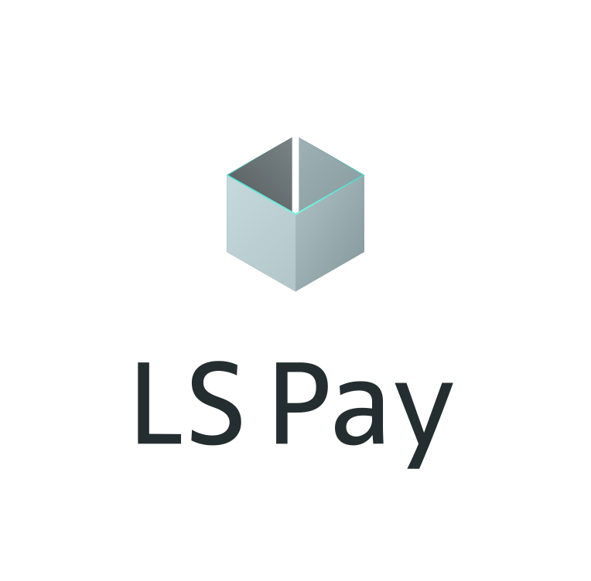
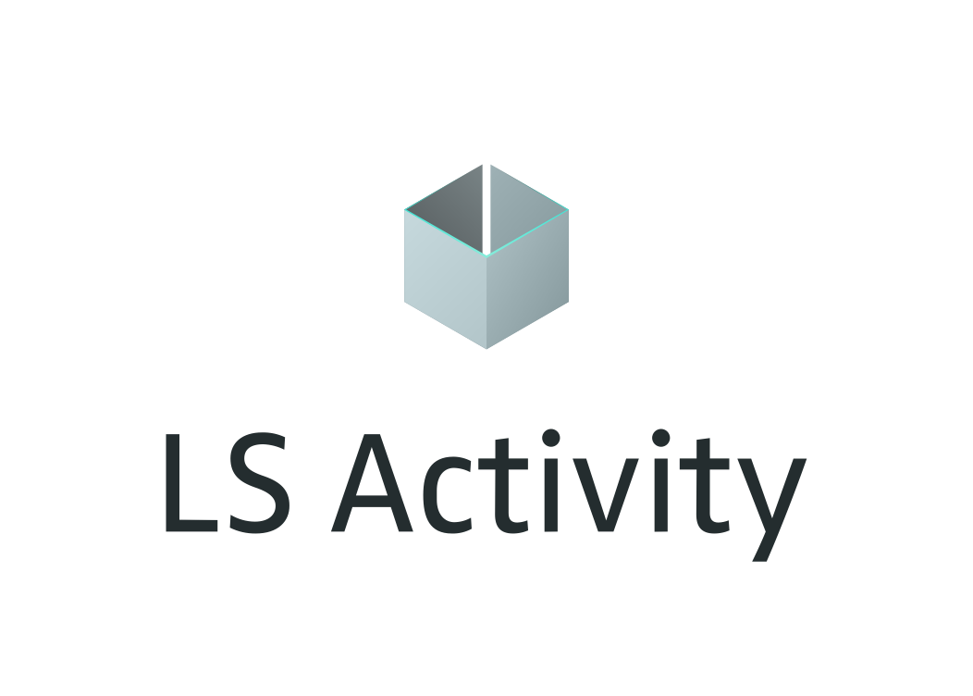
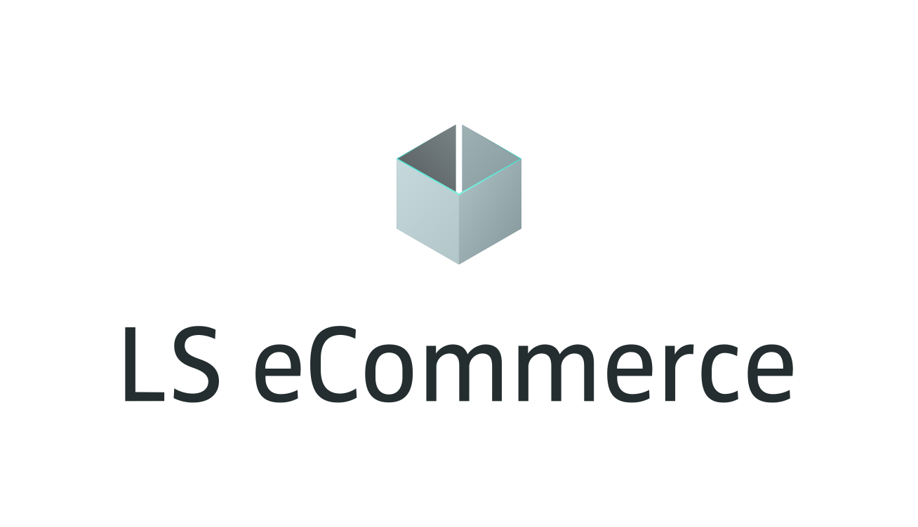
The width of the logo “box” marks the minimum space required around the logo

Slide 16











The width of the logo “box” and the logo ‘S’ mark the minimum space required around the logo

Slide 17











The width of the logo “box” marks the minimum space required around the logo

Slide 18



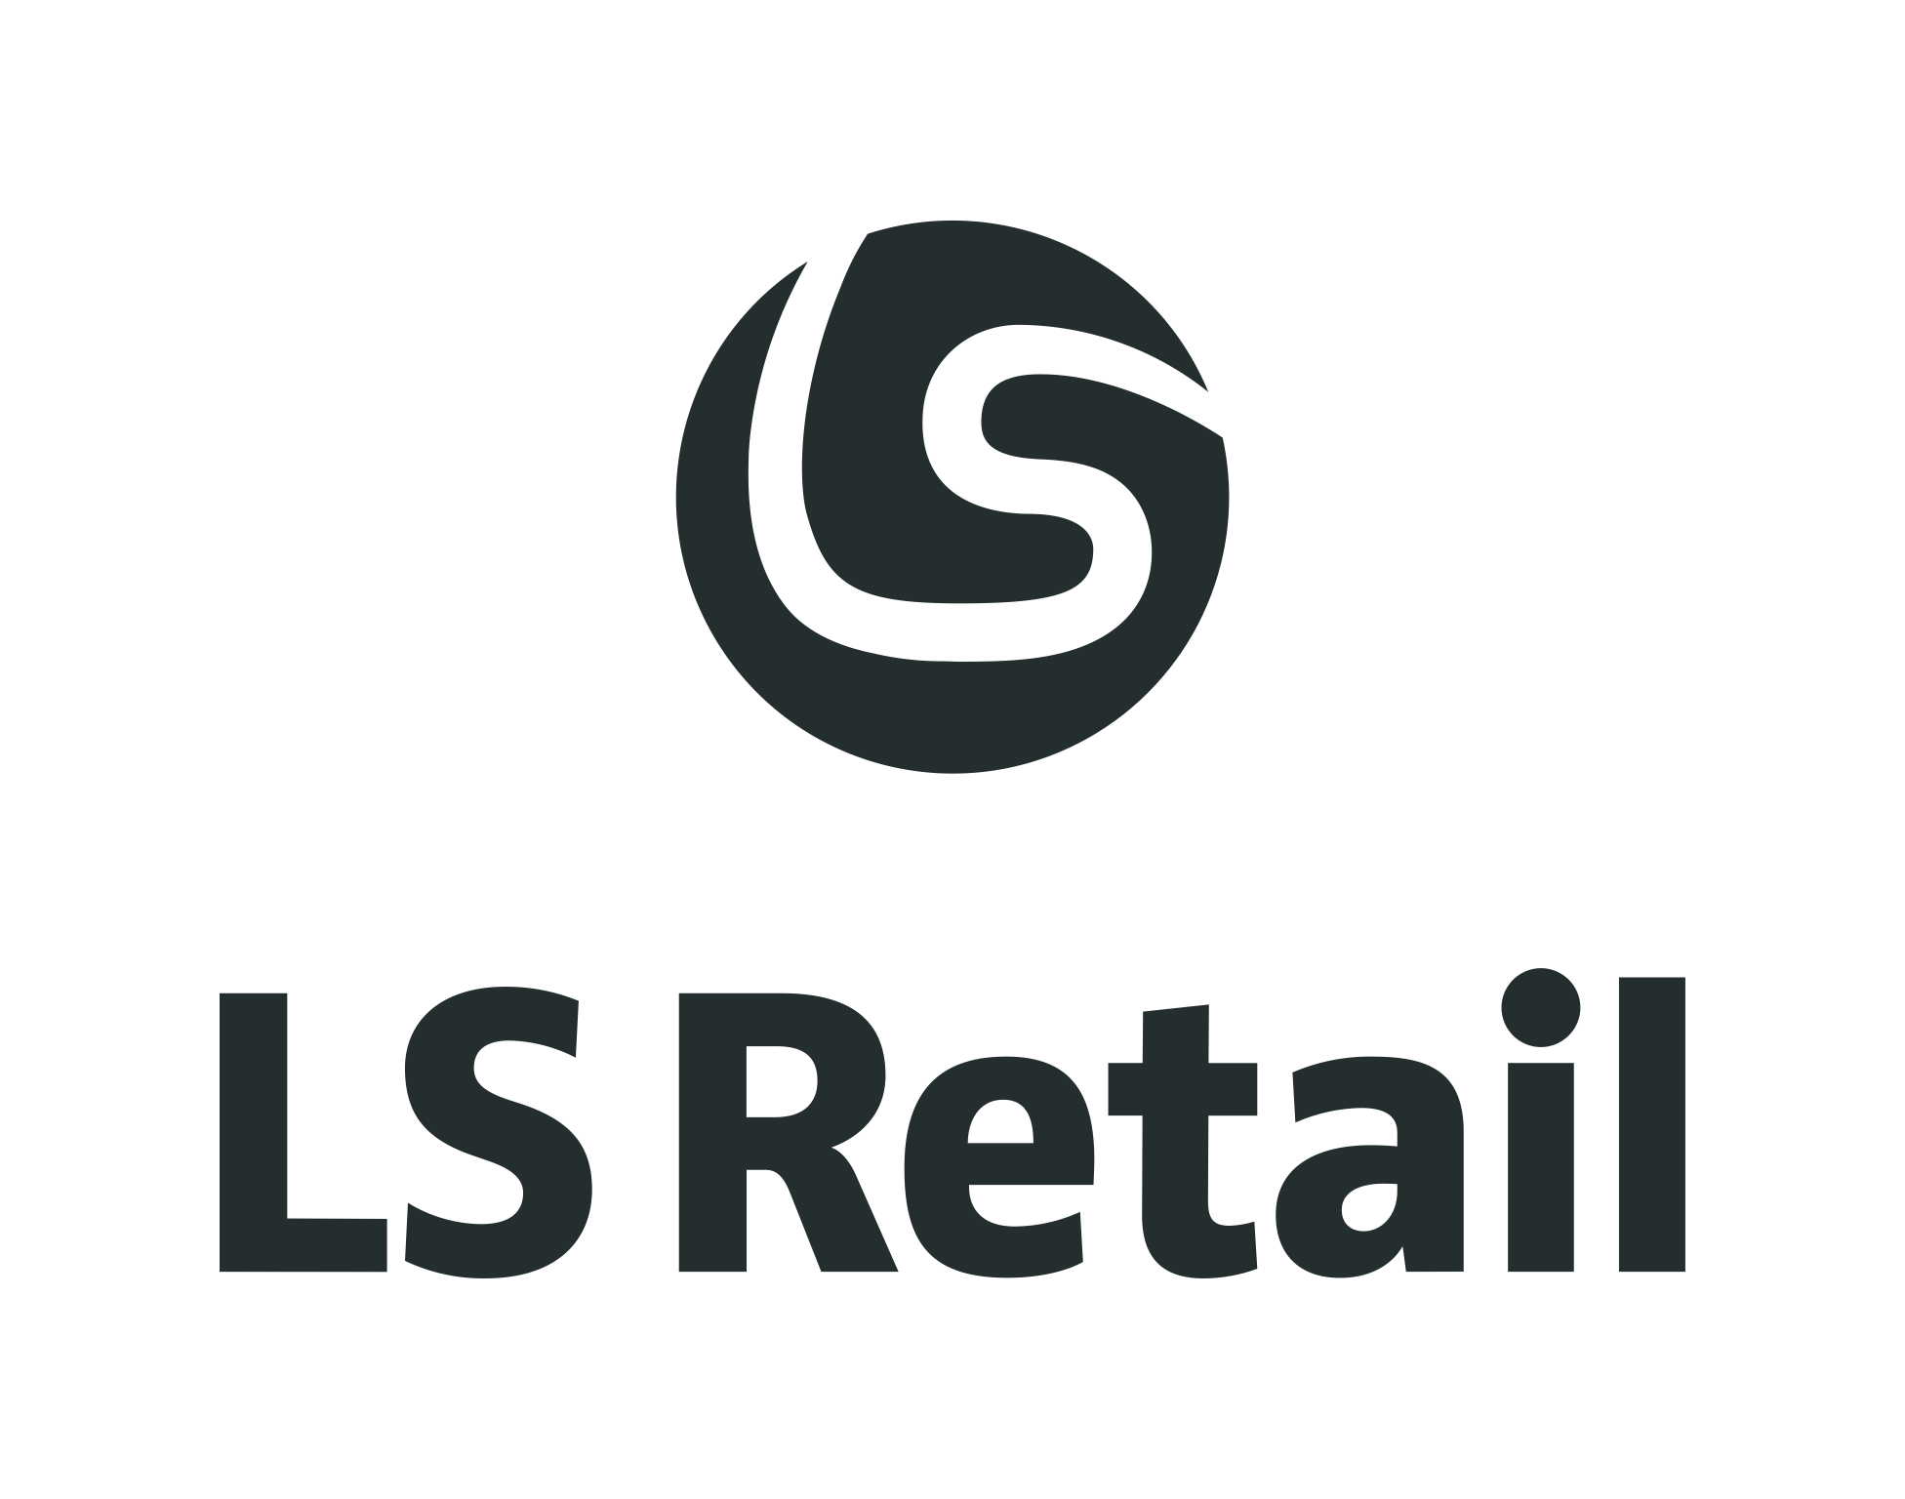
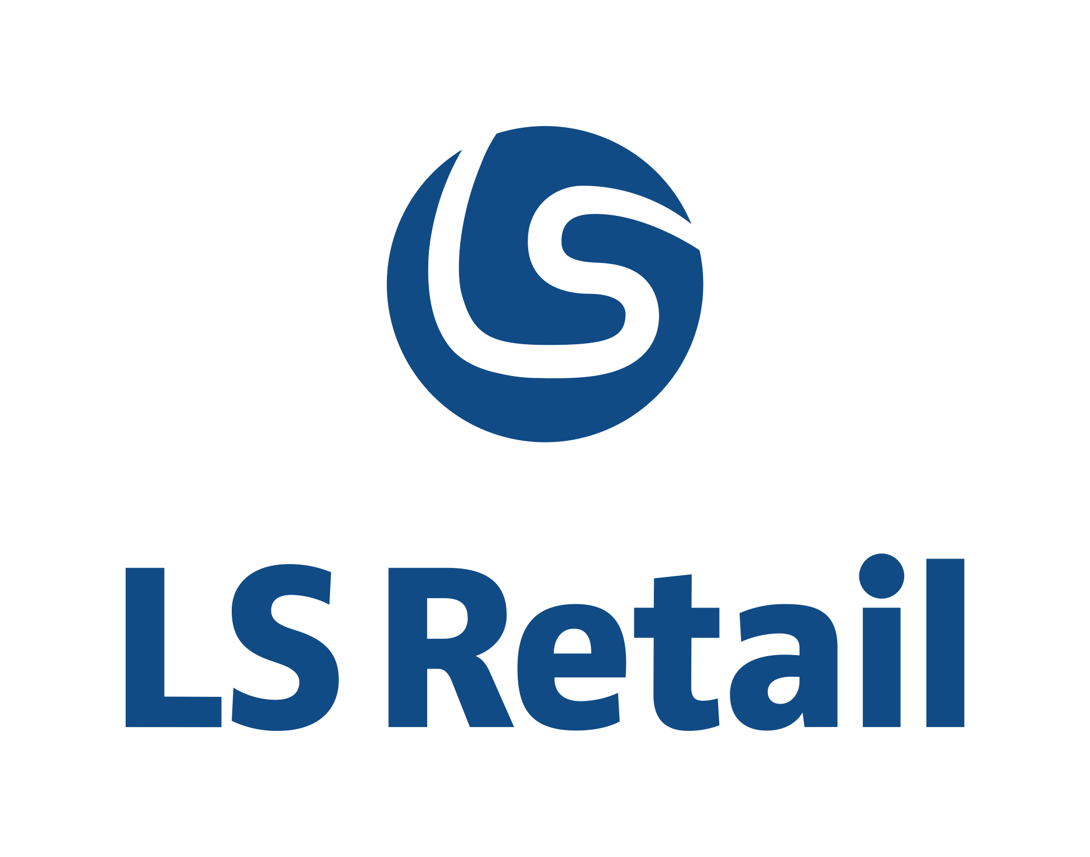

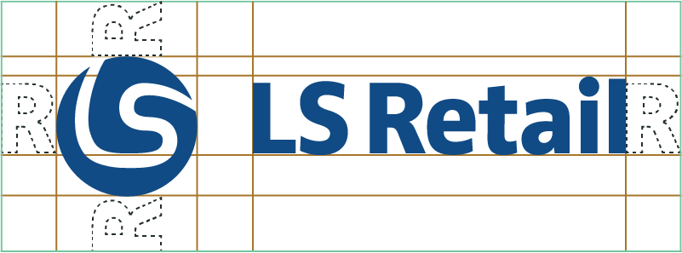
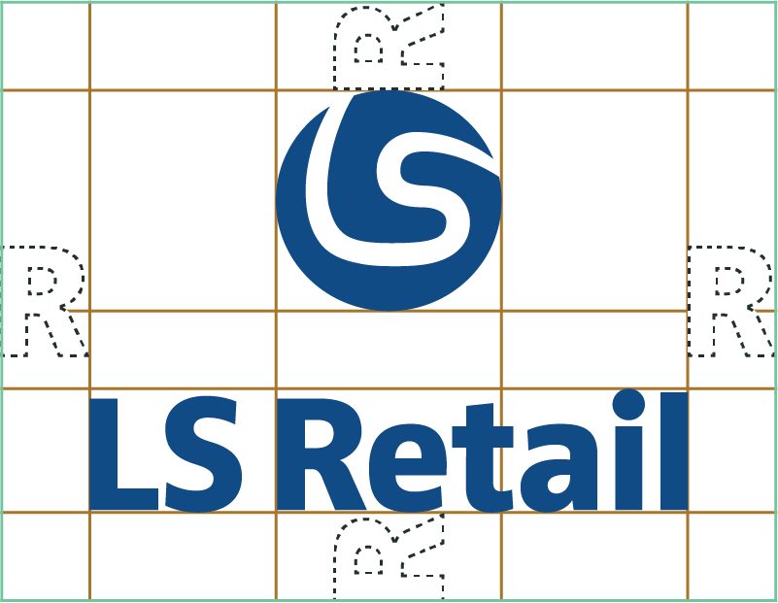
The logo ‘R’ marks the minimum space required around the logo

Slide 19







