Slide 4

Unified Experiences in hospitality with LS Central?
Gunnar Örn Thorsteinsson
Product Director
gunnarth@lsretail.com

Slide 5
Unified Experience
Unified: Cambridge dictionary
  brought together,
  combined, or united
Notes:
Unified Experiences!
If we look into what Unified means in a dictionary then we get brought together, combined or united. And this is exactly what we are aiming for with our LS Central offerings where we have a single solution in a single database providing multiple different business processes through configuration (mostly).

Slide 6

Unified Experience
Experience: Cambridge dictionary
  something that happens to you that affects how you feel
Notes:
Experience is something that happens to you that affects how you feel.
This is a market that is growing rapidly where more and more customers are seeking new experiences and not just physical goods. This can be a food experience at a restaurant or coffee shop, or it can be a spa experience, yoga class or golfing to name a few. And with our latest addition LS Hotels we have also added the resorting experiences to our portfolio.
and many retailers are offering experiences like bookstores selling coffees and snacks and IKEA running restaurants together with their furniture sales. In fact the biggest restaurant in Iceland today is in fact IKEA. Likewise more and more hospitality shops are not only selling food or experiences but also retail items with examples like Starbucks and Pret-a-manger selling coffee beans and branded goods.

Slide 7
Unified Experience
Experience: Cambridge dicionary
  (the process of getting) knowledge or skill from doing, seeing, or feeling things
Notes:
We can also take a look at another definition of Experience and that is: The process of getting knowledge or skill from doing, seeing or feeling things. How does that relate to our system? I think we not only have to provide our customers or users the possibility of selling experiences in a unified way, but we also need to give our users (being end-users and partners) a unified experience of our platform and products. This means we are working towards aligning business processes throughout our verticals and making them work seamlessly together. Another way of providing a good experience for partners is to enhance our demodata that we provide so they better map to best practices out in the field.
And by the way the picture you are seeing is from one of our partners trying to implement LS Hospitality from scratch!

Slide 8
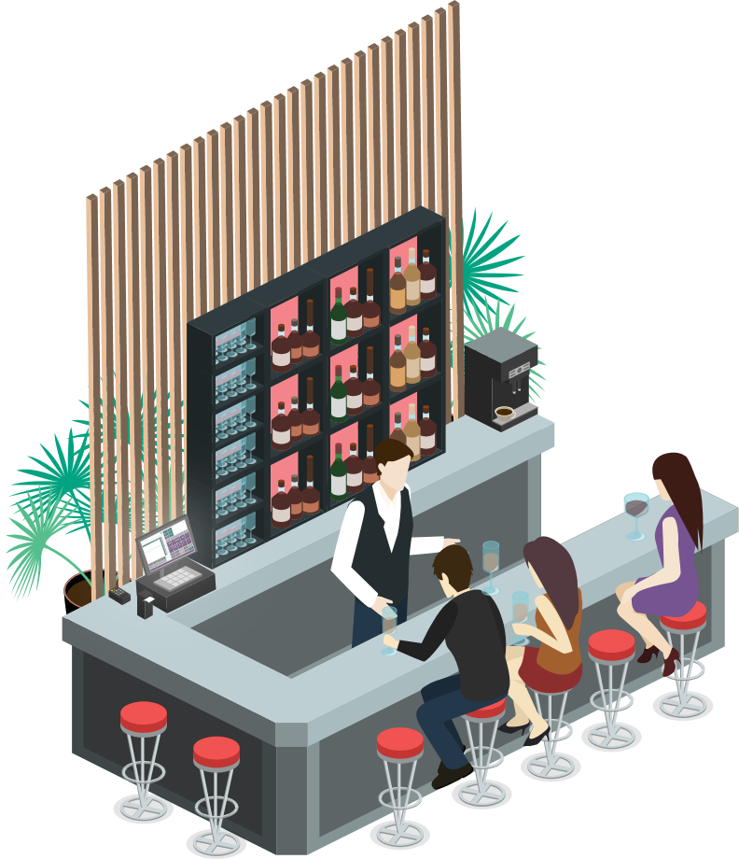
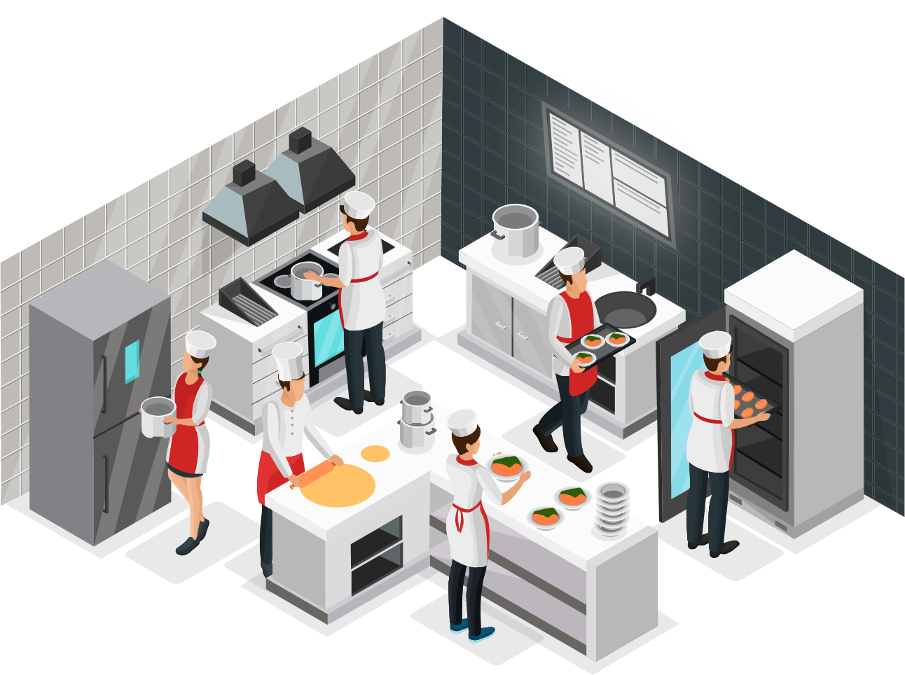

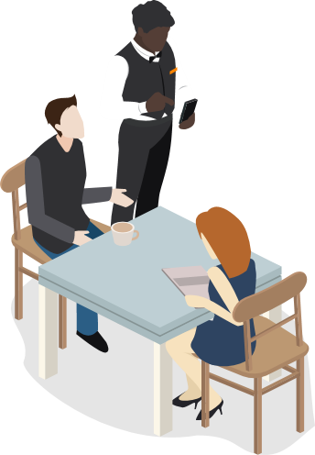



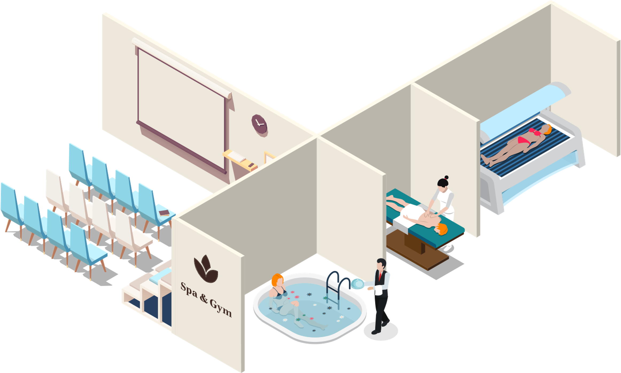
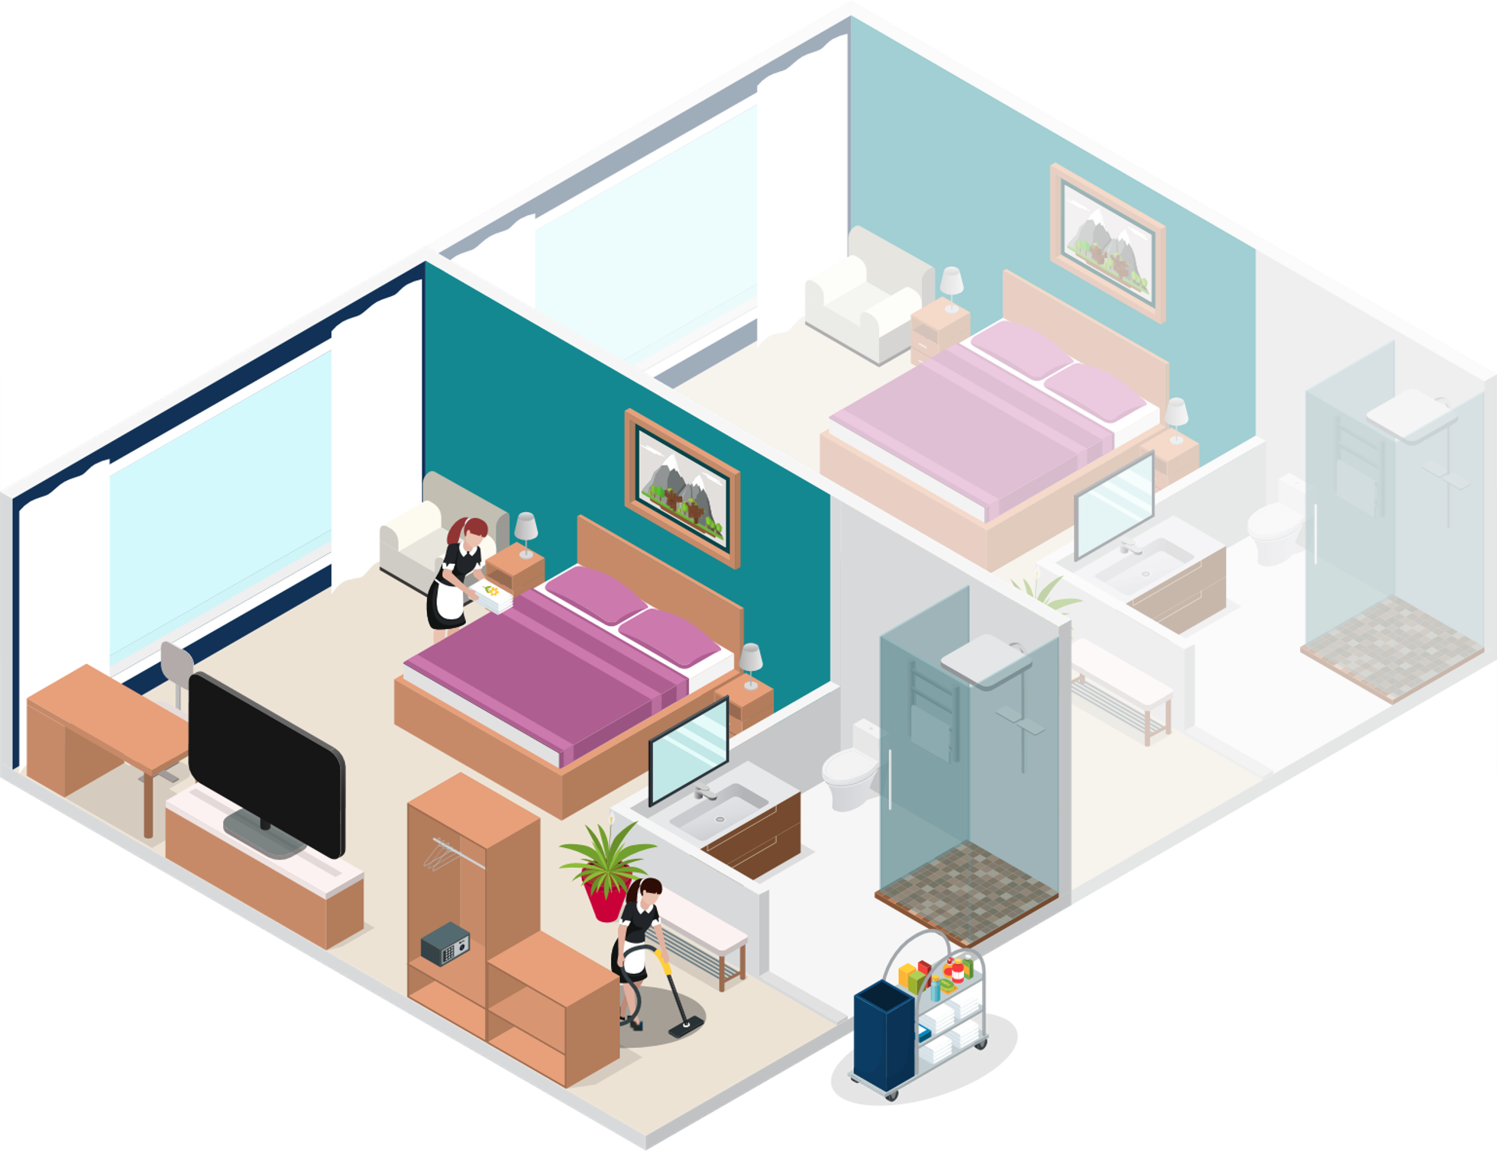
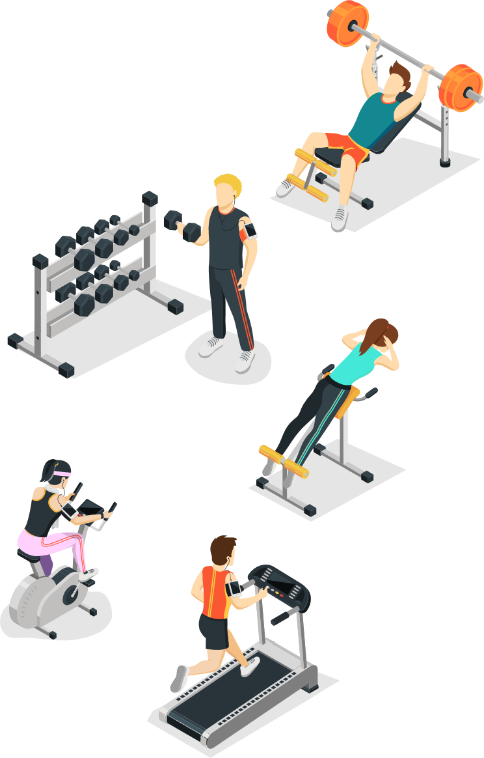
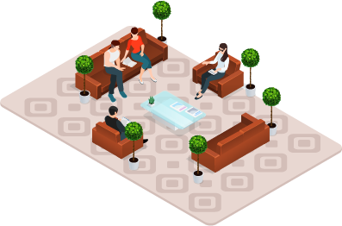
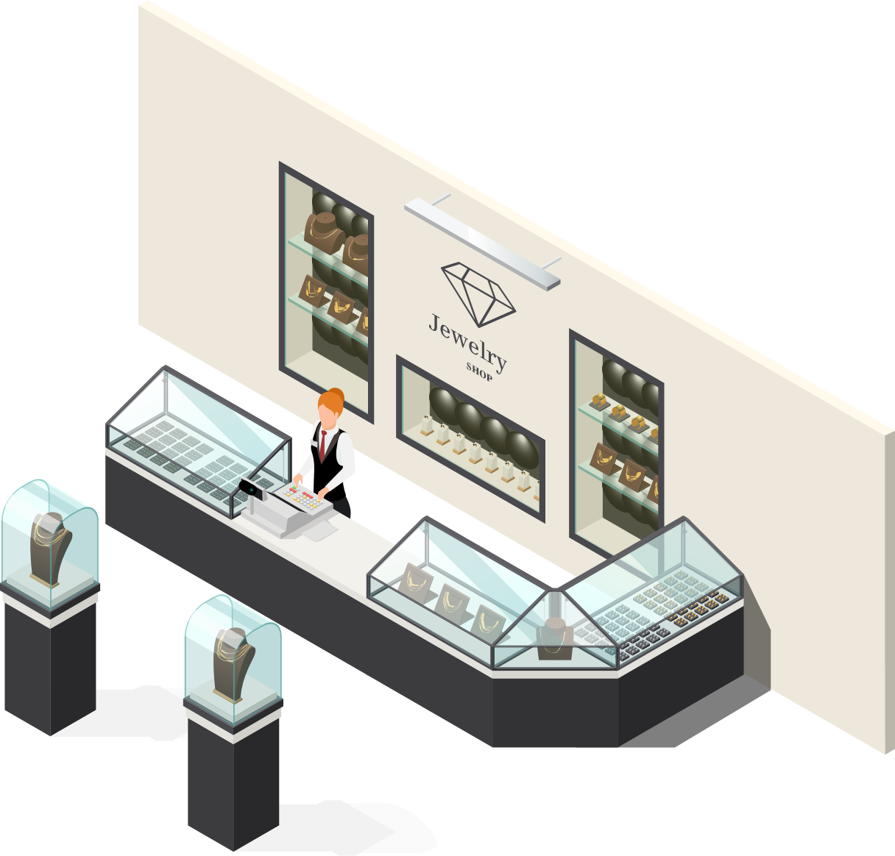


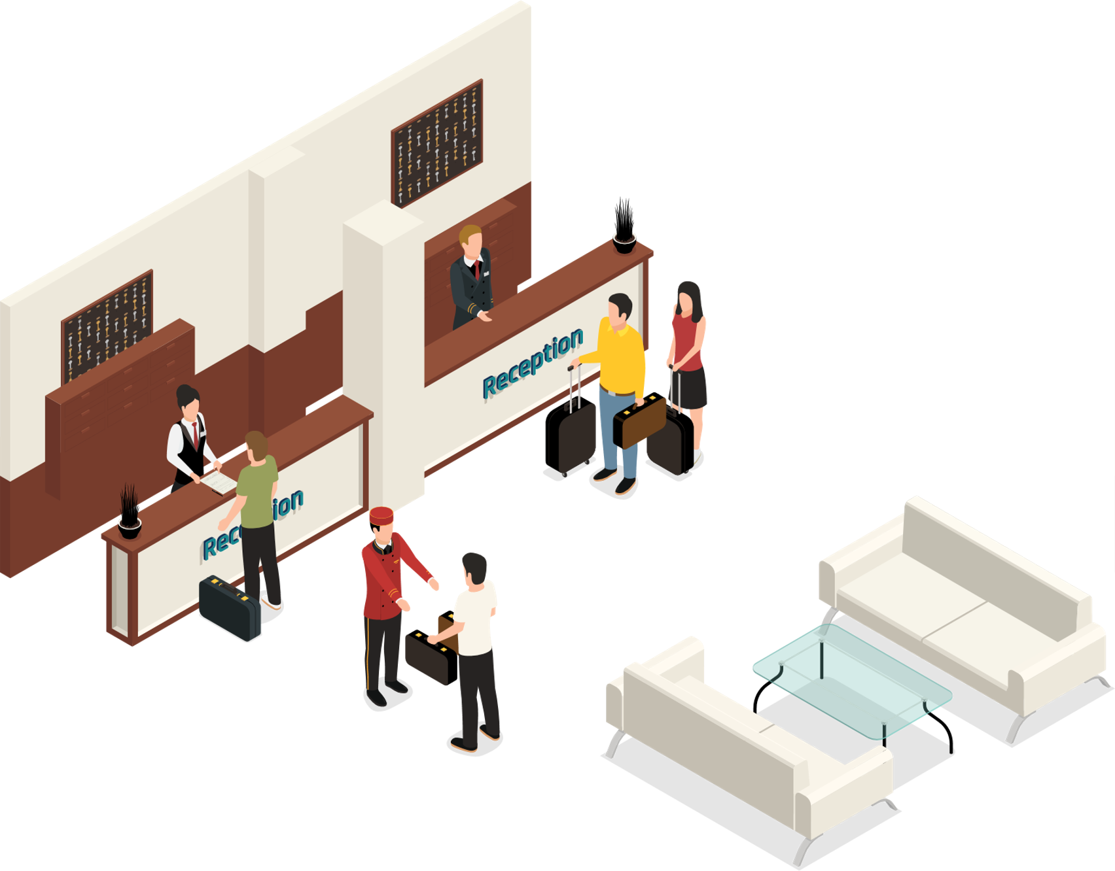
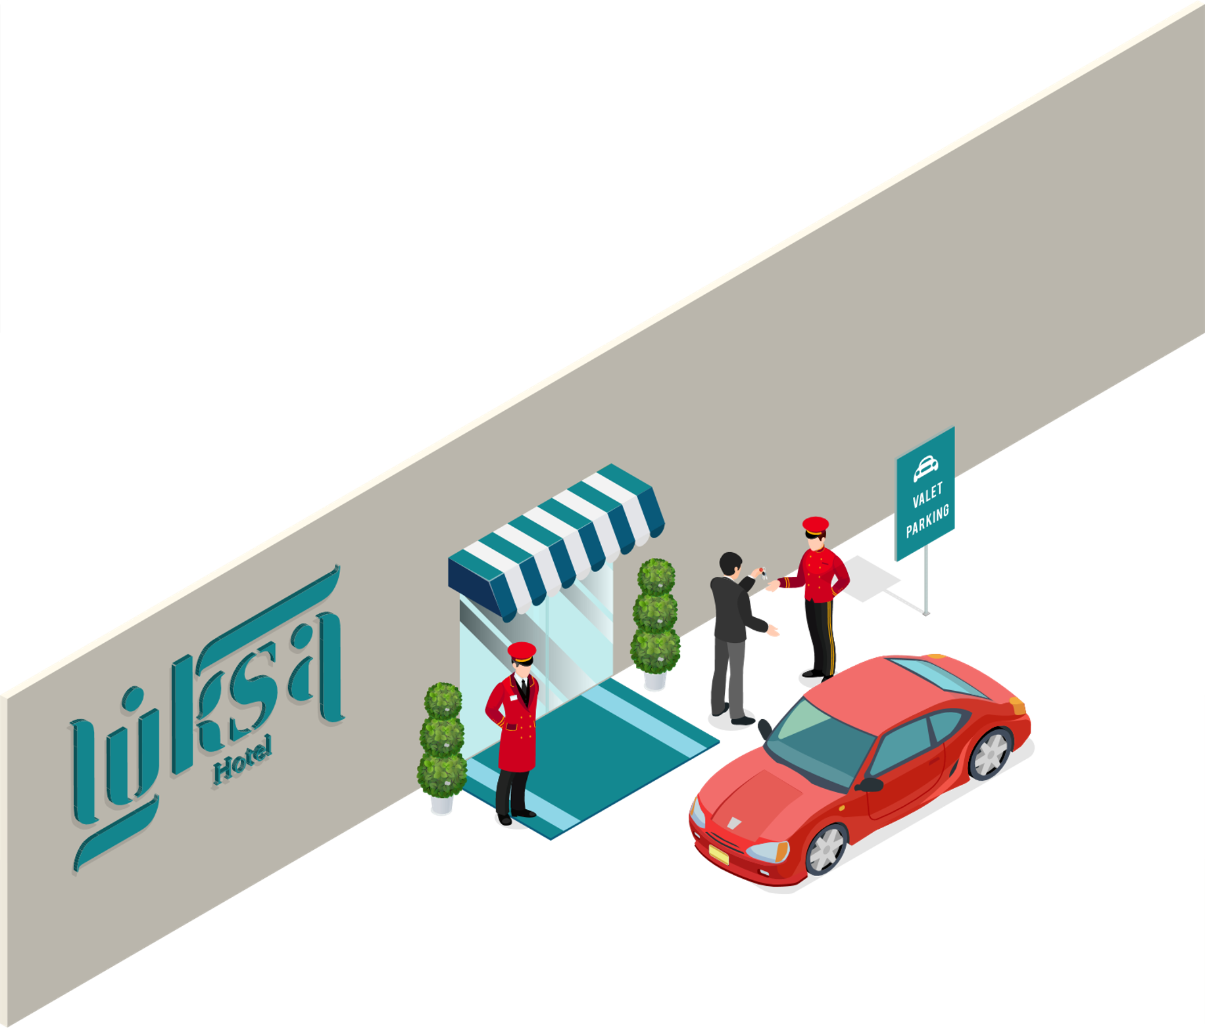



LS Hospitality
Hospitality
Food & Beverage
KDS
Staff Mgmt
Activity
Hotels
Notes:
The LS Hospitality solution includes five verticals that are Food and Beverage, the KDS or Kitchen Display System, the Staff Management module, the Activity module and the Hotel module. Each of these verticals can work independently of others but they really come to shine when working together. This is very often the case in resorts where all of the modules are needed and used.

Slide 9

Unified Experience with LS Hospitality
eCommerce Integration
Web Integration
3rd party
Channel Manager Connector
LS Pay
Integration to payment providers
LS Central
LS Insight
Analytics and predictive abilities
Staff Management
Staff rosters and timetabling
Activity
Reservations
and bookings
Hotels
Property Mgmt System and Channel Mgmt
LS KDS
Kitchen management
Restaurants
Food and beverage
Loyalty
Member
Mgmt
Retail
Stores and Backoffice
Microsoft Dynamics 365 Business Central
Power BI

Slide 10
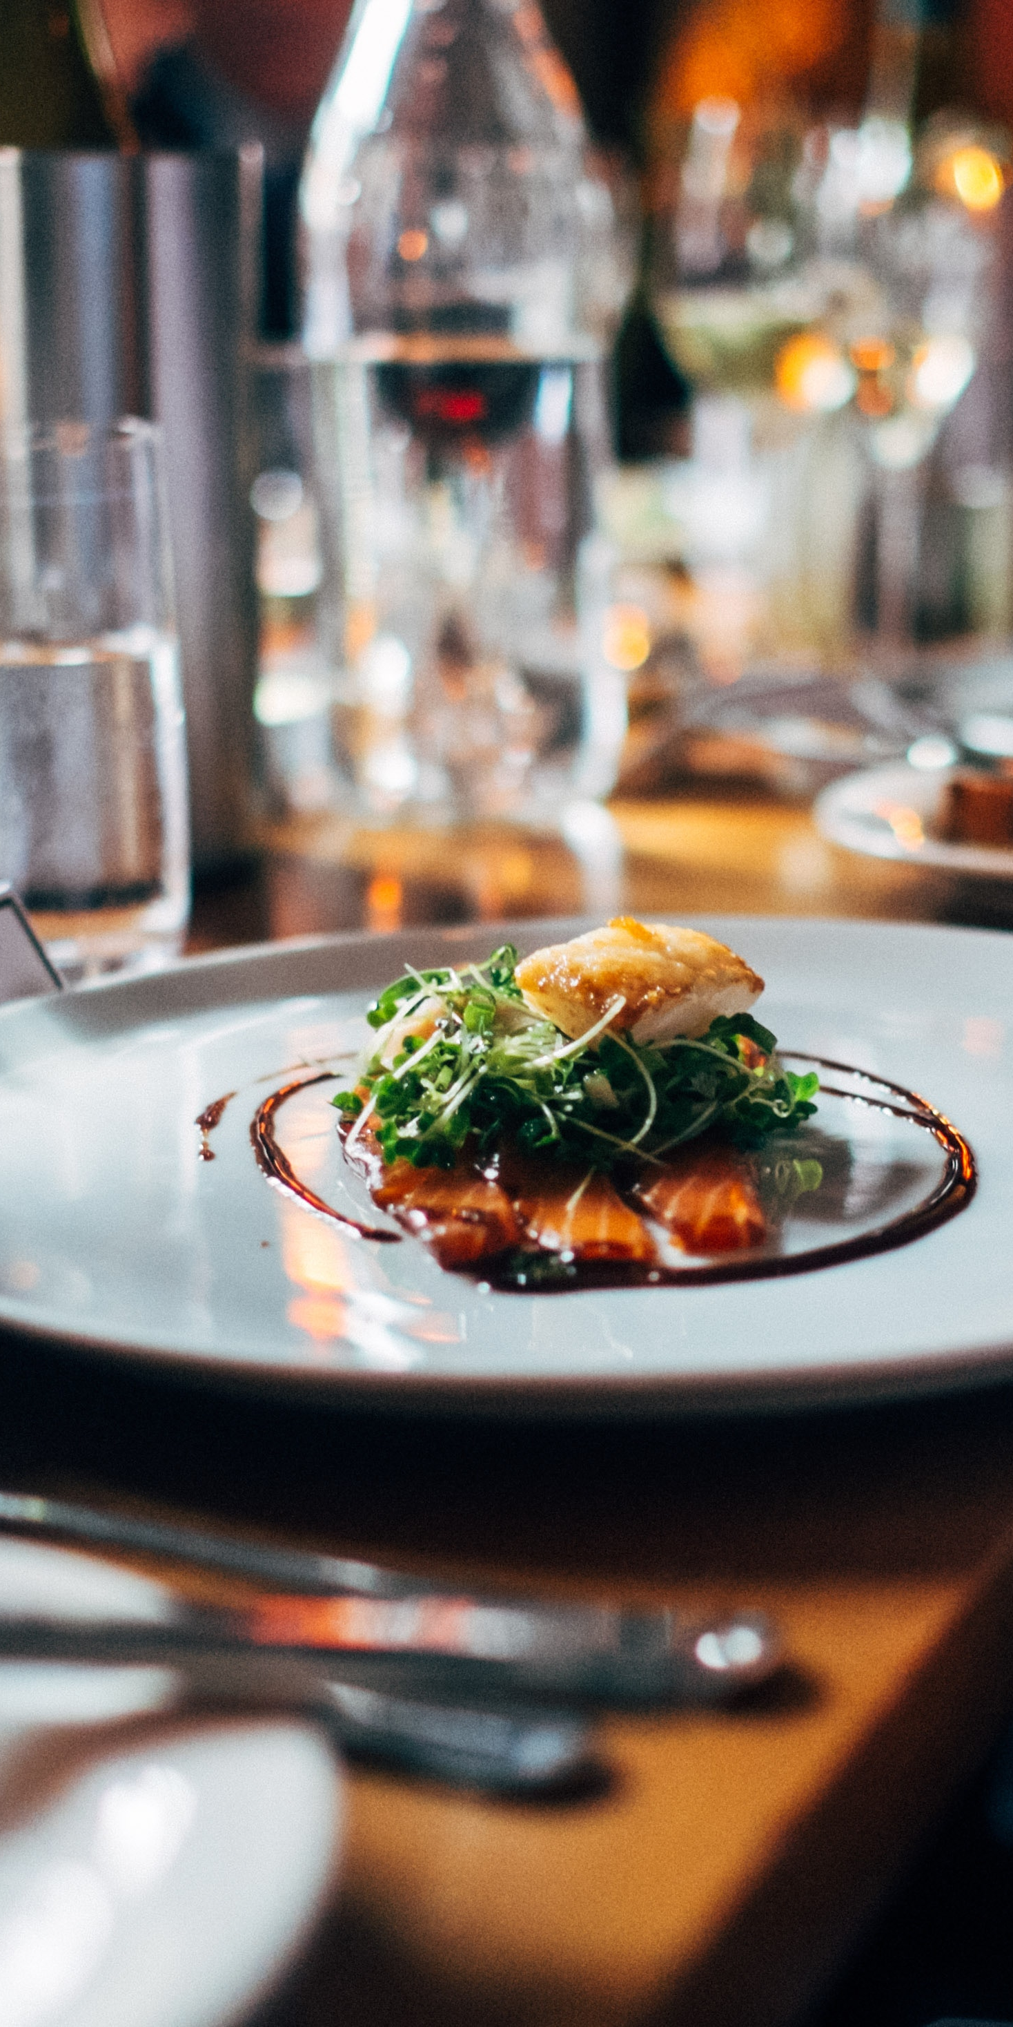
Food and Beverage (F&B)
Fine Dining, Casual Dining, Quick Service Restaurants, Coffee Shops, Pubs, …
Configurational Service Flows to support multiple types of restaurants
Recipes, Modifiers, Deals, Discounts, Allergens
Transfer orders, Split Bill
Quick Order taking
Kitchen communication on POS with Coursing
Table management
Mobile POS
Self-Service Kiosk
eCommerce with Takeout & Delivery

Slide 11
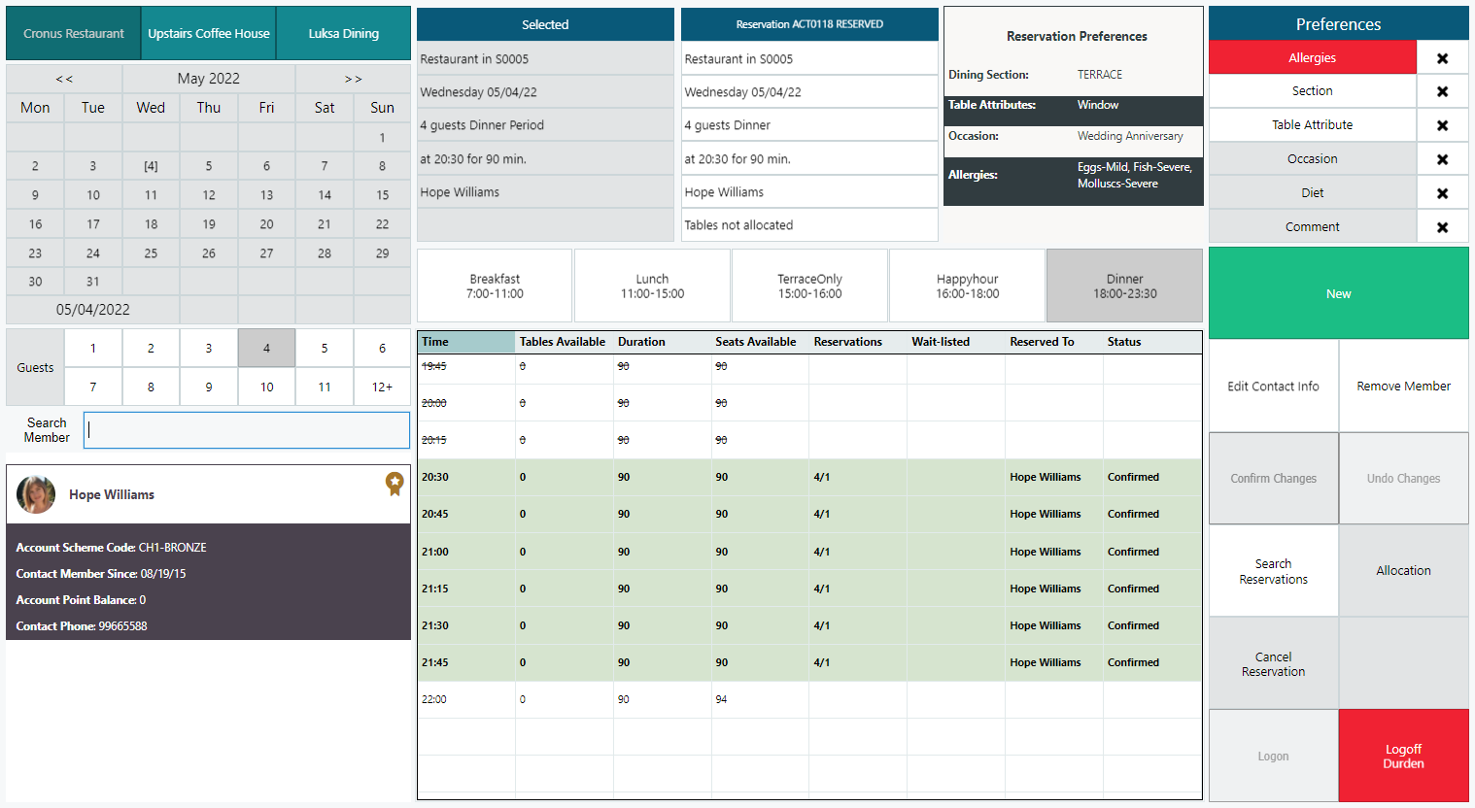
F&B Reservation Desk

Slide 12
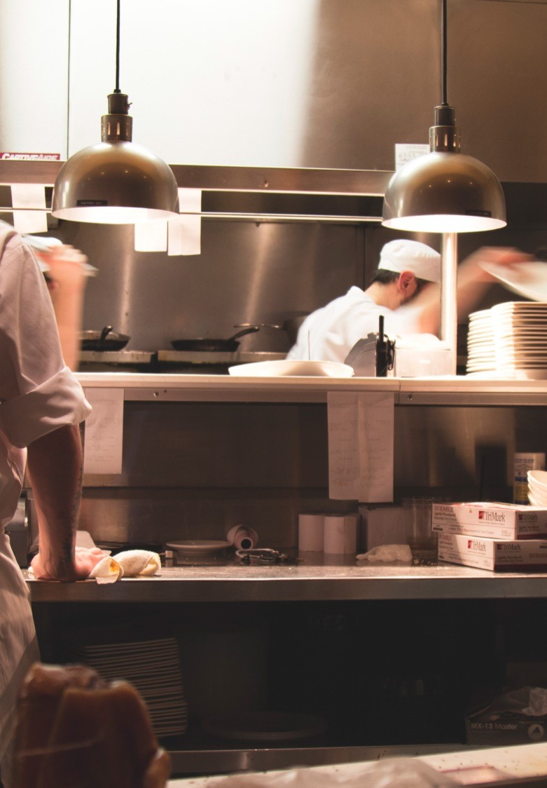
Kitchen Display System (KDS)
Standalone product that works with LS Central and LS First
Performance increase in POS
Displays and/or printers
Bi-directional communication (Displays only)
Routing logic on items, terminals or type
Fully configurable on operations and UI
Kitchen workflows
Multiple device types: Preorders, Preparation, Expeditor, Customer Facing Preparation, Customer Facing Ready

Slide 13
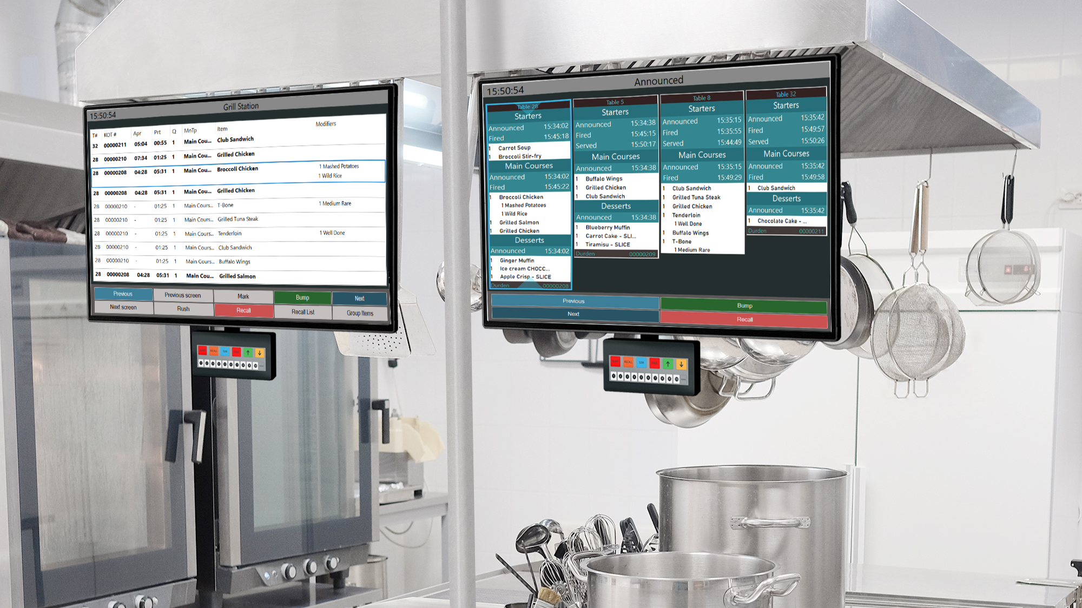
Kitchen Displays

Slide 14
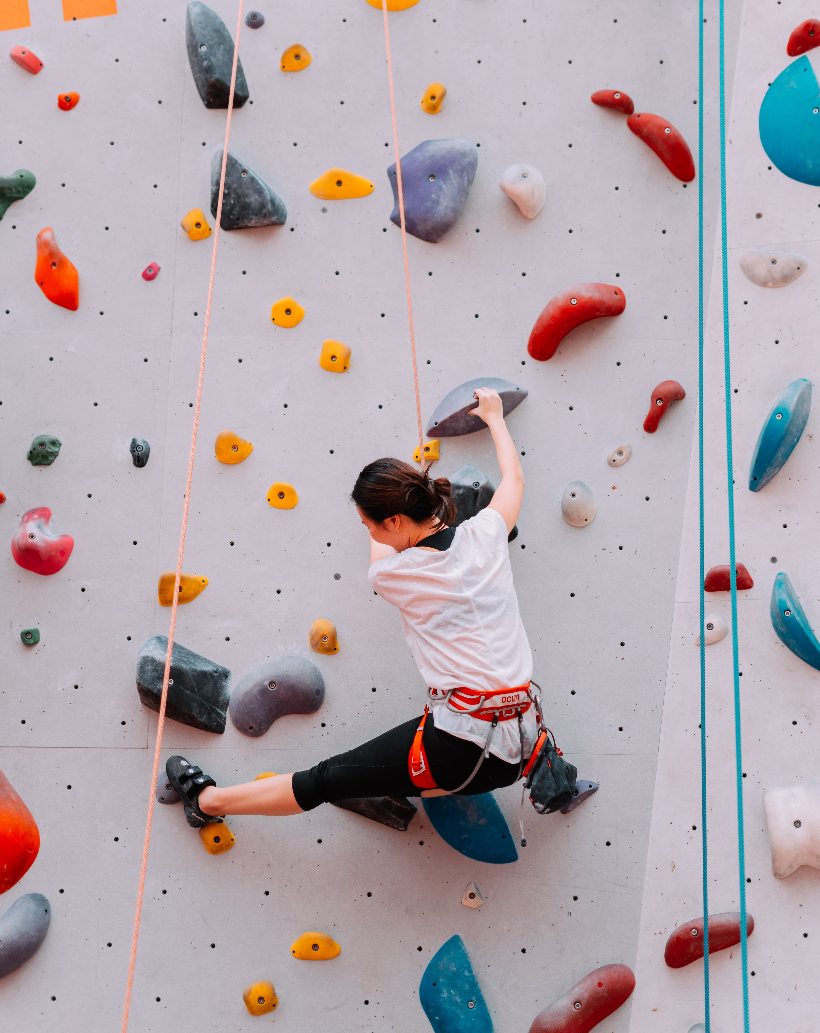
Activity
Multiple types of Activities in a single platform
Reservations and appointments, Groups, Classes, Courses, Ticketing, Rentals, Memberships, Events
Table reservations for F&B
Manage bookings with 3rd party operators
Manage resources like staff, rooms, assets
Memberships
POS processes allow for quick sales, charges and self checkout
Powerful API’s expose availability and take reservations
Notes:
LS Activity is a general booking engine that supports multiple activity types such as classes, courses, golf, subscriptions rentals, ticketing, events etc. All of these different activity types need one or more types of resources, like a human resource and/or some space or equipment needed for an activity.

Slide 15

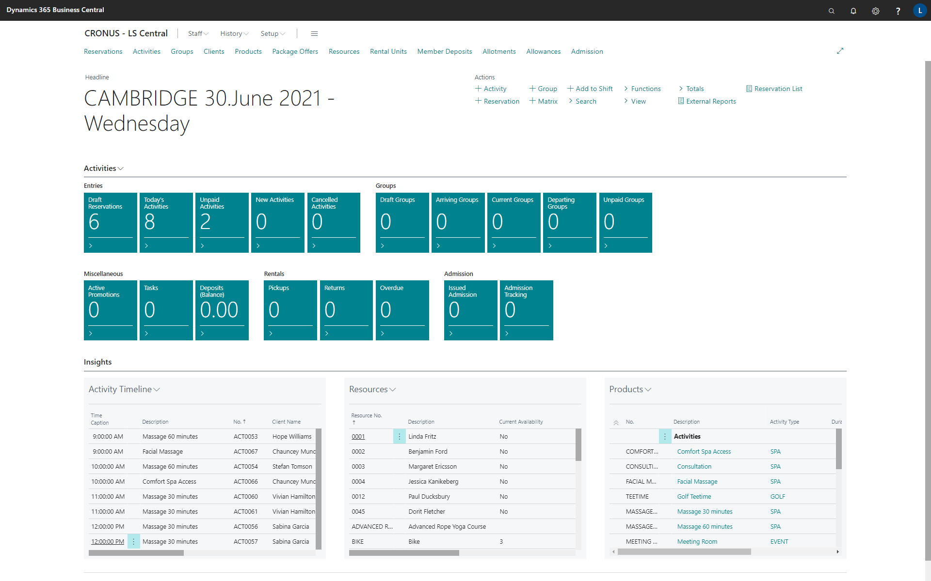

Slide 16

Staff Management
Manage employees, shifts and roles
Role budgets
Roster planning
Time registration on POS
Export to salary system
Employee analysis
Works well with LS Activity and LS Hotels to manage availability of human resources
Notes:
Staff management is great for managing rosters and role budges and manage shifts and timesheets. It is really powerful when used with other modules such as Activity and LS Hotels to manage availability of human resources in various roles.

Slide 17
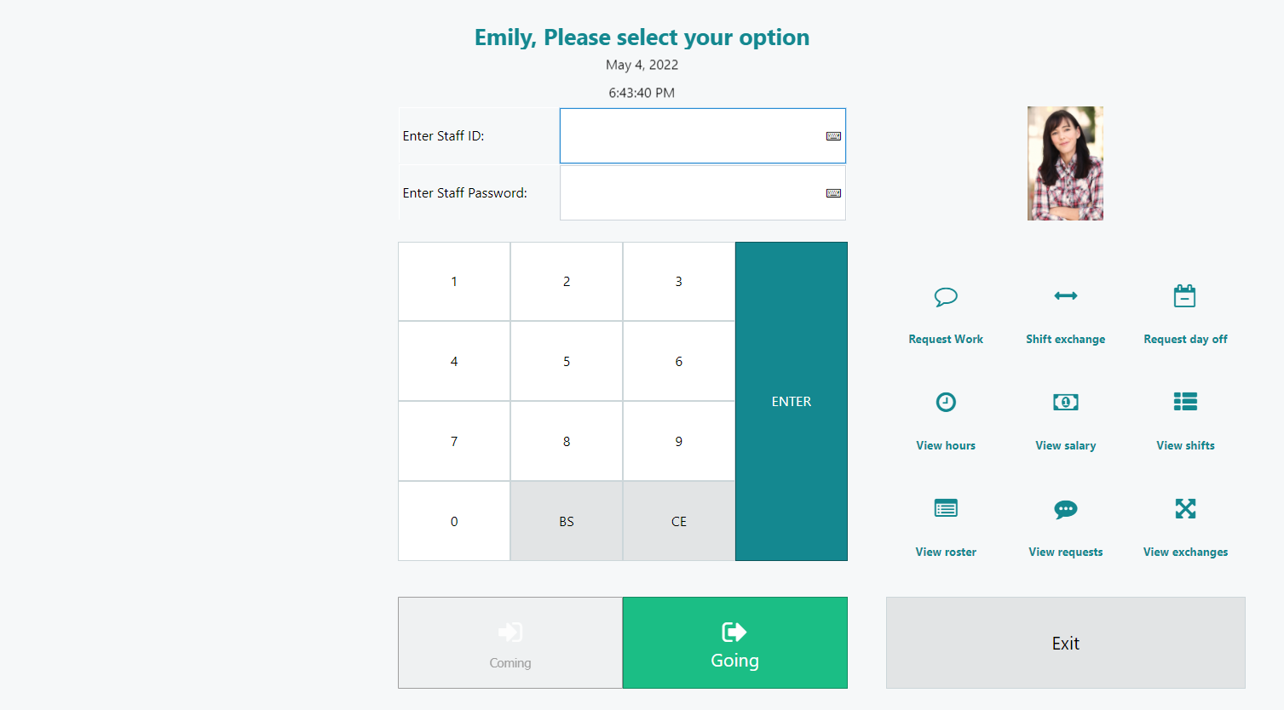
Time registration on POS
Notes:
Here is an example of how staff can clock in and clock out on the POS but also where they can get overview of hours, their rosters. Here they can also make requests for day off and change shifts. We are looking into options for making this functionality also available in Microsoft Powerapp in the future.

Slide 18
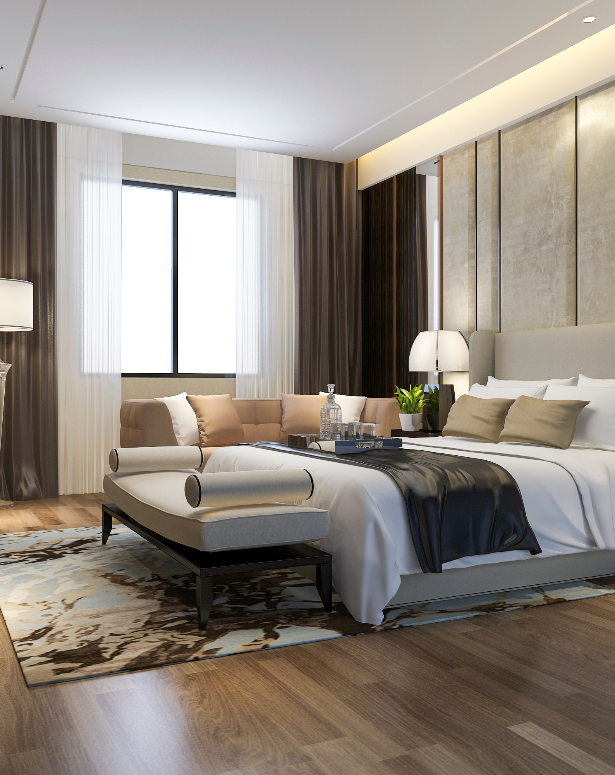
LS Central for Hotels
Property Management in ERP
Rate management with items, activities and/or packages
Manage the guest journey with powerful Reservation management
Calendar view to manage room allocations and get better overview
Invoice Management in POS or in BO
Hotel Front Desk Role Center and POS to speed up customer service
Housekeeping API
Channel Management (SynXis + SiteMinder)
Notes:
LS Hotels is a full blown Property Management System and this is our newest module in the LS Hospitality suite. It is now operational at the Blue Lagoon which has 2 hotels, one which is The Retreat with XX rooms and a five star hotel, the other is Silical with YY rooms and a four star hotel. One of the key element in their business is the tight coupling of PMS and Activity where all of the activities and charges for a guest are managed in the hotel reservation.

Slide 19
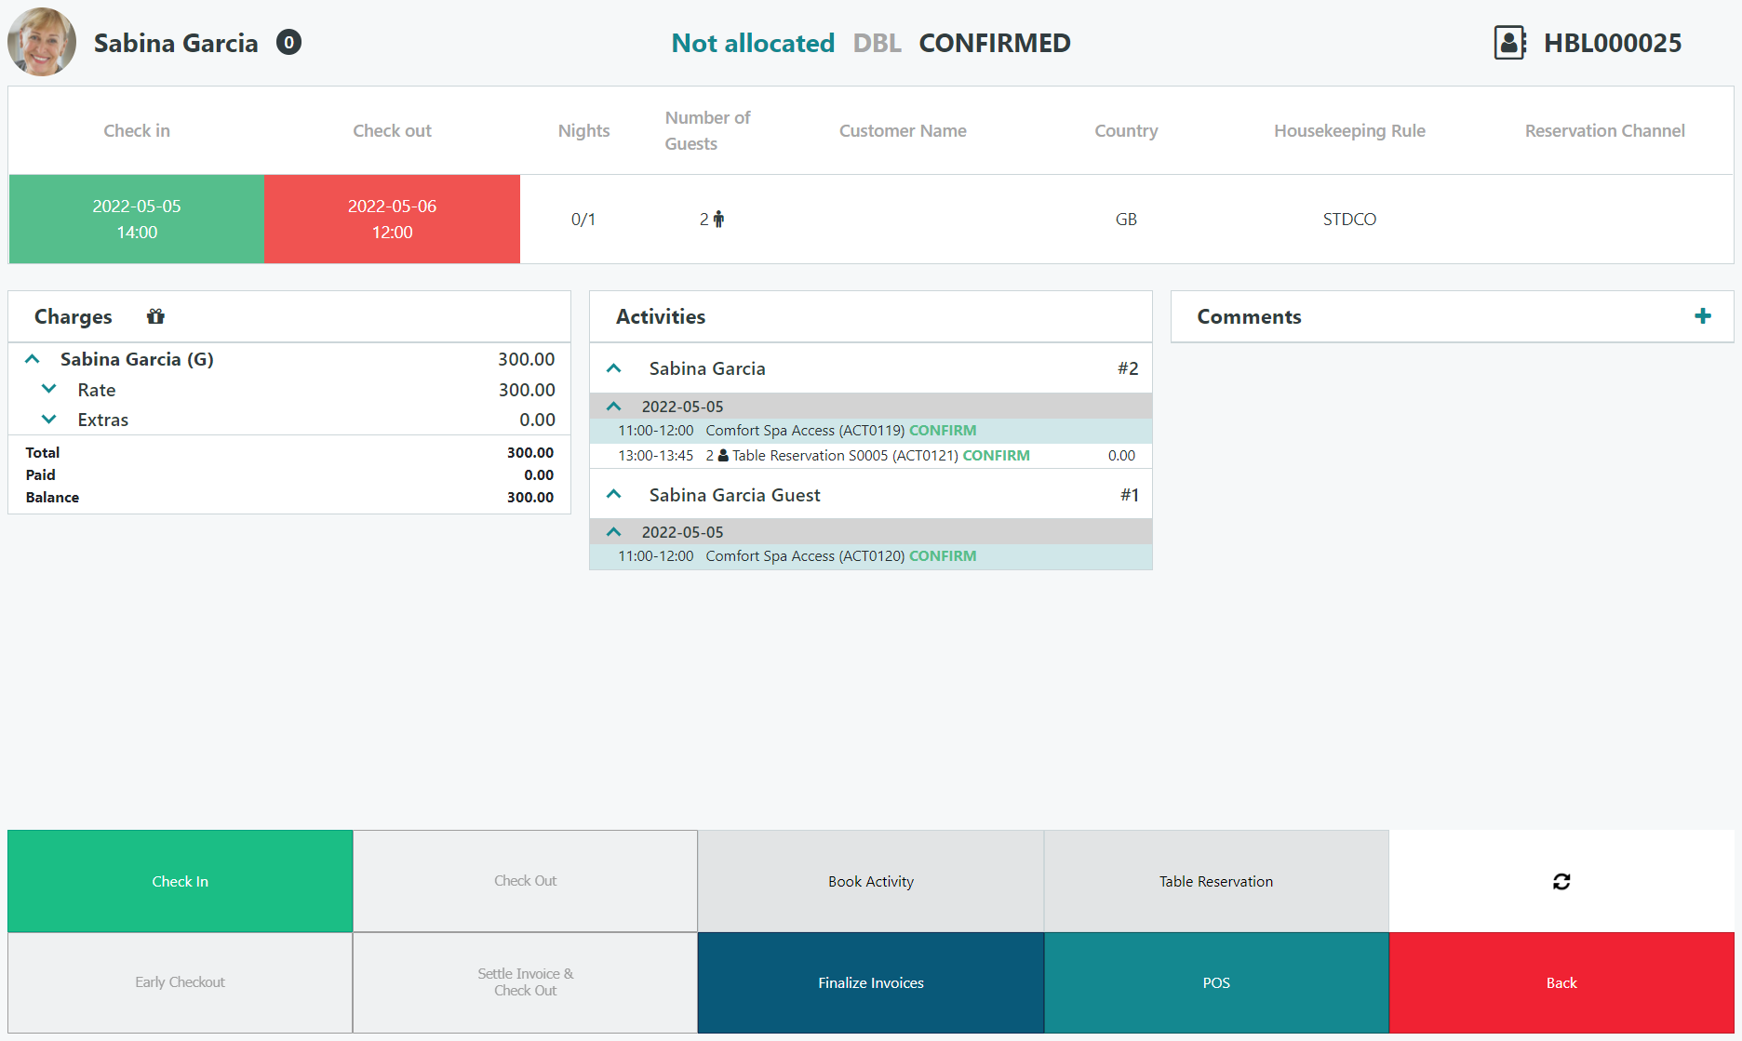
Hotel Front Desk

Slide 20
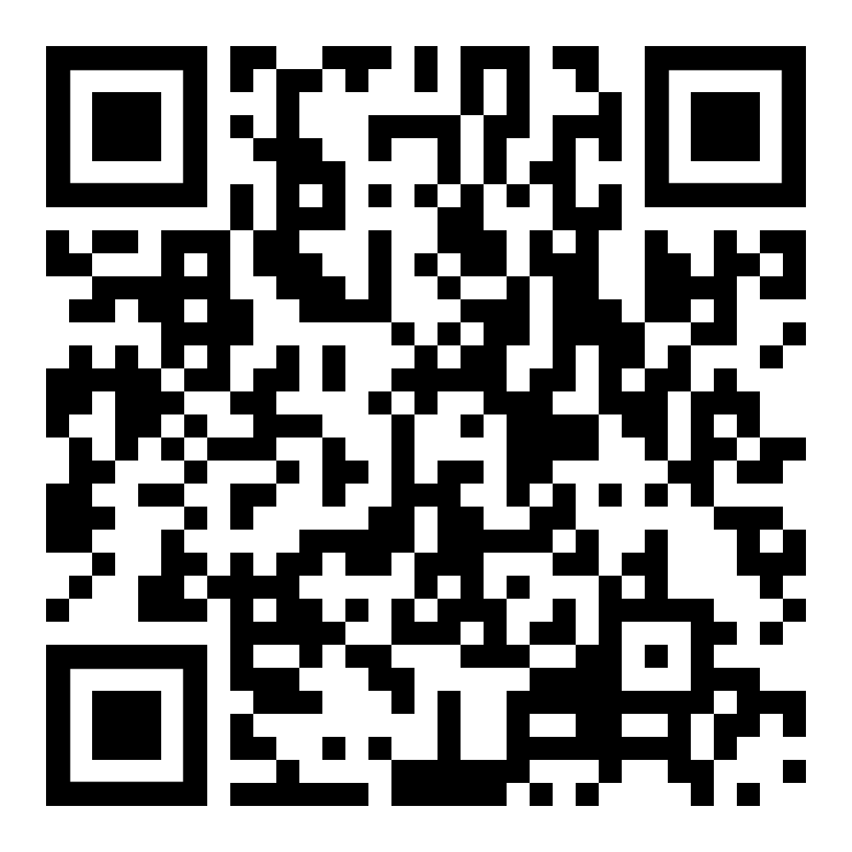
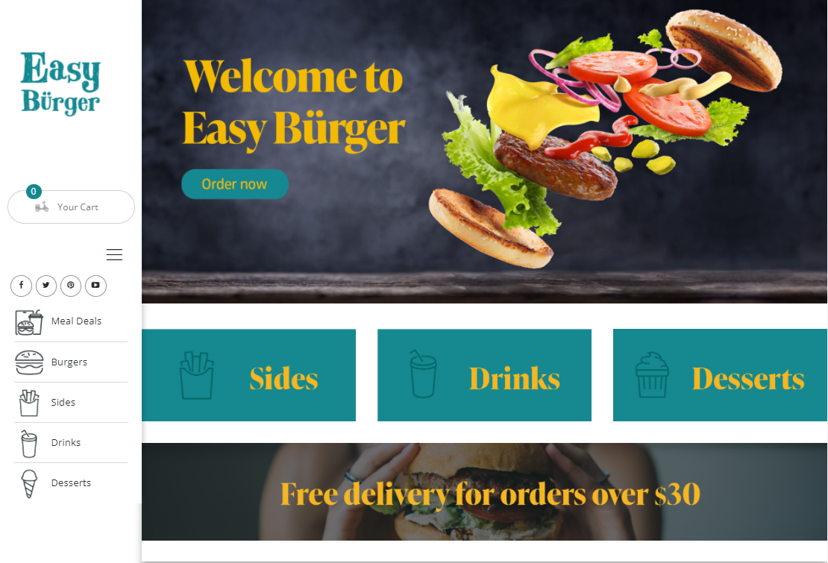
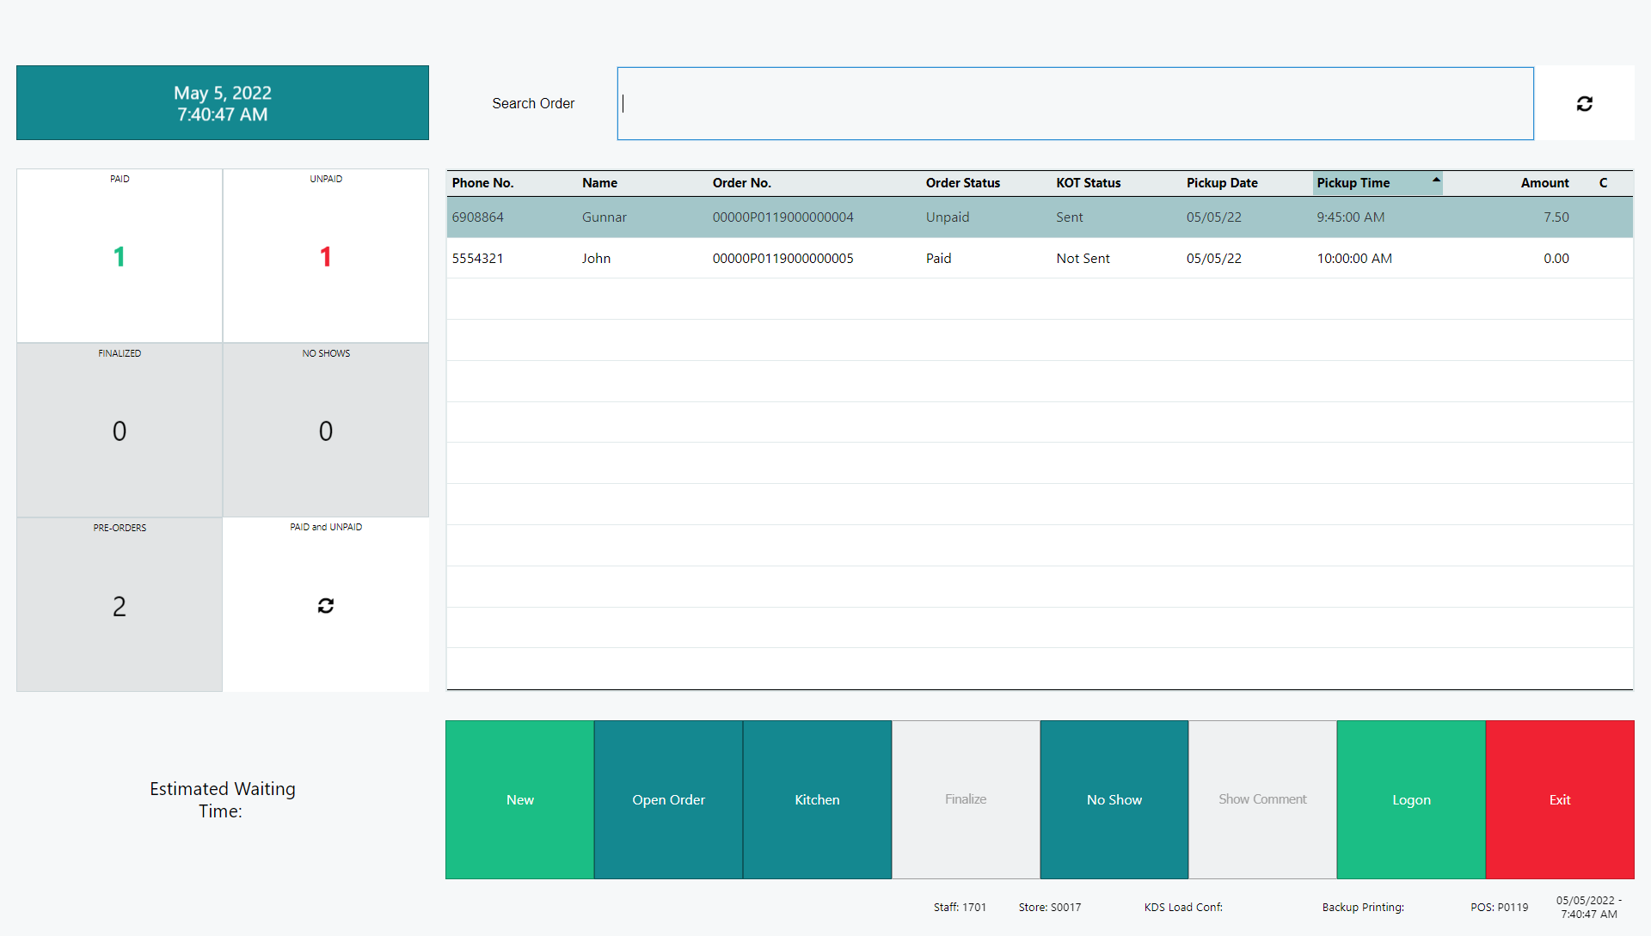
Unified Experiences
Notes:
So we have all of these verticals that help you provide experiences for your customers but how are they unified?
If we look at the eCom for restaurants then we start the process of generating a QR code for tables in the restaurant. When scanned this take the user to the landing page for hospitality where the customer submits and pays the order. The order is sent into the Kitchen Display System for production and when the customer comes and picks up the order we quickly find it in the new Takeout Host and mark it as delivered.

Slide 21
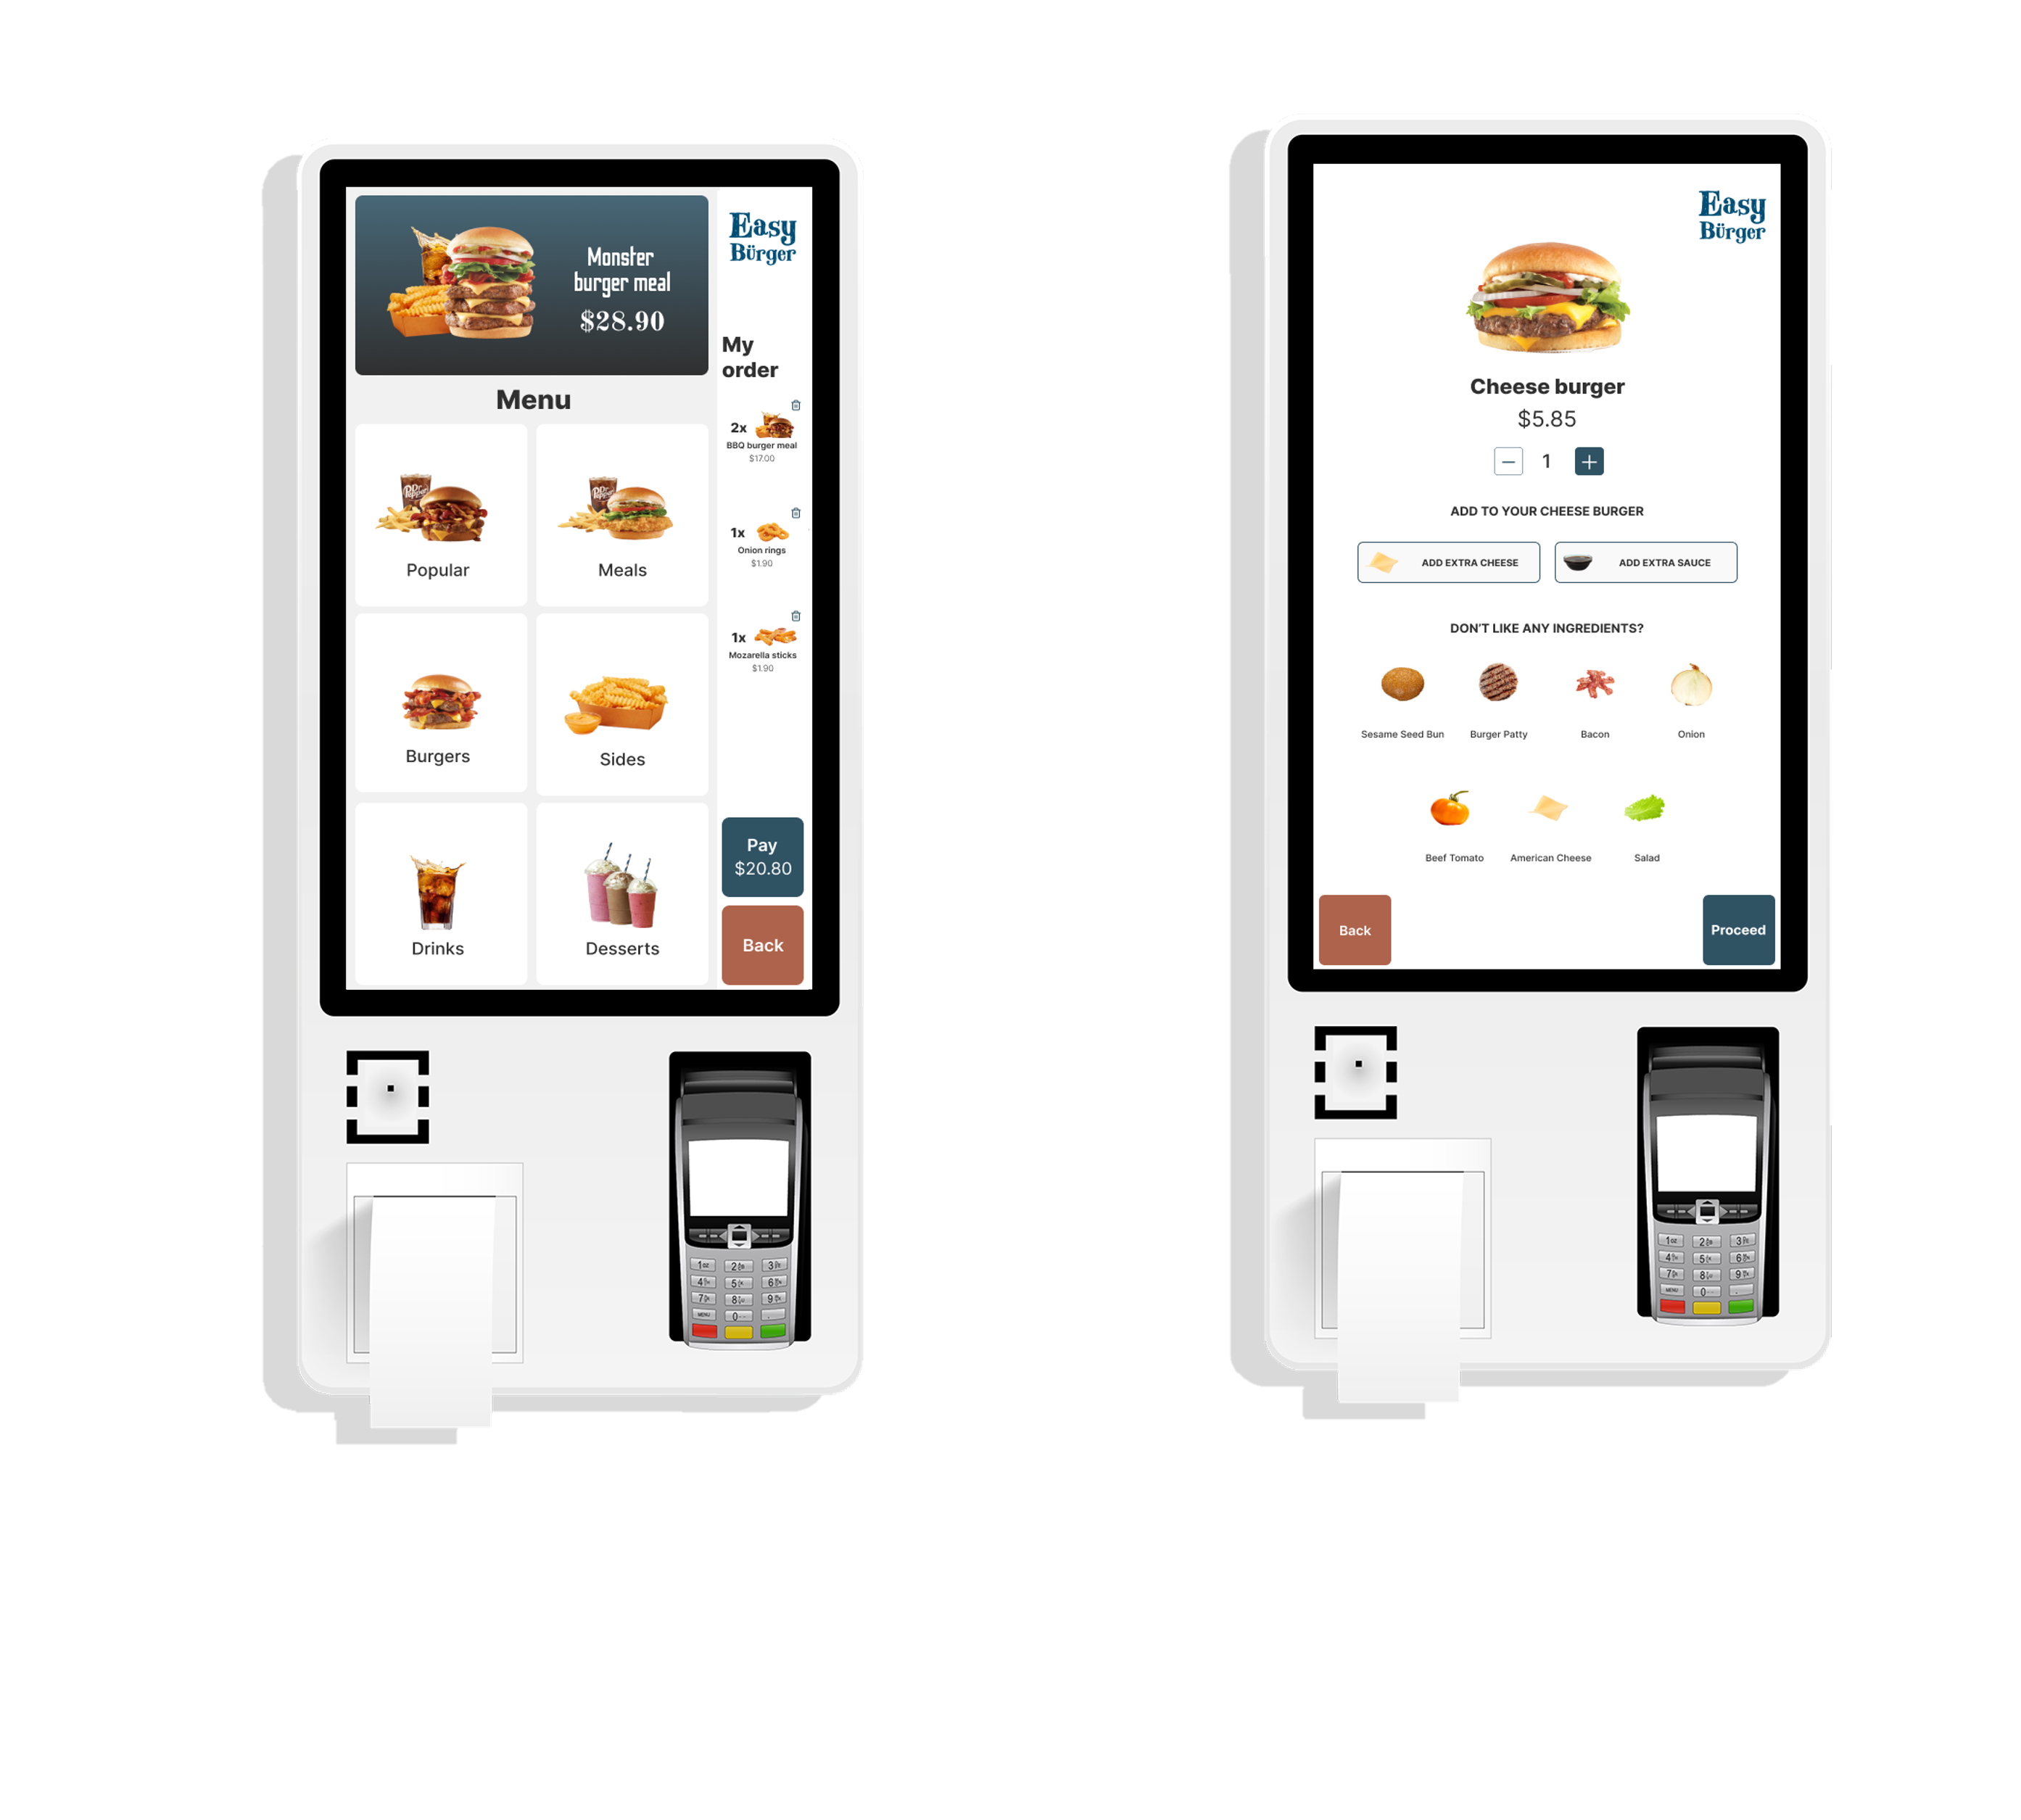
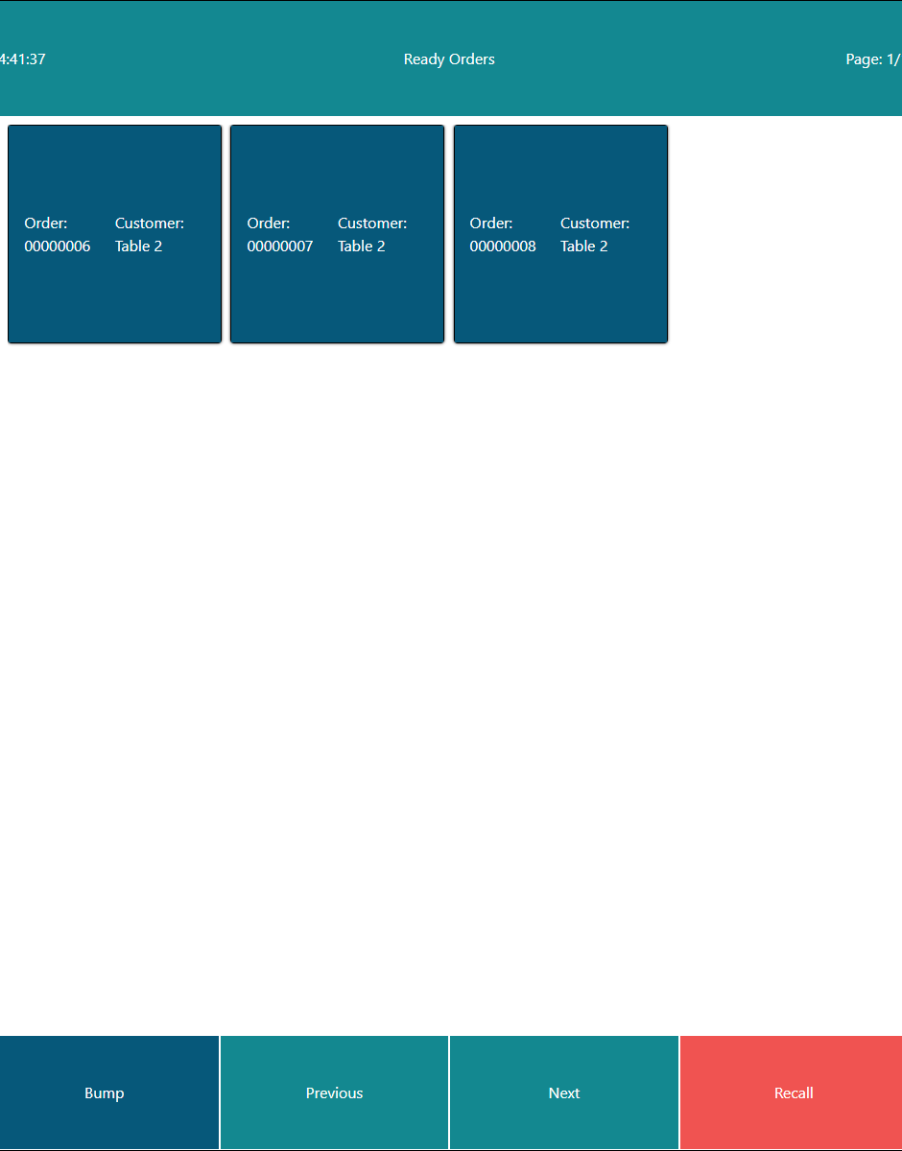
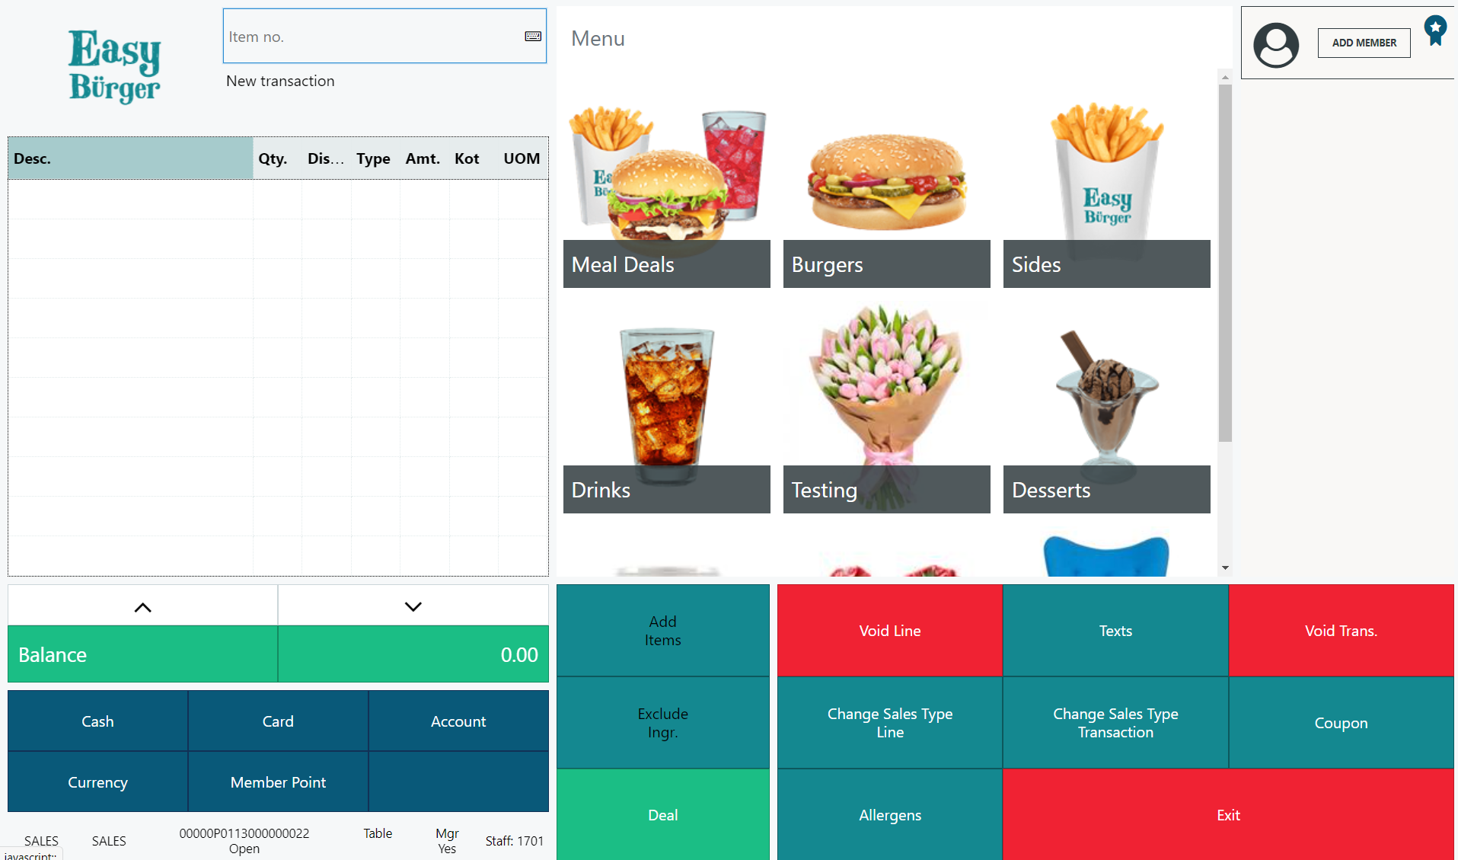
Unified Experiences
Notes:
With our new Self-Service kiosk we manage the menu with items and or deals in the hierarchy in the back office. Taking the order in the kiosk has now instant basket calculation in BC and we can make use of the member management system if we want to. The customer pays the order and like any other order in the restaurant the order is sent to kitchen and when ready the customer can easily see that on the Customer Facing Displays of the KDS. Because this is a normal POS transaction in the same system then it also opens up the possibility to mark the order as Go To counter (in case the customer forgot his credit card) and then continue the order process there.

Slide 22
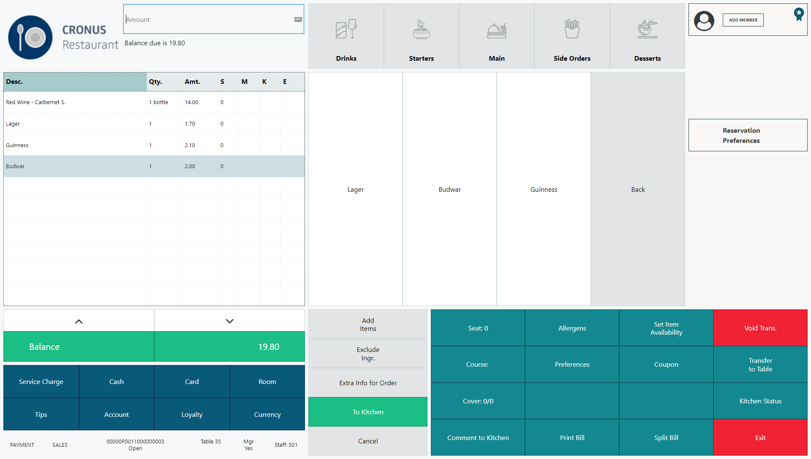
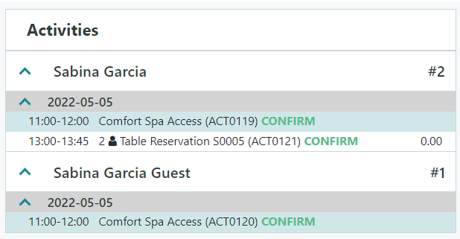
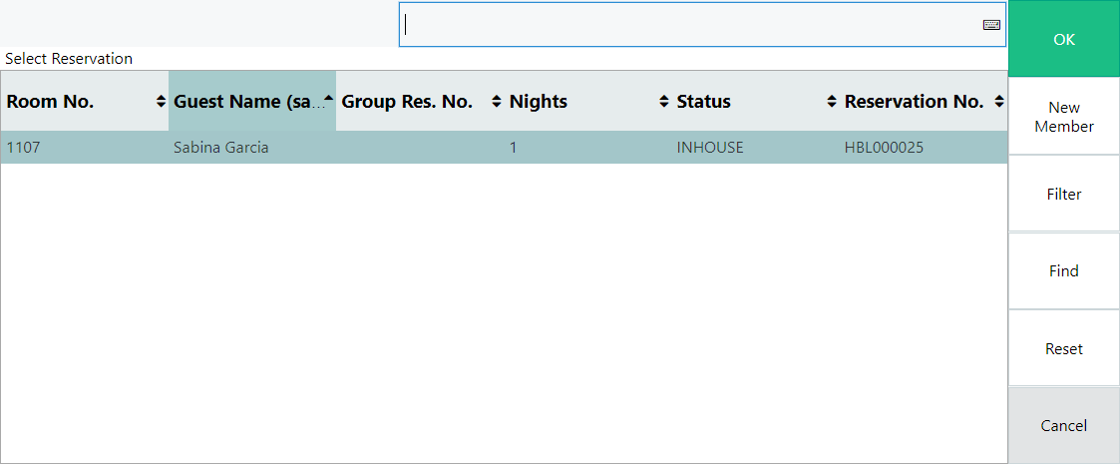
Unified Experiences
Notes:
We have the hotel solution and the restaurant solution both using LS Activity to manage reservations and they benefit of using the Activity API’s as well. This allows for Hotel and Restaurant using Activity
Hosting UX for Takeout host in Restaurants, Activity Host or Front Desk and Hotel Front Desk

Slide 23
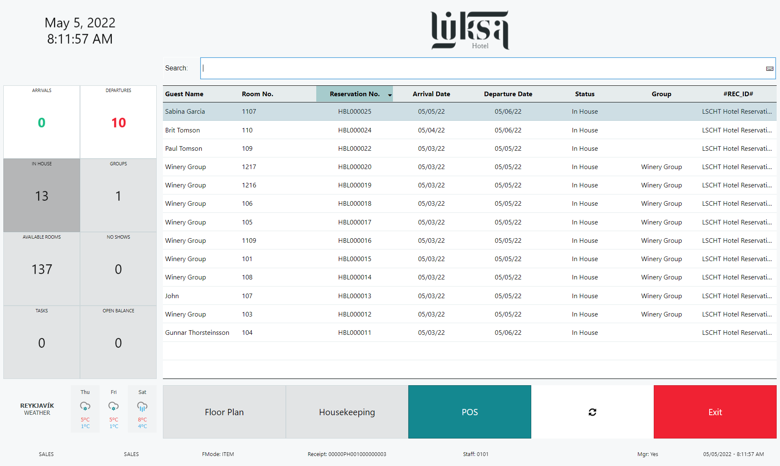
Unified Experiences
Hotel Host
QSR Host
+
Activity Host (in progress)
Notes:
Last but not least we are also working towards having a unified user experience in our devices and one of the best examples is where we are aligning the Hotel Front Desk, Activity Host and the Takeout Host for restaurants. Trying to unify the look and feel and the functionality of the processes makes the staff feel at home in every situation.

Slide 25

Questions?

Slide 26
Thank you

Slide 27
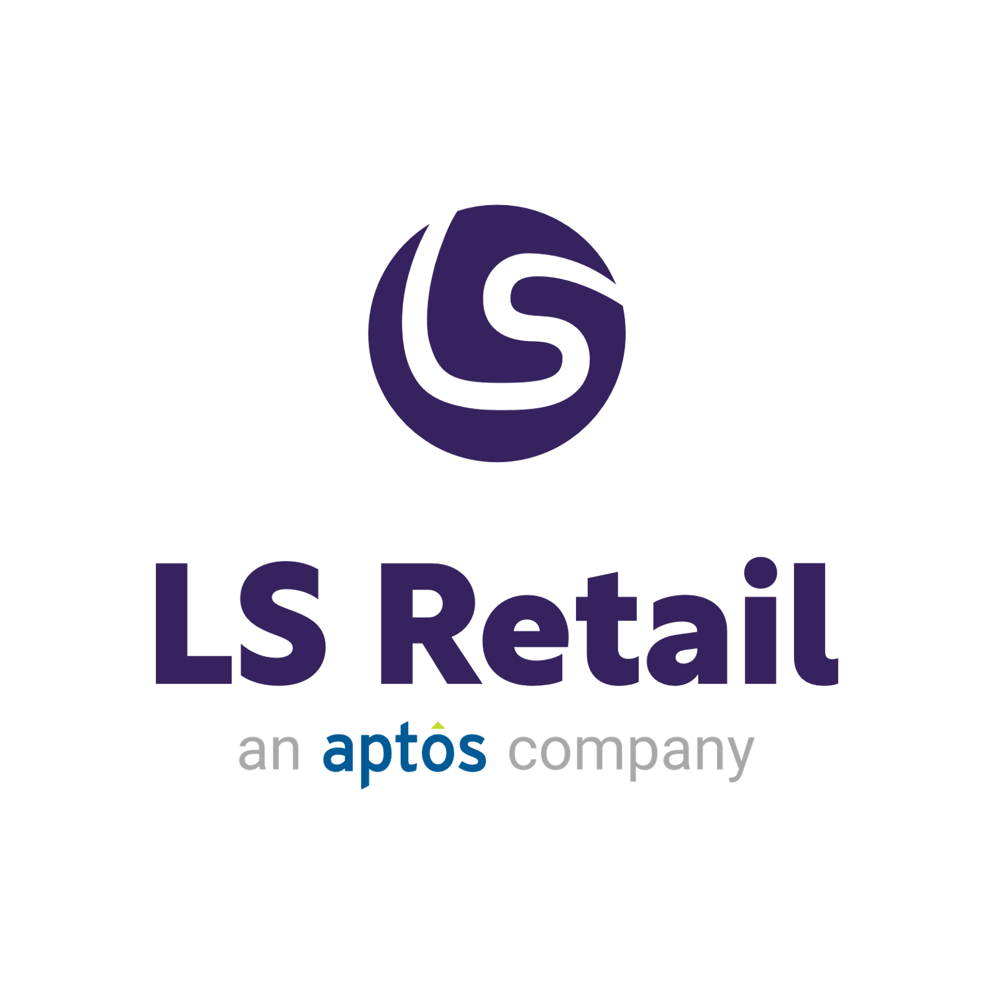




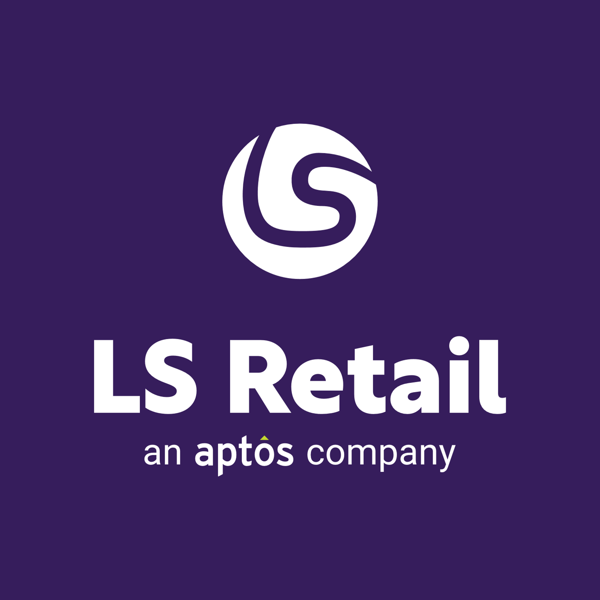



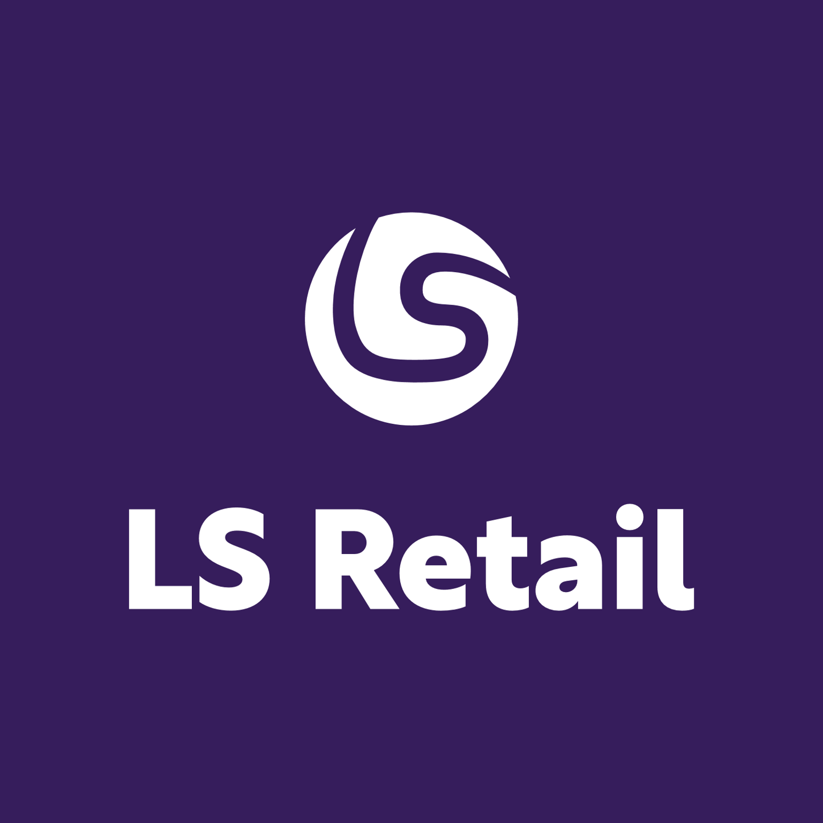
!IMPORTANT!
The “an Aptos company” version is the main version to use. Only use the logo without it if the logo is very small.
Primary
Secondary
Primary
Secondary

Slide 28

















Slide 29



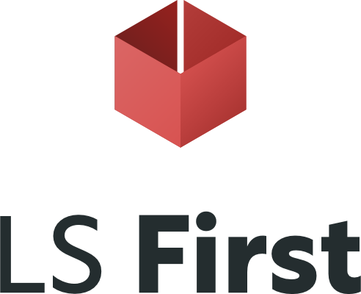










Slide 30










Slide 31




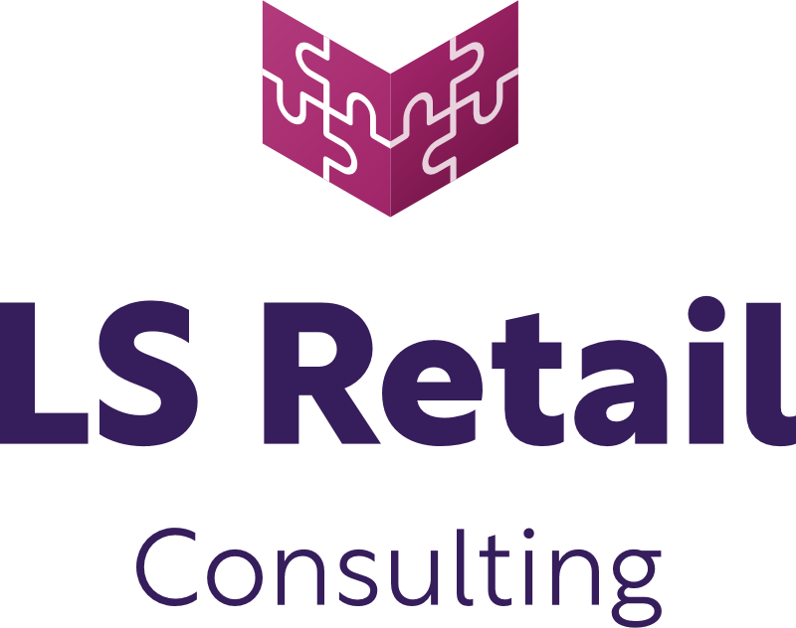


Slide 32

Desktop/POS

Slide 33

POS/Tablet

Slide 34

Tablet/surfacePro

Slide 35

Tablet/iPad

Slide 36

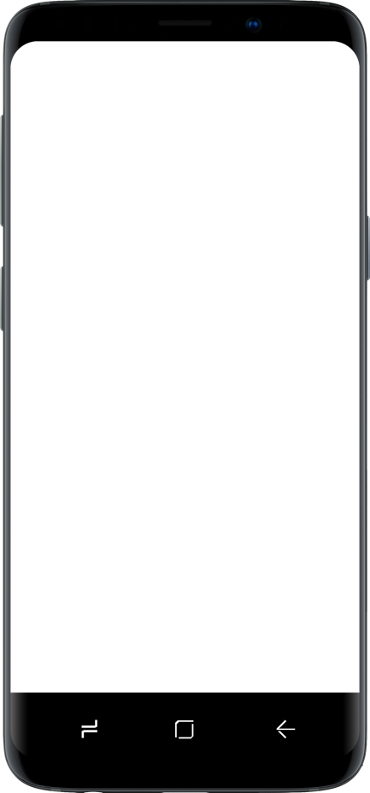
Mobile

Slide 37






















































