Slide 3

Your Journey to SaaS – What do you need to know?
Adalbjorg Karlsdottir
Onboarding Lead
Adalbjorg@lsretail.com

Slide 4


Slide 5

Educate yourself
This is LS Central SaaS LS Central Implementation Guide Onboarding Buddy and CAP

Slide 6

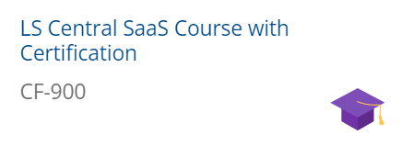
LS Retail Academy – SaaS Training
Partner Center
Admin Center
Administrative tasks for tenants
Online POS vs. Hybrid POS

Slide 7
LS Retail Academy – SaaS Training
Partner Center
Admin Center
Administrative tasks for tenants
Online POS vs. Hybrid POS

Slide 8
How to move your data to SaaS?

Slide 9
Upgrade Path for LS Central
On Prem
SaaS
The recommended way
LS NAV 2015
LS NAV 2016
LS NAV 2017
LS NAV 2018
LS NAV on BC v13
LS Central 13
LS Central 14.2
LS Central 15
LS Central 16
LS Central 17
LS Central 18 LS Central 19
LS Central 20
LS Central 20
Using Upgrade Codeunits
Using Table Migration Extensions
Using Cloud Migration Tool
Spoiler: Although it is recommended to migrate from the same LS Central version on-prem to the same version on SaaS, in theory you should be able to migrate directly from LS Central 17.5 or later to SaaS (as long as there are no breaking changes in your own extensions).
LS Central 17.5 or later
LS Central 20

Slide 10
Upgrade Path for LS Central
On Prem
SaaS
The recommended way
LS NAV 2015
LS NAV 2016
LS NAV 2017
LS NAV 2018
LS NAV on BC v13
LS Central 13
LS Central 14.2
LS Central 15
LS Central 16
LS Central 17
LS Central 18 LS Central 19
LS Central 20
LS Central 20
Using Upgrade Codeunits
Using Table Migration Extensions
Using Cloud Migration Tool
Spoiler: Although it is recommended to migrate from the same LS Central version on-prem to the same version on SaaS, in theory you should be able to migrate directly from LS Central 17.5 or later to SaaS (as long as there are no breaking changes in your own extensions).
LS Central 17.5 or later
LS Central 20

Slide 11
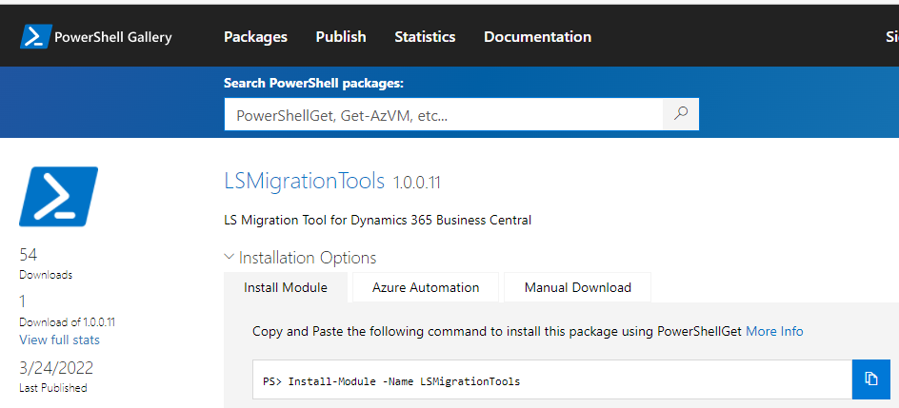
LS Migration Process
Documentation
Step-by-step documentation based on Microsoft’s guidelines
LS Migration Tools
Powershell module to automate some migration steps
Already available on the Powershell Gallery

Slide 12
Upgrade path for LS Central
Preparing the database to be migrated to SaaS
Migrating from on-prem to SaaS
Challenges
LS Migration Process
LS Migration Tools
Production Environment
Data Administration page
Cloud Migration Tool

Slide 13
Upgrade path for LS Central
Preparing the database to be migrated to SaaS
Migrating from on-prem to SaaS
Challenges
LS Migration Process
LS Migration Tools
Production Environment
Data Administration page
Cloud Migration Tool

Slide 14
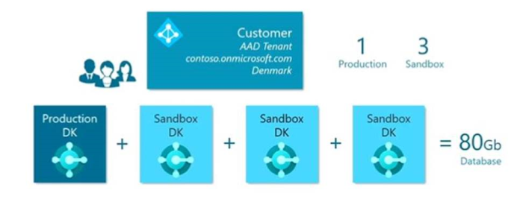
Production Environment
Every Production Environment comes with 3 sandboxes which all add up to the 80 GB of free space.
50% compression
+ 3/2/1 GB per user

Slide 15

Production Environment
Storage Examples
Named users | License type | Total free space
20 | Essentials | 120 GB (20*2 Gb + 80 GB)
30 | Essentials | 140 GB (30*2 Gb + 80 GB)
125 | Premium | 455 Gb (125*3 Gb + 80 Gb)
250 | Premium | 830 Gb (250*3 Gb + 80 Gb)
Example taken from Dynamics 365 Licensing FAQ
Storage Pricing
Offer name | Capacity | Price/tenant/month
D365 Business Central Database Capacity | 1 Gb | $ 10
D365 Business Central Database Capacity 100GB | 100 Gb | $ 500
D365 Business Central Database Capacity Overage* | 1 Gb | $ 5
For more information check our Pricelist in the Partner Portal
* Prerequisite Business Central Database Capacity 100GB

Slide 16
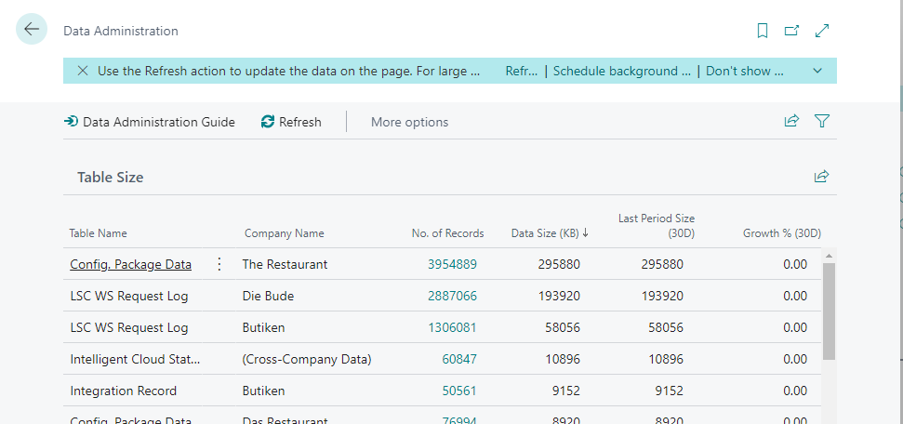
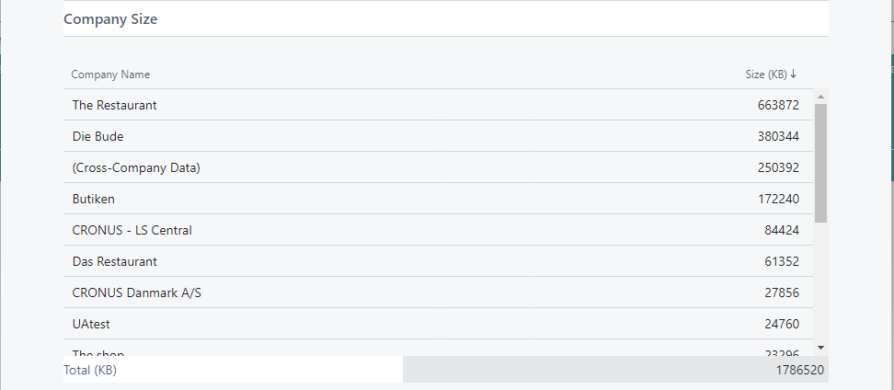
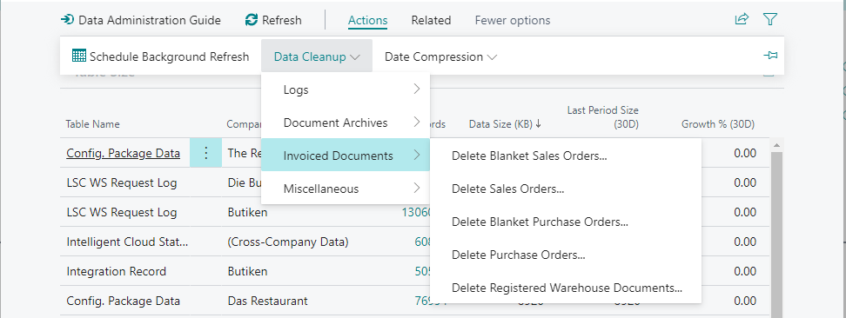
Data Administration
When moving to SaaS, you should clean up your data.
Data Administration page allows you to:
List the following, per table:
Nr of records
Data Size
Data Size 30 days before
Growth % in the last 30 days
List the total size per Company
Use the Cleanup Data methods

Slide 17
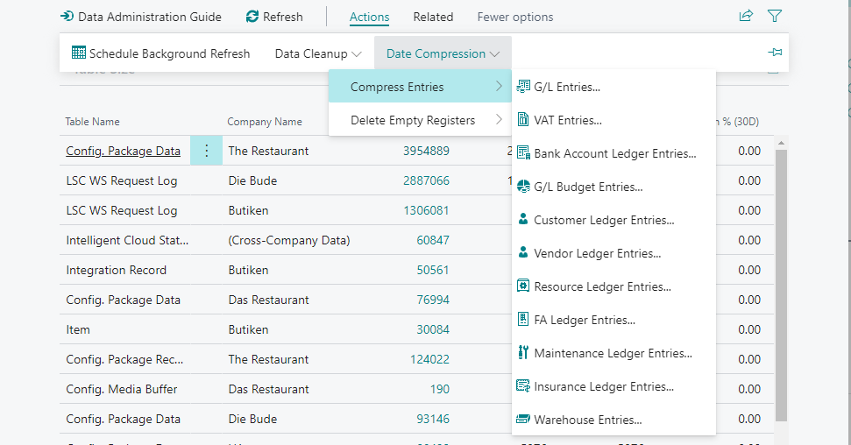
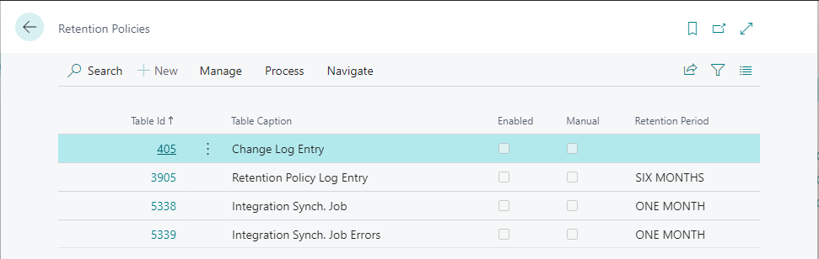
Data Administration
When moving to SaaS, you should clean up your data.
Data Administration page allows you to:
List the following, per table:
Nr of records
Data Size
Data Size 30 days before
Growth % in the last 30 days
List the total size per Company
Use the Cleanup Data methods
Use the Data Compression methods
Access to the Retention Policies page

Slide 18
Archiving in retail
LS Central offers archiving on:
Offers
Transactional data
Preactions/Actions
Scheduler logs
Memberships
LSC POS Card Print Text table

Slide 19
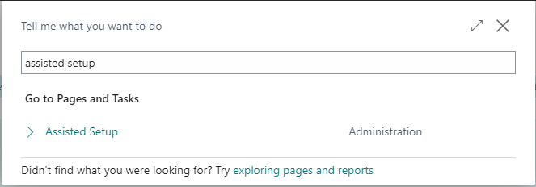
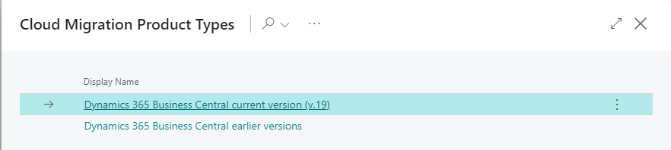
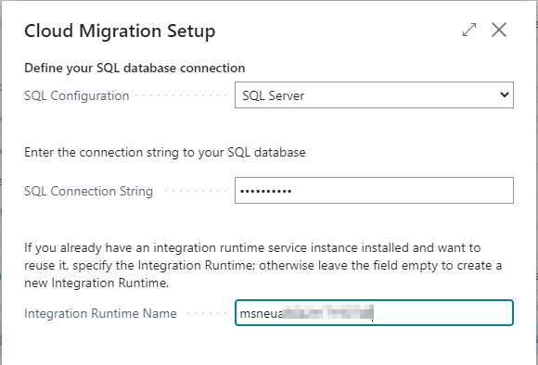
Cloud Migration Tool
Search for Assisted Setup
Select Set up Cloud Migration
Select the product version
Current version for V20
Earlier versions for V15 to 19
Enter:
SQL Connection String
Integration Runtime Name

Slide 20
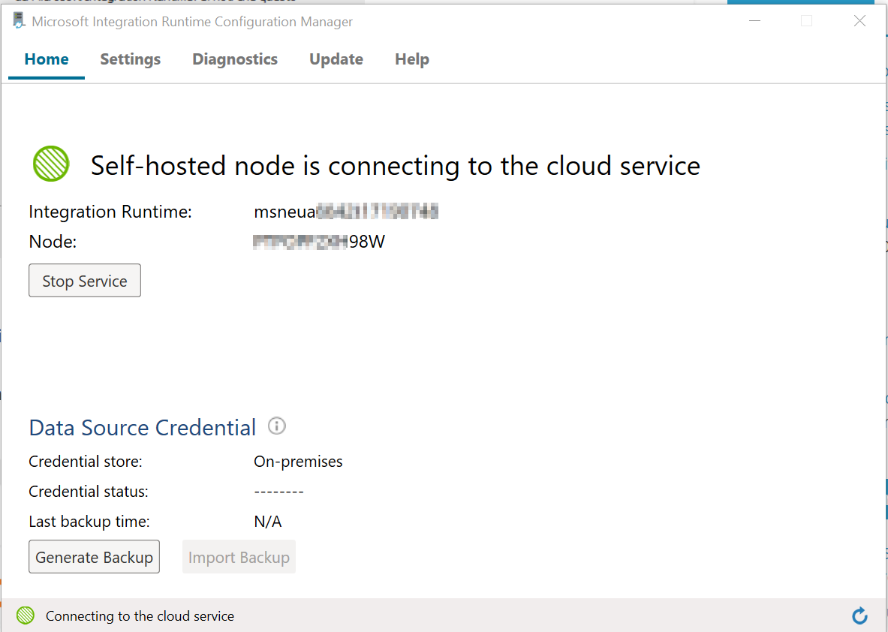
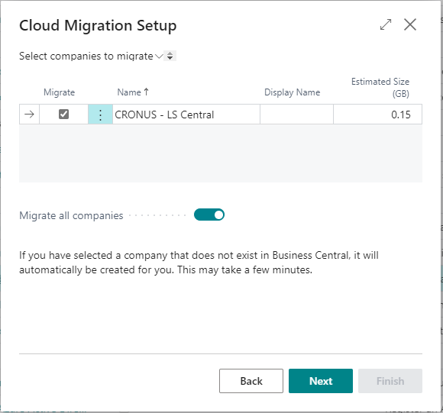
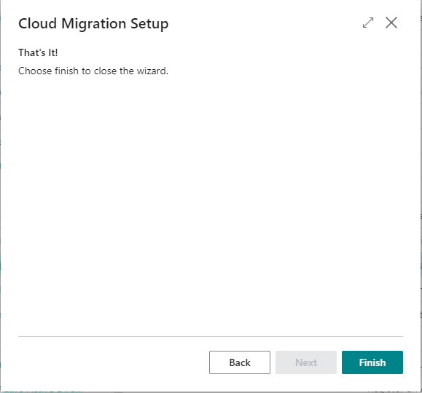
Cloud Migration Tool
The Integration Runtime is installed locally
Select the companies to migrate
Finish the Cloud Migration Setup
Integration Runtime Name

Slide 21
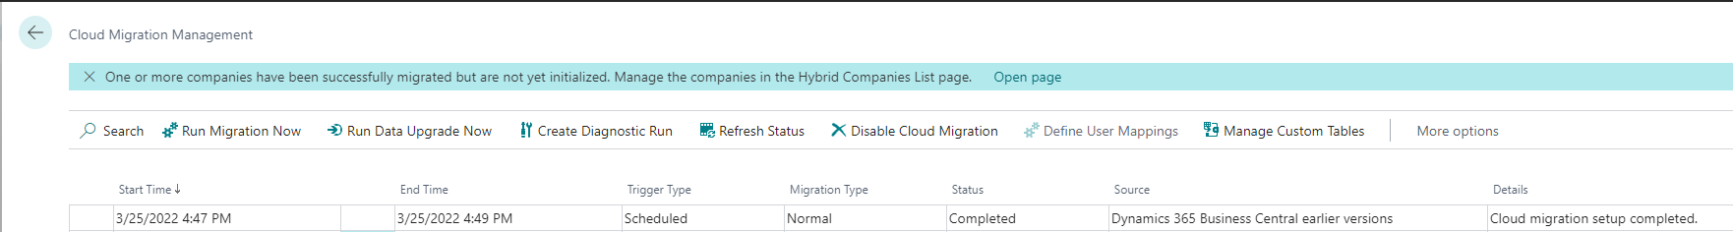
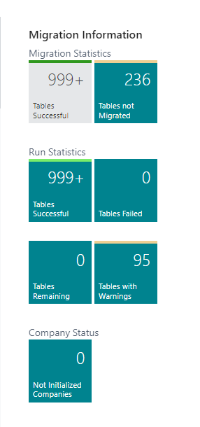
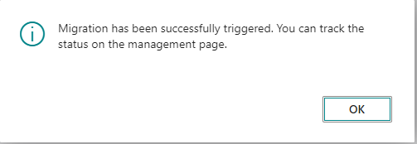
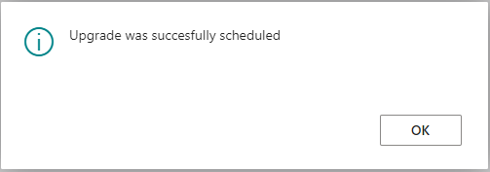
Cloud Migration Tool
Run Migration Now
Run Data Upgrade Now

Slide 22

Online or Hybrid?
In LS Central SaaS, you can choose between two deployment options:
Online POS
Hybrid POS.
You can also combine the two.
To select the right deployment option for each customer, consider:
The pros and cons of each option alongside specific customer factors (volume of transactions, stability and quality of internet connection, etc.)

Slide 23
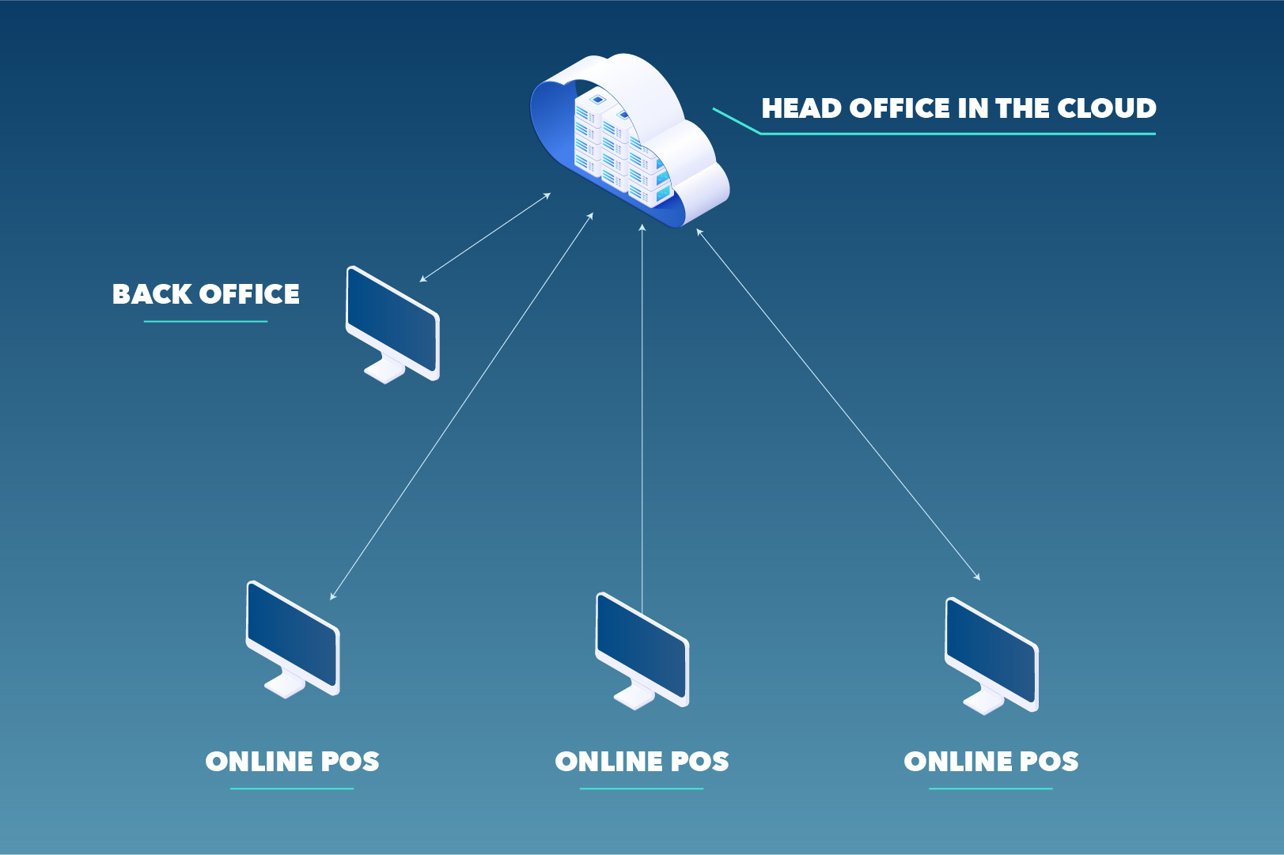
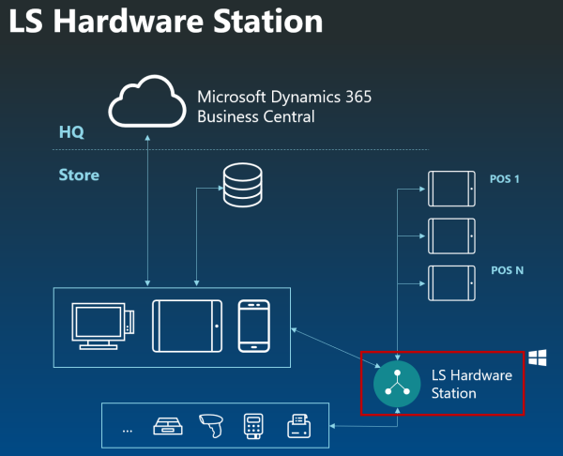
Online POS
POSs and back-office users run a modern web client and connect to the LS Central SaaS and are reliant on the internet works and they have access to the LS Central SaaS always
Software installation: Hardware station Install Hardware Station using Update Service

Slide 24
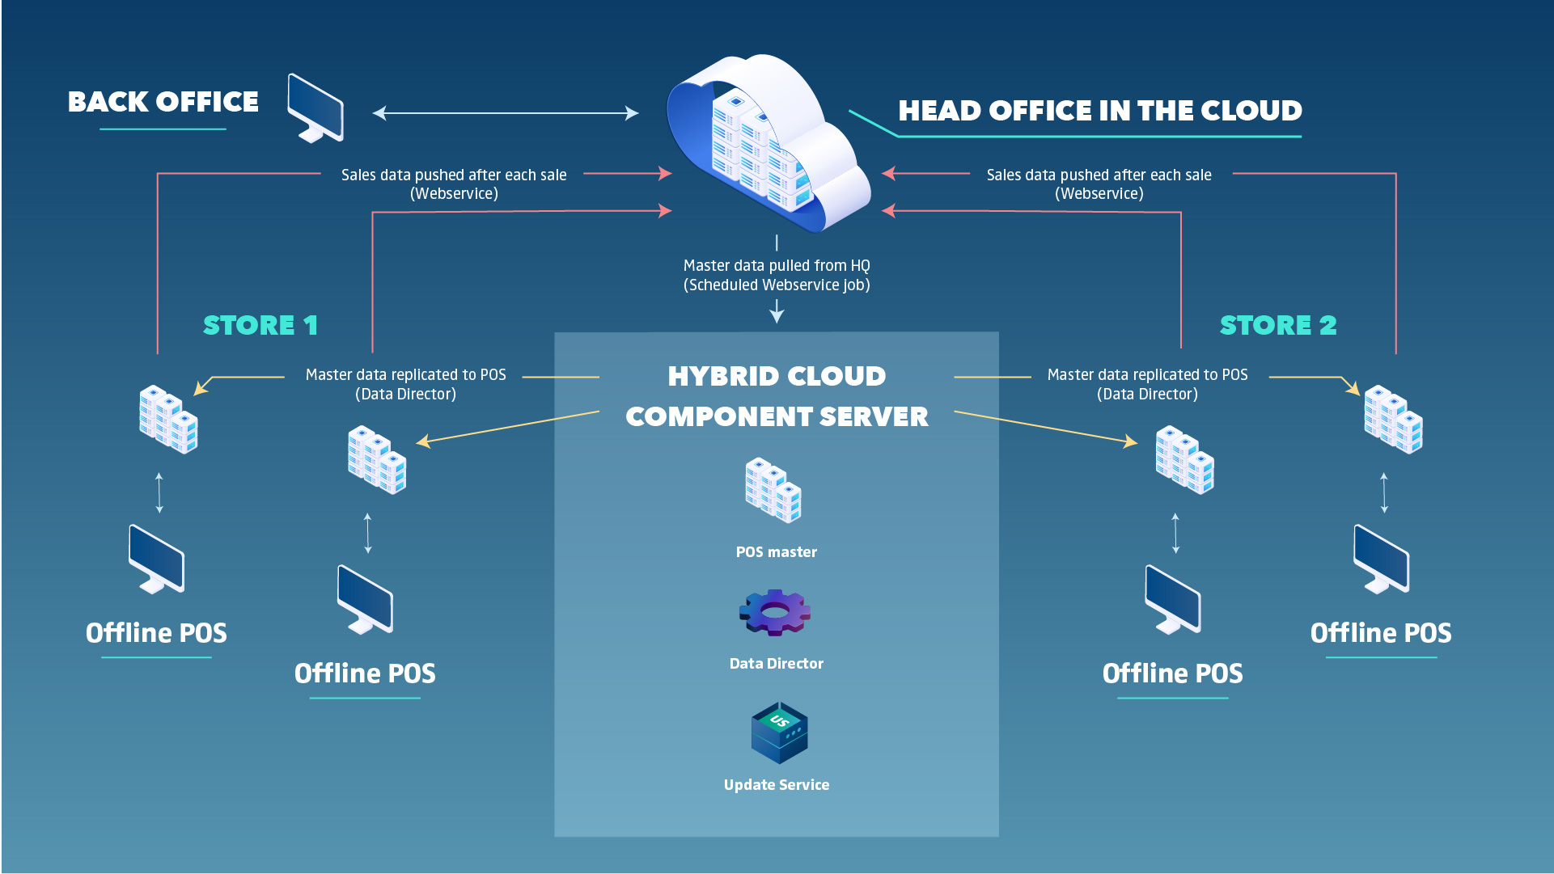
Hybrid POS
A hybrid setup gives customers the ability to take advantage of the benefits of cloud hosting and the resilience of an offline POS.
LS Retail uses the Hybrid Cloud Component Server to achieve offline device architecture.
There are two deployment options for setting up the Hybrid model:
Offline POS Database
Offline POS Server Database

Slide 25
How often does LS Retail release new updates?
Hotfixes are released when needed
New Events are released weekly
LS Central Releases
Jan.
Feb.
Mar.
Apr.
May
June
July
Aug.
Sept.
Oct.
Nov.
Des.
1*
2*
3*
4*
6*
7*
8*
9*
10*
12*
5**
11**
*LS Central release, including Microsoft Business Center monthly updates
**LS Central release including Microsoft Business Center major updates, usually in May and November each year

Slide 26
How do I know when a new update is available?
A new version of LS Central on-premises W1 version is available for download on the LS Retail Portal
The new LS Central version is available in SaaS**
LS Central Release
Upgrade window
LS Retail sends out an announcement/email to all LS Central partners including release notes*
Notifications sent to all email addresses that are listed in the Notification recipients list of the Business Central Administration Center
* If you are not receiving the email and want to be on the list, you can send an email to info@lsretail.com and request to be added to the recipient list.
**​ The localized update is available for upgrade in LS Central SaaS, typically 7 to 14 days later

Slide 27
Maintenance and upgrade timelines
Last selectable Scheduled Update date
Update is available
Outside upgrade window
Within upgrade window
Test window
Upgrade starts*
Day 1
Day 14
Day 21
* If Scheduled Update date has not been set earlier within the upgrade window
The day when the version of LS Central SaaS becomes available
The day when the update is automatically scheduled
The last day you can choose to extend your upgrade date to.

Slide 28
What do I need to do when a new update is released?
A new version of LS Central on-premises W1 version is available for download on the LS Retail Portal
The new LS Central version is available in SaaS
Outside upgrade window
LS Central Release
Upgrade window
Day 1
Day 21
Get familiar with the new release
Test your addons on the new release
Set Scheduled Update date and define update time window in the Business Central Admin Center
Notify customers

Slide 29
What if the update fails?
1W
2W
3W
Update fails
New update date scheduled +7 days
Update fails
Update fails
Update fails

Slide 30
What if the update fails?
1W
2W
3W
Update fails
New update date scheduled +7 days
Update fails
Update fails
Update fails

Slide 31

What is Telemetry in BC?
It is an event that is sent from BC to Application Insights

Slide 32

Why should you be using it?
Tool to troubleshoot Business Central
Events list will grow in the next few years
Allows you to analyse other kind of things

Slide 33
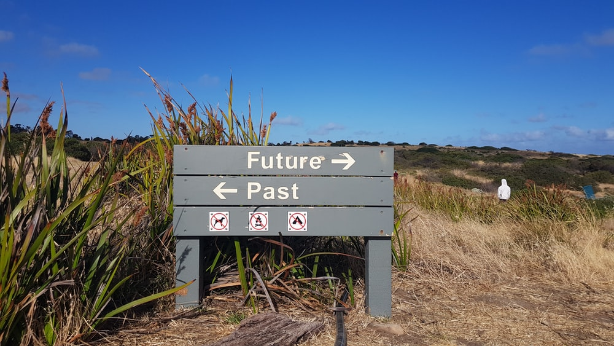
Why should you be using it?
Tool to troubleshoot Business Central
Events list will grow in the next few years
Allows you to analyse other kind of things
And, most of all, because you want to be part of the future!

Slide 34
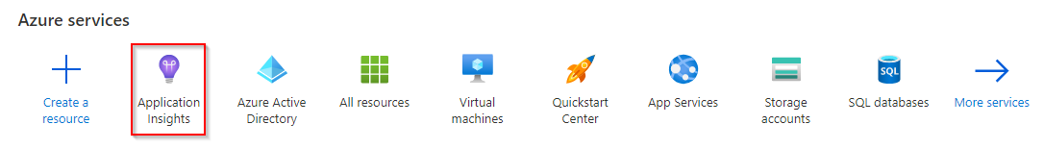
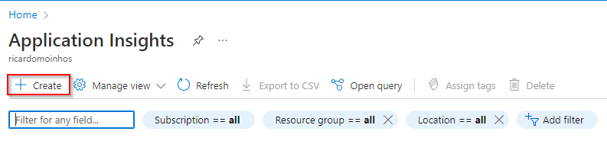
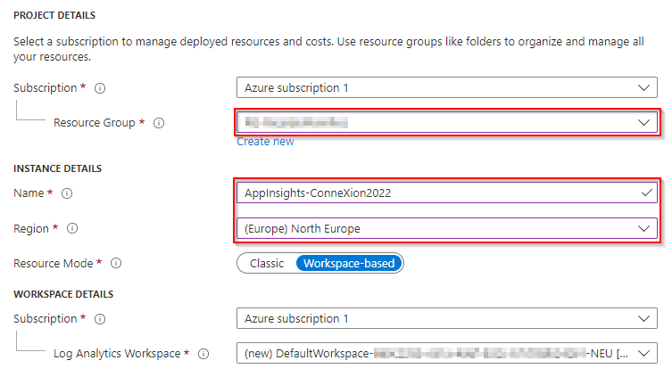
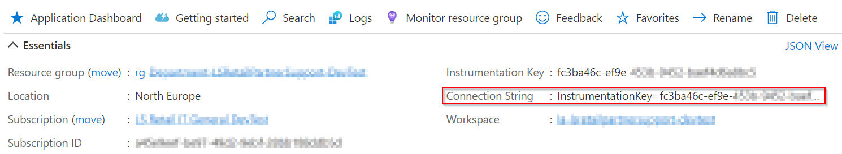
How to set it up?
Azure Portal

Slide 35
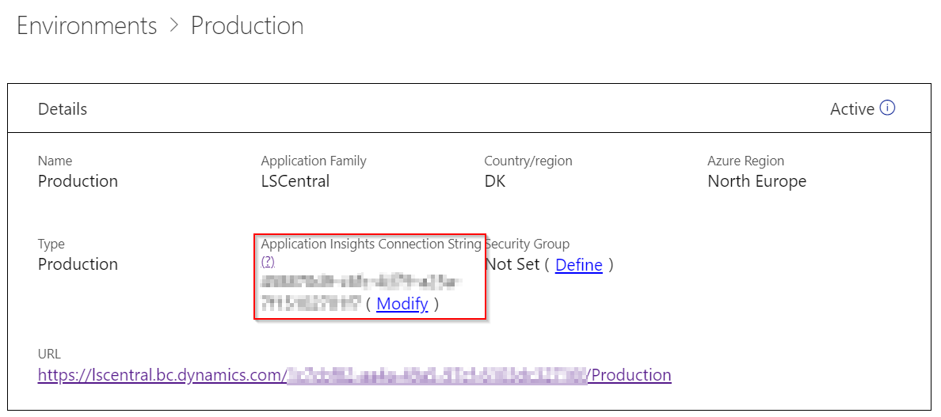
How to set it up?
For SaaS environments
Dynamics 365 Business Central Admin Center

Slide 36

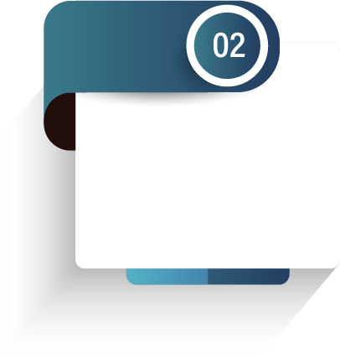
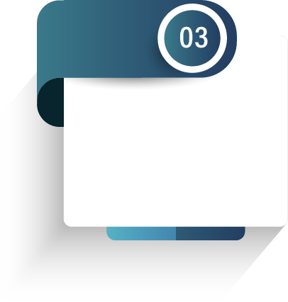
Partners journey to SaaS
Phase 1 – CSP Partner
Over 100 onboarding sessions with partners
CSP
Overview
Training

Slide 37

CAP
Cloud Acceleration Program

Slide 38
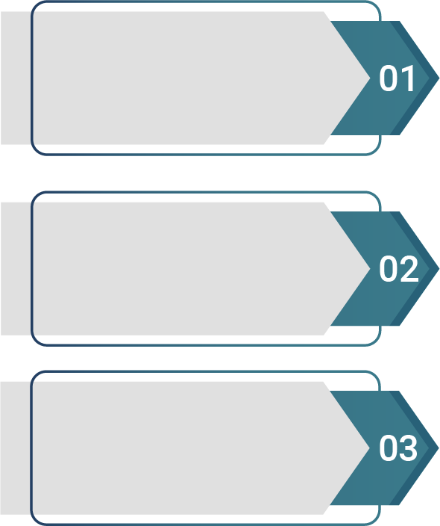

Partners journey to SaaS
Phase 2 – Cloud Acceleration Program (CAP)
Onboarding with Buddy Support
SaaS License
SaaS Project Evaluation Meeting
Guided Onboarding
Onboarding with Consulting Team

Slide 39

Onboarding with Buddy Support
Ad hoc support
Teams sessions
Support option for experienced partners

Slide 40
Onboarding with Buddy Support
Ad hoc support
Teams sessions
Support option for experienced partners

Slide 41
CAP – Guided Onboarding
Migration
Test environment

Slide 42
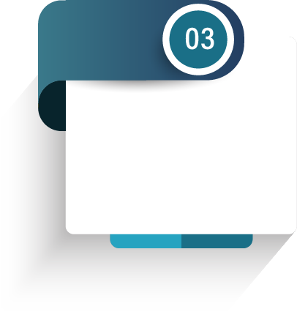


CAP – Guided Onboarding
First Store/ POS
Q&A Session
Migration
Test environment
First HO/POS Update

Slide 43
CAP – Guided Onboarding
First Store/ POS
Q&A Session
Migration
Test environment
First HO/POS Update

Slide 44

Onboarding with consulting

Slide 45
How much does it cost?

Slide 46
Partners journey to SaaS
Phase 2 – Cloud Acceleration Program (CAP)
Onboarding with Buddy Support
SaaS License
SaaS Project Evaluation Meeting
Guided Onboarding
Onboarding with Consulting Team
Second SaaS License

Slide 47
Book a session with the Onboarding team
https://calendly.com/lsconboarding/onboarding
https://calendly.com/lsconboarding/30minsession

