Slide 1
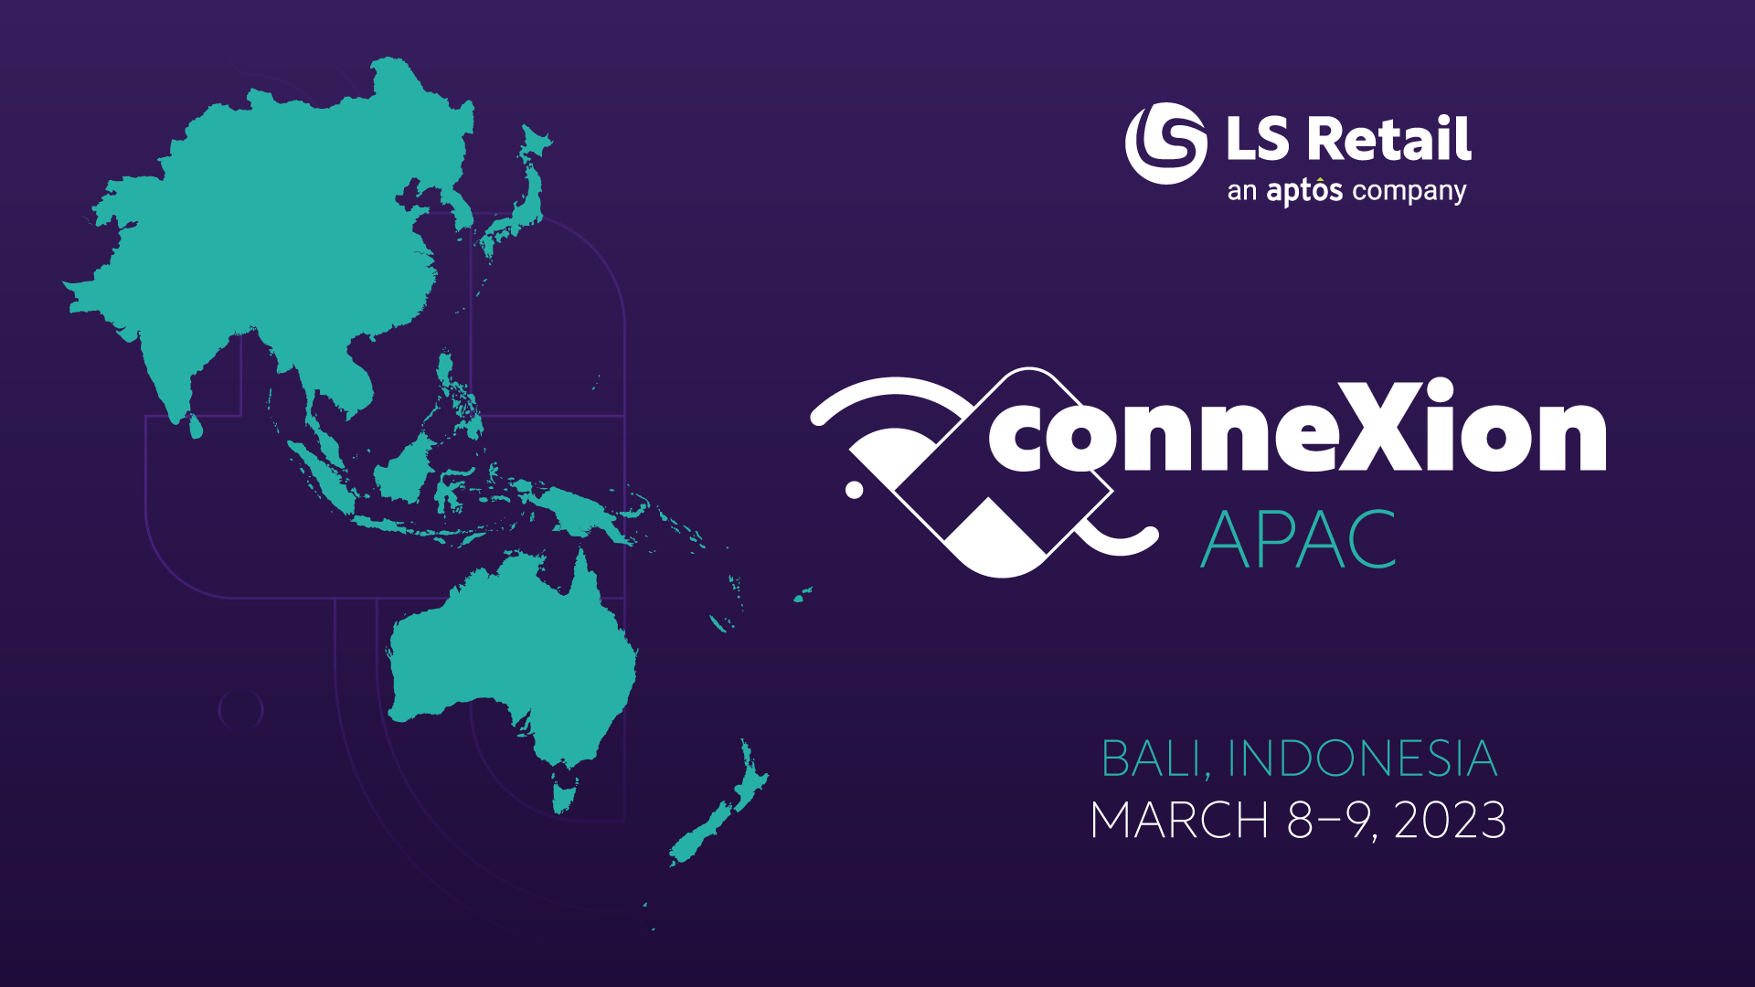

Slide 2

Forward 2023 with LS Central SaaS Hybrid Implementation
Jasvinder Singh
Technical Consultant

Slide 3
Agenda
Hybrid Component Server Implementation
  Azure
  In-House
Hybrid Component Server

Slide 4
Objective
Be aware of this service and familiarize with the Hybrid Component Server flow

Slide 5



Prerequisite

Slide 6


Hybrid Model Implementation
Azure Hybrid Component Server

Slide 7
Hybrid Model Implementation
In-House
  Get the Installer from our LS Retail Partner Portal
  PowerShell

Slide 8
Demo

Slide 9
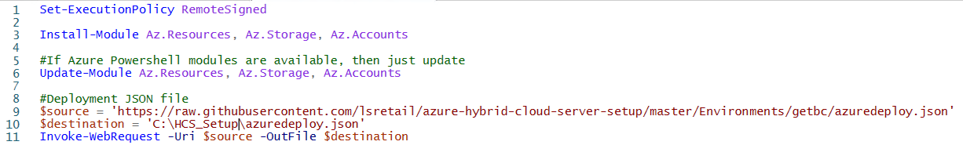
Create JSON Deployment File

Slide 10
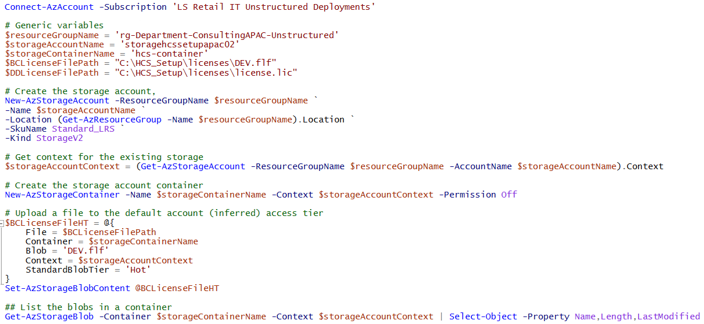
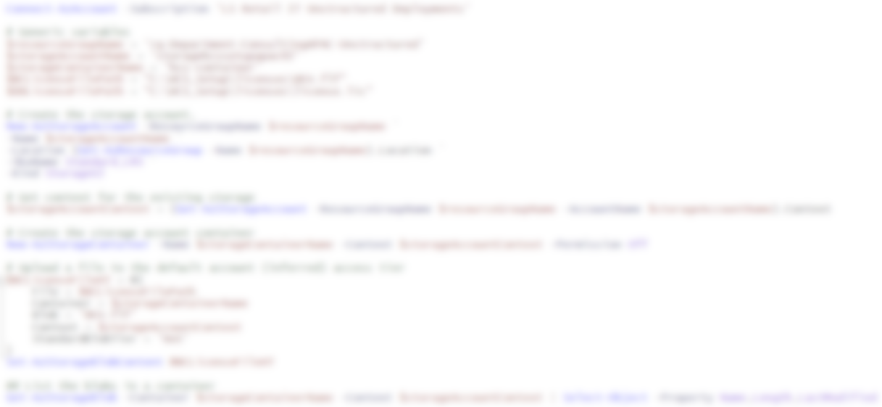
Setup Preparation

Slide 11
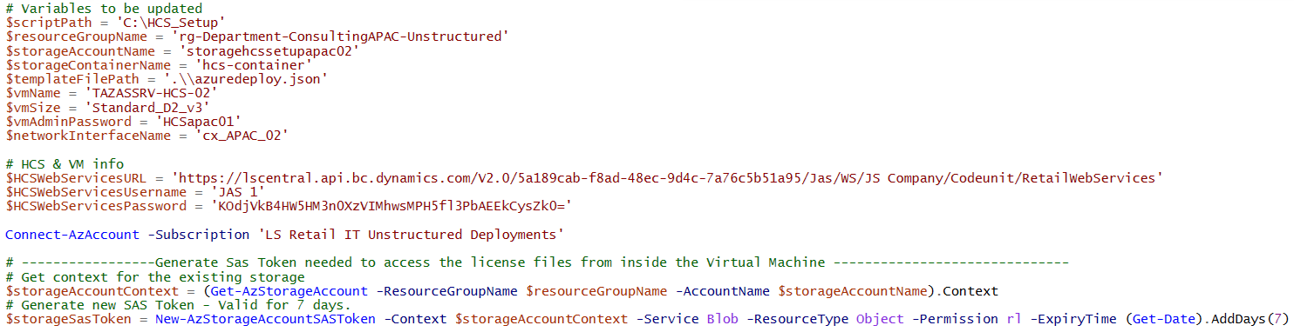
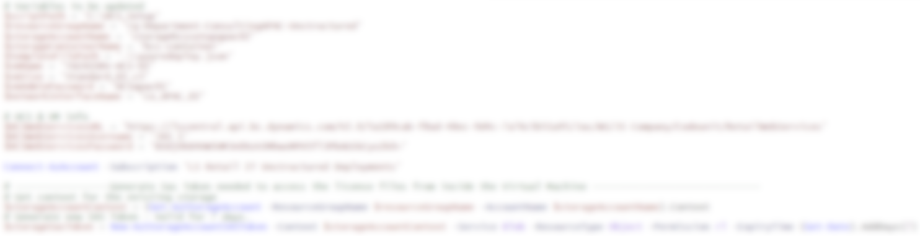
Setup Environment – Part 1

Slide 12
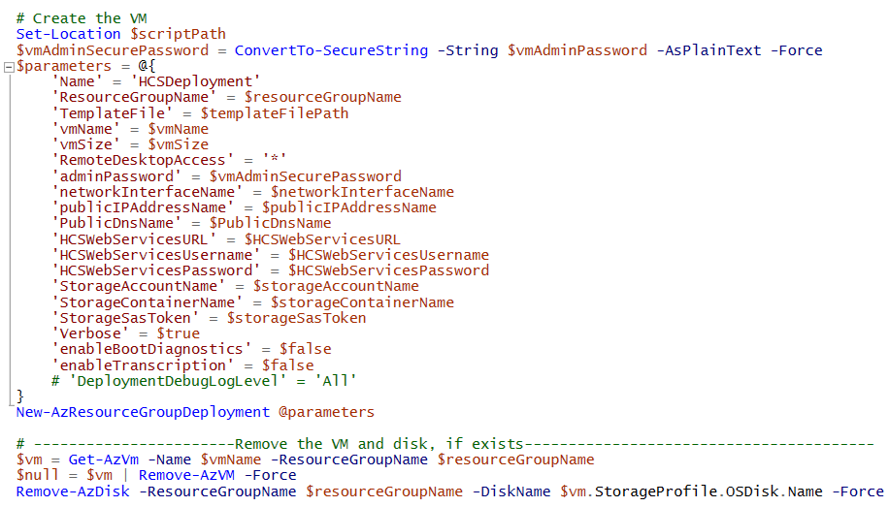
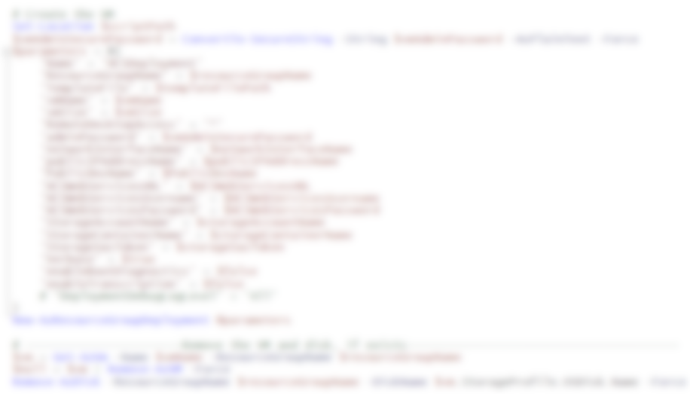
Setup Environment – Part 2

Slide 13
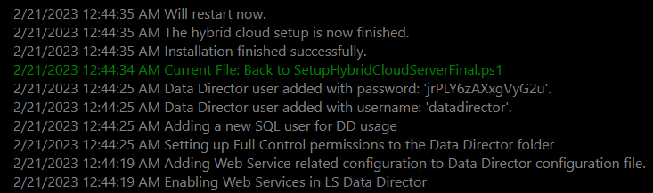
Deployment Progress

Slide 14
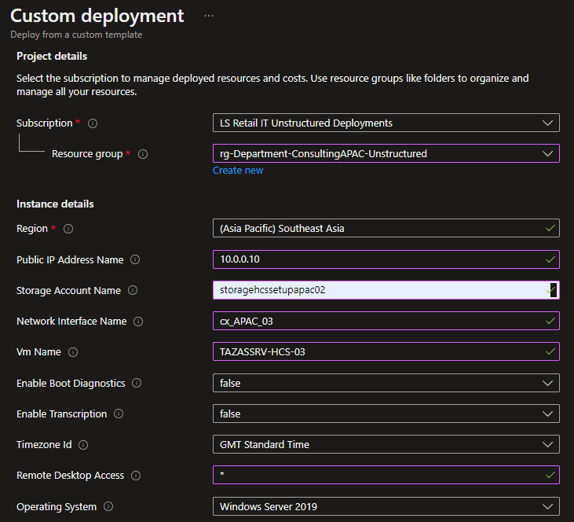
Azure Portal
Navigate to the Azure Portal
Open Custom Template
Upload JSON file
Validate & Create

Slide 15
Hybrid Model Implementation - Summary
Two approaches
  PowerShell
  Azure
Automate creation of VM & Hybrid Component Server

Slide 16
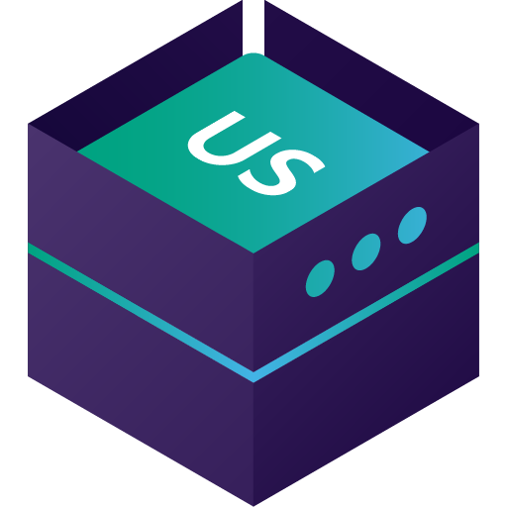


Hybrid Component Server
POS Master Database
POS Database

Slide 17
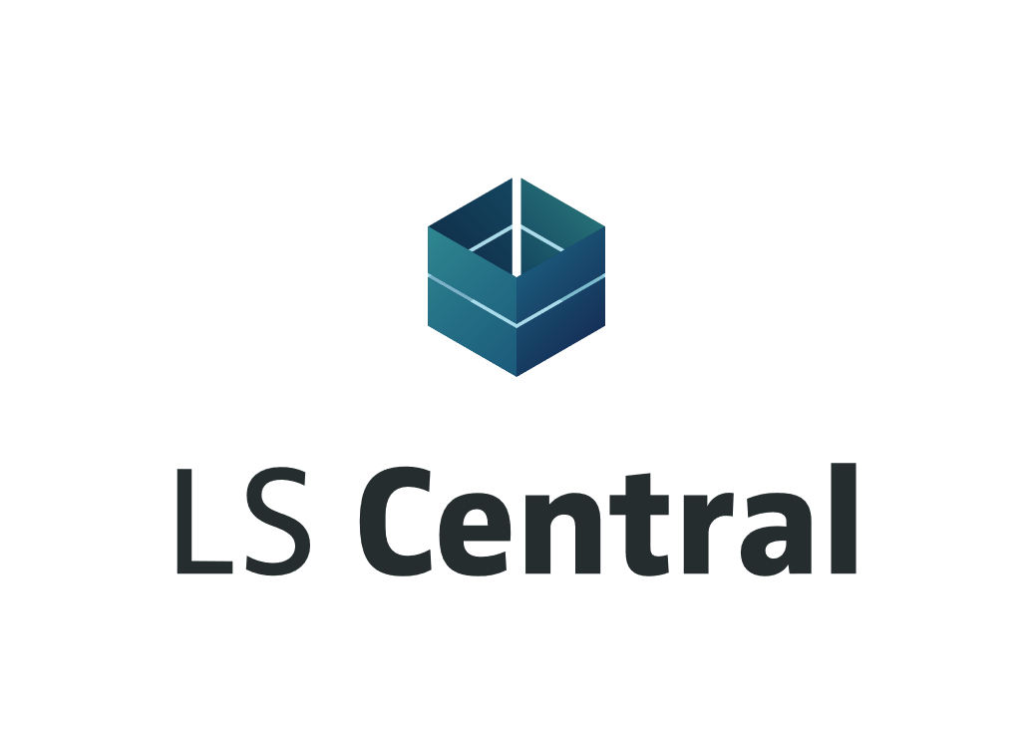


Hybrid Component Server
…….and more

Slide 18
Demo

Slide 19






Hybrid Component
Server Summary

Slide 20
Thank you

