Slide 2





Replenishment
Start me up!
Martin Kleindl | Brad Winslow | Frederic Descoust
Product Director | Funct. Consultant | Consultant

Slide 3
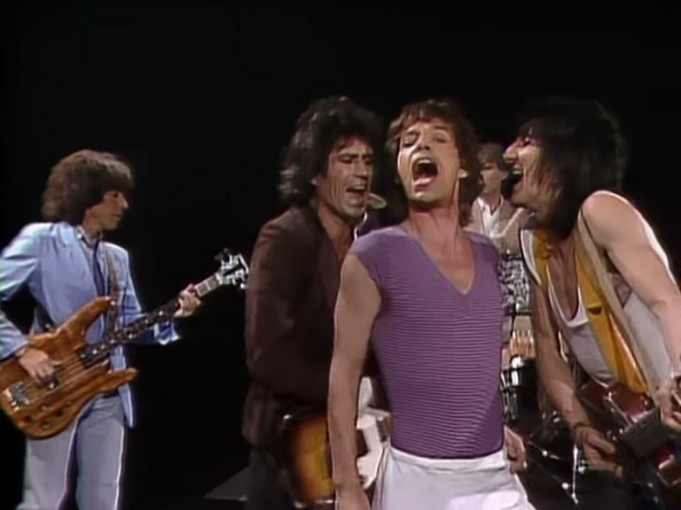
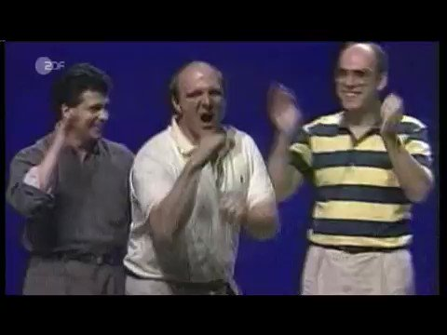

Slide 4


Slide 5

start me up !
(Replenishment)

Slide 6

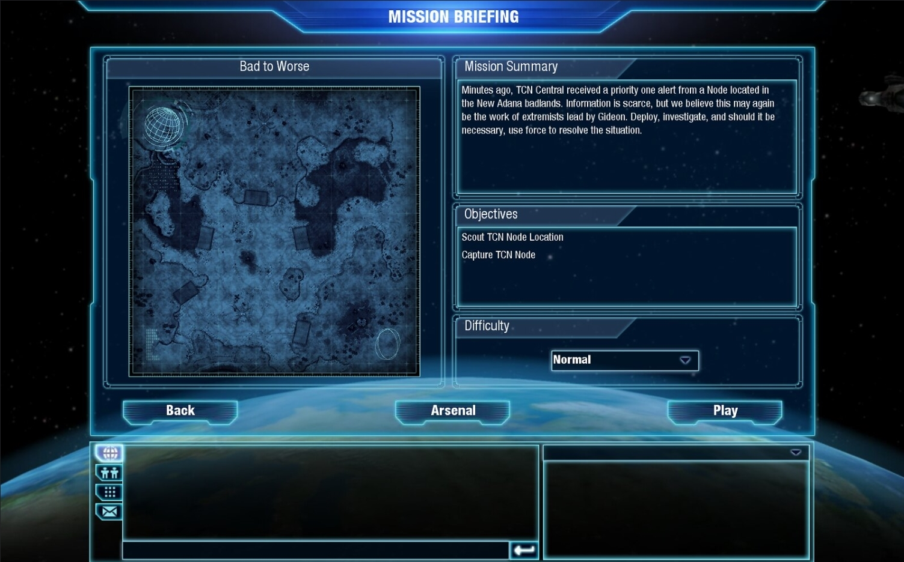
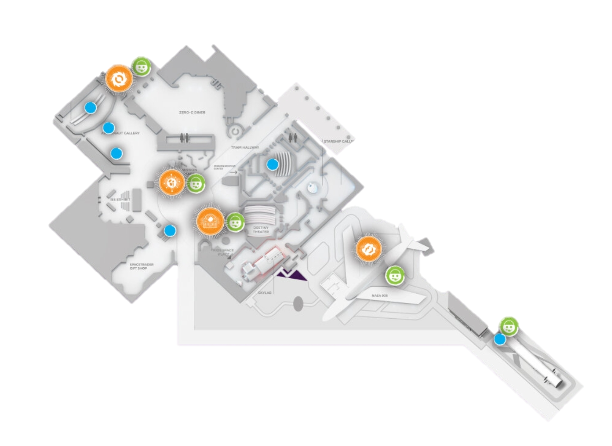
MISSION: Start me up!
Small Warehouse
Activate Replenishment for
Houston Space Center
→ for 2 Stores
Store
Cafe
Automatic PO & TO creation for Stores
- based on Stock
- based on Sales History
Store
Low/Medium. Time = 60 minutes
Hint 1: use Replenishment Implementation Guide
Hint 2: focus on a couple of items first, before you
setup all items

Slide 7

Replenishment
Setup
Basic
Setup
Warehouse,
Store Locations
Items,
Basic calc. rule
Replen.
Journals
Advanced calc. rules (sales history)
Sales History Adjustment
Planned Sales Demand
Document Creation
Automation
(Scheduler)

Slide 8
Replenishment
Setup
Basic
Setup
Warehouse,
Store Locations
Items,
Basic calc. rule
Replen.
Journals
Advanced calc. rules (sales history)
Sales History Adjustment
Planned Sales Demand
Document Creation
Automation
(Scheduler)

Slide 9
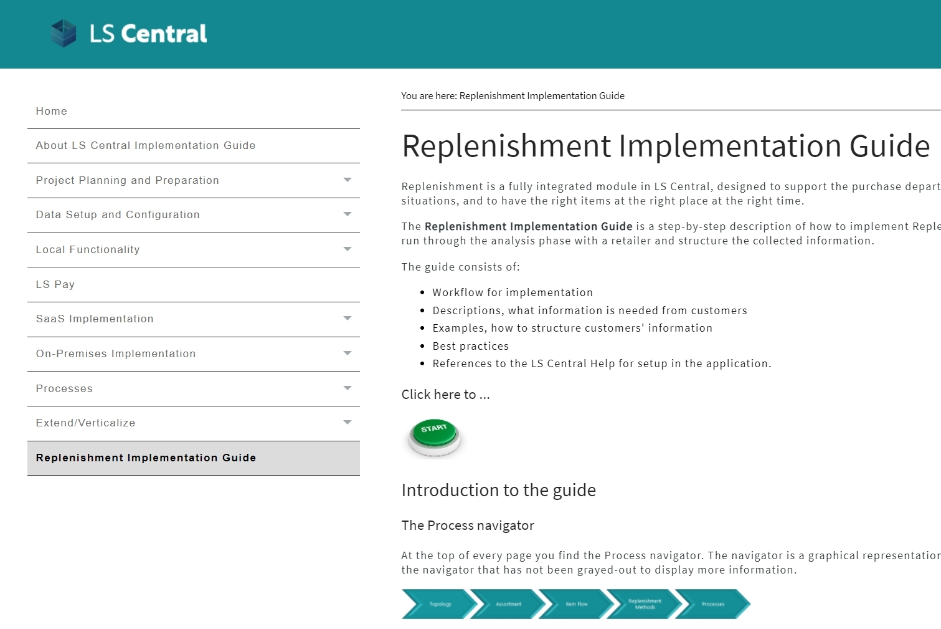
Basic Setup, Warehouse, Store Locations
How to start?
→ Replenishment Implement. Guide
Provides:
  Workflow for implementation
  Description what information is needed
  Explains different use cases / scenarios
  Best practices
  References to Online Help

Slide 10
Let’s set up …
Warehouses and Stores for Replenishment

Slide 11
Replenishment
Setup
Basic
Setup
Warehouse,
Store Locations
Items,
Basic calc. rule
Replen.
Journals
Advanced calc. rules (sales history)
Sales History Adjustment
Planned Sales Demand
Document Creation
Automation
(Scheduler)

Slide 12
Item Setup
Needed steps to activate items:
Select in which stores the items should be replenished
Select the replenishment calculation method
Specify parameters for the chosen method
Stores
Store 1
Store 2

Slide 13
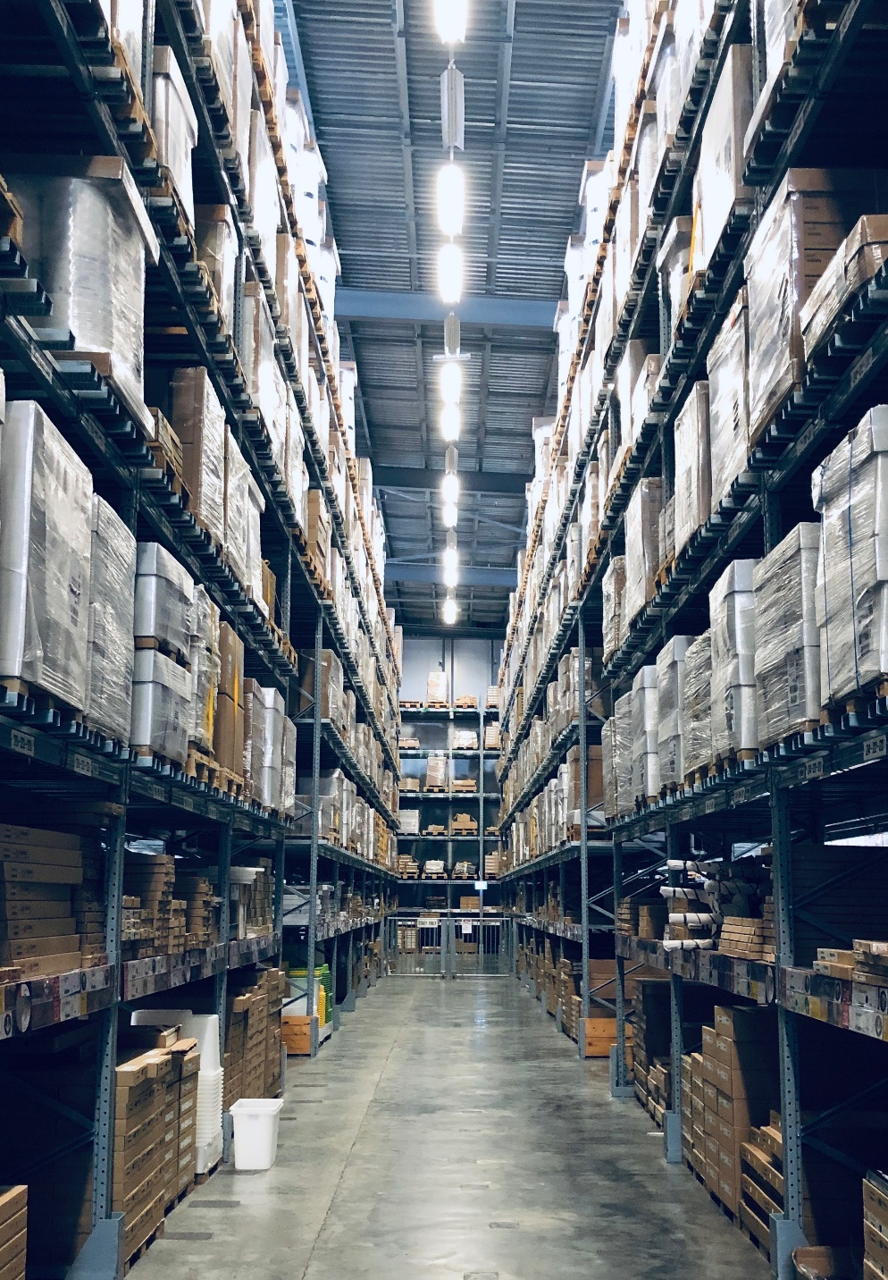
Replenishment calculation
Demand calculation methods
Supported methods:
Reorder Point / Max. Inventory
Like for Like
Manual Estimate
Average Usage
  Adaptive models
  Seasonality (Forward Profiles)
  Replenishment Calendars
  (moving events like Easter)
LS Forecast
  Advanced statistical methods

Slide 14
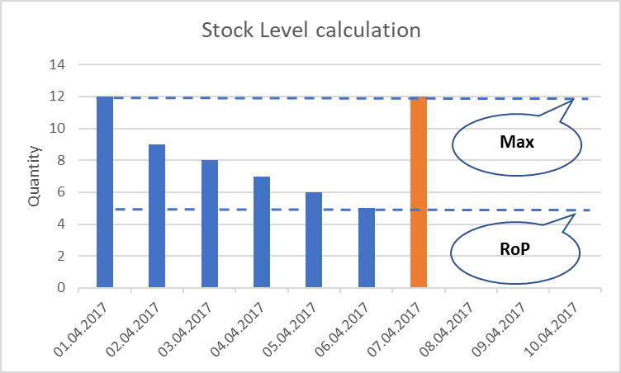
Item Setup
Needed steps to activate items:
Select in which stores the items should be replenished
Select the replenishment calculation method
Specify parameters for the chosen method
Stores
Store 1
Store 2
Stock Level
ordering based on existing store stock
Fields
Vendor
Reorder Point
Max. Inventory

Slide 15
Let’s set up …
Items for Replenishment

Slide 16
Replenishment
Setup
Basic
Setup
Warehouse,
Store Locations
Items,
Basic calc. rule
Replen.
Journals
Advanced calc. rules (sales history)
Sales History Adjustment
Planned Sales Demand
Document Creation
Automation
(Scheduler)

Slide 17

Replenishment Journals
The place where we calculate
the proposals for:
  Purchase Orders
  Transfer Orders
Elements
  Template
  Defines what should be calculated
  in the Journal and how (rules)
  Batch
  Defines when (in which interval)
  the Journal should be calculated

Slide 18
Template Types
Warehouse 1
Store 1
Store 2
Store 3
Warehouse 2
Store 4
Store 5
Vendor A
Vendor C
Vendor B
Types
Purchase Order
  Vendors to Stores
Purchase Order
  Vendors to Warehouses
Transfer Order
  Warehouses to Stores
Purchase Order
  Vendors to Warehouses
  with Cross Docking (Warehouses to Stores)
Redistribution
  Stores to Stores
To Store
To Warehouse
To Warehouse
with Xdocking
(A)
(B)
(D)
(C)
(E)

Slide 19
Template Types
Warehouse 1
Store 1
Store 2
Store 3
Warehouse 2
Store 4
Store 5
Vendor A
Vendor C
Vendor B
Types
Purchase Order
  Vendors to Stores
Purchase Order
  Vendors to Warehouses
Transfer Order
  Warehouses to Stores
Purchase Order
  Vendors to Warehouses
  with Cross Docking (Warehouses to Stores)
Redistribution
  Stores to Stores
To Store
To Warehouse
To Warehouse
with Xdocking
(A)
(B)
(D)
(C)
(E)

Slide 20
Let’s set up
Replenishment Templates
(and do our first calculation)

Slide 21
Replenishment
Setup
Basic
Setup
Warehouse,
Store Locations
Items,
Basic calc. rule
Replen.
Journals
Advanced calc. rules (sales history)
Sales History Adjustment
Planned Sales Demand
Document Creation
Automation
(Scheduler)

Slide 22
Replenishment
Setup
Basic
Setup
Warehouse,
Store Locations
Items,
Basic calc. rule
Replen.
Journals
Advanced calc. rules (sales history)
Sales History Adjustment
Planned Sales Demand
Document Creation
Automation
(Scheduler)

Slide 23
Replenishment calculation
Demand calculation methods
Supported methods:
Reorder Point / Max. Inventory
Like for Like
Manual Estimate
Average Usage
  Adaptive models
  Seasonality (Forward Profiles)
  Replenishment Calendars
  (moving events like Easter)
LS Forecast
  Advanced statistical methods

Slide 24
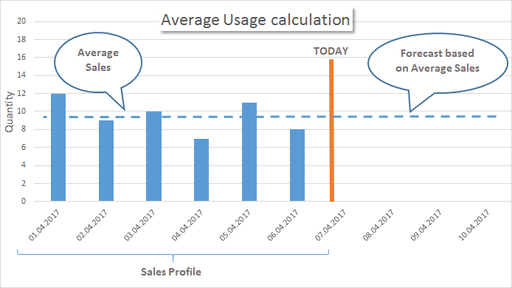
Calculation methods
Historical sales: Average usage
Transfer Orders and/or Purchase Orders are proposed, based on sales history.
Needed fields:
Sales Profile defines time horizon how far we look back
Coverage Period
  Warehouse: based on purchase interval
  Stores: based on store replenishment interval

Slide 25
Let’s change our
Item’s setup to use
Average Usage
(and do another calculation)

Slide 26
Replenishment
Setup
Basic
Setup
Warehouse,
Store Locations
Items,
Basic calc. rule
Replen.
Journals
Advanced calc. rules (sales history)
Sales History Adjustment
Planned Sales Demand
Document Creation
Automation
(Scheduler)

Slide 27
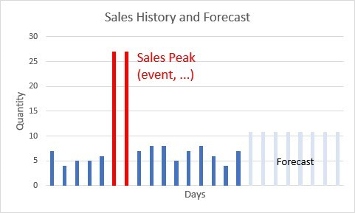
Sales history Adjustments
Simulation or adjustment of Sales History
Methods:
Simulate sales history for new items or stores
(from other item’s sales history with factors)
Correction of sales history
Automatic outlier detection,
Planned demand event / promotions tracking,
Manual corrections

Slide 28
Let’s simulate sales history for our new item
(and do another calculation)

Slide 29
Replenishment
Setup
Basic
Setup
Warehouse,
Store Locations
Items,
Basic calc. rule
Replen.
Journals
Advanced calc. rules (sales history)
Sales History Adjustment
Planned Sales Demand
Document Creation
Automation
(Scheduler)

Slide 30
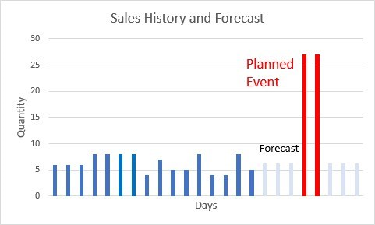
Planned demand events
Exhibitions, Events, Festivals, Promotions…
Feature:
Increase demand for future periods
with absolute or percentage values.
Needed information
  Which items
  Which stores
  Date period
  Effect on demand

Slide 31
Let’s create a planned demand event for our item
(and do another calculation and review the results)

Slide 32
Replenishment
Setup
Basic
Setup
Warehouse,
Store Locations
Items,
Basic calc. rule
Replen.
Journals
Advanced calc. rules (sales history)
Sales History Adjustment
Planned Sales Demand
Document Creation
Automation
(Scheduler)

Slide 33
Let’s create
Purchase Orders
(from the Template)

Slide 34
Replenishment
Setup
Basic
Setup
Warehouse,
Store Locations
Items,
Basic calc. rule
Replen.
Journals
Advanced calc. rules (sales history)
Sales History Adjustment
Planned Sales Demand
Document Creation
Automation
(Scheduler)

Slide 35
How to automate this process?

Slide 36

Replenishment
Setup
Basic
Setup
Warehouse,
Store Locations
Items,
Basic calc. rule
Replen.
Journals
Advanced calc. rules (sales history)
Sales History Adjustment
Planned Sales Demand
Document Creation
Automation
(Scheduler)

Slide 37
MISSION: Start me up!
Small Warehouse
Activate Replenishment for
Houston Space Center
→ for 2 Stores
Store
Cafe
Automatic PO & TO creation for Stores
- based on Stock
- based on Sales History
Store
Low/Medium. Time = 60 minutes
Hint 1: use Replenishment Implementation Guide
Hint 2: focus on a couple of items first, before you
setup all items

Slide 38
Replenishment
Planning & Data Maintenance
Manual Replenish- ment
Automatic Replenish- ment
Execution
Monitoring
Sales & Purchase Budgets
Allocation
Plans
Buyer‘s Push,
Stock Recall
Allocation Rules
Variant Weight Dim. Pattern
Demand Forecasts
Store Stock
Redistribution
Purchase & Transfer
Orders
Stock Requisition
Buyer‘s Workbench
Inventory and Demand
Store
Capacity
Stock Coverage
Vendor Performance
Open to Buy
Assortment Mgmt.
Lifecycle Mgmt.
Replenishment Journal Calculation
Threshold Mgmt.
Lifecycle Planning WS
Cross Docking
Manual Purch. & Transfer Orders
Replen. Item Quantity Calculation
Out-of-Stock Calculation
Item Import

Slide 39
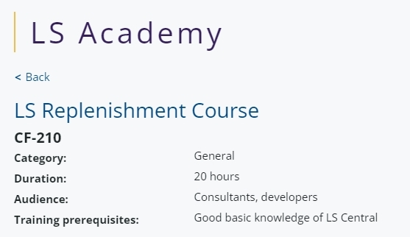
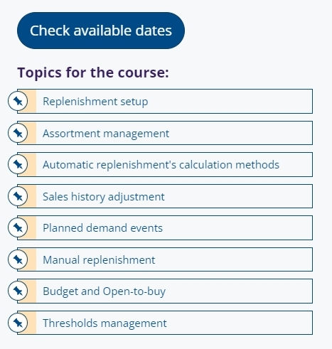
How to get started?
Training
  LS Retail Academy – training course
  https://www.lsretail.com/ls-academy/
  Individual training through LS Retail Consulting
  Webinars, LS Central Online Help
Sales support
  Presales, Solution design, Concept reviews
  by LS Retail Consulting
Implementation support
  by LS Retail Consulting

Slide 40
Thank you

