Slide 1
Road to SaaS for existing customers
Ricardo Moinhos
Migration Specialist

Slide 2




Slide 3

Road to SaaS for existing customers

Slide 4

Technical Challenges
Technical-wise, two tasks need to be handled in the migration process:
Business Data (Data Migration)
Application Code (Customizations)
Separate tasks
Challenges depends on various factors:
How old is the current version?
How much customized is the solution?
How big is the database?
How much the business depends on legacy data?
How many customizations are still used?

Slide 5


Data Migration
Re-implementation path
You can do the initial setup on SaaS but…
Why should you do it on an on-premise environment instead?
It’s faster to:
Import (large) configuration packages
Test extensions
Debug errors
1st Stage
On-Premise
Customer
Database
LS Central SaaS
1
4
Customer Tenant
Migrate
3
using Cloud Migration Tool
Production
Adjust setup/data
Customer Test
Database
2
Test

Slide 6
Data Migration
Re-implementation path
You can do the initial setup on SaaS but…
Why should you do it on an on-premise environment instead?
It’s faster to:
Import (large) configuration packages
Test extensions
Debug errors
2nd Stage
1
Disable Cloud Migration Tool
LS Central SaaS
Customer Tenant
3
Adjust setup/data
Production
Sandbox
2
Test

Slide 7

Data Migration
The upgrade paths
Business Central 14 (without LS Central) or later
LS Central SaaS
LS Central 17.5 or later
LS Central SaaS
Using Cloud Migration Tool
Older than LS14.2
LS Central 14.2 to 17.4
LS Central latest
LS Central SaaS
Using Upgrade Codeunits
Using Table Migration Extensions
Using Cloud Migration Tool

Slide 8

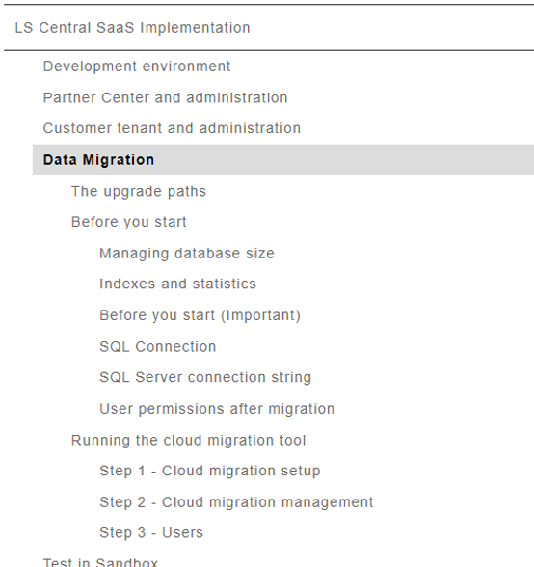
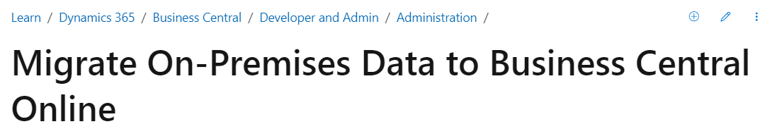
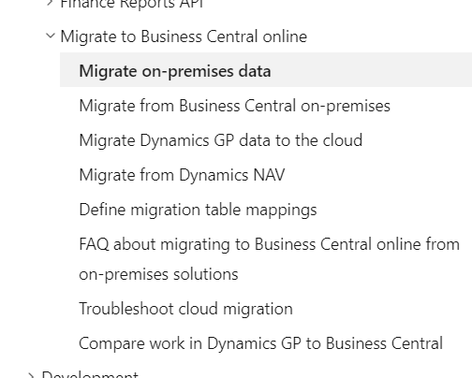
Cloud Migration Tool
Running the cloud migration tool | LS Central SaaS Implementation Guide
Migrate on-premises data to the cloud - Business Central | Microsoft Learn

Slide 9
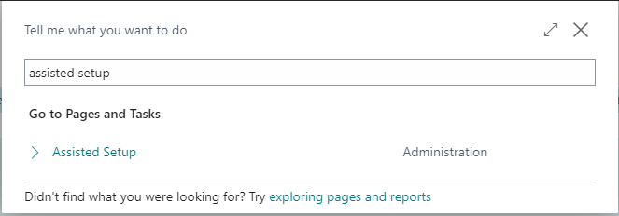
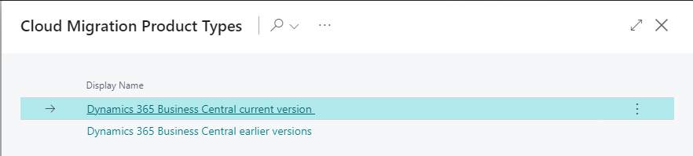
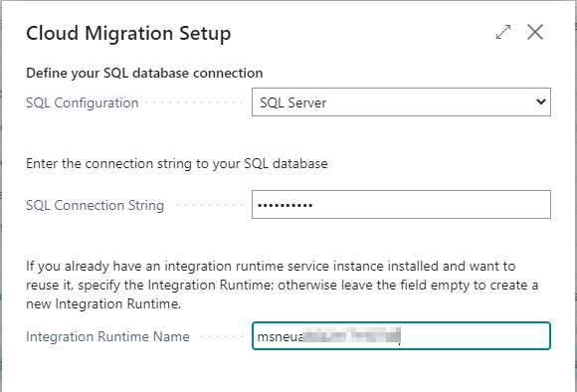
Cloud Migration Tool
Search for Assisted Setup
Select Set up Cloud Migration
Select the product version
Current version for V22
Earlier versions for V17.5 to 21
Enter:
SQL Connection String
Integration Runtime Name

Slide 10
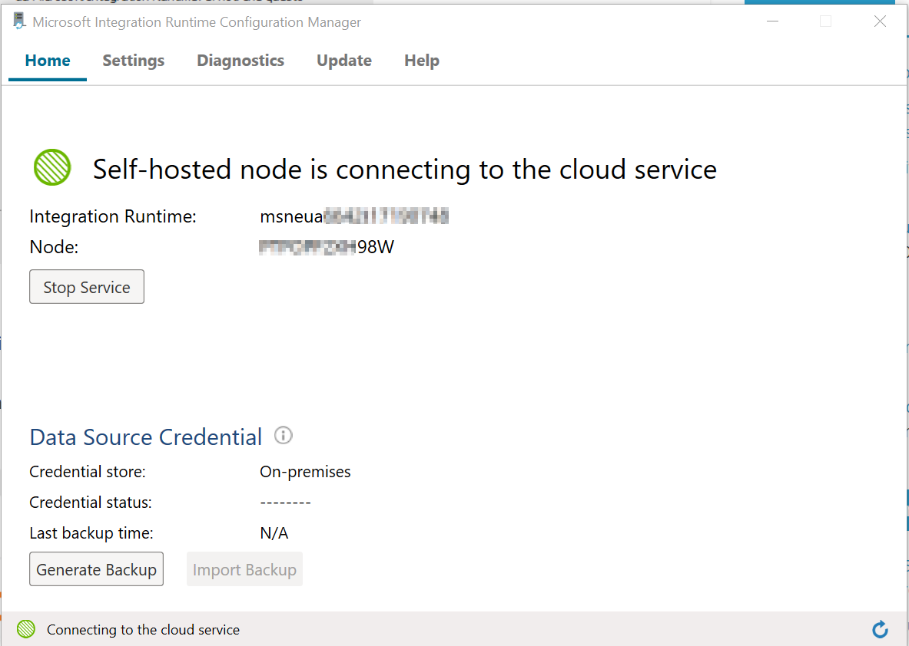
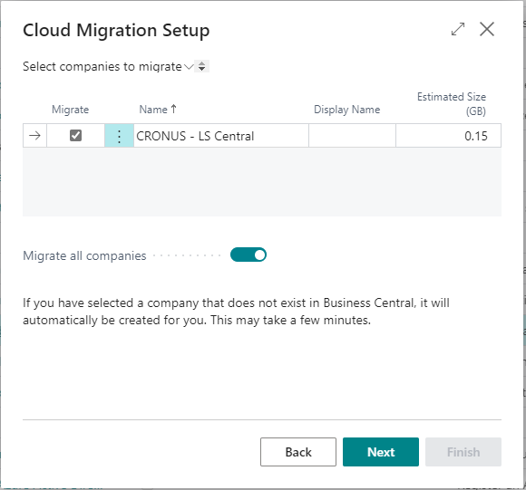
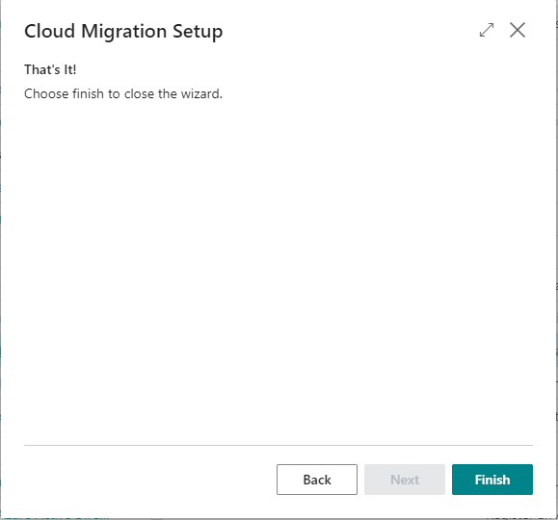
Cloud Migration Tool
The Integration Runtime is installed locally
Select the companies to migrate
Finish the Cloud Migration Setup
Integration Runtime Name

Slide 11
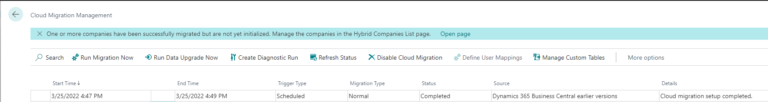
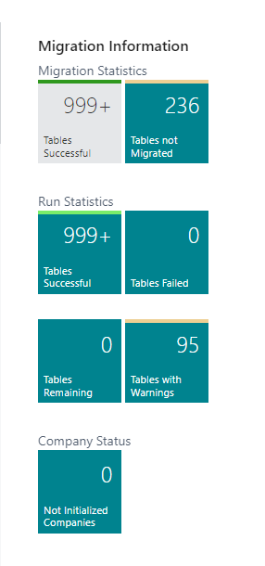
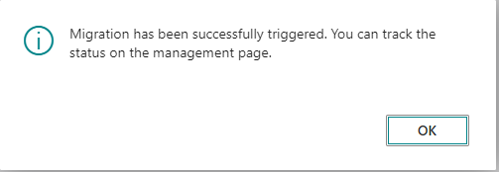
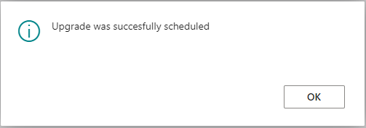
Cloud Migration Tool
Run Migration Now
Run Data Upgrade Now

Slide 12
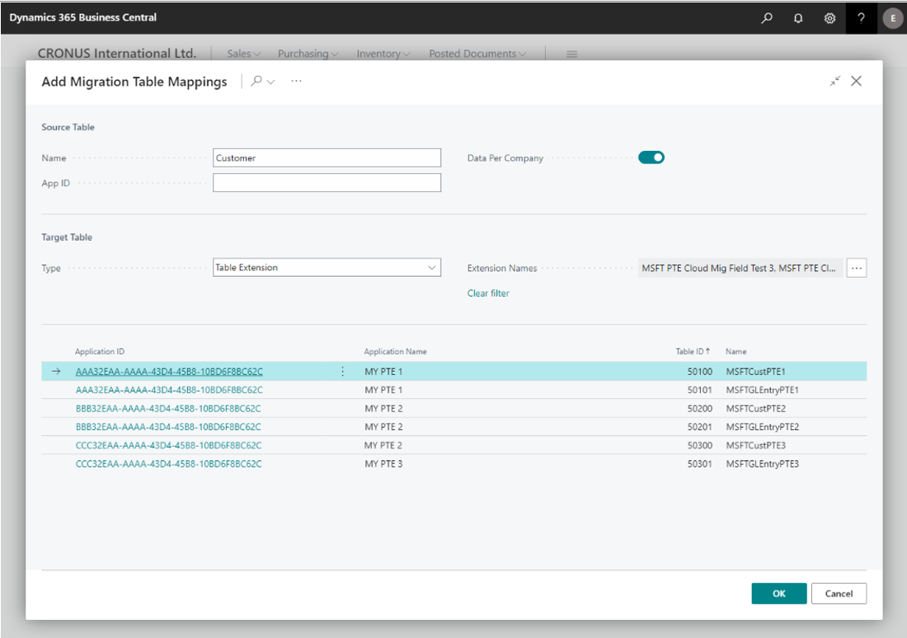
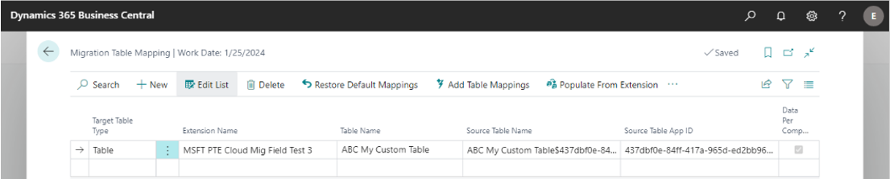
Cloud Migration Tool – New Features
Microsoft is improving the tool on every new release
New feature available in BC 2022 Wave 2 (V21)
Define Migration Table Mappings
Can be used to rename the table during the cloud migration or to move a subset of fields to a different table or table extension

Slide 13
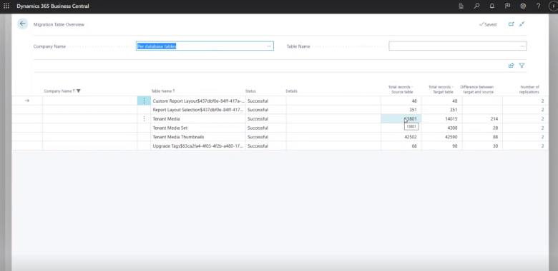
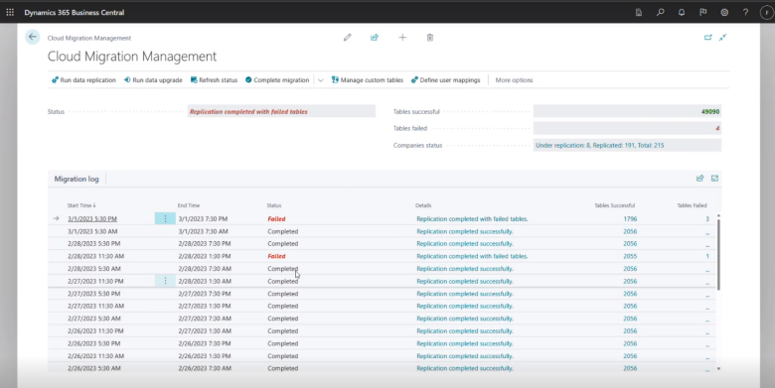
Cloud Migration Tool – New Features
Microsoft is improving the tool in every new release
New feature available in BC 2023 Wave 1 (v22)
Get an improved cloud migration status overview

Slide 14

What about LS Central 17.4 or earlier versions?
Application Code Challenges
Move from Non-Extension to Extension Framework
C/AL to AL
No changes in the base code
Events Subscription
LS Central Non-Public Methods
Objects renaming introduced in LS Central 17.5

Slide 15

Events to Subscribe
Business/Integration Events
Custom events created by Microsoft/ISV/Partner
Global Events
Predefined system events raised on several base application codeunits
Database/Page Trigger Events
Example:
OnBeforeInsertEvent
OnAfterInsertEvent
OnAfterDeleteEvent
OnAfterModifyEvent
OnAfterValidateEvent

Slide 16


(Custom) Events Availability
Microsoft Base App | LS Central App
Version | # Events | % | Version | # Events | %
15.4 | 7650 |  | 15.3 | 781
16.5 | 6134 | -20% | 16.4 | 888 | +14%
17.5 | 11488 | +87% | 17.5 | 1050 | +18%
18.5 | 13549 | +18% | 18.4 | 1272 | +21%
19.5 | 15084 | +11% | 19.5 | 1464 | +15%
20.5 | 17065 | +13% | 20.5 | 1808 | +24%
21.5 | 18443 | +8% | 21.4 | 2066 | +14%
New events requests
Making methods public requests
Request through the Technical Support Desk

Slide 17
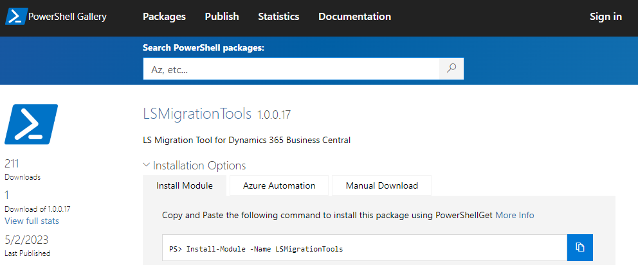
LS Migration Process
Documentation
Step-by-step documentation based on Microsoft’s guidelines
Available on request through the Technical Support Desk
LS Retail migration tools
Powershell module to automate some migration steps
Available on the Powershell Gallery

Slide 18
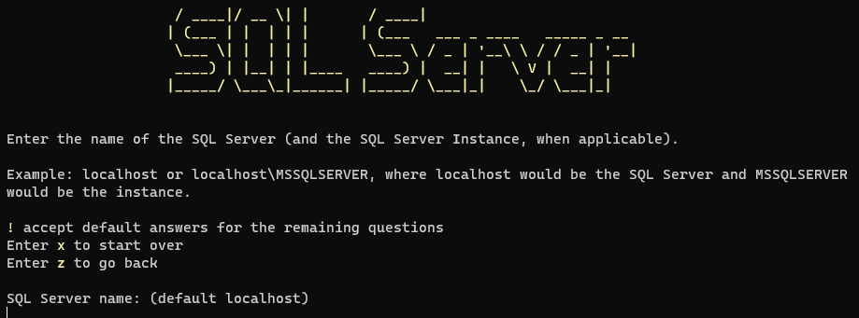
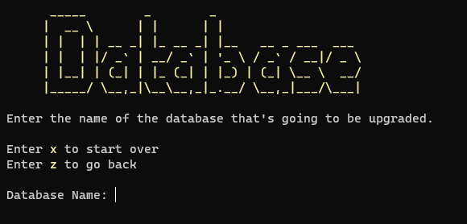
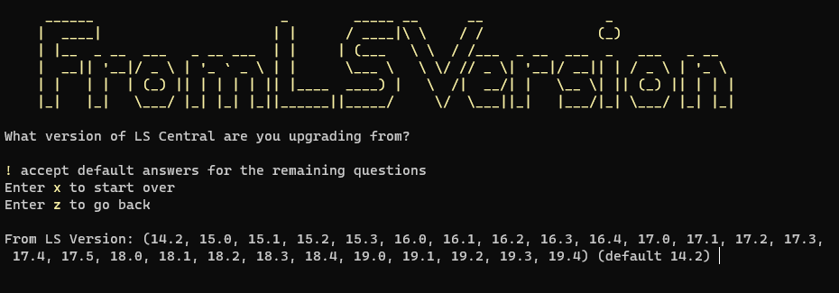
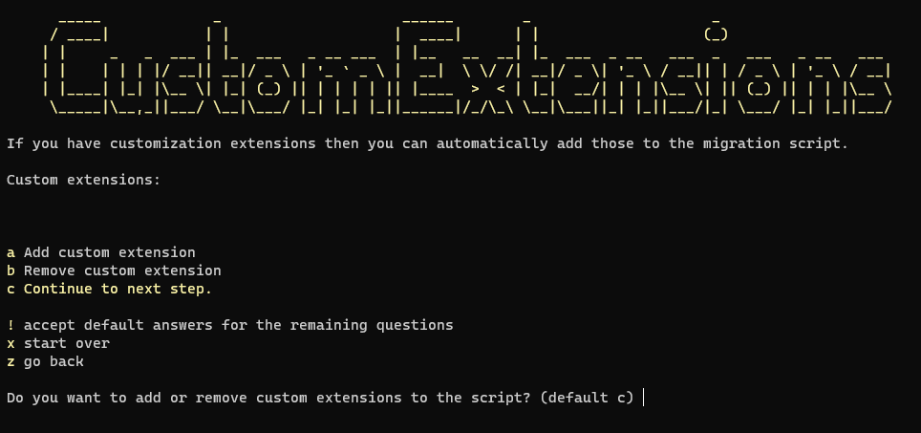
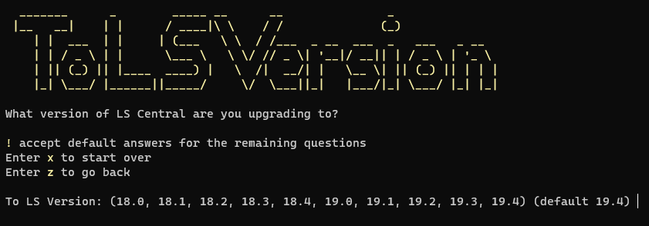
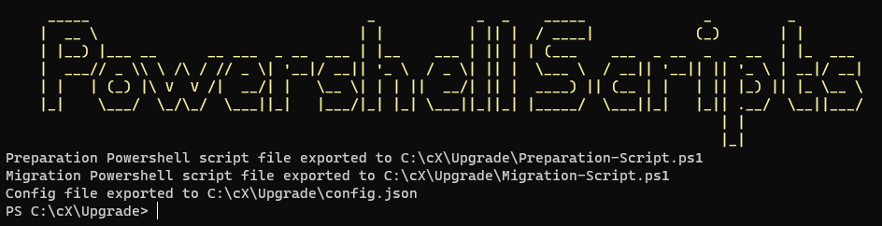
Migration Tools
New-UpgradeInitializationScript
A wizard to automate the migration scripts creation

Slide 19
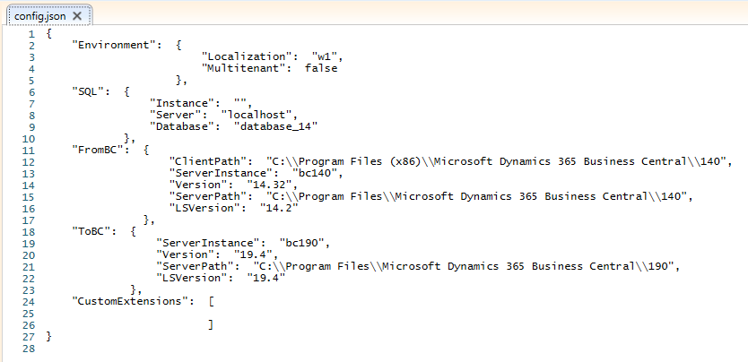
Migration Tools
The wizard generates a config.json file that can be reused

Slide 20
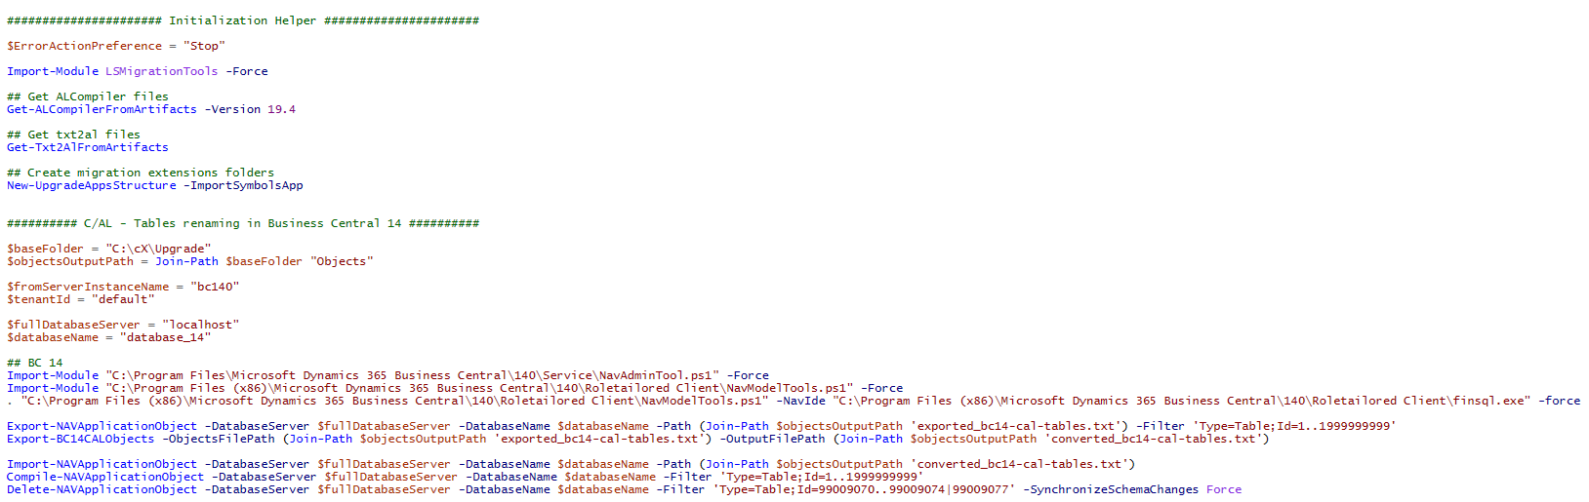
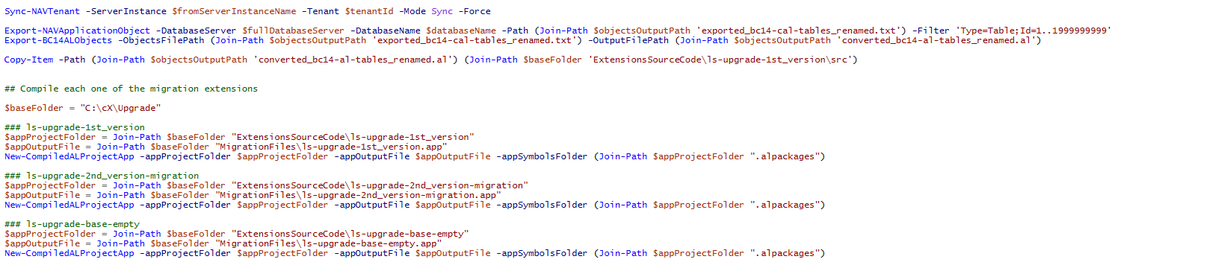
Migration Tools
Two scripts are created, that allows you to go through the migration process
Preparation-Script.ps1
- Setup the folder structure and create the extensions needed for the migration

Slide 21
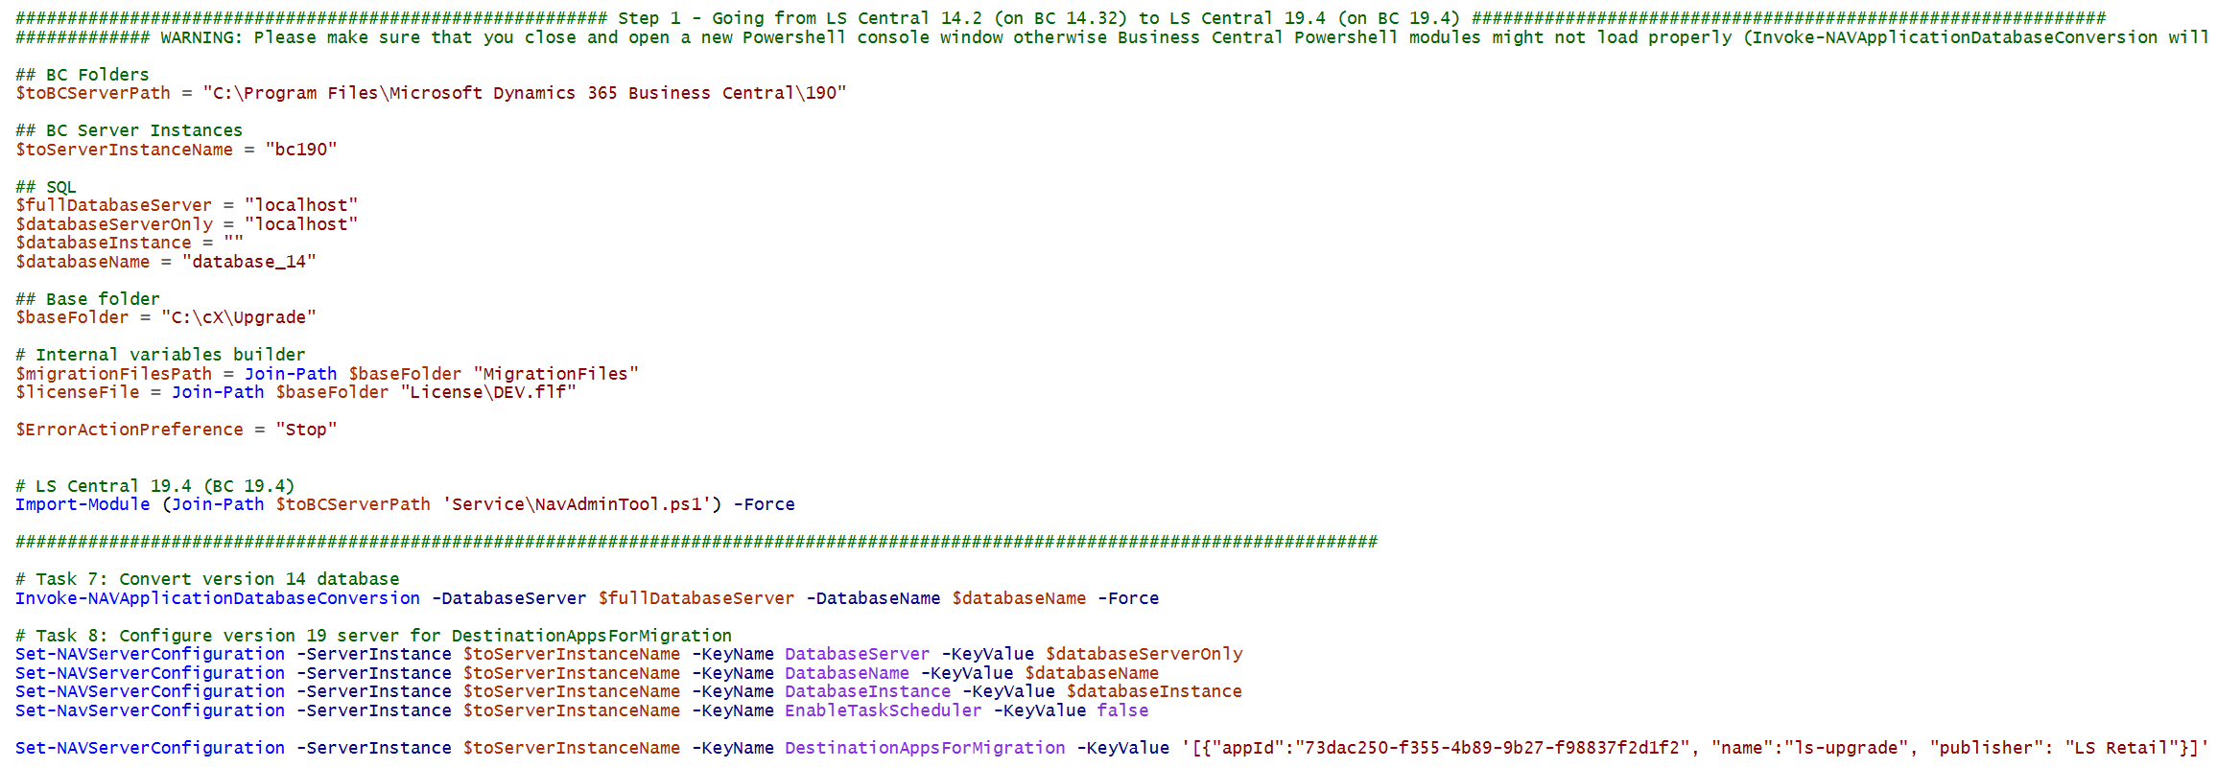
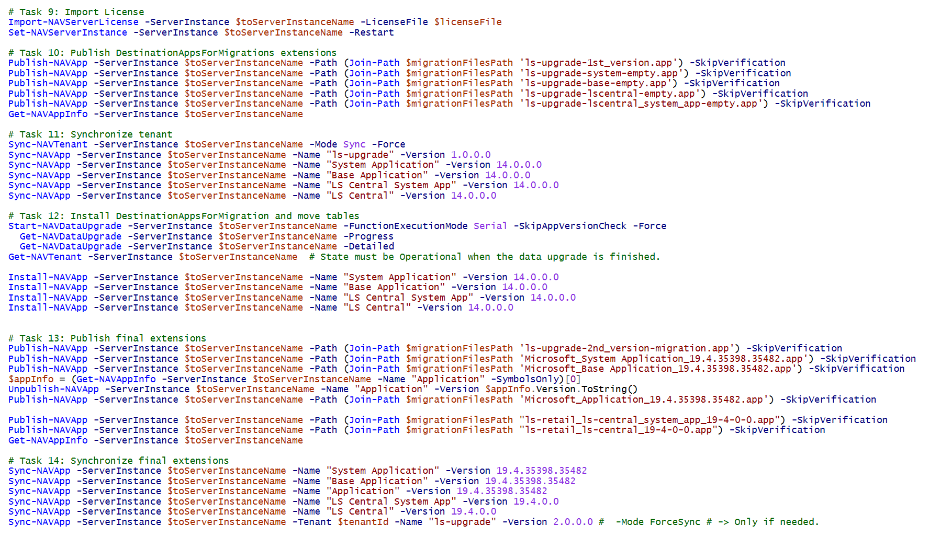
Migration Tools
Migration-Script.ps1
The migration process itself

Slide 22
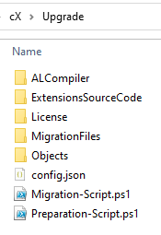
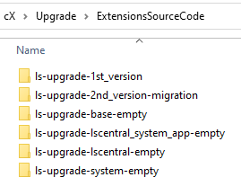
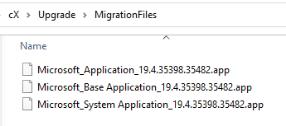
Migration Tools
New-UpgradeAppsStructure
Creates the migration extensions needed for the migration process, as suggested in Microsoft guidelines.

Slide 23

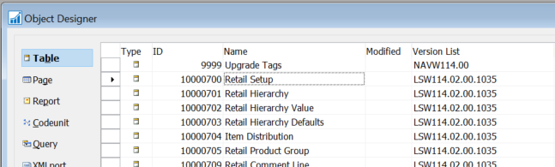
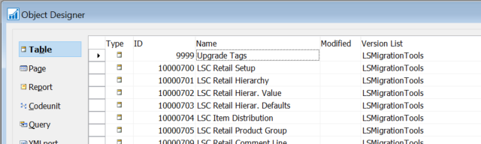
Migration Tools
Convert-BC14CALObjectsToTableSchemaOnly
Applies to Business Central 14
Strips out all the code from tables, for an existing C/AL text file, while renaming the LS Central tables name
- Only properties and fields will be included
Converted file will be imported back in BC 14
Allows to easily rename all the LSC tables in BC 14 before moving forward
Before
After importing the converted file

Slide 24
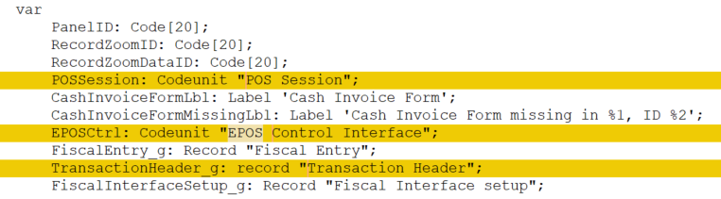
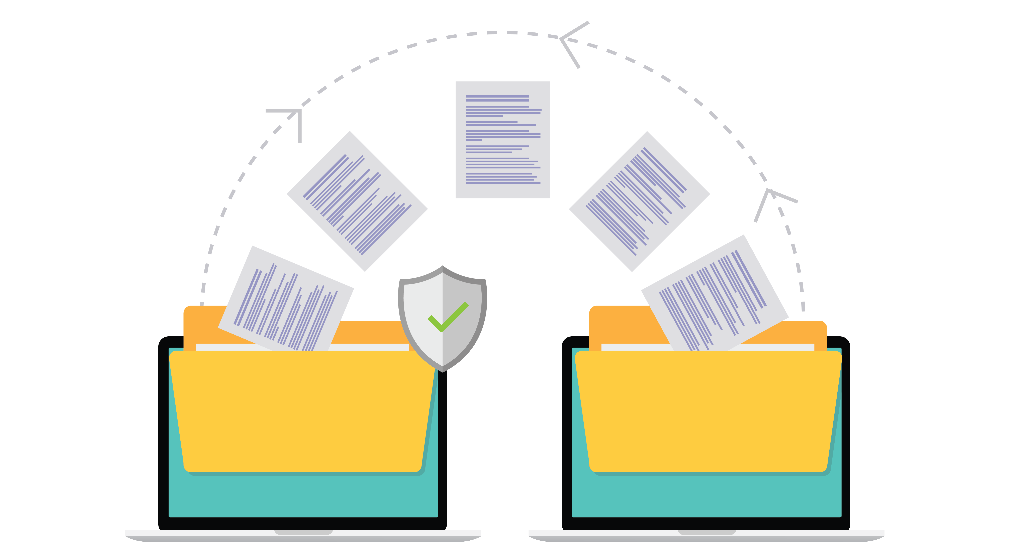
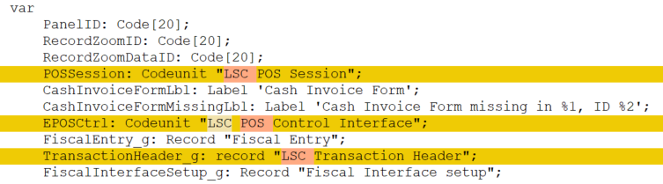
Migration Tools
Repair-CustomExtensionFrom174orEarlier
Will update references to LS Central objects in your custom extensions
Variables
Before
After

Slide 25
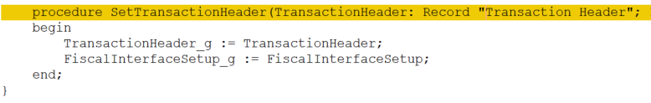
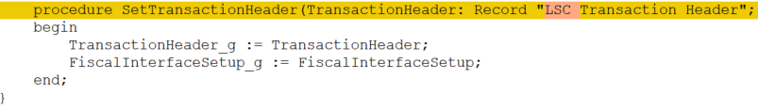
Migration Tools
Repair-CustomExtensionFrom174orEarlier
Will update references to LS Central objects in your custom extensions
Variables
Parameters
Before
After

Slide 26
Migration Tools
Repair-CustomExtensionFrom174orEarlier
Will update references to LS Central objects in your custom extensions
Variables
Parameters
Tables, pages and other object extensions
Before
After

Slide 27
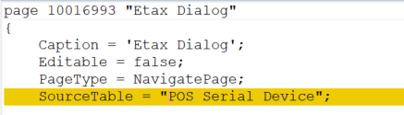
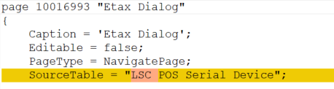
Migration Tools
Repair-CustomExtensionFrom174orEarlier
Will update references to LS Central objects in your custom extensions
Variables
Parameters
Tables, pages and other object extensions
Other properties
Before
After

Slide 28

Other tools available
Documentation
LS Central SaaS Implementation Guide
Microsoft Documentation
Cloud Migration group in D365 BC Development Yammer

Slide 29
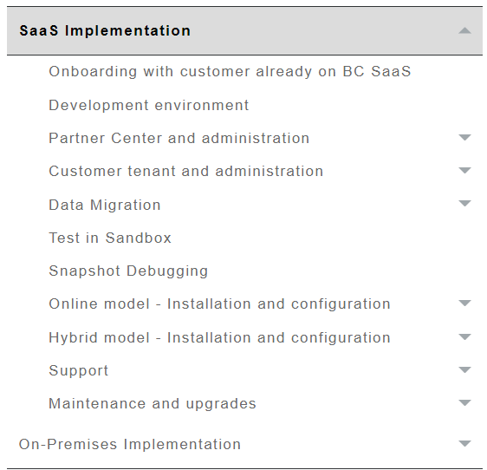
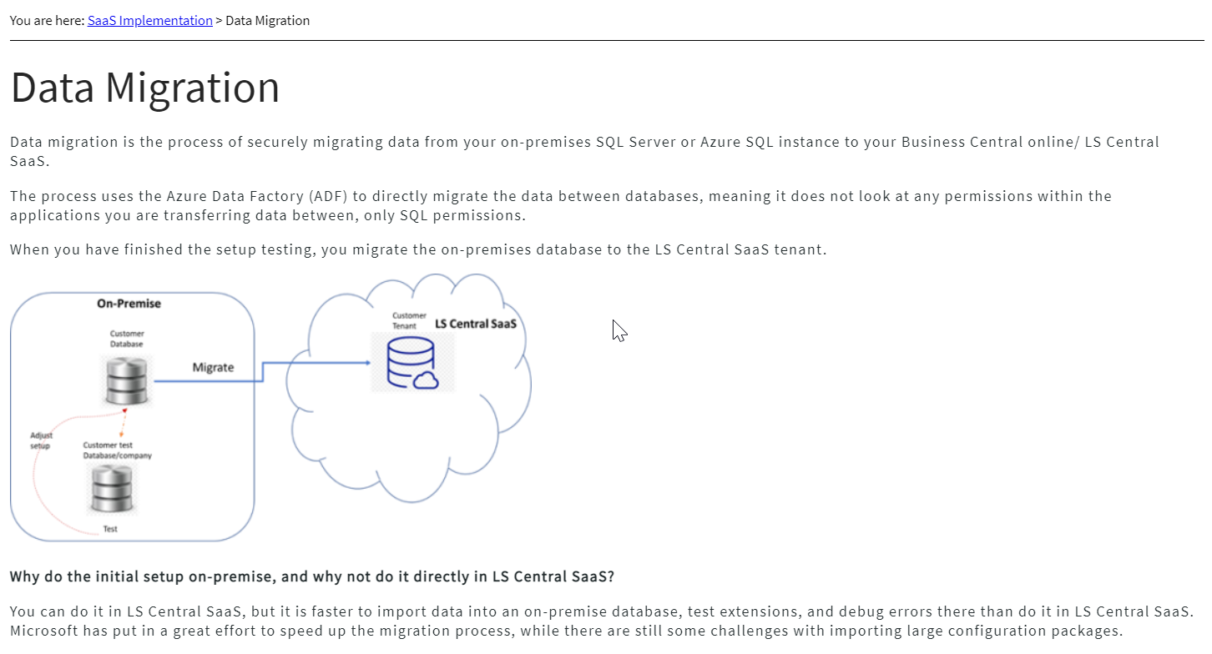
LS Central SaaS Implementation Guide
LS Central SaaS (lsretail.com)

Slide 30
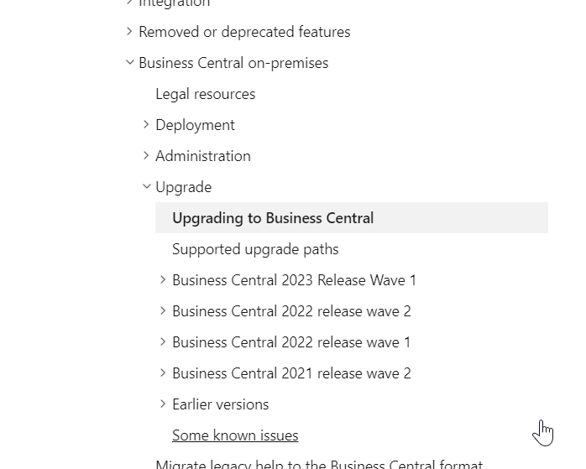
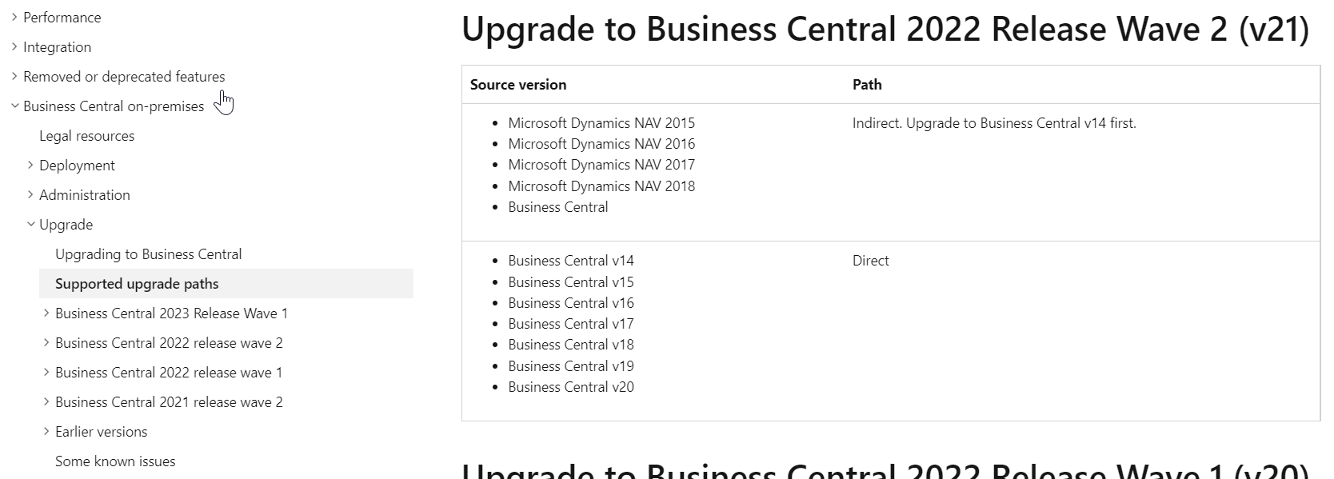
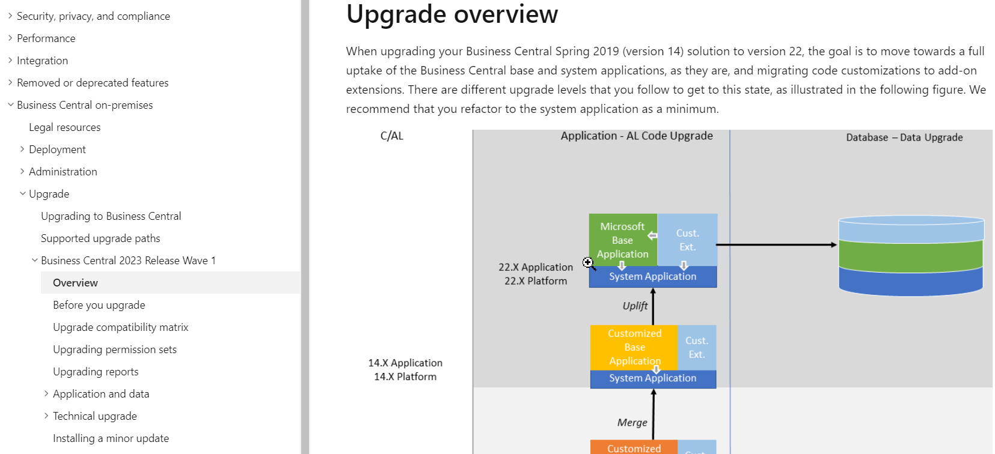
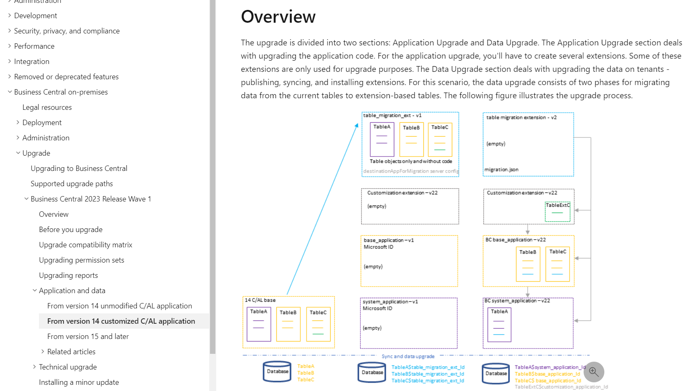
Microsoft Documentation
Upgrading to Microsoft Dynamics 365 Business Central - Business Central | Microsoft Learn

Slide 31
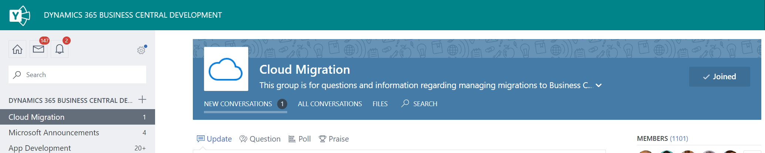
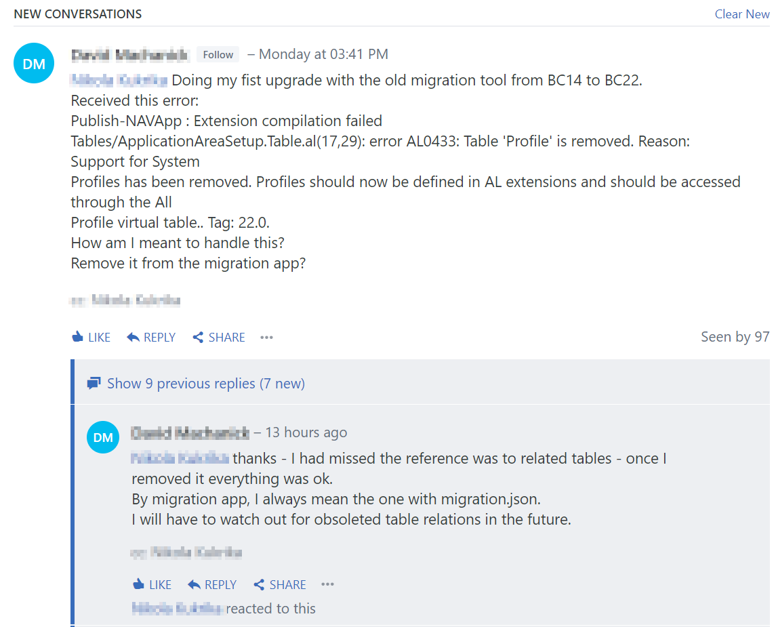
Cloud Migration group in D365 BC Development Yammer
Yammer : Cloud Migration

Slide 32
Thank you

