Slide 1
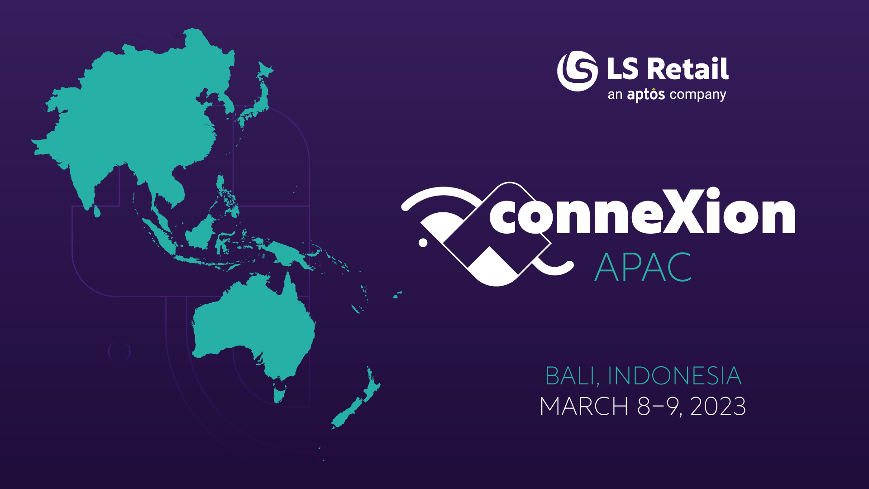

Slide 2

Reselling LS Central SaaS – value proposition
Della Chew
Regional Sales Manager APAC

Slide 3

Agenda
Why LS Central SaaS?
Prospects of LS Central SaaS
SaaS Economics
Cloud Promotions & Programs
SaaS Support for Partners

Slide 4

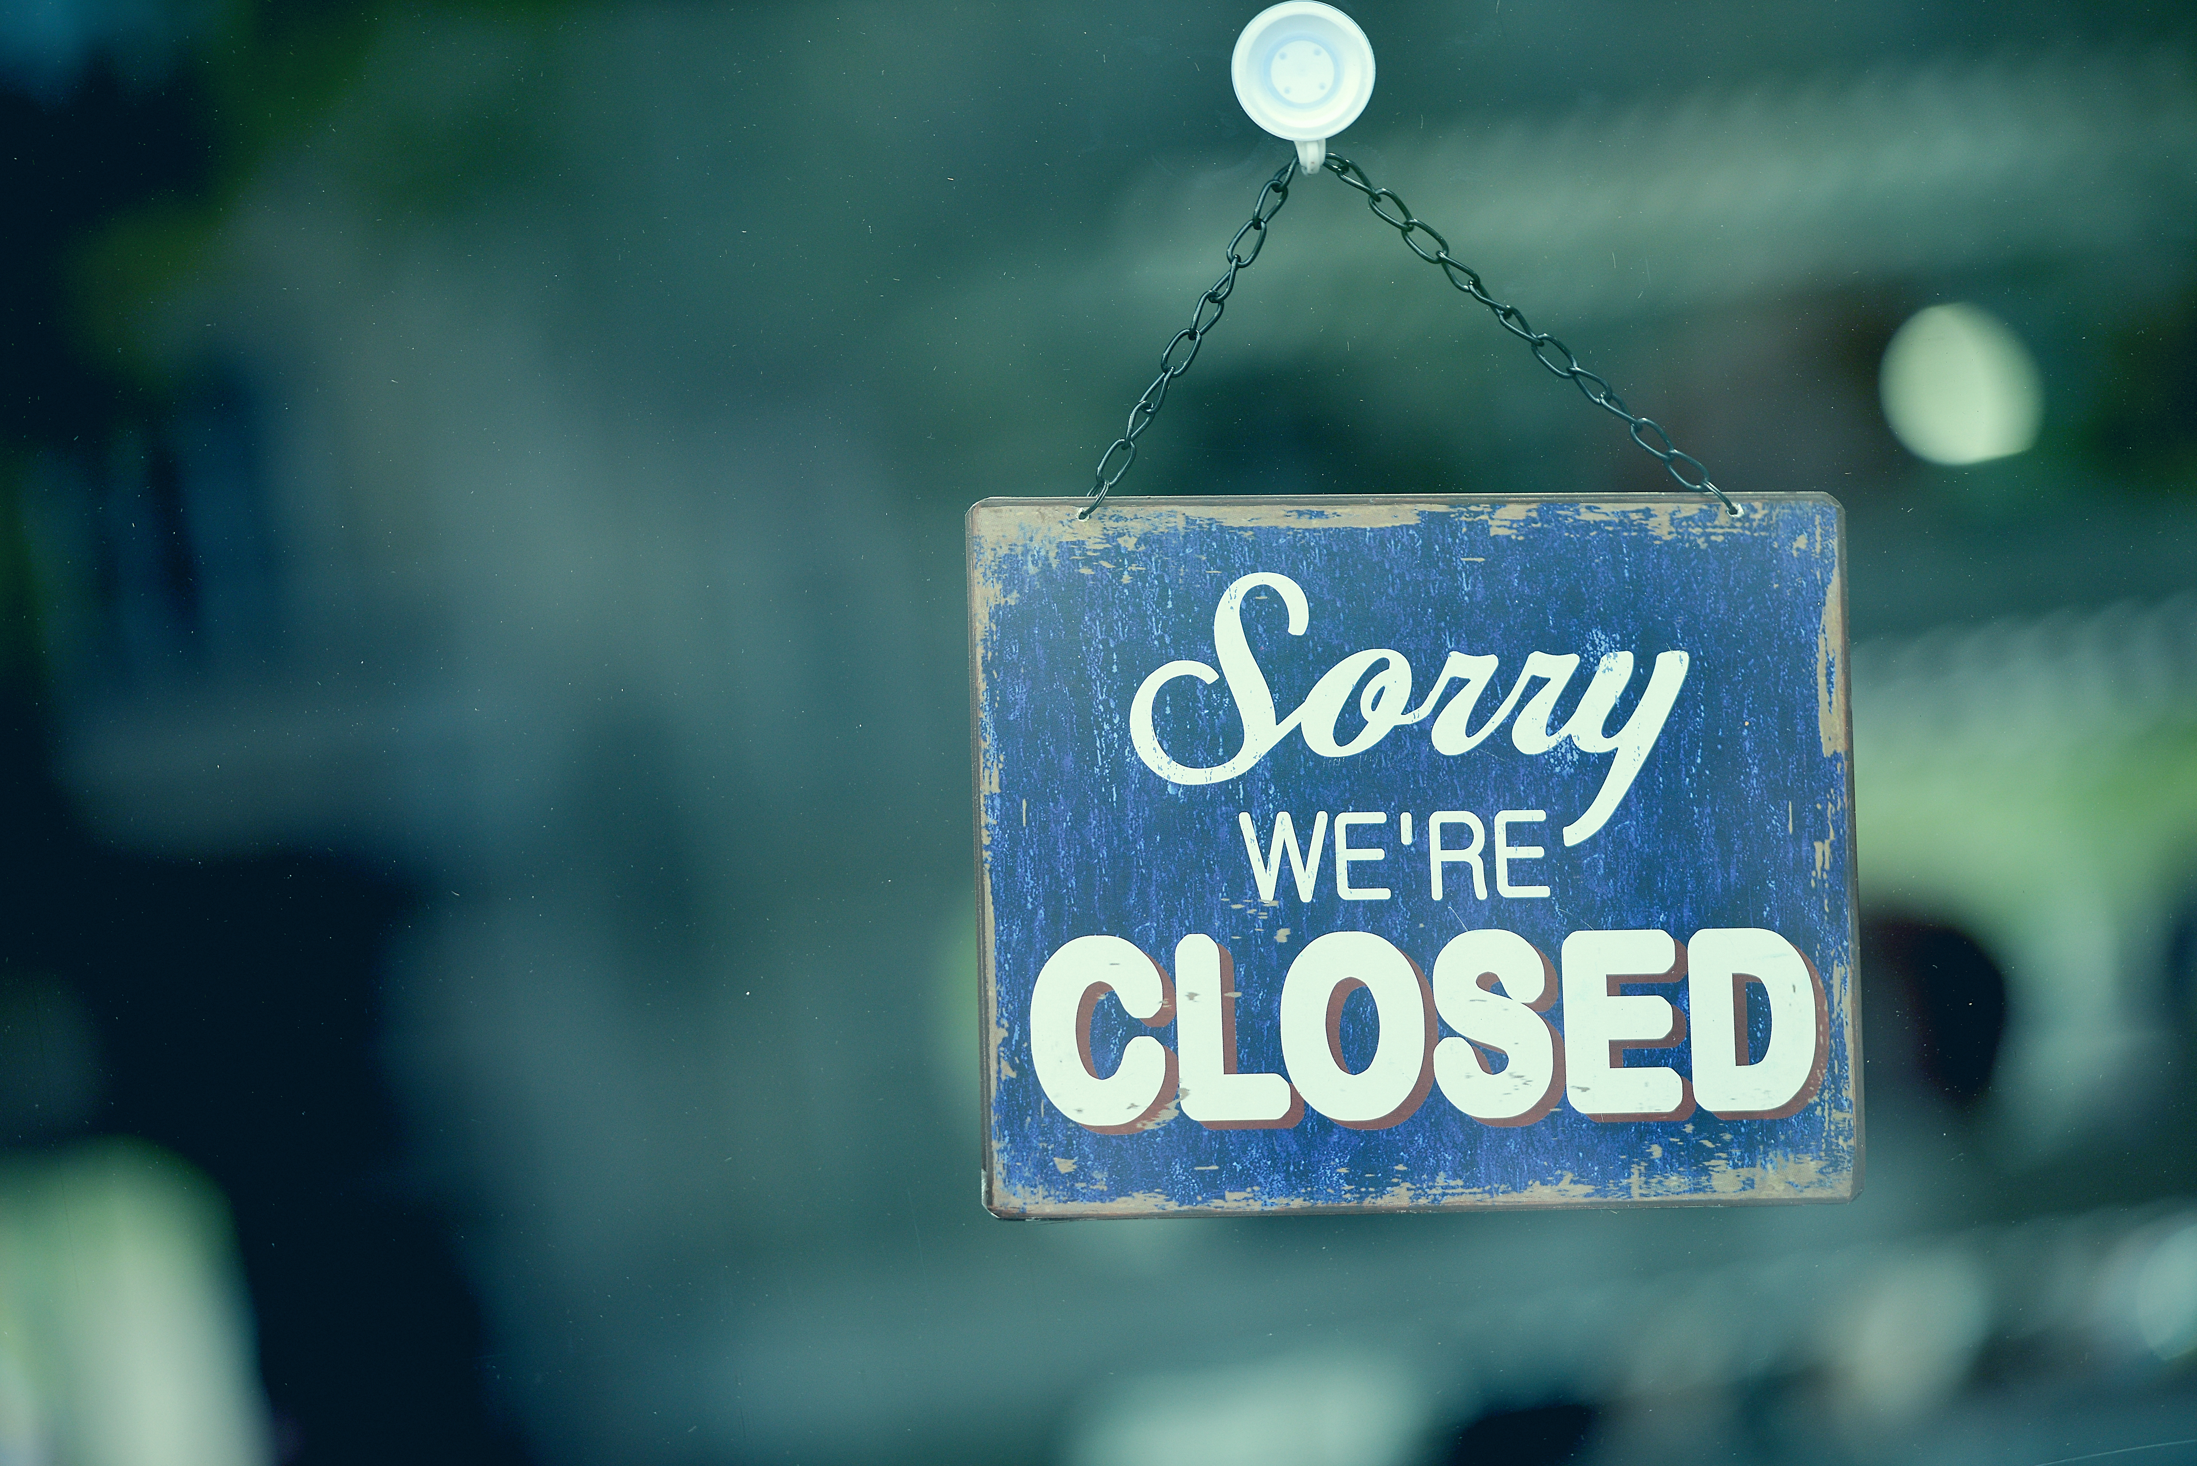

Titano
fashion and apparel retailer in Malaysia
Before Covid
During Covid
Living with Covid

Slide 5
Why LS Central SaaS?
Scalability
Increase collaboration
Lower capital expenses
Respond to market conditions
Anytime, anywhere
Latest features and versions
Centralized IT management
Hosting and infra by Microsoft
Enhance productivity

Slide 6
Latest innovation
Prospects of LS Central SaaS
Anytime,
Anywhere
Low investment
Flexible
Hassle free

Slide 7
SaaS Economics

Slide 8


Visible factors
License & maintenance cost
IT manpower
Energy cost for servers
IT infrastructure (servers, database etc)
Security costs
Network costs
Upgrade costs
Hidden factors

Slide 9
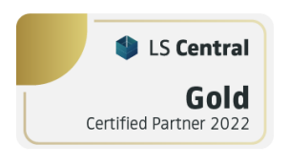
SaaS vs Perpetual license for Partner
Example: 10 users in Head Office, 30 stores with 1 device each, LS eCommerce integration, LS Pay.
SaaS subscription
Qty. | Module description | Unit price (USD) | List price | Customer price
10 | Dyn365 Business Central Essentials | $ 70.00 | $ 700.00 | $ 700.00
10 | LS Central Base - Per Full User | $ 30.00 | $ 300.00 | $ 300.00
30 | Offline Store | $ 5.00 | $ 150.00 | $ 150.00
30 | Retail Device SAL for Retail & Hospitality | $ 85.00 | $ 2,550.00 | $ 2,550.00
30 | LS Pay - per Device | $ 10.00 | $ 300.00 | $ 300.00
1 | LS eCommerce Base | $ 136.00 | $ 136.00 | $ 136.00
30 | LS eCommerce - per Device | $ 3.00 | $ 90.00 | $ 90.00
 |  |  | MRR | $ 4,226.00
 |  |  | Annual | $ 50,712.00
Partner margin: 20% | Partner Share
Monthly Recurring Revenue (MRR) | $ 845.20
Annual Recurring Revenue (ARR) | $ 10,142.40
Perpetual license
Qty | Module description | Unit price (USD) | List price | Customer price
10 | Dyn365 Business Central Essentials | $ 1,400.00 | $ 14,000.00 | $ 14,000.00
10 | LS Central Base - Per Full User | $ 697.20 | $ 6,972.00 | $ 6,972.00
30 | Store/Commerce Pack incl 1 Retail Device CAL | $ 1,411.20 | $ 42,336.00 | $ 42,336.00
0 | Retail Device CAL for Retail & Hospitality | $ 823.20 | $ - | $ -
30 | LS Pay - per Device | $ 134.40 | $ 4,032.00 | $ 4,032.00
1 | LS eCommerce Base | $ 3,276.00 | $ 3,276.00 | $ 3,276.00
30 | LS eCommerce - per Device | $ 40.60 | $ 1,218.00 | $ 1,218.00
 |  |  | LICENSE | $ 71,834.00
 |  |  | BREP | $ 12,930.12
Partner margin: 15% for lic, 14% for BREP | Partner Share
License | $ 10,775.10
BREP | $ 1,810.22

Slide 10
SaaS vs Perpetual license for Customer
Customer
 | Cost components | Year 1 | Year 2 | Year 3 | Year 4 | Year 5 | Total 5 Years
Licensing & maintenance | SaaS | $ 57,912.00 | $ 57,912.00 | $ 57,912.00 | $ 57,912.00 | $ 57,912.00 | $ 289,560.00
 | Perpetual | $ 84,764.12 | $ 12,930.12 | $ 12,930.12 | $ 12,930.12 | $ 12,930.12 | $ 136,484.60 | 47% | of SaaS subscription
Other cost | Infra/ hosting cost |  |  |  |  | $ 1000 per month | $ 60,000.00
 | IT manpower |  |  |  |  | $ 1000 per month | $ 60,000.00
 | Upgrade |  |  |  |  | 33% of 5 years total | $ 45,039.92
 |  |  |  |  |  | Total cost with Perpetual | $ 301,524.52 | 104% | of SaaS subscription

Slide 11
LS Central SaaS Licensing
Types of setup:
  Full Cloud
  Hybrid with offline POS
  Dual use rights for full on-premise implementation
Subscription terms:
  Monthly
  Annual (12 months)
  Triennial (36 months)

Slide 12
Differences between
Subscription Terms
Customers can have different terms
Annual and Triennial can have Monthly or Yearly payment terms
Monthly is 20% higher than Annual/Triennial subscriptions
Consistent cancellation policies
  Limited to the End of Term Renewal, and no cancellation fees
Deactivations can be done on annual basis for Annual and Triennial Terms
 | Monthly | Annual | Triennial
Term | One full month | 12 months | 36 months
Price | 20% Premium (20% higher than annual subscription) | Same as today | Same as annual offer with 3-year fixed price
Payment Option | Monthly | Monthly / Annual | Monthly / Annual
Price Lock | 1 month | 12 months | 36 months
Cancellations | At the end of each Monthly Term | At the end of each Annual Term | At the end of 36-month term
Flexibility | Decrease quantity monthly Increase daily | Decrease quantity on an annual basis Increase daily | Decrease quantity on an annual basis Increase daily

Slide 13
Cloud Promotions & Programs

Slide 14

Ongoing Cloud
Promotions & Programs
Bridge to the Cloud 2 (BTC2)
Cloud Migration
Move from on-Prem Subscription to SaaS

Slide 15
Quick comparison of
BTC2 vs Cloud Migration
 | BTC2 | Cloud Migration
Minimum monthly subscription | At least annual BREP divide by 12 and covering Microsoft cost | LS Central minimum
BREP benefit for existing Perpetual license | Yes | No
Extra discount | 40% | 35%
Term | 3 years | 3 years
Program availability | Dec 30, 2024 | June 30, 2023
Revert back to Perpetual | Pay back BREP + penalty | No penalty
Partner discount | Fixed 15% | As per Partner Program
For the full program information, please refer to the LS Retail Partner Portal.

Slide 16
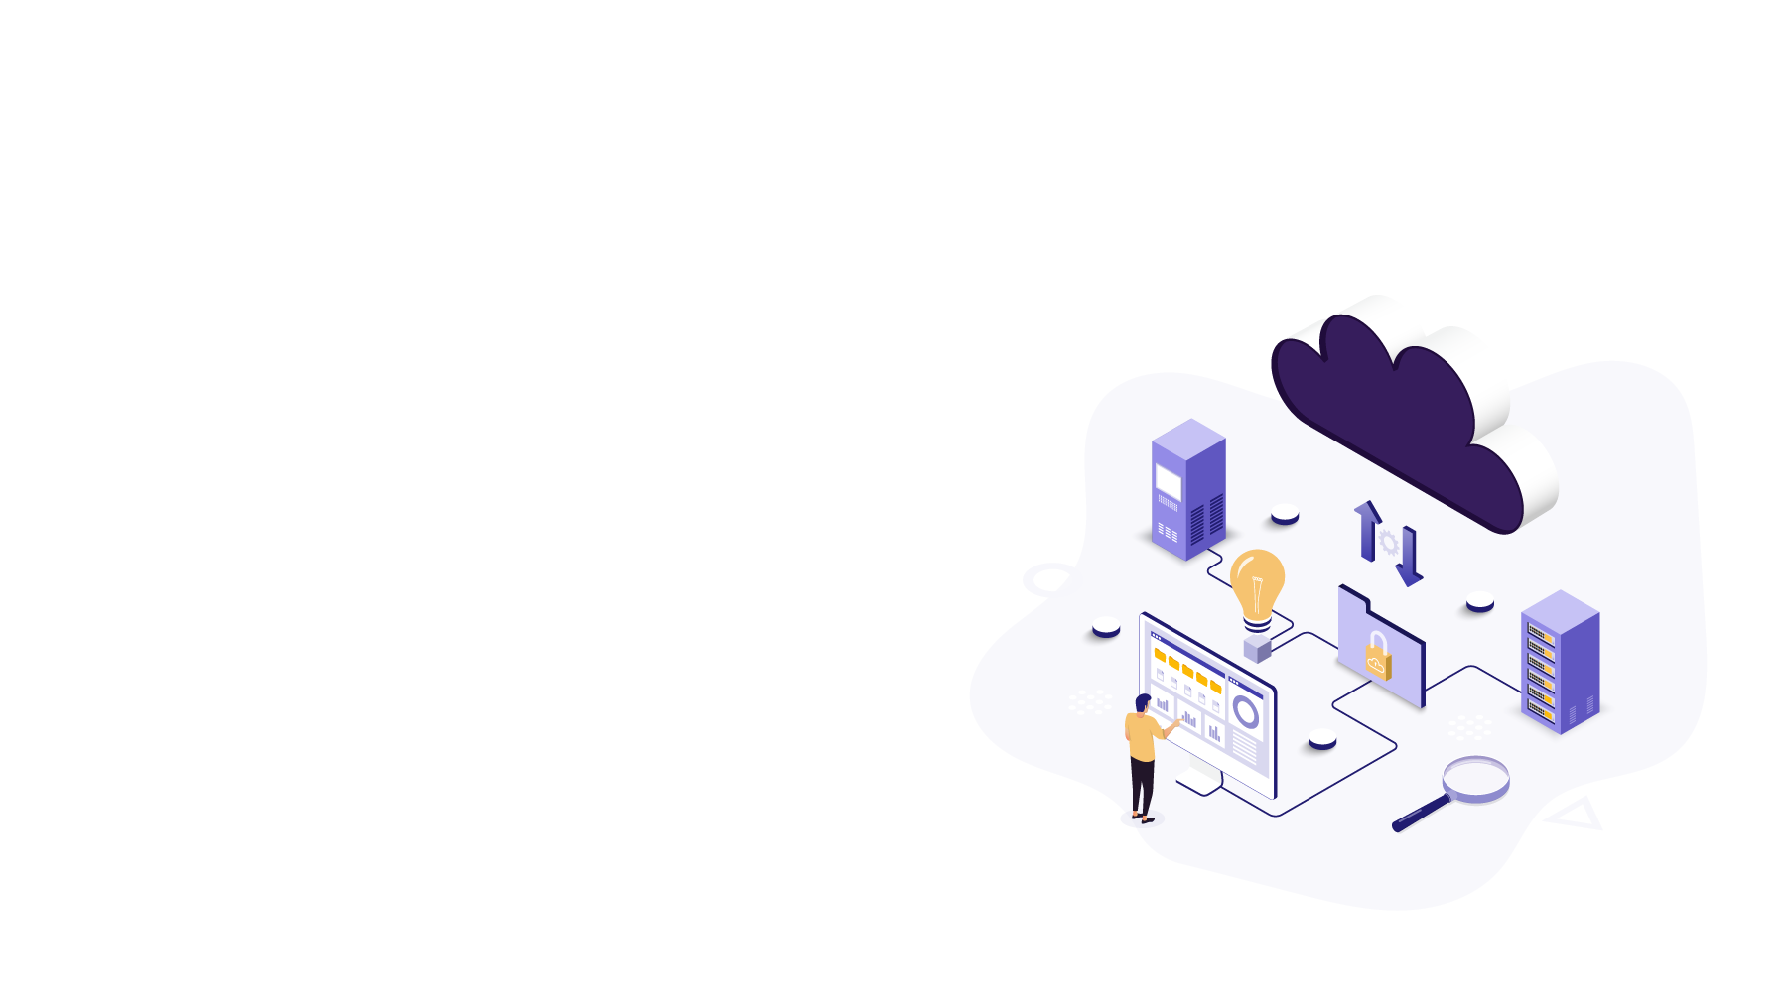
Move from On-Prem
Subscription to SaaS
For existing On-Prem Subscription customers
Valid to accept until June 29, 2023
Fixed 3-year Commitment Term, non-renewable/non-cancellable from enrollment
Customer must have an active LS Central/LS Nav on-Prem subscription license
Options:
  35% extra discount for 3 years, move to 100% cloud, no Dual Use Right *(DUR) license included
  15% extra discount for 3 years, new Dual Use Right *(DUR) license included.
*In order to run the POS in offline mode (hybrid setup) or on-premise, the Dual Use Right license is required.

Slide 17
SaaS Support for Partners

Slide 18

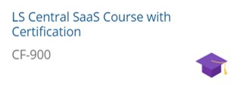
Getting started with LS Central SaaS…
SaaS Onboarding
Cloud Acceleration Program (CAP) – Prerequisite: Certified in CF-900 LS Central SaaS
Microsoft Concierge
Microsoft’s support for large SaaS implementation
To ensure a successful project
Subject to nomination by LS Retail *
Not yet taken LS Central SaaS training?
On-demand Starter Plan
EUR 750 for 3 months access
EUR 250 for certification test

Slide 19

Key Takeaways
LS Central SaaS is the best fit for SMB, companies who want flexibility and the latest innovation.
Factor in hidden cost when comparing SaaS vs Perpetual license.
Position the long term benefits of LS Central SaaS – technology and cost factor.
Migrate your existing customers to Cloud through promotions and programs.
Leverage on the support available to kick-start your LS Central SaaS journey.

Slide 20

First Challenge
Complete the LS Central SaaS training + close at least 1 LS Central SaaS deal within the next 3 months (June 2023)

Slide 21
Questions?

Slide 22
Thank you

