Slide 1
LS Central SaaS Experiences
(stories from the field)
Panel Discussion

Slide 2
Participating Partners
Dynavics UK
IT.Integro Poland
NAS Conception Germany
AdmiNetwork Hungary

Slide 3
Dynavics UK
Lluis Badenas
lluis.badenas@dynavics.co.uk

Slide 4

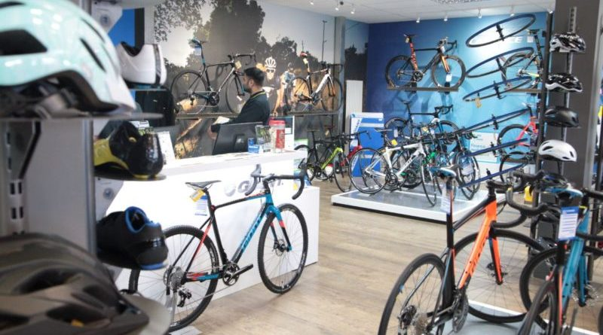
“Cycling stores”
  Main metrics:
  80 users, 44 POS,14 stores,
  UK only
  Timeline:
    March – December 2021 full SaaS
    BC reimplementation
    LS Central + Salesforce eComm integration
    BIG BANG Go Live

Slide 5
“Cycling stores”
  Positive experience:
    No replications of the Data Director removes a lot of friction points
    LS Buddy helping us through the process
    Excellent support and involvement from LS Retail Account Manager
  Challenges:
  Very early version of LS Central SaaS, “uncharted” territory
  Customer Orders not completely there in the beginning
  Adyen Refund Issue, LS Central vs LS Pay teams
  What would you do differently?
    Reinforce customer engagement in testing, and our standard functionality validation when it is a new solution
    Treat LS Central SaaS as a product, not just a setup mode of LS

Slide 6
IT.Integro
Poland
Jakub Abram
jakub.abram@it.integro.pl

Slide 7

“Customer X” – Coffee chain
  First BC + LS Central SaaS implementation in Poland
  Scope:
  Business Central + LS Central + PL Localization
  POSes, Purchases, Inventory, Finance Banking
  5 stores, 13 POS, 16 users
  LS Pay / Adyen (1 day implementation)
  Challenges:
    Short implementation time – 2 months
    LS Central cluster for Poland took longer than expected
    Localization for Poland (fiscal printers integration to SaaS)
    Getting test environment ready quickly (ex. POS setup, data migration)
    24/7 operations vs SaaS upgrade

Slide 8
NAS Conception
Germany
Nico Straub
nico.straub@nasconception.com

Slide 9

Fast Food Restaurants in Saudi Arabia
  23 users, 4 POS, 2 restaurants
  Scope:
  Integrate two fast food restaurants in the existing BC environment
  with the existing 19 companies
  Positive experience:
    Migration from public to LS cluster within one week
    Our predefined templates could quickly be rolled out
  Challenges:
    Implementation period 4 weeks to go live
    Applying the seamless Arabic translations

Slide 10
AdmiNetwork
Hungary
Zsolt Takas
zsolt.takacs@adminetwork.hu

Slide 11

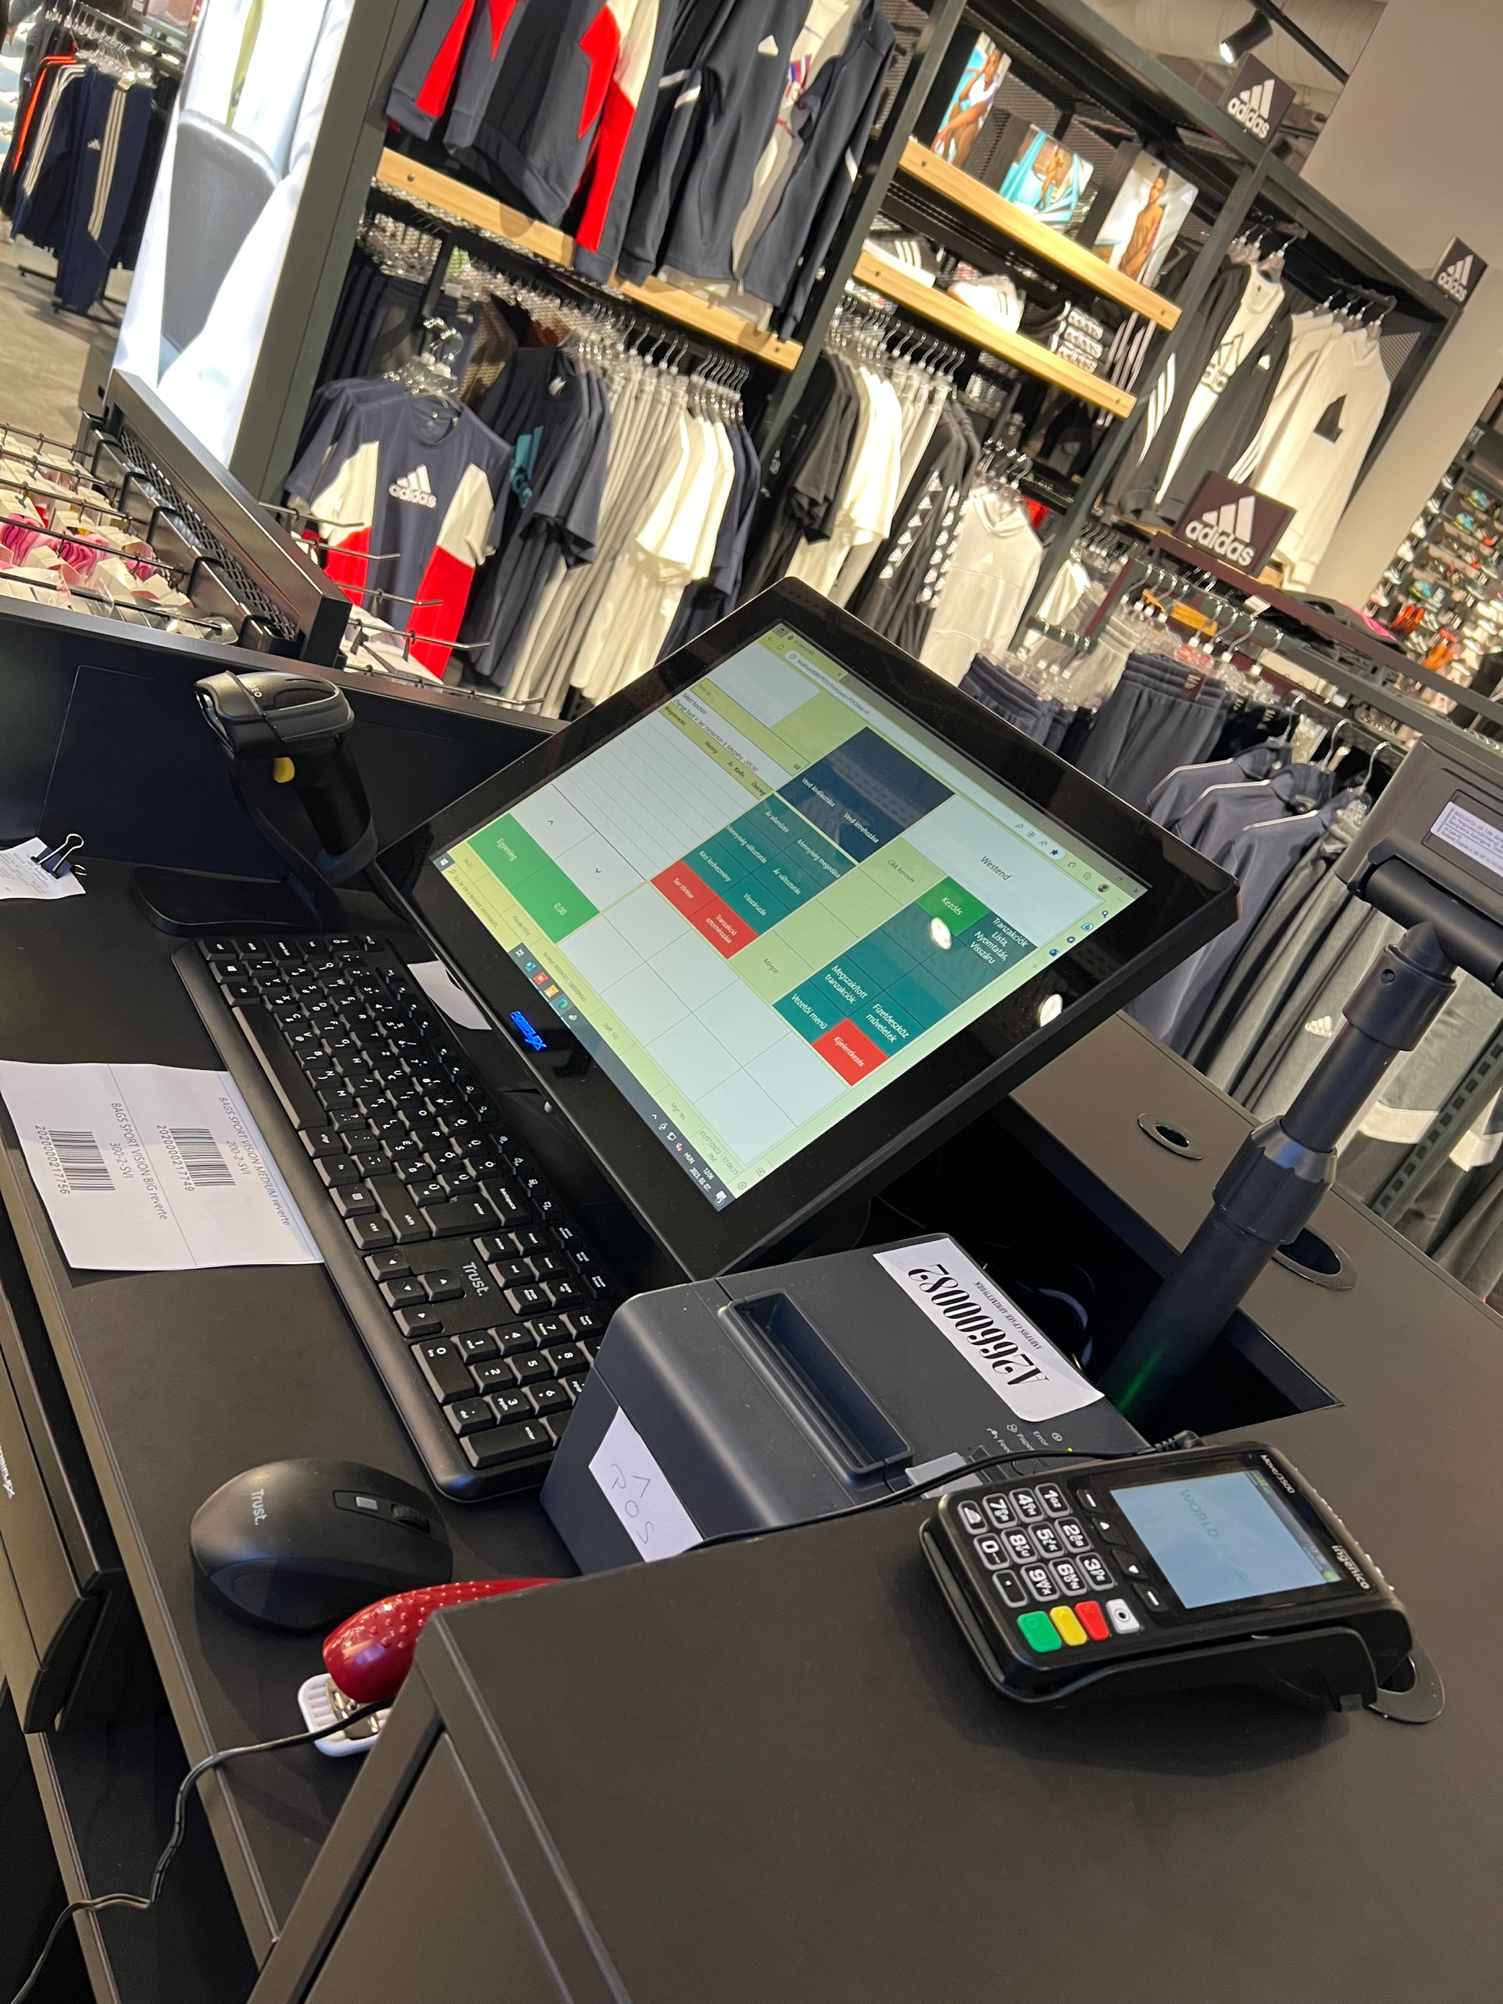
Sport Vision
  BC + LS Central SaaS + HCS + HU localization
  8 users, 1 store currently (5 stores until end of this year), 2 POS, 3 LS Inventory PDA
  Timeline of project:
    6th January – Contracted
    28th February – Go Live
    6th March – First store opened
  Positive experience:
    Easy to onboard to SaaS with OnBoard Buddy Support
    When we had issues with the App Source validation, we received great support
    Using the Update Service for POS installation is simple and quick

Slide 12
  Challenges:
    Short period of time to implement (8 weeks)
    Microsoft was slow to open the HU cluster and AppSource registration was a little bit complex
    System outage on the first live day caused by MS update
    HCS Script had to be reviewed with MS Consultant to work fine
    Complications with the DUR license
  What would you do differently?
    More time to do analysis for a better understanding
    Higher focus for training the customer

Slide 13
Thank you

