Slide 2

Bjarni Asmundsson
Introduction to Customer Engagement
Regional Director
bjarni@LSRetailcom
Notes:
We will wait a minute as there are more people joining the webinar
Okay, let us start
Hi
My name is Bjarni Asmundsson and I am a Regional Director for LS Retail, located in Kuala Lumpur Malaysia
and I would like to welcome you to todays webinar, Customer Engagement in LS Central
Before we get started … This Webinar will recorded and we will share the recording as well as slide deck after the session You can ask questions today by typing questions into the question pane, you can send the questions at any time during the presentation and I will try to address those in the Q&A session after the webinar All questions and responses will e shared as well with the other material

Slide 3
What do I mean by Customer Engagement?
Delight modern customers
Deliver the kind of experience that drives shoppers back
Create a smooth customer journey with a consistent look and feel, cross channels
Deliver relevant, timely and personalized offers and product recommendations across all touchpoints
Offer flexible services such as click & collect, online inventory visibility and returns across channels
Run loyalty programs that reward consumers across the channels
Notes:
In this webinar I will be trying to cover different functionality, applications and modules in LS Retail software solution
The customer is not interested in which technology is used when enquiring or searching for information. He might be in store asking staff member that is looking up information on the POS, or he might be using KIOSK or self-service POS. He might be browsing the retailer's website reviewing offers or loyalty information.
They want to do things when it is convenient for them, where they are – not necessarily in store when it is open.
Accessing information cross channel and getting consistent data or responses

Slide 4
What have we learned
The average cost of selling to new customers is as much as five times the cost of selling to existing ones
More than 90% of consumers use their smartphones while shopping in retail stores, according to a survey from SessionM.
While more than approximately 54% of consumers use their devices to compare prices, others search for product information (48.4%) and reviews (42%).
Notes:
It can be good to learn from somebody and take the best they got. Classical retail often looks to internet sales and learn from there.
As SalesForge says, the average cost of selling to new customers is as much as five times the cost of selling to existing ones, retailers should focus to loyalty members more.
Learning from eCommerce
The average cost of selling to new customers is as much as five times the cost of selling to existing ones
https://www.salesforce.com/solutions/industries/retail/resources/clienteling/#
https://www.sessionm.com/

Slide 5
Unified Commerce
LS Central is a complete unified commerce platform to manage your entire retail and food service operations efficiently
Unify your channels
Centrally manage products, prices, campaigns, offers, members and more for all your physical locations, e-commerce and m-commerce sites
All data centralized and shared with other channels: e-commerce and m-commerce
Business logic runs in LS Central – Unified experience
Unify your viewpoint
Get a comprehensive view of your enterprise and a 360-degree picture of your customers by maintaining all your core business information in one, centralized database
Using LS Central and/or LS Insight, a powerful PowerBI tool to review and work with your data
Notes:
And this is what is called Unified Commerce
LS Central is a complete unified commerce platform to manage your entire retail and food service operations efficiently - in one system - in one database
Unify your channels - Centrally manage products, prices, campaigns, offers and more for all your physical locations, e-commerce and m-commerce sites.
Unify your viewpoint - Get a comprehensive view of your enterprise and a 360-degree picture of your customers by maintaining all your core business information in one, centralized database.
But not only that - Unify your business front to back - Control all your business processes, including purchasing, warehouses, CRM, store sales, distribution, franchises and financials, in one platform.
Unify your brand - Manage all your retail and food service verticals across your enterprise within one solution with deep industry functionality.
LS Insight is built by LS Retail using the extraction and transformation power of Microsoft Azure Data Factory, the flexibility of Azure SQL and finally the reporting and analytic powers in Power BI, Microsoft’s business intelligence service in the cloud.

Slide 6
What have we been doing, what are we using?
LS Central
Member Management
Customer/Member Orders
Member Specific Personalized Offers
Enable employees with technology and data
Different approach on POS like Clientelling
Unified contact via all channels / touchpoints
Working with and analyzing data in LS Central and LS Insight
Customer/Member ready solutions like for Self-Service

Slide 7

What did we copy from eCommerce?
Item catalog on POS
Item recommendations on POS
Consumer data on POS
Notes:
Earlier I said we learned from others, we learned from eCommerce
So, what has classical retail copy from internet?
Item browsing in a catalog way, as consumers are doing it on internet
Item recommendations as soon as item is added to the basket or consumer is identified
Higher importance to data about consumer directly on the POS
With added functionalities we redefined customer service

Slide 8

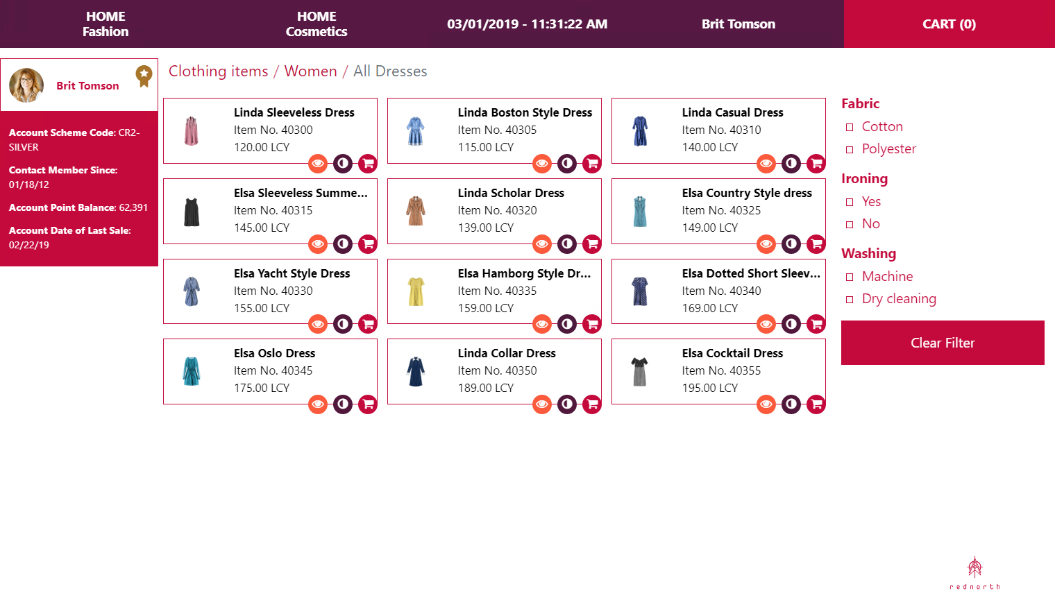
Clientelling
Redefined customer service
We added item hierarchy
We moved Win POS to Web POS – empowering the sales personnel
We added recommendation function
Notes:
Clientelling puts the personal back into in-store shopping. It means that when your customers want a bit of hands-on assistance, your staff are in the best position to give it to them. It allows them to easily identify high-value, repeat customers. And it gives them the tools they need to be truly informed, not just about their customers, but about your products as well.
According to the Boston Retail Partners’ Special Report on Mobile, 89% of retailers plan to put mobile solutions and apps in the hands of their store associates over the next three years, with specific aims to use them for customer identification, customer engagement, associate training and task management, point of sale (POS) and payments.
Customers want this technology too. A survey found that almost half of respondents would be encouraged to shop in store if they could talk to knowledgeable store associates who could suggest products based on their purchase history. And almost three-quarters who have dealt with a store associate using technology to provide things like product info, credit card checkout and inventory look-up said it resulted in a better shopping experience.

Slide 9
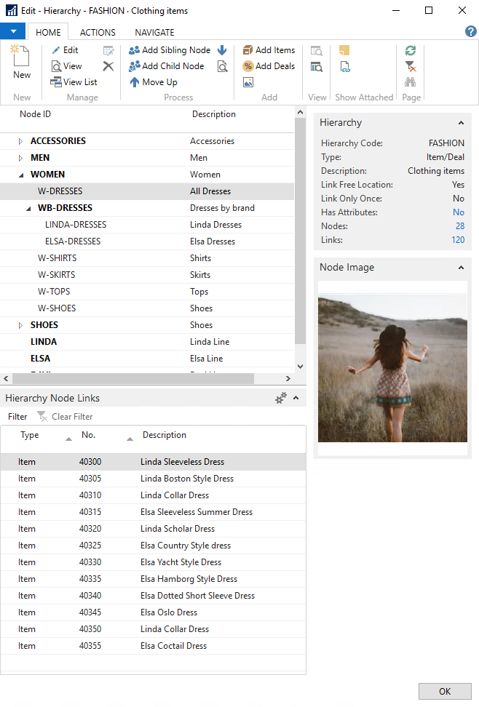
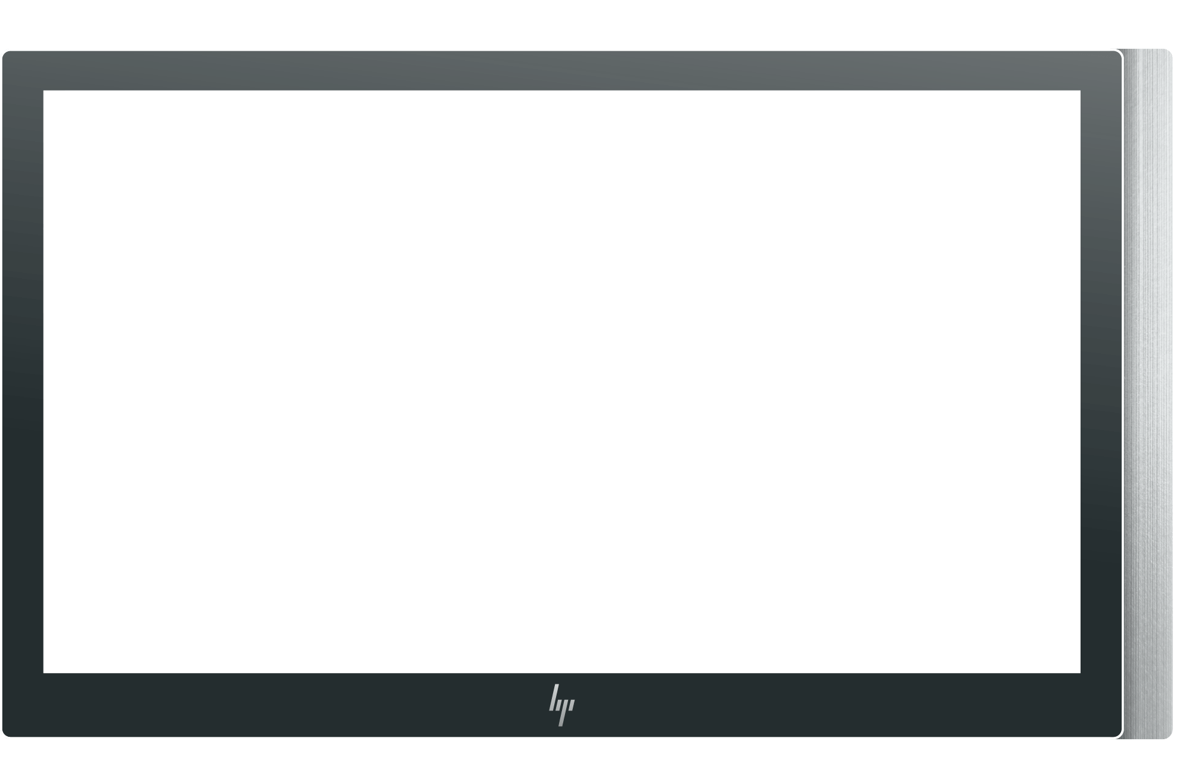
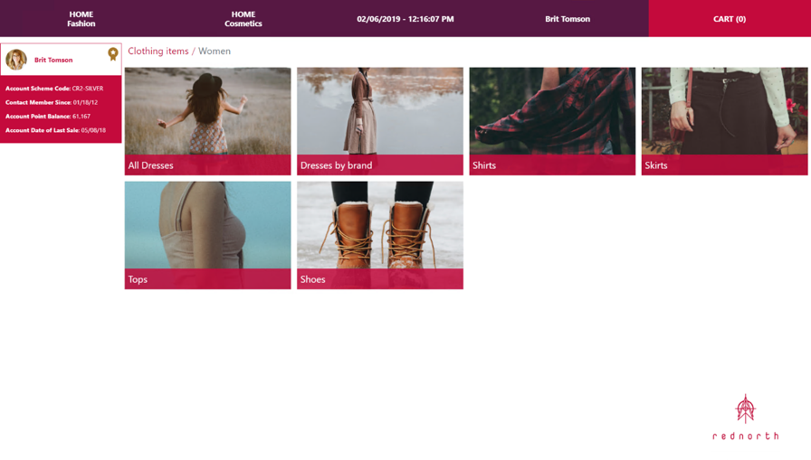
Retail Hierarchy for Clientelling
Gives you all the flexibility you need
As many levels as needed
Items can be in multiple places
Image for each level
Easy to add items
Data maintained on the retail item card
Notes:
Retail hierarchy for clientelling gives you the flexibility you need
eCommerce uses this same retail hierarchy as clientelling
we sometimes say that clientelling is the ecommerce in the POS
Retail hierarchy is similar to a tree, where you can have as many branches as you want, and the items can be in one or many places in the tree.
You can easily add images to the hierarchy, and it is easy to maintain and add items with actions based on select for example Category / product group /special group
All maintained in one place on the retail item card
We have been adding the functionality in other areas in the solution, like in replenishment

Slide 10
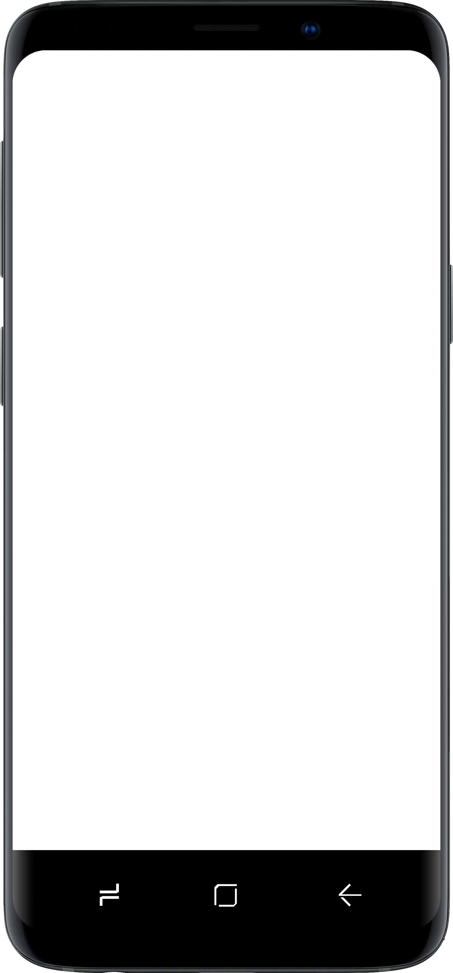
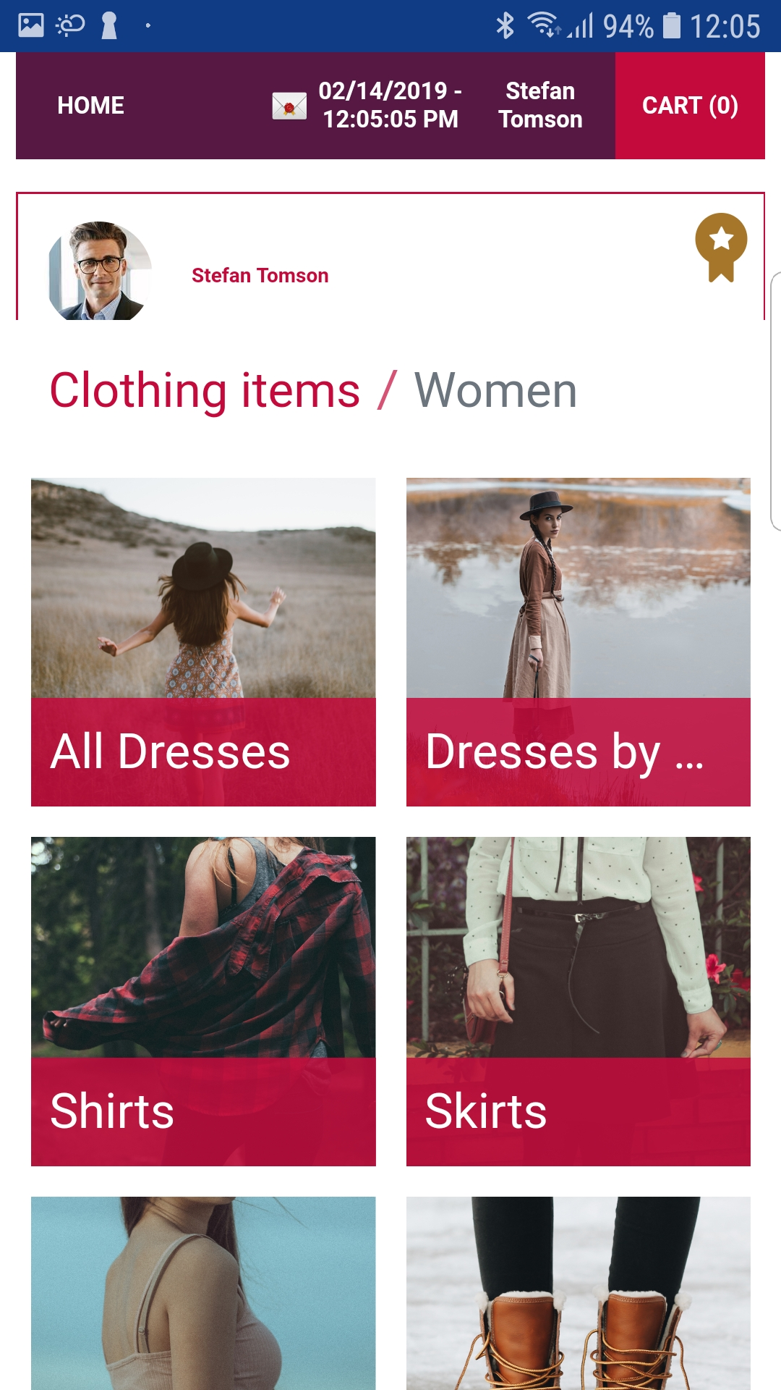
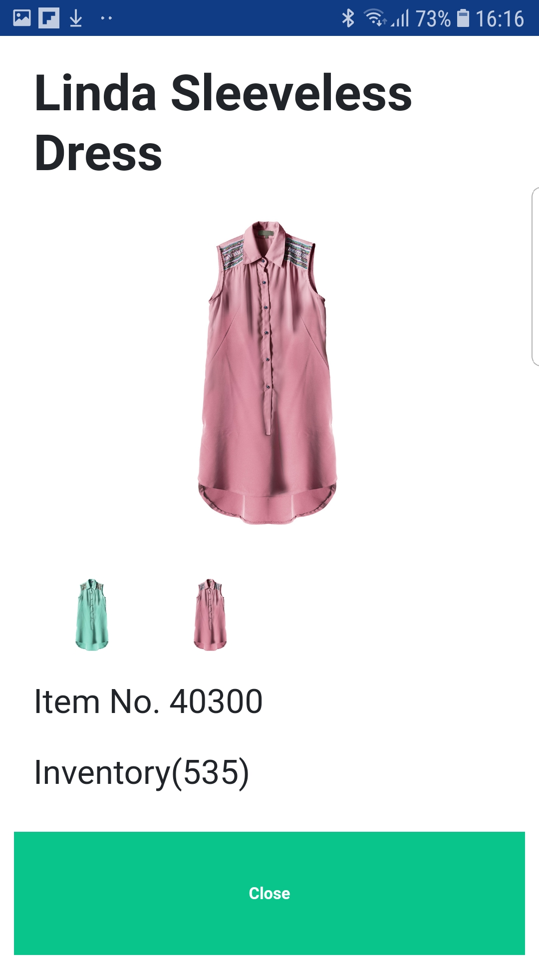
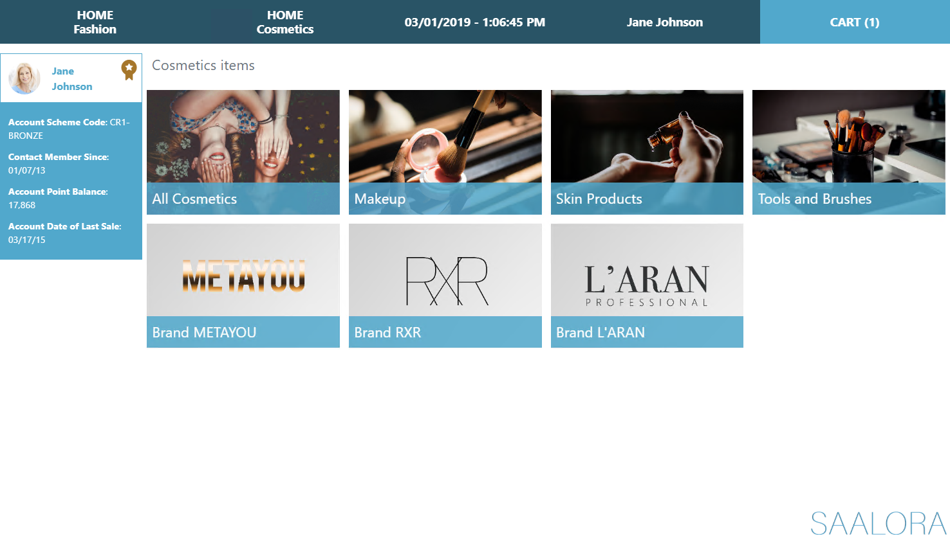
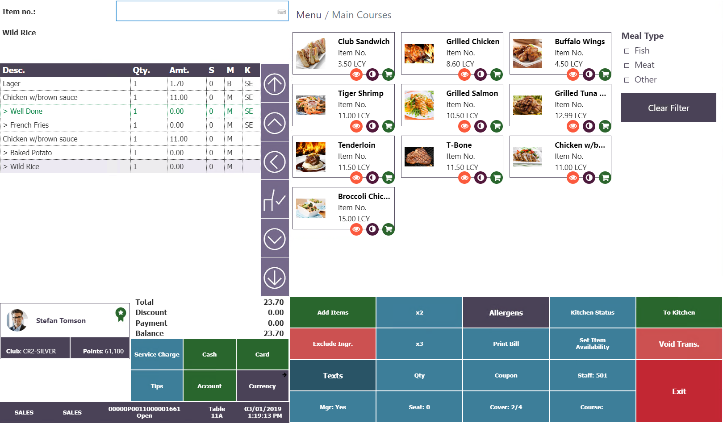
Clientelling fits different retail and hospitality sectors
Clienteling for different retail and hospitality verticals
Notes:
Clientelling fits different retail and hospitality sectors,
When we started with our work for clientelling we designed it with a tablet in mind, but it fits all hardware platforms – like on phones.
It is really flexible layout which you can manipulate to your needs.

Slide 11
Demo

Slide 12
Customer Orders / Click & Collect or delivered
Do you want to sell an item that does not exist in your store but is available in another store, warehouse or from a vendor?
OR
Do you have a customer in your store who wants to buy an item and either have it delivered or collect it at another store?
In LS Central, you can do this with Customer Order
Notes:
The customer wants things when it suits them, not when it fits the retailer
You might be out of stock in the store, or the item not available either in your warehouse. The customer might want to get the item delivered or want to collect it elsewhere.
We process this in our Customer Orders and you can have additional rules on prepayments, either full or partial – cancellation fee etc.
Sourcing the item can have lead time calculation
Lead Time Calculation - Shortest lead time decides from which location the item is transferred to the store that the item is collected from
Priority - When item is shipped then lowest priority decides from which location the item is shipped
Vendor Sourcing: - Selling items that are not in stock in the company but can be purchased from the vendor

Slide 13
Customer Orders / Click & Collect or delivered
Item shipped to Customer from warehouse
Item collected in different store
Item collected in same store
Transferred from another store
Transferred from warehouse
Item Out of Stock – sourced from Vendor
Customer Orders can be initiated both in store on POS, or on eCommerce site
Notes:
1.
Customer comes to the store and wants to buy a hat and a bag.
A sale is created with both items. The hat is in store, but the bag is out of stock in this store.
The bag is marked for Customer Order and the customer decides to have it delivered to his/her home.
The sale is finished. The customer receives a Customer Order ticket for the bag.
The company finalizes the order and ships the bag.
A few days later, the bag is delivered to the customer.
2.
Customer comes to the store and wants to buy a bag. The customer is a member of the company’s loyalty club.
The bag is out of stock, so we create a Customer Order for it.
Customer wants to collect the bag in another store and pay for it now.
We finish the sale and the customer pays for the bag and receives a Customer Order ticket for her bag.
In the other store, a salesperson finalizes the pickup for the item, and a notification is sent to the customer that the order is ready to be collected.
The customer goes to the other store to pick up her order.
The sales order is finalized, no payment is needed since this is a prepaid order.
3.
Customer comes into the Store and wants to buy a coat.
The coat is not available in his size and color, so a Customer Order is created.
Customer wants to come to the same store later to collect the coat.
The POS sale is finalized, and the customer decides to pay for his order now.
Another store, Red North, receives a request for the coat, so a transfer is processed in the POS for the coat to be sent to the correct store.
When the coat arrives at the Store, the pickup for this transfer is processed in the POS and a notification is sent to the Customer.
Customer goes to the Store and collects his item.
4.
Customer wants to buy a brush kit and some blush in our store.
The brush kit is not available, so a Customer Order is created.
The customer pays for the blush now and wants to come and collect the brush kit in the same store.
A Customer Order is created with a request for a transfer. The item is available in a warehouse and will be transferred from there to the store.
The store then picks the item, so it is ready for the customer to come and collect it.
The customer comes to the store and picks up her brush kit and pays for it now.
5.
Customer wants to buy a tablet in our Pulsar electronic store.
The tablet is out of stock in the company.
Customer pays for the tablet now since the company has prepayment restriction for the tablet on vendor-sourced customer order.
Customer wants to collect the tablet in the same Pulsar store.
A Customer Order is created for the order.
In back office, a purchase order is created in the usual way.
When the item is delivered to the store by the vendor, the store picks the tablet for the customer orders and a notification is sent to the customer. This will post the delivery of the purchase order.
Customer comes to the store and collects his tablet. No payment is needed now since the tablet has already been paid for.

Slide 14
Clientelling: conversational commerce
meaningful, personal staff customer interactions in store
Customer Order: no lost sales due to out of stocks
include all your stock, customers can choose where to collect their orders
Notes:
Clientelling: conversational commerce:
Clientelling helps deliver more meaningful, personal staff-customer interactions in store, boosting both sales and customer satisfaction
Customer Order, no lost sales any more due to out of sock
you can sell all your stock in all stores, customer chose where to collect their orders in store or at the warehouse or have the product delivered to them

Slide 15
Self Service / Self Check – Out
Configure the POS as KIOSK or Self-Service check-out
Hardware phobic? Why not let the customer use his own mobile phone and use Scan & Go functionality?
The customer knows his own phone
He is used to the functions and buttons
With Scan & Go the system could “find” where he is, or let him choose store manually
He could add items to the basket at his own pace, monitor transaction value and offers
He could choose to pay in Scan & Go or go to POS terminal using QR code for checkout and payment
Global Self Check-Out 18% expected year to year growth 2018-2022

Slide 16
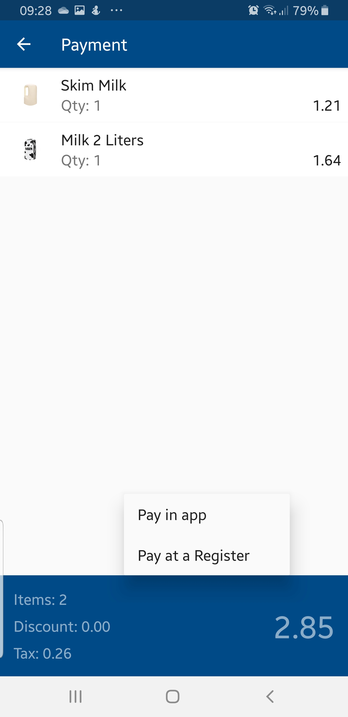
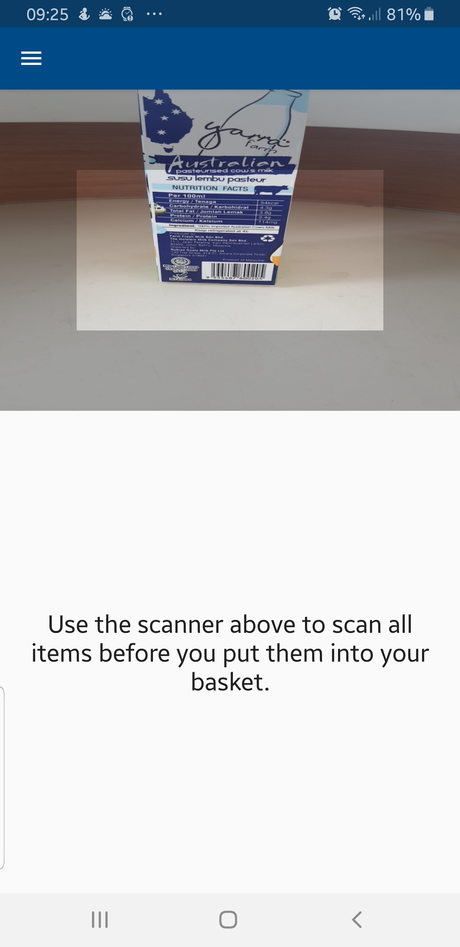
Self Service
Do-It-Yourself
We see it everywhere
Customer does it at his own pace
Rushed Customers
Avoiding queues
More transactions per hour
Smaller baskets
More frequent shopping
Notes:
Do it yourself
We see it everywhere
Travelling
Entertainment
Fast-food

Slide 17
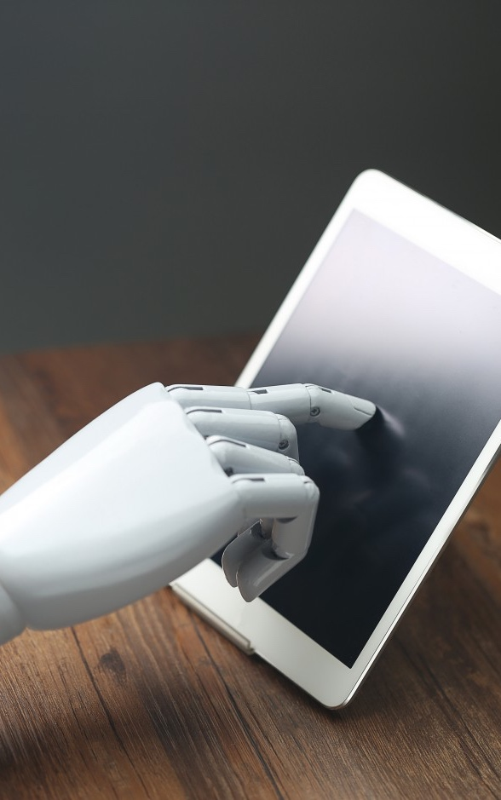
LS Recommend
Using AI model for sales recommendations:
specific item in the basket
all items in the basket
loyalty member
Same recommendations in
all stores
all channels
Works as SaaS

Slide 18
Demo

Slide 19
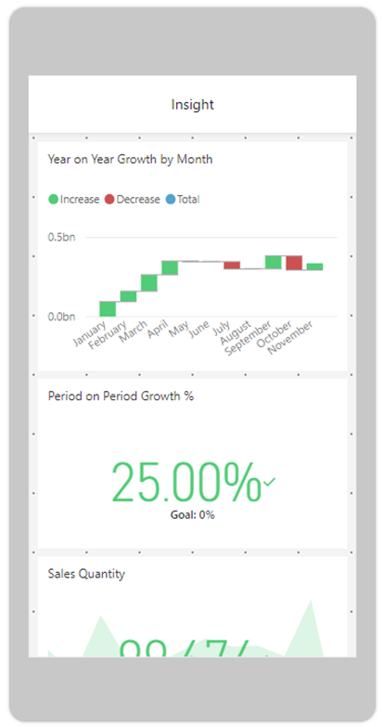
LS Insight
It is just BI tool…
But it is for free – just needs PowerBI subscription
Out of the box demonstrates the data from LS Central
Sales and Inventory reports
Store performance, Promotion analyzes, Member analyzes, Inventory Adjustment reasons, Sales or Purchase returns
…and natural language
Notes:
Natural language
Net sales
by store name
Member sales by store name
By scheme
Total discount by scheme

Slide 20
Demo

Slide 21
Member Management
Member Clubs / Schemes, Member Accounts / Contacts and Cards
Loyalty Point calculation rules
Member Account / Contacts having “all” basic data like Address, Date of Birth, Gender, phone, email etc.
Member Attributes
Dynamic Query
Member Campaign
Notes:
I am not going into the basics here … we can have multiple clubs and each club with multiple tiers. Automated up- and downgrade based on transaction history / loyalty point earning. Point can be calculated differently between clubs or tiers, differently within the item hierarchy or specific items, having date range and be related to payment types.
This is also, of course, used in our Promotion/Offer system, where you can link those documents to specific clubs, tiers, members or member attributes
But we also have member attributes … here you can create your own fields to collect data, and actively use that throughout the system. This can be interests – like soccer or red wine or travel. This could as well be linked to Item information like xxxxxx
So flexible system to gather basic info
Naturally, you can see transactional history for each member … but there are more options like Dynamic Query
With Dynamic Query you can build up your own criteria to find/select members, example would be NEW MEMBER or ITEM_01
Example of usage is the BIRTHDAY query where you can in our offers activate discount offer for members having birthday today, or just informs the cashier about the birthday so he can give more personalized greeting – and this is automatically actived on the POS when the customer identifies himselve
P1076 - Another usage is activating discount for all new members, with one-off offer for something

Slide 22

What will future bring?
New phase of mass personalization
38 % of global consumers want to have relevant discounts while in the store
Even more technology in the physical store
https://www.worldretailseries.com/news/planet-retail-10-future-retail-trends
Notes:
Retailers must be prepared to enter a new phase of mass personalisation.
Historically, bricks and mortar players have struggled to replicate the level of personalisation that can be found online.
However, recent advances in beacon technology mean that targeted, real-time offers are now a reality.
What’s more, Planet Retail research shows that 38% of global shoppers want to opt in to receiving relevant discounts when instore, compared to the 15% of shoppers currently doing this. This combination of shopper enthusiasm and technological capability means that bricks and mortar retailers should be looking to take personalisation to new heights, driving both customer loyalty and spend,”

Slide 23
Increase customer retention
Get clear, real-time information on your customers’ habits, preferences and behaviors, and use it to:
Offer personalized deals, promotions, and customer interactions
Optimize your upselling and cross-selling
Align pricing and replenishment to actual demand
Create effective loyalty programs

Slide 24
Empower your employees
Give your people the best tools to do their job effectively
Give customers all the information they need, close sales and perform inventory tasks anywhere in store: the Point of Sale runs on any type of device
Engage shoppers and help them discover new items with the system’s conversational commerce tools
Target customers’ desires with AI-powered product recommendations at the POS
Enable your staff to quickly find the information they need with the system’s role-based view
Easily move employees across departments: the same system, with the same interface, is used in the front and back of store, across retail and hospitality

Slide 25
Trends in retail - Customers wanting …
experiences
simplicity and convenience
re-commerce has grown 20 times waster than traditional sales
reuse, replace ownership with usage, rental
environmentally conscious, sustainability
How can you adopt to new trends in retail
Notes:
Apparently, millennials care less about accumulating things: They are exchanging ownership for convenience and fun.
Almost three quarters of people in their 20s and 30s prefer spending money on experiences over material things. There is an unmistakable indicator of a shifting shopper value: the desire for pleasure through experiences.
This desire for pleasure of doing over the pleasure of having is pushing retail brands to move into more experiential industries like hospitality.
Another interesting evolution that comes from a changed relationship with owning is secondhand items such as bags or clothes.
Between now and 2028, the secondhand market is expected to grow to nearly 1.5 times faster than fast fashion
We are finally becoming more environmentally conscious. Sustainability, identity and politics are now clearly intertwined with consumption.

Slide 26
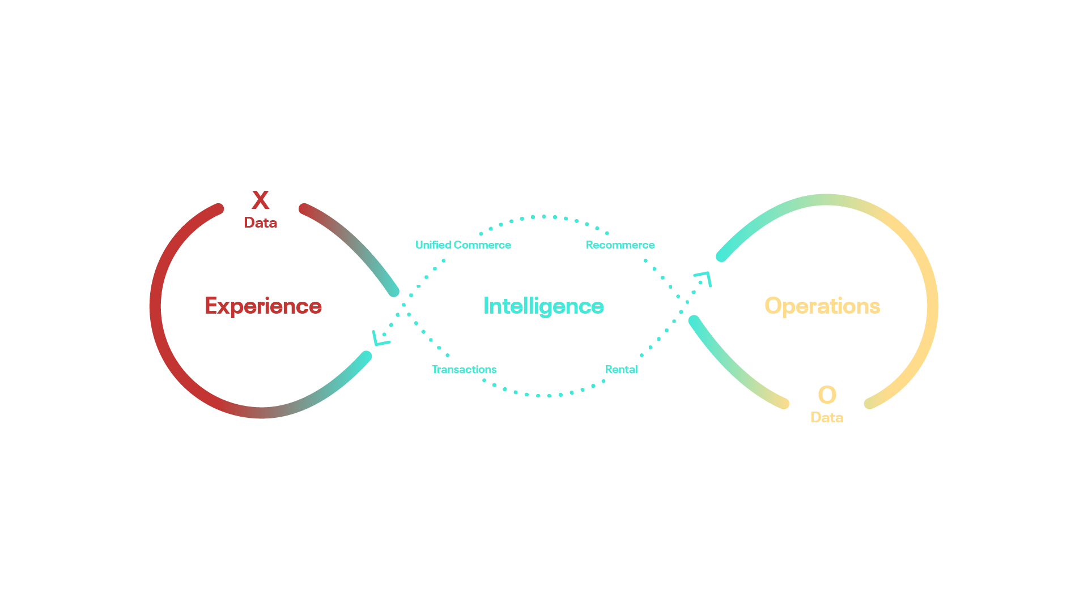
The answer lies in transforming the concept of retail and hospitality
Notes:
And to transform, we need new technology. Technology is driving all the examples I mentioned. It’s technology that enables them to deliver unique services and fulfil the customer needs.
We need to transform how we think. Transactions are at the heart of retail. But in rental, you have a new relationship, where both the quality of the product and of your processes matter. If you want consumers to choose you again and again, you must create a simple, straightforward way to return items. You must ensure that products are checked before they recirculate, so they are always in top shape. You must keep a large stock, and good variety. And you must have the technology to track everything –what’s out or coming back, the specific conditions of each single item, what is popular, and which kind of consumers like this kind of item. These are new challenges, but at the same time they represent a great opportunity to gain valuable information on consumers’ preferences and tastes.
Re-commerce looks more like traditional retail, but it also brings new challenges. You need to check your items for quality before you can sell them again. You might need to clean them or repair them. If they are branded, you need to ensure they are not counterfeit.
Technology can help facilitate experiences. But at the heart, experiences are about people. And your business is made of people. Your employees. There is a strong correlation between employee well-being and customer satisfaction.
To build a customer-first strategy, you need to start by empowering employees. Research shows that employee happiness and satisfaction increase when they feel respected and trusted. And we know that happy and satisfied workers stay longer in their jobs, have a higher performance and could even become your brand ambassadors.

Slide 27

The winning recipe:
Technology enables to deliver new direct services
The quality of your service keeps you in the game
The human connection part wins you the game
Notes:
So, the winning recipe is:
Technology enables to deliver new direct services
The quality of your service keeps you in the game
The human connection part wins you the game.

Slide 28

It does not matter if you work B2B, B2C it is all about H2H. Human to human. The new trends enable you to be service oriented and put consumers at the center.
This way High Tech and High Touch meet: Personal touch infused with technology.
This is to be remembered.
Notes:
It does not matter if you work B2B, B2C it is all about H2H. Human to human.
The new trends enable you to be service oriented and put consumers at the center. You need to understand your core business and the business drivers. Based on that evaluation you can decide to increase shopper values by the help of new trends and technology. By rethinking your physical store as a digital space, you can select technology that enables you to shift your format from traditional retail sales towards experiences and happy staff.
Unified commerce infused with intelligence allows employees to have the information they need exactly when they need it. When you employ a unified commerce approach, where the whole enterprise uses the same software system and collects all data in the same database, and you add the intelligent tools that the cloud offers, then you can really get a 360-degree view of your business, and of your consumers.
This kind of technology can empower your employees, as it gives them all the information they need about products and customers at their fingertips, at all times. This way, High Tech and High Touch meet: Personal touch infused with technology. This is what we - as a consumer - will remember.

Slide 29


The answer lies in transforming the concept of retail and hospitality
Notes:
And when you create unique experiences, consumers will talk about them to their friends and family. This is how the circle closes: This reputation is the driver for new business, and once again, word of mouth propagates via technology, as people praise you on social media, post ratings on TripAdvisor, give feedback to your own page or comment your amazing service on online forums.
Human emotions are amplified and made that much louder by technology.

Slide 30

5 tips to build enduring loyalty for the future:
Makreting Help Needed Please
Can you please insert the bird as of the next slide?
Exploit technology as an accelerator for business.
Build a customer-first strategy
Use data as your most valuable asset to get personal with your customer
Manage your staff actively
Consider the growing role of social responsibility as a moral and an economic obligation
Notes:
So, here are 5 tips to build enduring loyalty for the future:
Exploit technology as an accelerator for business.
Build a customer-first strategy
Use data as your most valuable asset to get personal with your customer
Manage your staff actively
Consider the growing role of social responsibility as a moral and an economic obligation

