Slide 2

Actionable Insights
the missing link between data and actions
Martin Kleindl
Product Director
Martin.Kleindl@LSRetail.com

Slide 3

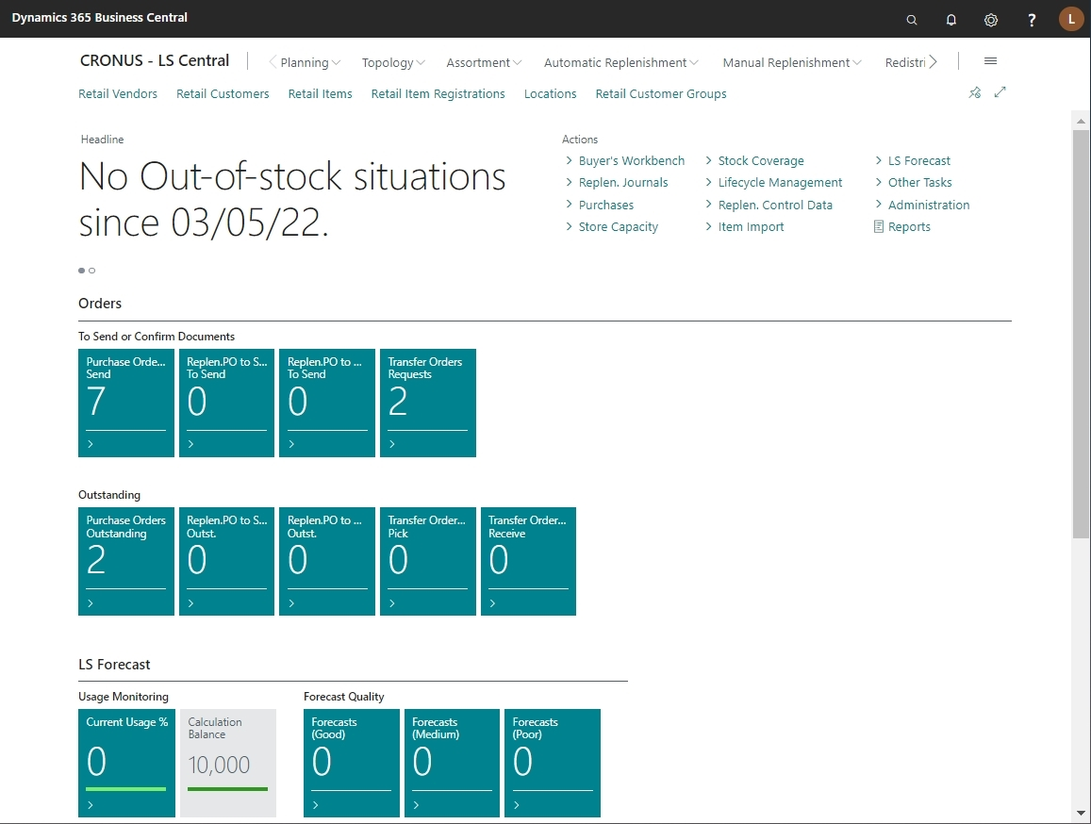

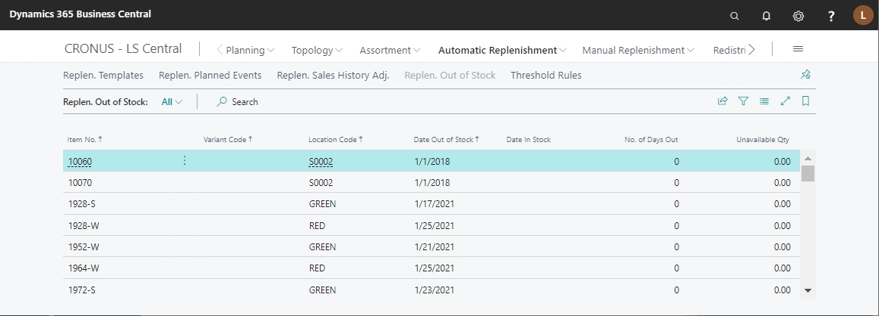
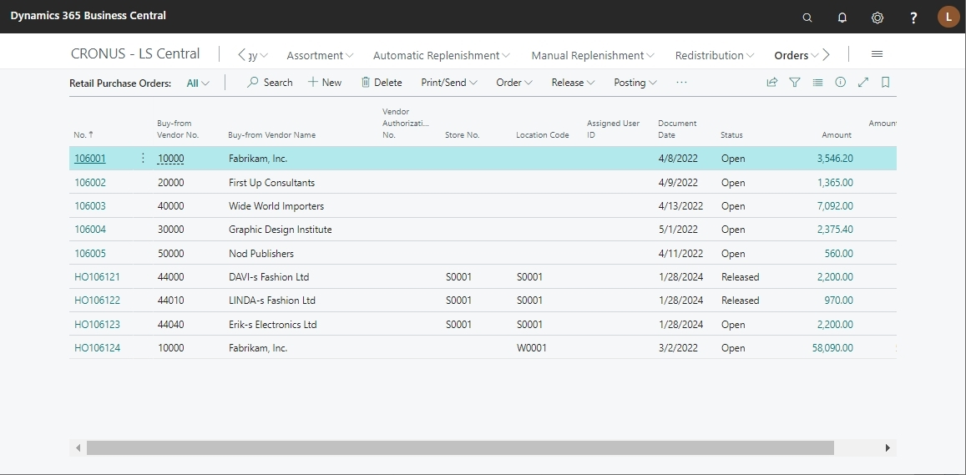
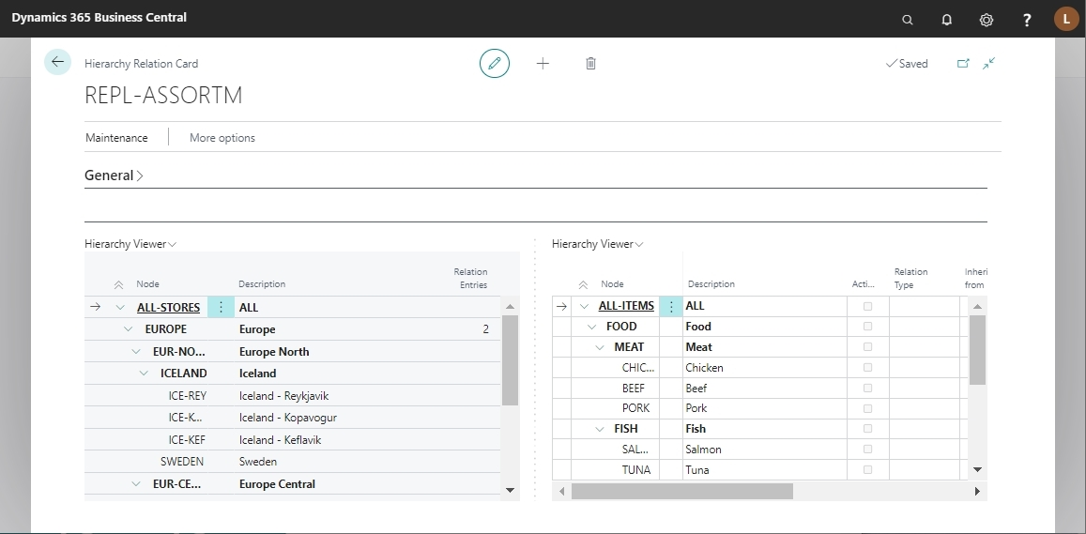
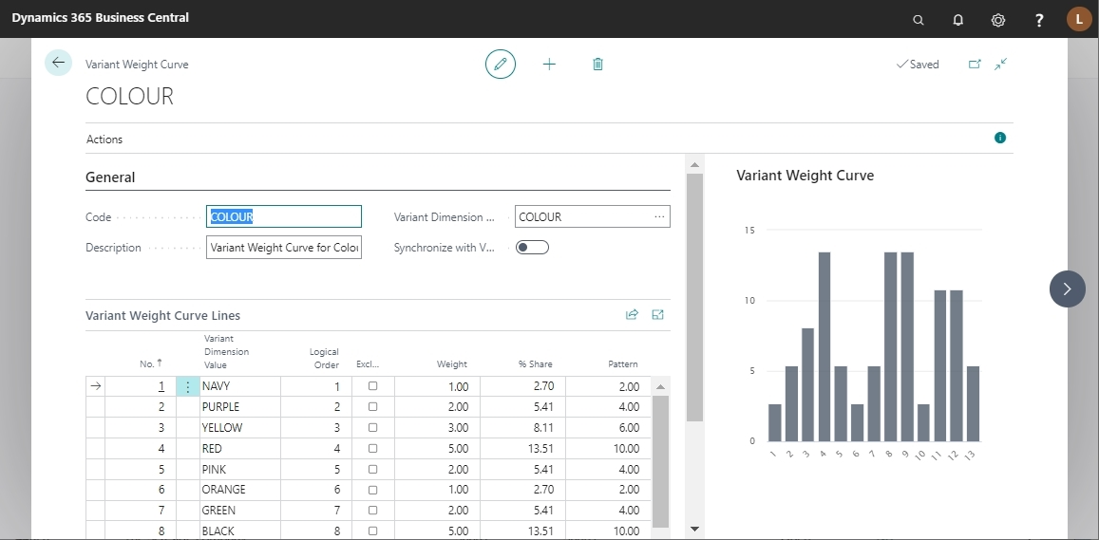
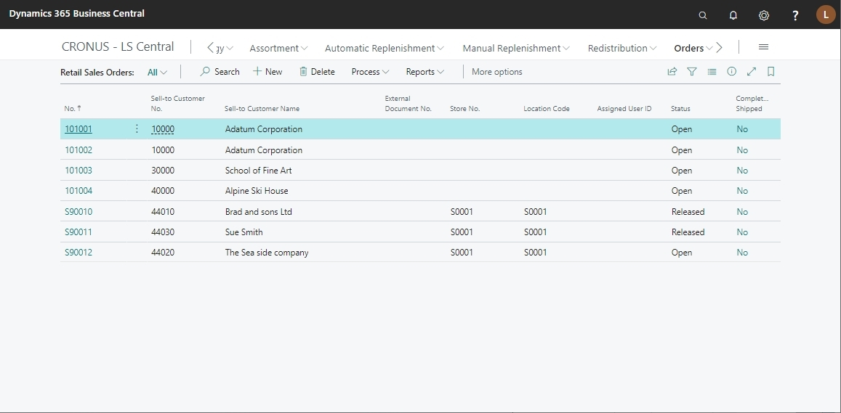

Slide 4
Actionable
Insights
collect data
into one
central place
transform data
into meaningful
insights
proactively
inform to
take actions

Slide 5
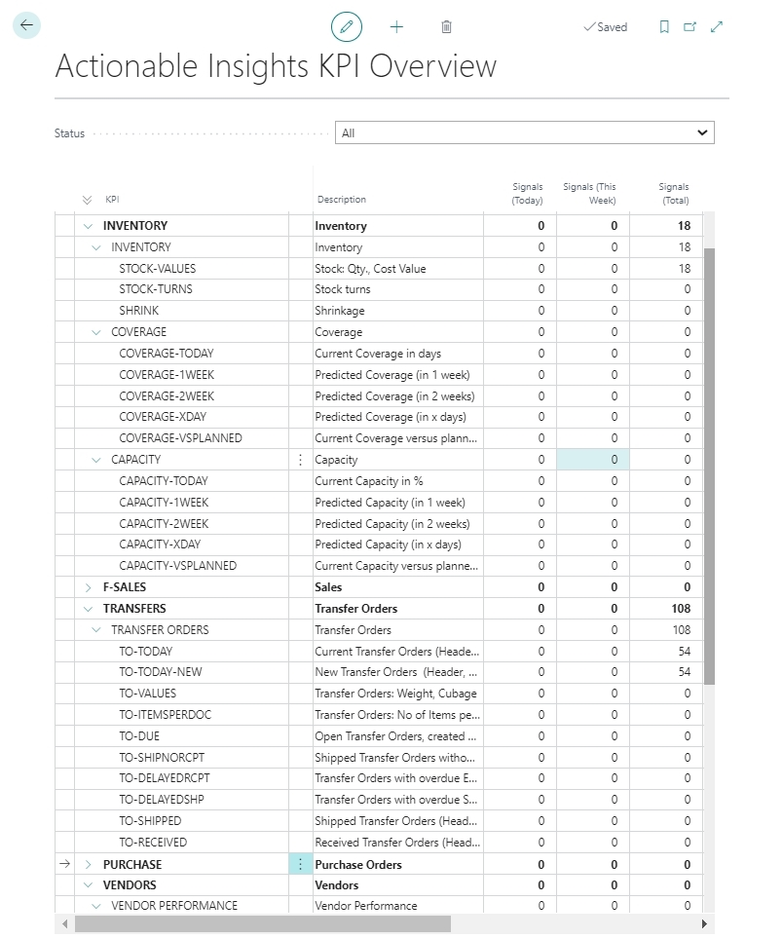
What data
do you want
to measure ?
Choose Key Performance Indicators that are relevant for your organization.

Slide 6
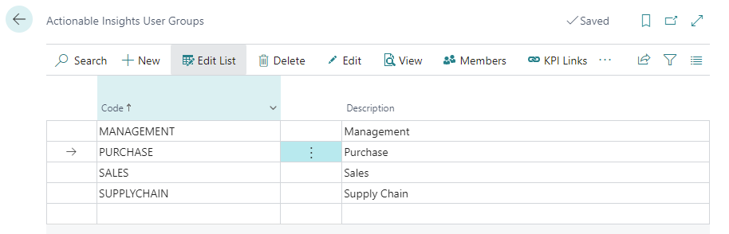
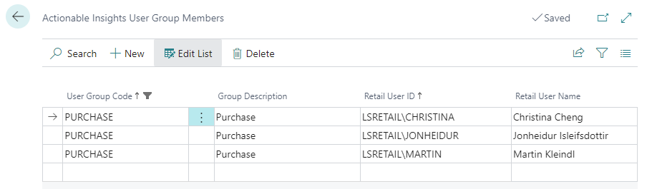
Who to
inform ?
Define User Groups and
Users that are responsible
to track the measures

Slide 7
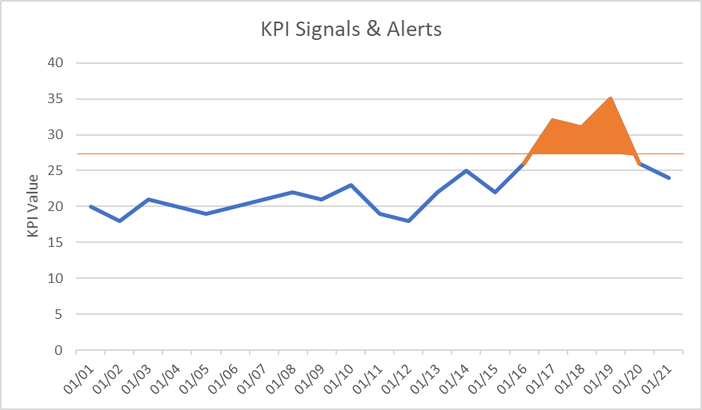
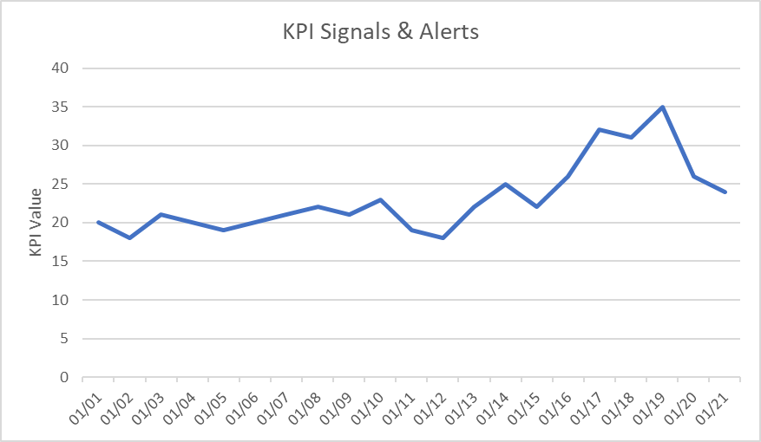

Main components
  KPI (key performance indicator)
    Metric to be measured
  Calculation Rules
  → Signals
    Measured value for KPI
  Alert Rules
  → Alerts
    Signals which violate a defined threshold
  Notification Rules
  → Notification
    Information to User or User Group
    about Alerts
KPI Hierarchy
KPI Family
KPI
KPI Group
KPI Pack

Slide 8
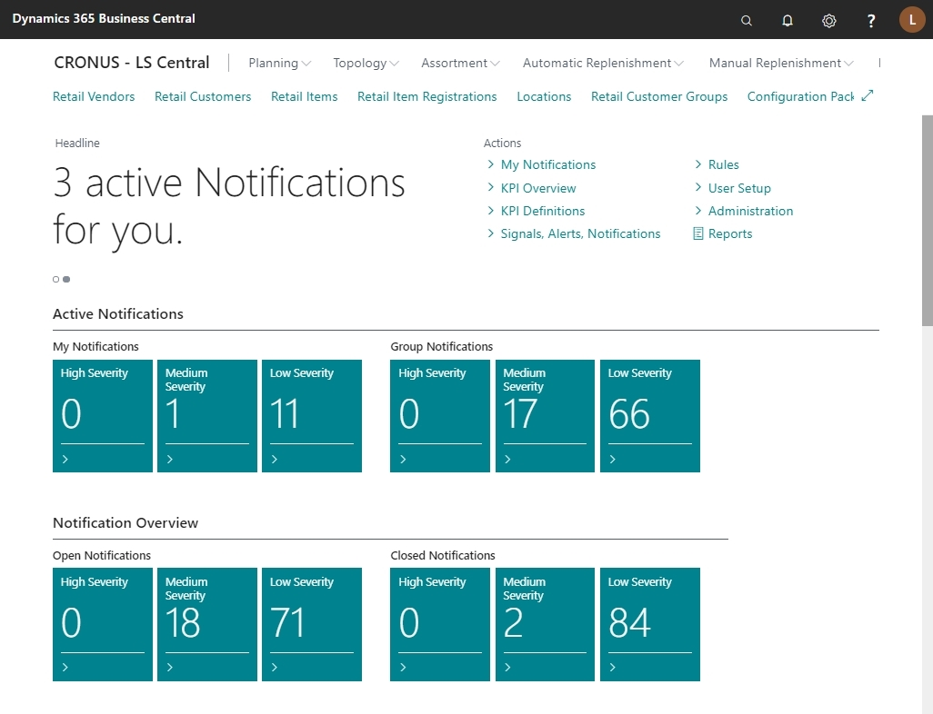
My Notifications
System is proactively informing me on areas that need my attention
Group Notifications
Notifications for my team, ready to be picked up.

Slide 9
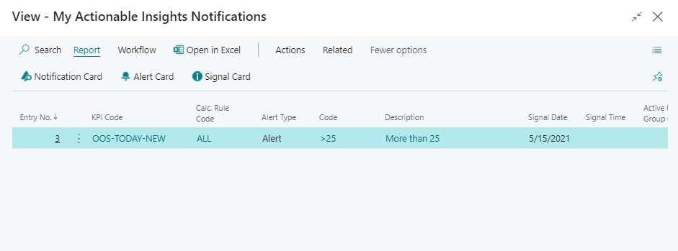
Notifications select
In the notification list it is easy to find more information and details
click

Slide 10
Live Demo

Slide 11
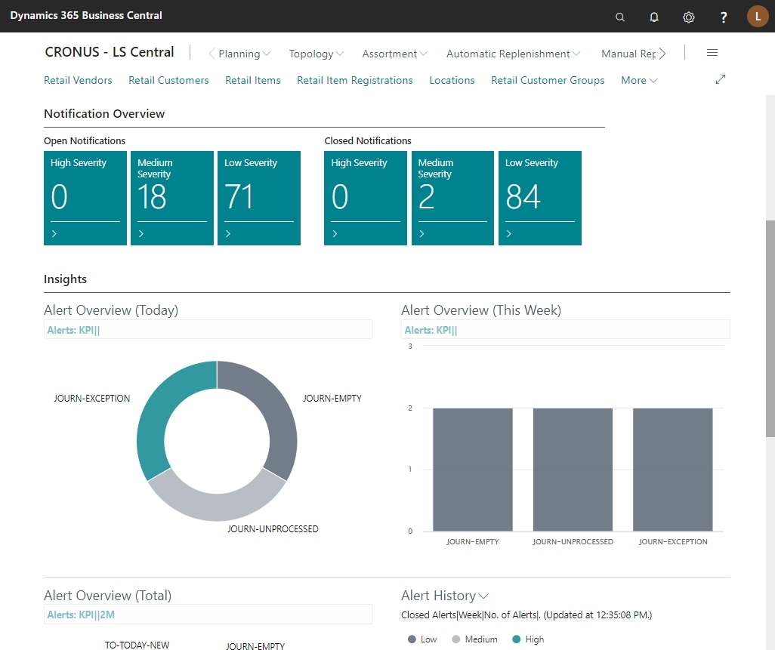

Target Groups
Team leaders
Operational teams
  Purchase
  Supply Chain
  Inventory
  <…>

Slide 12
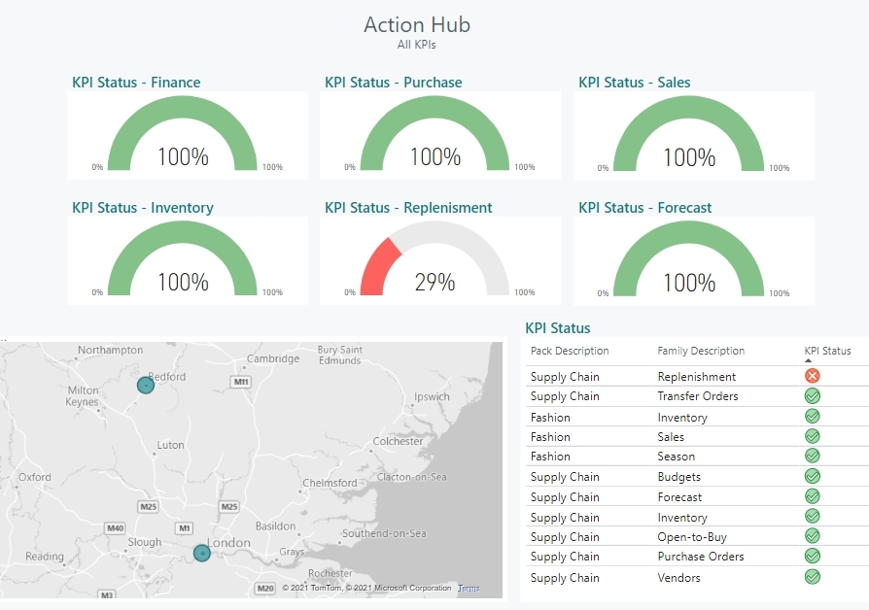

Company Overview
Shows aggregated status of KPI groups for the entire organization
Target Groups
Team leaders
Operational teams
  Purchase
  Supply Chain
  Inventory
  <…>
Management
Map
Shows status of stores and warehouses
KPI Status
Shows KPIs and raised alerts. Allows easy drill down to explore further.

Slide 13
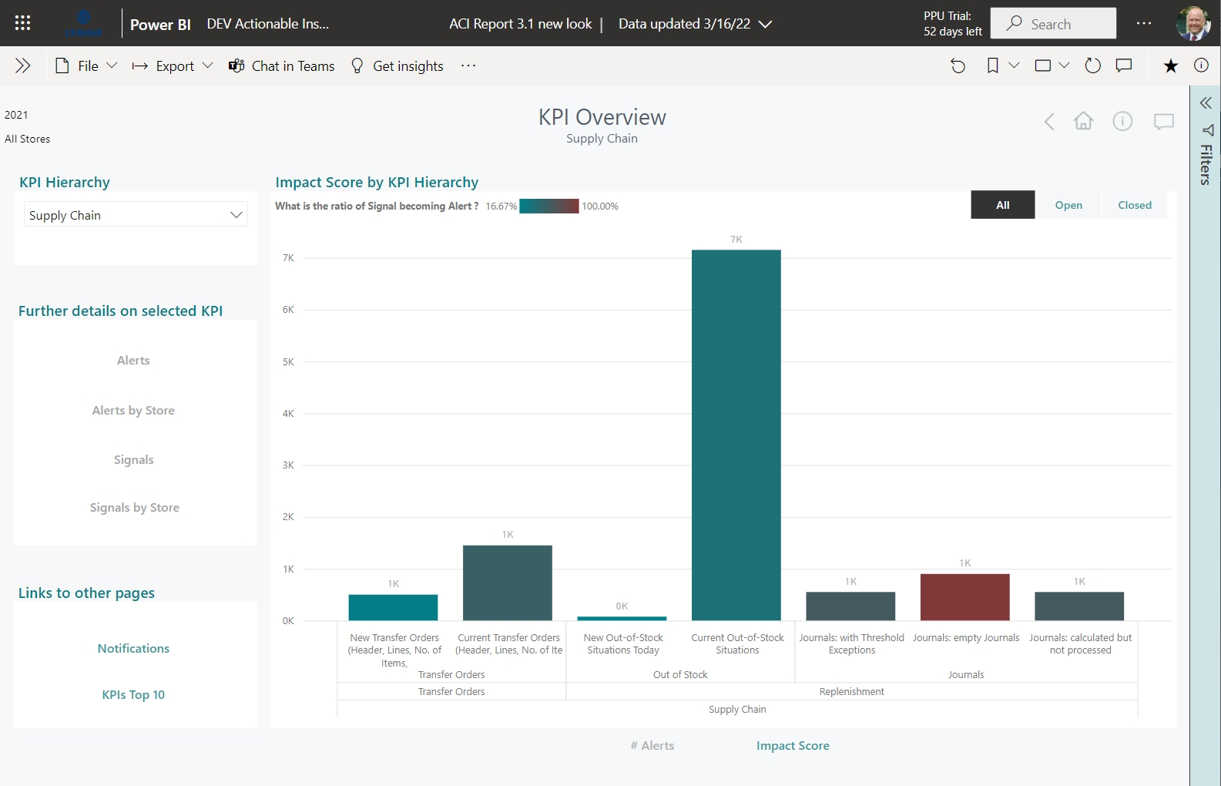
Navigation
Easy drill-down to further details
Alert Overview
Shows # of Alerts or
total Impact score

Slide 14
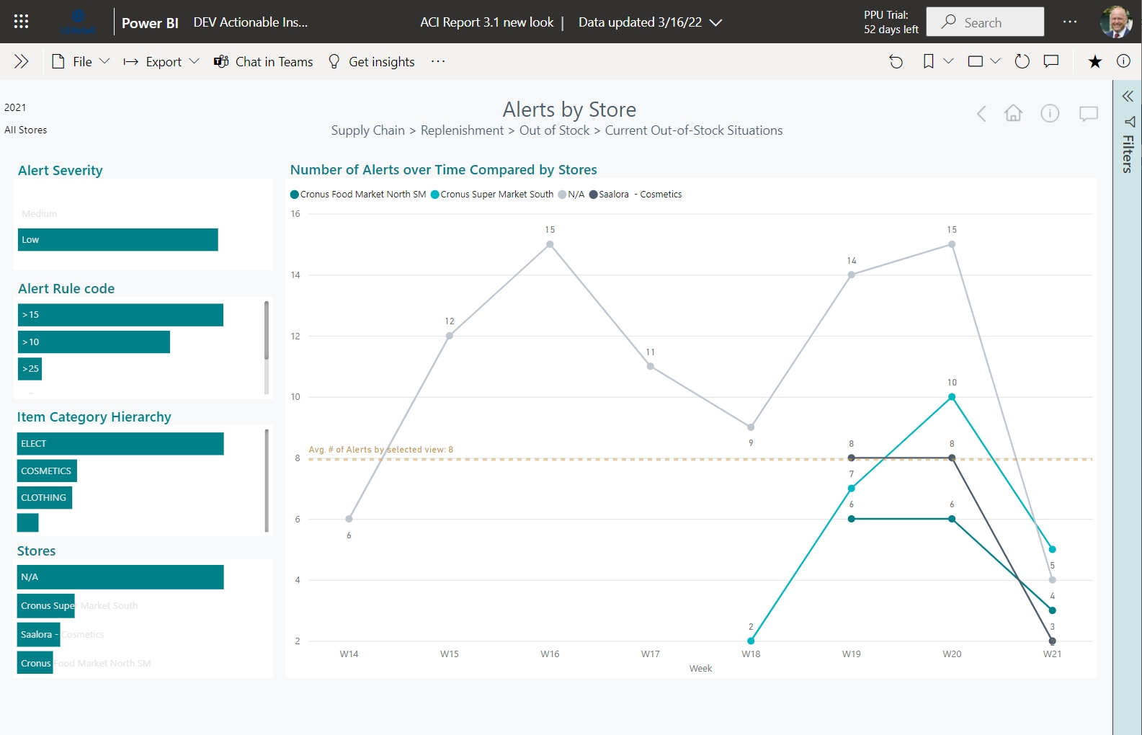
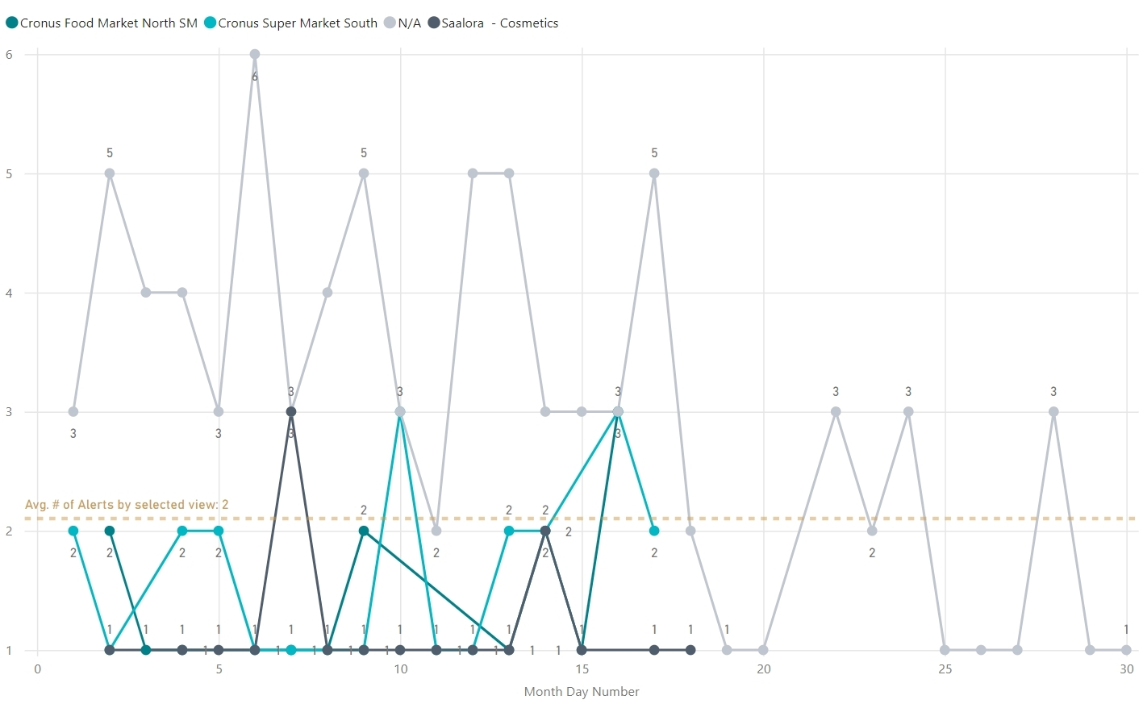
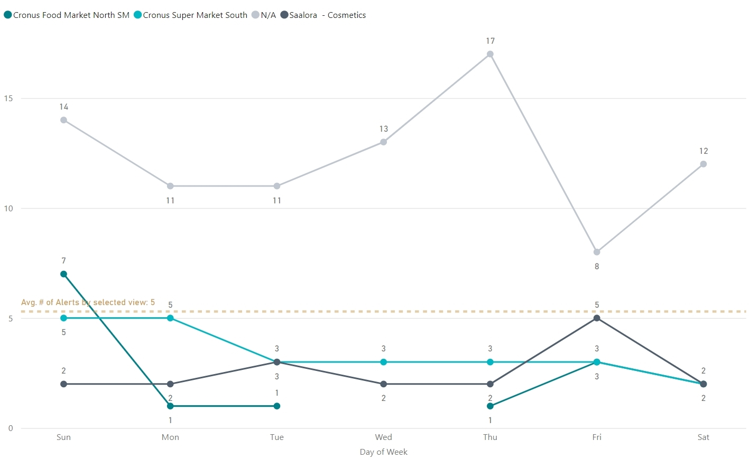
Alert History
dynamic timeline,
filter options for
Item Categories and
Stores

Slide 15
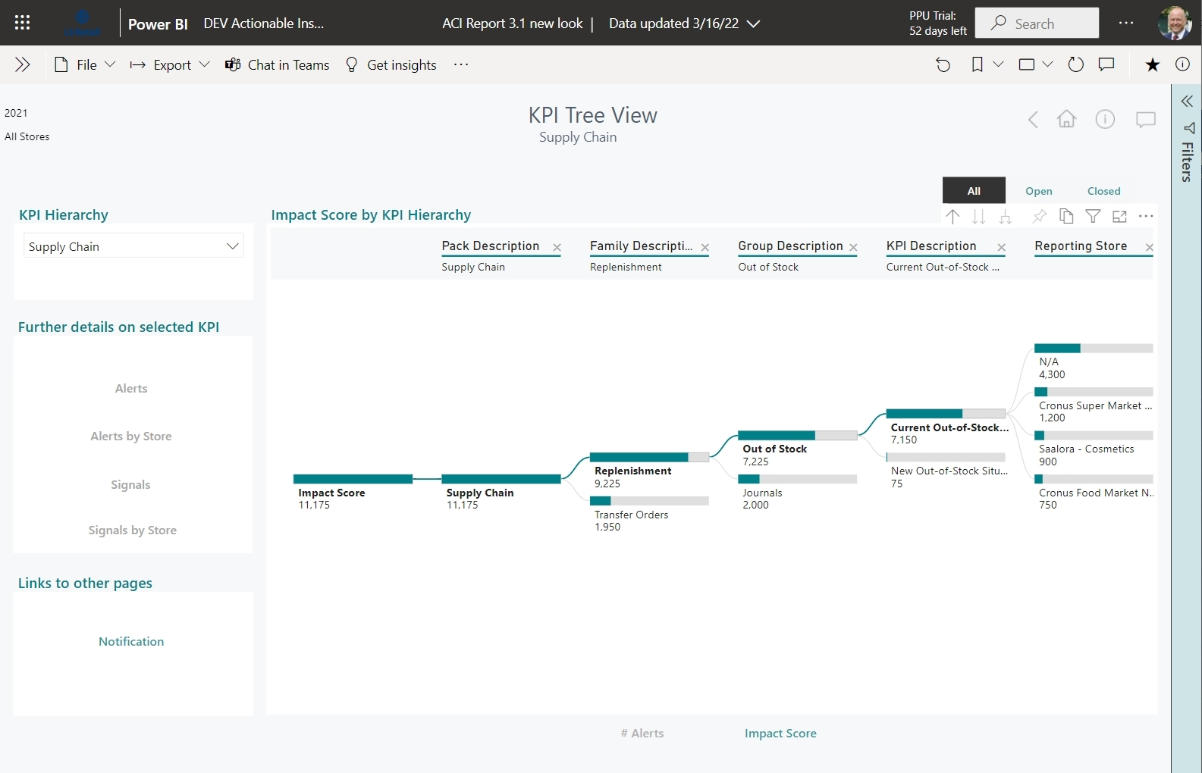

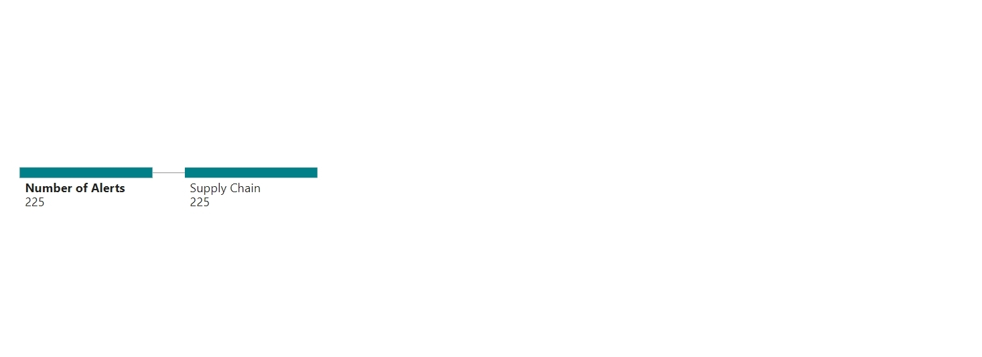
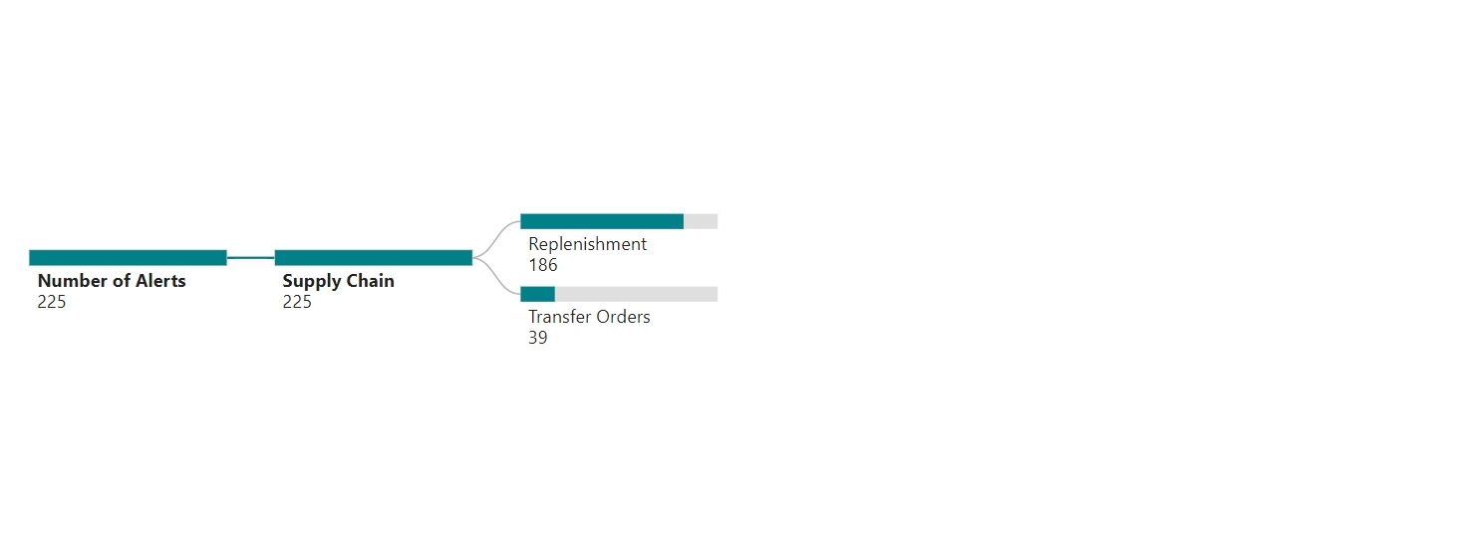
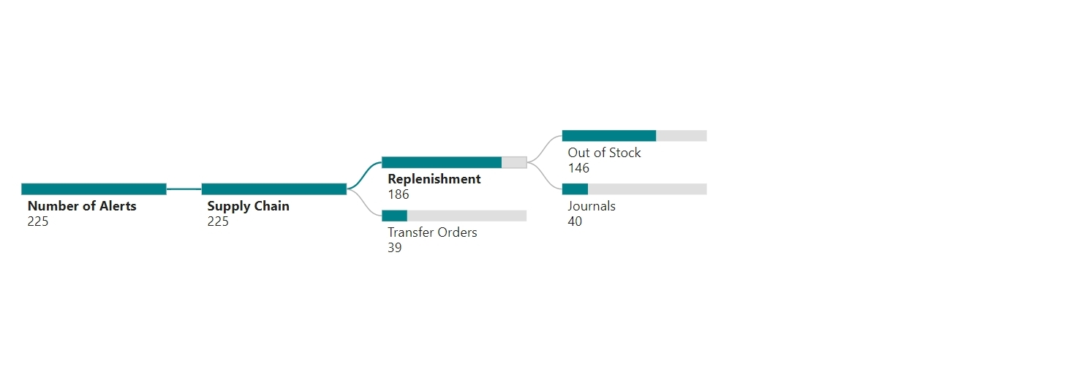
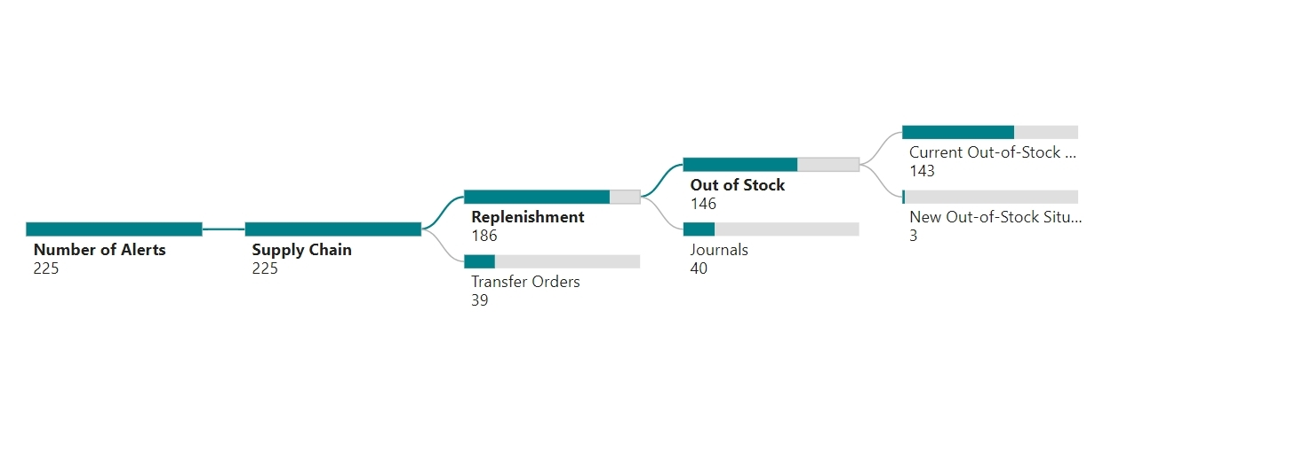
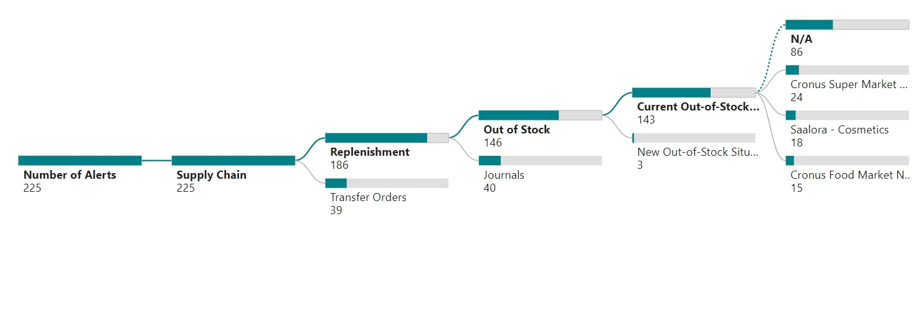
Alert Tree
interactive exploration
of Alerts and their
dependencies.
Expand/collapse and
drill-down

Slide 16
Architecture
LS Insight
(Analytics and BI)
Components:
  Actionable Insight Framework
  KPI Base pack (free)
  LS Insight reports
  KPI extension packs
    Additional KPIs
    Industry specific KPIs
Easy to extend:
  Partners can easily build and
  integrate their own KPI packs
LS Central: Framework
User Interface
Rules Engine
Workflow Engine
Users & Roles
LS Central: Base Pack
LS Central: Ext. Pack
KPIs
Calculation logic
KPIs
Calculation logic
Partner Pack
KPIs
Calculation logic

Slide 17
Status & Timeline
Budgets (2)
Replenishm. & Forecast (7)
Vendor Perform. (3)
Purchase (7)
Sales (8)
Transfers (11)
Inventory (10)
48 KPIs
in total
LS Central 19.5 (released May 2022):
  Actionable Insights
  KPI Base Pack with 48 KPIs
LS Insight 2022.1 (released May 2022)
  Integration and PowerBI reports
Roadmap:
  Loss Prevention KPI Pack (in design)
  Industry specific Packs
More information:
  Online Help

Slide 18

Your benefits
Get the control back
Better overview by having all relevant
KPI values in one single place
Increase focus on what counts with
Impact Scores and Severity levels
Reduce response time for exception handling
with proactive alerts and notifications
Better view on your data
Understand the development of your
KPIs better with interactive charts
Improve your responsiveness
Easy tracking of team response metrics
Reduce costly delays with escalation
procedures

Slide 19
Questions

Slide 21










