Slide 2
Unified Experiences
in LS Hospitality
Gunnar Orn Thorsteinsson
Product Director

Slide 3
Unified Experience
Unified: Cambridge dictionary
brought together, combined, or united

Slide 4

Unified Experience
Experience: Cambridge dictionary
something that happens to you that affects how you feel

Slide 5

Unified Experience
Experience: Cambridge dicionary
(the process of getting) knowledge or skill from doing, seeing, or feeling things

Slide 6
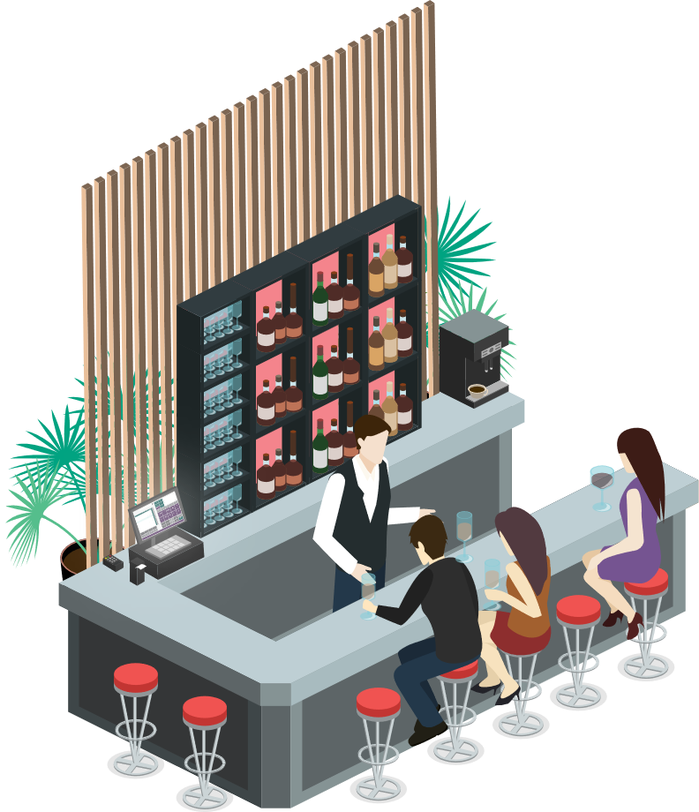
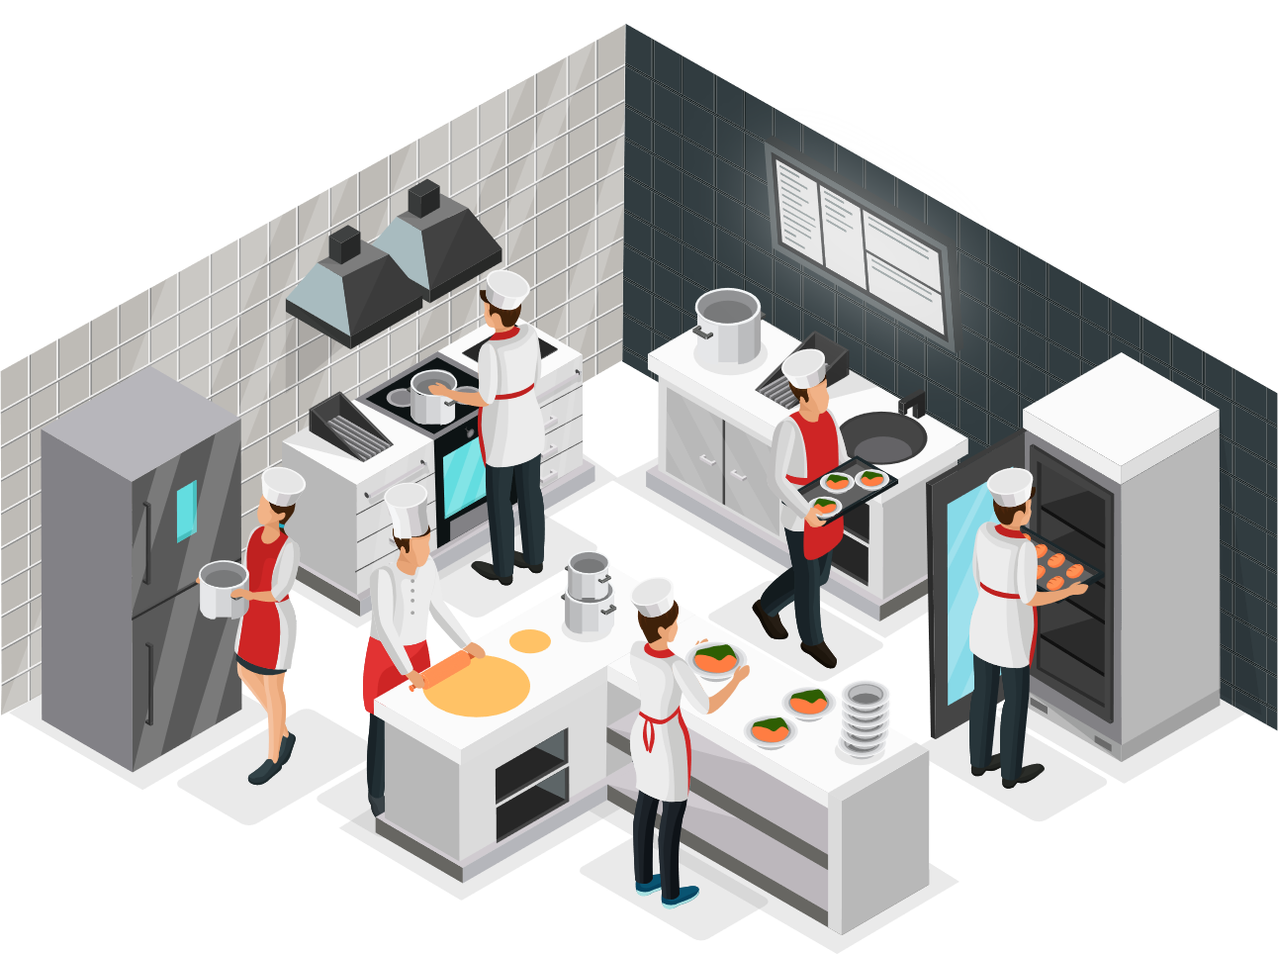

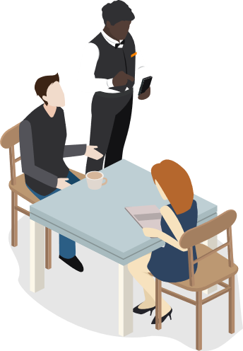



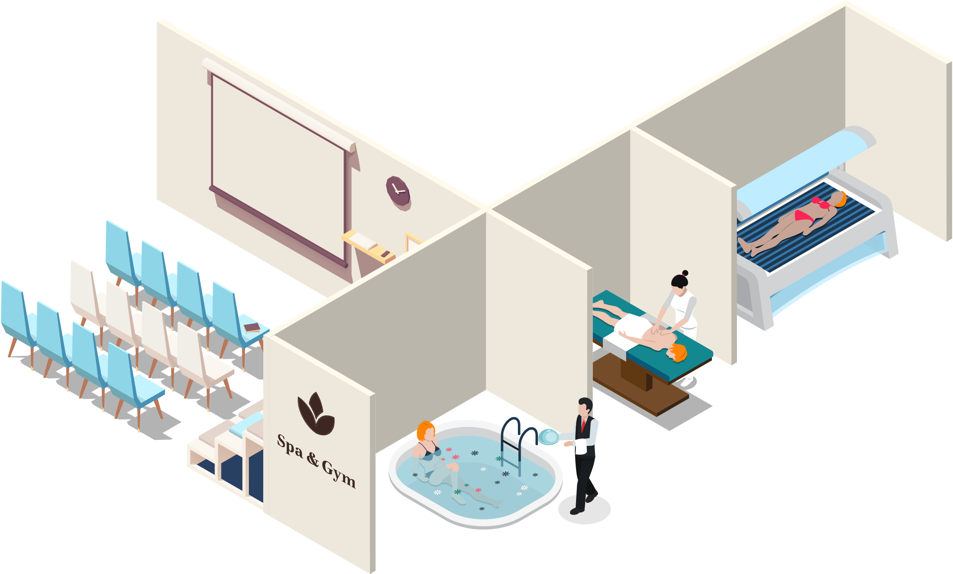
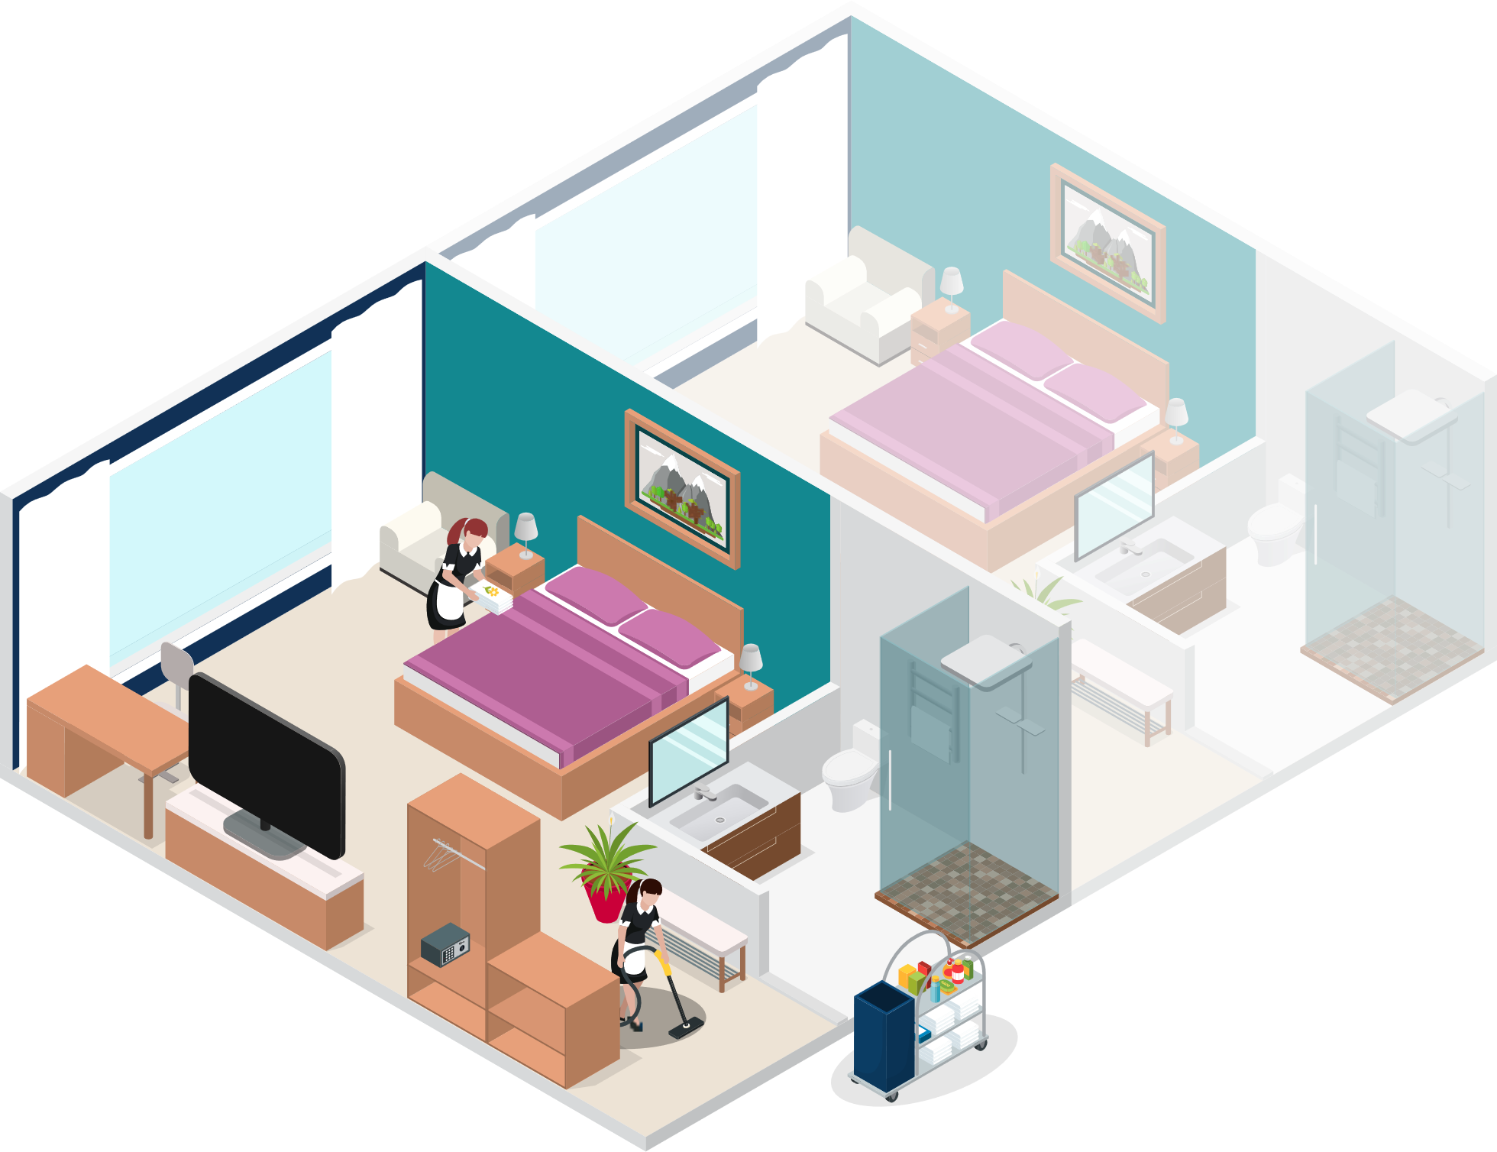
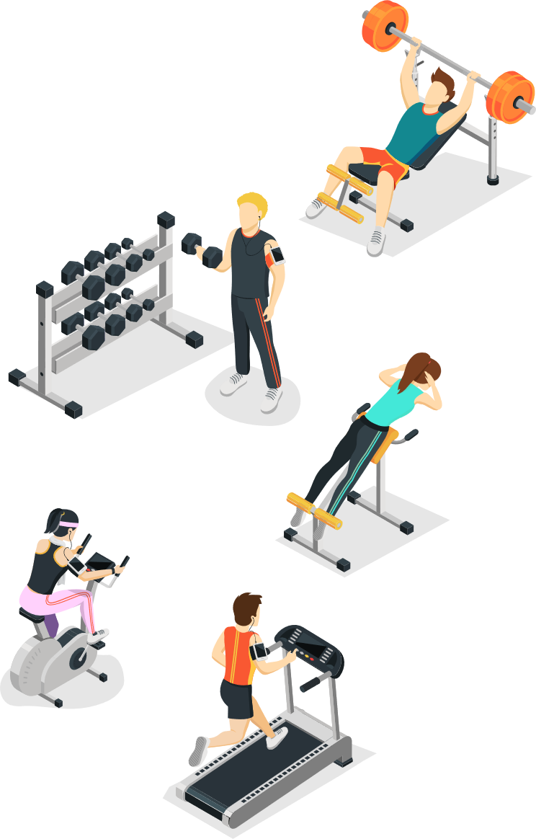

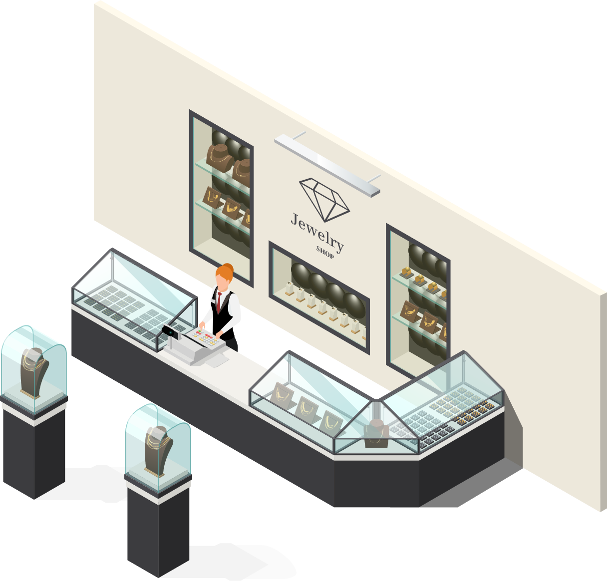


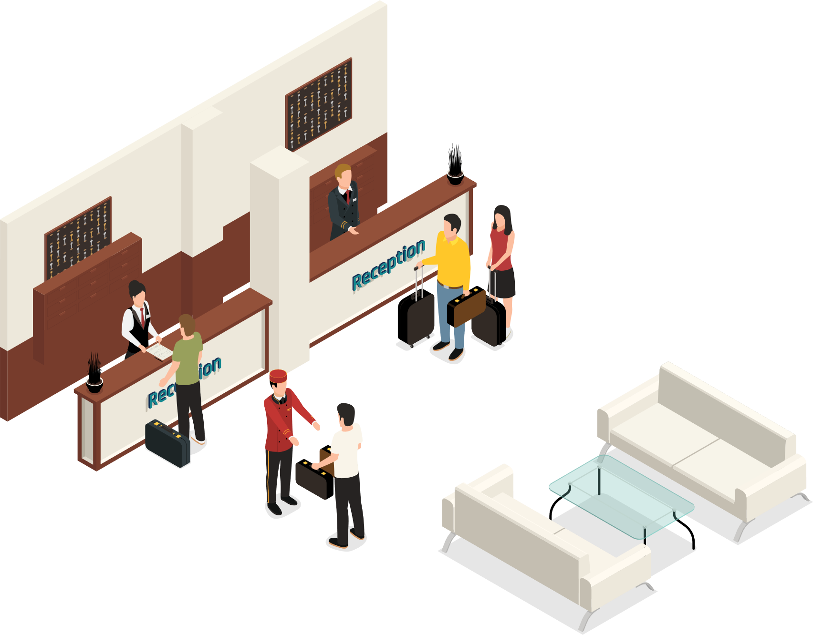
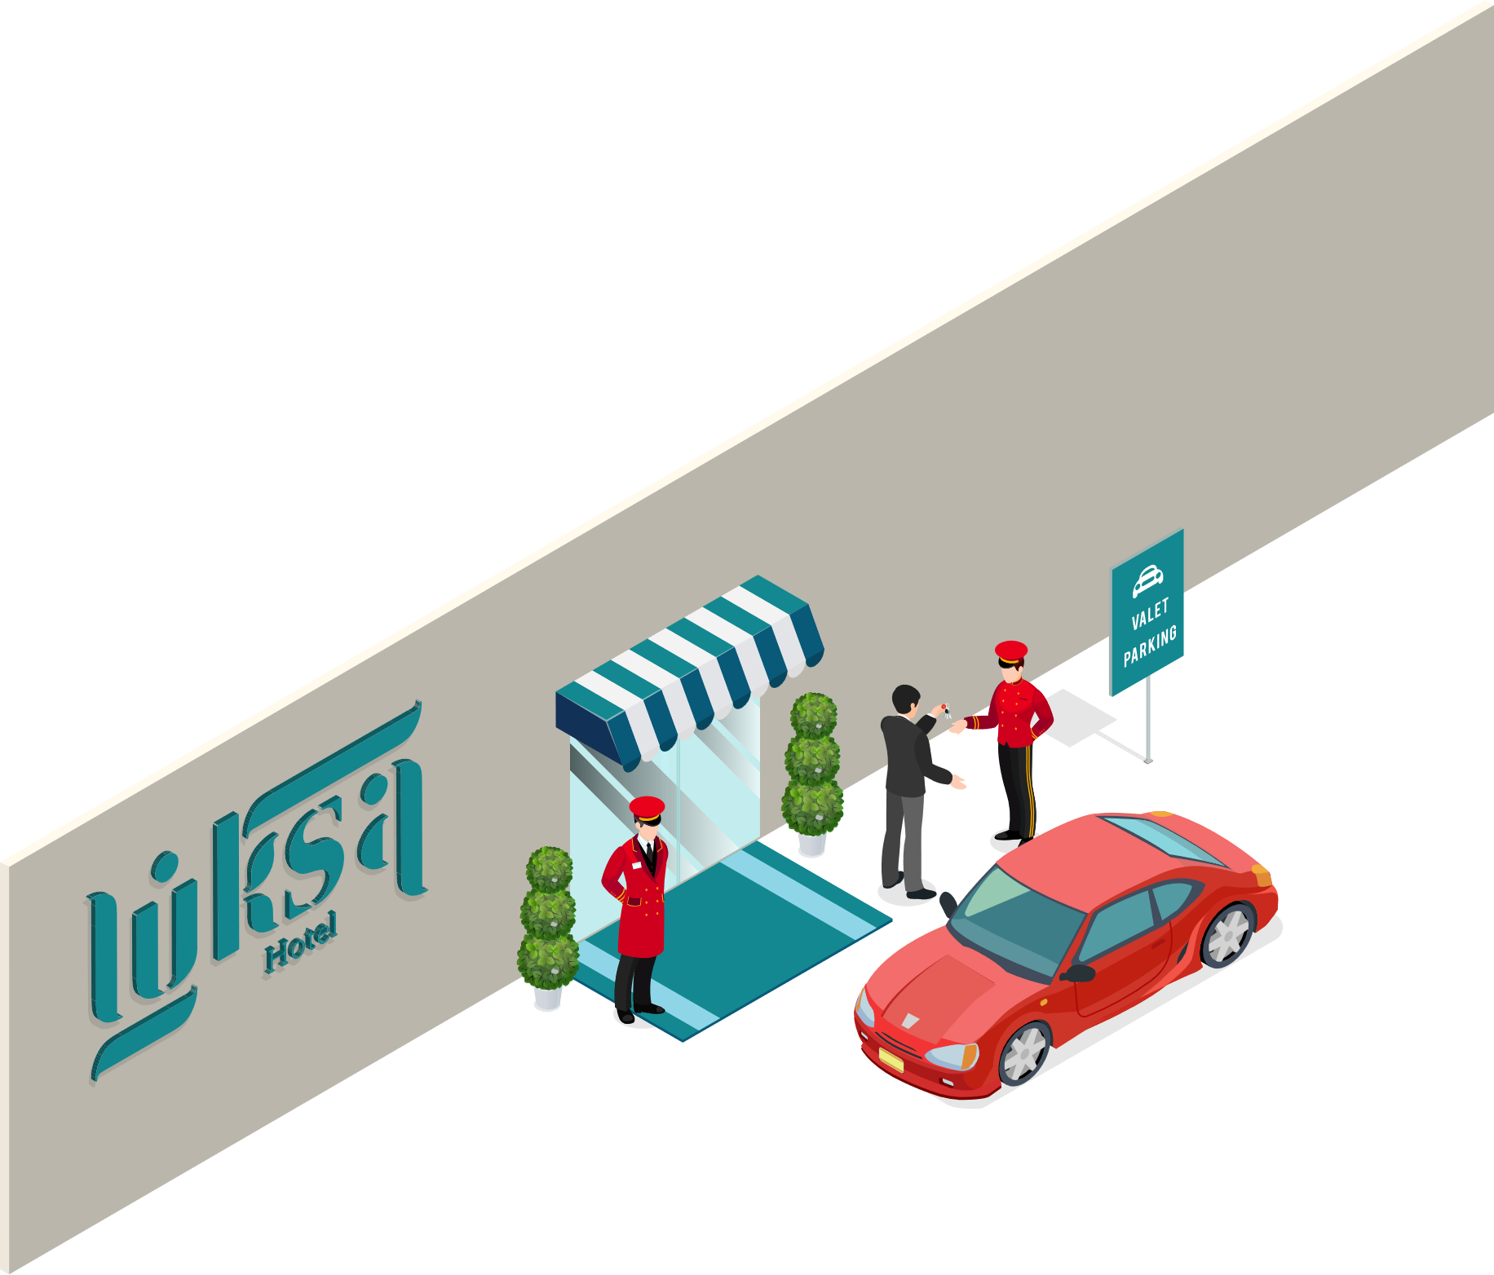


LS Hospitality
LS Central
Food & Beverage
Bookings
Staff Mgmt
KDS
Hotels

Slide 7

Not just a PMS
eCommerce Integration
Web Integration
3rd party
Channel Manager Connector
LS Pay
Integration to payment providers
LS Central
Analytics
predictive abilities
Staff Management
Staff rosters and timetabling
Bookings
Reservations
and activities
Hotels
Property Mgmt System and Channel Mgmt
KDS
Kitchen management
Restaurants
Food and beverage
Loyalty
Member
Mgmt
Retail
Stores and Backoffice
Microsoft Dynamics 365 Business Central
Power BI

Slide 8
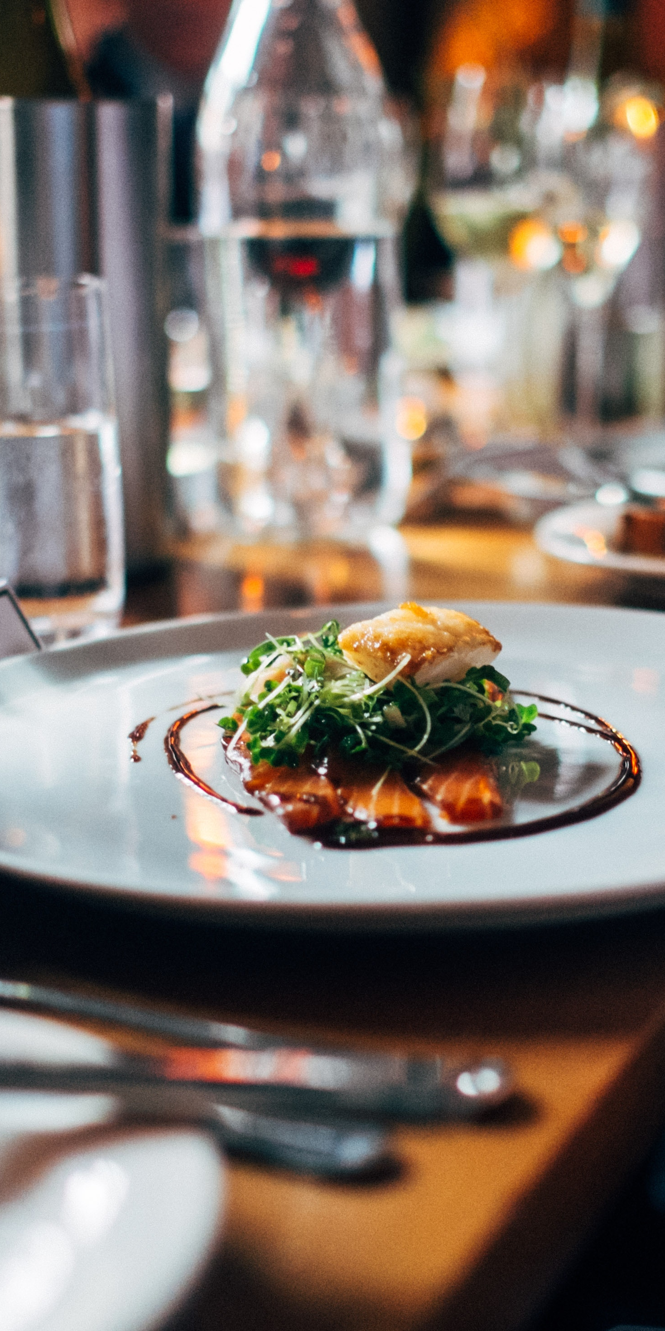
Food and Beverage (F&B)
Fine Dining, Casual Dining, Quick Service Restaurants, Coffee Shops, Pubs, …
Configurational Service Flows to support multiple types of restaurants
Recipes, Modifiers, Deals, Discounts, Allergens
Transfer orders, Split Bill
Quick Order taking
Kitchen communication on POS with Coursing
Table management
Mobile POS
Self-Service Kiosk
eCommerce with Takeout & Delivery

Slide 9
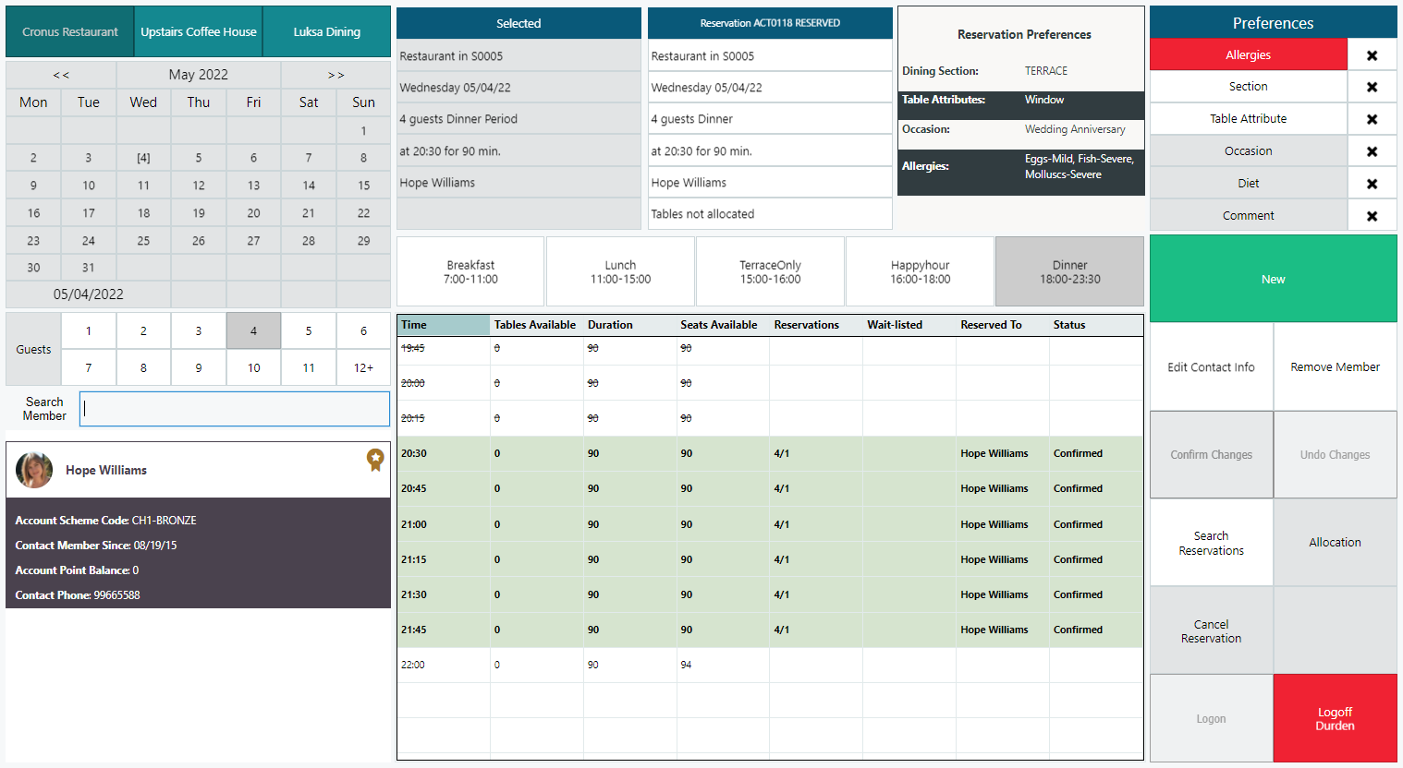
F&B Reservation Desk

Slide 10
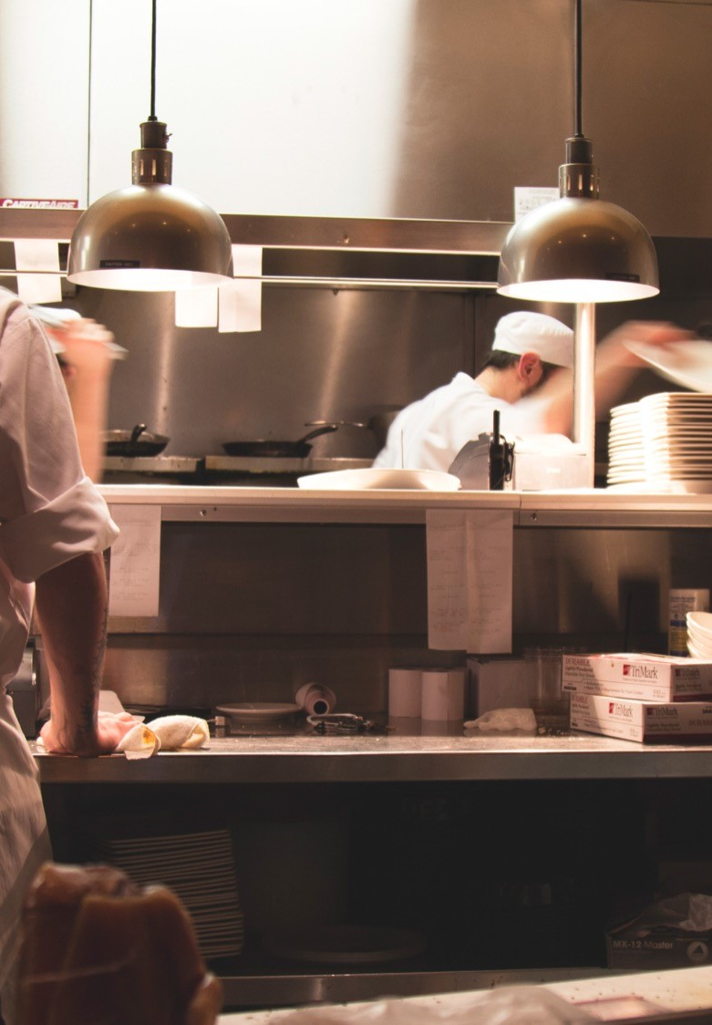
Kitchen Display System (KDS)
Standalone product that works with LS Central and LS First
Performance increase in POS
Displays and/or printers
Bi-directional communication (Displays only)
Routing logic on items, terminals or type
Fully configurable on operations and UI
Kitchen workflows
Multiple device types: Preorders, Preparation, Expeditor, Customer Facing Preparation, Customer Facing Ready

Slide 11
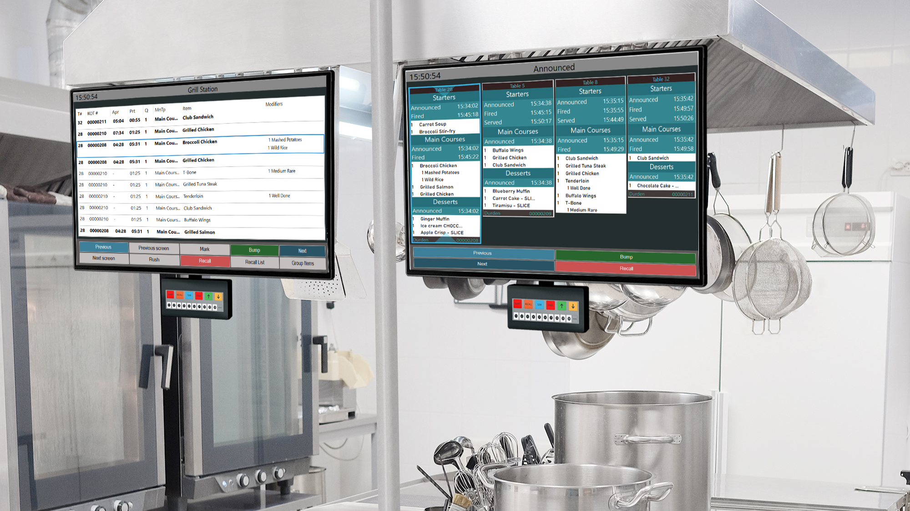
Kitchen Displays

Slide 12

Bookings
Multiple types of Activities in a single platform
Reservations and appointments, Groups, Classes, Courses, Ticketing, Rentals, Memberships, Events
Table reservations for F&B
Manage bookings with 3rd party operators
Manage resources like staff, rooms, assets
Memberships
POS processes allow for quick sales, charges and self checkout
Powerful API’s expose availability and take reservations

Slide 13

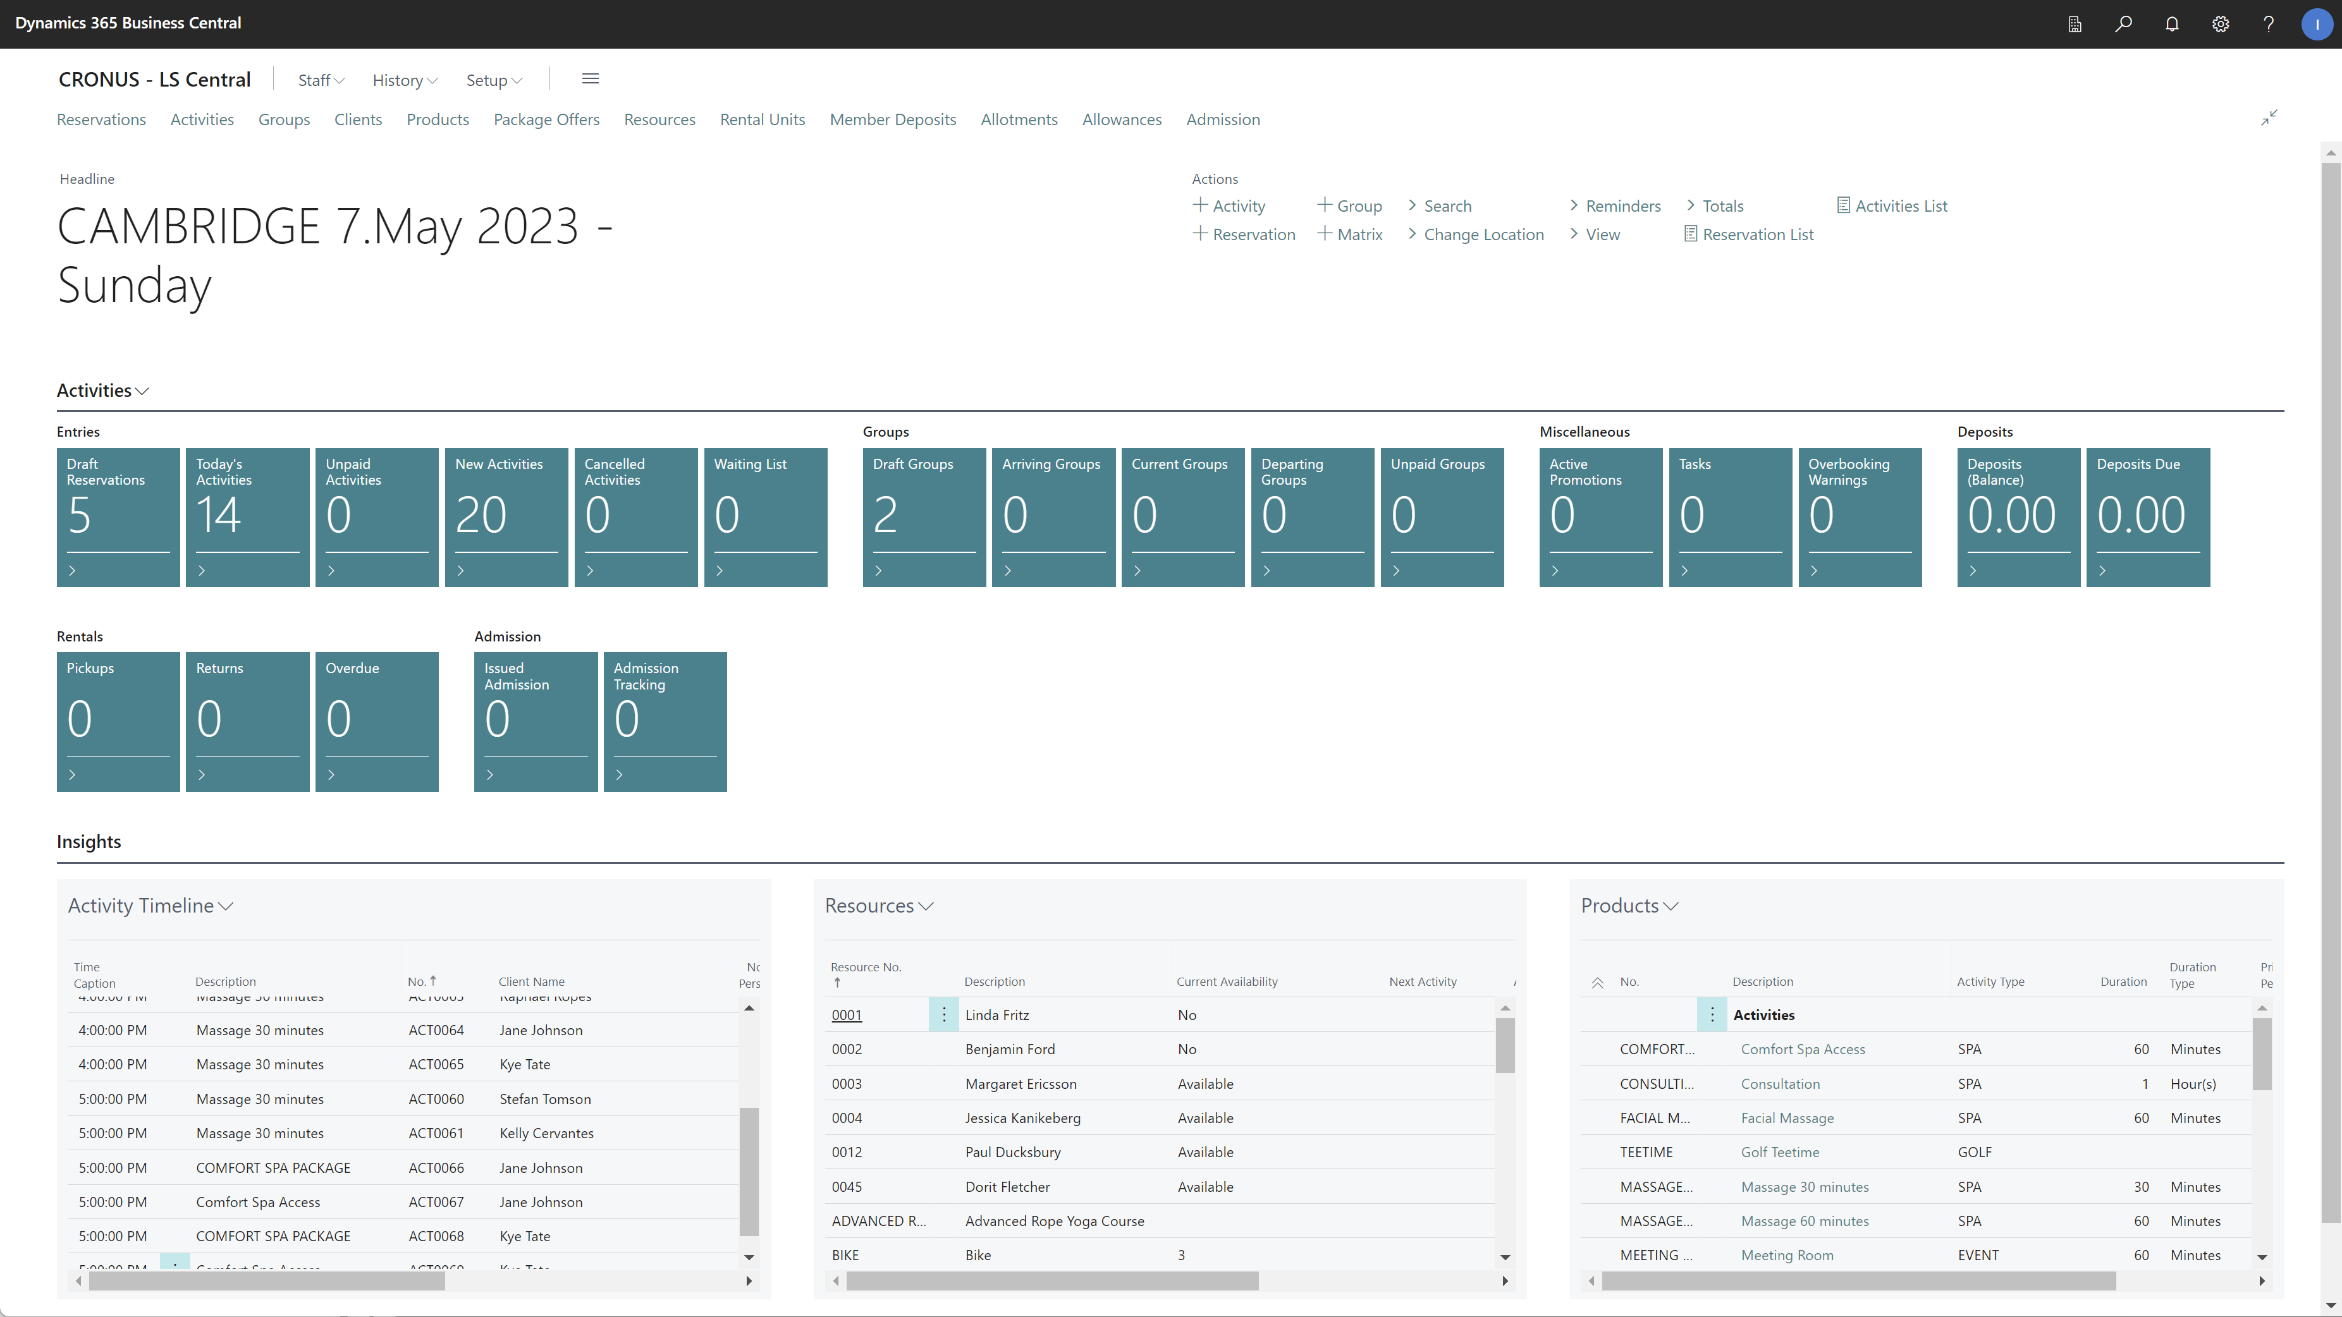

Slide 14

Staff Management
Manage employees, shifts and roles
Role budgets
Roster planning
Time registration on POS
Export to salary system
Employee analysis
Works well with Bookings and LS Hotels to manage availability of human resources

Slide 15
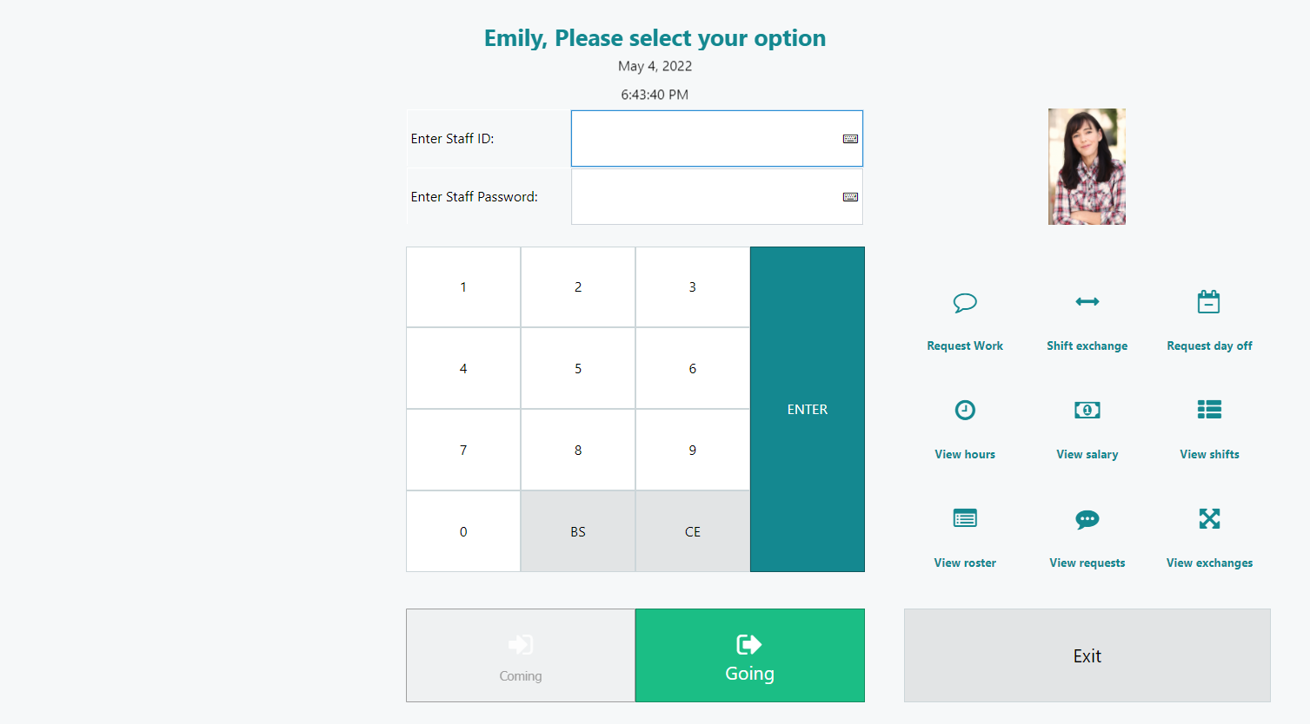
Time registration on POS

Slide 16
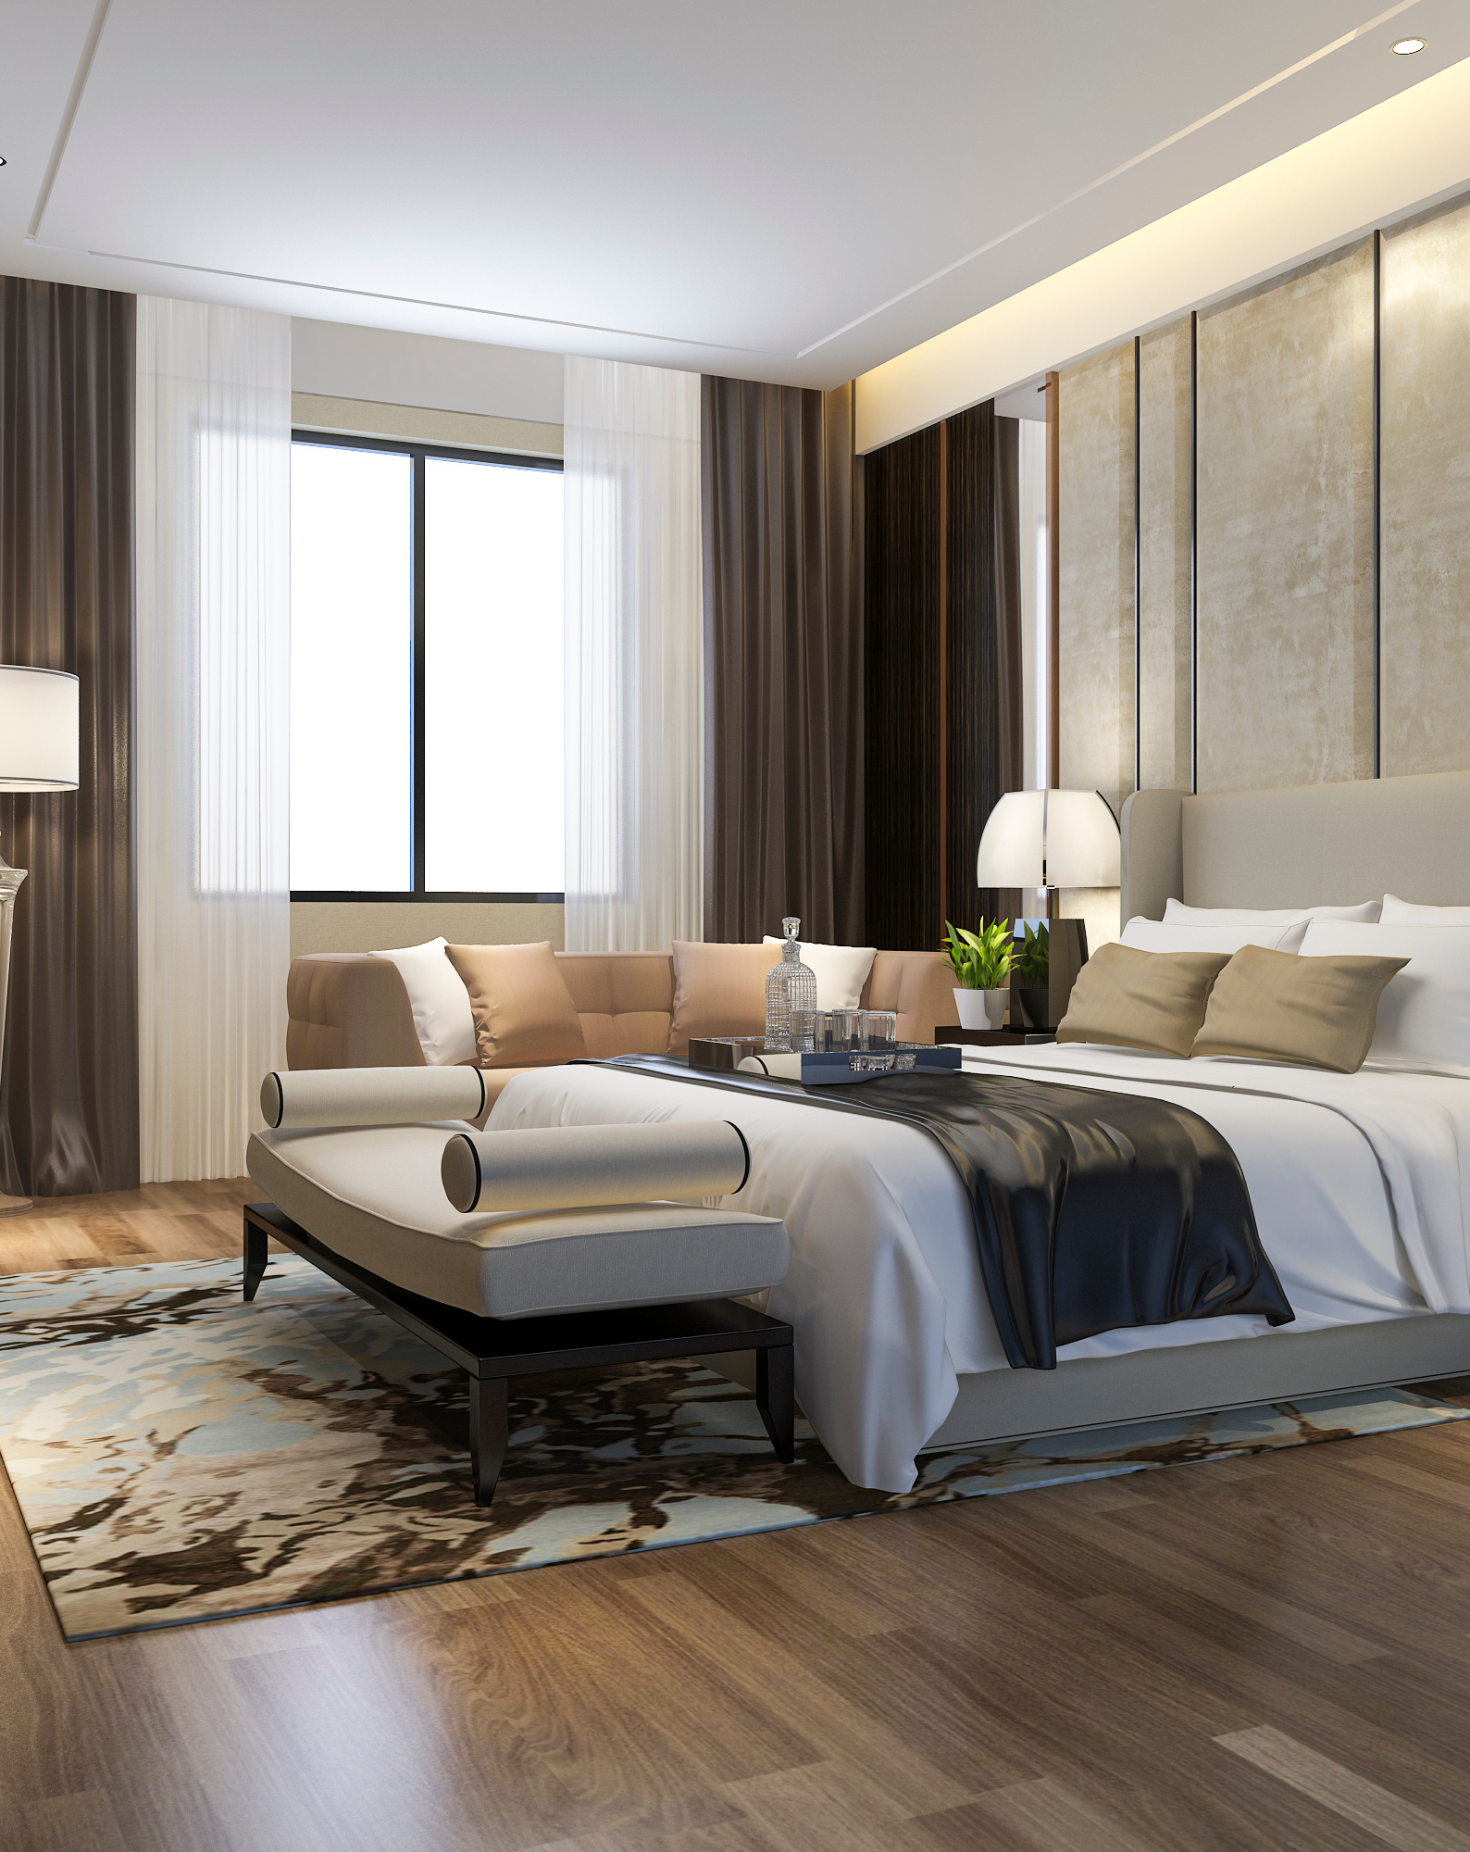
LS Central for Hotels
Property Management System in ERP
Rate management with items, activities and/or packages
Manage the guest journey with powerful Reservation management
Calendar view to manage room allocations and get better overview
Invoice Management in POS or in BO
Hotel Front Desk Role Center and POS to speed up customer service
Housekeeping API
Channel Management (SynXis + SiteMinder)

Slide 17
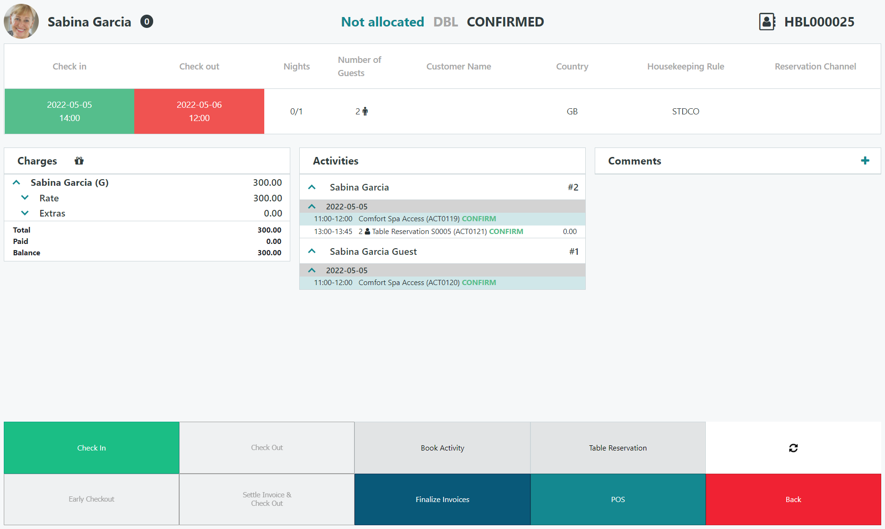
Hotel Front Desk

Slide 18
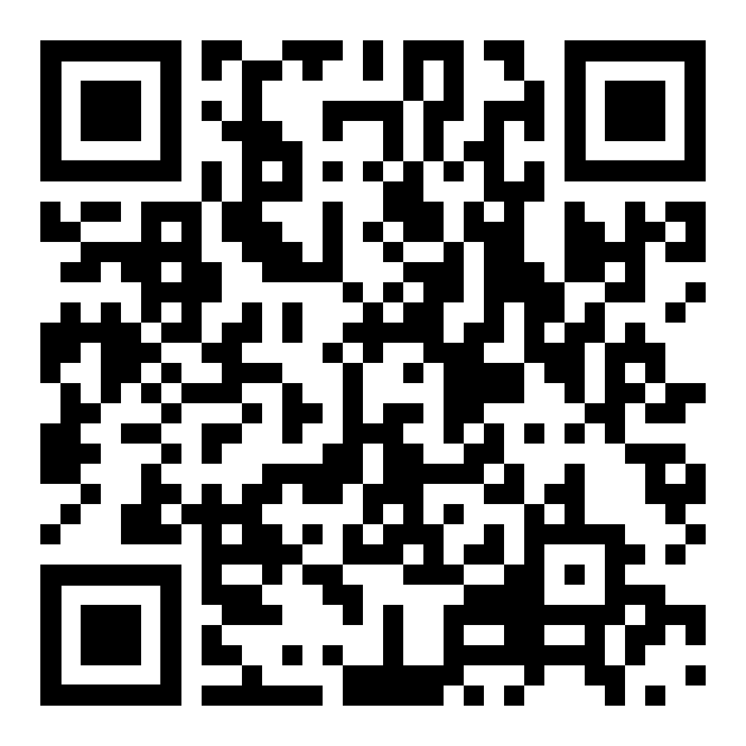
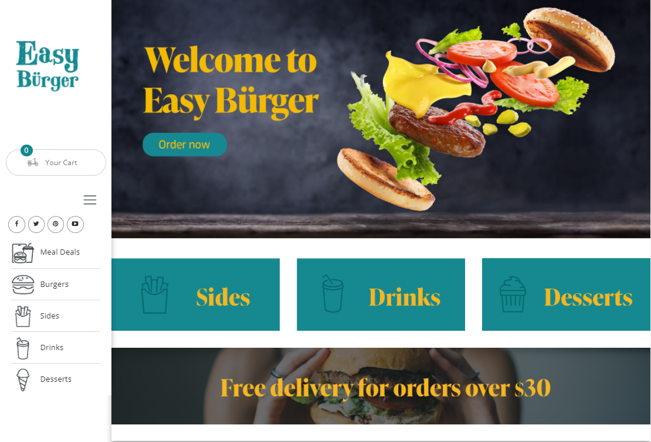
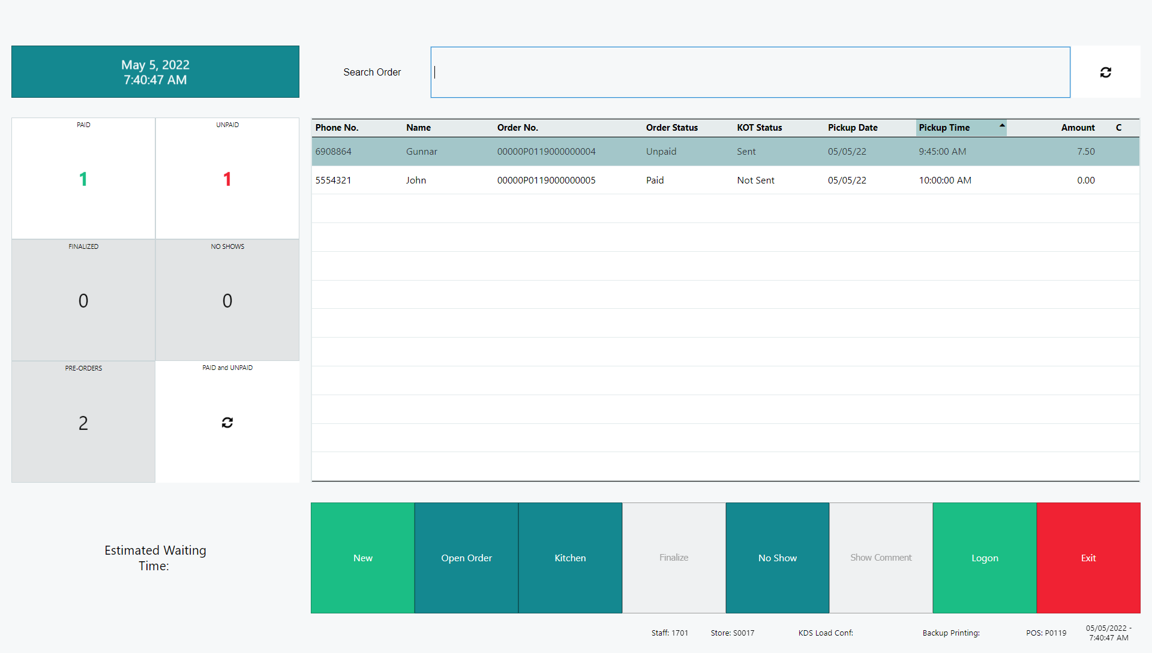
Unified Experiences

Slide 19
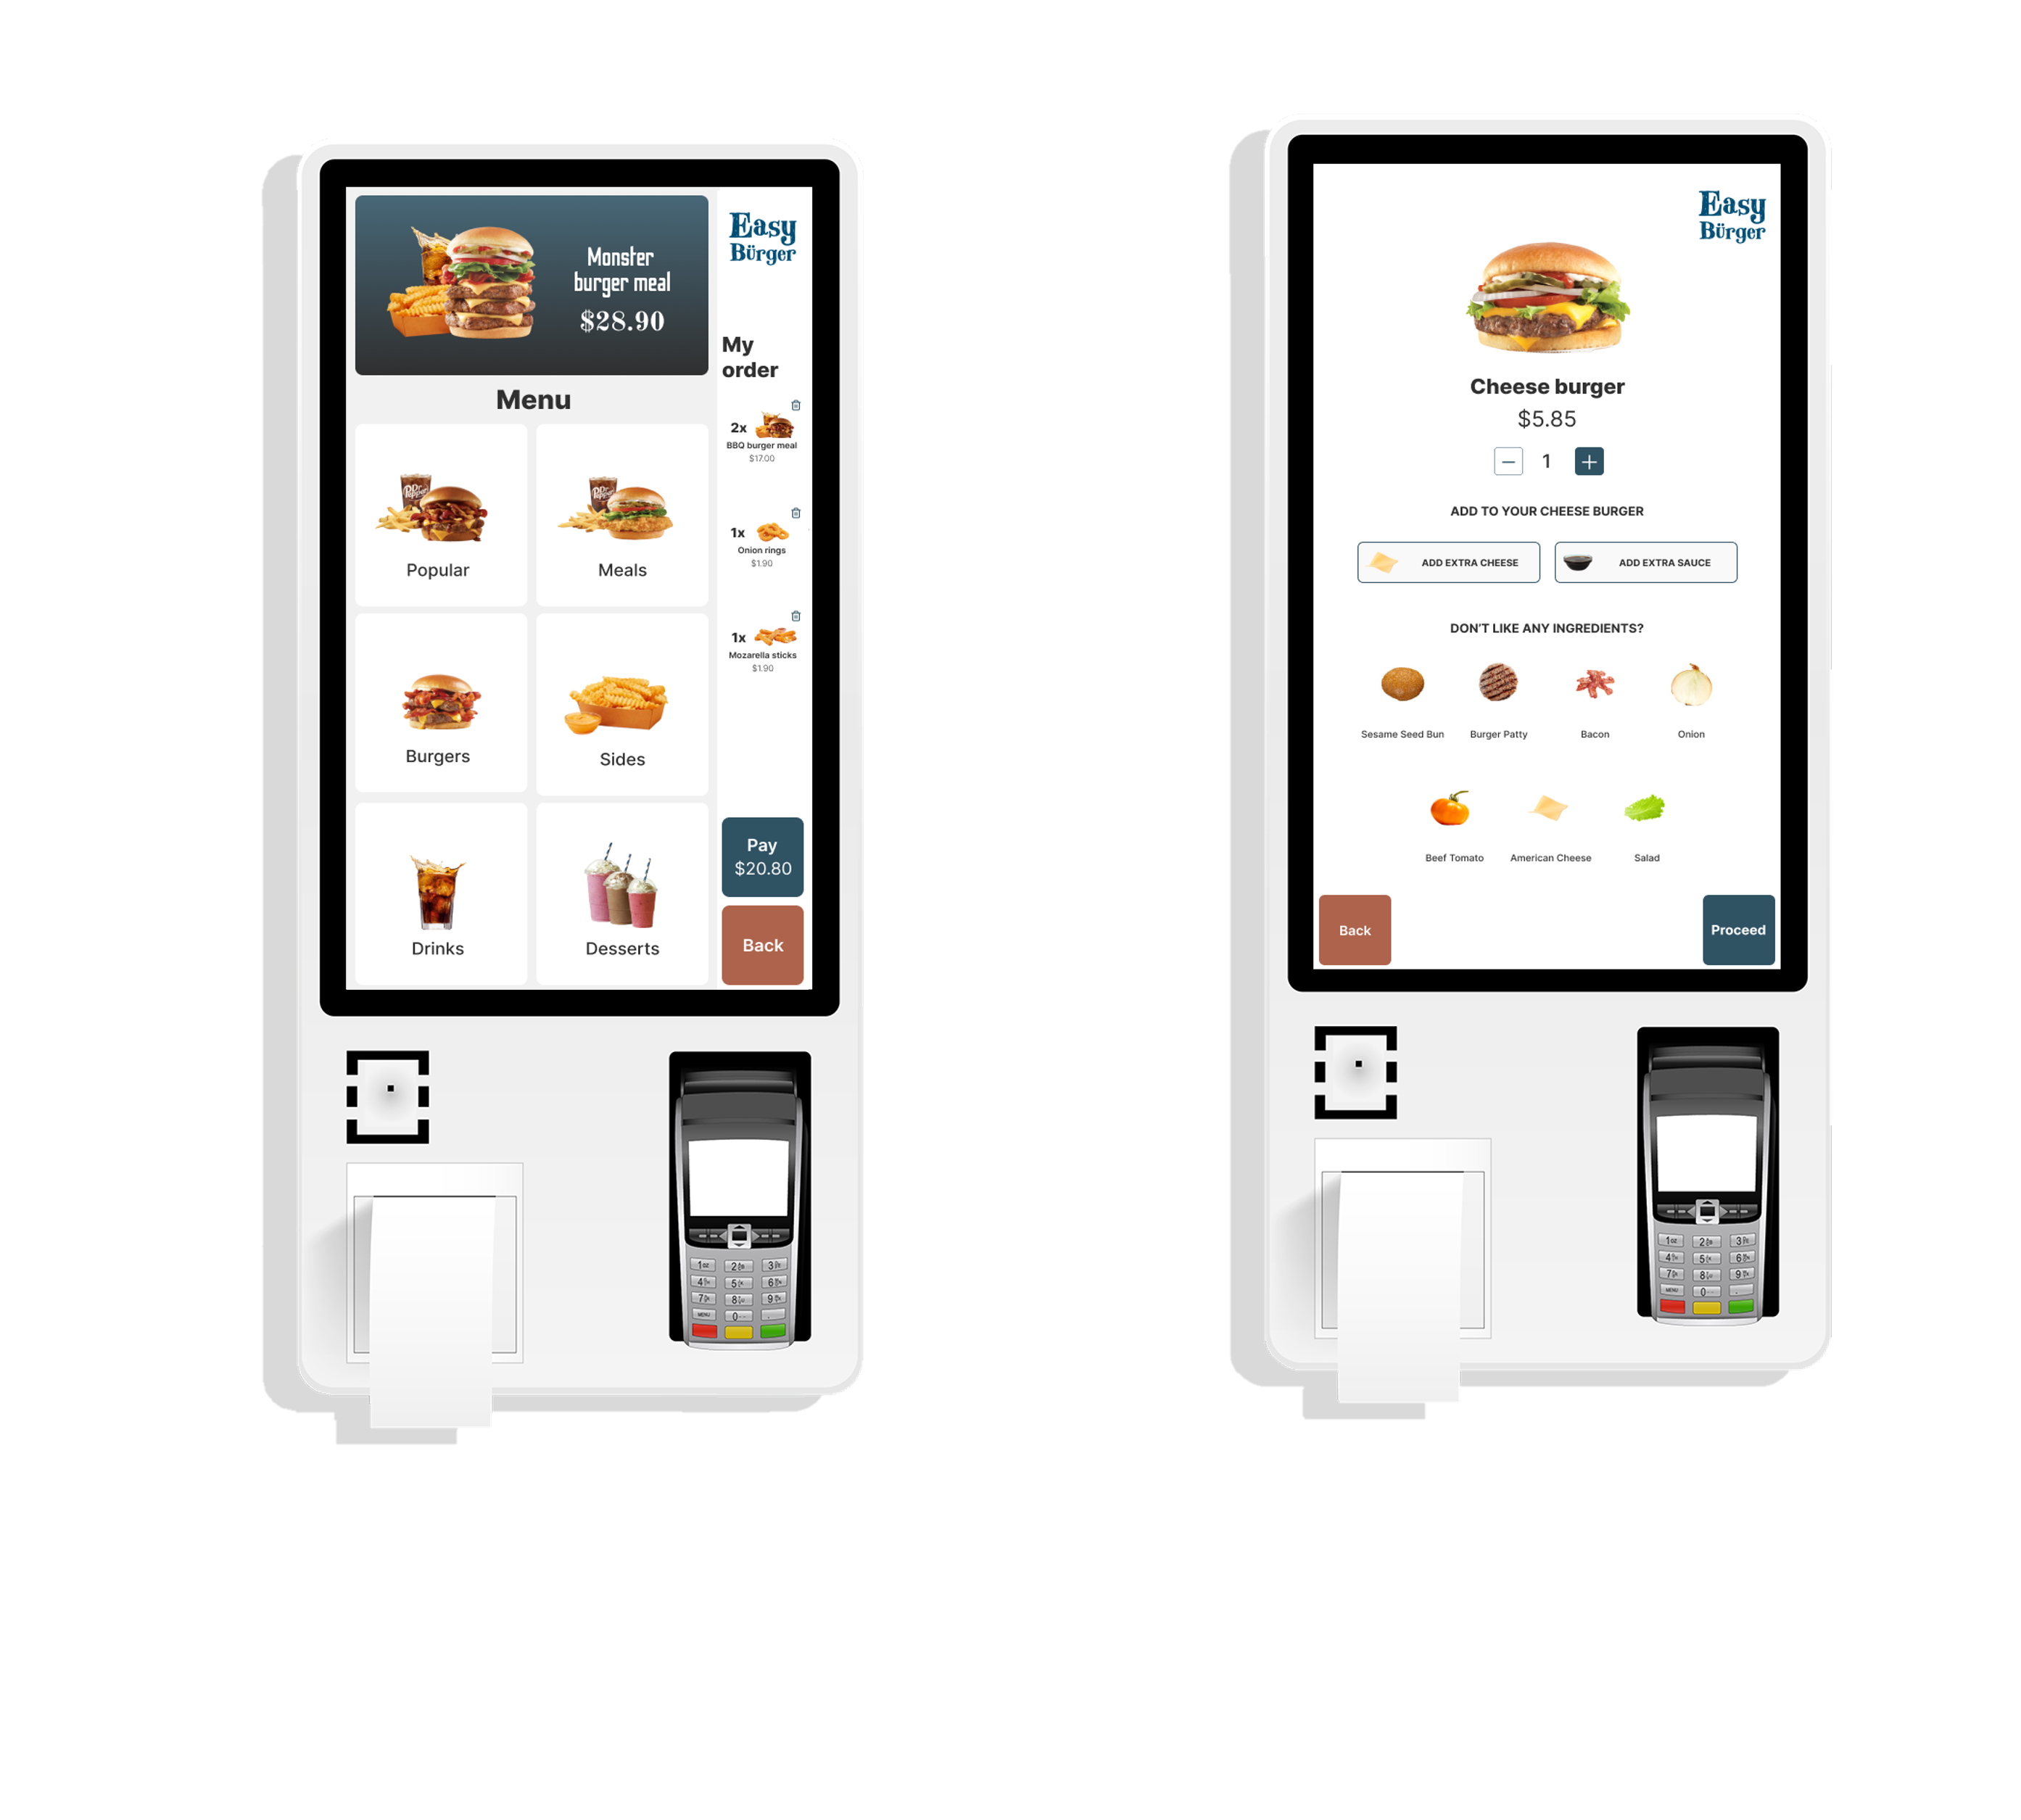
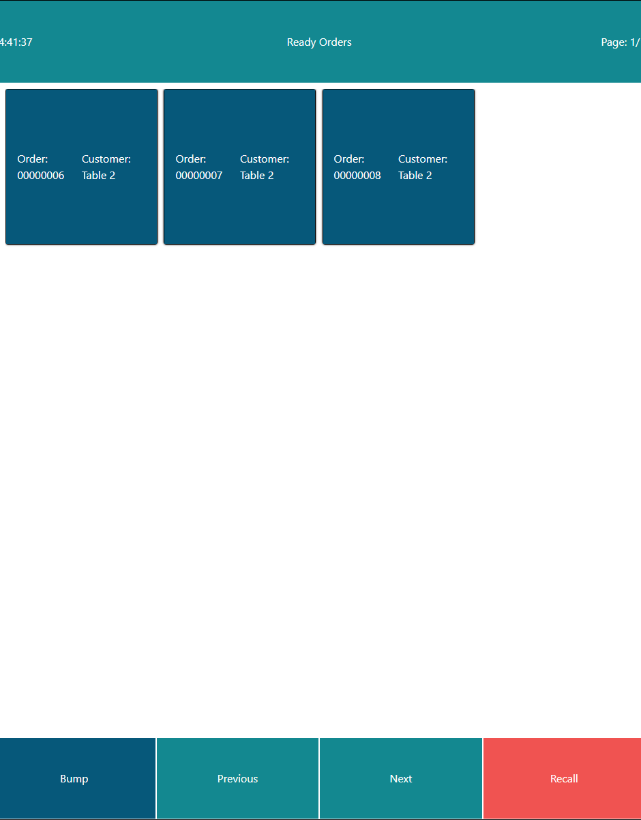
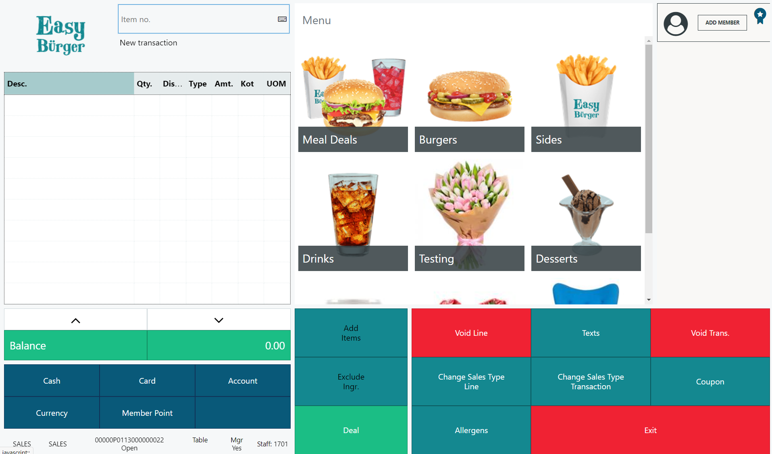
Unified Experiences

Slide 20
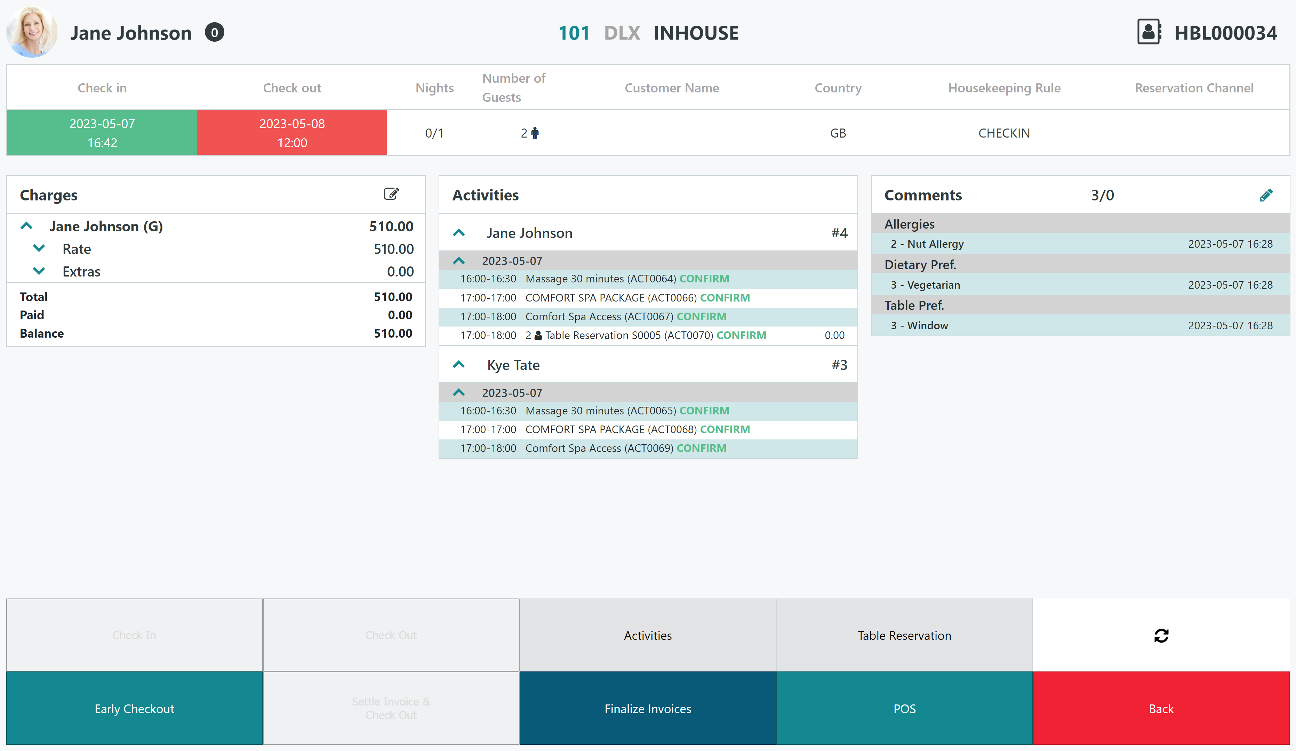
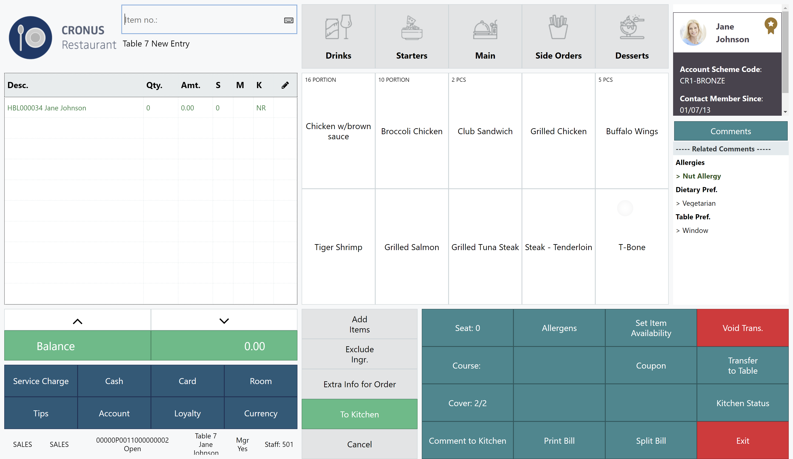
Unified Experiences

Slide 21
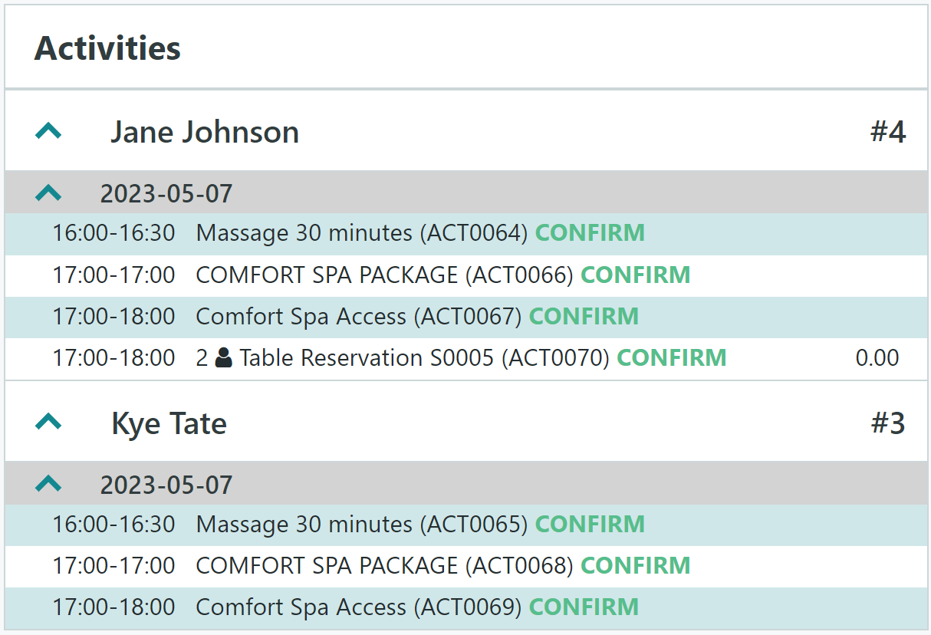
Unified Experiences

Slide 22
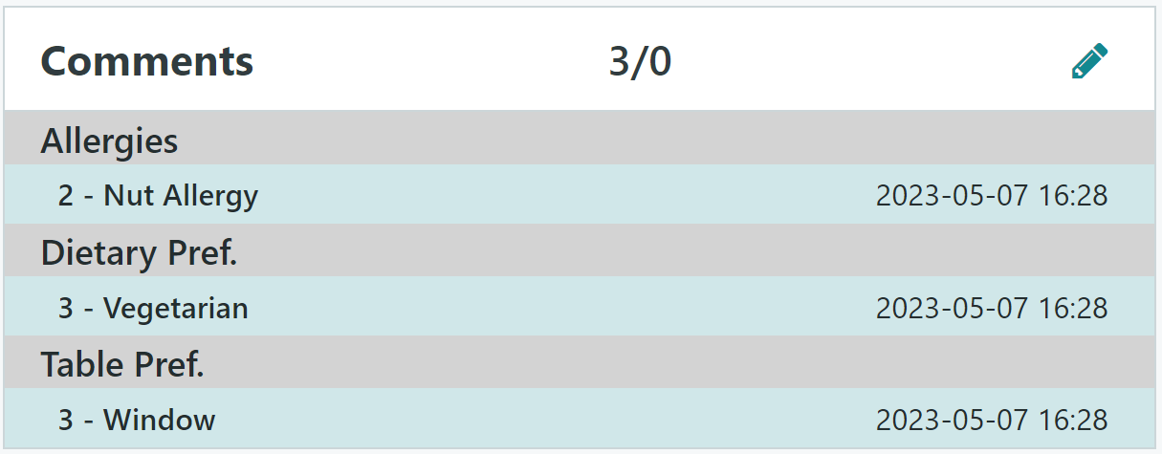
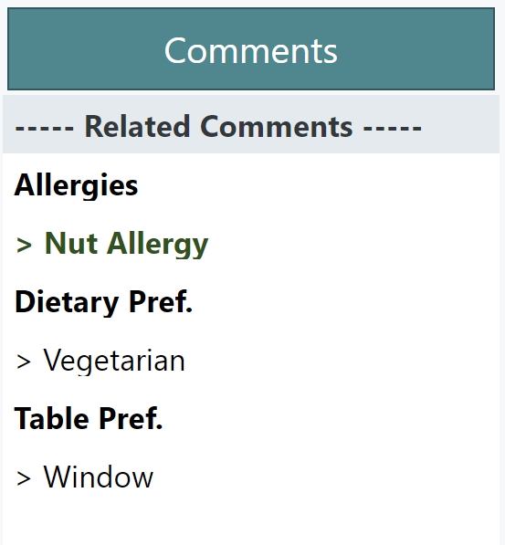
Unified Experiences

Slide 23
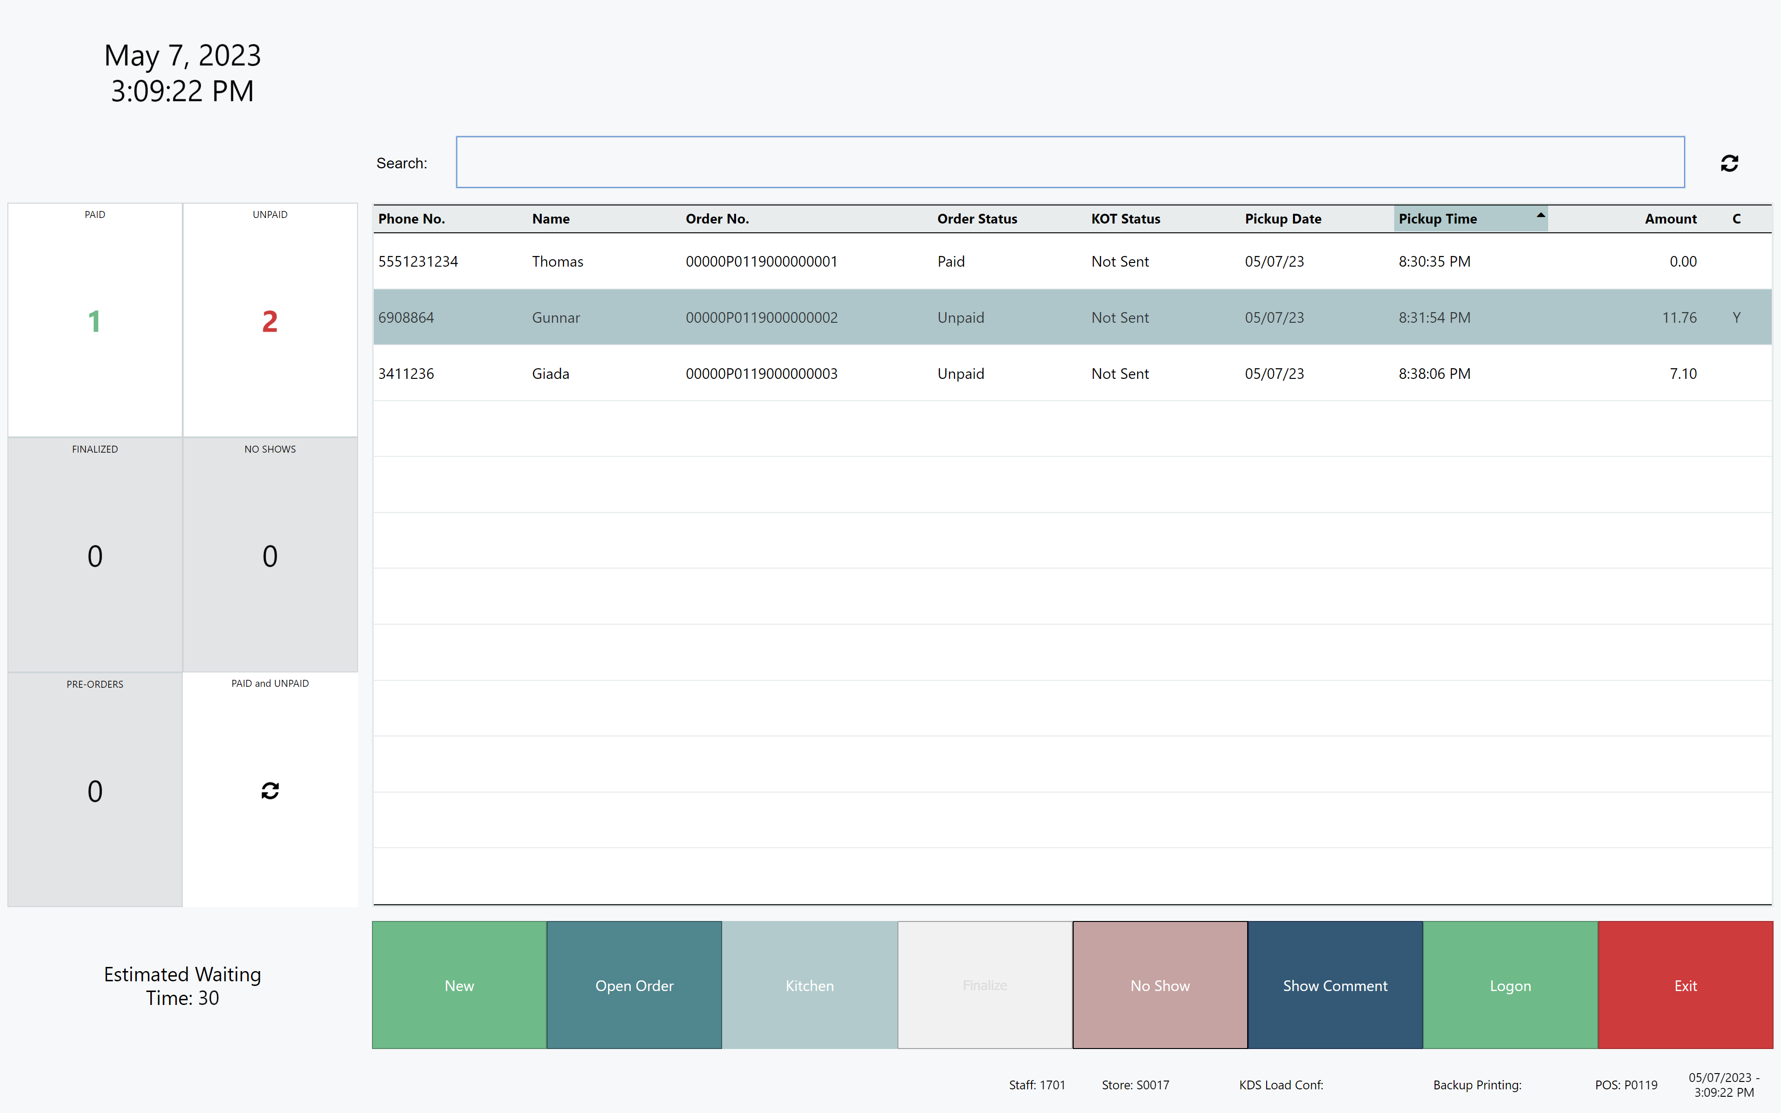
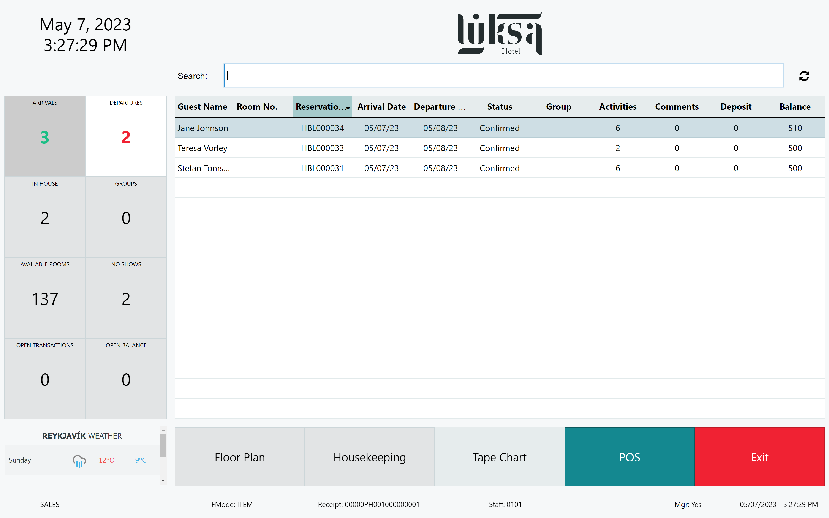
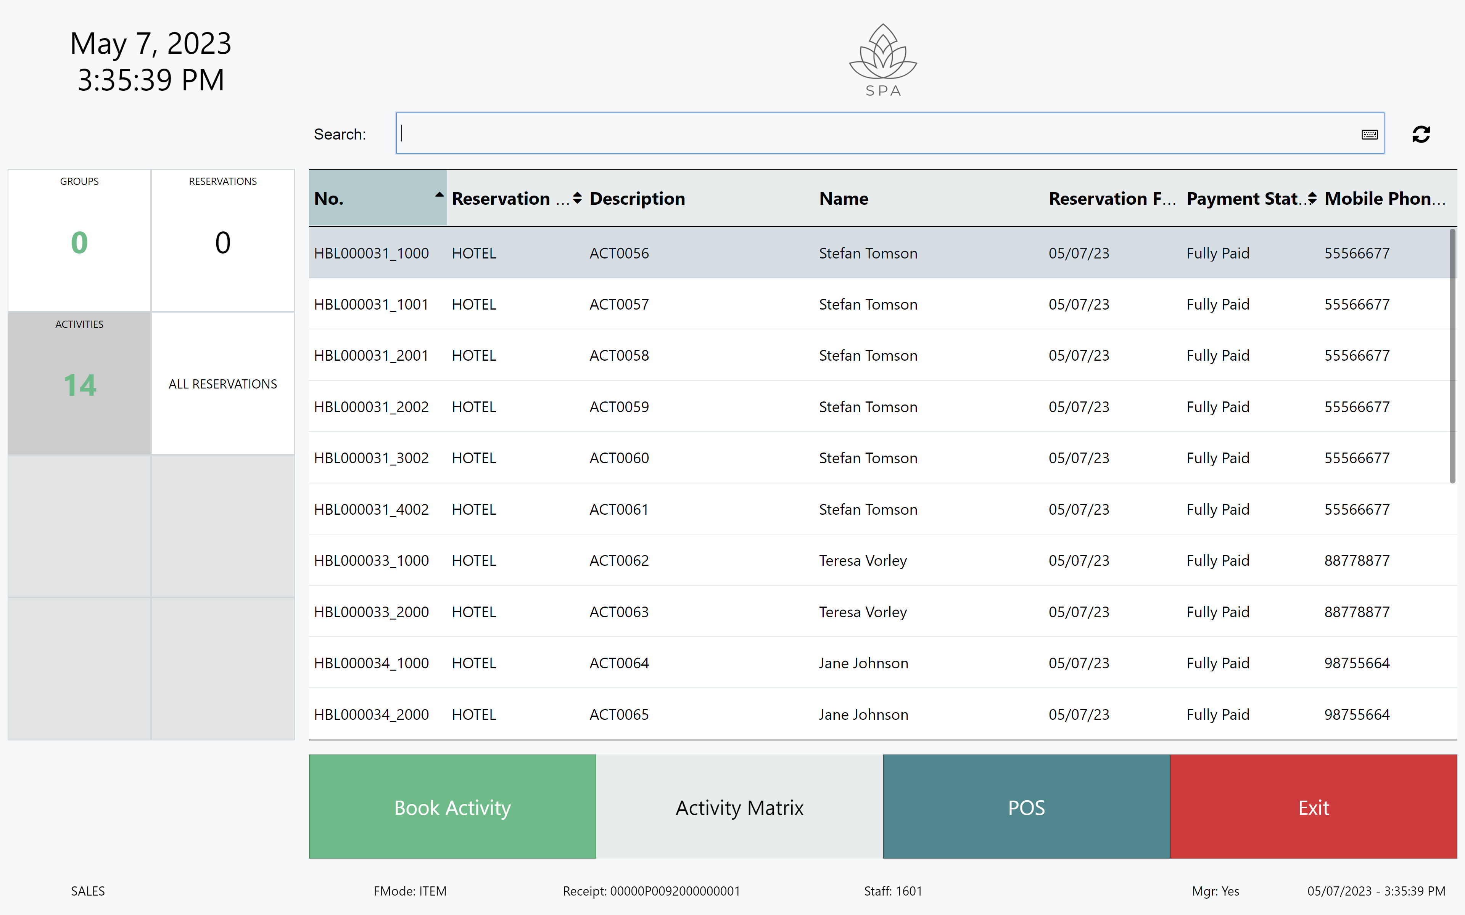
Unified Experiences
QSR Host
Hotel Host
Activity Host

Slide 24
Thank you

