Slide 1
Advantages of the all-in-one solution for Hospitality and Hotel Business
Anna Dís Þorvaldsdóttir
Senior Consultant
Gígja Eyjólfsdóttir
Senior Consultant

Slide 2
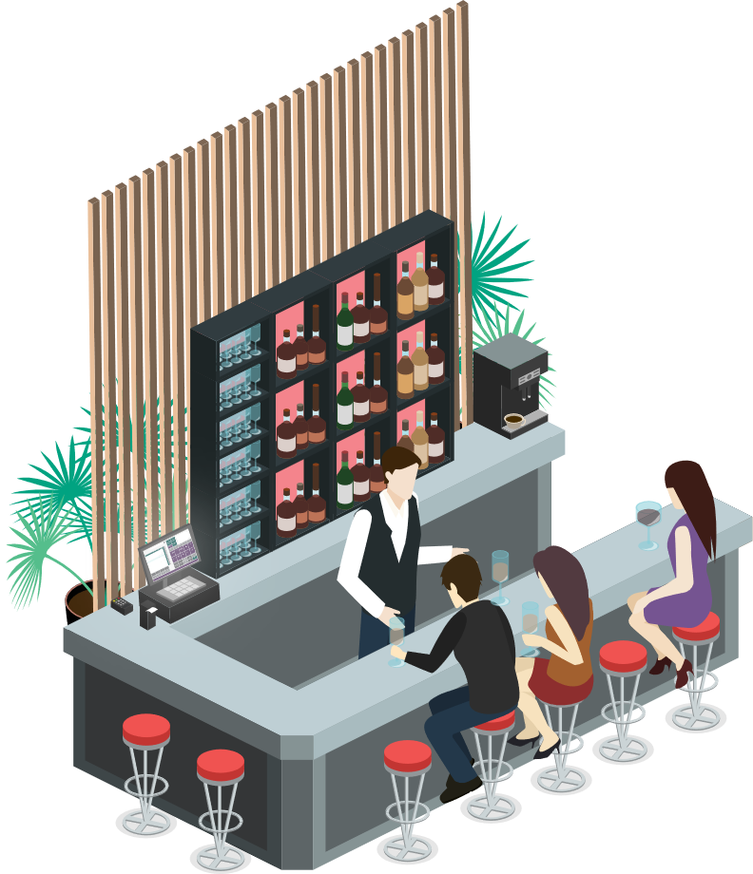
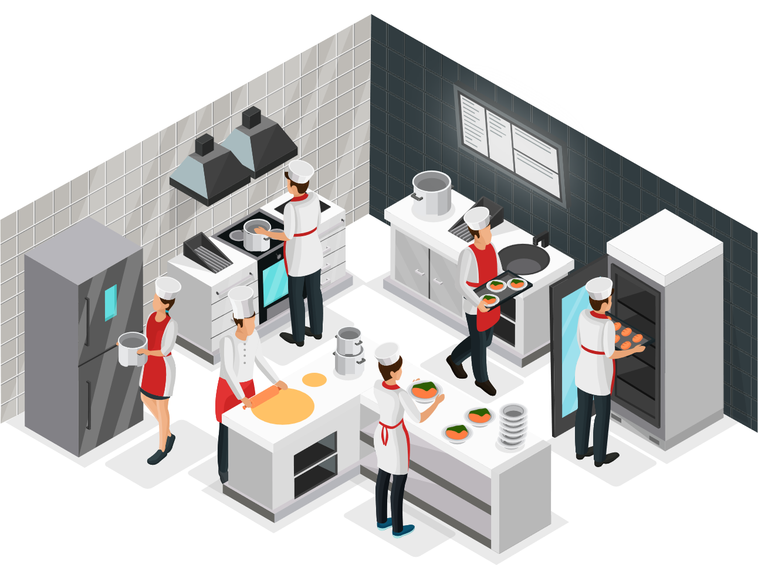





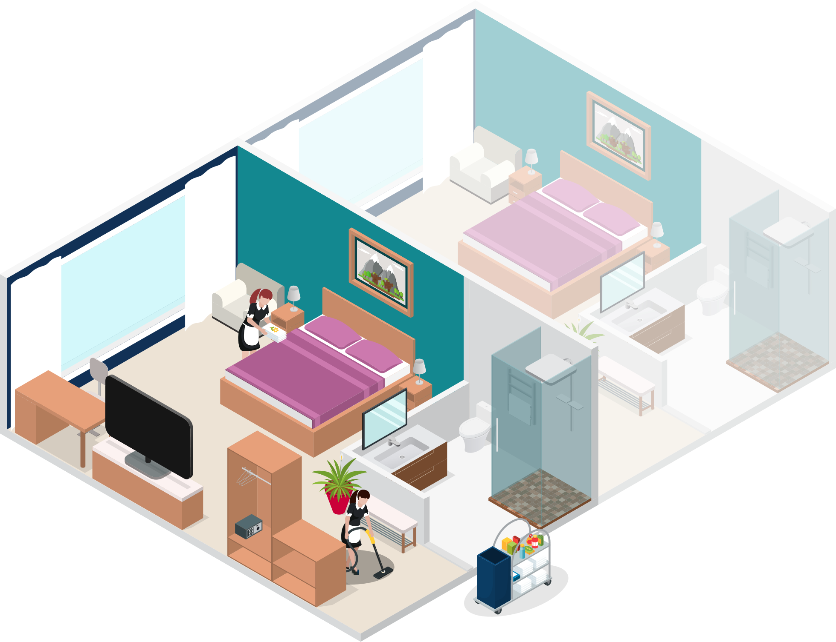
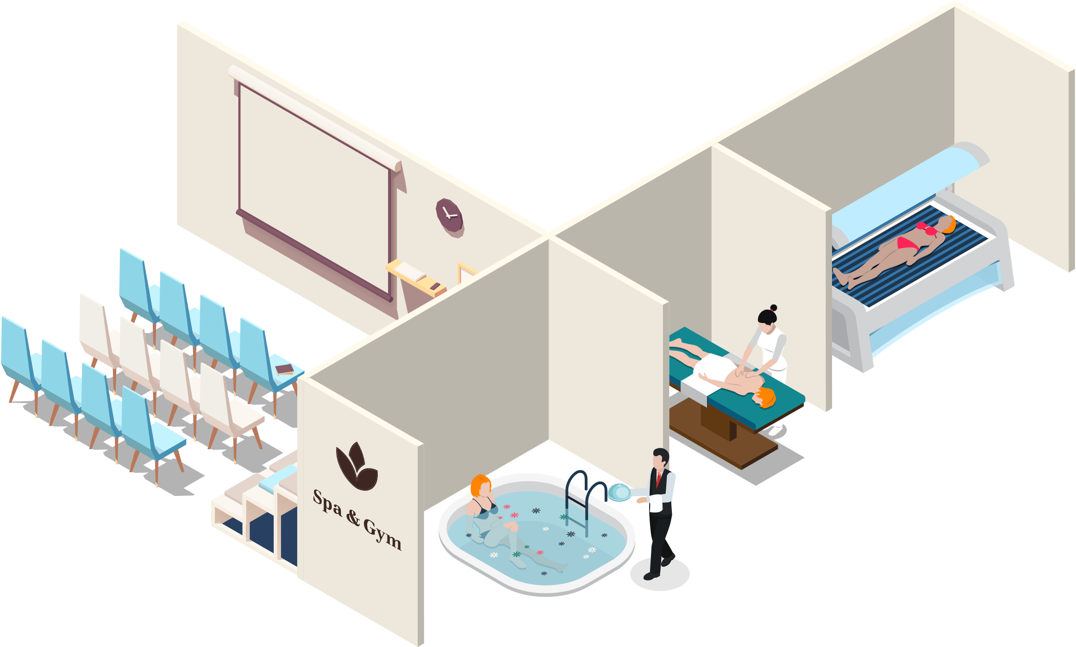
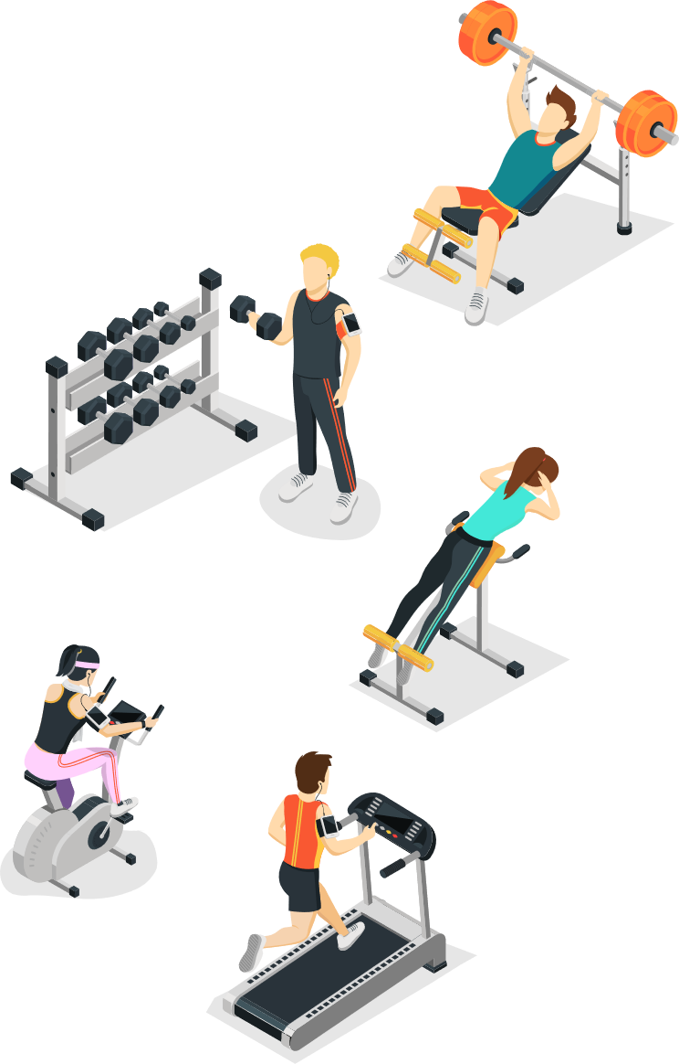

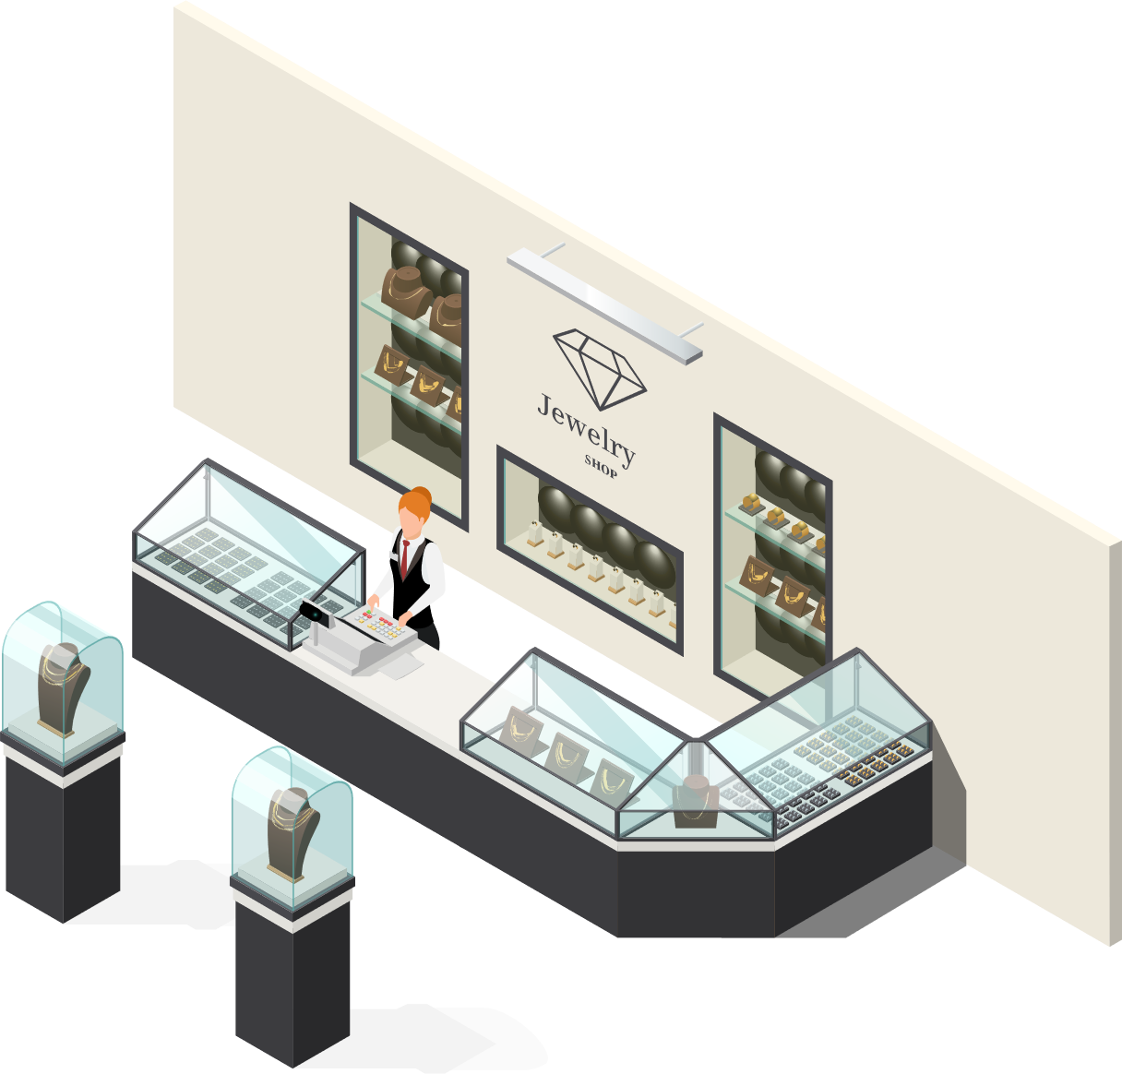


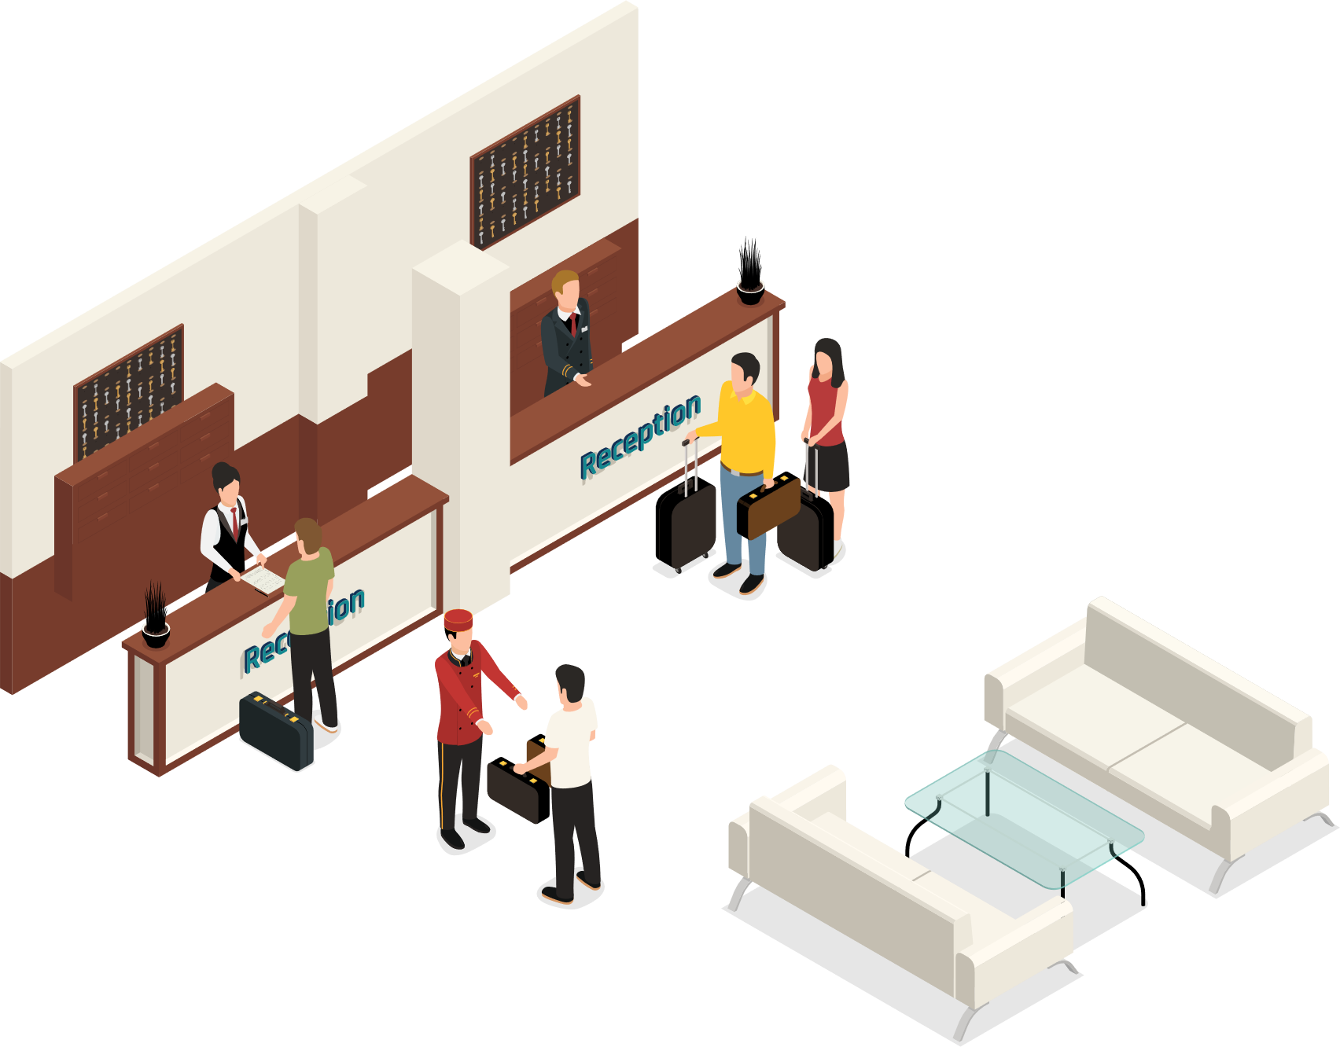
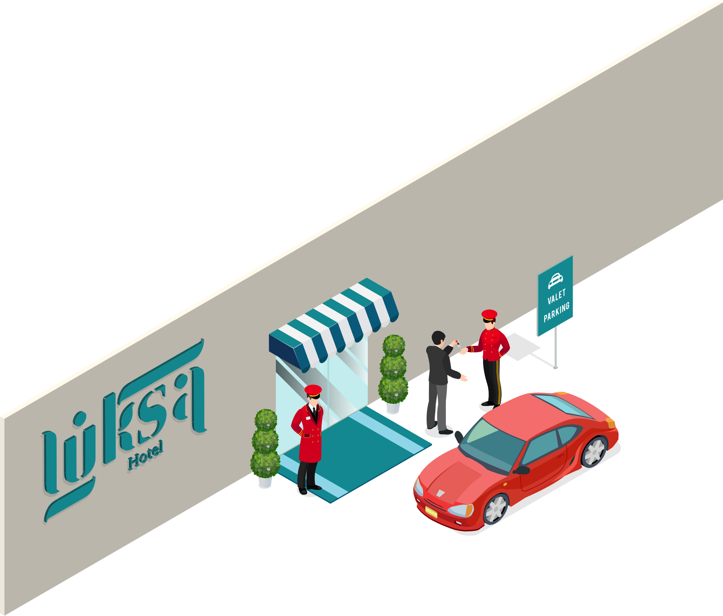



LS Central
Restaurants/KDS
Retail
Staff Mgmt
Bookings
Hotels
Member Mgmt

Slide 3

Lego methodology
Each component in the system is like a Lego brick with seamless data integration
Standalone or a complete ERP solution
Step by step introducing modules of the new system to the business
LS Central

Slide 4





KDS
Staff Mgt
Lego methodology
Food & Beverage
Each component in the system is like a Lego brick with seamless data integration
Standalone or a complete ERP solution
Step by step introducing modules of the new system to the business
Bookings
Hotels
LS Central
LS Central

Slide 5


Slide 6
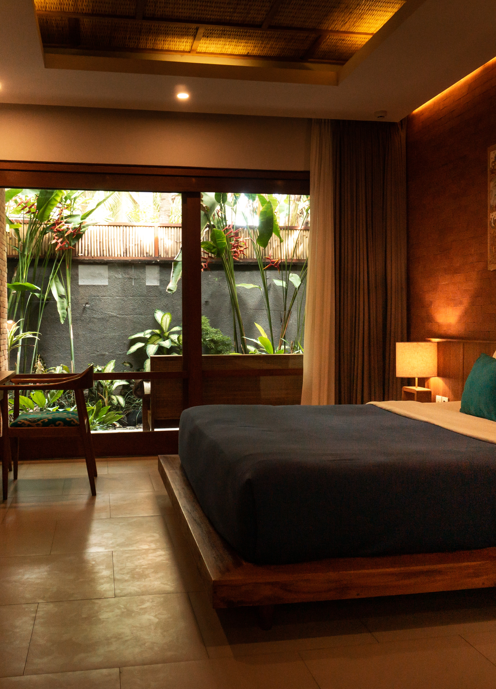
Benefits of multiple building blocks
One database/system
Allows the business to grow
No integrations
Less maintenance cost
Simplified upgrades
Easier to onboard new staff
More transparency
One guest profile and reservation

Slide 7

No integrations benefits
Save time on moving data
Correcting data between solutions
Posting to the room directly
Change information about the customer
Cancel/modify reservation and additional services are automatically changed

Slide 8
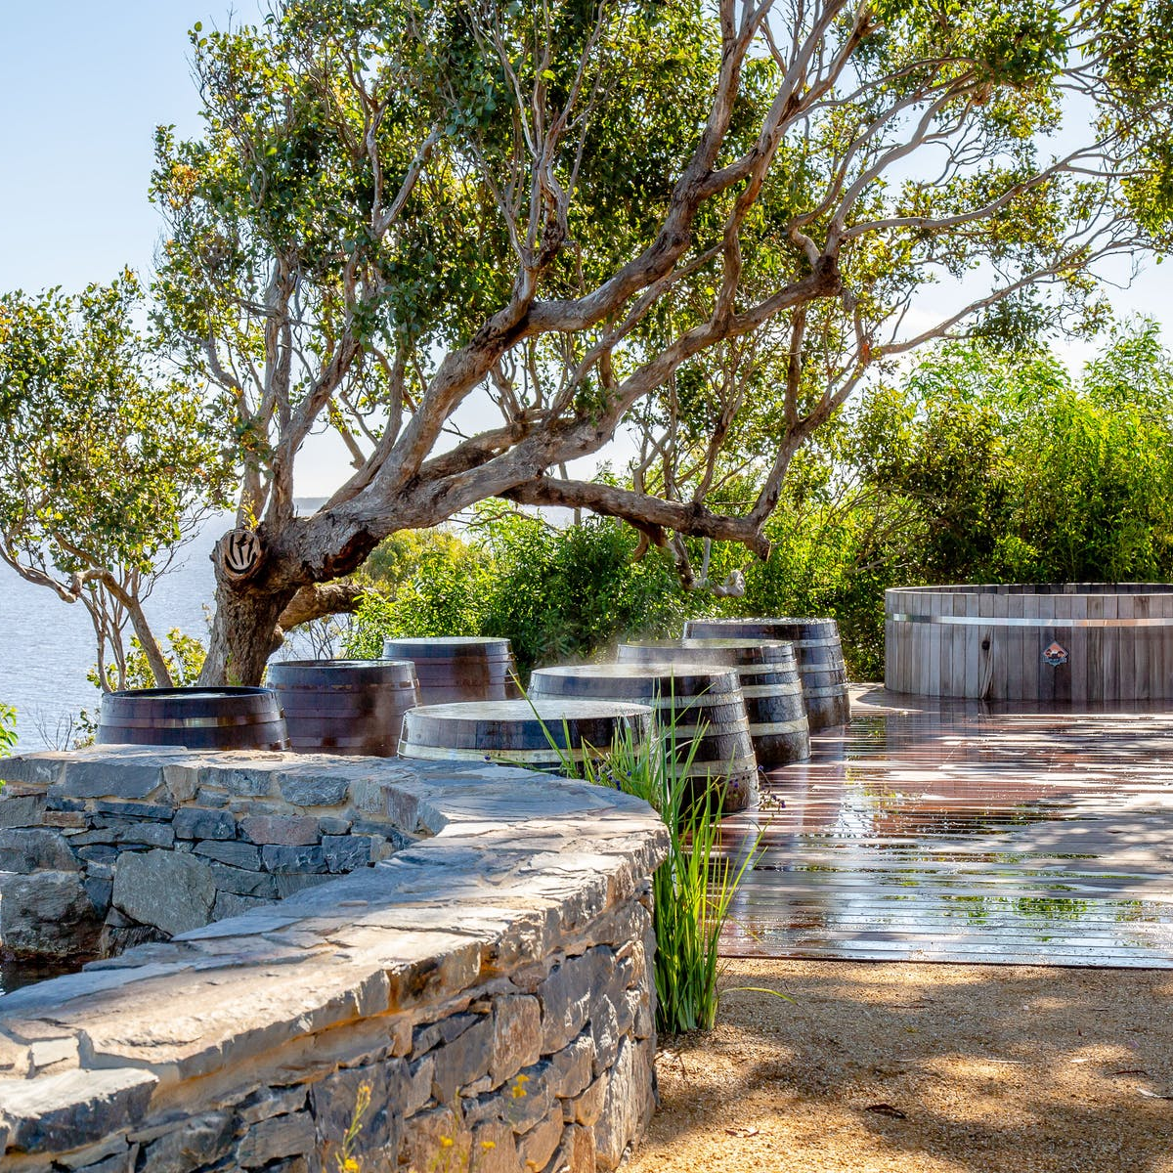
Customer Stories

Slide 9
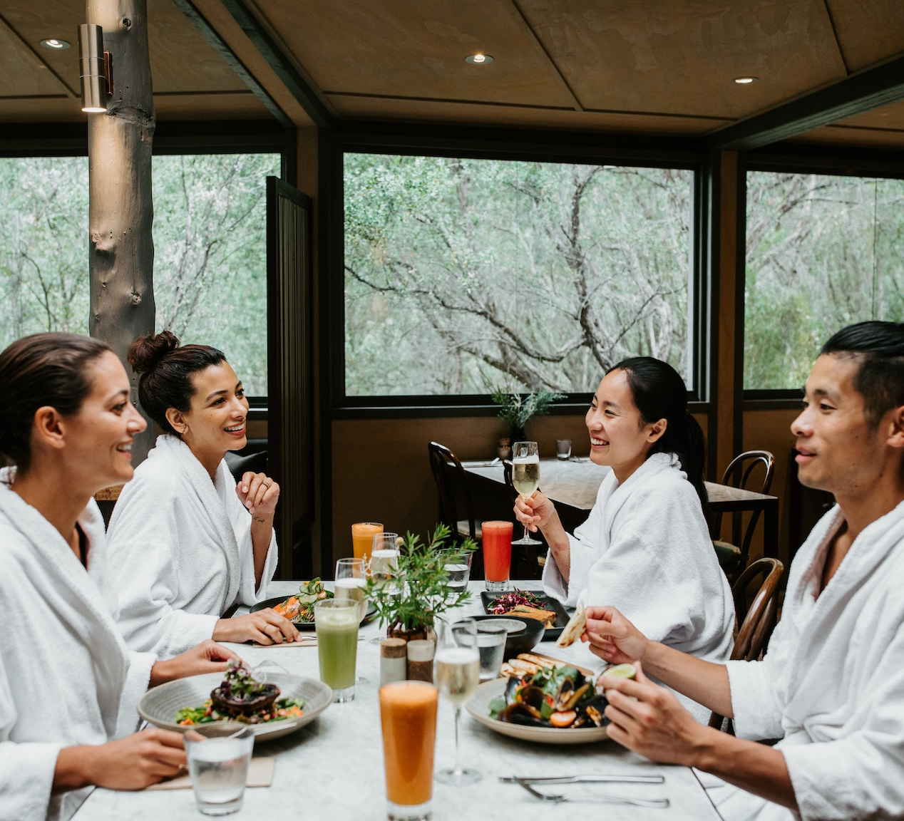
Peninsula Hot Springs
Located in Australia
  Metung Hot Springs
  Fingal Hot Springs
  Phillip Island Hot Springs
Spa Resort
  LS Central for Retail
  LS Central for Restaurants
  LS Central for Hotels
  Bookings for LS Central
  Staff Management for LS Central

Slide 10
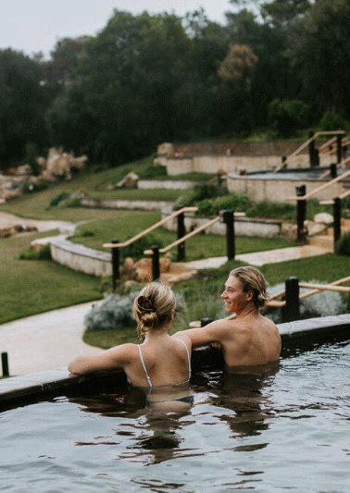


Peninsula Hot Springs
Reservation for accommodation, bathing, packages and treatments
Online and walk in reservations
Prebooked food orders and a la cart restaurants
Keeping track of guests details and history

Slide 11
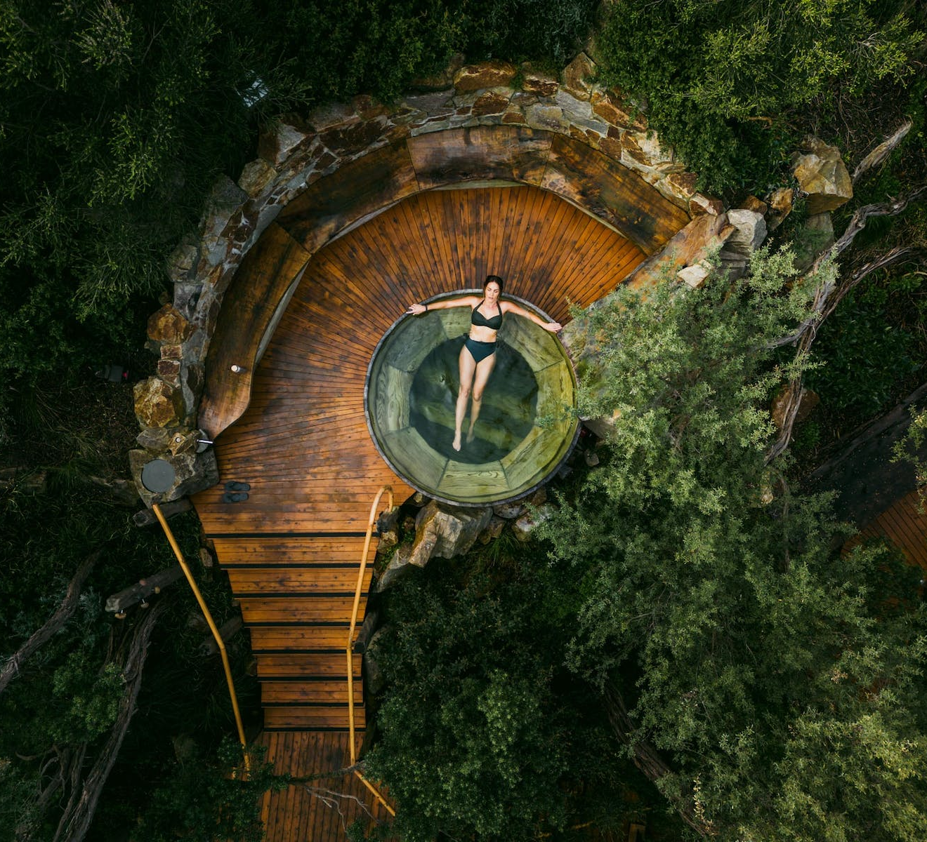
Peninsula Hot Springs
Looking to implement an "all in one" solution
Implementation in cooperation with local partner
Fully remote implementation
Management vision clear and project support important

Slide 12
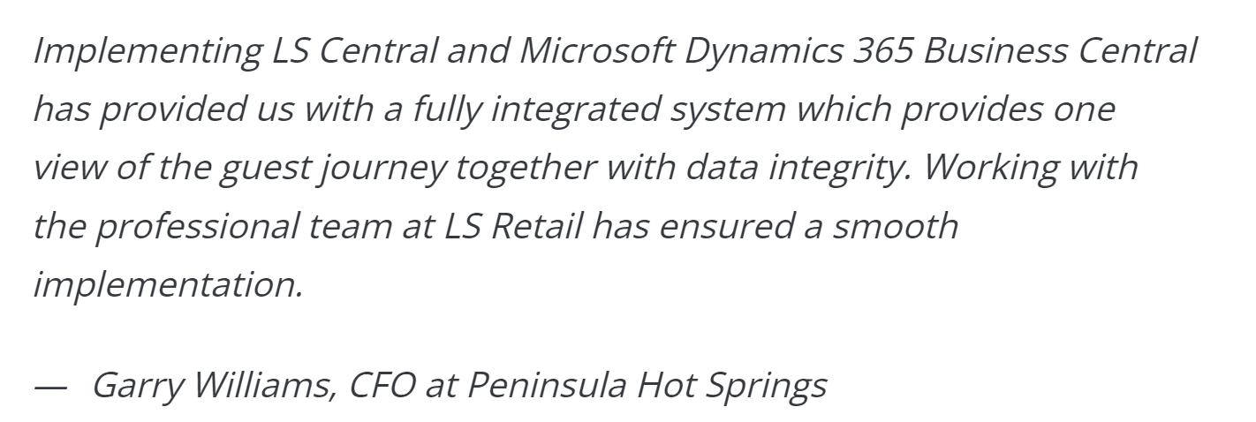
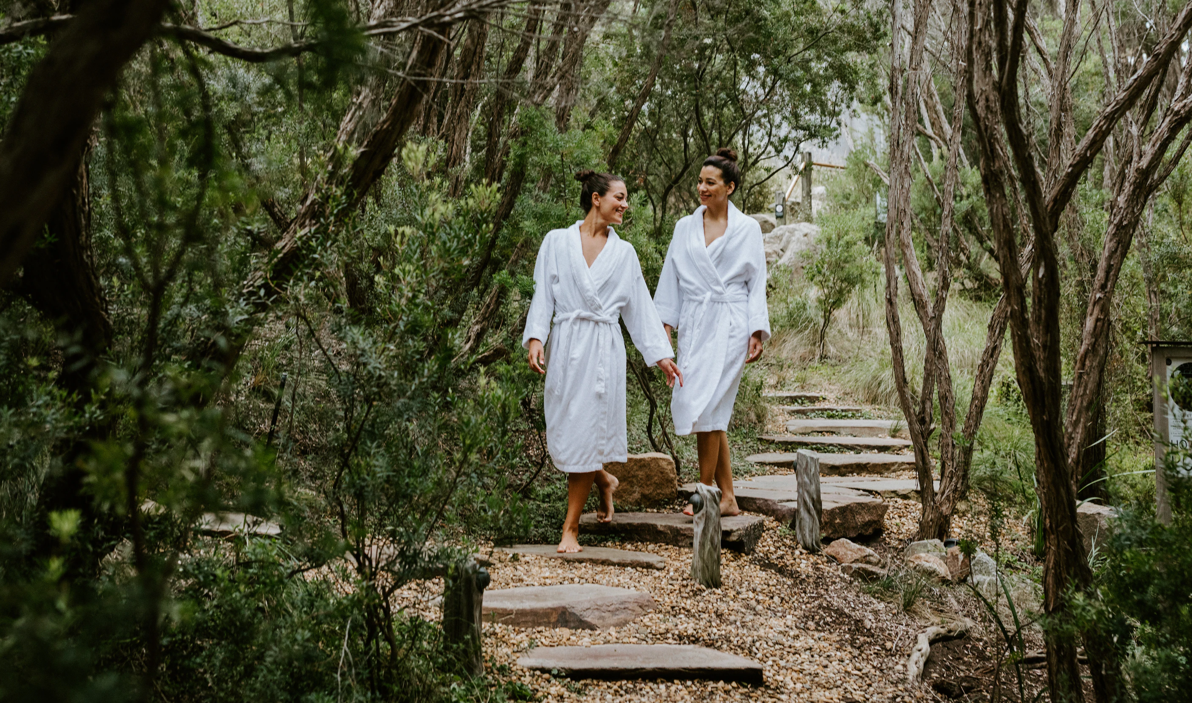
Peninsula Hot Springs
Customer pushing for a standard solution
As little customization as possible
Internal change management and training
Rollout of first small location
Smooth go live
Currently implementing next location

Slide 13
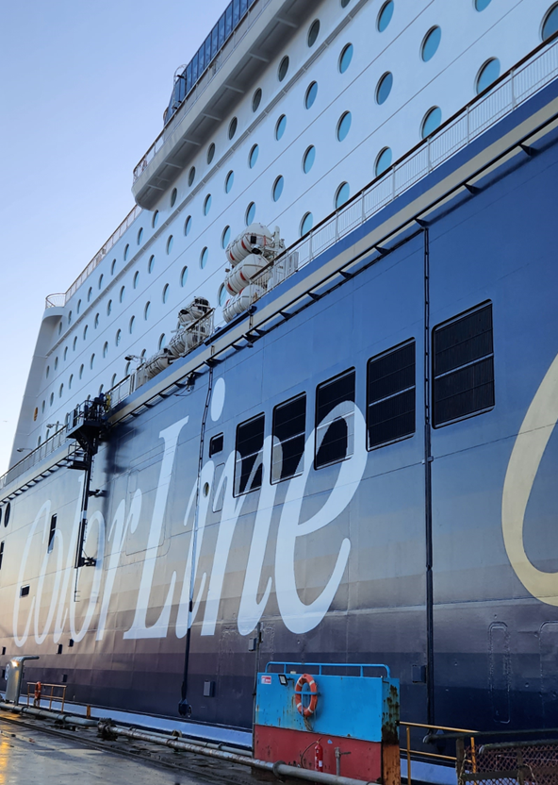
Color Line
Three transport vessels
Two cruise ships
  Over 1000 rooms/cabins
  Retail shops
    Tax free
    Cosmetics
    Fashion
  Restaurants
    A la cart
    Buffet
  Bars and disco
  Show lounge
  Prebooked services
  Self-service stations

Slide 14
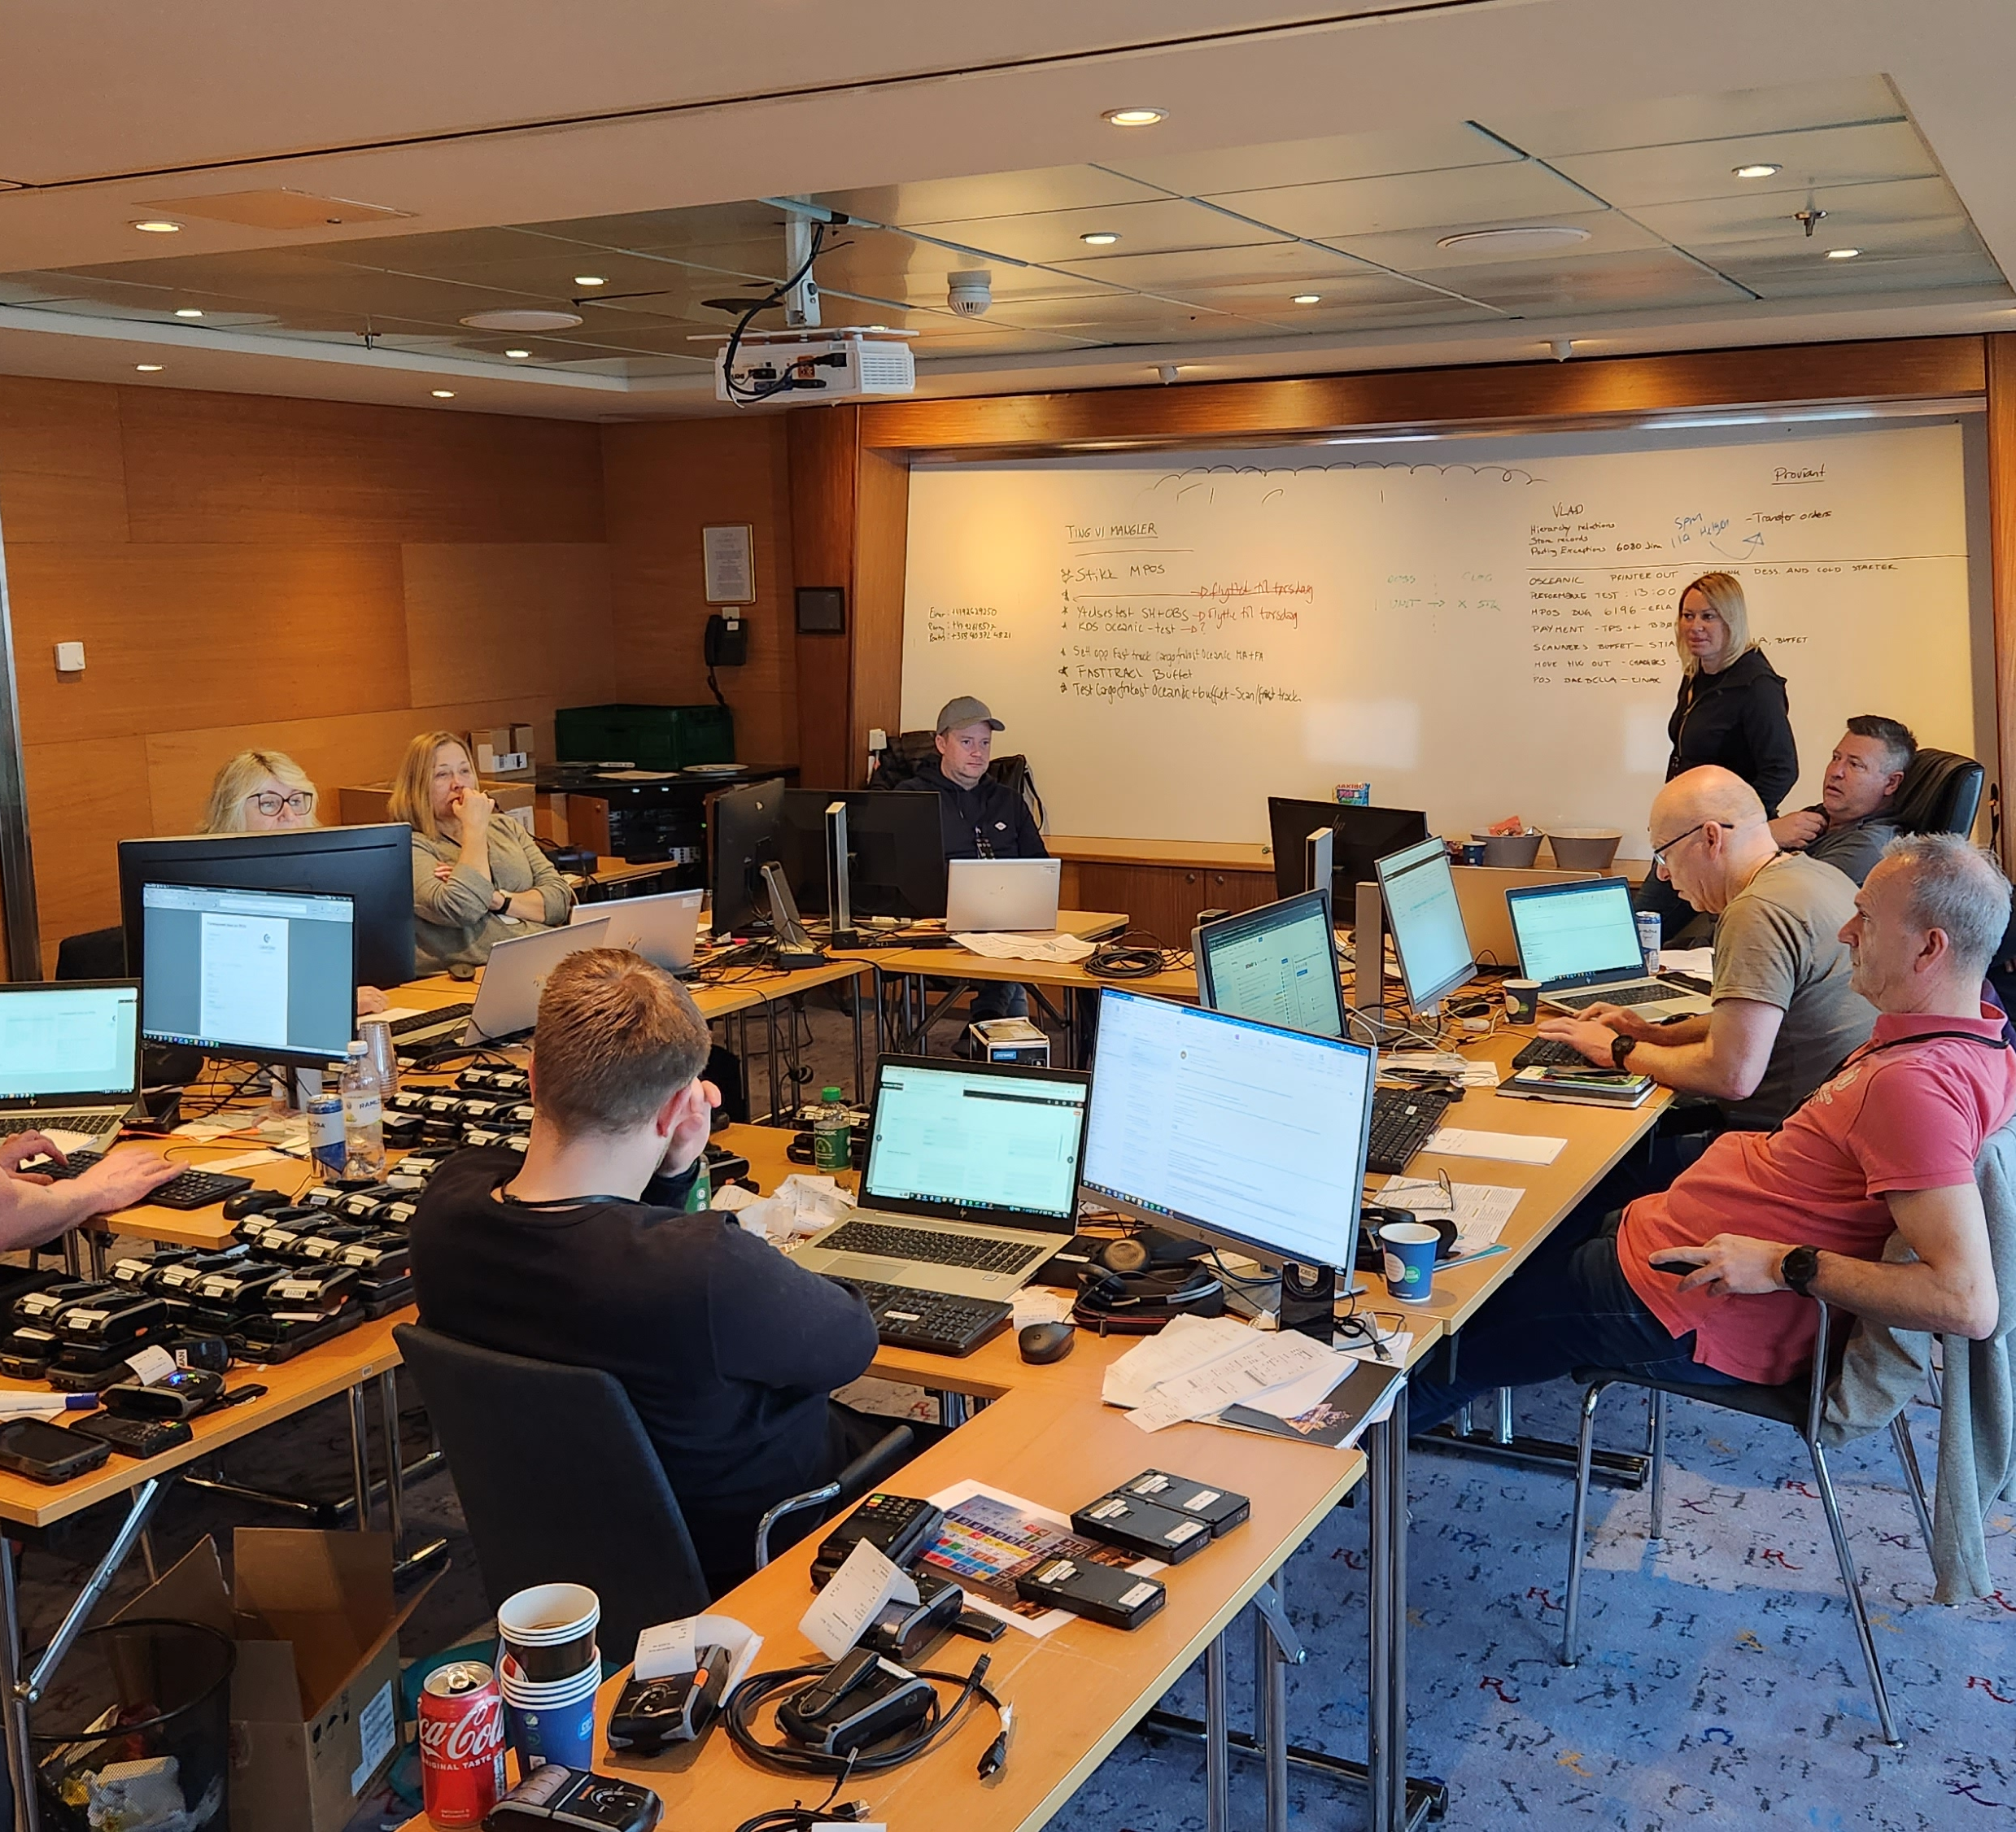
Color Line
Replacing custom made system
Standardized system
Major implementation
Ship in dock to implement
Distributed environment
Kept on newest version
Rollout first to transport vessels and then cruise ships

Slide 15
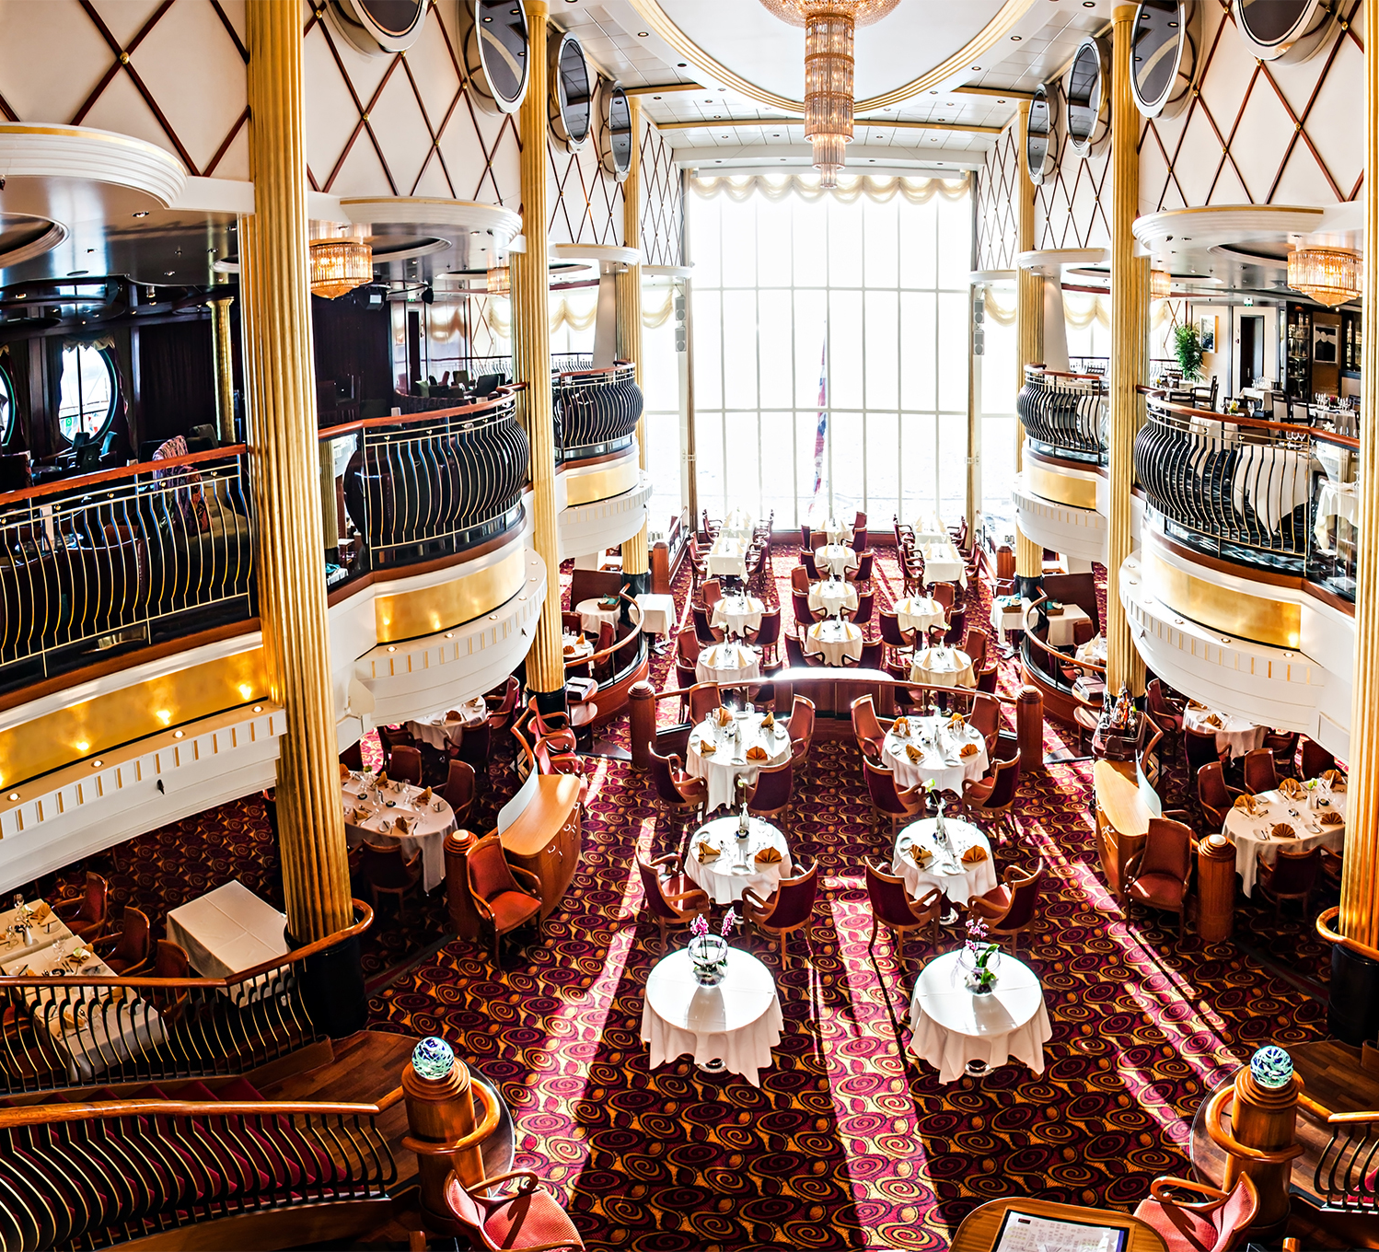


Color Line
LS Central for retail
LS Central for restaurants
Bookings for LS Central
Member Management
Ferry Add-on for LS Central
eCommerce for LS Central
Franchise Management

Slide 16
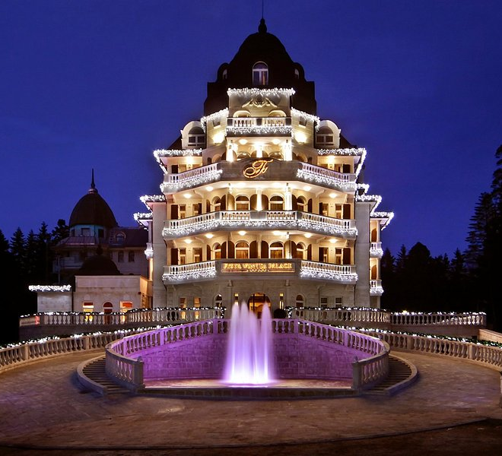
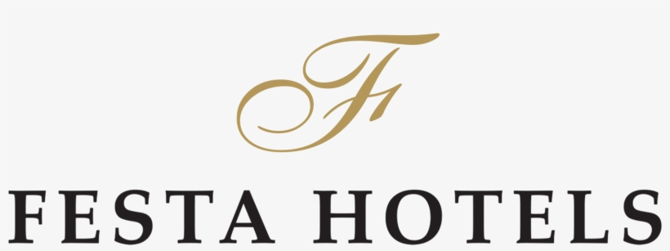

Festa Hotels
Hotel chain in Bulgaria with 4-5* hotels
7 hotel properties
963 rooms in total
  LS Central for hotels
  LS Central for restaurants
  Bookings for LS Central

Slide 17
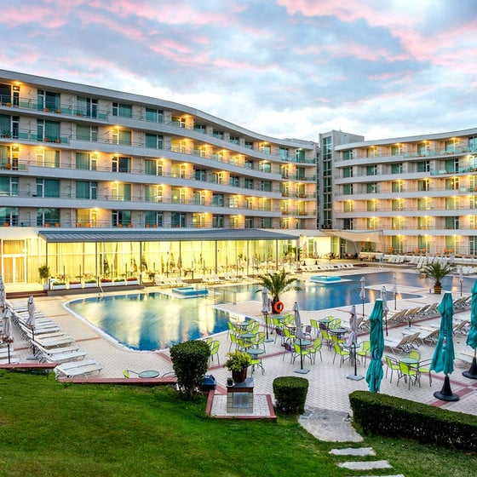
Festa Hotels
Winter Palace in December 2022
    Busy season
    Winter activities
Goals
  Automation
  Real time information
  Built on Microsoft Business Central
"With LS Central for hotels and their unique add-ons, they offer a complete solution that covers all our needs.
-Iva Gatseva, Executive Director and member of the management board at Festa

Slide 18
Thank you

