Slide 1
Leverage GitHub, DevOps with LS Central repository
Einar Pall Gudlaugsson
Hilmar Vilhjalmsson
Thorir Bjornsson

Slide 2
Agenda
  What is LS Central on GitHub
  Why LS Central on GitHub
  What to contribute
  How to contribute
  Who can contribute
  Q & A

Slide 3
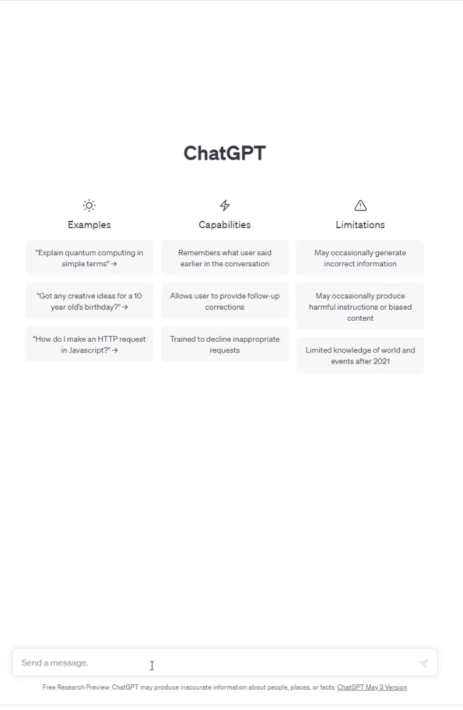
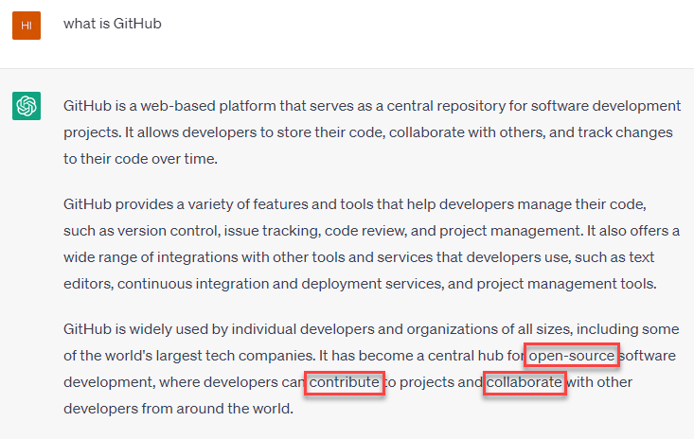
What is LS Central on GitHub

Slide 4



What is LS Central on GitHub
LS Retail Team
LS Central GitHub Repository
Mirror repository
Process Pull Requests
Fork
Pull request
Clone
Push
Partners
Local development environment

Slide 5
Why LS Central on GitHub
Simplify
Time to market
Quality
LS Retail Team
LS Central GitHub Repository
Mirror repository
Process Pull Requests
Fork
Pull request
Clone
Push
Partners
Local development environment

Slide 6



Requirements
Git
GitHub account
VS Code
AL

Slide 7
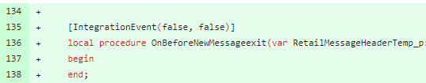

What to contribute
New events
Accessibility
Minor bug fixes

Slide 8
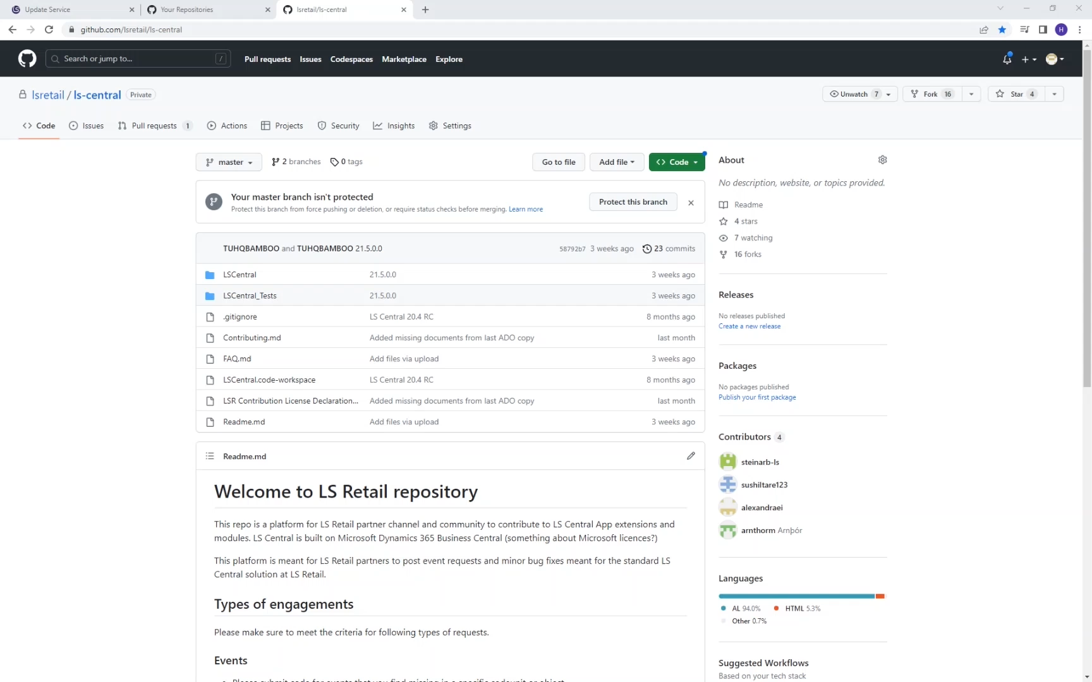

Slide 9
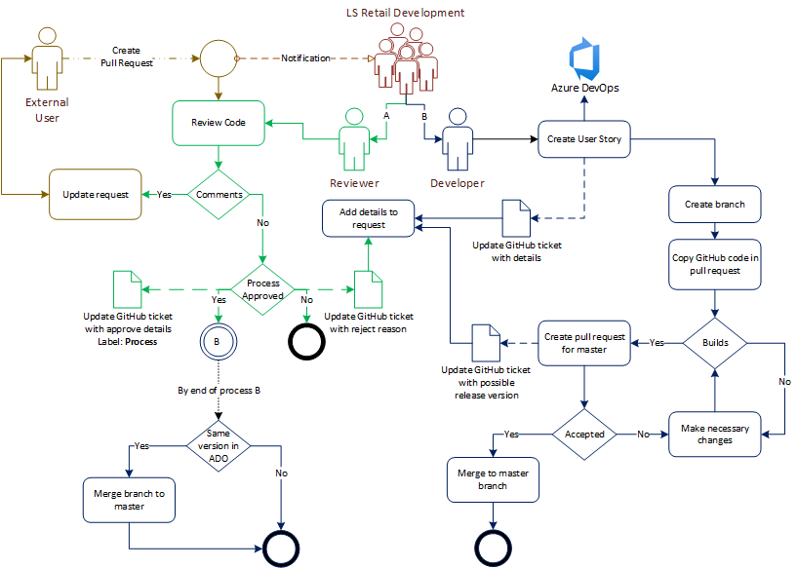


Slide 14

Who can contribute
Send a request to:
lscentralgithub@lsretail.com
Partner name
Name
Email address
GitHub ID

Slide 15
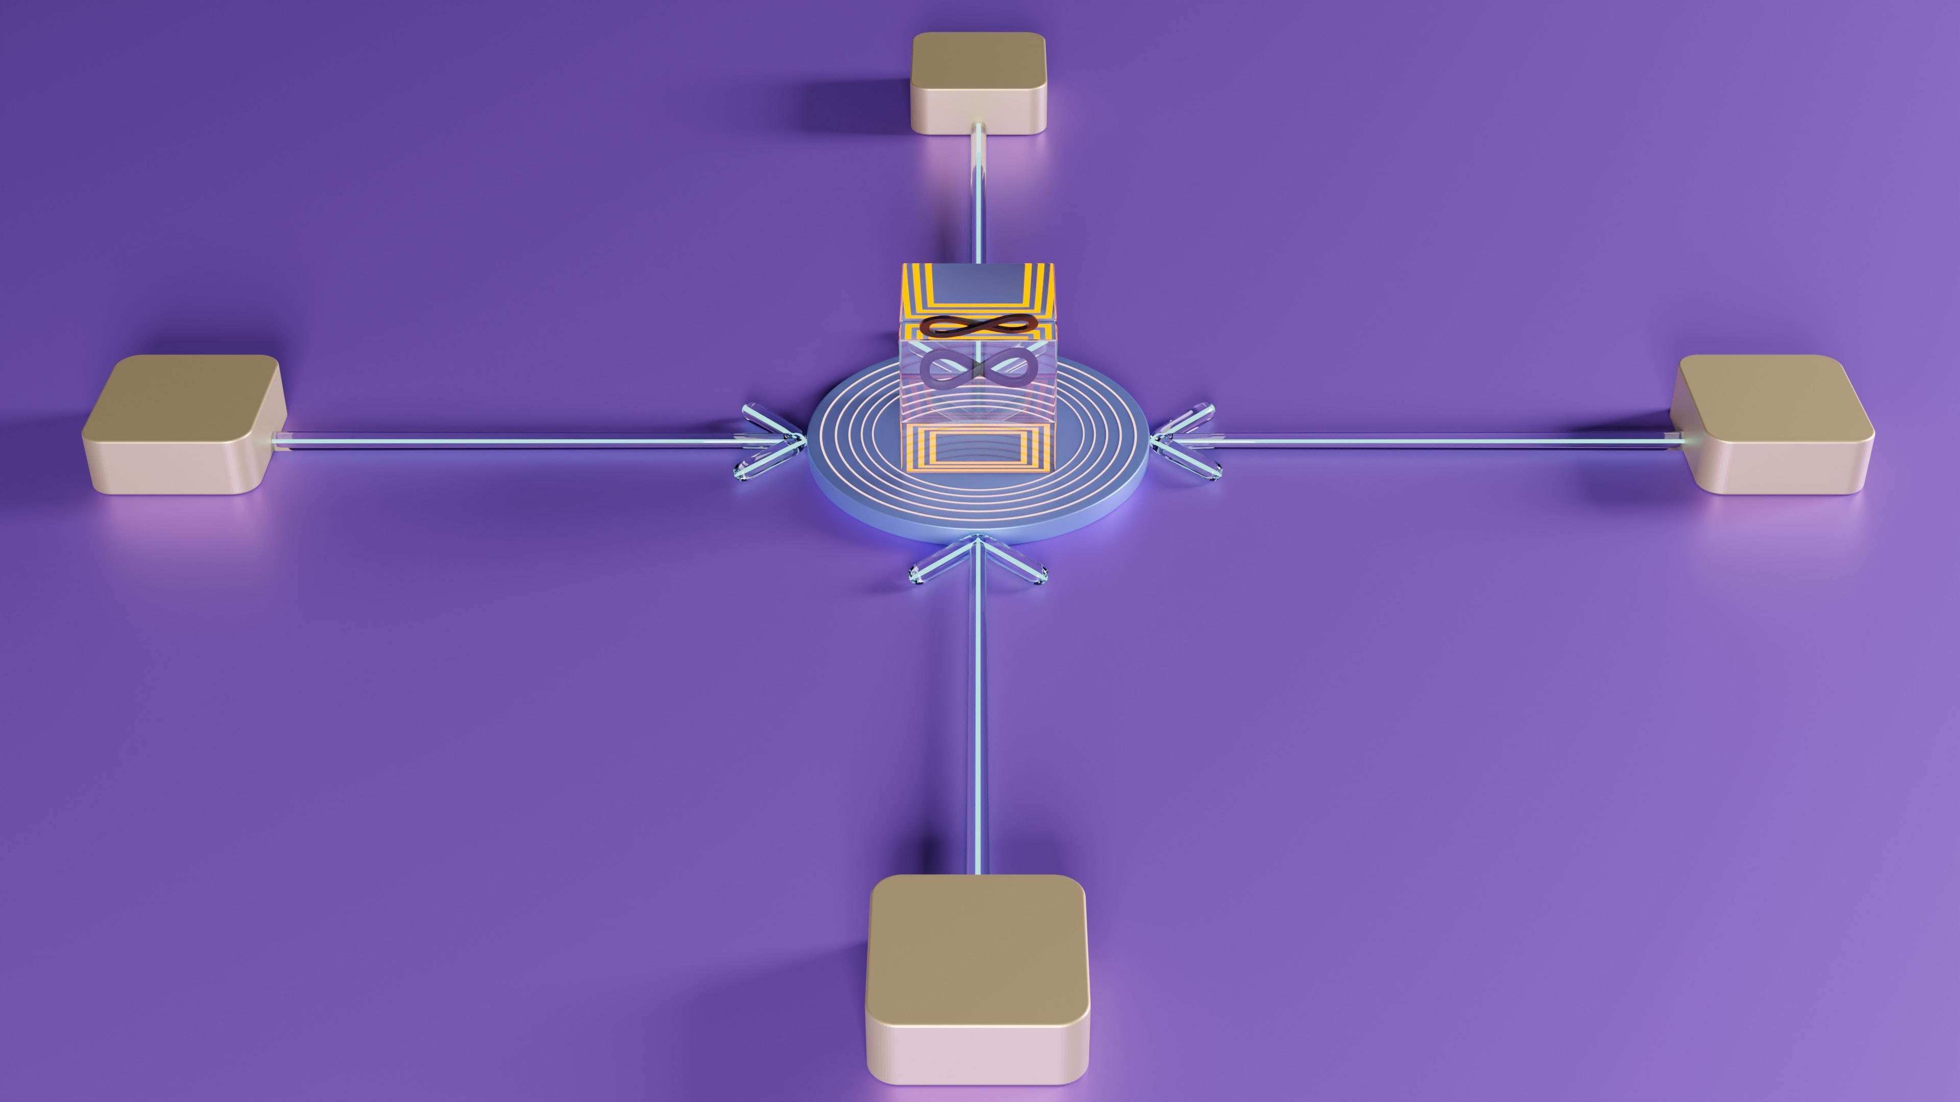
Conclusion
Partners to contribute to LS Central release for minor bug fixes and event requests.
  Simpler
  Faster turnaround
  Better quality

Slide 16
Thank you

