Slide 1
All the latest
LS Central SaaS
Matthias Matthiasson
Product Director

Slide 2


Slide 3

Subscription
Low upfront investment
Operational expenditure model (OPEX)
Adjustable monthly
Significant money savings

Slide 4

Staying current
Always updated
  Short update cycles
  Benefits of the newest technology and features
You stay current with minimal effort

Slide 5

Hosted by Microsoft
Forget about infrastructure maintenance/cost
Reliable scalable environment for performance
Tools to monitor and analyze – like telemetry
Best in class-security
Works great with cloud tools
  Power Apps, Power BI, Power Flow
  Hosted Office environment
Be productive on the go

Slide 6

How we support you

Slide 7
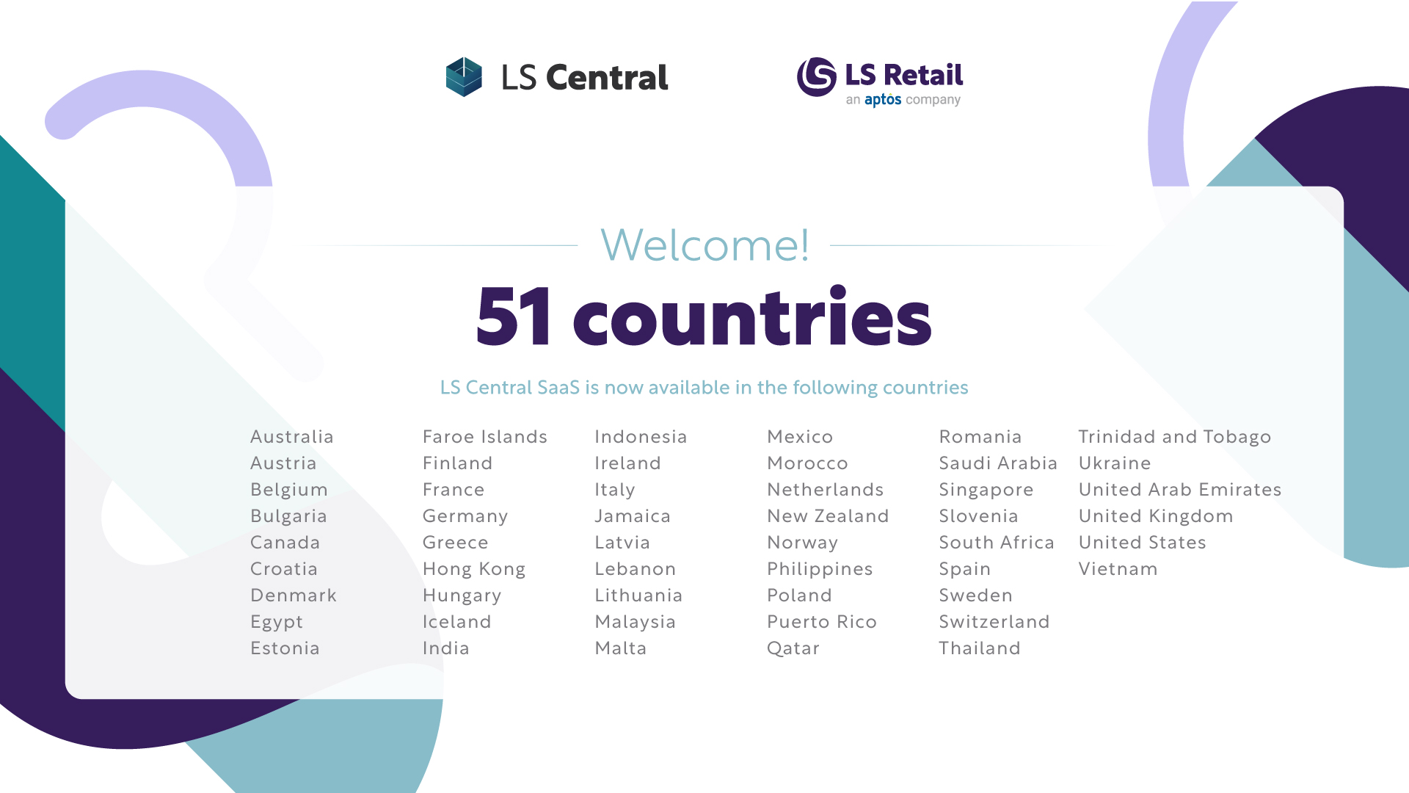
Localization
43 countries

Slide 8
Your journey to LS Central SaaS
Overview session
Onboarding guide
Implementation guide
SaaS training
Onboarding buddy and CAP

Slide 9

Book a session with the Onboarding Team
  Book your overview session when it fits you
  Use link
  https://calendly.com/lsconboarding/onboarding
  Do you need a 30-minute session to ask any SaaS-related questions
  Use link
  https://calendly.com/lsconboarding/30minsession

Slide 10

LS Central SaaS – Large Implementations
  Microsoft
  Concierge Program

Slide 11
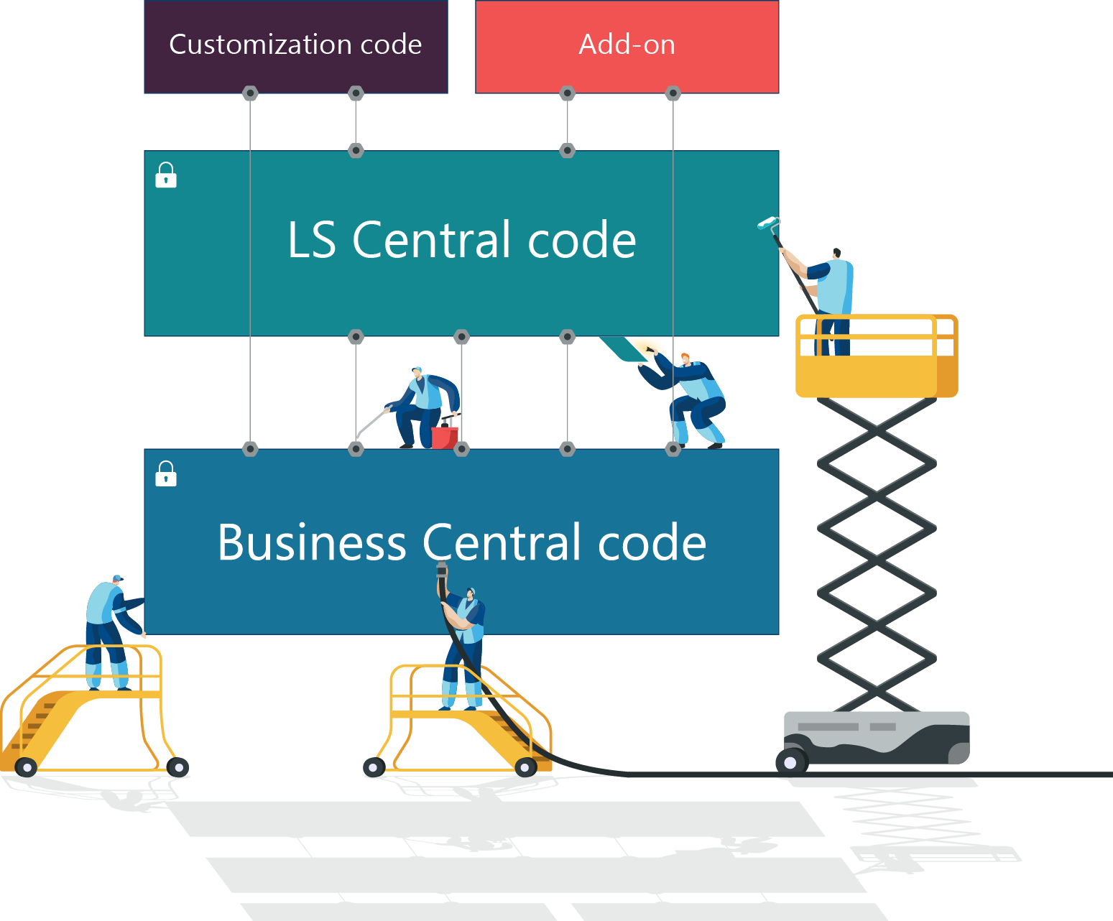
Extensibility framework
Coding with Events & Extensions
New modular development environment
Built for upgradability
Makes migration easier, simpler and faster
Still keeping the ability to extend functionality
This technology has ability to stay current without projects

Slide 12

LS Central journey to shared SaaS
LS Central
app in AppSource
Dedicated SaaS
cluster to
Shared SaaS cluster
LS Central
universal code
compliant
LS Central 22.0
May
LS Central 22.0
June
Start August
2 months

Slide 13

LS Central journey to shared SaaS
New customers in SaaS
Start with selected countries in June
Additional countries in August
All counties by September
Existing customers in SaaS
    Sandbox – selected customers in June
    Production – selected customers June
    Selected counties in June
    Additional countries in August
    All regions by end of September

Slide 14

Re-routing calls
Web service calls
If the environment is not found in LS Retail dedicated cluster, then re-routed to BC shared cluster
BC client call
URL needs to be specific
    Will not be re-routed
      http://lscentral.bc.dynamics.com not re-routed
    Will be re-routed
    https://lscentral.bc.dynamics.com/Production
    https://lscentral.bc.dynamics.com/Production?company=CRONUS%20International
    https://lscentral.bc.dynamics.com/19f83952-2d11-40da-8a18-446987ea8f1c/Production?company=CRONUS%20International

Slide 15


Discontinue - BC Windows authentication – web services
LS Central discontinues Windows authentication support in version 22.0 for web services
Only impacts OnPremise as SaaS only supports Oauth2
Use
Web Service Access Key
OAuth2 authentication
Workaround:
Environment with Windows authentication for BC client
Environment with Web Service Access Key for web services
HQ
Environment
BC Client
Environment
Web Services
Store
Client
Web Service
BackOffice
Device
POS
Device

Slide 16

Steps in moving to SaaS
Big bang – all at once
1st Head Office and then POS
1st POS and the Head Office
What are the challenges

Slide 17

Performance
Microsoft wants feedback on performance issues
  Microsoft will analyze and solve
LS Retail performance improvement initiatives
  Analyzes identified POS process
  Improve batch/heavy Backoffice processes
  Stress/Load tests
    Milestones for the development process
    Feedback for the sales process
Telemetry and monitoring in Azure
  Preventive
  Development process
  Analytical tools by partners

Slide 18

Releases / Requests
Highest priority by development teams
  Event request
  Internal/Global scope
SaaS critical bugs
  HotFixed to SaaS
Release every week
  Major/Minor releases (BC updates)
  Hotfix with events + internal/global
Pull requests from partners

Slide 19

Focus Groups
Replenishment
Hospitality (Restaurants & Hotels)
Unified Commerce
POS & Devices

Slide 20




SaaS Replication
Dynamics 365 cloud
Web
replication
Architecture
Data Director
SaaS?
Web Replication
What is it?
SaaS Replication & Azure Services
  Introduction
HQ
Hybrid component server
Store
Online POS
Offline POS
Offline POS Service

Slide 21
SaaS Replication
Dynamics 365 cloud
Web
replication
Architecture
Data Director
SaaS?
Web Replication
What is it?
SaaS Replication & Azure Services
Introduction
Hybrid Component Server
Offline POS and SaaS
Hybrid component server
HQ
Hybrid component server
Store
Online POS
Offline POS
Offline POS Service

Slide 22

Stay Current
SaaS monthly upgrading
  UI auto-tests for POS
    Verify business-critical processes
Keep POSes current
  Online POSes
    Use Update Service
    Hardware Station and AppShell
    Monthly if feasible
  Offline POSes
    Use Update Service
    All apps
    Maybe every 6 months

Slide 23

Partners SaaS
24/7 support for production environments
Outage = Customer/Partner can’t log into a tenant on SaaS through Admin Center
  No user can log in to Business Central 365
  Customer/Partner that has Delegate administrator must report directly to Microsoft and then share the support incident number with LS Partner Support.
Blocker = Customer can’t trade on any POS in a Store in a Live environment on SaaS
  ONLY for issues when customer can’t trade on any POS in a Store in a LIVE environment.
  If the issue turns out not being a blocker, then the partner can expect to be invoiced, for the hours spent on the issue.
Critical = Will be reviewed by the Partner Support team in their stand-up meeting at 8:15 GMT and 13:00 GMT
  Partners need to share a business case if the issue should be handled to be a Hotfix request

Slide 24

Contactless shopping
Self Ordering in hospitality
Self Checkouts
3rd party self-checkouts
LS Central POS
Scan Pay Go (SPG)
Customer app
Self-scanning
Pay on phone

Slide 25

ScanPayGo
Devices
Customers owned device
Retailers owned device
Unmanned stores
Addition service to customers
Payments
Apple Pay and Google Pay
Customer account

Slide 26
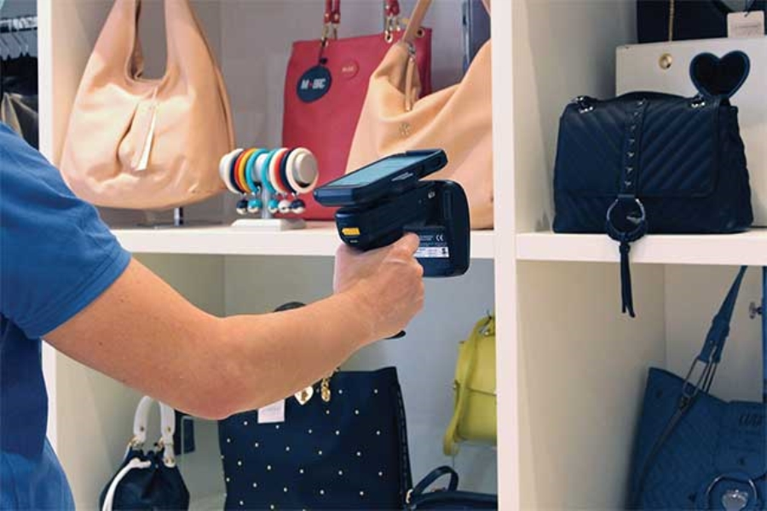
Latest
Mobile Inventory
RFID integration – identify items
Scan, receive, pick, and worksheets
Finalize sourcing in stores
AppShell
iOS AppShell, able to pay and print
Windows AppShell
Gamer mode to see the load and IT
environment
Developer console window
Easy to install on multiple devices

Slide 27

Coming
Forecourt
FuelPOS
Handle fuel sales post- and presale
EFT extension
Standard BC
POS
Back Office
Development quality and automation
POS UI autotests

Slide 28

Create the future
with us

Slide 29
We are just
getting started

Slide 30
Thank you

